Slide 1
To easily follow these notes, log on to our Wifi
Wifi: mycci01
p/w: ancientquail060
Go to OrHaOlam.com
Click on downloads, messages, 2017

Slide 2
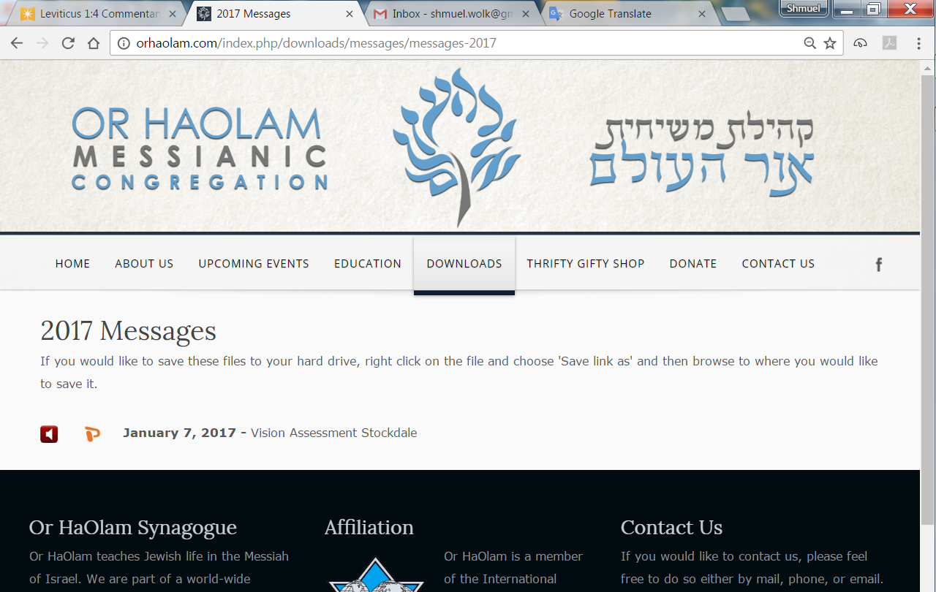

Slide 3
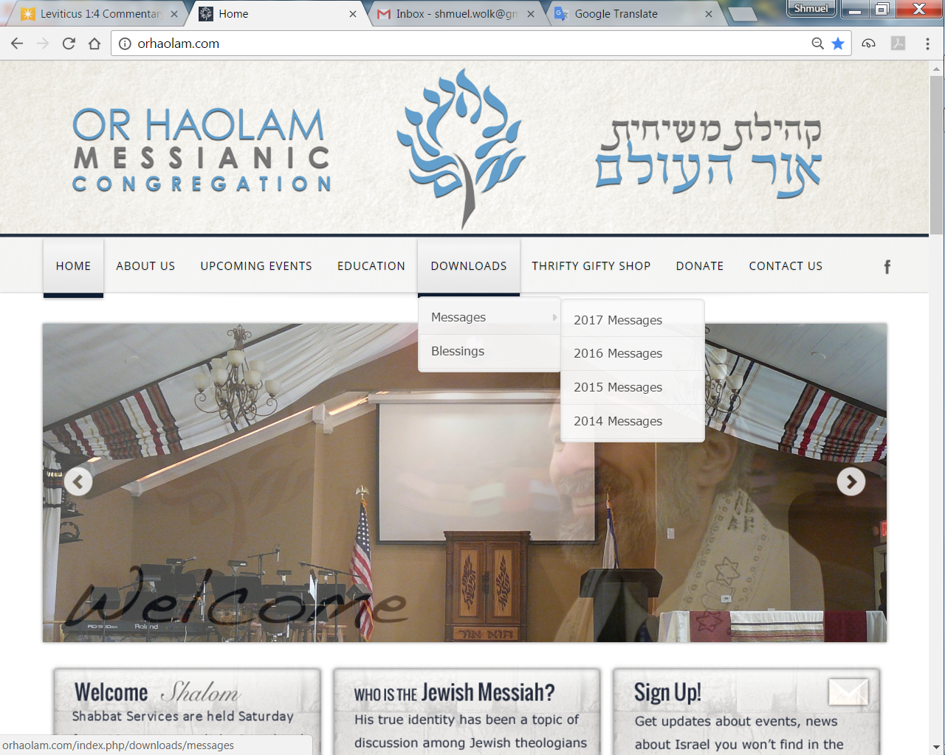
Downloads\messages\
2017 Messages

Slide 4
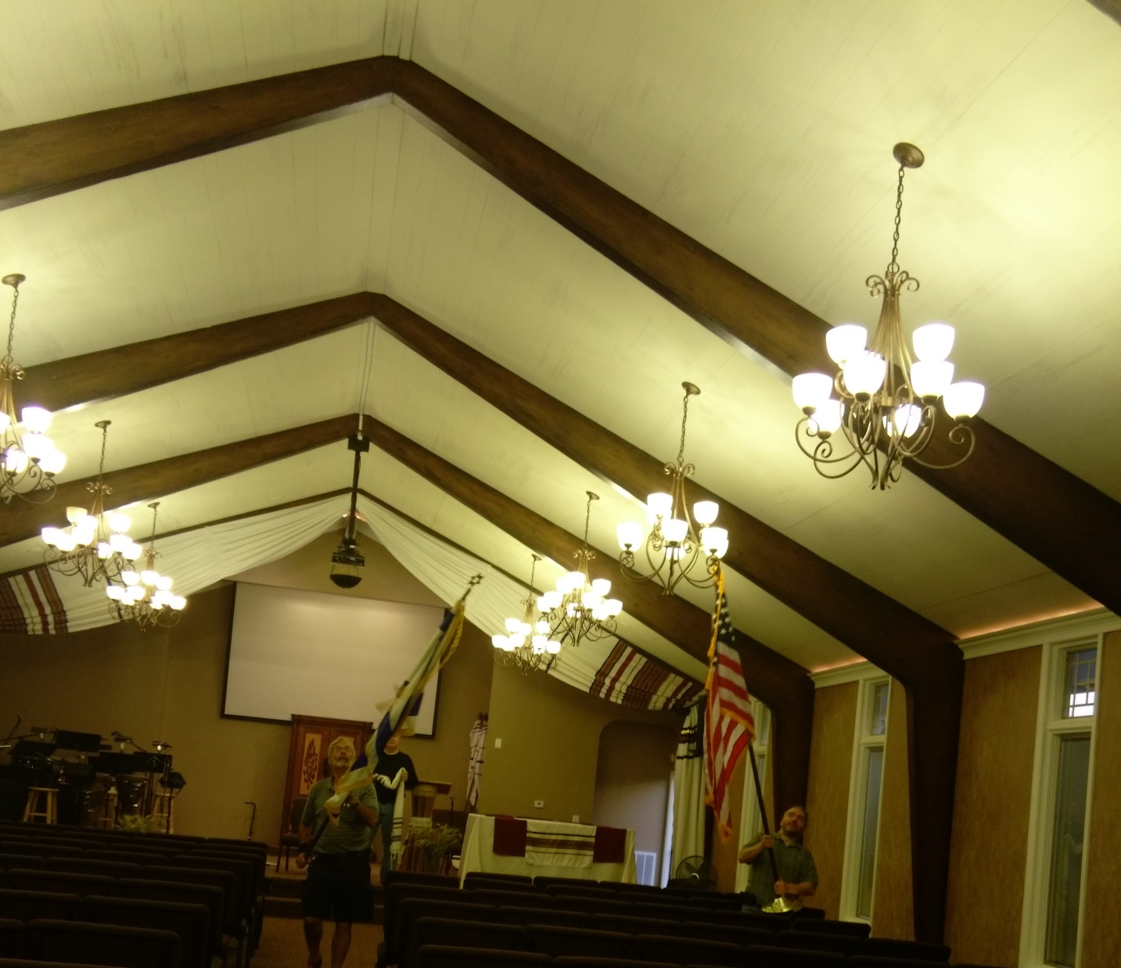
Sunday night, June 3
~8:45 p.m.
Notes:
About a half hour in bird pursuit!

Slide 5
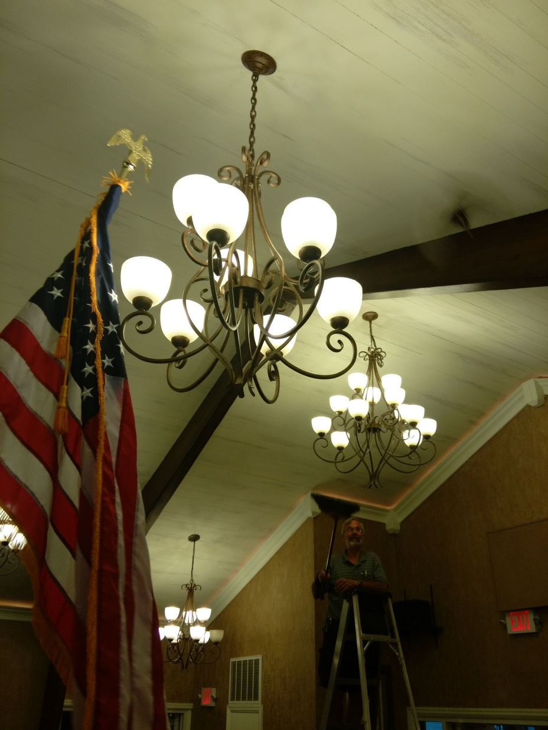
Black
Bird

Slide 6
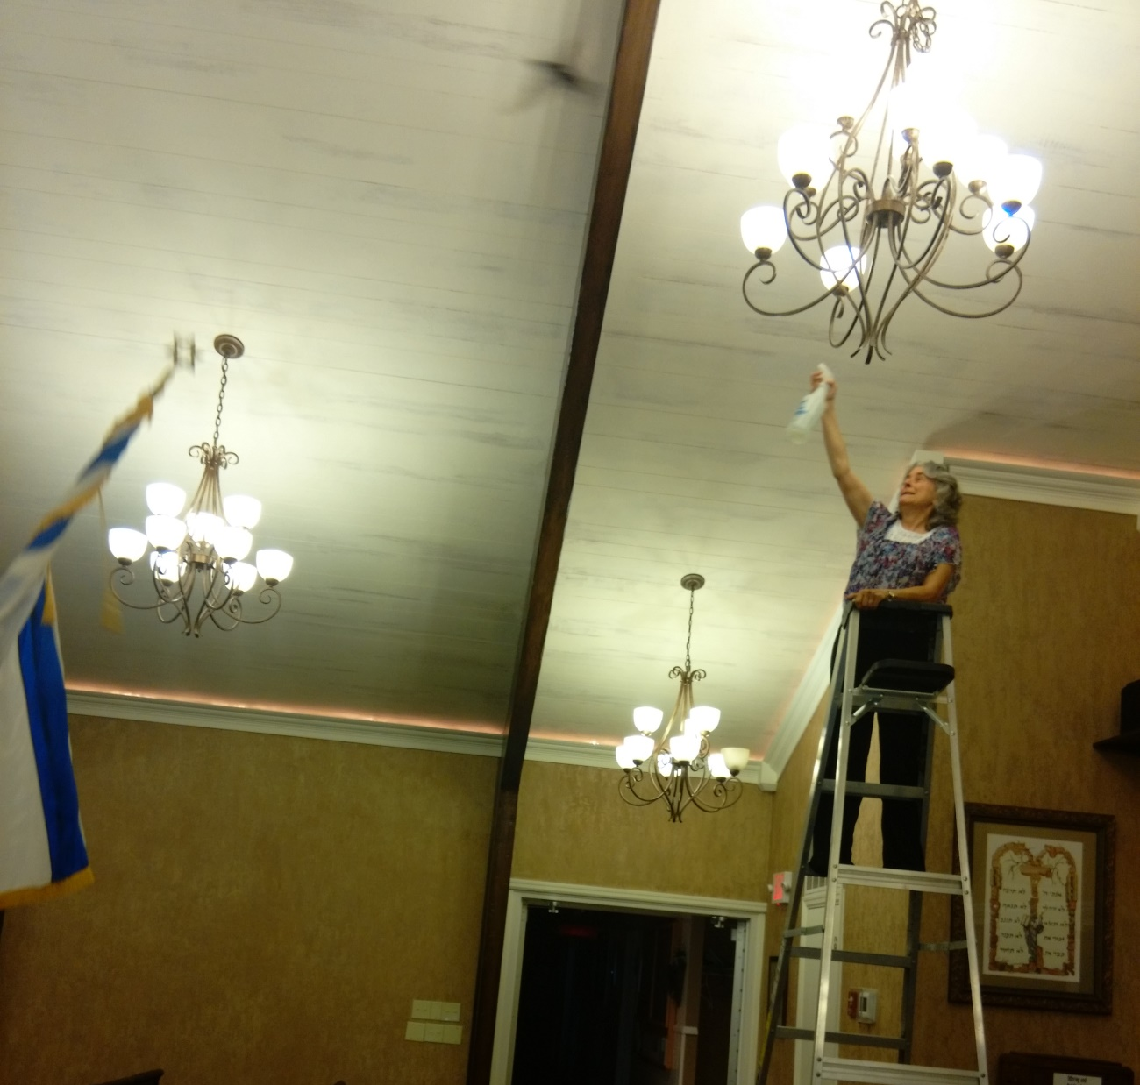

Notes:
After wetted with vinegar water, flew lower and found door at southwest corner

Slide 7
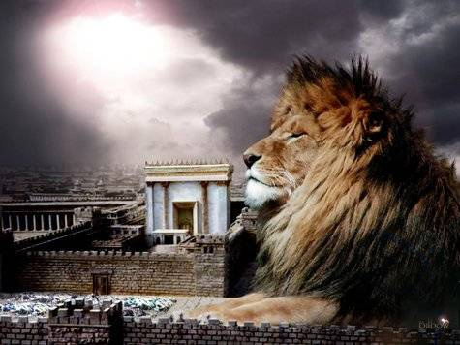
מַתִּתְיָהוּ Mattityahu
(Matthew) 18:12-13
Notes:
Last week about offending one of these little ones, and the acts of repentance MoR and good works [Little Hearts, Dental Clinic, poverty care at Millennium Center] to cover for offenses to little ones. Who are little ones? New believers, pre-believers. Today, a step further. Proactive. Seek and find the lost little ones who’ve strayed from offense or their own corruption. Seek and find.

Slide 8
Mattityahu (Matthew) 18:12
מַה דַּעְתְּכֶם? אִם יֵשׁ לְאִישׁ מֵאָה כְּבָשִׂים וְאָבַד אֶחָד מֵהֶם,
What's your opinion? What will somebody do who has a hundred sheep, and one of them wanders away?
אָבַד avad lost, stray, wander about, perish, die, cease
Notes:
Lost. Remember story Elizabeth Smart? Abducted 14 year old.

Slide 9
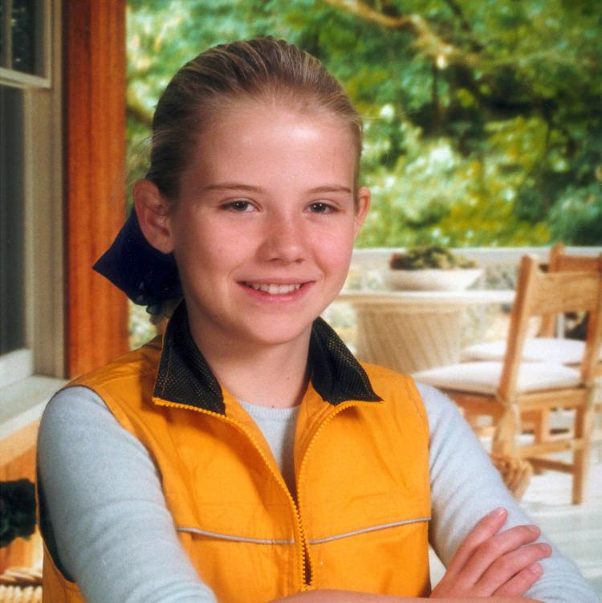
Elizabeth
Smart,
abducted at
age 14

Slide 10
In the early hours of June 5, 2002, Brian David Mitchell broke into the home and came to the bedroom that Elizabeth shared with her 9-year-old sister, Mary Katherine. While Mary Katherine pretended to be asleep, she watched the abduction.
Notes:
https://en.wikipedia.org/wiki/Elizabeth_Smart_kidnapping

Slide 11
^{Yekhezkael/Ezk 34.2-4} Adonai ELOHIM says this: 'Woe to the shepherds of Isra'el…You don't strengthen the weak, heal the sick, bandage the broken, bring back the outcasts or seek the lost;’

Slide 12
Lost:
From the health of the Ruakh
From the fellowship of the family.
From eternal salvation.

Slide 13
Mattityahu (Matthew) 18:12
הַאִם לֹא יַעֲזֹב אֶת הַתִּשְׁעִים וְתִשְׁעָה עַל הֶהָרִים וְיֵלֵךְ לְחַפֵּשׂ אֶת הָאוֹבֵד?
Won't he leave the ninety-nine on the hillsides and go off to find the stray?
Notes:
Need based service. Wandered.
Impossible meet every need.
Yet needs of lost should be our consuming passion. > material goods, reputation, convenience. LOST.
100 Sheep typical flock size then. Lots to keep count of. Our tour guide always 22, 19,

Slide 14
Mattityahu (Matthew) 18:13
וְכַאֲשֶׁר יִמְצָא אוֹתוֹ, אָמֵן אוֹמֵר אֲנִי לָכֶם, יִשְׂמַח עָלָיו יוֹתֵר מֵאֲשֶׁר עַל הַתִּשְׁעִים וְתִשְׁעָה שֶׁלֹּא אָבְדוּ.
And if he happens to find it? Yes! I tell you he is happier over it than over the ninety-nine that never strayed!

Slide 15
Ways to be lost
Rebel against G-d for pleasure.
Accept another concept of Truth: Islam, Buddhism, etc.
Deny that there IS any truth.

Slide 16
Ways to be lost
Rebel against G-d for pleasure.
Accept another concept of Truth: Islam, Buddhism, etc.
Deny that there IS any truth.

Slide 17
^{1 Yn 2.15-16} Do not love the world or the things in the world. If anyone loves the world, the love of the Father is not in him. For everything in the world—the desire of the flesh, the desire of the eyes, and the boasting of life—is not from the Father but from the world.
Notes:
Three toxicities in all of us

Slide 18
^{Lk 15.11-13} Then Yeshua said, “A certain man had two sons, and the younger of them said to the father, ‘Father, give me the share of the property that comes to me.’…“Not many days later, the younger son …traveled to a far country, and there he squandered his inheritance on wild living.”
Notes:
Why did he do it?

Slide 19
Shaunti Feldhan: It starts young. Yes, I knew men and boys were visual – but I didn’t really grasp just how visual until my son was thunderstruck by the pictures in the Victoria’s Secret shop window at age of 4. “I like those ladies,” he said, in an awed tone of voice,
Notes:
http://shaunti.com/2017/06/you-need-to-know-these-four-pitfalls-for-teenage-boys/

Slide 20
suddenly and completely oblivious to everything else around him. “Their bare tummies make my tummy feel good.” The male brain is the male brain from the earliest age.“
Notes:
http://shaunti.com/2017/06/you-need-to-know-these-four-pitfalls-for-teenage-boys/

Slide 21
2. It is an almost overwhelming curiosity — and temptation. Even the most honorable, godly young men have a deep-down curiosity to see the naked female form. And once they do, they are usually incredibly tempted to do whatever is necessary, to click on whatever link, to investigate whatever source will allow them to see it again.
Notes:
http://shaunti.com/2017/06/you-need-to-know-these-four-pitfalls-for-teenage-boys/

Slide 22
And again. Last year, I remember a few of my fellow moms being shocked that the eighth grade boys at our Christian school had all listed “pornography” as the primary life temptation they were trying to fight
Notes:
http://shaunti.com/2017/06/you-need-to-know-these-four-pitfalls-for-teenage-boys/

Slide 23

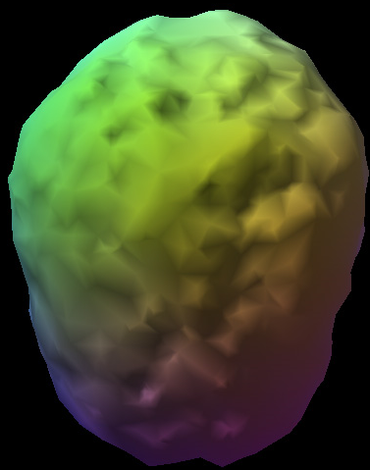
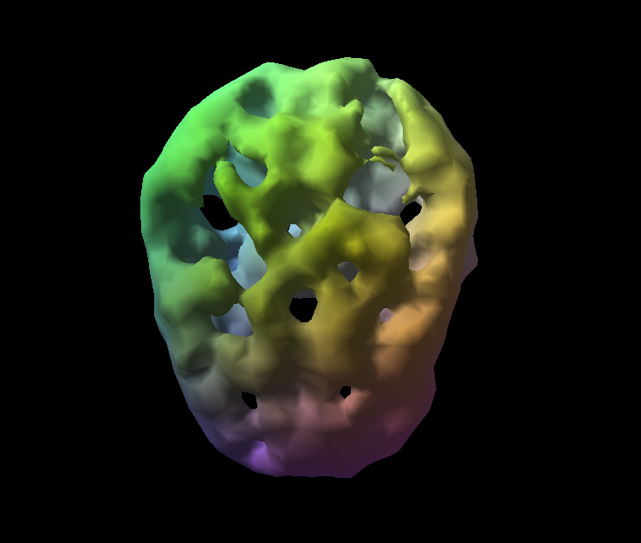
Weekend Alcohol Use Brain
Amen Clinic
SPECT
Scans
Notes:
This brain is a top down view of a 38 year old with 17 years of weekend alcohol use. The holes you see are not physical holes in the brain. The brain matter is still there. The holes reveal places in the brain where blood is not flowing and are therefore, not functioning. The physical brain structure is there but from a practical standpoint it might as well not be. ***

Slide 24
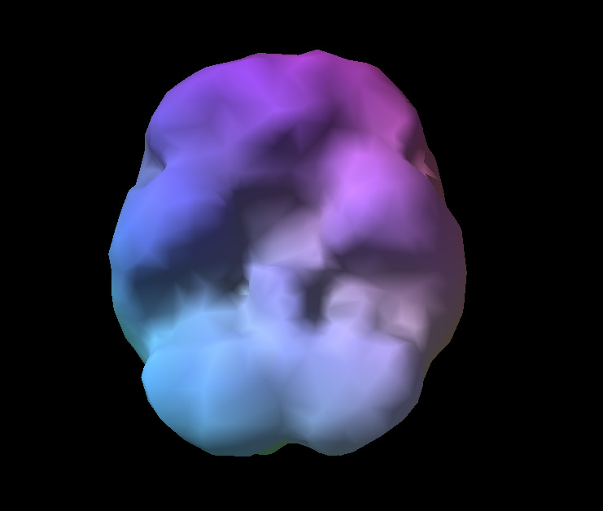
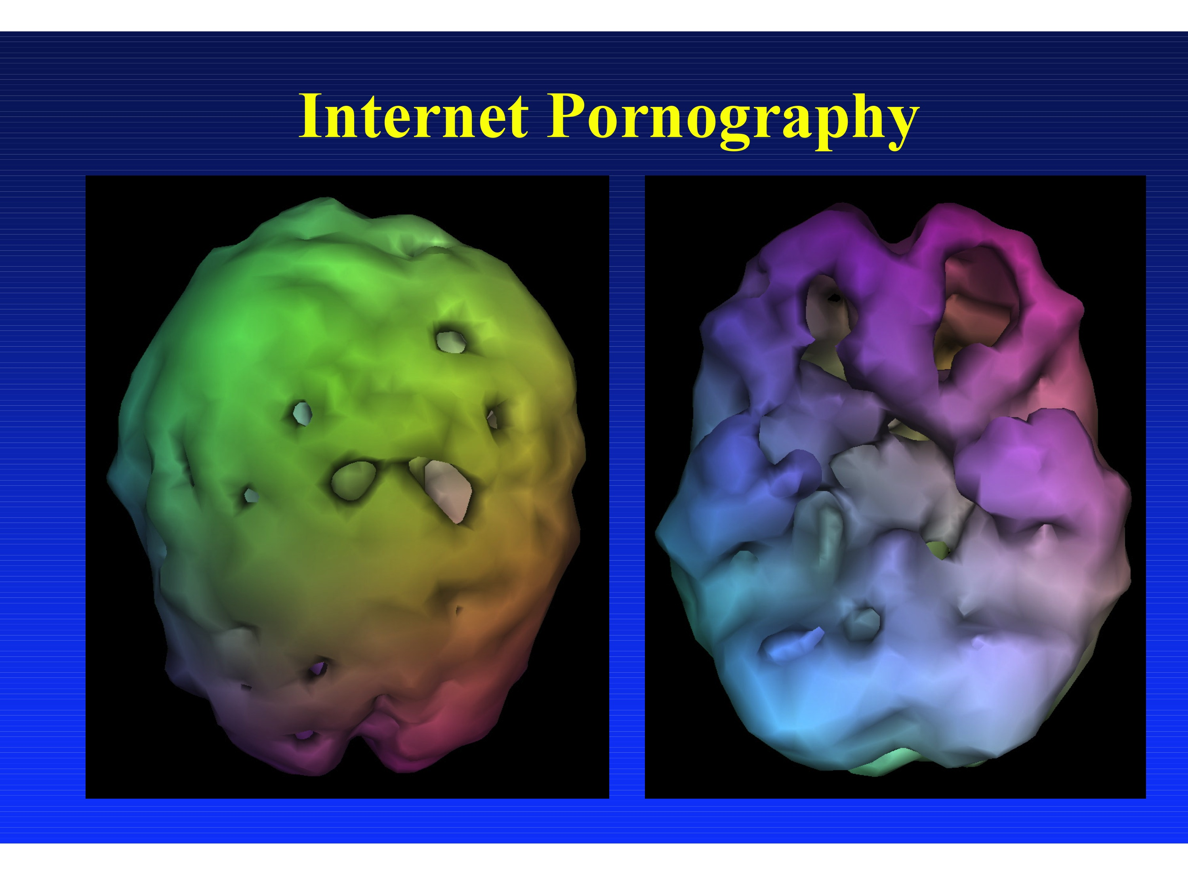
Internet Porn Addicted Brain
Amen Clinic
SPECT
Scans
Notes:
Here is a brain damaged by internet pornography
Just like other addictive substances, pornography floods the brain with dopamine. [7] But since the brain gets overwhelmed by the constant overload of chemicals that comes with consistent porn use, it fights back by taking away some of its dopamine receptors As a result, the pornography they were looking at doesn’t seem as arousing or exciting, and many pornography users go hunting for more pornography or more hardcore pornography to get the effect the old pornography used to offer. [10]
http://www.upliftfamilies.org/pornography_changes_the_brain

Slide 25
When a woman is intimate with a man, oxytocin is released, and this makes her bond to him emotionally. Have you wondered sometimes why a woman will stay with a man who’s abusing her? We know now that it’s because she bonded to him emotionally because of the oxytocin released during sex.
Notes:
http://www.charismamag.com/life/men/17635-how-premarital-sex-rewires-the-brain

Slide 26
Men produce vasopressin, which is also referred to as the “monogamy hormone,” and it has the same effect as oxytocin has on a woman. It bonds a man to a woman.
Notes:
http://www.charismamag.com/life/men/17635-how-premarital-sex-rewires-the-brain

Slide 27
Remedy for those lost in the choice to sin:
[No particular intellectual hangup, no particular resentment issues with believers less than exemplary.]
“Repent, and trust Yeshua.”

Slide 28
Ways to be lost
Rebel against G-d for pleasure.
Accept another concept of Truth: Islam, Buddhism, etc.
Deny that there IS any truth.

Slide 29
Dan Juster, recently: Today's culturally pervasive post-modernism teaches that there is no ultimate narrative to explain existence (meta-narrative) so that on the level of religious truth we have no way to judge one world view over against another.
Notes:
http://www.tikkuninternational.org/newsletters/dj-jun17.php

Slide 30
As such there is an equalization of all religions, and one preference becomes as good as another. Indeed, suggesting that one is superior to another is considered gross prejudice. Of course, this trivializes claims of religious truth.
Notes:
http://www.tikkuninternational.org/newsletters/dj-jun17.php

Slide 31
Over the decades I have found that if a person can be brought to the place of asking God to reveal the truth, and then orient to study and seek the truth, the person usually becomes a believer in Yeshua.
Notes:
http://www.tikkuninternational.org/newsletters/dj-jun17.php

Slide 32
Our challenge is to orient our young people to be truth seekers and to believe that there is an ultimate Truth. It is also to teach that the loss of seeking the truth and replacing it with the desire to be in the mainstream culture, is actually choosing self-centeredness above living by the Truth.
Notes:
http://www.tikkuninternational.org/newsletters/dj-jun17.php

Slide 33

Notes:
Josh McDowell
https://www.josh.org/even-possible-know-truth/

Slide 34
Some people, however, say “There is no truth.” The problem with this phrase is that it’s self-contradictory. The sentence refutes itself through its very existence. The statement “there is no truth” is a truth claim about at least one thing—namely that “there is no truth.”
Notes:
https://www.josh.org/even-possible-know-truth/

Slide 35
“We cannot be sure about anything” is another sentence that refutes itself, as does “Never say the word ‘never.’” Thus, the most important question becomes not if we can know truth, but what is truth?
Notes:
https://www.josh.org/even-possible-know-truth/

Slide 36
God is not only our standard of moral truth, but he has gone to extraordinary lengths to form a relationship with us. And relationship is key in knowing and living the truth.
Notes:
https://www.josh.org/even-possible-know-truth/

Slide 37
^{Yn 8. 31-32} So Yeshua said to the Judeans who had trusted him, "If you obey what I say, then you are really my talmidim, you will know the truth, and the truth will set you free."

Slide 38
^{Ro 11.17-18} A wild olive — were grafted in among them and have become equal sharers in the rich root of the olive tree…you are not supporting the root, the root is supporting you.
Notes:
We visited an olive press, olive oil factory. Questioned about grafting…olive branches never die. Story of stump for decoration in yard. If other fruit grafted in, has DNA of apple, pear, peach, etc. Still produce the same. BUT, different xylem…minerals, osmotic flow, different flavor!! Chinese, Polynesian, Hispanic, Slavic…keep the same identity, yet the LIFE is different!

Slide 39
^{Ro.6.3-4} Those of us who have been immersed into the Messiah Yeshua have been immersed into his death? Through immersion into his death we were buried with him; so that just as, through the glory of the Father, the Messiah was raised from the dead, likewise we too might live a new life.

Slide 40
Water immersion is a Torah practice expanded by Yokhanan/ John to be for a new life of repentance.
Jewish immersion = T’vilah
Immerse yourself
Three times
Notes:
Running water, total contact with water.

Slide 41
בָּרוּךְ אַתָּה יְיָ, אֶלהֵנוּ מֶלֶךְ הָעוֹלָם, אֲשֶׁר קִדְשָׁנוּ בְּמִצְווֹתָיו, וְצִוָּנוּ עַל הַטְּבִילָה
Ba-rookh A-tah A-do-ni,
E-lo-hay-noo me-lekh ha-o-lam, a-sher keed-sha-noo b'mitz-vo-tav, v'tsee-va-noo al ha-t'vee-lah.

Slide 42
Blessed are You,
Adoni our G-d,
King of the Universe,
Who sanctifies us with His commandments,
and has commanded us concerning the immersion.

Slide 43
אֲנִי מַאֲמִין בְּאַב, וּבְבֵן, וּבְרוּחַ הַקּדֶשׁ
Anee ma-a-meen b'av, oo-veh-bayn, oov-roo-akh ha-ko-desh
I believe in the Father, and the Son, and the Holy Spirit.

Slide 44
3. A brief exclamation of testimony and praise.

Slide 45
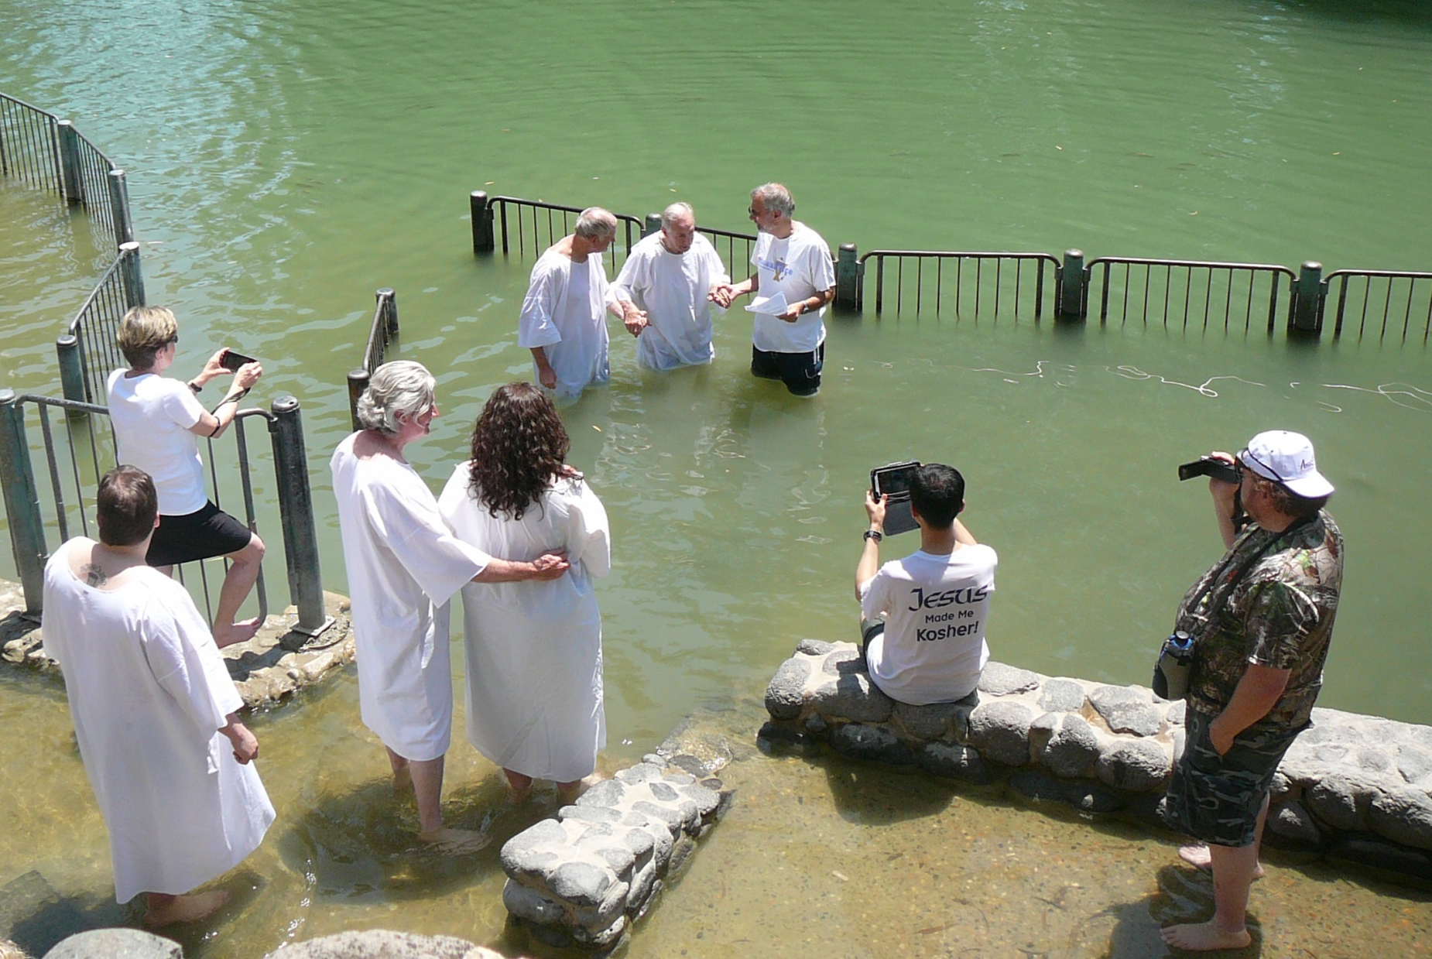

Slide 46
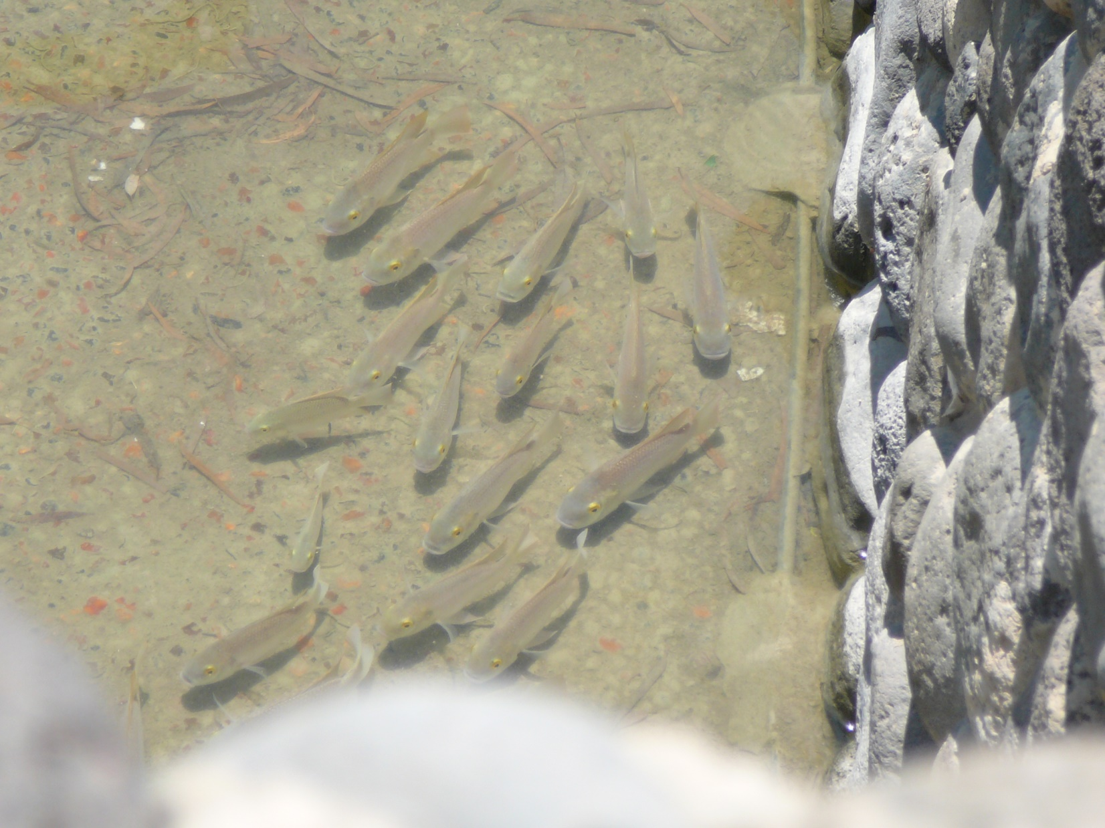

Slide 47
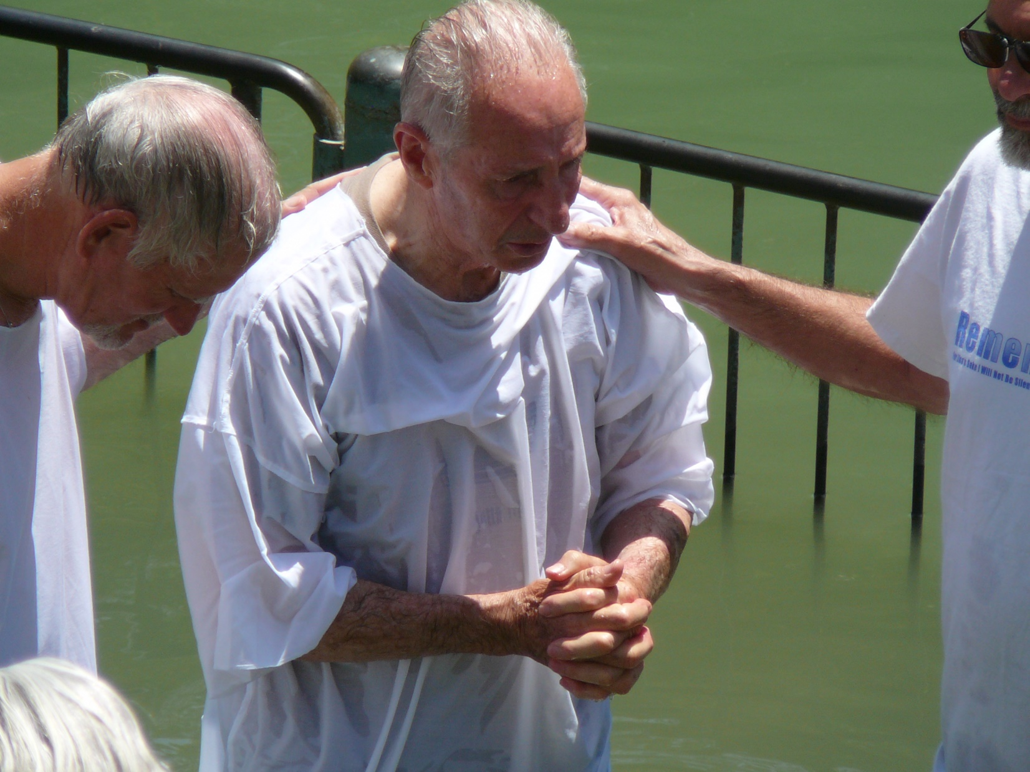

Slide 48
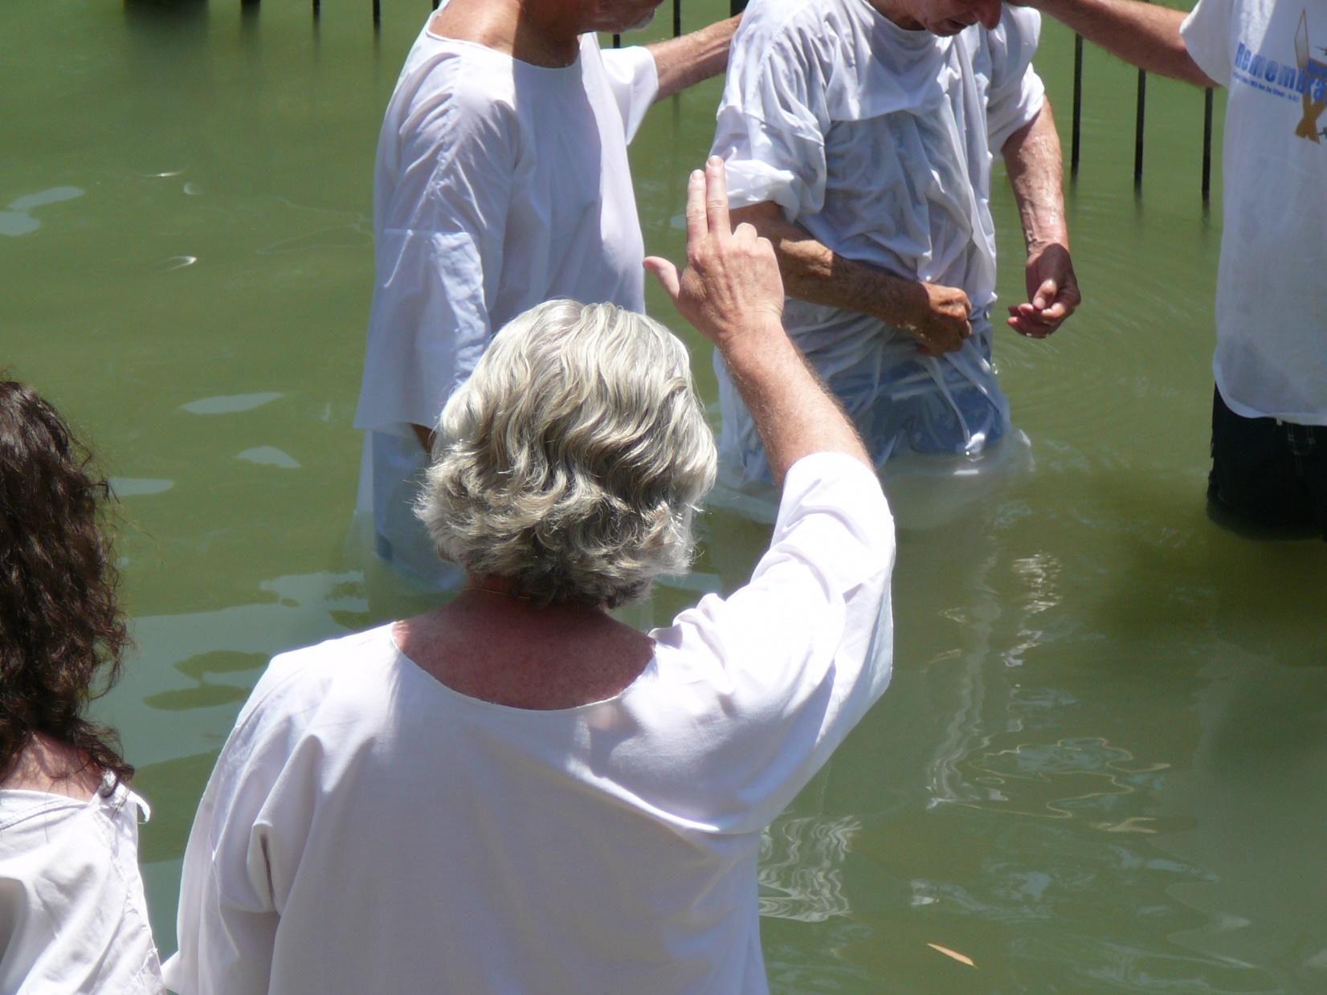

Slide 49
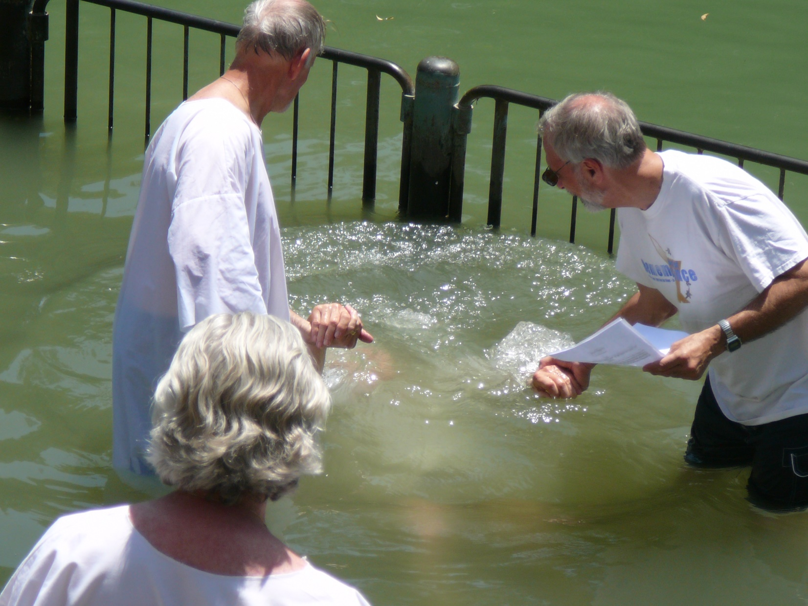
Notes:
Geoff Martin

Slide 50
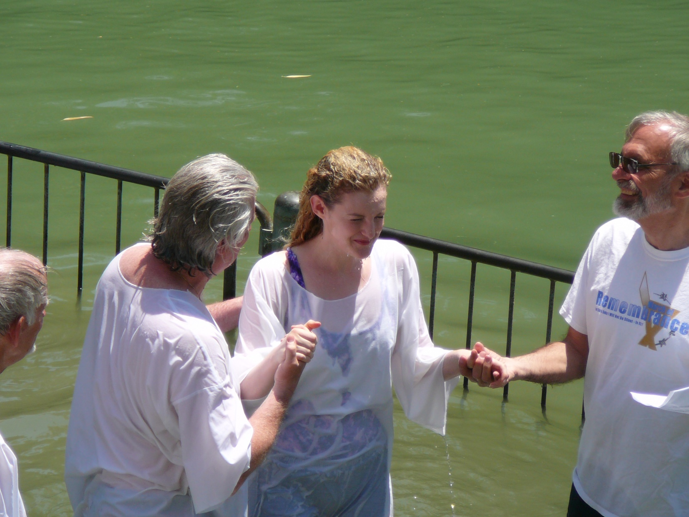

Slide 51
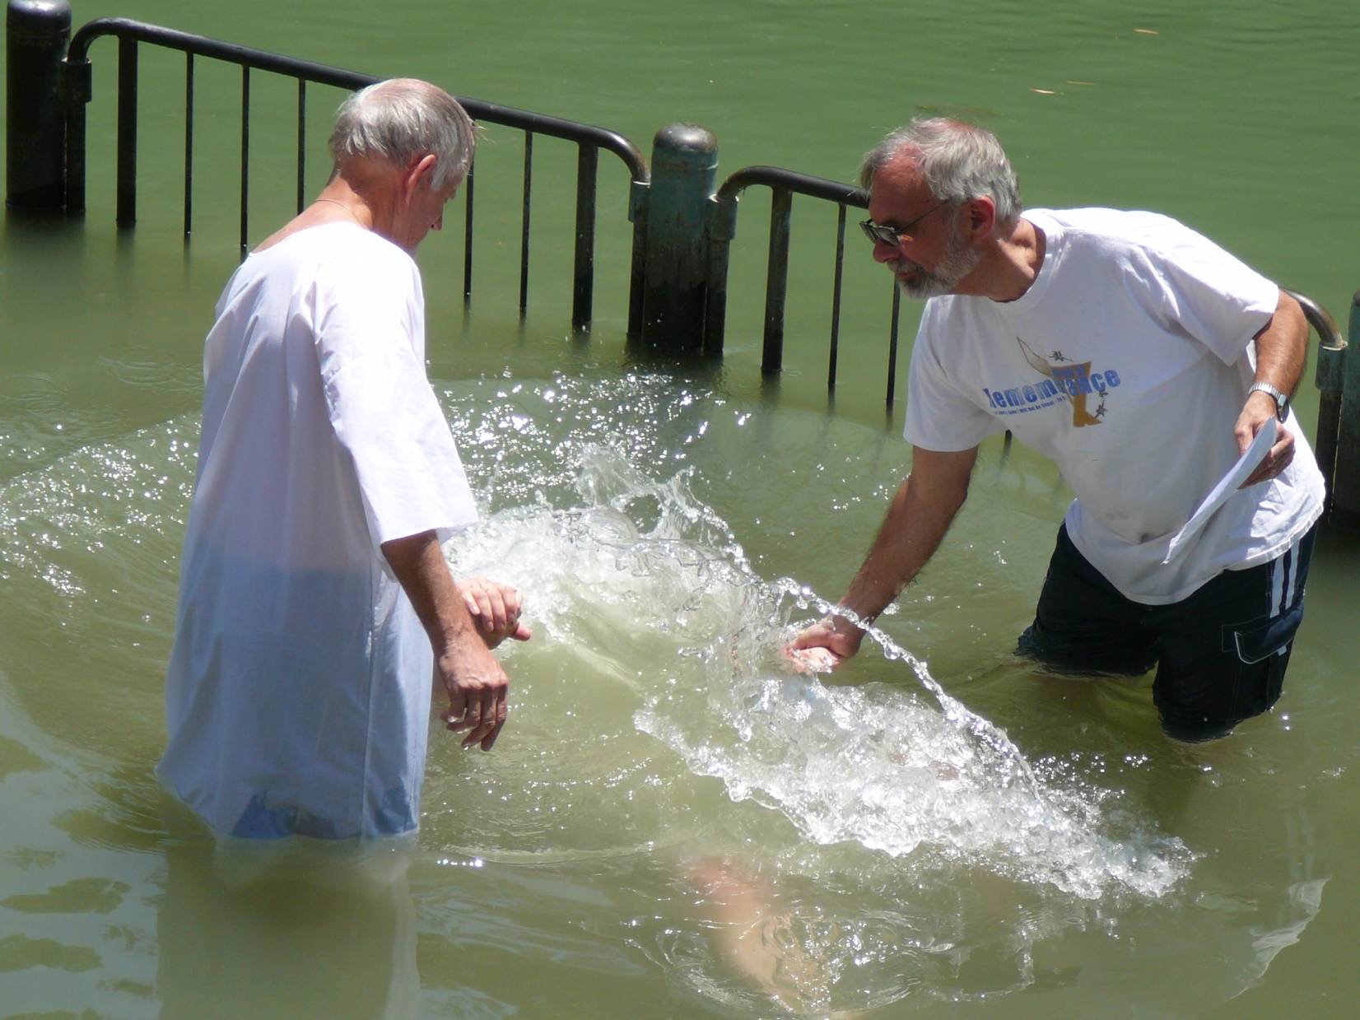

Slide 52
^{Ro 8.5} For if we have been united with him in a death like his, we will also be united with him in a resurrection like his

Slide 53
Mattityahu (Matthew) 18:12
הַאִם לֹא יַעֲזֹב אֶת הַתִּשְׁעִים וְתִשְׁעָה עַל הֶהָרִים וְיֵלֵךְ לְחַפֵּשׂ אֶת הָאוֹבֵד?
Won't he leave the ninety-nine on the hillsides and go off to find the stray?
Notes:
Need based service. Wandered.
Impossible meet every need.
Yet needs of lost should be our consuming passion. > material goods, reputation, convenience. LOST.
100 Sheep typical flock size then. Lots to keep count of. Our tour guide always 22, 19,

Slide 54
Mattityahu (Matthew) 18:13
וְכַאֲשֶׁר יִמְצָא אוֹתוֹ, אָמֵן אוֹמֵר אֲנִי לָכֶם, יִשְׂמַח עָלָיו יוֹתֵר מֵאֲשֶׁר עַל הַתִּשְׁעִים וְתִשְׁעָה שֶׁלֹּא אָבְדוּ.
And if he happens to find it? Yes! I tell you he is happier over it than over the ninety-nine that never strayed!

Slide 55
What has Or HaOlam done to find and save the lost?
Prayer station

Slide 56
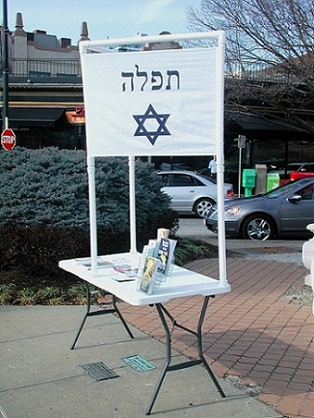

Slide 57
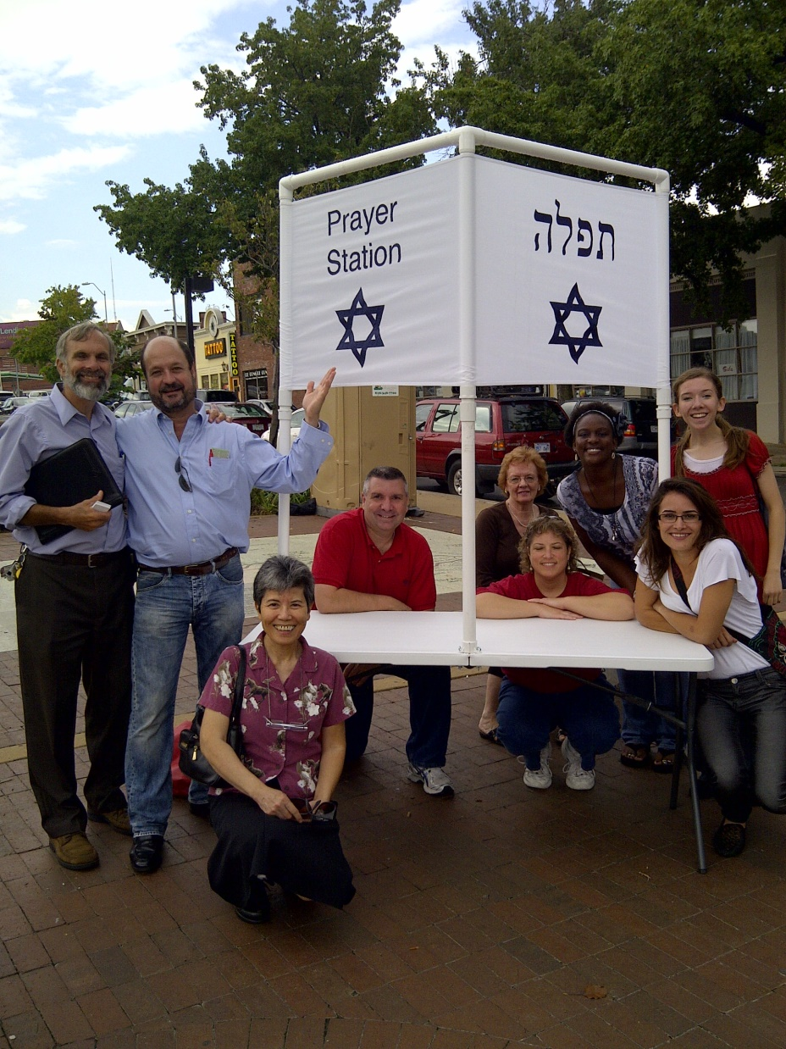

Slide 58
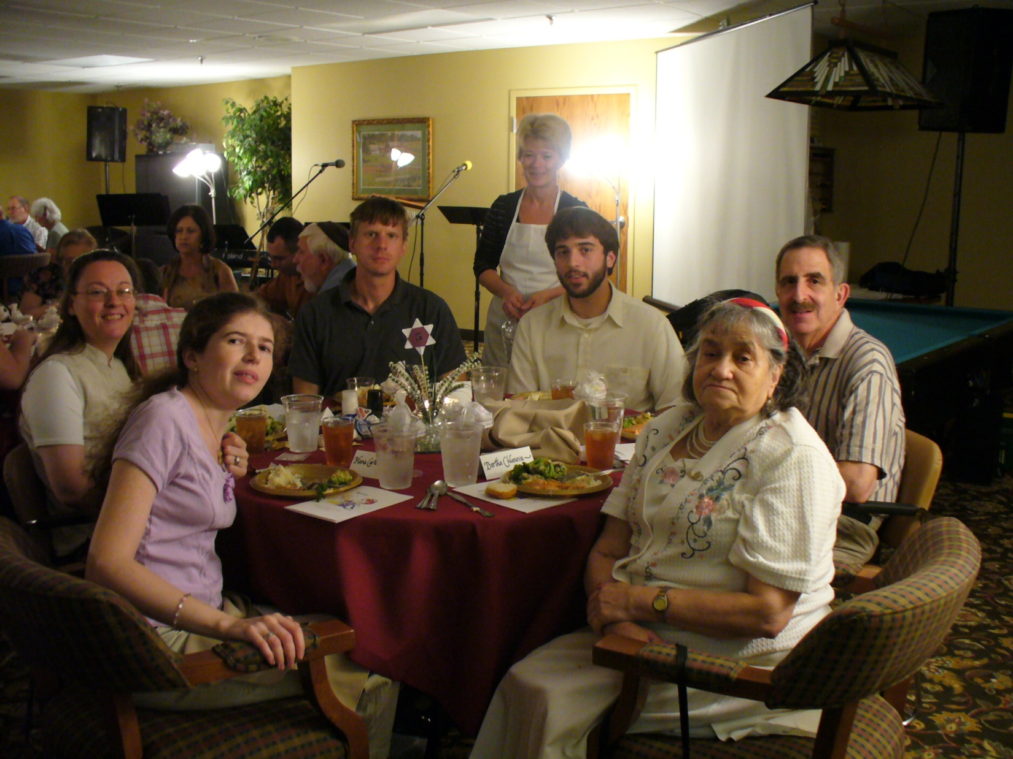
Alef

Slide 59

Movies

Slide 60
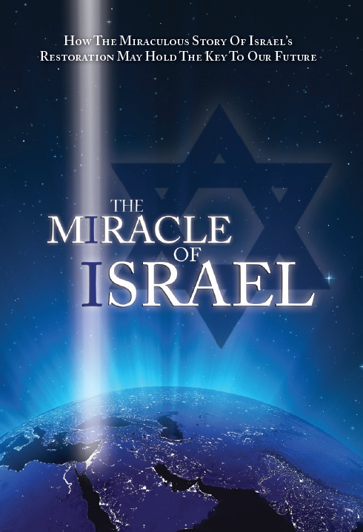
Movies

Slide 61
Literature distribution
Mailings
Passover outreach
JB coming.

Slide 62
Mattityahu (Matthew) 18:13
וְכַאֲשֶׁר יִמְצָא אוֹתוֹ, אָמֵן אוֹמֵר אֲנִי לָכֶם, יִשְׂמַח עָלָיו יוֹתֵר מֵאֲשֶׁר עַל הַתִּשְׁעִים וְתִשְׁעָה שֶׁלֹּא אָבְדוּ.
And if he happens to find it? Yes! I tell you he is happier over it than over the ninety-nine that never strayed!

