Slide 1
To easily follow these notes, log on to our Wifi
Wifi: mycci01
p/w: ancientquail060
Go to OrHaOlam.com
Click on downloads, messages, 2017

Slide 2
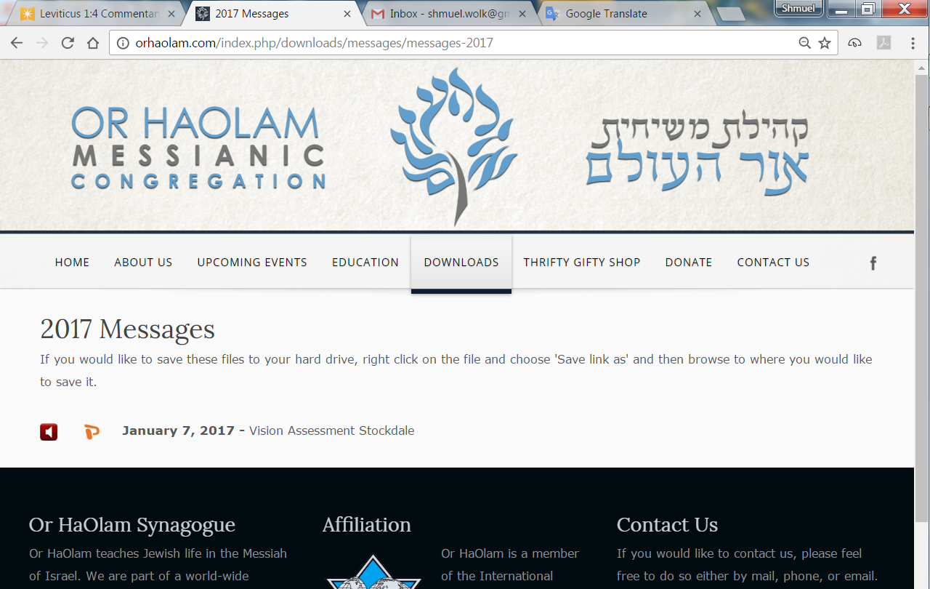

Slide 3
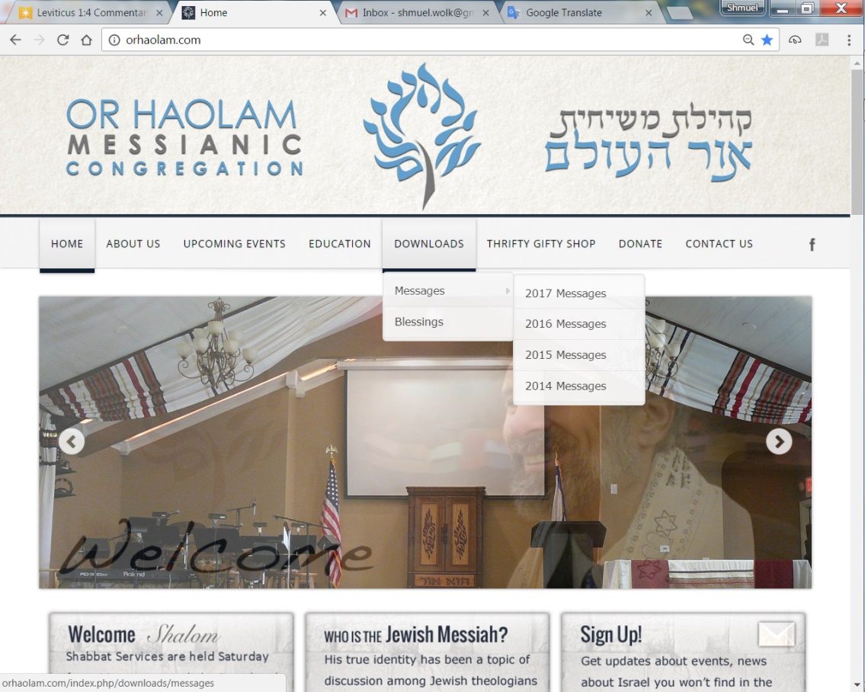
Downloads\messages\
2017 Messages

Slide 4
New level of Hebrew authenticity at Or HaOlam last week. I read two Hebrew words wrong.
לגרום ligrom “to cause” was supposed to be
לרגום lirgom “to stone”

Slide 5
ענבים anavim “grapes” was supposed to be
אבנים avanim “Stones.”
לִרְגּוֹם אֹתָם בָּאֲבָנִים לִגרוֹם אֹתָם בָּענבים
leergom otam b’avanim→
leegrom otam b’anavim
Notes:
Proud of Grace: read Yid.
Show something from our new technology.

Slide 6
Supposed to say,
“to stone them with stones.”
Instead, I said,
“to cause them with grapes.”
I was caught by one of our wonderful young women who made aliyah and surpassed my Hebrew skills!
Notes:
Proud of Grace: read Yid.
Show something from our new technology.

Slide 7
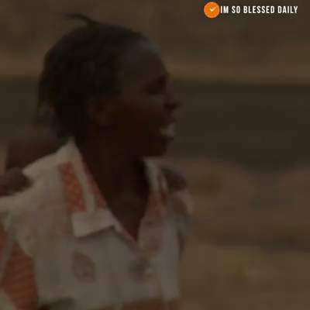

Slide 8
Last Shabbat was our
Father’s Day celebration.
Notes:
I proposed a radical definition or characterization of fatherhood, leaders in general.

Slide 9
A primary identity of Messiah is Word, דָּבָר Davar, מֵימְרָה Memra, Λόγος Logos
Communication
Radical statement:
A primary characteristic of a leader / father is communication.
Notes:
English, Hebrew, Aramaic, Greek
Real difference between us and animals…living soul in Genesis rendered “speaking spirit.” Nefesh khayah. נפש חיה
Especially when things get difficult.

Slide 10
Work to solve problems, bridge barriers, overcome difficulties.
Be there.
Notes:
Teach, model, exemplify, lead by serving, by imparting life in the Ruakh, building relations, making peace.
We spoke last week about some of the external hazards that our children, as well as ourselves, face in being righteous and communicating righteous living. I won’t go back into those external hazards today. I will address the internal hazards of our own hearts and failings.
Solve problems. Last week’s reading:

Slide 11
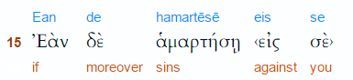
^{Matit 18.15} Moreover, if your brother commits a sin against you,
Notes:
Here you are the victim. Been violated, sinned against. Have accusation.

Slide 12
eis (a preposition) – properly, into (unto) – literally, "motion into which" implying penetration ("unto," "union") to a particular purpose or result.
You are the aggrieved party.

Slide 13
^{Mt 18.15} go and show him his fault — but privately, just between the two of you.
A person should never shame another publicly or he/she could be excluded from the world to come. ^{Sanh. 107a}
Notes:
What is the teaching / exhortation of Yeshua in a word?? GO

Slide 14
Work to solve problems, bridge barriers, overcome difficulties.
Be there.

Slide 15
Somewhat parallel teaching in Matityahu 5,
Midrash on the Mountain
Parallel but reversed, and so strengthens the teaching/ exhortation.

Slide 16
^{Matit 5.23} you remember there that your brother has something against you
Your conscience speaks up. Not nebulous, but specific wrong you’ve done in word, deed…

Slide 17
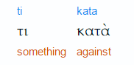
something against you
down from, against,
according to,
throughout, during
Notes:
Accusation, you are guilty, or thought to be, at the bar of judgement, in trouble

Slide 18
^{Mt 5.24} leave your gift where it is by the altar, and go, make peace with your brother. Then come back and offer your gift.
Notes:
What do you do?? GO. Stop offering: praying, praising. Immediately? May need to pray about, counsel about: how, when, where. But…GO.
Might be a long distance, since His hearers here Galileans, and offering in Yerushalayim. GO
Reverse situation…

Slide 19
Matityahu 5 -- We are at fault, sinned against someone.
Mtit. 18 – Someone else is at fault, and has sinned against us.
In both cases, the exhortation is the same: GO

Slide 20
Work to solve problems, bridge barriers, overcome difficulties.
Be there.
Notes:
In shepherding, there a LOT of times when people DON’T want to GO. Refuse to go.
I’ll just pray about it. [Good starter, but not what it says.]
I have to find the will of G-d. [It says!]
I don’t know how. [Very valid for a while. Seek wisdom.]
I don’t like confrontation. [Me neither. I’m not a conflict avoider, but certainly a conflict delayer.]
It’s not my gifting. [Obeying scripture?]
You go, rabbi, and fix this.

Slide 21
Or HaOlam Statement of Faith
8. I will practice the scriptural process, as needed, of conflict resolution. When a conflict arises, we will go to the individual in a loving, appreciative spirit, and try to get reconciliation.

Slide 22
Or HaOlam Statement of Faith
If that fails, we will seek the help of the "one or two" intermediaries appointed by the elders. (Mattityahu 18:15–18)

Slide 23
Goal: GO and…
Mtt 5 “make peace with your brother”
Mtt 18 “If he listens to you, you have won back your brother.”
Be reconciled.
But if not…
Notes:
It DOESN’T say, only pray and fast, study and memorize. Those are implied, but it says “GO.”

Slide 24
^{Matit 18.16-17} If he doesn't listen, take one or two others with you so that every accusation can be supported by the testimony of two or three witnesses. If he refuses to hear them, tell the congregation; and if he refuses to listen even to the congregation,
Notes:
Before witnesses only if necessary ^{Shab 119b}
But always with a purpose of restoration. 1 Cor 5.5, 2 Cor. 2:5-11, 1 Tim 1.20
DSS same sequence: private reproof, witnesses, gathered assembly. Qumran community detested disrespect. Heard recently of a Congregational community that had a great culture of honor. Gateway in Dallas.
If intractable…

Slide 25
^{Matit 18.16-20} treat him as you would a pagan or a tax-collector. Yes! I tell you people that whatever you prohibit on earth will be prohibited in heaven, and whatever you permit on earth will be permitted in heaven.
Notes:
7 individuals in the course of 22 years of Or HaOlam. 3 guys, 4 women. 3 for stalking, 4 for contentions Ro 16

Slide 26
^{Matit 18.16-20} To repeat, I tell you that if two of you here on earth agree about anything people ask, it will be for them from my Father in heaven. For wherever two or three are assembled in my name, I am there with them."
Notes:
These verses have been greatly misunderstood by the Christian world. Commonly interpreted as prayer. Messianic minyan. That is an application, a midrash, an expansion. Real meaning…

Slide 27
David Sterns Jewish New Testament Commentary:
I take the p'shat ("plain sense") of this passage to be dealing with making legal judgments and halakhah, not prayer. The words rendered "prohibit" and "permit" (v. 18) are,
Notes:
http://kifa.kz/eng/bible/stern/stern_matfey_18.php

Slide 28
literally, "bind" and "loose." These terms were used in first century Judaism to mean "prohibit" and "permit," as is clear from the article,
Notes:
http://kifa.kz/eng/bible/stern/stern_matfey_18.php

Slide 29
"Binding and Loosing," in the Jewish Encyclopedia. 3:215:
"Binding and loosing (Hebrew asar ve-hittir)... Rabbinical term for 'forbidding and permitting."...
"The power of binding and loosing was always claimed by the Pharisees.
Notes:
http://kifa.kz/eng/bible/stern/stern_matfey_18.php

Slide 30
Under Queen Alexandra the Pharisees, says Josephus ^{(Wars of the Jews 1:5:2)}, 'became the administrators of all public affairs so as to be empowered to banish and readmit whom they pleased, as well as to loose and to bind."...
Notes:
http://kifa.kz/eng/bible/stern/stern_matfey_18.php

Slide 31
The various schools had the power 'to bind and to loose'; that is, to forbid and to permit ^{(Talmud: Chagigah 3b)}: and they could bind any day by declaring it a fast-day (...Talmud: Ta'anit 12a...).
Notes:
http://kifa.kz/eng/bible/stern/stern_matfey_18.php

Slide 32
This power and authority, vested in the rabbinical body of each age or in the Sanhedrin, received its ratification and final sanction from the celestial court of justice (Sifra, Emor, ix: Talmud: Makkot 23b).
Notes:
http://kifa.kz/eng/bible/stern/stern_matfey_18.php

Slide 33
"In this sense Yeshua, when appointing his disciples to be his successors, used the familiar formula. ^{(Matt 16:19, 18:18)} By these words he virtually invested them with the same authority as that which he found belonging to
Notes:
http://kifa.kz/eng/bible/stern/stern_matfey_18.php

Slide 34
the scribes and Pharisees who 'bind heavy burdens and lay them on men's shoulders, but will not move them with one of their fingers'; that is, 'loose them,' as they have the power to do ^{(Matt 23:2-4).}
Notes:
http://kifa.kz/eng/bible/stern/stern_matfey_18.php

Slide 35
The passage is not about prayer — although it is not wrong to make a midrash on it which does apply to prayer.
the Mishna:
"Rabbi Chananyah ben-T'radyon said,
Notes:
http://kifa.kz/eng/bible/stern/stern_matfey_18.php

Slide 36
'If two sit together and words of Torah pass between them, the Sh'khinah abides between them, as it is said, "Those who feared Adonai spoke together, and Adonai paid heed and listened,
Notes:
http://kifa.kz/eng/bible/stern/stern_matfey_18.php

Slide 37
and a record was written before him for those who feared Adonai and thought on his name” (Malachi3:16). (Avot3:2)
Notes:
http://kifa.kz/eng/bible/stern/stern_matfey_18.php

Slide 38
^{Matit 18.16-20} treat him as you would a pagan or a tax-collector. Yes! I tell you people that whatever you prohibit on earth will be prohibited in heaven, and whatever you permit on earth will be permitted in heaven.

Slide 39
Is this easy?
Is this painful?
If someone sins against you, or if you’ve sinned against them…risky. They could get angry, alienated…fracture.
Do you find confrontation easy?

Slide 40
Work to solve problems, bridge barriers, overcome difficulties.
Be there.

Slide 41
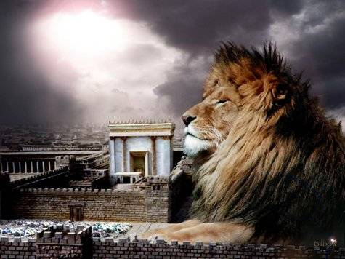
מַתִּתְיָהוּ Mattityahu
(Matthew) 18:21-23

Slide 42
Mattityahu (Matthew) 18:21
כֵּיפָא נִגַּשׁ וְשָׁאַל אוֹתוֹ: "אֲדוֹנִי, כַמָּה פְּעָמִים יֶחֱטָא לִי אָחִי וְאֶסְלַח לוֹ? הַאִם עַד שֶׁבַע פְּעָמִים?"
Then Kefa came up and said to him, "Rabbi, how often can my brother sin against me and I have to forgive him? As many as seven times?"
Notes:
SW paraphrase:
How long do I have to keep up this work of correcting with love, pleading, substantiating with truth, witnesses, evidence, building community?
How long do I have to put up with…left and right, deal with their baggage, lift their loads, correct, instruct. I can walk. This is a free country. No necessity to build community. No need to stay in this marriage. No need to stay in this family.
“My brother.” So, a sinning brother. I thought all the brothers and sisters were perfect. No sin.

Slide 43
Mattityahu (Matthew) 18:22
הֵשִׁיב לוֹ יֵשׁוּעַ: "אֵינֶנִּי אוֹמֵר לְךָ עַד שֶׁבַע פְּעָמִים אֶלָּא עַד שִׁבְעִים וָשֶׁבַע.
"No, not seven times," answered Yeshua, "but seventy times seven!
Notes:
There is an ancient Greek translation of the Torah called the Septuagint, which renders Gen. 4.24 different from the Hebrew text. Masoretic text, written in Tiveriah/ Tiberias, where we were on tour. Found the ATM.

Slide 44
^{Gen 4.23-24 LXX} And Lamech said to his wives, Ada and Sella, Hear my voice, ye wives of Lamech, consider my words, because I have slain a man to my sorrow and a youth to my grief.

Slide 45
^{Gen 4.23-24 LXX} Because vengeance has been exacted seven times on Cain’s behalf, on Lamech’s it shall be seventy times seven.
Notes:
Did Yeshua know about the LXX? Think so! Yeshua takes the words of Lamech on 490x vengeance, and applies it in a new way.
All this processing of offenses takes a LOT of forgiveness. How could you…?
Bring this home a bit. Who is closest to you, and greatest expectations of safety, love, affirmation? Therefore, most likely to offend you?
Family.
Spouse.

Slide 46
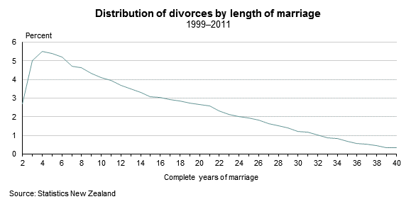
American census data shows a similar pattern to the above.
Notes:
Note 4th year spike in divorces.
Family Talk Dobson Thursday, June 22, 3 main times of divorce
Few years in, the glow fades. “I thought I loved you, but I don’t.”
Height of career. Other things more important than relationship.
Empty nest. Just each other.

Slide 47
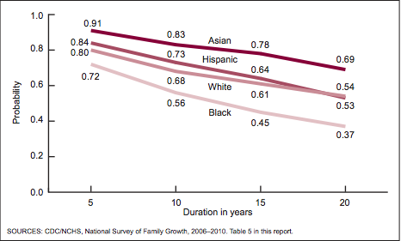
Notes:
From https://www.mckinleyirvin.com/Family-Law-Blog/2012/October/32-Shocking-Divorce-Statistics.aspx
By twenty years on average 50%. Varies somewhat by ethnic group.

Slide 48
41 percent of first marriages end in divorce.
60 percent of second marriages end in divorce.
73 percent of third marriages end in divorce.
Notes:
From https://www.mckinleyirvin.com/Family-Law-Blog/2012/October/32-Shocking-Divorce-Statistics.aspx

Slide 49
Divorce rates spikes at about the 4th year. However, they don’t stop and the cumulative effect is such that only about 50% of marriages are intact by the 20th year! The spike in divorce rate may be past

Slide 50
but the trickle of tragedy continues. Moreover, 2nd and 3rd marriages do worse yet! So, no marriage is guaranteed. However, that is NOT the intention of the Inventor of marriage!

Slide 51
Marriage was intended, by its Designer, to be a joyful unity of spirit, soul, and body for life! We want to ensure that this is the case with ALL the marriages at Or HaOlam. If you are newlywed, silver or golden anniversary, you need to work on your relationship!

Slide 52
One tool that we are offering is an eight session small group study called Marriage on the Rock, with video teacher Jimmy Evans.
Notes:
We are envisioning groups of 10 couples, some senior, some newlywed, sharing wisdom and struggles and victories and defeats.
Participating does NOT mean that your marriage is on the rocks.
Relate to forgiveness: one counselor described a married couple as ‘a pair of forgivers.’
Forgive, release, renew.
So, if I’m not married, I can nod off now?
Marriage is the MOST intense relationship, this message applies to all relationships.

Slide 53
Mattityahu (Matthew) 18:21
כֵּיפָא נִגַּשׁ וְשָׁאַל אוֹתוֹ: "אֲדוֹנִי, כַמָּה פְּעָמִים יֶחֱטָא לִי אָחִי וְאֶסְלַח לוֹ? הַאִם עַד שֶׁבַע פְּעָמִים?"
Then Kefa came up and said to him, "Rabbi, how often can my brother sin against me and I have to forgive him? As many as seven times?"

Slide 54
Mattityahu (Matthew) 18:22
הֵשִׁיב לוֹ יֵשׁוּעַ: "אֵינֶנִּי אוֹמֵר לְךָ עַד שֶׁבַע פְּעָמִים אֶלָּא עַד שִׁבְעִים וָשֶׁבַע.
"No, not seven times," answered Yeshua, "but seventy times seven!

Slide 55
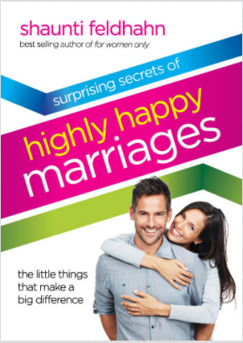
Notes:
Last week I spoke on things in the culture that are horrific. Non-binary gender neutrality, on-ramp to rampant sensuality.
More of that to say, but this week I think the King Messiah wants me to talk about the real antidote to all that. By the time I was an older teen, I had no interest in marriage, and could have done…did do some. The first apparently happy marriages I ever saw…cf aunts, uncles.
If we work to make our heterosexual marriages happy, we will influence cultural reversal. Not casting stones, building…

Slide 56
Some relational principles that form the relational core of “Highly Happy Marriages”
The most important factor for a happy marriage is believing that you married a well-intentioned person.
Notes:
from Highly Happy p 51
There are abusers. But, much of the time, we envision our spouses to be evil intended.

Slide 57
^{1 Cor. 13.5-7} Love…keeps no record of wrongs. Love does not gloat over other people’s sins
but takes its delight in the truth... it believes all things, it hopes all things.

Slide 58
“So many divorces could be prevented if people would assume that their spouses had goodwill instead of presuming that they didn’t.”
Notes:
from Highly Happy p 51 Positive spin.
Read p 56 bottom 58, 106
Forgiveness relates? The things you suspect are ill will…release. Breathe.
We can’t really forgive since it leaves a debt. Say Thank You. P 15, 16, 19, 20 Black Mercedes story p41

Slide 59
Mattityahu (Matthew) 18:23
עַל כֵּן דּוֹמָה מַלְכוּת הַשָּׁמַיִם לְמֶלֶךְ בָּשָׂר וָדָם שֶׁרָצָה לַעֲרֹךְ חֶשְׁבּוֹן עִם עֲבָדָיו.
Because of this, the Kingdom of Heaven may be compared with a king who decided to settle accounts with his deputies."

Slide 60
^{Mt 18.24-27} Right away they brought forward a man who owed him many millions; and since he couldn’t pay, his master ordered that he, his wife, his children and all his possessions be sold to pay the debt.

Slide 61
^{Mt 18.24-27} But the servant fell down before him. ‘Be patient with me,’ he begged, ‘and I will pay back everything.’ So out of pity for him, the master let him go and forgave the debt…

Slide 62
^{Mt 18.33-35} Wasn’t it necessary for you also to show mercy to your fellow slave, just as I showed mercy to you?’ Enraged, the master handed him over to the torturers until he paid back all he owed.

Slide 63
^{Mt 18.33-35} “So also My heavenly Father will do to you, unless each of you, from your hearts, forgives his brother.”

Slide 64
Conclusion
With resource of praise to Yeshua, forgive, release.
In the spirit of forgiveness, put the BEST construction on actions of offender.
Go: reconciliation, intervention, adjudication.

