Slide 1
To easily follow these notes, log on to our Wifi
Wifi: mycci01
p/w: ancientquail060
Go to OrHaOlam.com
Click on downloads, messages, 2017

Slide 2
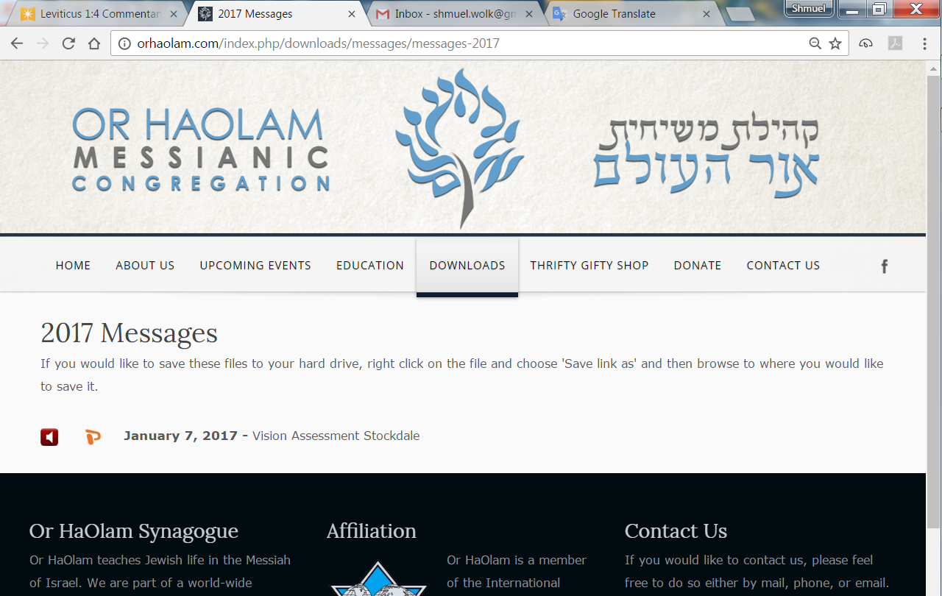

Slide 3
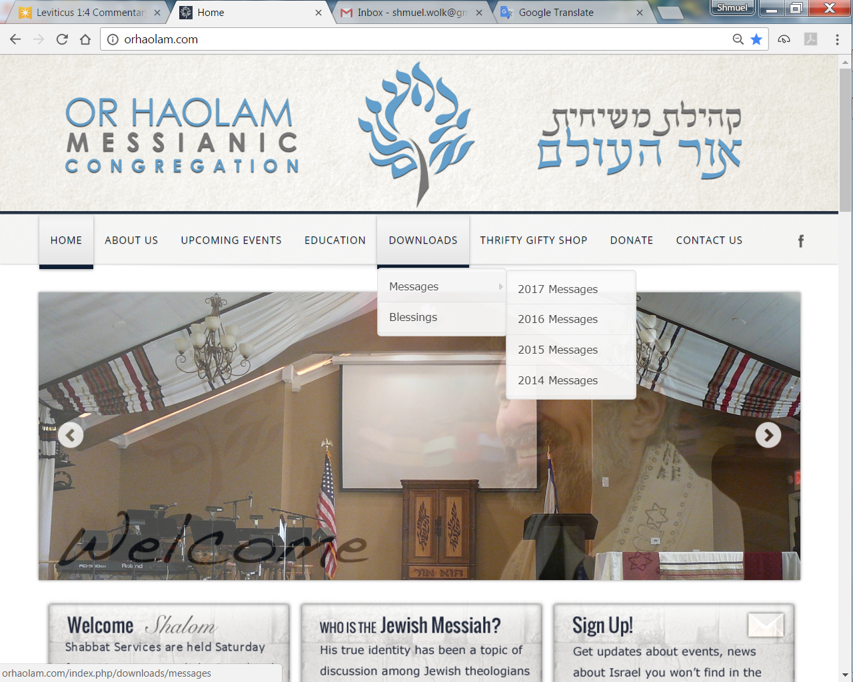
Downloads\messages\
2017 Messages

Slide 4

Total Solar Eclipse
Aug 21, 2017
Notes:
Penumbra → partial eclipse
umbra = totality, small shadow
Every 400 years given location

Slide 5
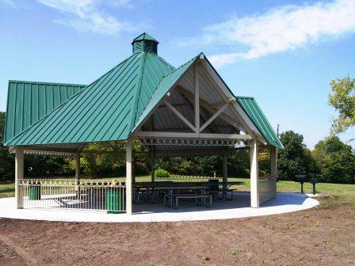
Shelter #20 at Claybrook
Email admin@orHaOlam.com
if you’re going

Slide 6
9 picnic tables
1 large grill and 2 small grills
20 amp service
Water hydrant 25 yards from shelter
Restroom with flush toilets 120 yards from shelter.
Close to Jesse James Farm Museum
21211 Jesse James Farm Rd.,
Kearney, MO 64060
Notes:
Need a picnic and a play coordinator.

Slide 7
I lost my balance on the escalator
and fell down the stairs for 2 hours.
Notes:
Matt Alford

Slide 8
A woman is sitting on a couch one evening with her husband. She says, "I love you." He asks, "Is that you or the wine talking?" She replies, It's me talking to the wine."

Slide 9
What kind of fish is made up of only two sodium atoms?
2 Na

Slide 10
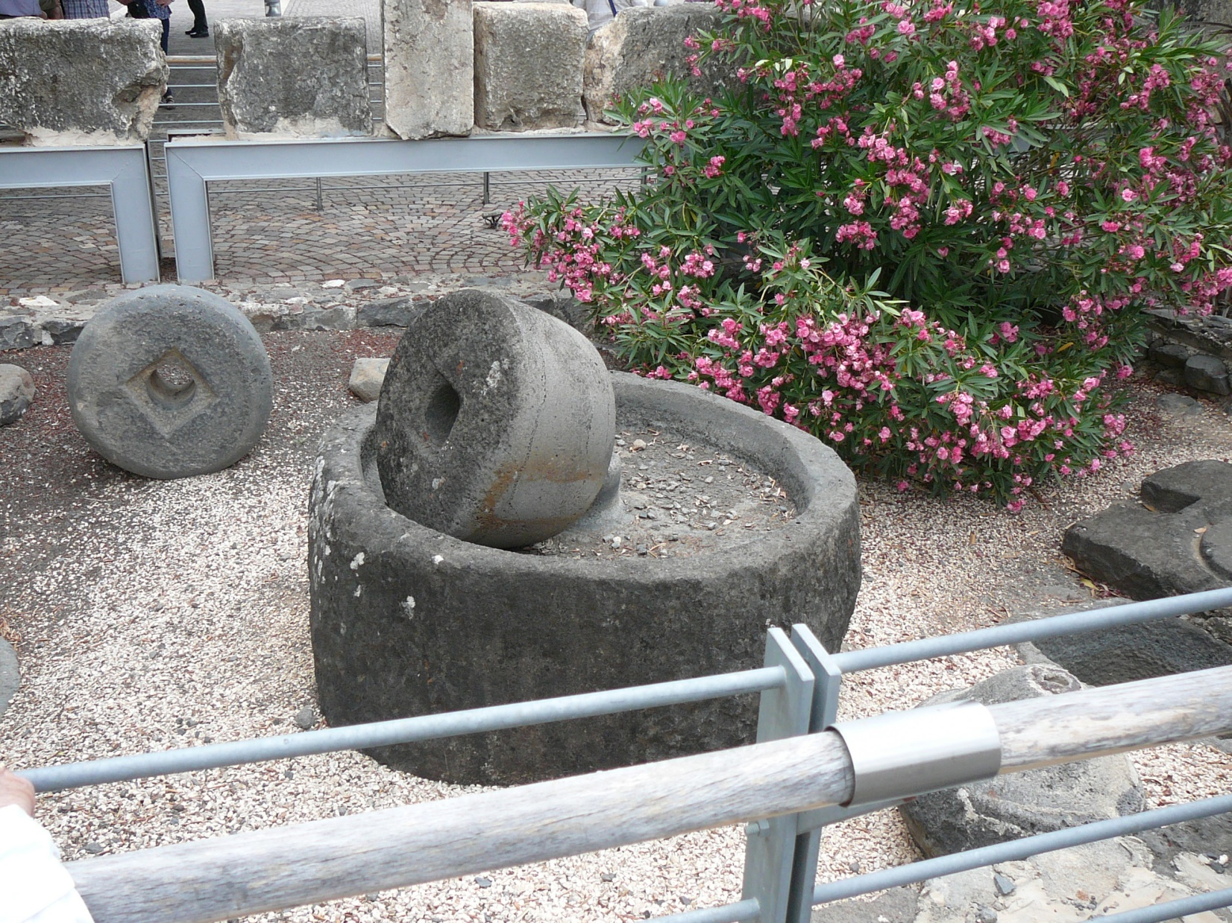
Millstones in Kfar Nahum
Notes:
The lower one that was in the image of tied around those that hurt new believers or pre-believers.

Slide 11
Mattityahu (Matthew) 18:10-11
Whoever ensnares one of these little ones who trust me, it would be better for him to have a millstone hung around his neck and be drowned in the open sea!

Slide 12
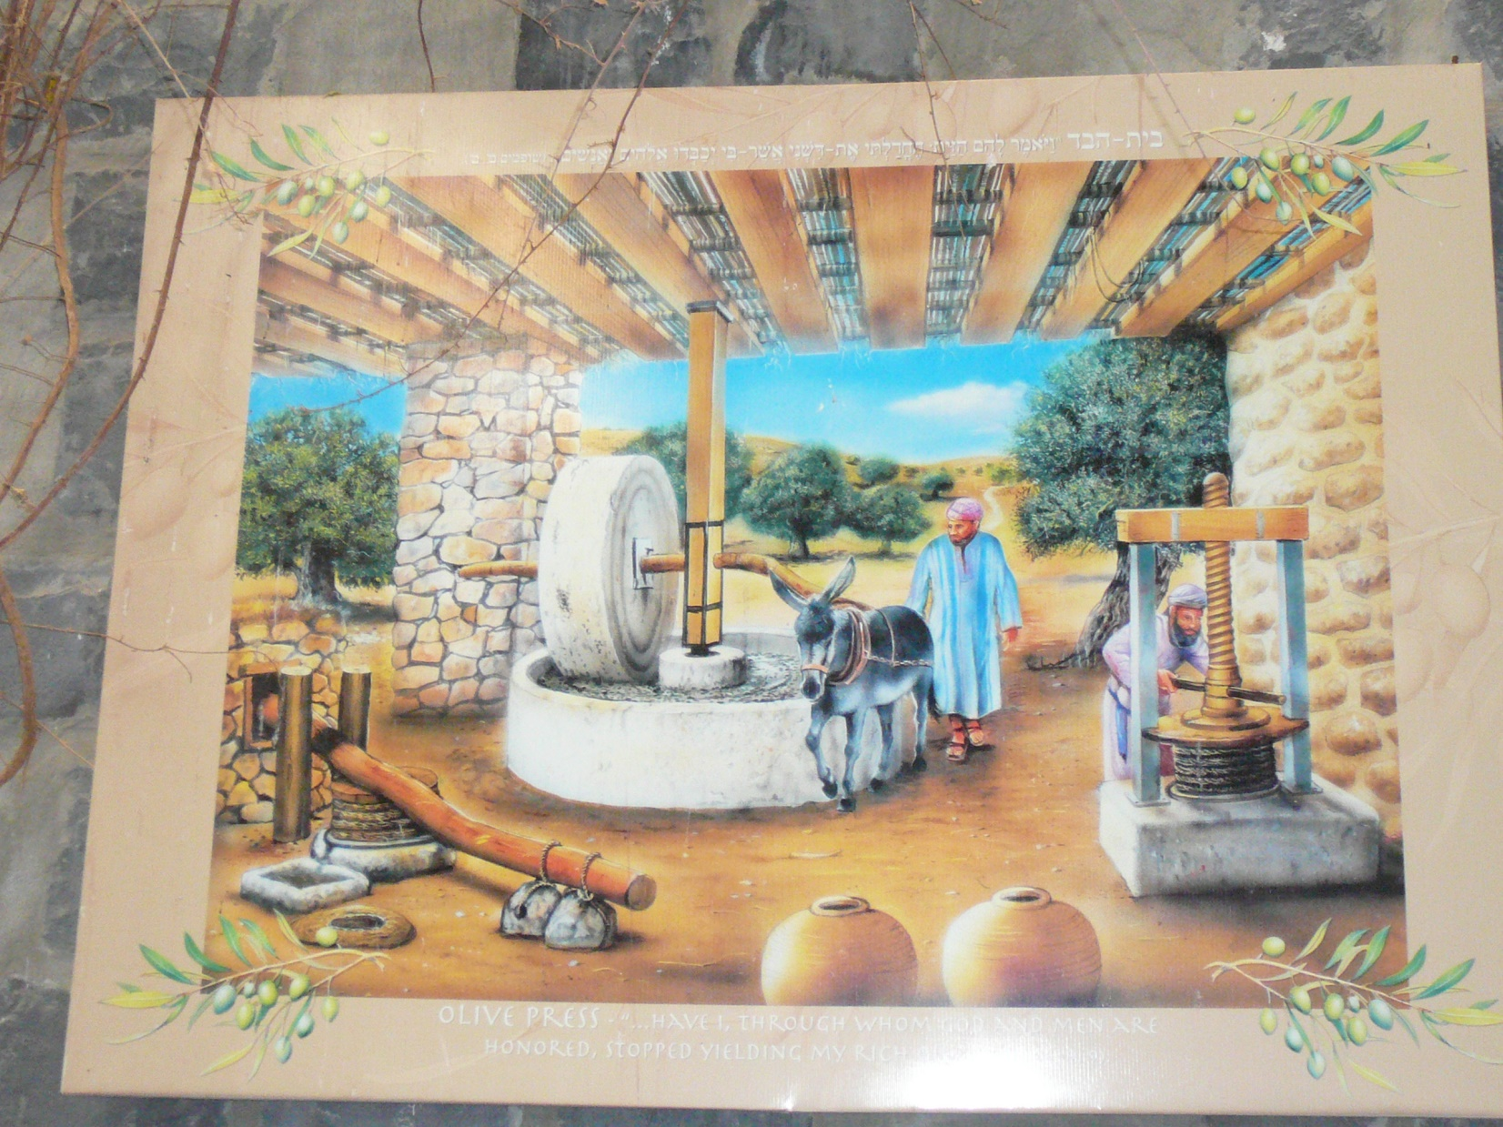
Notes:
From Olive works in the Golan
Particularly by unkindness.

Slide 13
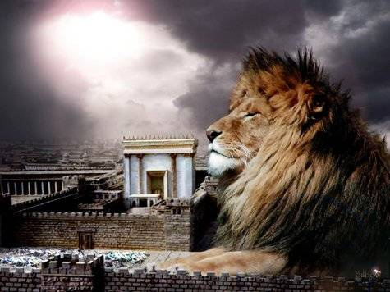
מַתִּתְיָהוּ Mattityahu
(Matthew) 18:8-9
Notes:
Taking this theme of offending others, especially new weak believers, or pre-believers:

Slide 14
Mattityahu (Matthew) 18:8
אִם יָדְךָ אוֹ רַגְלְךָ תַּכְשִׁיל אוֹתְךָ, קַצֵּץ אוֹתָהּ וְהַשְׁלֵךְ אוֹתָהּ מִמְּךָ. מוּטָב לְךָ לָבוֹא לַחַיִּים
So if your hand or foot becomes a snare for you, cut it off and throw it away! Better that you should obtain eternal life
Notes:
Jewish great abhorrence of self-mutilation. Obtaining life is shorthand for entering the life of the coming age. [Keener p 450]

Slide 15
Mattityahu (Matthew) 18:8
אִם יָדְךָ אוֹ רַגְלְךָ תַּכְשִׁיל אוֹתְךָ, קַצֵּץ אוֹתָהּ וְהַשְׁלֵךְ אוֹתָהּ מִמְּךָ. מוּטָב לְךָ לָבוֹא לַחַיִּים
maimed or crippled than keep both hands or both feet and be thrown into everlasting fire!
Notes:
Avoiding hell is worth any price.

Slide 16
Mattityahu (Matthew) 18:9
וְאִם עֵינְךָ תַּכְשִׁיל אוֹתְךָ, נַקֵּר אוֹתָהּ וְהַשְׁלֵךְ אוֹתָהּ מִמְּךָ.
And if your eye is a snare for you, gouge it out and fling it away!
Notes:
Parallelism, form of Hebrew poetry. Same thing in parallel wording. Sort of verbal rhythm.

Slide 17
Mattityahu (Matthew) 18:9
מוּטָב לְךָ לָבוֹא לַחַיִּים עִם עַיִן אַחַת מֵהֱיוֹתְךָ מֻשְׁלָךְ לְגֵיהִנּוֹם הָאֵשׁ עִם שְׁתֵּי עֵינַיִם.
Better that you should be one-eyed and obtain eternal life than keep both eyes and be thrown into the fire of Gei-Hinnom.

Slide 18
^{1 K 23.10} He Yoshiyahu /Josiah desecrated the Tofet fire pit in the Ben-Hinnom Valley
[Gei = valley], so that no one could cause his son or daughter to pass through fire [as a sacrifice] to Molekh.

Slide 19
Mattityahu (Matthew) 18:10-11
See that you never despise one of these little ones, for I tell you that their angels in heaven are continually seeing the face of my Father in heaven. For the Son of Man came to save the lost.
Notes:
Stern: Apocryphal bk Tobit ~300 BCE speaks of guardian angels. Daniel and Zekh mention angels of particular countries. Kefa knocking in Acts 12.15 they thought it was “his angel.”
So, summary: look out for the weaker ones. Yeshua came to save, and DON’T undermine!!
Son of Man came to save the lost.
To DO it!! I’ve seen it this last two weeks. Son of man is moving.

Slide 20
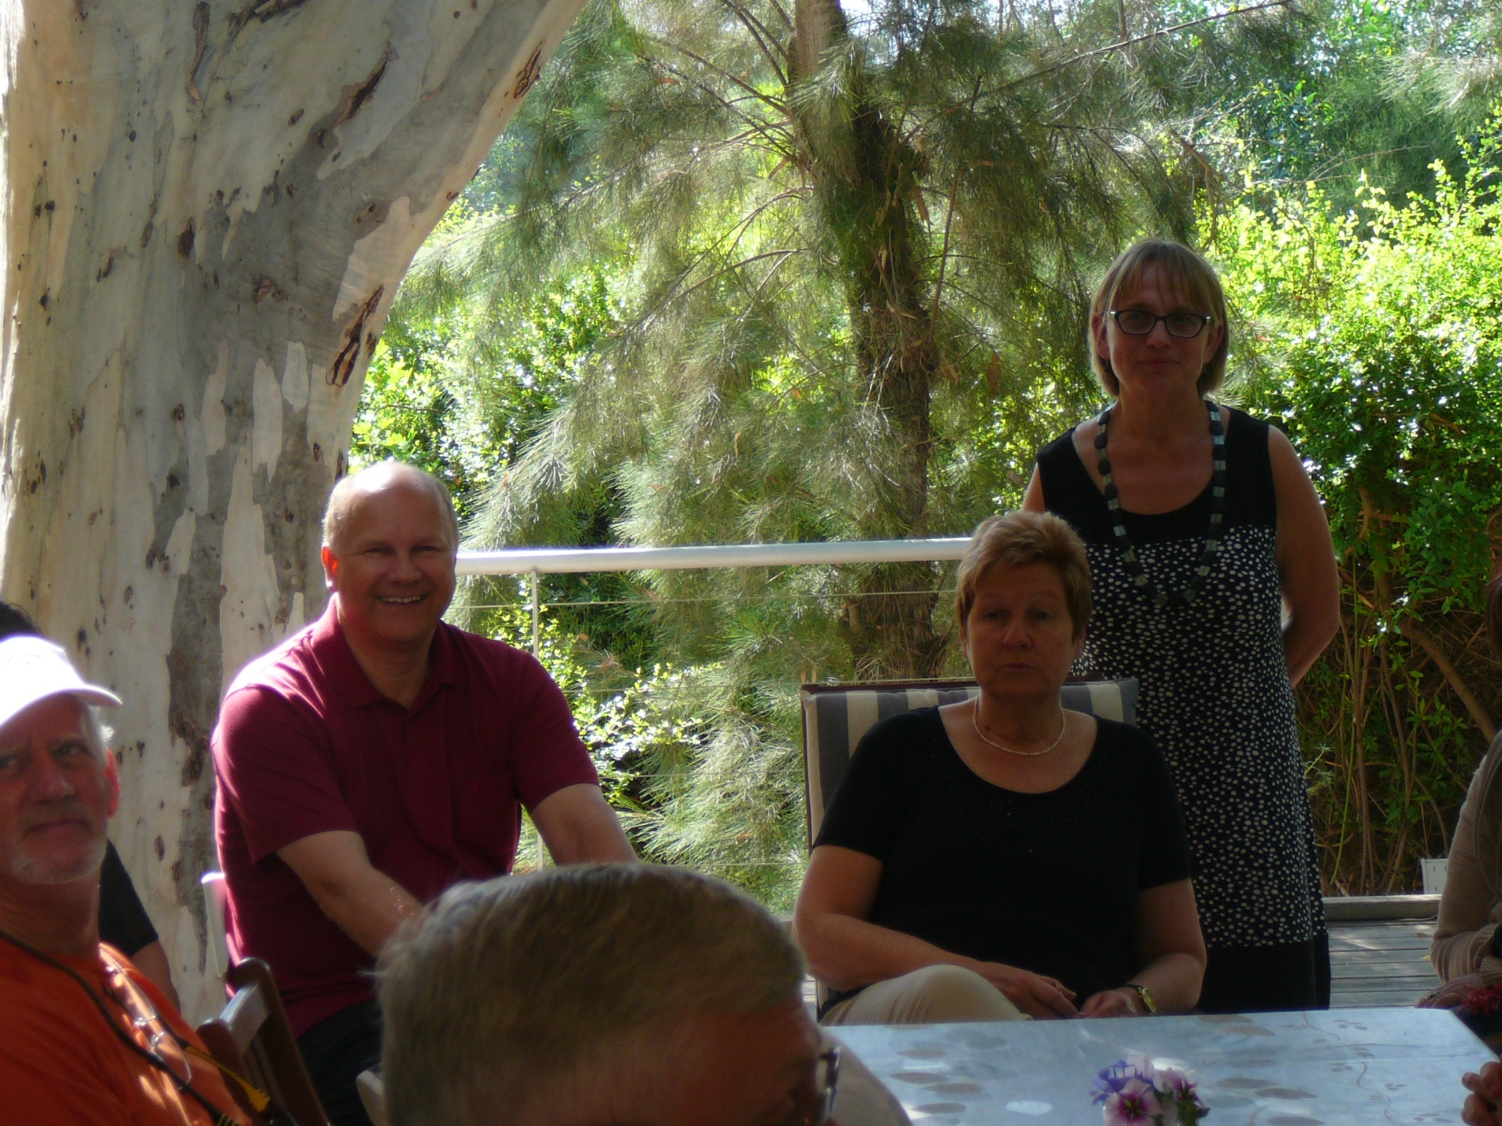
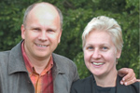
Notes:
Beautiful home in Caesarea, where they wine and dine and love on survivors. High end neighborhood where Netanyahu’s private home is located.
We are there on the porch. Jobst said, “Some in their private thoughts are saying, ‘What is this love? Maybe this is the real Messiah?’ and then inquiring.” PERFECT outreach. Can’t argue with love. Unconditional love!!

Slide 21
Jobst and Charlotte Bittner are the founders and directors of TOS. Since the beginning of her service, her heart has been beating the outsiders of society, both in Germany and in other nations.
Notes:
http://www.tos-ministries.org/ueber-uns/jobst-charlotte-bittner/

Slide 22
When they came to Tübingen more than 20 years ago to study, they had no intention of staying on in the city. But God had other plans and when they got together with other students to pray, this brought forth a lively congregational ministry.
Notes:
http://www.tos.info/j-ch-bittner/bio/

Slide 23
One of them initiated a reconciliation march from Berlin to Moscow in 1993 brought thousands of people to Messiah and made a special connection with Belarus.
Notes:
http://www.tos-ministries.org/ueber-uns/jobst-charlotte-bittner/
In addition to the Holocaust of the Jews, the Nazis had genocidal activities on others.
This picture following is the Belarussian Memorial to their own genocide.

Slide 24
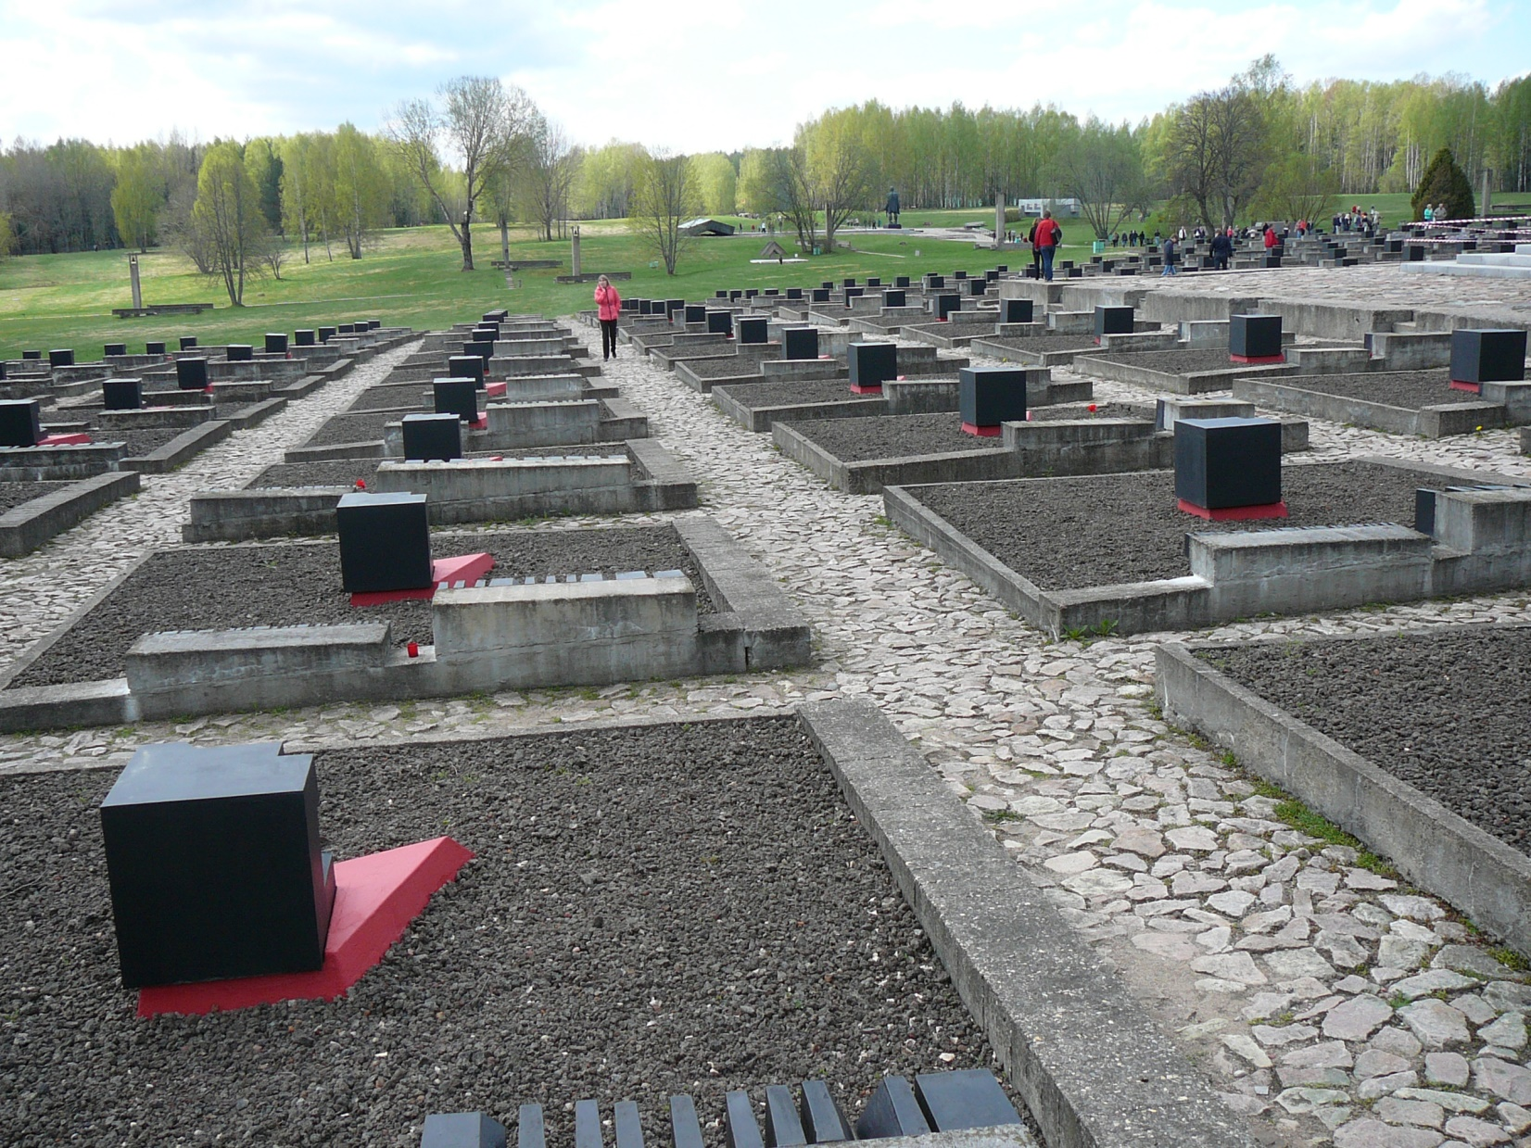
Notes:
The German concept of Lebensraum
Germany imposed a brutal regime, deporting some 380,000 people for slave labour, and killing hundreds of thousands of civilians more. The population was to be exterminated for German colonization. At least 5,295 Belarusian settlements were destroyed by the Nazis and some or all their inhabitants killed (out of 9,200 settlements that were burned or otherwise destroyed in Belarus during World War II).^{[1]} More than 600 villages like Khatyn were annihilated with their entire population.^{[1]} Altogether, 2,230,000 people were killed in Belarus during the three years of German occupation. Burned out village. Population in barns
https://en.wikipedia.org/wiki/German_occupation_of_Byelorussia_during_World_War_II

Slide 25
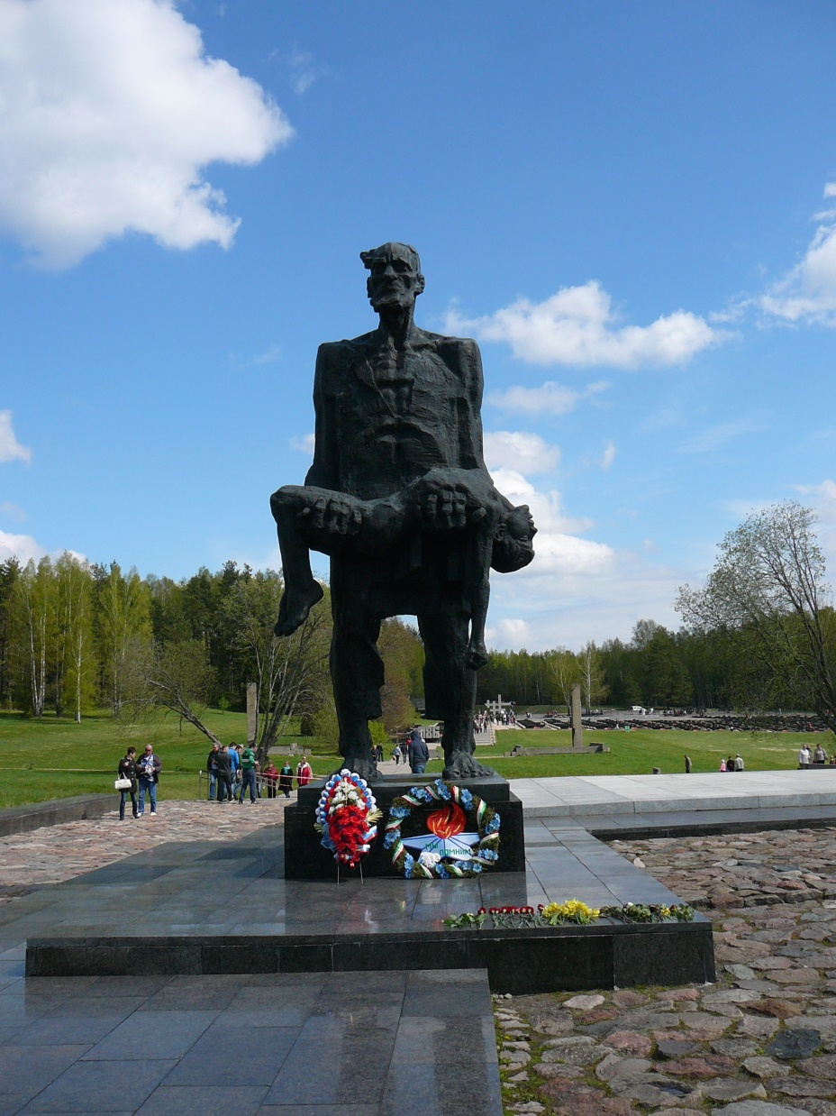
Notes:
Statue of a grandfather who survived the mass fire, and found his dead grandson.
So, Bittners and TOS Cong. did a March for the Belarussians. Other works…

Slide 26
From 1997 a very successful rehabilitation center for drug addicts, as well as an outpatient work was created. In addition, outpatient rehabilitation programs for drug addicts were launched in Greece and Siberia.
Notes:
http://www.tos-ministries.org/ueber-uns/jobst-charlotte-bittner/

Slide 27
At the same time, the vision was born to build 50 transformer houses for street children in Latin America. In Latin America, since 1998, they have been building a children's playground
Notes:
http://www.tos-ministries.org/ueber-uns/jobst-charlotte-bittner/

Slide 28
for street children in Argentina, Bolivia, Peru and Paraguay, with the vision of giving these children a home and the chance of a successful future.
Notes:
http://www.tos-ministries.org/ueber-uns/jobst-charlotte-bittner/

Slide 29
It is Jobst and Charlotte’s vision to see entire cities and nations changed and transformed by the power of God’s love. At the same time it is their hearts’ desire to actively meet the needs of the individual in word and deed. 12 new congregations were planted within Germany and abroad.
Notes:
http://www.tos.info/j-ch-bittner/bio/

Slide 30
In four countries of Latin America we have planted long term projects for street children, in Belarus and Greece we have planted successful rehabilitation programs for drug addicts.
Notes:
http://www.tos.info/j-ch-bittner/bio/

Slide 31
In Argentina and Bolivia, Jobst Bittner initiated national prayer movements with more than 60,000 intercessors from different denominations.
Notes:
http://www.tos.info/j-ch-bittner/bio/

Slide 32
The main focus of Jobst’s messages and teaching is on a radical conversion to Yeshua, the transformation and sanctification of each person’s life through the power of the Holy Spirit as well as the authority of continuous prayer.
Notes:
http://www.tos.info/j-ch-bittner/bio/
Ted Pearce told me that they went to Bolivia and had 24/7 prayer until G-d gave them a strategy. They bought a luxury hotel, and transformed it into a training center for ministry and the professions, to send young people into the culture for Messiah!!
How many are interested in our own 24/7 prayer chain. On line. Being developed. 168 = 24 x 7.

Slide 33
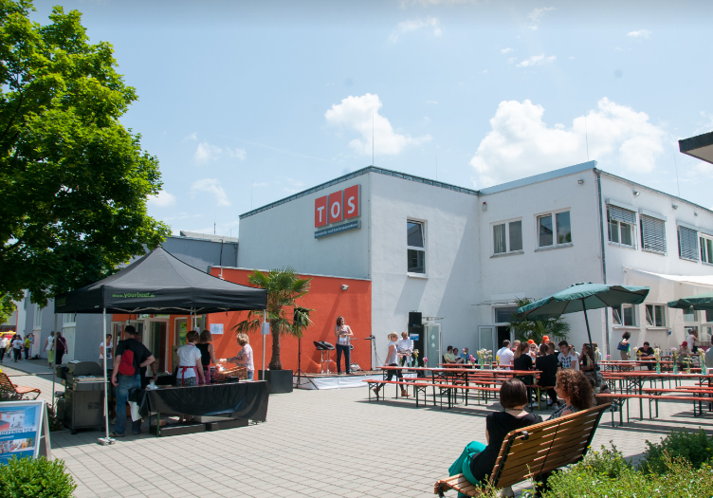
TOS Community and
Conference Center
Notes:
400 people in main congregation. All expected to take a shift, or two, in 24/7 prayer

Slide 34
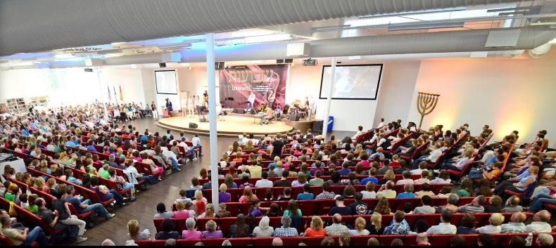

Slide 35
Notes:
See the flora around

Slide 36
Burma road March of Remembrance
Notes:
Burma Road was a diversionary road build by the Israelis to overcome the siege of Jerusalem in 1948. Out of sight of Latrun fortress.

Slide 37
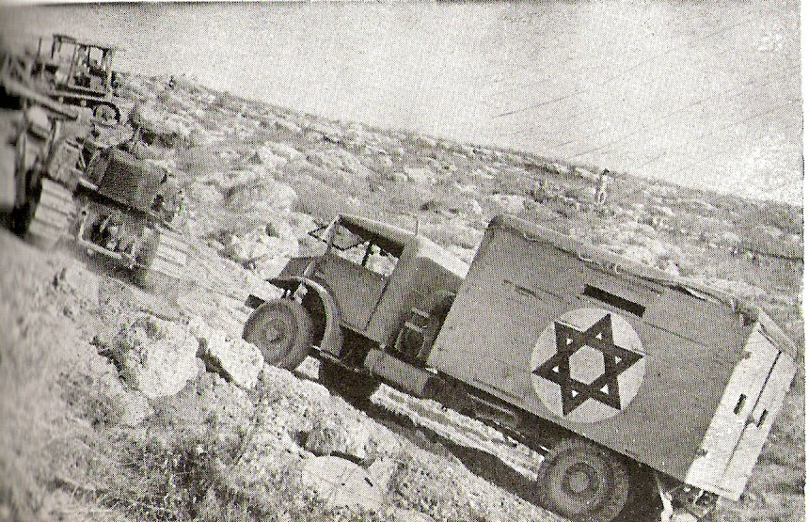
A bulldozer tows a
truck on Burma road,
June 1948

Slide 38
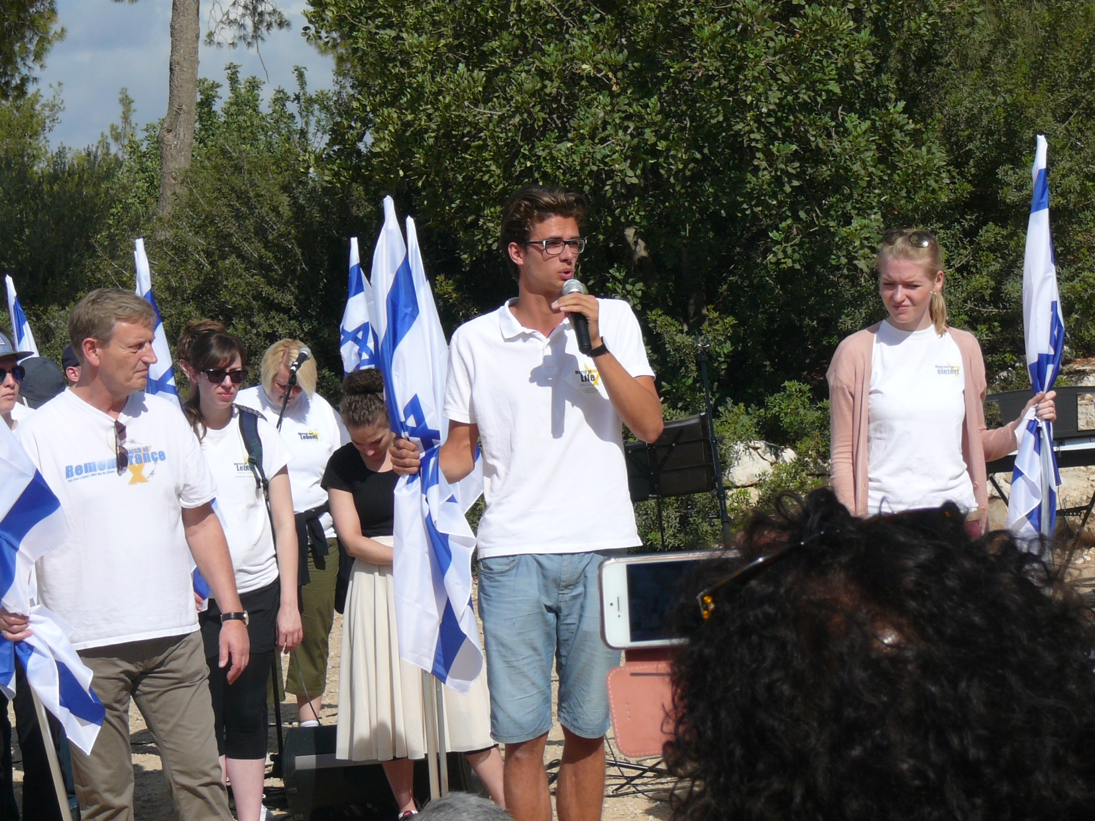
Notes:
His grandfather, “We didn’t kill enough Jews.”

Slide 39
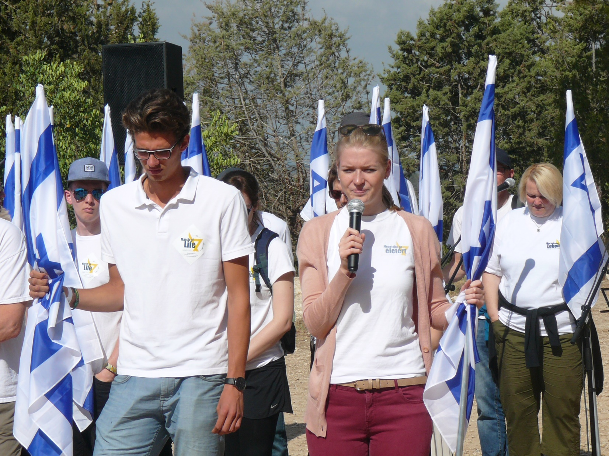
Notes:
My grandfather was at Babi Yar…

Slide 40
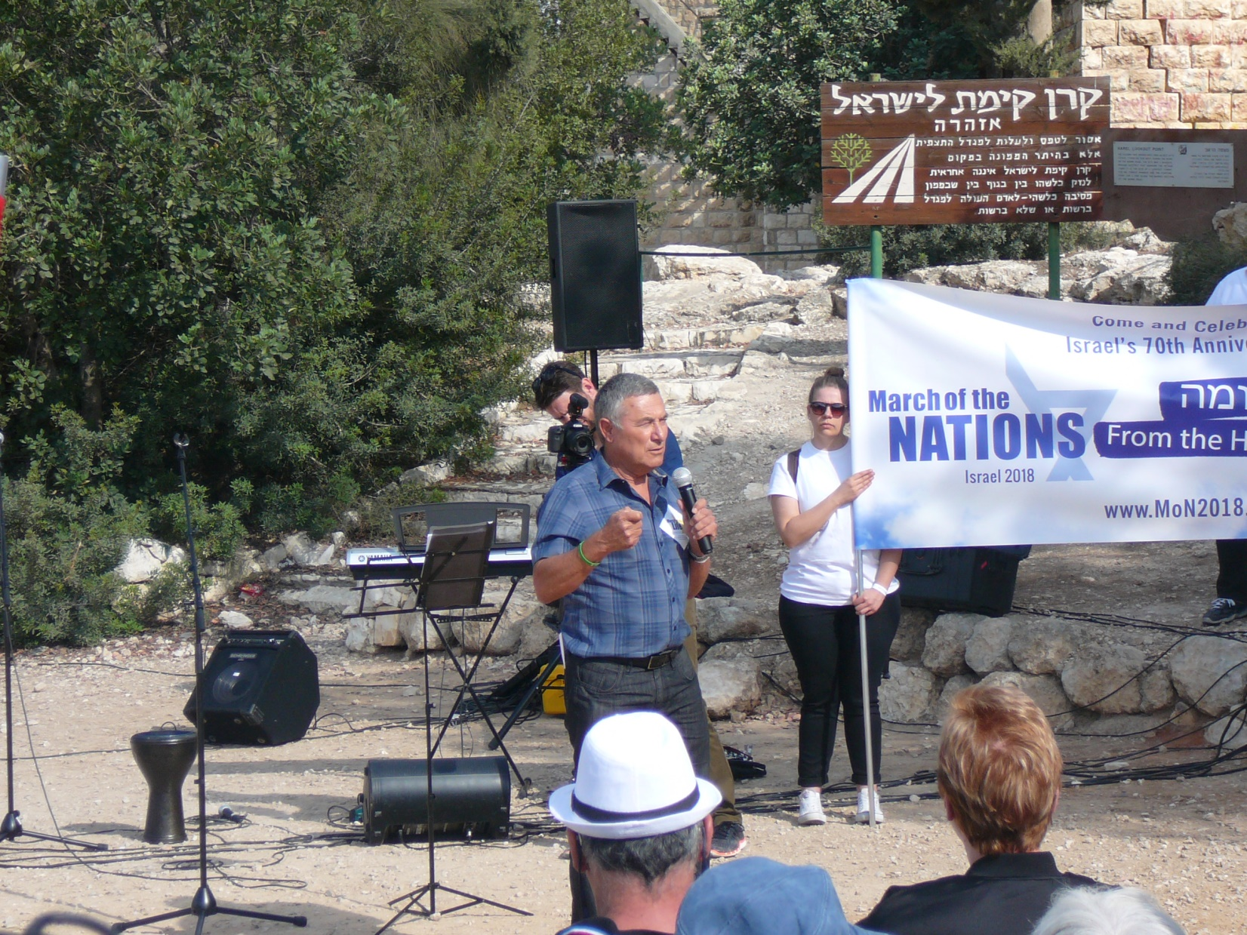
Notes:
Israeli General, first one off the plane at Entebbe. Had autistic son. Learned the value of life, protecting the helpless, from son. Appreciates Bittners, and March. Speaking on the Burma road gathering site.

Slide 41
Israeli TV coverage:
http://www.jerusalemonline.com/news/world-news/the-jewish-world/watch-descendants-of-nazis-fight-against-anti-semitism-28780?utm_source=ActiveCampaign&utm_medium=email&utm_content=Interior+Minister+Deri+questioned+by+police+on+corruption+allegations++and+more+news+from+JerusalemOnline&utm_campaign=EveningNewsletter+-+Recurring
http://mon2018.com/

Slide 42
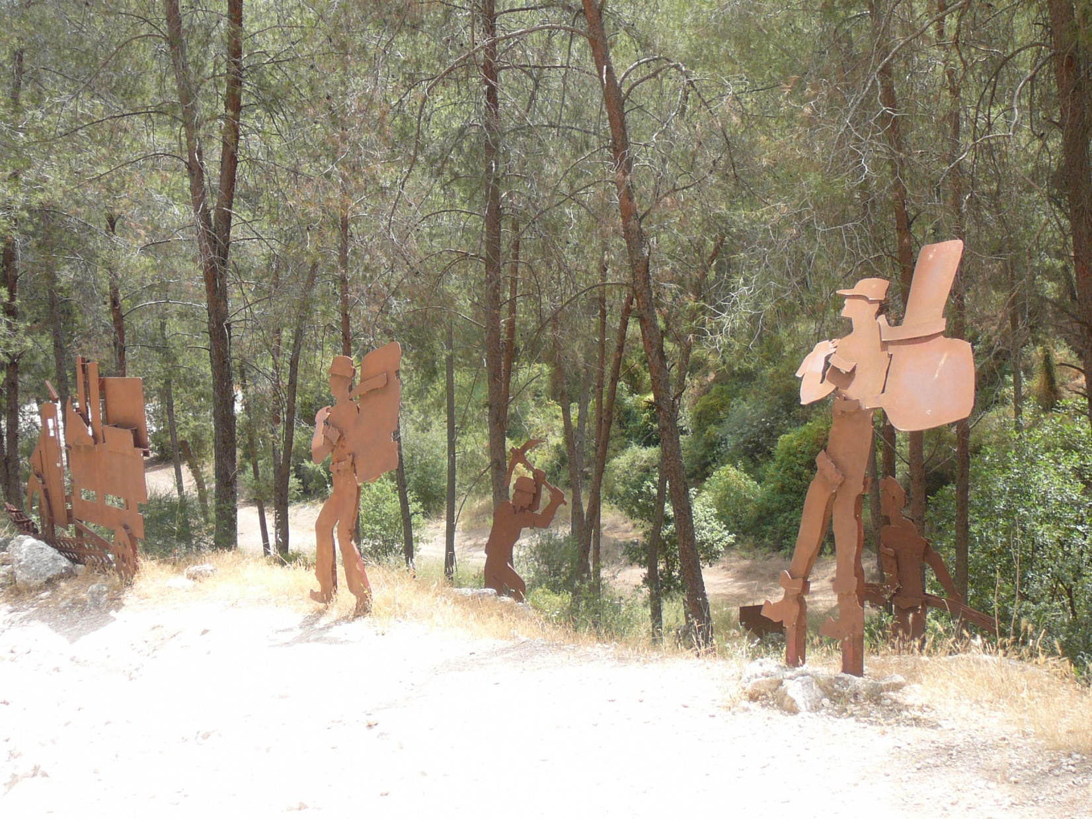

Slide 43
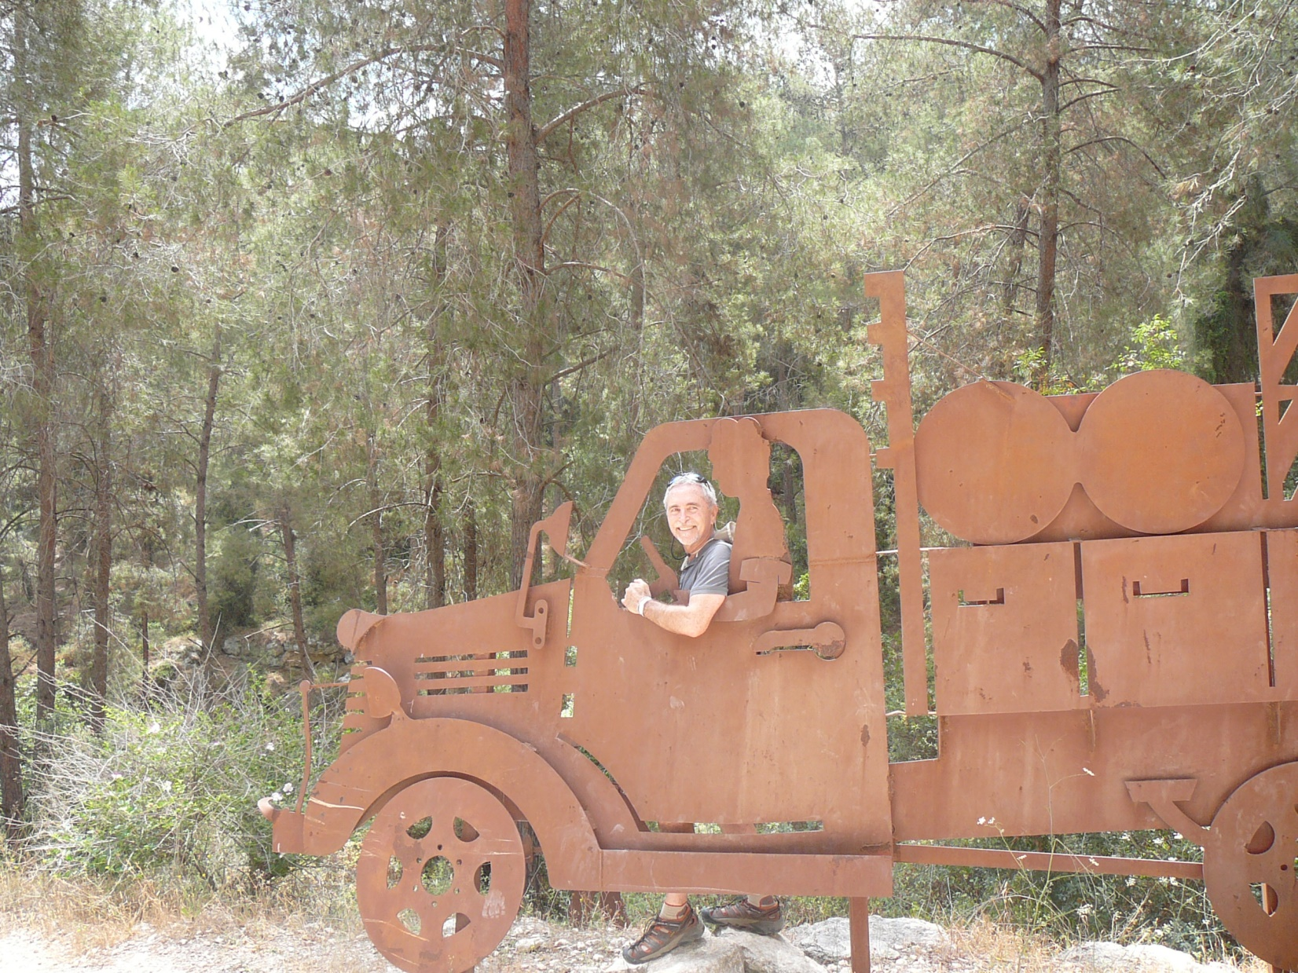

Slide 44
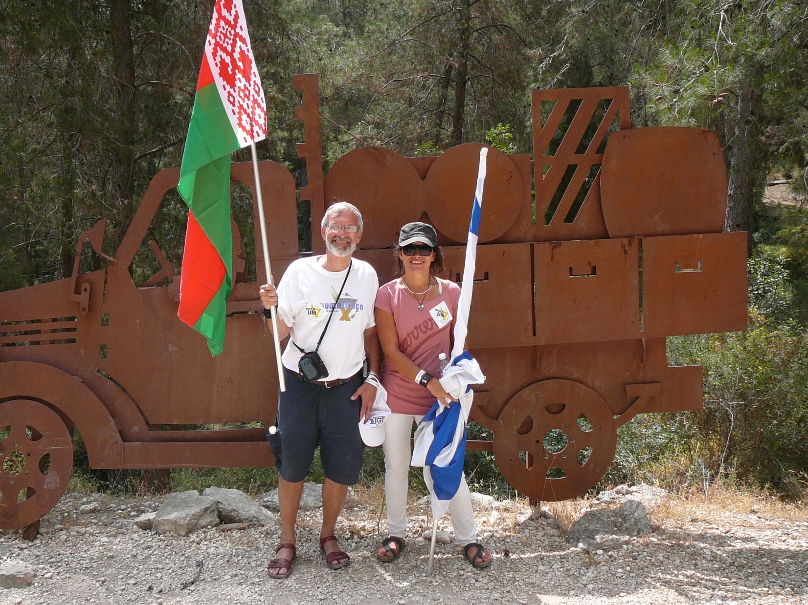
Notes:
Marina joined the tour for 3 days!
I’m carrying a Belarussian flag, of my maternal grandparents.

Slide 45
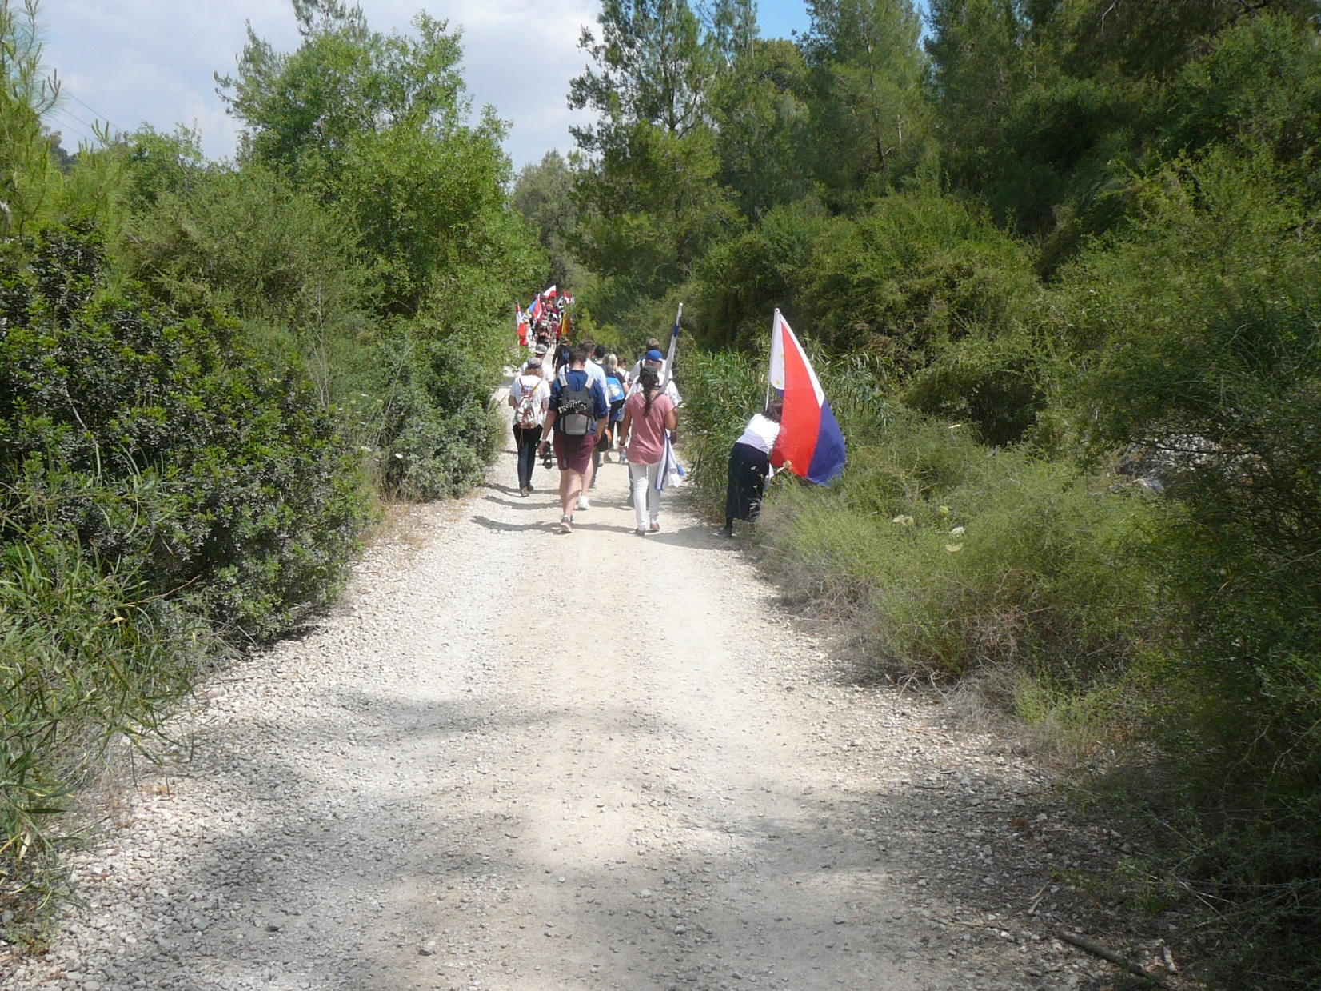
Notes:
Secluded road.

Slide 46
Mattityahu (Matthew) 18:10-11
See that you never despise one of these little ones, for I tell you that their angels in heaven are continually seeing the face of my Father in heaven. For the Son of Man came to save the lost.
Notes:
Stern: Apocryphal bk Tobit ~300 BCE speaks of guardian angels. Daniel and Zekh mention angels of particular countries. Kefa knocking in Acts 12.15 they thought it was “his angel.”
Son of Man came to save the lost.
To DO it!! I’ve seen it this last two weeks. Son of man is moving.

Slide 47
Little Hearts School:
vision of shalom through relationships
Lessons taught in Hebrew, English, and Arabic
Till kindergarten
Can’t show faces
Notes:
Clientele: Israeli Messianic Jews [Evan’s son] international Christians, Orthodox, Muslims
One Muslim family, child major tantrums. Continual love and prayer. Calmed eventually.
Unashamedly teach Yeshua and the Torah, and the festivals. Power of love!!

Slide 48
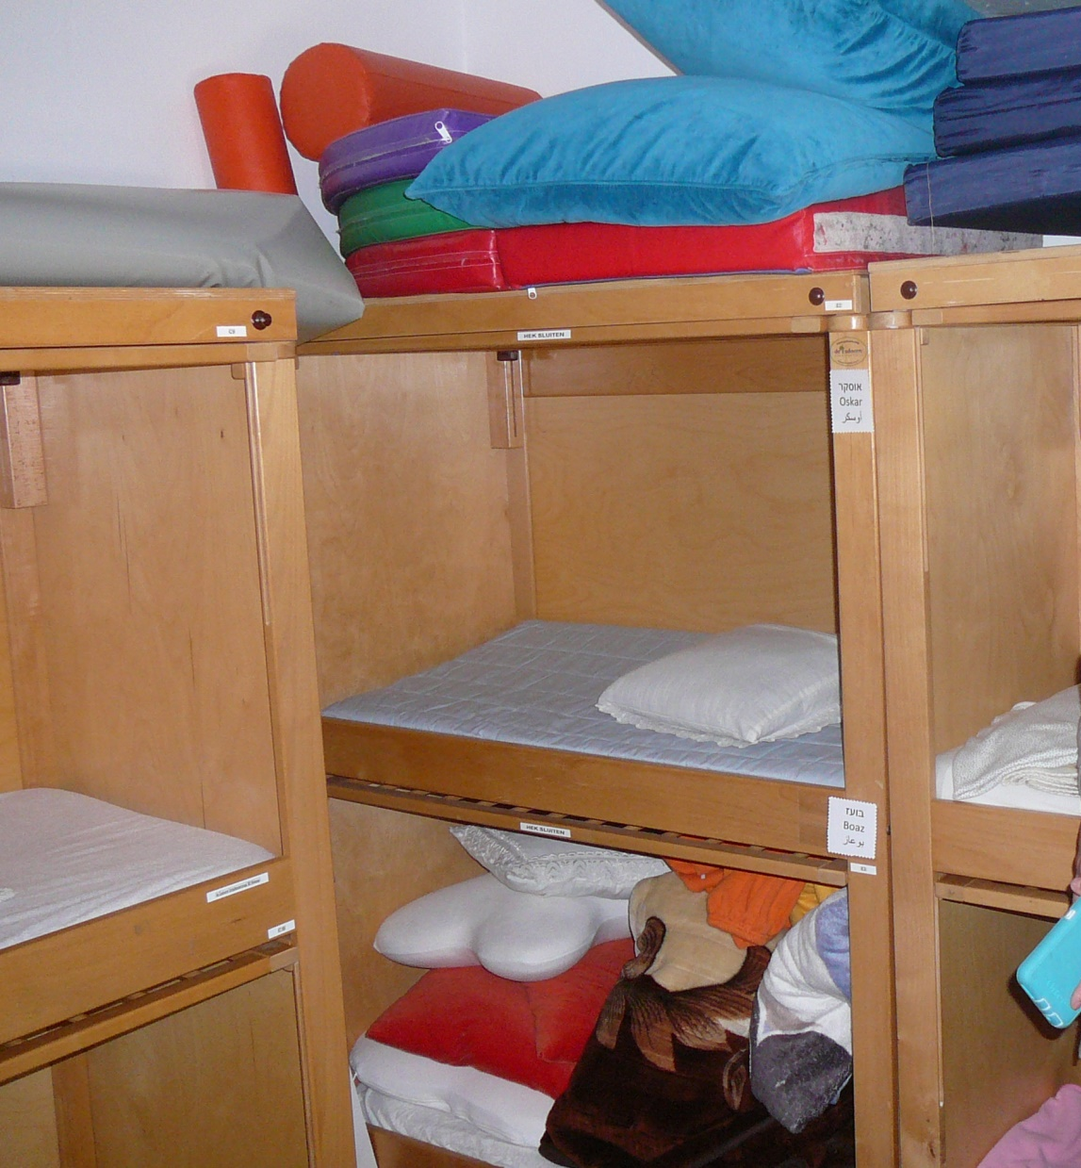
Cribs funded
by
anonymous
donor

Slide 49
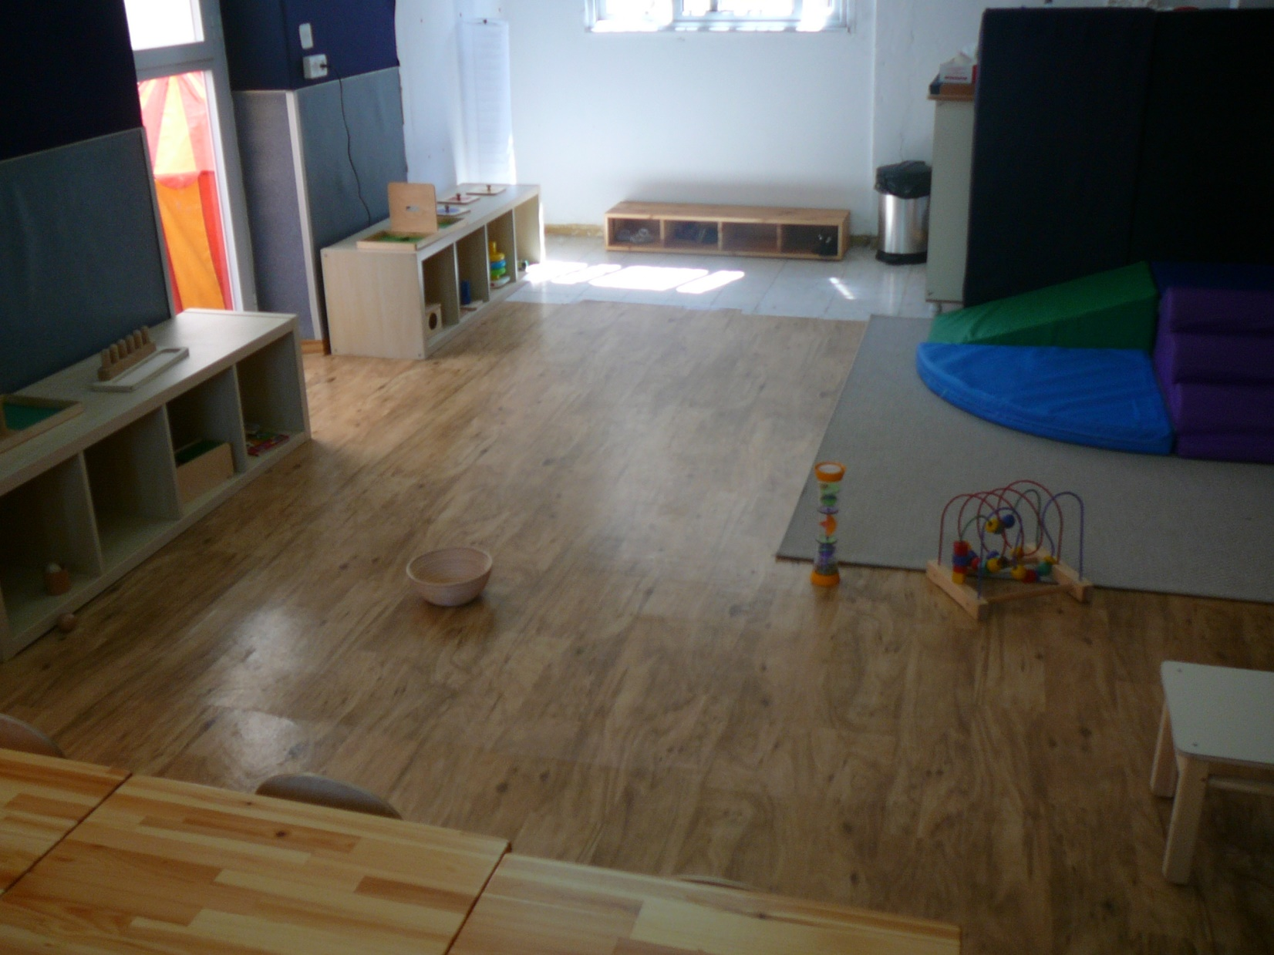

Slide 50
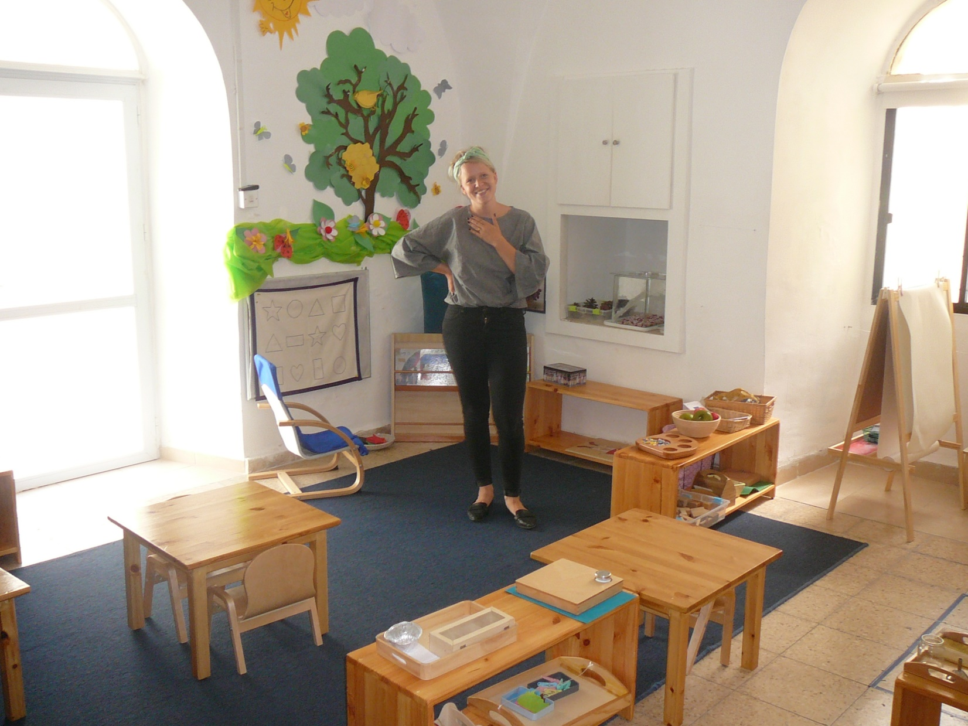
Notes:
Power of G-d raising up a work like this!

Slide 51
Vision Israel, Millenial Center
Vision for Israel is a non-profit organization created by Barry and Batya Segal in 1994 out of the desire to help build and restore the Land. VFI freely provides aid to the poor and needy people,
Notes:
https://www.visionforisrael.com/our-vision

Slide 52
Vision Israel, Millenial Center
both Jewish and Arab, living in the nation of Israel today through The Joseph Storehouse, an international humanitarian aid center operating in the Judean Hills just outside of Jerusalem.
Notes:
https://www.visionforisrael.com/our-vision

Slide 53
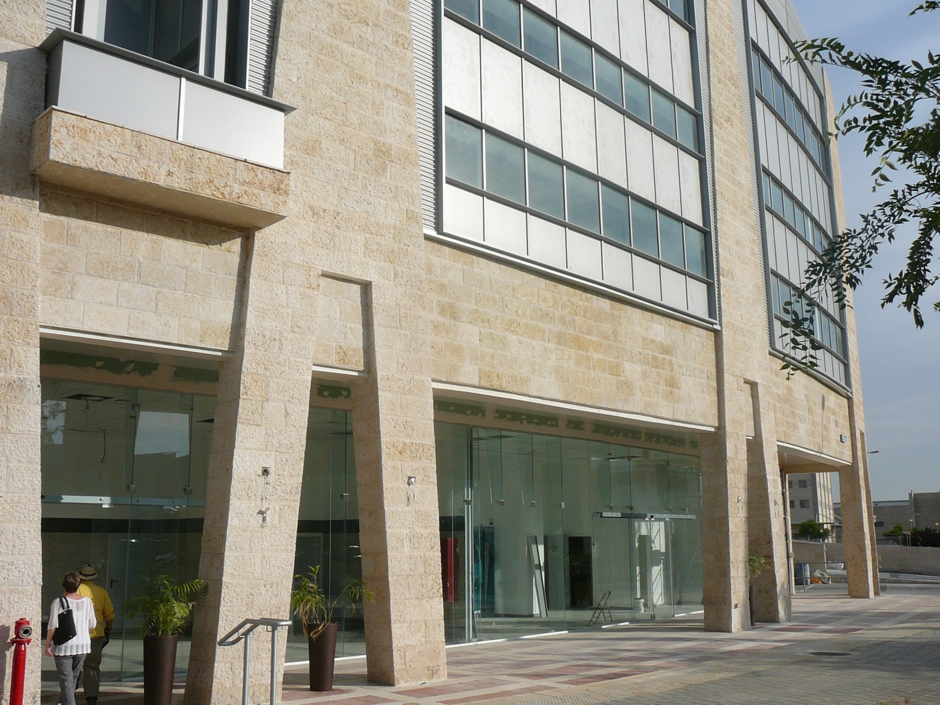
Notes:
This is their building!!

Slide 54
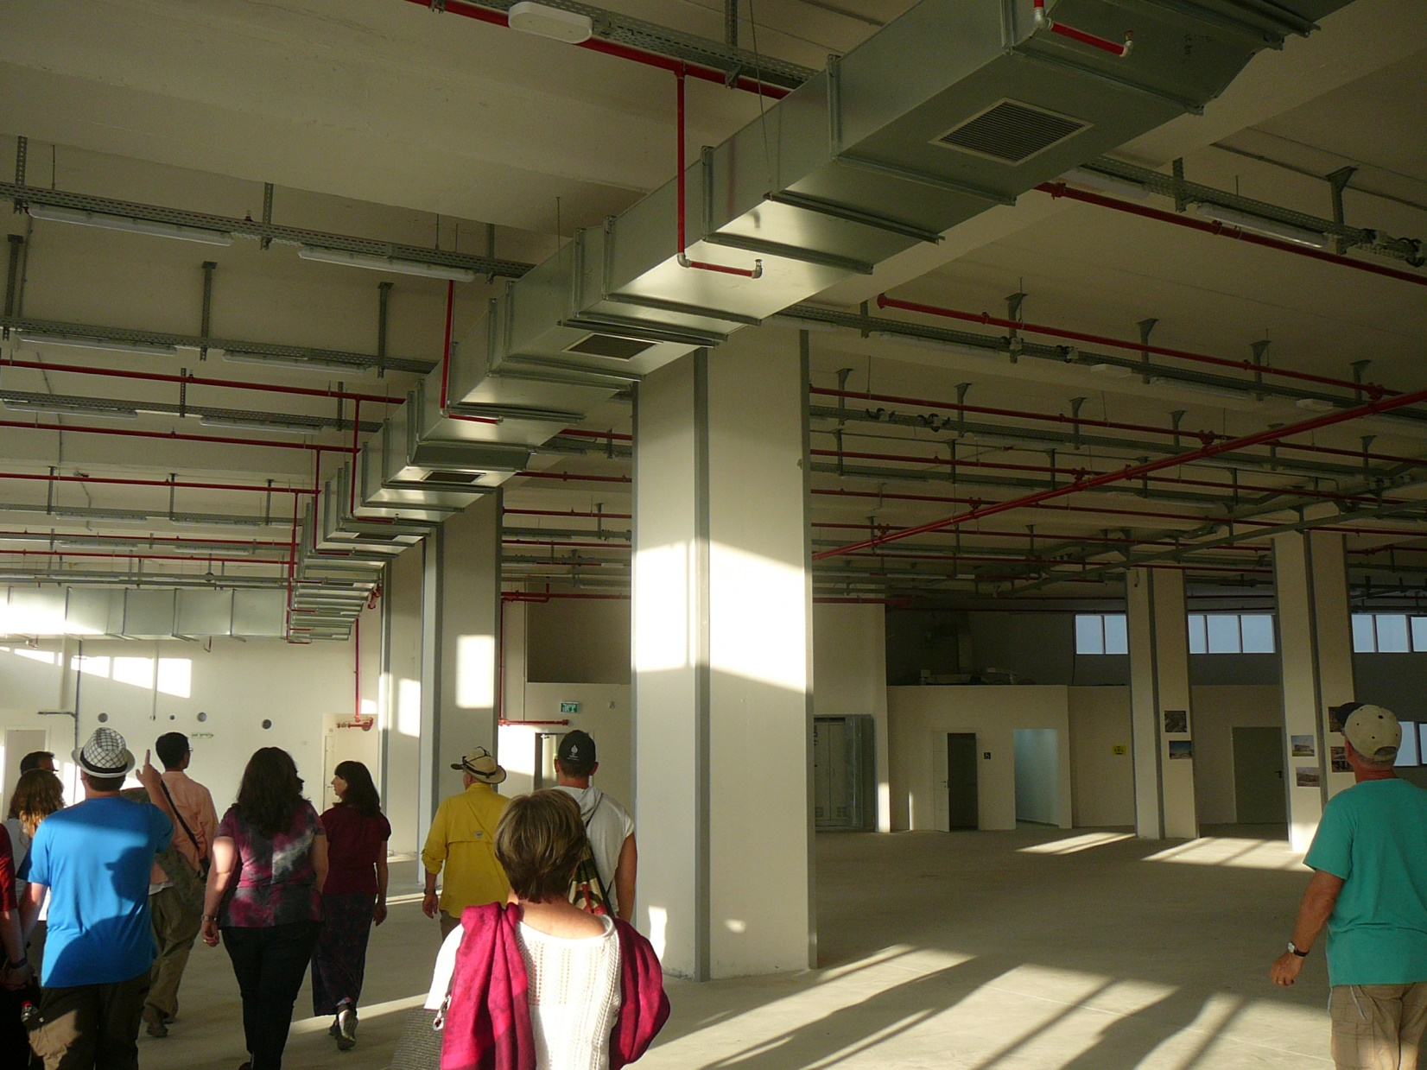
Notes:
For relief goods.

Slide 55
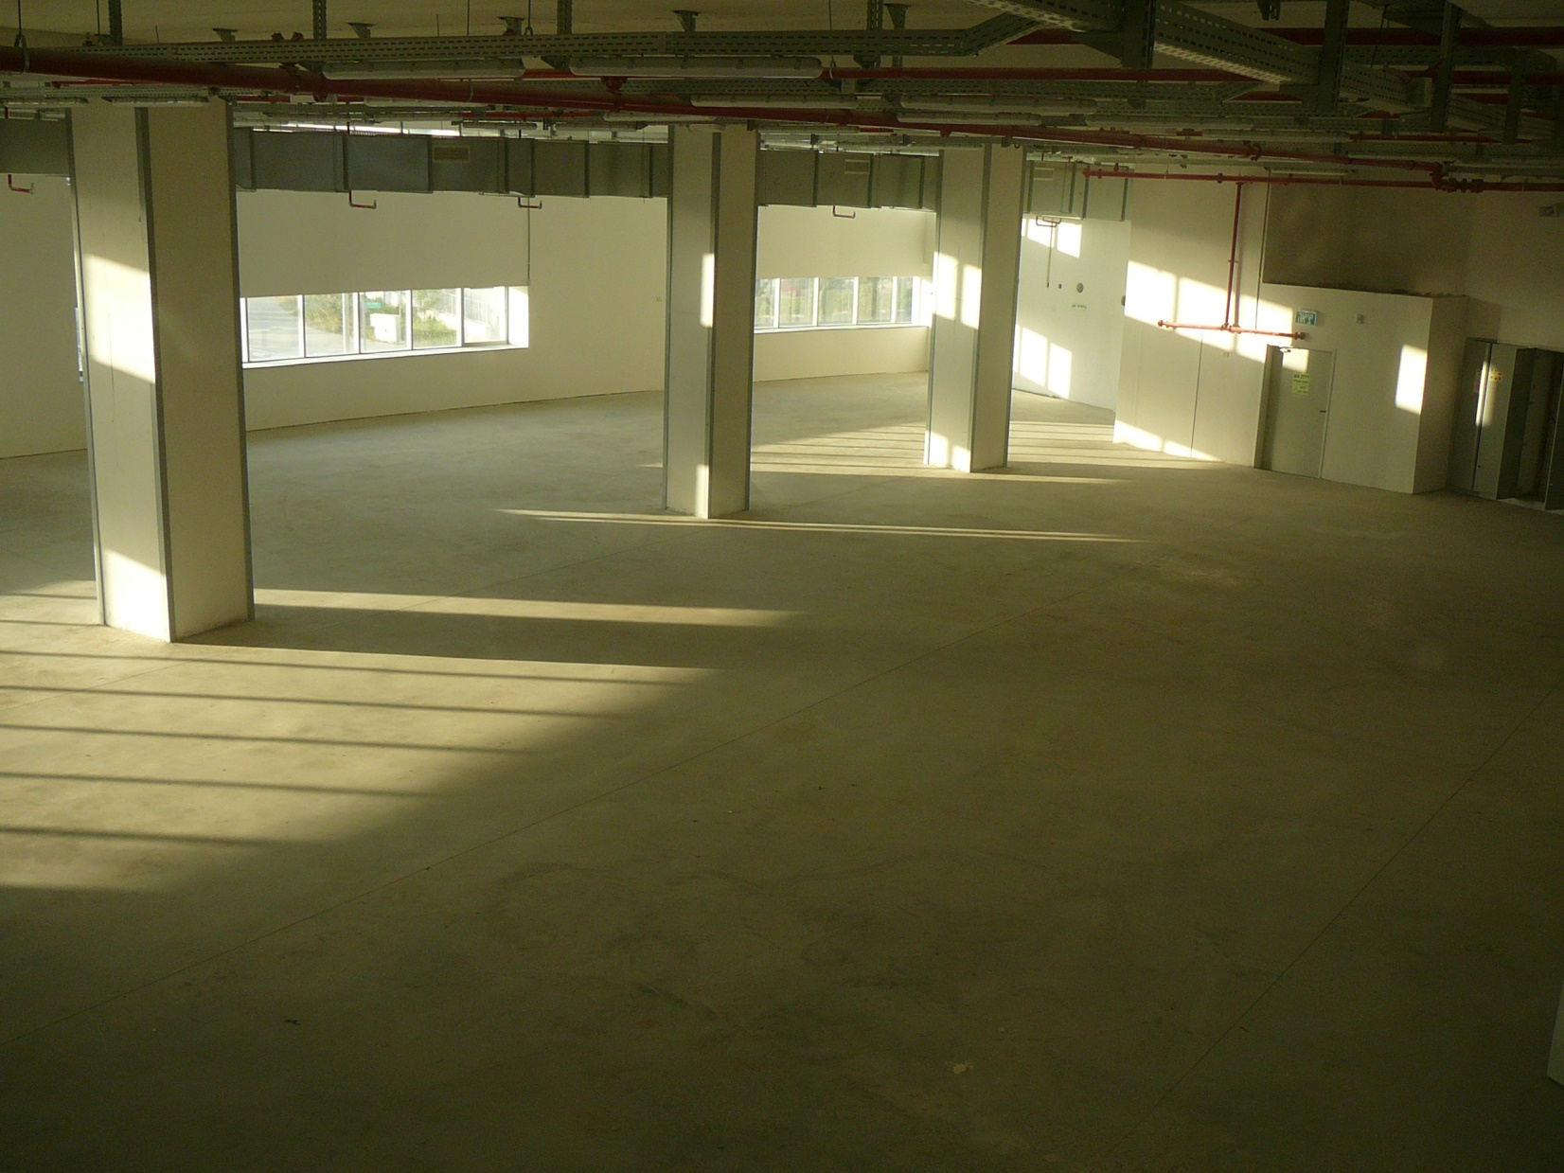

Slide 56
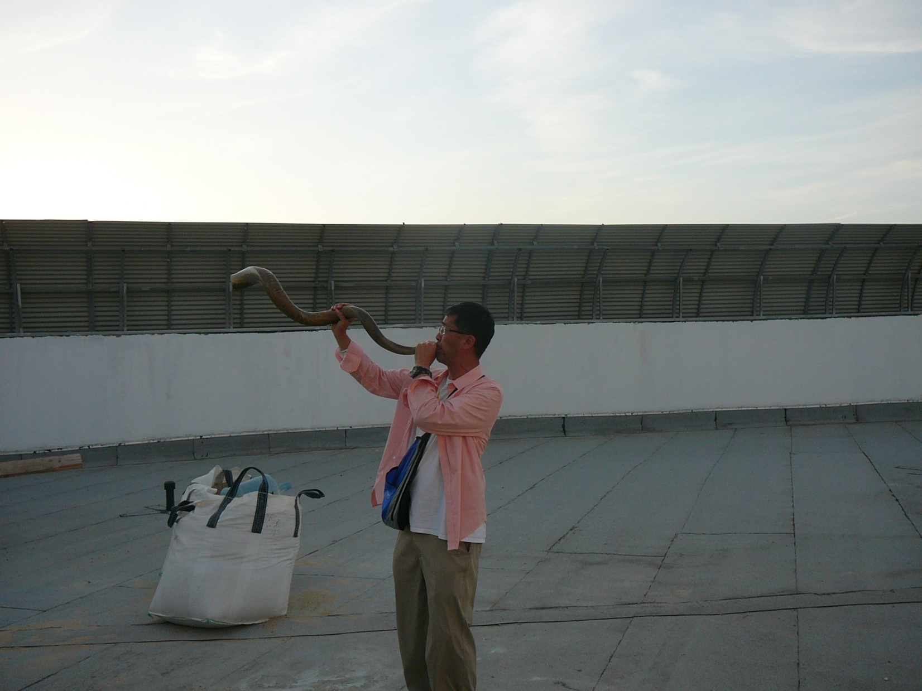
Notes:
In Modiin, so vision to have a vertical light shaft, visible to planes arriving in Israel at Ben Gurion airport, only a few miles away.

Slide 57
HaTikva Project: We operate the first and only Messianic non-profit dental clinic in Israel. Our clinic is staffed by local, Israeli believers and our faith is not compromised.

Slide 58
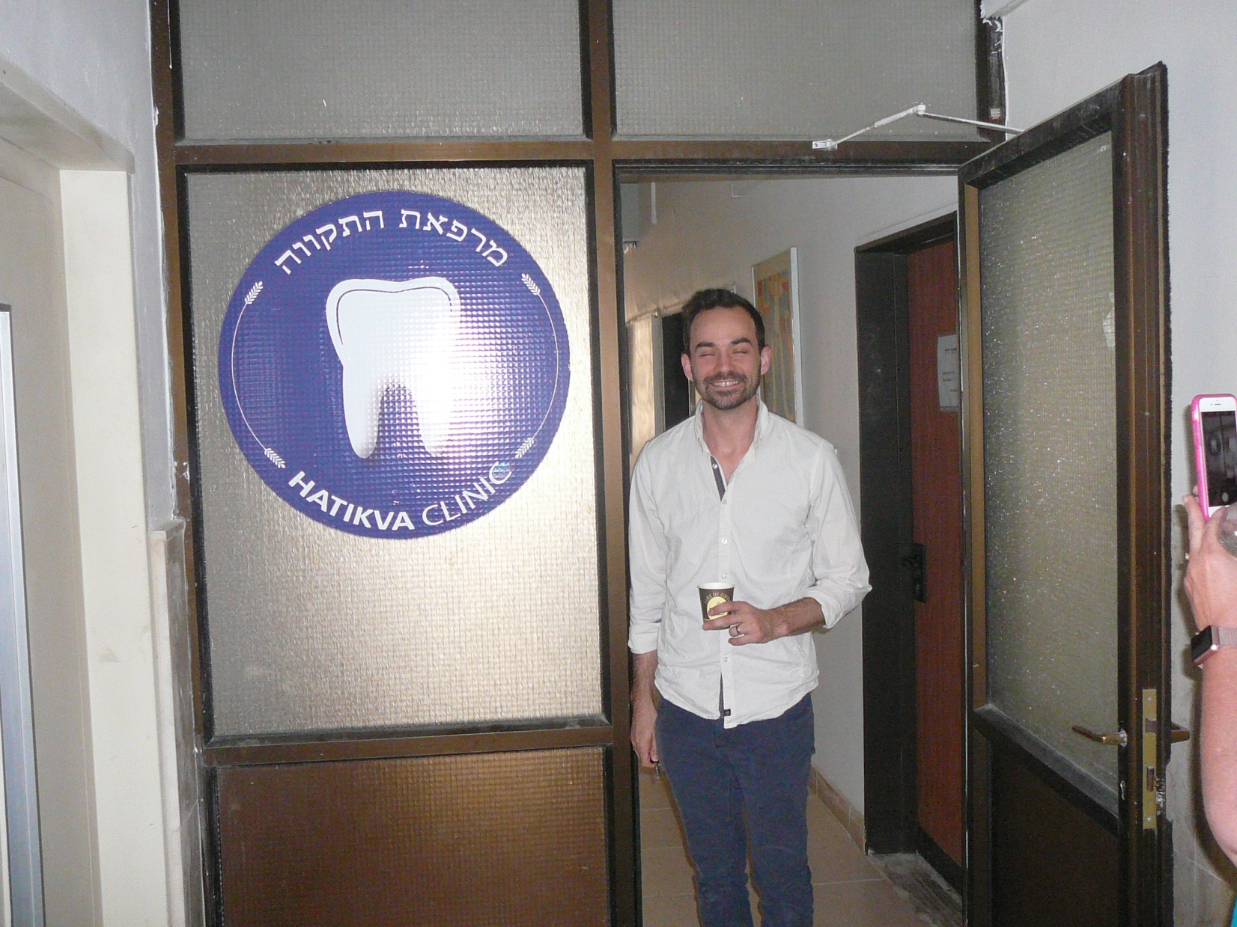

Slide 59
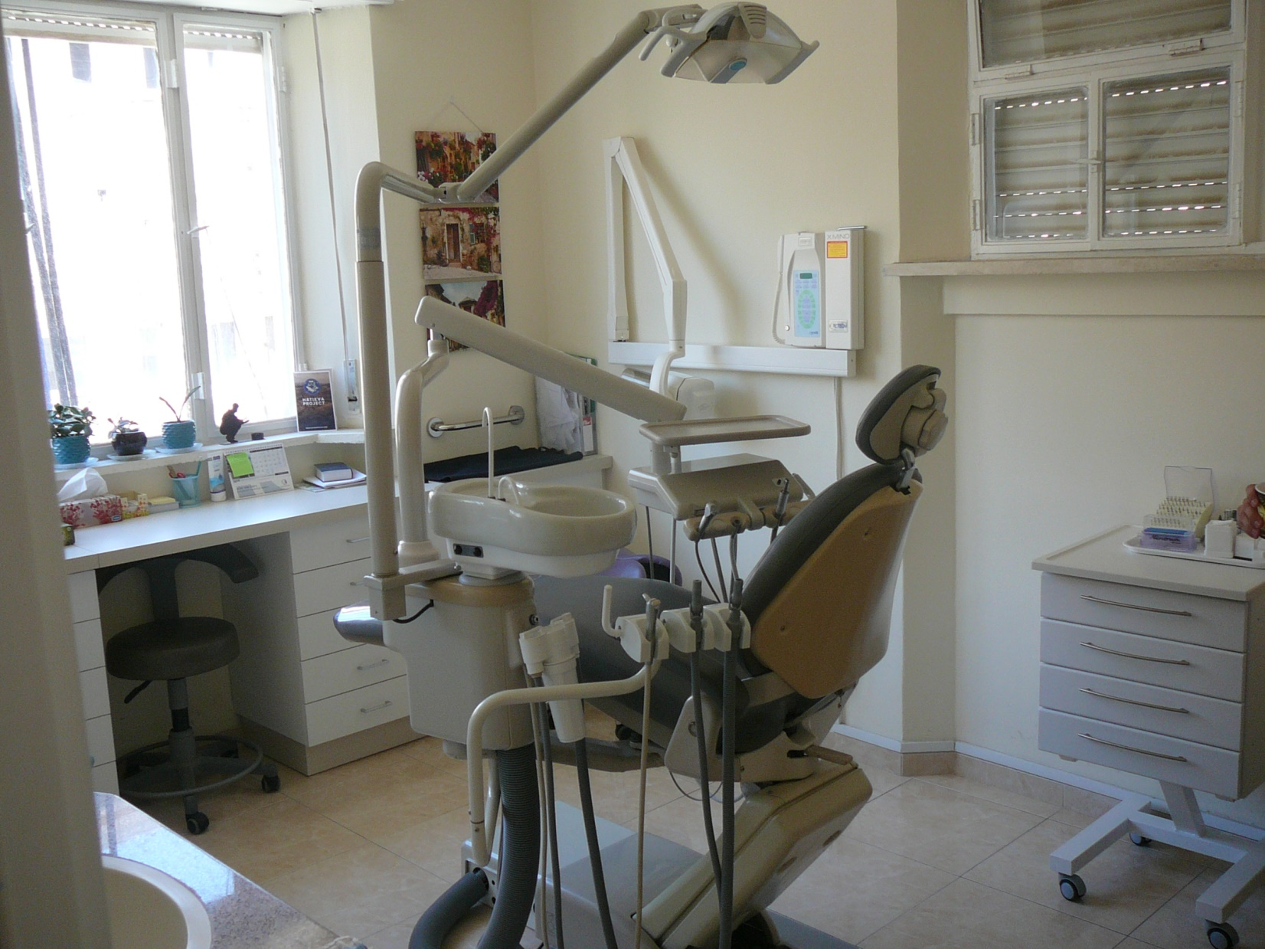

Slide 60
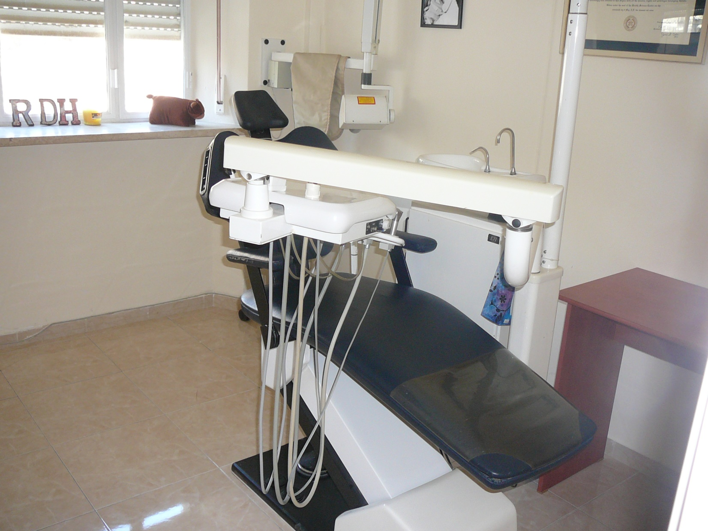

Slide 61
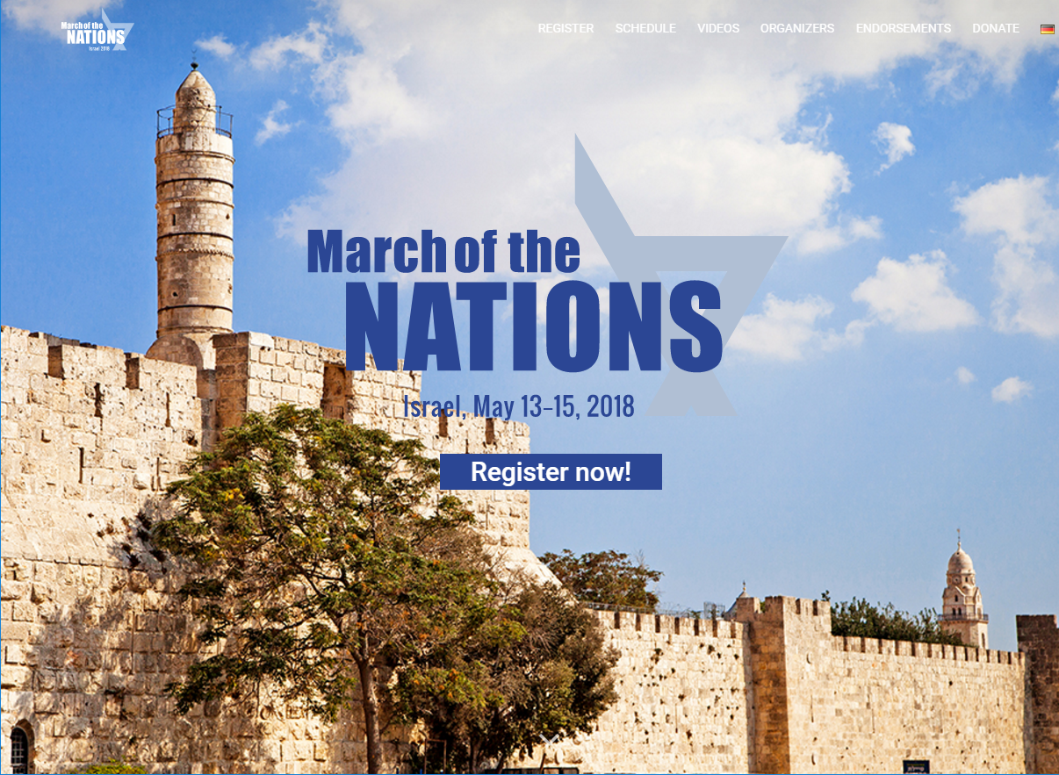

Slide 62
^{Yekhezkael /Ezek 37} With the hand of Adonai upon me, Adonai carried me out by his Spirit and set me down in the middle of the valley, and it was full of bones. He had me pass by all around them — there were so many bones lying in the valley,

Slide 63
^{Yekhezkael / Ezek 37} and they were so dry! He asked me, “Human being, can these bones live?” I answered, “Adonai Elohim! Only you know that!”

Slide 64
Yekhezkael / Ezek 37 Therefore prophesy; say to them that Adonai Elohim says, ‘My people! I will open your graves and make you get up out of your graves,

Slide 65
Yekhezkael / Ezek 37 and I will bring you into the land of Isra’el…I will put my Spirit in you; and you will be alive. Then I will place you in your own land; and you will know that I, Adonai, have spoken, and that I have done it,’ says Adonai.”

Slide 66
It’s happening, but it’s NOT a spectator sport: loving each other, shifts on 24/7 prayer, tithing, giving, serving, humbling ourselves!

