Slide 1
To easily follow these notes, log on to our Wifi
Wifi: mycci01
p/w: ancientquail060
Go to OrHaOlam.com
Click on downloads, messages, 2017

Slide 2
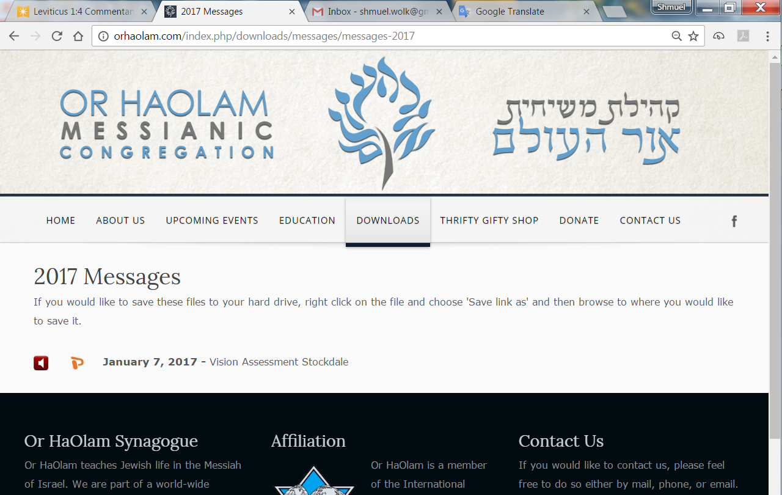

Slide 3
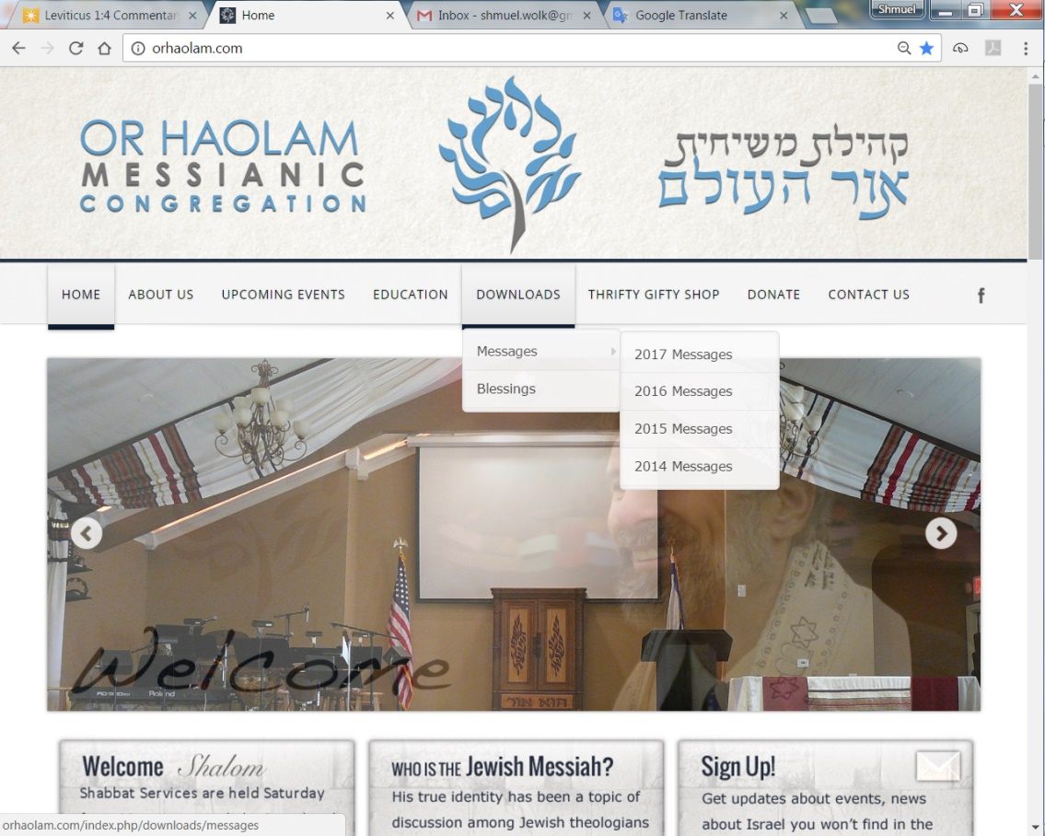
Downloads\messages\
2017 Messages

Slide 4

Total Solar Eclipse
Aug 21, 2017

Slide 5
During totality, the eclipsed sun is no brighter than the full moon, and it is an experience you simply will not believe. But please, do NOT look at the sun when ANY PART of it is still bright (not covered by the moon), or it will be the last thing you ever see.

Slide 6

Or HaOlam has 40 of these free. Another 75 for minimal charge. How many? [Show of hands]
Notes:
To review last week…

Slide 7
^{Matityahu/Mt.19.23-26} Then Yeshua said to his talmidim, "Yes. I tell you that it will be very hard for a rich man to enter the Kingdom of Heaven. Furthermore, I tell you that it is easier for a camel to pass through a needle's eye than for a rich man to enter the Kingdom of God."
Notes:
There is debate if eye of a needle is a gate or a real sewing needle. Not the point here. Point is an impossibility.

Slide 8
^{Matityahu/Mt.19.23-26} When the talmidim heard this they were utterly amazed. "Then who," they asked, "can be saved?“ Yeshua looked at them and said, "Humanly, this is impossible; but with God everything is possible."
Notes:
We have to surrender ALL to Yeshua and His kingdom. He may or may not take it all away, but wants ALL of our hearts.
So, next logical question…

Slide 9
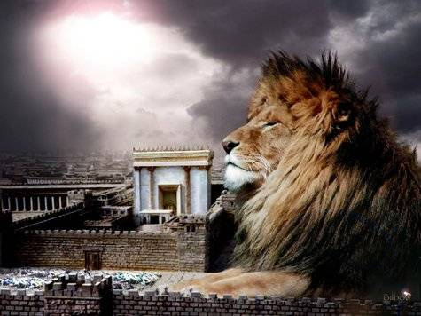
מַתִּתְיָהוּ Mattityahu
(Matthew) 19:27-29

Slide 10
Mattityahu (Matthew) 19:27
הֵגִיב כֵּיפָא וְאָמַר אֵלָיו: "הִנֵּה אֲנַחְנוּ עָזַבְנוּ הַכֹּל וְהָלַכְנוּ אַחֲרֶיךָ, אִם כֵּן מַה יִּהְיֶה לָנוּ?"
Kefa replied, "Look, we have left everything and followed you. So what will we have?"
Notes:
Double subject pronoun. What about US??
“We’re not rich, but we gave up what we had.”
Me: 1969 gave up everything to follow Yeshua, though didn’t know His Hebrew name yet then. Told disinherited. Gave up everything. Told, “Worse than Hitler…Hitler destroyed our bodies, you are destroying our souls.”
Remember one night in my fathers Buick LeSabre driving over 59th St. Queensboro Bridge, remember to this day, thinking, “This is a nice big solid car.” I have no particular promise of nice car, income. Working my way thru Bible school as a janitor. But, I have the Presence. Presence. Get it by time w Y. Conf theme. Worth everything, but…what about…

Slide 11
Mattityahu (Matthew) 19:28
אָמַר לָהֶם יֵשׁוּעַ: "אָמֵן. אוֹמֵר אֲנִי לָכֶם, אַתֶּם הַהוֹלְכִים אַחֲרַי, כַּאֲשֶׁר תִּתְחַדֵּשׁ הַבְּרִיאָה וּבֶן-הָאָדָם יֵשֵׁב עַל כִּסֵּא כְּבוֹדוֹ,
Yeshua said to them, "Yes. I tell you that in the regenerated world, when the Son of Man sits on his glorious throne,
Notes:
Great hope…What is renewed internally will be renewed universally…
Hebrew term Olam HaBa, עולם הבא

Slide 12
^{Yeshayahu/Is 65.17-19} “For, look! I create new heavens and a new earth; past things will not be remembered [relatively], they will no more come to mind. So be glad and rejoice forever in what I am creating; for look!

Slide 13
^{Yeshayahu/Is 65.17-19} I am making Yerushalayim a joy, and her people a delight. I will rejoice in Yerushalayim and take joy in my people.

Slide 14
^{1 Kefa/Pet 3.10-13} On that Day the heavens will disappear with a roar, the elements will melt and disintegrate, and the earth and everything in it will be burned up. Since everything is going to be destroyed like this, what kind of people should you be?
Notes:
Fusion atomic rxn, or fission.

Slide 15
^{1 Kefa/Pet} You should lead holy and godly lives, as you wait for the Day of God and work to hasten its coming. That Day will bring on the destruction of the heavens by fire, and the elements will melt from the heat; but we, following along with his promise,

Slide 16
^{1 Kefa/Pet} wait for new heavens and a new earth, in which righteousness will be at home.

Slide 17
Mattityahu (Matthew) 19:28
אָמַר לָהֶם יֵשׁוּעַ: "אָמֵן. אוֹמֵר אֲנִי לָכֶם, אַתֶּם הַהוֹלְכִים אַחֲרַי, כַּאֲשֶׁר תִּתְחַדֵּשׁ הַבְּרִיאָה וּבֶן-הָאָדָם יֵשֵׁב עַל כִּסֵּא כְּבוֹדוֹ,
Yeshua said to them, "Yes. I tell you that in the regenerated world, when the Son of Man sits on his glorious throne,
Notes:
Key to redeemed galaxies. Son of Man. Daniel 7.14

Slide 18
Mattityahu (Matthew) 19:28
תֵּשְׁבוּ גַּם אַתֶּם עַל שְׁנֵים-עָשָׂר כִּסְאוֹת לִשְׁפֹּט אֶת שְׁנֵים-עָשָׂר שִׁבְטֵי יִשְׂרָאֵל.
you who have followed me will also sit on twelve thrones and judge the twelve tribes of Isra'el.
Notes:
Don’t know if this happened to many other people, but when I became a believer I was concerned that I’d lost my Jewish identity. I was really happy to be in the Messiah, but I also ached to be in the covenantal identity. I loved the bread of life, but didn’t want to lose the hallah of Shabbat. So, this verse was a GREAT comfort to me. Other, later believers of the Nations can judge the Nations, continents. I just want to be with the my family, ethnos.
Why twelve when Y knew one would betray Him? כי governmental number, 12 tribes.

Slide 19
Mattityahu (Matthew) 19:29
וְכָל מִי שֶׁעָזַב בָּתִים אוֹ אַחִים וַאֲחָיוֹת אוֹ אָב וָאֵם אוֹ בָּנִים אוֹ שָׂדוֹת
Everyone who has left houses, brothers, sisters, father, mother, children, or fields
Notes:
Doesn’t say leave your wife in most translations. But, spouse may leave…
^{1 Cor 7.15} But if the unbelieving spouse separates himself, let him be separated. In circumstances like these, the brother or sister is not enslaved — God has called you to a life of peace.

Slide 20
Mattityahu (Matthew) 19:29
לְמַעַן שְׁמִי -- יְקַבֵּל פִּי מֵאָה וְיִירַשׁ חַיֵּי עוֹלָם.
for my sake will receive a hundred times more, and he will obtain eternal life.
Notes:
Parallel passage in Mark…

Slide 21
Mark 10:29-30
for my sake and for the sake of the Good News…will…receive a hundred times over, now, in the ‘olam hazeh, homes, brothers, sisters, mothers, children and lands — with persecutions! — and in the ‘olam haba, eternal life.
Notes:
So, imagine being under threat of disinheritance.
My Dad had a jewelry manufacturing hardware supply business. His catalogue cover..

Slide 22

Notes:
If Dad’s hardware business worth [hypothetically] $300K 1969, and 3 kids, so my share $100K. If by disinheritance I lost that, then Yeshua promised me $100k x 100 = $10 million! Wasn’t exactly worth that amount, but logic still holds. Great comfort when I was mopping floors to pay tuition. I just rested, trusted that promise.
They didn’t disinherit me, [Dad died, and helped Mom for a year]. That’s how we have the house we do.

Slide 23
How fulfill $10 million promise?
Response to faith.
^{Mark 10.23} Everything is possible to someone who has trust.
G-d is soooo creative.
Notes:
Several stories to tell. Some from Messiah Conf.
For example, you’ve heard of increasing European anti-Semitism.

Slide 24
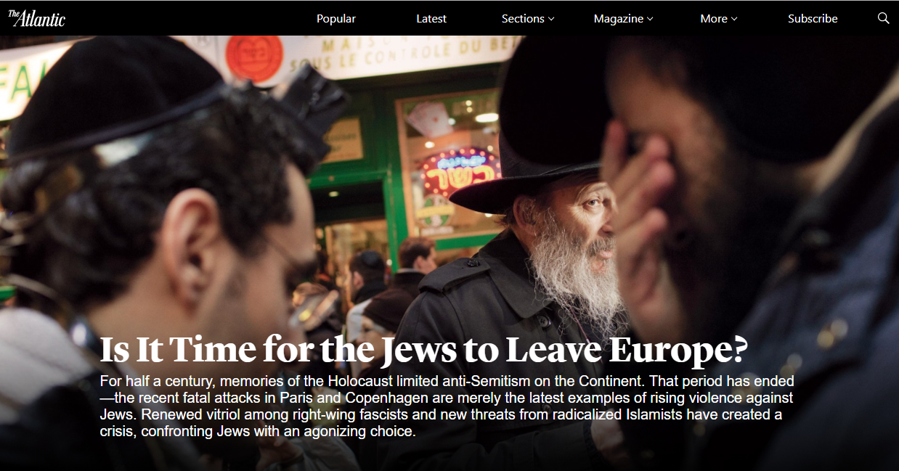
Notes:
https://www.theatlantic.com/magazine/archive/2015/04/is-it-time-for-the-jews-to-leave-europe/386279/

Slide 25
France’s 475,000 Jews represent less than 1 percent of the country’s population. Yet last year, according to the French Interior Ministry, 51 percent of all racist attacks targeted Jews. The statistics in other countries, including Great Britain, are similarly dismal.
Notes:
https://www.theatlantic.com/magazine/archive/2015/04/is-it-time-for-the-jews-to-leave-europe/386279/

Slide 26
In 2014, Jews in Europe were murdered, raped, beaten, stalked, chased, harassed, spat on, and insulted for being Jewish. Sale Juif—“dirty Jew”—rang in the streets, as did “Death to the Jews,” and “Jews to the gas.”
Notes:
https://www.theatlantic.com/magazine/archive/2015/04/is-it-time-for-the-jews-to-leave-europe/386279/

Slide 27
In Hungary, a leader of the right-wing Jobbik party called on the government—a government that has come under criticism for whitewashing the history of Hungary’s collaboration with the Nazis—to draw up a list of all the Jews in the country
Notes:
https://www.theatlantic.com/magazine/archive/2015/04/is-it-time-for-the-jews-to-leave-europe/386279/

Slide 28
who might pose a “national-security risk.” In Greece, a recent survey found that 69 percent of adults hold anti-Semitic views, and the fascists of the country’s Golden Dawn party are open in their Jew-hatred.
Notes:
https://www.theatlantic.com/magazine/archive/2015/04/is-it-time-for-the-jews-to-leave-europe/386279/
A bit of history to explain a miracle…

Slide 29
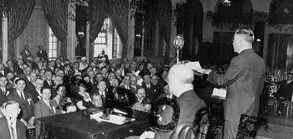
Delegates at the Evian Conference, 1938
Notes:
http://www.holocaust.com.au/The-Australian-Experience/Before-the-War/Evian-Conference

Slide 30
The Évian Conference was convened 6–15 July 1938, at Évian-les-Bains, France, to discuss the Jewish refugee problem and the plight of the increasing numbers of Jewish refugees fleeing persecution by Nazi Germany.
Notes:
https://en.wikipedia.org/wiki/%C3%89vian_Conference

Slide 31
It was convened at the initiative of United States President Franklin D. Roosevelt.
Notes:
https://en.wikipedia.org/wiki/%C3%89vian_Conference

Slide 32
The conference was attended by representatives from 32 countries, and 24 voluntary organizations also attended as observers, presenting plans either orally or in writing.
Notes:
https://en.wikipedia.org/wiki/%C3%89vian_Conference

Slide 33
The conference was ultimately doomed, as delegations from the 32 participating nations failed to come to any agreement about accepting the Jewish refugees fleeing the Third Reich.
Notes:
https://en.wikipedia.org/wiki/%C3%89vian_Conference

Slide 34
Only two countries, Costa Rica and the Dominican Republic, increased their quotas. The conference thus inadvertently proved to be a useful propaganda tool for the Nazis.
Notes:
https://en.wikipedia.org/wiki/%C3%89vian_Conference

Slide 35
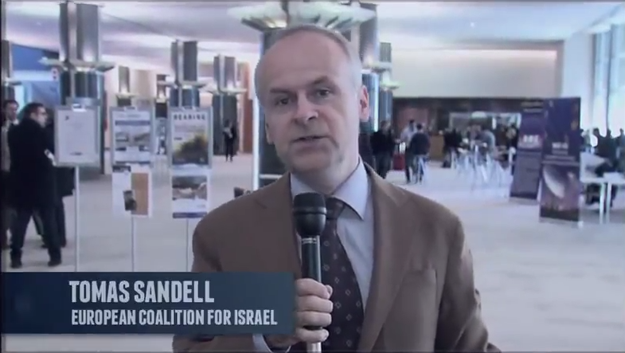
Notes:
Where did this ally come from?

Slide 36
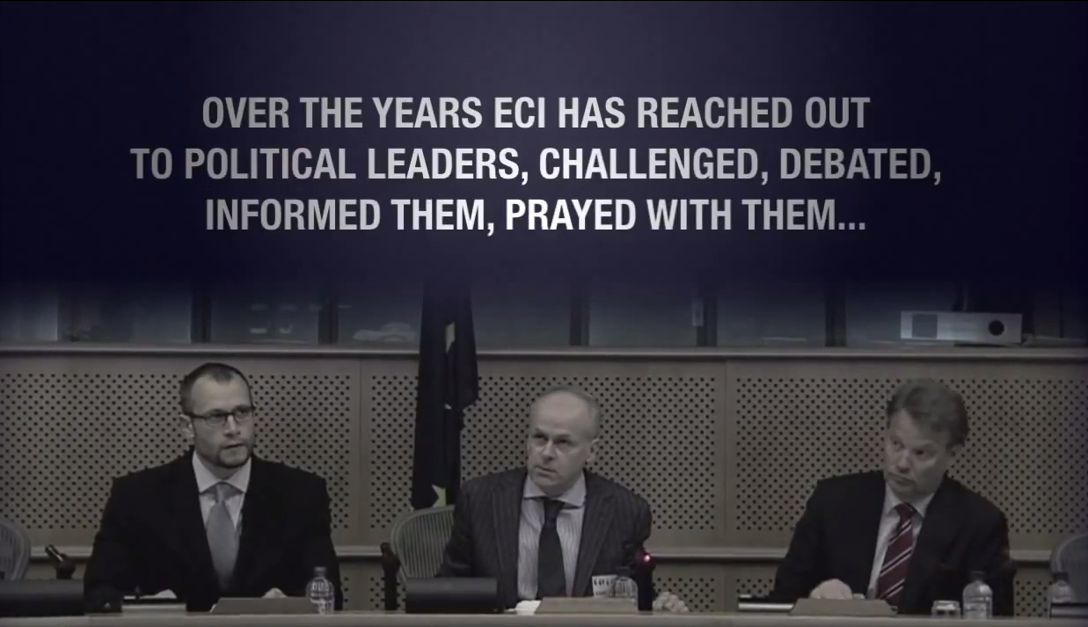
Thomas Sandell & Calev Myers

Slide 37

European Coalition for Israel
Notes:
Like Ester: Help and relief and deliverance will rise up to Israel…Faith
We were in the presence of a Mordekhi, or a Cyrus
San Remo Conference is the International Legal foundation of the legitimacy of the State of Israel, in addition to the Biblical legitimacy. NOT by Jewish or Colonial conquest. History of refugee camps.

Slide 38
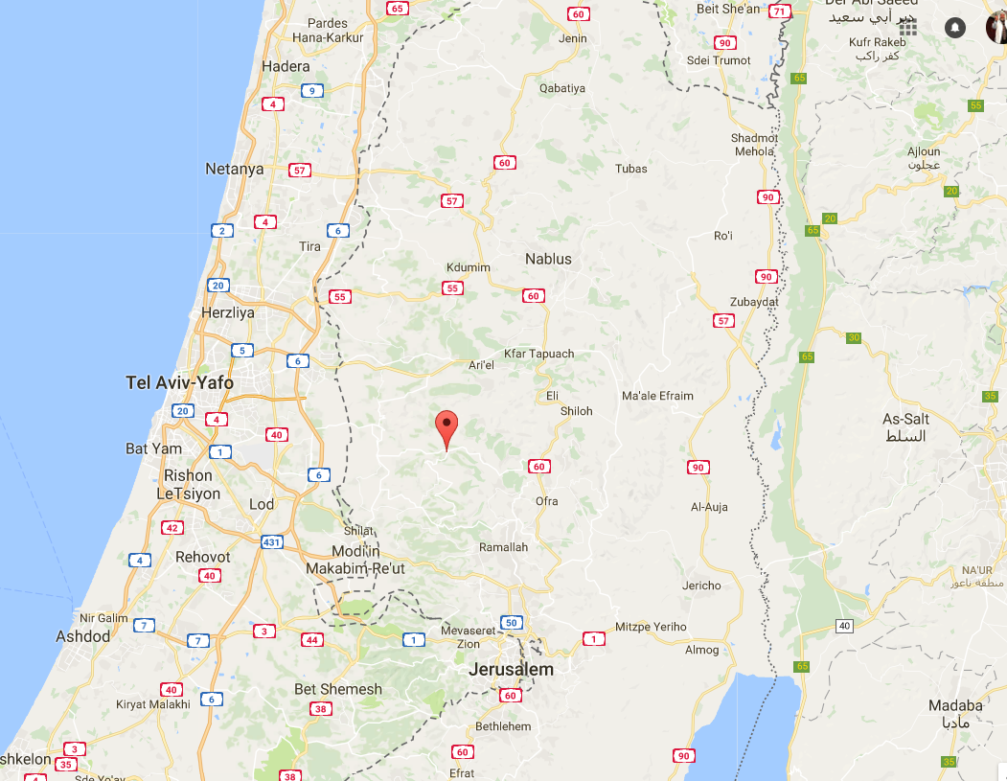
Halamish

Slide 39
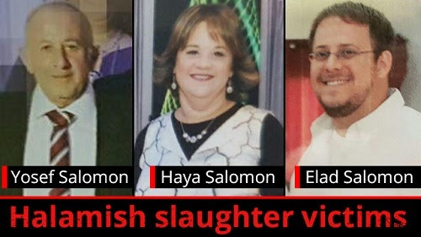
Notes:
Republican Jewish Coalition | 50 F Street, N.W., Suite 100 | Washington, DC 20001 | 202.638.6688 | rjc@rjchq.org
Last Friday night, July 21, 2017, the Salomon family in Halamish was celebrating the birth of a new grandson - until 19-year-old Omar al-Abed entered their home and attacked family members with a knife. He murdered grandfather Yosef Salomon, 70, and his children, Elad, 36, and Chaya, 46. The grandmother, Tova, was also seriously injured.

Slide 40
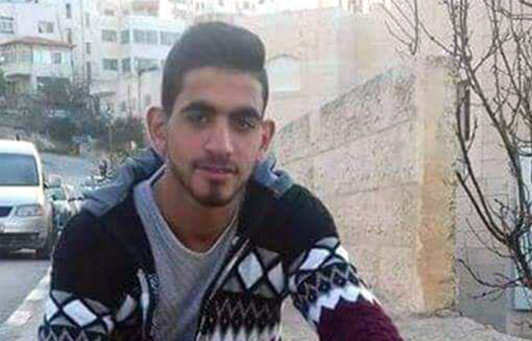
Omar al-Abed, 19
Notes:
MAOZ ISRAEL INTERCESSORS NETWORK LETTER No. 996 Wednesday, July 26, 2017
Halamish terrorist identified as Omar al-Abed, 19, Hamas supporter from Kobar

Slide 41
Omar al-Abed murdered three Jews this past Friday night. This means he will almost certainly be sentenced to more than 30 years in prison. According to the PA’s budget, this entitles him to NIS 12,000 each month, which is about $3,364. That’s $40,368 a year, or $1,211,040 for al-Abed’s presumed 30-year sentence.
Notes:
Republican Jewish Coalition | 50 F Street, N.W., Suite 100 | Washington, DC 20001 | 202.638.6688 | rjc@rjchq.org
Consider Taylor Force Act to defund payment for terrorism. Not approved by Congress.

Slide 42
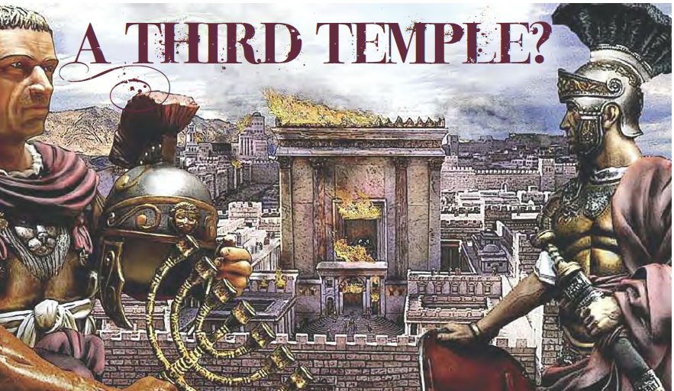
Notes:
http://metrovoicenews.com/kansas-city-archives/

Slide 43
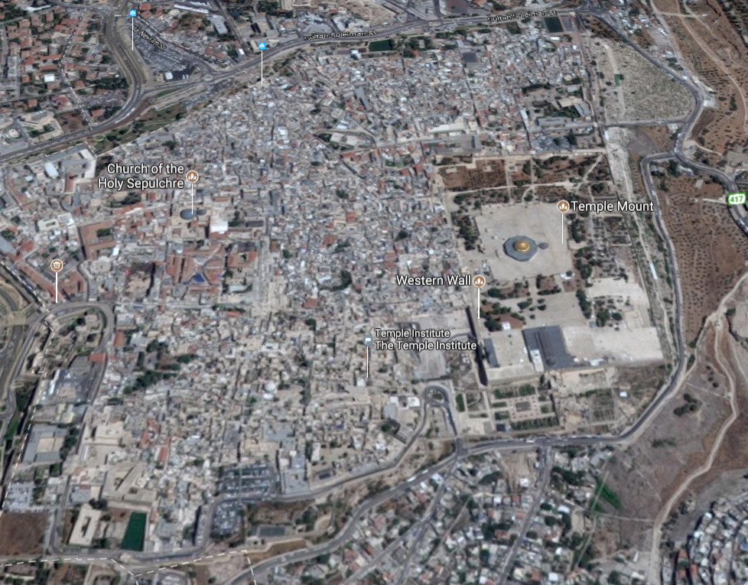

Slide 44
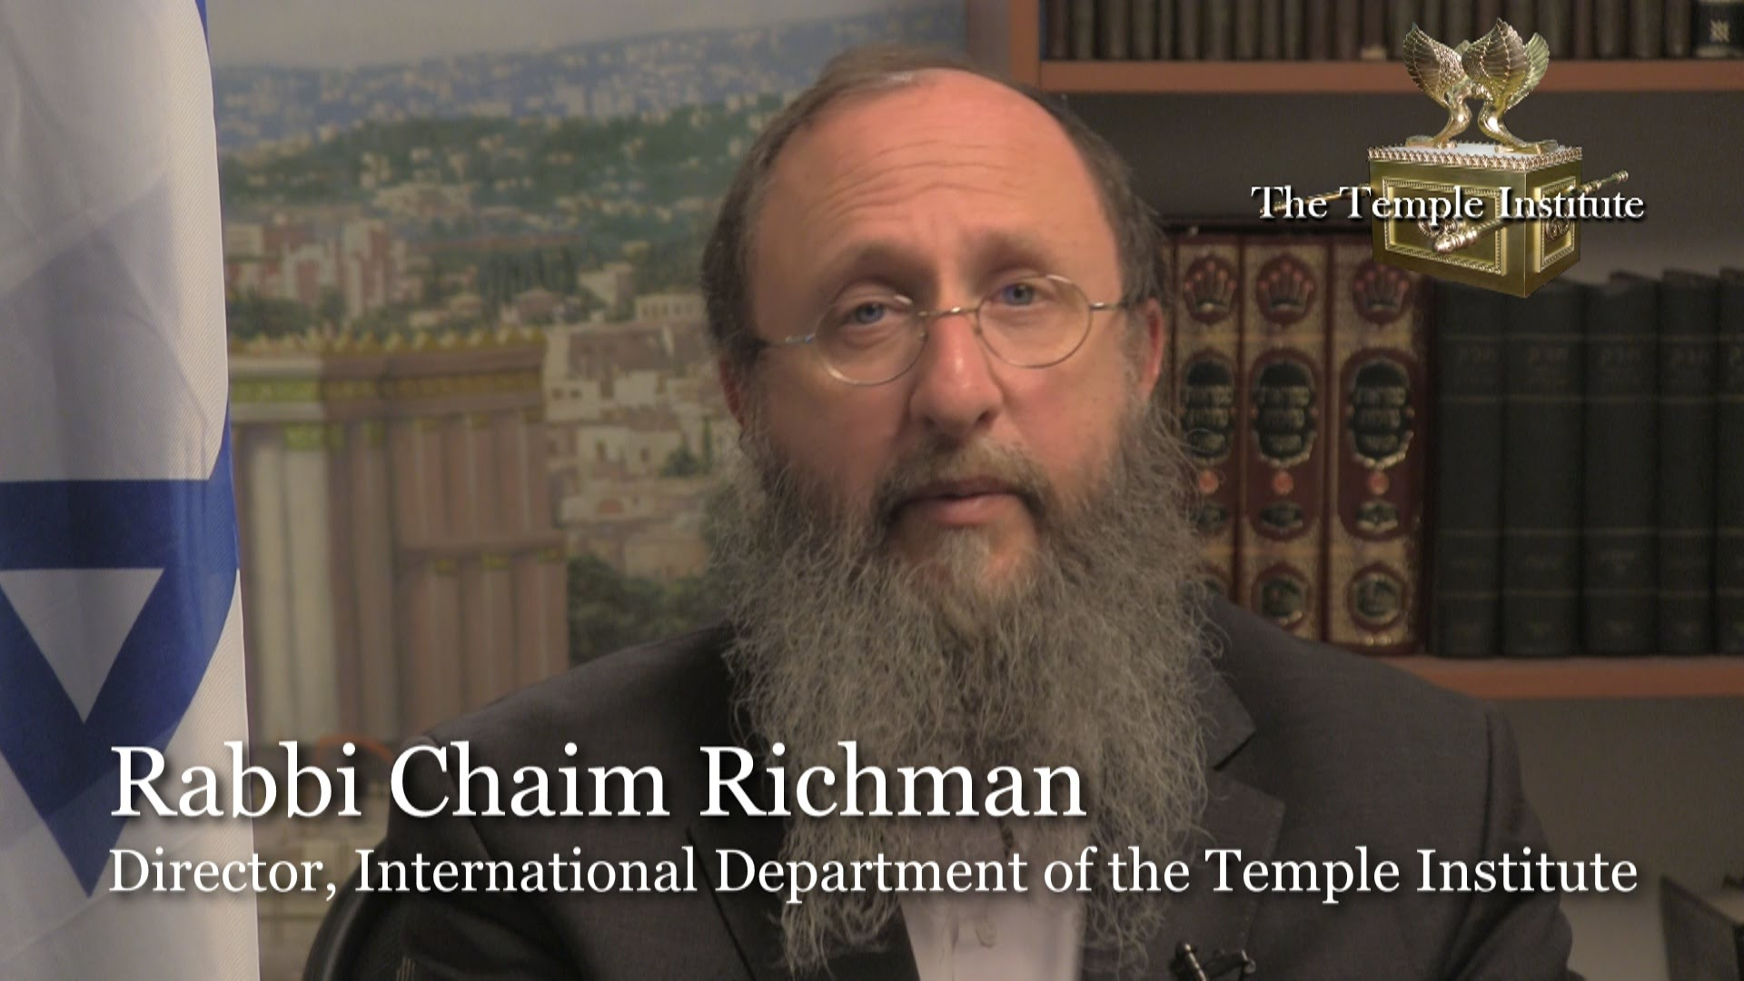

Slide 45
The Institute shares a key connection to the battle for Jerusalem. Its founder, Rabbi Yisrael Ariel, served with the 55th Paratroopers Brigade that captured the Temple Mount. After the victory, a Jordanian guide gave them a remarkable tour.
Notes:
http://metrovoicenews.com/kansas-city-archives/

Slide 46
The soldiers were on the Temple Mount and it was just like the first hour or so. And they were approached by a Jordanian fellow in Western dress who explained that he was the official tour guide for the Jordanian parliament and he offered to take the soldiers and to show them the sites on the Temple Mount. [June 1967]
Notes:
http://metrovoicenews.com/kansas-city-archives/

Slide 47
"He takes the soldiers, you know, and the rabbi there, and he says, 'well this is exactly where the sanctuary stood. This is where the altar stood and then this is where the Menorah stood.‘ "He tells them all these things about the history of the Holy Temple …
Notes:
http://metrovoicenews.com/kansas-city-archives/
Israel Ariel, as told by Chaim Richman

Slide 48
Finally, the rabbi asked him, 'why are you telling us all this?‘
And he said, 'well, we have tradition from our fathers [and] they from their fathers that one day the Jews would wage a war and conquer this mountain

Slide 49
and rebuild the Holy Temple, and I assume that you're starting tomorrow. I want this to be my part, my part in helping you,'" he said, according to Rabbi Richman.
Notes:
http://metrovoicenews.com/kansas-city-archives/

Slide 50
CBN News asked Richman what was their reaction to that story. "Well, I guess they were pretty surprised, but the bottom line is in hindsight; it doesn't look like we were ready.“
Gen. Moshe Dayan, gave the Temple Mount to the Waqf!!
Notes:
http://metrovoicenews.com/kansas-city-archives/
Gen. Moshe Dayan, a secular Jew, gave the Temple Mount to the Jordanian Islamic Waqf
Prime Minister Levi Eshkol complied.

Slide 51
Now, 50 years later, that's changed with the Temple Institute preparing blueprints and gathering official temple
elements such as the priestly garments.

Slide 52
All of this means talk of rebuilding the temple is no longer considered a fringe idea.
"Today…“ Richman continued. "There are members of Knesset that actually talk about the rebuilding the Holy Temple.
Notes:
http://metrovoicenews.com/kansas-city-archives/
PAUSE. REBUILDING TEMPLE.
Looks like only riots, but G-d working

Slide 53
In 1947, 4554 Jewish refugees, mostly Holocaust survivors, sailed towards Israel, then under control of the British Mandate, but were intercepted by British warships. After a bitter struggle, they were turned away and subsequently sent back to Germany.
Notes:
https://unitedwithisrael.org/israel-marks-70-years-since-famed-exodus-voyage/?utm_source=MadMimi&utm_medium=email&utm_content=Rabbi+Muzzled+on+Temple+Mount+for+Victims%27+Prayer%3B+Palestinian+Who+Murdered+Family+Gets+Big+Payoff%3B+Media+Equates+Israeli+Victims+with+Terrorists&utm_campaign=20170725_m140567819_Rabbi+Muzzled+on+Temple+Mount+for+Victims%27+Prayer%3B+Palestinian+Who+Murdered+Family+Gets+Big+Payoff%3B+Media+Equates+Israeli+Victims+with+Terrorists&utm_term=more_btn_dark_jpg

Slide 54
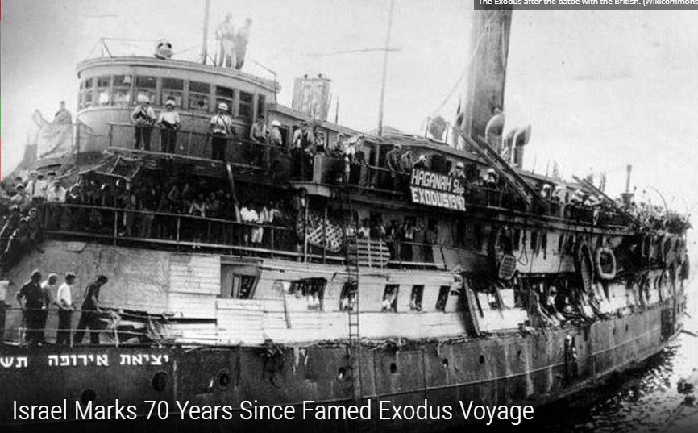

Slide 55
President Reuven Rivlin met at his residence in Jerusalem on Sunday with 12 passengers who traveled to Israel on the Haganah’s Exodus ship, marking seven decades since the ship’s iconic voyage to the Land of Israel.
Notes:
https://unitedwithisrael.org/israel-marks-70-years-since-famed-exodus-voyage/?utm_source=MadMimi&utm_medium=email&utm_content=Rabbi+Muzzled+on+Temple+Mount+for+Victims%27+Prayer%3B+Palestinian+Who+Murdered+Family+Gets+Big+Payoff%3B+Media+Equates+Israeli+Victims+with+Terrorists&utm_campaign=20170725_m140567819_Rabbi+Muzzled+on+Temple+Mount+for+Victims%27+Prayer%3B+Palestinian+Who+Murdered+Family+Gets+Big+Payoff%3B+Media+Equates+Israeli+Victims+with+Terrorists&utm_term=more_btn_dark_jpg

Slide 56
The Haganah was a Jewish paramilitary organization in the British Mandate of Palestine founded in 1920. It became the Israel Defense Forces after the establishment of the Jewish state.
Notes:
https://unitedwithisrael.org/israel-marks-70-years-since-famed-exodus-voyage/?utm_source=MadMimi&utm_medium=email&utm_content=Rabbi+Muzzled+on+Temple+Mount+for+Victims%27+Prayer%3B+Palestinian+Who+Murdered+Family+Gets+Big+Payoff%3B+Media+Equates+Israeli+Victims+with+Terrorists&utm_campaign=20170725_m140567819_Rabbi+Muzzled+on+Temple+Mount+for+Victims%27+Prayer%3B+Palestinian+Who+Murdered+Family+Gets+Big+Payoff%3B+Media+Equates+Israeli+Victims+with+Terrorists&utm_term=more_btn_dark_jpg

Slide 57
Today, the Islamic republic lumbers on as the Soviet Union did during its last years. It professes an ideology that convinces no one. It commands security services that proved unreliable in the 2009 rebellion, causing the regime to deploy the Basij militias because many commanders of the Revolutionary Guards refused to shoot the protesters.
Notes:
The RJC Weekly Newsletter July 6, 2017

Slide 58
The seminaries in the shrine city of Qom appreciate the damage that the government of God has done to Islam as the mosques remain empty even during important religious commemorations. Young men don’t wish to join the clergy, and women don’t want to marry clerics.
Notes:
The RJC Weekly Newsletter July 6, 2017

Slide 59
The system is engulfed by corruption, which is particularly problematic for a regime that bases its power on divine ordinance.
Today, the Islamic republic lumbers on as the Soviet Union did during its last years.
Notes:
The RJC Weekly Newsletter July 6, 2017
How many remember when Russia seemed unstoppable, then suddenly, Gorbechov, perestroika, dissolution of Union of Soviet Socialist Republics. Poland, Ukraine, looking West. Trumps greatest speech in Poland.

Slide 60
Today, the Islamic republic will not be able to manage a succession to the post of the supreme leader as its factions are too divided and its public too disaffected.
Notes:
The RJC Weekly Newsletter July 6, 2017
Tell other stories. New Hope: keep praying and persevering. Dobson.

Slide 61
Early yesterday morning, security forces removed the metal detectors and special cameras installed at the entrances to the Temple Mount. However, in spite of the removal, the majority of those who came to pray still refused to enter. Muslims interviewed on Israel’s Channel 2 News
Notes:
MAOZ ISRAEL INTERCESSORS NETWORK LETTER No. 996 Wednesday, July 26, 2017

Slide 62
claimed that even though metal detectors were gone, special scanners were installed secretly underground, which allow security forces to see people who pass above these scanners as if they were naked in order to check for weapons… (NO, I am not joking…) Last night, riots broke out again after evening prayers.
Notes:
MAOZ ISRAEL INTERCESSORS NETWORK LETTER No. 996 Wednesday, July 26, 2017

Slide 63
I received this from a Messianic rabbi, Steve Sheek, I would like you to keep Tree of Life Messianic Congregation in Houston in your prayers. The pastor of the church where we were meeting resigned Sunday and now, two days later, the board of the church asked us to leave. They actually said they didn't want a Jewish group using their facility.

Slide 64
So now I am on the hunt for a new location. Pray for G-d's favor in finding a location that we can afford. Our congregation is only 18 months old and we have grown from 16 to 40 in that time. We are small, but steadily growing. I know that Hashem will provide. Steve Sheek www.treeoflifehouston.com
713-206-2680
Notes:
Got this response on the Forum:

Slide 65
Steve [Sheek],
We faced the very same situation a few years ago when we only around 2 years old. We had 12 members including the kids and it seemed very bleak indeed. We began to pray, asking HaShem's favor and when it seemed hopeless we opted to move

Slide 66
into a less than pristine building that you wouldn't invite your dog to eat in. The first Shabbat there only 8 people showed up. One of my people said we should go to the property that we wanted to be housed in (which was an Assembly of God) and sound the shofarot. Now, I don't know if that had any spiritual meaning or not,

Slide 67
but it did catch the attention of the neighbors who asked us who we were. We told them and they told the Pastor that some "crazy Jews" who believed in Jesus was blowing horns at his church and told him who we were. On Tuesday we got a call from the Pastor wanting to meet with us.

Slide 68
We met on Wednesday and he asked if we were looking for a place to be housed. We told him yes.
For the rest of the story...that congregation never rented or leased to anyone in their 60 years of existence. But they did to us. We grew to a little over 30 there and now 5 years later are running over a hundred and looking to build our first

Slide 69
synagogue in an area where no one thought it possible. We have people from all over the world attending including numerous former Orthodox and Ultra-Orthodox Jews. It's a test my friend...and I know you and your congregation will

Slide 70
come through it and will be amazed at HaShem's handiwork! Beit Shofarot is praying for you guys!
Rabbi Yossi Wentz
Beit Shofarot Messianic Synagogue
Kannapolis, NC

Slide 71
Friday in Israel, the declared Day of Rage, will begin Thursday evening and night in the Americas. So today we are releasing a call, not for Christian rage, but for prayer for a proclamation of Isaiah 61:1-11: "The Spirit of the Sovereign Lord is on me because He has anointed me to proclaim good news to the poor. He has sent me to bind up the
Notes:
http://lightofzion.org/prophetic-views/temple-mount-crisis-escalating-tisha-bav-approaches-pray/

Slide 72
brokenhearted, to proclaim freedom for the captives and release from darkness for the prisoners, to proclaim the year of the Lord's favor and the day of vengeance of our God, to comfort all who mourn, and provide for those who grieve in Zion
Notes:
http://lightofzion.org/prophetic-views/temple-mount-crisis-escalating-tisha-bav-approaches-pray/

