Slide 1
To easily follow these notes, log on to our Wifi
Wifi: mycci01
p/w: ancientquail060
Go to OrHaOlam.com
Click on downloads, messages, 2017

Slide 2
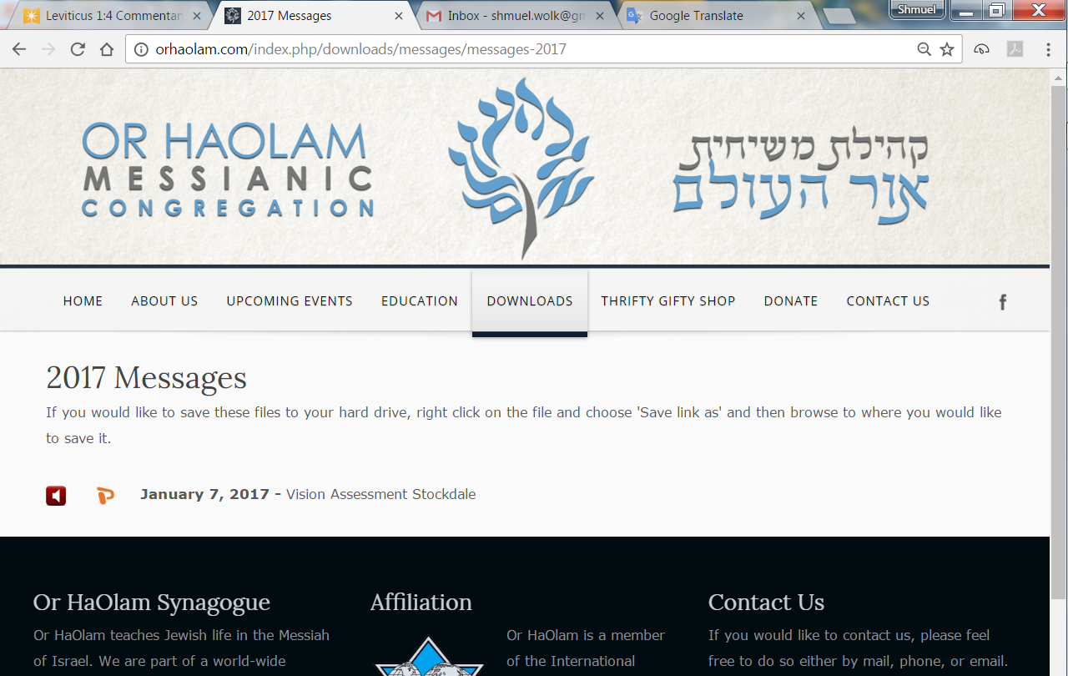

Slide 3
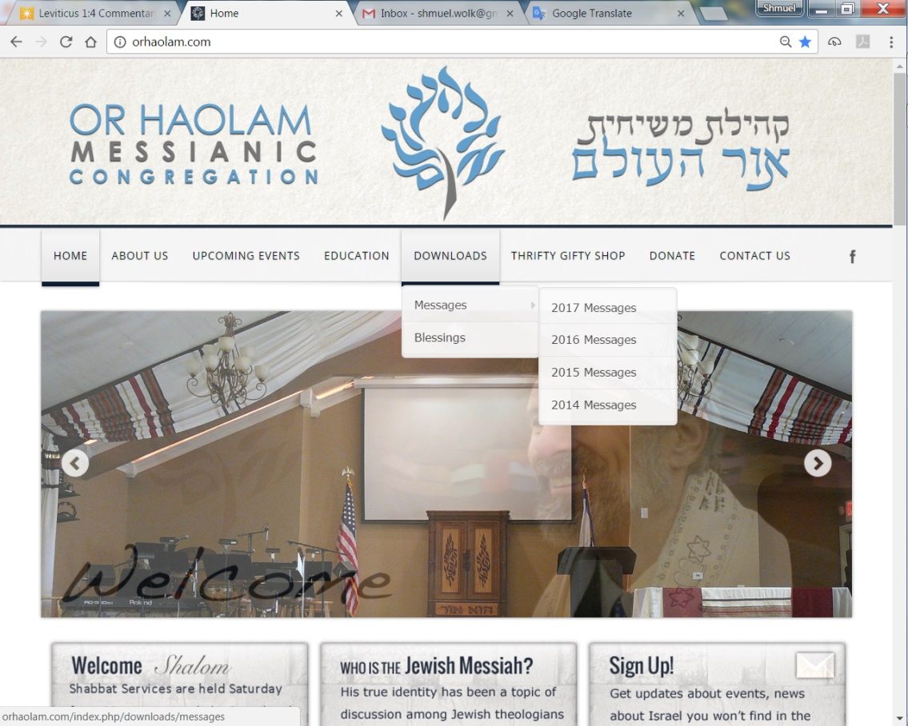
Downloads\messages\
2017 Messages

Slide 4
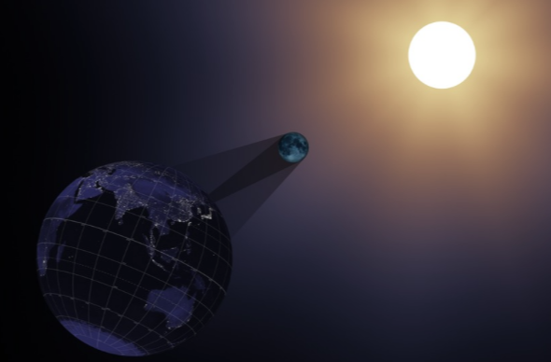
Total Solar Eclipse
Aug 21, 2017
Notes:
You’ve seen this slide a lot.
Last time till 400 years from now!

Slide 5
During totality, the eclipsed sun is no brighter than the full moon, and it is an experience you simply will not believe.

Slide 6
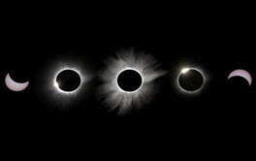
Umbraphiles
Notes:
See the corona

Slide 7
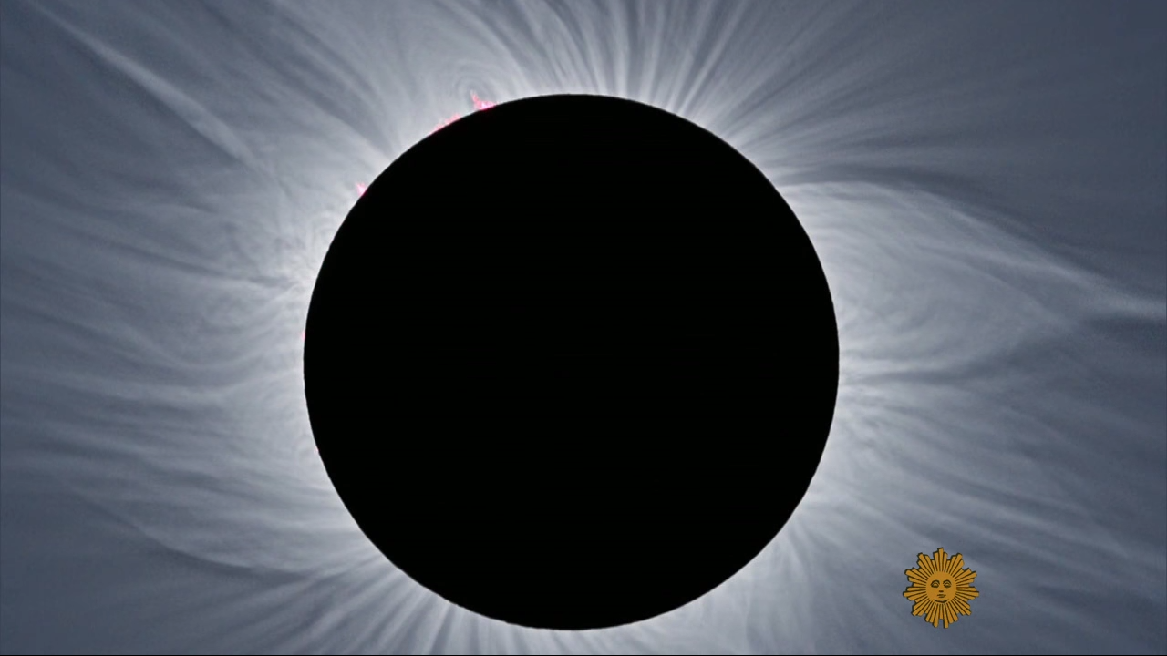
Notes:
https://www.youtube.com/watch?v=0Poc1HSe3bM&feature=em-subs_digest-vrecs
I think that this is the view that overwhelms people, makes even seculars weep, and fall on their knees

Slide 8
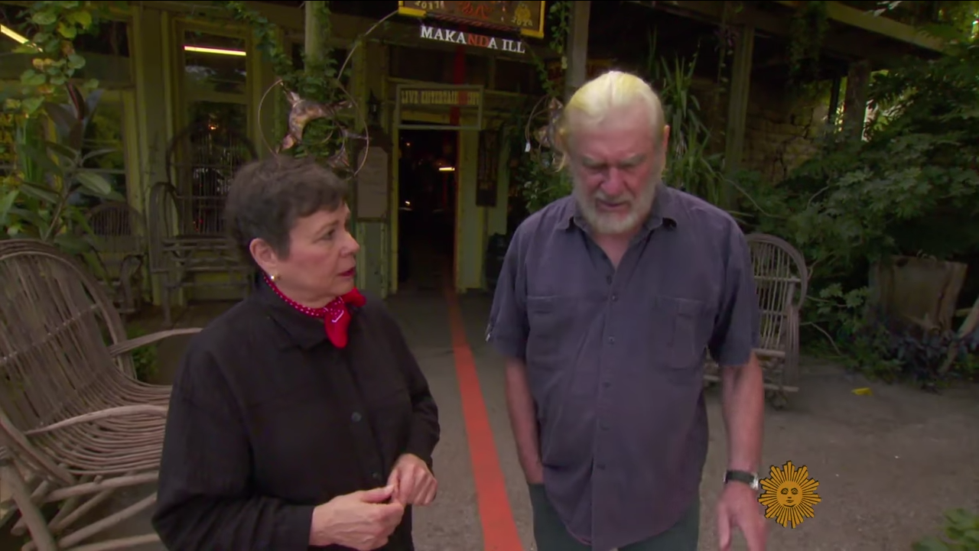
Notes:
https://www.youtube.com/watch?v=0Poc1HSe3bM&feature=em-subs_digest-vrecs
Makanda, IL longest umbra/totality 2 minutes 40 sec. Line through town of dead center of totality. Prof of Astrophysics interviewed.

Slide 9
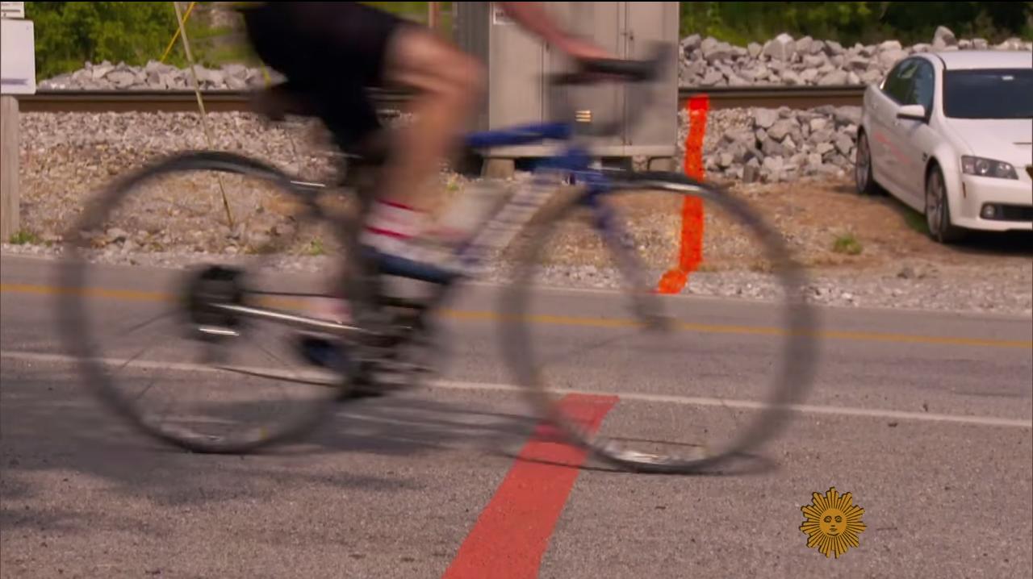
Notes:
https://www.youtube.com/watch?v=0Poc1HSe3bM&feature=em-subs_digest-vrecs

Slide 10
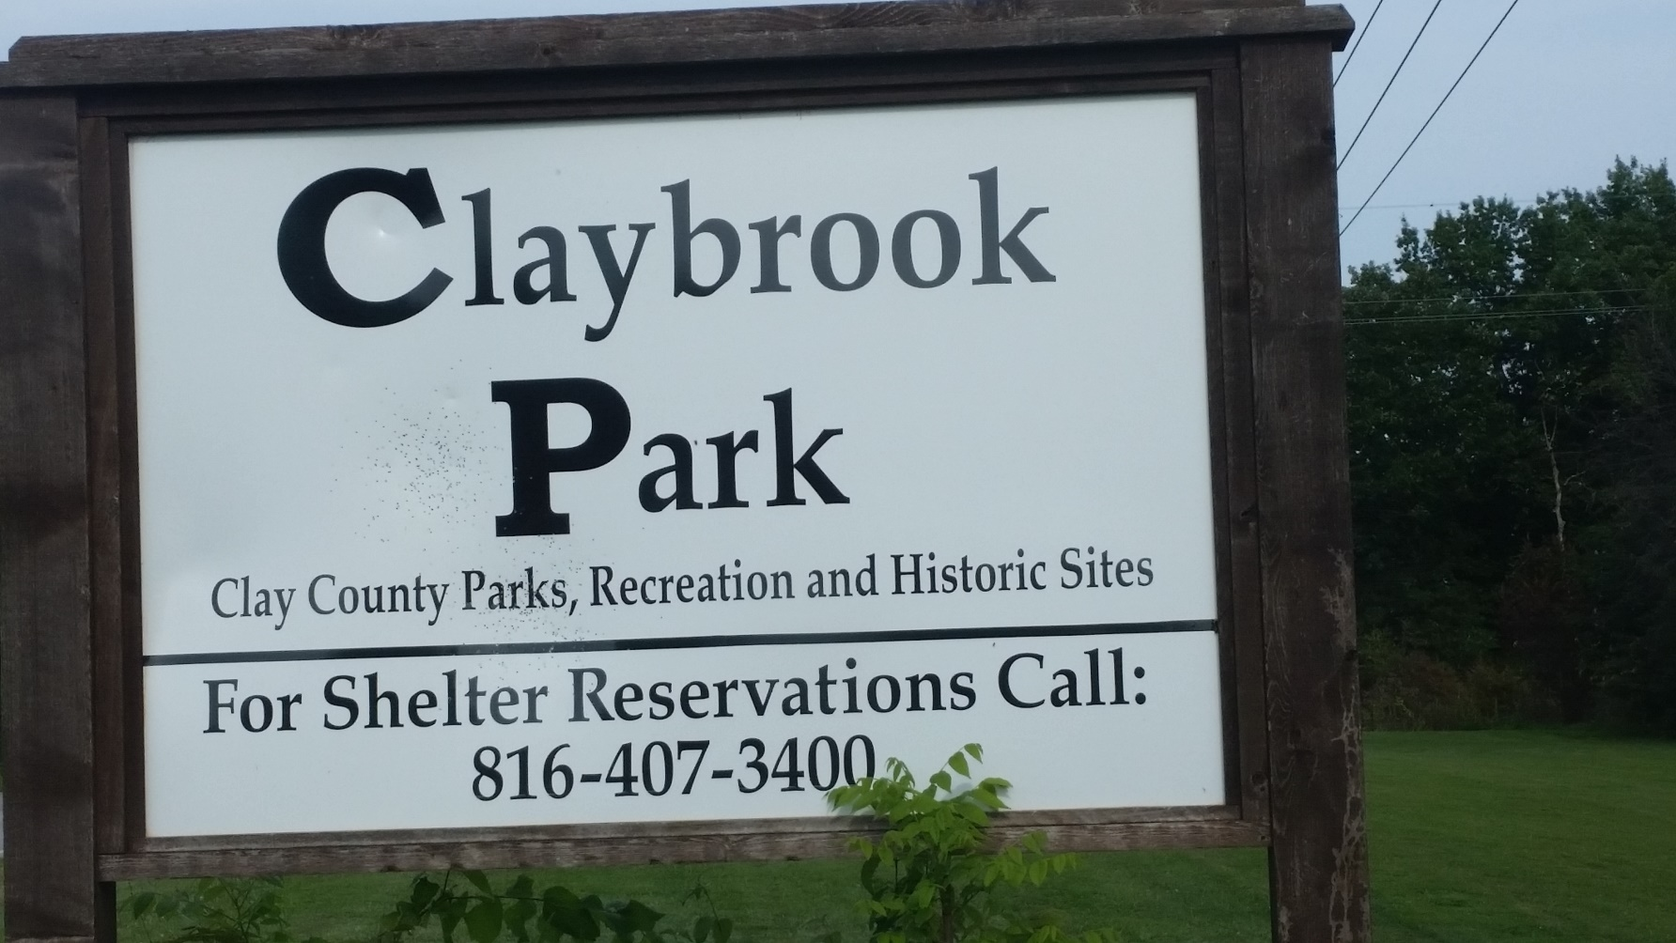
21211 Jesse James Farm Rd.,
Kearney, MO 64060
Notes:
Opens at 10 a.m.
Chance of gridlock, and inaccessible, therefore we’re distributing lenses today. Don’t forget them.

Slide 11
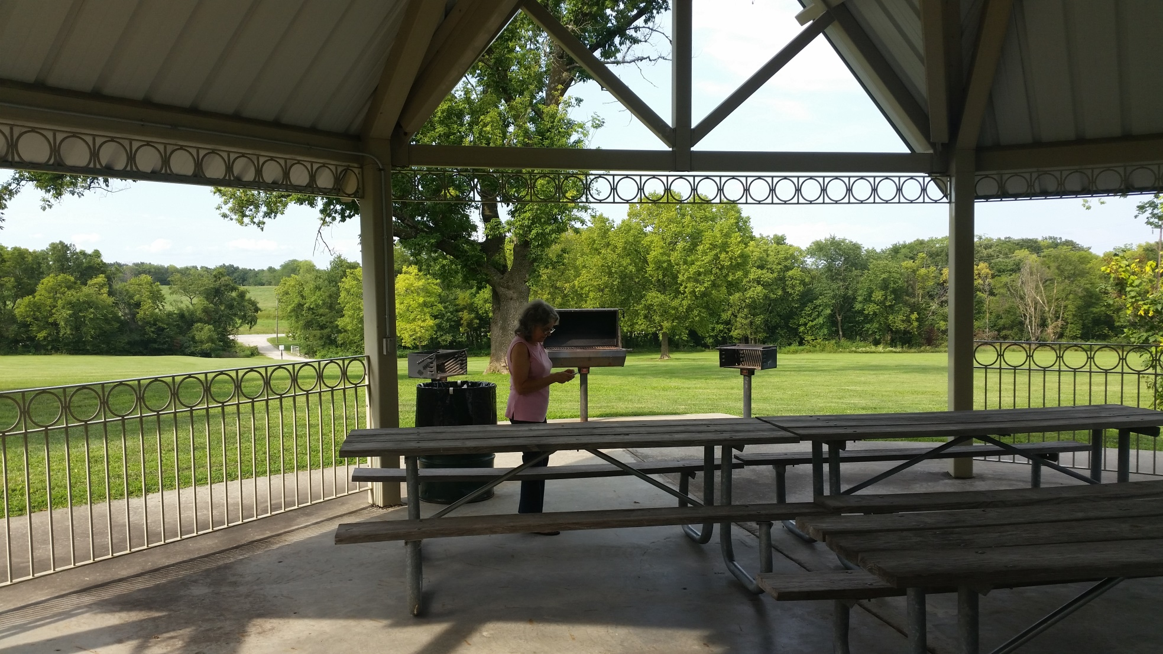

Slide 12
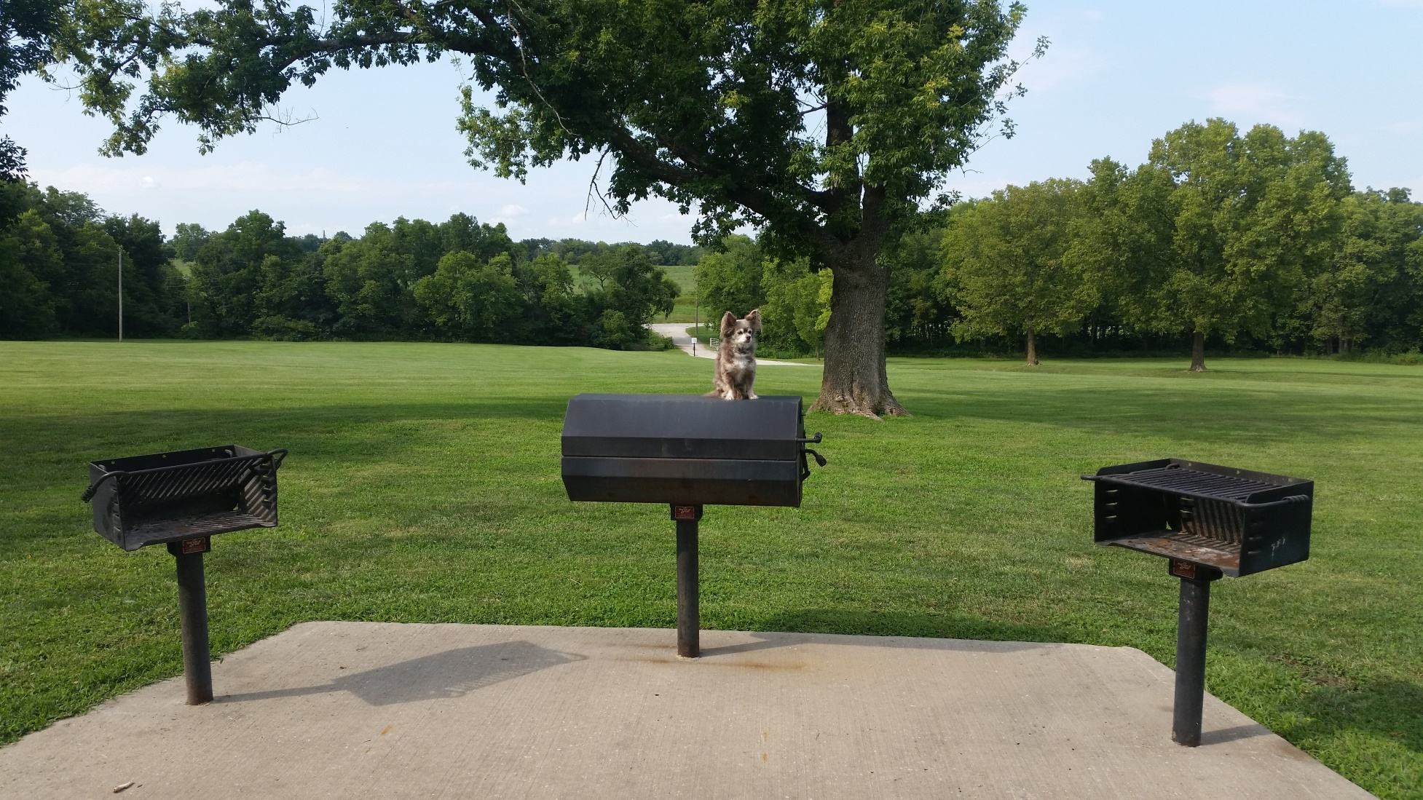

Slide 13
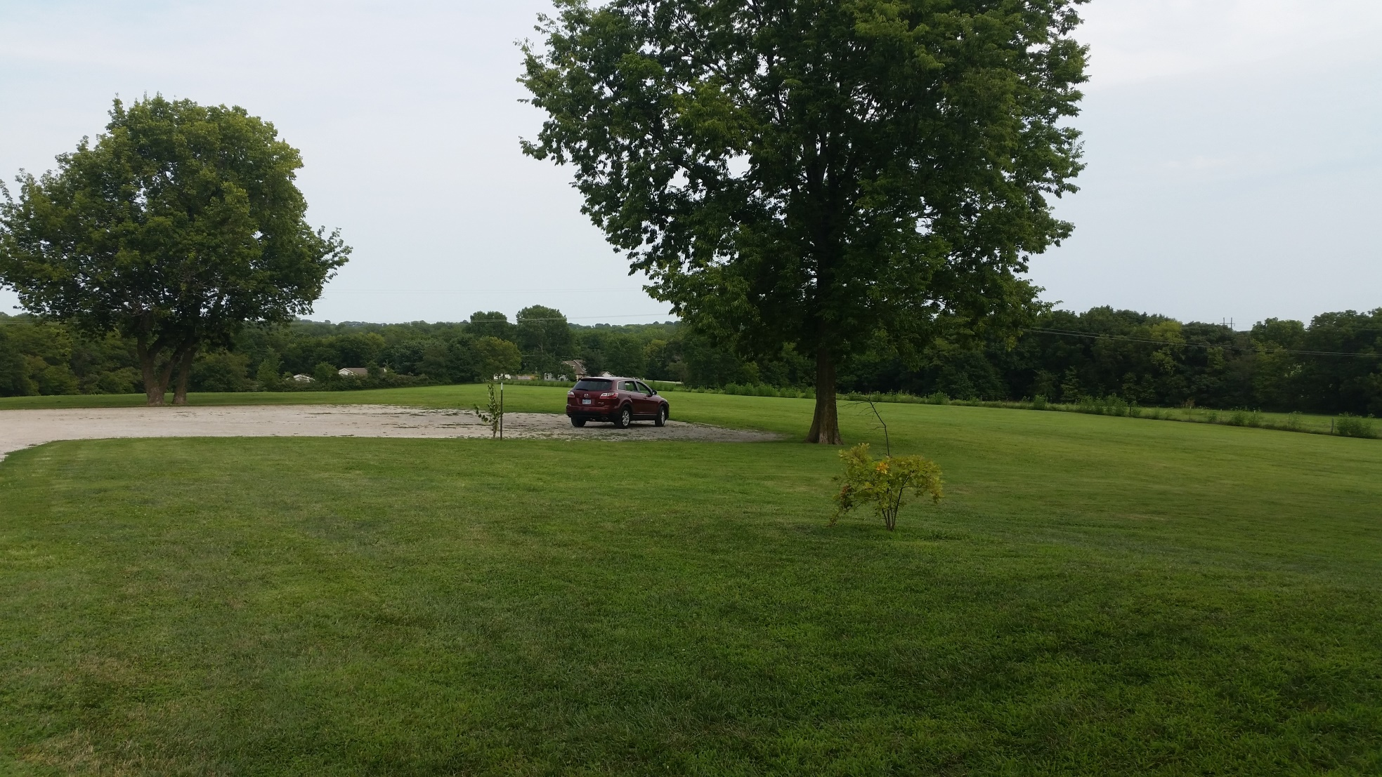
AFTER eclipse, sports and food. 2 p.m. Bring food,softball equipment, gloves. Frisbee golf

Slide 14
Please, do NOT look at the sun when ANY PART of it is still bright (not covered by the moon), or it will be the last thing you ever see.

Slide 15
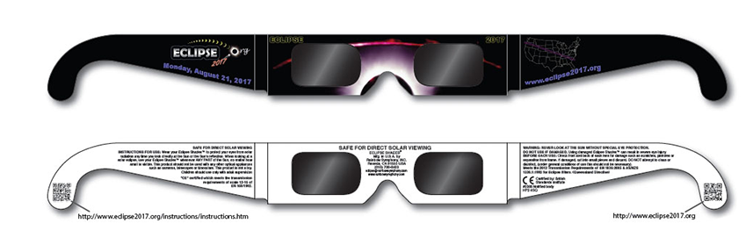
Or HaOlam has 140 of these $1. Distributing today in case of gridlock on the highways.
Notes:
James Thomas and helpers giving out and logging names. Don’t forget them!

Slide 16
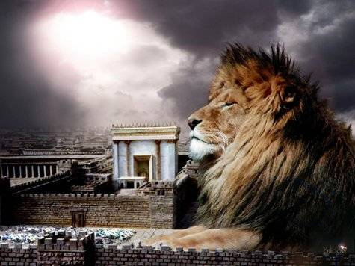
מַתִּתְיָהוּ Mattityahu
(Matthew) 20:17-19
Notes:
Y just spoke about rewards in the Kingdom, and bookended the teaching with the line that the first will be last, and the last will be first.
In other words, real rewarded life will surprise you.
The star players are not whom you might think.
This teaching qualifies WHO is the star player.
Outline of what I am going to say:

Slide 17
Vision of Yeshua
Vision of Or HaOlam
Diversions
Expressions

Slide 18
Mattityahu (Matthew) 20:17
כְּשֶׁהָיָה יֵשׁוּעַ קָרוֹב לַעֲלוֹת לִירוּשָׁלַיִם לָקַח אֶת הַשְּׁנֵים-עָשָׂר
As Yeshua was going up to Yerushalayim, he took the twelve talmidim
Notes:
How we recognize Hebrew primacy.
ALWAYS ‘go up’ to Jerusalem, even if parachuting in!

Slide 19
Mattityahu (Matthew) 20:17
לְבַדָּם וּבַדֶּרֶךְ אָמַר לָהֶם:
aside by themselves and said to them, as they went on their way,
Notes:
Aside, כי crowd, esp. if pilgrim holiday. Seems like a large group to be an aside en route, but apparently crowds.

Slide 20
Mattityahu (Matthew) 20:18
"הִנֵּה אֲנַחְנוּ עוֹלִים לִירוּשָׁלַיִם וּבֶן-הָאָדָם יִמָּסֵר לְרָאשֵׁי הַכֹּהֲנִים וְלַסּוֹפְרִים. הֵם יֶחֶרְצוּ אֶת דִּינוֹ לְמָוֶת
"We are now going up to Yerushalayim, where the Son of Man will be handed over to the head cohanim and Torah-teachers. They will sentence him to death
Notes:
Divine title, Daniel 7.14
Third repetition of this concept. Mt 16.21, 17.22-23 Apparently they were NOT getting it, כי response following. Expecting a kingdom, no clue the price of martyrdom for it.
This is really NOT changed. I lapse in this. We expect growth, prosperity, success, individually and congregationally. Need to focus on price of serving, humbling, giving, blessing, dying to self, martyrdom in spirit, maybe in deed.

Slide 21
Mattityahu (Matthew) 20:19
וְיִמְסְרוּ אוֹתוֹ לַגּוֹיִים לְהָתֵל בּוֹ וּלְהַלְקוֹתוֹ וְלִצְלֹב אוֹתוֹ, וּבַיּוֹם הַשְּׁלִישִׁי יָקוּם."
and turn him over to the Goyim, who will jeer at him, beat him and execute him on a stake as a criminal. But on the third day, he will be raised."
Notes:
First time in reference to execution stake mentions the Gentiles. Made it worse, especially in a culture emphasizing nationalism and shame.
It just didn’t compute. It still doesn’t compute.
Yeshua building the right vision in them. It’s the vision that determines our life.
Death to self and glory, resurrection LIFE.

Slide 22
Vision of Yeshua
Vision of Or HaOlam
Diversions
Expressions

Slide 23
^{Mishlei/Prov 29.18} בְּאֵין חָזוֹן, יִפָּרַע עָם;
וְשֹׁמֵר תּוֹרָה אַשְׁרֵהוּ.
^{TLV} Where there is no divine vision people cast off restraint, but blessed is the one who keeps Torah.

Slide 24
^{Yeshayahu/Is 50.5-7} Adonai ELOHIM has opened my ear, and I neither rebelled nor turned away. I offered my back to those who struck me, my cheeks to those who plucked out my beard; I did not hide my face from insult and spitting. For Adonai ELOHIM will help.
Notes:
Prophetic source and commissioning of Messiah

Slide 25
^{Yeshayahu/Is 50.5-7} This is why no insult can wound me. This is why I have set my face like flint, knowing I will not be put to shame.
Notes:
Vision

Slide 26
^{Luke} ^{9.51} And it came to pass, when the time was come that he should be received up, he steadfastly set his face to go to Jerusalem.

Slide 27
^{Mes. Jews/Heb 12.1-2 TLV} Let us run with endurance the race set before us, focusing on Yeshua, the initiator and perfecter of faith. For the joy set before Him, He endured the execution stake, disregarding its shame; and He has taken His seat at the right hand of the throne of God.
Notes:
His vision: to accomplish redemption BY DEATH AND RESURRECTION.

Slide 28
Vision of Yeshua
Vision of Or HaOlam
Diversions
Expressions

Slide 29
What is the vision of Or HaOlam?
“Working to bring Jewish people, and those grafted in, to their covenantal identity in Messiah.”

Slide 30
Salvation through the Atonement of the Messiah. We promote personal faith in the atoning death and resurrection of Yeshua, the King!
Covenantal identity of Jewish people, not replacement nor assimilation;

Slide 31
Restoration to Torah lifestyle;
Restoration/survival of the nation of Israel.
Could we be diverted? Consider a subtle diversion. Replacement Theology = Supersessionism.
Notes:
We intend for this to sync with, match and accomplish the vision of Yeshua.

Slide 32
Vision of Yeshua
Vision of Or HaOlam
Diversion
Expressions

Slide 33
Supersessionism: the belief that the covenants with Israel are over, and the Nations have superseded Israel as G-d’s people.
Somewhat debunked since the reestablishment of the nation of Israel. Somewhat.
Notes:
From Rabbi Michael Stepakoff:

Slide 34
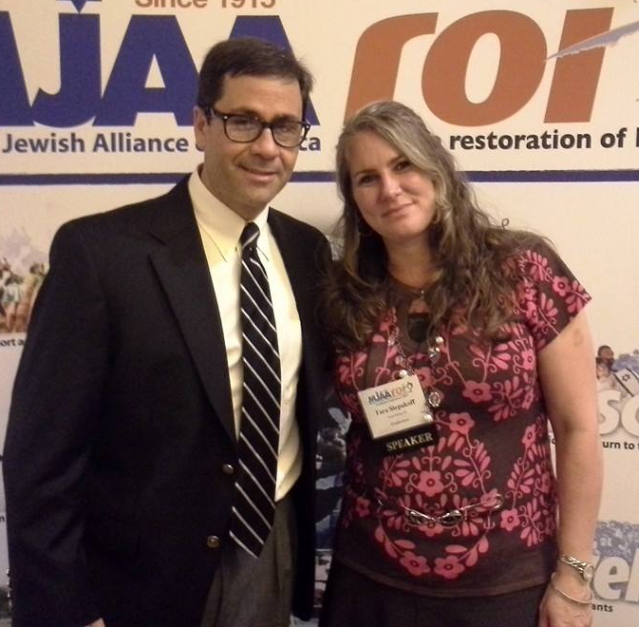
Rabbi Michael Stepakoff, Temple New
Jerusalem
Dunedin, FL
Notes:
Lawyer, rabbi, songwriter with Ted Pearce, movie maker

Slide 35
Another kind of supersessionism is people claiming and/or implying that they actually ARE Israel. This is the kind of supersessionism that we ought to be concerned about, I think. Because it isn't open and obvious. It is subtle and tricky.
Notes:
Michael Stepakoff

Slide 36
It isn't out there in the mainline church world, it is on our front door step and in our backyards. It is a creature that looks like us and acts like us, but it is not us.
Notes:
Michael Stepakoff

Slide 37
Of course, thanks to the internet and social media, the HRM [Hebrew Roots Movement] is well-known to us. Their key point is that what makes Israel the covenant nation is the keeping of the Sinai Covenant. In this vein, they claim they ARE Israel by virtue of their Torah observance.
Notes:
Michael Stepakoff

Slide 38
At some point we have to see the fundamental principle here, that anyone can keep Torah, but not everyone can be Jewish. And therefore, in the moment that you say being Jewish is based upon Torah-keeping, you unintentionally validate the claims of the HRM-variety supersessionists.
Notes:
Michael Stepakoff

Slide 39
So, in addressing supersessionism, I suggest we need to first be sure we have no misunderstanding of the source of Israel's nationhood and status as "the chosen people.“ Indeed, the covenant with Israel DOES NOT COME FROM SINAI.
Notes:
Michael Stepakoff

Slide 40
In fact, Israel is the chosen people not because of the Torah given to us at Sinai, but, rather, because of the PROMISE THAT GOD MADE TO THE AVOT, the fathers.
Notes:
Michael Stepakoff

Slide 41
Shaul made this clear: "What I am saying is this: the Torah which came 430 years later, does not cancel the covenant previously confirmed by God, so as to make the promise ineffective." (Gal. 3:17).
Notes:
Michael Stepakoff

Slide 42
What is the vision of Or HaOlam?
“Working to bring Jewish people, and those grafted in, to their covenantal identity in Messiah.”
Notes:
This should be the channel of your life passion, if you are happy to be here.
Consider, is that your passion?
We have constructed the government of Or HaOlam to expedite and promulgate this. We just had our Board of Directors Meeting. Friday, Aug. 11. Sort of my Acts 15 council for accountability and encouragement. MAY NOT BE OBVIOUS TO ALL.
Stewart Winograd,
Tim Gustafson [excellent counsellor]
Peter Greenspan: ob/gyn, mohel for us. Urged me to construct an org chart.

Slide 43
Vision of Yeshua
Vision of Or HaOlam
Diversions
Expressions

Slide 44
Rabbi
Directors
Elders
Shamashim
Staff
Notes:
Directors visited erev Shabbat Friday night dinner with Elders, and went around the table sharing our life passion. Impacting enough to share here…

Slide 45
A great way to express this vision is by immersion.
Spiritual cleansing
Statement of identity,
  Jewish
  grafted in.

Slide 46
Saturday, Sept 2 – Immersion service 4:30 p.m.,
15628 Lake Road #8 Gardner, KS 66030
preparation class, Aug 26, 1:30 p.m.
Hebrew terminology: Tvillah action, Mikveh place
Notes:
Sometimes Mikveh is used as a verb “mikved”

Slide 47
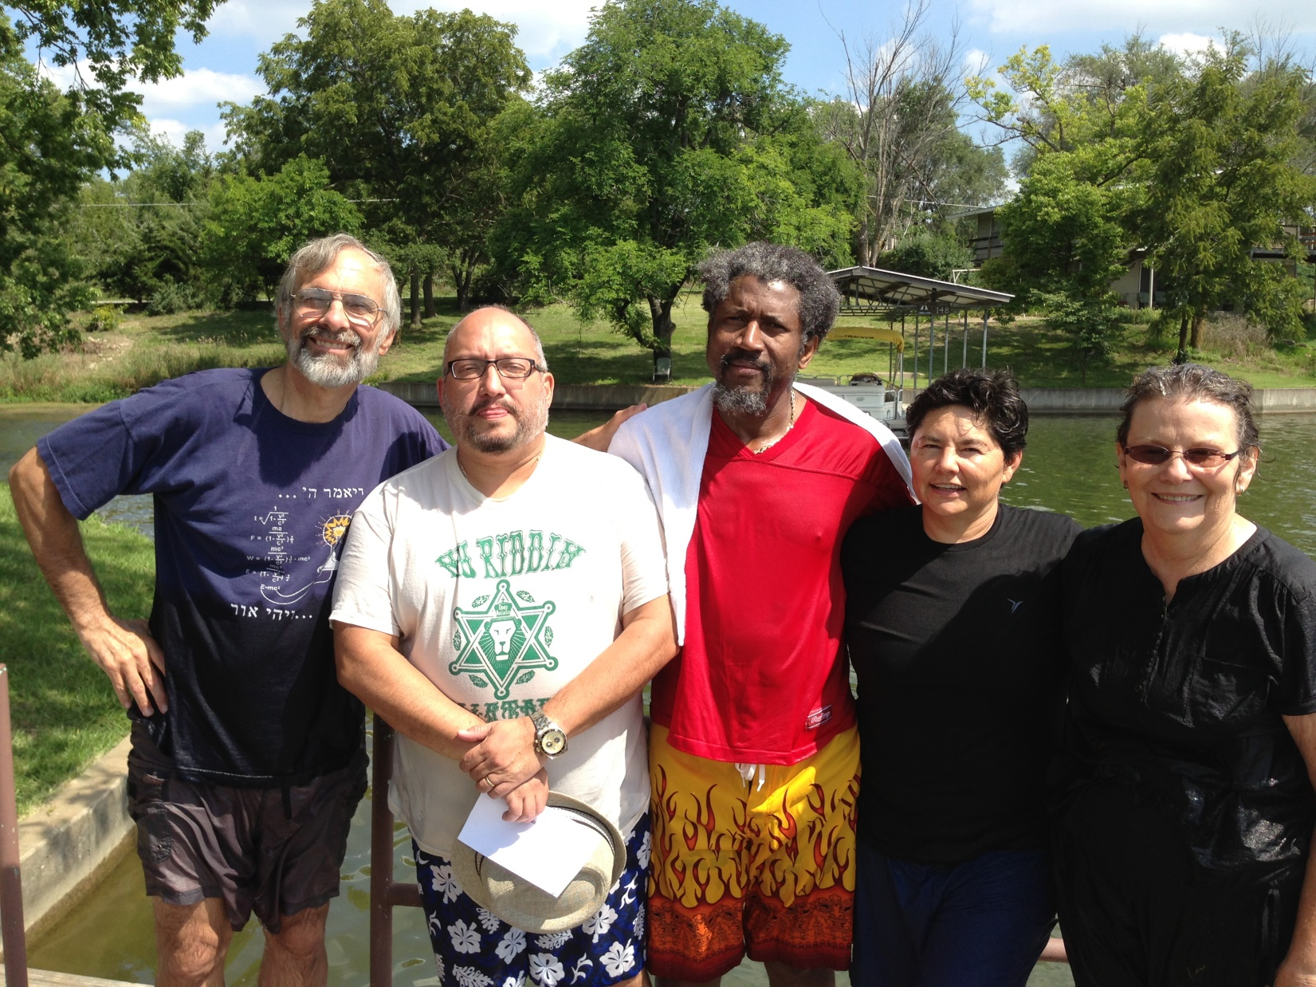
2008

Slide 48
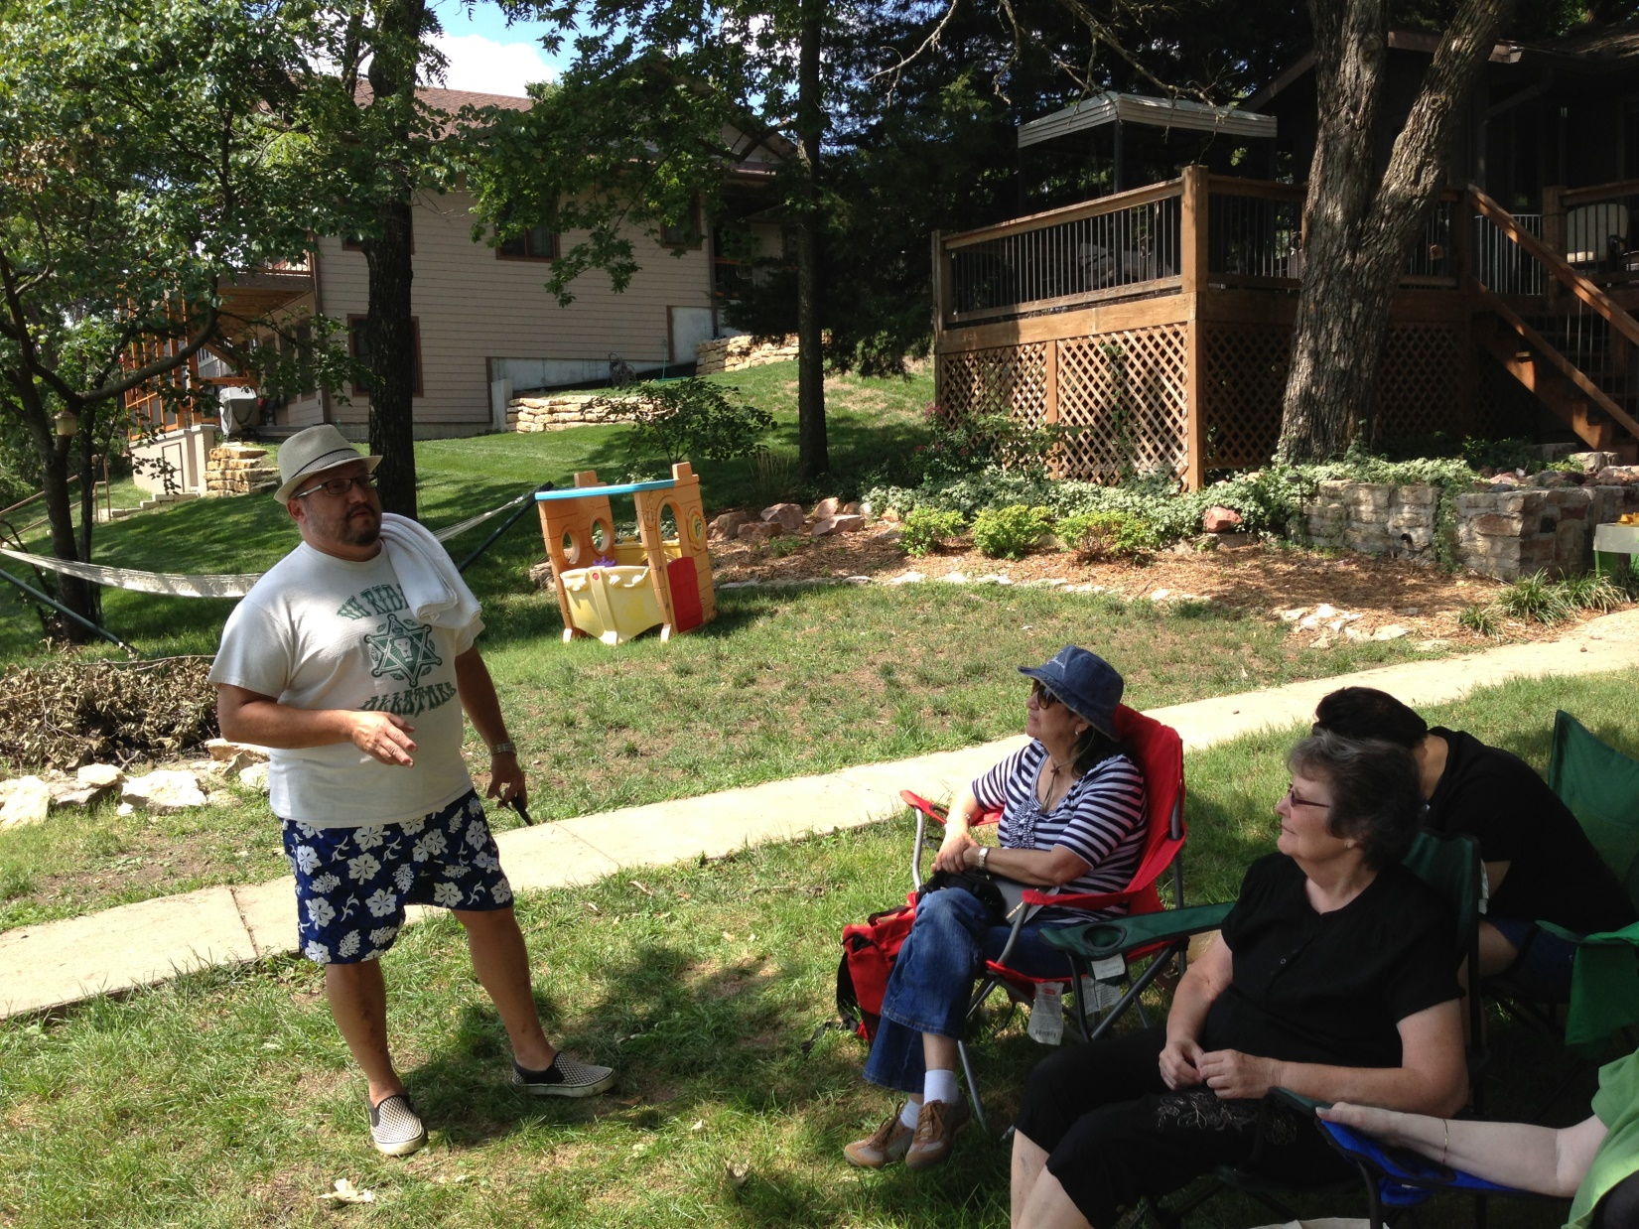
Notes:
Each person has a little time to share their testimony.

Slide 49
It is customary to immerse fully - covering every strand of hair with water - a total of three times.
We don’t dunk you, just provide a handhold so no one lost in the lake.
Notes:
http://www.mayyimhayyim.org/Using-the-Mikveh/Immersion-in-the-Mikveh

Slide 50
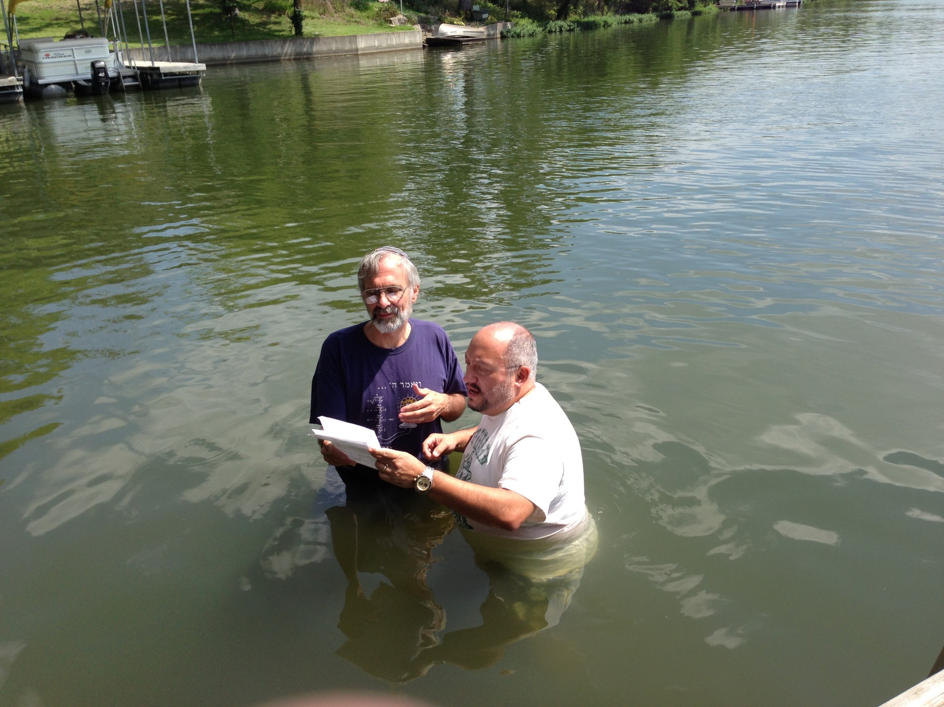

Slide 51
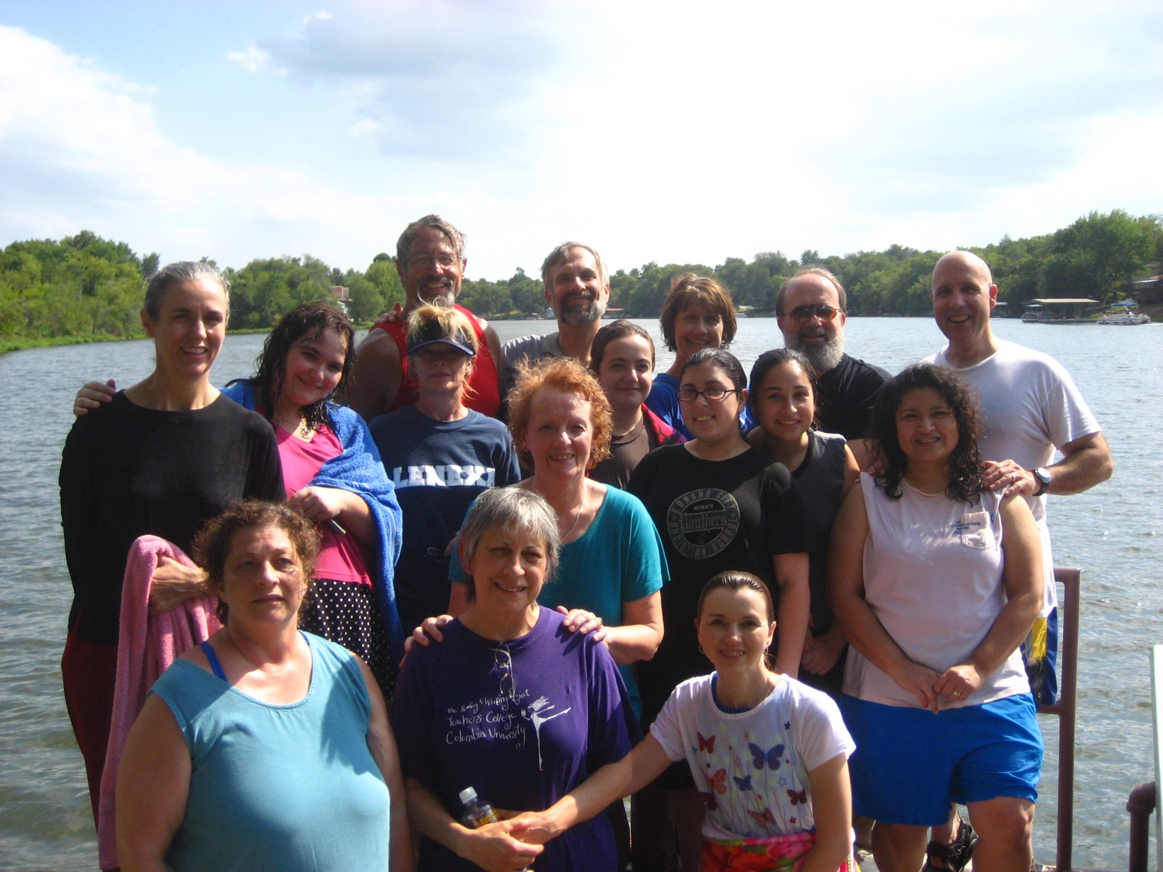
2007
Notes:
2007

Slide 52
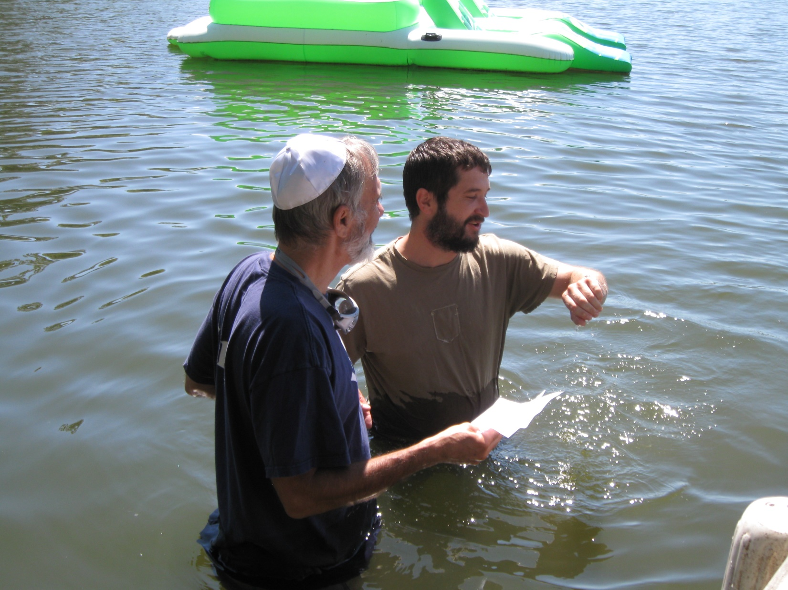

Slide 53
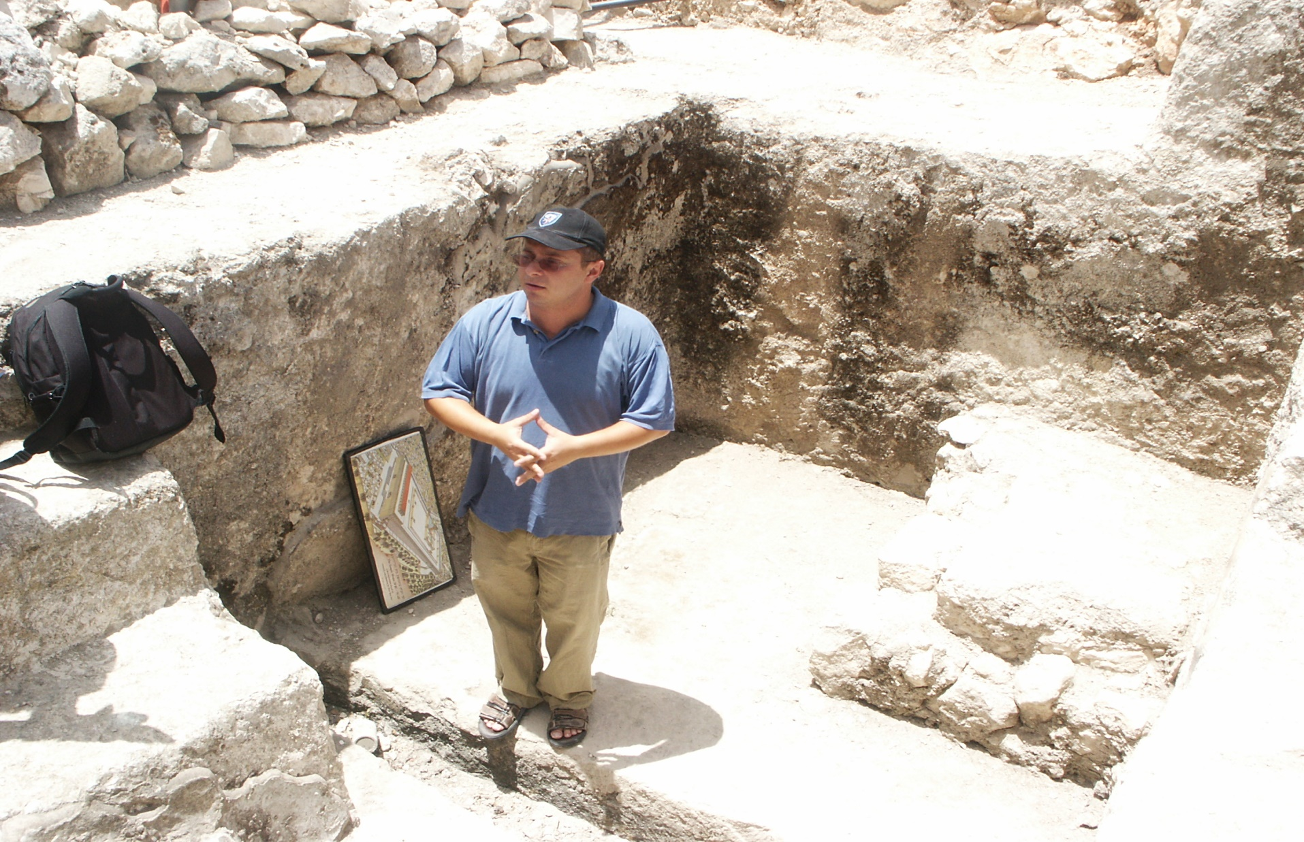
Notes:
On the street immediately west of the Temple Mount.

Slide 54
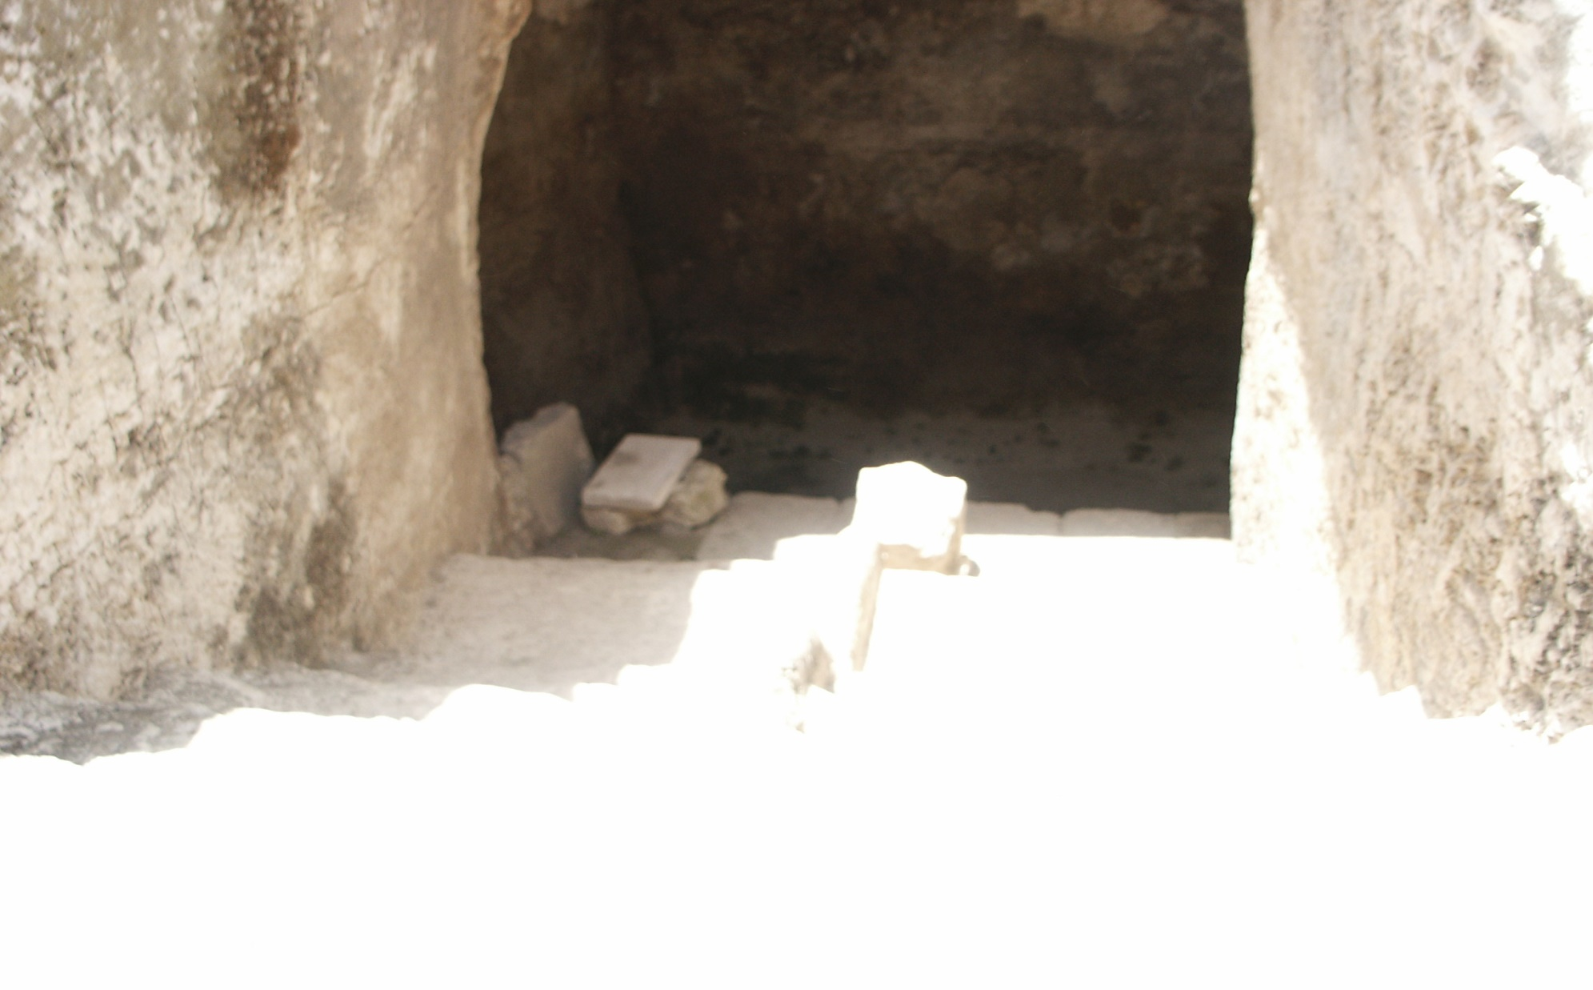
Notes:
Steps going down, and no touchy steps going up, not to be contaminated.

Slide 55
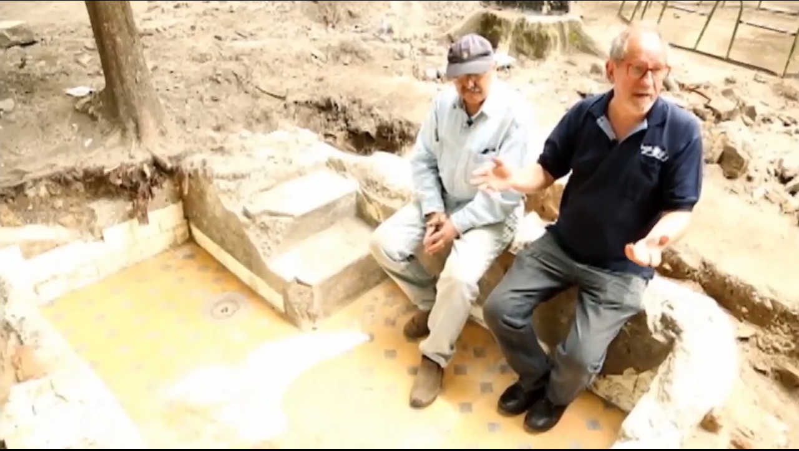
Ritual bath destroyed by Nazis uncovered in Vilnius, Lithuania
Notes:
10 reasons in scripture to go to mikveh

Slide 56
The Torah requires full immersion after
Normal emissions of semen, whether from sexual activity, or from nocturnal emission. in order that one should be allowed to consume from a heave offering or sacrifice; while Ezra instituted that one should also do so in order to be allowed to recite words of Torah.
after Zav/Zavah^{[20]} — abnormal discharges of body fluids
after Tzaraath^{[21]} — certain skin condition(s).
by anyone who came into contact with someone suffering from Zav/Zavah,
or into contact with someone still in Niddah(normal menstruation), or who comes into contact with articles that have been used or sat upon by such person, or the woman herself at the end of Niddah.
by a Kohen who is being consecrated^{[24]}
by the Kohen Gadol on Yom Kippur, after sending away the goat to Azazel, and by the man who leads away the goat^{[25]}
by the Kohen who performed the Red Heifer ritual^{[26]}
after contact with a corpse or grave,^{[27]} in addition to having the ashes of the Red heifer ritual sprinkled upon them
after eating meat from an animal that died naturally^{[28]}
Notes:
https://en.wikipedia.org/wiki/Mikveh
Leviticus 15:16
Leviticus 15:13
Leviticus 14:6-9
Leviticus 15:5-10
Leviticus 15:19-27
Exodus 29:4, Exodus 40:12
Leviticus 16:24, 16:26, 16:28
Numbers 19:7-8
Numbers 19:19
Leviticus 17:15
Modern Orthodox Judaism has several times /conditions for immersion:

Slide 57
Immersion in a mikveh is obligatory in contemporary Orthodox Jewish practice in the following circumstances:
Women
  Following the niddah period after menstruation, prior to resuming marital relations
  Following the niddah period after childbirth, prior to resuming marital relations
  By a bride, before her wedding
Either gender
  As part of a conversion to Judaism
Immersion of utensils acquired from a gentile
Customary immersion in Orthodox Judaism[edit]
Immersion in a mikveh is customary in contemporary Orthodox Jewish practice in the following circumstances:
Men
  By a bridegroom, on the day of his wedding, according to the custom of some communities
  By a father, prior to the circumcision of his son, according to the custom of some communities^{[which?]}
  By a kohen prior to a service in which he will recite the priestly blessing, according to the custom of some communities
  Before Yom Kippur, according to the custom of some communities
  Before a Jewish holiday, according to the custom of some communities
  Weekly before Shabbat, under Hasidic and Haredi customs
Notes:
https://en.wikipedia.org/wiki/Mikveh
Yokhanan the Immerser gave mikveh whole new meaning of REPENTANCE
Shaul/Paul furthered the meaning of repentance/new life.

Slide 58
^{Ro 6.3-5} Those of us who have been immersed into the Messiah Yeshua have been immersed into his death? Through immersion into his death we were buried with him; so that just as, through the glory of the Father, the Messiah was raised from the

Slide 59
^{Ro 6.3-5} the dead, likewise we too might live a new life. For if we have been united with him in a death like his, we will also be united with him in a resurrection like his.
Notes:
Not saying that one water immersion will do it. But, symbol of continual transformation.

Slide 60
בָּרוּךְ אַתָּה יְיָ, אֶלהֵנוּ מֶלֶךְ הָעוֹלָם, אֲשֶׁר קִדְשָׁנוּ בְּמִצְווֹתָיו, וְצִוָּנוּ עַל הַטְּבִילָה
Ba-rookh A-tah A-do-ni, E-lo-hay-noo me-lekh ha-o-lam, a-sher keed-sha-noo b'mitz-vo-tav, v'tsee-va-noo al ha-t'vee-lah.
Blessed are You, Adoni our G-d, king of the Universe, Who sanctifies us with His commandments, and has commanded us concerning the immersion.
Notes:
במים חיים

Slide 61
אֲנִי מַאֲמִין בְּאַב, וּבְבֵן, וּבְרוּחַ הַקּדֶשׁ
Anee ma-a-meen b'av, oo-veh-bayn, oov-roo-akh ha-ko-desh
I believe in the Father, and the Son, and the Holy Spirit.

Slide 62
A brief exclamation
of testimony and praise.
Notes:
She-he-che-yanu:
Baruch ata adonai eloheinu melech ha-olam she-heche-yanu, ve-ki-y'manu, ve-higi-yanu la-z'man ha-zeh.
Blessed are You, Source of all Life, Who has kept us alive and sustained us, and enabled us to reach this day.
Class next week after oneg.

Slide 63
Vision of Yeshua
Vision of Or HaOlam
Diversions
Expressions
Notes:
Enter into it!!!

