Slide 1
To easily follow these notes, log on to our Wifi
Wifi: mycci01
p/w: ancientquail060
Go to OrHaOlam.com
Click on downloads, messages, 2017

Slide 2
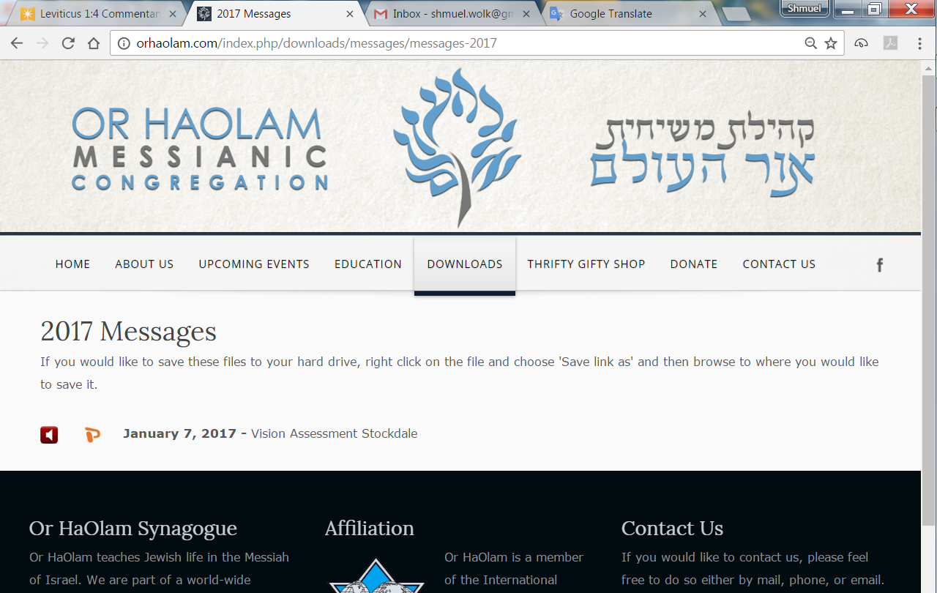

Slide 3
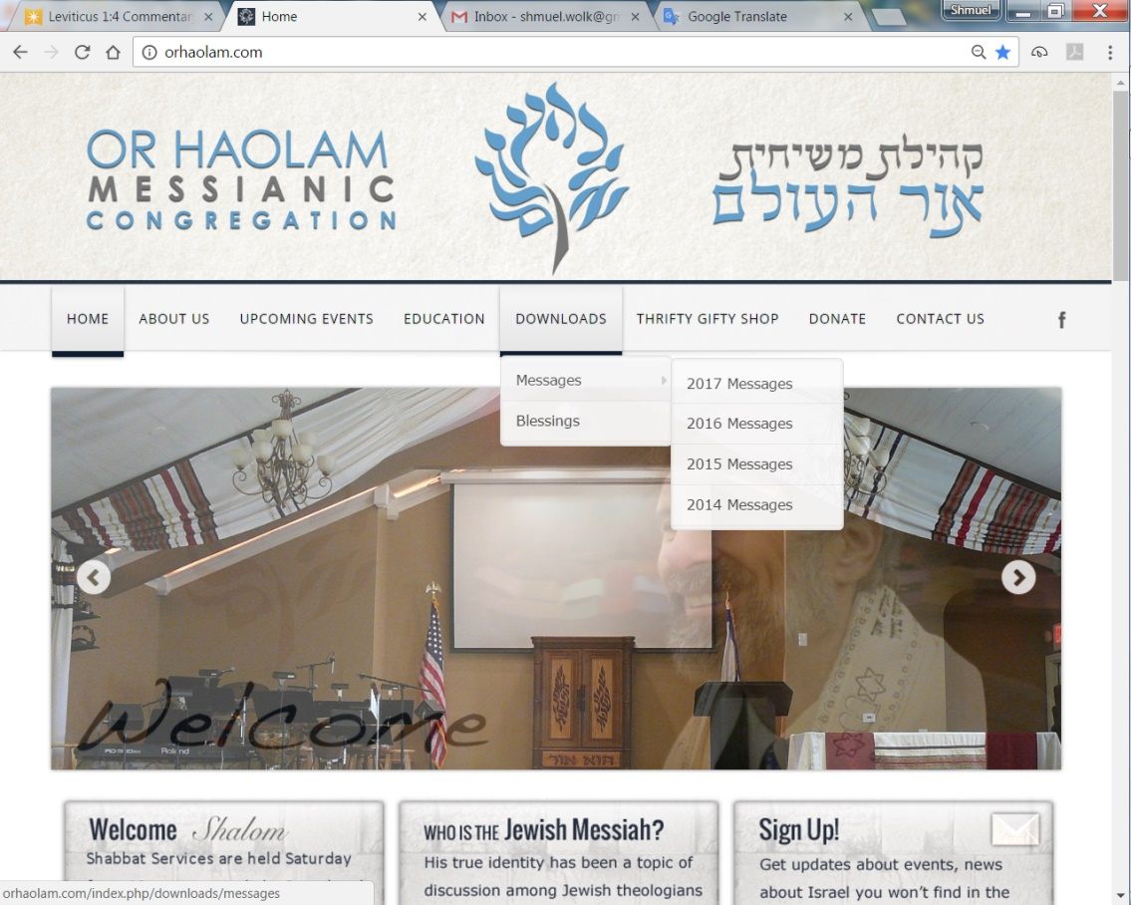
Downloads\messages\
2017 Messages

Slide 4
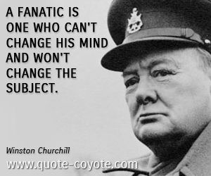
Is there
a time
to be so?

Slide 5
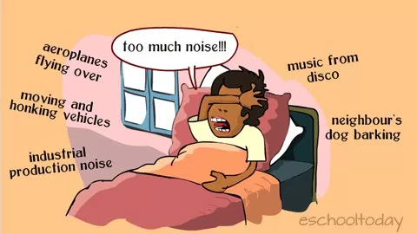
But is there a time for noise?
Notes:
https://www.google.com/search?q=too+noisy&safe=active&tbm=isch&tbs=rimg:Cegex1lMHT5RIjgvlHR4EGydWqamfry8F9cVZs8iEO2DcL7zCWM4qfZlHCTlV8DvMouevU9wdHUo2p9aicw2dlignioSCS-UdHgQbJ1aES5IniajNTg6KhIJpqZ-vLwX1xUROwaBnV_1bxZIqEglmzyIQ7YNwvhFVSlmO2xB_1JCoSCfMJYzip9mUcEWagE_1Vd5FoxKhIJJOVXwO8yi54RDCVnvHbTqH4qEgm9T3B0dSjanxFMwjnBoPLcnCoSCVqJzDZ2WKCeERfcaYmpreIk&tbo=u&sa=X&ved=0ahUKEwjZqb6FnqbWAhVr8IMKHQjBCUcQ9C8IHw&biw=1158&bih=867&dpr=1.1#imgrc=L5R0eBBsnVrX2M:

Slide 6
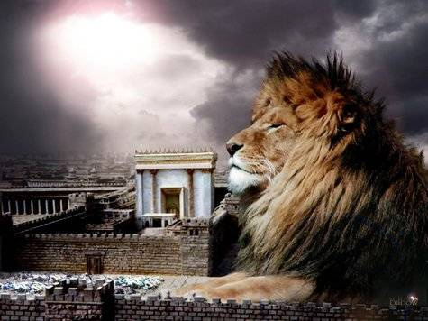
מַתִּתְיָהוּ Mattityahu
(Matthew) 20:29-31
Notes:
Prev: Vision and passion of Yeshua: sacrificial service to impart righteousness.

Slide 7
Mattityahu (Matthew) 20:29
בְּצֵאתָם מִירִיחוֹ הָלְכוּ אַחֲרָיו הֲמוֹן עַם רַב.
^{TLV} Now as they were leaving Jericho, a large crowd followed Him.
הָמוֹן hamon crowd; mob; (literary) tumult, noise
Notes:
Noisy time, apparently, lots commotion.

Slide 8
Mattityahu (Matthew) 20:30
וְהִנֵּה שְׁנֵי עִוְרִים, שֶׁיָּשְׁבוּ בְּצַד הַדֶּרֶך וְשָׁמְעוּ כִּי יֵשׁוּעַ עוֹבֵר, הֵחֵלּוּ לִצְעֹק: "אֲדוֹנֵנוּ בֶּן-דָּוִד, רַחֵם עָלֵינוּ!"
^{TLV} And here two blind men sitting by the roadside, when they heard that Yeshua was passing by, cried out, saying, “Have mercy on us, O Master, Ben-David !”
Notes:
“By the roadside” is an indication of beggars.
Cried out implies vehement, urgency!
Titles of royalty, deity, expression of faith!
Seemed to be desperate to break through commotion of the crowd.
A bit of context, geographically:

Slide 9
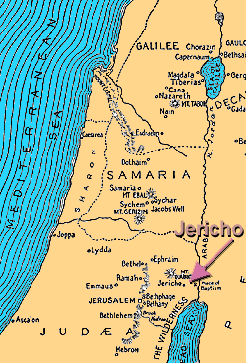
Jericho: 1200’
Below sea level
Jerusalem
2,474′ above sea
Level
3700’ drop in
10 miles
7% grade
Notes:
According to
U. S. Department of Labor Mine Safety and Health Administration Coal Mine Safety and Health Metal and Nonmetal Mine Safety and Health June 1999
Handbook Number PH99-I-4
https://arlweb.msha.gov/READROOM/HANDBOOK/PH99-I-4.pdf
the truck’s speed while descending a 6 percent (effective) grade should not exceed about 20 mph.

Slide 10
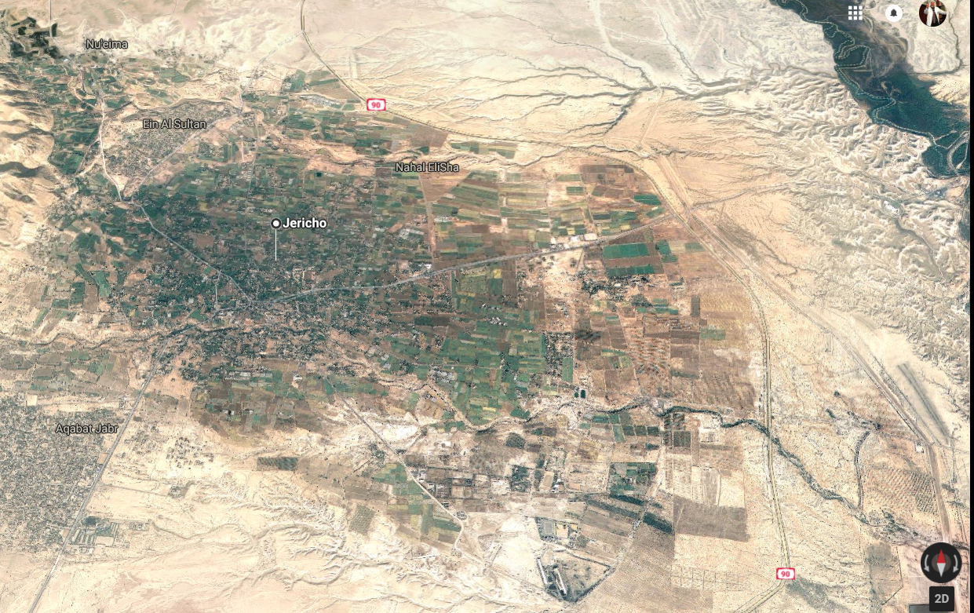
Notes:
Note Jordan River, city center, Elisha’s well

Slide 11
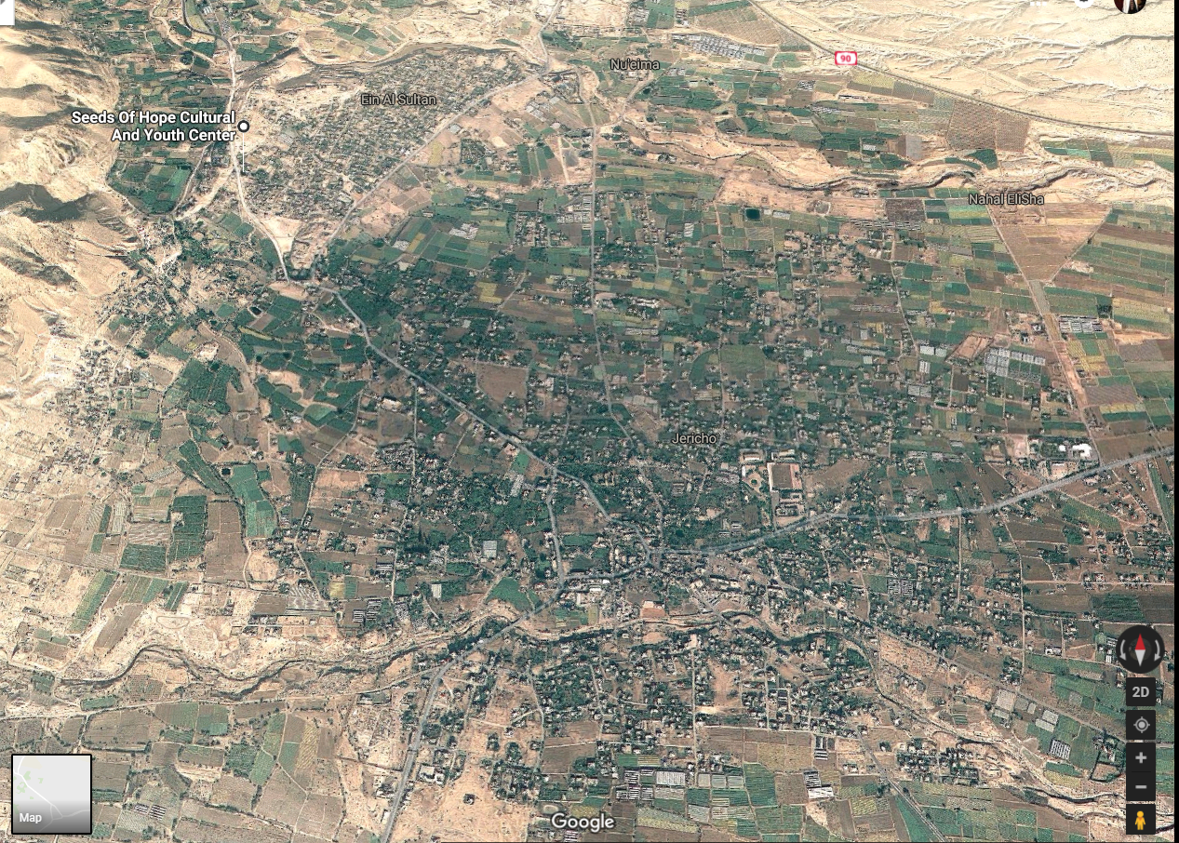
Notes:
Tel Jericho, ancient city with collapsed walls!, Taysir’s school and his friend’s restaurant.
Jericho was a relatively wealthy community with a priestly establishment. Herod’s winter palace was there. In Yeshua’s times Jericho stood some distance to the southeast of the ancient one, and near the opening of the valley of Achor. It was a rich and flourishing town, having a considerable trade, and celebrated for the palm trees which adorned the plain around. “The soil of the plain,” about the middle of which the ancient city stood, “is unsurpassed in fertility; there is abundance of water for irrigation, and many of the old aqueducts are almost perfect … The climate of Jericho is exceedingly hot. http://www.christiananswers.net/dictionary/jericho.html

Slide 12
Mattityahu (Matthew) 20:31
הָעָם גָּעַר בָּהֶם לְהַשְׁתִּיקָם,
The crowd scolded them and told them to be quiet,!"
Notes:
What was the problem?? Beggars, unsightly. Troubling to procession, maybe interfering with Yeshua’s teaching. Slowing down His ascent to Jerusalem estab Kingdom.
Crowd didn’t realize Kingdom based on serving the weakest!

Slide 13
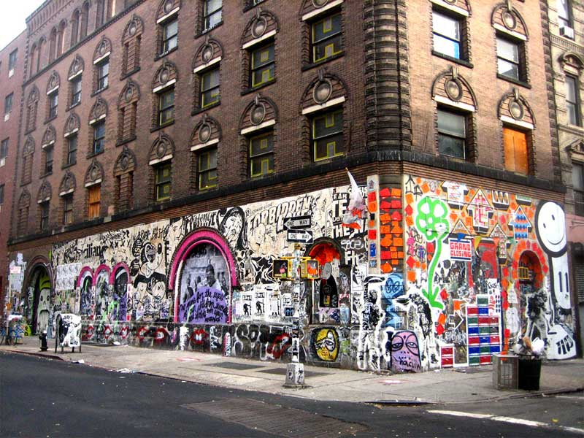
Notes:
Bowery NYC, where [to a 10 year old] scary looking guys would come out of the doorways if you stopped at a light and sort of wash your windshield, then “ask” for money for doing. Beggars with a manipulative edge. Scary. Unkempt.
For years I thought it would be cool to be a contractor climbing scaffolds steam cleaner of buildings elegant architecture.
Tension here: wealthy community, Kingdom in progress,
helpless, needy guys disrupting the setting.

Slide 14
Mattityahu (Matthew) 20:31
אַךְ הֵם צָעֲקוּ בְּיֶתֶר שְׂאֵת: "אֲדוֹנֵנוּ בֶּן-דָּוִד, רַחֵם עָלֵינוּ!"
But they shouted all the louder, "Lord! Son of David! Have pity on us!"
Notes:
CRYING OUT TO G-D. Later v.34 says, “ Filled with tenderness, Yeshua touched their eyes;”
They likely intuited this response already.
Cry out to G-d even in MOST unlikely circumstances.
Similar to the situation of a man only known by about 2 verses in scripture, buried in the genealogies: Yabetz or Jabez. Also had great grief, but emphatically called on Adoni!

Slide 15
^{Divrei HaYamim 1 Chron 4.9-10} Ya'betz was honored more than his brothers; his mother called him Ya'betz, she explained, "because I bore him in pain [Hebrew: 'otzev].
Notes:
Why honored MORE?
Relationship honor and name?

Slide 16
^{1 Chron 4.9 “}His mother called him Ya'betz, because I bore him in pain
וְאִמּוֹ קָרְאָה שְׁמוֹ יַעְבֵּצ יַעְבֵּץ כִּי יָלַדְתִּי בְּעֹצֶב
connection between the name and the word sorrow. ְעֹצֶב
She had to reverse the bet ב and the tsade צ to make the point.
obscured because the tsade goes to final form ץ= צ in the verb
Notes:
Those who know the Hebrew alphabet know mistake needed to explain.
Obetz is not a word. Otzev is a word ‘sorrow’
It’s a little joke. Heard of Prophecy of Jabez. This is the guy. Yabetz

Slide 17
We don’t know what sorrow was.
Traumatic birth delivery
Abandonment, death of father
Illness, congenital disability
Financial straits
A name any boy would love to hate. Yabetz, sorrow misspelled.
Notes:
Hebrew names are prophetic destiny:
Yosef [He will add],
Shlomo [peaceful],
Daveed [beloved],
Mahlon [sickly]
Imagine your name is SORROW, in pun form. As if called ‘Rowsor” Not a word. Yabetz is NOT a Hebrew word. Just a pun.
Kind of a lifelong mean joke.
What did he do? Only one thing known.
Cried out to G-d.

Slide 18
^{Divrei HaYamim 1 Chron 4.9-10} Ya'betz called on the God of Isra'el: "Please bless me by enlarging my territory.
אִם-בָּרֵךְ תְּבָרְכֵנִי וְהִרְבִּיתָ אֶת-גְּבוּלִי
Notes:
Doubled verb → urgency, emphasis
Not obvious doubling כי final form of letter.
P 22 Wilkinson: bless me a lot!
26 unopened boxes in vision! 33 pick an island!
Unspecified…but a lot >> his name/destiny. Moshe: show me your glory.
Enlarge my borders! Too full already? Prayed for years for College & Career → SSoF, for marriage class, for a cantor increased liturgy, for a building. For my kids…
What are your needs, hurts, wants, deficiencies?
Cry out! TEEROSH, COUPLE, PRIVATE PRAYER!!

Slide 19
^{Divrei HaYamim 1 Chron 4.9-10} May your hand be with me! Keep me from evil, so that it will not cause me pain [Hebrew: 'atzbi]."
וְעָשִׂיתָ מֵּרָעָה, לְבִלְתִּי עָצְבִּי
God granted his request…
Filled with tenderness, Yeshua touched their eyes;
Notes:
W64, 66 NEVER says resist temptation. Flee!
Joseph strategy: NEVER be alone with a member of the opposite gender. Even private email if married.
I had one incident like that right here in this sanctuary. I was ready to flee.

Slide 20
Yeshua stopped, called them and said, “What do you want me to do for you?” They said to him, “Lord, open our eyes.”
They cried out → had Messiah’s attention. Request.
Mattityahu (Matthew) 20:32-34
Notes:
That’s the theme: Cry out to G.

Slide 21
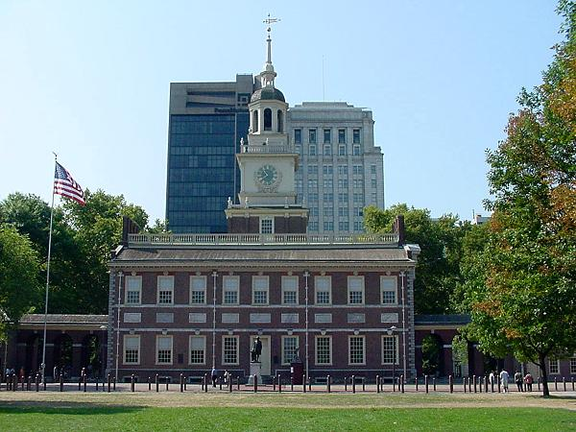
Independence Hall, Phila.

Slide 22
In Philadelphia at what we now call Independence Hall, fifty-five delegates from twelve states assembled on May 25, 1787 to determine the government of the newly independent nation.
Notes:
Rev. Pierre Bynum Chaplain & National Prayer Director Email: pbynum@frc.org
Family Research Council 801 G Street, NW Washington, DC 20001 Phone: 202-393-2100
Web: www.frc.org
Cornwallis surrender October 19, 1781, at Yorktown, Virginia, end of Revolution.

Slide 23
Delegate Edmund Jennings Randolph of Virginia offered the Virginia Plan, which favored the larger states. Delegates from the smaller states favored the rival plan offered by delegate William Patterson of New Jersey.
Notes:
Rev. Pierre Bynum Chaplain & National Prayer Director Email: pbynum@frc.org
Family Research Council 801 G Street, NW Washington, DC 20001 Phone: 202-393-2100
Web: www.frc.org

Slide 24
Roger Sherman of Connecticut offered a compromise, but it too failed on its first hearing. Even among these professing Christians, common ground was difficult to find when it came to what form our government should take.
Notes:
Rev. Pierre Bynum Chaplain & National Prayer Director Email: pbynum@frc.org
Family Research Council 801 G Street, NW Washington, DC 20001 Phone: 202-393-2100
Web: www.frc.org

Slide 25
With the Convention going badly and some delegates on the verge of leaving in disgust, the elder statesman Ben Franklin rose to address the remaining delegates on June 28th.
Notes:
Rev. Pierre Bynum Chaplain & National Prayer Director Email: pbynum@frc.org
Family Research Council 801 G Street, NW Washington, DC 20001 Phone: 202-393-2100
Web: www.frc.org

Slide 26
"We have been assured, Sir, in the Sacred Writings, that "except the Lord build the House, they labor in vain that build it." [Psalm 127:1a] I firmly believe this; and I also believe that without his concurring aid we shall succeed in this political building no better than the Builders of Babel [Gen. 11:1-9].
Notes:
Rev. Pierre Bynum Chaplain & National Prayer Director Email: pbynum@frc.org
Family Research Council 801 G Street, NW Washington, DC 20001 Phone: 202-393-2100
Web: www.frc.org

Slide 27
We shall be divided by our partial local interests; our projects will be confounded, and we ourselves shall become a reproach and bye word down to future ages [Deut. 28:37; Jer. 24:9].
Notes:
Rev. Pierre Bynum Chaplain & National Prayer Director Email: pbynum@frc.org Family Research Council 801 G Street, NW Washington, DC 20001 Phone: 202-393-2100 Fax: 202-393-2134 Web: www.frc.org

Slide 28
"I therefore beg leave to move that henceforth prayers imploring the assistance of Heaven and its blessing on our deliberations,
Notes:
Rev. Pierre Bynum
Chaplain & National Prayer Director
Email: pbynum@frc.org
Family Research Council
801 G Street, NW
Washington, DC 20001
Phone: 202-393-2100
Fax: 202-393-2134
Web: www.frc.org

Slide 29
be held in this Assembly every morning before we proceed to business, and that one or more of the clergy of this city be requested to officiate in that service."
Notes:
Rev. Pierre Bynum
Chaplain & National Prayer Director
Email: pbynum@frc.org
Family Research Council
801 G Street, NW
Washington, DC 20001
Phone: 202-393-2100
Fax: 202-393-2134
Web: www.frc.org

Slide 30
Delegate Dayton of New Jersey reported that: "We assembled again; and ... every unfriendly feeling had been expelled, and a spirit of conciliation had been cultivated." While some difficulties continued to arise before the conclusion of the Convention's business in September,

Slide 31
the delegates apparently never returned to the fruitless bickering that had existed prior to June 28th.
It is an exaggeration to say that our Constitutional government was the result of a prayer meeting in Philadelphia, but Dr. Franklin's call for prayer did play a critical role.
Notes:
So, similarly…

Slide 32
On September 17, 1787, the Constitution drafted by the convention's delegates to replace the Articles was adopted and signed. Tomorrow is the 230th Anniversary of adoption of the U.S. Constitution.
Notes:
Rev. Pierre Bynum Chaplain & National Prayer Director Email: pbynum@frc.org
Family Research Council 801 G Street, NW Washington, DC 20001 Phone: 202-393-2100
Web: www.frc.org

Slide 33
That’s what I teach about marriage conflict, and life in general: Individual and couple prayer doesn’t solve all the problems, but it changes the atmosphere, so that problems can be worked out.

Slide 34
Yeshua stopped, called them and said, “What do you want me to do for you?” They said to him, “Lord, open our eyes.” Filled with tenderness, Yeshua touched their eyes; and instantly they received their sight and followed him.
Mattityahu (Matthew) 20:32-34

Slide 35
The name of our synagogue is Light of the World
We have the worlds coolest Ner Tamid Eternal Light
Soon we’ll have a lighted flaming burning bush logo out front.

Slide 36
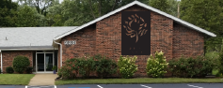
Stainless steel sheet and
colored, backlit logo and words

Slide 37
^{Yn 9.5} I am the Light of the World
^{Mtt 5.14} You are the light of the world.
How? Cry out to G-d!
Private prayer daily
Couple / family prayer
Corporate prayer
Notes:
My passion, fire in my belly…

Slide 38
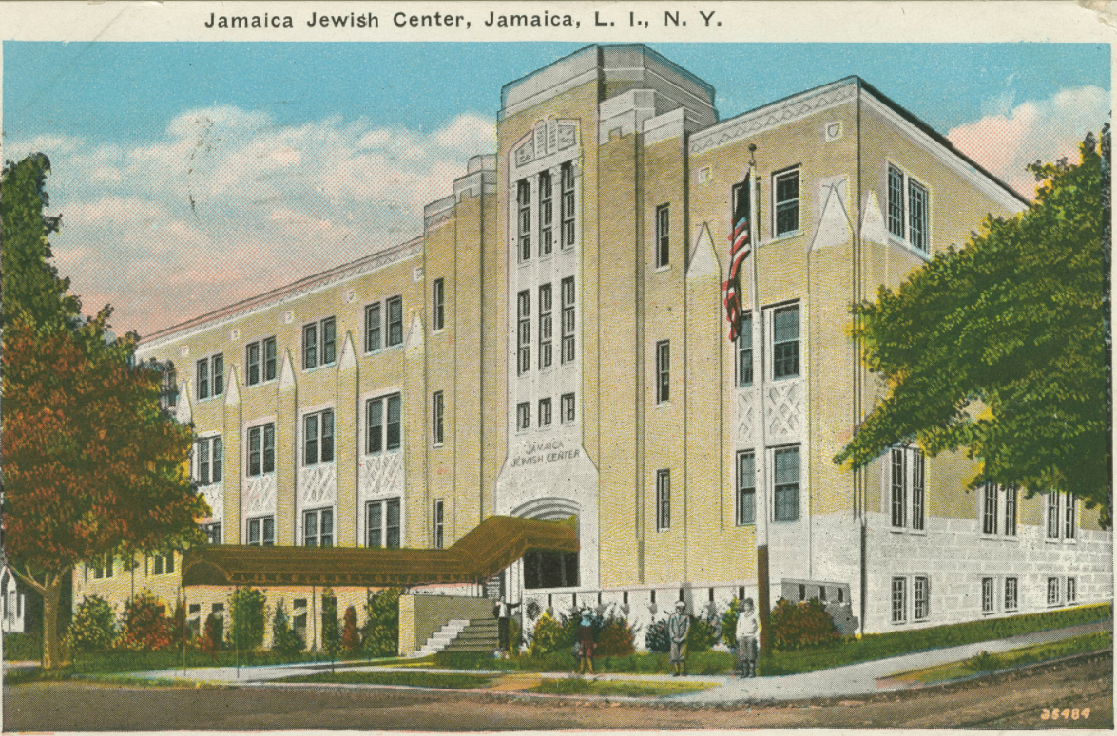
Notes:
http://lcdl.library.cofc.edu/lcdl/catalog/lcdl:63887 Date: 1933
Jamaica Jewish Center, Jamaica, NY
Where I was Bar Mitzvahed 1962.
Gym, bowling alley with pin boys, swimming pool
Rabbi Gershon Levi, served as rabbi of the Jamaica Jewish Center, Jamaica, N.Y., from 1947 to 1972, signed my Bar Mitzvah certificate
Lined up for Hebrew school at far doorway,
principal with Auschwitz # on forearm.
First ever heard the enchantment of the Kol Nidre

Slide 39
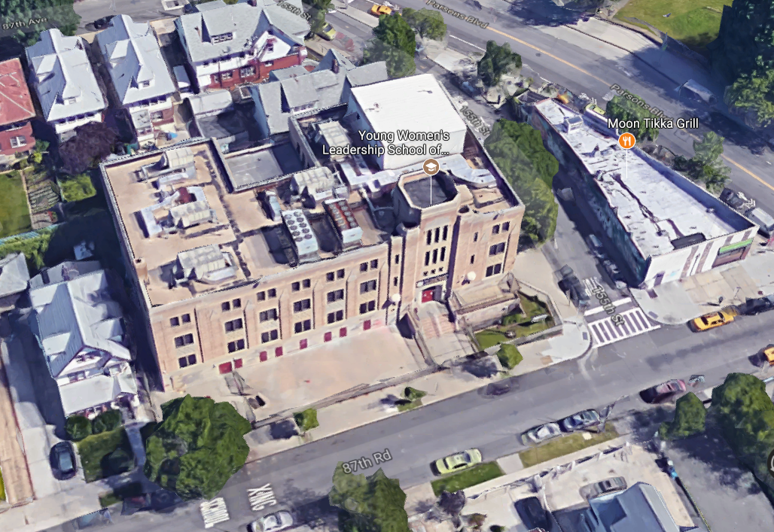
Notes:
Google earth:
Now closed as a Temple
and used as Young Women’s Leadership School of Queens plus health center.

Slide 40
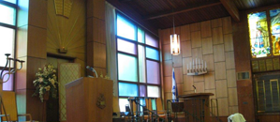
Temple Shalom Westbury, NY
Rabbi Aronoff
Notes:
Tenth grade moved from NYC to suburbs. This was the sanctuary where I sat and wondered along the lines of what was the meaning of life, and what was the source of all this elegant symbolic construction, siddur, symbolism, Aron, Torah, Ner Tamid, Menorah. Why do it? What was it really about? Enamoring, engaging, but mystery.
In this sanctuary, after coming to Yeshua, I first heard [again] the Shmoneh Esray line about G-d who raises the dead. מחיה מתים

Slide 41
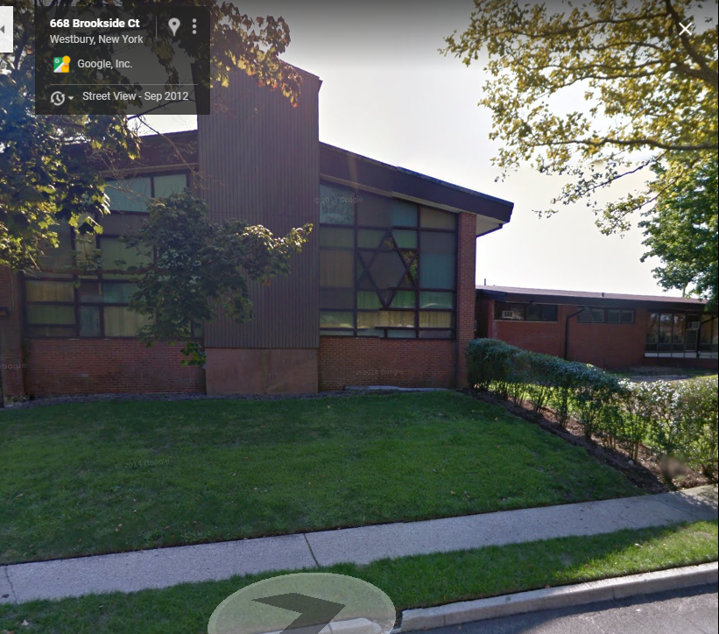
Temple Shalom Westbury, NY
Notes:
When I was considering the claims of Yeshua, I went to seem Rabbi Aronoff. Walked down the sidewalk at back right to entrance.
“What is the meaning of life according to Judaism?”
“To some, life has to have a meaning. To others, to go to work, raise your family, that’s enough.”
My passion, why I build this cong. and life, Fire in my belly:
Have this Jewish identity empowered, energized, aflame in the Resurrection LIFE of Messiah.
You may say, I’m not Jewish. What does this have to do with me?

Slide 42
^{Yeshayahu/Is 2.2-4} This is the word that Yesha‘yahu the son of Amotz saw concerning Y’hudah and Yerushalayim: In the acharit-hayamim [end of days] the mountain of Adoni’s house
will be established as the most important mountain.

Slide 43
^{Yeshayahu/Is 2.2-4} It will be regarded more highly than the other hills, and all the Nations will stream there. Many peoples will go and say, “Come, let’s go up to the mountain of Adoni, to the house of the God of Ya‘akov! He will teach us about his ways,

Slide 44
^{Yeshayahu/Is 2.2-4} and we will walk in his paths.” For out of Tziyon will go forth Torah, the word of Adoni from Yerushalayim. He will judge between the nations and arbitrate for many peoples.

Slide 45
^{Yeshayahu/Is 2.2-4} Then they will hammer their swords into plow-blades and their spears into pruning-knives; nations will not raise swords at each other,
and they will no longer learn war.

Slide 46
^{Yeshayahu/Is. 62. 6-7} On your walls, Jerusalem, I have set watchmen. All day and all night, they will never hold their peace. “You who remind Adoni, take no rest for yourselves, and give Him no rest until He establishes and makes Jerusalem a praise in the earth.”
Notes:
Jewish revival is key to world revival. Avner Boskey book.

Slide 47
^{Yn 9.5} I am the Light of the World
^{Mtt 5.14} You are the light of the world.
How? Cry out to G-d!
Private prayer daily
Couple / family prayer
Corporate prayer
Notes:
Let’s make our Ner Tamid, our logo emblems of King Messiah’s power in our lives, families, communities!

