Slide 1
To easily follow these notes, log on to our Wifi
Wifi: mycci01 p/w: ancientquail060
Go to OrHaOlam.com
Click on downloads, messages, 2017

Slide 2
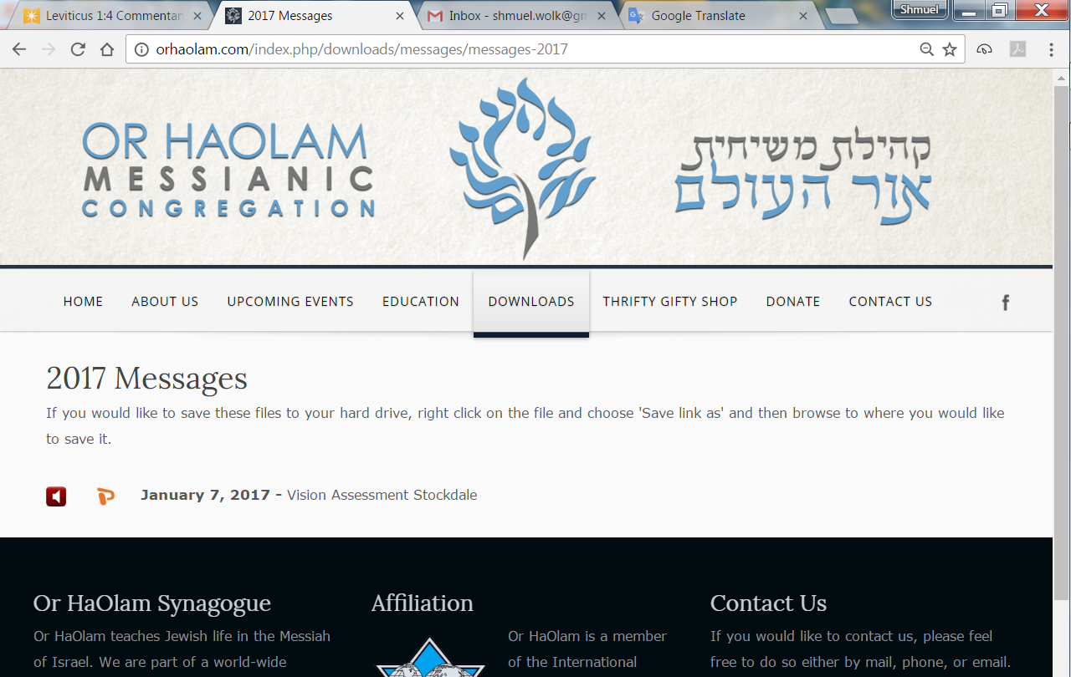

Slide 3
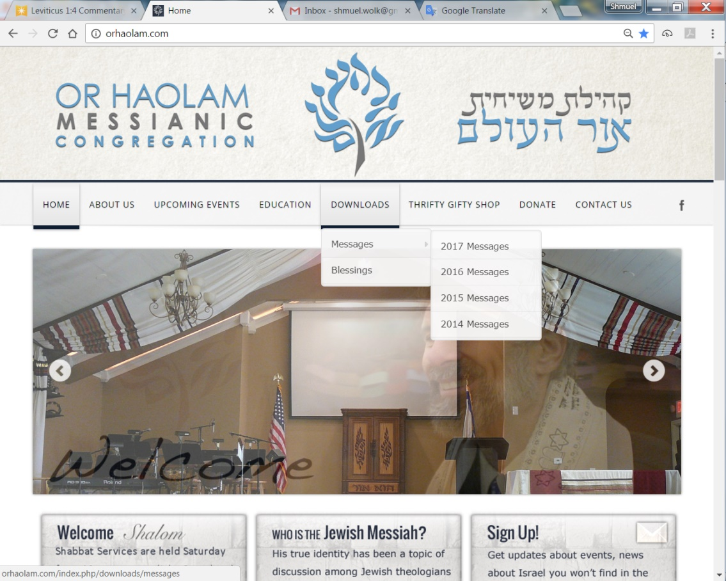
Downloads\messages\
2017 Messages

Slide 4
We have entered 5778
Shana Tovah שָׁנָה טוֹבָה
[Have a] Good Year
שָׁנָה טוֹבָה וּמְתוּקָה
Shana Tova oo-m’tukah
[Have a] Good and sweet year
Notes:
Lets practice together.
There are several variant forms, but this is the simplest and clearest. And scriptural.

Slide 5
Rosh Hashanah רֹאשׁ הַשָּׁנָה‎‎, literally "head [of] the year"
Why that name?

Slide 6
The historian Josephus, and the ancient Aramaic translation of the Bible, the Targum Jonathan, identify Rosh HaShanah as the New Year observed by the people of Israel before the holiday of Passover was instituted.
Notes:
Encyclopaedia Judaica

Slide 7
The traditional Jewish concept is that the world, Adam and Khava/Eve, were created on Rosh HaShanah, so this day is indeed the beginning of the year chronologically.
Birthday of the world!
Notes:
https://en.wikipedia.org/wiki/Rosh_Hashanah
Definitely for young earthers. True in a spiritual sense in any case.

Slide 8
The Babylonian name Tishri seems to derive from the root Ugaritic or Akkadian seru, which means "to begin." The ancient Semitic peoples thought of the year as beginning in the autumn, at the time of the late harvest. This was the beginning of the economic year, when crops began to be sold.
Notes:
School year too, probably based on agricultural cycle.

Slide 9
G-d made a spiritual cycle to start on Pesakh, but the chronological year didn't change. So, Jews have two [actually more] new years, a chronological one, and a spiritual one. Passover is described in these terms.

Slide 10
^{Shmot/Ex. 12:1-2} Now Adoni said
to Moses and Aaron in the land of Egypt, "This month shall be the beginning of months for you; it is to be the first month of the year to you." NASU
So, it’s scripturally OK to call this holiday Rosh HaShanah!

Slide 11
Contemplate and Celebrate what is new and exciting…
in the last 12 months…New things!
Notes:
There are amazing things happening in this day, from man, and from G-d!!

Slide 12
NEW Breakthrough
Technologies
Reversing Paralysis
wirelessly connecting the brain-reading technology directly to electrical stimulators on the body, creating what is called a “neural bypass” so that people’s thoughts can again move their limbs.
Notes:
https://www.technologyreview.com/lists/technologies/2017/

Slide 13
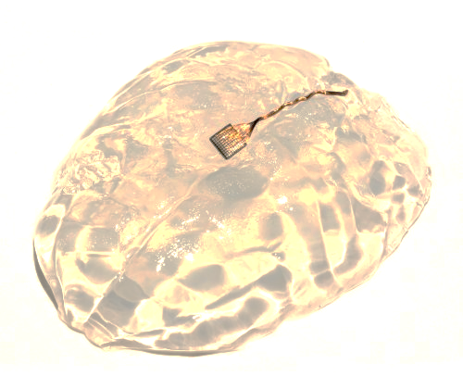
Notes:
https://www.technologyreview.com/lists/technologies/2017/

Slide 14
Monkey with severed spinal cord
And wireless transmitter/receiver
Notes:
https://www.technologyreview.com/lists/technologies/2017/

Slide 15
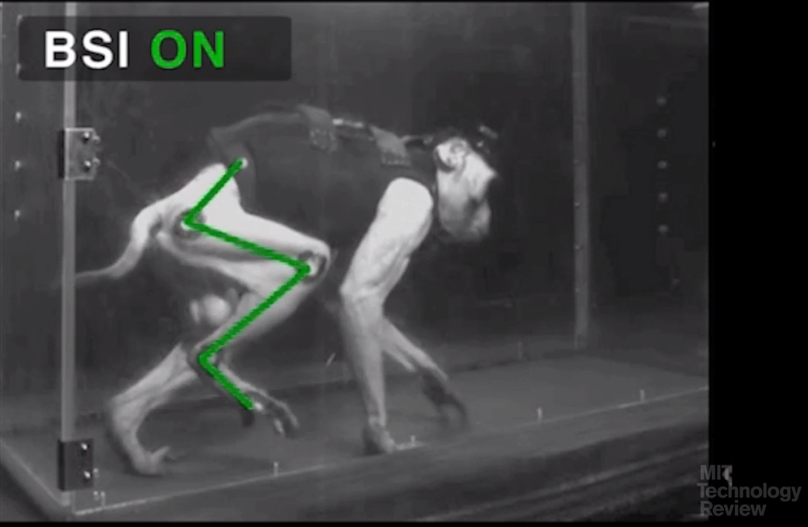
Notes:
https://www.technologyreview.com/lists/technologies/2017/

Slide 16
Notes:
https://www.technologyreview.com/lists/technologies/2017/
In this video made by EPFL researchers, a monkey with a spinal cord injury that paralyzed its right leg is able to walk again.
Hypothetically, one could control anything by their thoughts!!

Slide 17
2. Quantum computers could be exponentially faster at running artificial-intelligence programs and handling complex simulations and scheduling problems. They could even create uncrackable encryption.
Notes:
https://www.technologyreview.com/lists/technologies/2017/

Slide 18
At the heart of quantum computing is the quantum bit, or qubit, a basic unit of information analogous to the zeros and ones represented by transistors in your computer.
Notes:
https://www.technologyreview.com/lists/technologies/2017/

Slide 19
3. IoT Internet of Things
connecting any device with an on and off switch to the Internet (and/or to each other). This includes everything from cellphones, coffee makers, washing machines, headphones, lamps, wearable devices and almost anything else you can think of.
Notes:
https://www.forbes.com/sites/jacobmorgan/2014/05/13/simple-explanation-internet-things-that-anyone-can-understand/#78853bd31d09

Slide 20
Say for example you are on your way to a meeting; your car could have access to your calendar and already know the best route to take. If the traffic is heavy your car might send a text to the other party notifying them that you will be late.
Notes:
https://www.forbes.com/sites/jacobmorgan/2014/05/13/simple-explanation-internet-things-that-anyone-can-understand/#78853bd31d09

Slide 21
What if your alarm clock wakes up you at 6 a.m. and then notifies your coffee maker to start brewing coffee for you? What if your office equipment knew when it was running low on supplies and automatically re-ordered more?
Notes:
https://www.forbes.com/sites/jacobmorgan/2014/05/13/simple-explanation-internet-things-that-anyone-can-understand/#78853bd31d09

Slide 22
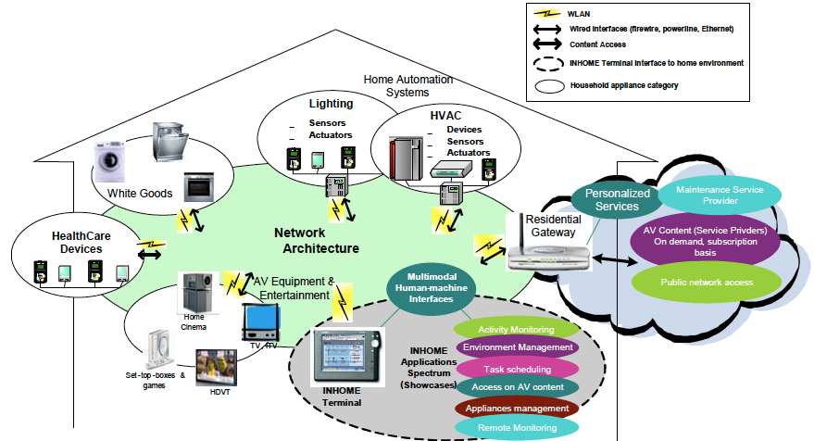
Notes:
http://www.thebookmyproject.com/cars/relay-selection-for-geographical-forwarding-in-sleep-wake-cycling-wireless-sensor-networks/

Slide 23
G-d Gives New Things
Better new things!!

Slide 24
#1 ^{Yermiyahu /Jer 21.22} For Adoni has created a new thing on earth: a woman surrounds a man.
כִּי בָרָא יְי חֲדָשָׁה בָּאָרֶץ נְקֵבָה תְּסוֹבֵב גָּבֶר סוֹבֵב to spin ; to surround, to encircle ; (flowery) to wander ; (colloquial) to wrap, to bind
Notes:
This is the amazing Messianic prophecy that precipitated this message

Slide 25
Three enigmatic scriptures resolved by this.

Slide 26
^{Yermihahu/Jer 22:30} This what Adoni says: “List this man as childless; he is a lifetime failure — none of his offspring will succeed, none will sit on David’s throne or rule again in Y’hudah.”
Notes:
Not royal offspring, yet David promised an eternal dynasty. ????

Slide 27
^{Beresheet/Gen 3.15} I will put animosity between you and the woman — between your seed and her seed. He will crush your head, and you will crush his heel.
Several verses with a woman having seed. Gen. 16.10 Hagar
Not a proof, a hint.

Slide 28
^{Yeshayahu/Is 7.14} Therefore Adoni Himself will give you a sign: Behold, the virgin will conceive. When she is giving birth to a son, she will call his name Immanuel.

Slide 29
#1 ^{Yermiyahu /Jer 21.22} For Adoni has created a new thing on earth: a woman surrounds a man.
כִּי בָרָא יְי חֲדָשָׁה בָּאָרֶץ נְקֵבָה תְּסוֹבֵב גָּבֶר סוֹבֵב to spin ; to surround, to encircle ; (flowery) to wander ; (colloquial) to wrap, to bind

Slide 30
נְקֵבָה תְּסוֹבֵב גָּבֶרn’kevah t’sovev gever
a woman shall encircle a man.
That is, the context in Jeremiah is “Come back, virgin Isra'el, come back…ADONI has created something new on earth: a woman shall encircle a man”

Slide 31
The new thing is the supernatural conception and birth of the Messiah. Ancient Jewish commentaries say, “this shall be in the time of the Messiah, which will be on the sixth day;'' that is, the sixth millennium,
Notes:
http://www.biblestudytools.com/commentaries/gills-exposition-of-the-bible/jeremiah-31-22.html

Slide 32
And elsewhere "a woman shall compass a man"; says R. Hona, in the name of R. Ame, this is the King Messiah.
Notes:
http://www.biblestudytools.com/commentaries/gills-exposition-of-the-bible/jeremiah-31-22.html

Slide 33
So says R. Joshua ben Levi , “He, that is, God, heals with the same he wounds; so will you find in Israel, they sinned from their virginity and purity, ^{Ezek 23:1-49, Lam 5:1-22 )} ; so he comforts them by a virgin, according to this very scripture;
Notes:
http://www.biblestudytools.com/commentaries/gills-exposition-of-the-bible/jeremiah-31-22.html

Slide 34
"turn again, O virgin of Israel" "a woman shall compass a man". R Huna, in the name of R. Idi and R. Joshua, said, that this man is the King Messiah, of whom it is said, ^{Ps 2:7} “this day have I begotten thee.”
Notes:
http://www.biblestudytools.com/commentaries/gills-exposition-of-the-bible/jeremiah-31-22.html

Slide 35
#1 Summary ^{Yermiyahu /Jer 21.22} For Adoni has created a new thing on earth: a woman surrounds a man.
כִּי בָרָא יְי חֲדָשָׁה בָּאָרֶץ נְקֵבָה תְּסוֹבֵב גָּבֶר
Virgin birth of Messiah
Amazingly creative solution!
Notes:
To
The Curse on Jeconiah
The promise of the seed of a woman defeating HaSatan
The redemption of Israel through the young woman.

Slide 36
#2 New Wine

Slide 37
^{Mishlei/Prov. 3.10} Honor Adoni with your wealth and with the firstfruits of all your income. Then your granaries will be filled and your vats overflow with new wine Teerosh תִירוֹש.
Notes:
A little plug here for our Tuesday Teerosh. Spectacular meeting with G-d! See the spam yesterday?

Slide 38
^{Dvarim/Dt. 33.28-29} So Isra'el lives in security; the fountain of Ya'akov is alone in a land of grain and new wine Teerosh תִירוֹשׁ, where the skies drip with dew. Happy are you, Isra'el! "Who is like you, a people saved by ADONI, your defender?

Slide 39
#3 New Sign
Those of you who were part of Or HaOlam in the days of the Blood Moons know I pooh poohed all the hooplah. This a bit similar, but more interesting.

Slide 40
^{Rev 12.1-2} Now a great sign was seen in heaven — a woman clothed with the sun, under her feet the moon, and on her head a crown of twelve stars. She was pregnant and about to give birth, and she screamed in the agony of labor.

Slide 41
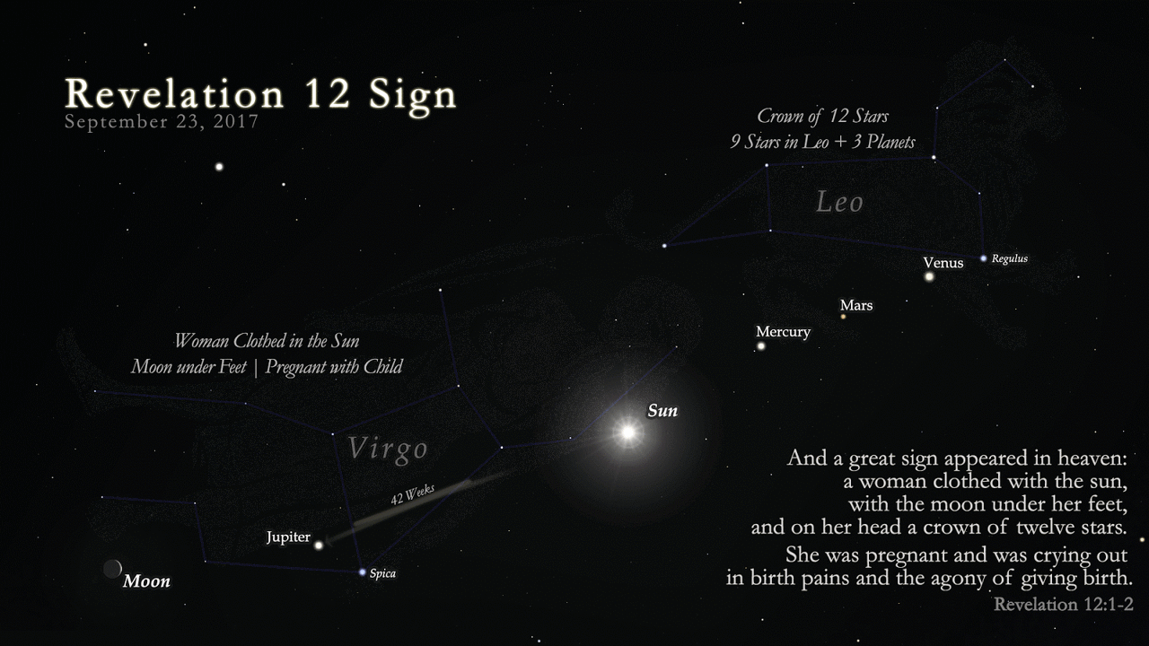
Sept. 23, 2017
Notes:
By Brad - Revelation 12 Daily, <a href="http://creativecommons.org/publicdomain/zero/1.0/deed.en" title="Creative Commons Zero, Public Domain Dedication">CC0</a>, <a href="https://commons.wikimedia.org/w/index.php?curid=60081275">Link</a>
Not so obvious that these stars can be connected to make drawings, but since ancient times…

Slide 42
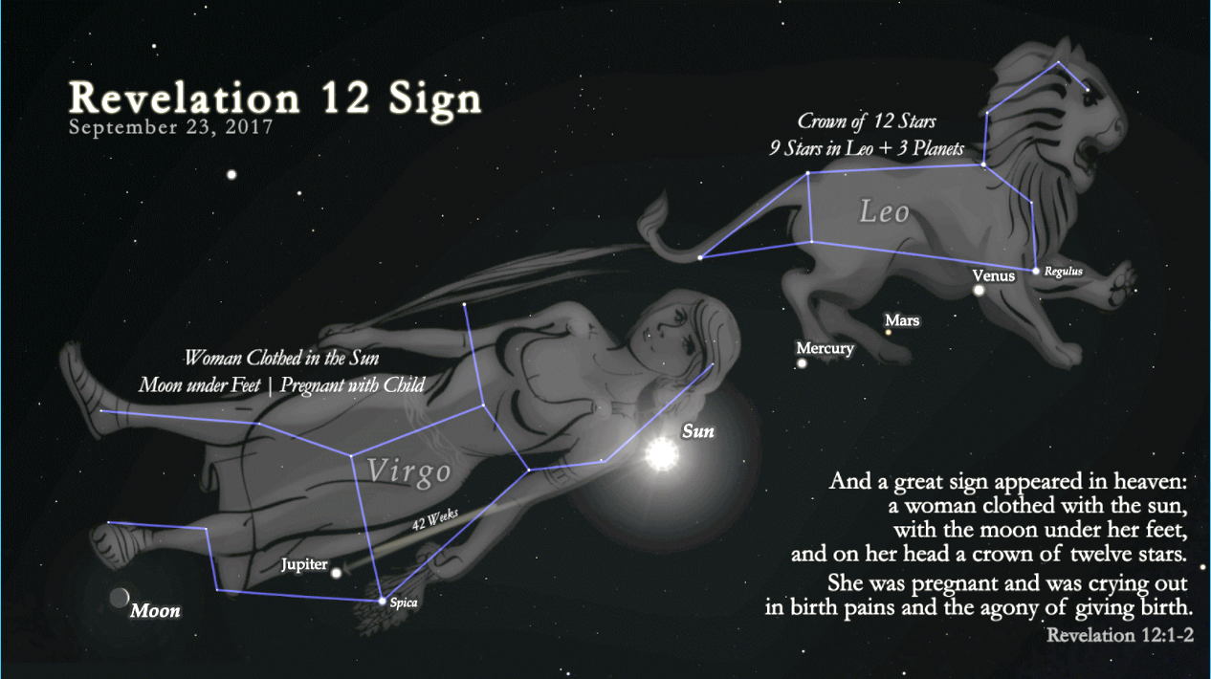
Notes:
Note blue lines. Sort of see a woman. Sort of see a lion.

Slide 43
"was pregnant and cried out in pain as she was about to give birth.“
Some suggest this will be fulfilled because the planet Jupiter [King planet?] will be traversing the constellation after having undergone apparent retrograde motion.
Notes:
https://en.wikipedia.org/wiki/Revelation_12_Sign
(normal gestation periods lasting from 37 to 42 weeks).
Planets generally move to the west relative to the fixed stars. Retrograde motion is the apparent backwards movement of a planet as the earth overtakes an outer planet.

Slide 44
After entering what they perceive to be Virgo's "womb" around November 20, 2016. Jupiter exits the lower part of the "womb" 42 weeks later, which is the approximate length of a human gestation.
Notes:
https://en.wikipedia.org/wiki/Revelation_12_Sign
(normal gestation periods lasting from 37 to 42 weeks).

Slide 45
Notes:
Location of Jupiter in the constellation Virgo.

Slide 46
Notes:
Location of Jupiter in the constellation Virgo.
Moving “backwards” and then forwards relative to normal motion. 42 weeks retrograde motion.

Slide 47
^{Rev 12.5-6} She gave birth to a son, a male child, the one who will rule all the nations with a staff of iron. But her child was snatched up to God and his throne; and she fled into the desert, where she has a place prepared by God so that she can be taken care of for 1,260 days.
Notes:
Gave birth to the Messiah Yeshua. Fast forward

Slide 48
^{Rev 12.13-14} When the dragon saw that he had been hurled down to the earth, he went in pursuit of the woman who had given birth to the male child. But the woman was given the two wings of the great eagle, so that she could

Slide 49
^{Rev 12.13-14} fly to her place in the desert, where she is taken care of for a season and two seasons and half a season.
How this plays out…unknown.
What is known…

Slide 50
Although US President Donald Trump spoke earlier against Iran, US special forces evacuated their military base in southeastern Syria, thus allowing Iranian militias to take control of the region.
Notes:
http://www.jerusalemonline.com/news/world-news/around-the-globe/us-forces-evacuate-base-on-syria-iraq-border-31217

Slide 51
The decision to leave the Al-Zaqaf base, which sits on the border between Syria and Iraq, brings an end to the US effort to prevent Iranian militias from settling in the region. Even earlier
Notes:
http://www.jerusalemonline.com/news/world-news/around-the-globe/us-forces-evacuate-base-on-syria-iraq-border-31217

Slide 52
US forces failed to prevent Assad’s military and Hezbollah from crossing the Euphrates to the east with the help of a Russian backed pontoon bridge.
Notes:
http://www.jerusalemonline.com/news/world-news/around-the-globe/us-forces-evacuate-base-on-syria-iraq-border-31217

Slide 53
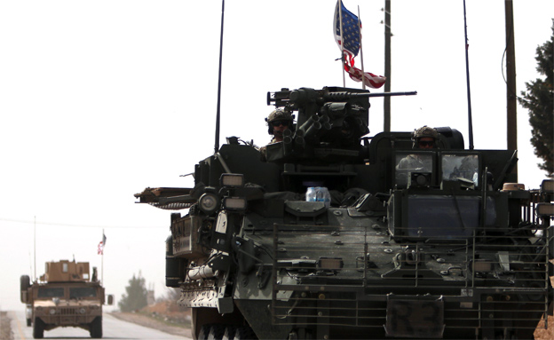
US military forces are evacuating Al-Zaqaf
Notes:
http://www.jerusalemonline.com/news/world-news/around-the-globe/us-forces-evacuate-base-on-syria-iraq-border-31217?utm_source=ActiveCampaign&utm_medium=email&utm_content=Over+200+killed+in+Mexico+City+earthquake%2C+Raqqa+operation+in+final+stages%2C+Sisi+urges+Palestinians+to+accept+Israel+and+more+news+at+JerusalemOnline&utm_campaign=MiddayNewsletter+-+Recurring+2017

Slide 54
As reported last week by JOL, Russia and the US rejected Israel’s request to forbid Iranian militias to settle closer than 60 kilometers (37 miles) from Israel’s border and instead agreed that the militias could be as close as 5 kilometers (3 miles) away from Israel.
Notes:
http://www.jerusalemonline.com/news/world-news/around-the-globe/us-forces-evacuate-base-on-syria-iraq-border-31217

Slide 55
Iran’s effort to strengthen its influence in the Middle East continues, especially in Syria and Lebanon.
Notes:
http://www.jerusalemonline.com/news/world-news/around-the-globe/us-forces-evacuate-base-on-syria-iraq-border-31217

Slide 56
^{Ezek 38} The word of Adonai came to me saying: “Son of man, set your face toward Gog of the land of Magog, chief prince of Meshech and Tubal…Paras [Persia /Iran], Ethiopia and Put [Libya] are with them, all with breastplates and helmets; Gomer with all its troops; the house of Togarmah [Turkey]
Notes:
Ezek 38, invasion of Gog, may be about to happen! Danger, Will Robinson…
You will hear the noise of wars nearby and the news of wars far off; see to it that you don't become frightened. Such things must happen, but the end is yet to come. For peoples will fight each other, nations will fight each other, and there will be famines and earthquakes in various parts of the world; all this is but the beginning of the `birth pains.'

Slide 57
^{Mtt. 24.44} Therefore you too must always be ready, for the Son of Man will come when you are not expecting him.
New thing?
RETURN OF THE KING!

Slide 58
#4 A new command

Slide 59
^{Yn 13.34} “I am giving you a new command: that you keep on loving each other. In the same way that I have loved you, you are also to keep on loving each other.
Notes:
Not really new, just in new standard, new role model. Andy Stanley class on staying married.

Slide 60
#5 New Spirit

Slide 61
^{Yekhezkael/Ezek 38. 24-28} For I will take you from among the nations, gather you from all the countries, and return you to your own soil. Then I will sprinkle clean water on you, and you will be clean; I will cleanse you from all your uncleanness and from all your idols. I will give you a new heart and put a new spirit inside

Slide 62
^{Yekhezkael/Ezek 38. 24-28} you; I will take the stony heart out of your flesh and give you a heart of flesh. I will put my Spirit inside you and cause you to live by my laws, respect my rulings and obey them. You will live in the land I gave to your ancestors. You will be my people, and I will be your God.

Slide 63
^{Eph. 4.21-24} As the truth is in Yeshua …you are to lay aside the old self corrupted by its deceitful desires, be renewed in the spirit of your mind, and put on the new self—created to be like God in true righteousness and holiness.
Notes:
Doesn’t always seem so ideal….Do the work!! Sozo, fellowship, Mens’ meeting, counselor, intercession.

Slide 64
Summary twitter line:
Expect NEW THINGS in your life from Adoni!!

Slide 65
RH creation
Notes:
This is the new Men’s Dance

