Slide 1
To easily follow these notes, log on to our Wifi
Wifi: mycci01
p/w: ancientquail060
Go to OrHaOlam.com
Click on downloads, messages, 2017

Slide 2
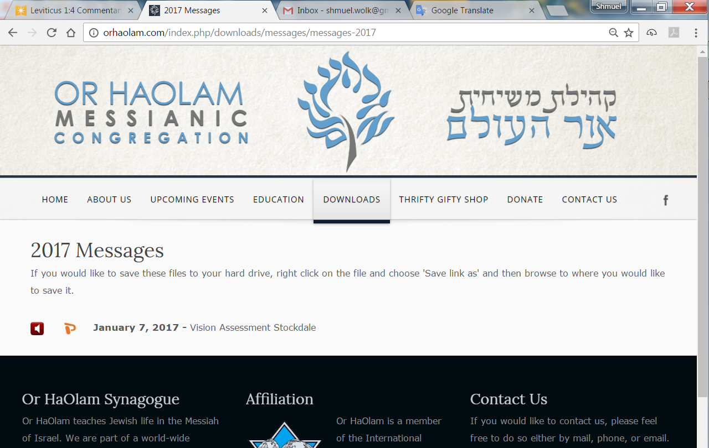

Slide 3
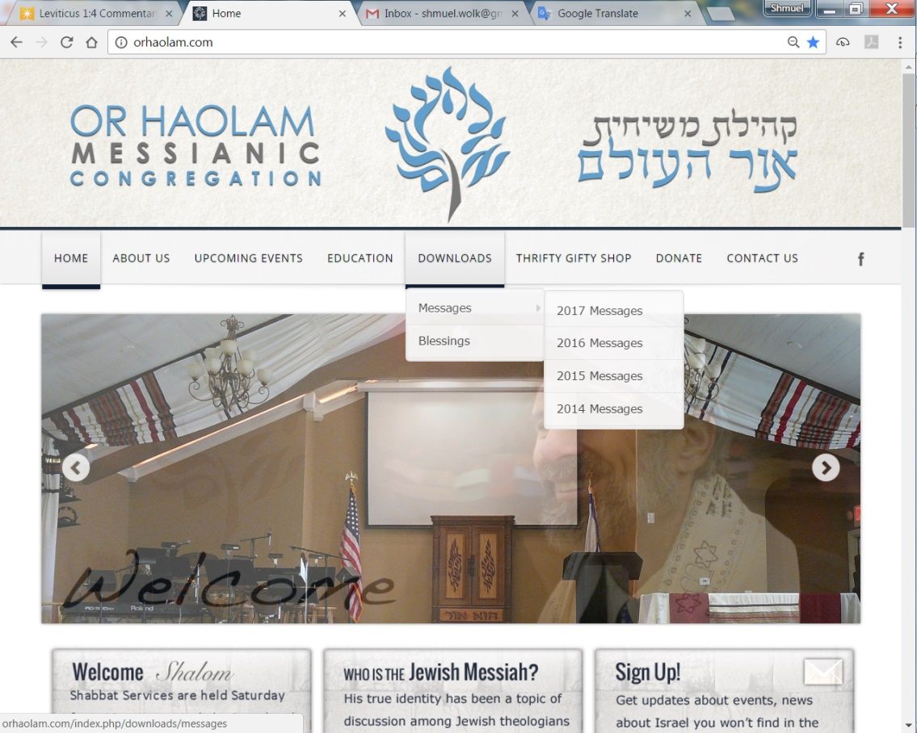
Downloads\messages\
2017 Messages

Slide 4
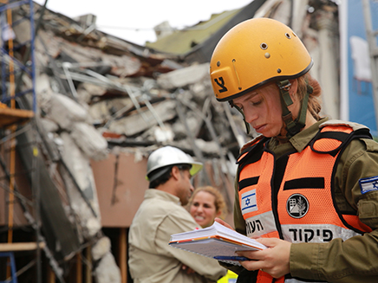
IDF officer in Mexico
פִּקּוּד military command, authority
Notes:
http://www.jerusalemonline.com/news/world-news/the-israeli-connection/israeli-aid-volunteers-bring-start-up-nation-tech-to-mexico-31263?utm_source=ActiveCampaign&utm_medium=email&utm_content=&utm_campaign=EveningNewsletter+-+Recurring+2017+%28new%29
She is the commander!
Using amazing Israeli technology to see through walls: for terrorism, rescue!

Slide 5
Camero offers a comprehensive solution for Through-Wall Imaging. Camero’s Xaver™ systems enable you to know in real-time whether there are people present, how many are present and where they are situated.
Notes:
http://www.jerusalemonline.com/news/world-news/the-israeli-connection/israeli-aid-volunteers-bring-start-up-nation-tech-to-mexico-31263?utm_source=ActiveCampaign&utm_medium=email&utm_content=&utm_campaign=EveningNewsletter+-+Recurring+2017+%28new%29
http://www.camero-tech.com/technology/technological-achievements/

Slide 6
Camero In addition, the system offers a first of its kind capability to map the general shape of the room or structure, behind the wall or under collapsed ceilings, with high sensitivity for simultaneous detection of non-moving live objects.
Notes:
http://www.jerusalemonline.com/news/world-news/the-israeli-connection/israeli-aid-volunteers-bring-start-up-nation-tech-to-mexico-31263?utm_source=ActiveCampaign&utm_medium=email&utm_content=&utm_campaign=EveningNewsletter+-+Recurring+2017+%28new%29
http://www.camero-tech.com/technology/technological-achievements/

Slide 7
Today is called
Shabbat Shuva,
Shabbat of repentance
Within the Ten Days of Awe
עשרת ימי נורא
Aseret Y’may Nora
Notes:
“I have nothing to repent of.” I’ll give you somethings.

Slide 9
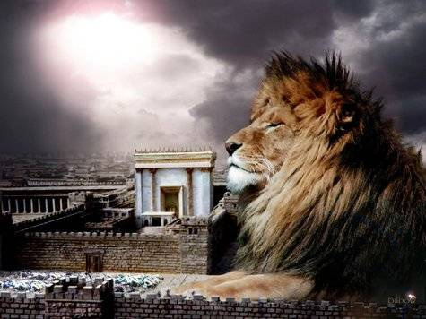
מַתִּתְיָהוּ Mattityahu
(Matthew) 21:1-3
Notes:
Previous, leaving Jericho to Jerusalem. 7% grade uphill

Slide 10
Mattityahu (Matthew) 21:1
כַּאֲשֶׁר הִתְקָרְבוּ לִירוּשָׁלַיִם וּבָאוּ אֶל בֵּית-פַּגֵּי, אֶל הַר הַזֵּיתִים,
As they were approaching Yerushalayim, they came to Beit-Pagei on the Mount of Olives.

Slide 11
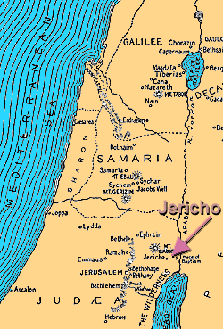
Jericho: 1200’
Below sea level
Jerusalem
2,474′ above sea
Level
3700’ drop in
10 miles
7% grade
Notes:
According to U. S. Department of Labor Mine Safety and Health Administration Coal Mine Safety and Health Metal and Nonmetal Mine Safety and Health June 1999
Handbook Number PH99-I-4
https://arlweb.msha.gov/READROOM/HANDBOOK/PH99-I-4.pdf
the truck’s speed while descending a 6 percent (effective) grade should not exceed about 20 mph.
Bethpage = Bethphage Aramaic בית פגי, lit. "House of un-ripe figs")

Slide 12
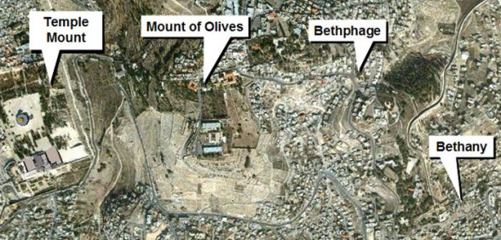
Notes:
Deep Kidron Valley, so suddenly:

Slide 13
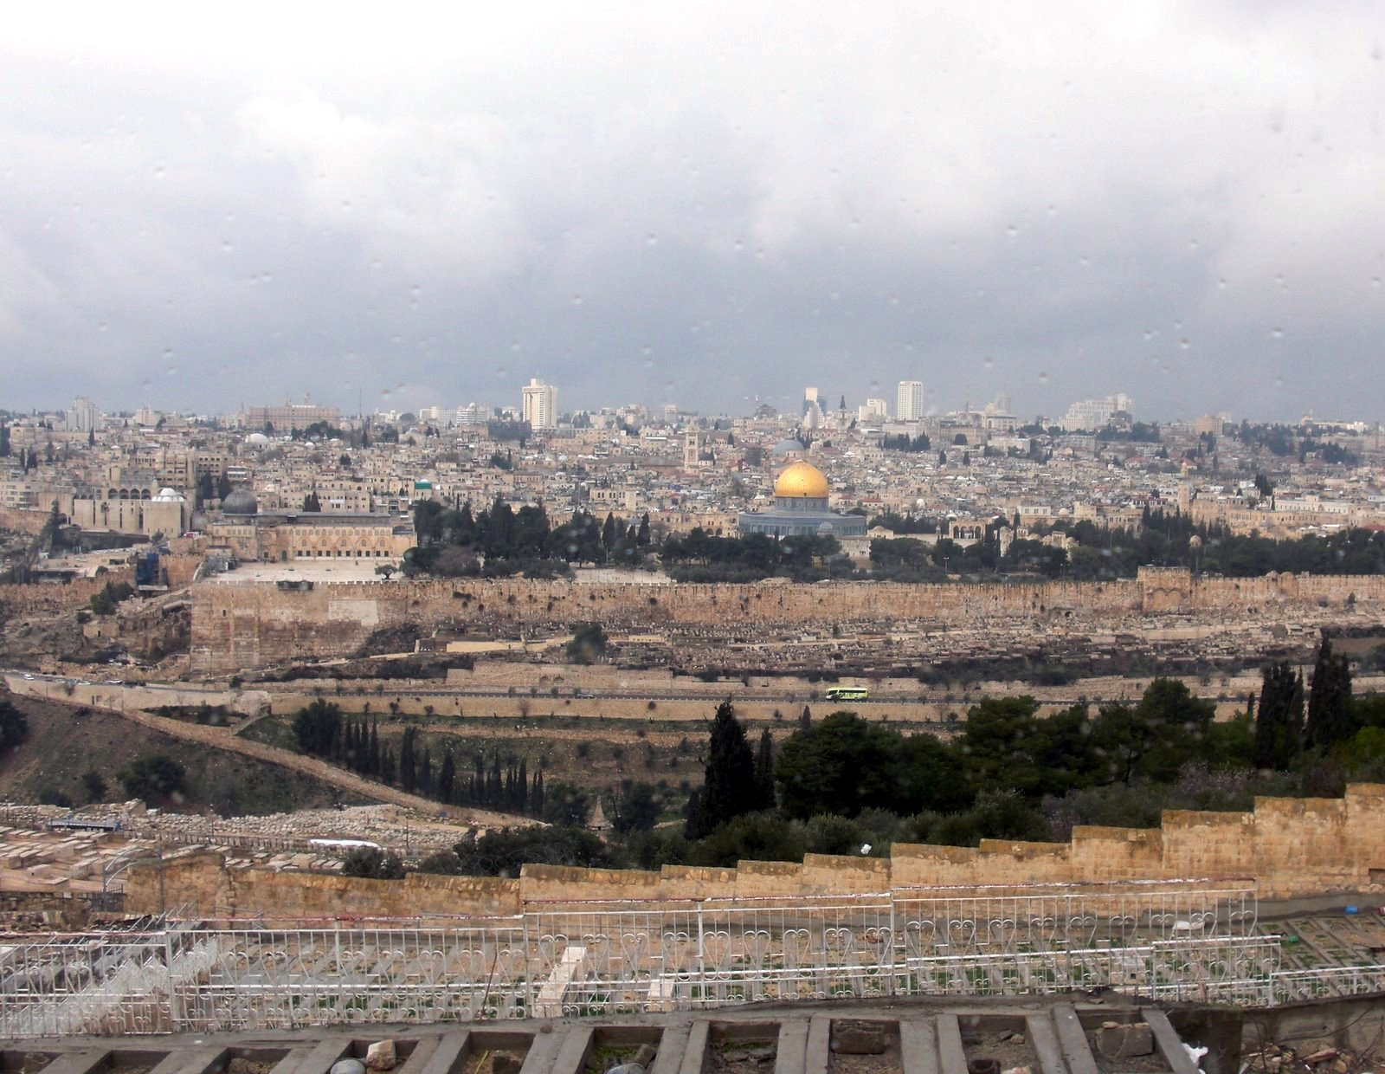
View of Jerusalem from
the Mount of Olives
Notes:
Amazing breathtaking view of Temple. Better view then, since the Temple was there.
He may have been tired!! 7% grade 10 or more miles.

Slide 14
Mattityahu (Matthew) 21:2
בְּאָמְרוֹ לָהֶם: "לְכוּ אֶל הַכְּפָר אֲשֶׁר מִמּוּלְכֶם, שָׁלַח יֵשׁוּעַ שְׁנֵי תַּלְמִידִים
Yeshua sent two talmidim
with these instructions: "Go into the village ahead of you,

Slide 15
Mattityahu (Matthew) 21:2
וּמִיָּד תִּמְצְאוּ אָתוֹן קְשׁוּרָה וְעַיִר אִתָּהּ. הַתִּירוּ אוֹתָם וְהָבִיאוּ אֵלַי.
and you will immediately find a donkey tethered there with its colt. Untie them and bring them to me.

Slide 16
Mattityahu (Matthew) 21:3
וְאִם מִישֶׁהוּ יֹאמַר לָכֶם דָּבָר, תֹּאמְרוּ 'הָאָדוֹן זָקוּק לָהֶם' וּמִיָּד יִשְׁלַח אוֹתָם."
If anyone says anything to you, tell him, 'The Lord needs them'; and he will let them go at once."
Notes:
Midrash here. Yeshua was preparing them for possible objections.

Slide 17
If anyone says anything to you
Midrash:
If anyone objects,
if anyone criticizes,
if anyone is antagonistic,
if anyone is accusatory.

Slide 18
Consider accusations.
We are in the
Ten Days of Awe
Ten Days of Repentance
עשרת ימי נורא
Aseret Y’may Nora
Notes:
Consider dealing with accusations, opposition, contention.
This is a topical expansion of the text, not an exposition, but relevant to the day.

Slide 19
^{T’hillim / Ps 8.3} You established strength because of your foes, in order that you might silence the enemy and the avenger.
You are safe and secure from all your enemies; you stop anyone who opposes you.
Notes:
We want to enter into the silencing of the voice of accusation. The accuser is rebuked by Adoni!

Slide 20
^{Rev. 12.10} Then I heard a loud voice in heaven saying, “Now have come God’s victory, power and kingship, and the authority of his Messiah; because the Accuser of our brothers, who accuses them day and night before God, has been thrown out!

Slide 21
Accusations of HaSatan:
Accuses G-d to us
Accuses us to G-d
Other people to us
Us to ourselves

Slide 22
Satan as accuser before God
Already in Tanakh (Zech 3:1; Job 1:6; 2:1)
Jewish tradition amplified this: he accused Israel day and night except on Day of Atonement
But here Yeshua’s victory silences him
Ancient system of accusers vs. advocates (1 Jn 2:1)
Notes:
By Craig Keener Messiah Conf lecture

Slide 23
^{Zekh. 3.1} He showed me Y’hoshua the cohen hagadol standing before the angel of Adoni, with the Accuser standing at his right to accuse him. Adoni said to the Accuser, “May Adoni rebuke you, Accuser! Indeed, may Adoni, who has made Yerushalayim his choice, rebuke you!
Notes:
We want to enter into the silencing of the voice of accusation. The accuser is rebuked by Adoni!

Slide 24
Accusations:
Accuses G-d to us
^{Beresheet/Gen. 3.1-6} “Did God really say, ‘You must not eat from any tree in the garden’?”…“For God knows that when you eat from it your eyes will be opened,
Notes:
G-d accused of denying Hava and Adam insight, understanding

Slide 25
Accusations:
Accuses G-d to us
^{Beresheet/Gen. 3.1-6} “and you will be like God, knowing good and evil.”…the woman saw that the fruit of the tree was good for food and pleasing to the eye, and also desirable for gaining wisdom.”
Notes:
Accusation of denial of pleasure of taste and eye appeal, sensuality and ownership. Entitlement.

Slide 26
Do you ever feel G-d is unfair?
Not giving you what you are entitled to?
Notes:
Entitlement is a loaded word. We’re really not entitled to anything but the bread we get by the sweat of our face. Plus mercy if we’re not able to sweat.
But, easy to hear the accusation, “Not enough quantity or quality of bread, housing, car, medical care…”

Slide 27
Response:
Meditate on attributes of G-d in Messiah. High Holiday theme of Thirteen Attributes of Mercy.

Slide 28
^{Shmot/Ex 34.5-7} Adoni descended in the cloud, stood with him there and pronounced the name of Adoni. Adoni passed before him and proclaimed: “Adoni!!! Adoni is God,

Slide 29
^{Shmot/Ex 34.5-7} merciful and compassionate, slow to anger, rich in grace and truth; showing grace to the thousandth generation, forgiving offenses, crimes and sins; yet not exonerating the guilty.
Notes:
Zipporah Bennett has this set to music.
Again, HaSatan accuses G-d to us, in this case, to Yeshua.

Slide 30
^{Mtt 4.8-11} The Adversary took him up to the summit of a very high mountain, showed him all the kingdoms of the world in all their glory, and said to him, “All this I will give you [which you deserve] if you will bow down and worship me.”
Notes:
Here is an easy way to gain the Kingship you have coming to you. Much better than Your Father’s plan…of the execution torture stake.

Slide 31
Response:
^{Mtt 4.8-11} “Away with you, Satan!” Yeshua told him, “For the Tanakh says, ‘Worship Adonai your God, and serve only him.’”
Notes:
Praise and worship are the greatest response to spiritual accusations.

Slide 32
Peace be unto you, ministering angels, angels of the Most High, From the King, the King of Kings, the Holy One, Blessed be He.
May your arrival be to peace, angels of peace...

Slide 33
שָׁלוֹם עֲלֵיכֶם, מַלְאֲכֵי הַשָּׁרֵת,
Shalom a-lay-khem, mal-a-khay ha-sha-rayt
מַלְאֲכֵי עֶלְיוֹן, מִמֶּֽלֶךְ מַלְכֵי הַמְּלָכִים,
Mal-a-khay El-yon, Mee-meh-lekh mal-khay ha-m'la-kheem
הַקָּדוֹשׁ בָּרוּךְ הוּא
Ha-Kadosh ba-rookh hoo.

Slide 34
Consider the destructive power of accusations.
We are in the
Ten Days of Awe
Ten Days of Repentance

Slide 35
^{T’hillim / Ps 8.3} You established strength because of your foes, in order that you might silence the enemy and the avenger.

Slide 36
Accusations:
Accuses G-d to us
Accuses us to G-d
Other people to us
Us to ourselves

Slide 37
^{Eyov 1.6-11} It happened one day that the sons of God came to serve Adoni, and among them came the Adversary…The Adversary answered Adoni, “Is it for nothing that Iyov fears God? You’ve put a protective hedge around him,

Slide 38
^{Eyov 1.6-11} his house and everything he has. You’ve prospered his work, and his livestock are spread out all over the land. But if you reach out your hand and touch whatever he has, without doubt he’ll curse you to your face!”

Slide 39
Response: Commit to Him --
Eyov/Job 13.15 Even if He kills me, I will hope in Him.
הֵן יִקְטְלֵנִי, לוֹ אֲיַחֵל;
קָטַלto kill, to exterminate, to destroy ; to criticize
יִחֵל to hope for, to await, to look forward to

Slide 40
Our lives are a saga of great warfare, glorifying G-d.
^{Eyov/Job 19.23} I wish my words were written down, that they were inscribed in a scroll, that, engraved with iron and filled with lead, they were cut into rock forever.
Notes:
They were, that’s why we’re reading them!

Slide 41
^{Eph 2.6-7} God raised us up with the Messiah Yeshua and seated us with him in heaven, in order to exhibit in the ages to come how infinitely rich is his grace, how great is his kindness toward us who are united with the Messiah Yeshua.
Notes:
Response to accusation, feeling abandoned by G-d?
Thank Him for your adverse circumstances. You are a hero to G-d
The Call p 202

Slide 42
We are in the
Ten Days of Awe
Ten Days of Repentance
Consider the destructive power of accusations.

Slide 43
^{T’hillim / Ps 8.3} You established strength because of your foes, in order that you might silence the enemy and the avenger.

Slide 44
Accusations:
Accuses G-d to us
Accuses us to G-d
Other people to us
Us to ourselves

Slide 45
^{Mishlei/Prov 16.28} וְנִרְגָּן מַפְרִיד אַלּוּף
נִרְגָּן complaining, grumbling
A whisperer separates close friends.
Notes:
This is almost inevitable in our community, since we are working for the redemption of Yisrael, which is the key to the redemption of the world! Especially at this time of the year, Ten Days of Awe.

Slide 46
Moshe accused
Ch 12, accused in regard to whom he married
Ch 14: giving them an impossible task: Giants
Ch 16: promoting himself to cohanut / priesthood

Slide 47
^{Bamidbar/Nu 16.1-3} Now [three groups]
Korach the son of Yitz'har, the son of K'hat, the son of Levi,
along with Datan and Aviram, the sons of Eli'av, and
On, the son of Pelet, descendants of Re'uven, took men and rebelled against Moshe.
Notes:
Analysis three groups
Proposed trial by ordeal of Leviim, with censers
With Datan and Aviram Moshe wanted to talk
On? Sages say his wise and righteous wife persuaded him to withdraw. Men: listen to the wise counsel of your wife. Almost always, she’s right. Almost.

Slide 48
^{Bamidbar/Nu 16.1-3} You take too much on yourselves! After all, the entire community is holy, every one of them. After all, the entire community is holy, every one of them and ADONI is among them. So why do you lift yourselves up above ADONI’s assembly?"
Notes:
This option is NOT usually available to us in our situations of accusation.

Slide 49
^{BaMidbar/Nu 16.28-31} Moshe said, "Here is how you will know that ADONI has sent me to do all these things and that I haven't done them out of my own ambition: if these men die a natural death like other people, only sharing the fate common to all humanity, then ADONI has not sent me. But if ADONI does something new -

Slide 50
^{BaMidbar/Nu 16.28-31} - if the ground opens up and swallows them with everything they own, and they go down alive to Sh'ol - then you will understand that these men have had contempt for ADONI ." The moment he finished speaking, the ground under them split apart -

Slide 51
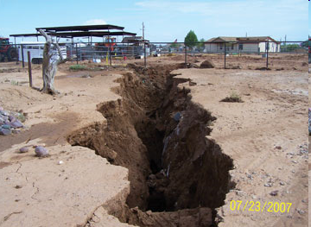

Slide 52
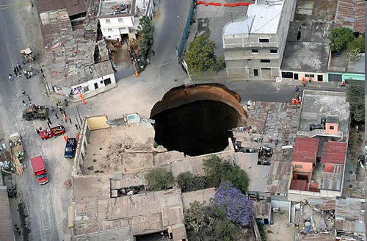
Notes:
Guatemala, also Florida sinkholes
It seems that this should address the issue of authority and justice. ~300 people died
This option is not usually available to us in situations of accusation.

Slide 53
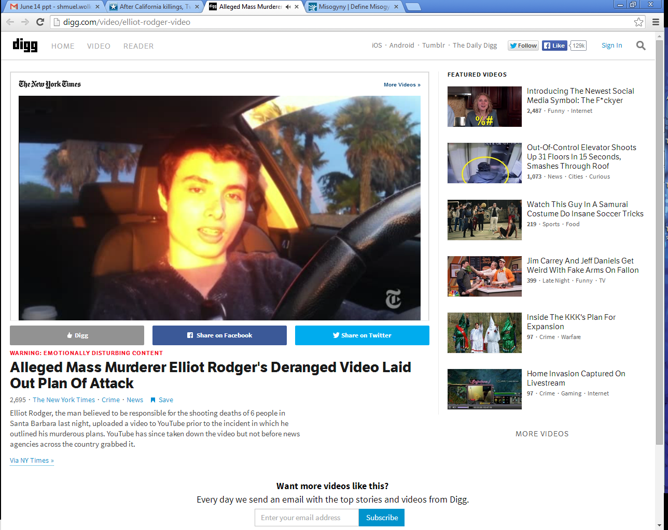
Elliot Roger in his BMW and
designer clothes, recording his
Plan of Retribution

Slide 54
His 144-page manifesto proclaimed, “I am going to enter the hottest sorority house of UCSB and I will slaughter every single spoiled, stuck-up, blonde [chick] I see inside there, all those girls I’ve desired so much. They would have all rejected me.”
Notes:
Univ CA Santa Barbara
Read more here: http://www.kansascity.com/news/local/article438881/After-California-killings-
Twitter%E2%80%99s-YesAllWomen-reveals-the-vast-extent-of-misogyny.html#storylink=cpy

Slide 55
Elliot Rodger was the 22-year-old who on May 23, 2014, killed six University of California, Santa Barbara students and wounded 13 others before killing himself in a rampage ignited, at least in part, by his misogyny — an all-consuming hatred of women.
Notes:
That’s how the media describes it.
So superficial, and PC. Rather, believed a lie.
Read more here: http://www.kansascity.com/news/local/article438881/After-California-killings-
Twitter%E2%80%99s-YesAllWomen-reveals-the-vast-extent-of-misogyny.html#storylink=cpy

Slide 56
Misogyny noun hatred, dislike, mistrust of women
Rodger grew up in wealth. His father, Peter Rodger, is a photographer and director who worked on one of “The Hunger Games” movies. Some posit that Elliot Rodger’s belief that he was sexually overlooked emanates from an inflated sense of entitlement.
Notes:
Read more here: http://www.kansascity.com/news/local/article438881/After-California-killings-
Twitter%E2%80%99s-YesAllWomen-reveals-the-vast-extent-of-misogyny.html#storylink=cpy

Slide 57
Others point to a history of mental illness. They speak of his overt narcissism, laid bare on a foundation of feeling weak, like nothing, diminished and overlooked.
Notes:
“They would have all rejected me.” He believed
a lie.
Read more here: http://www.kansascity.com/news/local/article438881/After-California-killings-
Twitter%E2%80%99s-YesAllWomen-reveals-the-vast-extent-of-misogyny.html#storylink=cpy

Slide 58
Rodger, referring to himself as the “supreme gentleman,” said in his video, “I will take great pleasure in slaughtering all of you. You will finally see that I am, in truth, the superior one, the true alpha male.”
Notes:
“They would have all rejected me.” He believed
a lie.
Read more here: http://www.kansascity.com/news/local/article438881/After-California-killings-
Twitter%E2%80%99s-YesAllWomen-reveals-the-vast-extent-of-misogyny.html#storylink=cpy

Slide 59
I believe there is a guaranteed way to win in every conflict.
The winner is the first one to see and say:
“I was wrong in xxxx. Will you forgive me?”
No “you” statements. Only “I”
Notes:
Always works in marriage.
Most conflictive situation of my life, some of you were involved, I won one confrontation because I found a way to do this.

Slide 60
^{T’hillim/Ps 141.5-8} Let the righteous strike me, let him correct me; it will be an act of love. Let my head not refuse such choice oil.
Notes:
for I will keep on praying about their wickedness.
Righteous don’t always correct with love. But take it as one from G-d.

Slide 61
Accusations that are patently absurd don’t hurt at all. Usually laughable.

Slide 62
^{Mishlei/Prov 26.2 CEB} Like a darting sparrow, like a flying swallow, so an undeserved curse never arrives.
^{ESV} Like a sparrow in its flitting, like a swallow in its flying, a curse that is causeless does not alight.
כַּצִּפּוֹר לָנוּד, כַּדְּרוֹר לָעוּף --כֵּן קִלְלַת חִנָּם לא תָבֹא.
Notes:
sparrow, as the word is sometimes rendered, leaves its nest and wanders from it; and flies here and there, and settles nowhere;
like Shimei's cursing David;
The Septuagint takes in both,
``so a vain curse shall not come upon any;''
דְּרוֹר dror
liberty

Slide 63
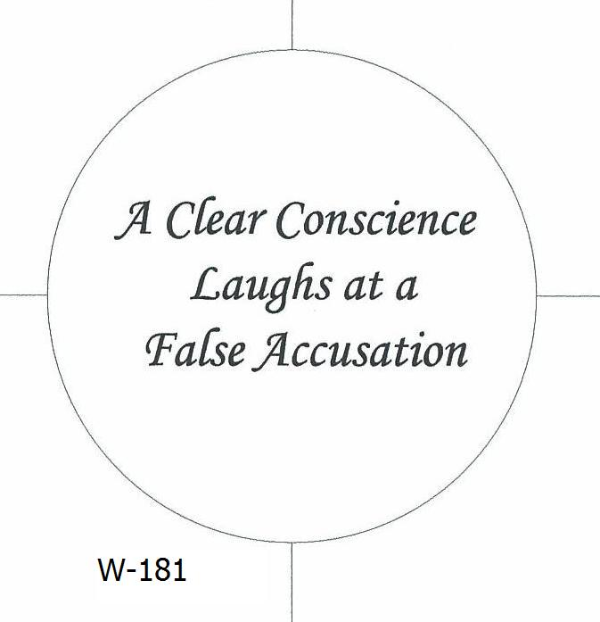

Slide 64
Accusations are usually half truths because we all always could do better.

Slide 65
^{1 Cor. 4.3-5} And it matters very little to me how I am evaluated by you or by any human court; in fact, I don't even evaluate myself. I am not aware of anything against me, but this does not make me innocent. The one who is evaluating me is the Lord. So don't pronounce judgment prematurely, before the Lord comes;
Notes:
In this case, he deferred judgment to G-d

Slide 66
We are in the
Ten Days of Awe
Ten Days of Repentance
Consider the destructive power of accusations.

Slide 67
^{T’hillim / Ps 8.3} You established strength because of your foes, in order that you might silence the enemy and the avenger.

Slide 68
Accusations:
Accuses G-d to us
Accuses us to G-d
Other people to us
Us to ourselves
Notes:
This could be true, or could be toxic. Have to determine. Have to examine, confess, repent. But if done…

Slide 69


Slide 70
^{Roman 8} Therefore, there is no longer any condemnation awaiting those who are in union with the Messiah Yeshua. Why? Because the Torah of the Spirit, which produces this life in union with Messiah Yeshua, has set me free from the "Torah" of sin and death…

Slide 71
^{Roman 8} For I am convinced that neither death nor life, neither angels nor other heavenly rulers, neither what exists nor what is coming, neither powers above nor powers below, nor any other created thing will be able to separate us from the love of God which comes to us through the Messiah Yeshua, our Lord.

Slide 72
Summary of Accusations:
Accuses G-d to us: Praise Him
Accuses us to G-d: Trust Him
Other people to us: Humble ourselves.
Us to ourselves: examine, confess, rely on the Atonement of Messiah!
Notes:
If you do the yellow, you’ll be a good fellow, and your soul will be mellow.

Slide 73
^{Rev. 129-10} "Now have come God's victory, power and kingship, and the authority of his Messiah; because the Accuser of our brothers, who accuses them day and night before God, has been thrown out!
Notes:
Satan doesn’t care if accusations are true. Just loves to accuse, condemn. Difference between conviction of the Ruakh, gentle, intreatable, and accusations. But they sound and feel very similar, since HaSatan can transform himself into an angel of light.
Satan can imitate the light of G-d’s truth, but he cannot imitate the warmth of G-d’s love.
Back to our story of Yeshua’s entry to Jerusalem…

Slide 74
Mattityahu (Matthew) 21:3
וְאִם מִישֶׁהוּ יֹאמַר לָכֶם דָּבָר, תֹּאמְרוּ 'הָאָדוֹן זָקוּק לָהֶם' וּמִיָּד יִשְׁלַח אוֹתָם."
If anyone says anything to you, tell him, 'The Lord needs them'; and he will let them go at once."
Notes:
Midrash here:

Slide 75
Mattityahu (Matthew) 21:4
This happened in order to fulfill what had been spoken through the prophet,

Slide 76
Mattityahu (Matthew) 21:5
“Say to the daughter of Tziyon, ‘Look! Your King is coming to you, riding humbly on a donkey, and on a colt, the offspring of a beast of burden!’”
Notes:
He will come on a war horse.

Slide 77
^{Rev 19.11-16} I saw heaven standing open and there before me was a white horse, whose rider is called Faithful and True. With justice he judges and wages war. His eyes are like blazing fire, and on his head are many crowns

Slide 78
^{Rev 19.11-16} He has a name written on him that no one knows but he himself. He is dressed in a robe dipped in blood, and his name is the Word of God. The armies of heaven were following him, riding on white horses and dressed in fine linen, white and clean.

Slide 79
^{Rev 19.11-16} Coming out of his mouth is a sharp sword with which to strike down the nations. “He will rule them with an iron scepter.” He treads the winepress of the fury of the wrath of God Almighty. On his robe and on his thigh he has this name written: King of kings and Lord of lords.

Slide 80
Summary of Accusations:
Accuses G-d to us: Praise Him
Accuses us to G-d: Trust Him
Other people to us: Humble ourselves.
Us to ourselves: examine, confess, rely on the Atonement of Messiah!
Notes:
If you do the yellow, you’ll be a good fellow, and your soul will be mellow.

