Slide 1
To easily follow these notes, log on to our Wifi
Wifi: mycci01
p/w: ancientquail060
Go to OrHaOlam.com
Click on downloads, messages, 2017

Slide 2
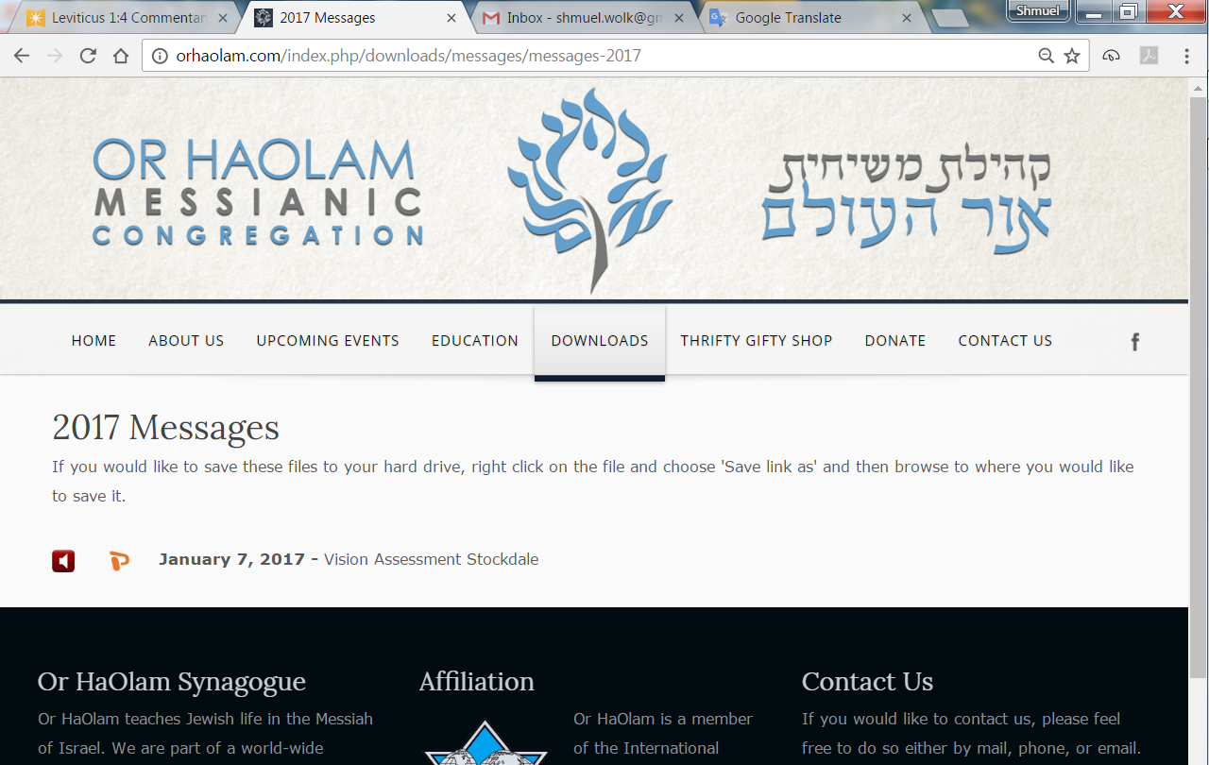

Slide 3
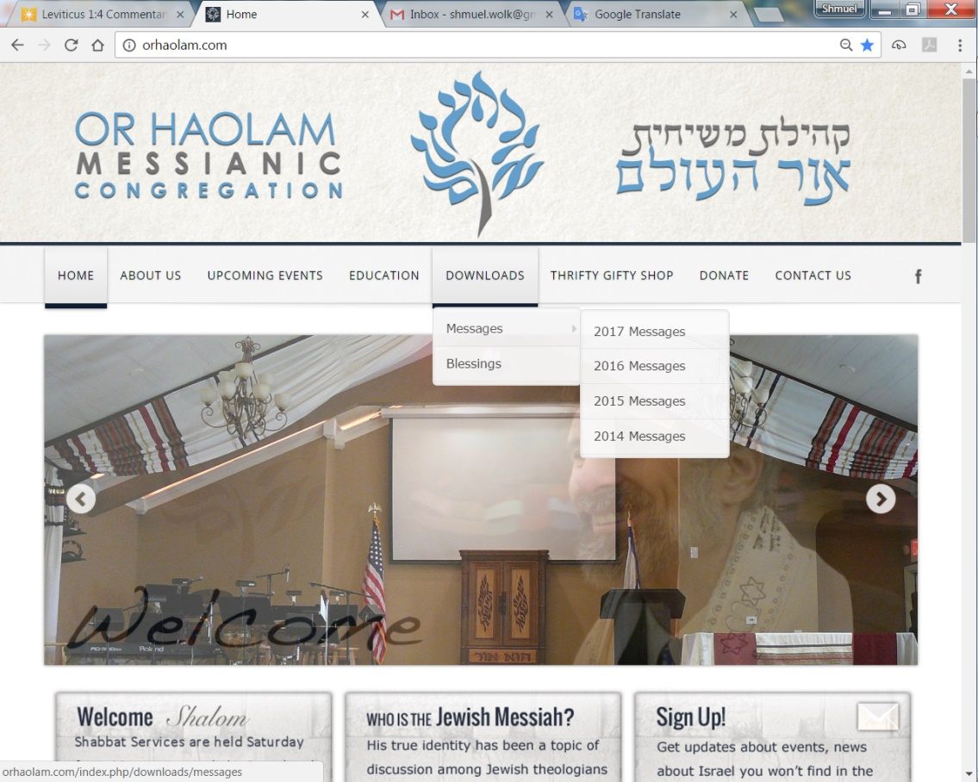
Downloads\messages\
2017 Messages

Slide 4
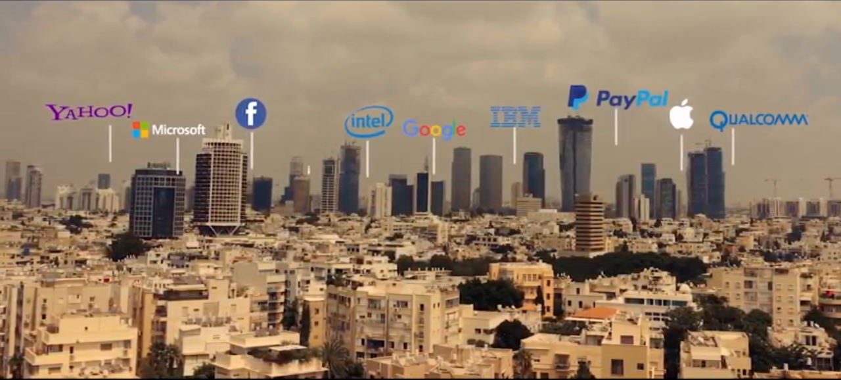
Major tech in Tel Aviv
Notes:
From Evan Liberman’s promo WiseMoneyIsrael.

Slide 5
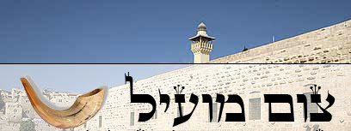
Tsom mo-eel ……..Profitable fast
Tsom Kal צום קל…Easy Fast
Notes:
מוֹעִיל effective, helpful, useful
Spoken about the importance of admitting wrong, esp. re YK.
Story of a rabbi visiting a sick, elderly person in nursing home. She had a bowl of peanuts, and he was munching on them as visiting. Ultimately realized he’d eaten them all. Apologized and confessed, “I’ve eaten all your peanuts.”
Lady responded, “That’ OK. I’m not able to eat them. I just suck off the chocolate.”

Slide 6
Why Kol Nidre?
“All Vows?
And why on Erev Yom Kippur?
Traditional text…
Notes:
Starting two slides same as last year. But varies after that!

Slide 7
"All vows [Kol Nidre כל נדרי], obligations, oaths, and anathemas, whether called 'ḳonam,' 'ḳonas,' or by any other name, which we may vow, or swear, or pledge, or whereby we may be bound, from this Day of Atonement until the next (whose happy coming we await)
Notes:
http://www.jewishencyclopedia.com/articles/9443-kol-nidre

Slide 8
we do repent. May they be deemed absolved, forgiven, annulled, and void, and made of no effect; they shall not bind us nor have power over us. The vows shall not be reckoned vows; the obligations shall not be obligatory; nor the oaths be oaths."
Notes:
http://www.jewishencyclopedia.com/articles/9443-kol-nidre
Why have such a prayer, and why does it strike such a chord in Jewish and those joining us’ hearts?

Slide 9
Kol Nidre Breaking
Things that bind us:
bondages.
Notes:
Are there things that bind you, and me?
Shaul Paul wrote re this:
^{Ro 7.18-19} I don’t understand my own behavior — I don’t do what I want to do; instead, I do the very thing I hate!... I can want what is good, but I can’t do it! For I don’t do the good I want; instead, the evil that I don’t want is what I do!
You might say, “Not me.” I do everything purely Messiah-like.” If so, raise hand…kidding.
KN, spiritually, is about breaking bondages.

Slide 10
This issue is the essence of Adoni’s identity. Essence of His Name is freedom from bondage.
^{Shmot/Ex 20.2} “I am Adoni your God, who brought you out of the land of Egypt, out of the house of bondage [slavery].
Notes:
First of the Ten Words, Ten Commandments
It’s WHO G-D is. The Liberator!!
Moshe’s commission…

Slide 11
^{Shmot/Ex 6.6} Therefore say to Bnei-Yisrael: I am Adoni, and I will bring you out from under the burdens of the Egyptians. I will deliver you from their bondage, and I will redeem you with an outstretched arm and with great judgments.
Notes:
TLV uses Bnei כי children not literal, adult children too clumsy, sons not exactly. Sort of gave up and transliterated.
Hundreds of years later, in the time of the Judges

Slide 12
^{Shoftim/Ju 6.8} Adoni sent a prophet to Bnei-Yisrael, and he said to them, “Thus says Adoni, God of Israel, ‘It was I who brought you up from Egypt, and brought you out of the house of bondage.
Notes:
Relative to Babylonian then Persian bondage…

Slide 13
^{Ezra 9.9} Though we are slaves, our God has not forsaken us in our bondage. He has extended lovingkindness to us in the sight of the kings of Persia, reviving us in order to restore the House of our God, to raise up its ruins, and to give us a wall in Judah and in Jerusalem.
Notes:
Messiah’s commissioning…

Slide 14
^{Lk.4.18 TLV} “The Ruakh Adoni is on me, because He has anointed me to proclaim Good News to the poor. He has sent me to proclaim release to the imprisoned and recovery of sight to the blind, to set free the oppressed,

Slide 15
^{Ro 8.15 Darby} For you have not received a spirit of bondage again for fear, but ye have received a spirit of adoption, whereby we cry, Abba, Father.
Notes:
Bondage to fear is a big one in scripture. Another translation of this verse…

Slide 16
^{Ro 8.15 CJB} For you did not receive a spirit of slavery to bring you back again into fear; on the contrary, you received the Spirit, who makes us sons and by whose power we cry out, "Abba!" (that is, "Dear Father!").
Notes:
This is really powerful. If you have fears, the best way out is the realization, deep receiving of the Spirit of sonship, daughter-ship.

Slide 17
^{2 Tim 1.7 KJV} For God has not given us the spirit of fear; but of power, and of love, and of a sound mind.

Slide 18
^{Mes Jews/Heb 2.14-15} Therefore, since the children share a common physical nature as human beings, he became like them and shared that same human nature; so that by his death he might render ineffective the one who had power over death

Slide 19
^{Mes Jews/Heb 2.14-15} (that is, the Adversary) and thus set free those who had been in bondage all their lives because of their fear of death.

Slide 20
^{2 Kefa/Peter 2.19} They promise them freedom, but they themselves are slaves of corruption; for a person is slave to whatever has defeated him.
Notes:
Slave to sexual sin, pornography, improper staring, rage, unforgiveness, gevaltism.

Slide 21
Kol Nidre Breaking:
Internal Bondages
Notes:
RTF book: Biblical Healing and Deliverance Chester and Betsy Kylstra p. 276 fears
Deliverance from bondage to these fears
Forgiving the original perpetrator
Confessing retaining the fear and believing in the fearful image
Faith that G-d the Father is NOT like that.
Receiving His fatherly love.

Slide 22
^{Ro.8.31-32} What, then, are we to say to these things? If God is for us, who can be against us? He who did not spare even his own Son, but gave him up on behalf of us all — is it possible that, having given us his Son, he would not give us everything else too?

Slide 23
Kol Nidre Breaking:
External Bondages
Notes:
Usually result from internal

Slide 24
^{Dvarim/Dt 23.21-23} "When you make a vow to ADONI your God, you are not to delay in fulfilling it, for ADONI your God will certainly demand it of you…if a vow passes your lips, you must take care to perform it according to what you

Slide 25
^{Dvarim/Dt 23.21-23} voluntarily vowed to ADONI your God, what you promised in words spoken aloud.

Slide 26
^{Mishlei/Prov 2.1-2} My son, if you have put up security for your friend,
if you committed yourself on behalf of another; you have been snared by the words of your mouth, caught by the words of your own mouth.
Notes:
Some examples in scripture and life of words that have ensnared people…

Slide 27
Deception of the Givonim/Gibeonists
^{Yehoshua/Josh 9.3-5} But when the inhabitants of Giv‘ah heard what Y’hoshua had done to Yericho and ‘Ai, they developed a clever deception: they made themselves look as if they had been on a long journey by

Slide 28
Deception of the Givonim/Gibeonists
^{Yehoshua/Josh 9.3-5} putting old sacks on their donkeys and taking used wineskins that had burst and been mended back together. They put old, patched sandals on their feet and dressed in worn-out clothes;

Slide 29
^{Yehoshua/Josh 9.14-16} The [Yehoshua and the men of Israel] men sampled some of their food but didn’t seek the advice of Adoni, so Y’hoshua made peace with them and made a covenant with them to spare their lives,
Notes:
Why seek spiritual wisdom from G-d? This one is obvious.
So important to pray, get the sense of the Ruakh on everything. Sometimes issues are just common sense, but not always.

Slide 30
^{Yehoshua/Josh 9.14-16} and the leading officials of the community swore to them. But three days later, after they had made the covenant with them, they heard that they were their neighbors, that they lived there with them.

Slide 31
^{Yehoshua/Josh 9.19-21} the leaders replied to the whole community, “We have sworn to them by Adoni, the God of Isra’el; so we can’t touch them. Here is what we will do to them: we will let them live, so that God’s anger will not be on us because of the oath we swore to them.
Notes:
Knew had to honor the oath, their words. Military trouble, later trouble. G-d walked with them thru troubles, but…

Slide 32
^{Yehoshua/Josh 9.19-21} Yes, let them live,” the leaders continued, “but let them chop wood and draw water for the whole community.” This is what the leaders said.
Notes:
Solution.
Side note: I am basically a Gibeonite in my home.

Slide 33
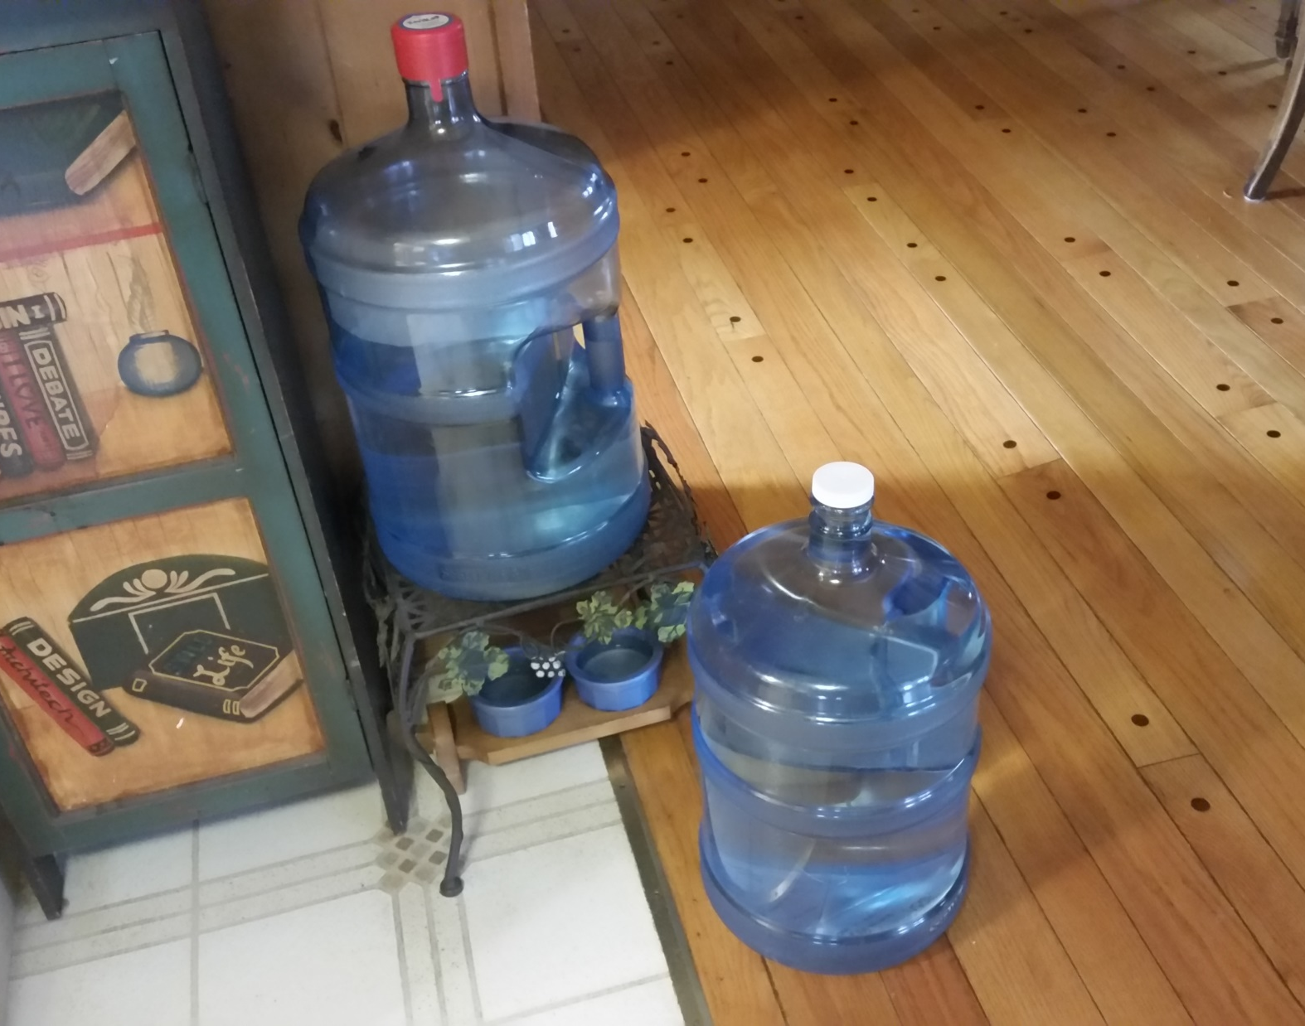
Notes:
Two of the three 5 gallon RSO water jugs that I haul to Hy-Vee for refill for my wife.
I am a draw-er of water.

Slide 34
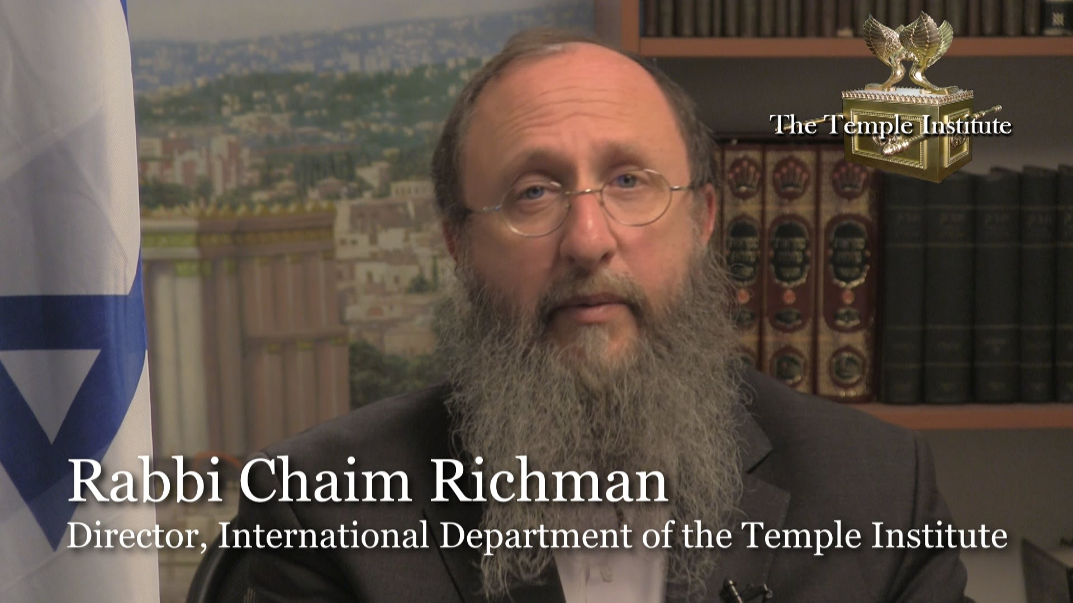
Notes:
You may remember this history that I’m about to share, but I need to add to it to relate how it reveals bondages.

Slide 35
The Institute shares a key connection to the battle for Jerusalem. Its founder, Rabbi Yisrael Ariel, served with the 55th Paratroopers Brigade that captured the Temple Mount. After the victory, a Jordanian guide gave them a remarkable tour.
Notes:
http://metrovoicenews.com/kansas-city-archives/

Slide 36
The soldiers were on the Temple Mount and it was just like the first hour or so. And they were approached by a Jordanian fellow in Western dress who explained that he was the official tour guide for the Jordanian parliament and he offered to take the soldiers and to show them the sites on the Temple Mount. [June 1967]
Notes:
http://metrovoicenews.com/kansas-city-archives/

Slide 37
"He takes the soldiers, you know, and the rabbi there, and he says, 'well this is exactly where the sanctuary stood. This is where the altar stood and then this is where the Menorah stood.‘ "He tells them all these things about the history of the Holy Temple …
Notes:
http://metrovoicenews.com/kansas-city-archives/
Israel Ariel, as told by Chaim Richman

Slide 38
Finally, the rabbi asked him, 'why are you telling us all this?‘
And he said, 'well, we have tradition from our fathers [and] they from their fathers that one day the Jews would wage a war and conquer this mountain

Slide 39
and rebuild the Holy Temple, and I assume that you're starting tomorrow. I want this to be my part, my part in helping you,'" he said, according to Rabbi Richman.
Notes:
http://metrovoicenews.com/kansas-city-archives/

Slide 40
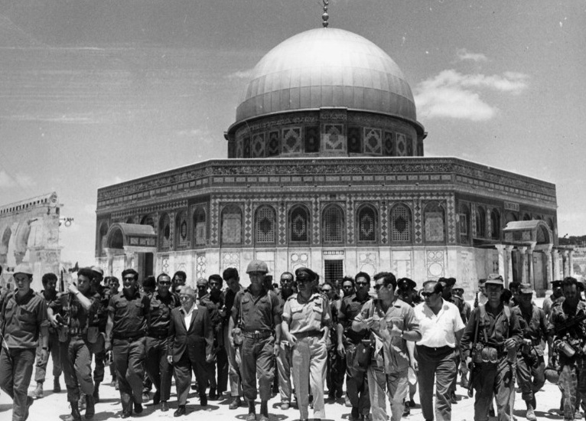
June, 1967, “The Temple Mount
Is in our hands.”
Notes:
https://www.google.com/search?q=the+temple+mount+is+in+our+hands&safe=active&tbm=isch&tbs=rimg:CSyQqPysuOnsIjifDf8H0wqRD4QuANhIO8npSnJQsutpzV5i1SDYFZywGEh8dlFkWbNxSn7ErxPn1dsMI_1PJHmrqKioSCZ8N_1wfTCpEPERg8rJSUbOu7KhIJhC4A2Eg7yekRJIPz0cr4wVkqEglKclCy62nNXhEW-tysy42IAioSCWLVINgVnLAYEemHr7lxPkInKhIJSHx2UWRZs3ER3-7RD3FQ1IsqEglKfsSvE-fV2xHSbBbFkXHQNCoSCQwj88keauoqETbFBbr_1wWsU&tbo=u&sa=X&ved=0ahUKEwilgLWF8crWAhXKy1QKHejbBogQ9C8IHw&biw=1164&bih=825&dpr=1.1#imgrc=LJCo_Ky46ezAOM:

Slide 41
Defense Minister Moshe Dayan’s first act on the Temple Mount, only a few hours after IDF Chief Rabbi Shlomo Goren blew the shofar and gave the Shehecheyanu blessing beside the Western Wall, was to immediately remove the Israeli flag that the
Notes:
http://jcpa.org/al-aksa-is-in-danger-libel-temple-mount/

Slide 42
paratroopers had raised on the mount.
Dayan’s second act was to clear out the paratroop company that was supposed to remain permanently stationed in the northern part of the mount.
Notes:
http://jcpa.org/al-aksa-is-in-danger-libel-temple-mount/
Narkiss reminded Dayan that Jordan, too, had stationed a military contingent on the mount to maintain order, and that long ago the Romans had done the same, deploying a garrison force in the Antonia Fortress that Herod had built near the mount.

Slide 43
June 1967. Defense Minister Moshe Dayan announces to the Wakf and the heads of the Supreme Muslim Council that they will be able to administer the compound themselves, while the Jews will be able to visit but not pray there. (courtesy of Schocken Books)
Notes:
http://jcpa.org/al-aksa-is-in-danger-libel-temple-mount/

Slide 44
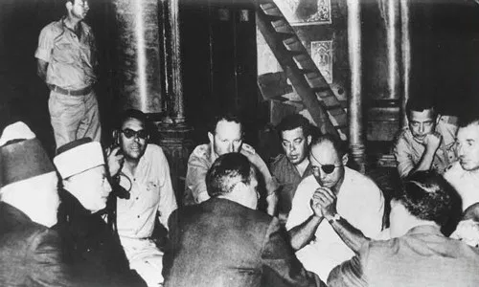
Notes:
http://jcpa.org/al-aksa-is-in-danger-libel-temple-mount/

Slide 45
Israeli Prime Minister Levi Eshkol announced to the chief rabbis of Israel that they would be responsible for arrangements in the vicinity of the Western Wall, and promised the religious leaders of the
Notes:
http://jcpa.org/al-aksa-is-in-danger-libel-temple-mount/

Slide 46
Christian and Muslim communities that they would continue to determine the arrangements at the places holy to them: the Church of the Holy Sepulchre and the Temple Mount.
Notes:
http://jcpa.org/al-aksa-is-in-danger-libel-temple-mount/

Slide 47
The basic elements of the status quo that Dayan designed on the Temple Mount have remained the same up to the present.
Israel is in bondage to the words of unwise leaders in 1967.
Notes:
http://jcpa.org/al-aksa-is-in-danger-libel-temple-mount/

Slide 49
R. Chaim Richman said to us on tour, “We Jews are so desperate to get the approval of the world that we give away our soul.”
Bondage to fear.
Kol Nidre breaking of bondages
Notes:
Not exact quote.
However, despite all that, there are plans afoot in the Temple Institute and other places to build the Temple, but it will take another divine intervention. I’m counting on the muffed opportunity in June 1967 as a divine intervention.
Keep in mind for May 2018 MoR tour!!

Slide 50
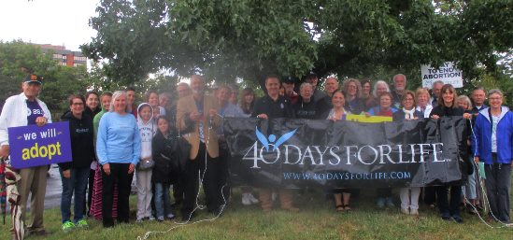
Some commitments CAN be broken.
Notes:
Wednesday, Sept. 27, 2017
Matt Britton leading opening rally.
56 million deaths worldwide
PLUS 56 meg abortions!
US 1 million plus abortions

Slide 51
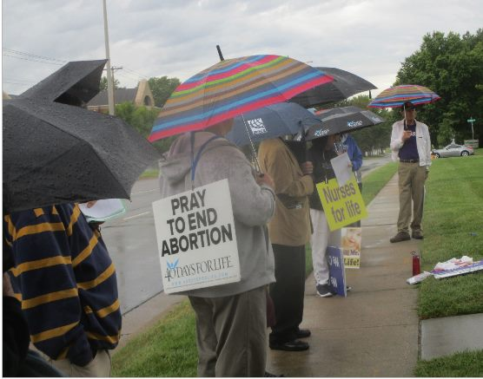
Or HaOlam’s turn Oct. 10.

Slide 52
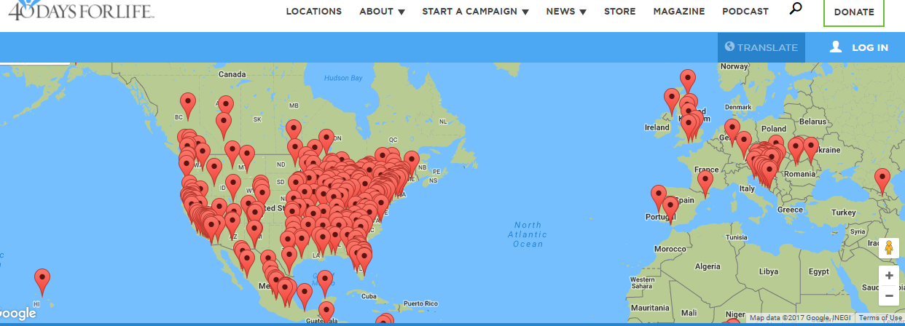
Kol Nidre breaking of bondages
Notes:
https://40daysforlife.com/browse-campaigns/
By just standing, praying outside abortion clinics, starting in Bryan TX, sometimes for decades
13K babies have been saved
150 abortion workers have repented
87 clinics have closed one is now their headquarters! Bryan TX

Slide 53
Some vows need to renew
Notes:
Shaunti p 208

Slide 54
Let’s determine to break all internal bondages with the love Atonement of Messiah.
Notes:
KN breakthrough

Slide 55
^{Yn 15.1-7} “I am the real vine, and my Father is the gardener. Every branch which is part of me but fails to bear fruit, he cuts off; and every branch that does bear fruit, he prunes, so that it may bear more fruit.

Slide 56
^{Yn 15.1-7} Right now, because of the word which I have spoken to you, you are pruned. Stay united with me, as I will with you — for just as the branch can’t put forth fruit by itself apart from the vine, so you can’t bear fruit apart from me.

Slide 57
^{Yn 15.1-7} “I am the vine and you are the branches. Those who stay united with me, and I with them, are the ones who bear much fruit; because apart from me you can’t do a thing.

Slide 58
^{Yn 15.1-7} Unless a person remains united with me, he is thrown away like a branch and dries up. Such branches are gathered and thrown into the fire, where they are burned up.

Slide 59
^{Yn 15.1-8} “If you remain united with me, and my words with you, then ask whatever you want, and it will happen for you. This is how my Father is glorified — in your bearing much fruit; this is how you will prove to be my talmidim.
Notes:
Your fears, lusts, evil, habits, porn viewing, rage, irritation?, language, pruned by the Master!

