Slide 1
To easily follow these notes, log on to our Wifi
Wifi: mycci01
p/w: ancientquail060
Go to OrHaOlam.com
Click on downloads, messages, 2017

Slide 2
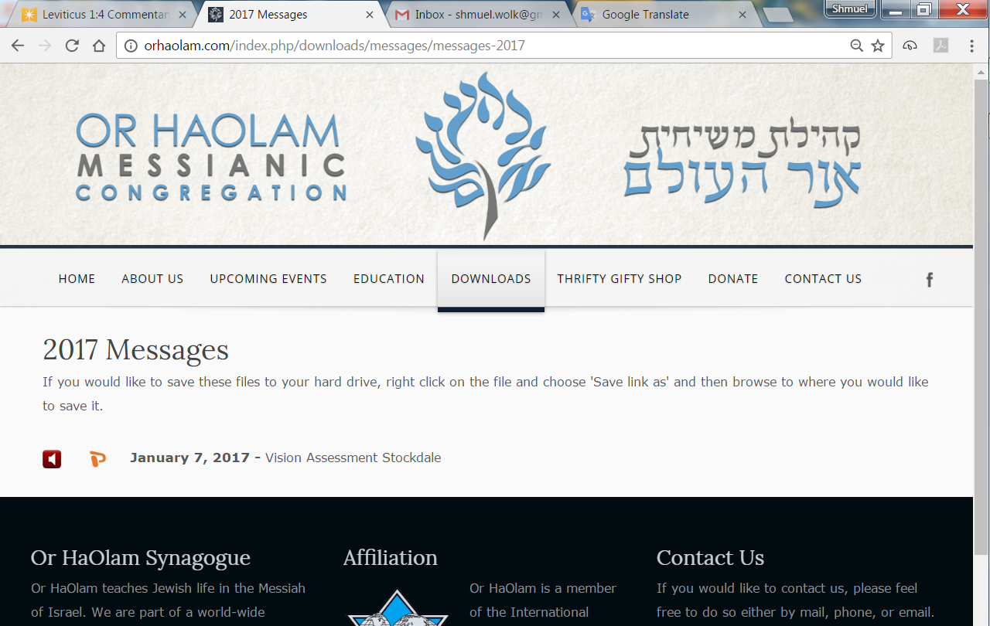

Slide 3
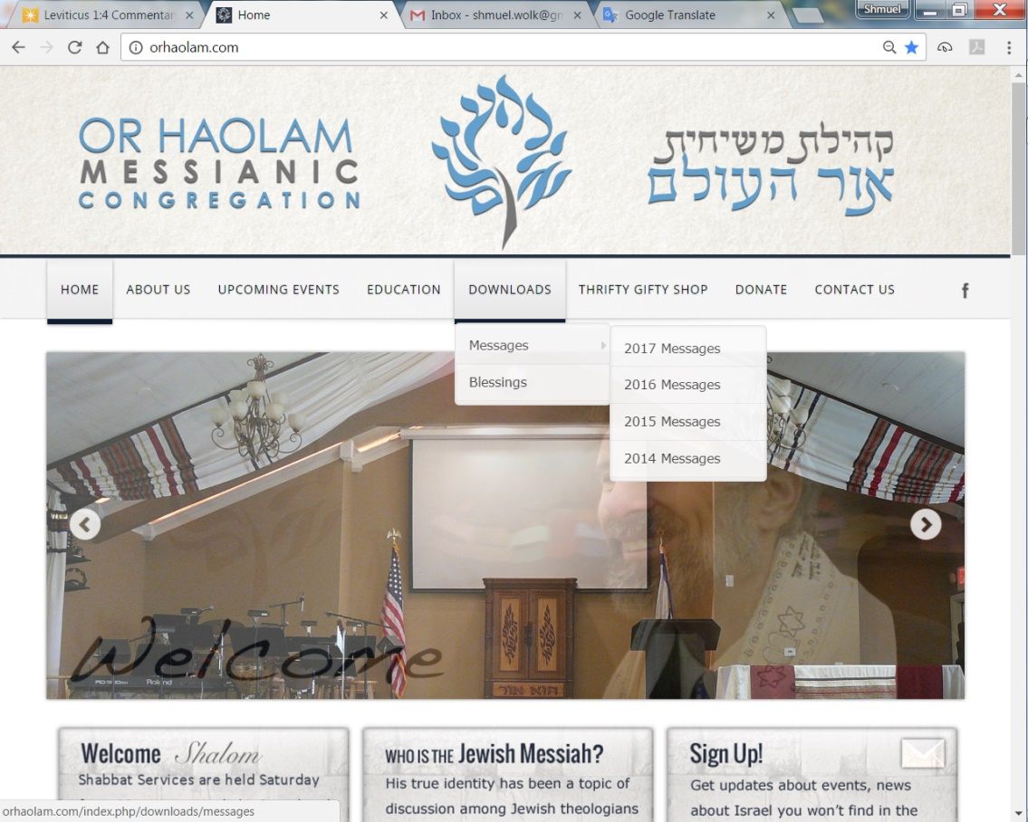
Downloads\messages\
2017 Messages

Slide 4
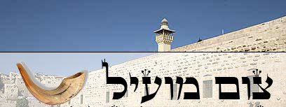
Tsom mo-eel ……..Profitable fast
Tsom Kal צום קל…Easy Fast

Slide 5
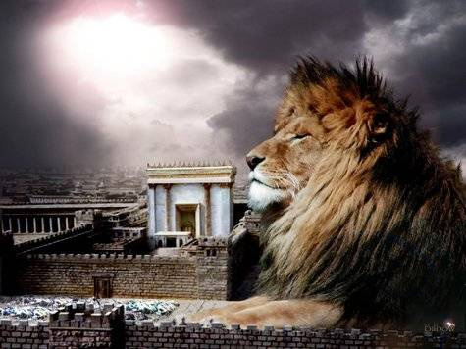
מַתִּתְיָהוּ Mattityahu
(Matthew) 21:6-8
Notes:
Last week, as Y was approaching Yerushaliyim, he sent his men to requisition a donkey for royal service, His service. In sending them, prepped them for accusations. Spoke on dissonance of accusations. Now He has the animals, and entering Yerushaliyim.

Slide 6
Mattityahu (Matthew) 21:6
הַתַּלְמִידִים הָלְכוּ וְעָשׂוּ כְּמִצְוַת יֵשׁוּעַ.
So the talmidim went and did as Yeshua had directed them.

Slide 7
Mattityahu (Matthew) 21:7
הֵם הֵבִיאוּ אֶת הָאָתוֹן וְאֶת הָעַיִר וּלְאַחַר שֶׁשָּׂמוּ עֲלֵיהֶם אֶת בִּגְדֵיהֶם הוּא יָשַׁב עֲלֵיהֶם.
They brought the donkey and the colt and put their robes on them, and Yeshua sat on them.

Slide 8
Mattityahu (Matthew) 21:8
רַבִּים מִן הֶהָמוֹן פָּרְשׂוּ אֶת בִּגְדֵיהֶם עַל הַדֶּרֶךְ וַאֲחֵרִים כָּרְתוּ עֲנָפִים מִן הָעֵצִים וְשָׁטְחוּ אוֹתָם עַל הַדֶּרֶךְ.
Crowds of people carpeted the road with their clothing, while others cut branches from trees and spread them on the road.
Notes:
This was an expression of royalty…

Slide 9
^{2 K 9.12-13} ‘Here is what Adoni says: “I have anointed you king over Isra’el.”’ At this, they hurried each one to take his cloak and put it under Yehu at the top of the stairs. Then they blew the shofar and proclaimed, “Yehu is king!”
Notes:
A significant detail added in the parallel passage in Yohanan/John.

Slide 10
^{Yokhanan 12.12-13} The next day, the large crowd that had come for the festival heard that Yeshua was on his way into Yerushalayim. They took palm branches and went out to meet him

Slide 11
It was Passover time, but they introduced a Sukkot custom. The theme of this message is Yom Kippur Joy [?!], there was here a mixture of Pesakh, Sukkot, royalty reception, and Yom Kippur.

Slide 12
^{Vayikra 23.40} On the first day you are to take choice fruit, palm fronds, thick branches and river-willows, and celebrate in the presence of Adoni your God for seven days.
Notes:
Sukkot instructions Lev 23

Slide 13
^{2 Maccabees 10:5-8 NRSVCE} It happened that on the same day on which the sanctuary had been profaned by the foreigners, the purification of the sanctuary took place, that is, on the twenty-fifth day of the same month, which was Kislev.
Notes:
https://www.biblegateway.com/passage/?search=2+Maccabees+10%3A5-8&version=NRSVCE

Slide 14
^{2 Maccabees 10:5-8 NRSVCE} They celebrated it for eight days with rejoicing, in the manner of the festival of booths, remembering how not long before, during the festival of booths, they had been wandering in the mountains and caves like wild animals.
Notes:
https://www.biblegateway.com/passage/?search=2+Maccabees+10%3A5-8&version=NRSVCE

Slide 15
^{2 Maccabees 10:5-8 NRSVCE} Therefore, carrying ivy-wreathed wands and beautiful branches and also fronds of palm, they offered hymns of thanksgiving to him who had given success to the purifying of his own holy place.
Notes:
https://www.biblegateway.com/passage/?search=2+Maccabees+10%3A5-8&version=NRSVCE
Maccabees about victory, dynasty, Sukkot, start of Hanukkah!

Slide 16
^{2 Maccabees 10:5-8 NRSVCE} They decreed by public edict, ratified by vote, that the whole nation of the Jews should observe these days every year.
Notes:
https://www.biblegateway.com/passage/?search=2+Maccabees+10%3A5-8&version=NRSVCE

Slide 17
וַהֲמוֹן הָעָם שֶׁהָלְכוּ לְפָנָיו וְאַחֲרָיו קָרְאוּ: "הוֹשַׁע-נָא לְבֶן-דָּוִד! בָּרוּךְ הַבָּא בְּשֵׁם יי!
The crowds ahead of him and behind shouted, “Please! Deliver us! “Blessed is he who comes in the Name of Adonai!” to the Son of David;
Mattityahu (Matthew) 21:9
Notes:
This wording is loaded with Sukkot imagery…Psalm 118 Written likely for Sukkot. We’ll read next week.

Slide 18
^{T’hillim/Ps 118.24-27} This is the day Adonai has made, a day for us to rejoice and be glad. Please, Adonai! Save us! Please, Adonai! Rescue us! Blessed is he who comes in the name of Adonai.
Notes:
This Psalm was likely written for Sukkot worship. We will read it in its entirety next week. But the theme fits here.

Slide 19
^{T’hillim/Ps 118.24-27} We bless you from the house of Adonai. Adonai is God, and he gives us light. Join in the pilgrim festival with branches all the way to the horns of the altar.

Slide 20
הוֹשַׁע-נָא בַּמְּרוֹמִים!"
“You in the highest heaven! Please! Deliver us!”
Mattityahu (Matthew) 21:9

Slide 21
וַתִּשְׁתָּחוּ; וַתֹּאמֶר, הוֹשִׁעָה הַמֶּלֶךְ.
^{2 Shmuel 14.4} When the woman of T’koa spoke to the king, she fell down with her face to the ground, prostrating herself, and said, “King, help!”
Notes:
Amy Jill Levine Jewish Annotated New Testament, not a believer but a commentary on the Messianic Scriptures published by Oxford Press, sees this royal treatment as carried into the cry to Yeshua.

Slide 22
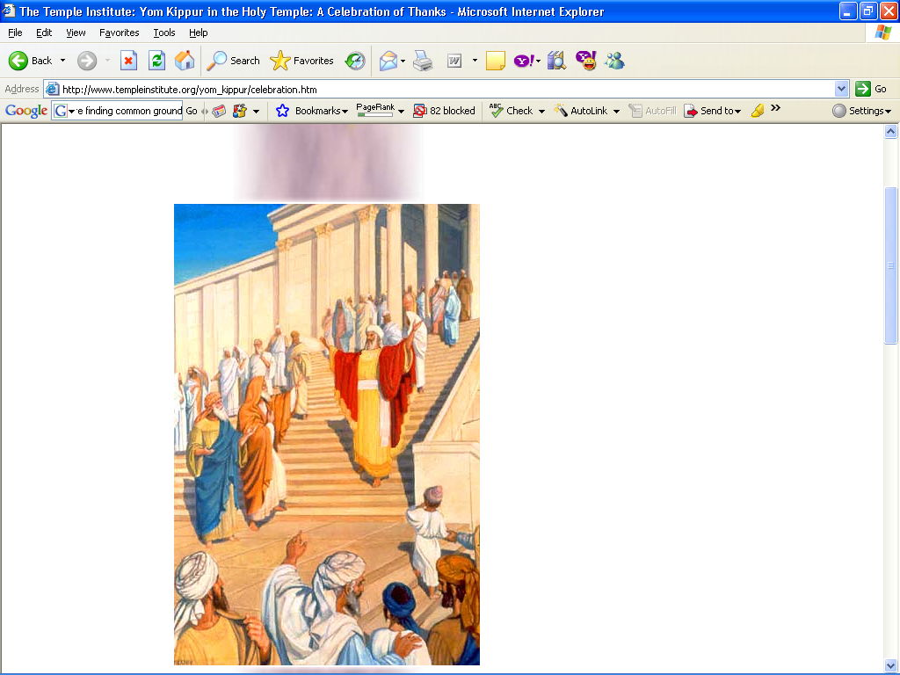

Slide 23
"When the High Priest exited from the holy place unharmed, he made a celebration for his loved ones" (ibid., 4) at the conclusion of Yom Kippur - to give thanks to God that he successfully guided the service, and was neither rendered unfit nor adversely affected.
Notes:
http://www.templeinstitute.org/yom_kippur/celebration.htm
Here is the YK connection. The people were celebrating the arrival of Yeshua as King, a bit like the celebration of the Cohen HaGadol, the High Priest, exiting the Temple after the YK ritual.
I have 79 slides that I used in 2006 that I thought of including here about that great day of YK ritual. But omitting here not to minimize but to magnify Yeshua.
Also because I realized, with the help of my dear wife, that I was cramming and jamming too much stuff, and reading too fast. “unworthy striving”

Slide 24
As we read in the High Holiday Prayer Book for the Day of Atonement, "How radiant was the appearance of the High Priest, when he exited in peace from the holy place! Like flashes of light that emanate from the splendor of the angels -such was the appearance of the High Priest.
Notes:
http://www.templeinstitute.org/yom_kippur/celebration.htm

Slide 25
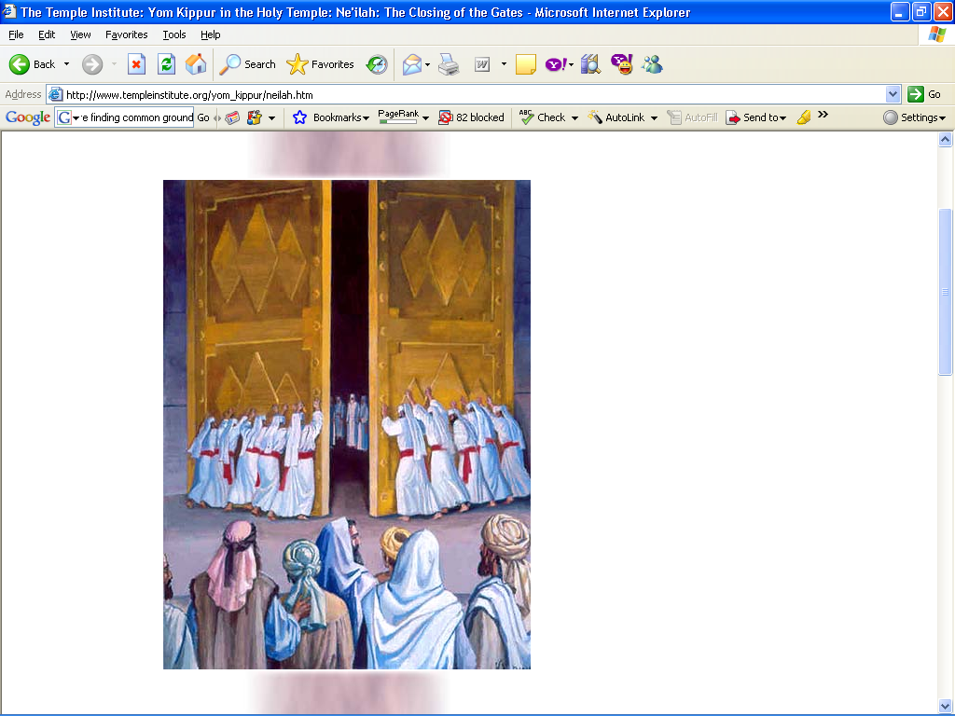
Notes:
NE'ILAH: THE CLOSING OF THE GATES
Just before the setting of the sun, the Levite gatekeepers push shut the gates of the Sanctuary and the Courtyard.

Slide 26
As the Talmud says, “There were never happier days for the Jews than the 15th of Av and Yom Kippur.” What is it about Yom Kippur that makes it such a happy day?
Notes:
https://unitedwithisrael.org/why-is-yom-kippur-the-happiest-day-of-the-year/?utm_source=MadMimi&utm_medium=email&utm_content=Yom+Kippur+Brings+Israel+Joy+and+Meaning%3B+Ancient%2C+Mystical+Ritual+Survives+the+Centuries%3B+Amazing+Insights+on+Holiest%2C+Happiest+Day+of+Year%21&utm_campaign=20170929_m141762098_Yom+Kippur+Brings+Israel+Joy+and+Meaning%3B+Ancient%2C+Mystical+Ritual+Survives+the+Centuries%3B+Amazing+Insights+on+Holiest+Day+of+Year%21&utm_term=more_btn_light_png

Slide 27
Yom Kippur is such a happy day because it is the day God forgives all our sins! Yom Kippur is the anniversary of the day God forgave the Jewish people for having made and worshipped a golden calf.
Notes:
https://unitedwithisrael.org/why-is-yom-kippur-the-happiest-day-of-the-year/?utm_source=MadMimi&utm_medium=email&utm_content=Yom+Kippur+Brings+Israel+Joy+and+Meaning%3B+Ancient%2C+Mystical+Ritual+Survives+the+Centuries%3B+Amazing+Insights+on+Holiest%2C+Happiest+Day+of+Year%21&utm_campaign=20170929_m141762098_Yom+Kippur+Brings+Israel+Joy+and+Meaning%3B+Ancient%2C+Mystical+Ritual+Survives+the+Centuries%3B+Amazing+Insights+on+Holiest+Day+of+Year%21&utm_term=more_btn_light_png

Slide 28
We don’t eat because on Yom Kippur we are supposed to imitate the angels in Heaven who don’t eat. This is also why we wear white and stand much more than usual in the course of the prayers on Yom Kippur – in order to imitate the angels.
Notes:
https://unitedwithisrael.org/why-is-yom-kippur-the-happiest-day-of-the-year/?utm_source=MadMimi&utm_medium=email&utm_content=Yom+Kippur+Brings+Israel+Joy+and+Meaning%3B+Ancient%2C+Mystical+Ritual+Survives+the+Centuries%3B+Amazing+Insights+on+Holiest%2C+Happiest+Day+of+Year%21&utm_campaign=20170929_m141762098_Yom+Kippur+Brings+Israel+Joy+and+Meaning%3B+Ancient%2C+Mystical+Ritual+Survives+the+Centuries%3B+Amazing+Insights+on+Holiest+Day+of+Year%21&utm_term=more_btn_light_png

Slide 29
^{Mes Jews/Heb 9.27-28} Just as human beings have to die once, but after this comes judgment, so also the Messiah, having been offered once to bear the sins of many, will appear a second time, not to deal with sin, but to deliver those who are eagerly waiting for him.
Notes:
His appearance in Jerusalem in this scripture is somewhat analogous to the celebratory appearing of the Cohen Hagadol/ High Priest.
A bit premature celebration, but anticipatory.

Slide 30
^{Mes. Jews/Heb. 9.7} Only the cohen hagadol enters the inner one; and he goes in only once a year, and he must always bring blood, which he offers both for himself and for the sins committed in ignorance by the people.
Notes:
Exactly a YK reference

Slide 31
^{Mes. Jews/Heb. 9.11-14 TLV} But when Messiah appeared as Kohen Gadol of the good things that have now come, passing through the greater and more perfect Tent not made with hands (that is to say not of this creation, He entered into the Holiest Place

Slide 32
^{Mes. Jews/Heb. 9.11-14 TLV} once for all—not by the blood of goats and calves but by His own blood, having obtained eternal redemption. For if the blood of goats and bulls and the ashes of a heifer sprinkling those who have been defiled
Notes:
Lev. 16:14-15. Num. 19:9, 17-18.

Slide 33
^{Mes. Jews/Heb. 9.11-14 TLV} sanctify for the cleansing of the flesh, how much more will the blood of Messiah—who through the eternal Spirit offered Himself without blemish to God—cleanse our conscience from dead works to serve the living God?

Slide 34

Clean up, YouTube
Notes:
https://unitedwithisrael.org/why-is-yom-kippur-the-happiest-day-of-the-year/?utm_source=MadMimi&utm_medium=email&utm_content=Yom+Kippur+Brings+Israel+Joy+and+Meaning%3B+Ancient%2C+Mystical+Ritual+Survives+the+Centuries%3B+Amazing+Insights+on+Holiest%2C+Happiest+Day+of+Year%21&utm_campaign=20170929_m141762098_Yom+Kippur+Brings+Israel+Joy+and+Meaning%3B+Ancient%2C+Mystical+Ritual+Survives+the+Centuries%3B+Amazing+Insights+on+Holiest+Day+of+Year%21&utm_term=more_btn_light_png

Slide 35
1517: Ottoman conquers Jerus
1517: Beginning of Luther’s Ref
1917: British Protestants Jerus
1967: Jewish nation Jerusalem
1967: Charismatic Renewal
1967: founding of the YMJA
2017: Global alignment and Muslim evangelism

Slide 36
Let’s summarize these years:
1517 was 500 years ago or 10 jubilees
1917 was 100 years ago or 2 jubilees
1967 was 50 years ago or 1 jubilee

Slide 37
Israel became a nation in 1948. The year 2018 is 70 years from that time. A period of 70 years is described as turning point dates for the restoration of the kingdom to Israel (Jeremiah 25:11; 29:10; Daniel 9:2, 24). The period of 70 years is to cross over to a new paradigm from what happened previously. It is to cross into the next historic stage.

Slide 38
The year 2018 is a 70-year completion for the State of Israel. Now is the time for the next stage. It is the time for the spiritual restoration to rise out of the natural restoration. It is the time for the revival stage of the restoration of the nation of Israel. It is the time for the Messianic remnant of Israel to take its place.

Slide 41
עֲבוֹדַת יוֹם כִּפּוּר
Yom Kippur Service
Shakharit
Yom Kippur

Slide 42
^{Viyikra/Lev. 16.4} “Here is how Aharon is to enter the Holy Place. . . He is to put on the holy linen tunic, have the linen shorts next to his bare flesh, have the linen sash wrapped around him, and be wearing the linen turban–– they are the holy garments. He is to bathe his body in water and put them on.

Slide 43
First of five immersions, above the Water Gate

Slide 44
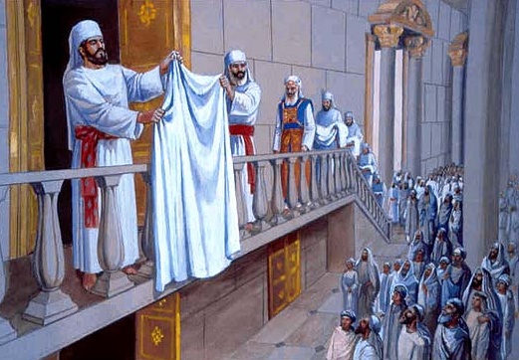
Notes:
THE IMMERSION OF THE HIGH PRIEST
On the morning of Yom Kippur, the High Priest ascends the stairway above the Water Gate, in order to perform his first of five required immersions into the ritual bath on Yom Kippur

Slide 45
The remaining four immersions that take place during the day are done in a ritual bath atop the Parvha Chamber. A white lined sheet is held up separating the High Priest from the onlookers. This is done as a reminder to all onlookers that the High Priest will administer the Atonement service wearing white garments only.

Slide 46
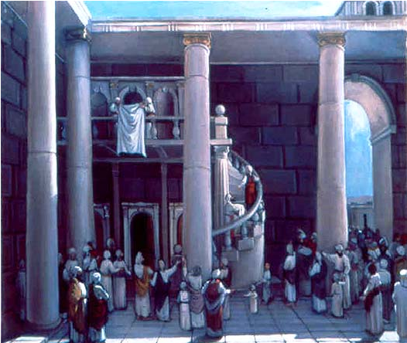
Notes:
THE IMMERSION OF THE HIGH PRIEST
The remaining four immersions that take place during the day are done in a ritual bath atop the Parvha Chamber. A white lined sheet is held up separating the High Priest from the onlookers. This is done as a reminder to all onlookers that the High Priest will administer the Atonement service wearing white garments only.

Slide 47
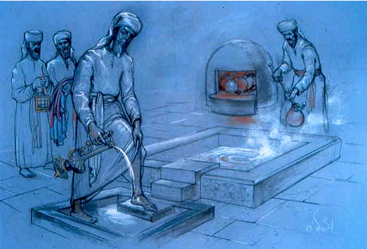
Notes:
THE HIGH PRIEST SANCTIFIES HIS HANDS AND FEET
Before entering the ritual bath, the High Priest first sanctifies his hands and feet, pouring water on them from a golden vessel. Upon emerging from the ritual bath, he would again sanctify his hands and feet in the same manner.

Slide 48
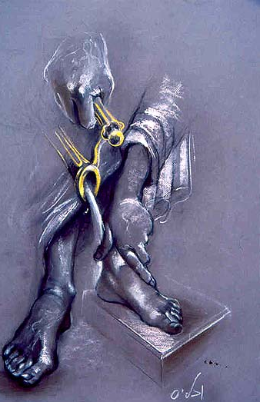
Notes:
SANCTIFYING THE HANDS AND FEET On all other days of the year, the High Priest would sanctify his hands and feet using a copper vessel. Only on Yom Kippur would he use a gold vessel for this purpose.

Slide 49
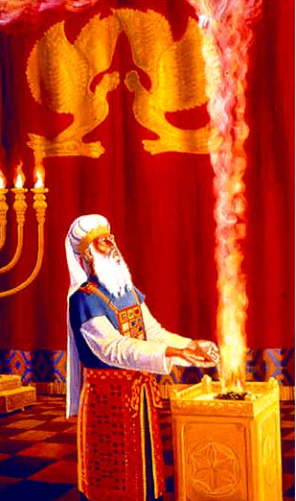
Notes:
THE DAILY INCENSE OFFERINGOn Yom Kippur The High Priest would make three separate offerings of incense. The first two offerings were done upon the golden incense altar located in the Kodesh, (the Sanctuary). Facing north, the High Priest pours the incense onto the altar, as the column of smoke rises.

Slide 50
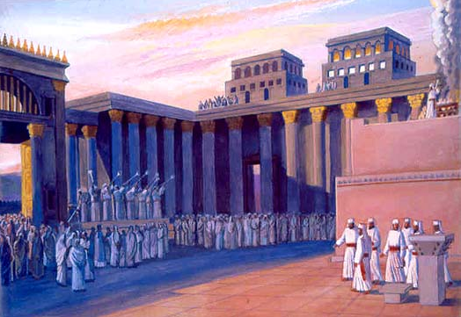
Notes:
THE COURTYARD FILLS WITH PEOPLE
At dawn the gates are opened, and the people begin to pour in.

Slide 51
^{Bamidbar/Nu 29.7-11} “‘On the tenth day of this seventh month you are to have a holy convocation. You are to deny yourselves, and you are not to do any kind of work; 8 but you are to present a burnt offering to Adoni to make a fragrant aroma: one young bull, one ram, and seven male lambs in their first year (they are to be without defect for you),

Slide 52
with their grain offering, fine flour mixed with olive oil, six quarts for the bull, four quarts for the one ram, and two quarts for each of the seven lambs; also one male goat as a sin offering; in addition to the sin offering for atonement and the regular burnt offering with its grain offering, and their drink offerings.

Slide 53
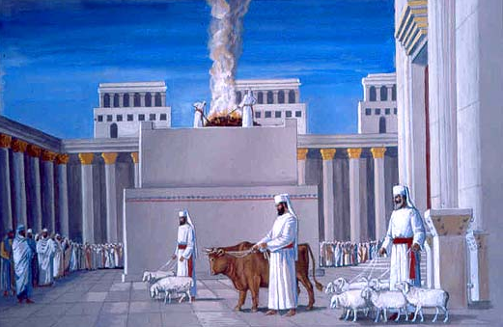
Notes:
THE YOM KIPPUR OFFERINGS
"You shall present a burnt offering for an appeasing fragrance to G-d: one young bull, one ram, and seven yearling sheep, making sure that all are devoid of blemish... There shall also be one goat for a sin offering..." (Numbers 29:11)

Slide 54
^{Viyikra/Lev. 16.3,5,6} “Here is how Aharon is to enter the Holy Place: with a young bull as a sin offering and a ram as a burnt offering. “He is to take from the community of the people of Israel two male goats for a sin offering and one ram for a burnt offering. Aharon is to present the bull for the sin offering which is for himself and make atonement for himself and his family.

Slide 55
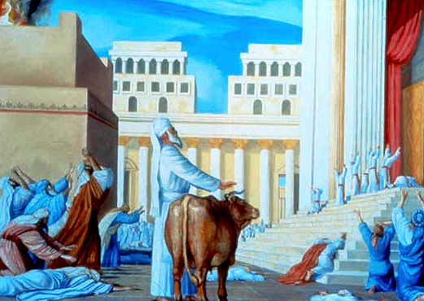
Notes:
THE YOM KIPPUR SERVICE
"And God spoke to Moses after the death of Aaron's two sons, who brought an (unauthorized) offering before the Lord and died. And God said to Moses: Speak to your brother Aaron, and let him not enter the holy place that is beyond the partition concealing the ark at any time, so that he may not die, since I appear over the ark cover in a cloud."
"Only thusly shall Aaron enter into the holy place: with a young bullock for a sin offering, and a ram for a burnt offering. He shall put on the sanctified white linen tunic, and have linen pants on his flesh. He shall gird himself with a linen sash, and bind his head with a linen turban. These are sacred vestments; before putting them on, he must immerse himself. And he shall take from the congregation of the children of Israel two goats for a sin offering, and one ram for a burnt offering. And Aaron shall offer the bullock of the sin offering which is for himself, and he shall make atonement for himself and for his family... " (Leviticus 16)
THE HIGH PRIEST'S ORAL CONFESSION
The High Priest drew near to the animal. Facing the sanctuary, he placed his two hands on the bullock's head, between its horns, and confessed. This was in keeping the directives of the verse (ibid.): "And Aaron shall offer the bullock of the sin offering which is for himself, and he shall make atonement for himself and for his family... " The sages of Israel received a tradition that these words refer to oral confession.
And this was the wording of the High Priest's confession:
"I beseech You, O Lord;
I have sinned, rebelled, and transgressed against You,
I, and my household;
I beseech You, O Lord,
Grant atonement for the sins,
and for the iniquities and transgressions
which I have commited against You,
I, and my household.
As it is written in the Torah
of Your servant, Moses:
'For on this day
atonement shall be made for you,
to purifiy you from all your sins
- before the Lord you shall be purified'."

Slide 56
Facing the sanctuary, he placed his two hands on the bullock's head, between its horns, and confessed.
The sages of Israel received a tradition that these words refer to oral confession.
And this was the wording of the High Priest's confession:

Slide 57
"I beseech You, YHVH; [שֵׁם הַמְּפֹרָשׁ
Shem HaM’forash, “proper Name”]
בָּרוּךְ שֵׁם כְּבוֹד מַלְכוּתוֹ לְעוֹלָם וָעֶד.
Ba-rookh shaym k'vod malkhoo-to
l'olam va-ed.
Blessed is the name of his glorious kingdom, forever and ever.
I have sinned, rebelled,

Slide 58
and transgressed against You,
I, and my household;
I beseech You, O YHVH,
בָּרוּךְ שֵׁם כְּבוֹד מַלְכוּתוֹ לְעוֹלָם וָעֶד.
Ba-rookh shaym k'vod malkhoo-to
l'olam va-ed.
Blessed is the name of his glorious kingdom, forever and ever.

Slide 59
Grant atonement for the sins,
and for the iniquities and transgressions
which I have committed against You,
I, and my household.
As it is written in the Torah
of Your servant, Moses:

Slide 60
'For on this day
atonement shall be made for you,
to purifiy you from all your sins
- before YHVH you shall be purified'.“
בָּרוּךְ שֵׁם כְּבוֹד מַלְכוּתוֹ לְעוֹלָם וָעֶד.
Ba-rookh shaym k'vod malkhoo-to
l'olam va-ed.
Blessed is the name of his glorious kingdom, forever and ever.

Slide 61
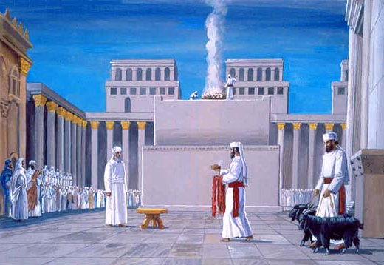
Notes:
THE SCAPEGOAT
Though all of the moving service on the Day of Atonement is fraught with poignancy, tense anticipation and deep personal stirrings of repentance, surely one of the most dramatic moments of the day is the lottery which the High Priest conducts... for this is the process that will determine the scapegoat, which will be cast off as an atonement for Israel's sins.
After confessing over his bullock, the High Priest walks to the eastern section of the court, facing the entrance. He is accompanied by two men: at his right, the "assistant," who is actually none other than the replacement priest who was designated as a stand-in for the High Priest, should he be rendered unfit. At his left, the head of the family clan who is responsible for the service in the Temple on that day of the week.

Slide 62
He is to take the two goats and place them before ADONAI at the entrance to the tent of meeting. 8 Then Aharon is to cast lots for the two goats, one lot for ADONAI and the other for ‘Az’azel.

Slide 63
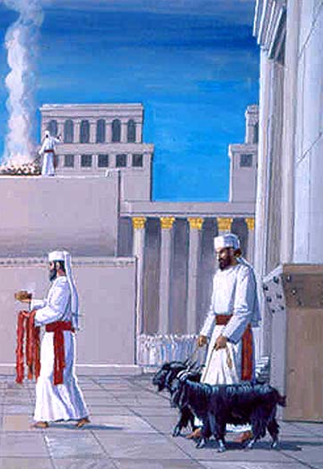
Notes:
THE TWO GOATS AND THE LOTTERY BOX
There in the eastern sector of the court, to the north of the altar, stand two goats in preparation for the lottery:
"And he shall take from the congregation of the children of Israel two goats for a sin offering, and one ram for a burnt offering... and he shall take the two goats, and present them before the Lord at the door of the Tent of Meeting. And Aaron shall cast lots upon the two goats; one lot for the Lord, and the other lot for Azazel... " (Lev. 16.7)
A wooden lottery box was kept there as well, and within it were the two lots, in accordance with the verses above. This box was just large enough to hold the two lots, and for the priest to put both his hands inside. On one lot the two Hebrew words meaning "For the Lord" were written, and the other was inscribed with single word "For Azazel."
Azazel is actually the name of a place; it was to this location that the scapegoat was sent. Azazel was a high, rocky precipice in the Judean desert. The goat was sent off this point to its death.
These lots were originally made of wood. This was probably what we know today as boxwood; some have written that a wood resembling mahogany was used. Later, the lots were prepared from gold by the High Priest, Yehoshua ben Gamla, during his term of office. He was praised by the sages for this initiative, which was done to increase the honor of the holy day.

Slide 64
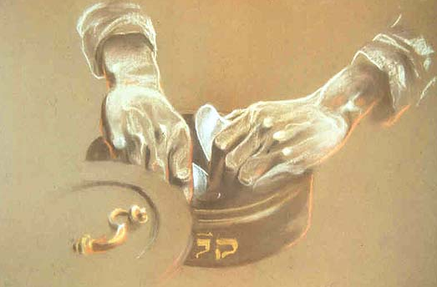
Notes:
DRAWING THE LOTS
Flanked by the two men on either side of him, the High Priest thrusts his hands into the lottery box and stirs the two lots within, in order to ascertain that he has no notion of which is inscribed "For the Lord." It was considered an auspicious sign from Heaven if that lot were to drawn by his right hand; thus he mixes the lots about so that he will not recognize them, and thereby raise that lot in his right hand. Tradition does in fact record that for a period of many years, it actually transpired that the High Priest's right hand did arbitrarily come up holding the lot marked "For the Lord." This phenomena ceased a number of years before the Temple's destruction.
Other opinions maintain that he drew the lots very quickly from their box, demonstrating that he acts without forethought or hesitation as to which lot he is raising.
In this manner, the High Priest raised up the two lots from the box, one in his right hand and one in his left. Only once he held them up did he learn which hand held each lot:

Slide 65
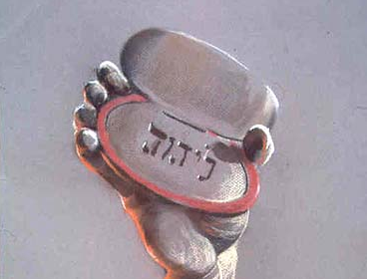
Notes:
"RAISE UP YOUR RIGHT HAND!"If his right hand held the lot of "For the Lord," the assistant would declare "Master! High Priest! Raise up your right hand!" And hearing this cry, all those assembled would receive the tiding, and know that this favorable sign has indeed transpired. But if his left hand was seen to contain this lot, the head of the family clan cried out "Master! High Priest! Raise up your left hand!" And thus the deed would be known.

Slide 66
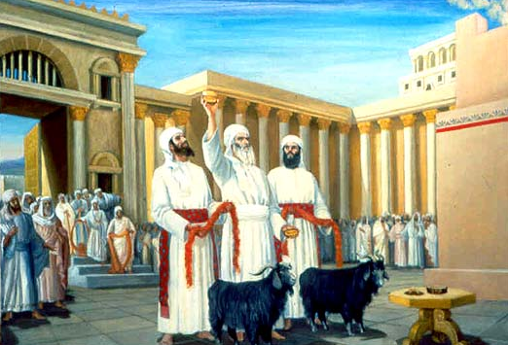
Notes:
THE FATEFUL LOTTERY
Great anticipation and feelings of repentance mark the entire Yom Kippur service. One of the most dramatic moments is the lottery selecting the scapegoat which acts as an atonement for Israel's sins. This High Priest is seen above, flanked by the Deputy High Priest on his right, and the head of the family on duty, on his left.

Slide 67
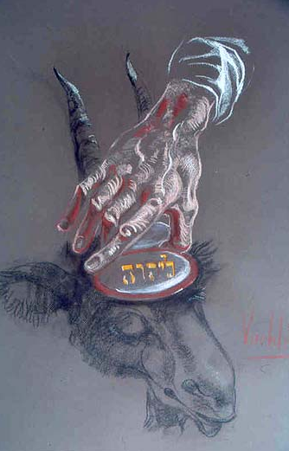
Notes:
PLACING THE LOTS
The High Priest then places these lots upon the heads of the goats, between their horns: that which he raised up in his right hand is placed upon the animal to his right, and of the left, to his left. When placing the lot of "For the Lord" upon the sacrifice, he recites aloud the words "For the Lord, a sin offering," once again pronouncing the holy Ineffable Name of God. All the priests and Israelites present who hear this name repeat the verse "Blessed is the name... ," as above.

Slide 68
After placing the lots upon the goats, the High Priest ties a length of crimson-dyed wool between the horns of the scapegoat, and stands the goat facing the Temple's eastern gate, through which it will be led off. He also ties a similar length of wool around the neck of the goat which will be sacrificed.

Slide 69
This elongated skein of wool is called a "tongue" in the language of the Mishna, on account of its shape. They were tied around the goats in order to prevent them from being mixed up with other animals, and each was tied in a distinctive manner so that they should not be confused with each other.

Slide 70
These lengths of wool were specifically dyed crimson on account of the verse which reads, "Though your sins are as scarlet, they shall whiten as snow; though they be red like crimson, they shall be white as wool" (Isaiah 1:18). It is related that a great miracle occurred concerning this crimson-colored wool:

Slide 71
The sage Rabbi Yishmael taught (Yoma 6, 8) that when the scapegoat reached its destination in the desert, this wool miraculously turned white before the eyes of all Israel, in keeping with the words of the prophet - and thus providing a Heavenly sign that the sins of the people had been atoned for.

Slide 72
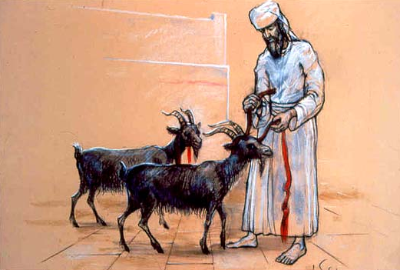
Notes:
A "TONGUE OF CRIMSON WOOL"
After placing the lots upon the goats, the High Priest ties a length of crimson-dyed wool between the horns of the scapegoat, and stands the goat facing the Temple's eastern gate, through which it will be led off. He also ties a similar length of wool around the neck of the goat which will be sacrificed. This elongated skein of wool is called a "tongue" in the language of the Mishna, on account of its shape. They were tied around the goats in order to prevent them from being mixed up with other animals, and each was tied in a distinctive manner so that they should not be confused with each other.
THE MIRACLE OF THE CRIMSON WOOL
These lengths of wool were specifically dyed crimson on account of the verse which reads, "Though your sins are as scarlet, they shall whiten as snow; though they be red like crimson, they shall be white as wool" (Isaiah 1:18). It is related that a great miracle occurred concerning this crimson-colored wool: For in addition to the piece which was tied to the scapegoat, a similar length was tied to the entrance of the Sanctuary where all could behold it, high up like a banner. The sage Rabbi Yishmael taught (Yoma 6, 8) that when the scapegoat reached its destination in the desert, this wool miraculously turned white before the eyes of all Israel, in keeping with the words of the prophet - and thus providing a Heavenly sign that the sins of the people had been atoned for.
The two goats thus prepared, the High Priest will now leave them be and proceed with other aspects of this singular day's ceremonies. He will return to the sacrifice and the azazel only later, after the services of the bullock and the incense are completed. All the various components and aspects of the Yom Kippur service must be done according to a specific order

Slide 73
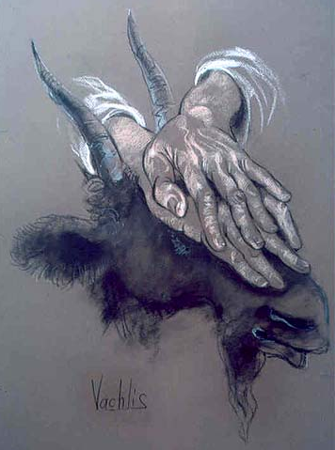
Notes:
THE SECOND ORAL CONFESSION
Now the High Priest once again draws near to his own offering, the bullock. At this time he will again confess over the animal; the first time he did this, his confession was on behalf of himself and his family. This time he confesses on behalf of all his fellow priests. Once again he places his hands on the animal's head, between its horns, and pronouncing the Ineffable Name he recites his plea:
"I beseech You, O Lord; I have sinned, rebelled, and transgressed against You, I and my household, And the sons of Aaron, Your holy people; I beseech You, O Lord, Grant atonement for the sins, and for the iniquities and transgressions which I have committed against You, I and my household, And the sons of Aaron Your holy people - . As it is written in the Torah of Your servant, Moses: 'For on this day atonement shall be made for you, to purify you from all your sins - before the Lord you shall be purified'."

Slide 74
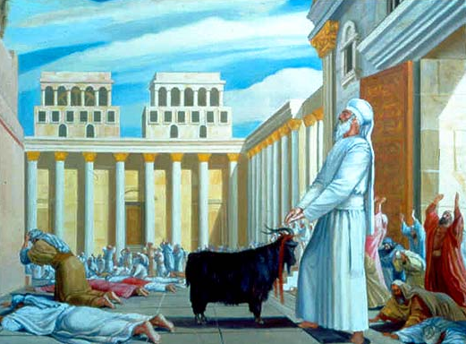
Notes:
"BLESSED BE THE NAME OF HIS GLORIOUS KINGDOM, FOR EVER AND EVER."As above, the congregation responds with the words "Blessed be the Name of His glorious kingdom, for ever and ever."The Talmud explains that first the High Priest atones for his own sins and those of his family, and only afterwards does he make atonement for his colleagues... for it is better for an innocent man to make rectification for those who are liable.

Slide 75
^{Viyikra/Lev. 16.11-13} “Aharon is to present the bull of the sin offering for himself; he will make atonement for himself and his household; he is to slaughter the bull of the sin offering which is for himself.

Slide 76
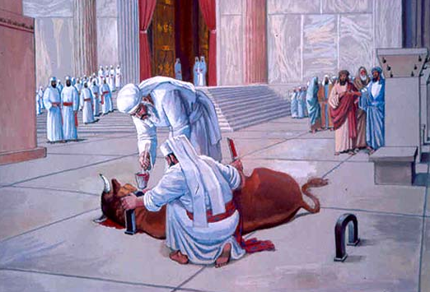
Notes:
THE BULLOCK IS SLAUGHTERED
At the conclusion of his second confession, the High Priest slaughters the bullock. He receives the offering's blood in the mizrak vessel, and then gives this vessel to another priest. The former immediately goes to prepare for the incense service, and the latter must stand outside the entrance to the Sanctuary and hold this vessel, continuously moving it with a stirring motion. This in done in order to prevent its contents from beginning to harden - since this would invalidate it to be dashed upon the altar.
The second priest, thus occupied with the mizrak, waits in this spot for the return of the High Priest, who will bring the mizrak into the Sanctuary. In the meantime, the High Priest asends to the top of the altar in the court, carrying a golden shovel equipped with a specially long handle - designed to aid him in performing the particularly difficult movements he will require to conduct the incense service alone on this holy day.

Slide 77
He is to take a censer full of burning coals from the altar before Adoni and, with his hands full [double handful] of ground, fragrant incense, bring it inside the curtain. He is to put the incense on the fire before Adoni, so that the cloud from the incense will cover the ark–cover which is over the testimony, in order that he not die.

Slide 78
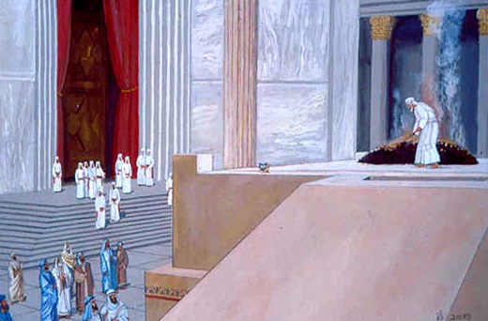
Notes:
COALS FOR THE INCENSE
Atop the altar, the High Priest uses the shovel to stir the fire, and he gathers some of the burning coals from the midst of the fire into this vessel. When he desends the ramp, he will return to where the priest waits with the mizrak, and he will place the shovel and its coals on the floor, next to where his colleague stands
THE HIGH PRIEST'S STEPS BEAR WITNESS TO THE GREATNESS OF THE DAY
Every aspect of the Divine service on this awesome day reflected the special status and sanctity which is inseparable from the very nature of the day itself; a day of sublime communion with the Creator; a day of resolve and repentance; a day of both great inner peace and national unity.
Thus every movement made during the service and literally every step taken by the High Priest was imbued with great significance and meaning. Even his very steps along the altar ramp marked the special character of the moment and rang out the words "This is the Day of Atonement!" For all year long, the priests would go to and fro the altar by walking along the periphery of the ramp; ascending along the eastern side and descending on the west. Their strong sense of reverence and awe for the Holy One had a humbling effect on their number, and they would have considered it a brazen act to walk right up the center of the ramp.
Yet today, on Yom Kippur, the High Priest (accompanied by the assistant, on his right side) walks right along the middle of the ramp. The symbolism of this action is clear: Today, let all take note of Israel's honor, and her fondness in the Holy One's eyes. So much does He cherish Israel, that today - on this day when all her sins are forgiven - Israel can behave like a child in her father's house, openly declaring their love and affection.

Slide 79
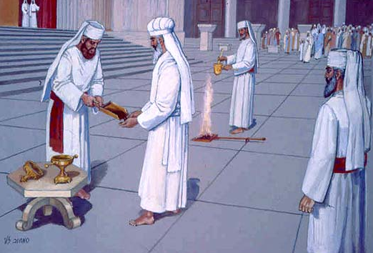
Notes:
THE INCENSE SERVICE
"He shall take a shovelful of burning coals from the altar that is before the Lord, and a double handful of finely ground incense, and he will bring them (into the inner sanctuary) beyond the curtain" (Lev. 16:12).
A "DOUBLE HANDFUL"
After having placed the shovelful of burning coals on the floor near the Sanctuary, other priests now bring their senior the two other items he will use to conduct the incense service:
a large golden spoon (empty) which was brought from the Chamber of Vessels, and a golden shovel, filled with finely ground incense, brought from the Chamber of the Avtinas Family where the incense is prepared.
From the verse above, the sages deduced that the High Priest must remove the incense from the shovel directly into his two palms, without the aid of a vessel; this is the Bible's requirement - "a double handful of finely ground incense." Thus, there was no set measurement of how much incense was to be brought. It was literally the amount which fitted into each High Priest's palms; the amount therefore differed for each man depending on the size of his hands

Slide 80
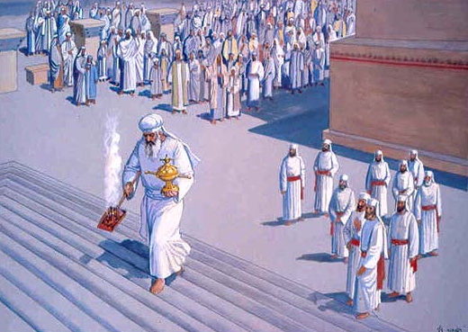
Notes:
ENTERING INTO THE SANCTUARY
He then places the incense in his hands into the golden spoon and holds it with his left hand. In his right hand, he picks up the shovelful of burning coals from the floor before him. In this manner, carrying the spoonful of incense and the shovel of coals, he enters into the Sanctuary until he comes to the two curtains which separate between the Holy (the Sanctuary, which housed the menorah, table and incense altar) and the Holy of Holies.
In the First Temple, a wall the thickness of one amah (app. 48 or 60 centimeters) separated between these two areas. However, in the Second Temple the two curtains once again formed this distinction, as in the days of the Tabernacle. The two curtains themselves were separated by an empty space measuring one amah wide, like that wall which stood in Solomon's Temple

Slide 81
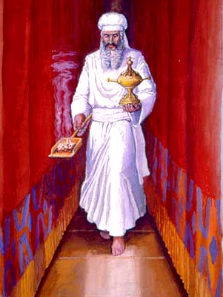
Notes:
BETWEEN THE CURTAINS
One end of each of these two curtains was folded over on the outside and pinned up by a golden clasp; the outer curtain was pinned on the southern side, and the inner, on the northern side. Thus an aisle was formed which provided an open passageway between the two curtains. Carrying the implements, the High Priest walked between the curtains until he reached the northern side of the inner curtain - the spot where it was held up.

Slide 82
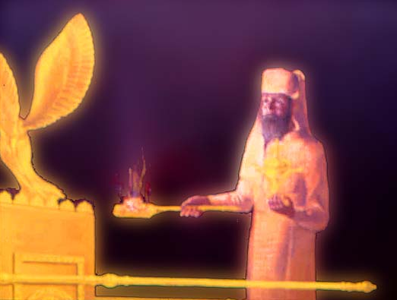
Notes:
IN THE HOLY OF HOLIES
Here the High Priest stood at the opening of the Holy of Holies. He now turns and faces the south with his left side along the length of the curtain, so that he may walk to the center of the room to stand in the place known as "between the poles" - between the two poles of the Ark of the Testimony. However, the Holy of Holies was empty... for the Ark of the Testimony did not stand in the Second Temple.

Slide 83
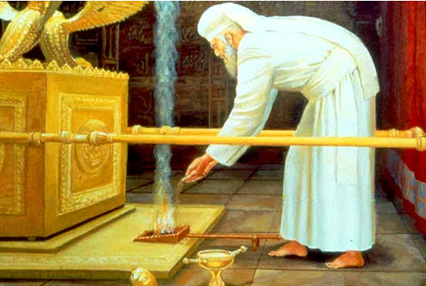
Notes:
PLACING THE COALS DOWN: FIRST TEMPLE
When the Tabernacle and First Temple stood, the High Priest faced the holy Ark of the Testimony and placed the shovel of coals down, directly between the two poles of the ark

Slide 84
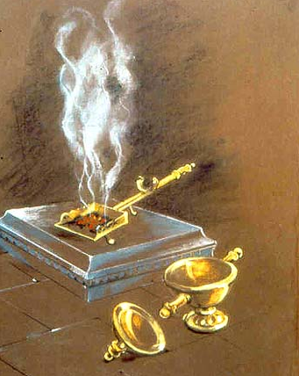
Notes:
PLACING THE COALS DOWN: SECOND TEMPLE
But in the face of the ark's absence in the Second Temple era, he would place the shovel down on the foundation stone itself, in the place where the poles would be extending had the ark been there.

Slide 85
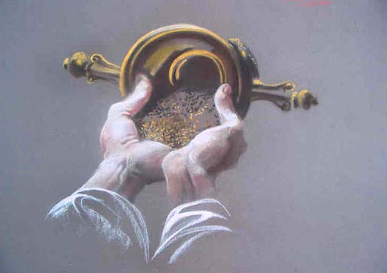
Notes:
THE MOST DIFFICULT TASK OF ALL
Once the High Priest put down the shovel, he must then return the fine incense powder from the spoon and back into his palms - for when he places the incense on the coals, it must be directly from his palms, the "double handful." This was the most difficult task ever done by one person in the Holy Temple; it required great expertise. It would appear to be a nearly impossible feat for someone who had not practiced and been totally prepared. It was done in the following manner: The High Priest takes the spoon full of incense and slowly pulls it with his two thumbs against his arms and body, with the handle resting against him (some maintain that he actually held the top of the handle in his teeth). He balances the body of the spoon itself until it is level with his hands. Then he gently leans the spoon into his palms, turning and rocking it back and forth so that the contents are emptied into his palms.

Slide 86
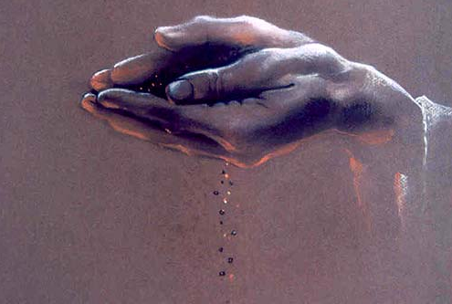
Notes:
NOT EVEN ONE GRAIN MAY FALL
As we have described it, this process is difficult enough to accomplish. But what makes the exercise even more formidable - enough to merit the appellation of "the most difficult task of all" - is the requirement that the High Priest must not allow even one tiny grain to fall. The entire contents within the spoon must be completely transferred to his hands, to the very last drop. For if even a negligible measure is missing, then the amount he will be placing on the coals is no longer a double handful, for something fell from his hands. Thus he would not be fulfilling God's requirement
PLACING THE INCENSE ON THE COALS
From his palms the High Priest places the incense onto the coals in the shovel, on the side of the shovel away from where he is standing, so that he will not be burned as the flames ignite. He stands there and waits momentarily, until the entire chamber is filled with smoke.
The Yom Kippur incense offering completed, he then exits the Holy of Holies with extreme reverence - backwards, entering through the two curtains back into the Sanctuary without once having turned his back on the holy place

Slide 87
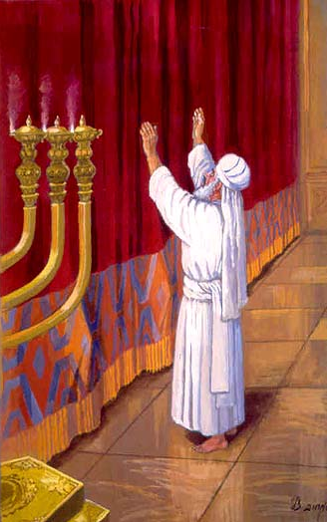
Notes:
THE HIGH PRIEST'S "SHORT" PRAYER
Standing alone in the Sanctuary, the High Priest has successfully entered and exited the holiest place on earth - the center of creation and of God's glory. He has made atonement for his people in the manner which God has prescribed for this holy day. Thus it would be most natural for him to reflect upon this rarefied moment of Divine communion by offering his own heartfelt prayer.
Yet this prayer, recorded by the Talmud, is remarkably short and concise:
"May it be Your will, Lord our God, that if this coming year be hot, that it also be rainy; and may the scepter not depart from the house of Judah (see Gen. 49:10); and may Your people Israel not be dependent on each other for their livlihood; and do not pay heed to the prayers of wayfarers (who pray that it should not rain, so that they will not be inconvenienced in their journey).“A TIME FOR BREVITY
There was good reason for the High Priest's decision not to elongate his prayer at this particular time: many a High Priest was struck down dead while in the Holy of Holies. Although the First Temple stood for 410 years, in all there were only 12 High Priests during that entire period; because they were very righteous, they were blessed with longevity. However the Second Temple, which stood for a total of 420 years, was presided over by more than 300 High Priests. This is because in the spiritual decline of those days, many of these men were corrupted, and bought their office through influence.
Additionally, if he would change any detail of the incense service within the Holy of Holies (as we mentioned with regard to the Sadducees), he would also die. With this is mind, it is understandable that the eyes of all Israel awaited the exit of the High Priest with bated breath. Being aware of his people's agitation, the High Priest's first concern was that he should not cause them any unnecessary anxiety... and the longer he stayed within, the more Israel's apprehension grew. Thus the High Priest saw fit to forego the opportunity to engage in a long personal prayer, and recited the shorter version so as to exit the Sanctuary with reasonable speed.

Slide 88
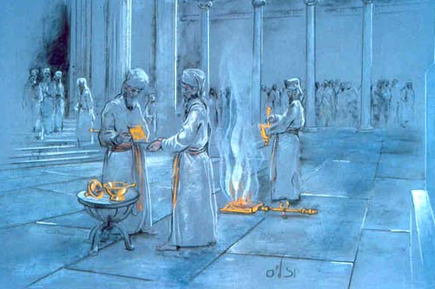
Notes:
EXITING - AND REENTERING
In the next stage of the Yom Kippur service, after the High Priest concluded the incense service, uttered his prayer and exits the Sanctuary, he returns to the priest who is waiting for him outside the entrance. This priest has been waiting here since the bullock was slaughtered, holding the mizrak and moving it about so that its contents will not harden.
The High Priest now receives this vessel from his colleague and returns back into the Holy of Holies a second time, exactly as he did previously. Walking through the two curtains and carrying the vessel holding the blood of his offering, he comes back to spot "between the poles" where he placed the incense on the coals atop the foundation stone

Slide 89
^{Viyikra/Lev. 16.14} He is to take some of the bull’s blood and sprinkle it with his finger on the ark–cover toward the east; and in front of the ark–cover he is to sprinkle some of the blood with his finger seven times.

Slide 90
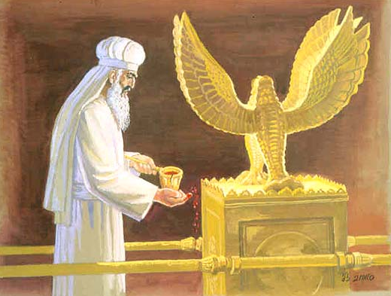
Notes:
SPRINKLING THE BLOOD OF THE BULLOCK
There, he sprinkles in the air with his finger from the contents of the mizrakh, towards the spot of the ark-cover. This is as specified by the verse (Lev. 16:14), "He shall take some of the bullock's blood, and with his forefinger he shall sprinkle it above the east side of the ark cover. He shall then sprinkle with his forefinger seven times directly towards the ark cover."
Afterwards he leaves the Holy of Holies (in the same manner we have discussed above), and places the vessel on a golden stand within the Sanctuary. SPRINKLING THE BLOOD OF THE BULLOCK (CONTINUED)
The verse refers to small drops flung from the tip of the finger. As in the incense service, when the ark was not present the High Priest sprinkled in the direction of the place of the ark. He sprinkles with an upwards motion once...

Slide 91
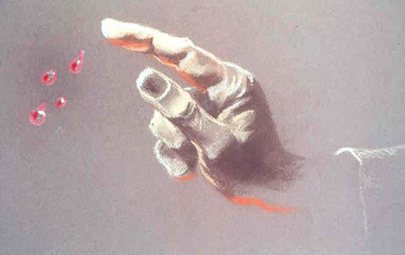
Notes:
SPRINKLING THE BLOOD OF THE BULLOCK (CONTINUED)
... followed by seven times down.
Afterwards he leaves the Holy of Holies (in the same manner we have discussed above), and places the vessel on a golden stand within the Sanctuary.

Slide 92
^{Viyikra/Lev. 16.15-16} “Next, he is to slaughter the goat of the sin offering which is for the people, bring its blood inside the curtain and do with its blood as he did with the bull’s blood, sprinkling it on the ark–cover and in front of the ark–cover.

Slide 93
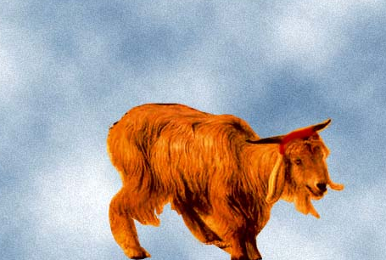
Notes:
SLAUGHTERING THE GOAT DESIGNATED "FOR GOD"
ENTERING THE HOLY OF HOLIES AGAIN
Outside in the court, the goat which had been designated as "For God" by the lottery is now brought to the High Priest. He slaughters the animal and gathers its blood into another mizrak vessel.
He then enters into the Holy of Holies for the third time, this time carrying the vessel with the blood of the goat. He enters into the chamber exactly as he did the previous times, and again walks to the same precise spot. Here, "between the poles," he sprinkles from the blood as before and then exits, placing this vessel on a second golden stand pre-positioned within the Sanctuary.

Slide 94
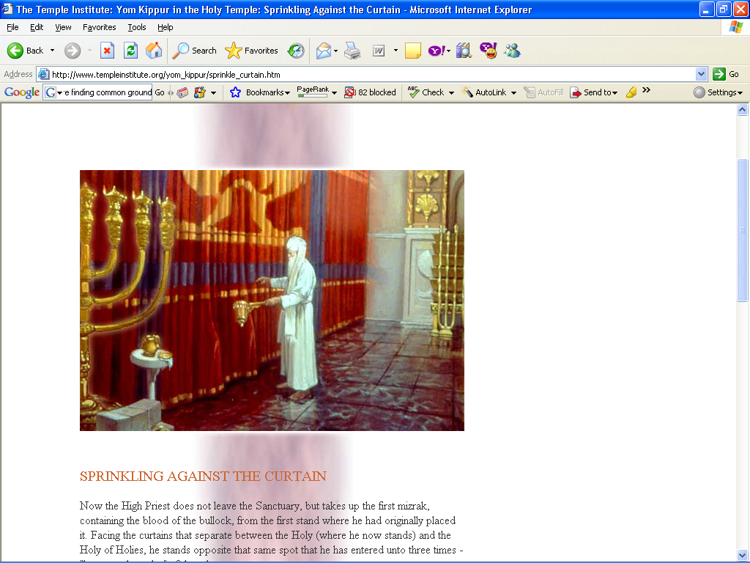
Notes:
SPRINKLING AGAINST THE CURTAIN
Now the High Priest does not leave the Sanctuary, but takes up the first mizrak, containing the blood of the bullock, from the first stand where he had originally placed it. Facing the curtains that separate between the Holy (where he now stands) and the Holy of Holies, he stands opposite that same spot that he has entered unto three times - "between the poles" of the ark.
This time, he dashes from the blood of the bullock outside the curtain but towards the same spot, in the same manner we have described. Next, he places this mizrak down on its stand, once again takes up the second vessel containing the blood of the sacrificial goat, and repeats his action against the curtain.

Slide 95
^{Viyikra/Lev. 16.17-19} No one is to be present in the tent of meeting from the time he enters the Holy Place to make atonement until the time he comes out, having made atonement for himself, for his household and for the entire community of Isra’el.

Slide 96
Then he is to go out to the altar that is before Adoni and make atonement for it; he is to take some of the bull’s blood and some of the goat’s blood and put it on all the horns of the altar. He is to sprinkle some of the blood on it with his finger seven times, thus purifying it and setting it apart from the uncleannesses of the people of Isra’el.

Slide 97
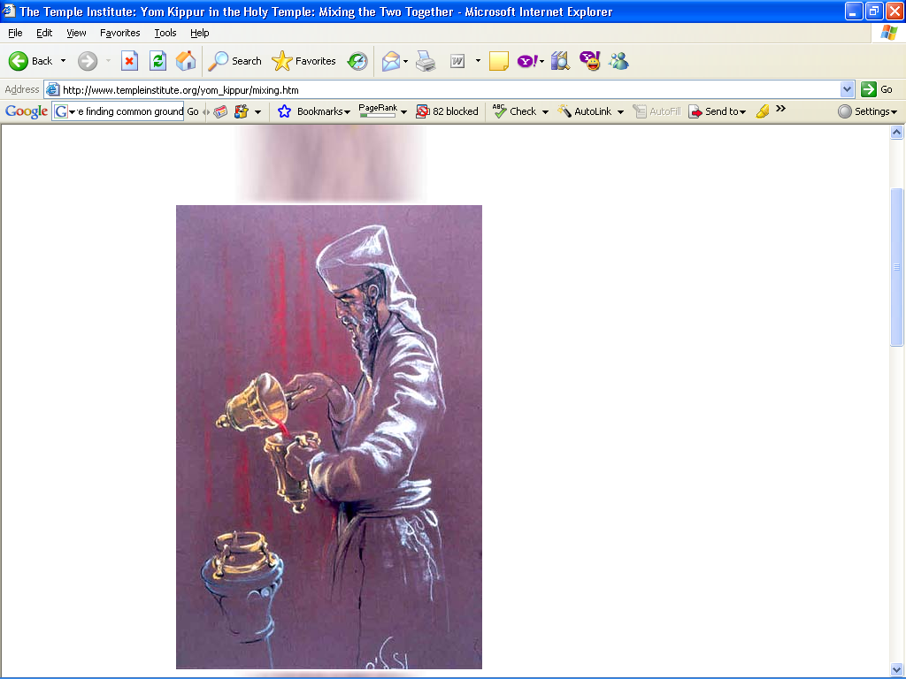
Notes:
MIXING THE TWO TOGETHER
Finally, while still in the Sanctuary, the High Priest mixes the contents of both vessels together. He pours the mizrak containing the bullock's blood into that of the goat, and then pours from this full vessel back into the empty one (of the bullock) so that they will blend completely together. All this is on account of the verse (Lev. 16:18) "He shall then go out to the altar that is before God and make atonement on it. He shall take some of the bullock's blood and some of the goat's blood, and place the mixture on the horns of the altar all around." We shall now look at the portion of the service, referred to by this verse

Slide 98
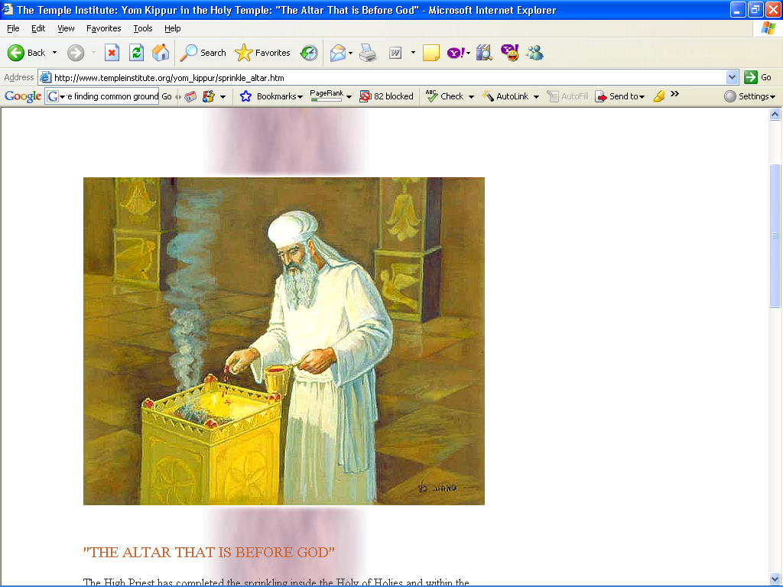
Notes:
"THE ALTAR THAT IS BEFORE GOD"
The High Priest has completed the sprinkling inside the Holy of Holies and within the Sanctuary. The Bible instructs us that he is now to sprinkle on the corners of "the altar that is before God" from the mixture of both vessels. This expression refers only to the golden incense altar within the Sanctuary, because of its proximity to the holy place - the outer altar that stands in the court is never referred to as being "before God." As to the Bible's instructions that he is now to "go out," this indicates that he is to go out from the place where he had been standing by the curtain, and serve on the outer side of the altar.
The High Priest walks around the incense altar and sprinkles on each of its four corners. Afterwards, he clears away some of the coals on top and exposes some of the gold surface of the altar. On this area, the "floor" of the small incense altar, he sprinkles an additional seven times, as per the verse (ibid. 19): "He shall sprinkle the blood on it seven times with his forefinger." Whatever was left in the mizrak when he concluded, he poured out onto the western side of the outer altar's foundation, in keeping with the instructions (ibid. 4:7): "He shall then spill out all the rest of the bull's blood at the base of the sacrificial altar, which is in front of the Communion Tent's entrance."

Slide 99
^{Viyikra/Lev. 16.20-21} “When he has finished atoning for the Holy Place, the tent of meeting and the altar, he is to present the live goat. 21 Aharon is to lay both his hands on the head of the live goat and confess over it all the transgressions, crimes and sins of the people of Isra’el;

Slide 100
he is to put them on the head of the goat and then send it away into the desert with a man appointed for the purpose.

Slide 101
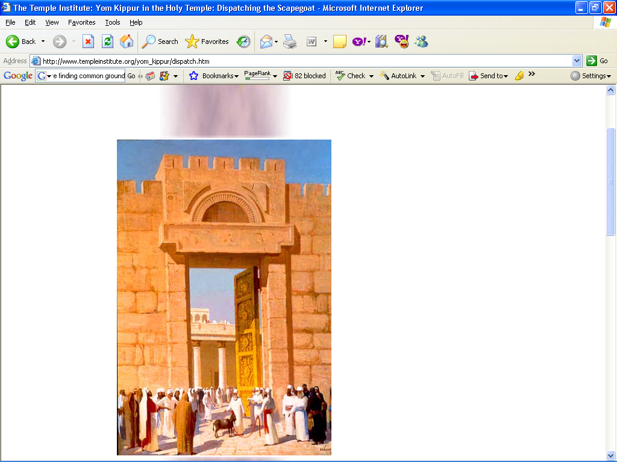
Notes:
DISPATCHING THE SCAPEGOAT
CONFESSING FOR ALL OF ISRAEL
The High Priest now returns to the place where the scapegoat is waiting, opposite the gate through which it will be led off into the desert - the Eastern Gate.
Placing his two hands on the animal's head between its horns, the High Priest now offers his confession for the entire nation of Israel, as Scripture states (ibid. 20-21): "And when he has made an end of atoning for the holy place, and the Tent of Meeting, and the altar, he shall present the live goat. And Aaron shall lay both his hands on the head of the live goat, and confess over it all the iniquities of the Children of Israel, and all their transgressions in all their sins, putting them upon the head of the goat... "

Slide 102
THE CONFESSION
"I beseech You, Adoni;
Grant atonement for the sins,
and for the iniquities and transgressions
which the entire house of Israel
has committed against You,
As it is written in the Torah
of Your servant, Moshe:
'For on this day

Slide 103
"atonement shall be made for you,
to purify you from all your sins
- before the Lord you shall be purified'."
As above, the congregation responds with the words "Blessed be the Name of His glorious kingdom, for ever and ever

Slide 104
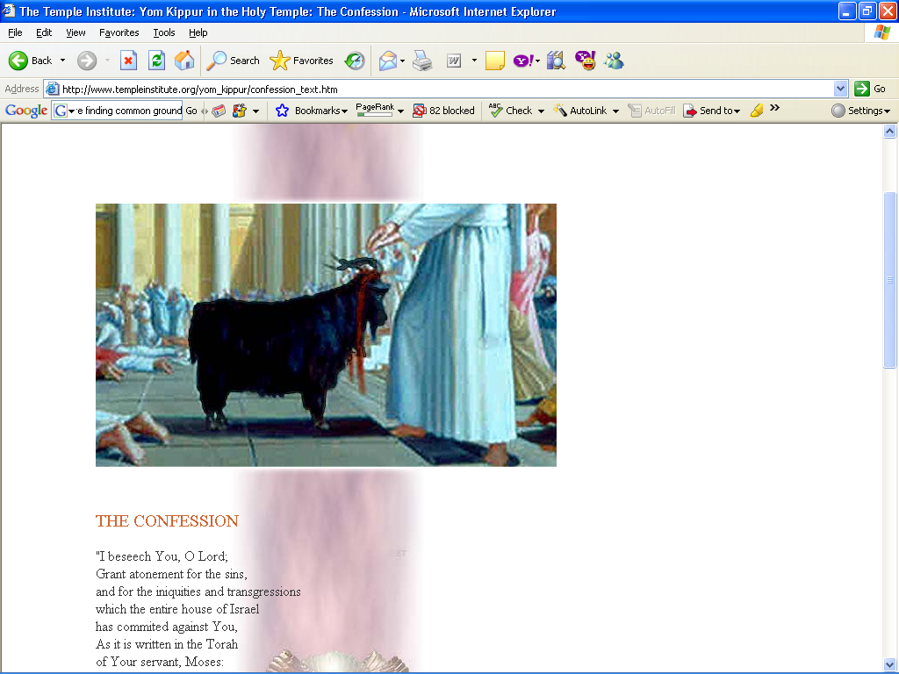
Notes:
THE CONFESSION
"I beseech You, O Lord;
Grant atonement for the sins,
and for the iniquities and transgressions
which the entire house of Israel
has commited against You,
As it is written in the Torah
of Your servant, Moses:
'For on this day
atonement shall be made for you,
to purifiy you from all your sins
- before the Lord you shall be purified'."
As above, the congregation responds with the words "Blessed be the Name of His glorious kingdom, for ever and ever."

Slide 105
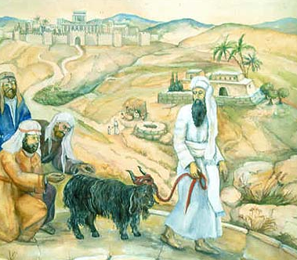
Notes:
ACROSS THE BRIDGE
After confessing for Israel, the High Priest gives the scapegoat into hands of the individual who had been designated to lead it into the desert. This, too, was considered a great privilege. Even though it is not an intrinsic part of the service and therefore could even be done by an Israelite, it was customarily safeguarded within the priestly ranks.

Slide 106
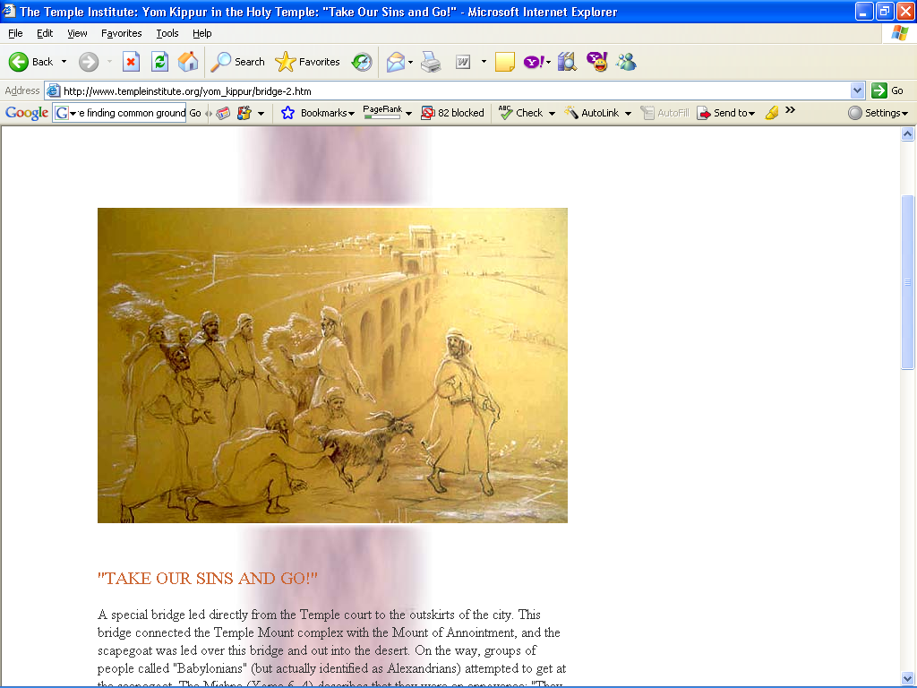
Notes:
"TAKE OUR SINS AND GO!"
A special bridge led directly from the Temple court to the outskirts of the city. This bridge connected the Temple Mount complex with the Mount of Annointment, and the scapegoat was led over this bridge and out into the desert. On the way, groups of people called "Babylonians" (but actually identified as Alexandrians) attempted to get at the scapegoat. The Mishna (Yoma 6, 4) describes that they were an annoyance: "They pulled at the goat's hair and cried Ôtake our sins and be off with you! Take our sins and go!'" They were eager to urge the priest who led the scapegoat, that he should not tarry or hesitate in the least.

Slide 107
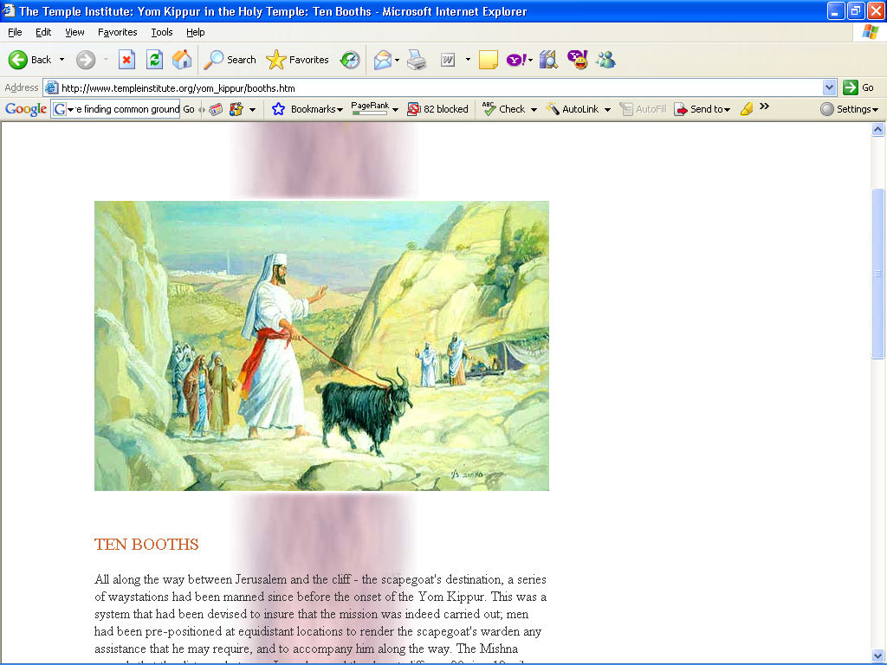
Notes:
TEN BOOTHS
All along the way between Jerusalem and the cliff - the scapegoat's destination, a series of waystations had been manned since before the onset of the Yom Kippur. This was a system that had been devised to insure that the mission was indeed carried out; men had been pre-positioned at equidistant locations to render the scapegoat's warden any assistance that he may require, and to accompany him along the way. The Mishna records that the distance between Jerusalem and the desert cliff was 90 ris - 12 mil. The distance between each station was one mil, or 2,000 amot (with the exception of the distance betweent the last station and the cliff, which was 2 mil).

Slide 108
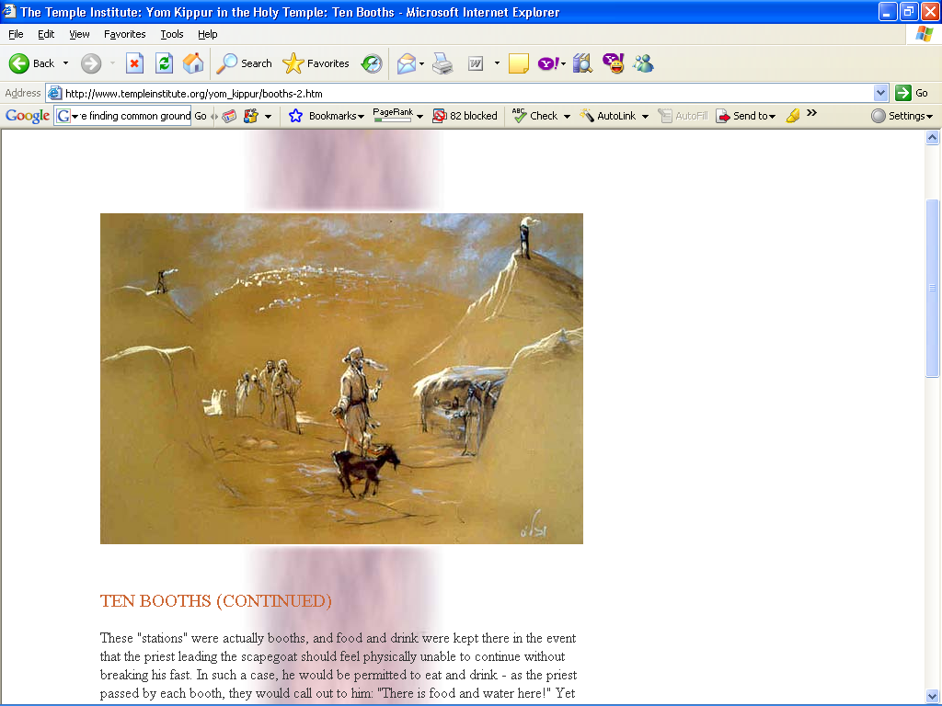
Notes:
TEN BOOTHS (CONTINUED)
These "stations" were actually booths, and food and drink were kept there in the event that the priest leading the scapegoat should feel physically unable to continue without breaking his fast. In such a case, he would be permitted to eat and drink - as the priest passed by each booth, they would call out to him: "There is food and water here!" Yet despite the distance and the heat, the Talmud records that no priest ever had to break his fast; the psychological advantage for the priests of knowing that the food and water were there should the need arise was enough. Distinguished citizens of Jerusalem accompanied the priest until the first booth; afterwards, men from each booth accompanied him as far as the next station.

Slide 109
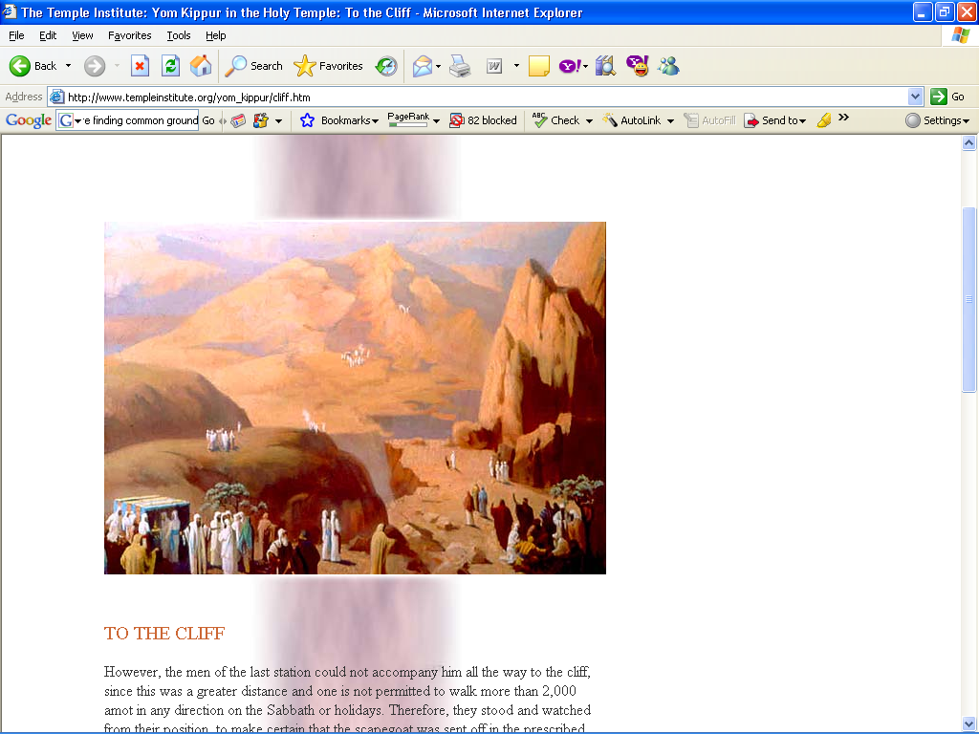
Notes:
TO THE CLIFF
However, the men of the last station could not accompany him all the way to the cliff, since this was a greater distance and one is not permitted to walk more than 2,000 amot in any direction on the Sabbath or holidays. Therefore, they stood and watched from their position, to make certain that the scapegoat was sent off in the prescribed manner.

Slide 110
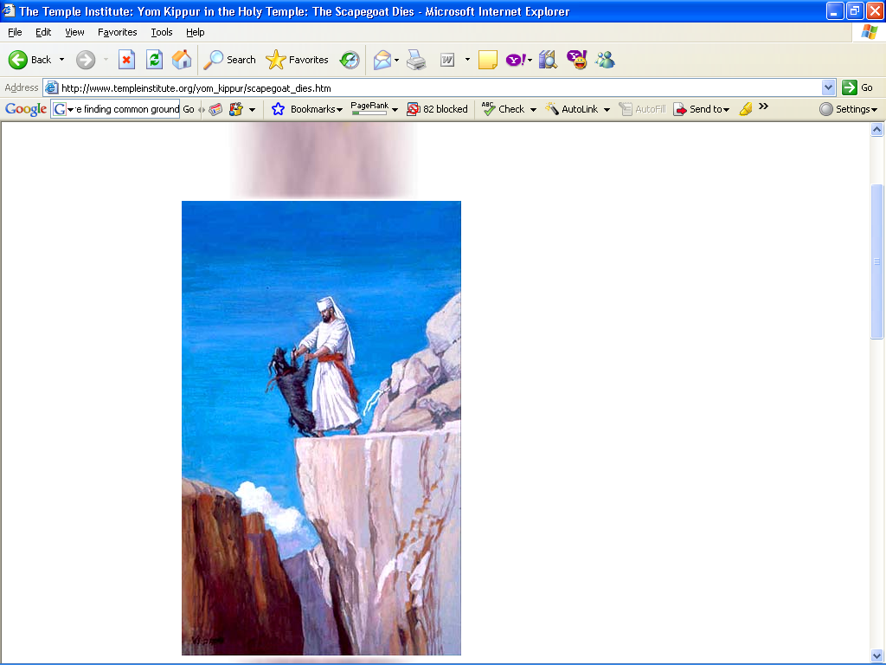
Notes:
THE SCAPEGOAT DIES
Arriving at the cliff, the priest removes the crimson wool that the High Priest had tied to the scapegoat's horns. He divides it into two pieces; one piece he reties once again to the animal's horns, and the second, to a rock. This is so that he will also be able to see when the crimson color has turned white, and know that atonement has been made for Israel's sins. Then he pushes the goat backward with his two hands.

Slide 111
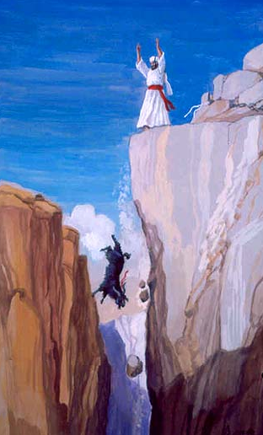
Notes:
THE SCAPEGOAT DIES (CONTINUED)
After he has accomplished his task, the priest who led the scapegoat walks back to the last booth, and waits there until dark before he returns to Jerusalem - for it has only been permitted for him to travel this distance in order to fulfill the duty of the scapegoat. However once that has been done, he must wait until the conclusion of the Day of Atonement before he returns.

Slide 112

Notes:
THE SCOUTS' SIGNALS
Back inside the Holy Temple, after having delivered the scapegoat into the hands of his colleague, the High Priest must wait to receive word that the scapegoat has reached the desert, for he is not permitted to begin the next stage of the day's service until then. In addition to the miracle of the crimson wool on the Sanctuary turning white, this information reached the Temple another way as well: scouts were positioned at high points all along the route to the cliff. As the goat was led from one station to the next, these scouts would signal each other by waving cloths. When the scapegoat had been sent off, the news was relayed back to the Temple through the scouts' signals.

Slide 113

Notes:
READING FROM THE TORAH
Once this news has been received, the High Priest descends to the Women's Court and reads aloud from the book of Leviticus (chapter 16, the reading for Yom Kippur) before the congregation. This is done with great ceremony. In the words of the Mishna (Yoma 7, 1): "The synagogue assistant takes the Torah scroll from the synagogue, and gives it to the synagogue head. He, in turn, hands the Torah to the assistant priest. The latter delivers it into the hands of the High Priest." All of this was done out of honor for the High Priest, who is served by such a large staff.

Slide 114
^{Viyikra/Lev. 16.27} “The bull for the sin offering and the goat for the sin offering, whose blood was brought in to make atonement in the Holy Place, is to be carried outside the camp; there they are to burn up completely their hides, meat and dung.

Slide 115

Notes:
THE BURNING OF THE BULL AND GOAT
"The bull and goat presented as sin-offerings, the blood of which was brought into the Sanctuary to make atonement, shall be taken outside the camp." (leviticus 16:27)
The two offerings are taken out the northern gate of Jerusalem to the site known as "the Place of the Ashes."

Slide 116

Notes:
DISPOSING OF THE WHITE VESTMENTS
At the conclusion of the service, the High Priest gives the two sets of white vestments he has worn for the morning and afternoon services, over to his assistants, who dispose of them in the Chamber of Pinchas, a storeroom for priestly garments.

Slide 117

Notes:
IN CONCLUSION
"Whoever says, 'I will sin, and then I will repent afterwards' is denied the opportunity to repent. And one who says, 'I will sin, and Yom Kippur will grant me atonement' - for such an individual, Yom Kippur does not atone.
The Day of Atonement only functions to grant atonement for sins commited between man and G-d. But for sins commited between man and his fellow, even Yom Kippur cannot atone... until the wronged man has been asked forgiveness and appeased.
Rabbi Akiva taught: 'Happy is your lot, Israel! For before whom do you purify yourselves, and who purifies you? Your Father in heaven, as the verse states (Ez. 36:25) I will sprinkle on you pure waters, and you shall be cleansed'." (Yoma 8, 9).

