Slide 1
To easily follow these notes, log on to our Wifi
Wifi: mycci01
p/w: ancientquail060
Go to OrHaOlam.com
Click on downloads, messages, 2017

Slide 2
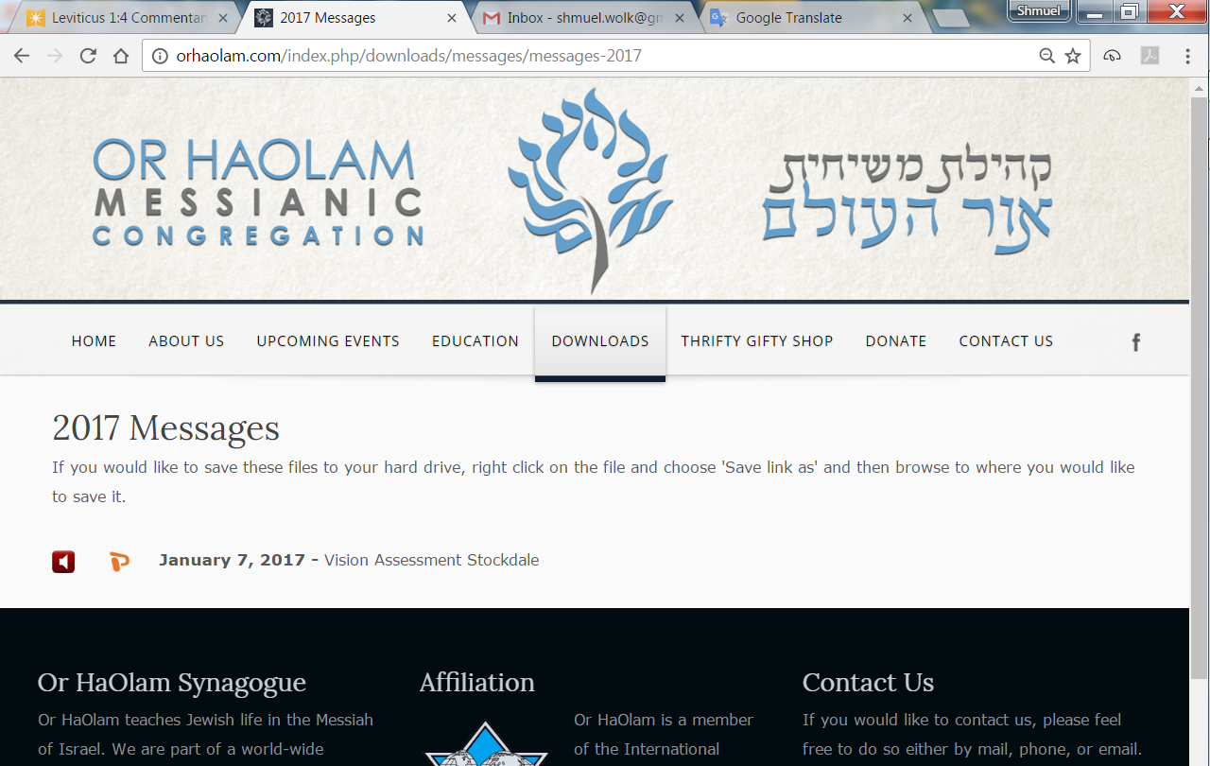

Slide 3
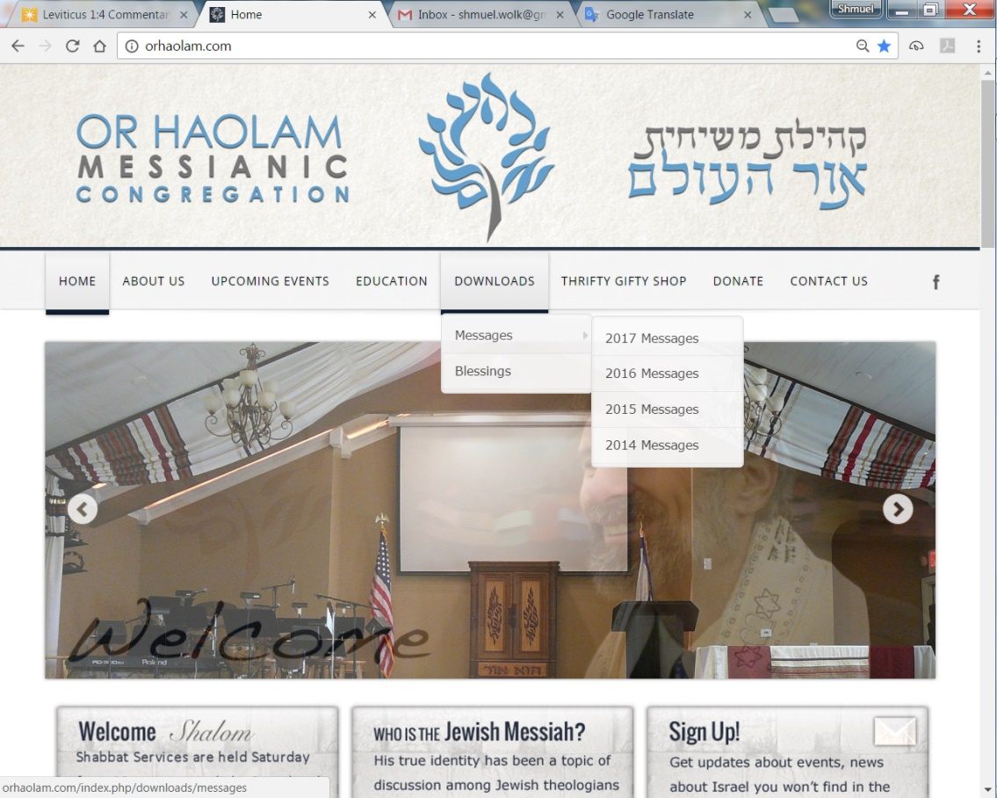
Downloads\messages\
2017 Messages

Slide 4
Humorous Intro
Notes:
If you have to tell the crowd it’s humor, probably isn’t

Slide 5
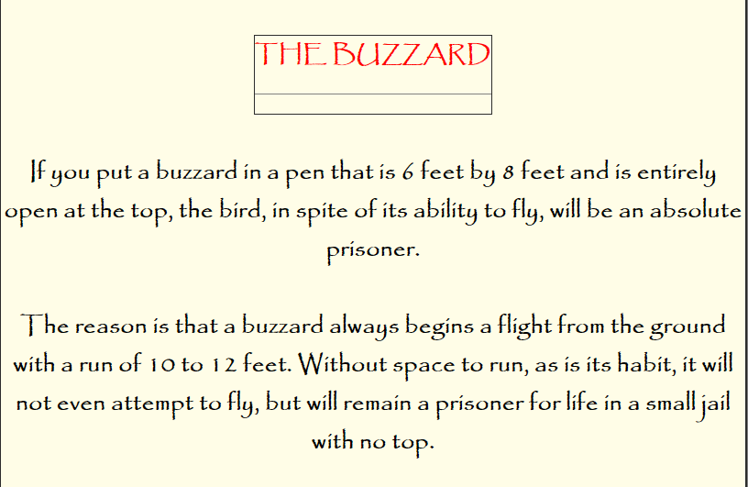

Slide 6
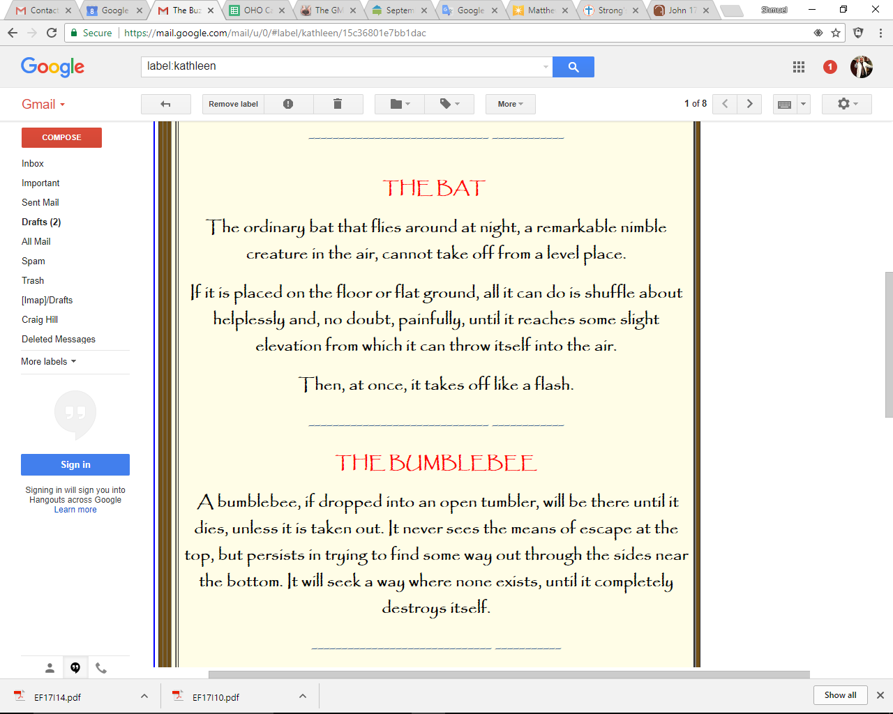

Slide 8
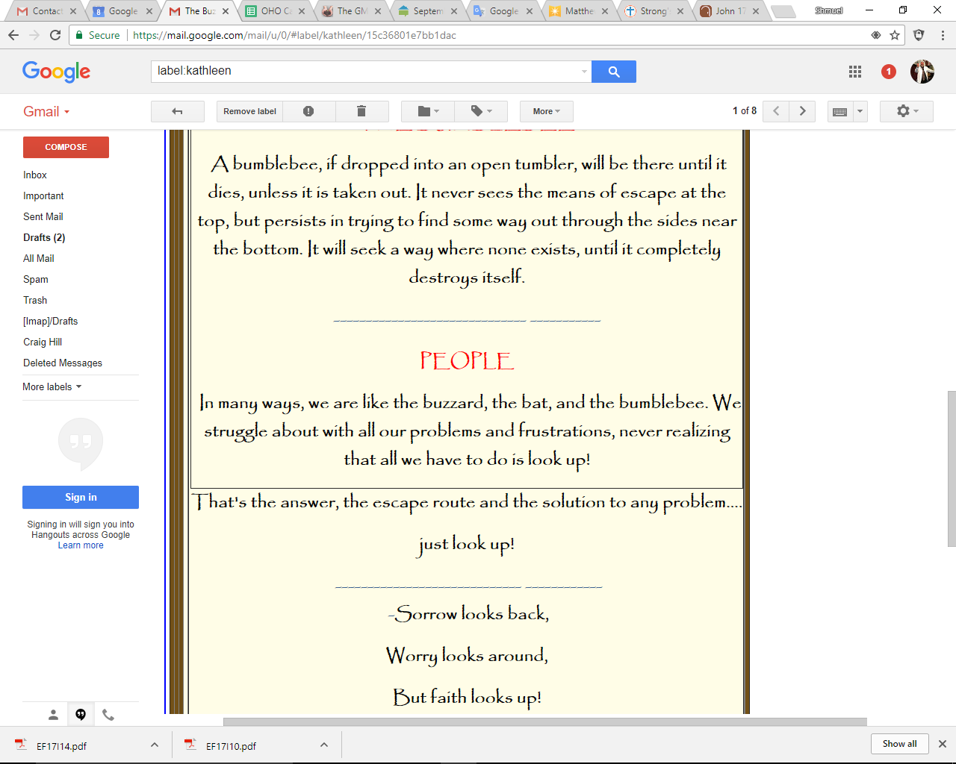
Notes:
Trust and thank Messiah! Imperfect analogy, but useful.

Slide 9
Depression looks within

Slide 10
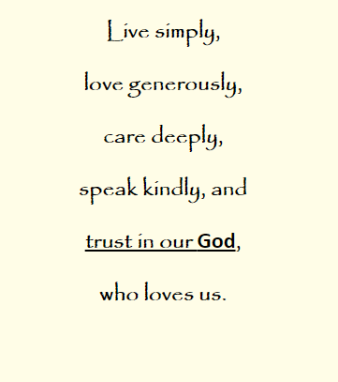
From Kathleen Eltrich

Slide 11
Encouraging news
From Israel!

Slide 12
Tel Aviv, known as the “Start-up City,” has doubled the number of international research and development (R&D) centers in the city over the past five years, jumping from 35 R&D centers in 2012, to 73 centers in 2017, serving as a home to 20 percent of all R&D centers in “Start-up Nation.”
Notes:
https://worldisraelnews.com/tel-aviv-shines-research-hotbed-corporate-giants/?utm_source=MadMimi&utm_medium=email&utm_content=Israel%27s+Ties+with+Arab+World+%27Stronger+than+Ever%27%3B+IDF+Intel+Chief+Advises+Trump+to+Strike+North+Korea&utm_campaign=20170906_m141302951_Israel%27s+Ties+with+Arab+World+%27Stronger+than+Ever%27%3B+IDF+Intel+Chief+Advises+Trump+to+Strike+North+Korea&utm_term=_0A_09_09_09_09_09_09_09_09_09_09Read+Now_0A_09_09_09_09_09_09_09_09_09

Slide 13
The international credit card and fintech giant Visa just recently decided to establish an R&D center in Tel Aviv, joining Renault, Bosch, MasterCard, Google, Facebook, Amazon, Coca Cola, Microsoft, AOL, Samsung, Siemens, Paypal, Deutsche Telekom, Citibank, Intel, Yahoo, Barclays, IBM, Apple, Porsche, and other multinational companies.
Notes:
https://worldisraelnews.com/tel-aviv-shines-research-hotbed-corporate-giants/?utm_source=MadMimi&utm_medium=email&utm_content=Israel%27s+Ties+with+Arab+World+%27Stronger+than+Ever%27%3B+IDF+Intel+Chief+Advises+Trump+to+Strike+North+Korea&utm_campaign=20170906_m141302951_Israel%27s+Ties+with+Arab+World+%27Stronger+than+Ever%27%3B+IDF+Intel+Chief+Advises+Trump+to+Strike+North+Korea&utm_term=_0A_09_09_09_09_09_09_09_09_09_09Read+Now_0A_09_09_09_09_09_09_09_09_09

Slide 14
“The Tel Aviv ecosystem is considered a leader in the nurturing of entrepreneurial spirit and is home to a large amount of start-ups, collaborative workspaces and acceleration programs

Slide 15
From the maker of WhatsApp:
Israelis learn in the military to make the best [creative] decisions, under pressure, with imperfect information.
It’s no shame in Israeli culture to fail in a venture. Second start ups are much more successful!

Slide 16
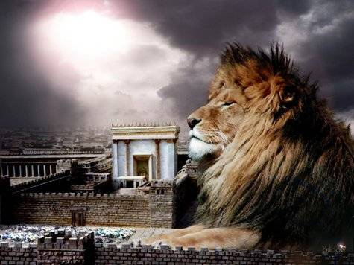
מַתִּתְיָהוּ Mattityahu
(Matthew) 20:25-27
Notes:
Last week we talked about drinking His cup: sacrifice for others. Mitigate if possible.

Slide 17
Mattityahu (Matthew) 20:25
קָרָא לָהֶם יֵשׁוּעַ וְאָמַר: "אַתֶּם יוֹדְעִים שֶׁהַמּוֹשְׁלִים בַּגּוֹיִים רוֹדִים בָּהֶם וְהַגְּדוֹלִים שׁוֹלְטִים בָּהֶם.
But Yeshua called them and said, "You know that among the Goyim, those who are supposed to rule them become tyrants, and their superiors become dictators.
Notes:
The Jews were familiar with Roman rulers and their client kings, like Herod. Plus their own history…
Greek for tyrants:

Slide 18
Tyrant:
κατακυριεύω katakurieuo
From kata and kurieuo;
to lord against,
i.e. Control, subjugate -- exercise dominion over (lordship), be lord over, overcome.
Notes:
Brought my grandson Max here, and he asked, “Are you the boss of this place?”
OK assessment from a 6 year old.

Slide 19
Mattityahu (Matthew) 20:26
אַל יְהִי כֵן בֵּינֵיכֶם. אַדְּרַבָּא, הֶחָפֵץ לִהְיוֹת גָּדוֹל בָּכֶם יְהֵא מְשָׁרֵת שֶׁלָּכֶם,
Among you, it must not be like that. On the contrary, whoever among you wants to be a leader must become your servant
Notes:
Story of RekhavAm, son of Solomon, who was approached for tax relief by his nation at his ascension to Solomon’s throne.

Slide 20
^{2 K 12.6-7} The older men who had been in attendance on Shlomo his father…said to him, “If you will start today being a servant to these people — if you will serve them, be responsive to them and give them favorable consideration, then they will be your servants forever.”
Notes:
noblesse oblige
the inferred responsibility of privileged people to act with generosity and nobility toward those less privileged.

Slide 21
^{2 K 12.10-11} The young men he had grown up with said to him…“Here’s the answer you should give them: ‘My little finger is thicker than my father’s waist! Yes, my father burdened you with a heavy yoke, but I will make it heavier! My father controlled you with whips, but I will control you with scorpions!’”
Fomented a rebellion still ongoing.
Notes:
Divided kingdom never restored.

Slide 22
Mattityahu (Matthew) 20:27
וְהֶחָפֵץ לִהְיוֹת רִאשׁוֹן בֵּינֵיכֶם יְהֵא עֶבֶד לָכֶם,
and whoever wants to be first must be your slave!
Notes:
Surprising Kingdom rank and reward

Slide 23
Mattityahu (Matthew) 20:28
For the Son of Man did not come to be served, but to serve -- and to give his life as a ransom for many."
Notes:
Big picture of Yeshua’s life and heart…

Slide 24
What was the driving passion of the Messiah Yeshua?
A few weeks ago we talked about the passion in the hearts of some of our leaders.
What is your driving passion?
Yeshua’s driving passion?
Notes:
To be continued today, but first, let’s try to look into the heart of Yeshua.
How can we understand Him better?

Slide 25
^{Lk. 12.49-50} “I came to pour out fire on the earth, and how I wish it were already ablaze!
But I have an immersion to endure, and how distressed I am until it is finished!”
Notes:
Fulfilling prophecy of Messiah

Slide 26
^{Malakhi 3.1-4} “Behold, I am sending My messenger and he will clear the way before Me. Suddenly He will come to His Temple —the Lord whom you seek— and the Messenger of the covenant —the One whom you desire—behold, He is coming,” says Adonai-Tzva’ot.

Slide 27
^{Malakhi 3.1-4} ^{TLV} But who can endure the day of His coming? Or who can stand when He appears? For He will be like a refiner’s fire, and like soap for cleaning raw wool. And He will sit as a smelter or a purifier of silver, and He will cleanse the sons of Levi,

Slide 28
^{Malakhi 3.1-4 TLV} and purify them like gold or silver. Then they will become for Adonai those who present an offering in righteousness. Then the offering of Judah and Jerusalem will be pleasing to Adonai, as in days of antiquity and years of old.
Notes:
Yeshua’s passion was to empower people to walk in righteousness, beyond expectation.
This is no hurried add on to the Plan of the Ages from the beginning of time!

Slide 29
^{Eph 1.3-4} Praised be Adoni, Father of our Lord Yeshua the Messiah, who in the Messiah has blessed us with every spiritual blessing in heaven. In the Messiah he chose us in love before the creation of the universe to be holy and without defect in his presence.
Notes:
Common notion that G-d saw sin in Gan Eden, the Garden, and scrambled for a remedy.
Rather, G-d gave humanity the risky gift of free will, and with it was a contingency of infinite love, if we chose wrong. And we did choose evil, not just our first parents, but all of us!
Two ways to read this verse:
G-d chose us, ie individuals pre-destiniation, form of Calvinism
G-d chose us in love, ie means of redemption. Arminianism

Slide 30
^{Eph 1.5-6} He determined in advance that through Yeshua the Messiah we would be his sons — in keeping with his pleasure and purpose — so that we would bring him praise commensurate with the glory of the grace he gave us through the Beloved One.
Notes:
Expressed in the Servant Songs of Isaiah/ Yeshayahu

Slide 31
^{Yeshuyahu/Is 43.1} But now this is what Adoni says, he who created you, Ya‘akov, he who formed you, Isra’el: “Don’t be afraid, for I have redeemed you; I am calling you by your name; you are mine.

Slide 32
^{Yeshuyahu/Is 44.21-22} “Keep these matters in mind, Ya‘akov, for you, Isra’el, are my servant. I formed you, you are my own servant; Isra’el, don’t forget me. Like a thick cloud, I wipe away your offenses; like a cloud, your sins. Come back to me, for I have redeemed you.”
Notes:
Yeshua’s passion was to empower people to walk in righteousness, beyond expectation.

Slide 33
^{T’hillim/Ps 77.15-16} You are the God who does wonders, you revealed your strength to the peoples.
With your arm you redeemed your people, the descendants of Ya‘akov and Yosef.

Slide 34
^{Yeshuyahu/Is 53.5} But he was wounded because of our crimes, crushed because of our sins; the disciplining that makes us whole fell on him, and by his bruises we are healed.

Slide 35
^{Mes. Jews/Heb 12.2} Yeshua — who, in exchange for obtaining the joy set before him, endured execution on a stake as a criminal, scorning the shame, and has sat down at the right hand of the throne of God.
Notes:
Here’s another view of Messiah Yeshua’s passion: Joy of obtaining a bride. Empowering us to be so. Story of Yaakov/Jacob laboring for Rachel to be his bride. Seven years seems as 7 days, because of the love he had for her.

Slide 36
^{Yn 17.17-19} Set them apart for holiness by means of the truth — your word is truth. Just as you sent me into the world, I have sent them into the world. On their behalf I am setting myself apart for holiness, so that they too may be set apart for holiness by means of the truth.
Notes:
Yeshua’s passion was to empower people to walk in righteousness, beyond expectation.

Slide 37
^{Yn 17.22-23} The glory which you have given to me, I have given to them; so that they may be one, just as we are one — I united with them and you with me, so that they may be completely one, and the world thus realize that you sent me, and that you have loved them just as you have loved me.
Notes:
Many of the following points defining the passion of Yeshua are from John Piper’s The Passion of Yeshua the Messiah [actually other wording: ‘Jesus Christ’]

Slide 38
To please the Father
^{Eph 5.2} Messiah loved us, indeed, on our behalf gave himself up as an offering, as a slaughtered sacrifice to God with a pleasing fragrance.
Notes:
Piper p 23

Slide 39
To show the wealth of G-d’s love
^{Eph. 1.7-9} In union with him, through the shedding of his blood, we are set free — our sins are forgiven; this accords with the wealth of the grace he has lavished on us. In all his wisdom and insight he has made known to us his secret plan
Notes:
Piper 29

Slide 40
Demonstrate His own love for us
^{Eph. 5.25-26} The Messiah loved the Messianic Community, indeed, gave himself up on its behalf, in order to set it apart for God, making it clean through immersion in the mikveh.
Notes:
31

Slide 41
Cancel the Legal Demands of Torah
^{Col 2.13-14} You were dead because of your sins, that is…your old nature. But God made you alive along with the Messiah by forgiving you all your sins.
Notes:
Often said that “Our good deeds will outweigh our bad deeds.” Nonsense. Doesn’t work that way at law. Traffic ticket. Y didn’t come to make bad people good. Rather, make dead people alive!

Slide 42
Cancel the Legal Demands of Torah
^{Col 2.13-14} He wiped away the bill of charges against us. Because of the regulations, it stood as a testimony against us; but he removed it by nailing it to the execution-stake.
Notes:
Didn’t nail the Torah, but the charges against us. P 33

Slide 43
To establish the New Covenant
^{Yer. 31} I will make a new covenant with the house of Isra’el and with the house of Y’hudah...All will know me, from the least of them to the greatest; because I will forgive their wickednesses and remember their sins no more.”

Slide 44
To establish the New Covenant
^{Mtt. 26.28} For this is my blood, which ratifies the New Covenant, my blood shed on behalf of many, so that they may have their sins forgiven.
Notes:
Do you think Y was consciously aware of Jer 31 when he said this?? ABSOLUTELY

Slide 45
Provide the basis of justification
Justified = just as if I’d never sinned

Slide 46
Provide the basis of justification
^{Ro 3.28} Therefore, we hold the view that a person comes to be considered righteous [justified] by God on the ground of trusting, which has nothing to do with observance of Torah commands.
Notes:
38-39

Slide 47
To impute righteousness to us
^{2 Cor. 5.21} He made the One who knew no sin to become a sin offering on our behalf, so that in Him we might become the righteousness of God.
Notes:
40

Slide 48
To take away our condemnation
^{Ro 8. 33-34} Who shall bring a charge against God’s elect? It is God who justifies. Who is the one who condemns? It is Messiah who died and moreover was raised, and is now at the right hand of God and who also intercedes for us.
Notes:
In the Life Model series, the book Joy Starts Here that we worked through over about 3 years, we learned one relational matrix. All people are:
Predators: takers, defile others
Protectors: givers, bless others
Possums: avoiders
Possums hide mostly כי abuse and false condemnation. Who will beat me up next? Yeshua is here to take that away, if we enter into it.

Slide 49
To make us holy, “unleavened”
^{1 Cor. 5.7-8} Get rid of the old hametz, so that you can be a new batch of dough, because in reality you are unleavened. For our Pesakh lamb, the Messiah, has been sacrificed.

Slide 50
To make us holy, “unleavened”
^{1 Cor. 5.7-8} So let us celebrate the Seder not with leftover hametz, the hametz of wicked-ness and evil, but with the matzah of purity and truth.
Notes:
48, 49

Slide 51
To clear our consciences
^{Mes Jews/Heb.9.14} How much more the blood of the Messiah, who, through the eternal Spirit, offered himself to God as a sacrifice without blemish, will purify our conscience from works that lead to death, so that we can serve the living God!
Notes:
51

Slide 52
To give us access to all blessings
^{Ro 8.31-32} If God is for us, who can be against us? He who did not spare even his own Son, but gave him up on behalf of us all — is it possible that, having given us his Son, he would not give us everything else too?
Notes:
This is kal v’homer, if this then surely that. 53

Slide 53
To bring us healing
^{Mtt 8.16-17} When evening came, many people…were brought to him. He… healed all who were ill. This was done to fulfill what had been spoken through the prophet Yesha‘yahu, “He himself took our weaknesses and bore our diseases”

Slide 54
Rabbi
Directors
Elders
Shamashim
Staff
Members and
Congregants
Notes:
Directors visited erev Shabbat Friday night dinner with Elders, and went around the table sharing our life passion. Impacting enough to share here…

Slide 55
Mattityahu (Matthew) 20:26
אַל יְהִי כֵן בֵּינֵיכֶם. אַדְּרַבָּא, הֶחָפֵץ לִהְיוֹת גָּדוֹל בָּכֶם יְהֵא מְשָׁרֵת שֶׁלָּכֶם,
Among you, it must not be like that. On the contrary, whoever among you wants to be a leader must become your servant.
Look left, right: serve, pray, give.
Notes:
Get GRACE and help and fire from the Ruakh/Spirit!

