Slide 1
e-handout
To have these notes
without taking notes
Go to OrHaOlam.com
Click on downloads,
messages, 2018
Notes:
Been a lot of promotion of online dating…

Slide 2
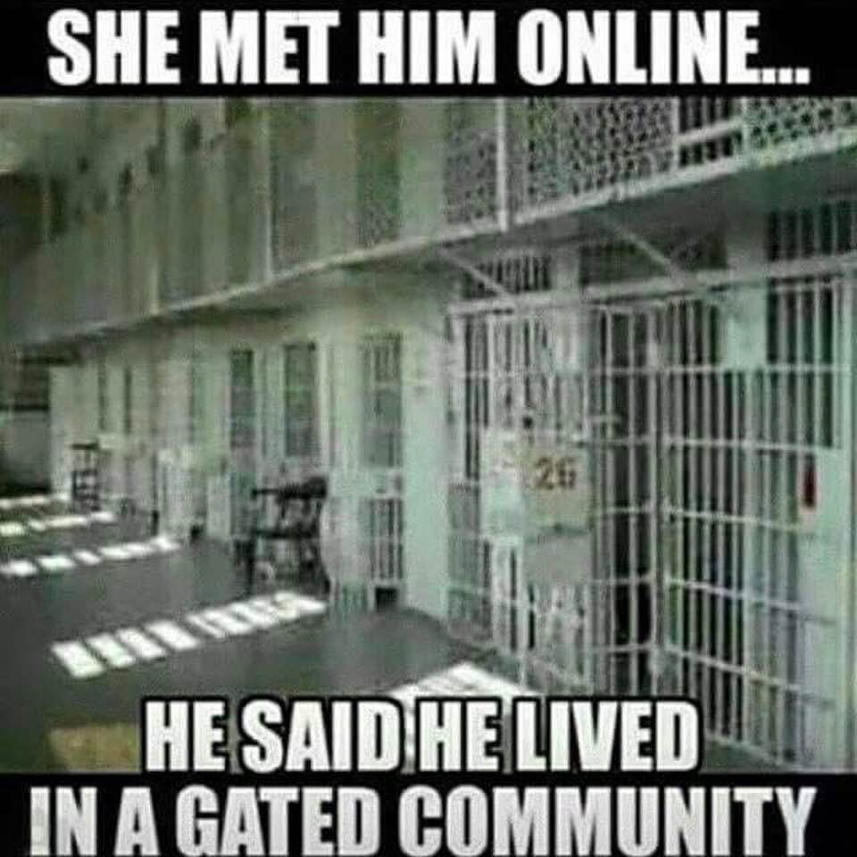

Slide 3
Report: Nearly 80% Of Israeli Drivers Say Traffic Biggest Cause Of Stress: Respondents said dangerous driving on Israeli roads and traffic congestion to and from work were more stressful than the increasing price of food, the security situation and the divide between the country’s religious and secular communities.
Notes:
Barry Segal

Slide 4
The Waze study was based on a survey conducted via nearly 700 online interviews, in a representative sample of Jewish and Arab drivers. Since 2000, crowding on the country’s roads has grown by 63%, and the number of vehicles on Israel’s roads has increased by 84%, (J.Post)
Notes:
Barry Segal
Concerning the difficulties of police work…

Slide 5
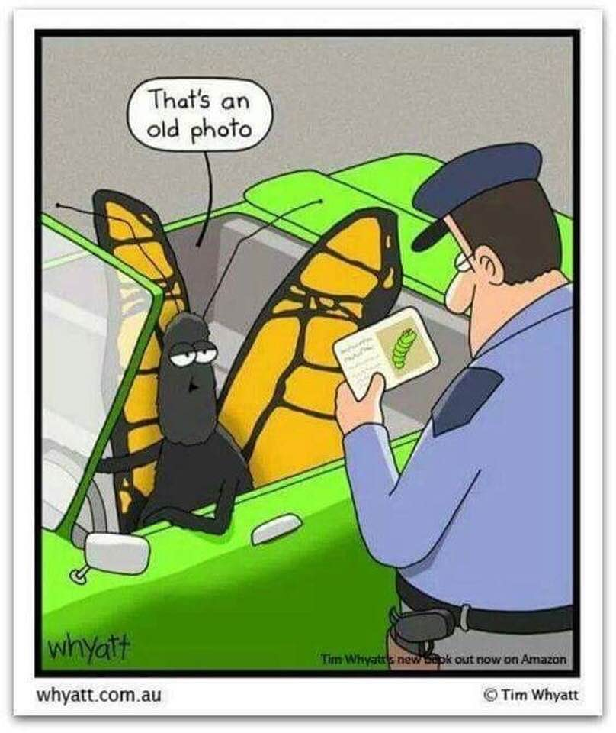

Slide 6
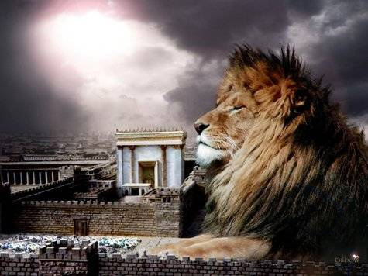
מַתִּתְיָהוּ Mattityahu
(Matthew) 25:1-4

Slide 7
Mattityahu (Matthew) 25:1
”אָז תִּדְמֶה מַלְכוּת הַשָּׁמַיִם לְעֶשֶׂר עֲלָמוֹת אֲשֶׁר לָקְחוּ אֶת מְנוֹרוֹתֵיהֶן וְיָצְאוּ לִקְרַאת הֶחָתָן.
“The Kingdom of Heaven at that time will be like ten bridesmaids who took their lamps and went out to meet the groom.
Notes:
In Hebraic speech and writing "heaven" is often a circumlocution for God as occurs in the book of Matthew. [Robison] For those Sacred Namers.
Stern says, "The concept of the Kingdom of God …refers neither to a place or time, but to a condition in which the rulership of God is acknowledged by humankind, a condition in which God’s promises of a restored universe free from sin and death are, or begin to be fulfilled“
Parable. Analogy, but not minutely.
Amy Jill Levine: Bridesmaids עלמות Gk parthenoi = virgins “They accompany bridegroom to the house of the bride, and then escort both to the house where the wedding and feast will take place.
Edersheim: custom in the east to carry in a bridal procession ten lamps. Round receptacle for oil with wick, then long pole so borne aloft. Ten ~ minyan.
Keener: some see torches sticks wrapped w oiled rags, only good for 15 minutes, need to be rewrapped w oiled cloth.

Slide 8
The actions of the virgins may be an allusion to Psalm 45:14, "She will be led to the King in embroidered work; the virgins (Heb. betulah), her companions (Heb. reah) who follow her, will be brought to You.“ ^{[blainerobison.com]}
Notes:
David sends messengers to fetch Abigail, a widow, to be his wife. Abigail has five maidens (Heb. na'arah) who attend her as she goes to David.
"Our ignorance of ancient Semitic marriage customs exceeds our knowledge. And what knowledge we do have shows considerable variation in those customs" ^{BlaineRobison.com}

Slide 9
Mattityahu (Matthew) 25:2
חָמֵשׁ מֵהֶן הָיוּ כְּסִילוֹת וְחָמֵשׁ הָיוּ נְבוֹנוֹת,
“Five of them were foolish and five were sensible.

Slide 10
Mattityahu (Matthew) 25:3
שֶׁכֵּן הַכְּסִילוֹת לָקְחוּ אֶת הַמְּנוֹרוֹת וְלֹא לָקְחוּ אִתָּן שֶׁמֶן,
”The foolish ones took lamps with them but no oil,

Slide 11
Mattityahu (Matthew) 25:4
אֲבָל הַנְּבוֹנוֹת לָקְחוּ שֶׁמֶן בִּכְלֵיהֶן יַחַד עִם מְנוֹרוֹתֵיהֶן.
“whereas the others took flasks of oil with their lamps.”
Notes:
Issue: some not prep sufficient oil.

Slide 12
Since this is a parable, and the thrust is insufficient oil,
What is the significance of oil?
What is the meaning and application of insufficient oil?
What is the meaning and application of sufficient oil?
Notes:
What may have been in the women’s mind about oil? What was in Yeshua’s mind about oil?

Slide 13
Since this is a parable, and the thrust is insufficient oil,
What is the significance of oil?

Slide 14
First, the facts:
Olive oil consists mainly of
oleic acid (up to 83%),
linoleic acid (up to 21%) and
palmitic acid (up to 20%).
Notes:
Linoleic acid is one of the essential acids that our body needs, but cannot make from other sources.

Slide 15
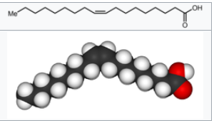
Oleic acid: CH₃(CH₂)₇CH=CH(CH₂)₇COOH
Notes:
That should explain everything. No?

Slide 16
In Jewish observance,
olive oil was the only fuel allowed to be used in the seven-branched menorah in the Mishkan service during the Exodus of the tribes of Israel from Egypt,
and later in the permanent Temple in Jerusalem.
It was obtained by using only the first drop from a squeezed olive.
Notes:
https://en.wikipedia.org/wiki/Olive_oil

Slide 17
The olives were beaten down from the tree with poles (Isa. 17:6) and were pounded into pulp in mortars or by the feet (Micah 6:15). The pulp was placed in wicker baskets from which the lightest and finest oil could easily run off. This grade of oil, known as beaten oil (Heb. shemen katit), is mentioned five times in the Bible
Notes:
https://www.jewishvirtuallibrary.org/oils

Slide 18
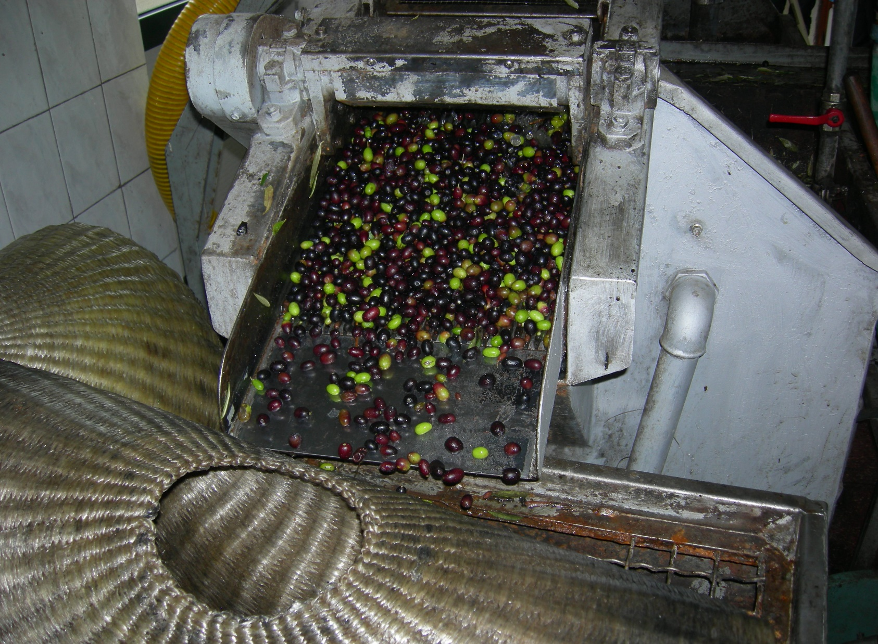
Olive press
Notes:
https://en.wikipedia.org/wiki/Olive_oil#/media/File:Frantoio_Maraldi_2.JPG
Still using wicker

Slide 19
and was consecrated for use only in the Temple by the priests and stored in special containers.
Another use of oil in Jewish religion was for anointing the kings and prophets of the Kingdom of Israel, originating from King Shaul. Tzidkiyahu was the last anointed King of Israel.
Notes:
https://en.wikipedia.org/wiki/Olive_oil

Slide 20
Oil served as an element in food (I Kings 17:12), as a cosmetic (Eccles. 9:7–8), as a fuel for lamps (Ex. 25:6), as a medicine (Isa. 1:6), and as a principal export in foreign trade (I Kings 5:25).
Notes:
https://www.jewishvirtuallibrary.org/oils

Slide 21
the three blessings of the land in time of God's favor – grain, wine, and oil (Deut. 11:14,
Notes:
https://www.jewishvirtuallibrary.org/oils

Slide 23
^{Ber./Gen 28:18} Early in the morning Jacob got up and took the stone, which he had placed by his head, and set it up as a memorial stone and poured oil on top of it.
Why do that?

Slide 24
^{Ber./Gen 28:22} and this stone, which I have set up as a standing-stone, will be God’s house; and of everything you give me, I will faithfully return one-tenth to you.”
Notes:
To mark it, according to Ibn Ezra. [Seems unlikely marker for decades till return?]
First vow in the Bible.
Oil was an indication of holy purpose.
What is the significance of oil?
What is the meaning and application of insufficient oil to the young women, to Yeshua?
What is the meaning and application of sufficient oil to the young women, to Yeshua?

Slide 25
^{Shmot/Ex.27.20} “Also you are to command Bnei-Yisrael, that they are to bring to you pure olive oil beaten for the light, to cause a lamp to burn continually.
Notes:
Only oil allowed.

Slide 26
^{Shmot/Ex 29.1-3} “Now this is what you are to do to consecrate them, so that they may minister as kohanim. Take one young bull and two rams without blemish, along with matzot, cakes of matzot mixed with oil, and matzot wafers spread with oil.
Notes:
Matzot not puffed up, but G-d’s glory, anointing oil.

Slide 27
^{Shmot/Ex 29.1-3} Make them from fine wheat flour. You are to put them into one basket and present them, along with the bull and the two rams.

Slide 28
^{Shmot/Ex 29.6-7} Put the turban on his head and attach the holy ornament to the turban. Then take the anointing oil, and anoint him by pouring it on his head.
Notes:
Ornament ~ crown. Jewish Kings not described with crowns, only anointing. Cohanim/priests had crown.
What is the significance of oil?
What is the meaning and application of insufficient oil to the young women, to Yeshua?
What is the meaning and application of sufficient oil to the young women, to Yeshua?

Slide 29
^{Shmot/Ex 30.22-25} Adoni said to Moshe, “Take the best spices — 500 shekels of myrrh [12 1/2 pounds], half this amount (250 shekels) of aromatic cinnamon [6 1/4 pounds], 250 shekels of aromatic cane, 500 shekels of cassia

Slide 30
^{Shmot/Ex 30.22-25} (use the sanctuary standard), and one gallon of olive oil — and make them into a holy anointing oil; blend it and perfume it as would an expert perfume-maker; it will be a holy anointing oil.

Slide 31
^{Shmot/Ex 40.9-10} “Take the anointing oil, and anoint the tabernacle and everything in it — consecrate it with all its furnishings; then it will be holy. Anoint the altar for burnt offerings with all its utensils — consecrate the altar; then the altar will be especially holy.
Notes:
What is the significance of oil?
What is the meaning and application of insufficient oil to the young women, to Yeshua?
What is the meaning and application of sufficient oil to the young women, to Yeshua?

Slide 32
^{Vayikra/Lev 2:4} “‘When you bring a grain offering which has been baked in the oven, it is to consist of either unleavened cakes made of fine flour mixed with olive oil or matzah spread with olive oil.

Slide 33
^{Vayikra/Lev 21.10-12} “‘The cohen who is ranked highest among his brothers, the one on whose head the anointing oil is poured and who is consecrated to put on the garments, is not to stop grooming his hair, tear his clothes, go in to where any dead body is or make himself unclean,

Slide 34
^{Vayikra/Lev 21.10-12} even when his father or mother dies. He may not leave the sanctuary then or profane the sanctuary of his God, because the consecration of the anointing oil of his God is on him; I am Adoni.
Notes:
Example of this with immediate family member, not parent, in Vayikra 10. Aharon’s sons just struck dead by G-d.

Slide 35
^{Vayikra/Lev 10:6-7} Then Moshe told Aharon and his sons El‘azar and Itamar, “Don’t unbind your hair [תִּפְרָעוּ tif’r’oo dishevel] or tear your clothes in mourning, so that you won’t die and so that Adoni won’t be angry with the entire community. Rather, let your kinsmen —

Slide 36
^{Vayikra/Lev 10:6-7} Moreover, don’t leave the entrance to the tent of meeting, or you will die, because Adoni’s anointing oil is on you.”
Notes:
Marriage Builder by Larry Crabb, p111-112

Slide 37
Never despair!
The anointing oil is on you!
Never rage.
Notes:
What is the significance of oil?
What is the meaning and application of insufficient oil to the young women, to Yeshua?
What is the meaning and application of sufficient oil to the young women, to Yeshua?

Slide 38
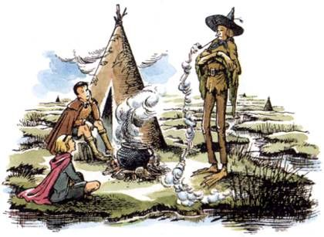
Puddleglum
Notes:
https://www.pinterest.com/pin/295196950553868715/?conversation_id=4994523222578844787&message=4994523221733699408&sender=808959289224934930

Slide 39
C.S. Lewis’ Chronicles The Silver Chair, I love the eternal pessimist Puddleglum. He’s always convinced doom is just around the corner, he nevertheless perseveres, TRUSTS…
Notes:
http://zackhunt.net/2015/08/07/the-curious-faith-of-puddleglum-the-marshwiggle/

Slide 40
He joins Eustace Scrub and Jill Pole in their search for Rilian, the lost prince of Narnia.
Notes:
http://zackhunt.net/2015/08/07/the-curious-faith-of-puddleglum-the-marshwiggle/

Slide 41
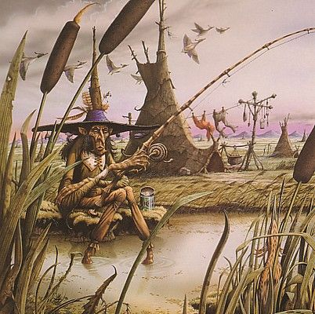
Fishing
for eels
Notes:
https://www.pinterest.com/pin/302585668683842218/visual-search/?x=12&y=12&w=377&h=376

Slide 42
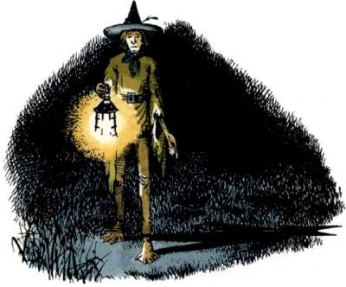
Notes:
https://www.google.com/url?sa=i&rct=j&q=&esrc=s&source=images&cd=&cad=rja&uact=8&ved=2ahUKEwjixNSn5obeAhUBI6wKHRBCCfsQjRx6BAgBEAU&url=http%3A%2F%2Fwww.patheos.com%2Fblogs%2Fstandingonmyhead%2F2015%2F11%2Fthanksgiving-and-narnias-puddleglum.html&psig=AOvVaw1v61hQE1Pze1WrO-eeTgsf&ust=1539635517102607

Slide 43
Towards the end of the book, as Puddleglum himself would have predicted, doom walks through the door just as our heroes begin celebrating the successful discovery of the lost prince.
Notes:
http://zackhunt.net/2015/08/07/the-curious-faith-of-puddleglum-the-marshwiggle/

Slide 44
Just as their making plans to leave the underground kingdom where they found Prince Rilian, the lost prince’s captor, the Lady of the Green Kirtle, walks in and bars their escape. Rather than immediately engaging the escapees in combat, the Lady of the Green Kirtle – with the help of a fragrant fire and a magical instrument
Notes:
http://zackhunt.net/2015/08/07/the-curious-faith-of-puddleglum-the-marshwiggle/

Slide 45
tries to convince Puddleglum and company that neither Narnia nor Aslan nor anything in the world above ground is real and therefore they have no reason to leave.
Hypnotizing, intoxicating music and aroma and speech…
Notes:
http://zackhunt.net/2015/08/07/the-curious-faith-of-puddleglum-the-marshwiggle/

Slide 46
On the brink of succumbing to the Lady’s deception, Puddleglum stomps out the magical fire with his bare feet and delivers one of the most inspiring declarations of faith I’ve ever read.
Notes:
http://zackhunt.net/2015/08/07/the-curious-faith-of-puddleglum-the-marshwiggle/
Three forms of the speech, for backup

Slide 47
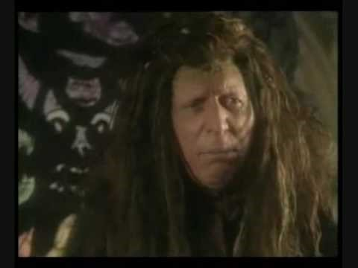
https://youtu.be/1Wuiq7j4nCA

Slide 48
“One word, Ma’am,” he said, coming back from the fire; limping, because of the pain. “One word. All you’ve been saying is quite right, I shouldn’t wonder. I’m a chap who always liked to know the worst and then put the best face I can on it. So I won’t deny any of what you said. But there’s one more thing to be said, even so. Suppose we have only dreamed, or made up, all those things-trees and grass and sun and moon and stars and Aslan himself. Suppose we have. Then all I can say is that, in that case, the made-up things seem a good deal more important than the real ones. Suppose this black pit of a kingdom of yours is the only world. Well, it strikes me as a pretty poor one. And that’s a funny thing, when you come to think of it. We’re just babies making up a game, if you’re right. But four babies playing a game can make a play-world which licks your real world hollow. That’s why I’m going to stand by the play world. I’m on Aslan’s side even if there isn’t any Aslan to lead it. I’m going to live as like a Narnian as I can even if there isn’t any Narnia. So, thanking you kindly for our supper, if these two gentlemen and the young lady are ready, we’re leaving your court at once and setting out in the dark to spend our lives looking for Overland. Not that our lives will be very long, I should think; but that’s a small loss if the world’s as dull a place as you say.”
Notes:
http://zackhunt.net/2015/08/07/the-curious-faith-of-puddleglum-the-marshwiggle/
https://www.goodreads.com/quotes/tag/puddleglum

Slide 49

Puddleglum and the Green Witch

Slide 50
I’m on Aslan’s side even if there isn’t any Aslan to lead it.
Never despair!
The anointing oil is on you!
Never rage, abandon kindness!
The anointing oil is on you!
Notes:
What is the significance of oil?
What is the meaning and application of insufficient oil to the young women, to Yeshua?
What is the meaning and application of sufficient oil to the young women, to Yeshua?

Slide 51
^{Vayikra/Lev 14.15-18} Next, the cohen is to take some of the two-thirds-pint of olive oil and pour it into the palm of his own left hand, dip his right finger in the oil that is in his left hand and sprinkle from the oil with his finger seven times before Adoni.
Notes:
Cleansing celebration from “leprosy” tsaraat.

Slide 52
^{Vayikra/Lev 14.15-18} Then the cohen is to put some of the remaining oil in his hand on the tip of the right ear of the person being purified, on the thumb of his right hand, on the big toe of his right foot and on the blood of the guilt offering.
Notes:
Cleansing of the leper/tsaraat.

Slide 53
^{Vayikra/Lev 14.15-18} Finally, the cohen is to put the rest of the oil in his hand on the head of the person being purified; and the cohen will make atonement for him before Adoni.

Slide 54
^{Dvarim/Dt 8.7-8} For Adoni your God is bringing you into a good land, a land with streams, springs and water welling up from the depths in valleys and on hillsides. It is a land of wheat and barley, grapevines, fig trees and pomegranates; a land of olive oil and honey.
Notes:
What is the significance of oil?
What is the meaning and application of insufficient oil to the young women, to Yeshua?
What is the meaning and application of sufficient oil to the young women, to Yeshua?

Slide 55
^{M’lakhim 1 Kings 17.14-16} For this is what Adoni the God of Isra’el, says: ‘The pot of meal will not get used up, nor will there fail to be oil in the jug, until the day Adoni sends rain down on the land.’” She went and acted according to what Eliyahu had said; and she,

Slide 56
^{M’lakhim 1 Kings 17.14-16} he and her household had food to eat for a long time. The pot of meal did not get used up, nor did there fail to be oil in the jug, in fulfillment of the word of Adoni spoken through Eliyahu.
Notes:
What is the significance of oil?
Supernatural provision. Bondage of indebtedness. Pour out. Multiplied at point of pouring out.

Slide 57
^{Yeshayahu/Is. 1.6} From the sole of the foot to the head there is nothing healthy, only wounds, bruises and festering sores that haven’t been dressed or bandaged or softened up with oil.
Notes:
We are to be healers to the world, albeit wounded healers.

Slide 58
^{Yermiyahu/Jer 41.8} However, ten of them said to Yishma‘el, “Don’t kill us, for we have stores of wheat, barley, olive oil and honey hidden in the field.” So he relented, and did not kill them along with their comrades.
Notes:
Oil is a treasure!!

Slide 59
^{Hoshea 2.10} For she doesn’t know it was I who gave her the grain, the wine and the oil; I who increased her silver and gold, which they used for Ba‘al.

Slide 60
^{Yoel 2.18-19} Then Adoni will become jealous for his land and have pity on his people. Here is how Adoni will answer his people: “I will send you grain, wine and olive oil, enough to satisfy you; and no longer will I make you a mockery among the Goyim.

Slide 61
^{Zekh 4.2-7} “I’ve been looking at a menorah; it’s all of gold, with a bowl at its top, seven lamps on it, and seven tubes leading to the lamps at its top. Next to it are two olive trees, one on the right side of the bowl and the other on its left.”…

Slide 62
^{Zekh 4.2-7} Then he answered me, “This is the word of Adoni to Z’rubavel: ‘Not by force, and not by power, but by my Spirit,’ says Adonai-Tzva’ot. ‘What are you, you big mountain? Before Z’rubavel you will become a plain;
Notes:
Oil…grace, mercy, purity, power of love, influence

Slide 63
^{T’hillim/Ps 23.5} You prepare a table for me, even as my enemies watch; you anoint my head with oil from an overflowing cup.
Notes:
Me at Ein Gedi 1971

Slide 64
^{T’hillim/Ps 45.8} You have loved righteousness and hated wickedness. Therefore, God, your God, anointed you with the oil of gladness above your companions.

Slide 65
^{T’hillim/Ps 133.1-2} Oh, how good, how pleasant it is for brothers to live together in harmony. It is like fragrant oil on the head that runs down over the beard, over the beard of Aharon, and flows down on the collar of his robes.
Notes:
Dawn and I saw Pureflix movie [better than Netflix] Samson. Pour a horn full of oil on him.
We need.

Slide 66
^{T’hillim/Ps 119.105} Your word is a lamp to my feet and a light to my path.

Slide 67
^{Mishlei/Prov. 21:17, 20} Pleasure-lovers will suffer want; he who loves wine and oil won’t get rich…In the home of the wise are fine treasures and oil, but a fool quickly devours it.

Slide 68
^{Song 1.3} Your anointing oils have a wonderful fragrance; your name is like anointing oil poured out.

Slide 69
^{Divrei Hayamim 1 Chron. 9.29} Some of [the L’vi’im] were in charge of the articles used for the service; they had to keep records of them when bringing them in and out. Others were in charge of the equipment, the holy utensils, the fine flour, the wine, the olive oil, the frankincense and the spices

Slide 70
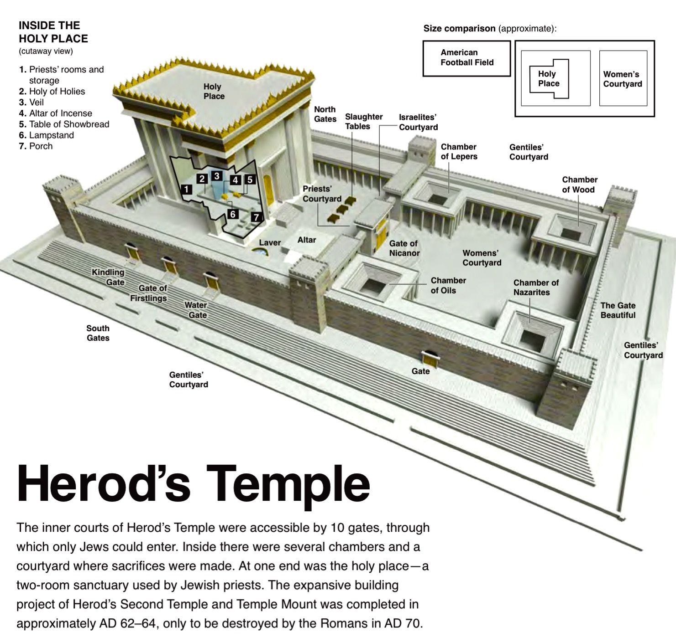
Chamber
of oils
Note: 22
stories
Football
field
Notes:
https://www.google.com/search?q=jerusalem+temple+diagram&safe=active&tbm=isch&source=iu&ictx=1&fir=wFopPvOinEWHgM%253A%252C6AENVeKH-0r9mM%252C_&usg=AI4_-kTFlegd45LR0bRoD1Psq2n2T9xaWw&sa=X&ved=2ahUKEwjR-dSrk5TeAhUFc60KHTrNAGcQ9QEwDHoECAQQHA#imgrc=wFopPvOinEWHgM:

Slide 71
Oil is a metaphor for righteousness
^{Mishlei/Pr 6.23} For the mitzvah is a lamp, Torah a light, and corrective discipline the way of life.
^{Mishlei/Pr 13.9} The light of the righteous [shines] joyfully, but the lamp of the wicked will be extinguished.

Slide 72
^{Iyov/Job 18.5-6} “The light of the wicked will flicker and die, not a spark from his fire will shine, the light in his tent is darkened, the lamp over him will be snuffed out.

Slide 73
^{Kohelet/Eccles. 7.1} A good name is better than perfumed oil, and the day of death better than the day of birth.

Slide 74
Cyrus / Koresh the Lord's "anointed^{" (Isa. 45:1)} Thus says Adoni to Koresh, his anointed, whose right hand he has grasped, so that he subdues nations before him and strips kings of their robes, so that doors open in front of him, and no gates are barred:

Slide 75
^{Yeshayahu 61.1-3} The Ruakh of Adoni Elohim is on me, because Adoni has anointed me…to comfort all who mourn to console those who mourn in Zion, to give them beauty for ashes,

Slide 76
^{Yeshayahu 61.1-3} the oil of joy for mourning, the garment of praise for the spirit of heaviness, that they might be called oaks of righteousness, the planting of Adoni, that He may be glorified.

Slide 77
Since this is a parable, and the thrust is insufficient oil,
What is the significance of oil?
What is the meaning and application of insufficient oil?
What is the meaning and application of sufficient oil?
Notes:
What may have been in the women’s mind about oil? What was in Yeshua’s mind about oil?

Slide 78
Most basic food
Cosmetic, beauty
Heat and light
Medicine

Slide 79
Designation for worship
Symbol of G-d’s glory & presence
Denotes separation
Supernatural sustenance
Emblem of the Ruakh/Spirit
Protection from UV

Slide 80
Gladness
Enlightenment in the Ruakh
Oil of Righteousness
G-d’s purpose
Comfort

Slide 81
Love, joy, peace. Opposite of bitterness, pride, discouragement, raging lust, distrust, gloom.
Servant spirit.
Gifts of the Spirit: words of knowledge.

Slide 82
But you have to seek it, and remove false oils.
Oil of the Ruakh stimulates…
Dopamine…activates oxytocin production in your hypothalamus and hippocampus
Notes:
Darrel Brazell Power of Joy lectures.

Slide 83
A special chemical in your body, called oxytocin, helps to create the feeling of falling in love. Oxytocin naturally enhances a sense of:
Optimism, Trust, Mastery, Self-esteem
Notes:
https://bodyecology.com/articles/this-bliss-hormone-can-heal-your-body-the-many-benefits-of-oxytocin

Slide 84
Conclusion: Keep seeking oil from Yeshua even if there seems to be no hope. Keep on trusting that there will be deliverance.
Keep on using EVERY resource, every oil source, remove every toxin that you can.
Trust Yeshua. For example…

Slide 85
"All day Friday I had been feeling unsettled and I didn't know why," Airline pilot, Captain Icoze Mafella recounted at a Jakarta congregation, on Sunday, Sept. 30, 2018
Notes:
https://www.charismanews.com/world/73475-pilot-saves-hundreds-when-holy-spirit-prompts-him-to-take-off-moments-before-quake-strikes

Slide 86

Captain Mafella, right Reports/Courtesy)
Notes:
https://www.charismanews.com/world/73475-pilot-saves-hundreds-when-holy-spirit-prompts-him-to-take-off-moments-before-quake-strikes

Slide 87
To displace his feelings of unease, Mafella—a strong Christian—began to loudly sing worship songs on his flight from Ujung Pandang to Palu. "Usually I only hummed, but that day I wanted to praise the Lord as best I could," Mafella said.
After they landed, the Holy Spirit prompted Mafella once more that he needed to be quick. He instructed his crew to take a shorter, 20-minute break before the plane was due to take off for Jakarta via Ujung Pandang
Notes:
https://www.charismanews.com/world/73475-pilot-saves-hundreds-when-holy-spirit-prompts-him-to-take-off-moments-before-quake-strikes

Slide 88
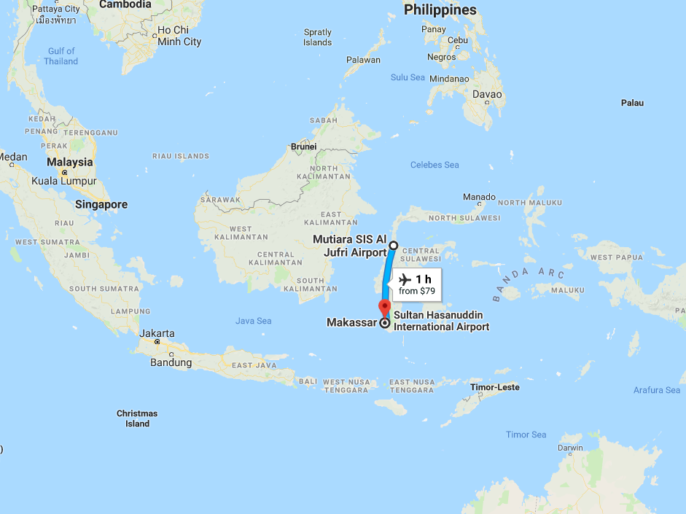
    Mutiara Sis Al Jufri Airport
    in Palu

Slide 89
"I didn't even leave the cockpit and requested permission from the control tower to depart three minutes ahead of schedule," Mafella recounted. He received approval for the expedited time for takeoff from Air Controller Anthonius Agung, and the crew prepared for departure.
Notes:
https://www.charismanews.com/world/73475-pilot-saves-hundreds-when-holy-spirit-prompts-him-to-take-off-moments-before-quake-strikes

Slide 90
Mafella felt such an urgency that he broke with standard flight procedures and took over some of the co-pilot's responsibilities to speed up their exit.
The moment arrived for takeoff, and the plane barreled down the runway. "I don't know why, but my hand kept pushing the lever, causing the plane to speed up as it took off," Mafella said.
Notes:
https://www.charismanews.com/world/73475-pilot-saves-hundreds-when-holy-spirit-prompts-him-to-take-off-moments-before-quake-strikes

Slide 91
As they sped down the airstrip, the massive earthquake began to strike Palu, and both pilots felt the plane sway noticeably to the left and right. The Muslim co-pilot glanced at Mafella with a look of fear in his eyes.
Notes:
https://www.charismanews.com/world/73475-pilot-saves-hundreds-when-holy-spirit-prompts-him-to-take-off-moments-before-quake-strikes

Slide 92
"If I had taken off three minutes later, I would not have been able to save the 140 passengers, because the asphalt on the landing strip was moving up and down like a curtain blowing in the wind," Mafella testified.
Notes:
https://www.charismanews.com/world/73475-pilot-saves-hundreds-when-holy-spirit-prompts-him-to-take-off-moments-before-quake-strikes

Slide 93
    Mutiara Sis Al Jufri Airport
    in Palu

Slide 94
When the plane arrived in Ujung Pandang, he was told the shocking news that there had been an earthquake and tsunami in Palu. The air controller, Anthonius Agung, 21, made sure their plane—the last to leave the airport — had safely taken off before he jumped from the crumbling control tower at the height of the quake.
Notes:
https://www.charismanews.com/world/73475-pilot-saves-hundreds-when-holy-spirit-prompts-him-to-take-off-moments-before-quake-strikes
I have one story a bit like that on a small scale. Leaving my dorm room after Messiah Conf. Everything packed and rolling. STRONG sense that I was leaving something behind. Looked again. Again. Finally thought to look in my roommate’s dresser. “Is that even right?” Finally did, and there was lots of clothes. I had no room left except the liner of the garbage bag. Took and met him later.

Slide 95
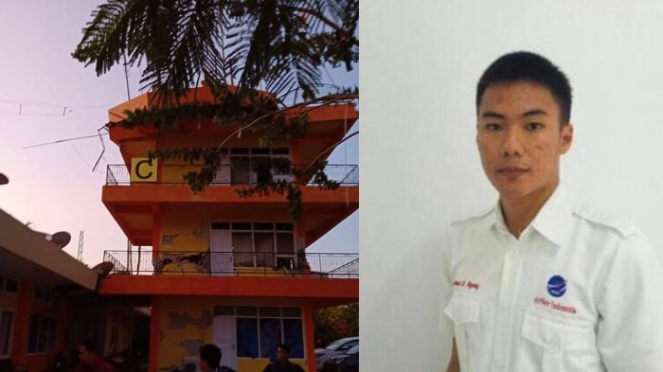
Anthonius Agung, Palu airport
Notes:
https://www.google.com/url?sa=i&source=images&cd=&cad=rja&uact=8&ved=2ahUKEwiZlcyziZTeAhXJDewKHZt2ArkQjRx6BAgBEAU&url=http%3A%2F%2Fwww.tribunnews.com%2Fregional%2F2018%2F09%2F30%2Fantonius-gunawan-agung-sempat-lompat-ke-luar-menara-saat-gempa-mengguncang-palu&psig=AOvVaw1YxgNmLbTKQPxZakywRHrc&ust=1540092211423916

Slide 96
"They said people tried to call him to get away from the tower, but he said, 'No, the aircraft isn't airborne yet.' Then the roof started collapsing, and he jumped," Mafella explained. Tragically, Agung broke his legs, arms and ribs as a result of the fall and died from internal injuries on his way to the hospital.
Notes:
https://www.charismanews.com/world/73475-pilot-saves-hundreds-when-holy-spirit-prompts-him-to-take-off-moments-before-quake-strikes
I have one story a bit like that on a small scale. Leaving my dorm room after Messiah Conf. Everything packed and rolling. STRONG sense that I was leaving something behind. Looked again. Again. Finally thought to look in my roommate’s dresser. “Is that even right?” Finally did, and there was lots of clothes. I had no room left except the liner of the garbage bag. Took and met him later.

Slide 97
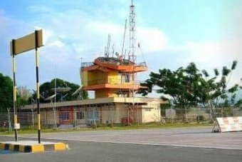
Air Traffic Tower of Mutiara Sis Al Jufri Airport in Palu

Slide 98
Conclusion: Keep on trusting that there will be deliverance.
Keep on using EVERY resource, every oil source, remove every toxin that you can. [RTF coming]
Keep seeking oil from Yeshua even if there seems to be no hope. Listen to His voice. Trust Yeshua.

Slide 99
^{Rev 3.18} Yeshua offers: My advice to you is to buy from me gold refined by fire, so that you may be rich; and white clothing, so that you may be dressed and not have to be ashamed of your nakedness; and eyesalve to rub on your eyes, so that you may see.

Slide 100
^{Yeshayahu/Is 55.1-2} “All you who are thirsty, come to the water! You without money, come, buy, and eat! Yes, come! Buy wine and milk without money — it’s free! ² Why spend money for what isn’t food,
your wages for what doesn’t satisfy? Listen carefully to me, and you will eat well, you will enjoy the fat of the land.
Notes:
Prayer afterward. RTF in a few weeks.

Slide 101
Be filled with the Spirit.
Keep being filled with the Spirit.

