Slide 1
e-handout
To have these notes
without taking notes
Go to OrHaOlam.com
Click on downloads,
messages, 2018
Notes:
.

Slide 2
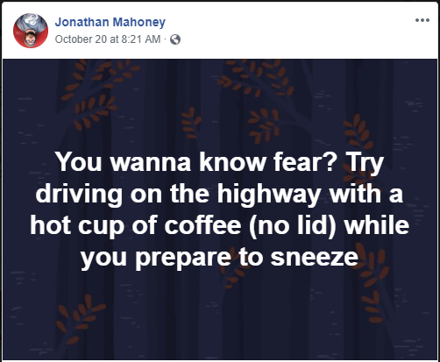
The rest of the story…

Slide 3
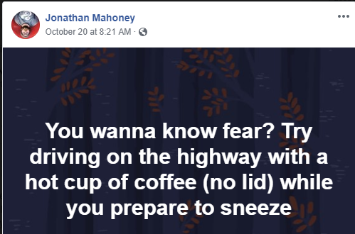
Notes:
Was Denise there, in the hazard zone?

Slide 4
A four year old tugged on her dad who had been watching political ads, begging him to stop and read her a fairy tale before bed. Weary of seeing all these endless campaign ads, he agreed and started reading the fairy tale,

Slide 5
but she interrupted him, looked up into his face and asked sweetly: "Daddy, do all fairy tales begin with: ‘Once Upon a Time?'" He shook his head and answered cynically, "No sweetheart, most fairy tales begin with: 'And when I'm elected...'"
Notes:
From FRC, Tony Perkins

Slide 6
I heard one preacher say that if Christopher Columbus were around today, he could have been the greatest politician of all time. When he left he didn't know where he was going. When he got here, he didn't know where he was. When he went back, he didn't know where he'd been. And he did it all on government money!
Notes:
From FRC, Tony Perkins

Slide 7
For the Sake of America
Pray Vote Stand
Tuesday, November 6
www.FRC.org/Pledge

Slide 8

https://drjamesdobson.org/media/get-out-and-vote-pray/?sc=FEM&mc=FEM1018GOVPV&utm_source=SilverpopMailing&utm_campaign=20181023%20-%20Get%20Out%20and%20Vote%20-%20(FEM1018GOVPV)%20(5)&spMailingID=20438499&spUserID=MTk2NDM5NTE5MAS2&spJobID=1361388074&spReportId=MTM2MTM4ODA3NAS2

Slide 9


Slide 10
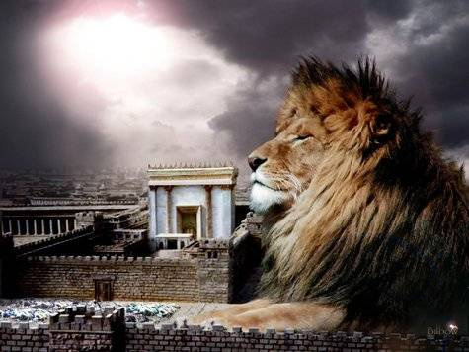
מַתִּתְיָהוּ Mattityahu
(Matthew) 25:5-7
Notes:
Continuing the somewhat enigmatic story of the 5 bridesmaids waiting for the bride. They had insufficient oil.
I realize and apologize that I had far too much information last week about oil.
This is a bit different angle on the continuation of the story.

Slide 11
Mattityahu (Matthew) 25:5
כֵּיוָן שֶׁהִתְמַהְמַהּ הֶחָתָן נִמְנְמוּ כֻּלָּן וְנִרְדְּמוּ.
“ Now the bridegroom was late, so they all went to sleep.
Notes:
They would have been OK if on time, but not prepared for unexpected. Craig Keener: common for delay.
Personal illustration.

Slide 12
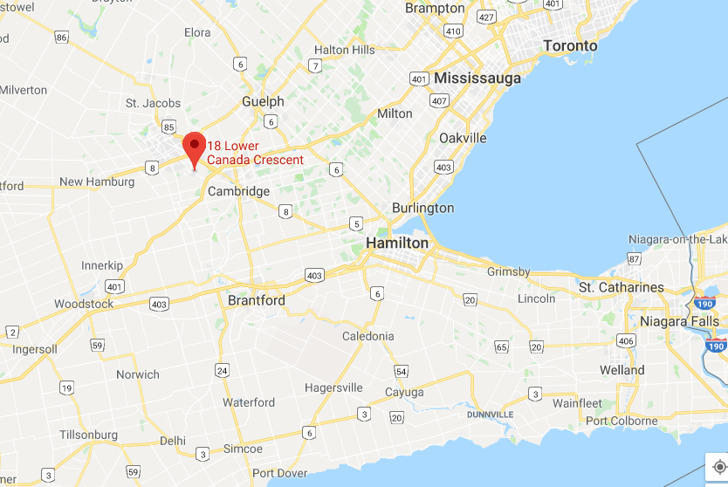
Lake
Ontario
Lake
Ontario
Lake Erie
Notes:
This is Southern Ontario, Canada. Note Toronto. West on the 401 is the home city of my Queen and bride: Kitchener. The word Kitchener is covered over by Google’s presentation of the street address. So, zooming in…

Slide 13
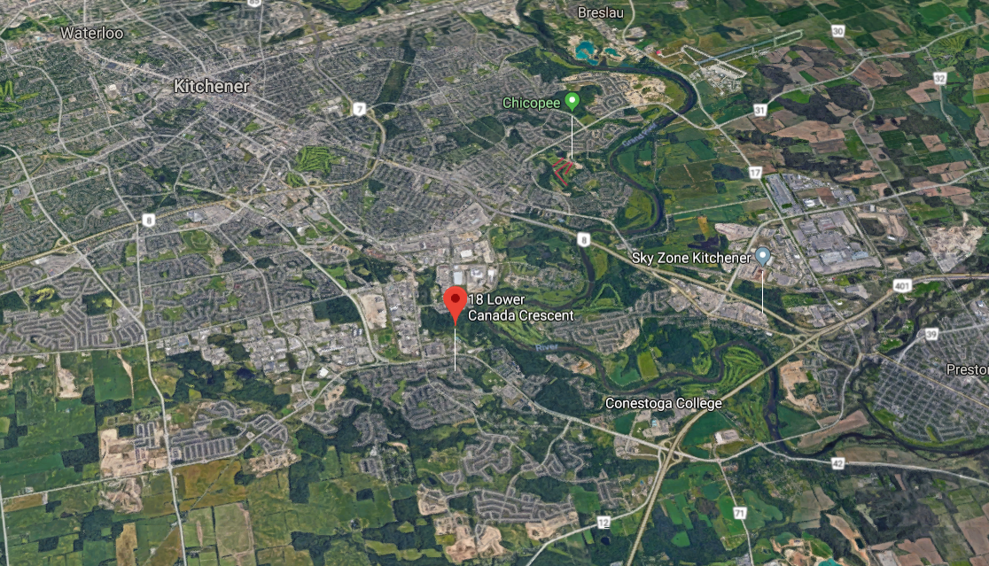
Notes:
401 from Toronto then north on Homer Watson Blvd.

Slide 14
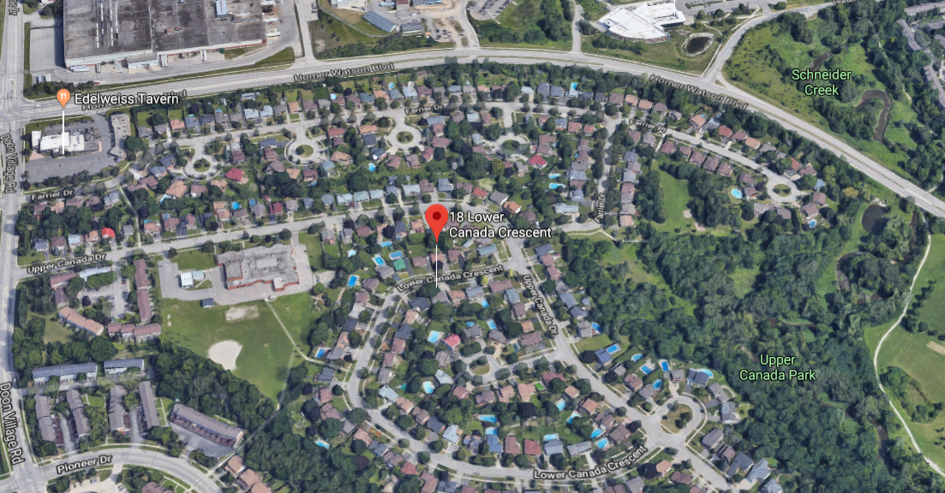

Slide 15
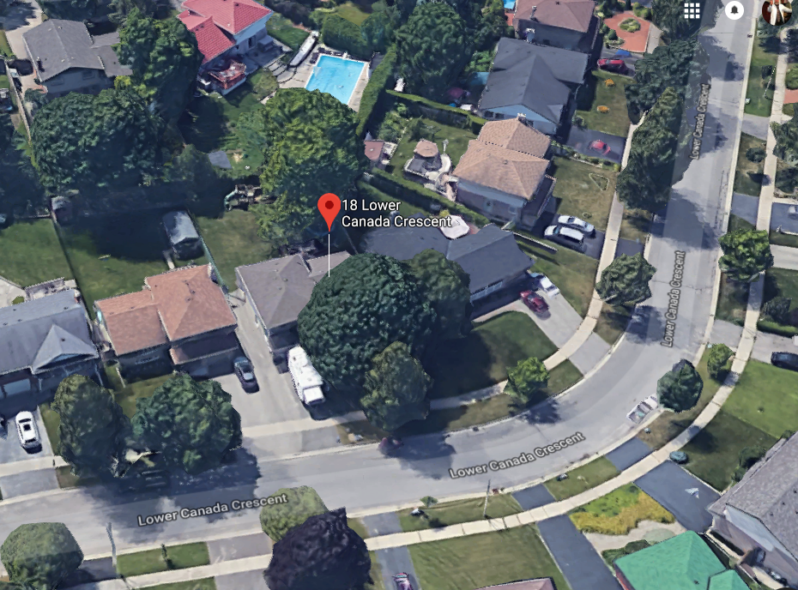

Slide 16
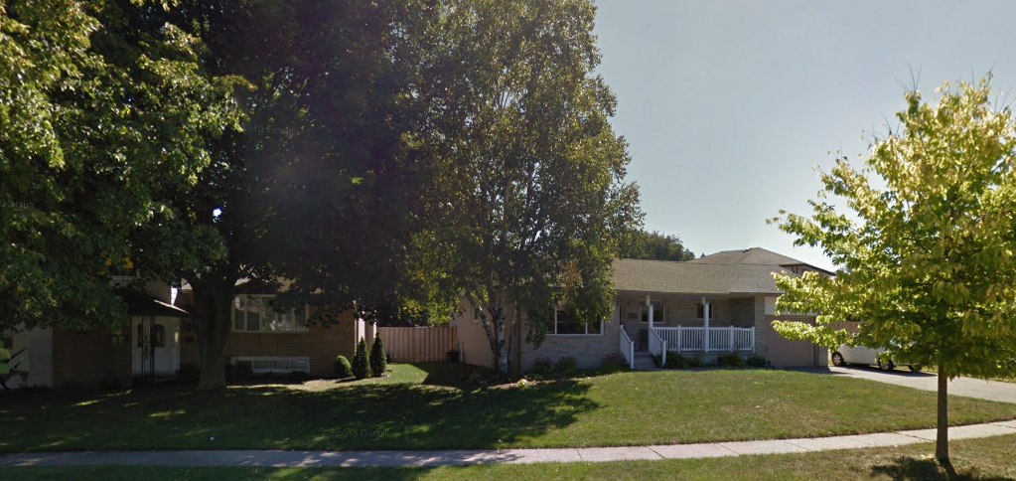
18 Lower Canada Crescent, Kitchener, Ont.
Notes:
The neighbors loaned the use of their house, on the right, to the grooms party to dress. July, 21, 1973
Her Dad had a flower bed in the front of the house, and intended to take photos of his daughter, in front of that flower bed, but not until the groom and friends had left. But, to quote a scripture, “the bridegroom was late.” So, he wouldn’t let Dawn come out of the house till we were gone. Then, he took his own sweet time, since he was the official photog. So I got to the building at the time of the wedding, but I was supposed to be there 10 or 15 minutes earlier. We were waiting and waiting and waiting for her to arrive. People thought she was late, and maybe bailed, but it was me who was late.
Note the front of the house…

Slide 17
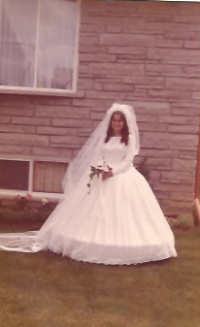
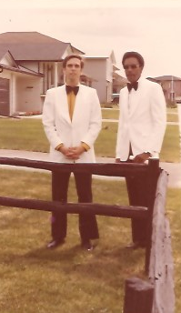
Notes:
The bride Me and Ray Glenn, my mentor and best man
So, it does happen in Jewish weddings.

Slide 19
Mattityahu (Matthew) 25:5
כֵּיוָן שֶׁהִתְמַהְמַהּ הֶחָתָן נִמְנְמוּ כֻּלָּן וְנִרְדְּמוּ.
“ Now the bridegroom was late, so they all went to sleep.
Notes:
Maybe Yeshua was giving a forewarning relative to ancient and modern expectations, especially in times of trouble.
Sleeping isn’t a sin, but it’s passive, instead of passionate waiting.
A forewarning especially to be strong when the Temple fell in 70, or other disasters. In Fiddler on the Roof, when Anatevka was depopulated of Jews by the Tsar.

Slide 20
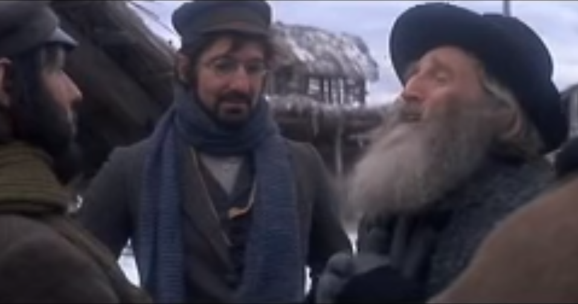
https://www.youtube.com/watch?v=uu_QQLM4biQ
Notes:
Backup, next slide

Slide 21

Expulsion from Anatevka

Slide 22
“Rabbi, Wouldn’t this be a good time for the Messiah to come?”
“We’ll have to wait for Him someplace else.
Meanwhile, let’s start packing.”

Slide 23
Mattityahu (Matthew) 25:6
בַּחֲצוֹת הַלַּיְלָה נִשְׁמְעָה קְרִיאָה, ’הִנֵּה הֶחָתָן, צְאֶינָה לִקְרָאתוֹ!‘
It was the middle of the night when the cry rang out, ‘The bridegroom is here! Go out to meet him!’

Slide 24
^{1 Thes 4.13, 16-17} Now, brothers, we want you to know the truth about those who have died; otherwise, you might become sad the way other people do who have nothing to hope for…For the Lord himself will come down from heaven with a rousing cry, with a call from one of the ruling angels,

Slide 25
^{1 Thes 4.13, 16-17} and with God's shofar; those who died united with the Messiah will be the first to rise; then we who are left still alive will be caught up with them in the clouds to meet the Lord in the air; and thus we will always be with the Lord.
Notes:
He WILL come. We want to be ready to go, how ever it plays out.

Slide 26
Mattityahu (Matthew) 25:7
שאָז הִתְעוֹרְרוּ הָעֲלָמוֹת הָהֵן וְהֵכִינוּ אֶת מְנוֹרוֹתֵיהֶן.
“The girls all woke up and prepared their lamps for lighting.”

Slide 27
Mattityahu (Matthew) 25:2
Remember from last week
[my apologies: too much info]
חָמֵשׁ מֵהֶן הָיוּ כְּסִילוֹת וְחָמֵשׁ הָיוּ נְבוֹנוֹת,
“Five of them were foolish and five were sensible.”
כְּסִיל literary: fool, idiot, imbecile, moron

Slide 28
^{Mtt.25.3} For when the foolish ones took their lamps, they took no oil with them.
Insufficient oil

Slide 29


Slide 30
[This root (mōr-) "properly refers to physical nerves causing one to become dull, sluggish (so Hipp., Aristotle); used of the mind, dull, stupid, foolish" (Abbott-Smith); "flat/insipid“
“What were you thinking?”

Slide 31
Why were the foolish young women not prepared? I have four reasons, that we need to address in our lives.
They assumed that they would ride the wave of benefit from the others.
Notes:
G-d has many children, but G-d has no grandchildren. Can’t get by, in the judgement, on the strength of the community. It helps lots, but ultimately, the secrets of our hearts are before Him privately, personally. How are you living? Praying, reading, fasting, loving Him and others?

Slide 32
^{Mtt. 25.8} Now the foolish ones said to the wise, ‘Give us some of your oil, since our lamps are going out.’
Notes:
Can’t get it from community in that day.

Slide 33
Why were the foolish young women not prepared?
2. They need to be guided by a vision.

Slide 34
^{Mishlei/Prov 29.18} Without a prophetic vision, the people throw off all restraint; but he who keeps Torah is happy.
So, we train to walk in the vision…to WIN.

Slide 35
Guided by a vision:
^{1 Kefa/Peter 1.3-4,8} Praised be God, Father of our Lord Yeshua the Messiah, who, in keeping with his great mercy, has caused us, through the resurrection of Yeshua the Messiah from the dead, to be born again to a living hope,

Slide 36
^{1 Kefa/Peter 1.3-4,8} to an inheritance that cannot decay, spoil or fade, kept safe for you in heaven…Without having seen him, you love him. Without seeing him now, but trusting in him, you continue to be full of joy that is glorious beyond words.
Notes:
There were a few times before we were married that Dawn had to go home, from school in Cincinnati to home in Kitchener, Ontario, Canada, and I’d see her off at the bus station, and my heart would go with her. But, I didn’t look around at other girls. I had a vision of loveliness. Kept me working, preparing, saving $ for travel, honeymoon. Built our huppah and took it to Kitchener on the side of my 1964 Chevy Bel Aire..

Slide 37
Why were the foolish young women not prepared?
2. They need to be guided by a vision. Our vision:
^{Ro 11.15} What will their [the Jewish people’s] acceptance [of Messiah and the Kingdom] be but life from the dead?
Notes:
Jewish covenantal leadership of the Kingdom. GLORY!! We’re not just cruising along, we have royal leadership destiny.
We have hope that is the basis of our trust and love!!

Slide 38
^{1 Cor. 13.13} Three things last — trust, hope, love; and the greatest of these is love.
Notes:
So, we need to shine for the Messiah. Not minimums

Slide 39
Why were the foolish young women not prepared?
3. Training failure. No one should expect that serving the King in this antagonistic world will be easy.

Slide 40
^{Acts 14.21-22} After proclaiming the Good News in that city and making many people into talmidim, they returned to Lystra, Iconium and Antioch, strengthening the talmidim, encouraging them to remain true to the faith, and reminding them that it is through many hardships that we must enter the Kingdom of God.

Slide 41
Why were the foolish young women not prepared?
3. Training failure. In the Israeli military: At the beginning of each basic training course, there are several days of 'integration', where drill instructors convert recruits from civilians to soldiers.

Slide 42
These are usually considered the most difficult days of any basic training program, even though they are not physically draining.

Slide 43
Shaul’s training regimen:
^{1 Cor 9.24-27} Don’t you know that in a race all the runners compete, but only one wins the prize? So then, run to win! Now every athlete in training submits himself to strict discipline, and he does it just to win a laurel wreath that will soon wither away.

Slide 44
^{1 Cor 9.24-27} But we do it to win a crown that will last forever. Accordingly, I don’t run aimlessly but straight for the finish line; I don’t shadow-box but try to make every punch count. I treat my body hard and make it my slave so that, after proclaiming the Good News to others, I myself will not be disqualified.

Slide 45
John Wesley wrote the following words: I am a creature of a day, passing through life as an arrow through the air. I am a spirit come from God, and returning to God: just hovering over the great gulf; till, a few moments hence, I am no more seen; I drop into an unchangeable eternity!
Notes:
https://www.gbs.edu/wp-content/uploads/2018/09/GR-2018-OCT-web-.pdf
Wesley is the English spiritual leader who in the 1700’s changed the course of British history. Reversed the corruption of the culture so that there was no need for revolution, as in France. Out of the transformation, the slave trade was abolished. Great influence on America as well. Wesleyan Methodists founded as abolitionists in the USA.

Slide 46
I want to know one thing: the way to heaven; how to land safe on that happy shore. God Himself has condescended to teach the way. He hath written it down in a book. O give me that book! At any price, give me the book of God! I have it: here is knowledge enough for me.
Notes:
https://www.gbs.edu/wp-content/uploads/2018/09/GR-2018-OCT-web-.pdf

Slide 47
1. Set apart a time each day, morning [and evening if possible] to read the Scriptures. Make it a habit to dedicate the best possible time of our day to the unhindered reading of the Bible.

Slide 48
2. At each time, read a chapter out of the Old and one out of the New Testament. If this is not possible, then focus on a single chapter or a part of a chapter. Have an orderly, systematic means of working through the Bible, and that we should do so with relatively small units of Scripture.

Slide 49
3. Read with a focus to know the whole will of God and a firm commitment to do His will as it is revealed to you. The Word of God should both enlighten and change us.

Slide 50
4. As you read, look for any connection, clarification, and explanation you might find between the fundamental doctrines of sin, justification by faith, the new birth, inward and outward holiness.

Slide 51
5. We should pray before, during, and after our time of Bible reading because Scripture can only be understood through the same Spirit who gave it. Prayer should accompany our reading of the Scriptures.

Slide 52
6. We should frequently pause as we read and examine ourselves both inwardly in our hearts and outwardly in our lives. Whatever light we receive, we should promptly obey it by its immediate application in our lives.

Slide 53
Quiet reflection and self-examination that is prompted by the Word of God, enabled by the Holy Spirit, and carried out in the context of grace can result in great spiritual blessing if we walk in the light of what has been revealed to us.

Slide 55
Why were the foolish young women not prepared?
4. Negativity. The life in Messiah is hard. No fun. We are defeated. We are weird. We just have to bear with all this.

Slide 56
We ARE winning. The Kingdom is advancing. Our 40 days of fasting and nightly prayer…

Slide 57
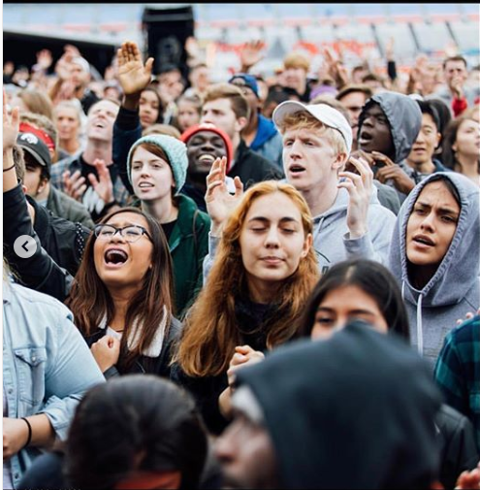
This
Generation:
Gen Y
Gen Z
Millennials
ARE
arising…
Notes:
Note ages…

Slide 58
'A New Yeshua Movement' : 90,000 Young People Gather to Hear “Encounter Yeshua.” More than 90,000 attendees gathered in Fort Worth at Texas Motor Speedway to hear from a diverse set of 45-plus Spirit filled music artists and speakers last weekend [Oct 20] at Together 2018.
Notes:
https://www.charismanews.com/us/73740-90-000-gather-to-hear-francis-chan-todd-white-hillsong-ravi-zacharias

Slide 59
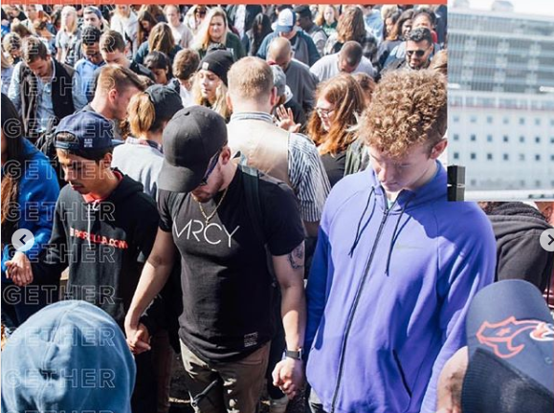
Notes:
https://www.instagram.com/p/BpK6JoBjQBq/?utm_source=ig_embed

Slide 60
PULSE, a Minneapolis-based Millennial-led organization, joined forces with more than 1,000 congregations nationwide to bring thousands together with a focus and call to overcome the divisiveness that marks our country by moving closer to Yeshua and the world He loves.
Notes:
https://www.charismanews.com/us/73740-90-000-gather-to-hear-francis-chan-todd-white-hillsong-ravi-zacharias

Slide 61
An additional 13,000 people from 89 different countries joined Together 2018 via livestream, and attendees committed to sponsor 1,200 children.
"This was not an event—this was the start of a movement," said Nick Hall, founder of Pulse.
Notes:
https://www.charismanews.com/us/73740-90-000-gather-to-hear-francis-chan-todd-white-hillsong-ravi-zacharias

Slide 62
"Together is about equipping a generation to live a different way. The Together lifestyle is rooted in prayer, discipleship, evangelism, Scripture reading and loving others. The unity we saw this weekend gives me hope—hope that this generation is going to change the world—and the work starts once they leave the Speedway."
Notes:
https://www.charismanews.com/us/73740-90-000-gather-to-hear-francis-chan-todd-white-hillsong-ravi-Zacharias
You may say, “Well, that’s not in the Jewish world…”

Slide 63
We ARE winning. The Kingdom IS advancing. Our 40 days of fasting and nightly prayer is also done in Israel…

Slide 64
Ron Cantor [Jewish Israeli leader] wrote: Earlier this week, my dear friend, Paul Wilbur, did a worship concert. The place was full. I had brought a friend who is not a believer. He is an Israeli—he is what we call “traditional.” That means he respects Judaism, goes to synagogue, but is not a super religious person.
Notes:
https://tikkun.tv/the-favor-of-god-is-upon-you/

Slide 65
He saw the joy and light in their faces. He saw God’s favor upon them. He turned to Elana [Ron’s wife] and said, “I have never seen anything like this. I’ve never see people who love God like this.” All he knew was the traditional synagogue and rote repetition. Now he is reading material about Yeshua.
Notes:
https://tikkun.tv/the-favor-of-god-is-upon-you/

Slide 66
We ARE winning. The Kingdom IS advancing. Our 40 days of fasting and nightly prayer brings us to the next step.
I am proposing an
Eruv+ prayer drive.
Notes:
Here is the thrust of the message. So, all who are sleeping bridesmaids, WAKEN, ARISE

Slide 67
^{Mishlei/Prov 29.18} Without a prophetic vision, the people throw off all restraint; but he who keeps Torah is happy.
So, we train…to WIN.

Slide 68


Slide 69
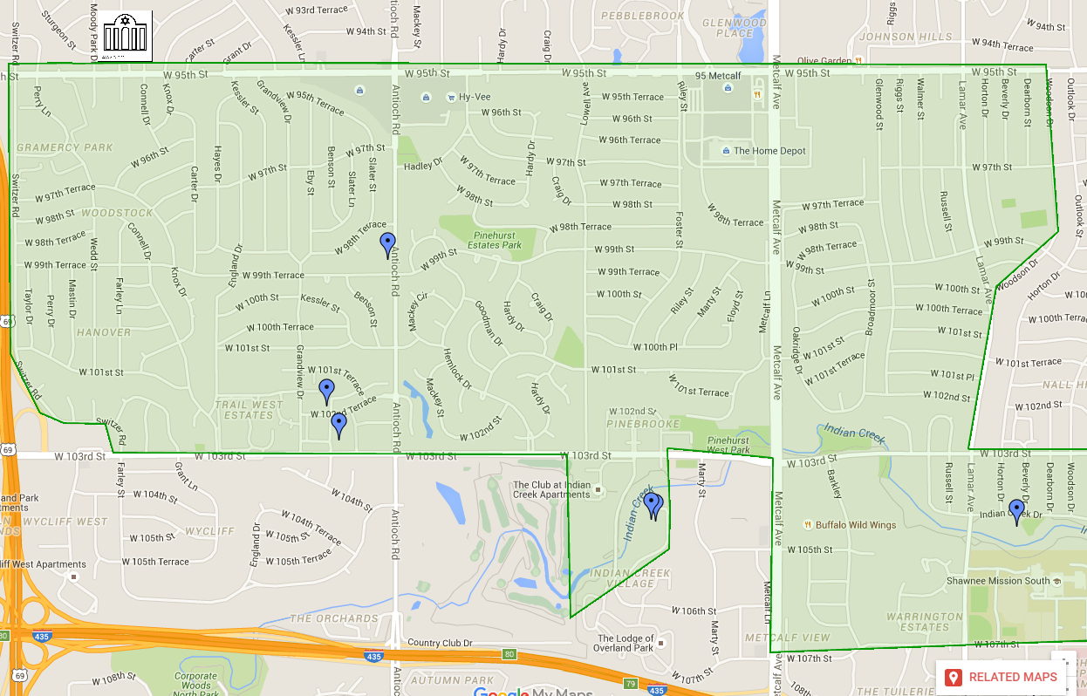
Notes:
The Eruv is the area that is mentioned in the Book of Acts as a Sabbath Day’s journey. How far you can carry a burden on Shabbat before it’s defined as work. Many of the major Jewish institutions are in the eruv. Or HaOlam is in the northwest corner.

Slide 70
I am proposing a prayer drive project, like what a friend that some of you know did in a Haredi Jewish neighborhood that seemed impenetrable.
We have a list of the streets of the Eruv, and some nearby areas, and are looking for
Notes:
She eventually had people ask her questions, other encounters.

Slide 71
volunteers to adopt a street. Drive through it relatively slowly once or twice or more each week, and pray for the homes, residents, families, fathers, mothers, teens, kids, marriages, businesses!
Notes:
How long? Another 40 days…two months. Then assess.

Slide 72
Notes:
While the sheet is being passed around,
More than one person, couple, can sign up for a given street.
You can add your street, if outside the Eruv.
We’ll be making this available by spamming, etc., if you want to thing about it.
Please note what street you took, so Lori doesn’t have to send reminders.

Slide 73
Tuesday nights at Teerosh we’ll ask if there are impressions, testimonies, leadings. Maybe do the drive at 8:30p.m., instead of, or on the way to Mi Ranchito! I’m going to pass around a sign up sheet that Lori, who handles the details, wonderfully made.
Notes:
While it’s being passed around, a victory in progress story.

Slide 74
So, we ARE winning. The Kingdom IS advancing. Our 40 days of fasting and nightly prayer brings us to see Changing history through Prayer

Slide 75

book on
prayer
during
WW II and the
1948 Israeli
War of
Independence
Notes:
We are changing history.

Slide 76
Iran’s economic crisis has caused 70 per cent of factories, workshops and mines to shut down or go bankrupt, the IRNA news agency reported Expediency Discernment Council member Mostafa Mirsalim saying.
Notes:
https://unitycoalitionforisrael.org/?p=15708993

Slide 77
There had been warnings that factories had to shut down due to lack of raw materials and hard currency as a result of US sanctions imposed on Iran after America unilaterally withdrew from the nuclear deal sign in 2015.
Notes:
https://unitycoalitionforisrael.org/?p=15708993

Slide 78
According to official figures, food prices have increased from between 50 and 100 per cent, prompting the government to consider distributing 10 million ration cards worth $7 per month.
Remember the collapse of the dreaded Soviet evil empire?
Notes:
https://unitycoalitionforisrael.org/?p=15708993
Pressure on the Iranian government of President, Hassan Rouhani is mounting
After the Evil Empire’s collapse
Refusniks were allowed to emigrate [millions to Israel]
Spiritual outreach started:
Belarus, Minsk, David & Philip’s parents and the congregation there
Other forms of outreach
Capitalism took off, but then mired in corruption.

Slide 79
So the bridesmaids needed:
Individual spirituality
A captivating vision
Disciplined reading & prayer
Hope and optimism! We are on the winning side!!
Commit! Pray & then do!

