Slide 1
e-handout
To have these notes
without taking notes
Go to OrHaOlam.com
Click on downloads,
messages, 2018
Notes:
.

Slide 2
From Evan Levine:
A Messianic family just finalized the adoption of two children which is a monumental step forward for our cause here in Israel. I wanted to you to see what they had to say, in their own words, about their connection with HaTikva Families. Thanks so much for being a part of this amazing success story.
Notes:
Culture in Israel 40K abortions. 300 adoptions. Less shameful to abort than to have someone else raise your child!!

Slide 3
We want to take a moment to say a huge thank you to HaTikva Families - a new initiative under the umbrella of the Messianic non-profit organization the HaTikva Project. When we first moved to Nesher and realized we needed a sturdy fence around the garden for the children's safety, but had no budget left whatsoever, HaTikva Families immediately stepped in to fund it.

Slide 4
When we have had any prayer needs relating to the children or to the process of fostering and adoption, they have always been a listening ear and have put out confidential prayer requests to their networks.

Slide 5
HaTikva Families are doing a wonderful work. Please pray that the Lord would bring forth much fruit from their ministry and that through them, many other children like Y. and H. would find safe and loving homes.
Notes:
Yehuda and Hallel, just made up

Slide 6
Sukkah malfunction
Notes:
Got a text letting me know that the wind, Wednesday afternoon…

Slide 7
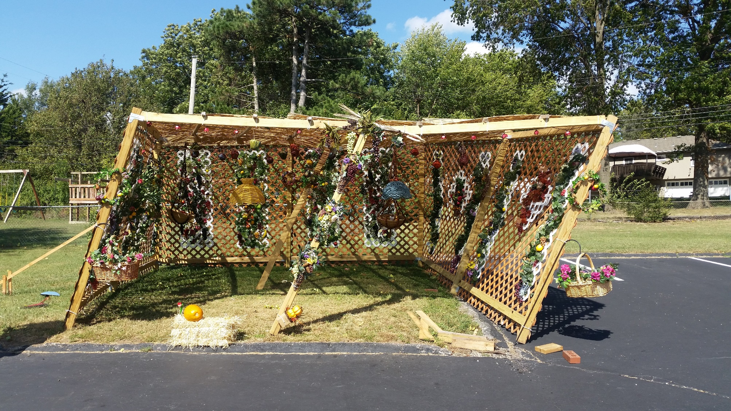
Notes:
Strong west wind

Slide 8
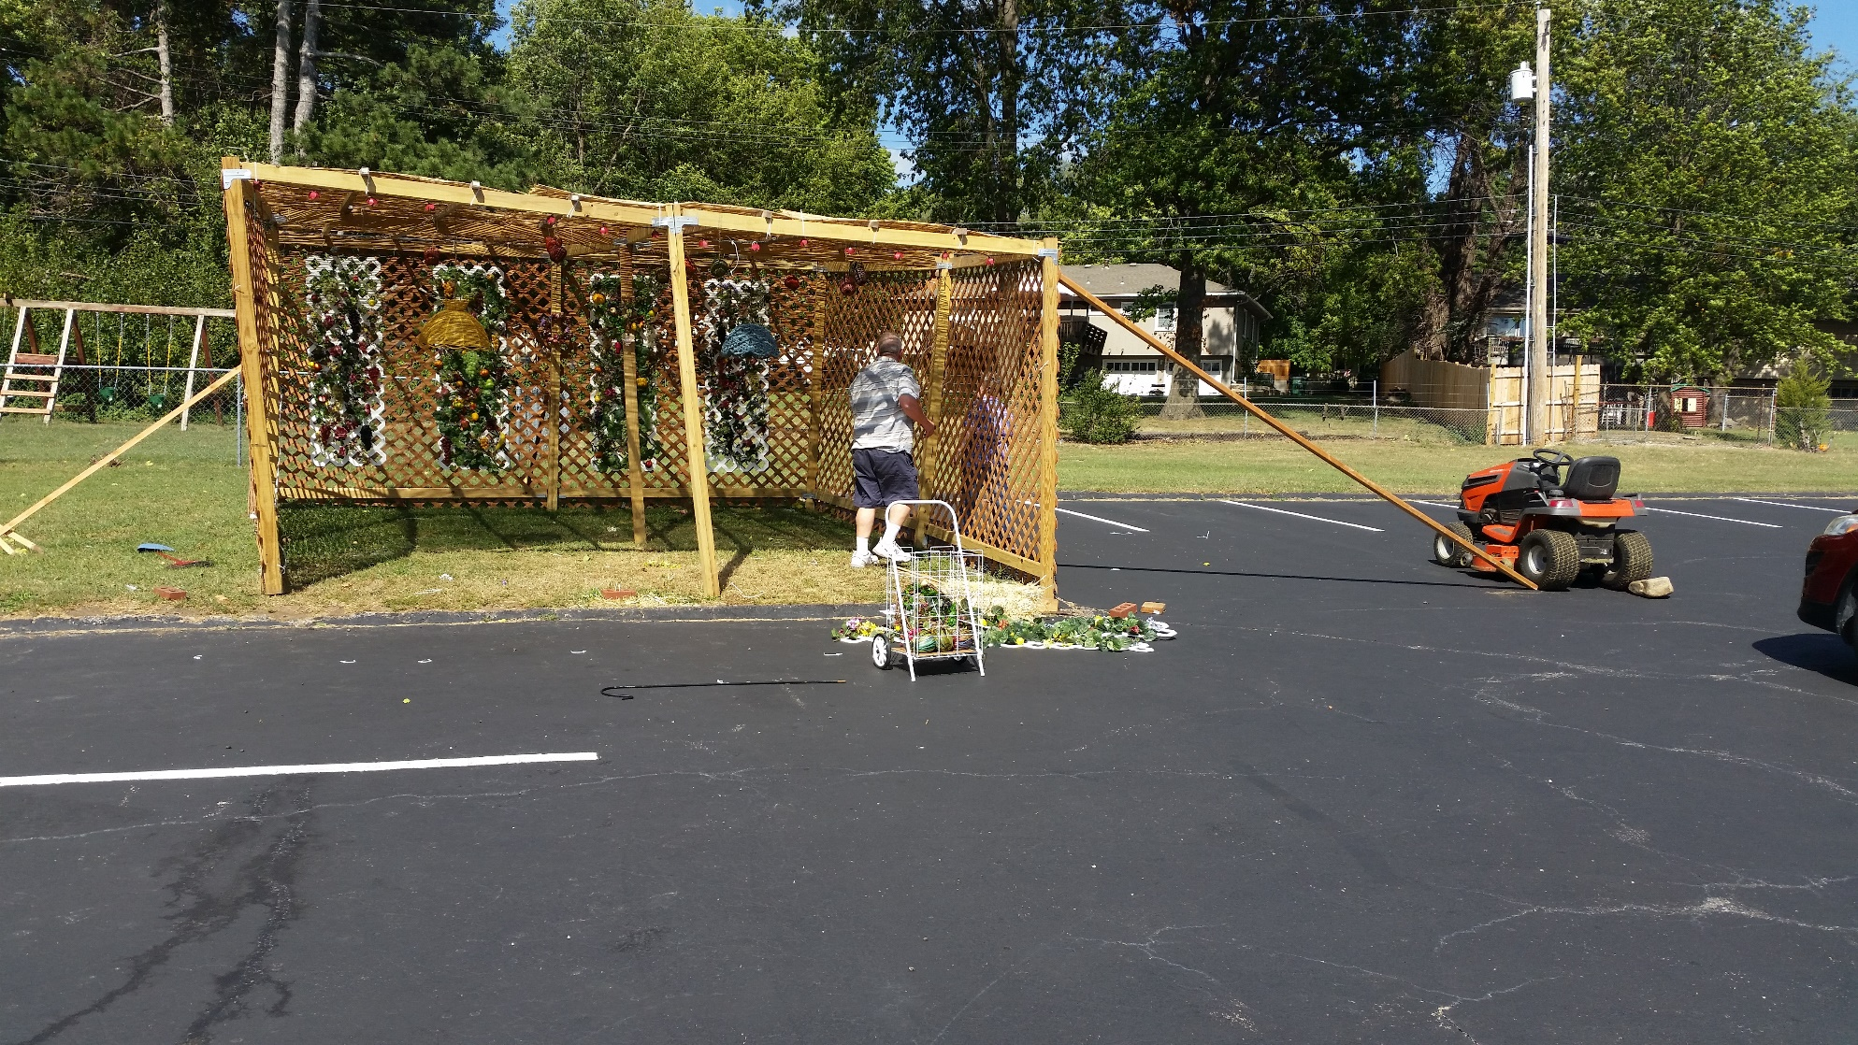
Notes:
First stop gap. I had to drive to Grandview to get my screw gun to disassemble. By time I returned Roy almost swept away airborne. Sukkah all twisted. Did our best to remove decorations, lights, dismantle, but too twisted and misshapen.

Slide 9
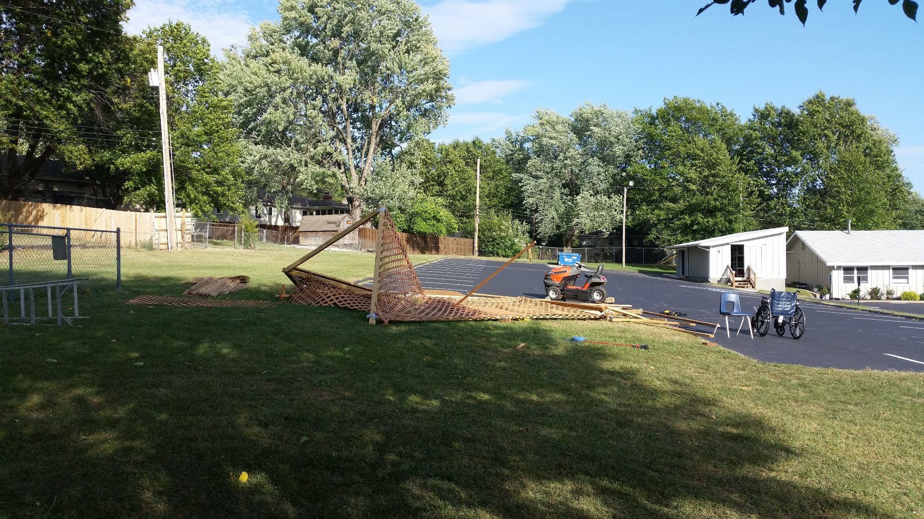

Slide 10
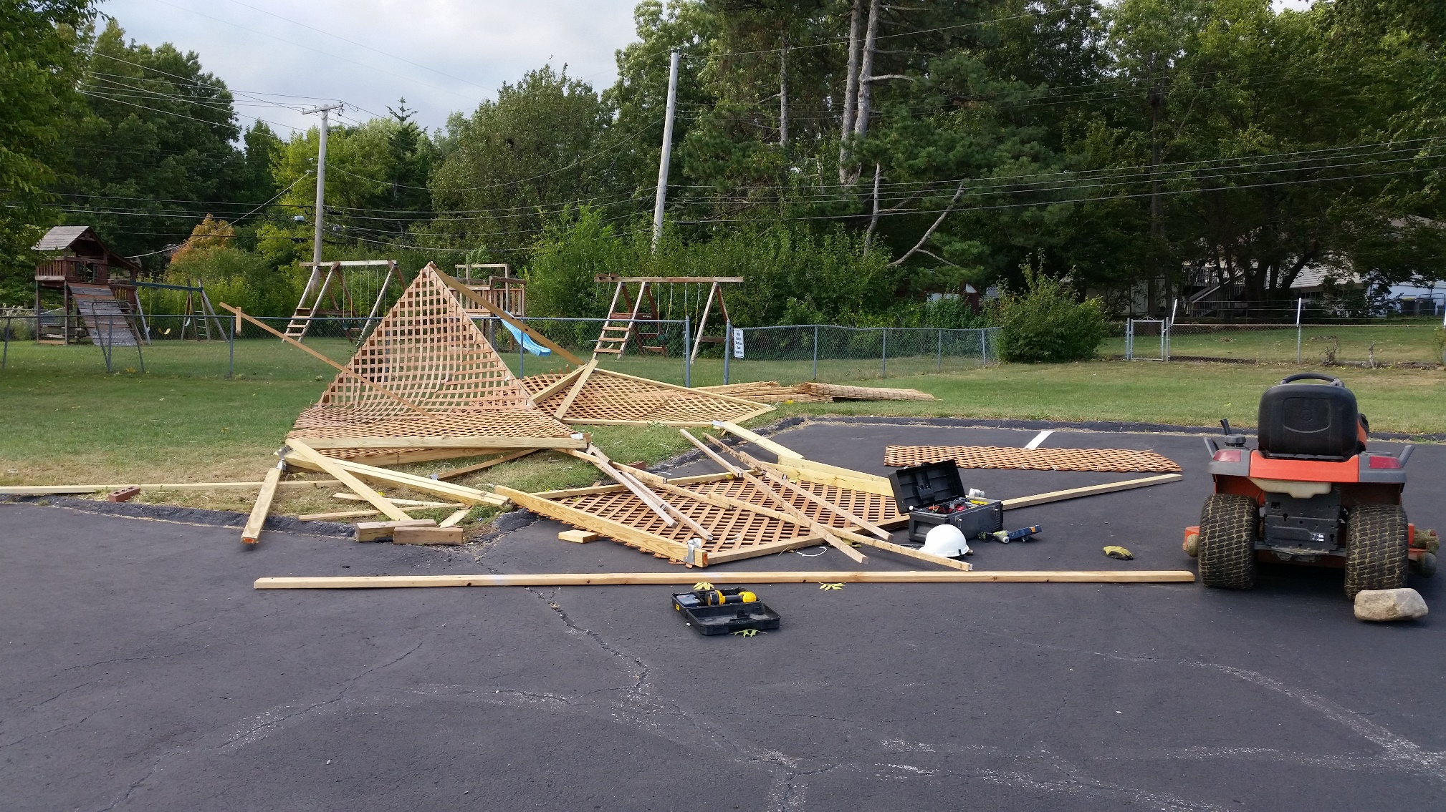
Notes:
It’s all finished being dismantled, and put into storage for next year. But, we will prepare better for the west wind!!

Slide 11
Rabbis Urge Immediate Confirmation Of Judge Kavanaugh: After a day of painful testimony from both Judge Brett Kavanaugh and Dr. Christine Ford, who accused him of misconduct 36 years ago during high school, the Coalition for Jewish Values (CJV),
Notes:
Barry and Batya Segal

Slide 12
representing over 1,000 traditional rabbis in matters of public policy, renewed its call for the confirmation of Judge Kavanaugh to the USA Supreme Court. The CJV stated that to abandon previous evaluations of Judge Kavanaugh based solely upon uncorroborated testimony
Notes:
Barry and Batya Segal

Slide 13
would violate both Biblical and accepted modern standards for evidence - and basic fairness as well. "The Bible not only doubly emphasizes that 'justice, justice shall you pursue,' ^{(Deut. 16:20)}," said Rabbi Dov Fischer, "but it also enjoins us to avoid peddling in unsubstantiated rumors ^{(Lev. 19:16)}. People can easily make mistakes and harm the innocent.
Notes:
Barry and Batya Segal

Slide 14
Furthermore, we should be judged on the totality of our lives, not merely on one alleged incident, and certainly not on an incident that is unsubstantiated and unprovable." While appreciating the pain of the events experienced by Dr. Ford, the Rabbis pointed out that the Senate was prepared to
Notes:
Barry and Batya Segal

Slide 15
confirm Judge Brett Kavanaugh as an extraordinarily well-qualified candidate until opposing Senators pulled out her initially-anonymous letter as a last-ditch effort to block the vote - and then failed to corroborate her charge. It is immoral to besmirch someone's name in the court of public opinion on 'evidence' that would not stand in a court of law." (Arutz-7)
Notes:
Barry and Batya Segal
I’ve heard the statement that women don’t lie about such things.

Slide 16
(Worthy News) - The federal debt increased by $1,271,158,167,126.72
$1 trillion…
in fiscal 2018, according to data released today by the Treasury.

Slide 17
The total federal debt started the fiscal year at $20,244,900,016,053.51
$20 trillion… last year
according to the Treasury, and finished the fiscal year at $21,516,058,183,180.23. ^{CNS News}
÷329,000,000 US = $65,000 / US
Notes:
Unsustainable… $65,000 / US each man, woman, child in America. That’s why newborn babies cry!
$3000/year each US person.
Actually the first info that ever cause me to think seriously about life. Killer debt and govt shut down in 1960’s on the radio! Get out of debt.
BTW, mortgage retirement promo on our building coming!
.

Slide 18
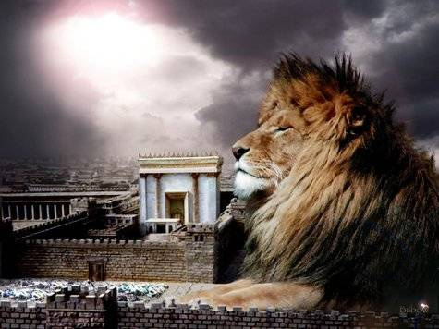
מַתִּתְיָהוּ Mattityahu
(Matthew) 24:36-38
Notes:
Series through Matityahu. Culmination…

Slide 19
Mattityahu (Matthew) 24:36
אֲבָל אֶת הַיּוֹם הַהוּא וְהַשָּׁעָה אֵין אִישׁ יוֹדֵעַ, גַּם לֹא מַלְאֲכֵי הַשָּׁמַיִם וְגַם לֹא הַבֵּן, אֶלָּא הָאָב לְבַדּוֹ.
“But when that day and hour will come, no one knows — not the angels in heaven, not the Son, only the Father.
Notes:
Theological problem. Son is Deity. The Son doesn’t know?!

Slide 20
The Son doesn’t know??
צִמְצוּם שֵם זreduction, decrease noun masc tsimtsum
Tsakhi Shapira Return of the Kosher Pig, p 267

Slide 21
^{Phil 2. 6-7} Though he was in the form of God, he did not regard equality with God something to be possessed by force. On the contrary, he emptied himself, in that he took the form of a slave by becoming like human beings are.

Slide 22
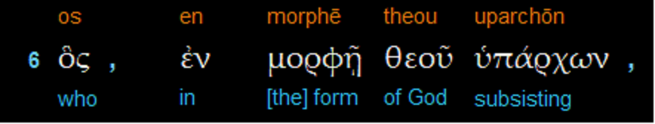
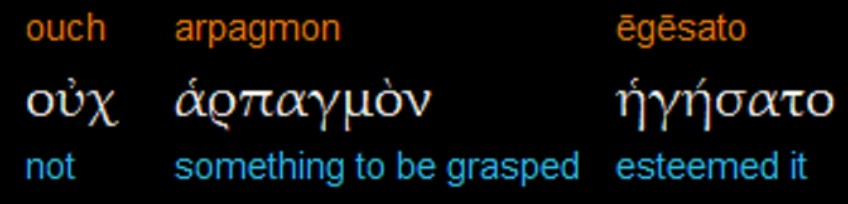
Phillipians 2.6-7
Notes:
Morphe is not just external form, but reality of form
the term morphē, which refers to the inner nature or substance of something, not its external or outward shape. So, while the English word form can convey merely the outward appearance of something (i.e., the shape or contour or facade of some object), not its inner reality, the Greek word morphē conveys just the opposite, as can be seen with Plato's “forms”—i.e., those substances of ultimate realities such as beauty, truth, justice, goodness

Slide 23
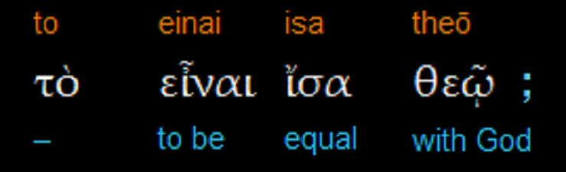
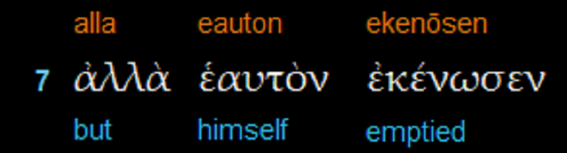
Notes:
“equality [isa] with God” (Philippians 2:6), which likewise makes clear his full deity. Nothing is equal to God except God! “emptied himself” or “poured out himself.” Note that Paul is not saying that the Messiah emptied something from himself or poured something out of himself, as if in so doing he became less fully God than he was before (which, as we have seen, is impossible). Rather, he emptied himself; he poured out himself. the Messiah Yeshua, existing and remaining fully who he is as God, accepts his divine calling to come to earth and carry out the mission assigned him from the Father. As the eternal Son of God, who is himself the form (morphē, i.e., very nature) of God, he must come in the form (morphēn, i.e., very nature) of a servant. That is, he must come fully as a man, and as a man he must live his life and give his life as one of us.

Slide 24
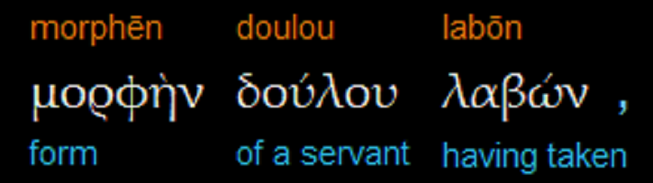
Notes:
In so doing, the Messiah pours himself out (all of who he is) as he takes on, in addition to his full divine nature, a full human nature. Again, it is crucial to see that in the self-emptying (ekenōsen) of the eternal Son, Paul does not say that he poured something “out of” himself. No, absolutely not! Rather, he poured out himself. It is a “subtraction” (i.e., a pouring out, an emptying) by adding human nature to his divine nature. He came, then, to become the God-man—the one whose very divine nature took on fully the existence of a created human nature. He poured himself out by adding to himself the nature of a man, indeed, the nature of a servant par excellence who would give his life in obedience on the cross to fulfill the will of his Father.
Similar to “form of G-d” really a servant in every dimension.

Slide 25
Mattityahu (Matthew) 24:37
כִּימֵי נֹחַ כֵּן יְיָ בּוֹאוֹ שֶׁל בֶּן־הָאָדָם.
“For the Son of Man’s coming will be just as it was in the days of Noakh.

Slide 26
Mattityahu (Matthew) 24:38
כְּמוֹ שֶׁבַּיָּמִים קֹדֶם לַמַּבּוּל הָיוּ אוֹכְלִים וְשׁוֹתִים וּמִתְחַתְּנִים עַד הַיּוֹם שֶׁנִּכְנַס נֹחַ לַתֵּבָה
“Back then, before the Flood, people went on eating and drinking, taking wives and becoming wives, right up till the day Noakh entered the ark.”
Notes:
This could be a description of sinful revelry, licentious living, more likely just life at usual.

Slide 27
^{Mattityahu (Matthew) 24:39-44} And they did not understand until the flood came and swept them all away. So shall it be at the coming of the Son of Man. Then two men will be in the field, one taken and one left. Two women will be grinding at the mill, one taken and one left.

Slide 28
^{Mattityahu (Matthew) 24:39-44} Therefore stay alert; for you do not know what day your Lord is coming. But know this, that if the master of the house had known what time the thief was coming, he would have kept watch and not let his house be broken into. So you also must be ready, for the Son of Man is coming at an hour you do not expect.”
Notes:
Watch…in the sense of active patrol? We have had lights installed all around our building. Still had theft and vandalism.
We are installing surveillance system to WATCH.

Slide 29
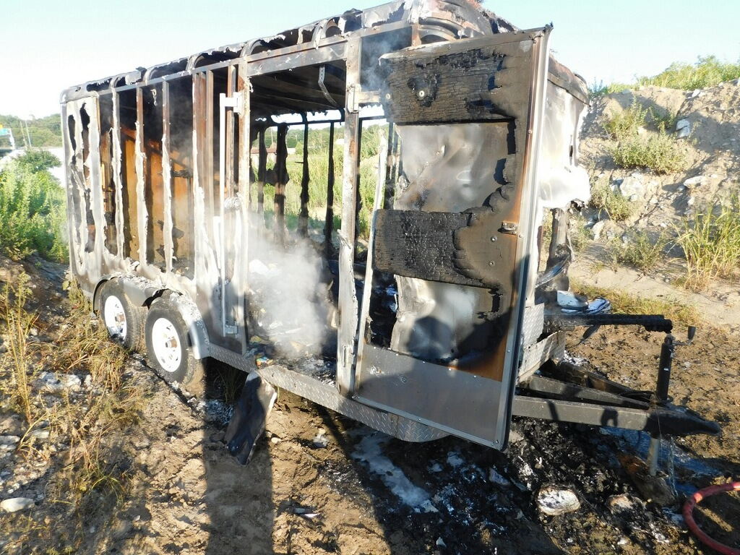
Notes:
Storage trailer stolen, robbed, then torched from our back parking lot.

Slide 30


Slide 31
Messiah’s return
date is unknown

Slide 32
"Rabbi Shmu'el bar-Nachmani said in the name of Rabbi Yochanan, 'May the bones of those who calculate the end [that is, the time of the Messiah's coming] be blasted away! As soon as the time [which they have determined] arrives and the Messiah has not come, they say, "He will never come!" Rather, wait for him, as it is written, 'Though he tarry, wait for him' (Habakkuk 2:3)." (Sanhedrin 97b; the same phrase from Habakkuk is echoed in Article XII of Maimonides' creed.)
Notes:
David Stern’s Jewish New Testament Commentary

Slide 33
"Whenever Rabbi Zera' came upon scholars trying [to calculate when the Messiah would arrive], he would say to them, 'It has been taught that three things come when the mind is diverted: the Messiah, finding a lost article, and a scorpion. So don't postpone his coming by thinking about it!'" (Sanhedrin 97a) (Zohar 1:117b-118a)
Notes:
David Stern’s Jewish New Testament Commentary

Slide 34
If an astronomical prophetic event is
completely unexpected
then it’s
cause for apprehension.
Notes:
No one knows, cannot pre-empt time to prepare. Be ALWAYS ready.

Slide 36
If you [or someone smart enough]
can calculate it,
then you can celebrate it!

Slide 37
^{T’hillim/Ps 147.4-5} He determines the number [mathematically determined movements] of the stars and calls them each by name. Great is our Lord and mighty in power; his understanding has no limit.

Slide 38
^{T’hillim/Ps 19.1-3} The heavens declare the glory of God, and the sky shows His handiwork. Day to day they speak, night to night they reveal knowledge. There is no speech, no words, where their voice goes unheard.

Slide 39
^{T’hillim/Ps 8.1-3} Adoni! Our Lord! How glorious is your name throughout the earth! The fame of your majesty spreads even above the heavens!... When I look at your heavens, the work of your fingers,

Slide 40
^{T’hillim/Ps 8.1-3} the moon and stars that you set in place — what are mere mortals, that you concern yourself with them; humans, that you watch over them with such care?

Slide 41
^{Yeshayahu / Is 40.26} Lift up your eyes on high, and see! Who created these? The One who brings out the army of them by number [equations], the One who calls them all by name. Because of His great strength and vast power, not one is missing.

Slide 42
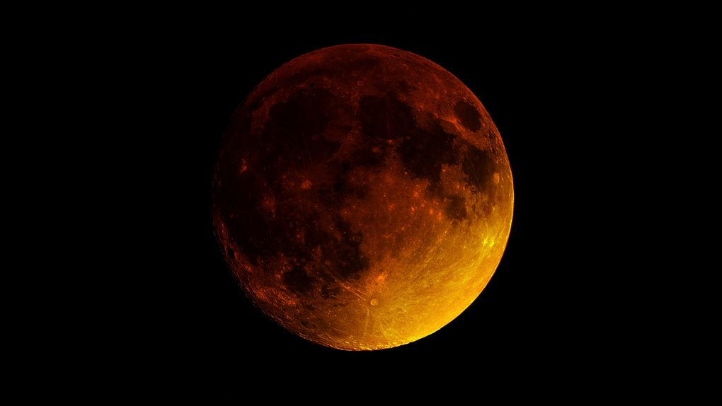
What about the Blood Moons?

Slide 43


Notes:
Something is about to change!!
Imminent Heavenly signs?

Slide 44
They were beautiful,
but amounted to nothing prophetic!

Slide 45
If an astronomical prophetic event is
computer calculationally predictable…
then it’s
completely cause for praise.

Slide 46
If an astronomical prophetic event is
calculable
then it’s
celebratory!

Slide 47
Two extremes when it comes to apocalyptic prophecy relating to astronomy:
joy
Judgement
What determines the category of a prophetic, astronomical statement?

Slide 48
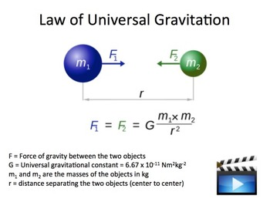
Notes:
https://www.google.com/url?sa=i&rct=j&q=&esrc=s&source=imgres&cd=&cad=rja&uact=8&ved=2ahUKEwilgobfzO7dAhUHna0KHUyoBKwQjRx6BAgBEAU&url=https%3A%2F%2Fwww.teacherspayteachers.com%2FProduct%2FUniversal-Gravitation-A-Physics-PowerPoint-Lesson-Note-1522532&psig=AOvVaw1nM_twmWlm4m1Ty7JFnGlD&ust=1538804082371273
Kevin and Janel Lind, founding rabbinic couple of Brit Ahavah, now in Livermore, CA. They both worked for NASA, and did the calculations on the early space probes. I believe Pioneer 10 to Jupiter
Looped around Venus and Mars → Jupiter.
Seen movie Hidden Figures?

Slide 49
If an astronomical prophetic event is
calculable
then it’s
celebratory!

Slide 50
A rabbit trail on the up side of prophetically significant astronomical events, some that are calculable, at least in a measure.
Notes:
In Messianic circles, it’s a rabbi trail.

Slide 51
What are constellations?

Slide 52
^{Iyov/Job 9.8-10} He alone spreads out the heavens, and treads on the waves of the sea; He makes the Bear, Orion and Pleiades, and the constellations of the south; He does great and unfathomable things, wonders beyond number.

Slide 53
^{Iyov/Job 38.31-33} “Can you tie up the cords of the Pleiades or loosen the belt of Orion? Can you lead out the constellations of the zodiac in their season or guide the Great Bear and its cubs? Do you know the laws of the sky?
Can you determine how they affect the earth?

Slide 54
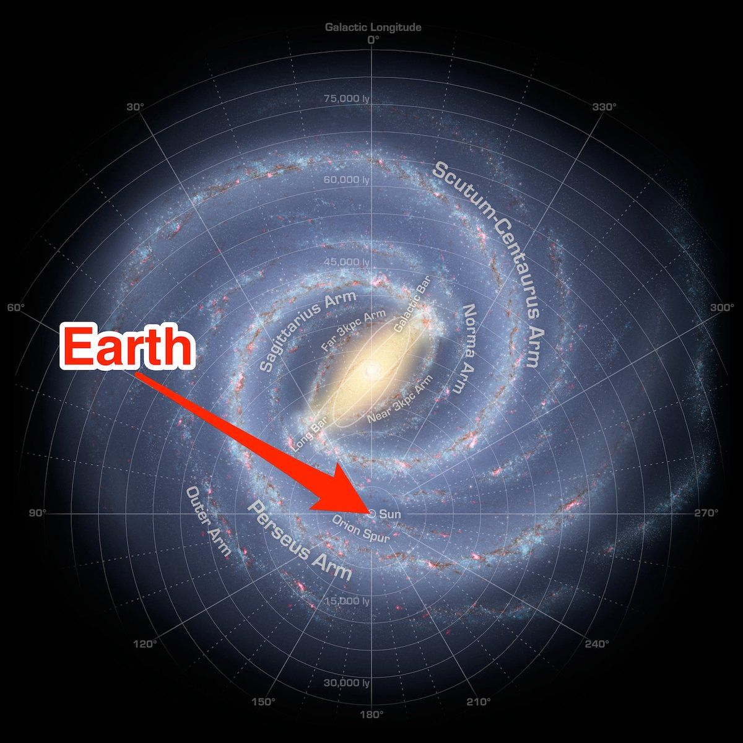
Location
of the Earth in our Milky Way Galaxy, inner edge of Orion Arm
Notes:
https://www.google.com/search?q=where+in+the+galaxy+is+earth&safe=active&source=lnms&tbm=isch&sa=X&ved=0ahUKEwjtoobdq-7dAhUEW60KHapqASQQ_AUIDigB&biw=1165&bih=822#imgdii=Ni1DOKKgrOp6XM:&imgrc=lK-hag3XcQtIGM:
There are probably at least 100 billion stars in the Milky Way. The Solar System is located within the disk, 26,490 (± 100) light-years from the Galactic Center, on the inner edge of the Orion Arm, one of the spiral-shaped concentrations of gas and dust.

Slide 55
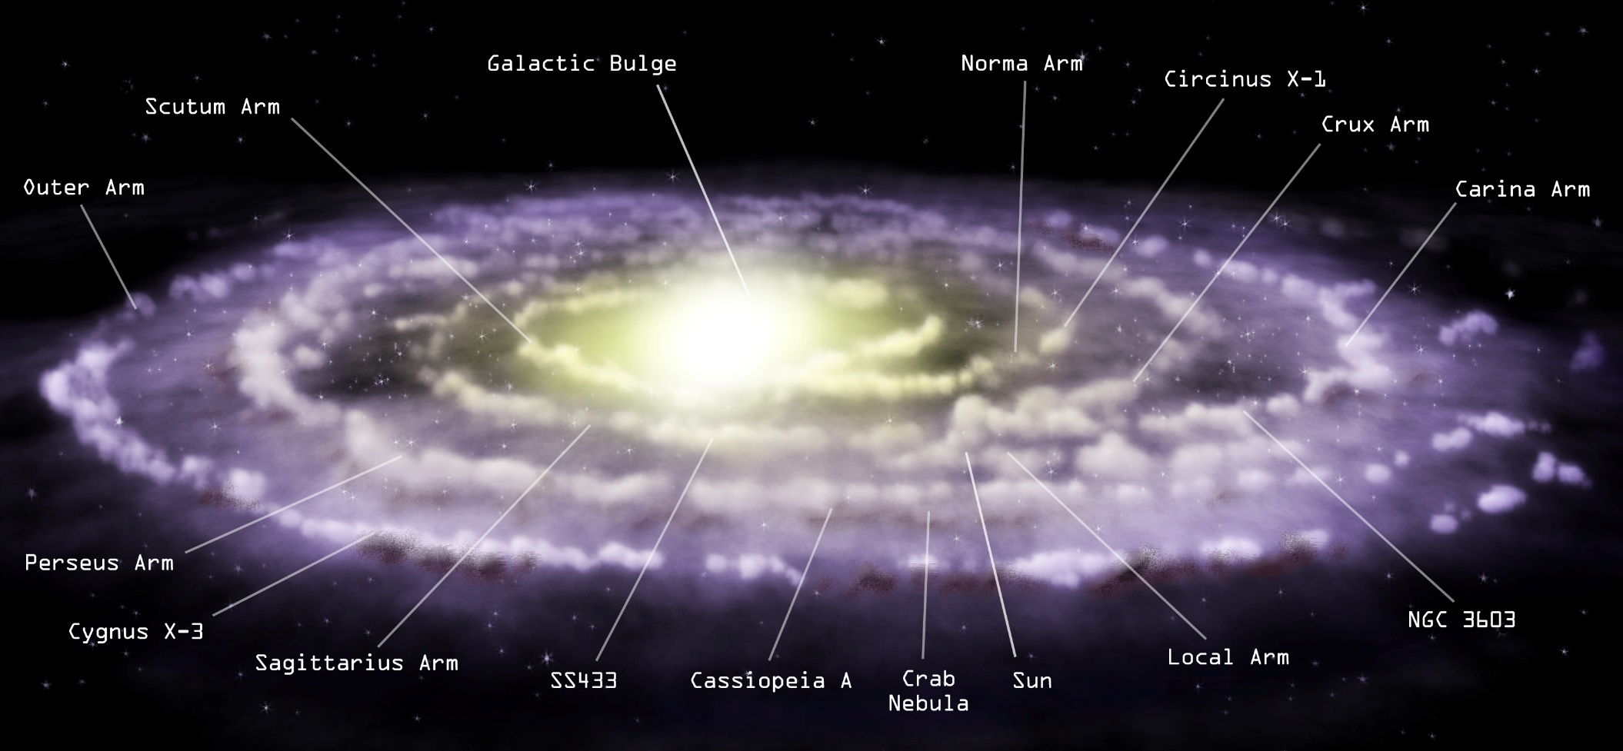
Notes:
https://www.google.com/url?sa=i&rct=j&q=&esrc=s&source=images&cd=&cad=rja&uact=8&ved=2ahUKEwjinafPsu7dAhUQHqwKHd-4CsMQjRx6BAgBEAU&url=http%3A%2F%2Fchandra.harvard.edu%2Fresources%2Fillustrations%2FmilkyWay.html&psig=AOvVaw0c-geYQuohTiSbwqjkFuo0&ust=1538797735825087

Slide 56
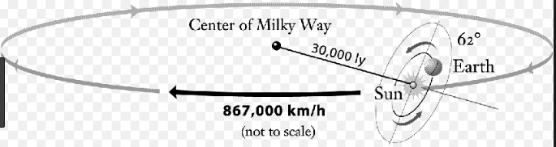
Earth is traveling 67,000 mph counter-clockwise around the sun.
Solar system, Orion arm, is traveling 538,000 mph clockwise around the galactic center.
Notes:
https://www.universetoday.com/119827/does-the-solar-system-line-up-with-the-milky-way/
Milky Way is actually inclined from the celestial equator at 63-degrees.

Slide 57
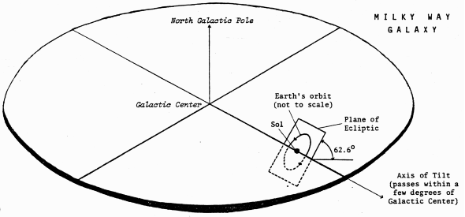
Consider the star view. There is a line
that is the plane of the sun’s motion.
Notes:
https://www.google.com/search?q=orientation+of+the+ecliptic+in+the+galaxy&safe=active&source=lnms&tbm=isch&sa=X&ved=0ahUKEwiFyMuBtu7dAhUHLK0KHe3mCtYQ_AUIDigB&biw=1165&bih=822#imgdii=5tNUxBTI1xVwyM:&imgrc=NttAwESba2xY7M:

Slide 58
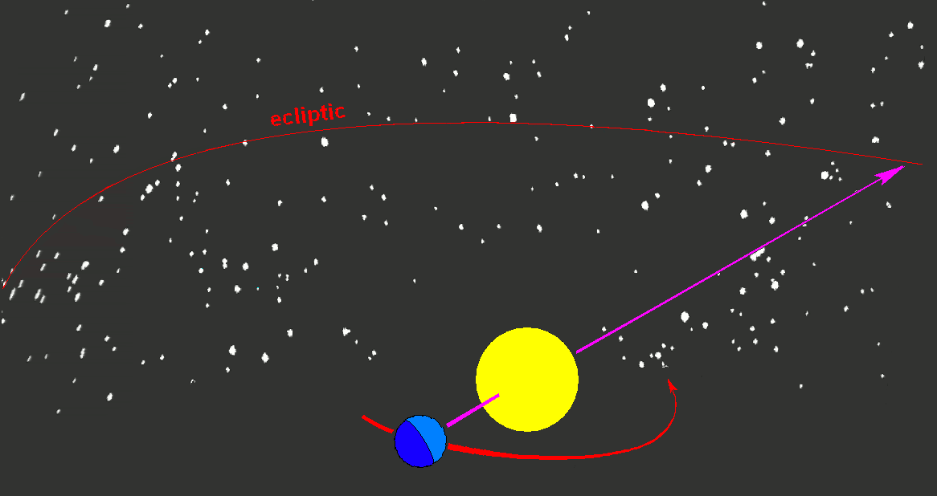
Notes:
Line of the path of the sun is called the ecliptic. All the planets appear on or close to this line. SkyView free appl
Constellations that are on the path of the sun are call the Zodiac. Maybe from Hebrew word Sod, for foundation. HaYesod.

Slide 59
What are constellations?
Imaginary pictures made from the stars we see.

Slide 60
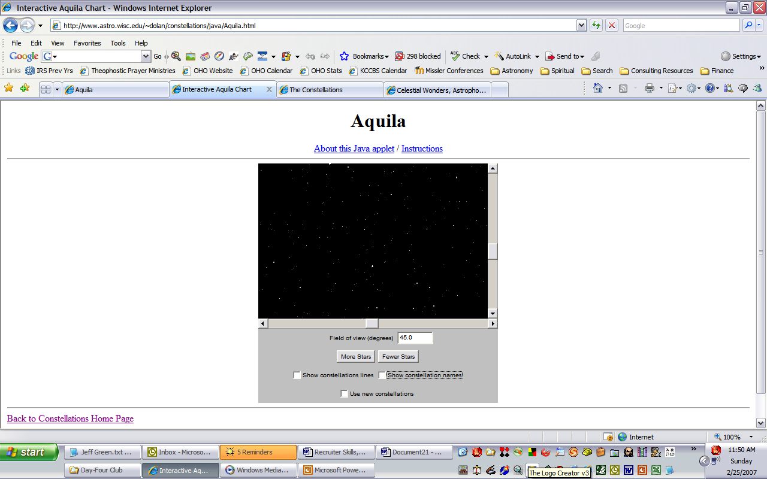
The Sky
Can You Pick Out Any Constellations?

Slide 61

The Sky
Can You Pick Out Any Constellations?

Slide 62

The Sky
Could You Have Possibly Guessed This?

Slide 63
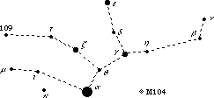
Does This Look Like A Woman?
Notes:
Two legs on left, arm, head.

Slide 64
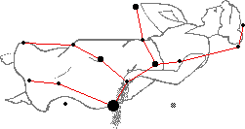
Does This Look Like A Woman?

Slide 65
The Stars As A Story, Mazzeroth (Zodiac)
The Basic Concept
  Some Indicators That Support The Mazzeroth Actually Being
  G-d’s Plan Of Redemption Told Through The Use Of Identifying Specific Stars In The Sky And Assigning Them Meanings Based On Their Names And Positions
Traditions
  Ancient Persian And Arabian Traditions Ascribe Invention Of Astronomy To Adam, Seth, And Enoch.
  “That Their Revelation Of Two Coming Judgments Of Water And Fire Not Be Lost...” — Josephus.
Twelve Primary Signs Along Orbital Plane Are The Same In All Ancient Nations Of The World:
  Chinese, Chaldean, Egyptian, Etc.; Zodiacs In The Temples Of Denderah And Esneh In Egypt.
Notes:
As I said, we are on a Rabbi trail, but illustration of the astronomical thinks that can speak, as opposed to what we totally don’t know.

Slide 66
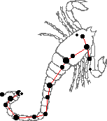





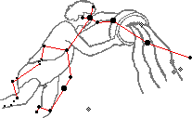
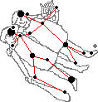
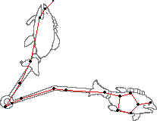
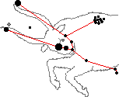

The Mazzeroth
Mazzeroth (Job 38:32).
Libra
Virgo
Tribe Of Israel
Scorpio
Tribe Of Zebulon
Tribe Of Dan
Sagittarius
Tribe Of Asher
Leo
Tribe Of Judah
Capricornus
Tribe Of Naphtali
Cancer
Tribe Of Issachar
Aquarius
Tribe Of Reuben
Gemini
Tribe Of Benjamin
Pisces
Taurus
Aries
Tribe Of Simeon
Tribe Of Joseph
Tribe Of Gad

Slide 67
Earth is traveling 67,000 mph counter-clockwise around the sun.
Solar system, Orion arm, is traveling 538,000 mph clockwise around the galactic center.

Slide 68
Notes:
https://www.google.com/url?sa=i&rct=j&q=&esrc=s&source=images&cd=&cad=rja&uact=8&ved=2ahUKEwjinafPsu7dAhUQHqwKHd-4CsMQjRx6BAgBEAU&url=http%3A%2F%2Fchandra.harvard.edu%2Fresources%2Fillustrations%2FmilkyWay.html&psig=AOvVaw0c-geYQuohTiSbwqjkFuo0&ust=1538797735825087
Milky Way is actually inclined from the celestial equator at 63-degrees. https://www.universetoday.com/119827/does-the-solar-system-line-up-with-the-milky-way/

Slide 69
What are constellations?
Imaginary pictures made from the stars we see.
The following is speculation about the imagined pictures.
NOT doctrine.
Notes:
But, it’s cool, and useful.

Slide 70
#1 Virgo
Virgo בְּתוּלָה The Promised Seed Of The Woman (Gen 3:15).
  A Woman With A Branch In Her Right Hand, Ears Of Corn In Her Left. Really a lulav / date palm of Sukkot celebration.
  The Word Branch
    Hebrew: Tsemech (Branch).
      There Are 20 Hebrew Words Translated Branch, But Only One Of Them (Tsemech) Is Used Exclusively Of The Messiah (4x) Jer 23:5,6; Zech 3:8, 6:12; Isa 4:2. Brightest Stars
    (Isa 7:14; 9:6).
  Sun is in this constellation during Rosh HaShannah / Feast of Trumpets.
Tribe Of Israel Zebulon, Where Nazareth Is Located.

Slide 71
#2 Libra
Libra The Balances The Price Deficient Balanced By The Price Which Covers.
  Hebrew: Monznaim, מֹאזְנַיִם The Scales, Weighing.
  Arabic: Al Zubena, Purchase, Redemption.
  Coptic: Lambadia, Station Of Propitiation.
  Latin: Libra, Weighing.
  Akkadian: Tulku, Sacred Mound, Altar.
Tribe Of Israel Levi. Redeemer

Slide 72
#3 Scorpius
Wounding Him That Cometh ^{(Gen 3:13-16).}
  Akrab, עַקְרָב Scorpion, War, Conflict.
  Arabic: Al Akarab.
Tribe Of Israel Dan.
Mostly idolatrous: one judge: Samson.
Conflict, war
Sufferer
Notes:
The Scorpion. Scorpius represents death, darkness, and everything that we look on as evil.

Slide 73
#4 Sagittarius
The Archer; Bow, Conquering (Rev 6:2). קַשָּׁת
Tribe Of Israel Asher.
^{Gen 49.20} “Asher’s food is rich — he will provide food fit for a king.
Conqueror by Resurrection

Slide 74
#5 Capricornus
Capricorn noun גְּדִי Gadi kid, troop
Capricornus Is Associated With The Tribe Of Gad
^{Gen 49.19} Gad will be attacked by a band of raiders, but he will attack them at their heels.
Sacrifice: 50 days Omer prayer
Notes:
The Arabs, Persians, Turks, and Syrians all knew Capricornus as the Goat. In certain parts of the Orient, the constellation was known as the Southern Gate of the Sun, indicating that it is in this constellation that the Sun reaches its lowest point on the ecliptic and thereafter begins to appear higher and higher each day.

Slide 75
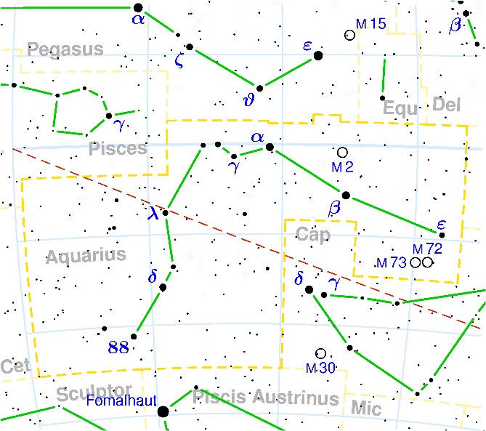
#6 Aquarius D’lee
שֵם ז’ דְּלִי bucket, pail)
The Water-bearer: immersion deep repentance, deep sin. ^{Dt. 33.6} “Let Re’uven live and not die out, even though his numbers grow few.”
Pouring out of the Spirit, Ruakh, Living water
Notes:
In modern times this constellation was immortalized by the counterculture of the 1960's, which proclaimed the Age of Aquarius. This was a bit premature as the Aquarian age will not actually begin for another 600 years. As astrological age is identified by the name of the constellation in which the vernal equinox (the position of the Sun on the first day of spring, March 21 is located. This location moves slowly from one zodiac constellation to the next as a results of Earth's procession.

Slide 76
#7 Pisces
The Fish;
  דָּגִים = Dagim, The Fish ^{(Num 24:7).} Tied Together; Divided Kingdom.
Tribe Of Israel: Simeon.
Killed the Shekhemites, “I will divide them in Ya‘akov and scatter them in Isra’el^{.” Gen 49.7}
Fishers of Men and persecuted believers
Notes:
Pisces was known by the Babylonians as Nunu, by the Persians as Mahik, and the Turks as Balik, all meaning "Fish." The Arabs also knew Pisces as Al Samakatain, or "the Two Fishes." The Syrians regarded fish as holy animals and so refused to eat them.

Slide 77
#8 Aries
The Ram. Hebrew: Taleh, טָלֶה The Lamb
“Naftali is a doe set free that bears beautiful fawns.” ^{Ber 49.21}
Glorious followers of the Lamb

Slide 78
#9 Taurus
The Ox. Hebrew: Shur, שור The Ruler, wall ^{Deut 33:17} For Joseph he said,
‘May his land be blessed by Adonai
with heavenly bounty from the dew… The firstborn ox—majesty is his.
The Tribe Of Israel: Joseph
Yeshua returning as Judge

Slide 79
#10 Gemini
The Twins. תְּאוֹמִים T’omim,.
The Tribe Of Benjamin.
  Ben-oni → Ben-yamin
  Son of sorrow → son of my right hand
^{Gen 49.27} Binyamin is a ravenous wolf
  Sorrow and strength “he has born our griefs.
Yeshua as Millennial King

Slide 80
#11 Cancer
Sartan סַרְטָן שֵם ז’ crab ; (astronomy, astrology) Cancer
Tribe Of Issachar.
Protector: Satan bound 1000 years
Notes:
1531 Halley's Comet was discovered in this part of the sky. In the summer of 1895, all of the planets, except Neptune, congregated here--and extremely rare event.

Slide 81
#12 Leo
The Lion. Hebrew: Arieh, אַרְיֵה Lion.
The Tribe Of Israel
  Leo Is Associated With The Tribe Of Judah.
Victor
Notes:
The Sumerians also saw this group of stars as a lion. The form of the Lion was probably passed along to the Babylonians, Greeks, Roman and others.
The Persians knew Leo as Ser, to the Turk, Artan, to the Syrians, Aryo, to the Jews, Arye, and to the Babylonians, Aru, all meaning "Lion."

Slide 82
Person, work and triumph of Yeshua the Messiah:
Virgo: Seed of the Woman, Yeshua Incarnate
Libra: Redeemer
Scorpio: Sufferer
Sagittarius: Conqueror
Notes:
http://www.patheos.com/blogs/hedgerow/2016/02/the-original-horoscope/

Slide 83
The Fruit of His Work and Mediation, the body of people spiritually born to Him through faith:
Capricorn: Sacrifice
Aquarius: The Pouring Out of the Holy Spirit & Living Water
Pisces: Fishers of Men and the Persecuted Church
Aries: Glorious Lamb
Notes:
http://www.patheos.com/blogs/hedgerow/2016/02/the-original-horoscope/

Slide 84
The final consummation of the Redeemer who is reunited with His Redeemed:
Taurus: Judge
Gemini: King
Cancer: Protector
Leo: Victor
Notes:
http://www.patheos.com/blogs/hedgerow/2016/02/the-original-horoscope/

Slide 85
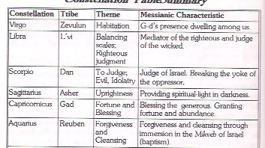
Notes:
From Signs in the Heavens by Avi ben Mordechai p 78

Slide 86
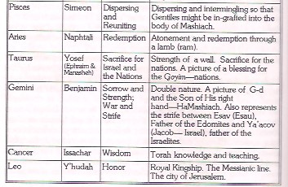
Notes:
From Signs in the Heavens by Avi ben Mordechai p 78

Slide 87
A practical use of this, but believing astrophysicists.
Edersheim Life and Times I:212
Avi ben Mordechai Signs in the Heavens p 164

Slide 88
Back to the text:
the downside of astronomically based prophecy:
Messiah’s return
date is unknown

Slide 89
^{1 Thes. 5.1-3} Now concerning the times and seasons, brothers and sisters, you have no need for anything to be written to you. For you yourselves know very well that the Day of the Lord comes like a thief in the night. When they are saying,

Slide 90
^{1 Thes. 5.1-3} “Shalom and safety,” sudden destruction comes upon them like a woman having birth pains in the womb—there is no way they will escape.

Slide 91
^{Lk 21.34-36} “But keep watch on yourselves, or your hearts will become dulled by carousing, drunkenness and the worries of everyday living, and that Day will be sprung upon you suddenly like a trap! For it will close in on everyone, no matter where they live, throughout the whole world.
Notes:
Temper cf praises
Porn: just one click on that side bar
Servanthood

Slide 92
^{Lk 21.34-36} Stay alert, always praying that you will have the strength to escape all the things that will happen and to stand in the presence of the Son of Man.”
Notes:
Always praying!

Slide 93
^{Luke 12.42-48} the Lord said, “Who then is the faithful and wise manager, whom the master will put in charge of his servants, to give them their food portion at the proper time? Blessed is that servant whose master finds him so doing when he comes. Truly I tell you, his master will put him in charge of all his possessions.

Slide 94
^{Luke 12.42-48} “But if that servant says in his heart, ‘My master is taking a long time to come,’ and he begins to beat the young slave boys and girls and to eat and drink and get drunk, the master of that servant will come

Slide 95
^{Luke 12.42-48} on a day when he does not expect him and at an hour he does not know. And he will cut him in two and assign him a place with the unfaithful.

Slide 96
^{Luke 12.42-48} “That slave who knew his master’s will but did not prepare or act according to his desire will be harshly whipped. But the one who did not know and did things worthy of a beating will be whipped lightly. From everyone given much, much will be required; and from the one for whom more is provided, all the more they will ask of him.

Slide 97
If it’s calculable, it’s celebratory.
If an astronomical prophetic event is
completely unexpected
then it’s
cause for apprehension.

Slide 98
^{Mattityahu (Matthew) 24:39-44} Therefore stay alert; for you do not know what day your Lord is coming…So you also must be ready, for the Son of Man is coming at an hour you do not expect.”
Notes:
Watch…in the sense of active patrol? We have had lights installed all around our building. Still had theft and vandalism.
We are installing surveillance system to WATCH.

