Slide 1
e-handout
To have these notes
without taking notes
Go to OrHaOlam.com
Click on downloads,
messages, 2018
Notes:
.

Slide 2
There once was a man who was a widower, and moved into a retirement community to spend the rest of his life there. It wasn’t long until he had made a number of friends among the other residents. There was one lady he was especially attracted to, and she was attracted to him, also. So they spent a lot of time together.

Slide 3
Finally one evening he proposed, asking her to marry him. The next morning he woke up remembering his proposal, but he couldn’t remember her answer. So he went to her and said, “I’m really embarrassed. I proposed to you last night but I can’t remember if you said ‘Yes’ or ‘No.’”

Slide 4
“Oh, thank goodness!” she replied. “I remembered saying ‘Yes’ but I couldn’t remember who asked me.”

Slide 5
Cain couldn't please God because He wasn't Abel
If Abraham and Isaac were to build a computer together, the Hebrew patriarch would have told his son that "God will provide the RAM."

Slide 6
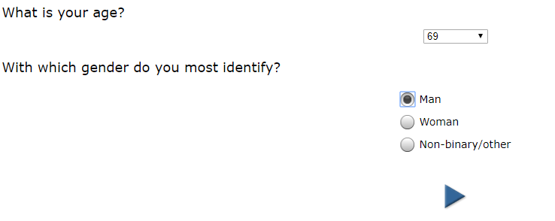
Survey I took this week
Notes:
http://www.strategic-insights.net/JGN/cgi-bin/ciwweb.pl

Slide 7
Survey

Slide 8
https://youtu.be/UvzhydUOYLo

Slide 9
30 seconds to save your life

Slide 10
The southern town of Sderot has sustained more Gaza rocket attacks than any other Israeli community. Despite its nickname as the “kassam capital of Israel,” Sderot refuses to give up on life. The town’s proud residents have displayed a remarkable resilience and an embrace of everything that symbolizes life.
Notes:
https://unitedwithisrael.org/israel-an-island-of-success-against-all-odds/?utm_source=MadMimi&utm_medium=email&utm_content=Israel%27s+%27Patience+is+Gone%27%3B+Reporter+Amazed+by+IDF+Efforts+to+Avoid+Casualties%3B+Tell+Bollywood+Stars+to+Come+to+Israel%2C+Ignore+BDS%21&utm_campaign=20181116_m148277807_Israel%27s+%27Patience+is+Gone%27%3B+Reporter+Amazed+by+IDF+Efforts+to+Avoid+Casualties%3B+Tell+Bollywood+Stars+to+Come+to+Israel%21&utm_term=more_btn_dark_jpg

Slide 11
A disproportionate number of Israeli musicians, artists and poets hail from this small town. Local artists have even created beautiful art from old kassam rockets. In addition, Sderot has a thriving academic college and hosts an annual film festival with Israeli
Notes:
https://unitedwithisrael.org/israel-an-island-of-success-against-all-odds/?utm_source=MadMimi&utm_medium=email&utm_content=Israel%27s+%27Patience+is+Gone%27%3B+Reporter+Amazed+by+IDF+Efforts+to+Avoid+Casualties%3B+Tell+Bollywood+Stars+to+Come+to+Israel%2C+Ignore+BDS%21&utm_campaign=20181116_m148277807_Israel%27s+%27Patience+is+Gone%27%3B+Reporter+Amazed+by+IDF+Efforts+to+Avoid+Casualties%3B+Tell+Bollywood+Stars+to+Come+to+Israel%21&utm_term=more_btn_dark_jpg

Slide 12
and foreign visitors. Sderot also hosts a large annual food and wine festival that attracts an increasing number of people.
While Israel yearns for genuine peace, few Israelis believe that it will happen any time soon.
Notes:
https://unitedwithisrael.org/israel-an-island-of-success-against-all-odds/?utm_source=MadMimi&utm_medium=email&utm_content=Israel%27s+%27Patience+is+Gone%27%3B+Reporter+Amazed+by+IDF+Efforts+to+Avoid+Casualties%3B+Tell+Bollywood+Stars+to+Come+to+Israel%2C+Ignore+BDS%21&utm_campaign=20181116_m148277807_Israel%27s+%27Patience+is+Gone%27%3B+Reporter+Amazed+by+IDF+Efforts+to+Avoid+Casualties%3B+Tell+Bollywood+Stars+to+Come+to+Israel%21&utm_term=more_btn_dark_jpg

Slide 13
This does not mean that the country suffers from chronic depression. Quite the opposite. Israel ranks among the happiest nations in the world and among the leading countries in terms of human development index and life expectancy.
Notes:
https://unitedwithisrael.org/israel-an-island-of-success-against-all-odds/?utm_source=MadMimi&utm_medium=email&utm_content=Israel%27s+%27Patience+is+Gone%27%3B+Reporter+Amazed+by+IDF+Efforts+to+Avoid+Casualties%3B+Tell+Bollywood+Stars+to+Come+to+Israel%2C+Ignore+BDS%21&utm_campaign=20181116_m148277807_Israel%27s+%27Patience+is+Gone%27%3B+Reporter+Amazed+by+IDF+Efforts+to+Avoid+Casualties%3B+Tell+Bollywood+Stars+to+Come+to+Israel%21&utm_term=more_btn_dark_jpg

Slide 14
Israel’s enemies do not understand its national strength. The more Israelis are threatened, the more they defiantly embrace life. This is true not only in Israel’s main population centers, like Jerusalem and Tel Aviv, but also a few hundred meters from Hamas’s factory of death and destruction in the Gaza Strip.
Notes:
https://unitedwithisrael.org/israel-an-island-of-success-against-all-odds/?utm_source=MadMimi&utm_medium=email&utm_content=Israel%27s+%27Patience+is+Gone%27%3B+Reporter+Amazed+by+IDF+Efforts+to+Avoid+Casualties%3B+Tell+Bollywood+Stars+to+Come+to+Israel%2C+Ignore+BDS%21&utm_campaign=20181116_m148277807_Israel%27s+%27Patience+is+Gone%27%3B+Reporter+Amazed+by+IDF+Efforts+to+Avoid+Casualties%3B+Tell+Bollywood+Stars+to+Come+to+Israel%21&utm_term=more_btn_dark_jpg

Slide 15
מַתִּתְיָהוּ Mattityahu
(Matthew) 25:14-16

Slide 16
Mattityahu (Matthew) 25:14
”דּוֹמֶה הַדָּבָר לְאִישׁ הַיּוֹצֵא לְמַסָּע. קֹדֶם לָכֵן קָרָא לַעֲבָדָיו וְהִפְקִיד בְּיָדָם אֶת הוֹנוֹ:
“For it will be like a man about to leave home for awhile, who entrusted his possessions to his servants.

Slide 17
Mattityahu (Matthew) 25:15
עלְאֶחָד נָתַן חָמֵשׁ כִּכְּרֵי כֶּסֶף, לְאַחֵר שְׁתַּיִם
“To one he gave five talents; to another, two talents;

Slide 18
In Roman times one talent equaled 6,000 denarii, a denarius being roughly a day's wages for a common laborer.
Notes:
https://kifa.kz/eng/bible/stern/stern_matfey_25.php
https://kifa.kz/eng/bible/stern/stern_matfey_18.php

Slide 19
According to the Bureau of Labor Statistics (BLS), the median wage for workers in the United States in the fourth quarter of 2017 was $857 per week or $44,564 per year for a 40-hour workweek or 171/day.
$171 x 6000 = $1,028,000 /talent
Notes:
https://www.thebalancecareers.com/average-salary-information-for-us-workers-2060808

Slide 20
Mattityahu (Matthew) 25:15
עלְאֶחָד נָתַן חָמֵשׁ כִּכְּרֵי כֶּסֶף, לְאַחֵר שְׁתַּיִם
“To one he gave five talents; to another, two talents;
$5,000,000
$2,000,000

Slide 21
Mattityahu (Matthew) 25:15
וּלְאַחֵר אַחַת, לְכָל אִישׁ לְפִי כִּשְׁרוֹנוֹ, וְנָסַע.
and to another, one talent — to each according to his ability. Then he left.
$1,000,000
Notes:
immediacy

Slide 22
Mattityahu (Matthew) 25:16
זֶה שֶׁקִּבֵּל חָמֵשׁ כִּכָּרִים הָלַךְ מִיָּד, סָחַר בָּהֶן וְהִרְוִיחַ חָמֵשׁ אֲחֵרוֹת.
“The one who had received five talents immediately went out, invested it and earned another five.”
Notes:
immediacy

Slide 23
Mattityahu (Matthew) 25:17-18
In the same way, the one with two gained two more. But the one who received one went off and dug a hole in the ground and hid his master’s money.

Slide 24
Why differing amounts of investment capital = talents.
Was that fair?

Slide 27
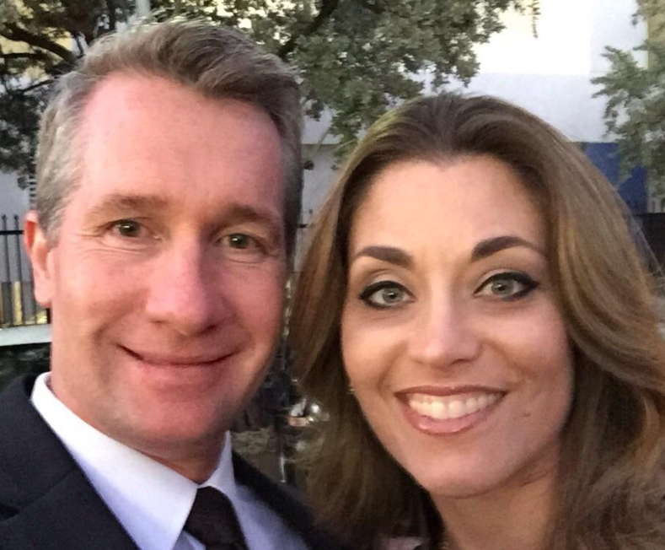
One of our teachers at the MLR this week, Allan [& Stephanie] Kelsey

Slide 28
Allan Kelsey, South African born swimmer with Olympic potential. South Africa did not compete at Olympic Games from 1964 to 1988 due to world apartheid protest. Scholarship to U. Nebraska.

Slide 29
Trained intensely, coach inspired him, but got slower. !?
Tested. Biopsy needle.

Slide 30
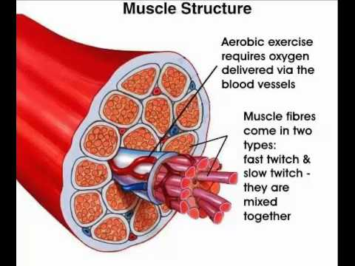
Fast
twitch
muscle
white
meat,
E from
ATP
Notes:
In mitochondria, in the breast of a chicken powers the wings for short rapid flight when the fox appears.
Slow twitch are dark meat. Great blood supply. Energy from oxygen process. A duck’s breast is dark meat, for long migratory flight.

Slide 31
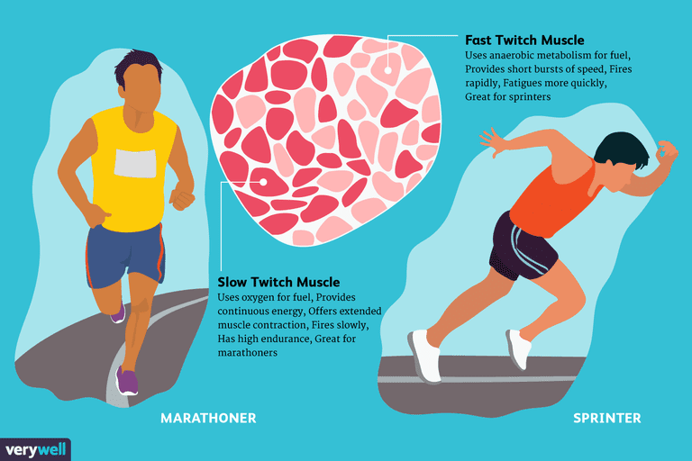
Notes:
https://www.google.com/search?safe=active&tbm=isch&q=fast+twitch+muscle+fibers&chips=q:muscle+fibers+fast+twitch+muscles,online_chips:fibre+types&usg=AI4_-kQXxNxfuXbMko6_ntJnBRobsPlNdw&sa=X&ved=0ahUKEwi75I-hydreAhUIi6wKHfVxB-4Q4lYIKSgB&biw=1164&bih=865&dpr=1.1#imgrc=Rw6B9gj3fTGyPM:

Slide 32
Notes:
https://www.google.com/search?q=fast+twitch+muscle+fibers&safe=active&source=lnms&tbm=isch&sa=X&ved=0ahUKEwj6353cx9reAhVGAqwKHdlTD14Q_AUIDigB&biw=1164&bih=865#imgdii=pVfU66NICnDZhM:&imgrc=zVr5i-AQCfbcNM:

Slide 33
He had mostly fast twitch muscle fibers.
He started short training intervals for short distance swims. Broke World records.

Slide 34
^{Eph. 2.10} We are of God’s making, created in union with the Messiah Yeshua for a life of good actions already prepared by God for us to do.
^{TLV} We are His workmanship—created in Messiah Yeshua for good deeds, which God prepared beforehand so we might walk in them.
Notes:
We are designer creations. Specific. Custom built…home, car.

Slide 35
Speed reading test story.
A university did a test on students reading abilities. The survey showed that some students could read 90 words/per minute while others could read 350 words pre minute, both with retention.
Notes:
http://jezfieldresource.blogspot.com/2015/03/allan-kelsey-strengfinders-training.html

Slide 36
They then put the students through a test to try and increase their reading levels. After 6 weeks of trying to increase people’s reading abilities. The students who were reading at 90 words per minute could afterwards read 140 words per minute (a 60% increase).
Notes:
http://jezfieldresource.blogspot.com/2015/03/allan-kelsey-strengfinders-training.html

Slide 37
The remarkable thing however is that the students who were reading 350 words per minute, ended up being able to read 2970 words per minute. The test realized the impact of natural talent and ability on a persons ability to improve an ability.
Notes:
http://jezfieldresource.blogspot.com/2015/03/allan-kelsey-strengfinders-training.html

Slide 38
They needed to be trained according to how they were made!

Slide 39
I believe Humanity is suffering under the worst epidemic of all time. It is an Identity Crisis. We do not adequately know who we are. How powerfully we are equipped.
Notes:
Allan Kelsey Facebook

Slide 40
Consequently, we are blind to the unique contribution we were put on this earth to make. So we amble through life, lured by the media into multiple distractions, and coerced by society's 'image' to conform. What apathy ensues. What tragedy for Mankind.
Notes:
Allan Kelsey Facebook

Slide 41
No man is ever more apathetic, than when in the pursuit of another man's dreams - Simon Cooper (Ritz Carlton) When you come to the end of your life, will you die fully alive?
Notes:
Allan Kelsey Facebook: https://www.facebook.com/allan.kelsey/about?lst=100002482638983%3A1572551724%3A1542434940&section=bio

Slide 42
Turn to your neighbor and say,
“You are a rich man/woman.”
“I am a rich man/woman.”

Slide 43
^{Eph.1.4-6} In the Messiah he chose us in love before the creation of the universe to be holy and without defect in his presence. He determined in advance that through Yeshua the Messiah we would be his sons —

Slide 44
^{Eph.1.4-6} in keeping with his pleasure and purpose — so that we would bring him praise commensurate with the glory of the grace ¹ he gave us through the Beloved One.

Slide 45
^{Eph.2.11-12} We were given an inheritance, we who were picked in advance according to the purpose of the One who effects everything in keeping with the decision of his will, so that we who earlier had put our hope in the Messiah would bring him praise commensurate with his glory.²

Slide 46
^{Eph.2.13-14} Your trust in the Messiah [was] sealed by him with the promised Ruakh HaKodesh, who guarantees our inheritance until we come into possession of it and thus bring him praise commensurate with his glory. ³

Slide 47
"Hide not your talents. They for use were made. What's a sundial in the shade?" -- Benjamin Franklin
Notes:
https://www.gallup.com/press/176429/strengthsfinder.aspx

Slide 48
^{Ro.12.6-8} We have gifts that differ according to the grace that was given to us—if prophecy, in proportion to our faith; if service, in our serving; or the one who teaches, in his teaching;

Slide 49
^{Ro.12.6-8} or the one who exhorts, in his exhortation; the one who gives, in generosity; the one who leads, with diligence; the one who shows mercy, with cheerfulness.

Slide 50
Importance of finding your strength and gifting…

Slide 52
After extensive tests they realised that there are 600 natural talents in humanity. They then boiled that down into 34 categories/ideas.
The human brain takes 40% of all the energy created by your body. The whole literally exists to serve the brain. The brain has 100 billion cells. 15,000 connections / sec.
Notes:
Strengthfinder 2000 questions 600 talents 40 years Consolidated to 34
Gallupstrenghtcenter.com
Find same 5 strength one in 33 million.
Same 6 one chance in 1 billion.
Same 8 one chance in 700 billion

Slide 53
Each neuron may be connected to up to 10,000 other neurons, passing signals to each other via as many as 1,000 trillion synaptic connections, equivalent by some estimates to a computer with a 1 trillion bit per second processor.

Slide 54
The human brain ‘specialises’ around the ages of 35-37. Up until that point you can experiment with all sorts of things but around 35-37 the parts of our brain that aren’t used as much will begin to shut down and resources reallocated to the areas of your brain that are being used. God wants us to be ‘about something’.
Notes:
http://jezfieldresource.blogspot.com/2015/03/allan-kelsey-strengfinders-training.html

Slide 55
Good but not best. CEO Brought company $250 Meg to $500 Meg 20% of Co was key. Met managers who protested. All divisions profitable but not vision.

Slide 56
Brains are filled with connectors. The ones that are used the most get ‘fatter’ than the thins ones. The difference is like that between a coffee straw and a fire hydrant hose.
Notes:
http://jezfieldresource.blogspot.com/2015/03/allan-kelsey-strengfinders-training.html

Slide 57
When we add: skill, experience and knowledge to an existing skill/talent that we have moves it from a talent to a strength, from something we’re good at to something we’re excellent at.
What about difficulties?
Notes:
http://jezfieldresource.blogspot.com/2015/03/allan-kelsey-strengfinders-training.html

Slide 58
^{Mark 10.28-30} Kefa began saying to him, “Look, we have left everything and followed you.” Yeshua said, “Yes! I tell you that there is no one who has left house, brothers, sisters, mother, father, children or fields
Notes:
Olam hazeh,
olam = world , so this world

Slide 59
^{Mark 10.28-30} for my sake and for the sake of the Good News, who will not receive a hundred times over, now, in the ‘olam hazeh, homes, brothers, sisters, mothers, children and lands — with persecutions! — and in the ‘olam haba, eternal life.
Notes:
Olam hazeh,
olam = world , so this world

Slide 60
Mattityahu (Matthew) 25:17-18
In the same way, the one with two gained two more. But the one who received one went off and dug a hole in the ground and hid his master’s money.

Slide 61
The phrase seems to point out the earthly mindedness of the man, his worldly disposition, and his eager pursuit after the things of life; which were the reason why he disregarded his talent, and made no use of his ministerial gifts:
Notes:
https://www.biblestudytools.com/commentaries/gills-exposition-of-the-bible/matthew-25-18.html

Slide 62
he could not deny worldly self, nor leave all to follow Messiah; but rather than drop the world, he chose to bury his talent in it: it was his Lord's money and not his own, and he was accountable to him for it, and should have used it in another manner.
Notes:
https://www.biblestudytools.com/commentaries/gills-exposition-of-the-bible/matthew-25-18.html

Slide 63
Applications
We need to appreciate and affirm each other’s particular strength mix and gifting. Affirmation is about who you are. Praise is about what you do. Affirmation needs to be accurate or it’s flattery.

Slide 64
2. Serve Adoni with gladness. Come before His presence with joyful singing. Rejoice in the atoning death and resurrection and soon return, and present power of Messiah.

Slide 65
3. Serve from your strength. You are NOT like others.
4. Don’t compare → pride or depression.
5. DON’T let discouragement take hold of you.

Slide 66
On Oct. 31, 1917, 600 soldiers of the Australian 4th and 12th Light Horse Brigade, under the command of Brigadier Genl Wm Grant, led a daring attack against the Ottoman army in Beersheva. Armed with only horses and bayonets they charged the deeply entrenched Ottoman army.

Slide 67
As machine guns fired, and men and horses were dying, the Lighthorsemen dug in their spurs and continued to press forward to victory. The bewildered enemy failed to adjust their gun sights and their fire began passing harmlessly over the heads of the horsemen,

Slide 68
who then quickly overran the Ottoman army utterly defeating them in less than an hour. Historians describe this remarkable battle as the last successful cavalry charge in history.

Slide 69
Gallupstrenghtcenter.com
https://www.pastoralcareinc.com/surveys/spiritual-gifts-inventory/
We’ll be make this more available in further communications.
Notes:
https://www.christianbook.com/strengths-upgraded-edition-online-gallups-discover/tom-rath/9781595620156/pd/620156?kw=21904556892&mt=b&dv=c&event=PPCSRC&p=1186432&gclid=EAIaIQobChMIi7L7qNXb3gIVhcDACh0Xbg2BEAEYAyAAEgLPbPD_BwE

Slide 70
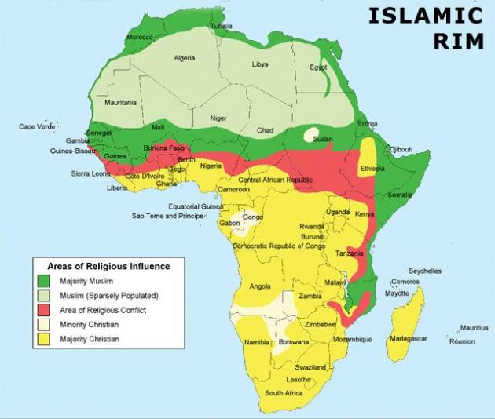
Notes:
http://metrovoicenews.com/wp-content/uploads/2018/11/christianIslamAfricaMap.jpg

Slide 71
In Algeria, about 95 percent of the population follows Islam and less than two percent are Christians. The government bans conversion from Islam to Christianity, regulates non-Muslim worship, and enforces blasphemy laws, which can be used as a cudgel against followers of Messiah.
Notes:
http://metrovoicenews.com/algeria-warns-parents-about-happy-children-being-secret-christians/

Slide 72
“Believer growth has been strong in my country, “Every three months we hold an immersion, sometimes for more than 100 people.”
When government officials got wind of the immersions, they reacted swiftly. “Then the government closed our own church, along with four others.
Notes:
http://metrovoicenews.com/algeria-warns-parents-about-happy-children-being-secret-christians/

Slide 73
House congregations have been growing so fast, government officials recently released this incongruous warning:
“If you see your child suddenly forgiving, jolly, happy, listening to you, not arguing, talking about not hating, these are signs that they might be going to an underground church. This is a threat to your family.”
Notes:
http://metrovoicenews.com/algeria-warns-parents-about-happy-children-being-secret-christians/

Slide 74
The vision of Or HaOlam Messianic Synagogue is:
“Working to bring Jewish people, and those grafted in, to their covenantal identity in Messiah.” Project PrayEruv is a way you can be part of the mission and vision of Or HaOlam.

Slide 75
Applications
We need to appreciate and affirm each other’s particular strengths and gifting. Affirmation who you are. Praise what you do. Affirmation needs to be accurate or it’s flattery.

Slide 76
2. Serve Adoni with gladness. Come before His presence with joyful singing. Rejoice in the atoning death and resurrection and soon return, and present power of Messiah.

Slide 77
3. Serve from your strength. You are NOT like others.
4. Don’t compare → pride or depression.
5. DON’T let discouragement take hold of you.

