Slide 1
For the Sake of America
Pray Vote Stand
Tuesday, November 6
www.FRC.org/Pledge

Slide 2
Israeli Trauma Coalition has landed in Pittsburgh, PA. The delegation is made up of Israeli experts, who have international experience in two main areas. The first is therapeutic: a specialization in mental trauma
Notes:
https://www.jerusalemonline.com/headlines/israel-sends-trauma-unit-to-pittsburgh

Slide 3
grief and anxiety. They will accompany families and law enforcement agencies that help the population. Second: a community based support group which seeks to help communities that have experienced crisis.
Notes:
https://www.jerusalemonline.com/headlines/israel-sends-trauma-unit-to-pittsburgh

Slide 4
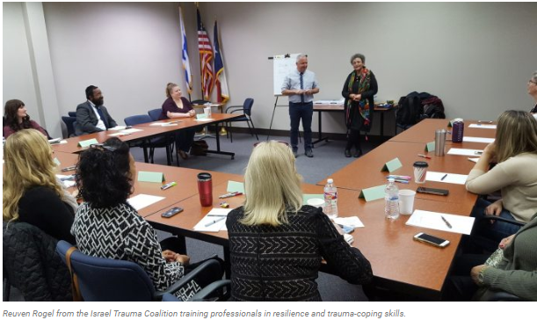
Israel Trauma Coalition training professionals in resilience and trauma-coping skills.
Notes:
https://www.jerusalemonline.com/headlines/israel-sends-trauma-unit-to-pittsburgh

Slide 5
When a loved one dies, Jewish religious law requires that representatives of the living accompany the body until burial. In a ritual known as tahara, the remains are carefully washed and placed in a white shroud. Jewish law mandates that the burial take place as soon as possible.
Notes:
https://apnews.com/492e6f445fe74ec69a860fbb62449cec

Slide 6
Recovering and preparing a body for burial are traditionally done by the local chapter of the burial society called Chevra Kadisha, led in Pittsburgh by an Orthodox rabbi, Daniel Wasserman. He works alongside Admon, who, as a member of Israel-based Zaka International, spent many years in his home country recovering bodies at the scenes of accidents and terrorist attacks.
Notes:
https://apnews.com/492e6f445fe74ec69a860fbb62449cec

Slide 7
Inside the desecrated temple, the men donned white forensic coveralls, face masks and gloves, and set to work.
Judaism asks the living to take special care of the dead, and this group had a last, sacred duty to fulfill: gather up every drop of blood and other bodily traces of the 11 people killed in the deadliest attack against Jews in U.S. history.
Notes:
https://apnews.com/492e6f445fe74ec69a860fbb62449cec
Serious challenging times. How do we respond. Any lesson in the continuing study in Matityahu, story of the bridesmaids?

Slide 8
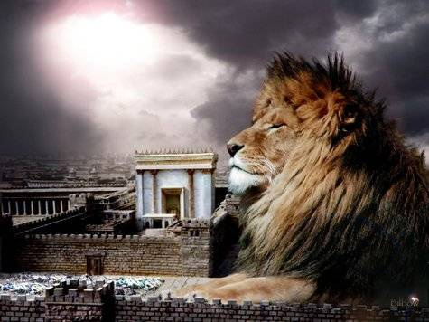
מַתִּתְיָהוּ Mattityahu
(Matthew) 25:8-10

Slide 9
Mattityahu (Matthew) 25:8
אָמְרוּ הַכְּסִילוֹת לַנְּבוֹנוֹת, ’תֵּנָּה לָנוּ מִן הַשֶּׁמֶן שֶׁלָּכֶן, כִּי מְנוֹרוֹתֵינוּ דּוֹעֲכוֹת‘.
“The foolish ones said to the sensible ones, ‘Give us some of your oil, because our lamps are going out.’
Notes:
No one has oil to spare.
Gill: to ask their grace of them was exceeding foolish; when grace only comes from God, who is the God of all grace,

Slide 10
Mattityahu (Matthew) 25:9
עָנוּ הַנְּבוֹנוֹת וְאָמְרוּ, ’שֶׁמָּא לֹא יַסְפִּיק לָנוּ וְלָכֶן. לֵכְנָה אֶל הַמּוֹכְרִים וּקְנֶינָה בִּשְׁבִילְכֶן‘.
“‘No,’ they replied, ‘there may not be enough for both you and us. Go to the oil dealers and buy some for yourselves.’
Notes:
NO:
(literary) in case, so as not to
Greek: not ever, never
That seems to be: EMPHATIC NO way Jose. To avoid the possibility of us losing it!

Slide 11
Mattityahu (Matthew) 25:10
בְּשָׁעָה שֶׁהָלְכוּ לִקְנוֹת בָּא הֶחָתָן: הָעֲלָמוֹת הַמּוּכָנוֹת נִכְנְסוּ אִתּוֹ לַחֲתֻנָּה וְהַדֶּלֶת נִסְגְּרָה.
“But as they were going off to buy, the bridegroom came. Those who were ready went with him to the wedding feast, and the door was shut.”

Slide 12
Why did the wise bridesmaids say such an emphatic “NO!”
Lack of compassion?
Lack of generosity?
an uncivil, morose, and churlish disposition?
being unconcerned what became of these persons?

Slide 13
Craig Keener: If they shared their oil, then it could have been that ALL the torches would go out, ruining the whole procession.

Slide 14
Arguably, they showed the same spirit, as Paul and Barnabas did, when the Lystrians were going to sacrifice to them. Moreover, this denial arose from a consciousness of insufficiency to help them.

Slide 15
Bridal processions took precedence over
Rabbinic lectures, so all could hail the passing bride
Recitation of the Shma ^{Dvarim 6.7} “when you lie down and when you rise up” detailed interp
Notes:
Keener, p 598
1. Rabbi would stop the class, and turn the attention of his talmidim/students to the procession, to cheer!

Slide 16
^{Sukkah 25b} Where the time to recite Shema had already arrived during the wedding…it is necessary to teach that the groom is exempt… The exemption from Shema is due to the fact that it is not a stringent mitzva, as there is no karet administered to one who fails to fulfill it.
Notes:
https://www.jcfhartford.org/Learn/JCFBlog/tabid/256/PostID/42/A-Wedding-and-A-Funeral.aspx

Slide 17
Bridal processions took precedence over
3. Funeral processions
Notes:
Keener, p 598

Slide 18
There is a story in the Talmud of two processions – a wedding procession and a funeral procession – that meet at an intersection too narrow to allow both to pass. One of the processions will need to step aside to allow the other to progress; but which one should go first?
Notes:
https://www.jcfhartford.org/Learn/JCFBlog/tabid/256/PostID/42/A-Wedding-and-A-Funeral.aspx

Slide 19
The rabbis concluded that the wedding procession should get the right of way. Why? Because hope and optimism about the future (as represented by the bride and groom) should always take precedence over the past.
Notes:
https://www.jcfhartford.org/Learn/JCFBlog/tabid/256/PostID/42/A-Wedding-and-A-Funeral.aspx

Slide 20
Rabbinic interpretation is that G-d Himself officiated at the wedding of Adam and Khavah [Eve].

Slide 21
^{Ber.Gen. 1.27-28} God created humankind in His image, in the image of God He created him, male and female He created them. God blessed them and God said to them, “Be fruitful and multiply, fill the land, and conquer it. Rule over the fish of the sea, the flying creatures of the sky, and over every animal that crawls on the land.”
Notes:
Officiant blessing and commisioning

Slide 22
^{Ber/Gen 2.22-23} Adonai Elohim built the rib, which He had taken from the man, into a woman. Then He brought her to the man. Then the man said, “This one, at last, is bone of my bones and flesh from my flesh. This one is called woman, for from man was taken this one.”
Notes:
Divine procession and Adam’s response

Slide 23
Participating in the procession was a great honor for these twelve to sixteen year olds. Spoiling the procession would be a great dishonor to the bride, groom, family, guests!!
A great insult!

Slide 24
Therefore, sharing oil and risking ruining the bridal procession was properly refused.
Lesson to us:
It’s OK to say, “NO” to seemingly legitimate requests for compassion that could be ruinous. PRIORITIES.
Notes:
Counter-cultural priorities

Slide 25
Repeat: It’s OK to say, “NO” to seemingly legitimate requests for compassion.
Stay alert, don’t compromise your oil, your dwelling in the Presence by unsound mercy, compliance with the culture, seeming compassion that will ultimately destroy.
We are the Counter-culture

Slide 26
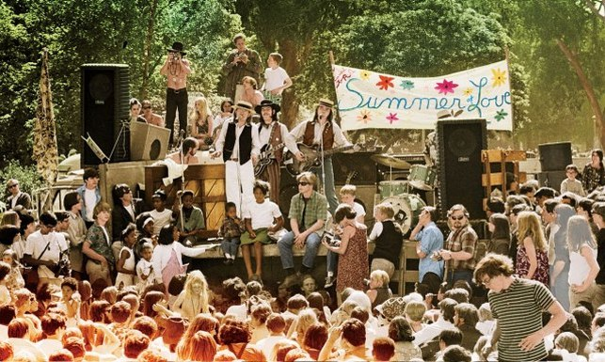
Counter-culture ?? Summer of love

Slide 27
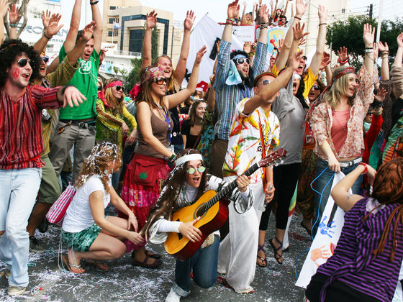

Slide 28
We are the real counter-culture.
We have the oil of His presence. Out of sync with the culture.
Say “no” to apparent but undermining compassion.
Application #1: Not to fear rising anti-Semitism

Slide 29
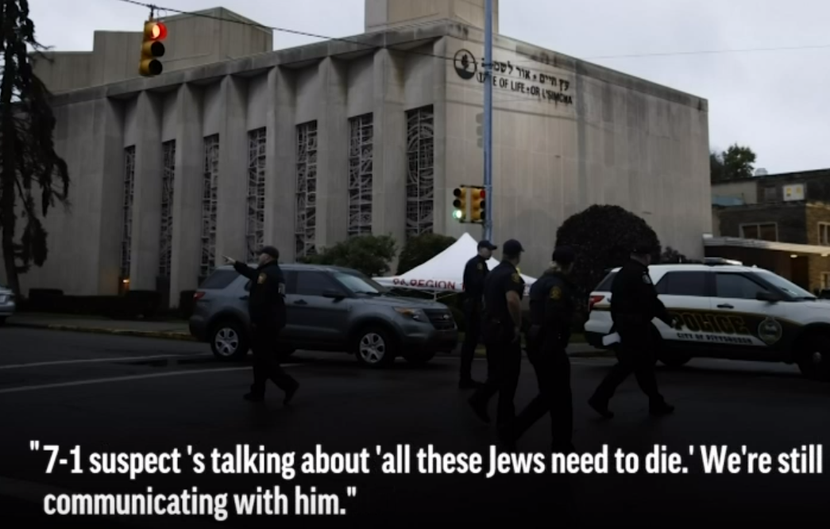
Police radio:
Notes:
https://www.onenewsnow.com/general/video?vid=14271&utm_source=OneNewsNow&utm_medium=email&utm_term=16792200&utm_content=323193037843968512&utm_campaign=36778

Slide 30
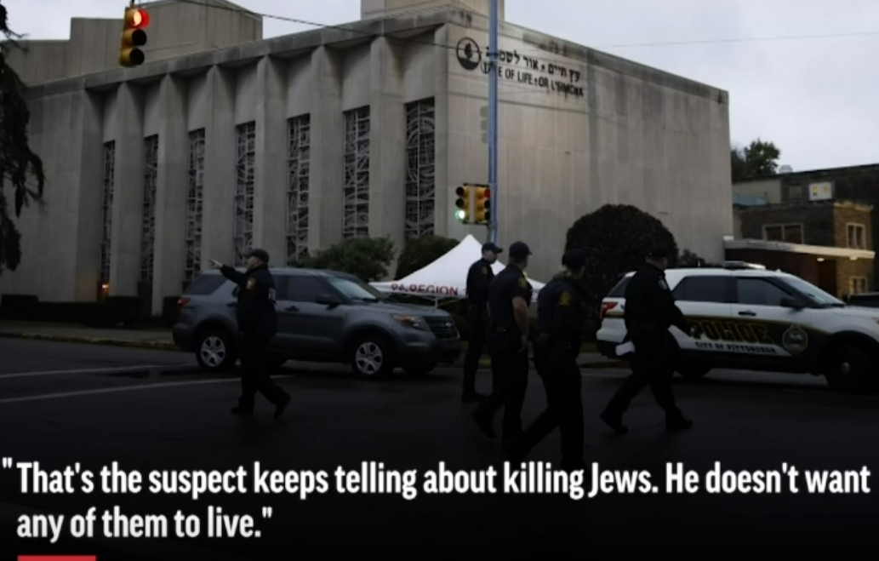
Police radio:
Notes:
https://www.onenewsnow.com/general/video?vid=14271&utm_source=OneNewsNow&utm_medium=email&utm_term=16792200&utm_content=323193037843968512&utm_campaign=36778

Slide 31
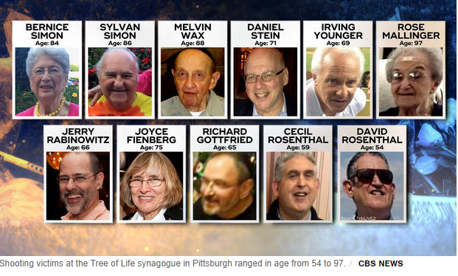
Notes:
Murdered by Robert Bowers, who was armed with an AR-15 rifle and three handguns, told an officer "he wanted all Jews to die and also that they (Jews) were committing genocide to his people," an affidavit said.
https://www.cbsnews.com/news/pittsburgh-shooting-victims-identified-tree-of-life-synagogue-deadly-shooting-squirrel-hill-2018-10-29/

Slide 32
The Anti-Defamation League observed that there were nearly 2,000 reported and verified incidents of anti-Semitism in America in 2017. This marked a 57% increase in anti-Semitic hate crimes since 2016. In college campuses and coffee shops,
Notes:
https://www.messianicdailynews.com/blog/response-to-synagogue-shooting-in-pittsburgh

Slide 33
extremists from the right and the left have distributed vile literature blaming Jewish people for a variety of societal ills, calling for the dismantling of the state of Israel, or for acts of violence against American Jews. Today, the rhetoric became a reality.
Notes:
https://www.messianicdailynews.com/blog/response-to-synagogue-shooting-in-pittsburgh

Slide 34
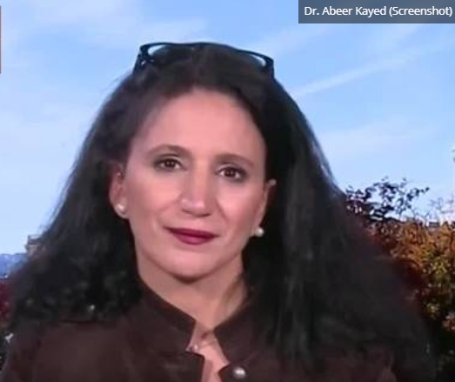
It hasn’t
stopped.
Notes:
https://unitedwithisrael.org/act-now-tell-dr-kayed-what-you-think-of-her-anti-semitism/?utm_source=MadMimi&utm_medium=email&utm_content=Israel+and+US+Fight+Cuba+at+UN%3B+Israel+Foils+Iranian+Plots+Around+World%3B+Snake+Scares+Worshipers+at+Western+Wall%3B+Much+More%21&utm_campaign=20181102_m148055187_Israel+and+US+Fight+Cuba+at+UN%3B+Israel+Foils+Iranian+Plots+Around+World%3B+Snake+Scares+Worshipers+at+Western+Wall%3B+Much+More%21&utm_term=TAKE+ACTION_21+Speak+Up+Against+Professor_E2_80_99s+Post-Pittsburgh+Anti-Semitic+Comments

Slide 35
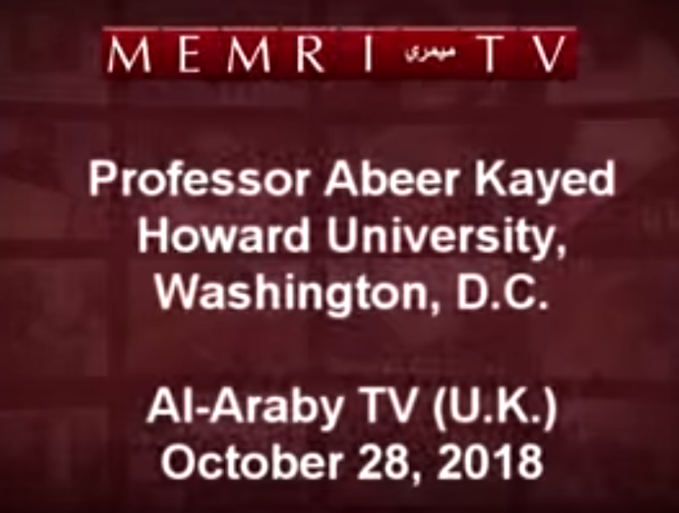
Notes:
https://www.youtube.com/watch?v=Awj93FVoRDM&bpctr=1541216685

Slide 36
Dr. Abeer Kayed, a US-based professor of political science, went on TV only a day after the worst anti-Semitic attack in US history and blamed “the media” for distorting the motive behind the Pittsburgh synagogue massacre of 11 Jewish
Notes:
https://unitedwithisrael.org/act-now-tell-dr-kayed-what-you-think-of-her-anti-semitism/?utm_source=MadMimi&utm_medium=email&utm_content=Israel+and+US+Fight+Cuba+at+UN%3B+Israel+Foils+Iranian+Plots+Around+World%3B+Snake+Scares+Worshipers+at+Western+Wall%3B+Much+More%21&utm_campaign=20181102_m148055187_Israel+and+US+Fight+Cuba+at+UN%3B+Israel+Foils+Iranian+Plots+Around+World%3B+Snake+Scares+Worshipers+at+Western+Wall%3B+Much+More%21&utm_term=TAKE+ACTION_21+Speak+Up+Against+Professor_E2_80_99s+Post-Pittsburgh+Anti-Semitic+Comments

Slide 37
worshipers, which she claims was “strictly political” and “not a hate crime.” Kayed further alleged that “the power of the Zionist lobby” is to blame, referring to the “the historical significance of the role of the Jews in American life.”
Notes:
https://unitedwithisrael.org/act-now-tell-dr-kayed-what-you-think-of-her-anti-semitism/?utm_source=MadMimi&utm_medium=email&utm_content=Israel+and+US+Fight+Cuba+at+UN%3B+Israel+Foils+Iranian+Plots+Around+World%3B+Snake+Scares+Worshipers+at+Western+Wall%3B+Much+More%21&utm_campaign=20181102_m148055187_Israel+and+US+Fight+Cuba+at+UN%3B+Israel+Foils+Iranian+Plots+Around+World%3B+Snake+Scares+Worshipers+at+Western+Wall%3B+Much+More%21&utm_term=TAKE+ACTION_21+Speak+Up+Against+Professor_E2_80_99s+Post-Pittsburgh+Anti-Semitic+Comments
I learned of 3 more incidents: Brooklyn synagogue, US Senate race, gun show paraphrenalia

Slide 38
We are the real counter-culture.
We have the oil of His presence.
Say “no” to apparent but undermining compassion.
Application #1: Not to fear rising anti-Semitism

Slide 39
Why the rising anti-Semitism?
^{Rev 12.7,10-12} And war broke out in heaven…the accuser of our brothers and sisters — the one who accuses them before our God day and night — has been thrown out. They overcame him by the blood of the Lamb and by the word of their testimony,

Slide 40
^{Rev 12.7,10-12} and they did not love their lives even in the face of death. Therefore rejoice, O heavens, and you who dwell in them! Woe to the earth and the sea, for the devil has come down to you with great rage, knowing that his time is short.

Slide 41
^{Rev 12.7,10-12} So the dragon became enraged at the woman and went off to make war with the rest of her offspring—those who keep the commandments of God and hold to the testimony of Yeshua.
Who are these?
Messianic Jews: Torah of Yeshua
Notes:
Not Torah and Yeshua. He gave and loves Torah, holidays, Shabbat, dietary laws, Land, language.

Slide 42
Messiah said, ^{Mt 23.39} “For I tell you, you will never see Me again until you say,
ברוך הבא בשם יי
‘Baruch ha-ba b’shem Adonai. Blessed is He who comes in the name of the Lord!’”

Slide 43
We are the real counter-culture.
We have the oil of His presence.
Say “no” to apparent but undermining compassion.
Application #1: Not to fear rising anti-Semitism

Slide 44
There will be rising anti-Semitism.
Jewish salvations are all important to the future of the Kingdom. G-d loves Israel.
We need to chose to NOT FEAR, be bold.

Slide 45
If we have an active shooter invade, I’ve played the clip from DHS some months ago:
[Dept. of Homeland Security]

Slide 46
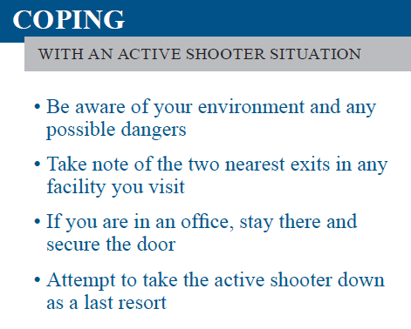
Run
Hide
Fight
Notes:
https://www.dhs.gov/sites/default/files/publications/active_shooter_pocket_card_508.pdf

Slide 47
I don’t believe that anymore, and I’ve consulted with a few about this.
We need to fight.
We need to rush him.
Some of us will die, but not as many, and we’ll die as defenders, as heroes.

Slide 48
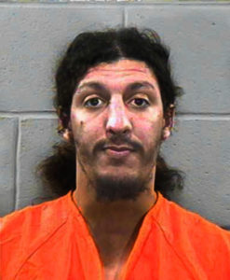
Richard
Reid,
failed shoe
Bomber.
Notes:
https://www.google.com/search?q=richard+reid&safe=active&source=lnms&tbm=isch&sa=X&sqi=2&ved=0ahUKEwjRj7OqlLfeAhWmyoUKHRQBCTAQ_AUIEygB&biw=1164&bih=821#imgdii=3dp4UUO8eNif7M:&imgrc=jijdlxY7aKUsIM:

Slide 49
On December 22, 2001, after passengers and crew saw Reid trying to light a fuse and subdued him by tying him to his seat. A doctor on board administered a tranquilizer.
FBI bomb technicians and explosives experts found explosives in Reid's shoes.
Notes:
http://www.cnn.com/2009/CRIME/12/25/richard.reid.shoe.bomber/index.html
So now we have to take off our shoes before boarding a plane.

Slide 50
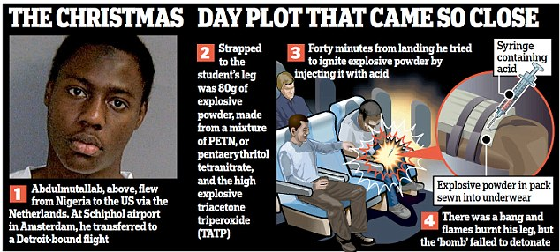

Slide 51
On Christmas Day 2009, Abdulmutallab travelled from Ghana to Amsterdam, where he boarded Northwest Airlines Flight 253 en route to Detroit Abdulmutallab spent about 20 minutes in the toilet as the flight approached Detroit, and then covered himself with a blanket after returning to his seat.
Notes:
https://en.wikipedia.org/wiki/Umar_Farouk_Abdulmutallab

Slide 52
Other passengers then heard popping noises, smelled a foul odour, and some saw Abdulmutallab's trouser leg and the wall of the plane on fire. Fellow passenger Jasper Schuringa, a Dutch film director, jumped on Abdulmutallab and subdued him as flight attendants used fire extinguishers to douse the flames.
Notes:
https://en.wikipedia.org/wiki/Umar_Farouk_Abdulmutallab
TSA hasn’t yet required that we take off our underwear for inspection.

Slide 53
If we have an active shooter invade,
I plan to cry out “Intruder” “Rush him!”
Any people here who are “conceal carry” prepare to fire and cry out “Down!”

Slide 54
We need to fight.
We need to rush him.
Some of us will die, but not as many, and we’ll die as heroes.
In Israel, they don’t have a Holocaust Memorial Day as such. Couldn’t bear for the children to remember Jews as victims.

Slide 55
Yom Hazikaron laShoah ve-laG'vurah
יום הזיכרון לשואה ולגבורה
Holocaust and Heroism Remembrance Day
known colloquially in Israel and in English as Holocaust Remembrance Day, or Holocaust Day,
Notes:
https://en.wikipedia.org/wiki/Yom_HaShoah

Slide 56
We’re not ghetto Jews anymore.
We’re not ghetto Messianics anymore.
We’re not hiding and cowering, physically or spiritually.
We can say no to depletion, and fight, in the Ruakh/Spirit

Slide 57
We need to fight.
We need to rush him.
Some of us will die, but not as many, and we’ll die as defenders, not victims!
Application #2 Outreach
May seem unrelated…

Slide 58
From the Fijian islands to the Ugandan wilderness, from the frozen Canadian Arctic to the Brazilian metropolis, to deep
in the mists and mountains of Kentucky; God is on the move.
Notes:
http://www.sentinelgroup.org/store.html

Slide 59
For more than 20 years, the LRA, led by the infamous Joseph Kony, employed satanic rituals and brutal force to abduct and control over 25,000 children to serve as sex slaves and child soldiers.
Notes:
http://www.sentinelgroup.org/store.html

Slide 60
In 2002, national believers were stirred into action. If you go to
https://vimeo.com/ondemand/anunconventionalwar
You will meet abducted children and their parents, Uganda's president, a former sorceress, and men and women of God who braved pure evil to see a generation delivered.
Notes:
http://www.sentinelgroup.org/store.html

Slide 61
http://www.sentinelgroup.org/a-force-for-change.html#affc-trailer
Sao Paulo police transformation

Slide 62
We’re not ghetto Jews anymore.
We’re not ghetto Messianics anymore.
We’re not hiding and cowering, physically or spiritually.
We can say no to depletion, and fight, in the Ruakh/Spirit
Application #2 Outreach

Slide 63


Slide 64
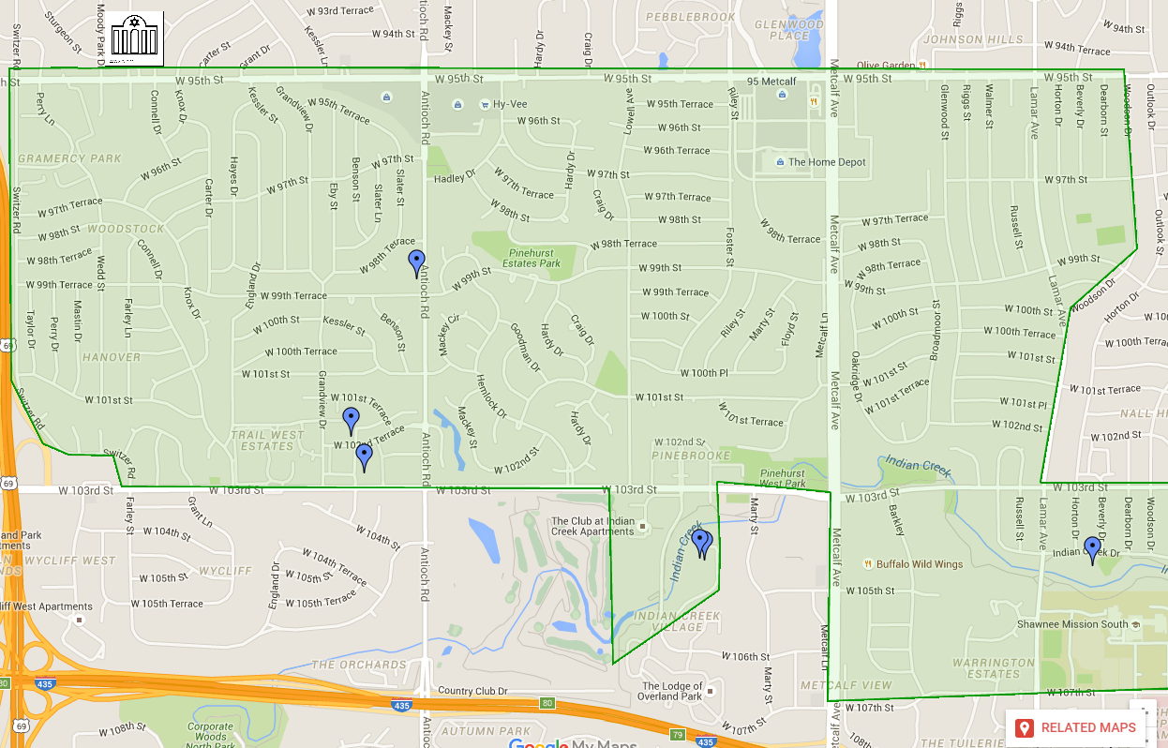
Notes:
The Eruv is the area that is mentioned in the Book of Acts as a Sabbath Day’s journey. How far you can carry a burden on Shabbat before it’s defined as work. Many of the major Jewish institutions are in the eruv. Or HaOlam is in the northwest corner.

Slide 65
I am proposing a prayer drive project, like what a friend that some of you know did in a Haredi Jewish neighborhood that seemed impenetrable.
We have a list of the streets of the Eruv, and some nearby areas, and are looking for
Notes:
I am posing a challenge.
She eventually had people ask her questions, other encounters.

Slide 66
volunteers to adopt a street. Drive through it relatively slowly once or twice or more each week, and pray for the homes, residents, families, fathers, mothers, teens, kids, marriages, businesses!
Notes:
How long? Another 40 days…two months. Then assess.

Slide 67
We’re not ghetto Jews anymore.
We’re not ghetto Messianics anymore.
We’re not hiding and cowering, physically or spiritually.
We can say no to depletion, and fight, in the Ruakh/Spirit
Application #3 Culture War

Slide 68
There is a commonly accepted lie in the culture that homosexuality is innate, genetic to some people. That compassion demands that we accept them as is.
Scientific?

Slide 69
Genetics is the study of DNA sequences. 4 nucleic acids are the alphabet of life:
C A T G
Cytosine, Adenine, Thyamine, Guanine
Notes:
This is the key and killer issue. To many people, it seems that homosexual attraction is their innate proclivity. They were made this way. It’s only a half truth. But it is a half truth.

Slide 70
Epigenetics is the study of heritable changes that do not involve alterations in the DNA sequence. The Greek prefix epi- (ἐπι- "over, outside of, around") in epigenetics implies features that are "on top of" or "in addition to" the traditional genetic basis for inheritance.
Notes:
This is the key and killer issue. To many people, it seems that homosexual attraction is their innate proclivity. They were made this way. It’s only a half truth. But it is a half truth.

Slide 71
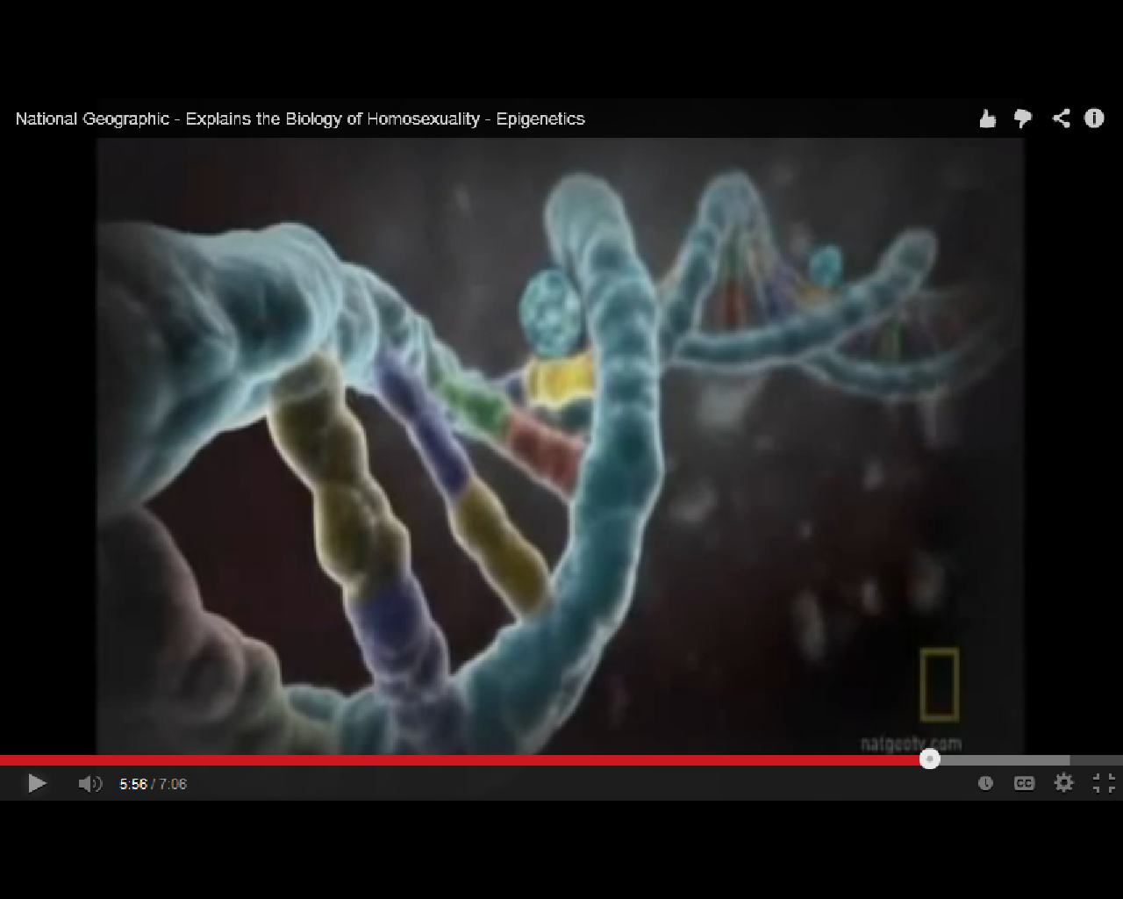
epigentic methyl group
Epigenetics is affected by behavior.
Notes:
Four colors are the four nucleic acids, guanine, cytosine, adenine, thiamine. Controlling components, alphabet of life. Determines if an organism is a fish or an elephant. All have the same DNA alphabet.
Epigentics doesn’t change the underlying guanine, cytosine, adenine, thiamine. But DOES affect expressions: on/off switch. Behavior of past generations affects your tendency to behave a certain way. TENDENCY.
Sins of our ancestors can make a proclivity in us. BUT, ancestors added it on by willful behavior, we can overcome by willful choices.

Slide 72
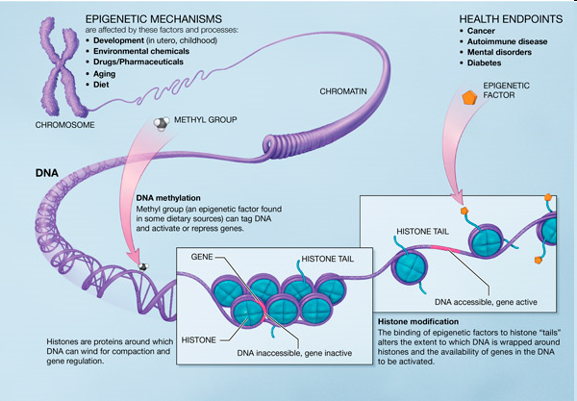
Notes:
In biology, and specifically genetics, epigenetics is the study of inherited changes in phenotype (appearance) or gene expression caused by mechanisms other than changes in the underlying DNA sequence, hence the name epi- (Greek: επί- over, above) -genetics. These changes may remain through cell divisions for the remainder of the cell's life and may also last for multiple generations.
“third or fourth generation…”

Slide 73
Environmental stress has been shown to increase the risk of substance use. In an attempt to cope with stress, alcohol and drugs can be used as an escape. Once substance use commences, however, epigenetic alterations may further exacerbate the biological
Notes:
http://en.wikipedia.org/wiki/Behavioral_epigenetics
Once aberrant behavior, hormonal activity occurs, epigenetic alterations may exacerbate the biological.

Slide 74
and behavioral changes associated with addiction.
Even short-term substance use can produce long-lasting epigenetic changes in the brain of rodents, via DNA methylation and histone modification.
Notes:
http://en.wikipedia.org/wiki/Behavioral_epigenetics

Slide 75
DNA cannot be changed by behavior. But the molecules surrounding it [epi] can be changed.
Notes:
http://en.wikipedia.org/wiki/Behavioral_epigenetics

Slide 76
^{Ex 34.6-7} [ADONI] is God, merciful and compassionate, slow to anger, rich in grace and truth; showing grace to the thousandth generation, forgiving offenses, crimes and sins; yet not exonerating the guilty, but visiting parents' offenses to be experienced by their children and grandchildren, and even by the third and fourth generations.

Slide 77
G-d doesn’t punish the next generation, but the sins continue.
The consequences continue.

Slide 78
Identical twins have identical DNA, which leads to the perceived conclusion that all identical twins are either heterosexual or homosexual. However, it is evident that this is not the case, consequently leaving a gap in the explanation for homosexuality. A "gay" gene does not produce homosexuality, rather, epigenetic modifications act as a temporary "switches" that regulate how the genes are expressed.
Notes:
http://en.wikipedia.org/wiki/Epigenetic_theories_of_homosexuality
Repeat:
A gay gene does not exist that causes homosexuality.
Parental, ancestral behavior [porn, sin, imaginations] give the appearance of genetic proclivity. It’s really epi-genetic proclivity.
Time Mag May 25, 2015, epigenetic pot addiction tendency.

Slide 79
Only twenty percent of identical twins are both homosexual which leads to the hypothesis that even though identical twins share the same DNA, homosexuality is created by something else rather than the genes. Epigenetic transformation allows the on and off switch of certain genes, subsequently shaping how cells respond to androgen signaling, which is critical in sexual development.
Notes:
http://en.wikipedia.org/wiki/Epigenetic_theories_of_homosexuality

Slide 80
Another example of epigenetic consequences is evident in multiple sclerosis in monozygotic (identical) twins. There are pairs of twins that are discordant with multiple sclerosis and do not both show the trait. After gene testing, it was suggested that DNA was identical and that epigenetic differences contributed to the gene difference between identical twins.
Notes:
http://en.wikipedia.org/wiki/Epigenetic_theories_of_homosexuality

Slide 81
We’re not ghetto Jews anymore.
We’re not ghetto Messianics anymore.
We’re not hiding and cowering, physically or spiritually.
We can say no to depletion, and fight, in the Ruakh/Spirit
Application #3 Culture War

Slide 82
Homosexuality is a sin.
Active practice
Passive tendency
^{Vayikra/Lev 18.22} You are not to go to bed with a man as with a woman; it is an abomination.
וְאֶת-זָכָר לֹא תִשְׁכַּב מִשְׁכְּבֵי אִשָּׁה, תּוֹעֵבָה הִוא.
Cp ^{Vayikra/Lev 11.7} the pig is unclean for you וְאֶת-הַחֲזִיר...טָמֵא הוּא לָכֶם
Notes:
Homosexuality is an abomination to G-d,
unkosher foods are an abomination to us. Actually just says “unclean.” Not as strong a word as “abomination.” Not sin intrinsically, but so designated by G-d in Torah, so a sin to us. Homosexuality is intrinsically wrong. Abomination to G-d.

Slide 83
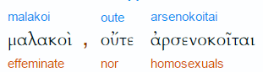
^{1 Cor 6.9-11} People who engage in sex before marriage…who engage in sex after marriage with someone other than their spouse, who engage in active or passive homosexuality…
Notes:
Thayer
malakos soft, soft to the touch
2) metaphorically in a bad sense
2a) effeminate
2a2) of a boy kept for homosexual relations with a man
2a3) of a male who submits his body to unnatural lewdness
2a4) of a male prostitute
arsenokoítēs (from 730 /árrhēn, "a male" and 2845 /koítē, "a mat, bed") – properly, a man in bed with another man; a homosexual.
http://biblehub.com/greek/3120.htm

Slide 84
^{1 Cor 6.9-11} none of them will share in the Kingdom of God. Some of you used to do these things. But you have cleansed yourselves, you have been set apart for God, you have come to be counted righteous through the power of the Lord Yeshua the Messiah and the Spirit of our God.
Notes:
Not an irredeemable sin or condition.
To explain cause, as I understand it, need to introduce some terminology. Joy Starts Here book of the Life Model series, school, combining neuroscience with scripture: neurotheology. P. 13

Slide 85
By-Laws: Or HaOlam believes in the scriptural definition of the marriage covenant…In accordance with scripture, our Rabbinate, staff, and facilities will be only be used to conduct Scripturally permissible weddings between one chromosomally XX woman, and one chromosomally XY man.

Slide 86
We’re not ghetto Jews anymore.
We’re not ghetto Messianics anymore.
We’re not hiding and cowering, physically or spiritually.
We can say no to depletion, and fight, in the Ruakh/Spirit
Application #3 Culture War

Slide 87
On October 16, a mother and her children went to a Target in Woburn, Massachusetts, to do some shopping. While inside the store, the mother's 10-year-old daughter entered the women's restroom where a man later offered her candy, commented on her clothing, and reportedly tried to get into the stall that the little girl was using.
Notes:
https://www.onenewsnow.com/culture/2018/11/01/terrified-at-target?utm_source=OneNewsNow&utm_medium=email&utm_term=16792233&utm_content=323193037843968512&utm_campaign=36829

Slide 88
"Now, she's terrified – but she got out of there and fortunately, she was unharmed," says Andrew Beckwith of Keep MA Safe, a group urging people to vote No on 3. "She told her parents, they called the police and investigators were able to ultimately identify this guy from the security footage at the store."
Notes:
https://www.onenewsnow.com/culture/2018/11/01/terrified-at-target?utm_source=OneNewsNow&utm_medium=email&utm_term=16792233&utm_content=323193037843968512&utm_campaign=36829

Slide 89
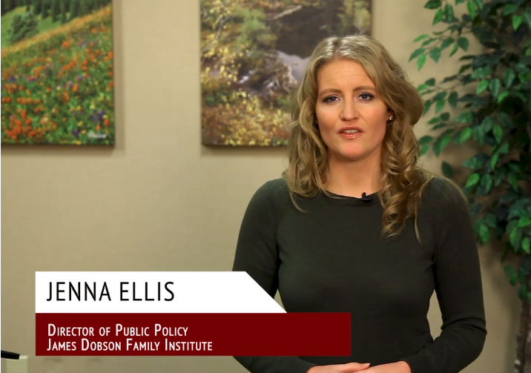
https://drjamesdobson.org/media/get-out-and-vote-engage?sc=FEM&mc=FEM1018GOVEV&utm_source=SilverpopMailing&utm_campaign=20181030%20-%20Get%20Out%20and%20Vote%20-%20(FEM1018GOVEV)%20(2)&spMailingID=20470884&spUserID=MTk2NDM5NTE5MAS2&spJobID=1361777720&spReportId=MTM2MTc3NzcyMAS2

Slide 90


Slide 91
We’re not ghetto Jews anymore.
We’re not ghetto Messianics anymore.
We’re not hiding and cowering, physically or spiritually.
We can say no to depletion, and fight, in the Ruakh/Spirit

Slide 92
Stand against anti-Semitism.
Stand for outreach, in love, but in prayerful power.
Stand in the culture war, speaking the truth in love!

