Slide 1
e-handout
To have these notes
without taking notes
Go to OrHaOlam.com
Click on downloads,
messages, 2018
Notes:
.

Slide 3
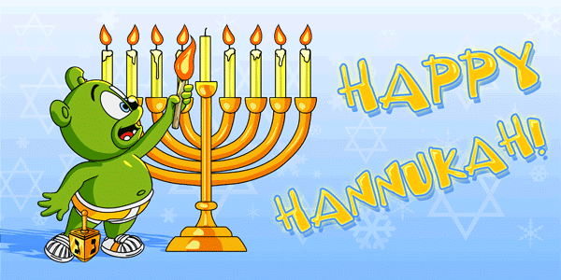

Slide 4
Yosef / Joseph had a G-d given dream and calling.
Notes:
What is your calling?

Slide 5
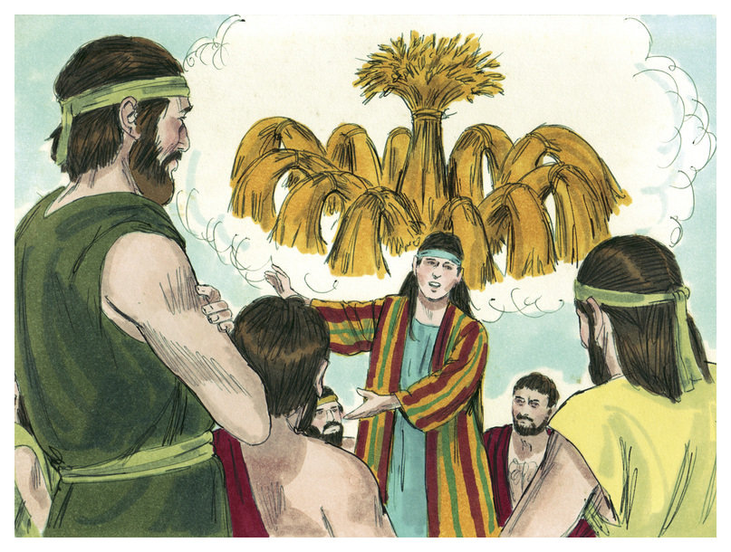
Notes:
https://www.google.com/search?q=joseph%27s+dream&safe=active&tbm=isch&tbs=rimg:CTXh6dqUP02BIjg807FbwiTL1nJ89WNcTTZ5RA1tNMtW-LXQCsfHfr7UI1N_1QV5LmrRMQ0NE5rk5gI_1bWqoToQgULSoSCTzTsVvCJMvWEel9VxuaRt_1qKhIJcnz1Y1xNNnkROCTJcUzuGGoqEglEDW00y1b4tRGYW6-oPF1PZSoSCdAKx8d-vtQjEfCevySJhacSKhIJU39BXkuatEwRt30Jo1VZbmwqEglDQ0TmuTmAjxGIVbjQtw4qyyoSCdtaqhOhCBQtEU83wUzdr14N&tbo=u&sa=X&ved=2ahUKEwiwxY27j_3eAhUIOq0KHbfvCzgQ9C96BAgBEBs&biw=1164&bih=821&dpr=1.1#imgdii=uudbuj24ALLdVM:&imgrc=cnz1Y1xNNnnsKM:

Slide 6
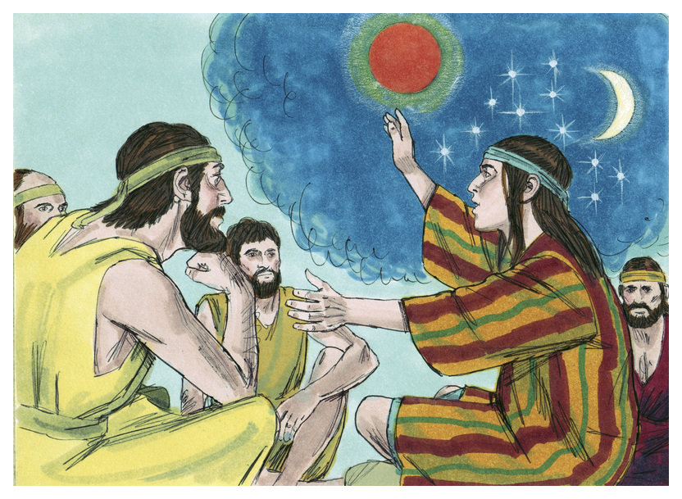
Notes:
https://www.google.com/url?sa=i&source=images&cd=&cad=rja&uact=8&ved=2ahUKEwitv4nZj_3eAhVIRqwKHRcQB4QQjRx6BAgBEAU&url=http%3A%2F%2Fpregacaocrista.com%2Fhistoria-de-jose-do-egito%2F&psig=AOvVaw016EvZ5nUMeEZiwVCgHfpD&ust=1543701847139817

Slide 7
^{Ber/Gen 37.18-20} Now they saw him from a distance. Before he was close to them they plotted together against him in order to kill him. They said to one another, “Here comes the master of dreams! Come on now! Let’s kill him and throw him into one of those pits, so we can say that an evil animal devoured him. Then let’s see what becomes of his dreams.”
Notes:
What is the dream G-d has given you? The hope, the passion, what gets you going, stirs your blood?

Slide 8
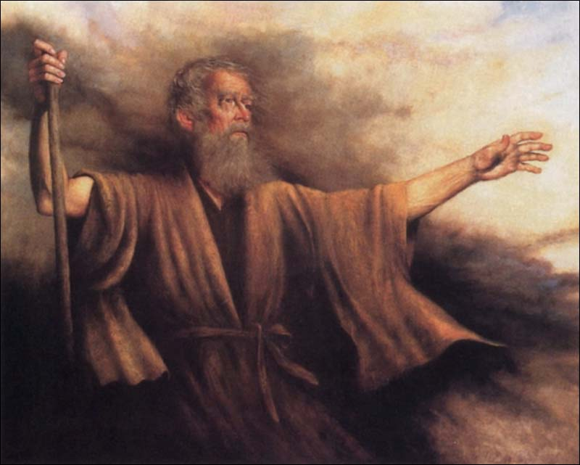
B’resheet בְּרֵאשִׁית
(Genesis) 37:26-28
וישב(from) Vayeshev (He continued living)

Slide 9
B’resheet (Genesis) 37:26
ג כִּי שֵׁם יְהוָה אֶקְרָא ס הָבוּ גֹדֶל לֵאלֹהֵינוּ׃
ג כִּי שֵׁם יְהוָה אֶקְרָא ס הָבוּ גֹדֶל לֵאלֹהֵינוּ׃
וַיֹּ֥אמֶר יְהוּדָ֖ה אֶל־אֶחָ֑יו מַה־בֶּ֗צַע כִּ֤י נַהֲרֹג֙ אֶת־אָחִ֔ינוּ וְכִסִּ֖ינוּ אֶת־דָּמֽוֹ׃
Y’hudah said to his brothers, “What advantage is it to us if we kill our brother and cover up his blood?

Slide 10
B’resheet (Genesis) 37:27
ג כִּי שֵׁם יְהוָה אֶקְרָא ס הָבוּ גֹדֶל לֵאלֹהֵינוּ׃
ג כִּי שֵׁם יְהוָה אֶקְרָא ס הָבוּ גֹדֶל לֵאלֹהֵינוּ׃
לְכ֞וּ וְנִמְכְּרֶ֣נּוּ לַיִּשְׁמְעֵאלִ֗ים וְיָדֵ֙נוּ֙ אַל־תְּהִי־ב֔וֹ כִּֽי־אָחִ֥ינוּ בְשָׂרֵ֖נוּ ה֑וּא וַֽיִּשְׁמְע֖וּ אֶחָֽיו׃
Come, let’s sell him to the Yishma‘elim, instead of putting him to death with our own hands. After all, he is our brother, our own flesh.” His brothers paid attention to him.

Slide 11
B’resheet (Genesis) 37:28
ג כִּי שֵׁם יְהוָה אֶקְרָא ס הָבוּ גֹדֶל לֵאלֹהֵינוּ׃
ג כִּי שֵׁם יְהוָה אֶקְרָא ס הָבוּ גֹדֶל לֵאלֹהֵינוּ׃
וַיַּֽעַבְרוּ֩ אֲנָשִׁ֨ים מִדְיָנִ֜ים סֹֽחֲרִ֗ים וַֽיִּמְשְׁכוּ֙ וַיַּֽעֲל֤וּ אֶת־יוֹסֵף֙ מִן־הַבּ֔וֹר
So when the Midyanim, merchants, passed by, they drew and lifted Yosef up out of the cistern

Slide 12
B’resheet (Genesis) 37:28
ג כִּי שֵׁם יְהוָה אֶקְרָא ס הָבוּ גֹדֶל לֵאלֹהֵינוּ׃
ג כִּי שֵׁם יְהוָה אֶקְרָא ס הָבוּ גֹדֶל לֵאלֹהֵינוּ׃
וַיִּמְכְּר֧וּ אֶת־יוֹסֵ֛ף לַיִּשְׁמְעֵאלִ֖ים בְּעֶשְׂרִ֣ים כָּ֑סֶף וַיָּבִ֥יאוּ אֶת־יוֹסֵ֖ף מִצְרָֽיְמָה׃
and sold Yosef for half a pound of silver shekels to the Yishma‘elim, who took Yosef on to Egypt.

Slide 13
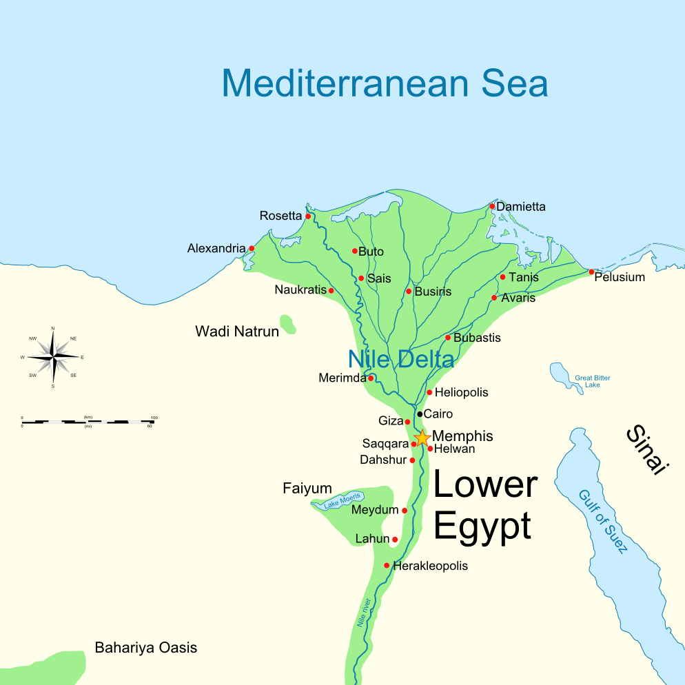

Slide 14
In Egypt Yosef was
A household slave
An incarcerated sex offender
A distress adviser to Pharaoh
Prime Minister to Pharaoh!!

Slide 15
In G-d’s economy, what seems to stop our dreams is what fulfills them…if we respond right.
Notes:
What is your dream?
What is hindering it?

Slide 16
^{T’hillim/Ps 105.17-19} Yosef…was sold as a slave. They shackled his feet with chains, and they bound him in irons; until the time when his word proved true, God’s utterance kept testing him.
בַּרְזֶל בָּאָה נַפְשׁוֹ. עַד-עֵת בֹּא-דְבָרוֹ-אִמְרַת יְיָ צְרָפָתְהוּ. Refined him

Slide 17
In G-d’s economy, what seems to stop our dreams is what fulfills them…if we respond right.
Notes:
What is your dream?
What is hindering it?

Slide 18
  Two criteria for right response:
  Commitment to vision
  Gratitude & Joy in the pursuit
  Task joy, relational joy!
Notes:
Resurrection power of Yeshua and the Ruakh to accomplish!
Send me a testimony of praise, thanksgiving

Slide 19
Historical affirmation of scripture from Timothy Mahoney: Pattern of Evidence

Slide 21
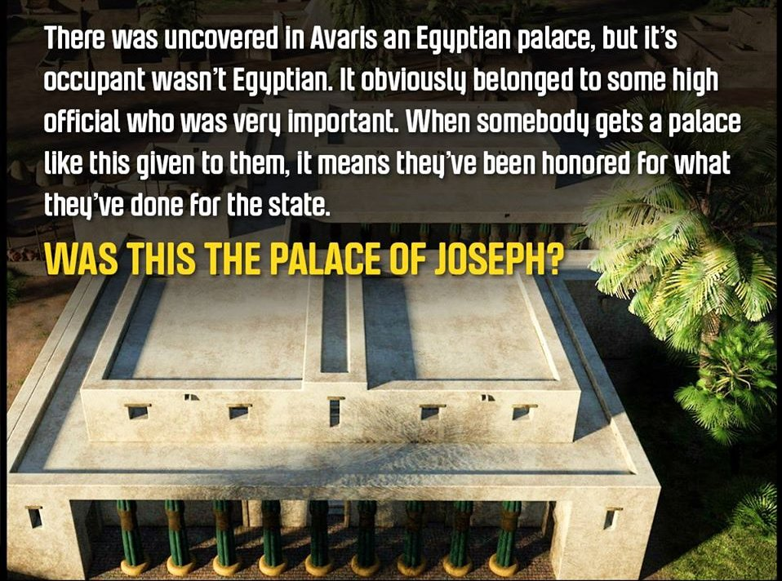
Notes:
https://www.google.com/search?q=tomb+of+joseph+tim+Mahoney&safe=active&tbm=isch&source=iu&ictx=1&fir=wni6c7UZ458vjM%253A%252CbDhm2pDTiV0SbM%252C_&usg=AI4_-kQamri0K3fEJkZ0qjlmDsUEqx92Jg&sa=X&ved=2ahUKEwjj6sPGkf3eAhUDyYMKHagHBk4Q9QEwCXoECAUQBg#imgrc=0zlOBIAbuZ-luM:
Timothy Mahoney

Slide 22
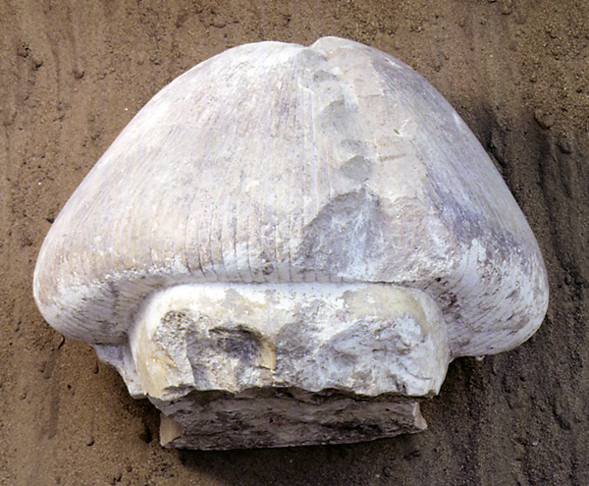
Notes:
https://www.google.com/search?q=tomb+of+joseph+tim+Mahoney&safe=active&tbm=isch&source=iu&ictx=1&fir=wni6c7UZ458vjM%253A%252CbDhm2pDTiV0SbM%252C_&usg=AI4_-kQamri0K3fEJkZ0qjlmDsUEqx92Jg&sa=X&ved=2ahUKEwjj6sPGkf3eAhUDyYMKHagHBk4Q9QEwCXoECAUQBg#imgrc=0zlOBIAbuZ-luM:
Hammer marks: possible vengeance of the Egyptians after Israel left

Slide 23
They call it a “mushroom” hairdo and it’s specifically related to non-Egyptians from the area of ancient Canaan/ Israel. Interestingly, it’s quite the “do”, and the Talmud goes out of its way to tell us that Joseph was quite the fashionista ^{(Gen Rab, 87:3)}.

Slide 24
In fact, the Rabbinic Midrash ^{Tanhuma Vayyesheb 8} specifically talks about Joseph curling his hair. The statue was found in a layer corresponding to the year c. 1,700 BCE.
Notes:
https://www.google.com/search?q=tomb+of+joseph+tim+Mahoney&safe=active&tbm=isch&source=iu&ictx=1&fir=wni6c7UZ458vjM%253A%252CbDhm2pDTiV0SbM%252C_&usg=AI4_-kQamri0K3fEJkZ0qjlmDsUEqx92Jg&sa=X&ved=2ahUKEwjj6sPGkf3eAhUDyYMKHagHBk4Q9QEwCXoECAUQBg#imgrc=0zlOBIAbuZ-luM:

Slide 25
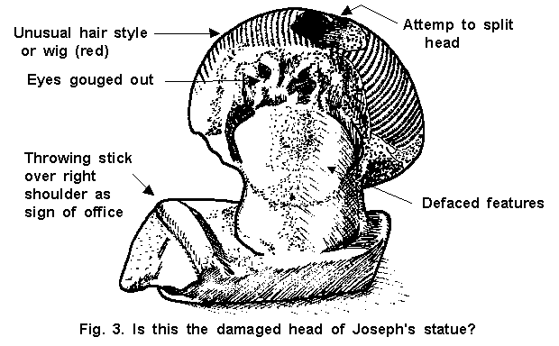
Notes:
https://www.google.com/search?q=tomb+of+joseph+tim+Mahoney&safe=active&tbm=isch&source=iu&ictx=1&fir=wni6c7UZ458vjM%253A%252CbDhm2pDTiV0SbM%252C_&usg=AI4_-kQamri0K3fEJkZ0qjlmDsUEqx92Jg&sa=X&ved=2ahUKEwjj6sPGkf3eAhUDyYMKHagHBk4Q9QEwCXoECAUQBg#imgrc=0zlOBIAbuZ-luM:

Slide 26
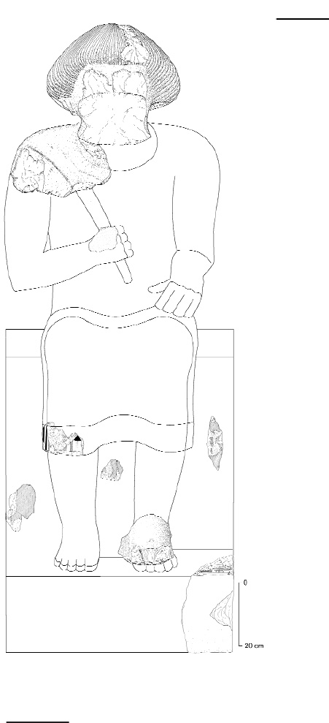
Notes:
https://www.google.com/search?q=tomb+of+joseph+tim+Mahoney&safe=active&tbm=isch&source=iu&ictx=1&fir=wni6c7UZ458vjM%253A%252CbDhm2pDTiV0SbM%252C_&usg=AI4_-kQamri0K3fEJkZ0qjlmDsUEqx92Jg&sa=X&ved=2ahUKEwjj6sPGkf3eAhUDyYMKHagHBk4Q9QEwCXoECAUQBg#imgrc=0zlOBIAbuZ-luM:
reconstruction

Slide 27
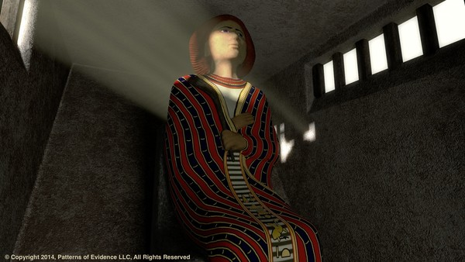
Notes:
https://www.google.com/search?q=tomb+of+joseph+tim+Mahoney&safe=active&tbm=isch&source=iu&ictx=1&fir=wni6c7UZ458vjM%253A%252CbDhm2pDTiV0SbM%252C_&usg=AI4_-kQamri0K3fEJkZ0qjlmDsUEqx92Jg&sa=X&ved=2ahUKEwjj6sPGkf3eAhUDyYMKHagHBk4Q9QEwCXoECAUQBg#imgrc=0zlOBIAbuZ-luM:

Slide 28
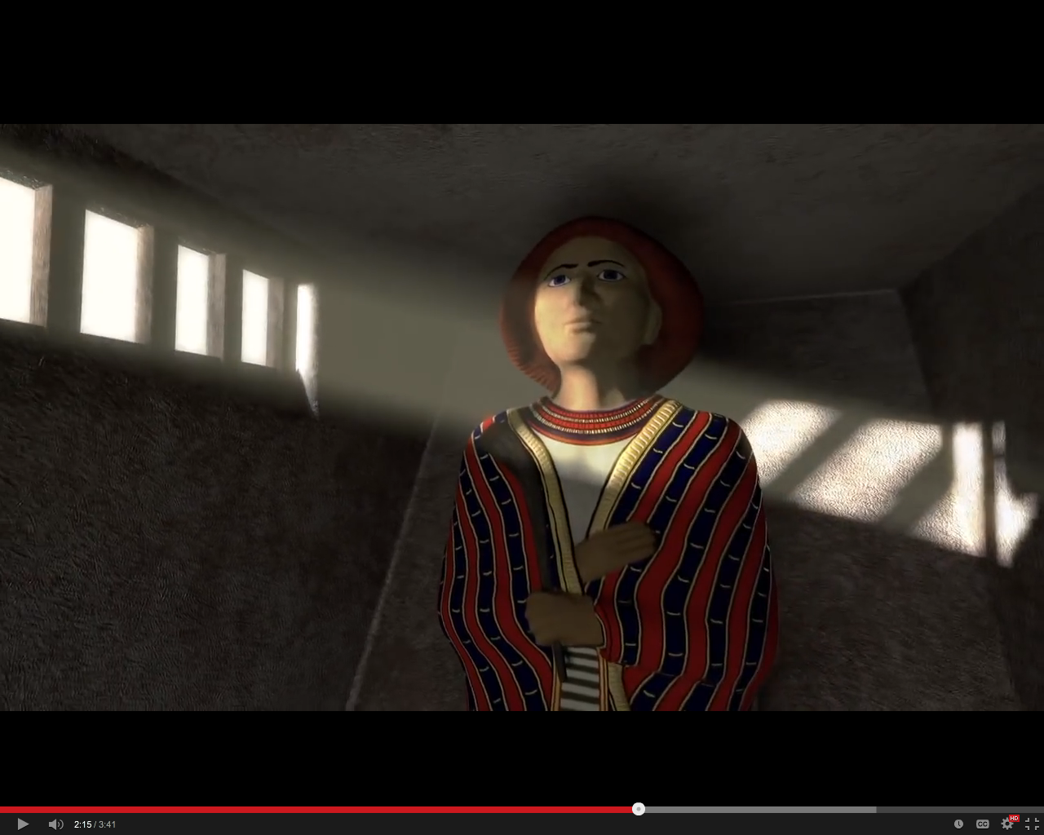
Notes:
https://www.google.com/search?q=tomb+of+joseph+tim+Mahoney&safe=active&tbm=isch&source=iu&ictx=1&fir=wni6c7UZ458vjM%253A%252CbDhm2pDTiV0SbM%252C_&usg=AI4_-kQamri0K3fEJkZ0qjlmDsUEqx92Jg&sa=X&ved=2ahUKEwjj6sPGkf3eAhUDyYMKHagHBk4Q9QEwCXoECAUQBg#imgrc=0zlOBIAbuZ-luM:

Slide 29
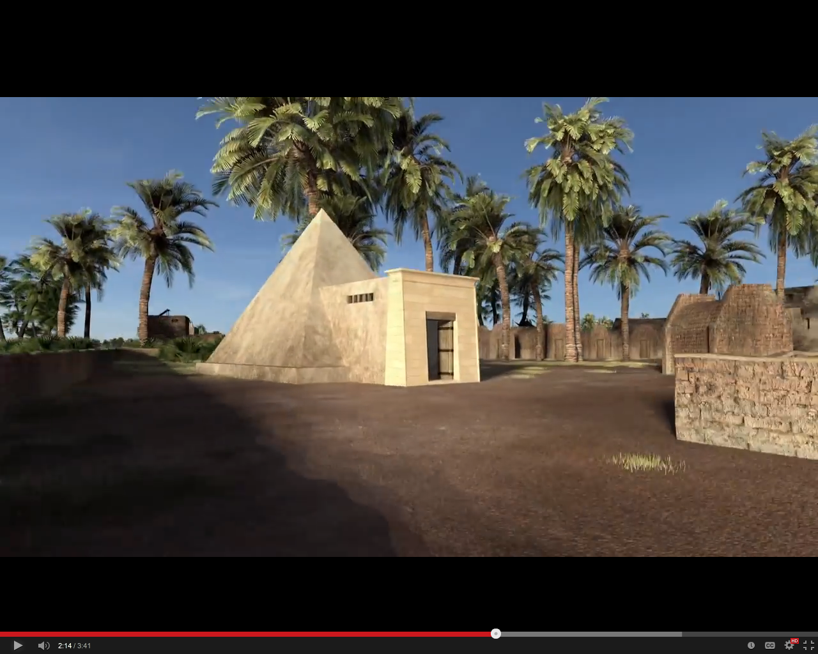
Tomb of Yosef in Avaris?
Notes:
https://www.google.com/search?q=tomb+of+joseph+tim+Mahoney&safe=active&tbm=isch&source=iu&ictx=1&fir=wni6c7UZ458vjM%253A%252CbDhm2pDTiV0SbM%252C_&usg=AI4_-kQamri0K3fEJkZ0qjlmDsUEqx92Jg&sa=X&ved=2ahUKEwjj6sPGkf3eAhUDyYMKHagHBk4Q9QEwCXoECAUQBg#imgrc=0zlOBIAbuZ-luM:
reconstruction

Slide 30
In G-d’s economy, what seems to stop our dreams is what fulfills them…if we respond right.
Setback → stepup

Slide 31
  Two criteria for right response:
  Commitment to vision
  Gratitude & Joy in the pursuit
  Task joy, relational joy!
Notes:
Power of Yeshua and the Ruakh to accomplish!
Send me a testimony of praise, thanksgiving

Slide 33
Summarized
Story of Hanukkah
And how this relates to theme of
Setback → stepup
Notes:
Some verses in Daniel that you may never have considered

Slide 34
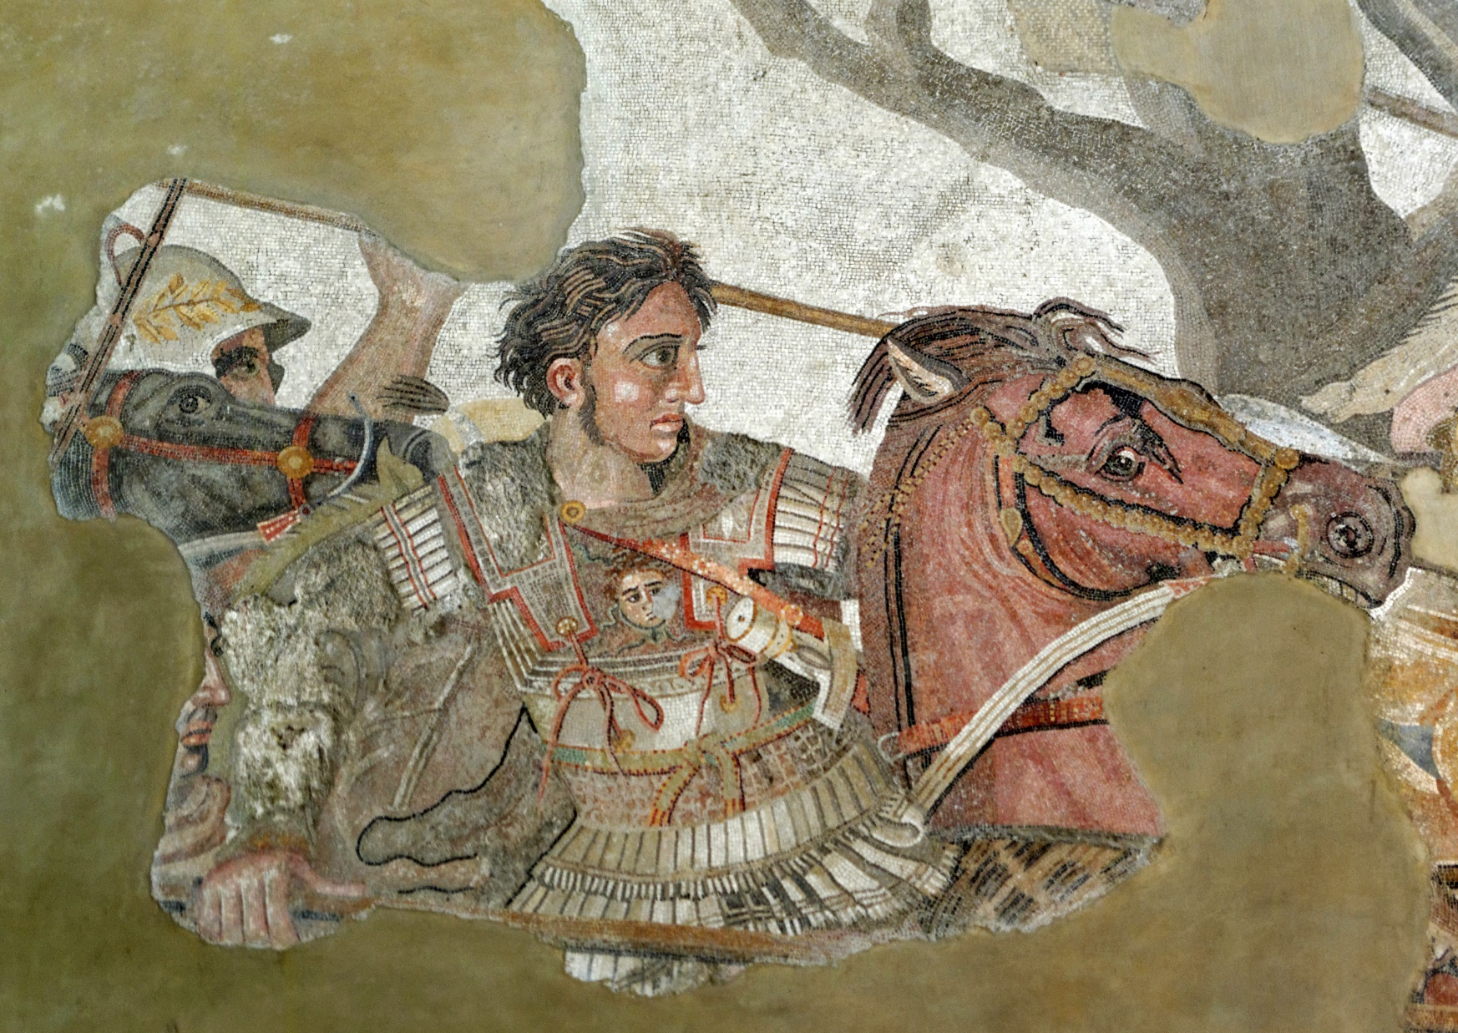
Alexander fighting the Persian king
Darius III. From the Alexander Mosaic, Naples
National Archaeological Museum.
Notes:
Alexander fighting the Persian king Darius III. From the Alexander Mosaic, Naples National Archaeological Museum.

Slide 35
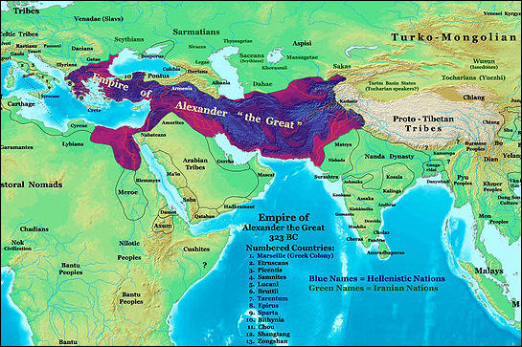
Notes:
https://www.google.com/url?sa=i&source=imgres&cd=&ved=2ahUKEwju867kp_3eAhVPEawKHbcIA9oQjRx6BAgBEAU&url=http%3A%2F%2Ffactsanddetails.com%2Fworld%2Fcat56%2Fsub371%2Fitem1978.html&psig=AOvVaw1H3G8a7xop98k8gpg9mKRN&ust=1543708325279882

Slide 36
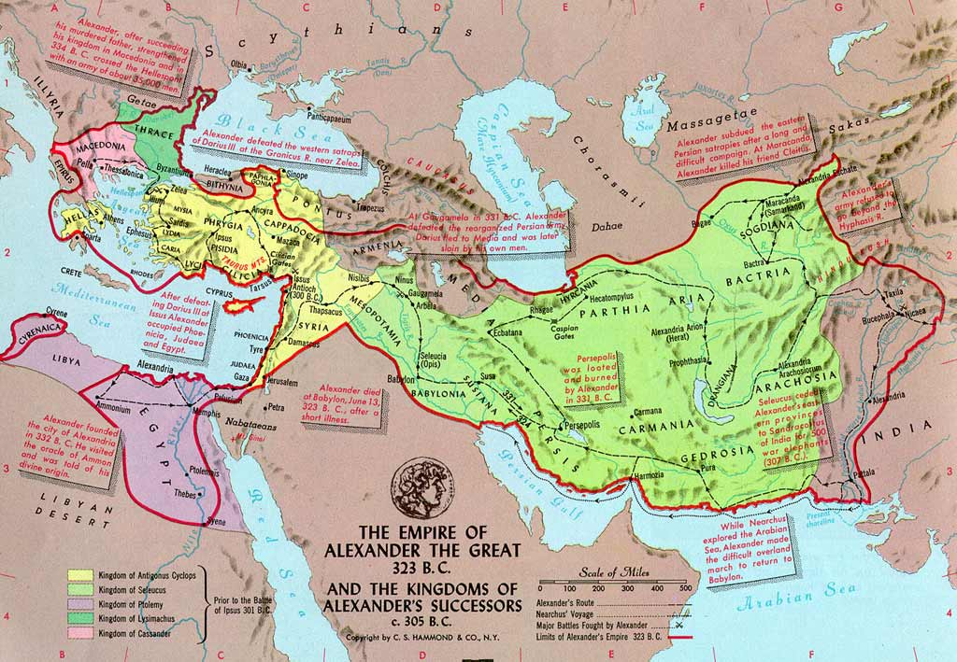
Notes:
Zoom in on Israel…

Slide 37
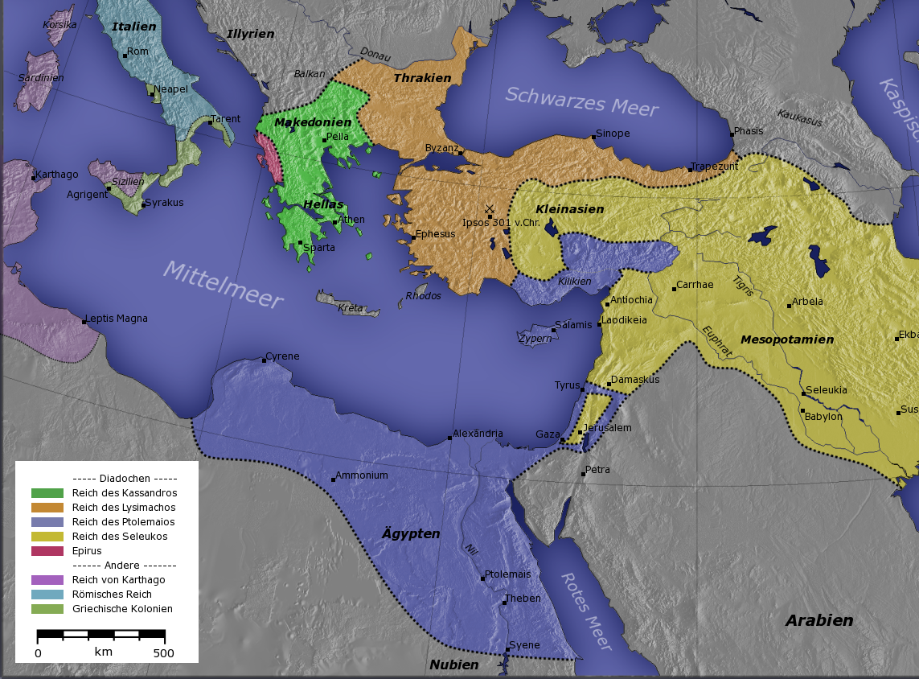
Notes:
https://en.wikipedia.org/wiki/Ptolemaic_Kingdom
Two claims on the Land.

Slide 38
In the 2nd century BCE, Judea lay between the Ptolemaic Kingdom (S., based in Egypt) and the Seleucid empire (NE, based in Syria), monarchies which had formed following the death of Alexander the Great (356–323 BCE). Judea had initially come under Ptolemaic rule, but fell to the Seleucids around 200 BCE.

Slide 39
Some Jews, mainly those of the urban upper class, notably the Tobiad family, wished to dispense with Jewish Torah and to adopt a Greek lifestyle. According to the historian Victor Tcherikover, the main motive for the Tobiads' Hellenism
Notes:
https://en.wikipedia.org/wiki/Maccabees

Slide 40
was economic and political. The Hellenizing Jews built a gymnasium in Jerusalem, competed in international Greek games, "removed their marks of circumcision and repudiated the holy covenant.”
Notes:
https://en.wikipedia.org/wiki/Maccabees

Slide 41
In the conflict over the office of Cohen HaGadol / High Priest, traditionalists with Hebrew / Aramaic names like Onias חוֹנִיוֹ Khonio [grace of YHVH] contested with Hellenizers with Greek names like Jason and Menelaus.
Notes:
https://en.wikipedia.org/wiki/Maccabees
https://en.wikipedia.org/wiki/Onias_I#cite_note-1

Slide 42
When Antiochus IV Epiphanes (ca. 215–164 BCE) became ruler of the Seleucid Empire [northern part] in 175 BCE, Onias III חוֹנִיוֹKhonio [grace of YHVH] held the office of כוהן הגדול Cohen HaGadol, High Priest in Jerusalem.
Notes:
https://en.wikipedia.org/wiki/Maccabees
Try to remember this name, key to the story from this angle. Onias III חוֹנִיוֹKhonio

Slide 43
He was the son of the יַדּוּעַYadua mentioned in Nekhemiah
^{Nekhemia 12.11-12} Yeshua was the father of Yoyakim…and Yonatan was the father of יַדּוּעַ Yadua. In the days of Yoyakim these were the cohanim who were heads of fathers’ clans.
Notes:
https://en.wikipedia.org/wiki/Onias_I#cite_note-1
BTW, note that Yeshua is a relatively common male name in the later Tanakh

Slide 44
^{Nekhemia 12.8,9} The L’vi’im: Yeshua…who was in charge of the songs of thanksgiving …singing antiphonally with them in the service.

Slide 45
To Antiochus, the High Priest was merely a local governor within his realm, a man whom he could appoint or dismiss at will, while Jews saw the holder of the Cohanut / High Priesthood as divinely appointed.
Notes:
https://en.wikipedia.org/wiki/Maccabees

Slide 46
Jason, the brother of Onias חוֹנִיוֹ Khonio [grace of YHVH], bribed Antiochus to make him High Priest instead of Onias Khonio.
Notes:
https://en.wikipedia.org/wiki/Maccabees

Slide 47
Jason abolished the traditional theocracy and received from Antiochus permission to convert Jerusalem into a Greek polis called Antioch. Built a gym. However, Menelaus then bribed Antiochus and was appointed Cohen HaGadol in place of Jason. Menelaus had Onias חוֹנִיוֹ Khonio assassinated.
Notes:
https://en.wikipedia.org/wiki/Maccabees

Slide 48
Menelaus' brother Lysimachus stole holy vessels from the Temple; the resulting riots led to the death of Lysimachus. Menelaus was arrested for Onias חוֹנִיוֹ Khonio’s murder, and was arraigned before Antiochus, but he bribed his way out of trouble.
Notes:
https://en.wikipedia.org/wiki/Maccabees

Slide 49
Jason subsequently drove out Menelaus and became High Priest again.
Notes:
https://en.wikipedia.org/wiki/Maccabees

Slide 50
Onias חוניו Khonio [grace of YHVH] Cohen HaGadol, High Priest, son of the יַדּוּעַYadua mentioned in NeKhemiah
Jason his brother, stole the cohanut by bribery.

Slide 51
Menelaus bribed Antiochus stole the Cohanut from Jason. 171 BC to about 161 BCE. His brother Lysimachus stole Temple objects, causing riots. Menelaus arrested for assassination of Onias חוֹנִיוֹ Khonio. Bribed his way out, but Jason became Cohen again.
Notes:
Apparently, the holiness of Temple and Torah worship was on no great consequence to Israel and her leaders. So…

Slide 52
Antiochus pillaged the Temple, attacked Jerusalem and "led captive the women and children.” (168 BCE). From this point onwards, Antiochus pursued a zealous Hellenizing policy. Until Modiin…
Notes:
https://en.wikipedia.org/wiki/Maccabees
After the spiritual failure of Israel, our enemy was emboldened and intensified his attacks. Our own failures, as G-d’s people, opens doors for our enemies.

Slide 53
^{Daniel 11.28} Then the king of the north will return to his own land with great wealth; with his heart set against the holy covenant, he will take action and then return home.

Slide 54
Most of the Jewish people and our leadership corrupted their way.
Then the incident of sacrificing a pig took place in Modiin, starting the revolt. If we hadn’t had this crisis, assimilation would have continued.

Slide 55
In G-d’s economy, what seems to stop our dreams is what fulfills them…if we respond right.
Setback → stepup

Slide 56
^{1 Macabees 2.15-28} The king's officers, such as compelled the people to revolt, came into the city Modin, to make them sacrifice. And when many of Israel came unto them, Mattathias also and his sons came together. Then answered the king's officers, and said to Mattathias on this wise,
Notes:
ie sacrifice a pig
from Apocrypha: additional ancient Jewish books, NOT Scripture
This one in Heb orig, Greek surviving

Slide 57
^{1 Macabees 2.15-28} You are a ruler, and an honorable and great man in this city, and strengthened with sons and brethren: Now therefore come first, and fulfill the king's command, like as all the heathen have done, and the men of Judah also, and such as remain at Jerusalem: so shall you and thy house be in the number of the king's friends, and you and your children shall be honored with silver and gold, and many rewards.

Slide 58
^{1 Macabees 2.15-28} Then Mattathias answered and spake with a loud voice, Though all the nations that are under the king's dominion obey him, and fall away every one from the religion of their fathers, and give consent to his commandments: Yet will I and my sons and my brethren walk in the covenant of our fathers.
Notes:
Us also. Purpose of Messianic Judaism is COVENANT

Slide 59
^{1 Macabees 2.15-28} God forbid that we should forsake the law and the ordinances. We will not hearken to the king's words, to go from our religion, either on the right hand, or the left. Now when he had left speaking these words, there came one of the Jews in the sight of all to sacrifice on the altar which was at Modin, according to the king's commandment.
Notes:
Compliant.
What can it hurt?
Let’s don’t make trouble. Ralph Beren Jewish humor there were these two Jewish men standing before a firing squad in Czarist Russia. Their crime? Being Jewish. So the Cossack captain [Ive forgiven Cossack, Poles] heading the firing squad looks at Abie and Yankele and shouts, “Jews, take off your hats.” Abie takes off his hat. But Yankele says, “No, I won’t take off my hat.” So Abie leans over to Yankele and whispers, “Yankele, don’t make trouble.”

Slide 60
^{1 Macabees 2.15-28} Which thing when Mattathias saw, he was inflamed with zeal, and his reins trembled, neither could he forbear to show his anger according to judgment: wherefore he ran, and slew him upon the altar.

Slide 61
Mattathias stabs him, also killing the Greek official present. He then turns to the crowd and announces: “Follow me, all of you who are for God’s law and stand by the covenant.” ^{1 Maccabees 2:27}
Notes:
Even if all the nations that live under the rule of the king obey him, and have chosen to do his commandments, departing each one from the religion of his fathers, yet I and my sons and my brothers will live by the covenant of our fathers…We will not obey the king’s word by turning aside from our religion to the right hand or to the left. ^{(I Maccabees 2:19-22)}

Slide 62
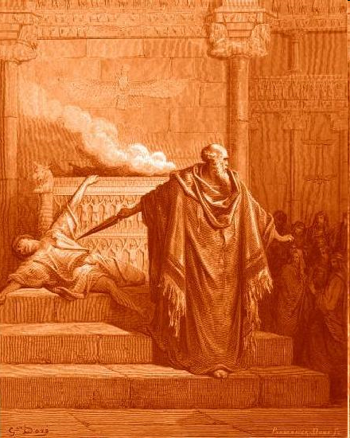
Notes:
Best photp we have sepia
This guy was about to sacrifice a pig on the altar.
So after this came the Maccabean Wars, and in about a year the liberation of Jerusalem under Mattathias’ sons, principally Yehuda/Judah Maccabee.

Slide 63
In G-d’s economy, what seems to stop our dreams is what fulfills them…if we respond right.
Setback → stepup

Slide 64
  Two criteria for right response:
  Commitment to vision
  Gratitude & Joy in the pursuit
  Task joy, relational joy!
Notes:
Power of Yeshua and the Ruakh to accomplish!
Send me a testimony of praise, thanksgiving

Slide 65
The original Feast of Hanukah had nothing to do with a menorah miracle, where supposedly one day’s ration of oil burned for eight days. According to the historical record written less than 100 years after the first Hanukkah in 2 Maccabees, “on the very same date on which the Temple was profaned by foreigners,
Notes:
Copyright © 2018 Final Frontier Ministries, All rights reserved.

Slide 66
there occurred the purification of the Temple – on the 25th day of the ninth month (that is, Kislev). Joyfully they held an eight-day celebration after the pattern of Tabernacles … remembering how a short time before, they spent the Festival of Tabernacles like beasts… Therefore, holding wreathed wands
Notes:
Copyright © 2018 Final Frontier Ministries, All rights reserved.

Slide 67
and branches bearing ripe fruit, and palm fronds, they offered songs of praise to Him Who had victoriously brought about the purification of His Place. By vote of the commonwealth they decreed a rule for the entire nation of the Jews to observe these days annually” ^{2 Maccabees 10:5-8.}
Notes:
Copyright © 2018 Final Frontier Ministries, All rights reserved.

Slide 68
They rose up initially as a prophesied Levitical and Aaronic revivalist movement, calling Israel back to obedience to God’s words.
Notes:
Copyright © 2018 Final Frontier Ministries, All rights reserved.

Slide 69
^{Daniel 11.29-35} but the people who know their God will stand firm and prevail. Those among the people who have discernment will cause the rest of the people to understand
Notes:
. In 168 B.C., his soldiers descended upon Jerusalem, massacring thousands of people and desecrating the city’s holy Second Temple by erecting an altar to Zeus and sacrificing pigs within its sacred walls. Forbad study of the Bible.

Slide 70
^{Daniel 11.29-35} what is happening; nevertheless, for a while they will fall victim to sword, fire, exile and pillage. When they stumble, they will receive a little help, although many who join them will be insincere.
Notes:
“We can still be Jews, but embrace new insights, sports, activities, learning…”
Nudity, death, sensuality, violence, intellectual fads and pride
Wisdom, discernment of the Macabbees.

Slide 71
^{Daniel 11.29-35} Even some of those with discernment will stumble, so that some of them will be refined, purified and cleansed for an end yet to come at the designated time.

Slide 72
The Maccabee Hasmoneans (a family from the tribe of Levi) had a divine calling to be priests ^{(Ex 29:44):} “I will also consecrate Aaron and his sons to minister as priests to Me.” But the kingship and the royal line were reserved only for King David and his dynasty, from the tribe of Judah ^{2 Samuel 7:8-17}.
Notes:
Copyright © 2018 Final Frontier Ministries, All rights reserved.

Slide 73
Though their revival movement had started out safeguarding the calling and gifts of the Jewish people (see Romans 11:28-29; 3:1-2; Numbers 23:7-9), within thirty years it had morphed into a movement advocating Hellenistic assimilation and accommodation with paganism.
Notes:
Copyright © 2018 Final Frontier Ministries, All rights reserved.
So the very issue that they fought against, they succumbed to!!

Slide 74
The Maccabean King Alexander Jannaeus (Yannai in Hebrew) faced strong opposition during his reign from the Bible believers of that time, the P’rushim/Pharisees. At that time the Pharisees had risen up as a revival movement, calling the people of Israel back to the Bible and back to the God of their fathers.
Notes:
Copyright © 2018 Final Frontier Ministries, All rights reserved.

Slide 75
They could not tolerate Aaron’s descendants usurping the kingship and spreading Greek influence among Jacob’s children. On one occasion Jannaeus [Maccabee line] had 6,000 of his P’rushim Pharisee opponents murdered.
Notes:
Copyright © 2018 Final Frontier Ministries, All rights reserved.

Slide 76
At another time he had 800 P’rushim/Pharisees crucified (but only after their wives and children were massacred before their eyes; see Josephus, Antiquities of the Jews 13:14:2, http://penelope.uchicago.edu/josephus/ant-13.html):
Notes:
Copyright © 2018 Final Frontier Ministries, All rights reserved.

Slide 77
When the Pharisees took over the reins of Judaism from the Sadducees (the High Priestly family known as Bnei Tzadok or the Tzedukim) 150 years later, this burgeoning rabbinic movement had little desire to speak kindly of Maccabean faded glory.
Notes:
Copyright © 2018 Final Frontier Ministries, All rights reserved.
So assimilated Jews overthrown by Maccabbees.
Maccabees assimilated to Greek ways overthrown in Jewish leadership by the P’rushim.
P’rushim Biblical revival movement at the start.

Slide 78
By 135 AD, the Pharisees had created a ‘fake news’ reason for Hanukkah in their ‘Scroll Concerning Fasting’ (Megilat Ta’anit folio 9). This pseudo-history now shifted attention away from the Maccabees, placing it on a heretofore unknown miracle.
Notes:
Copyright © 2018 Final Frontier Ministries, All rights reserved.

Slide 79
The Greek evil King Antiochus [exploited the] divided Jewish people against themselves as he whittled away their spiritual and physical inheritance. The pull on the Jewish people to exchange our gifts and calling for international flattery and favor is as much a pitfall today as it was 2,000 years ago.
Notes:
Copyright © 2018 Final Frontier Ministries, All rights reserved.

Slide 80
“Give me liberty or give me death” was not only a byword of the American Revolution. It was the ‘Semper Fi’ of the Maccabees as well.
Notes:
Copyright © 2018 Final Frontier Ministries, All rights reserved.

Slide 81
Hanukkah teaches us that military operations (carried out at the right time and led by the right men and women) can turn into God-blessed exploits of amazing bravery. This applies in a special way to when Israel’s believing remnant defends the land and people of Israel from our mortal enemies.
Notes:
Copyright © 2018 Final Frontier Ministries, All rights reserved.

Slide 82
It strengthens us to remember that the God of Israel prophesied both about these conflicts as well as about a remnant standing faithfulness in trying times. YHVH knows the challenges that we face, and He will be with us in the same way as He stood by the Maccabees.
War and persecution are running mates with revival.
Notes:
Copyright © 2018 Final Frontier Ministries, All rights reserved.

Slide 83
The Maccabees spearheaded a revival in Israel which ultimately safeguarded the light entrusted by God to the Jewish people (Romans 3:1-2). The birth of Yeshua in Bethlehem of Judah would not have happened if Antiochus’ strategies had become reality for the Jewish people. 2:26-34).
Notes:
Copyright © 2018 Final Frontier Ministries, All rights reserved.

Slide 84
The Maccabees corrupted their way so in a century or so the Pharisees arose to bring Israel back to scripture against the Maccabean Hellenists!

Slide 85
Today, faithfulness to the message of Hanukkah means being faithful to Yeshua, David’s Greater Son and Israel’s Messiah – the Light to enlighten the Gentiles, and the Glory of His people Israel (Luke 2:26-34).
Notes:
Copyright © 2018 Final Frontier Ministries, All rights reserved.

Slide 86
In G-d’s economy, what seems to stop our dreams is what fulfills them…if we respond right.
Setback → stepup

Slide 87
  Two criteria for right response:
  Commitment to vision
  Gratitude & Joy in the pursuit
  Task joy, relational joy!
Notes:
Power of Yeshua and the Ruakh to accomplish!
Send me a testimony of praise, thanksgiving

Slide 88
Some practical illustrations of this:
We would not have gotten this building if not “eviction notice” Nov., 2015
No resurrection, without death.
American longevity.

Slide 89
For the third year in a row, life expectancy is on the decline -- a pattern this country hasn't seen since World War I. On average, Americans can expect to live 78.6 years, down a tenth of a year from 2016. "Most researchers look at longevity as a snapshot of America's overall health.
Notes:
https://www.frcaction.org/updatearticle/20181129/mortality-morality

Slide 90
And Johns Hopkins's Joshua Sharfstein thinks this is a pretty "dismal picture" of where the nation is at. In developing countries especially, "Life expectancy is improving in many places in the world.
Notes:
https://www.frcaction.org/updatearticle/20181129/mortality-morality

Slide 91
For now, experts are blaming two crises: the explosion of opioid abuse and a spike in suicides. Back when Bob Morrison, a former FRC fellow, worked in the Reagan administration, he was researching a project on teen suicide. He poured over the manual from the CDC on the suicide rates for virtually every U.S. demographic.
Notes:
https://www.frcaction.org/updatearticle/20181129/mortality-morality

Slide 92
"I became familiar with the suicide rates for almost every group, from Ashkenazi Jews to Zuni Indians," Bob explains. "I noticed that black females had an almost nonexistent suicide rate. Could that be accurate? I quickly called the CDC and the desk officer there assured me it was correct: 'We call it the BFPF.' What's that, I pressed? 'The Black Female Protective Factor -- black women are very religious.'"
Notes:
https://www.frcaction.org/updatearticle/20181129/mortality-morality

Slide 93
Turns out, faith just doesn't help black women. It helps all women. In 2016, experts were blown away to find that the women who went to church more than once a week had a 33 percent lower risk of dying compared to those who never went. Maybe, the researchers said, religion gives people more meaning to their lives.
Notes:
https://www.frcaction.org/updatearticle/20181129/mortality-morality

Slide 94
Or maybe, other experts pointed out, it promotes the kind of discipline that leads to healthy living. Either way, it was obvious to everyone on the project that going to services didn't just lead to eternal life -- it led to longer life.
Notes:
https://www.frcaction.org/updatearticle/20181129/mortality-morality

Slide 95
Religion also happens to be the best anti-depressant. A 2013 study found that people who believe in a higher power actually respond better to psychiatric care. Dr. David Rosmarin of Harvard Medical said, "Our work suggests that people with a moderate to high level of belief... do significantly better in short-term [mental] treatment than those without, regardless of their [religion]."
Notes:
https://www.frcaction.org/updatearticle/20181129/mortality-morality
Next factor I say with compassion. There are exceptions, and many of you have been through the great trauma of marriage disruption. But as a general rule…

Slide 96
And belief isn't the only thing that helps. So does marriage. After 80 years of studying the connection, the Longevity Project released an entire book about life span and divorce. Starting in the 1920s, children who grew up in broken homes died an average of five years earlier than kids from intact families, they discovered.
Notes:
https://www.frcaction.org/updatearticle/20181129/mortality-morality

Slide 97
That's a sobering statistic when you consider that almost half of all marriages end in divorce. And unfortunately, the unhappiness of splitting up is harder on your health than the frustration of sticking together
Notes:
https://www.frcaction.org/updatearticle/20181129/mortality-morality

Slide 98
In studies like Dr. Kate Scott's, marriage reduced the symptoms of depression in 34,000 people -- dramatically more than people who are divorced, separated, or widowed. Even unhappily married partners [generally] fare better psychologically than people who never tie the knot.
Notes:
https://www.frcaction.org/updatearticle/20181129/mortality-morality

Slide 99
In G-d’s economy, what seems to stop our dreams is what fulfills them…if we respond right.
Setback → stepup
Notes:
Yosef, Maccabees, life issues, RESURRECTION, family issues.

Slide 100
  Two criteria for right response:
  Commitment to vision
  Gratitude & Joy in the pursuit
  Task joy, relational joy!
Notes:
Power of Yeshua and the Ruakh to accomplish!
Send me a testimony of praise, thanksgiving

