Slide 1
e-handout
To have these notes
without taking notes
Go to OrHaOlam.com
Click on downloads,
messages, 2018
Notes:
.

Slide 2
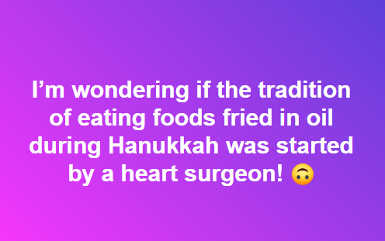
Notes:
Jim Adler

Slide 3
During a special prayer time a leader was laying hands on those in need and praying for them. One man came up and was asked him what he needed prayer for. He said for his hearing. Immediately the preacher spit on his fingers,

Slide 4
put them in the man’s ears and began shouting prayers for healing. He asked him, “How’s your hearing?”
The man said, “I don’t know. It’s not until next Tuesday.”

Slide 5
table sugar = sucrose
= C₁₂H₂₂O₁₁

Slide 6
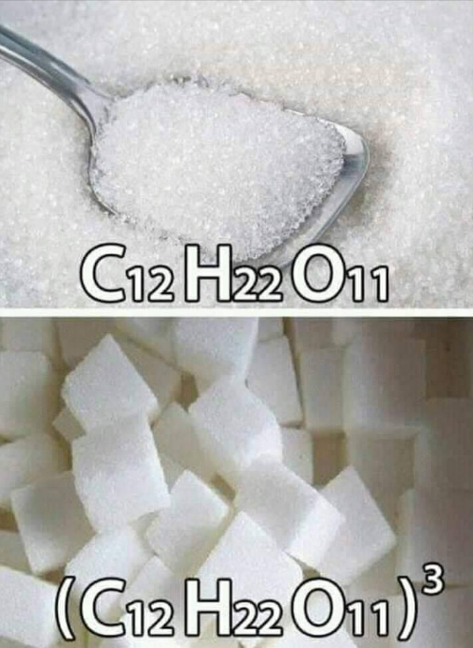
Notes:
Sugar.
But, do you know what this is….?

Slide 7
Notes:
cubed
From Andrea Robinson.

Slide 8
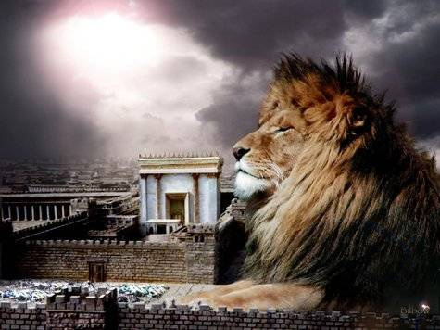
מַתִּתְיָהוּ Mattityahu
(Matthew) 25:31-33
Notes:
Last week about unfaithful servant who justified his unfaithfulness by believing lies…about his Master.
Do we believe lies about G-d, about people, about ourselves?
This week: criteria by which we are judged: sheep or goats.

Slide 9
Mattityahu (Matthew) 25:31
”כַּאֲשֶׁר יָבוֹא בֶּן־הָאָדָם בִּכְבוֹדוֹ וְכָל הַמַּלְאָכִים אִתּוֹ,
“When the Son of Man comes in his glory, accompanied by all the angels,
Son of man?

Slide 10
The idiom is thoroughly Hebraic and has no counterpart in Greek culture. The "Son of Man" is a Messianic title that refers to the supra-natural figure from heaven who establishes a kingdom on the earth.
Notes:
http://www.blainerobison.com/bible2-matt/mattnotes25.htm

Slide 11
^{Dan 7:13-14} “I kept watching the night visions, when I saw, coming with the clouds of heaven, someone like a son of man. He approached the Ancient One and was led into his presence. To him was given rulership,
Notes:
http://www.blainerobison.com/bible2-matt/mattnotes25.htm

Slide 12
^{Dan 7:13-14} glory and a kingdom, so that all peoples, nations and languages should serve him. His rulership is an eternal rulership that will not pass away; and his kingdom is one that will never be destroyed.
Notes:
http://www.blainerobison.com/bible2-matt/mattnotes25.htm

Slide 14
David Flusser, Orthodox Jewish scholar and professor at Hebrew University, explains,
For first-century Jews the "Son of Man" is Daniel's divine redeemer in human form.
Notes:
http://www.blainerobison.com/bible2-matt/mattnotes25.htm

Slide 15
^{Flusser:} “In all of the sources, the one resembling a man is portrayed in a consistent manner. The Son of Man has a superhuman, heavenly sublimity. He is the cosmic judge at the end of time. Sitting upon the throne of God, judging the entire human race with the aid of the heavenly hosts, he will consign
Notes:
http://www.blainerobison.com/bible2-matt/mattnotes25.htm

Slide 16
^{Flusser:} the just to blessedness and the wicked to the pit of hell. Frequently he is identified with the Messiah, but he can also be identified with Enoch, who was taken up into heaven.”
Notes:
http://www.blainerobison.com/bible2-matt/mattnotes25.htm

Slide 17
Mattityahu (Matthew) 25:31
יֵשֵׁב עַל כִּסֵּא כְּבוֹדוֹ
He will sit on his glorious throne.
Notes:
Ex 19.6 Israel is called “goy kadosh”

Slide 18
then He will sit: Grk. kathizō, to take a seated position in order to assume a position of authority. on His glorious throne: This throne corresponds to the "judgment seat of the Messiah" ^{(2Cor 5:10)} before which "we" must all stand.

Slide 19
Mattityahu (Matthew) 25:31
וְיֵאָסְפוּ לְפָנָיו כָּל הַגּוֹיִים.
All the nations will be assembled before Him,
Ethnos, goyim, neutral terms. Jews and all the other nations.
Notes:
Ex 19.6 Israel is called “goy kadosh”
Overwhelms the imagination. All the billions. 7,670,027,111 at 11:28 p.m. Thursday, Dec. 13, 2018. Quite the sound system!

Slide 21
Mattityahu (Matthew) 25:32
אָז יַפְרִידֵם זֶה מִזֶּה כְּרוֹעֶה הַמַּפְרִיד אֶת הַכְּבָשִׂים מִן הָעִזִּים
and he will separate people one from another as a shepherd separates sheep from goats.

Slide 22
Mattityahu (Matthew) 25:33
ה וְיַצִּיב אֶת הַכְּבָשִׂים לִימִינוֹ וְאֶת הָעִזִּים לִשְׂמֹאלוֹ.
“The sheep he will place at his right hand and the goats at his left.”
Right and left??
Notes:
^{Kohelet 10.2} The heart of the wise is to his right, and the heart of the fool is to his left.

Slide 23
^{1 K 2.19} So Bat-Sheva went to King Shlomo to speak to him on behalf of Adoniyah. The king rose to meet her and bowed down to her. Then he sat down on his throne and had a throne set up for the king’s mother, so that she sat at his right.

Slide 24
^{T’hillilm/Ps 110.1} Adoni says to my Lord, “Sit at my right hand,
until I make your enemies a footstool for your feet.”
^{T’hillilm/Ps 45.9} Daughters of kings are among your favorites;
at your right stands the queen in gold from Ofir.
Notes:
One of the most quoted vss in the Tanakh: 4x
cf. Matt. 22:44; Acts 2:34-35; 1 Cor. 15:25; Heb. 1:13

Slide 25
^{Ykhez/Ezek 34.17} ‘As for you, my flock,’ Adoni Elohim says this: ‘I will judge between sheep and other sheep, between rams and billy-goats.
Why sheep and goat imagery?

Slide 26
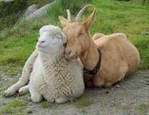
Notes:
http://www.sheep101.info/sheepandgoats.html

Slide 27
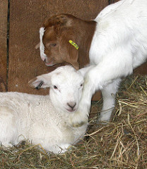
A lamb and
a goat.

Slide 28
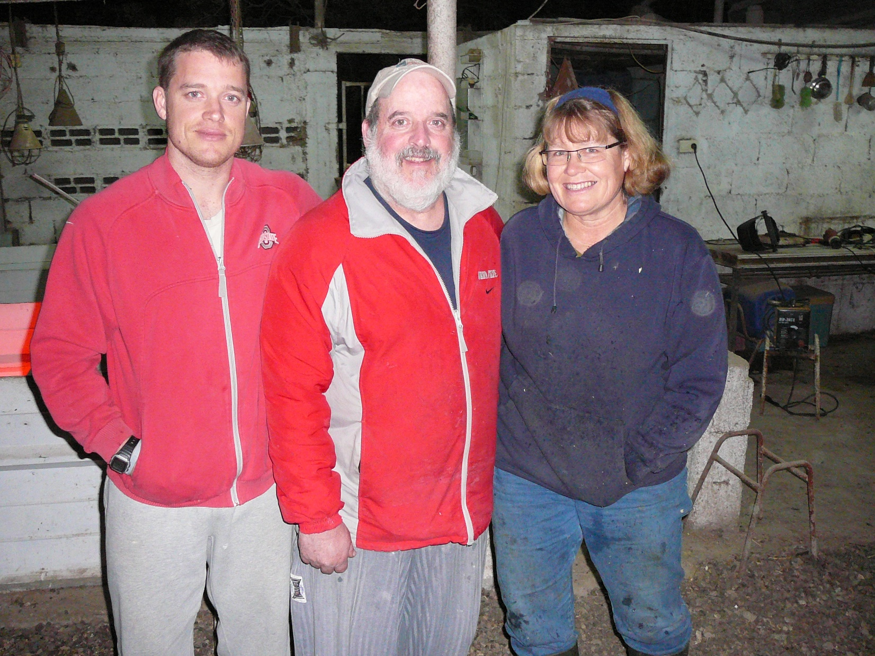
Ellis family goat farmers in
Tsippori, N. Israel
Notes:
Boaz Ellis was part of Or HaOlam for a while, when he worked for Cerner. Olympic class fencer.

Slide 29
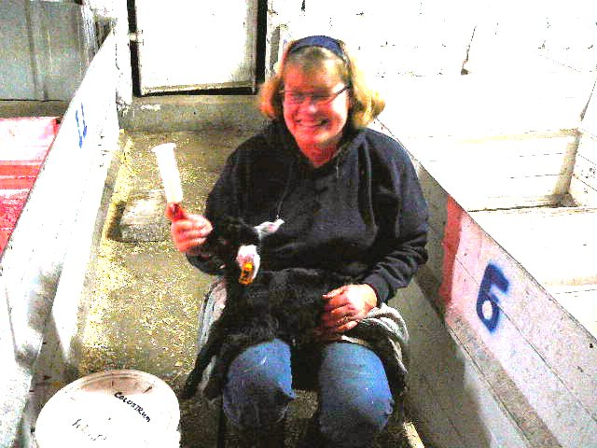
Notes:
Adi Ellis goat farm in Tsipori

Slide 30
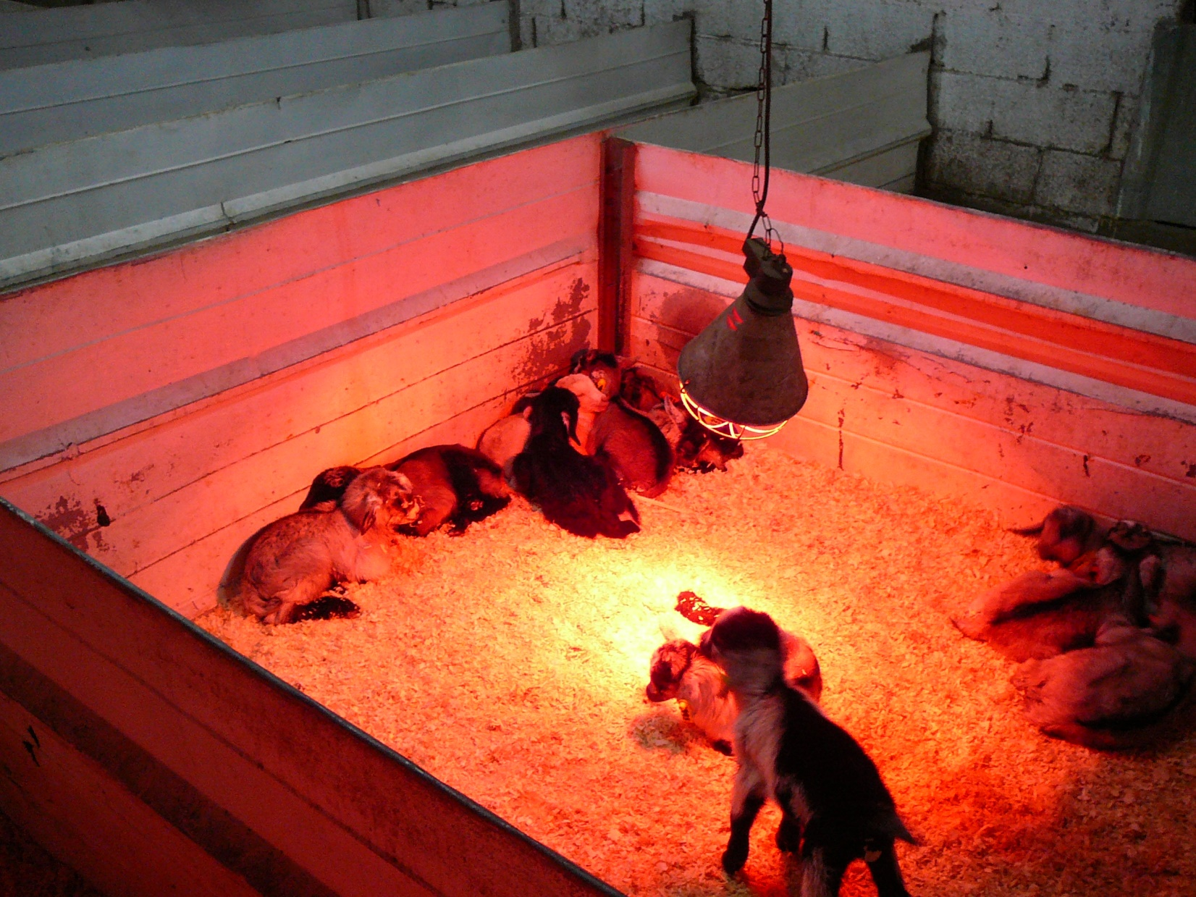

Slide 31
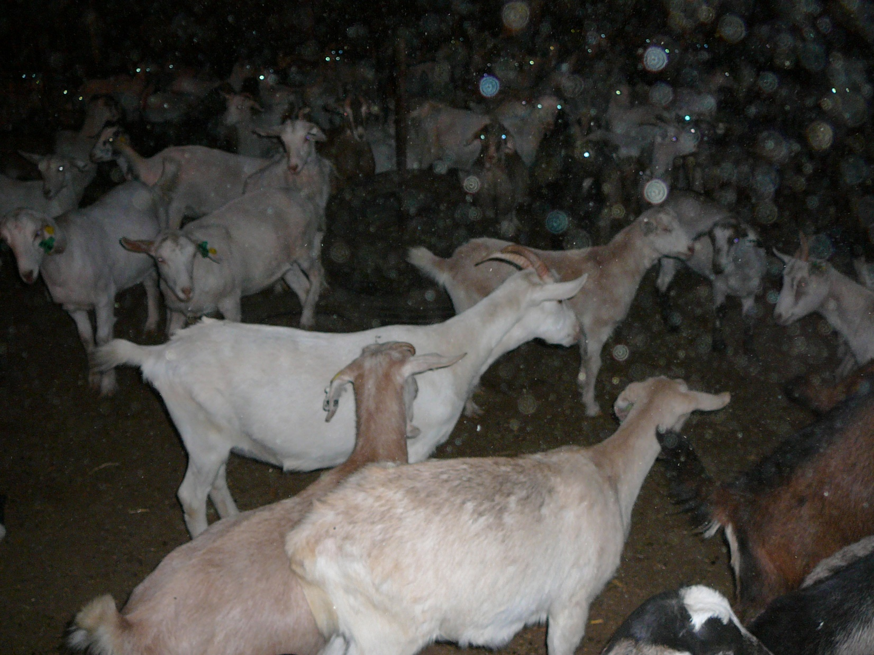
Notes:
goat farm in Tsipori

Slide 32
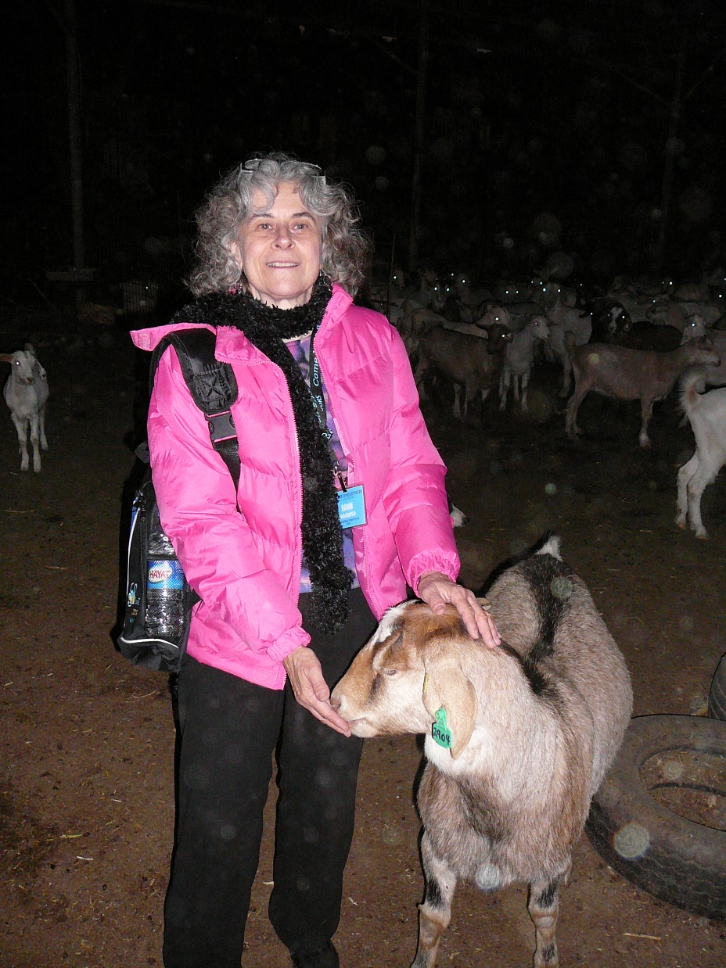

Slide 33
Each is a distinct species and genus. Sheep have 54 chromosomes, while goats have 60.
Notes:
http://www.sheep101.info/sheepandgoats.html
Humans have 23.

Slide 34
Most goats are naturally horned. Some goats have beards. Many breeds of sheep are naturally hornless (polled).
Notes:
http://www.sheep101.info/sheepandgoats.html
My cousin Lowell had a goat that just suddenly butted us, when we were petting it.
Are you a sheep or a goat? Lash out?

Slide 35
A goat's tail goes up (unless it is sick, frightened, or in distress). Sheep tails hang down.
Notes:
http://www.sheep101.info/sheepandgoats.html

Slide 36
Goats are naturally curious and independent, while sheep tend to be more distant and aloof. Sheep have a stronger flocking instinct and become very agitated if they are separated from the rest of the flock. It is easier to keep sheep inside a fence than goats.
Notes:
http://www.sheep101.info/sheepandgoats.html
Are we family loyal, or aloof? Time for solitude is real, but isolation?

Slide 37
Sheep are grazers, preferring to eat short, tender grasses and clover. Their dietary preference is broadleaf weeds, and they like to graze close to the soil surface
Notes:
http://www.sheep101.info/sheepandgoats.html

Slide 38
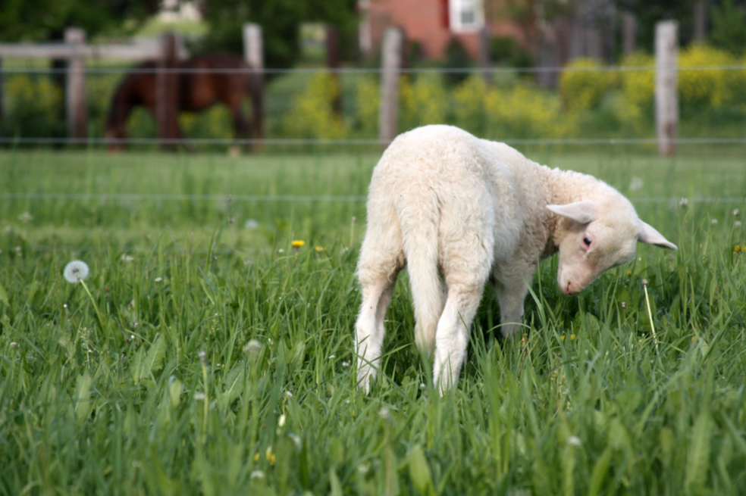
A sheep grazing.
Notes:
https://www.flickr.com/photos/baalands/2454731081/

Slide 39
Goats are natural browsers, preferring to eat leaves, twigs, vines, and shrubs. They are very agile and will stand on their hind legs to reach vegetation
Notes:
http://www.sheep101.info/sheepandgoats.html

Slide 40
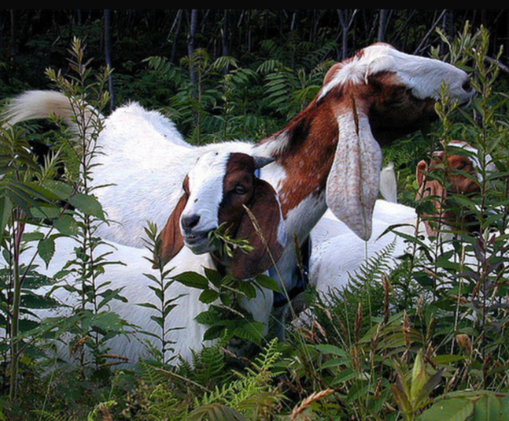
Goats browsing
Notes:
https://www.flickr.com/photos/baalands/406356266/in/photostream/

Slide 41
Most goats have hair coats that do not require shearing or combing. Most sheep grow woolly coats that need to be sheared at least annually.
Notes:
http://www.sheep101.info/sheepandgoats.html
Useful, even in relatively minor things.

Slide 42
Sheep are gentle, quiet, innocent animals. They do not give their shepherds a lot of problems. They are easily led. Sheep are grazers, unlike the goat, which likes to browse. Goats are rebellious. In the Bible, goats are sometimes used to symbolize evil.
Notes:
http://www.sheep101.info/sheepbible.html

Slide 43
Mattityahu (Matthew) 25:33
ה וְיַצִּיב אֶת הַכְּבָשִׂים לִימִינוֹ וְאֶת הָעִזִּים לִשְׂמֹאלוֹ.
“The sheep he will place at his right hand and the goats at his left.”
Notes:
^{Kohelet 10.2} The heart of the wise is to his right, and the heart of the fool is to his left.

Slide 44
Yeshua’s explanation of what qualifies a person to be considered as sheep-like and goat-like…
The narrative changes the title of the Judge from heavenly "Son of Man" to "King."
Notes:
http://www.blainerobison.com/bible2-matt/mattnotes25.htm

Slide 45
^{Mattityahu (Matthew) 25:34-40} Then the King will say to those on His right, ‘Come, you who are blessed by My Father, inherit the kingdom prepared for you from the foundation of the world. For I was hungry and you gave Me something to eat;

Slide 46
^{Mattityahu (Matthew) 25:34-40} ₁I was thirsty and you gave Me something to drink; ₂I was a stranger and you invited Me in; ₃I was naked and you clothed Me; ₄I was sick and you visited Me; ₅I was in prison and you came to Me.’…I tell you, whatever you did to one of the least of these My brethren, you did it to Me.’
Notes:
Five points of service in compassion. Sheeplike.
Thirsty
Alienated
Unclothed
Ill health
Jailed
None are admirable, attractive qualities

Slide 47
^{Mattityahu (Matthew) 25:46} These shall go off to everlasting punishment, but the righteous into everlasting life.”
^{Daniel 12.2} Multitudes who sleep in the dust of the earth will awake—some to everlasting life, and others to shame and everlasting contempt.

Slide 48
What is Messiah Yeshua’s qualifier that divides the sheep and the goats here? What distinguishes those welcomed as righteous and those rejected as wicked?

Slide 49
Those who serve the needy,
who serve and bless
the “least of these my brothers.”
Notes:
http://www.blainerobison.com/bible2-matt/mattnotes25.htm
Someone might say, “I thought salvation is by faith alone.”
Consider, “Faith without works is dead.”

Slide 50
^{Proverbs 19:17} One who is kind to the poor lends to Adoni, and Adoni will reward him for his good deed.
^{Isa. 58:7} Share your bread with the hungry…bring the homeless poor into your house…when you see the naked, to cover him.
Who are these “brothers of the King?”

Slide 51
The identification of “these brothers of mine” has five possible meanings
The blood siblings of Yeshua
His native Jewish countrymen. Fits with original calling of Avraham. Mutual blessing.
Notes:
http://www.blainerobison.com/bible2-matt/mattnotes25.htm
Restricted to Yeshua’s day. Too limited
How people treat the Jews?.

Slide 52
^{Ber/Gen 12.2-3} My heart’s desire is to make you into a great nation, to bless you, to make your name great so that you may be a blessing. My desire is to bless those who bless you.
Reciprocal blessing
Jews ⇌ Nations
Notes:
We don’t all need or want to be Jewish.
We all need to be and give blessing. Sheeplike.

Slide 53
The identification of “these brothers of mine” has five possible meanings
Yeshua’s disciples
Jews and Gentiles who believe in Yeshua and are obedient to the will of God
Needy humanity.
Notes:
http://www.blainerobison.com/bible2-matt/mattnotes25.htm
Restricted to Yeshua’s day. Too limited
How people treat believers.
How people treat the needy in general.

Slide 54
Who are the brothers that we are called to serve? Primarily, at Or HaOlam?

Slide 55
The vision of Or HaOlam is to draw Israel, and all Nations, to their covenantal identity in Messiah.
Jewish Yeshua-ish renewal
fulfilling Ro. 11.15 “life from the dead to all the world”

Slide 56
Outreach is Yeshua’s definition of sheep-ness

Slide 57
A leader recently asked me why I thought his congregation was not growing. I asked him what his people did every single week to reach, invite and serve the community. His silence was his own answer. Many of us conservative believers would rather fight each other than fight against the gates of hell.
Notes:
https://www.charismanews.com/marketplace/74349-why-america-s-churches-are-at-a-tipping-point?utm_source=Charisma%20News%20Daily&utm_medium=email&utm_content=subscriber_id:5160390&utm_campaign=CNO%20daily%20-%202018-12-10

Slide 58
Is attendance important?
Book of numbers has lots of numbers.
B’sorot [Gospels] and Acts records numbers.

Slide 59
Our average 2017 was 137
2016 was 142.
2015 was 136.
2014 was 122.
2013 was 133.
2012 was 147
2011 was 155
2010 was 139.
2009 was 119.
2008 was 120.
2007 was 147.
2006 was 163.
Notes:
Many of you were here and saw this.
Meaning? “150 wall?”

Slide 60
Or HaOlam leadership recently considered a building expansion as a way to break the “150 wall.”

Slide 61
“If you build it, they will come.” Really?
A growth study: If you don’t have a certain amount of space, Americans won’t come – 80-85% capacity and people will turn away or not come back.
Notes:
We considered…

Slide 62
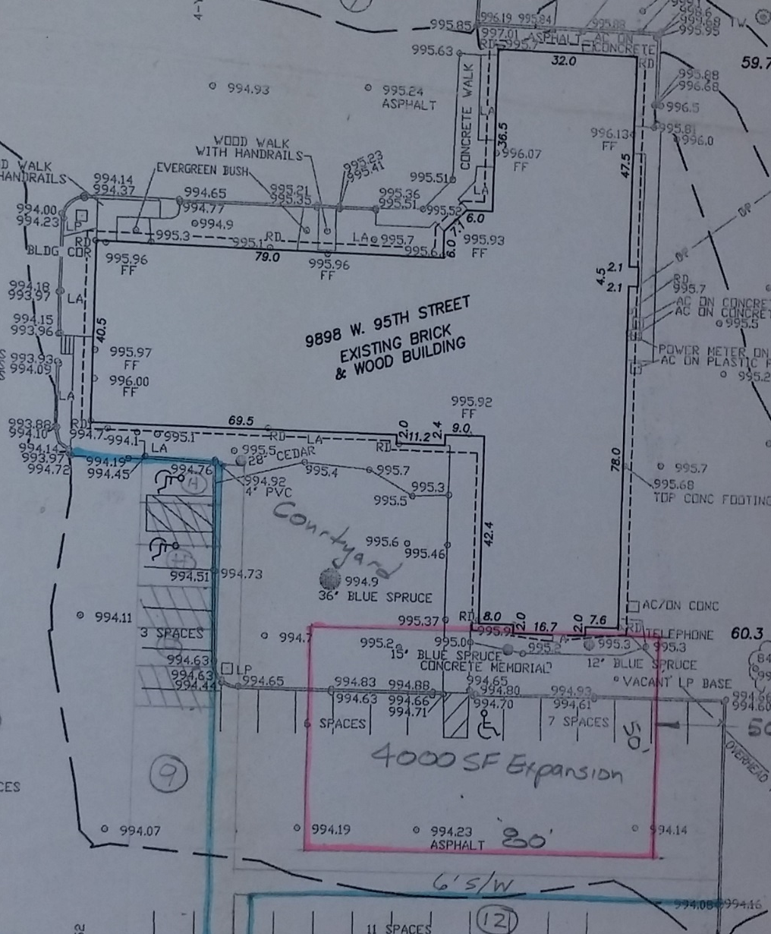
Notes:
50 x 80 addition to the south. Behind where I stand.

Slide 63
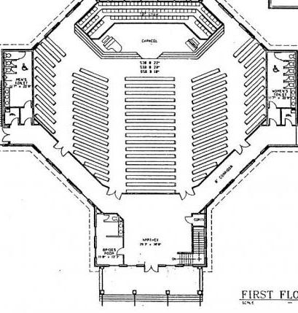
Notes:
Octagonal addition, to the south

Slide 64
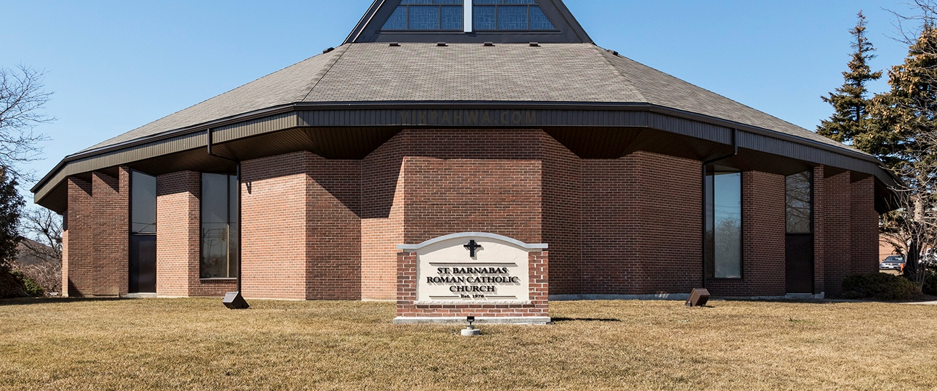
Or HaOlam
אור העילם

Slide 65
Downsides to building expansion
We had thought exposure, Jewish décor, handicap access, would bring growth.
Parking is already limited.
Sukkot takes up more parking.
Future resale of overbuilt lot.
Notes:
So, maybe not. Then what? How to break the 150 wall?

Slide 66
Other growth options:
Two services??
Improve facility: children’s wing
Expand parking. Sometimes FULL currently!!
Serve community.
Pray.
Notes:
In the time that remains, present to you HOW to do these..

Slide 67

Our prototype friend spend 10
years prayer walking an Orthodox
neighborhood

Slide 68
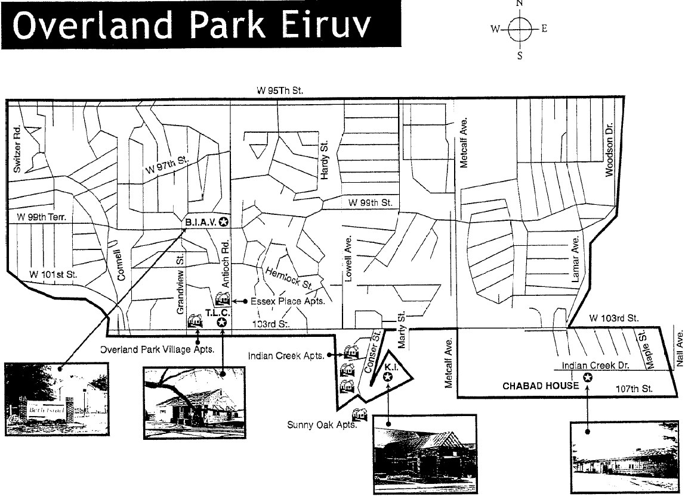

Slide 69
Shalom Shmuel, great talking to you. I also meant to say that on prayer-drives you can do things that you can’t do when walking out in the open without drawing attention to yourself – you can sing, open your Bible and quote Scriptures, and such, even blow the shofar.
Notes:
20 people have signed up.
Have you?

Slide 70
There’s more freedom in the car, especially in winter when no one’s on the street. I pray the Lord will guide and give you MUCH fruit in a much SHORTER time than I had to wait.
Blessings and Love in Yeshua, xxx
Notes:
Some Eruvim…

Slide 71
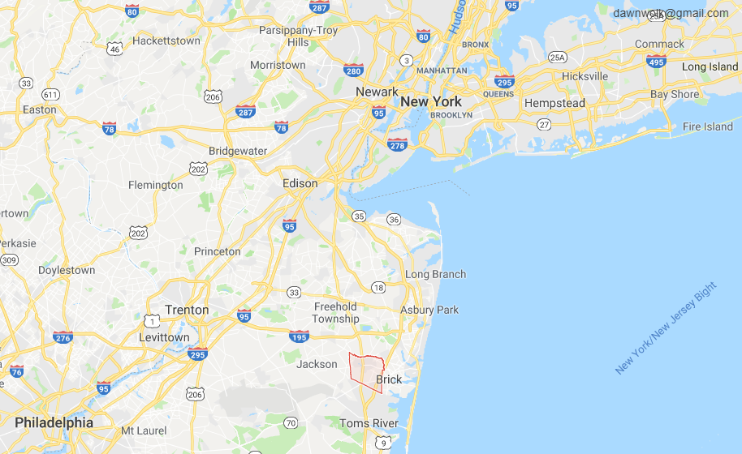
E. Lakewood

Slide 72
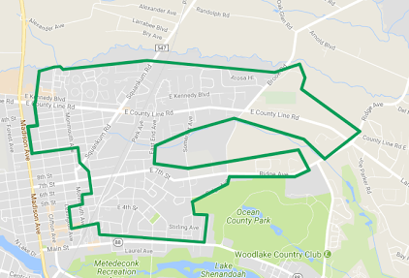
Eruv Map for East Lakewood, NJ
Notes:
http://hefkervelt.blogspot.com/2018/02/interactive-eruv-map-for-east-lakewood.html

Slide 73
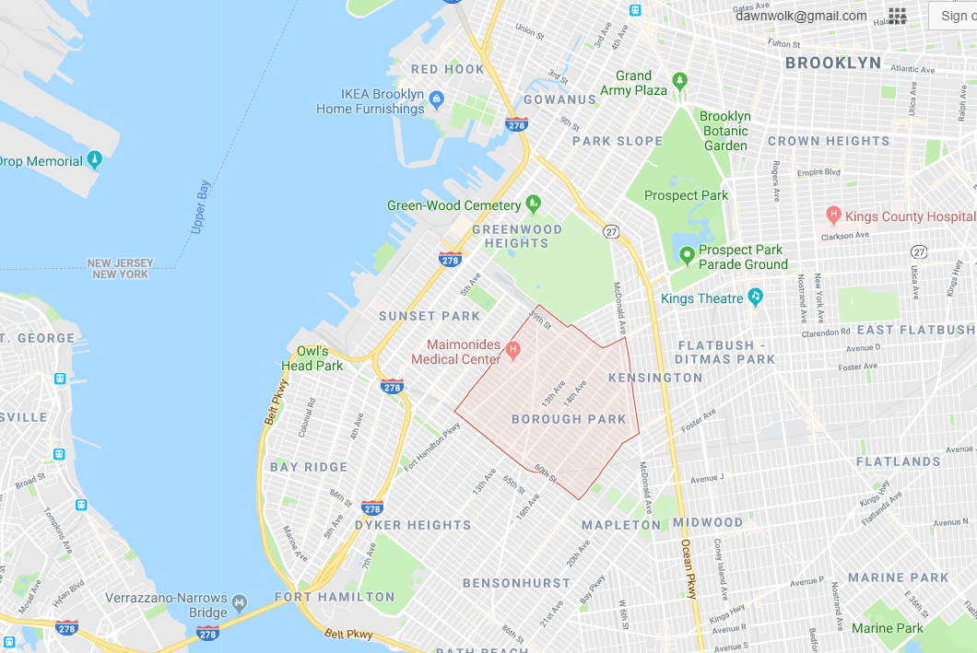
Notes:
See where the two streets cross and there is a hospital to the northwest of the intersection?

Slide 74
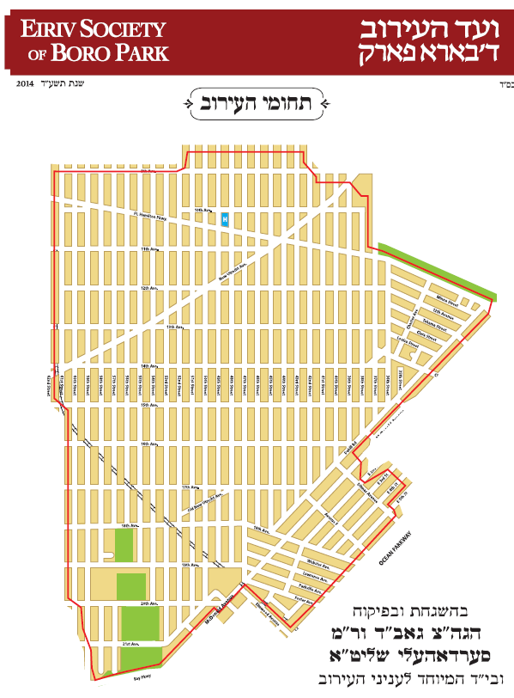

Slide 75
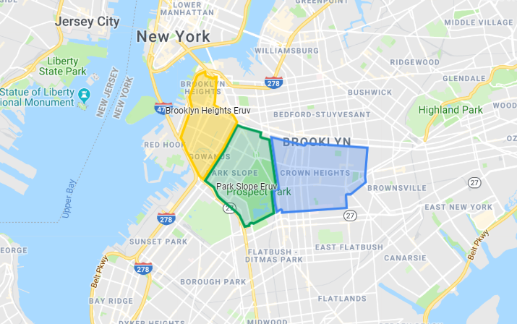

Slide 76
Other opportunities,
follow up to prayer,
for growth,
for outreach,
for sheep-ness

Slide 77
Upgrade children’s classroom.
Expand parking.
Pay down and retire the mortgage, currently $449,789, down from $520,000 in July, 2016. How does that serve the community? Frees us up for everything else!!

Slide 78
  1. Children’s wing concerns:
    Window AC noisy and not that effective. Need central air. Furnace in west wing ancient.
    New doors in W wing.
    Split Nursery door
    Better sound barrier room dividers

Slide 79

2. Parking lot
expansion.

Slide 80
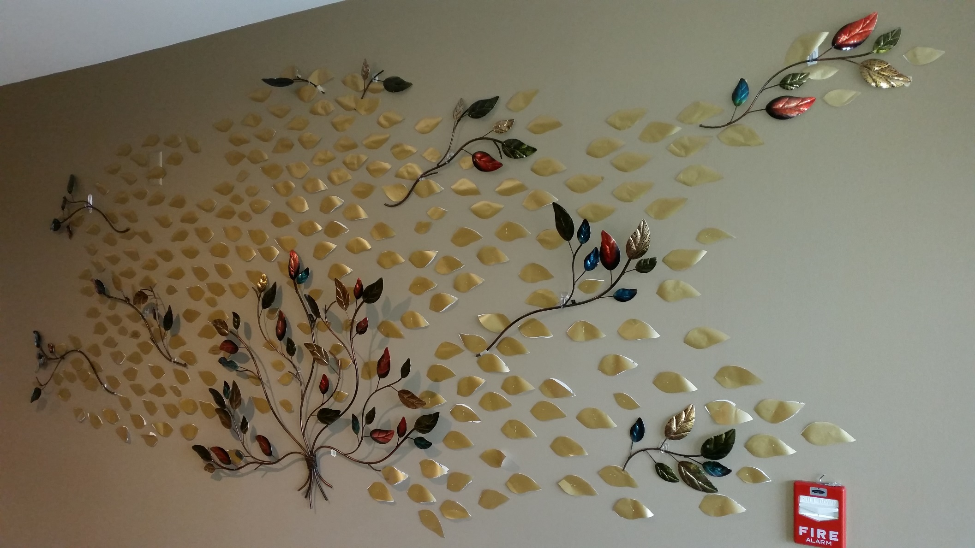
Mortgage retirement donor tree

Slide 81
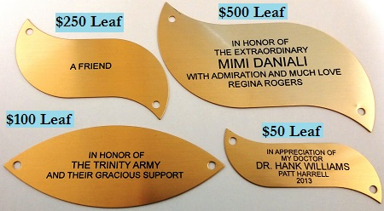

Slide 82
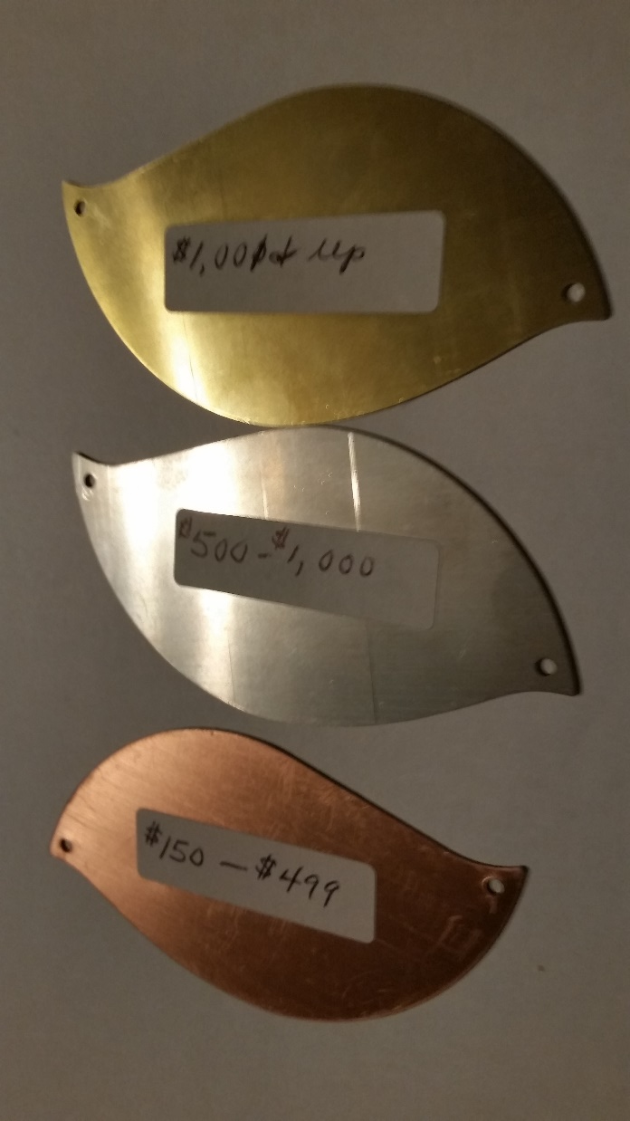
Bronze $250-$499
Silver $500-$999
Gold $1000 and up

Slide 83
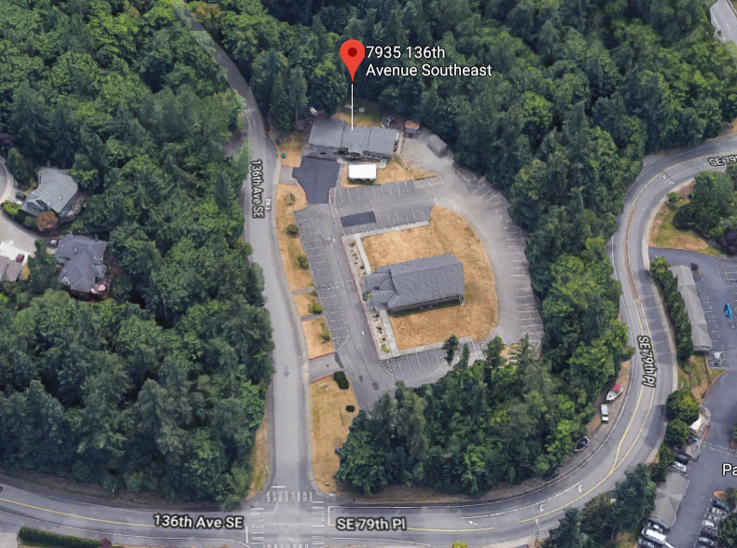
Beit Tikvah Messianic Congregation
Newcastle,
WA
beittikvah.us/

Slide 84
Oureach strategies from Rabbi Hylan Slobodkin, Beit Tikvah Messianic Cong., Newcastle, WA [suburb of Seattle] beittikvah.us/
We bought an ad in our local paper for years.
We are on a semi-major road, so our sign gets lots of drive-by attention.

Slide 85
We also have city signs on the road with arrows pointing to turn at the next intersection.
I have a radio show that airs two to three times a week and has the potential to reach 50,000 homes, vehicles, radios, etc.

Slide 86
We encourage our people to participate in events at the JCC for Yom HaShoah, Purim, etc. We are involved with the local Holocaust Center for Humanity in Seattle.
We have an annual food drive for Jewish Family Services.

Slide 87
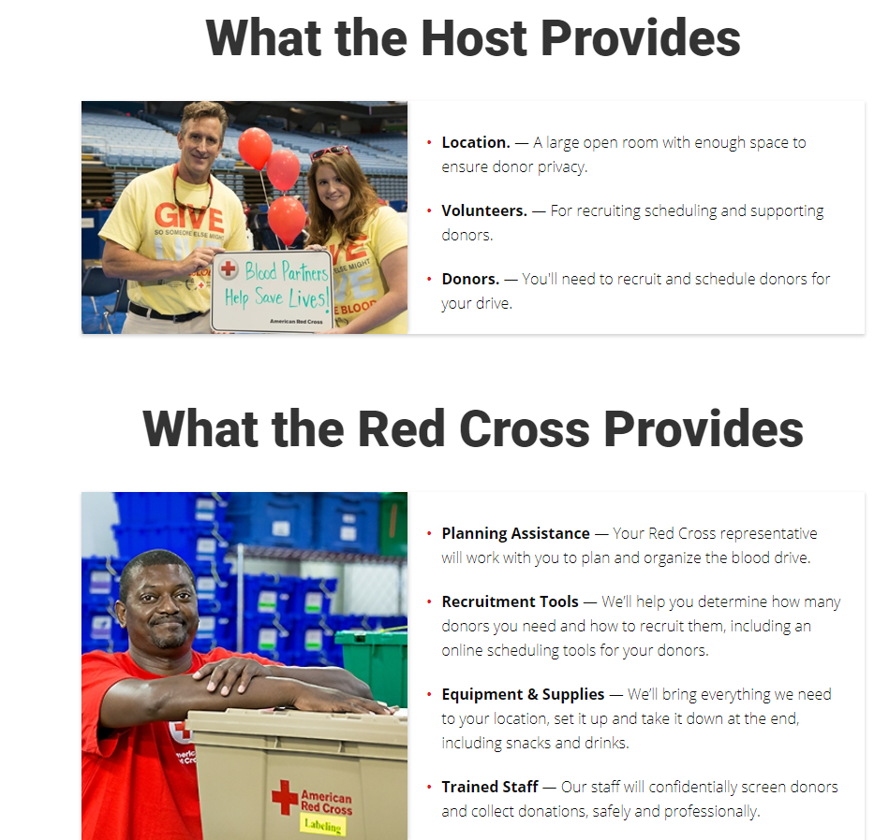
6.5 We could host a Blood Drive

Slide 89
We update our website all the time and people find us online. We average 5-10 visitors every week.
Twice a year we offer a Getting To Know You luncheon where we invite all those who filled out visitor slips to a catered lunch where we explain our vision, mission, history, identity and destiny. We average 15-20 each time.

Slide 90
We do an annual concert in the park where we have a congregational picnic and our worship team performs on the big stage (we rent a professional sound system) and do some local advertising.
We printed beautiful, full-color welcome cards that we pass out at these community events.

Slide 91
I occasionally preach in churches, since I’m free on Sundays, which attracts those wishing to learn more about their Jewish roots.
We are members of the Newcastle Chamber of Commerce, and I attend the monthly luncheons and special meetings affecting our community.

Slide 92
We let local groups use our parking lot, which fosters good will.
We are also on the City of Newcastle list of emergency shelters. We support numerous local homeless ministries, which in turn tell their “clients” about us.

Slide 93
We print thousands of Invitation Cards and make them available in our foyer for our people to take and pass out wherever they go.
We have volunteered in the local elementary school in August to help teachers prepare their classrooms for the fall semester. https://www.citywideprayerkc.com/index.php?option=com_content&view=article&id=83&Itemid=480

Slide 94
Sheep-ness Summary:
Pray [Eruv]
Give
Serve

Slide 95
^{Mattityahu (Matthew) 25:34-40} Then the King will say to those on His right, ‘Come, you who are blessed by My Father, inherit the kingdom prepared for you from the foundation of the world. For I was hungry and you gave Me something to eat;

Slide 96
^{Mattityahu (Matthew) 25:34-40} ₁I was thirsty and you gave Me something to drink; ₂I was a stranger and you invited Me in; ₃I was naked and you clothed Me; ₄I was sick and you visited Me; ₅I was in prison and you came to Me.’…I tell you, whatever you did to one of the least of these My brethren, you did it to Me.’

