Slide 1
e-handout
To have these notes
without taking notes
Go to OrHaOlam.com
Click on downloads,
messages, 2018
Notes:
.

Slide 2
Some remarkable
Hanukkah menorahs, Hanukkiahs

Slide 3
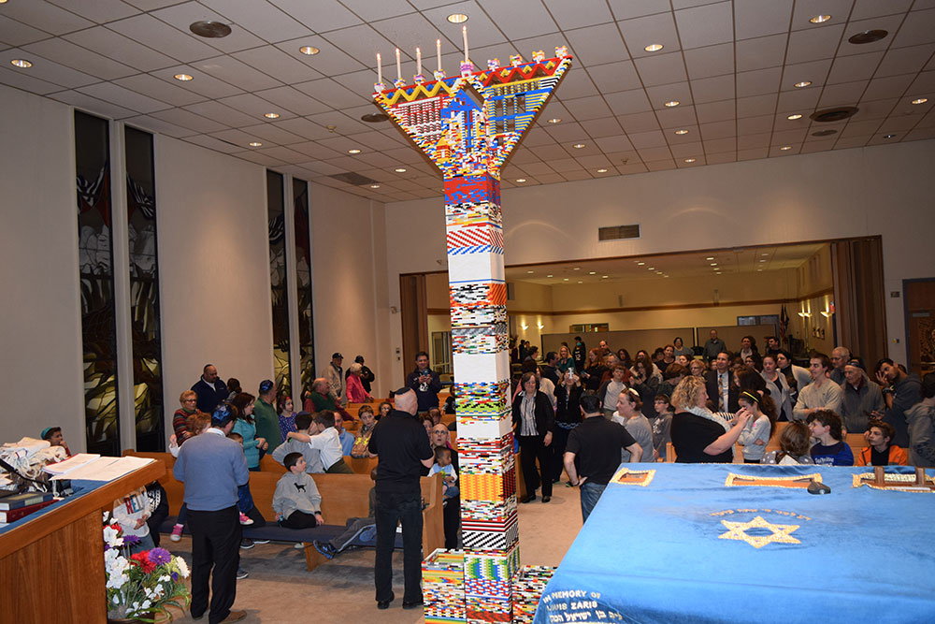
16 feet 3 inches
made with
almost 50,000
[lego] plastic bricks

Slide 4
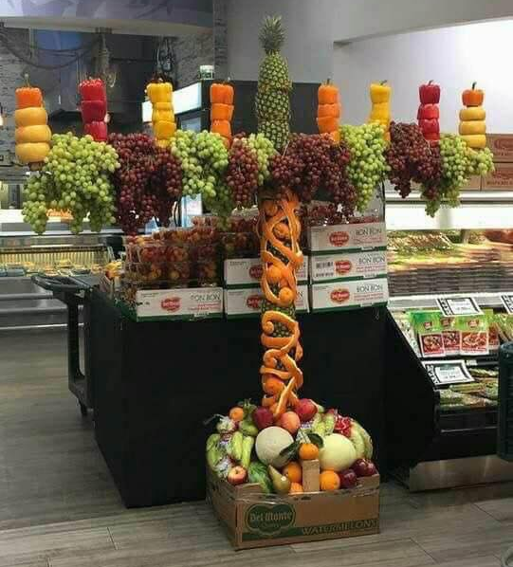
Edible
Menorah

Slide 5
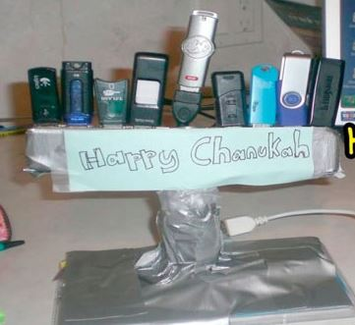
Those old
cell
phones!

Slide 6
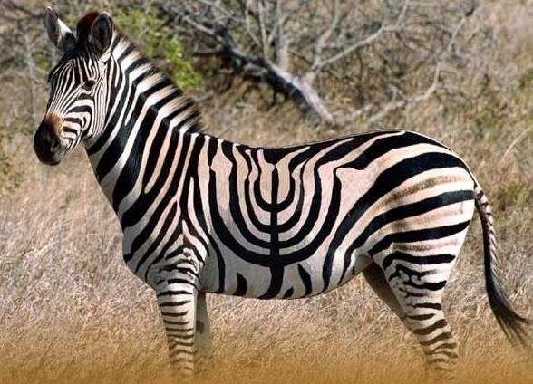
Bred in Israel

Slide 7
Israel news

Slide 8
The IDF has exposed a new and immediate threat to Israel’s security: heavily fortified attack tunnels breaching into Israel, built by Hezbollah in Lebanon.
Notes:
Brian Shankman Director of Regional Affairs and Development P: 202-639-5200 membership@aipac.org

Slide 9
Even more advanced than those built by Hamas under Gaza, these tunnels pose a new danger to Israeli citizens. The IDF believes Hezbollah’s tunnels could be used in conjunction with its massive missile arsenal to overwhelm Israeli defenses and inflict major damage in a future war.
Notes:
Brian Shankman Director of Regional Affairs and Development P: 202-639-5200 membership@aipac.org
Hassan Nasrallah said that he had a plan to conquer the Galil. Missile barrage plus elite troops infiltrating.

Slide 10
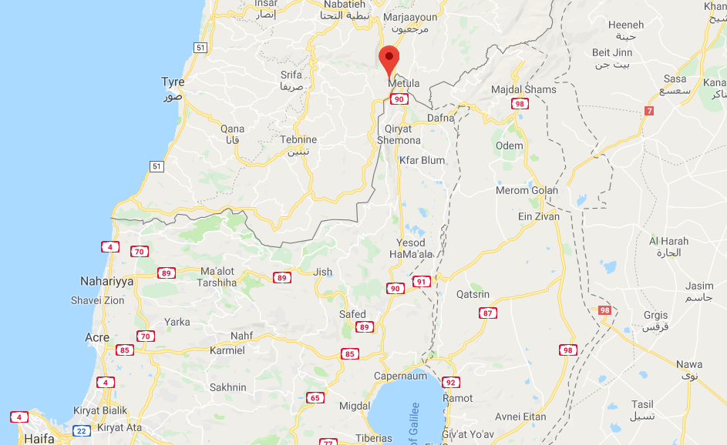
Kfar Kila

Slide 11
Overnight, the IDF launched ‘Operation Northern Shield' to protect Israeli citizens from this threat. This morning, the first Hezbollah tunnel was exposed – built more than 80 feet underground, dug directly beneath a home in the Lebanese village of Kafr Kela, and 40 yards into Israel near the city of Metulla (population of 1,600).
Notes:
Brian Shankman Director of Regional Affairs and Development P: 202-639-5200 membership@aipac.org

Slide 12
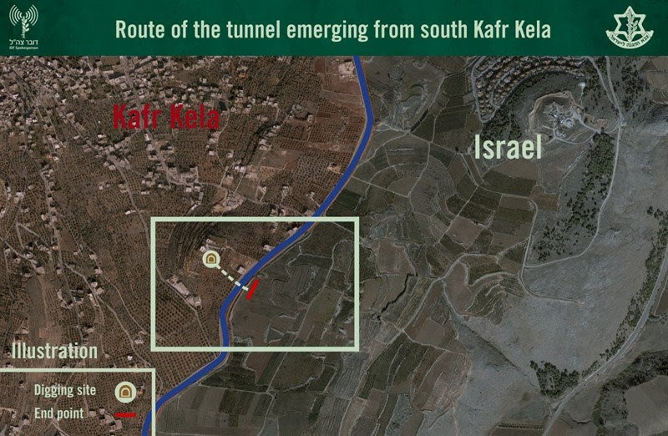

Slide 13

Hezbulloh tunnel workers

Slide 14
United Nations
news

Slide 15
Last Friday, Nov. 30, 2018, the United Nations General Assembly convened and passed 6 anti-Israel resolutions.
Notes:
https://blessedbuyisrael.com/blogs/news/the-united-nations-hanukkah-gift-to-israel?mc_cid=0483244cb1&mc_eid=1221f9360d

Slide 16
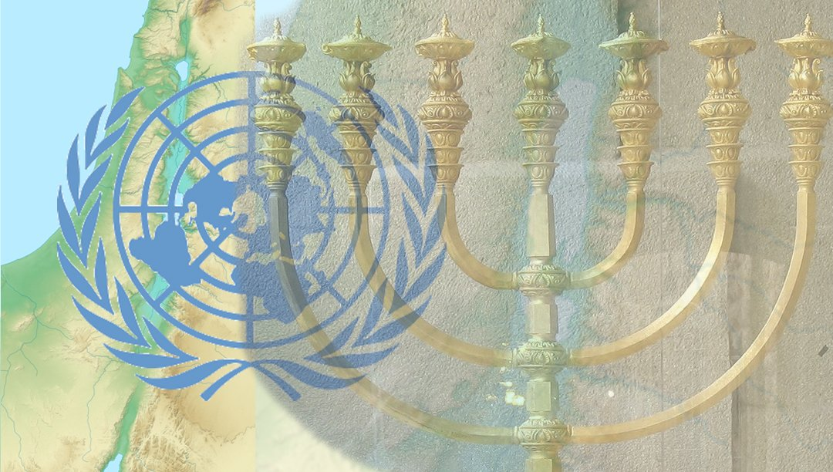

Slide 17
The Jerusalem resolution, “Implies that Israeli administration of Jerusalem hinders freedom of religion”
The truth is that Israel guarantees freedom of religion in all places that it controls. It is only on the Temple Mount,
Notes:
https://blessedbuyisrael.com/blogs/news/the-united-nations-hanukkah-gift-to-israel?mc_cid=0483244cb1&mc_eid=1221f9360d

Slide 18
which is under Waqf Muslim control – which the resolution refers to using only the Islamic term Haram al-Sharif – that freedom of religion is restricted.
Notes:
https://blessedbuyisrael.com/blogs/news/the-united-nations-hanukkah-gift-to-israel?mc_cid=0483244cb1&mc_eid=1221f9360d

Slide 19
The Golan resolution expressed “[Deep Concern] that Israel has not withdrawn from the Syrian Golan, which has been under occupation since 1967…” It ignores Israel’s legal right to the land, as well as the security situation and the massacres currently taking place in Syria.
Notes:
https://blessedbuyisrael.com/blogs/news/the-united-nations-hanukkah-gift-to-israel?mc_cid=0483244cb1&mc_eid=1221f9360d
When the Syrians held the Golan, they shelled Israeli settlements regularly. Kids in those kibbutzim went to bed in bomb shelters nightly. Six day war kibbutz farmers: this has to stop or we will all move to Tel Aviv.

Slide 20
Vote to consider Hamas a terrorist organization
In the end, the vote on the resolution to condemn Hamas was 87 in favor against 57 opposed, with 33 abstentions — a plurality but below the two-thirds requirement to adopt it.

Slide 21
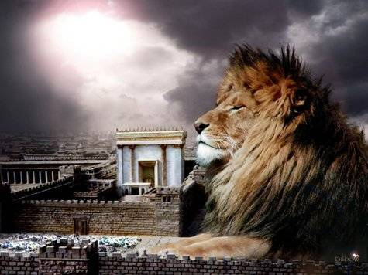
מַתִּתְיָהוּ Mattityahu
(Matthew) 25:24-26
Notes:
Last time in this series: two weeks ago, Two criteria for reward:
Good & faithful
Commitment to vision
Gratitude & Joy in the pursuit
Task joy, relational joy
Today, the other side…

Slide 22
Mattityahu (Matthew) 25:24
נִגַּשׁ גַּם זֶה שֶׁקִּבֵּל כִּכָּר אַחַת וְאָמַר, ’אֲדוֹנִי, יָדַעְתִּי שֶׁאַתָּה אִישׁ קָשֶׁה,
“Now the one who had received one talent came forward and said, ‘I knew you were a hard man.

Slide 23
Mattityahu (Matthew) 25:24
הַקּוֹצֵר בְּמָקוֹם שֶׁלֹּא זָרַעְתָּ וְאוֹסֵף בְּמָקוֹם שֶׁלֹּא פִּזַּרְתָּ,
You harvest where you didn’t plant and gather where you didn’t sow seed.

Slide 24
Mattityahu (Matthew) 25:25
וּמֵאַחַר שֶׁפָּחַדְתִּי הָלַכְתִּי וְהִטְמַנְתִּי אֶת כִּכָּרְךָ בָּאֲדָמָה. הִנֵּהִי אֲשֶׁר לְךָ!‘
“I was afraid, so I went and hid your talent in the ground. Here! Take what belongs to you!’

Slide 25
Mattityahu (Matthew) 25:26
הֵשִׁיב אֲדוֹנָיו וְאָמַר אֵלָיו, ’עֶבֶד רַע וְעָצֵל!
“‘You wicked, lazy servant!’ said his master,
רַע bad, nasty ; malicious ; negative, wrong
Notes:
His only sin was inaction, inoffensiveness, harmlessness. “I didn’t hurt anyone.”
Yeshua did not think that passivity was an acceptable neutrality.

Slide 26
πονηρέ (ponēre) evil, bad, wicked, malicious, slothful

Slide 27
Mattityahu (Matthew) 25:26
יָדַעְתָּ שֶׁאֲנִי קוֹצֵר בְּמָקוֹם שֶׁלֹּא זָרַעְתִּי וְאוֹסֵף בְּמָקוֹם שֶׁלֹּא פִּזַּרְתִּי,
‘So you knew, did you, that I harvest where I haven’t planted? and that I gather where I didn’t sow seed?”

Slide 28
^{Mattityahu (Matthew) 25:27-30} Then you should have deposited my money with the bankers, so that when I returned, I would at least have gotten back interest with my capital!
Notes:
That is, “You are inconsistent. If you knew I was that demanding, you should have been all the more diligent!”
Moreover, interest was considered unethical. Farmers would sometimes need to borrow seed money to plant. A radical statement by the Master.

Slide 29
Shmot / Ex 22.24.If you lend money to any of My people, to the poor among you, you are not to act like a debt collector with him, and you are not to charge him interest:
לֹא-תְשִׂימוּן עָלָיו נֶשֶׁךְ.
Notes:
https://www.biblestudytools.com/commentaries/gills-exposition-of-the-bible/exodus-22-25.html

Slide 30
It is in the plural, number, and Ibn Ezra observes, that the lender, scribe, and witness, all transgress this law; that is, when a man lends money on interest, and a bond is made by the scribe for it, and this signed by witnesses, all are guilty of the breach of it:
Notes:
https://www.biblestudytools.com/commentaries/gills-exposition-of-the-bible/exodus-22-25.html

Slide 31
^{T’hillim/Ps 15.5} …who lends his money without interest, and takes no bribe against the innocent. One who does these things will never be shaken.

Slide 32
^{Dvarim 23.20} To an outsider you may lend at interest, but to your brother you are not to lend at interest, so that ADONI your God will prosper you in everything you set out to do in the land you are entering in order to take possession of it.
Notes:
Not saying that this was fair, but it was just for that culture to treat foreign nationals differently.

Slide 33
^{Mattityahu (Matthew) 25:27-30} Take the talent from him and give it to the one who has ten. For everyone who has something will be given more, so that he will have more than enough; but from anyone who has nothing,

Slide 34
^{Mattityahu (Matthew) 25:27-30} even what he does have will be taken away. As for this worthless servant, throw him out in the dark, where people will wail and grind their teeth!’
Notes:
Passivity in the Kingdom has the ultimate punishment!

Slide 35
What inhibited, intimidated the $1 million [1 talent ] man from venturing, investing, entrepreneurship?
What he believed about his master: “I knew you were a hard man. You harvest where you didn’t plant and gather where you didn’t sow seed.”
Notes:
But, did he really Know the Master?

Slide 36
He believed a lie and it affected his life actions.
Ever happen to us?
Believing lies is the essence of sin.
^{Ber 3.5} “God knows that on the day you eat from it, your eyes will be opened, and you will be like God, knowing good and evil.”
Notes:
Mother Havah / Eve and Adam believed the Enemy’s accusation of G-d, and disobeyed.
We have all this fallen world’s chaos from that choice to believe a lie.

Slide 37
The one talent servant pretends he knew the master; but if he had, he would have had a true affection for him, faith in him, and would have observed his commands; and he would also have appeared altogether lovely to him, and of an amiable character, and not in such a light as he represents him;
Notes:
https://www.biblestudytools.com/commentaries/gills-exposition-of-the-bible/matthew-25-24.html

Slide 38
Messiah’s true character; who accepts of the meanest services of his people: and takes what is done, though ever so little, as even a cup of cold water, given to the least of his disciples, as done to himself;
Notes:
https://www.biblestudytools.com/commentaries/gills-exposition-of-the-bible/matthew-25-24.html

Slide 39
Rather, the one talent / $1 million man viewed his Master like the Egyptian task masters, who demanded the full tally of bricks, but gave no straw.
Notes:
https://www.biblestudytools.com/commentaries/gills-exposition-of-the-bible/matthew-25-24.html

Slide 40
He believed a falsehood, a fallacy, an error about his Master.
Do we ever do that?
Four components of Restoring the Foundations that we recently had here Nov. 10-11, 2018

Slide 41
Sins of the fathers: epigenetics
Ungodly beliefs UGBs
Soul spirit hurts
Demonic Oppression
examples
Notes:
2. So, we can blame G-d for our sins, כי our disadvantages.
Examples pp 126-129 Biblical Healing and Deliverance Chester & Betsy Kylstra https://www.restoringthefoundations.org/
http://www.heritagehouseministries.com/

Slide 42
Beliefs determine perceptions, opinions, actions, character, destiny.
Mishei/Prov 23.7
כִּי כְּמוֹ שָׁעַר בְּנַפְשׁוֹ – כֶּן הוּא
For as he thinks within himself, [literally: as he opens the gates of this soul]
so is he.

Slide 43
Steps to deliverance [Just to give you a taste, you really need the weekend]
I choose to submit to the process of being transformed in this issue of ______.
I ask for grace to work in me.

Slide 44
3. I declare, by the blood atonement of Yeshua, that I am changed, redeemed.
4. I confess my sin of believing the lie of ______
5. I forgive those who contributed to this UGB.

Slide 45
6. I choose to forgive myself for...
7. I choose to accept, BELIEVE Godly Beliefs that ____
Notes:
Tim story p 104-105 Kylstra

Slide 46
Our beliefs about our Master,
about G-d

Slide 47
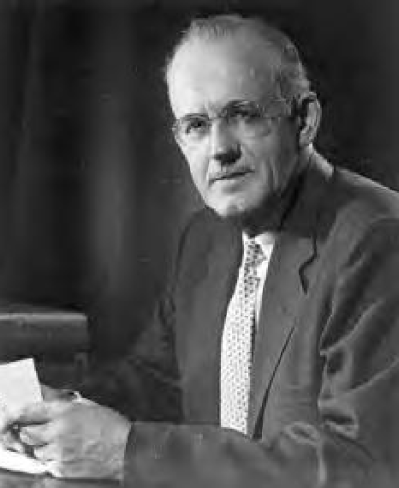
A.W. Tozer
Knowledge of the Holy
Notes:
The writings of Tozer are anointed and lyrical. Fresh wind to the soul.

Slide 48
No people has ever risen above its religion, and man’s spiritual history will positively demonstrate that no religion has ever been greater than its idea of God. Worship is pure or base as the worshiper entertains high or low thoughts of God.
Notes:
Tozer – Knowledge of the Holy

Slide 49
For this reason the gravest question before believers is always God Himself, and the most portentous fact about any man is not what he at a given time may say or do, but what he in his deep heart conceives God to be like. We tend by a secret law of the soul to move toward our mental image of God.
Notes:
Tozer – Knowledge of the Holy

Slide 50
It is my opinion that the evangelical conception of God current in these middle years of the twentieth century is so decadent as to be utterly beneath the dignity of the Most High God and actually to constitute for professed believers something amounting to a moral calamity.
Notes:
Tozer – Knowledge of the Holy

Slide 51
“You thought,” said the Lord to the wicked man in the psalm, “that I was altogether such as one as yourself.” Surely this must be a serious affront to the Most High God before whom cherubim and seraphim continually do cry, “Holy, holy, holy, Lord God Tsvaot [of the armies of heaven].”
Notes:
Tozer – Knowledge of the Holy
Self sufficiency

Slide 52
One of G-d’s attributes:
Self sufficiency

Slide 53
“The Father hath life in himself,” said Messiah, and it is charac-teristic of His teaching that He thus in a brief sentence sets forth truth so lofty as to the transcend the highest reaches of human thought. God, He said, is self-sufficient; He is what He is in Himself, in the final meaning of those words.
Notes:
Tozer – Knowledge of the Holy

Slide 54
Whatever God is, and all that God is, He is in Himself. All life is in and from God, whether it be the lowest form of unconscious life or the highly self-conscious, intelligent life of a seraph. No creature has life in itself; all life is a gift from God.
Notes:
Tozer – Knowledge of the Holy

Slide 55
The life of God, conversely, is not a gift from another. Were there another from whom God could receive the gift of life, or indeed any gift whatever, that other would be God in fact.
Notes:
Tozer – Knowledge of the Holy

Slide 56
An elementary but correct way to think of God is as the One who contains all, who gives all that is given, but who Himself can receive nothing that He has not first given.
Notes:
Tozer – Knowledge of the Holy

Slide 57
The river grows larger by its tributaries, but where is the tributary that can enlarge the One out of whom came everything and to whose infinite fullness all creation owes its being? Frederick W. Faber:
Unfathomable Sea:
all life is out of Thee,
And Thy life is Thy blissful Unity.
Notes:
Tozer – Knowledge of the Holy

Slide 58
The problem of why God created the universe still troubles thinking men; but if we cannot know why, we can at least know that He did not bring His worlds into being to meet some unfulfilled need in Himself,
Notes:
Tozer – Knowledge of the Holy

Slide 59
as a man might build a house to shelter him against the winter cold or plant a field of corn to provide him with necessary food. The word necessary is wholly foreign to God.
Notes:
Tozer – Knowledge of the Holy

Slide 60
Goodness of God

Slide 61
Fountain of good, all blessing flows from Thee; no want Thy fulness knows; What but Thyself canst Thou desire? Yet, self-sufficient as Thou art, Thou dost desire my worthless heart. This, only this, dost Thou require.
Johann Scheffler
Notes:
Tozer – Knowledge of the Holy

Slide 62
When theology says that God is good, it is not the same as saying that He is righteous or holy. The holiness of God is trumpeted from the heavens and re-echoed on earth
Notes:
Tozer – Knowledge of the Holy

Slide 63
by saints and sages wherever God has revealed Himself to men; however, we are not at this time considering His holiness but His goodness, which is quite another thing.
Notes:
Tozer – Knowledge of the Holy

Slide 64
The goodness of God is that which disposes Him to be kind, cordial, benevolent, and full of good will toward men. He is tenderhearted and of quick sympathy, and His unfailing attitude toward all moral beings
Notes:
Tozer – Knowledge of the Holy

Slide 65
is open, frank, and friendly. By His nature He is inclined to bestow blessedness and He takes holy pleasure in the happiness of His people.
Notes:
Tozer – Knowledge of the Holy

Slide 66
The goodness of God is the drive behind all the blessings He daily bestows upon us. God created us because He felt good in His heart and He redeemed us for the same reason.
Notes:
Tozer – Knowledge of the Holy

Slide 67
Divine goodness, as one of God’s attributes, is self-caused, infinite, perfect, and eternal. Since God is immutable He never varies in the intensity of His loving-kindness. He has never been kinder than He now is, nor will He ever be less kind.
Notes:
Tozer – Knowledge of the Holy

Slide 68
He is no respecter of persons but makes His sun to shine on the evil as well as on the good, and sends His rain on the just and on the unjust. The cause of His goodness is in Himself, the recipients of His goodness are all His beneficiaries without merit and without recompense.
Notes:
Tozer – Knowledge of the Holy

Slide 69
Prayer is not itself meritorious. It lays God under no obligation nor puts Him in debt to any. He hears prayer because He is good, and for no other reason. Nor is faith meritorious; it is simply confidence in the goodness of God, and the lack of it is a reflection upon God’s holy character.
Notes:
Tozer – Knowledge of the Holy

Slide 70
O God, my hope, my heavenly rest, My all of happiness below,
Grant my importunate request,
To me, to me, Thy goodness show;
Notes:
Tozer – Knowledge of the Holy

Slide 71
Thy beatific face display,
The brightness of eternal day.
Before my faith’s enlightened eyes, Make all Thy gracious goodness pass;
Notes:
Tozer – Knowledge of the Holy

Slide 72
Thy goodness is the sight I prize: might I see Thy smiling face: They nature in my soul proclaim, Reveal Thy love, Thy glorious name.
Charles Wesley
Notes:
Tozer – Knowledge of the Holy

Slide 73
Beliefs determine perceptions, opinions, actions, character, destiny.
Mishei/Prov 23.7
כִּי כְּמוֹ שָׁעַר בְּנַפְשׁוֹ – כֶּן הוּא
For as he thinks within himself, [literally: as he opens the gates of this soul]
so is he.

Slide 74
What lies, what accusations of evil, have you and I believed about ourselves, about others, and about G-d?
Notes:
Tozer – Knowledge of the Holy

Slide 75
Notes:
Tozer – Knowledge of the Holy

Slide 76
An encouraging news note from Iran…
Notes:
Tozer – Knowledge of the Holy

Slide 77


Slide 78
In 1979, there were fewer than 500 known Evangelical believers from a Muslim background [MBBs] in Iran. Today there are at least 100,000 believers . The religious violence that accompanied the reign of President Ahmadinejad drained its perpetrators

Slide 79
of political and religious legitimacy, and has opened the door to other faiths.
Clint Hall of Westbrooke: 5000 new believers in Messiah each month by conservative estimate! Mullahs.
Notes:
In Israel, MBBs don’t call themselves Christians, כי that would be understood as Roman Catholic or Eastern Orthodox. Rather, they are using the Arabic term for Messianic. Messianic Arabs in Israel. Similar terminology. After all they are cousins.

Slide 80
Beliefs determine perceptions, opinions, actions, character, destiny.
Mishei/Prov 23.7
כִּי כְּמוֹ שָׁעַר בְּנַפְשׁוֹ – כֶּן הוּא
For as he thinks within himself, [as he opens the gates of this soul]
so is he.

Slide 81
^{Ro 12.1-2} I urge you therefore, brothers and sisters, by the mercies of God, to present your bodies as a living sacrifice—holy, acceptable to God—which is your spiritual service.

Slide 82
^{Ro 12.1-2} Do not be conformed to this world but be transformed by the renewing of your mind, so that you may discern what is the will of God—what is good and acceptable and perfect.

Slide 83
^{2 Cor. 10.4-5} For the weapons of our warfare are not fleshly but powerful through God for the tearing down of strongholds. We are tearing down false arguments and every high-minded thing that exalts itself against the knowledge of God. We are taking every thought captive to the obedience of Messiah.

Slide 84
Steps to deliverance [Just to give you a taste, you really need the weekend]
I choose to submit to the process of being transformed in this issue of ______.
I ask for grace to work in me

Slide 85
3. I declare, by the blood atonement of Yeshua, that I am changed, redeemed.
4. I confess my sin of believing the lie of ______
5. I forgive those who contributed to this UB

Slide 86
6. I choose to forgive myself for...
7. I choose to accept, BELIEVE Godly Beliefs that ____
Notes:
Tim story p 104-105 Kylstra

