Slide 1
If you saw our livestream YouTube last week, it wasn’t quite HD video and audio.
Working on it!

Slide 2
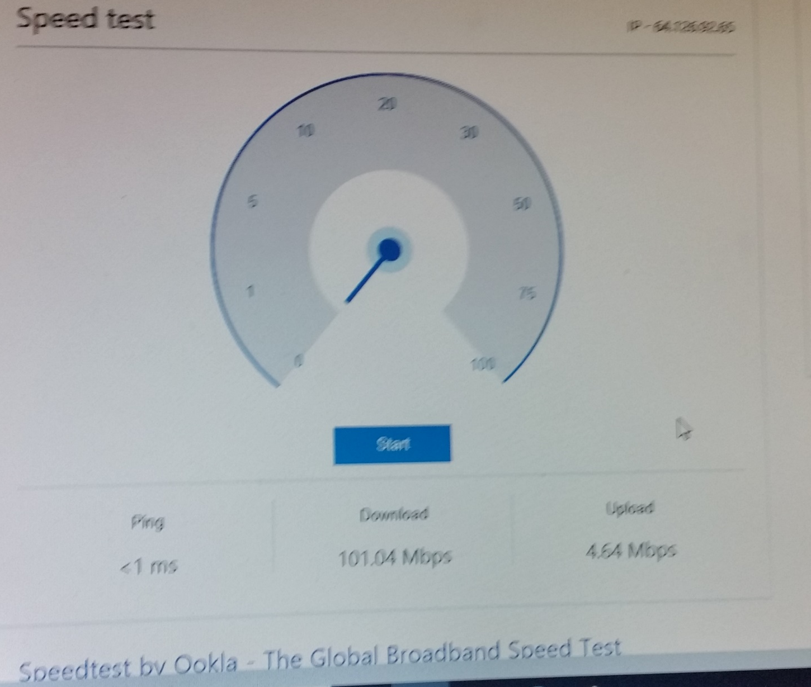
Notes:
4.64 mbps Should be ok, although minimal. Best possible with Cu wires, not fiber optic.

Slide 3
Please do not download or upload anything. Don’t view the livestream. No games.
No email.
Some of the online games we ask you NOT to do:

Slide 4
Minecraft
Overwatch
Diablo 3
CS:GO
Team Fortress 2
Towerfall Ascension
Unreal Tournament
Worms
League of Legends/Dota 2
Playerunknown’s Battlegrounds
Rocket League
Keep Talking and Nobody Explodes
Quake III Arena
Rainbow Six Siege
Arma 3
Battlefield 1

Slide 5
One exception:

Slide 6
To easily follow these notes, log on to our Wifi as per instructions in the bulletin

Slide 7
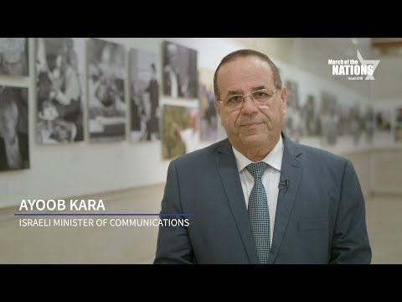
Notes:
Ayoob Kara is an Israeli Druze politician who currently serves as a member of the Knesset for Likud and as Minister of Communications

Slide 8
Be a part of history and prophecy! 70 years after the founding of the State is the year of Release!
Except don’t register there, just go to OrHaOlam.com
Deadline Feb. 12 before price increase! If no enrollment by then tour dropped!
Notes:
Some insights from Ted Alongi

Slide 9
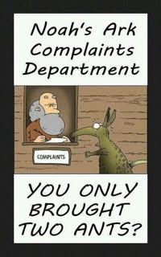

Slide 10
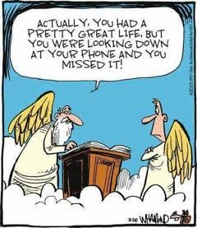
Notes:
Doctors are concerned about “tilt neck syndrome”
Netanyahu been questioned several times by police for possible wrongdoing, bribery. Trump administration being questioned by Robert Mueller. Maybe Pres. Trump himself!

Slide 11
Third Questioning
of Yeshua

Slide 12
^{Mattityahu (Matthew) 22:34-35} When the P’rushim learned that he had silenced the Tz’dukim, they got together, and one of them who was a Torah expert asked a sh’eilah to trap him.
[Third try in this chapter]

Slide 13
First: ^{Mtt. 22.15-16} Then the P’rushim went away and put together a plan to trap Yeshua with his own words. They sent him some of their talmidim and some members of Herod’s party.
Taxation loyalty question
Notes:
Few weeks ago

Slide 14
Second:
^{Mtt. 22.23} That same day, some Tz’dukim came to him.
Apparent resurrection absurdity challenge.
Notes:
Last week: Resurrection power of G-d

Slide 15
Is there any spiritual / prophetic meaning to this extended interrogation?
Consider: Passover sacrifice

Slide 16
^{Shmot/Ex 12.1-5} Now Adoni spoke to Moses and Aaron in the land of Egypt saying, “This month will mark the beginning of months for you…Tell all the congregation of Israel that on the tenth day of this month,

Slide 17
^{Shmot/Ex 12.1-5} each man is to take a lamb for his family one lamb for the household…Your lamb is to be without blemish, a year old male. You may take it from the sheep or from the goats.
Notes:
Why take the lamb as designated, separate 10th till 14th evening = 15th?

Slide 18
^{Shmot/Ex 12.6} You must watch over it [mishmeret משמרת] until the fourteenth day of the same month. Then the whole assembly of the congregation of Israel is to slaughter it at twilight.
Yeshua was being inspected!
Notes:
10th till 14th Inspection. Maimonides Hilchot Biath Hamikdash, c. 7. sect. 1. reckons no less than fifty blemishes in a creature, anyone of which makes it unfit for sacrifice.
^{Vayikra/Lev 22.22} The blind, injured, maimed, having an abnormal growth or festering or a running sore are not to be offered to Adoni.
Yeshua had to be spiritually perfect to bear all our faults, sins, inconsistencies, attitudes, reactions to stress, to antagonism. Easy to be nice when honored. When ridiculed, mocked, exposed to vileness, how to we respond?

Slide 19
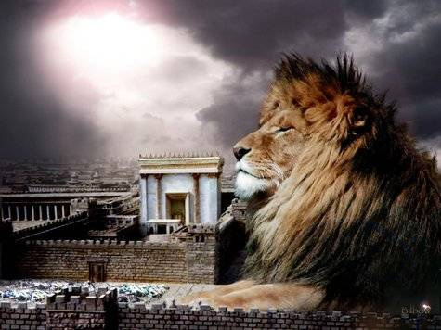
מַתִּתְיָהוּ Mattityahu
(Matthew) 22:36-39

Slide 20
Mattityahu (Matthew) 22:36
"רַבִּי, אֵיזוֹהִי הַמִּצְוָה הַגְּדוֹלָה שֶׁבַּתּוֹרָה?"
"Rabbi, which of the mitzvot in the Torah is the most important?"
Notes:
Common rabbinic discussion point.

Slide 21
Mattityahu (Matthew) 22:37
הֵשִׁיב לוֹ יֵשׁוּעַ: "וְאָהַבְתָּ אֶת יְיָ אֱלֹהֶיךָ בְּכָל־לְבָבְךָ וּבְכָל־נַפְשְׁךָ וּבְכָל מְאֺדֶךָ.
He told him, " 'You are to love Adonai your God with all your heart and with all your soul and with all your strength.'
Notes:
Quoting Dvarim/Dt 6.5 Parallel passage in Mark, also 6.4. Shma.

Slide 22
Mattityahu (Matthew) 22:38
זֺאת הַמִּצְוָה הַגְּדוֹלָה וְהָרִאשׁוֹנָה.
This is the greatest and most important mitzvah.
Notes:
Rabbis and Yeshua agree.

Slide 23
Mattityahu (Matthew) 22:39
הַשְּׁנִיָּה דּוֹמָה לָהּ: וְאָהַבְתָּ לְרֵעֲךָ כָּמוֹךָ.
And a second is similar to it, 'You are to love your neighbor as yourself.’
All of the Torah and the Prophets are dependent on these two mitzvot.”
Notes:
Interesting bit of word structure here, so there is a that language principle: The Hebrew word V’ahavta appears only three times in Scripture. Puts those sentences in a special classification:

Slide 24
Gezerah shavah גזירה שוה ("Similar laws, similar verdicts")
^{Dt 6.5}וְאָהַבְתָּ, אֵת יְיָ אֱלֹהֶיךָ, בְּכָל-לְבָבְךָ
And you shall love Adoni your G-d
^{Lev 19.18} אָהַבְתָּ לְרֵעֲךָ כָּמוֹךָ:
And you shall love your neighbor…
^{Dt 11.1}וְאָהַבְתָּ אֵת יְיָ אֱלֹהֶיךָ
And you shall love Adoni your G-d
אָהַבְתָּ לְרֵעֲךָ כָּמוֹךָ:
Notes:
Loving G-d should → loving your neighbor. If it leads to harsh religion, it’s NOT really loving G-d.
Philo and Josephus also co-joined loving G-d and neighbor.
Yet, is there really a GREATER commandment? In another sense, no.

Slide 25
^{Matt.5.19-20} So whoever disobeys the least of these mitzvot and teaches others to do so will be called the least in the Kingdom of Heaven. But whoever obeys them and so teaches will be called great in the Kingdom of Heaven.

Slide 26
^{Matt.5.19-20} For I tell you that unless your righteousness is far greater than that of the Torah-teachers and P’rushim, you will certainly not enter the Kingdom of Heaven!
Notes:
All commandments are essential. So need to pour over the word, that we don’t miss ANY. My wife is a recipe cook. ALL the ingredients, all the steps in sequence!

Slide 27
^{Yaakov/Jas 2.10-11} For a person who keeps the whole Torah, yet stumbles at one point, has become guilty of breaking them all. For the One who said, “Don’t commit adultery,” also said, “Don’t murder.” Now, if you don’t commit adultery but do murder, you have become a transgressor of the Torah.

Slide 28
Rabbi (Judah) said… Be as scrupulous about a light commandment as of a weighty one, for you do not know the reward allotted for each commandment. ^{(m.Avot 2:1)}
Notes:
http://www.emethatorah.com/blog/2014/july-25/light-heavy-commandments-fact-or-fiction
For example

Slide 29
^{Dvarim 22.6-7} “If, as you are walking along, you happen to see a bird’s nest in a tree or on the ground with chicks or eggs, and the mother bird is sitting on the chicks or the eggs, you are not to take the mother with the chicks. You must let the mother go, but you may take the chicks for yourself; so that things will go well with you, and you will prolong your life.
Notes:
Serious consequence to what might seem trivial

Slide 30
^{Shmot 20.12} Honor your father and mother, so that you may live long in the land which Adoni your God is giving you.
Notes:
Similar consequence to a much heavier commandment. Some said that THIS was the first and greatest commandment.
Very famous story from about 30 years before Messiah Yeshua’s birth, about the greatest commandment:

Slide 31
A Talmudic story contrasts Hillel (c. 110 BCE - CE 10) and Shammai (50 BCE – CE 30):
"It happened that a certain heathen came before Shammai and said to him, ‘Make me a proselyte,
Notes:
http://www.blainerobison.com/bible2/marknotes12.htm

Slide 32
on condition that you teach me the whole Torah while I stand on one foot.’ Thereupon he [Shammai] repulsed him with the builder's cubit [stick] which was in his hand. When he went before Hillel, he said to him, ‘What is hateful to you, do not to your neighbor:
Notes:
http://www.blainerobison.com/bible2/marknotes12.htm

Slide 33
that is the whole Torah, while the rest is the commentary thereof; go and learn it.’ (Shab. 31a)
No doubt knowing Hillel's maxim, the scribe was curious to see how Yeshua would answer.
Notes:
http://www.blainerobison.com/bible2/marknotes12.htm
In fact, Yeshua’s answer is the central focus of most or all the writers of the Messianic Scriptures/ New Covenant.

Slide 34
^{Ro 13.8-10} Owe no one anything except to love one another, for the one who loves another has fulfilled the Torah. For the commandments—“You shall not commit adultery, you shall not murder, you shall not steal, you shall not covet,”

Slide 35
^{Ro 13.8-10} and any other commandment — are summed up in this word: “You shall love your neighbor as yourself.” Love does no harm to a neighbor; therefore love is the fullness of the Torah

Slide 36
^{Yaakov 2 8} If, however, you fulfill the royal law according to the Scripture, “You shall love your neighbor as yourself,” you do well.
Notes:
One of my own favorites

Slide 37
^{1 Yn 4.7-8} Beloved friends, let us love one another; because love is from God; and everyone who loves has God as his Father and knows God. Those who do not love, do not know God; because God is love.
Notes:
Many adjectives about G-d: holy, powerful, wise. This unique noun equivalence. NOT love = G-d. But very nature, essence.
So, how important is love? Love of G-d, love of neighbor. Consider them in reverse order…

Slide 38
In 1945, Austrian physician René Spitz investigated an orphanage that took extra care to make sure its infants were not infected with disease. The children received first-class nutrition and medical care, but they were barely touched to minimize their contact with germs.
Notes:
http://www.kansascity.com/opinion/opn-columns-blogs/syndicated-columnists/article195643119.html By David Brooks New York Times News Service
January 21, 2018

Slide 39
The approach was a catastrophe. Thirty-seven percent of the babies died before reaching age 2.
The famous Grant Study investigated a set of men who had gone to Harvard in the 1940s.
Notes:
http://www.kansascity.com/opinion/opn-columns-blogs/syndicated-columnists/article195643119.html By David Brooks New York Times News Service
January 21, 2018

Slide 40
The men who grew up in loving homes earned 50 percent more over the course of their careers than those from loveless ones. They suffered from far less chronic illness and much lower rates of dementia in old age. A loving home was the best predictor of life outcomes.
Notes:
http://www.kansascity.com/opinion/opn-columns-blogs/syndicated-columnists/article195643119.html By David Brooks New York Times News Service
January 21, 2018

Slide 41


Slide 42
If the power of loving touch is astounding, the power of invasive touch is horrific. Christie Kim of NYU surveyed the research literature on victims of child sexual abuse. The victims experience higher levels of anxiety throughout their lifetimes.
Notes:
http://www.kansascity.com/opinion/opn-columns-blogs/syndicated-columnists/article195643119.html By David Brooks New York Times News Service
January 21, 2018

Slide 43
They report higher levels of depression across the decades and higher levels of self-blame. They are more than twice as likely to experience sexual victimization again.
Notes:
http://www.kansascity.com/opinion/opn-columns-blogs/syndicated-columnists/article195643119.html By David Brooks New York Times News Service
January 21, 2018

Slide 44
It seems that the smarter we get about technology, the dumber we get about relationships. We live in a society in which loneliness, depression and suicide are on the rise. We seem to be treating each other worse.
Notes:
http://www.kansascity.com/opinion/opn-columns-blogs/syndicated-columnists/article195643119.html By David Brooks New York Times News Service
January 21, 2018

Slide 45
The guiding moral principle here is not complicated: Try to treat other people as if they possessed precious hearts and infinite souls. Everything else will follow.
Even the least important of all people.
Notes:
Application now: turn to someone near you with appropriate affectionate touch. Mixed gender: arm, shoulder & kind words. “I appreciate you.” You can say that even if you don’t know them well, or even cause you pain. Pain → growth, if you respond right. Your chance to respond. Command about love is NOT nebulous. Applies to real people. These people.
Further application to distressed:

Slide 46
^{Mtt. 25.40-44} The King will say to them, ‘Amen, I tell you, whatever you did to one of the least of these My brethren, you did it to Me.’ Then He will also say to those on the left, ‘Go away from Me, you cursed ones, into the everlasting fire which has been prepared for the devil and his angels.

Slide 47
^{Mtt. 25.40-44} For I was hungry and you gave Me nothing to eat; I was thirsty and you gave Me nothing to drink; I was a stranger and you did not invite Me in; naked and you did not clothe Me; sick and in prison and you did not visit Me.’

Slide 48
^{Mtt. 25.40-44} “Then they too will answer, saying, ‘Lord, when did we see You hungry or thirsty or a stranger or naked or sick or in prison, and did not care for You?’ Then He will answer them, saying, ‘Amen, I tell you,

Slide 49
^{Mtt. 25.40-44} whatever you did not do for one of the least of these, you did not do for Me.’ These shall go off to everlasting punishment, but the righteous into everlasting life.”
In history, who have been least?

Slide 50
International Holocaust Remembrance Day, is an international memorial day on 27 January commemorating the tragedy of the Holocaust that occurred during the Second World War.
Notes:
When Jews were considered the least of all people.

Slide 51
It commemorates the genocide that resulted in the murder by the Nazis and collaborators of an estimated
6 million Jewish people,
200,000 Romani [Gypsy] people,
250,000 mentally and physically disabled people, and
9,000 homosexual men

Slide 52
International Holocaust Remembrance Day was designated by the United Nations General Assembly on 24 January 2005 during which the United Nations General Assembly marked the 60th anniversary of the liberation of Auschwitz.

Slide 53
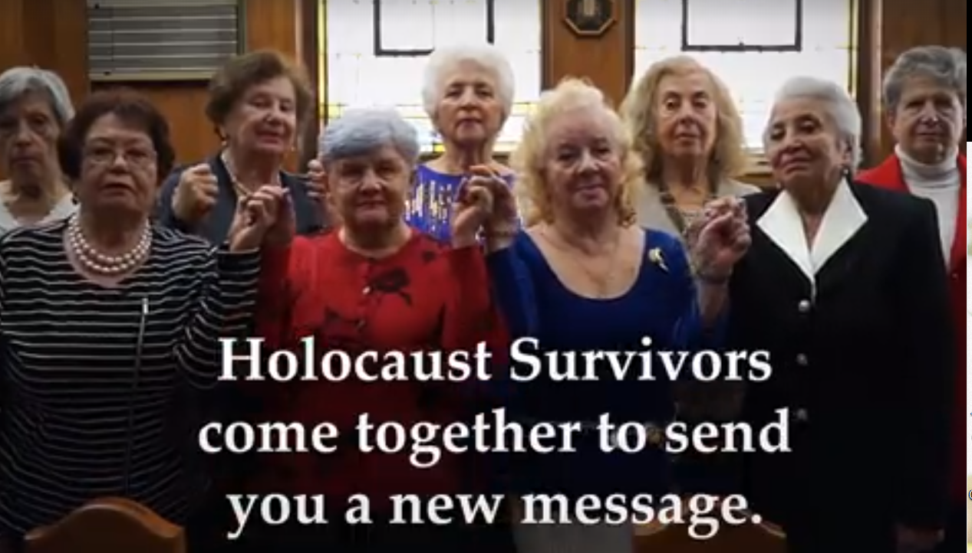

Slide 54
These nine Holocaust Survivors have come together to send you a message. It’s unforgettable. For International Holocaust Remembrance Day, let’s show them we are listening. Post your picture holding a sign with the words "We Remember"

Slide 55
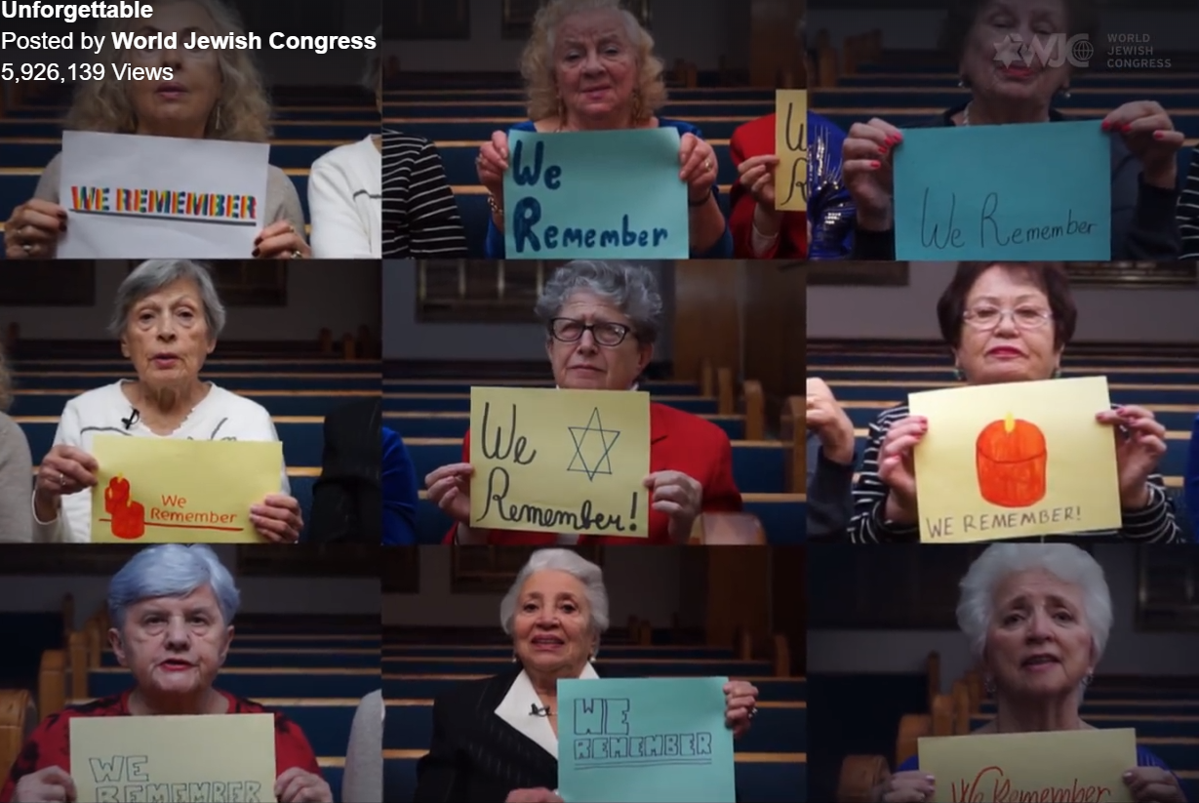

Slide 56
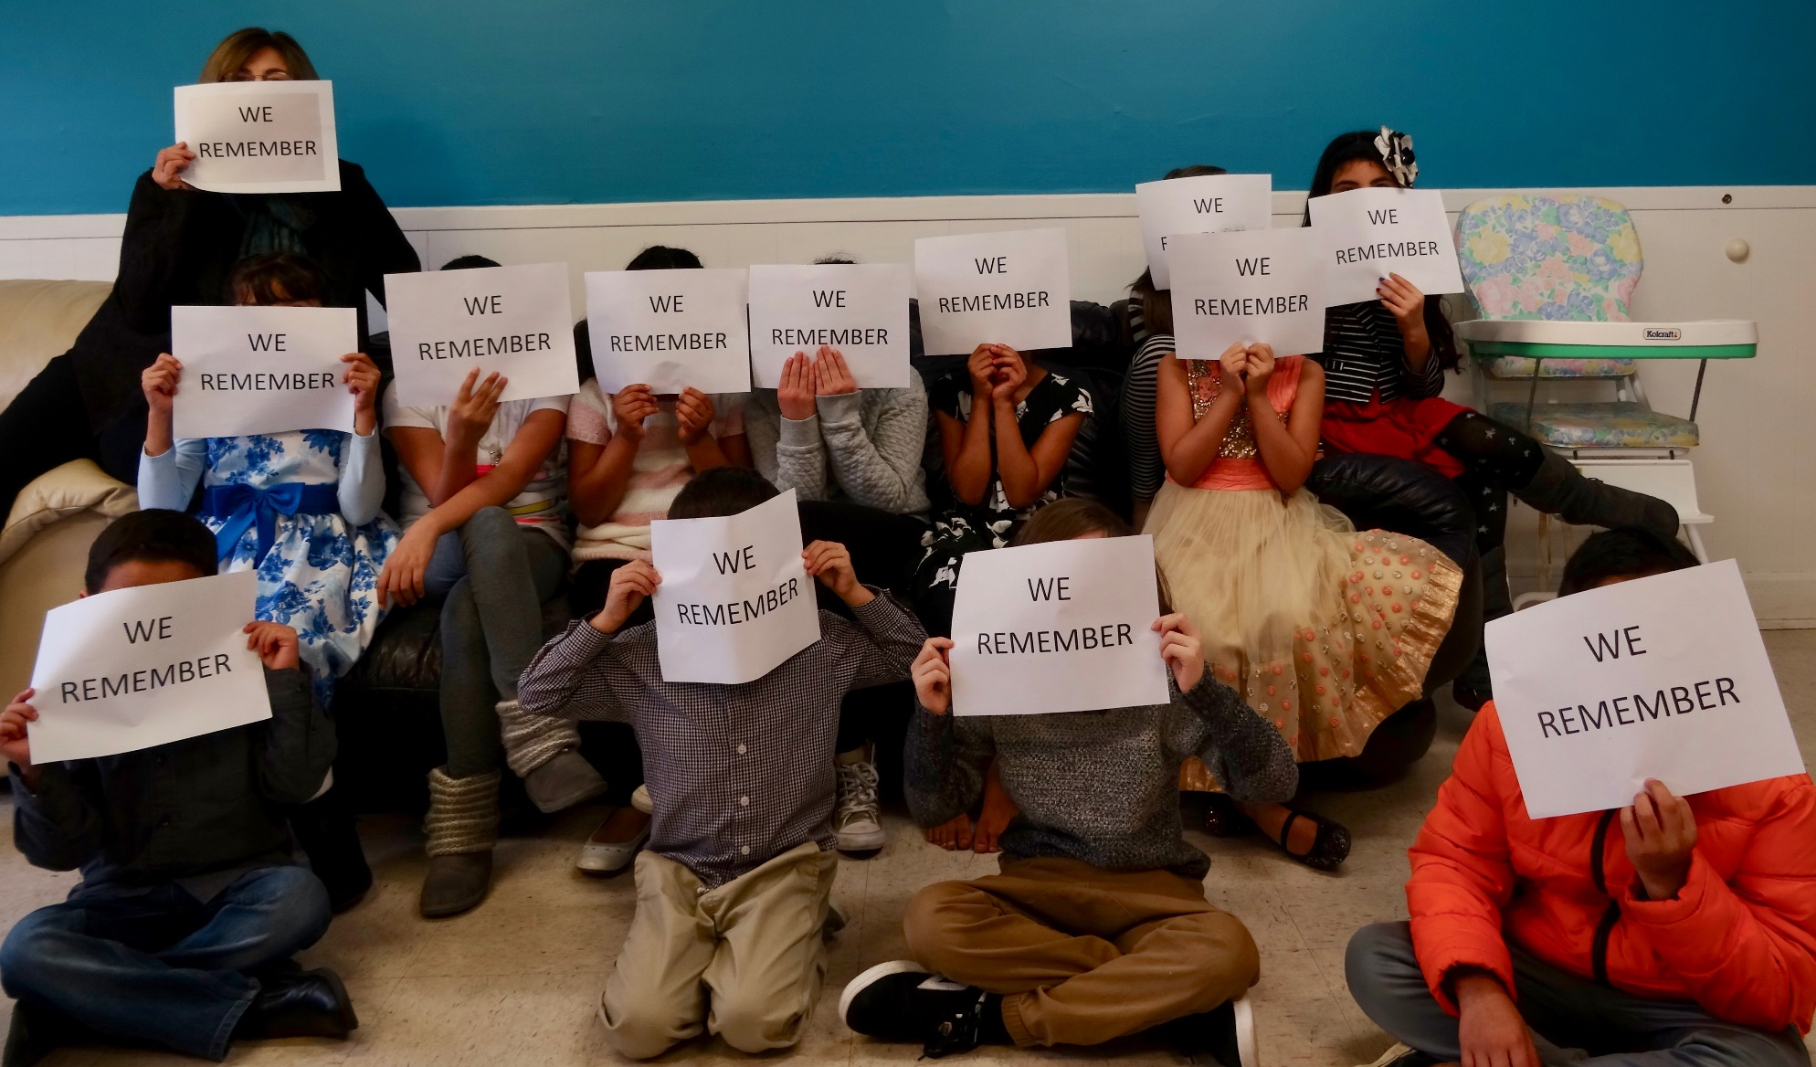
Notes:
please encourage everyone to take selfies with their own We Remember signs and post to Facebook on Shabbat.

Slide 57
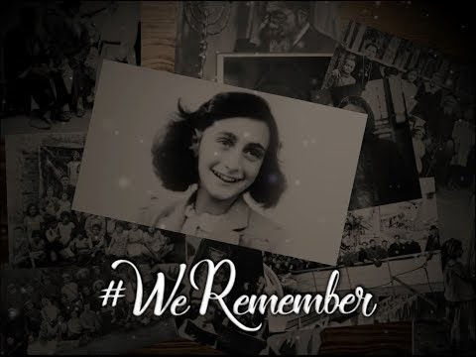

Slide 58
Notes:
please encourage everyone to take selfies with their own We Remember signs and post to Facebook on Shabbat.
PAUSE

Slide 59
The other first commandment:
Loving G-d

Slide 60
What I’m about to say is possibly counterproductive. We love, appreciate and need servants to teach, greet, usher, do ppp, serve food, bring food, sing, play, mow, set up, plant, weed eat, etc., etc., etc.
Notes:
Everyone who SERVES here, stand.
But, bigger picture…

Slide 61
Willow Creek Community congregation is an American non-denominational and multi-generational Evangelical mega-congregation located in the northwestern Chicago suburb of South Barrington, Illinois.
Notes:
https://en.wikipedia.org/wiki/Willow_Creek_Community_congregation

Slide 62
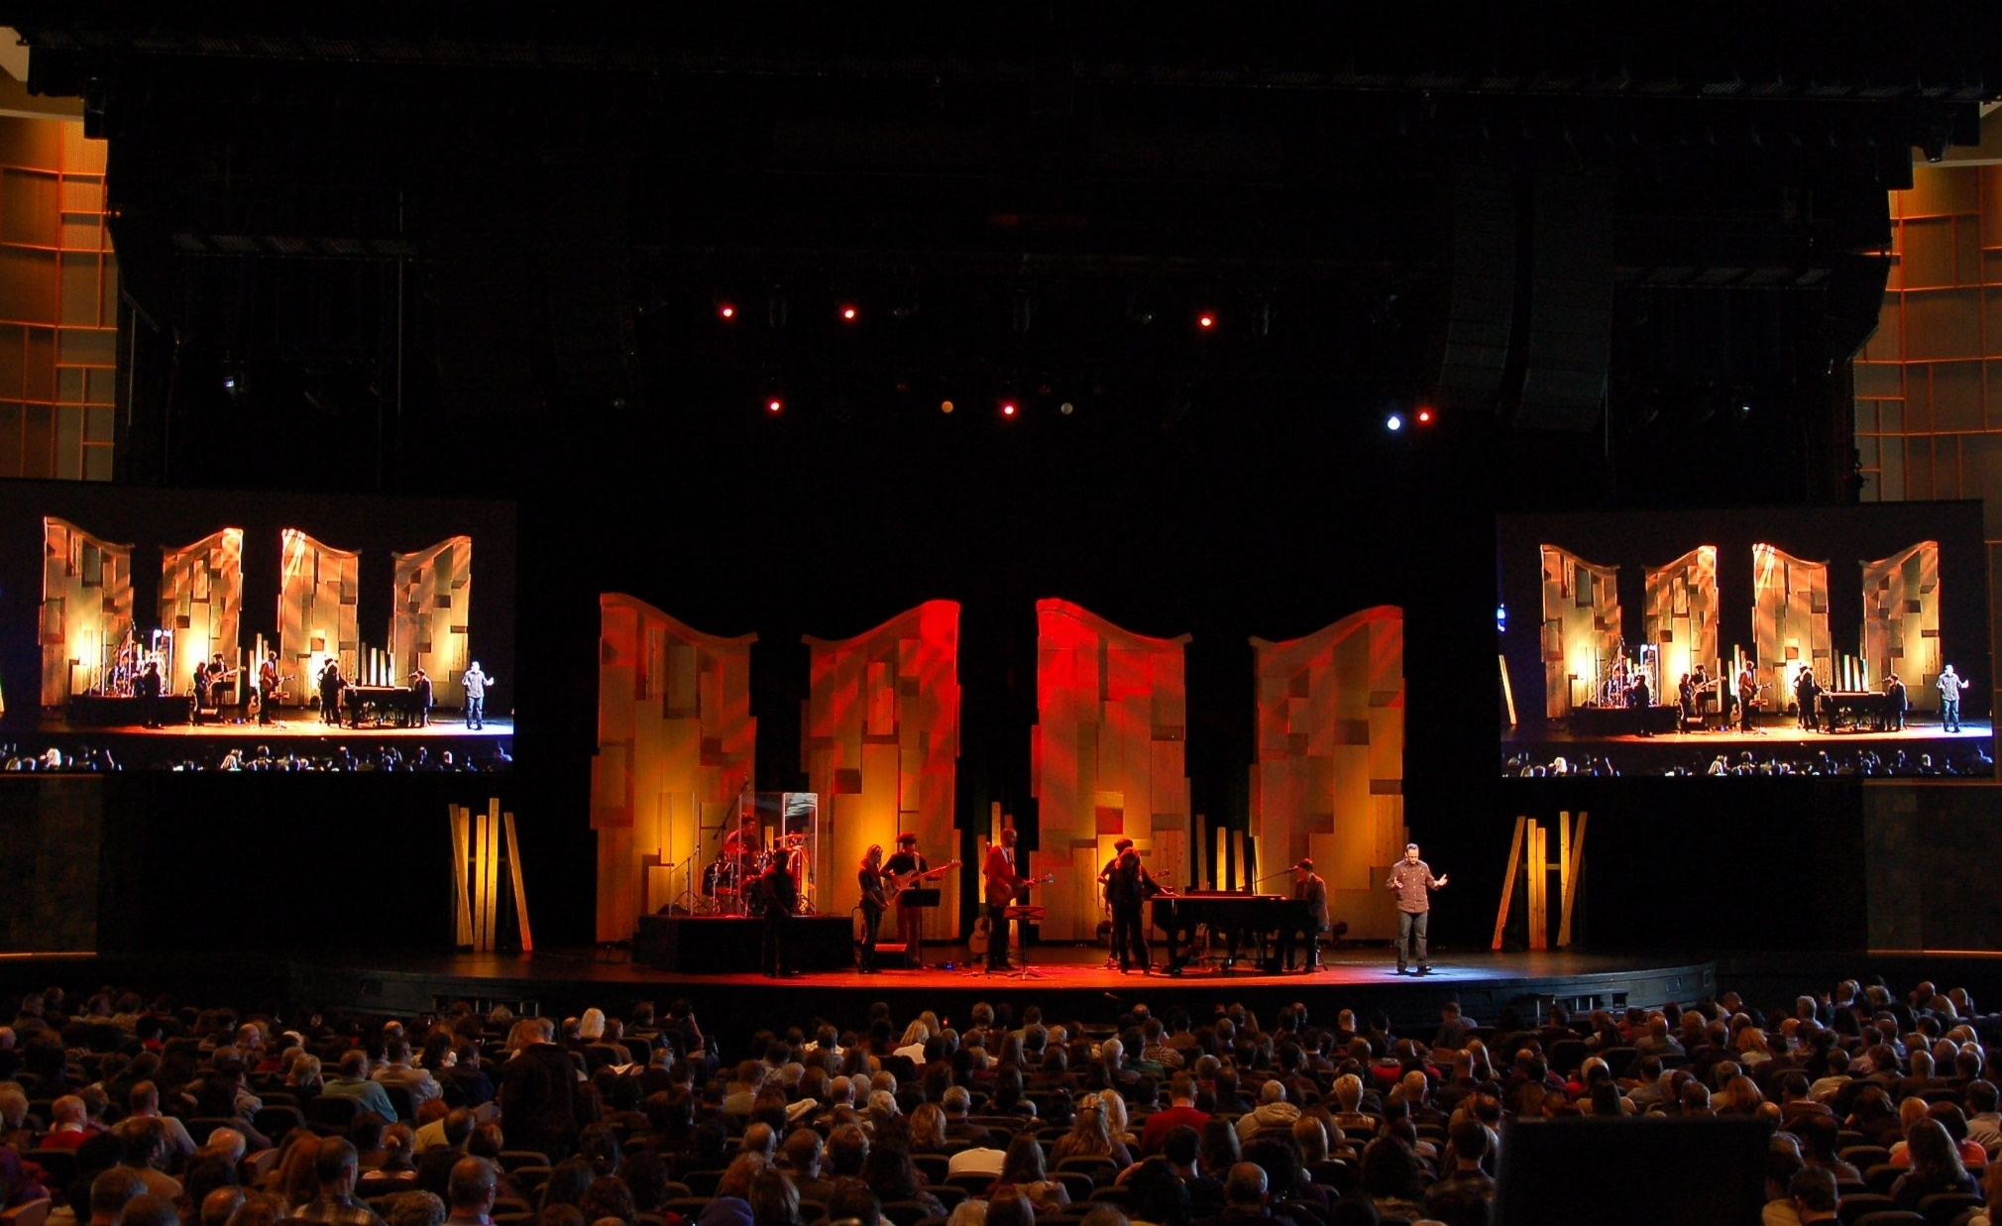
Sanctuary of Willow Creek

Slide 63
It was founded on October 12, 1975, by Bill Hybels, who is currently the senior pastor. It has three weekend services averaging 26,000 attendees.
Notes:
https://en.wikipedia.org/wiki/Willow_Creek_Community_congregation

Slide 64
4 to 26,000 in 42 years.
Increased by ~23% per year.
Notes:
Famous for volunteer culture. Book, The Volunteer Revolution

Slide 65
Decades after founding Willow Creek Community congregation in Chicago and his popular “seeker sensitive” approach to congregational growth, Pastor Bill Hybels commissioned a study to identify the programs most effective in producing spiritual growth. He and his leadership team were convinced
Notes:
https://www.gbs.edu/wp-content/uploads/2018/01/Gods-Revivalist-2018-JAN-FEB-web.pdf

Slide 66
that involvement in congregational activities—small groups, weekend worship services, volunteering, etc.—was the key to producing spiritual growth. They thought they only needed to identify which activities most successfully replicated the deepest levels of spirituality in order to implement congregation resources advantageously.
Notes:
https://www.gbs.edu/wp-content/uploads/2018/01/Gods-Revivalist-2018-JAN-FEB-web.pdf

Slide 67
While the survey did identify some good traits about the congregation, some much more negative findings bothered Hybels so deeply that he “wanted to strangle the messengers.” He continued, “It was hard for me to admit that I’d poured thirty years of my life into this thing, and part of the findings showed that we’d fallen short in some ways.”
Notes:
https://www.gbs.edu/wp-content/uploads/2018/01/Gods-Revivalist-2018-JAN-FEB-web.pdf

Slide 68
In reality, extensive involvement in congregational activity “barely moved people to love God and others more” (emphasis original). Only about fifty percent of the congregation claimed to “love God more than anything else,”
Notes:
https://www.gbs.edu/wp-content/uploads/2018/01/Gods-Revivalist-2018-JAN-FEB-web.pdf

Slide 69
and many of those felt spiritually stalled, unable to get to the next level, and considered the congregation no help to them. And they were on the verge of leaving.
Notes:
https://www.gbs.edu/wp-content/uploads/2018/01/Gods-Revivalist-2018-JAN-FEB-web.pdf

Slide 70
The REVEAL study, later used in over a thousand congregations, categorizes four levels on The Spiritual Continuum:
Exploring Messiah —Those who have a basic belief in God, are not yet born again, but are interested in who Yeshua is.
Notes:
https://www.gbs.edu/wp-content/uploads/2018/01/Gods-Revivalist-2018-JAN-FEB-web.pdf

Slide 71
Growing in Messiah —Those who are recently converted and learning what discipleship means.
Close to Messiah —Those who are dedicated believers and are dependent on Messiah for daily life.
Notes:
https://www.gbs.edu/wp-content/uploads/2018/01/Gods-Revivalist-2018-JAN-FEB-web.pdf

Slide 72
Messiah-Centered —Those who have fully surrendered their personal dreams, desires, and agenda, and have exchanged them for Messiah’s.
Notes:
https://www.gbs.edu/wp-content/uploads/2018/01/Gods-Revivalist-2018-JAN-FEB-web.pdf

Slide 73
The study revealed the deepest level of spirituality to be pitiably scarce. What astounded Hybels most was that, “By far the largest, toughest chasm is between those who are ‘Close to Messiah’ and those who are ‘Messiah Centered.’
Notes:
https://en.wikipedia.org/wiki/Willow_Creek_Community_congregation

Slide 74
People who are close to Messiah are still fundamentally self-centered. They believe ‘God is for me, and my plans, and my agenda in this world.’ Those who are truly Messiah-centered, however, are fully surrendered.”
Notes:
https://en.wikipedia.org/wiki/Willow_Creek_Community_congregation

Slide 75
Hybel’s congregation had no shortage of people who were dedicated to service, but stopped short of surrender.
We have a bit of a shortage of both, but primarily we need to surrender to Yeshua!!

Slide 76
Mattityahu (Matthew) 22:37
הֵשִׁיב לוֹ יֵשׁוּעַ: "וְאָהַבְתָּ אֶת יְיָ אֱלֹהֶיךָ בְּכָל־לְבָבְךָ וּבְכָל־נַפְשְׁךָ וּבְכָל מְאֺדֶךָ.
He told him, " 'You are to love Adonai your God with all your heart and with all your soul and with all your strength.'
Notes:
Quoting Dvarim/Dt 6.5 Parallel passage in Mark, also 6.4. Shma.

Slide 77
Mattityahu (Matthew) 22:38
זֺאת הַמִּצְוָה הַגְּדוֹלָה וְהָרִאשׁוֹנָה.
This is the greatest and most important mitzvah.
Notes:
Rabbis and Yeshua agree.

Slide 78
Mattityahu (Matthew) 22:39
הַשְּׁנִיָּה דּוֹמָה לָהּ: וְאָהַבְתָּ לְרֵעֲךָ כָּמוֹךָ.
And a second is similar to it, 'You are to love your neighbor as yourself.’
All of the Torah and the Prophets are dependent on these two mitzvot.”
Notes:
Interesting bit of word structure here, so that language principle: The Hebrew word V’ahavta appears only three times in Scripture. Puts those sentences in a special classification:

Slide 79
Do we love the least of all people?
Are we Messiah centered, fully surrendered? He is our joy.

