Slide 1
If you want to have notes without taking notes,
Go to OrHaOlam.com
WITHOUT WIFI
Click on downloads, messages, 2018 messages
Today’s should be on the top.

Slide 2
Be a part of history and prophecy! 70 years after the founding of the State is the year of Release!
Go to OrHaOlam.com
Notes:
Some insights from Ted Alongi

Slide 3
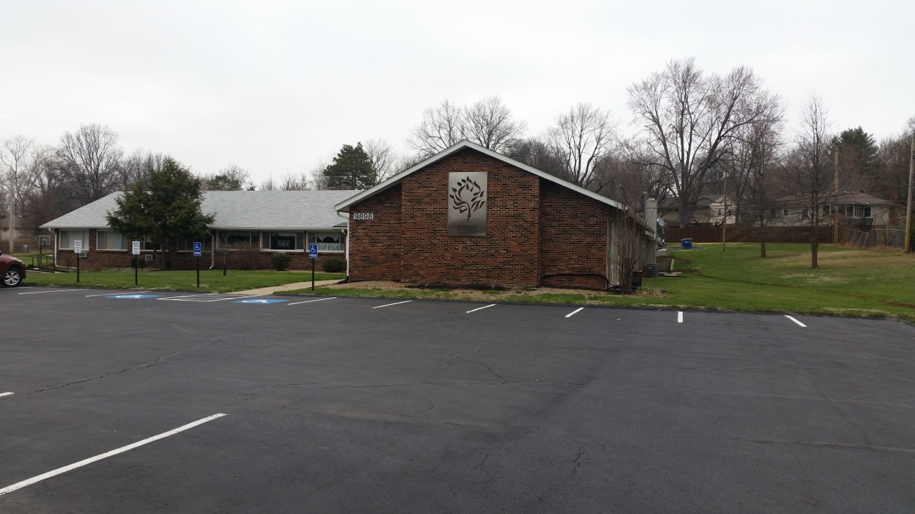

Slide 4
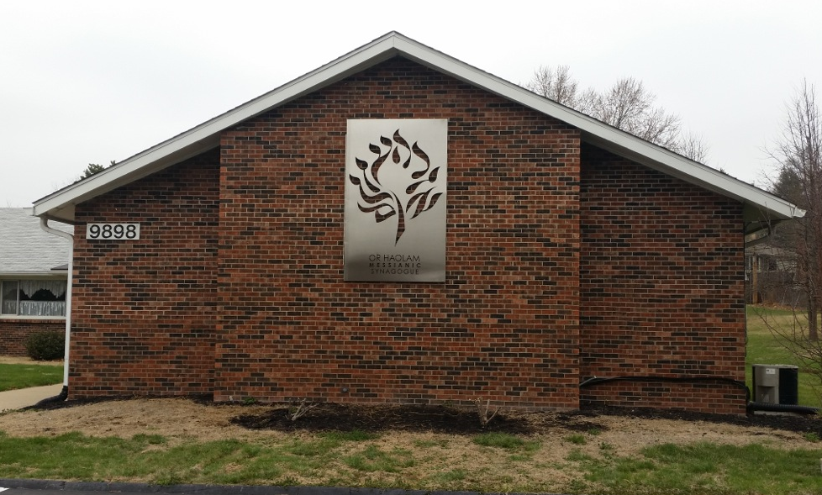
Notes:
Lights to be installed for backlit effect. Probably will paint bricks behind sign white.

Slide 5
Good news from Israel

Slide 6
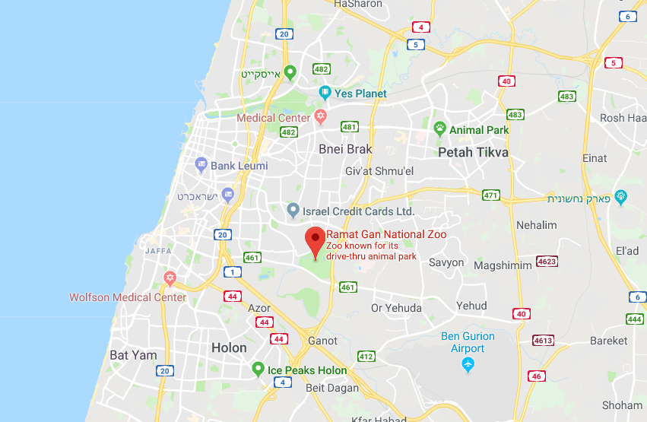
Notes:
Ramat Gan National Zoo, Drive thru

Slide 7
Ramat Gan Safari Lion keeper, Yifat, had spread black coffee on the ground and released them from their night enclosure, the lions spent more than a half hour…rolling around in the coffee. Safari staff think up ways to encourage the animals to behave as they would in nature. (Times of Israel)
Notes:
http://www.netmail411.com/mail/vfi/JOLmar3018.html?mc_cid=cbea24a906&mc_eid=5c6cdd3ee6

Slide 8
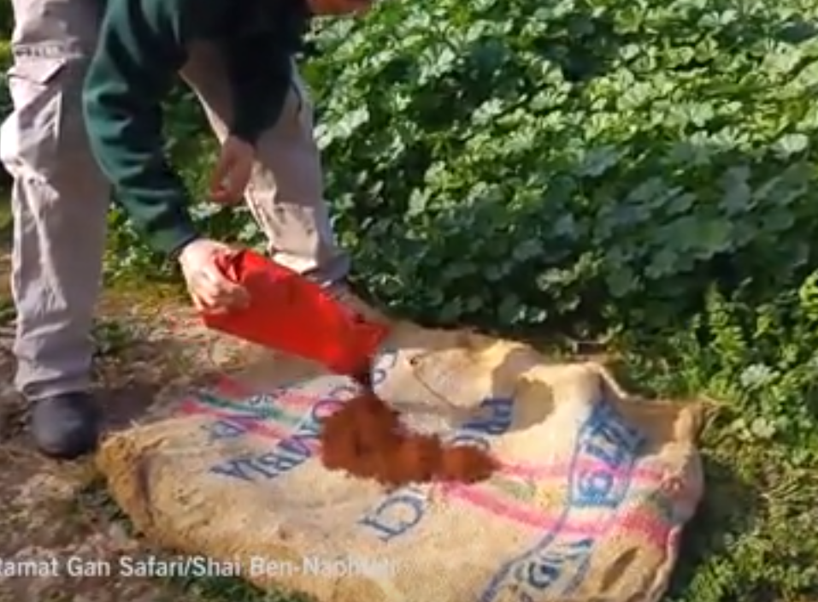
Notes:
https://www.timesofisrael.com/lions-wake-up-and-smell-the-coffee-at-the-ramat-gan-safari/
Yifat, a keeper at the Ramat Gan Safari, near Tel Aviv, spreads coffee powder on a jute sack for the lions.

Slide 9
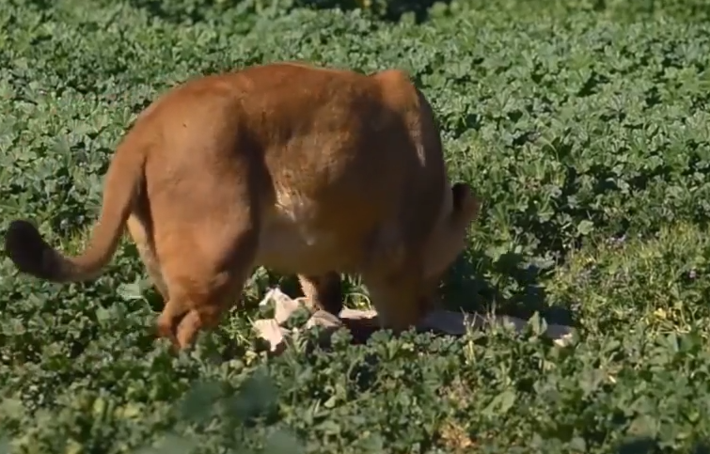
Notes:
https://www.timesofisrael.com/lions-wake-up-and-smell-the-coffee-at-the-ramat-gan-safari/

Slide 10
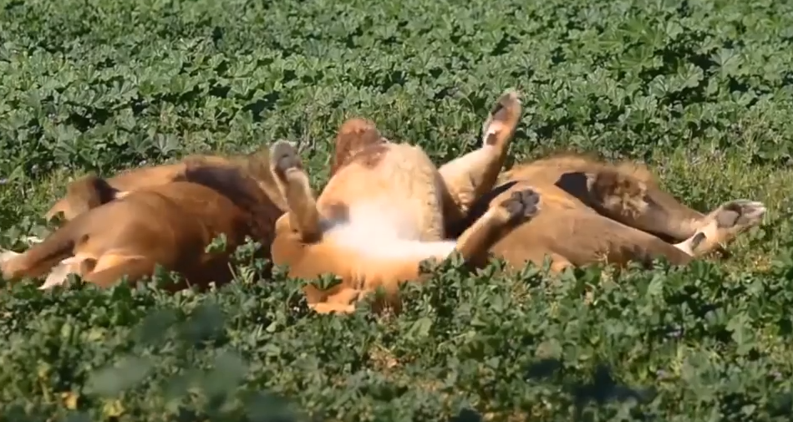
Notes:
https://www.timesofisrael.com/lions-wake-up-and-smell-the-coffee-at-the-ramat-gan-safari/
So, if you think your morning coffee is important to get you going, you are lion like.

Slide 11
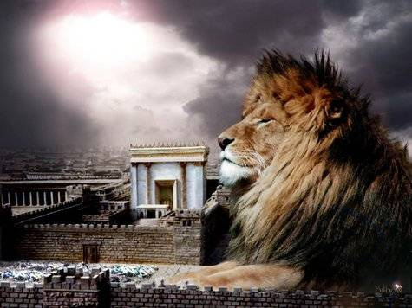
מַתִּתְיָהוּ Mattityahu
(Matthew) 26:1-3

Slide 12
Mattityahu (Matthew) 26:1
לְאַחַר שֶׁדִּבֵּר יֵשׁוּעַ אֶת כָּל הַדְּבָרִים הָאֵלֶּה אָמַר לְתַלְמִידָיו:
When Yeshua had finished speaking, he said to his talmidim,

Slide 13
Mattityahu (Matthew) 26:2
”אַתֶּם יוֹדְעִים כִּי בְּעוֹד יוֹמַיִם הַפֶּסַח בָּא וּבֶן־הָאָדָם יִמָּסֵר לְהִצָּלֵב.“
“As you know, Pesakh is two days away, and the Son of Man will be handed over to be nailed to the execution-stake.”

Slide 14
Mattityahu (Matthew) 26:3
בְּאוֹתָהּ עֵת נִקְהֲלוּ רָאשֵׁי הַכֹּהֲנִים וְזִקְנֵי הָעָם אֶל חֲצַר הַכֹּהֵן הַגָּדוֹל, קַיָּפָא שְׁמוֹ,
Then the head cohanim and the elders of the people gathered in the palace of Kayafa the cohen hagadol.

Slide 15
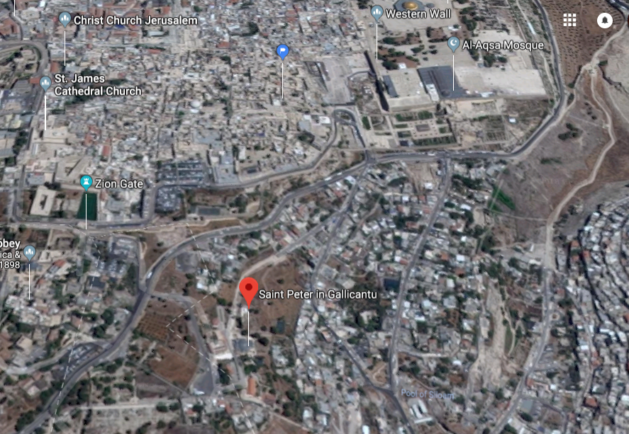
Notes:
https://www.google.com/maps/place/Saint+Peter+in+Gallicantu/@31.7635443,35.2317195,1093a,35y,39.01t/data=!3m1!1e3!4m5!3m4!1s0x150329cb44edb7ed:0xe93a1164fcc03272!8m2!3d31.7712875!4d35.2321113

Slide 16
^{Mattityahu (Matthew) 26:4-5} They plotted together in order that they might seize Yeshua by stealth and kill Him. “But not during the festival,” they were saying, “so there won’t be a riot among the people.”

Slide 17
Spiritual Significance
of Pesakh

Slide 18
(JNS) According to a Jewish People Policy Institute survey of 3,000 respondents, 97 percent of Israelis Jews say they either host or participate in a Passover Seder, compared to the 2013 Pew Study’s finding of 70 percent of American Jews who participated in the Seder the prior year.
Notes:
http://www.americanisraelite.com/news/israel_news/article_14ed6ace-31ea-11e8-8f8c-db53244d21ca.html

Slide 19
The Passover Seder is one of the only practices of Jews in Israel that is almost equally observed across the spectrum of Jewish sectors, including 93 percent of “totally secular” Jews.

Slide 20
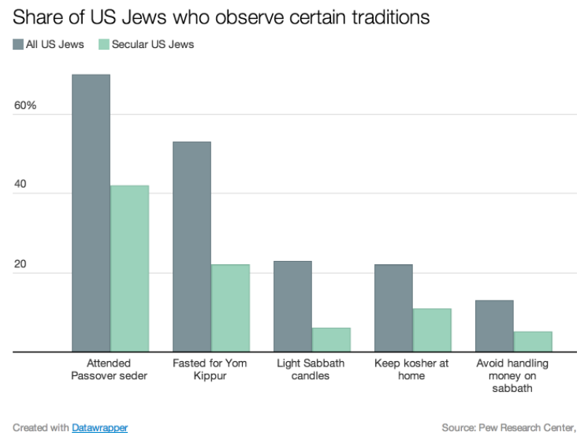
Notes:
Updated Apr 3, 2015, 1:34pm EDT https://www.vox.com/2014/4/14/5613562/why-passover-is-such-a-big-deal-for-american-jews-in-one-chart

Slide 21
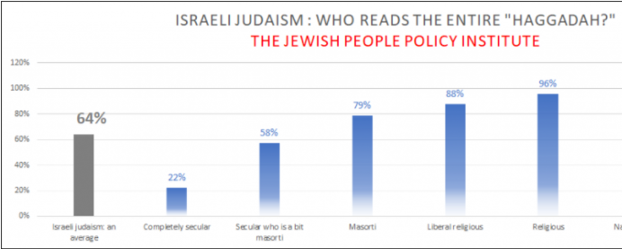
Notes:
Know personally a Russian Jewish lady, brought up in the militantly atheistic days of communism, who knew NOTHING of her family’s Jewish identity. Except, her father would get “holiday crackers” once /year. Not explained.
Passover is the oldest, yet the MOST observed of all Jewish festivals, even if a family is assimilating. Last relic of Jewish ID to be discarded.

Slide 22
David Ben-Gurion, Israel’s first Prime Minister, told the UN Commission of Inquiry in 1947: "300 years ago, the ‘Mayflower’ launched its historical voyage. How many Am ericans remember the month of the voyage, how many passengers
Notes:
https://www.democracyunderattack.org/?p=851%3futm_source=newsletter&utm_campaign=nl_open&utm_medium=email

Slide 23
were on the Mayflower and what kind of bread did they consume?
However, 3,300 years earlier, the Exodus from Egypt took place.
Every Jew knows the date of the Exodus - 15th of the month of Nissan - and the kind of bread - matzah - consumed.
Notes:
https://www.democracyunderattack.org/?p=851%3futm_source=newsletter&utm_campaign=nl_open&utm_medium=email

Slide 24
Until today, Jews all over the world tell the story of the Exodus and eat matzah on the 15th of Nissan. They conclude the story of the Exodus with a statement: 'This year we're slaves, but next year we shall be liberated; this year we're here, but next year in Jerusalem.' "
Notes:
https://www.democracyunderattack.org/?p=851%3futm_source=newsletter&utm_campaign=nl_open&utm_medium=email

Slide 25
What makes Passover
so important?

Slide 26
^{Shmot/Ex 12.42} This was a night when Adoni kept vigil to bring them out of the land of Egypt, and this same night continues to be a night when Adoni keeps vigil for all the people of Isra’el through all their generations.
Notes:
Adoni still continues to keep a vigil.
Targum:
Moses shall go out of the midst of the wilderness, and the King Messiah out of Rome; so it is said in the Jerusalem Targum on the place.

Slide 27
when Adoni kept vigil
ֵליל שִׁמֻּרִים הוּא לַיי
guarded ; kept ; preserved, maintained ; reserved, saved

Slide 28
From Chabad.org:
While the first night of Passover commemorates the redemption from exile in Egypt, the final day celebrates the future Redemption, which G‑d will bring about through Moshiach.
Notes:
https://www.chabad.org/holidays/passover/pesach_cdo/aid/1820/jewish/The-First-and-Final-Redemption.htm

Slide 29
The connection between the first and the last redemption is also gleaned from the verse:
^{Mikhah/Micah 7.15} "As in the days when you left Egypt, I shall show you wonders [during the final Redemption]."
Notes:
https://www.chabad.org/holidays/passover/pesach_cdo/aid/1820/jewish/The-First-and-Final-Redemption.htm

Slide 30
First and final redemptions
are related.
Notes:
That is why we open the door for Eliyahu/ Elijah. Redemption time.

Slide 31
Passover Ongoing Vigil Spiritual Story Summary:
Desperate situation of slavery
Intercessory prayer
Much plagues, warfare, miracles, suffering
Victory

Slide 32
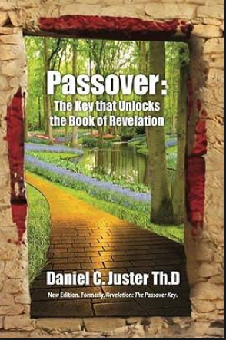

Notes:
Very abbreviated summary

Slide 33
1. ^{Shmot/Ex 2.23-25} Sometime during those many years the king of Egypt died, but the people of Isra’el still groaned under the yoke of slavery, and they cried out, and their cry for rescue from slavery came up to God.

Slide 34
^{Shmot/Ex 2.23-25} God heard their groaning, and God remembered his covenant with Avraham, Yitz’chak and Ya‘akov. God saw the people of Isra’el, and God acknowledged them.

Slide 35
^{Rev 8.3-5} Another angel came and stood at the altar, holding a golden incense burner. He was given much incense to offer up along with the prayers of all the kedoshim/holy people upon the golden altar before the throne. And the smoke of the incense,

Slide 36
^{Rev 8.3-5} with the prayers of the kedoshim, rose before God from the angel’s hand. Then the angel took the incense burner and filled it with fire from the altar, and threw it to the earth; and there were clashes of thunder and rumblings and flashes of lightning and earthquakes.

Slide 37
Pharaoh is like the anti-Messiah.
Pharaoh’s occult powered magicians are like the False prophet.
Aharon and Moshe are like the two prophetic witnesses, Rev. 11.3.

Slide 38
Plagues of Egypt are like the plagues of Revelation.
Battle almost lost to Pharaoh at shores of Reed Sea like woman almost lost to flood Rev. 12.15
Rev. 12.16 The woman [Israel] was protected from the flood is like Israel protected in Goshen.

Slide 39
Israel was protected for nine of the plagues by their bloodline / genealogy. Tenth by the blood of the lamb. Believers Rev 14 protected by Lamb.

Slide 40
Israel’s crossing the Reed Sea is like the believers crossing into the new heaven and earth.
Rev. 19.14 Believers on victorious battle horses like Israel leaving Egypt well armed.
Destruction of Pharaoh and his army like the defeat of HaSatan

Slide 41
Passover Ongoing Vigil Spiritual Story Summary:
Desperate situation of slavery
Intercessory prayer
Much plagues, warfare, miracles suffering
Victory

Slide 42
Joel C. Rosenberg addressed the National Religious Broadcasters convention before releasing his new book, The Kremlin Conspiracy. Excerpts from that speech:
Notes:
Family Research Council 801 G Street NW, Washington, D.C. 20001 1-800/225-4008

Slide 43
Joel C. Rosenberg
Preaching the gospel in the open air is now illegal in Russia. So is sharing the gospel with friends and coworkers -- even in your own home. So is inviting friends to come to church.
Notes:
Family Research Council 801 G Street NW, Washington, D.C. 20001 1-800/225-4008

Slide 44
The new Russian law signed in July 2016 is the "most restrictive measure [against religious freedom] in post-Soviet history." Darkness is falling in Russia. A new czar has risen, and his name is Vladimir Putin. Putin calls himself a Christian, but he has declared war on the gospel.
Notes:
Family Research Council 801 G Street NW, Washington, D.C. 20001 1-800/225-4008

Slide 45
Opponents wind up in jail. Journalists disappear or die. The economy is suffocating. Poverty is rampant. Deaths by alcoholism and drug overdoses are exploding. Since Putin came to power in 2000, the population has shrunk by more than three million people.
Notes:
Family Research Council 801 G Street NW, Washington, D.C. 20001 1-800/225-4008

Slide 46
One in four Russian men die before age fifty-five. And Russians aren't having enough children to replace themselves. Why would they? They have no hope.
Notes:
Family Research Council 801 G Street NW, Washington, D.C. 20001 1-800/225-4008

Slide 47
Yet on March 18 Russians went to the polls and reelect Vladimir Putin once again, giving him power to rule until 2024. Vladimir Putin poses a grave and growing threat to the national security of the United States and our allies [above] any power in the world -- greater than Radical Islam, Iran, North Korea or China...
Notes:
Family Research Council 801 G Street NW, Washington, D.C. 20001 1-800/225-4008

Slide 48
Putin made global headlines around the world by announcing that Russia has developed new first-strike nuclear missiles and state-of-the-art hypersonic underwater torpedoes
Notes:
Family Research Council 801 G Street NW, Washington, D.C. 20001 1-800/225-4008

Slide 49
that make NATO defenses "completely useless." Putin is hungry for wealth, hungrier for power, hungrier still for territory. He must be stopped, yet no one is stopping him...
Notes:
Family Research Council 801 G Street NW, Washington, D.C. 20001 1-800/225-4008

Slide 50
Putin sees himself as a modern-day czar. He's not a Communist, not a Marxist or Leninist. He is an imperialist. He feels humiliated by the collapse of the Soviet Empire. He sees his mission as rebuilding the glory of Mother Russia, and, [thus] is hell-bent on expanding Russia's borders...
Notes:
Family Research Council 801 G Street NW, Washington, D.C. 20001 1-800/225-4008

Slide 51
One-part mafia kingpin, one-part imperialist czar, Putin is: 1) rebuilding the Russian offensive war machine, 2) rebuilding Russia's strategic and tactical nuclear forces, 3) selling advanced weapons and even nuclear technology to Iran
Notes:
Family Research Council 801 G Street NW, Washington, D.C. 20001 1-800/225-4008

Slide 52
4) selling weapons to N. Korea,
5) invading her neighbors,
6) silencing her critics, and
7) threatening the West.
The big question is: What's next? Yekez/Ezk. 38-39? Gog?
(Joel C. Rosenberg; 3/6/18 Blog:"Darkness")
Notes:
Family Research Council 801 G Street NW, Washington, D.C. 20001 1-800/225-4008

Slide 53
Passover Ongoing Vigil Spiritual Story Summary:
Desperate situation
Intercessory prayer
Much plagues, warfare, miracles, suffering
Victory

Slide 54
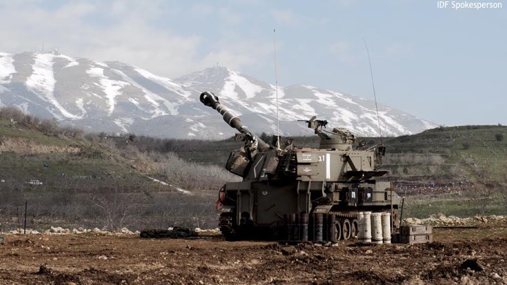
Israel prepares for war in the North
Notes:
http://www.israeltoday.co.il/NewsItem/tabid/178/nid/33488/Default.aspx

Slide 55
Maj.-Gen. Eyal Ben-Reuven, who is also a member of Knesset, said:
"The people who were supposed to be the 'brakes' in this situation were the Russians, whose planes are currently massacring Syrian civilians in Damascus.
Notes:
http://www.israeltoday.co.il/NewsItem/tabid/178/nid/33488/Default.aspx

Slide 56
Maj.-Gen. Eyal Ben-Reuven, who is also a member of Knesset, said:
The Russians aren't doing their job, and the Americans, unfortunately, aren't in the area and hardly say anything. So if the situation continues the way it is, we're on our way to another wide-scale war in Israel's north. I pray that I'm wrong.
Notes:
http://www.israeltoday.co.il/NewsItem/tabid/178/nid/33488/Default.aspx
And Pres. Trump said this week that the US is soon getting out of Syria, after 7 trillion dollars of waster war effort. True that many problems. If Saddam Hussein were still here, he would be facing off the Iranians. ??
We are leaving the Kurds unaided.
Historical digression…
Hebrides Islands, northern Scotland.

Slide 57
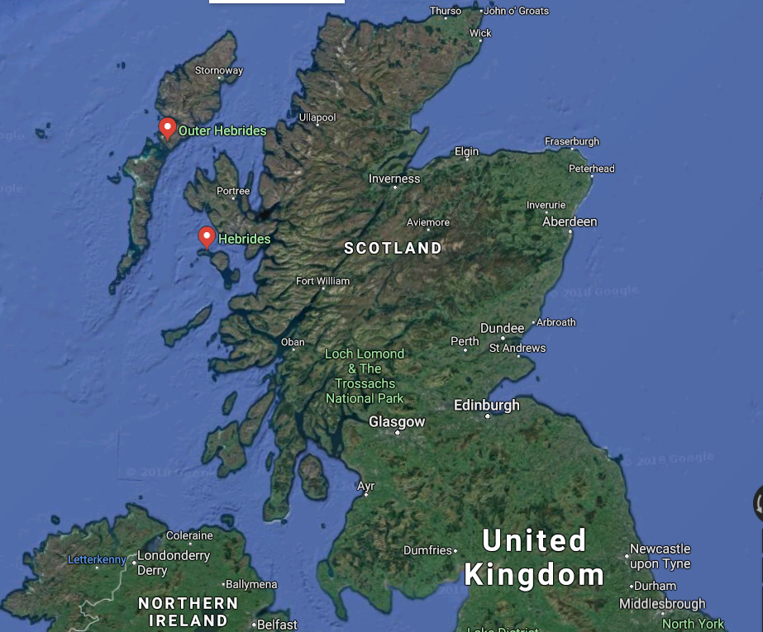

Slide 58
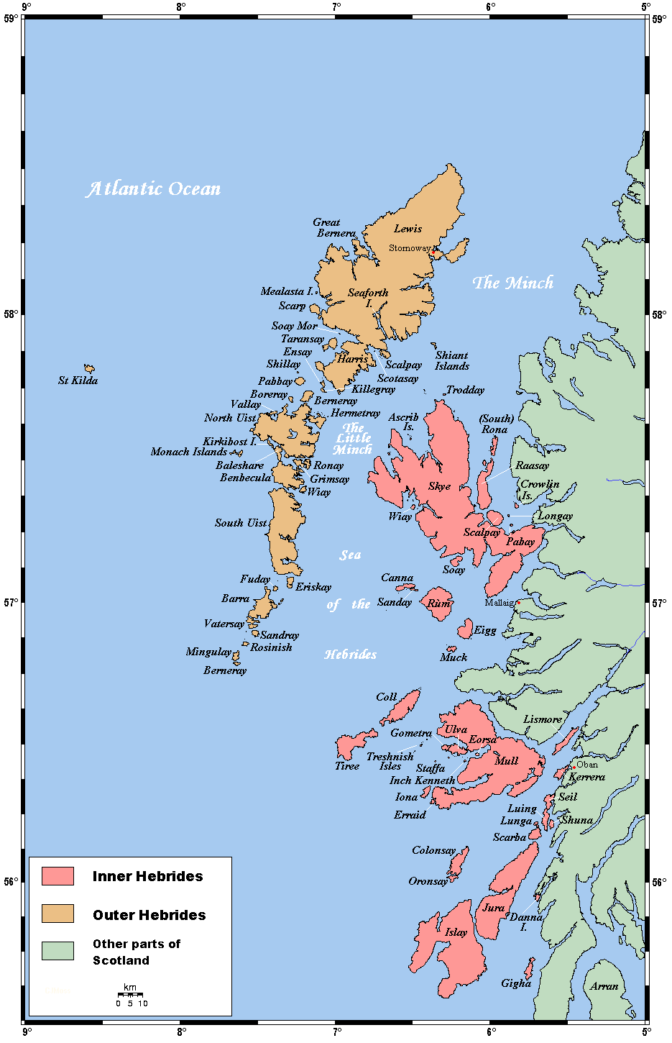
Notes:
Note Island of Lewis

Slide 59
In 1949, the Island of Lewis was much like any other part of England. The town of Stornoway, where the revival began, had emptying pews as attendance waned, while pubs were thriving. Not a single young persons attended services.
Notes:
http://www.chapelofgrace.org.uk/a-profile-of-the-hebrides-revival-1949/

Slide 60
Two elderly sisters, housebound and infirm, unable to attend services, made their small home their prayer closet. Peggy and Christine Smith were 82 and 84 and though they were weak in flesh, one blind and the other crippled with arthritis,
Notes:
http://www.chapelofgrace.org.uk/a-profile-of-the-hebrides-revival-1949/

Slide 61
these women were mighty intercessors and friends of God. The Lord gave them the promise of Isaiah 44.3 and they contended for this promise for their island in prayer day and night.
Notes:
http://www.chapelofgrace.org.uk/a-profile-of-the-hebrides-revival-1949/

Slide 62
For I will pour water on the thirsty land, and streams on the dry ground; I will pour out my Spirit on your offspring, and my blessing on your descendants.
Notes:
http://www.chapelofgrace.org.uk/a-profile-of-the-hebrides-revival-1949/

Slide 63
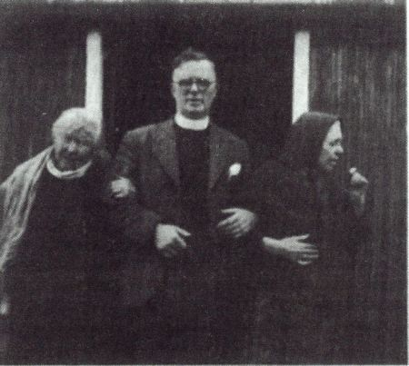
Peggy and Christine Smith
with Duncan Campbell

Slide 64
One night, one of the sisters had a vision. Now remember, in revival, God works in wonderful ways. A vision came to one of them, and in the vision she saw the congregation of her fathers crowded with young people.
Notes:
http://www.revival-library.org/index.php/pensketches-menu/historical-revivals/the-hebrides-revival

Slide 65
That morning, one of the sisters said to the minister, "You must do something about it. And I would suggest that you call your office bearers together and that you spend with us at least two nights in prayer in the week.
Notes:
http://www.revival-library.org/index.php/pensketches-menu/historical-revivals/the-hebrides-revival

Slide 66
Tuesday and Friday if you gather your elders together, you can meet in a barn - and as you pray there, we will pray here.
Notes:
http://www.revival-library.org/index.php/pensketches-menu/historical-revivals/the-hebrides-revival

Slide 67
Well, that continued for some weeks--indeed, I believe almost a month and a half. One night a young man stood up and said, “It seems to me to be so much humbug to be praying as we are praying, to be waiting as we are waiting, if we ourselves are not rightly related to God. Ps 24
Notes:
This is taken from a recounting of the story by Duncan Campbell. I’m skimming through, but if you get the notes, you can go to the link and read the supernatural details.
http://www.revival-library.org/index.php/pensketches-menu/historical-revivals/the-hebrides-revival

Slide 68
When that happened in the barn, the power of God swept into the parish. And an awareness of God gripped the community such as hadn't been known for over 100 years. An awareness of God-that's revival, that's revival. And on the following day,
Notes:
http://www.revival-library.org/index.php/pensketches-menu/historical-revivals/the-hebrides-revival

Slide 69
the looms were silent, little work was done on the farms as men and women gave themselves to thinking on eternal things gripped by eternal realities.
Notes:
http://www.revival-library.org/index.php/pensketches-menu/historical-revivals/the-hebrides-revival

Slide 70
One of the sisters sent for the minister. And she said to him, "I think you ought to invite someone to the parish. I cannot give a name, but God must have someone in His mind for we saw a strange man in the pulpit, and that man must be somewhere.
Notes:
http://www.revival-library.org/index.php/pensketches-menu/historical-revivals/the-hebrides-revival

Slide 71
Duncan Campbell came to the Hebrides and arrived in the evening. Went to a service that was supposed to be brief, but on exiting
Notes:
http://www.revival-library.org/index.php/pensketches-menu/historical-revivals/the-hebrides-revival

Slide 72
Six hundred people--where had they come from? What had happened? I believe that that very night God swept in Shavuot power-the power of the Holy Spirit. And what happened in the early days of the apostles was happening now in the parish of Barvas.
Notes:
http://www.revival-library.org/index.php/pensketches-menu/historical-revivals/the-hebrides-revival

Slide 73
Over 100 young people were at the dance in the parish hall and they weren't thinking of God or eternity. God was not in all of their thoughts. They were there to have a good night when suddenly the power of God fell upon the dance.
Notes:
http://www.revival-library.org/index.php/pensketches-menu/historical-revivals/the-hebrides-revival

Slide 74
The music ceased and in a matter of minutes, the hall was empty. They fled from the hall as a man fleeing from a plague. And they made for the service. They are now standing outside.
Notes:
http://www.revival-library.org/index.php/pensketches-menu/historical-revivals/the-hebrides-revival
During one of the prayer meetings, there was an earth tremor.

Slide 75
'Seventy-five percent (of the people) were gloriously saved before they came near a meeting..... the power of God was moving!'"
Notes:
https://en.wikipedia.org/wiki/Duncan_Campbell_(revivalist)
Many stories of huge gatherings unadvertised, amazing responses to Yeshua.

Slide 76
You ask me, "What is the fruit of this type of movement?" Some little time ago the parish minister was asked to give a report in the record of the church of Scotland. He was asked to give a report on the fruit of the revival. Did they stand?
Notes:
http://www.revival-library.org/index.php/pensketches-menu/historical-revivals/the-hebrides-revival

Slide 77
Any backsliding? Now this is what he wrote: "I will confine my remarks to my own parish--I will allow the other ministers to give their own reports. But let me speak of my own parish. In a certain village 122 young people found the faith and I'm not talking about middle age or the old.
Notes:
http://www.revival-library.org/index.php/pensketches-menu/historical-revivals/the-hebrides-revival

Slide 78
They were wonderful, but I'm thinking about the young people. 122 all of them over the age of 17. They found the Savior during the first day of the revival. Today I can say that they are growing like flowers in the garden of God, there is not a single backslider among them."
Notes:
http://www.revival-library.org/index.php/pensketches-menu/historical-revivals/the-hebrides-revival

Slide 79
Between 1949 and 1952 a wide spread revival swept through these islands in answer to the prayers of God’s people. This revival became knows as the Hebrides Revival.
Notes:
https://steemit.com/christianity/@buddy67/donald-trump-s-connection-to-the-hebrides-revival
The next details are where it gets contemporary.

Slide 80
Mary Anne Smith MacLeod, niece of the two intercessors of the Hebrides Revival, cousin of Donald Smith the 15 year old converted at the revival, emigrated from the Hebridean Island of Lewis, off the west coast of Scotland, from where she emigrated to America and met a gentleman named Frederick Trump
Notes:
https://steemit.com/christianity/@buddy67/donald-trump-s-connection-to-the-hebrides-revival
Father of Donald Trump. Pres. Trump is heir to this revival heritage. Visited the cottage of his ancestors, and proud of heritage.

Slide 81

Notes:
This is not the cottage, but is in the Hebrides. Other family

Slide 82
^{Shmot/Ex 20.5-6} I, Adoni your God, am a jealous God, punishing the children for the sins of the parents to the third and fourth generation of those who hate me, but displaying grace to the thousandth generation of those who love me and obey mymitzvot.
Notes:
Trump’s family heritage is bit like James Dobson: grandfather prayed.

Slide 83
Passover ongoing Vigil Spiritual Story Summary:
Desperate situation of slavery
Intercessory prayer
Much plagues, warfare, miracles suffering
Victory
Notes:
I’m saying that we need to be people of intercession. Tuesday, private, other times. Passion for G-d to move in Israel.
I believe in the power of publicity and media and excellence. But most of all, I believe in the power of prayer.
Desperate times?

Slide 84
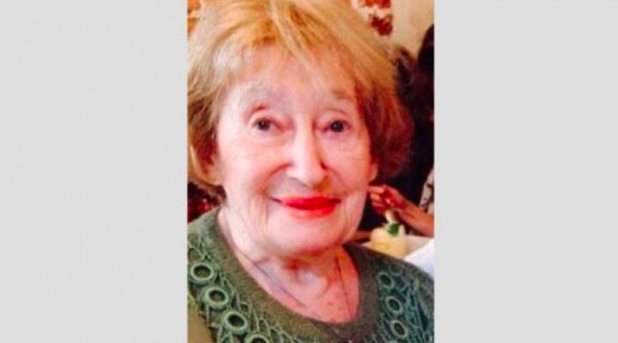
Mireille Knoll, an 85-year-old Holocaust survivor, murdered.
Notes:
https://worldisraelnews.com/france-2-arrested-brutal-murder-holocaust-survivor/?utm_source=MadMimi&utm_medium=email&utm_content=IDF+Catches+Armed+Terrorists+12+Miles+into+Israel%3B+Exclusive%3A+How+NFL+Champions+Love+the+Land+of+Israel%3B+Today%27s+Top+Stories%21&utm_campaign=20180327_m144706857_IDF+Catches+Armed+Terrorists+12+Miles+into+Israel%3B+Exclusive%3A+How+NFL+Champions+Love+the+Land+of+Israel%3B+Today%27s+Top+Stories%21&utm_term=_0D_0A_09_09_09_09_09_09_09_09_09_09Read+Now_0D_0A_09_09_09_09_09_09_09_09_09

Slide 85
“She was absolutely massacred. Eleven knife wounds. That is hatred of the Jews, we see it in the fury of the murderer. This is how we recognize anti-Semitism.”

Slide 86
A granddaughter of the victim, Noa Goldfarb, wrote on Facebook: “Twenty years ago, I left Paris knowing that neither my future nor that of the Jewish People is to be found there. But who would’ve thought that I was leaving my relatives where terrorism and cruelty would lead to such a tragedy.

Slide 87
Grandmother was stabbed to death 11 times by a Muslim neighbor she knew well, who made sure to set fire to her home and left us not even one object, a letter, a photograph, to remember her by. All we have are our tears and each other.”

Slide 88
A number of anti-Semitic episodes have shaken France, including the murder last year of Sarah Halimi, an elderly Jewish woman, by a man of Malian origin who shouted, “God is great” before throwing her out a window.

Slide 89
Passover ongoing vigil Spiritual Story Summary:
Desperate situation of slavery
Intercessory prayer
Much plagues, warfare, miracles suffering
Victory

Slide 90
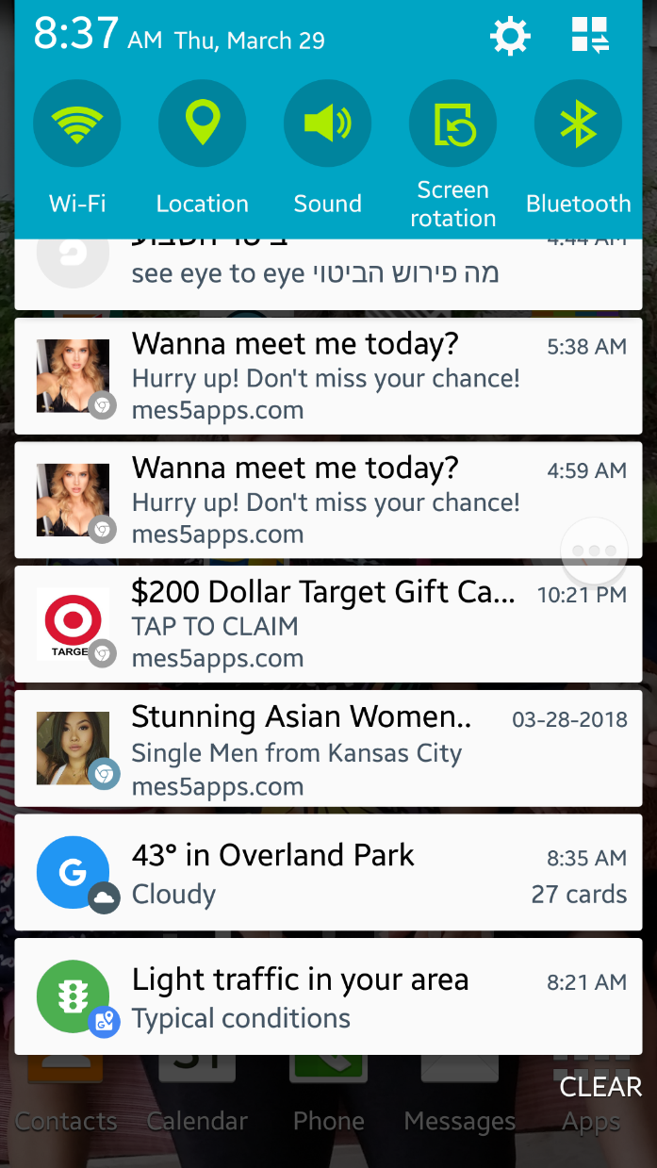
Screenshot from
my AT&T Galaxy 5
phone
Malicious adware
mes5apps.com
59 minutes 22 sec
phone call w AT&T
Notes:
Getting out khametz

Slide 91

Screenshot from
my AT&T Galaxy 5
phone
permissions needed
To have Facebook
Messenger
Notes:
I read that Facebook app monitors your texts and phone calls.
We currently don’t have a government like Putin’s, but who knows?
Person of Interest series. NSA

Slide 92
Intercessory prayer, then G-d intervenes supernaturally.

Slide 93
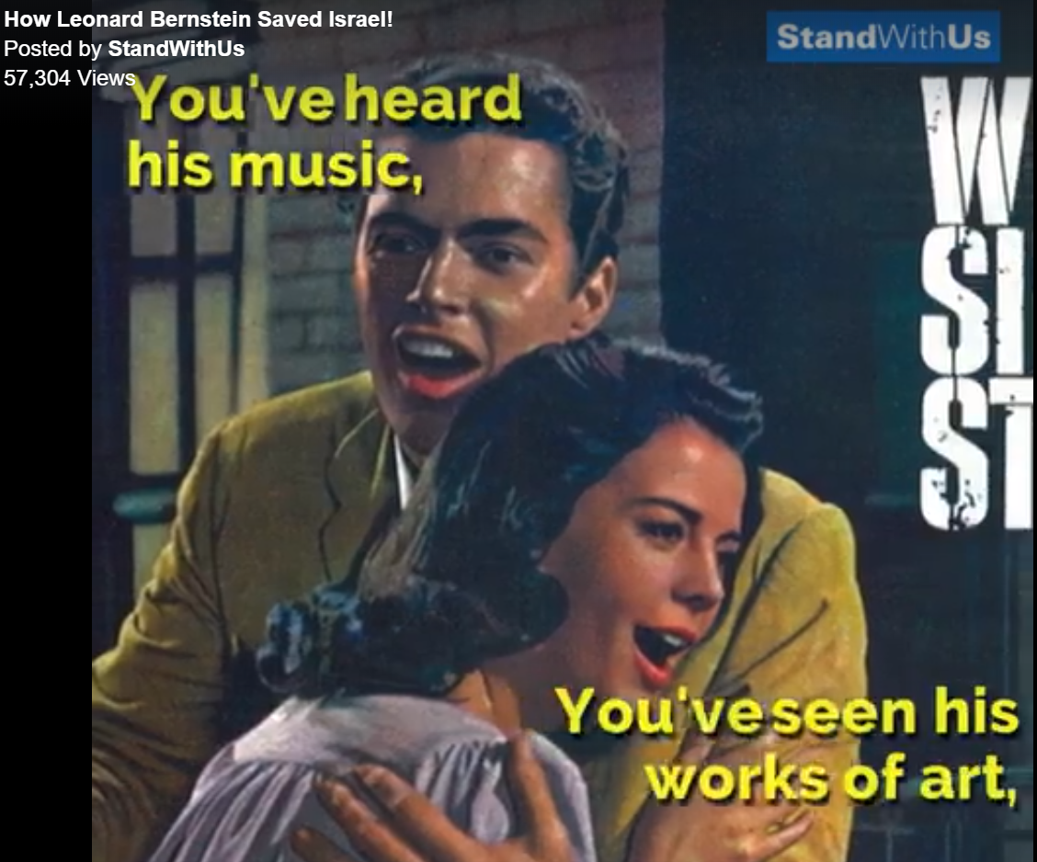

Slide 94
Leonard Bernstein saved Israel
https://www.facebook.com/StandWithUs/videos/10155542553397689/?t=0
Notes:
I imagine most are aware of the current crisis on the Gaza border.

Slide 95
From George Whitten, Worthy News.
The New Testament records that when Yeshua died; there was a great earthquake and the veil of the Temple was torn in two. The size of this gigantic veil is not recorded in the NT...

Slide 96
From George Whitten, Worthy News.
but we read from other sources that it was roughly 60 feet long and 30 feet wide with multiple woven layers the thickness of a man's hand! It was hung on a crossbeam stone – a lintel – which was over 30 feet long and weighed more than 30 tons! It was not an easy cloth to tear...

Slide 97
From George Whitten, Worthy News.
Jerome, a fourth century Church Father, writes concerning the tearing of the veil, that not only was the veil torn, but the great earthquake had also caused the lintel of the Temple to be broken in two.

Slide 98
From George Whitten, Worthy News.
In fact, it seems that the breaking of the lintel was what caused the veil to be torn in half from top to bottom, since the veil hung down from the lintel.

Slide 99
From George Whitten, Worthy News.
In the culture of the Jewish people, a father will commonly mourn the loss of his son by rending or tearing his garment...Can we suggest that the rending of the Temple's veil likewise, dramatically expressed our Heavenly Father's agony over the death of Yeshua, His only begotten Son?

Slide 100
From George Whitten, Worthy News.
The way was prepared through the death of the Son of God for us to have access to the Holy of Holies, that place on earth which was prepared for the abiding Presence of God's Spirit, and, in earlier Temple times, actually contained His Glory

Slide 101
From George Whitten, Worthy News.
In the death of the Messiah Yeshua, every barrier and obstacle, even a 30 ton stone that needed to be broken – was removed, to make a way for us to have an intimate relationship with the Father!

Slide 102
From George Whitten, Worthy News.
The sound of ripping cloth, the rending of a massive veil, echoes throughout history to this very day. The agony of that sound of mourning opened for us "a new and living way which He consecrated for us, through the veil, that is, His flesh" [Hebrews 10:20]...

Slide 103
From George Whitten, Worthy News.
so that now, at any time, we can approach our Heavenly Father with boldness and confidence in His love and acceptance. As we embrace the sacrifice of Yeshua,

Slide 104
From George Whitten, Worthy News.
come with a clean heart in His righteousness, we may fully expect His constant intervention and blessing in our everyday lives--- because the way has been permanently opened to us!

Slide 105
Passover ongoing vigil Spiritual Story Summary:
Desperate situation of slavery
Intercessory prayer
Much plagues, warfare, miracles suffering
Victory
Notes:
Do we have clean hands, pure heart, like young man in Hebrides revival story, cousin of the POTUS.
G-d has power, and will help Israel and us supernaturally. Halleluyah!

