Slide 1
Things you’ll see only in Israel
Notes:
We’re leaving on our trip soon, so prep….from Kathleen Eltrich

Slide 2
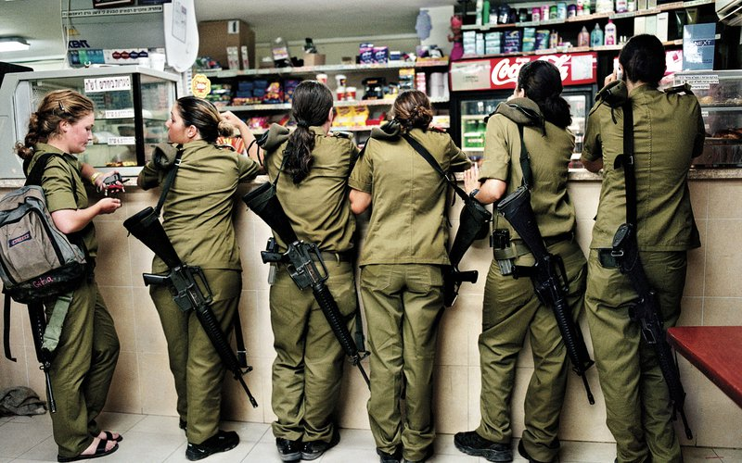
Why convenience stores are seldom robbed.

Slide 3
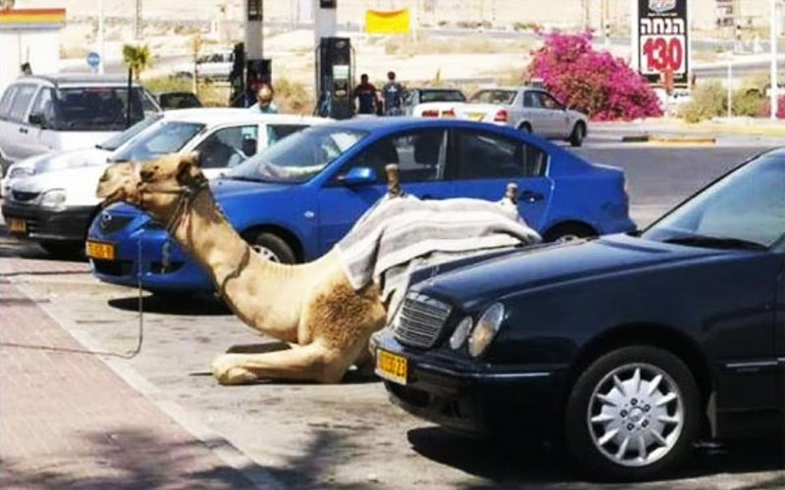

Slide 4
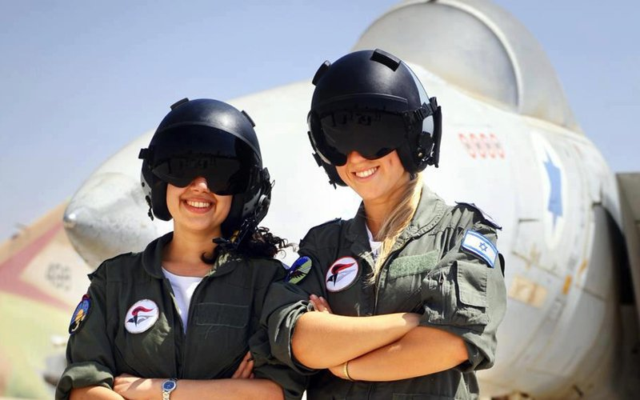
More women fly F-16’s in Israel
than drive cars in Saudi Arabia.
Notes:
At least, at the time this was taken. Now MbS is liberalizing some things.

Slide 5
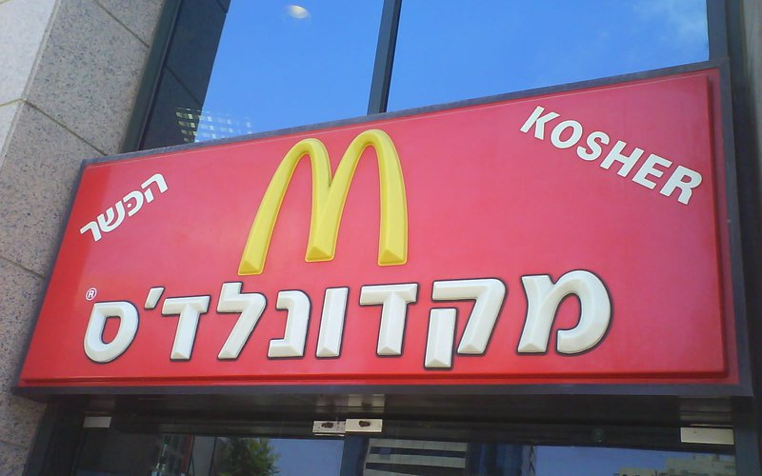

Slide 6
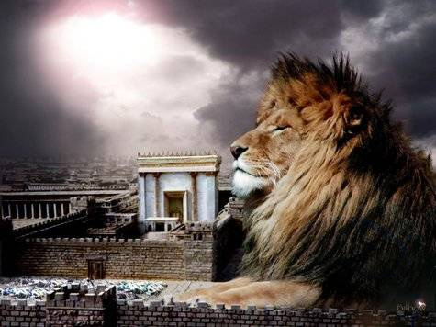
מַתִּתְיָהוּ Mattityahu
(Matthew) 9:22
Notes:
Thinking about last week’s message, and blessing, I felel there is more that G-d wants us to consider. Daniel read this verse about faith…

Slide 7
Mattityahu (Matthew) 9:22 (Tree of Life version/TLV)
וַפָּנָה יֵשׁוּעַ וְרָאָה אוֹתָה. אָמַר לָהּ: "חִזְקִי, בִּתִּי,
But then Yeshua turned and saw her. “Take heart, daughter,” He said,

Slide 8
Mattityahu (Matthew) 9:22 (Tree of Life version/TLV)
אֱמוּנָתֵךְ הוֹשִׁיעָה אוֹתָךְ." מֵאוֹתָהּ שָעָה נִרְפְּאָה הָאִשָּׁה.
“your faith has made you well.” That very hour the woman was healed.

Slide 9
Faith in G-d = confidence that He is a loving father. A blesser…
Notes:
The blessing of a father was the theme of my message at the Bat Mitzvah last week. Much more to that.
As we read the following, breathe it in…G-d in Yeshua is Your loving Father, or wants to be if you’ve received Him as Savior.

Slide 10
^{Matityahu 6.8-12} Your Father knows what you need before you ask him. You, therefore, pray like this: ‘Our Father in heaven! May your Name be kept holy. May your Kingdom come…Give us the food we need today. Forgive us what we have done wrong.

Slide 11
^{Matityahu5.45} …your Father in heaven. He causes His sun to rise on the evil and the good, and sends rain on the righteous and the unrighteous.

Slide 12
^{Matityahu 7.11} …how much more will your Father in heaven give good things to those who ask Him!
^{Matityahu 10.29} Aren’t sparrows sold for next to nothing, two for an assarion? Yet not one of them will fall to the ground without your Father’s consent.

Slide 13
^{Ro. 1.7} Grace to you and shalom from God our Father and the Lord Yeshua the Messiah.
Notes:
Yeshua brings the love of the Father.

Slide 14
^{Ro. 8.15} For you did not receive a spirit of slavery to bring you back again into fear; on the contrary, you received the Spirit, who makes us sons and by whose power we cry out, “Abba!” (that is, “Dear Father!”)
Notes:
This is the heart of our walk with Messiah, confidence that we are forgiven, and a child of the Living G-d through the Messiah Yeshua.

Slide 15
^{2 Thes 2.16-17} Now may our Lord Yeshua the Messiah Himself and God our Father, who loved us and by grace gave us eternal comfort and good hope, comfort and strengthen your hearts in every good deed and word.

Slide 16
Matityahu ch 5-7 Midrash [message] on the Mountain
Matityahu ch 8-9 Yeshua exemplifying the sermon: service, some supernatural. Twelve miracles. Faith in the loving power and presence of the Father repeated theme.
Notes:
Faith → receiving blessing

Slide 17
^{Mtt 8.13} Then Yeshua said to the officer, “Go; let it be for you as you have trusted.” And his orderly was healed at that very moment.

Slide 18
^{Mtt 8.26} He said to them, “Why are you afraid, O you of little faith?” Then He got up and rebuked the winds and the sea, and it became totally calm.

Slide 19
^{Mark 5.35} While he was still speaking, people from the synagogue official’s house came, saying, “Your daughter has died. Why bother the rabbi any longer?” Ignoring what they had said, Yeshua told the synagogue official, “Don’t be afraid, just keep trusting.”
Notes:
Parallel passage in Mark

Slide 20
Faith in G-d = confidence that He is a loving father. A blesser…
Faith in G-d has positive effects beyond what we might imagine…

Slide 21
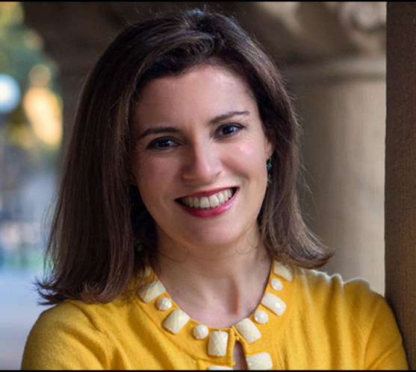
Ilana Horwitz
a doctoral
student in
Sociology of
Education &
Jewish Studies
at Stanford
University
Notes:
http://thefederalist.com/2018/04/19/stanford-study-religious-kids-best-school/
Stanford U. the Harvard of the West Coast, not exactly a friend of faith & religion!!

Slide 22
Adolescents who practice religion regularly perform better in school than those adolescents who do not, finds a recent study performed by Dr. Ilana M. Horwitz at Stanford’s Graduate School of Education.
Notes:
http://thefederalist.com/2018/04/19/stanford-study-religious-kids-best-school/

Slide 23
Horwitz bucketed the students into five different levels of religious adherence, from most religious to least religious: Abiders, Adapters, Assenters, Avoiders, and Atheists. She found the most religious kids had the highest GPAs.
Notes:
http://thefederalist.com/2018/04/19/stanford-study-religious-kids-best-school/
~Yeshua says: Yn 15. 7-8 If you abide in Me and My words abide in you, ask whatever you wish, and it shall be done for you. In this My Father is glorified, that you bear much fruit and so prove to be My disciples.”

Slide 24
Horwitz found that, within each income bracket, Abiders consistently received better grades than Adapters, Assenters, and Avoiders did, while the GPA gap between Abiders and Avoiders was most pronounced.
Notes:
http://thefederalist.com/2018/04/19/stanford-study-religious-kids-best-school/

Slide 25
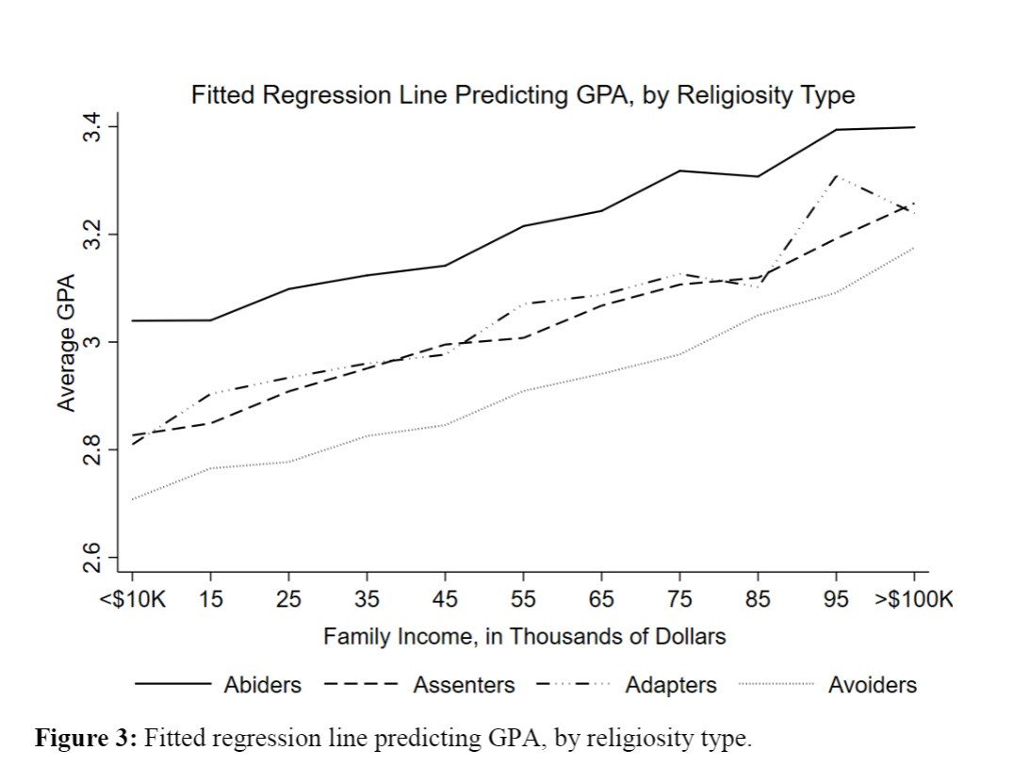
Abiders
Avoiders
Notes:
http://thefederalist.com/2018/04/19/stanford-study-religious-kids-best-school/

Slide 26
Even after controlling for a host of factors, including “Gender, race/ethnicity, family socio-economic status, religious affiliation, and region of the country,” Abiders had an average GPA of 3.21, while Avoiders had just a 2.92 GPA.
Notes:
http://thefederalist.com/2018/04/19/stanford-study-religious-kids-best-school/

Slide 27
^{Ro. 3.1} Then what is the advantage of being Jewish?... Much in every way! In the first place, the Jews were entrusted with the very words of God.
Notes:
Sometimes people ask me, “Why are all Jews rich?”
First of all, we’re not.
Second, why 22% of Nobel Prizes to us .02% world’s population? Above: culture of Biblical literacy.
Best reading material supernatural benefits
Biblical literacy → all literacy.

Slide 29
Faith in G-d = confidence that He is a loving father. A blesser…
Such confidence builds emotional, social, psychological
health, wholeness, holiness.
Blessing: fatherly & motherly love.

Slide 30

How to Bless Your Child
Notes:
vadimguzhva/iStock/Thinkstock

Slide 31
How to Bless Your Child
Meaningful touch
A spoken message — words of love and acceptance
Attaching High Value
Picturing a Special Future
An Active Commitment: time, listening [touch, talk, time]
Notes:
When I began playing football in high school, one par­ticular coach thought I was filled with raw talent (emphasis on raw!). He was constantly chewing me out, and he even took extra time after practice to point out mistakes I was making. After I missed an important block in practice one day (a frequent occurrence), this coach stood one inch from my face mask and chewed me out six ways from Sunday. When he finally finished, he had me go over to the sidelines with the other players who were not a part of the scrimmage. Standing next to me was a third-string player who rarely got into the game. I can remember leaning over to him and saying, "Boy, I wish he would get off my case."
"Don't say that," my teammate replied. "At least he's talk­ing to you. If he ever stops talking to you, that means he's given up on you."

Slide 32

Notes:
https://www.google.com/search?q=father+blessing+son+quotes&safe=active&tbm=isch&source=iu&ictx=1&fir=tZt9OPcrn6ChKM%253A%252CKXqYZdnCDlVniM%252C_&usg=__VzvCa0TSxlihf9CMc1WXa0E3KV4%3D&sa=X&ved=0ahUKEwjZq8KIlMraAhULyoMKHaa5B_UQ9QEIKzAA#imgrc=VFrSz3mLHCbiOM:
These are for each of us…breathe them in, inhale this reality, drink

Slide 33

Notes:
https://www.google.com/search?q=father+blessing+son+quotes&safe=active&tbm=isch&tbs=rimg:CVRa0s95ixwmIjgSf7kTmEKVS8l1KC21zZBch2rLm_1roFMWoxAyOWSmbGGSLDdZOi987XpiOpEcWk3q68VaQaxBqZCoSCRJ_1uROYQpVLES59wYTjMH2wKhIJyXUoLbXNkFwR3cC_1jtaHNX4qEgmHasub-ugUxRGPSXG50tzynCoSCajEDI5ZKZsYESynJc6H5l5gKhIJZIsN1k6L3zsRJj0ZewV5wt0qEglemI6kRxaTehHksqF5b5WuvSoSCbrxVpBrEGpkESvepVgvYrvT&tbo=u&sa=X&ved=2ahUKEwi0rJqPlMraAhWM7IMKHTg-B1IQ9C96BAgAEBs&biw=1165&bih=848&dpr=1.1#imgrc=ucojnSfRlzwruM:

Slide 34
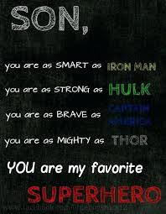
Notes:
https://www.google.com/search?q=father+blessing+son+quotes&safe=active&tbm=isch&tbs=rimg:CVRa0s95ixwmIjgSf7kTmEKVS8l1KC21zZBch2rLm_1roFMWoxAyOWSmbGGSLDdZOi987XpiOpEcWk3q68VaQaxBqZCoSCRJ_1uROYQpVLES59wYTjMH2wKhIJyXUoLbXNkFwR3cC_1jtaHNX4qEgmHasub-ugUxRGPSXG50tzynCoSCajEDI5ZKZsYESynJc6H5l5gKhIJZIsN1k6L3zsRJj0ZewV5wt0qEglemI6kRxaTehHksqF5b5WuvSoSCbrxVpBrEGpkESvepVgvYrvT&tbo=u&sa=X&ved=2ahUKEwi0rJqPlMraAhWM7IMKHTg-B1IQ9C96BAgAEBs&biw=1165&bih=848&dpr=1.1#imgdii=2yPPJ9mMjMJASM:&imgrc=vQPQvvc_M8aoRM:

Slide 35
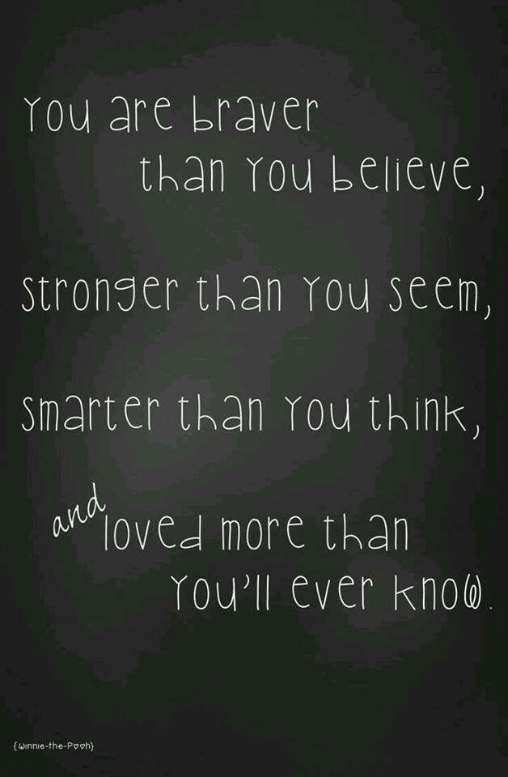
Notes:
https://www.google.com/search?q=father+blessing+son+quotes&safe=active&tbm=isch&tbs=rimg:CVRa0s95ixwmIjgSf7kTmEKVS8l1KC21zZBch2rLm_1roFMWoxAyOWSmbGGSLDdZOi987XpiOpEcWk3q68VaQaxBqZCoSCRJ_1uROYQpVLES59wYTjMH2wKhIJyXUoLbXNkFwR3cC_1jtaHNX4qEgmHasub-ugUxRGPSXG50tzynCoSCajEDI5ZKZsYESynJc6H5l5gKhIJZIsN1k6L3zsRJj0ZewV5wt0qEglemI6kRxaTehHksqF5b5WuvSoSCbrxVpBrEGpkESvepVgvYrvT&tbo=u&sa=X&ved=2ahUKEwi0rJqPlMraAhWM7IMKHTg-B1IQ9C96BAgAEBs&biw=1165&bih=848&dpr=1.1#imgdii=nFjtR6QyFAXAKM:&imgrc=eU48T6Afx8Aj3M:

Slide 36
Having blessing doesn’t mean you won’t have fierce enemies and opposition.

Slide 37
^{Rev. 12.10} Then I heard a loud voice in heaven saying, “Now have come the salvation and the power and the kingdom of our God and the authority of His Anointed One,

Slide 38
^{Rev. 12.10} for the accuser of our brothers and sisters—the one who accuses them before our God day and night—has been thrown out.
Notes:
Military enemies…

Slide 39
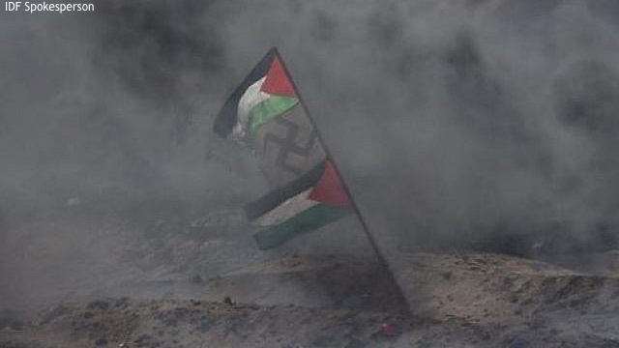
Notes:
You’ve heard of the “peaceful Gaza protests.”

Slide 40
Israel Prime Minister Benjamin Netanyahu clarified: “I salute the soldiers of the IDF who keep us safe…from those who pretend to speak of human rights, while holding a Nazi flag. Here is the naked truth. They speak of human rights, but they really want to crush the Jewish state.
Notes:
http://www.israeltoday.co.il/NewsItem/tabid/178/nid/33744/Default.aspx

Slide 41
We won’t let them. We’ll stand strong. We’ll keep our country safe.”
The Nazi flag and the ideology behind it mean but one thing for both Israel and the Palestinian nationalist movement - the eradication of the Jewish people.
Notes:
http://www.israeltoday.co.il/NewsItem/tabid/178/nid/33744/Default.aspx

Slide 42
Having blessing often means you’ll receive help from unexpected sources.
Iran is Israel’s main current enemy, underlying Hezbullah & Hamas, destroying Syria.

Slide 43
Since the beginning of the year, the Iranian currency, the rial has lost nearly one-third of its value. When Iranian President Hassan Rouhani came to power in 2013, $1 equaled 36,000 rials;
Notes:
https://worldisraelnews.com/analysis-irans-plummeting-currency-reflects-countrys-economic-military-concerns/?utm_source=MadMimi&utm_medium=email&utm_content=US+Blasts+Palestinians%27+%27Empty+Rhetoric%27%3B+Revealed%3A+Israel+Attacked+Iranians+in+Syria%3B+Israel+and+Russia%3A+Friends+or+Foes+in+Syria%3F&utm_campaign=20180416_m145002708_US+Blasts+Palestinians%27+%27Empty+Rhetoric%27%3B+Revealed%3A+Israel+Attacked+Iranians+in+Syria%3B+Israel+and+Russia%3A+Friends+or+Foes+in+Syria%3F&utm_term=_0D_0A_09_09_09_09_09_09_09_09_09_09Read+Now_0D_0A_09_09_09_09_09_09_09_09_09

Slide 44
now that figure stands near 60,000 rials to the dollar. However, the currency devaluation has been a trend since the 1979 Islamic Revolution, when the dollar equaled 70 rials.
Notes:
https://worldisraelnews.com/analysis-irans-plummeting-currency-reflects-countrys-economic-military-concerns/?utm_source=MadMimi&utm_medium=email&utm_content=US+Blasts+Palestinians%27+%27Empty+Rhetoric%27%3B+Revealed%3A+Israel+Attacked+Iranians+in+Syria%3B+Israel+and+Russia%3A+Friends+or+Foes+in+Syria%3F&utm_campaign=20180416_m145002708_US+Blasts+Palestinians%27+%27Empty+Rhetoric%27%3B+Revealed%3A+Israel+Attacked+Iranians+in+Syria%3B+Israel+and+Russia%3A+Friends+or+Foes+in+Syria%3F&utm_term=_0D_0A_09_09_09_09_09_09_09_09_09_09Read+Now_0D_0A_09_09_09_09_09_09_09_09_09

Slide 45
In order to ease the panic, the Iranian government announced this week that it was going to set the official exchange rate at 42,000 rials to the dollar, while threatening harsh punishment to anyone trying to exchange money at a different rate.
Notes:
https://worldisraelnews.com/analysis-irans-plummeting-currency-reflects-countrys-economic-military-concerns/?utm_source=MadMimi&utm_medium=email&utm_content=US+Blasts+Palestinians%27+%27Empty+Rhetoric%27%3B+Revealed%3A+Israel+Attacked+Iranians+in+Syria%3B+Israel+and+Russia%3A+Friends+or+Foes+in+Syria%3F&utm_campaign=20180416_m145002708_US+Blasts+Palestinians%27+%27Empty+Rhetoric%27%3B+Revealed%3A+Israel+Attacked+Iranians+in+Syria%3B+Israel+and+Russia%3A+Friends+or+Foes+in+Syria%3F&utm_term=_0D_0A_09_09_09_09_09_09_09_09_09_09Read+Now_0D_0A_09_09_09_09_09_09_09_09_09

Slide 46
“The larger issues continue to be rampant” in Iran…official corruption, at levels not seen in modern history of Iran; mismanagement of the banking sector, which is on the verge of collapse.”
Keep believing and praying!!
Notes:
https://worldisraelnews.com/analysis-irans-plummeting-currency-reflects-countrys-economic-military-concerns/?utm_source=MadMimi&utm_medium=email&utm_content=US+Blasts+Palestinians%27+%27Empty+Rhetoric%27%3B+Revealed%3A+Israel+Attacked+Iranians+in+Syria%3B+Israel+and+Russia%3A+Friends+or+Foes+in+Syria%3F&utm_campaign=20180416_m145002708_US+Blasts+Palestinians%27+%27Empty+Rhetoric%27%3B+Revealed%3A+Israel+Attacked+Iranians+in+Syria%3B+Israel+and+Russia%3A+Friends+or+Foes+in+Syria%3F&utm_term=_0D_0A_09_09_09_09_09_09_09_09_09_09Read+Now_0D_0A_09_09_09_09_09_09_09_09_09

Slide 47
Faith in G-d = confidence that He is a loving father. A blesser…
Key to joy, health, blessing.
Notes:
But in order to receive blessing, one active response, in faith…

Slide 48
^{T’hillim/Ps 22.4-5} You are holy,
enthroned on the praises of Isra’el. In you our ancestors put their trust; they trusted, and you rescued them.

Slide 49
^{Mes.Jews/Heb13.15} Through Yeshua, let us continually offer up to God a sacrifice of praise—the fruit of lips giving thanks to His name.
Believe in the active redemption of G-d through Yeshua.
Notes:
Sometimes praise hurts. Sacrifice.
Shalom Arush praise stories.

Slide 50
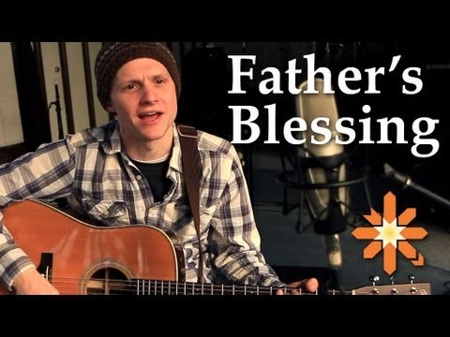
Notes:
https://www.youtube.com/watch?v=cEJdvqQBfr8
Trevor Parker, 2013

