Slide 1
If you want to have notes without taking notes,
Go to OrHaOlam.com
WITHOUT WIFI
Click on downloads, messages, 2018 messages
Today’s should be on the top.
Notes:
The effects of a looooong Seder

Slide 2

Notes:
From Ted Alongi
No sound to this one.

Slide 3
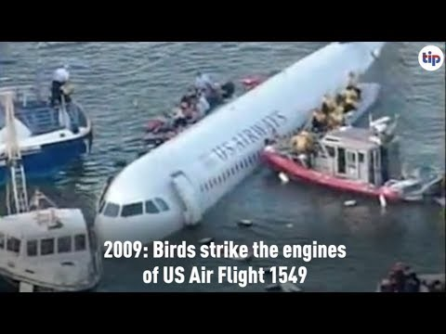

Slide 4

Attack on Jewish men in Brooklyn

Slide 5
Did you ever feel
attacked, accused, condemned,
guilty, toxically guilty, so that there is no hope for you?
Notes:
“You’re a loser, a disaster.”
Dante: Abandon hope, all you who enter here.

Slide 6
A new study from Princeton University documents a dramatic increase in rates of death among the middle-aged. Equally surprising, the causes of the increase in deaths were not the usual suspects, such as heart disease.
Notes:
https://www.psychologytoday.com/us/blog/the-economy-happiness/201511/epidemic-hopelessness

Slide 7
Instead, mortality is on the rise because of higher levels of suicide and greater numbers of drug and alcohol overdoses (along with alcohol-related liver disease).
Notes:
https://www.psychologytoday.com/us/blog/the-economy-happiness/201511/epidemic-hopelessness

Slide 8
Further, and almost as troubling, the paper also documented higher rates of other maladies short of death—“declines in health, mental health, and ability to conduct activities of daily living.”
Notes:
https://www.psychologytoday.com/us/blog/the-economy-happiness/201511/epidemic-hopelessness

Slide 9
Professor Case summarized the results for CNN by saying “more despair and worse health.” Overall, as Professor Ellen Meara observed, the study illustrates the sad reality that what we are observing is an “epidemic of hopelessness.”
Notes:
https://www.psychologytoday.com/us/blog/the-economy-happiness/201511/epidemic-hopelessness

Slide 10
^{Yekhezkek/Ezk 37.11} The whole house of Isra’el…they are saying, ‘Our bones have dried up, our hope is gone, and we are completely cut off.’
אָבְדָה תִקְוָתֵנוּAvdah tikvatenu
Our hope is lost
Notes:
Have you heard these words? אָבְדָה תִקְוָתֵנוּ Avdah tikvatenu
This is interpreted exegetically nationally to Israel, but can be applied to any and all of us: emotionally, spiritually, marital-ly, financially, bodily. Ever feel hopeless, and maybe your own doing?

Slide 11
Messiah has denounced Jewish practice of His time, in ch 23
Teaching and not doing
Prideful spiritual appearance and titles
Lack of servant spirit
Abusing widows

Slide 12
Making cult converts
Dishonoring the Holy
Spiritual minutiae, omitting mercy, justice, faith
Religious pretense.
Summary: Hopelessness & rejection for Israel?

Slide 13
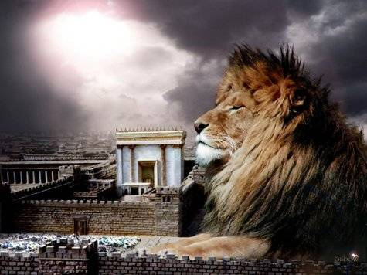
מַתִּתְיָהוּ Mattityahu
(Matthew) 23:37-39

Slide 14
Mattityahu (Matthew) 23:37
”יְרוּשָׁלַיִם, יְרוּשָׁלַיִם, הַהוֹרֶגֶת אֶת הַנְּבִיאִים וְסוֹקֶלֶת אֶת הַשְּׁלוּחִים אֵלֶיהָ,
“Yerushalayim! Yerushalayim! You kill the prophets! You stone those who are sent to you!
Notes:
Reads like a dirge, not a denunciation. Grief in the heart of the King Messiah.
Just as an FYI, when scripture says “Jerusalem” ≠ “church.” Some people have been astonished to realize that when scripture says “Israel” “Jews” it’s talking about those bagel eating types. Nathan’s hot dogs. Important to establish, because when dirge turns to promise, still same recipients.

Slide 15
Mattityahu (Matthew) 23:37
כַּמָה פְּעָמִים חָפַצְתִּי לְקַבֵּץ אֶת בָּנַיִךְ כְּתַרְנְגֹלֶת הַמְקַבֶּצֶת אֶת אֶפְרוֹחֶיהָ תַּחַת כְּנָפֶיהָ וְלֹא רְצִיתֶם.
How often I wanted to gather your children, just as a hen gathers her chickens under her wings, but you refused!
Notes:
G-d tried, and is still trying. YOU are part of that…

Slide 16
Mattityahu (Matthew) 23:38
הִנֵּה בֵּיתְכֶם יִנָּטֵשׁ לָכֶם,
“Look! God is abandoning your house to you, leaving it desolate.
Notes:
As college students, Dawn and I were taken under the wing of an older woman who wanted to broaden our perspective on the pre-Millennial pro-Israel prophetic grid we were taught at the Bible College. The pastor went over this list and concluded that G-d was done with Israel. Hopeless condemnation. But really, like the words of the prophet.

Slide 17
^{Yeshayahu/Is 1.5-8} “Your land is desolate, your cities are burned to the ground; foreigners devour your land in your presence; it’s as desolate as if overwhelmed by floods. The daughter of Tziyon is left like a shack in a vineyard, like a shed in a cucumber field, like a city under siege.”

Slide 18
^{Yeshayahu/Is 1.5-8}“Where should I strike you next, as you persist in rebelling? The whole head is sick, the whole heart diseased. From the sole of the foot to the head there is nothing healthy, only wounds, bruises and festering sores that haven’t been dressed or bandaged or softened up with oil.

Slide 19
Mattityahu (Matthew) 23:39
וַאֲנִי אוֹמֵר לָכֶם: מֵעַתָּה לֹא תִּרְאוּנִי עַד אֲשֶׁר תֹּאמְרוּ ’בָּרוּךְ הַבָּא בְּשֵׁם יְיָ!“
“For I tell you, from now on, you will not see me again until you say, ‘Blessed is he who comes in the name of Adoni.’”

Slide 20
But is it really then
all hopeless for Israel?
Look closer
at the words of Messiah…
Notes:
And for any of us, following Israel as prototype

Slide 21
Mattityahu (Matthew) 23:37
כַּמָה פְּעָמִים חָפַצְתִּי לְקַבֵּץ אֶת בָּנַיִךְ כְּתַרְנְגֹלֶת הַמְקַבֶּצֶת אֶת אֶפְרוֹחֶיהָ תַּחַת כְּנָפֶיהָ וְלֹא רְצִיתֶם.
How often I wanted to gather your children, just as a hen gathers her chickens under her wings, but you refused!
Notes:
G-d tried, and is still trying. YOU are part of that…for Isreal
As it applies to ourselves, G-d doesn’t stop, trying…

Slide 22
^{Mtt. 23.34} Therefore I am sending you prophets and sages and Torah-teachers [scribes, scholars].
Notes:
Yeshua didn’t stop. Present tense “sending” still. You are among those. Mix, involve, invite. To Jews, to all.

Slide 23
Mattityahu (Matthew) 23:37
כַּמָה פְּעָמִים חָפַצְתִּי לְקַבֵּץ אֶת בָּנַיִךְ כְּתַרְנְגֹלֶת הַמְקַבֶּצֶת אֶת אֶפְרוֹחֶיהָ תַּחַת כְּנָפֶיהָ וְלֹא רְצִיתֶם.
How often I wanted to gather your children, just as a hen gathers her chickens under her wings, but you refused!
Notes:
G-d tried, and is still trying. YOU are part of that…
Several illustrations from Scripture of G-d’s wonderful, passionate love for Israel. Why?

Slide 24

Notes:
1999

Slide 25
^{Yeshayahu/Is 49.14-16} “But Tziyon says, ‘Adoni has abandoned me, Adoni has forgotten me.’ Can a woman forget her child at the breast, not show pity on the child from her womb? Even if these were to forget, I would not forget you.
Notes:
Misty Edwards set this to music.
Avner: Hebrew language is earthy, like the people who speak it. His love for Israel is softer than a mother’s breast, throbbing with more compassion than a mother’s womb.
Israel immediately, all of us by application.

Slide 26
^{Yeshayahu/Is 49.14-16} “I have engraved you on the palms of my hands, your walls are always before me.”

Slide 27
^{Dvarim/Dt. 7.6-8} You are a holy people to Adoni your God—from all the peoples on the face of the earth, Adoni your God has chosen you to be His treasured people. “It is not because you are more numerous than all the

Slide 28
^{Dvarim/Dt. 7.6-8} peoples that Adoni set His love on you and chose you — for you are the least of all peoples. Rather, because of His love for you and His keeping the oath He swore to your fathers.
Notes:
Avner: The relationship between Israel and her G-d is not a dry theological treatise. It is a hot-blooded Middle Eastern love story, a divine “Thousand and One Nights.” p.2 Israel The Key to World Revival

Slide 29
^{Ber./Gen.12.2-3} My heart’s desire is to make you into a great nation, to bless you, to make your name great so that you may be a blessing. My desire is to bless those who bless you, but whoever curses you I will curse, and in you all the families of the earth will be blessed.
Notes:
Avner: Abrahamic covenant is the nuclear core of the love affair between G-d and the Jewish people.
I said recently: three sectors to Or HaOlam population:
Jews by birth and upbringing,
Jews by birth but unknown and now recovery,
non-Jewish people choosing to bless Israel and be blessed in the process.
It’s a process of PASSIONATE blessing every which way.

Slide 30
^{Gal. 3.15-18} Brothers and sisters, I speak in human terms: even with a man’s covenant, once it has been confirmed, no one cancels it or adds to it. Now the promises were spoken to Abraham and to his seed…

Slide 31
^{Gal. 3.15-18} What I am saying is this: Torah, which came 430 years later, does not cancel the covenant previously confirmed by God, so as to make the promise cancelled… But God has graciously given it to Abraham by means of a promise.

Slide 32
G-d’s tender, covenantal love for Israel doesn’t exclude non-Jews, even from the Land…

Slide 33
^{Yekhezkel/Ezk 47.21-23} You are to divide this land for yourselves to the tribes of Israel. So you are to divide it by lot for an inheritance for you and for the outsiders who dwell among you, whoever bears children among you.

Slide 34
^{Yekhezkel/Ezk 47.21-23} They will be to you like the native-born of Bnei-Yisrael; they will be allotted an inheritance along with you among the tribes of Israel. In whatever tribe the outsider lives, there you will give him his inheritance.” It is a declaration of Adoni.
Notes:
On the other hand, more from Avner…

Slide 35
^{T’hillim/Ps 117 [Boskey]} Praise Adoni, all you nations! Glorify Him, all you peoples. For heroically powerful is His covenant lovingkindness toward us, and Adoni’s truth endures forever.
Halleluyah!
Notes:
Avner: Here the psalmist encourages the world to praise and worship Adoni because of His khesed/covenant love toward the Jewish people!
Israel was called to bring blessing to all.
Testing the Nations, take on servant spirit like centurion to bless Israel.
Story of a non-Jew in the land, doing EXACTLY the above.

Slide 36
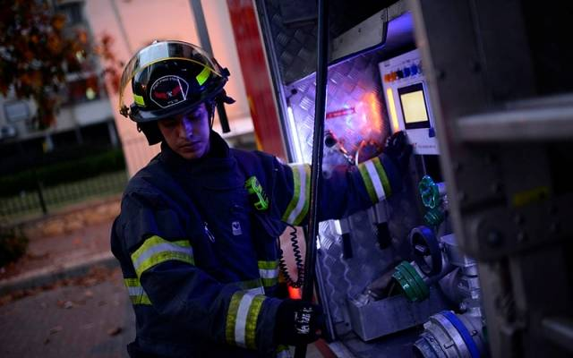
Druze firefighter Wiam Nevuani

Slide 37
^{By: United with Israel Staff} Druze firefighter Wiam Nevuani arrived at a fire in a synagogue at the northern city of Nahariah on Monday and did not hesitate when he burst into the burning building to save the Torah scrolls. He told Israel’s Channel 20 that he felt he was saving a soul, even though he knew that no one was trapped in the burning building.

Slide 38
“We were four teams of firefighters, and as we drove I realized the importance of the site of the fire. I thought about the site’s importance and high level of sanctity. Based on the report that we’d received, that no one was trapped, I started thinking about how to save the contents of the building – the Torah scrolls, all the prayer books,” he recounted.

Slide 39
“When we arrived at the site, the flames were immense; there was a rain of fire. The temperature reading was very high, and the building was surrounded by smoke. We started working to put out the fire and very quickly got it under control. As we were working,

Slide 40
I identified a Torah scroll, and immediately jumped, grabbed it, and brought it outside,” he recalled. “As I brought it outside, I felt like I was holding a soul, like I was saving a person, saving a baby,” he said.

Slide 41
When asked about risking his life to save the Torah, Nevuani said that “the warmth radiating from the Torah scroll touched my heart, and for a few seconds I wondered and thought to myself about what is written in the scroll.”

Slide 42
Druze firefighter Wiam Nevuani

Slide 43
^{Zekh 2.12} Adoni-Tzva’ot has sent me on a glorious mission to the nations that plundered you, and this is what he says: “Anyone who injures you injures the very pupil of my eye.”
Notes:
One of the Ten Boom family to the Nazi officer.
Concerning all of world history and geopolitics…

Slide 44
^{Dt. 32.8-11} “When ‘Elyon [the Most High] gave each nation its heritage, when he divided the human race, he assigned the boundaries of peoples according to Isra’el’s population; but Adoni’s share was his own people, Ya‘akov his allotted heritage.

Slide 45
However, the Palestinian Central Council (PCC), a supreme decision-making body, last week announced an escalation of the PA’s diplomatic actions against Israel through the annulment of the Oslo peace accords and withdrawal of its recognition of Israel.
Notes:
https://worldisraelnews.com/abbas-fails-garner-european-support-palestine/

Slide 46

2
State
dead
Notes:
https://youtu.be/Ab0N7FG9iMM

Slide 47
^{Dt. 32.8-11} “He found his people in desert country, in a howling, wasted wilderness. He protected him and cared for him, guarded him like the pupil of his eye, like an eagle that stirs up her nest, hovers over her young, spreads out her wings, takes them and carries them as she flies.

Slide 48
^{T’hillim/Ps 91.4} He will cover you with His feathers, and under His wings you will find refuge. His faithfulness is body armor and shield.

Slide 49
^{1 K 9.2-3} Adoni appeared to Solomon a second time...Adoni said to him: “I have heard your prayer and your petition that you made before Me. I have consecrated this House, which you have built, to put My Name there forever, and My eyes and My heart will be there every day.

Slide 50
^{Yer 32.40-41} I will make an everlasting covenant with them: I will never turn away from doing good for them. I will put My fear in their hearts, so that they will not depart from Me. “Yes, I will delight in doing good for them, and with all My heart and all My soul I will in truth plant them in this land.”
Notes:
Only time ever said of G-d “all my heart.”

Slide 51
Note that abandonment
of Israel by G-d is conditional, and has an implied grief to G-d…

Slide 52
Mattityahu (Matthew) 23:39
וַאֲנִי אוֹמֵר לָכֶם: מֵעַתָּה לֹא תִּרְאוּנִי עַד אֲשֶׁר תֹּאמְרוּ ’בָּרוּךְ הַבָּא בְּשֵׁם יְיָ!“
For I tell you, from now on, you will not see me again until you say, ‘Blessed is he who comes in the name of Adoni.’”
Notes:
The world will not see Yeshua again until the Jewish people welcome Him? Marty Waldman says that there is a tipping point. Maybe when the Knesset cries out:
ברוך הבא בשם יי
Barukh HaBa B’Shem Adoni.
Maybe return of Yeshua contingent on Jews welcoming Him. Certainly world revival contingent…

Slide 53
^{Ro. 11.11-15} “In that case, I say, isn’t it that they have stumbled with the result that they have permanently fallen away?” Heaven forbid! Quite the contrary, it is by means of their stumbling that the deliverance has come to the Gentiles, in order to provoke them to jealousy.

Slide 54
^{Ro. 11.11-15} Moreover, if their stumbling is bringing riches to the world, how much greater riches will Isra’el in its fullness bring them! …For if their casting Yeshua aside means reconciliation for the world, what will their accepting him mean? It will be life from the dead!

Slide 55
Mattityahu (Matthew) 23:39
וַאֲנִי אוֹמֵר לָכֶם: מֵעַתָּה לֹא תִּרְאוּנִי עַד אֲשֶׁר תֹּאמְרוּ ’בָּרוּךְ הַבָּא בְּשֵׁם יְיָ!“
“For I tell you, from now on, you will not see me again until you say, ‘Blessed is he who comes in the name of Adoni.’”

Slide 56
Mattityahu (Matthew) 23:39
וַאֲנִי אוֹמֵר לָכֶם: מֵעַתָּה לֹא תִּרְאוּנִי עַד אֲשֶׁר תֹּאמְרוּ ’בָּרוּךְ הַבָּא בְּשֵׁם יְיָ!“
“For I tell you, from now on, you will not see me again until you say, ‘Blessed is he who comes in the name of Adoni.’”
Notes:
So, consider Israel and hopelessness, consider by application, you own situation and hopelessness: marital, financial, health, family relational, emotional. There is hope. Od lo avda tikvatenu.
Consider those words for Israel specifically, until you say. One unforgettable application

Slide 57
^{Yekhezkek/Ezk 37.11} the whole house of Isra’el; and they are saying, ‘Our bones have dried up, our hope is gone, and we are completely cut off.’
אָבְדָה תִקְוָתֵנוּ Avdah tikvatenu
Notes:
Have you heard these words? אָבְדָה תִקְוָתֵנוּ Avdah tikvatenu

Slide 58
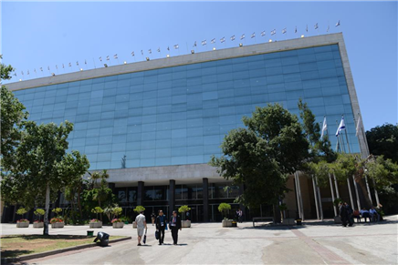
בניני האומה Binyanei HaUma
Jerus.
Internatl
Conv.
Center

Slide 59

בניני האומה
Binyanei
HaUma
Jerusalem
Internatl
Conv.
Center

Slide 60
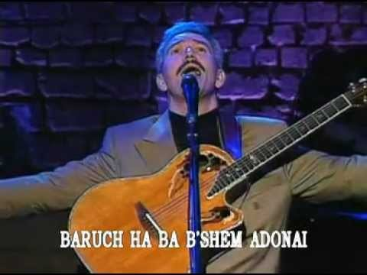
Paul Wilbur Concert Welcoming Yeshua 34:00 to
Jeru-
salem
Notes:
Passover, 1995, at the בניני האומה Binyanei HaUma Jerusalem International Convention Center, where the March of the Nations Conference will be. Some of us there in May.
https://www.youtube.com/watch?v=RKnJHkHV2fE
Go to 34:00

