Slide 1
If you want to have notes without taking notes,
Go to OrHaOlam.com
WITHOUT WIFI
Click on downloads, messages, 2018 messages
Today’s should be on the top.
Notes:
The effects of a looooong Seder

Slide 2
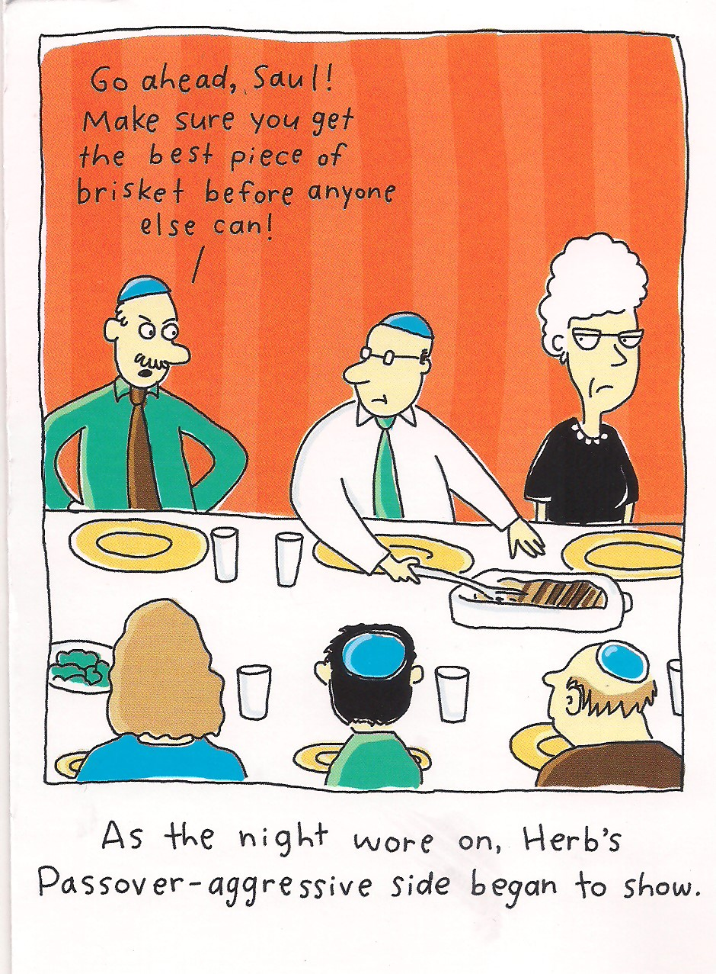
Notes:
From Janette Ramos. Note the Passover-Aggressive side?
However, the joys of Matzah…

Slide 3
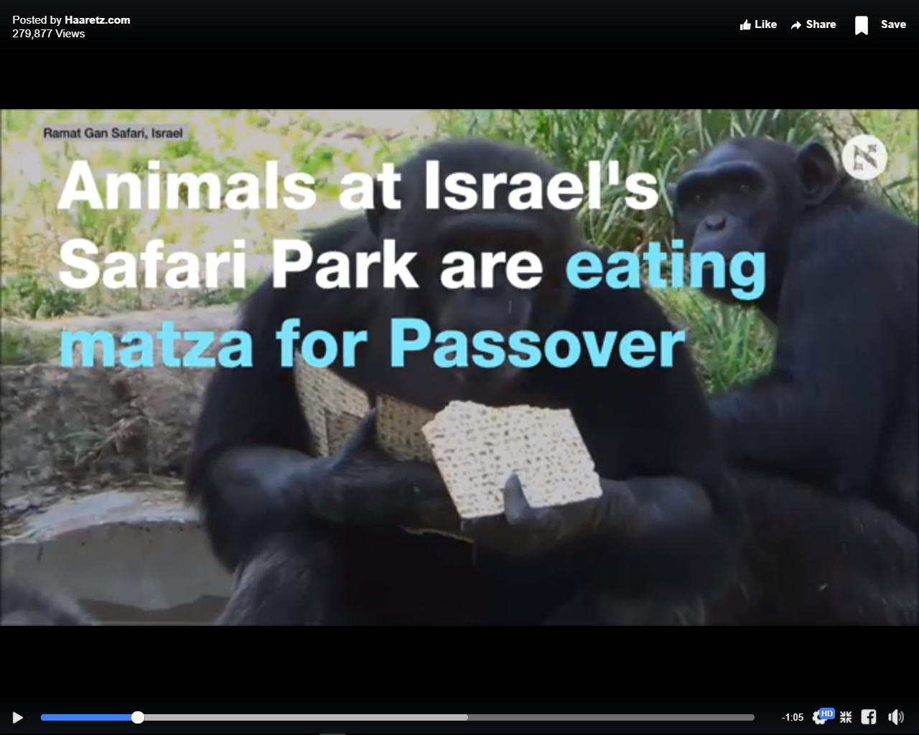
Notes:
Same place as the lions rolling in coffee last week.
Screen shots of video.

Slide 4
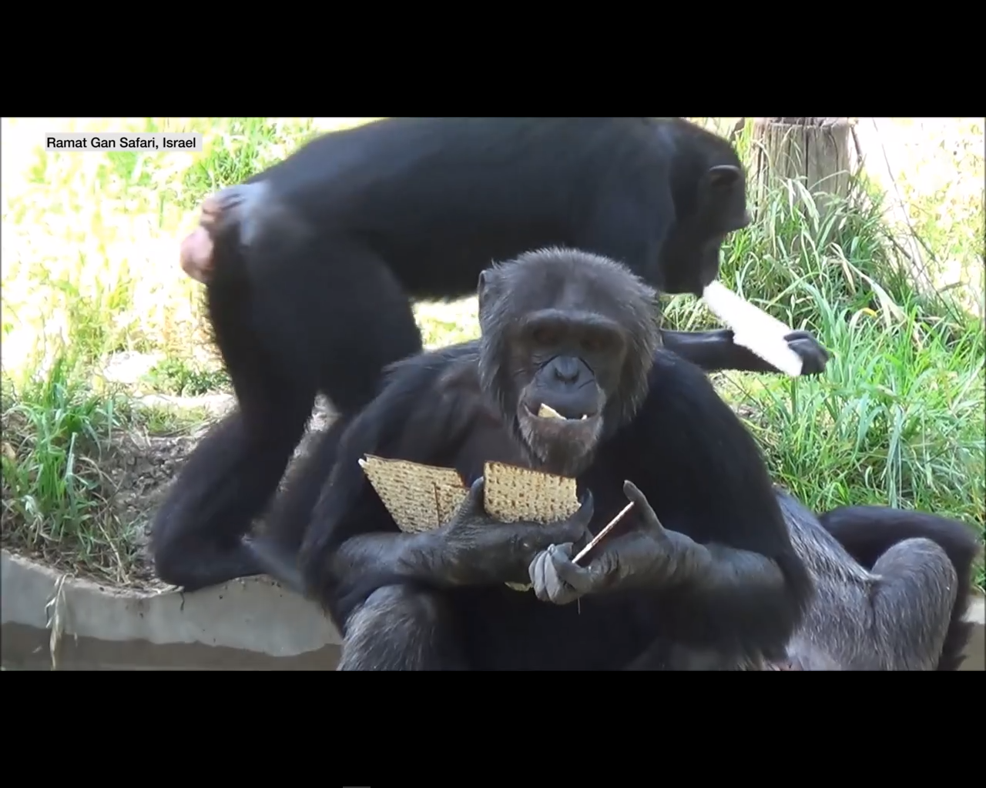

Slide 5
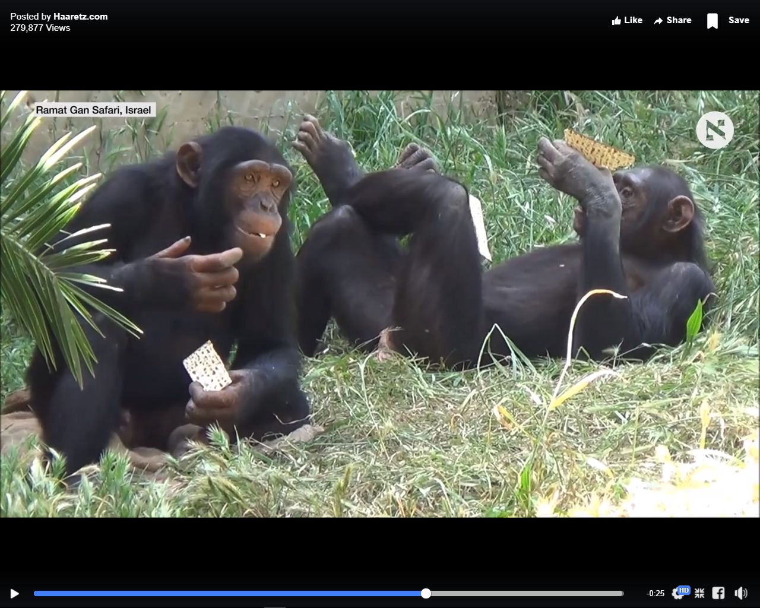

Slide 6
50 Days
Counting the Omer
Notes:
Said the blessing and counted earlier.

Slide 7
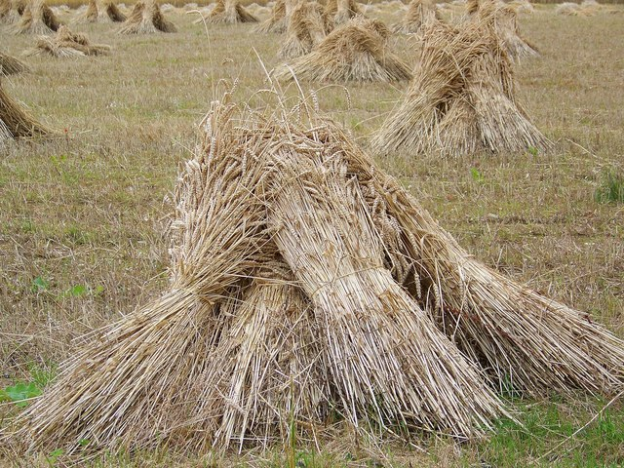
An omer = bundle of wheat
Notes:
https://en.wikipedia.org/wiki/Counting_of_the_Omer
NOT counting the omer per se, but counting the days during the binding of the omers/sheaves/bundles of wheat.

Slide 8
Why do this count?
We are commanded…
Notes:
Commanded…

Slide 9
^{Lev 23.15-16} “‘From the day after the day of rest — that is, from the day you bring the sheaf for waving — you are to count seven full weeks, until the day after the seventh week; you are to count fifty days; and then you are to present a new grain offering to ADONI.’”
Notes:
Note: Two things to count, weeks, days.
NOT counting the omer, counting the days and weeks during the binding of the omers/sheaves/bundles

Slide 10
You are to count for yourselves
וּסְפַרְתֶּם לָכֶם
סָפַר to count ; to enumerate
seven full weeks
you are to count fifty days;
Count aloud for yourselves L’kem לָכֶם
Notes:
Another construction of this verb is: to read aloud, to relate, to tell (a joke, a story); to talk about
Rabbinic interp: The sole stipulation of the commandment is that the number of the particular day of the Omer [period] be spoken aloud.
Of all the weird and legalistic ideas, why count each day? Calendar counts them
וּסְפַרְתֶּם לָכֶם to yourselves

Slide 11
All in Israel were obliged to number those days, except women and servants Maimon. Hilchot Tamidin Umusaphim, c. 7. sect. 24.
The manner of doing it was this: Shulchan Arukh, par. 1. c. 489. sect. 1
On the night of the second (day of the passover), after the evening prayer, they began to number,
Notes:
I’M an equal opportunity counter
Women and servants included!!

Slide 12
but if anyone forgot to number at the beginning of the night, he went and numbered [in] the night; for the commandment is for everyone to number by himself, and he ought to number standing, and to bless first, and number the days and weeks:
Notes:
But WHY do this??
Don’t really need a reason, just understand what scripture says.

Slide 13
Risky time of year: wheat crop is maturing, in danger of frost, hail, thunderstorm, insects “white to harvest” Time of semi-mourning: disasters especially first 33 days
Holocaust Memorial
Yom HaZikaron
Notes:
יום הזיכרון לשואה ולגבורה
Orig Nisan 14, beginning of Warsaw uprising, just < Pesakh
Count ki careful, number our days.

Slide 14
^{Tehillim/Ps 90.12} So teach us to count our days, so that we will become wise.
^{T’hillim/Ps 79:8} Don't count past iniquities against us, but let your compassion come quickly to meet us, for we have been brought very low.
Notes:
Stop here, count our days
BUT, here’s an alternate reason for the count…

Slide 15
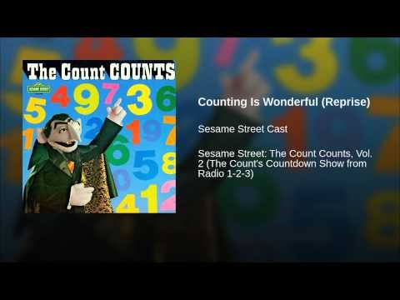
Count von Count Reprise

Slide 16
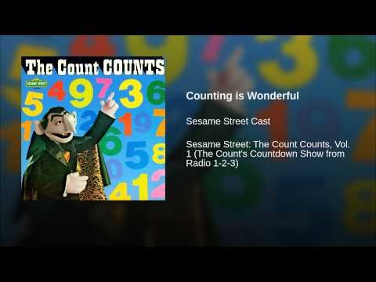

Slide 17
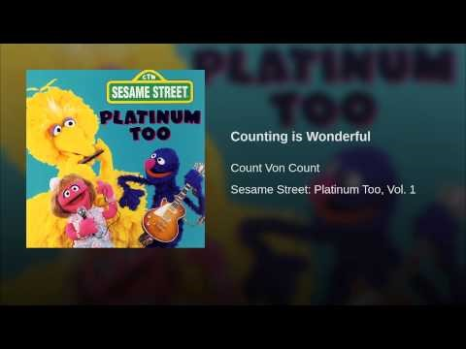
Why do this count?
Notes:
https://www.youtube.com/watch?v=K638qDe5CMI
So, we count because it’s wonderful! Maybe not. Ever done in Messianic scriptures?

Slide 18
seven full weeks
Fifty days
^{Acts 2:1} The festival of Shavu’ot [שָׁבֻעֹות weeks] arrived, and the believers all gathered together in one place.
Notes:
Seven Sabbaths not in regular sense

Slide 19
^{Acts 2.1} When the Day of Pentecost had fully come συμπλεροο
Phonetic Spelling soom-play-ro'-o
Definition συμπλεροο
to fill completely, of the hold of a ship
to complete entirely, be fulfilled: of time
Notes:
“Fully come.” Seemed talmiday Yeshua counted after He left.
Seemed to work pretty well→ Ruakh HaKodesh FILLING, IMMERSION
Our Shalikhim, primary founding leaders

Slide 20
^{Acts 2.1-4} The festival of Shavu‘ot arrived, and the believers all gathered together in one place. Suddenly there came a sound from the sky like the roar of a violent wind, and it filled the whole house where they were sitting.

Slide 21
^{Acts 2.1-4} Then they saw what looked like tongues of fire, which separated and came to rest on each one of them. They were all filled with the Ruakh HaKodesh and began to talk in different languages, as the Spirit enabled them to speak.
Notes:
Similarly, several years later…

Slide 22
^{Acts 11.15-16} I had hardly begun speaking when the Ruakh HaKodesh fell on them, just as on us at the beginning! And I remembered that the Lord had said, 'Yokhanan used to immerse people in water, but you will be immersed in the Ruakh HaKodesh.'
Notes:
At Cornelius house, same effect as after the counting… the Ruakh
So, we are counting our way to Shavuot…wheat harvest, Torah given, Ruakh given

Slide 23
We are today at the beginning of this 50 day count. Day 7, actually, and this message really should have been given on Day 1. Next year? 2019 Pesakh is also on Friday/Saturday.
First Day of Omer Count Sunday, April 28, 2019. Extra service?
Notes:
Our people are commanded to make this a special day, Day 1, last Sunday, but no synagogue on earth does, except Messianics, get the meaning of this otherwise obscure day, which starts the Omer count…

Slide 24
^{Vayikra/Lev. 23.10-11} "Tell the people of Isra'el, 'After you enter the land I am giving you and harvest its ripe crops, you are to bring a sheaf of the firstfruits of your harvest to the cohen.

Slide 25
^{Vayikra/Lev. 23.10-11} He is to wave the sheaf before ADONI, so that you will be accepted; the cohen is to wave it on the day after the Shabbat [=Pesakh].

Slide 26
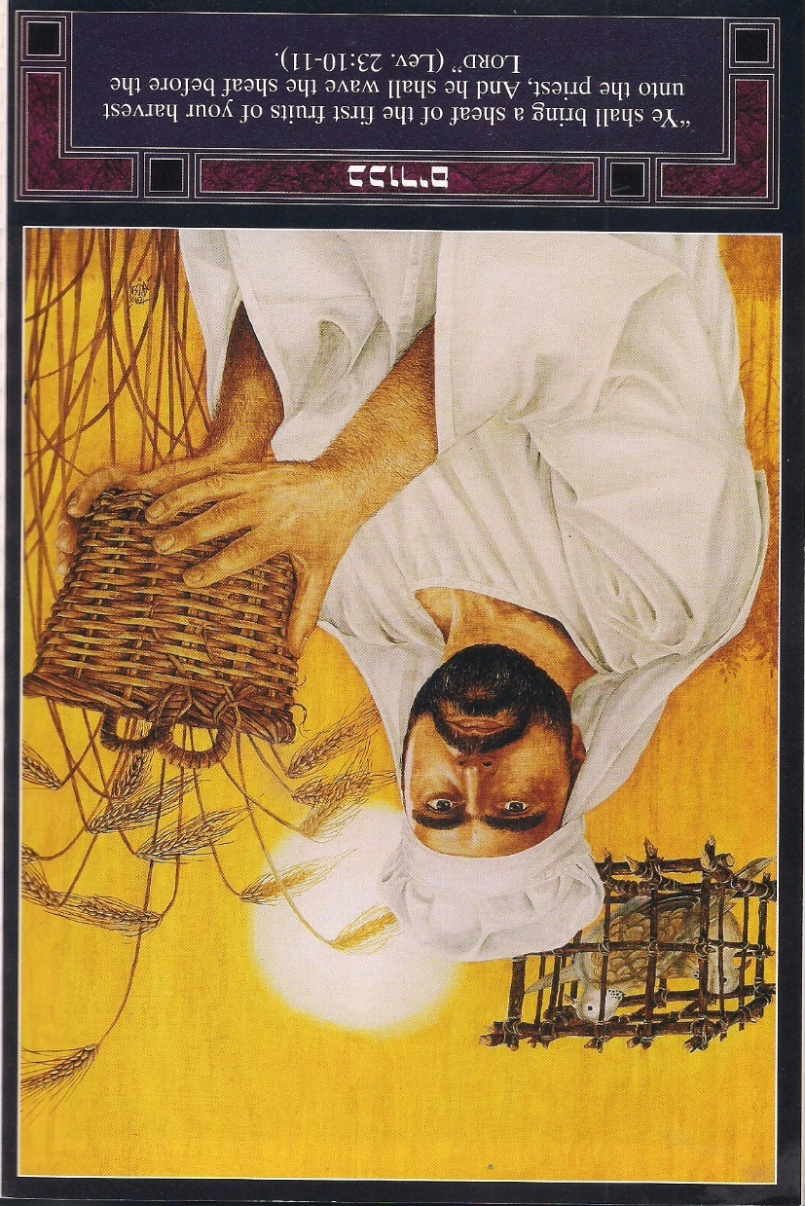
Cohen waving the
barley firstfruits,
expressing faith
in the new harvest,
new life
Resurrection
Notes:
Kevin Howard & Marv Rosenthal The Feasts of the Lord p74
Let’s wave our barley, as an expression of faith/revelation!
Messiah meaning of the day…
We’ll do it big time later, but it fits to do it now!

Slide 27
^{1 Cor.15.20-21} But now Messiah has been raised from the dead, the firstfruits of those who have fallen asleep. For since death came through a man, the resurrection of the dead also has come through a Man.
Notes:
This is the Biblical symbol of resurrection, not lilies, not eggs, not bunnies, although all things are sanctified by chocolate.
Barley is the first of the firstfruits, the first winter grain to come ripe in the Middle East.

Slide 28
^{1 Cor. 15.3-9} For among the first things I passed on to you was what I also received, namely this: the Messiah died for our sins, in accordance with what the Tanakh says; and he was buried; and he was raised on the third day, in accordance

Slide 29
^{1 Cor. 15.3-9} with what the Tanakh says; and he was seen by Kefa, then by the Twelve; and afterwards he was seen by more than five hundred brothers at one time, the majority of whom are still alive, though some have died. Later he was seen by Ya‘akov,
Notes:
And they were transformed by what they saw.

Slide 30
^{1 Cor. 15.3-9} then by all the emissaries; and last of all he was seen by me, even though I was born at the wrong time. For I am the least of all the emissaries, unfit to be called an emissary, because I persecuted the Messianic Community of God.

Slide 31
^{Acts 9.1-6} Sha’ul, still breathing murderous threats against the Lord’s talmidim, went to the cohen hagadol and asked him for letters to the synagogues in Dammesek, authorizing him to arrest any people he might find,

Slide 32
^{Acts 9.1-6} whether men or women, who belonged to “the Way,” and bring them back to Yerushalayim. He was on the road and nearing Dammesek, when suddenly a light from heaven flashed all around him.

Slide 33
^{Acts} Falling to the ground, he heard a voice saying to him, “Sha’ul! Sha’ul! Why do you keep persecuting me?” “Sir, who are you?” he asked. “I am Yeshua, and you are persecuting me.
Notes:
He saw then, and was transformed. Became the great Shaliakh, emissary to the Roman world.
Yeshua’s own physical brother, Yaakov/James, did NOT believe in Him as Messiah under he saw Him after the resurrection.

Slide 34
^{Yokhanan/Jn 20.24-29} Now T’oma (the name means “twin”), one of the Twelve, was not with them when Yeshua came. When the other talmidim told him, “We have seen the Lord,” he replied, “Unless I see the nail marks in his hands, put my finger into the place where the nails were and put my hand into his side, I refuse to believe it.”

Slide 35
^{Yokhanan/Jn 20.24-29} A week later his talmidim were once more in the room, and this time T’oma was with them. Although the doors were locked, Yeshua came, stood among them and said, “Shalom aleikhem!” Then he said to T’oma, “Put your finger here, look at my hands,
Notes:
Addressed Toma in his very point of doubt!

Slide 36
^{Yokhanan/Jn 20.24-29} take your hand and put it into my side. Don’t be lacking in trust, but have trust!” T’oma answered him, “My Lord and my God!” Yeshua said to him, “Have you trusted because you have seen me? How blessed are those who do not see, but trust anyway!”

Slide 37
^{1 Kefa/Peter 1.8-9} Though you have not seen Him, you love Him. And even though you don’t see Him now, you trust Him and are filled with a joy that is glorious beyond words, receiving the outcome of your faith—the salvation of your souls.
Notes:
Do you love Him? Trust Him. Seen the resurrected Messiah in the Ruakh, in the sweetness of your forgiveness?
Let’s wave now. Halleluyah!

Slide 38
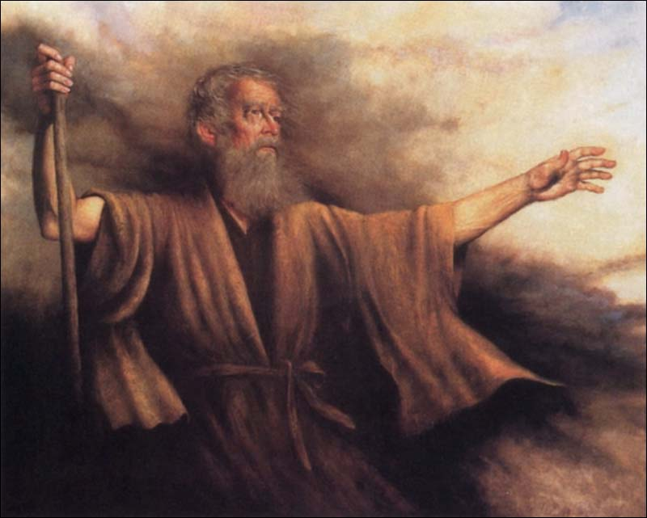
Sh'mot שְׁמוֹת
(Exodus) 34: 4-9
(from) Ki Tisa (When you take) כִּי תִּשָּׂא
Notes:
Moshe had many revelations of G-d’s glory, but not greater than this one.

Slide 39
Sh’mot (Exodus) 34:4
ג כִּי שֵׁם יְהוָה אֶקְרָא ס הָבוּ גֹדֶל לֵאלֹהֵינוּ׃
ג כִּי שֵׁם יְהוָה אֶקְרָא ס הָבוּ גֹדֶל לֵאלֹהֵינוּ׃
וַיִּפְסֹ֡ל שְׁנֵֽי־לֻחֹ֨ת אֲבָנִ֜ים כָּרִאשֹׁנִ֗ים וַיַּשְׁכֵּ֨ם מֹשֶׁ֤ה בַבֹּ֙קֶר֙
Moshe cut two stone tablets like the first. Then he got up early in the morning

Slide 40
Sh’mot (Exodus) 34:4
ג כִּי שֵׁם יְהוָה אֶקְרָא ס הָבוּ גֹדֶל לֵאלֹהֵינוּ׃
ג כִּי שֵׁם יְהוָה אֶקְרָא ס הָבוּ גֹדֶל לֵאלֹהֵינוּ׃
וַיַּ֙עַל֙ אֶל־הַ֣ר סִינַ֔י כַּאֲשֶׁ֛ר צִוָּ֥ה יְהוָ֖ה אֹת֑וֹ וַיִּקַּ֣ח בְּיָד֔וֹ שְׁנֵ֖י לֻחֹ֥ת אֲבָנִֽים׃
with the two stone tablets in his hands, ascended Mount Sinai, as Adoni had ordered him to do.

Slide 41
Sh’mot (Exodus) 34:5
ג כִּי שֵׁם יְהוָה אֶקְרָא ס הָבוּ גֹדֶל לֵאלֹהֵינוּ׃
ג כִּי שֵׁם יְהוָה אֶקְרָא ס הָבוּ גֹדֶל לֵאלֹהֵינוּ׃
ווַיֵּ֤רֶד יְהוָה֙ בֶּֽעָנָ֔ן וַיִּתְיַצֵּ֥ב עִמּ֖וֹ שָׁ֑ם וַיִּקְרָ֥א בְשֵׁ֖ם יְהוָֽה׃
Adoni descended in the cloud, stood with him there and pronounced the name of Adoni.

Slide 42
Sh’mot (Exodus) 34:6
ג כִּי שֵׁם יְהוָה אֶקְרָא ס הָבוּ גֹדֶל לֵאלֹהֵינוּ׃
ג כִּי שֵׁם יְהוָה אֶקְרָא ס הָבוּ גֹדֶל לֵאלֹהֵינוּ׃
וַיַּעֲבֹ֨ר יְהוָ֥ה ׀ עַל־פָּנָיו֮ וַיִּקְרָא֒ יְהוָ֣ה ׀ יְהוָ֔ה אֵ֥ל רַח֖וּם וְחַנּ֑וּן אֶ֥רֶךְ אַפַּ֖יִם וְרַב־חֶ֥סֶד וֶאֱמֶֽת ׀
Adonai passed before him and proclaimed: “YUD-HEH-VAV-HEH!!! Yud-Heh-Vav-Heh [Adoni] is God, merciful and compassionate, slow to anger, rich in grace and truth;

Slide 43
Sh’mot (Exodus) 34:7
ג כִּי שֵׁם יְהוָה אֶקְרָא ס הָבוּ גֹדֶל לֵאלֹהֵינוּ׃
ג כִּי שֵׁם יְהוָה אֶקְרָא ס הָבוּ גֹדֶל לֵאלֹהֵינוּ׃
נֹצֵ֥ר חֶ֙סֶד֙ לָאֲלָפִ֔ים נֹשֵׂ֥א עָוֺ֛ן וָפֶ֖שַׁע וְחַטָּאָ֑ה וְנַקֵּה֙ לֹ֣א יְנַקֶּ֔ה
“showing grace to the thousandth generation, forgiving offenses, crimes and sins; yet not exonerating the guilty

Slide 44
Sh’mot (Exodus) 34:7
ג כִּי שֵׁם יְהוָה אֶקְרָא ס הָבוּ גֹדֶל לֵאלֹהֵינוּ׃
ג כִּי שֵׁם יְהוָה אֶקְרָא ס הָבוּ גֹדֶל לֵאלֹהֵינוּ׃
נפֹּקֵ֣ד ׀ עֲוֺ֣ן אָב֗וֹת עַל־בָּנִים֙ וְעַל־בְּנֵ֣י בָנִ֔ים עַל־שִׁלֵּשִׁ֖ים וְעַל־רִבֵּעִֽים׃
but causing the negative effects of the parents’ offenses to be experienced by their children and grandchildren, and even by the third and fourth generations.”

Slide 45
Sh’mot (Exodus) 34:8
ג כִּי שֵׁם יְהוָה אֶקְרָא ס הָבוּ גֹדֶל לֵאלֹהֵינוּ׃
ג כִּי שֵׁם יְהוָה אֶקְרָא ס הָבוּ גֹדֶל לֵאלֹהֵינוּ׃
וַיְמַהֵ֖ר מֹשֶׁ֑ה וַיִּקֹּ֥ד אַ֖רְצָה וַיִּשְׁתָּֽחוּ׃
At once Moshe bowed his head to the ground, prostrated himself

Slide 46
Sh’mot (Exodus) 34:9
ג כִּי שֵׁם יְהוָה אֶקְרָא ס הָבוּ גֹדֶל לֵאלֹהֵינוּ׃
ג כִּי שֵׁם יְהוָה אֶקְרָא ס הָבוּ גֹדֶל לֵאלֹהֵינוּ׃
וַיֹּ֡אמֶר אִם־נָא֩ מָצָ֨אתִי חֵ֤ן בְּעֵינֶ֙יךָ֙ אֲדֹנָ֔י יֵֽלֶךְ־נָ֥א אֲדֹנָ֖י בְּקִרְבֵּ֑נוּ
and said, “If I have now found favor in your view, Adonai, then please let Adonai go with us,

Slide 47
Sh’mot (Exodus) 34:9
ג כִּי שֵׁם יְהוָה אֶקְרָא ס הָבוּ גֹדֶל לֵאלֹהֵינוּ׃
ג כִּי שֵׁם יְהוָה אֶקְרָא ס הָבוּ גֹדֶל לֵאלֹהֵינוּ׃
כִּ֤י עַם־קְשֵׁה־עֹ֙רֶף֙ ה֔וּא וְסָלַחְתָּ֛ לַעֲוֺנֵ֥נוּ וּלְחַטָּאתֵ֖נוּ וּנְחַלְתָּֽנוּ׃
even though they are a stiffnecked people; and pardon our offenses and our sin; and take us as your possession.”
Notes:
Moshe had long since turned to serve the G-d of Israel, but this was a sort of second revelation, or third!
Similarly for us…

Slide 48
Yeshua’s Great
Prayer for His followers

Slide 49
^{Yn 17.22-24} The glory which you have given to me, I have given to them; so that they may be one, just as we are one — I united with them and you with me, so that they may be completely one, and the world thus realize that you sent me,

Slide 50
^{Yn 17.22-24} and that you have loved them just as you have loved me. “Father, I want those you have given me to be with me where I am; so that they may see my glory, which you have given me because you loved me before the creation of the world.
Notes:
Have you seen His resurrection glory, by faith? Let’s wave the barley!!

Slide 51
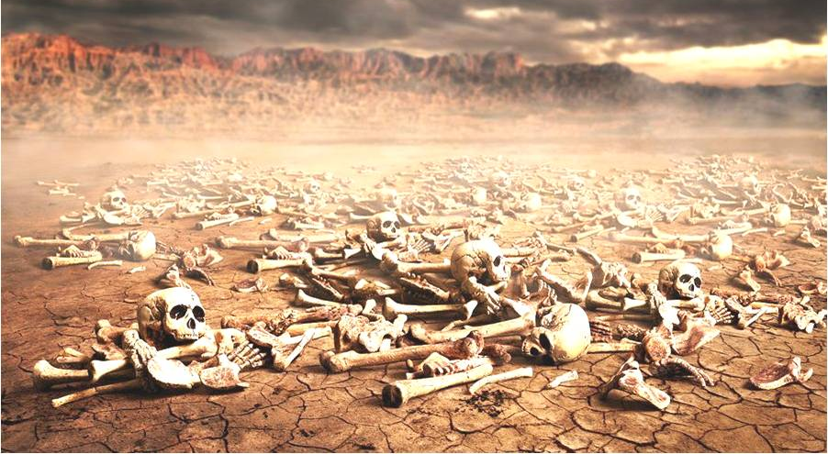
Yechezk’el xxxx
(Ezekiel) 37:11-14

Slide 52
Yechezk’el (Ezekiel) 37:11
ג כִּי שֵׁם יְהוָה אֶקְרָא ס הָבוּ גֹדֶל לֵאלֹהֵינוּ׃
ג כִּי שֵׁם יְהוָה אֶקְרָא ס הָבוּ גֹדֶל לֵאלֹהֵינוּ׃
וַיֹּאמֶר֮ אֵלַי֒ בֶּן־אָדָ֕ם הָעֲצָמ֣וֹת הָאֵ֔לֶּה כָּל־בֵּ֥ית יִשְׂרָאֵ֖ל הֵ֑מָּה הִנֵּ֣ה אֹמְרִ֗ים יָבְשׁ֧וּ עַצְמוֹתֵ֛ינוּ וְאָבְדָ֥ה תִקְוָתֵ֖נוּ נִגְזַ֥רְנוּ לָֽנוּ׃
Then he said to me, “Human being! These bones are the whole house of Isra’el; and they are saying, ‘Our bones have dried up, our hope is gone, and we are completely cut off.’
Notes:
Sort of stopped counting. No hope. Not waving.

Slide 53
Yechezk’el (Ezekiel) 37:12
ג כִּי שֵׁם יְהוָה אֶקְרָא ס הָבוּ גֹדֶל לֵאלֹהֵינוּ׃
ג כִּי שֵׁם יְהוָה אֶקְרָא ס הָבוּ גֹדֶל לֵאלֹהֵינוּ׃
לָכֵן֩ הִנָּבֵ֨א וְאָמַרְתָּ֜ אֲלֵיהֶ֗ם כֹּֽה־אָמַר֮ אֲדֹנָ֣י יְהוִה֒ הִנֵּה֩ אֲנִ֨י פֹתֵ֜חַ אֶת־קִבְרֽוֹתֵיכֶ֗ם וְהַעֲלֵיתִ֥י אֶתְכֶ֛ם מִקִּבְרוֹתֵיכֶ֖ם עַמִּ֑י וְהֵבֵאתִ֥י אֶתְכֶ֖ם אֶל־אַדְמַ֥ת יִשְׂרָאֵֽל׃ (ס)
”Therefore prophesy; say to them that Adonai Elohim says, ‘My people! I will open your graves and make you get up out of your graves, and I will bring you into the land of Isra’el.
Notes:
Apparently about national resurrection, not physical, but the images are parallel

Slide 54
Yechezk’el (Ezekiel) 37:13
ג כִּי שֵׁם יְהוָה אֶקְרָא ס הָבוּ גֹדֶל לֵאלֹהֵינוּ׃
ג כִּי שֵׁם יְהוָה אֶקְרָא ס הָבוּ גֹדֶל לֵאלֹהֵינוּ׃
וִֽידַעְתֶּ֖ם כִּֽי־אֲנִ֣י יְהוָ֑ה בְּפִתְחִ֣י אֶת־קִבְרֽוֹתֵיכֶ֗ם וּבְהַעֲלוֹתִ֥י אֶתְכֶ֛ם מִקִּבְרוֹתֵיכֶ֖ם עַמִּֽי׃
‘Then you will know that I am Adoni — when I have opened your graves and made you get up out of your graves, my people!

Slide 55
Yechezk’el (Ezekiel) 37:14
ג כִּי שֵׁם יְהוָה אֶקְרָא ס הָבוּ גֹדֶל לֵאלֹהֵינוּ׃
ג כִּי שֵׁם יְהוָה אֶקְרָא ס הָבוּ גֹדֶל לֵאלֹהֵינוּ׃
וְנָתַתִּ֨י רוּחִ֤י בָכֶם֙ וִחְיִיתֶ֔ם וְהִנַּחְתִּ֥י אֶתְכֶ֖ם עַל־אַדְמַתְכֶ֑ם וִידַעְתֶּ֞ם כִּי־אֲנִ֧י יְהוָ֛ה דִּבַּ֥רְתִּי וְעָשִׂ֖יתִי נְאֻם־יְהוָֽה׃ (פ)
‘I will put my Spirit in you; and you will be alive. Then I will place you in your own land; and you will know that I, Adonai, have spoken, and that I have done it,’ says Adonai.”

Slide 56
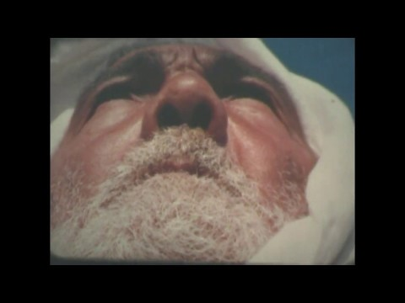
Dry Bones Shira Sorko Ram
Play from 3.10 to 5.15
Notes:
https://youtu.be/ZVUUpwt0IQQ
I viewed this on 16mm in her apartment in 1971 with Dolah, the, daughter of Eliezer Ben Yehuda. Shira showed it to Golda Meir.
Play 3:10 to 5:20

Slide 57
Jewish people, and those grafted in are STILL facing death, overwhelming odds. However, our hope is in the Resurrection of Messiah, and our resurrection to come, spiritually, nationally, eternally!

Slide 58
Hamas aims to replace Palestinian Authority Chairman Mahmoud Abbas and his veteran PLO cronies. Hamas blames them for collaborating with the enemy and entertaining the heresy of a two-state deal.
Notes:
voices@unitycoalitionforisrael.org.
Peace with Israel is a heresy to Hamas. These are NOT peaceful demonstrations on the Gaza border!

Slide 59
Its leaders hope that the March of Return (and the televised sacrifices of its young martyrs) will incite impressionable viewers sign on as recruits in a new and improved intifada.
Notes:
voices@unitycoalitionforisrael.org.

Slide 60
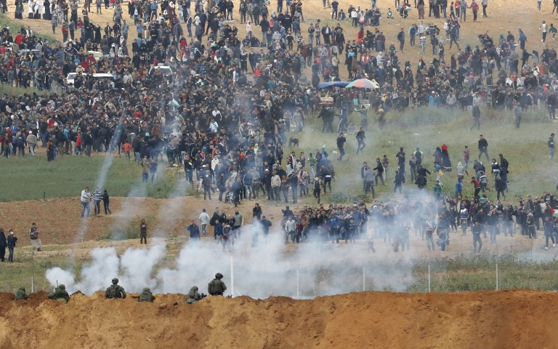
Notes:
https://www.timesofisrael.com/idf-hamas-cynically-sent-7-year-old-girl-to-breach-gaza-border/
A picture taken on March 30, 2018 from the southern Israeli kibbutz of Nahal Oz across the border from the Gaza strip shows tear gas grenades falling during a Palestinian city protest, with Israeli soldiers seen below in the foreground. (AFP/Jack Guez)

Slide 61
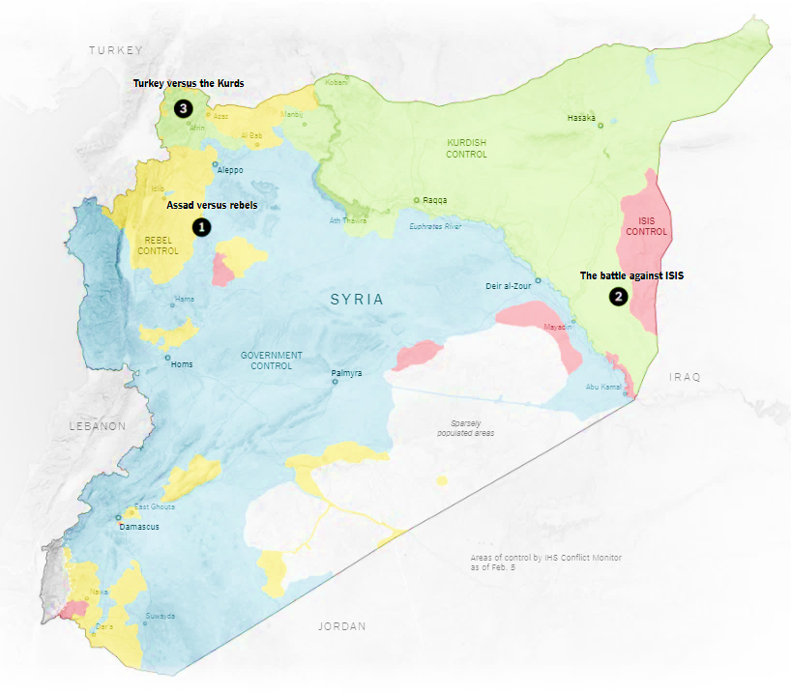
Notes:
Kurds, in pale green territories, are Israel’s only REALLY reliable ally in this region.
There are really three wars going on in Syria.

Slide 62
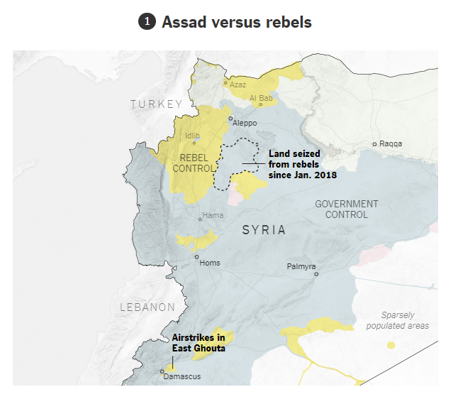

Slide 63
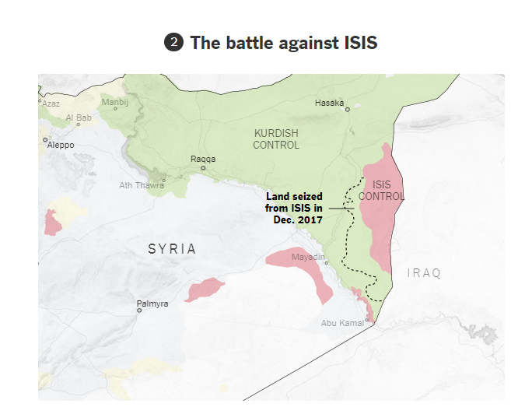

Slide 64
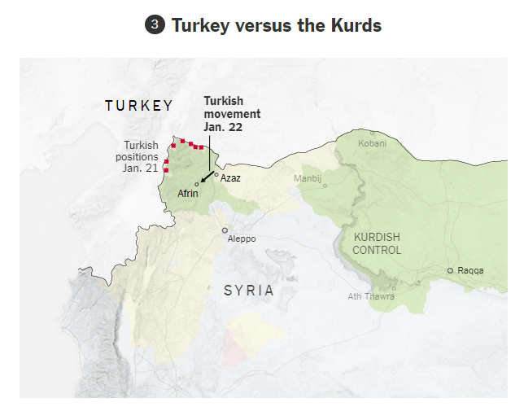
Notes:
It’s a bad deal to me that Turkey is a NATO member. Not really in sync with Western civilization.
Pres. Trump has recently reversed his intention to abandon the Kurds.

Slide 65
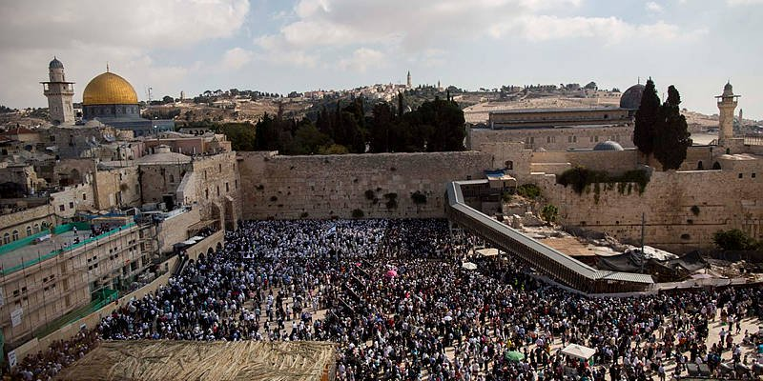
100,000 people receive the
Aharonic blessing for Pesakh
Notes:
Hearing the voice of G-d, the revelation of His presence, in a sense.

Slide 66
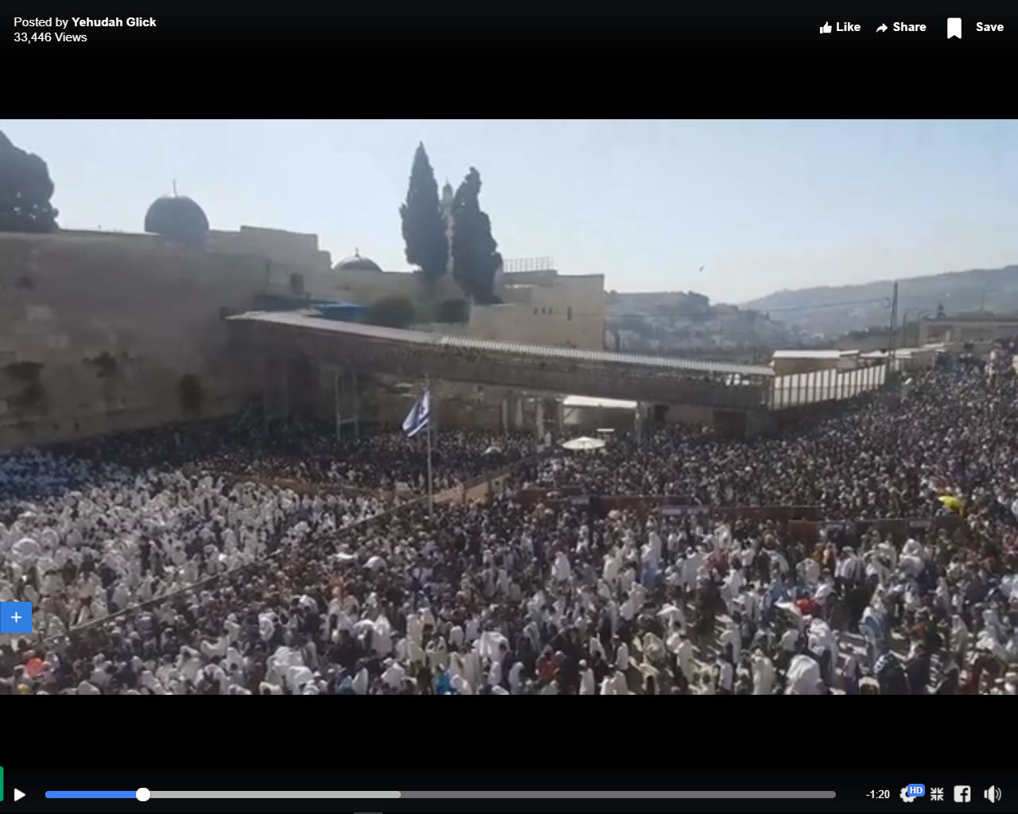
100,000 people receive the
Aharonic blessing for Pesakh
Notes:
http://www.jerusalemonline.com/news/in-israel/local/100000-gather-for-priestly-blessing-35312?utm_source=ActiveCampaign&utm_medium=email&utm_content=The+Latest+News+From+Israel&utm_campaign=MiddayNewsletter+-+Recurring
The mass priestly blessing ceremony is held twice a year, during Passover and Sukkot.

Slide 67
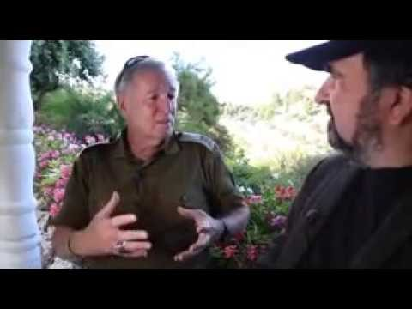
Shmura Matza Military Miracle
Notes:
https://www.youtube.com/watch?v=_yLKRInM6Po

Slide 68
^{Rev. 11.15} The seventh angel sounded his shofar; and there were loud voices in heaven, saying, “The kingdom of the world has become the Kingdom of our Lord and his Messiah, and he will rule forever and ever!”
Notes:
Ongoing warfare, intensifying in our day!
Neil and Jamie Lash, of Jewish Jewels TV program, write…

Slide 69
Wednesday, February 14, 2018, a deranged teenager with an assault weapon violently ended the lives of 17 people at Marjory Stoneman Douglas High School only 20 minutes north of our home. M’kaila Brown, a ninth-grade Christian student at the school, was walking down the hallway from her
Notes:
http://www.jewishjewels.org/blog/the-voice-of-the-lord/?utm_source=April+2018&utm_campaign=May+Newsletter+2017%21&utm_medium=email

Slide 70
classroom when she heard a voice say, “Turn back.” She was a bit confused at hearing this, but quickly returned to her classroom. And then she heard shots, from the direction in which she had been walking. M’kaila managed to get back to her classroom in time to join
Notes:
http://www.jewishjewels.org/blog/the-voice-of-the-lord/?utm_source=April+2018&utm_campaign=May+Newsletter+2017%21&utm_medium=email

Slide 71
a teacher and other students. The teacher locked the door behind them, and then led them to another room within that room, so that they had double protection. M’kaila’s mother has been quoted as saying that she was so glad that her daughter obeyed THE VOICE OF GOD. It probably saved her life.
Notes:
http://www.jewishjewels.org/blog/the-voice-of-the-lord/?utm_source=April+2018&utm_campaign=May+Newsletter+2017%21&utm_medium=email
This is resurrection power, supernatural. Trust. Wave that barley.

Slide 72
“Give ear and hear My voice. Listen and hear My speech” ^{(Isaiah 28:23).} The Shulamite maiden (the bride) in the Song of Songs longs to hear the voice of her beloved. She cries out, “The voice of my beloved!”
Notes:
http://www.jewishjewels.org/blog/the-voice-of-the-lord/?utm_source=April+2018&utm_campaign=May+Newsletter+2017%21&utm_medium=email

Slide 73
( קול דודי kohl doe-DEE) ^{(Song 2:8)}. In Song 5:2, she hears him saying, “Open for me, my sister, my love, my dove, my perfect one…” Words of love and intimacy. She hears his voice because they are in close relationship.
Notes:
http://www.jewishjewels.org/blog/the-voice-of-the-lord/?utm_source=April+2018&utm_campaign=May+Newsletter+2017%21&utm_medium=email

Slide 74
^{1 Corinthians 15:20} “But now Messiah is risen from the dead, and has become the firstfruits of those who have fallen asleep.” The Voice Of God Proclaims: The resurrection is intrinsically associated with the Passover and the Feast of Unleavened Bread.
Notes:
http://www.jewishjewels.org/blog/the-voice-of-the-lord/?utm_source=April+2018&utm_campaign=May+Newsletter+2017%21&utm_medium=email

Slide 75
The separation occurred at the Council of Nicaea in 325 A.D., but the truth is the truth: The death, burial, and resurrection of Yeshua happened during a Jewish feast.
Notes:
http://www.jewishjewels.org/blog/the-voice-of-the-lord/?utm_source=April+2018&utm_campaign=May+Newsletter+2017%21&utm_medium=email

Slide 76
Story from Clint Hall, “retired” pastor in this building ~20 years when it was owned by Westbrooke.
Las Vegas is considered the graveyard of missions. “Sin City”

Slide 77
We have outreach backwards. Expect newcomers, who walk in, to
Behave
Believe, then
Belong
People need to belong first. Acceptance, welcome. Res hope.

Slide 78
With that approach they’ve immersed 2000 new believers.
Yeshua’s order
Belong [feel acceptance]
Believe [hear the Word]
Behave [Ruakh/Spirit leads]
Notes:
I had a transgender person say to me, “They felt uplifted at Or HaOlam.”
One woman came to this cong. in Las Vegas late and rushing and forgot to change clothes. Worked as a stripper! They put a choir robe on her and welcomed her.
There is in KCMO an LGBT congregation, preaching the truth in love.

Slide 79
^{Yn.17.25-26} Righteous Father, the world has not known you, but I have known you, and these people have known that you sent me. I made your name known to them, and I will continue to make it known; so that the love with which you have loved me may be in them, and I myself may be united with them.”

Slide 80
Do we know Him in resurrection glory, albeit by faith?

Slide 81
Saw the movie, I Can Only Imagine. “Go into your pain, and find the joy.
If you live out of your woundedness, you’ll sow death.
I believe in the resurrection power of prayer!!

Slide 82
^{1 Kefa/Peter 1.8-9} Though you have not seen Him, you love Him. And even though you don’t see Him now, you trust Him and are filled with a joy that is glorious beyond words, receiving the outcome of your faith—the salvation of your souls.
Notes:
Last slide Clyde. Barley procession…

