Slide 1
If you want to have notes without taking notes,
Go to OrHaOlam.com
WITHOUT WIFI
Click on downloads, messages, 2018 messages
Today’s should be on the top.
Notes:
For those who didn’t get the email spam, this is what our building looks like now at night…

Slide 2
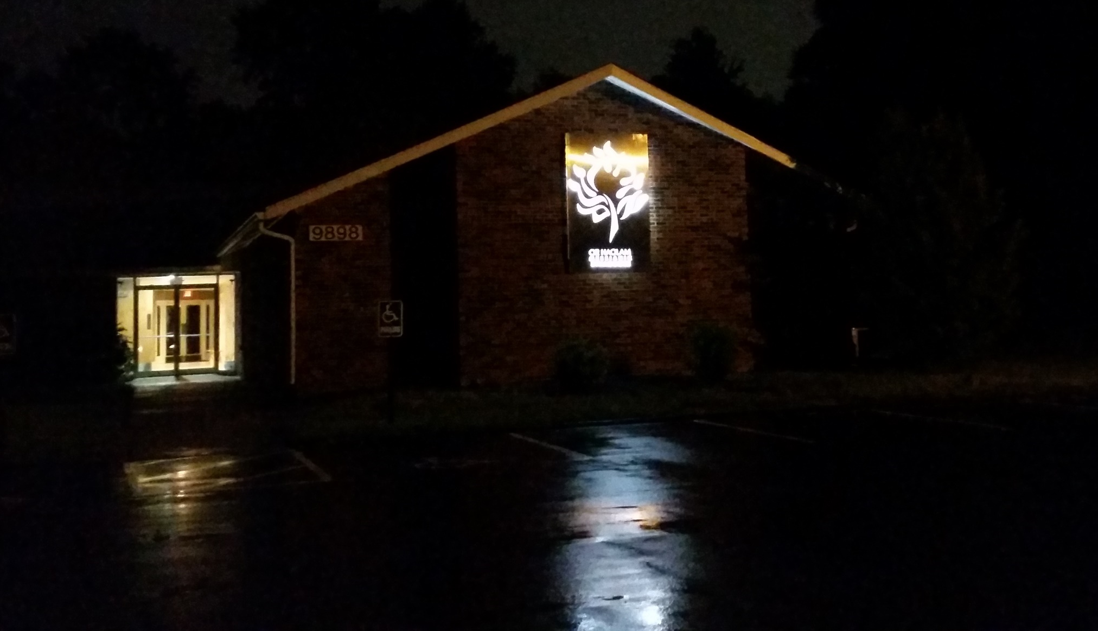
Notes:
We are the light of the world, as Yeshua shines through us!! Now dramatized in a whole new way.

Slide 3


Slide 4
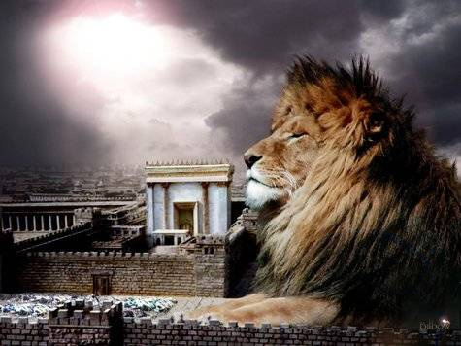
מַתִּתְיָהוּ Mattityahu
(Matthew) 24:6-8

Slide 5
Mattityahu (Matthew) 24:6
וְאַתֶּם עֲתִידִים לִשְׁמֹעַ מִלְחָמוֹת וּשְׁמוּעוֹת מִלְחָמָה. שִׂימוּ לֵב, אַל תִּבָּהֲלוּ: כִּי צָרִיךְ לִהְיוֹת הַדָּבָר הַזֶּה, וּבְכָל זֹאת עוֹד לֹא בָּא הַקֵּץ.
“You will hear the noise of wars nearby and the news of wars far off; see to it that you don’t become frightened. Such things must happen, but the end is yet to come.
Notes:
According to Craig Keener, these words are NOT the typical rhetoric of sensational apocalyptic revelation, but rather EXHORTATIONS BASED ON END TIME MOTIFS COMMON TO JEWISH THINKING. Key thought is NOT that this is the end. Not yet.
As you know, I was NOT a fan of Blood Moon/Shmittah meltdown, or Yeshua in the constellation, although that was fascinating.
We just arranged a session in Dec. with FFOZ on the Book of Revelation: Not dispensational, not sensational, Jewishly Revelational.
Yet, Yeshua’s exhortation according to the prophets…

Slide 6
^{Yeshayahu/Is 51.46} Do not be faint-hearted, or be intimidated by the rumor heard in the land— one year one rumor comes, next year, another rumor. Yet violence will be in the land,
with ruler against ruler.
Notes:
Get steel in your soul for war.

Slide 7
^{Daniel 7.21-22} I watched, and that horn made war with the holy ones and was winning, until the Ancient One came, judgment was given in favor of the holy ones of the Most High, and the time came for the holy ones to take over the kingdom.
Notes:
We are apparently losing, but that will reverse, ultimately, and incrementally.

Slide 8
Such things must happen, but the end is yet to come.

Slide 9
Mattityahu (Matthew) 24:7
גּוֹי יָקוּם עַל גּוֹי וּמַמְלָכָה עַל מַמְלָכָה
“For peoples will fight each other, nations will fight each other,
[both on a global scale and locally]

Slide 10
Conflict avoidance is a method of reacting to conflict, which attempts to avoid directly confronting the issue at hand. Methods of doing this can include changing the subject, putting off a discussion until later, or simply not bringing up the subject of contention.
Notes:
Putting off the discussion, my tendency.

Slide 11
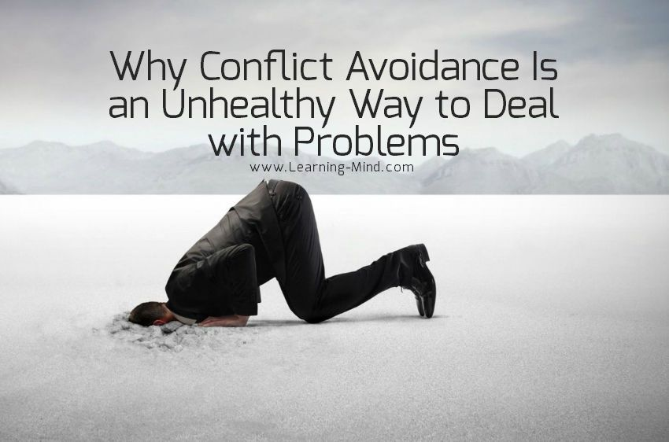
Notes:
https://www.google.com/imgres?imgurl=https://i2.wp.com/www.learning-mind.com/wp-content/uploads/2018/01/conflict-avoidance.jpg?fit%3D850%252C562%26ssl%3D1&imgrefurl=https://www.learning-mind.com/conflict-avoidance/&h=562&w=850&tbnid=1-HkHeIDDx_f4M:&q=conflict+avoidance&tbnh=160&tbnw=242&usg=__1BTzzjQxCbh-D2_OODprVgWMI80%3D&vet=10ahUKEwjzgsa0rKPbAhUFHqwKHXpRA74Q9QEILTAA..i&docid=iiz44Lrff3m2aM&sa=X&ved=0ahUKEwjzgsa0rKPbAhUFHqwKHXpRA74Q9QEILTAA#h=562&imgdii=1-HkHeIDDx_f4M:&tbnh=160&tbnw=242&vet=10ahUKEwjzgsa0rKPbAhUFHqwKHXpRA74Q9QEILTAA..i&w=850
Mt. 18 to face life’s difficulties. Neville Chamberlain in the 1930’s sought to avoid conflict with Hitler.

Slide 12
Mattityahu (Matthew) 24:7
וְיִהְיוּ רָעָב וּרְעִידוֹת אֲדָמָה בִּמְקוֹמוֹת רַבִּים,
and there will be famines and earthquakes in various parts of the world;

Slide 13
Mattityahu (Matthew) 24:8
אַךְ כָּל אֵלֶּה רֵאשִׁית הַצָּרוֹת.
“all this is but the beginning of the ‘birth-pains.’”
Notes:
Yeshua was using imagery common to Israeli culture.

Slide 14
^{Yeshayahu 26.16-18} Adoni, when they were troubled, they sought you. When you chastened them, they poured out a silent prayer. As a pregnant woman about to give birth cries out and writhes in her labor pains,

Slide 15
^{Yeshayahu 26.16-18} so we have been at your presence, Adoni — we have been Pregnant And Been In Pain. But we, as it were, have given birth to wind; we have not brought salvation to the land, and those inhabiting the world have not come to life.

Slide 16
^{T’hillim/Ps 48.6-7} They saw and were filled with consternation;
terrified, they took to flight.
Trembling took hold of them,
pains like those of a woman in labor.

Slide 17
There are Talmudic references to the “birth pangs” or “travail” of the Messiah (Sanhedrin 98b and Shabat 118a). These are based on Tanakhic [OT] prophecies of suffering before the coming of the Messiah. The time is likened to the ordeal of childbirth.
Notes:
https://jewsforjesus.org/newsletter-jan-1994/newsletter-jan-1994/newsletter-jan-1994/the-birth-pangs-of-the-messiah/

Slide 18
When a woman begins to have birth pangs, it means that things are not going to get easier, only much harder. Joy lies ahead, but first comes the painful part.
Notes:
https://jewsforjesus.org/newsletter-jan-1994/newsletter-jan-1994/newsletter-jan-1994/the-birth-pangs-of-the-messiah/

Slide 19
Yeshua predicted that before the joy of His return, there would be an increase in painful events. There would be famines, earthquakes, lawlessness and wars between countries.
Notes:
https://jewsforjesus.org/newsletter-jan-1994/newsletter-jan-1994/newsletter-jan-1994/the-birth-pangs-of-the-messiah/
I thought I’d go back 3 centuries to give history of war destructions.

Slide 20
The casualties of the Napoleonic Wars (1803–1815), direct and indirect, break down as follows:
2,500,000 military personnel in Europe
1,000,000 civilians were killed in Europe and in French overseas colonies.
Total: 3,500,000 casualties
Notes:
US War of 1812 was an indirect part.

Slide 21
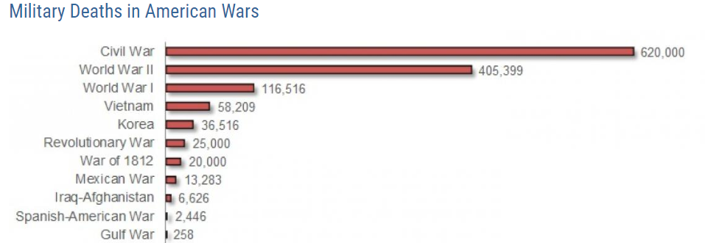
US Civil War 620,000 US military deaths

Slide 22
World War I 1914-1917
Nearly 10 million died.
The Allies [UK, Fr, USA, Russia] lost about 6 million soldiers.
The Central Powers [Germany, Austria, Turkey] lost about 4 million. More than 65 million men from 30 countries fought in WW I.

Slide 23
World War II was the deadliest conflict in human history, marked by 50 to 85 million fatalities, most of which were civilians in the Soviet Union and China. It included massacres, the genocide of the Holocaust, strategic bombing,
Notes:
https://en.wikipedia.org/wiki/World_War_II

Slide 24
premeditated death from starvation and disease, biological and chemical warfare, and the only use of nuclear weapons in war.
Total: 50 to 85 million fatalities
Notes:
https://en.wikipedia.org/wiki/World_War_II
Since WW II

Slide 25
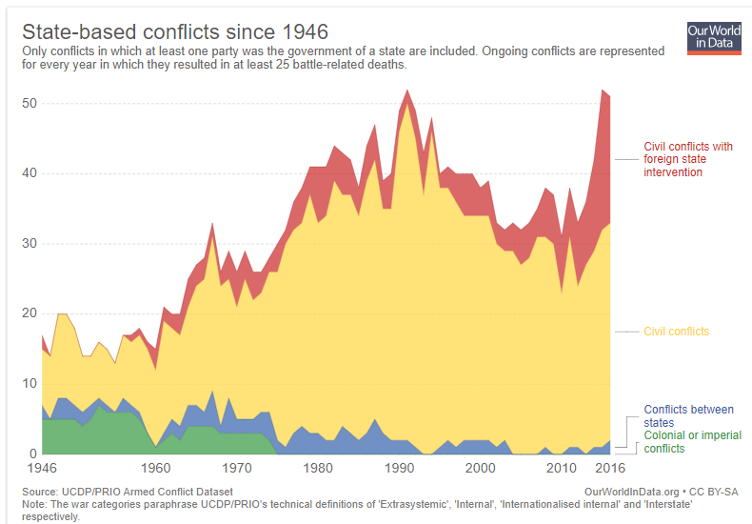
Notes:
https://ourworldindata.org/war-and-peace
Smaller, more focused wars, but increasing number of them.

Slide 26
On Nov. 1, 1983, leading Russian and American scientists -- including author Carl Sagan -- discussed the possible consequences of a nuclear war. Apart from the immediate destruction of infrastructure and the loss of millions of lives, the scientists were mostly concerned about the possible aftermath of such a war.
Notes:
https://www.forbes.com/sites/davidbressan/2017/08/12/even-a-small-nuclear-war-would-still-have-effects-on-global-scale/#2c4cbfc8507d

Slide 27
The detonation of some hundreds of atomic bombs would cause a nuclear winter, with disastrous impacts on the environment and human food resources. The ash and dust, transported by the atomic blasts into the higher layers of Earth's atmosphere, would form a cloud layer, making it impossible for sunlight and heat to reach the surface.
Notes:
https://www.forbes.com/sites/davidbressan/2017/08/12/even-a-small-nuclear-war-would-still-have-effects-on-global-scale/#2c4cbfc8507d
Not absurd speculation. The 1883 eruption of Krakatoa in the Dutch East Indies (now Indonesia) began in the afternoon of Sunday, 26 August 1883. The 1883 Krakatoa eruption darkened the sky worldwide for years afterwards and produced spectacular sunsets throughout the world for many months.

Slide 28
Dropping temperatures would plunge Earth into a nuclear winter, maybe for decades or even centuries. Plants, no longer able to produce nutrients by photosynthesis, would quickly die off, followed by the starving animals and finally humans.
Notes:
https://www.forbes.com/sites/davidbressan/2017/08/12/even-a-small-nuclear-war-would-still-have-effects-on-global-scale/#2c4cbfc8507d

Slide 29
So with the threat of nuclear extinction of the human species, wars have gotten smaller, but more frequent.
Spiritual war has gotten more intense.

Slide 30
^{2 Tim 3.11-13} What persecutions I endured! Yet the Lord rescued me from all of them. And indeed, all who want to live a godly life united with the Messiah Yeshua will be persecuted, while evil people and impostors will go from bad to worse, deceiving others and being deceived themselves.
Notes:
For example…here’s a shocker:

Slide 31
BSA Scouts out New Condom Policy May 22, 2018
What kind of fire are the Boy Scouts teaching kids to start? Angry parents want to know now that the organization is making condoms an official part of its World Jamboree.
Notes:
https://www.frc.org/get.cfm?i=WA18E43&f=WU18E14

Slide 32
Almost five years to the day that it threw open doors to homosexuality, BSA leaders are making their leftward lurch complete with the announcement that birth control would be provided at their next 12-day jamboree where 12- to 17-year-olds will convene.
Notes:
https://www.frc.org/get.cfm?i=WA18E43&f=WU18E14
Alcohol too, and name change Scouts BSA

Slide 33
A document from the three-country planning committee is making the rounds -- and the hosts of the West Virginia event have an interesting mandate. Jamboree organizers must now guarantee that “condoms are readily and easily accessible for all participants and IST [staff] at a number of locations on the site.”
Notes:
https://www.frc.org/get.cfm?i=WA18E43&f=WU18E14

Slide 34
This is by CBN. http://www1.cbn.com/cbnnews/us/2018/may/parents-and-experts-say-kids-movie-grooms-children-for-sex-abuse

Slide 35

Notes:
On Israel issues, a great deception the news media generally buys into...

Slide 36
Gaza Protest: The goal, according to Yahya Sinwar, the Hamas political leader, was to “take down the border” and “tear their hearts from their bodies.” According to an article in The Wall Street Journal, “Hamas posted maps for their operatives showing the quickest
Notes:
Barry Batya Segal newsletter

Slide 37
routes from the border to Israeli homes, schools and day care centers near the border.” Yet many in the media insist on portraying this invasion as a peaceful demonstration. One of Hamas’ co-founders, Mahmoud Al-Zahar, recently told Al Jazeera
Notes:
Barry Batya Segal newsletter

Slide 38
“When we talk about ‘peaceful,’ we are deceiving the public.” Hamas provided free transportation throughout Gaza to the recent border demonstrations for civilians, including women and children.
Notes:
Barry Batya Segal newsletter

Slide 39
Hamas hired them, paying $14 a person or $100 a family for attendance - and $500 if they managed to get injured. Hamas forced all of their commanders and operatives to go to the border dressed as civilians.
Notes:
Barry Batya Segal newsletter

Slide 40
Yeshua predicted that before the joy of His return, there would be an increase in painful events. There would be famines, earthquakes, lawlessness and wars between countries.
Notes:
https://jewsforjesus.org/newsletter-jan-1994/newsletter-jan-1994/newsletter-jan-1994/the-birth-pangs-of-the-messiah/

Slide 41
However, not without victories en route.
^{Mtt. 2412-14} Because lawlessness will multiply, the love of many will grow cold. But the one who endures to the end will be saved.

Slide 42
^{Mtt. 2412-14} This Good News of the kingdom shall be proclaimed in the whole world as a testimony to all the nations, and then the end will come.

Slide 43

Jobst Bittner report
Jobst Bittner report
Notes:
Up to 2.00
Next up: Yehudah Glick, who advocates opening the Temple Mount on an equal footing to prayer by Muslims, Jews, Christians, and others. On October 29 2014, Glick gave a speech, and afterward a man on a motorcycle who spoke with a "thick Arab accent" approached Glick as he loaded equipment into the back of his car, and asked if he was Yehuda Glick, before shooting him in the chest 4 times and speeding off. He has recovered, and is still working for the Temple Mount restoration. Had us dancing!

Slide 44
MK Yehudah Glick appreciation
Notes:
So, we’re not done with the March of Remembrance. Maybe. Need a coordinator.

Slide 45
Go to
JerusalemofPeace.com
And sign the covenant!

Slide 46
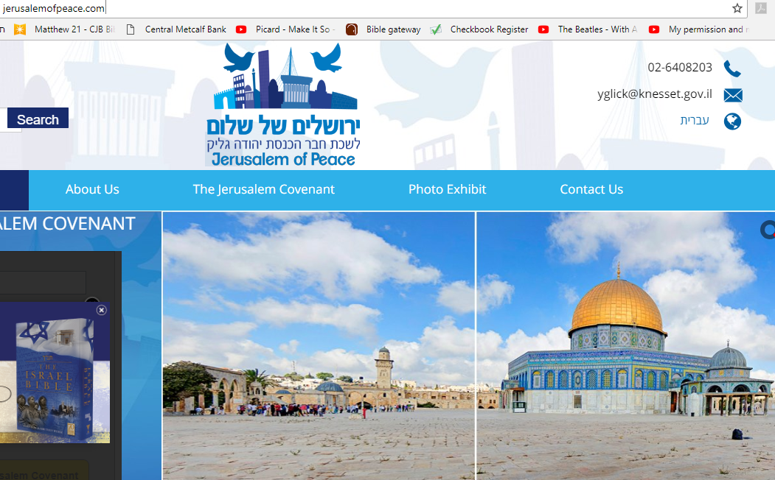
Notes:
Let’s hear from some of the participants. This was a great time of celebration and victory.

Slide 47
Valerie Alejandre report

Slide 48
Amy Stewart report

Slide 49
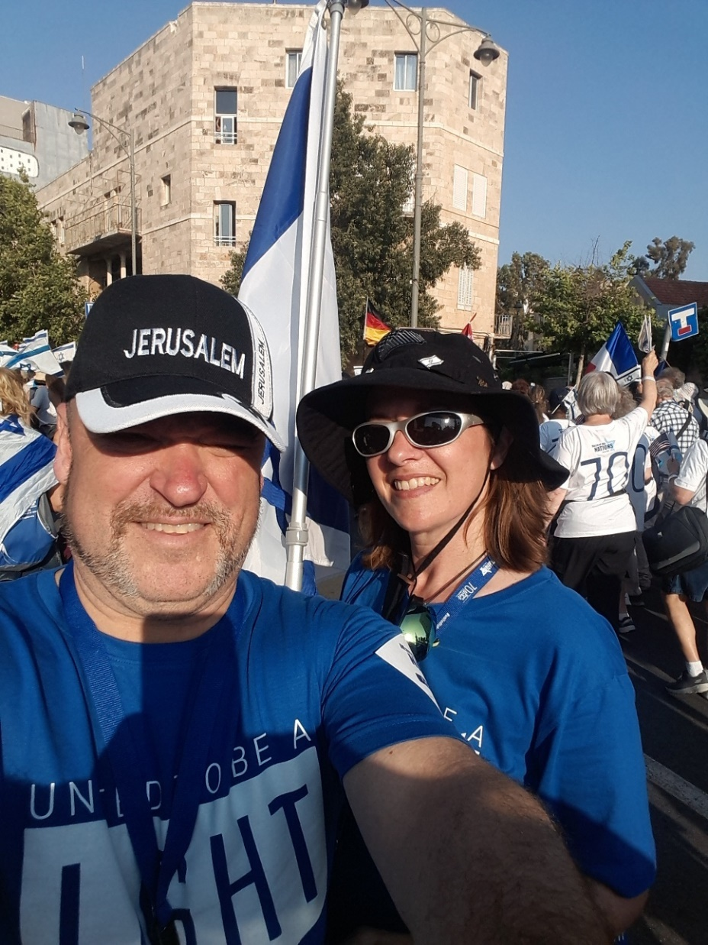

Slide 50
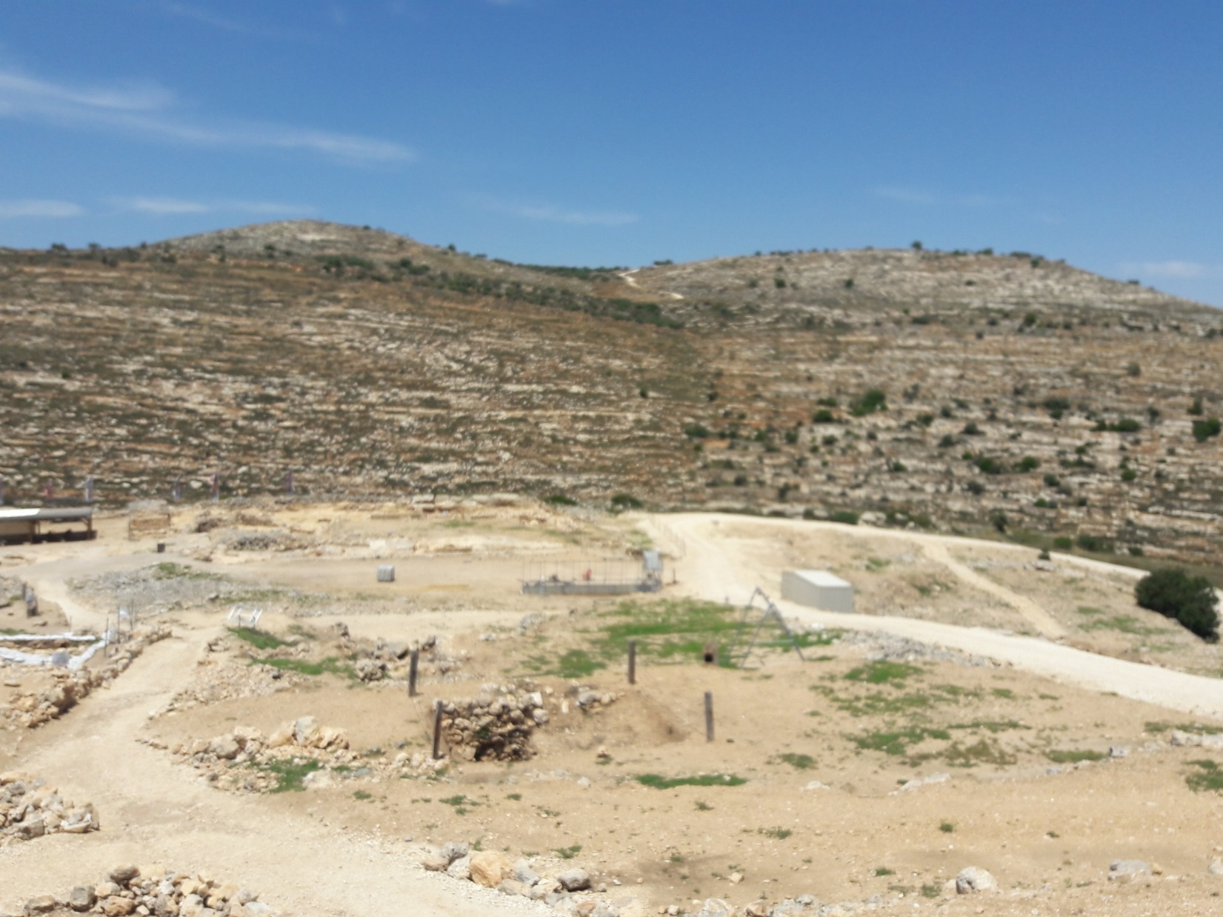

Slide 51
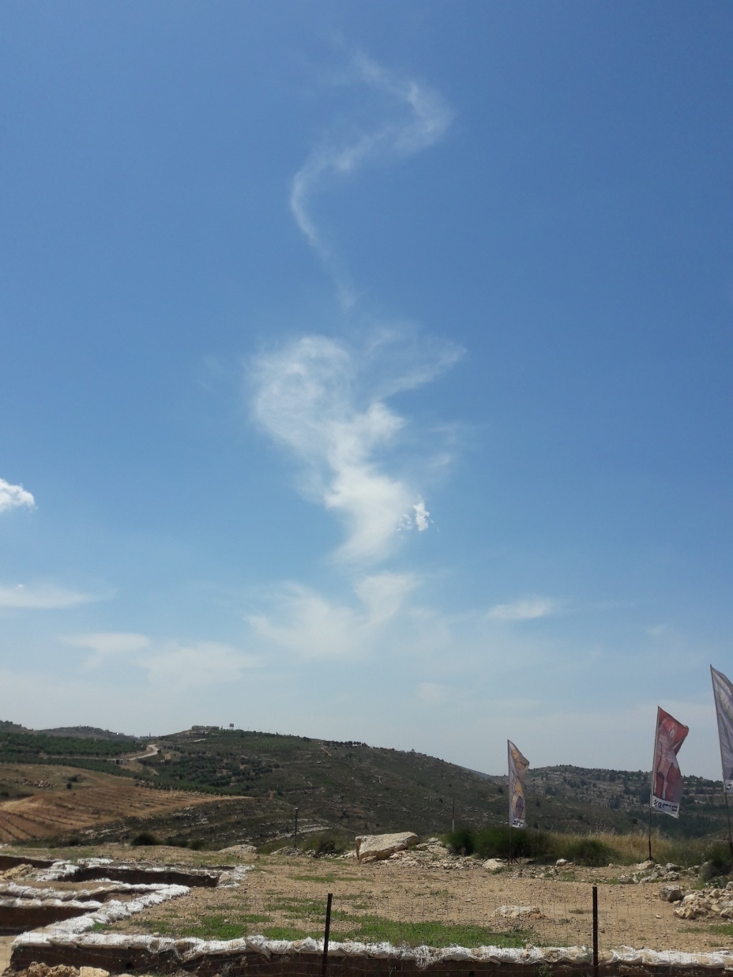

Slide 52
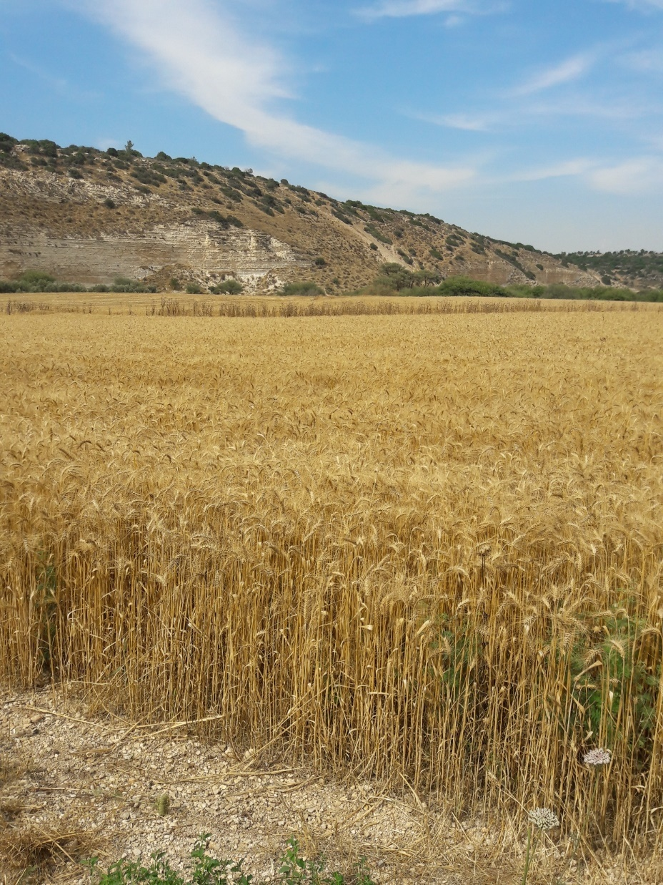

Slide 53
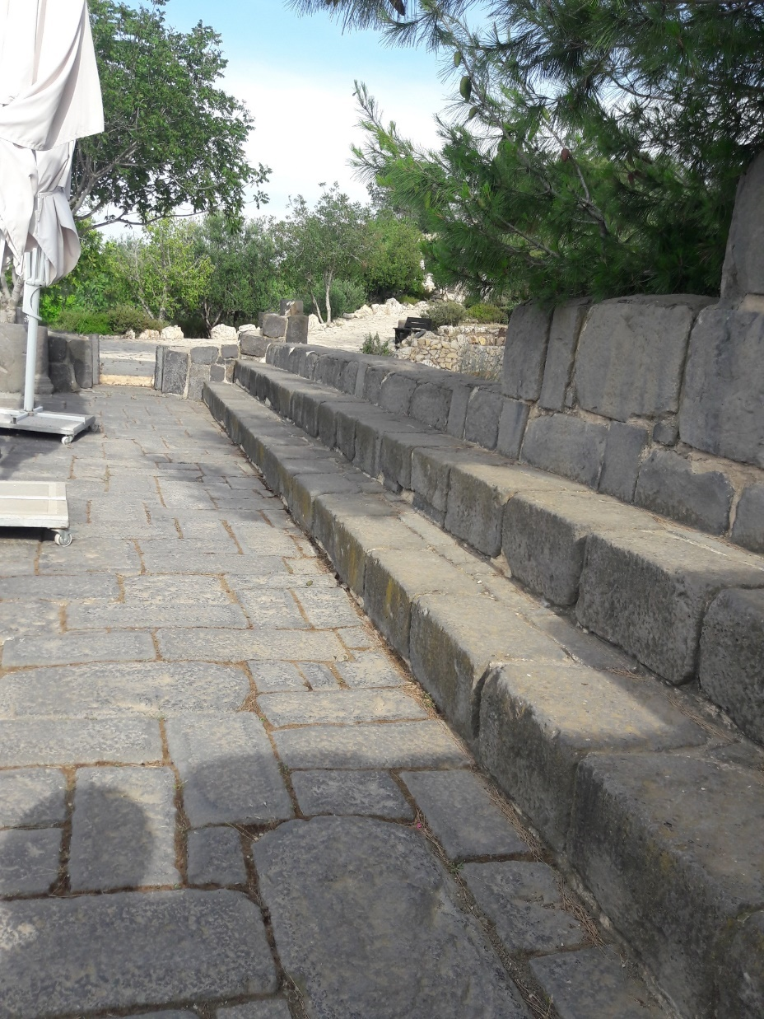

Slide 54
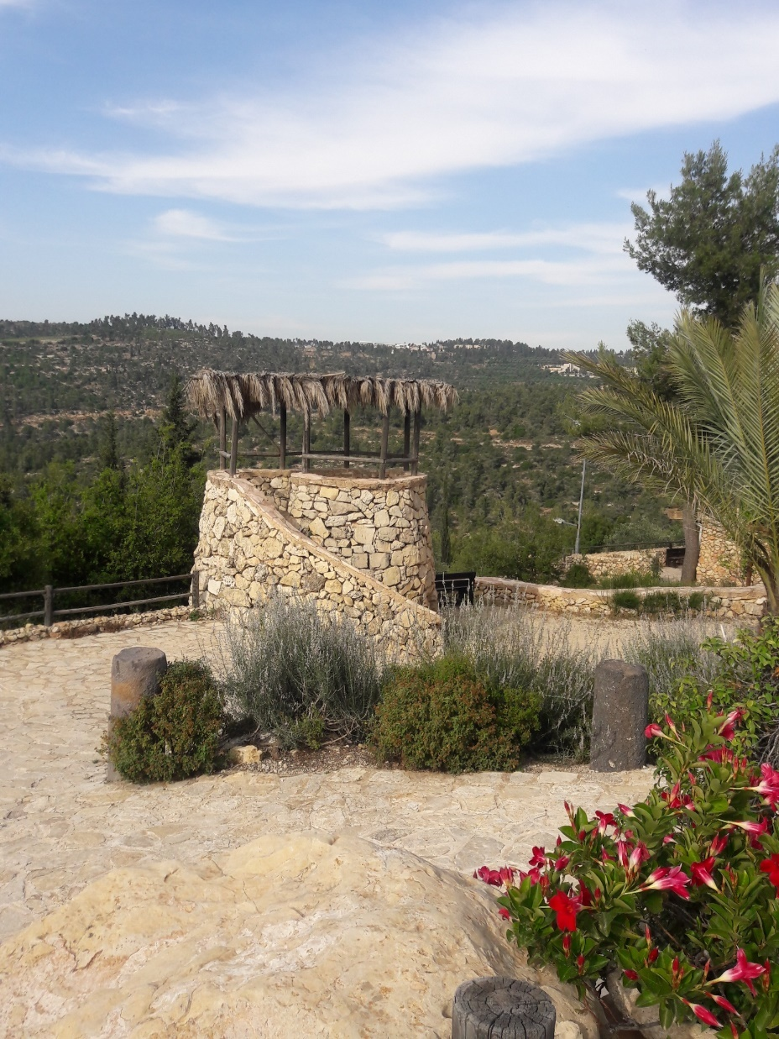

Slide 55
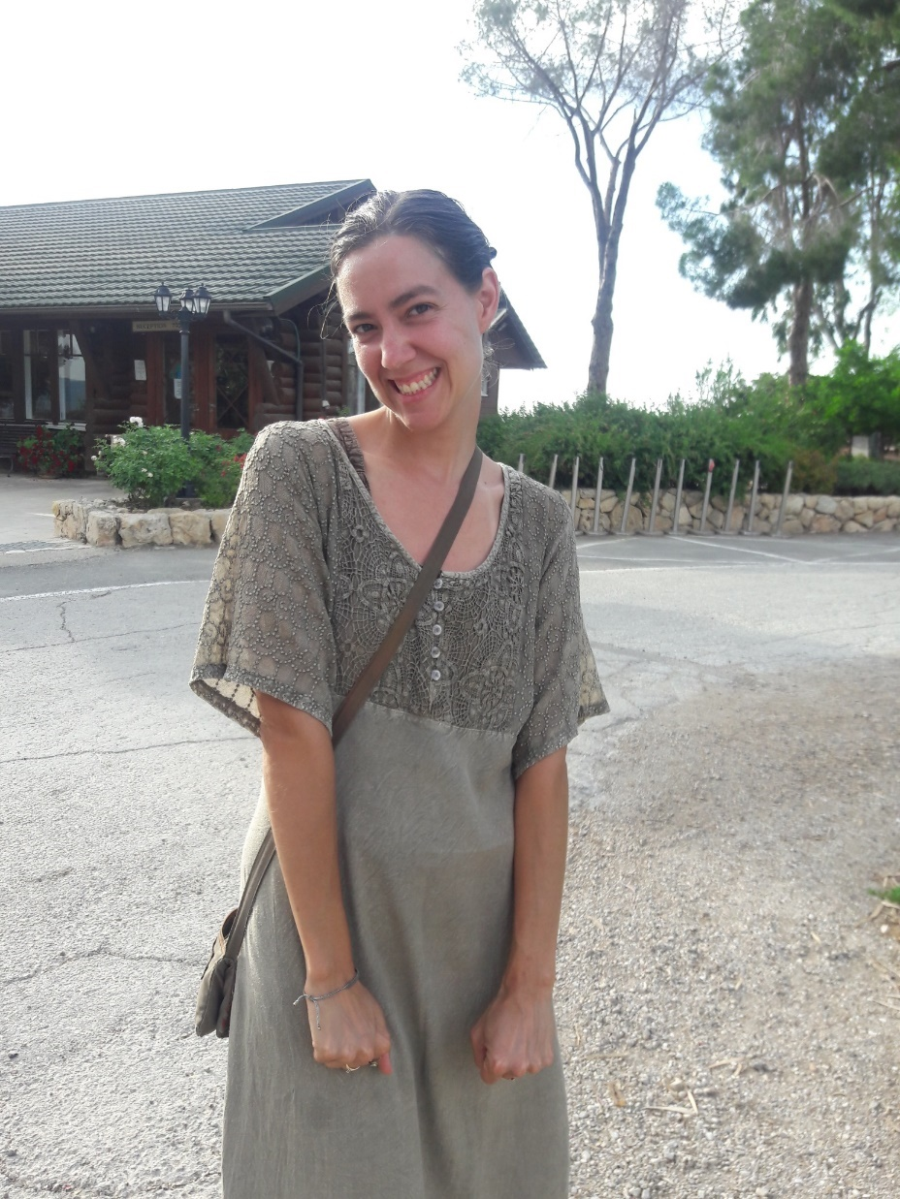

Slide 56
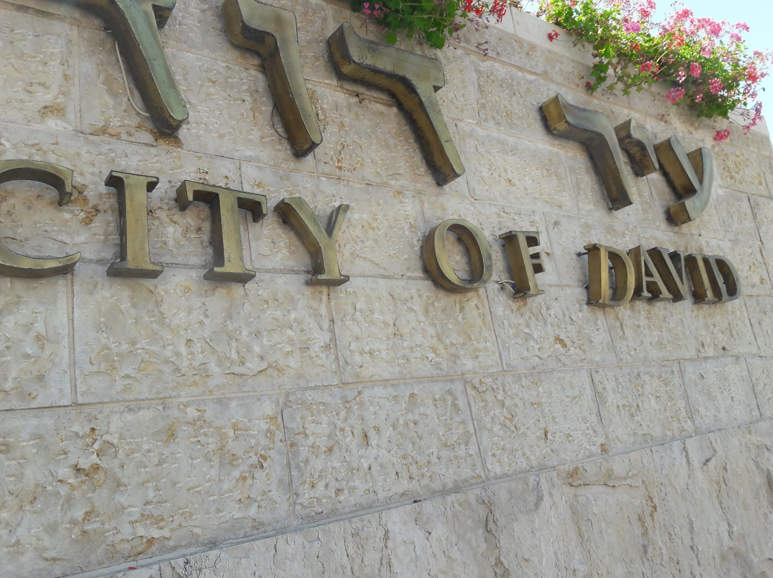

Slide 57
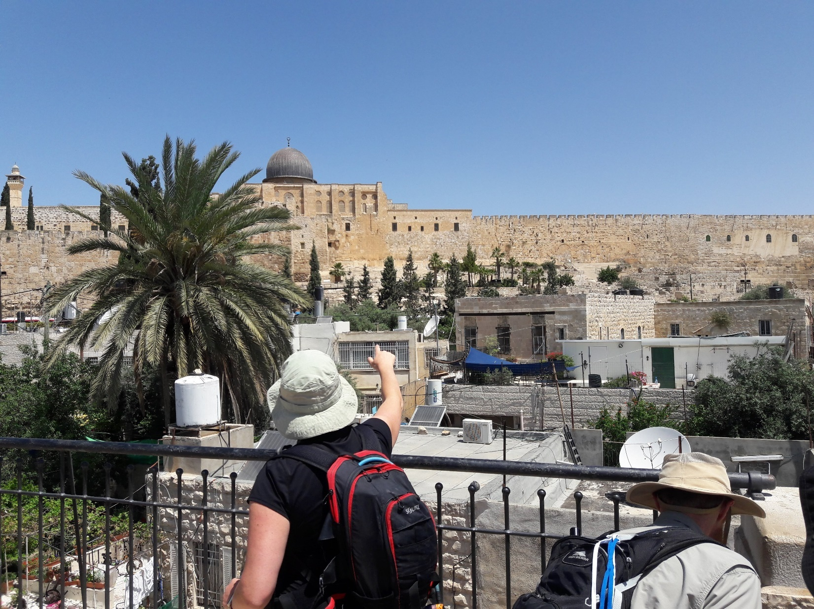

Slide 58
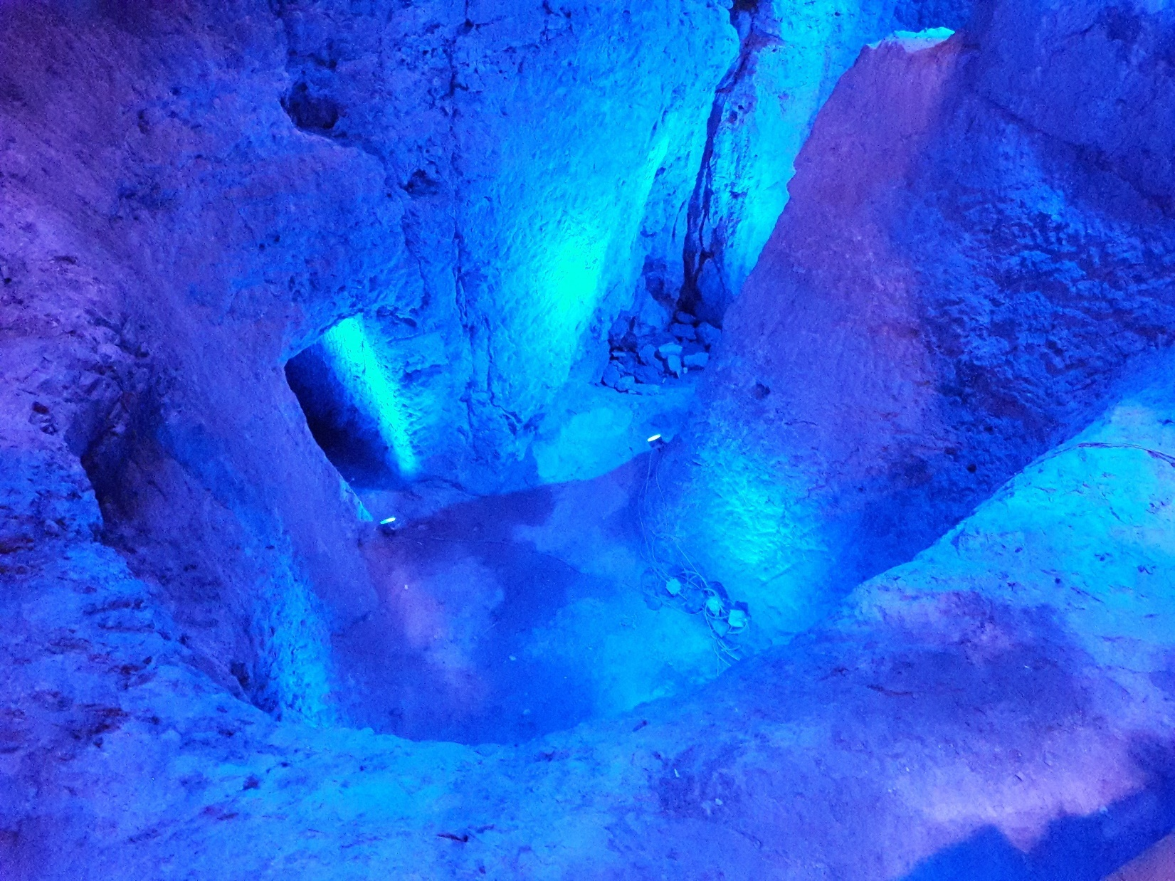

Slide 59
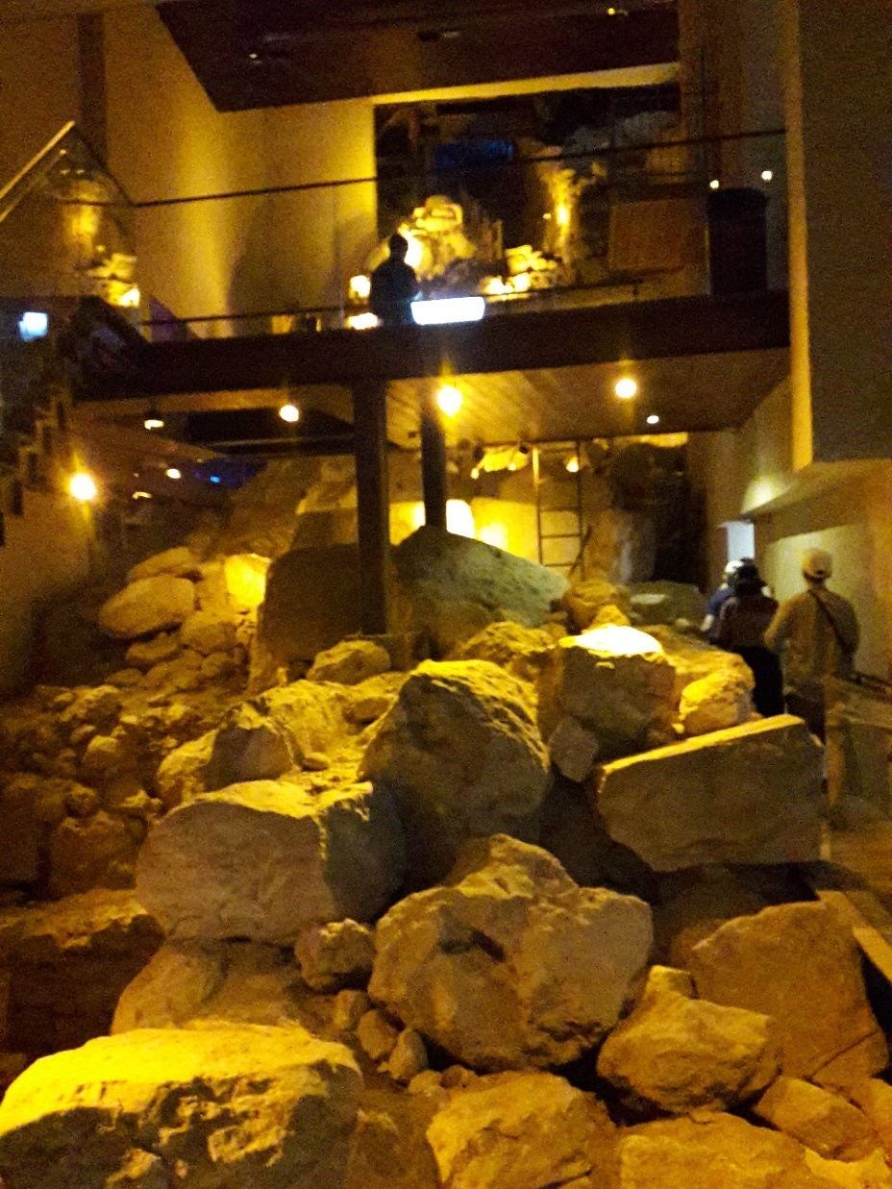

Slide 60
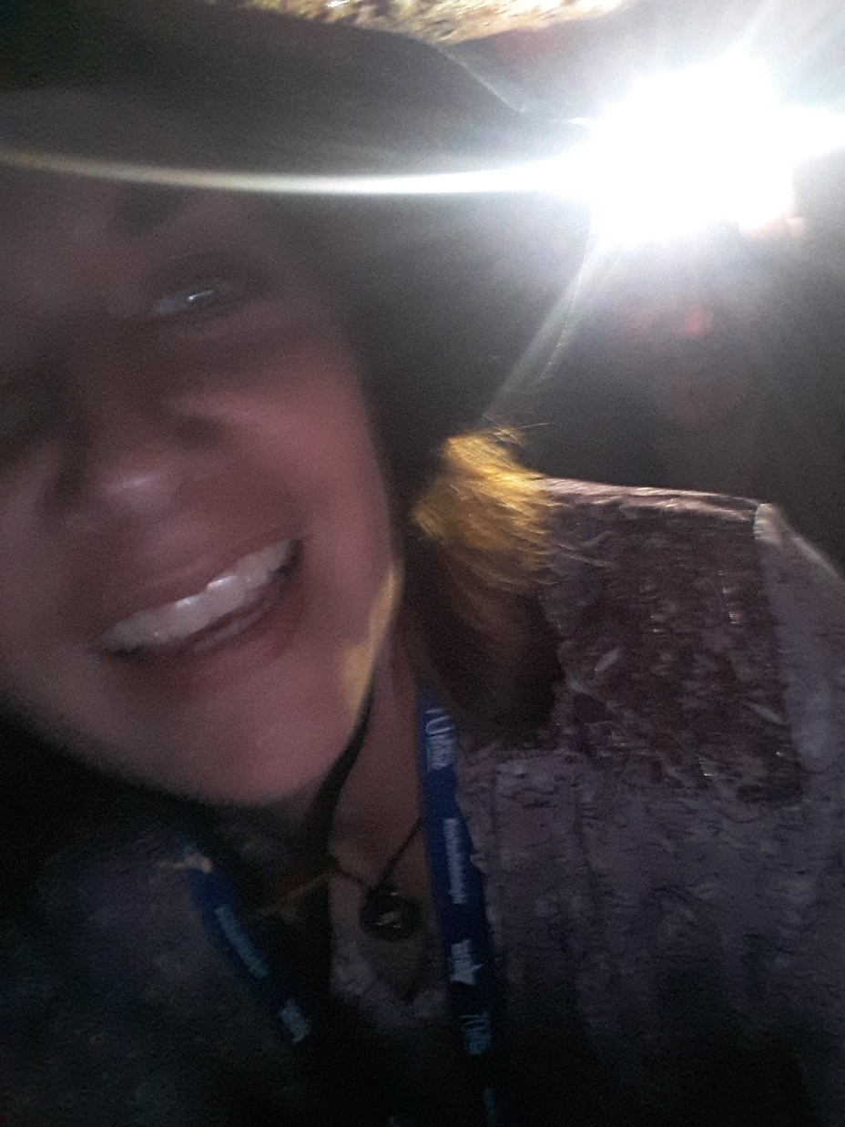

Slide 61
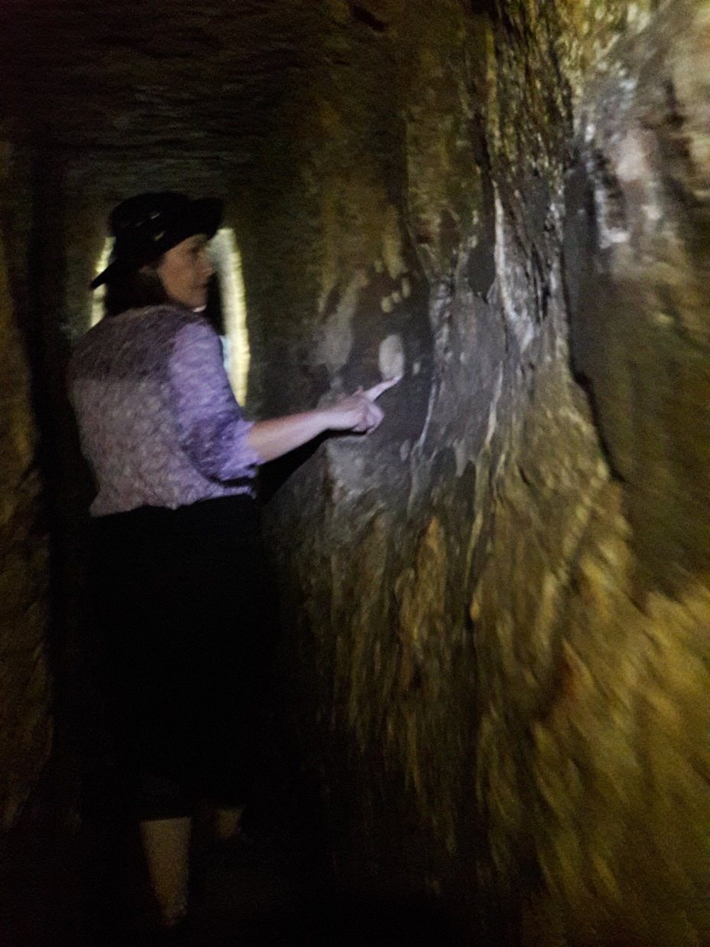

Slide 62
John Stewart report

Slide 63
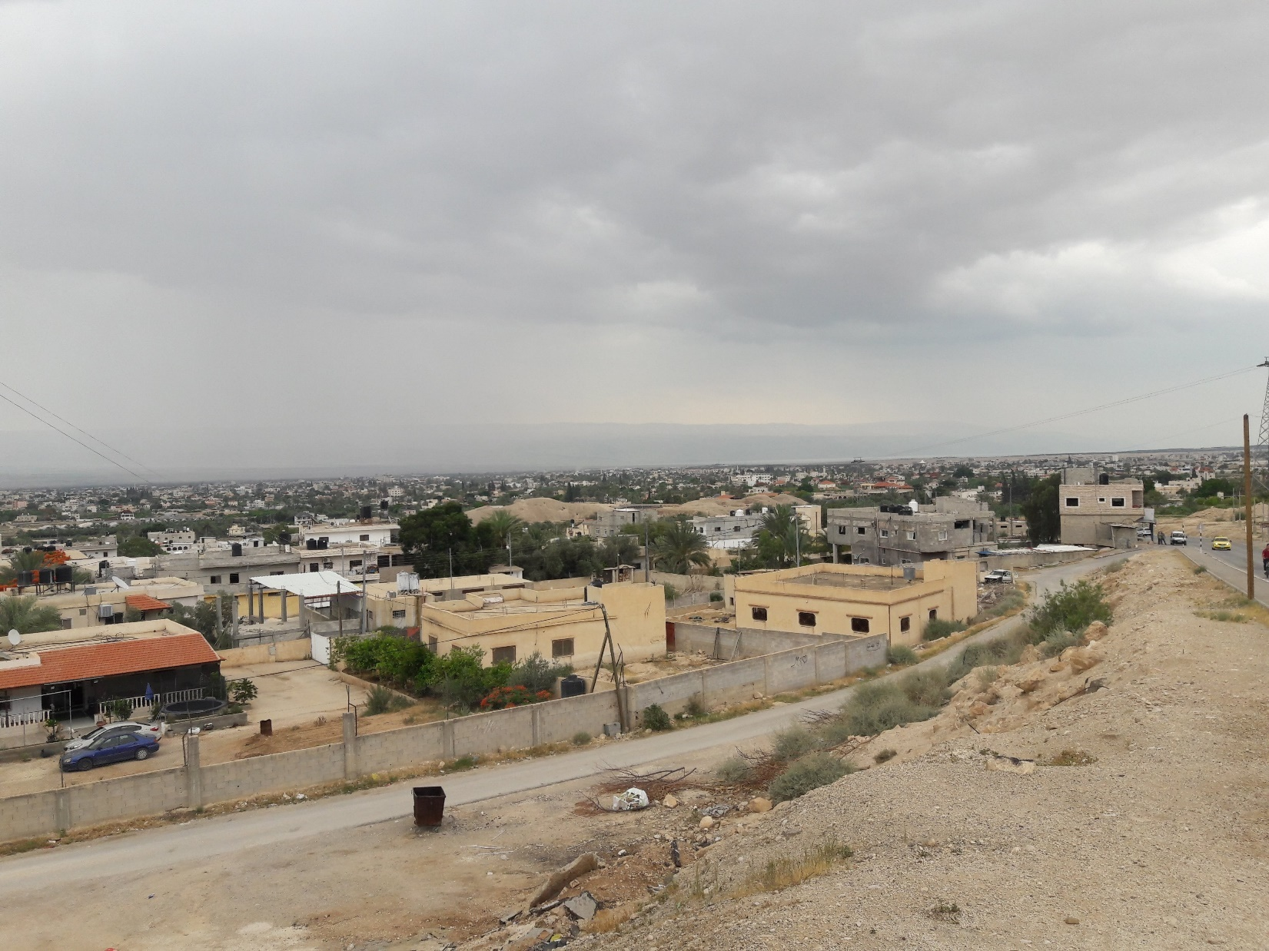

Slide 64
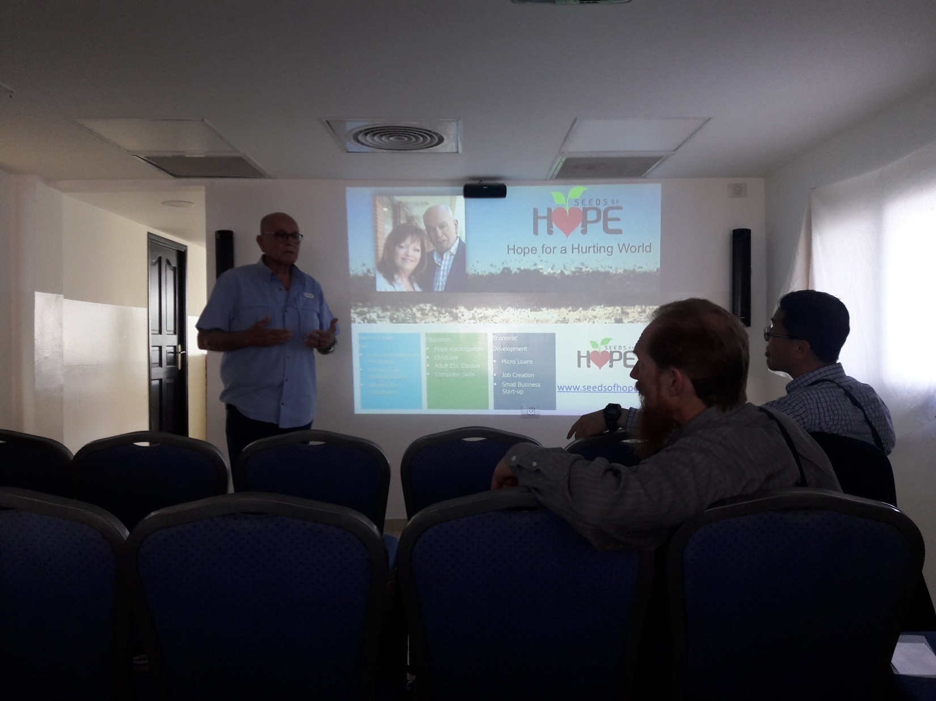

Slide 65
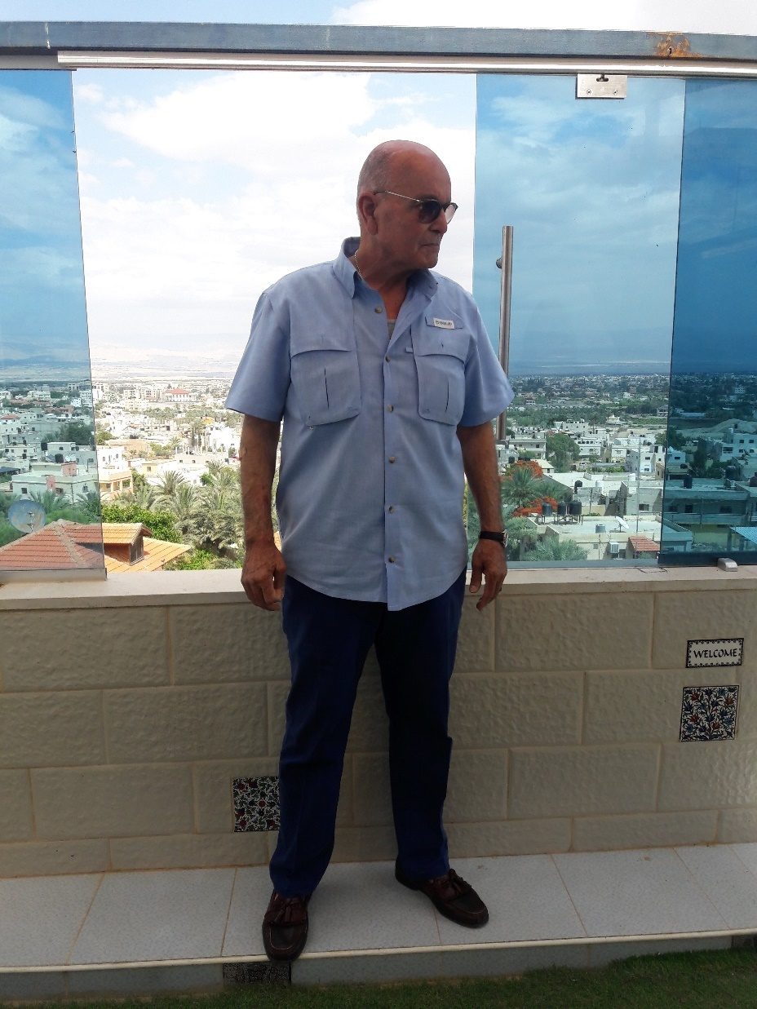

Slide 66


Slide 67
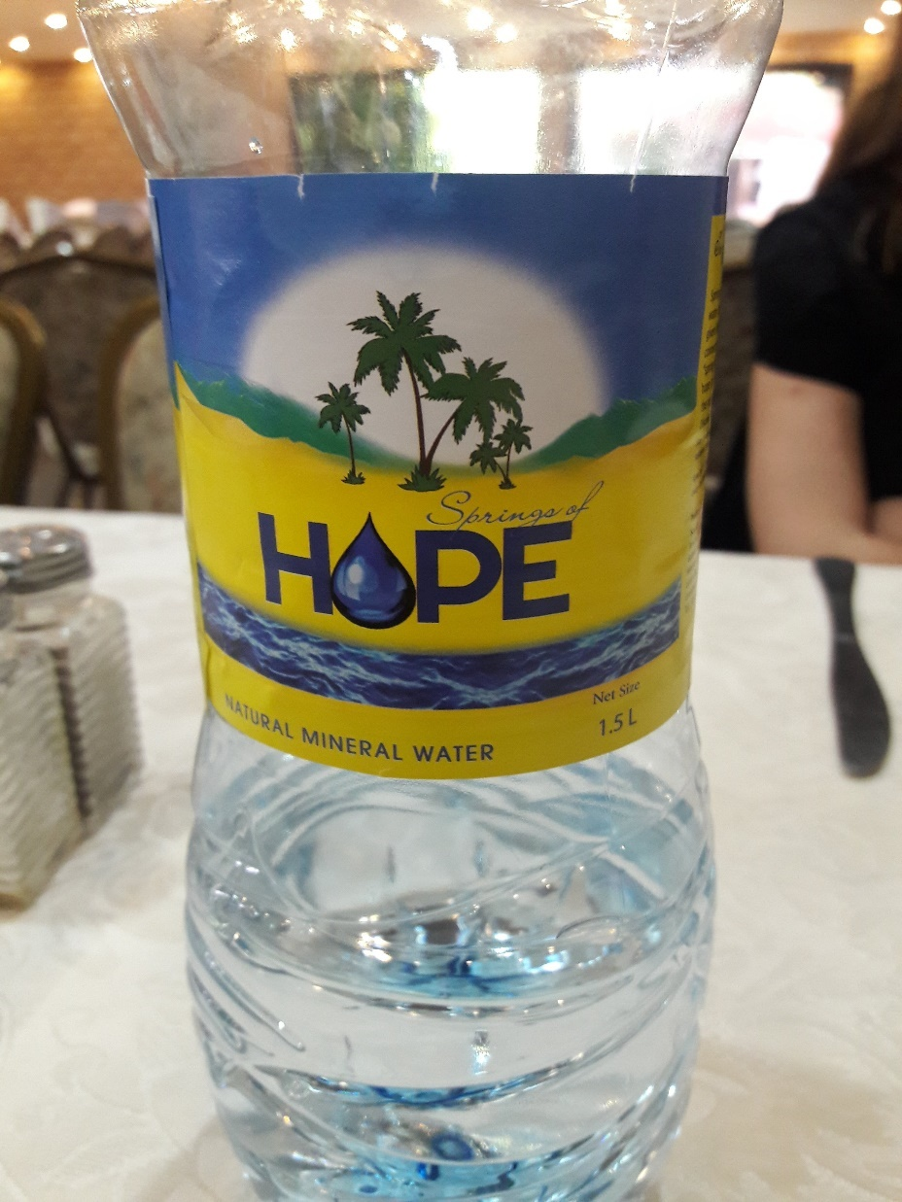

Slide 68
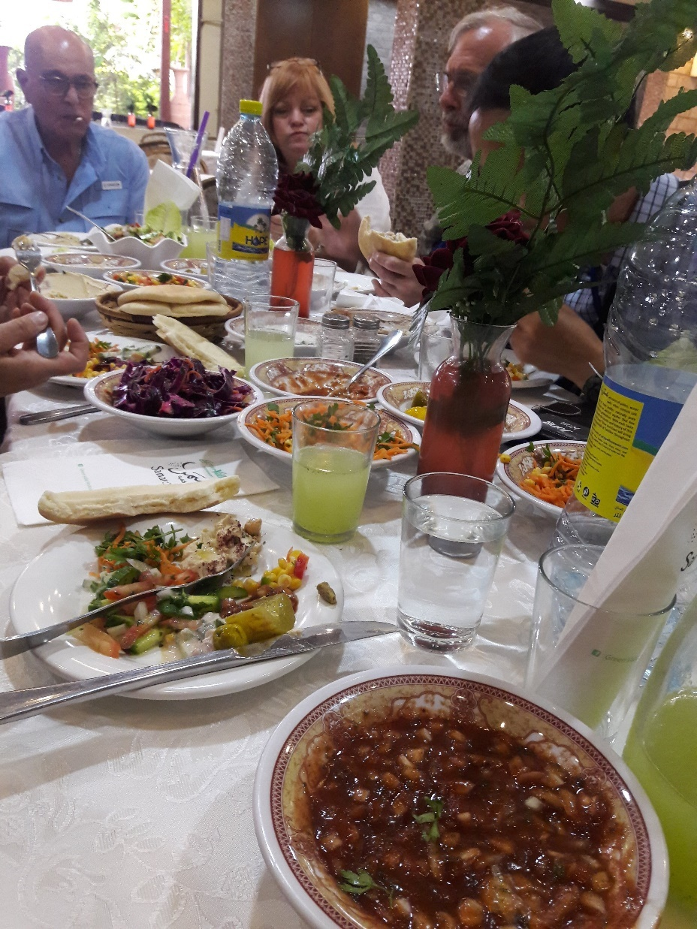

Slide 69
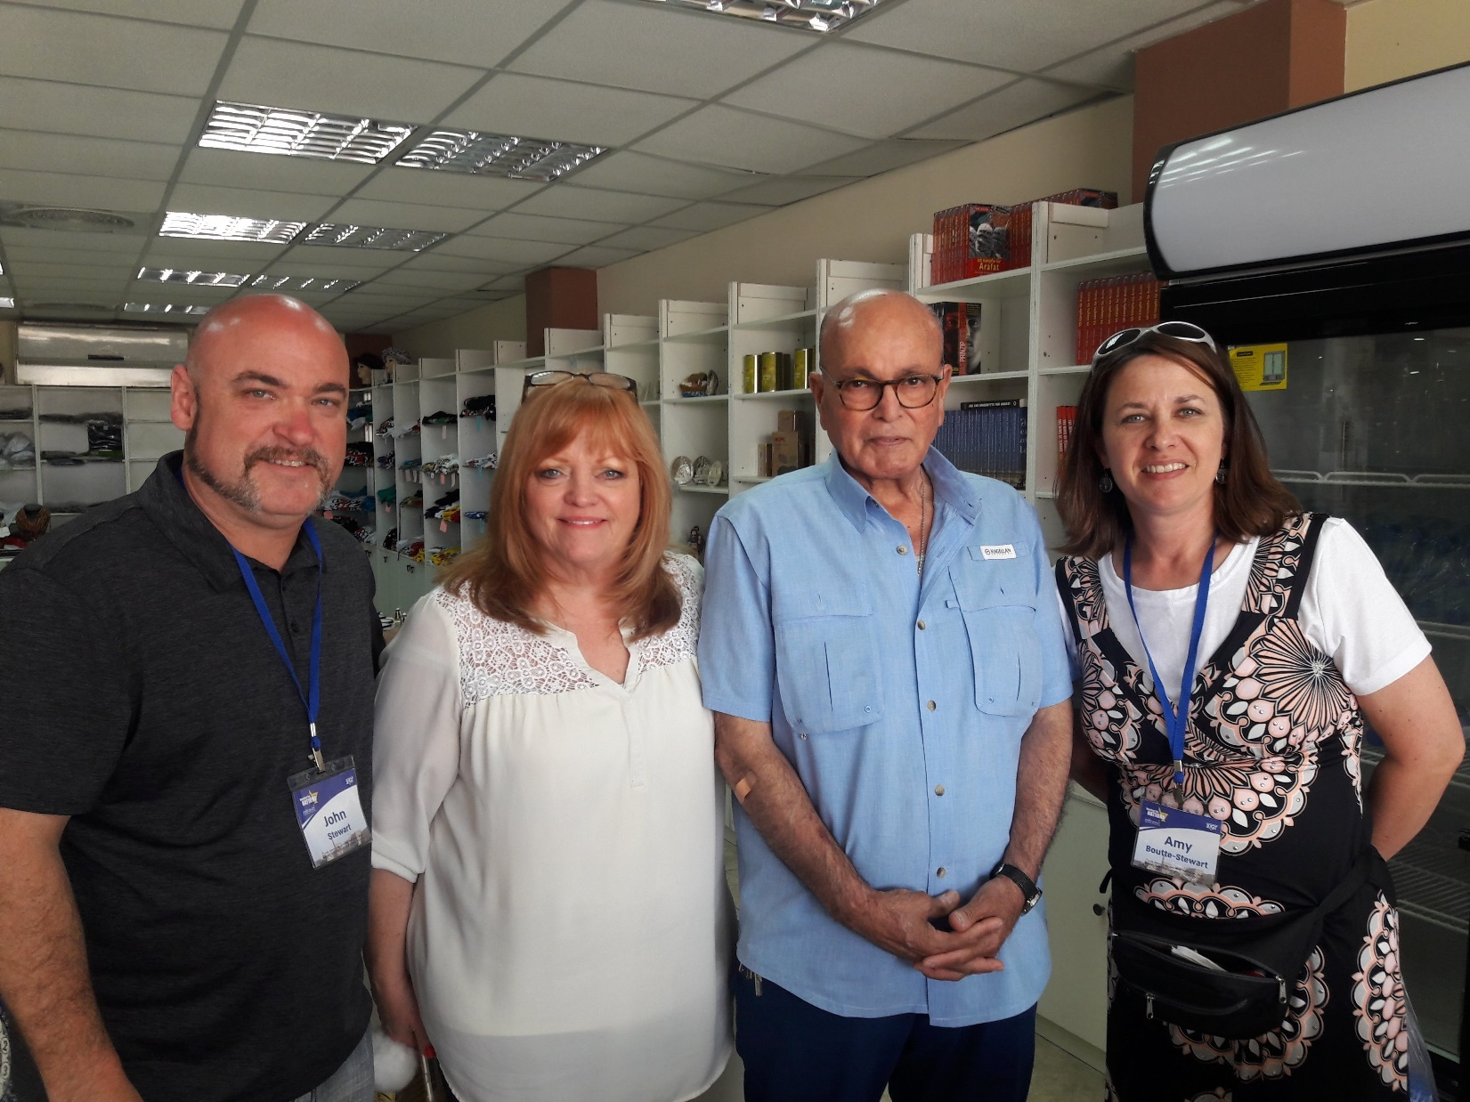
Notes:
https://www.frc.org/get.cfm?i=WA18E33&f=WU18E11

Slide 70
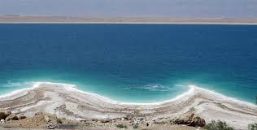

Slide 71
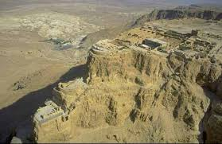

Slide 72
Rabbi’s report
Notes:
PUT ON attire…

Slide 73
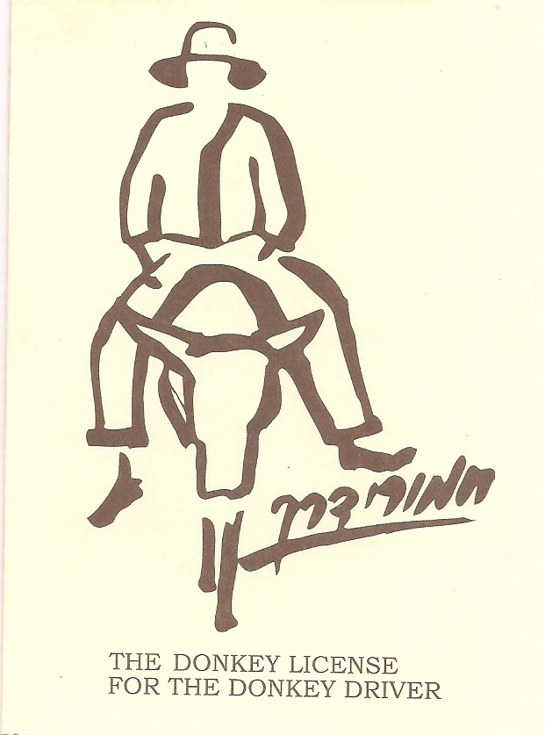

Slide 74
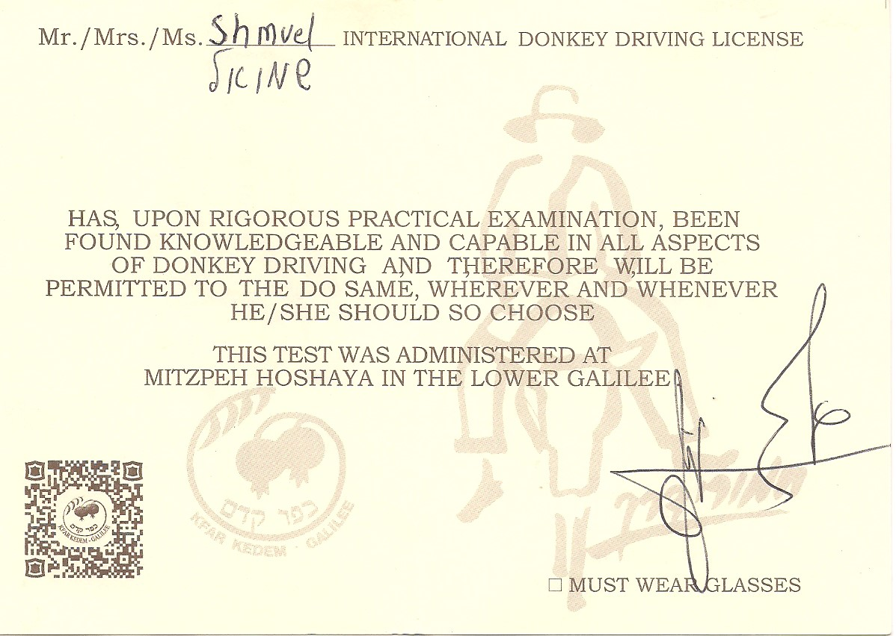

Slide 75
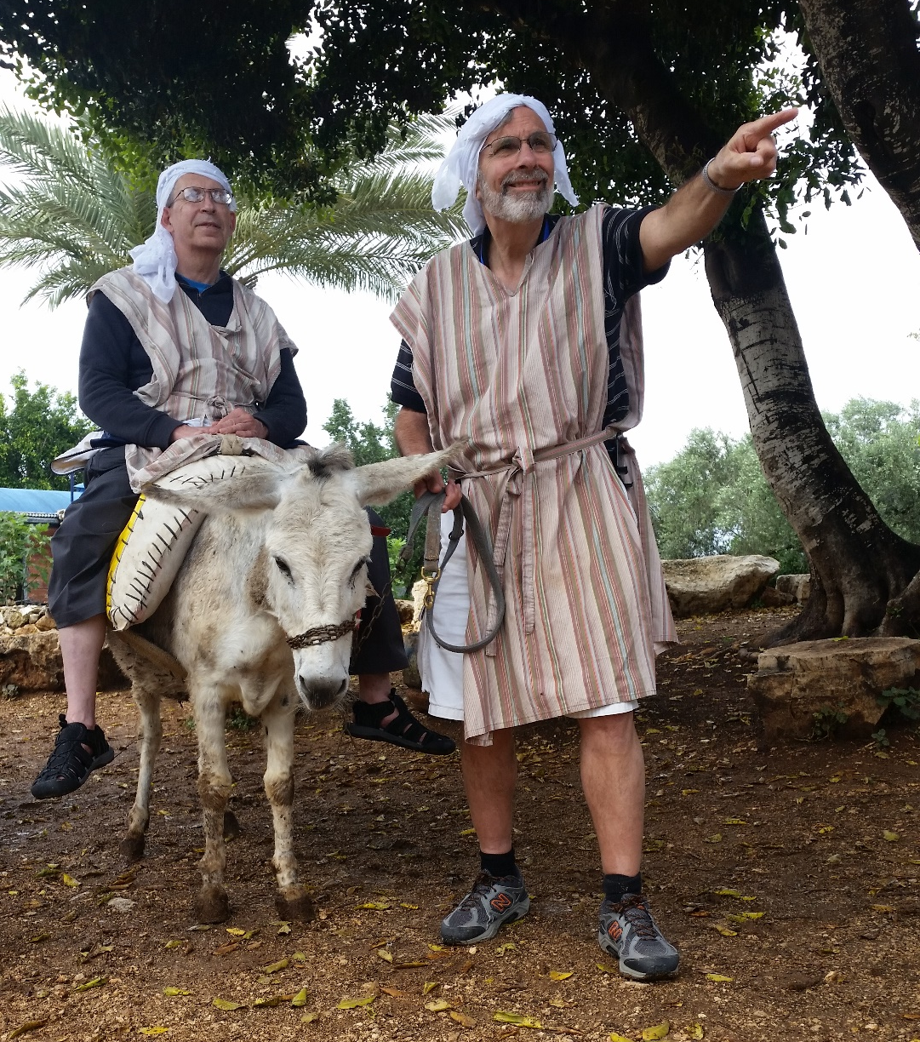

Slide 76
The spirit of the people in Israel is GREATLY lifted by
the destruction of pretty much the entire military infrastructure of Iran in Syria. May 9, 2018
The US Embassy opening May 14

Slide 77
The withdraw of the US from the JCPoA
70th birthday of the Nation, on the Gregorian calendar May 15
Jerusalem Day, on the Hebrew Calendar May 13

Slide 78
Mossad capture of 100,000 Iranian documents about their nuclear ambitions. Maybe history’s GREATEST intel coup!
Our 6000 person March of the Nations Convention and march through Jerusalem,

Slide 79
as international support for Israel and the memory of the Holocaust, the day after the embassy opening, May 15!
May this spirit of euphoria, optimism, lead to another outpouring of the Spirit, as the 1967 Six Day War euphoria did!
Notes:
So, there is still warfare. Still victories…

Slide 80
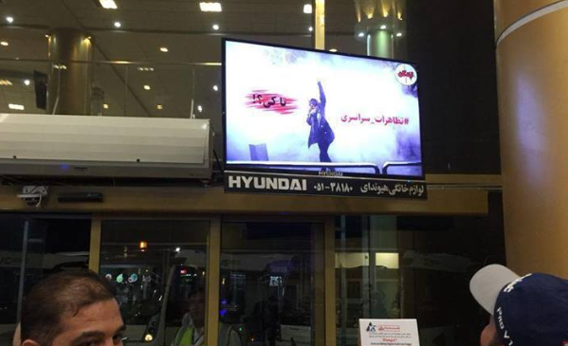
A hacked monitor at Iranian airport
Notes:
http://www.jerusalemonline.com/news/world-news/around-the-globe/iran-airport-screens-hacked-by-anti-government-protesters-35930?utm_source=ActiveCampaign&utm_medium=email&utm_content=The+Latest+News+From+Israel&utm_campaign=EveningNewsletter+-+Recurring+2017+Dec+17

Slide 81
At the #2 Iranian airport, replacing the arrival and departure times were messages calling on the Islamic Revolution Guards Corps to exit Gaza, Lebanon and Syria and stop “wasting Iranians lives and financial resources.”
Notes:
http://www.jerusalemonline.com/news/world-news/around-the-globe/iran-airport-screens-hacked-by-anti-government-protesters-35930?utm_source=ActiveCampaign&utm_medium=email&utm_content=The+Latest+News+From+Israel&utm_campaign=EveningNewsletter+-+Recurring+2017+Dec+17

Slide 82
In an unofficial, unscientific survey, a firm majority of respondents from across the Arab Middle East said they would back Israel in a war against Iran and its proxies in Syria.
Notes:
http://www.israeltoday.co.il/NewsItem/tabid/178/nid/33487/Default.aspx

Slide 83
Al Jazeera's Faisal al-Kasim, one of the most influential TV personalities in the Arab world, asked his five million followers, in Arabic, who they'd support if war broke out between Israel and Iran and its militias in Syria. Nearly 24,000 of al-Kasim's followers responded to the poll, 56% said Israel.
The times, they are a-changin'...
Notes:
http://www.israeltoday.co.il/NewsItem/tabid/178/nid/33487/Default.aspx

Slide 84
Conclusion: We need to purpose to battle
Sin in our lives, and walk in holy servanthood and joy, by spending time with Yeshua
Sin in our society, by prayer, outreach, and activism.

Slide 85
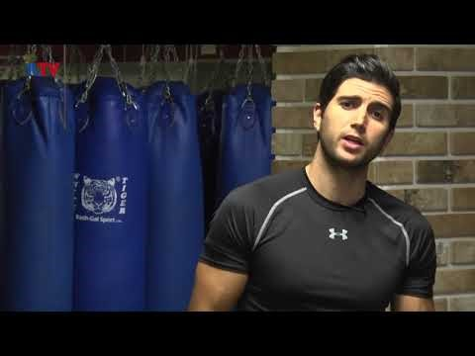
Krav Maga basics

Slide 86
Conclusion: We need to purpose to battle
Sin in our lives, and walk in holy servanthood and joy,by spending time with Yeshua
Sin in our society, by prayer, outreach, and activism.

