Slide 1
Good news from Israel

Slide 2
AT 70, ISRAEL’S ECONOMY EXCEEDS EXPECTATIONS: In 1948, conventional wisdom considered the newly re-established Jewish state insolvent economically and indefensible militarily, a basket case. In the 30 years from 1987 to 2017, Israel's population doubled
Notes:
Netanyahu years, much of it.

Slide 3
its per capita GDP went from $8,000 to $41,000; its exports, from $10 billion to $102 billion; independent energy resources, from 4% to 65%; life expectancy, from 75 to 82 years. Since the year 2000, Israel's economy has grown 65%,

Slide 4
the second best among OECD countries. (Jewish News)
“Let the Lord be magnified, Who has pleasure in the prosperity of His servant.” Ps. 35:27
Notes:
Now we segue into a chapter of doom and judgment.

Slide 5
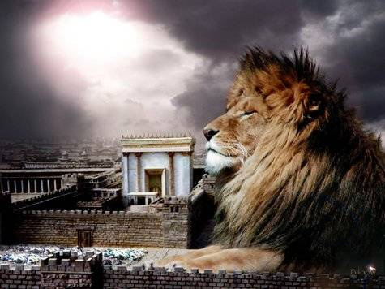
מַתִּתְיָהוּ Mattityahu
(Matthew) 24:1-2

Slide 6
Mattityahu (Matthew) 24:1
בְּצֵאתוֹ מִבֵּית הַמִּקְדָשׁ לָלֶכֶת לְדַרְכּוֹ נִגְּשׁוּ תַּלְמִידָיו לְהַרְאוֹת לוֹ אֶת בִּנְיְנֵי הַמִּקְדָּשׁ.
As Yeshua left the Temple and was going away, his talmidim came and called his attention to its buildings.
Notes:
A little more info in the parallel passages.

Slide 7
^{Mark 13.1} As Yeshua came out of the Temple, one of the talmidim said to him, “Look, Rabbi! What huge stones! What magnificent buildings!”
^{Luke 21.5} Some people were remarking about the Temple, how beautiful its stonework and memorial decorations were.
Notes:
I didn’t really have a good perspective on this until this study…

Slide 8
Made of marble and gold, Herod's temple was taller than a fifteen-story building. Built on the exact location of Solomon's temple and the temple Nehemiah constructed, it could accommodate hundreds of thousands of pilgrims at one time and was twice as large as the largest temple enclosure in Rome.
Notes:
https://www.thattheworldmayknow.com/herods-temple
We don’t usually GET the glory of this building!

Slide 9
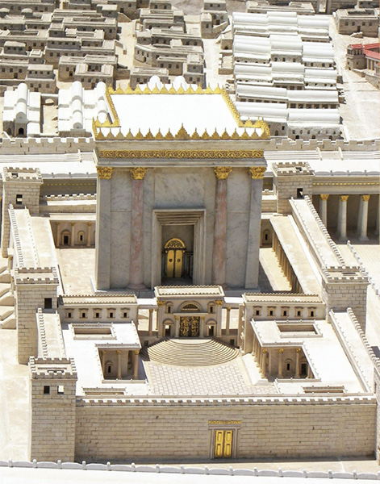
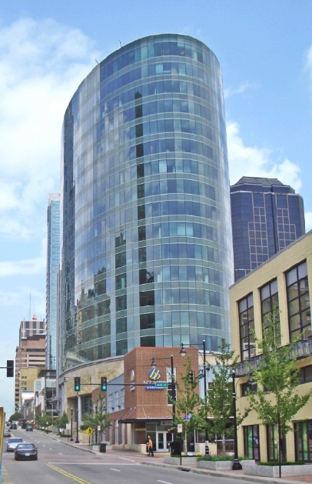
17 stories ≈ 170 ft
180 ft
Notes:
https://www.biblicalarchaeology.org/wp-content/uploads/herods-temple-avi-yonah.jpg
Larger and more magnificent than ANY other temple of antiquity, known throughout the Roman world. Keener p 560 Certain sense of it’s invincibility. See doors and figure 30 feet.

Slide 10
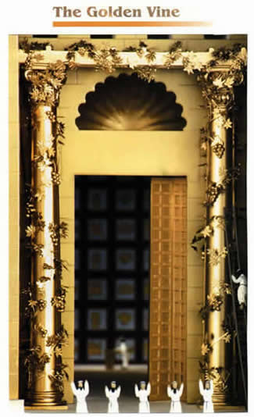
Notes:
https://www.google.com/search?q=golden+vine+of+the+Jerusalem+Temple&safe=active&source=lnms&tbm=isch&sa=X&ved=0ahUKEwj7ue3Kx9_ZAhWL0FMKHcLTC6kQ_AUIDCgD&biw=1282&bih=933#imgrc=AbD6B9jYL7UN2M:
Adding gold leaves.

Slide 11
The Golden Vine was one of the most remarkable in all the Temple precincts. [Talmud] Middot records that “A golden vine stood over the entrance to the sanctuary, trained over posts; and whosoever gave a leaf, or a berry, or a cluster as a freewill-offering
Notes:
https://www.ritmeyer.com/2015/12/14/the-gold-of-the-jerusalem-temple/

Slide 12
he brought it and the cohenim hung it thereon.” This vine was so famous that even Tacitus (History 5.5) wrote about it. Messiah may also have alluded to this very feature of the Temple when he said in John 15.1: “I am the true vine.”
Notes:
https://www.ritmeyer.com/2015/12/14/the-gold-of-the-jerusalem-temple/
Tacitus was the Roman general who demolished the Temple. Some say unintentionally.

Slide 13
A thousand priests trained as masons by Herod worked on the temple, as did ten thousand highly skilled laborers using ten thousand wagons. Some limestone blocks of the supporting platform weighed more than five hundred tons.
Notes:
https://www.thattheworldmayknow.com/herods-temple

Slide 14
^{John Gill’s commentary} The Jews give very great praises of the second temple, as repaired by Herod; and it was undoubtedly a very fine structure. They say, that he built the house of the sanctuary, “an exceeding beautiful building”; and that he
Notes:
John Gill’s commentary

Slide 15
repaired the temple, in beauty "greatly exceeding" that of Solomon's. They moreover observe, that “he who has not seen the building of Herod, has never seen a beautiful building.” With what is it built? says Rabbah, “with stones of
Notes:
John Gill’s commentary

Slide 16
green and white marble. And there are others say, that it was built with stones of spotted green and white marble.”
These, very likely, were the very stones the disciples pointed to, and admired; and were of a prodigious size, as well as
Notes:
John Gill’s commentary

Slide 17
worth. Some of the stones were, as Josephus says, “forty five cubits long, five high, and six broad.” Others of them, as he elsewhere affirm, “were twenty five cubits long, eight high, and twelve broad.” And he also tells us, in the same place, that there
Notes:
John Gill’s commentary

Slide 18
were, “in the porches, four rows of pillars: the thickness of each pillar was as much as three men, with their arms stretched out, and joined together, could grasp; the length twenty seven feet, and the number of them an hundred and sixty two, and
Notes:
John Gill’s commentary

Slide 19
beautiful to a miracle.''
At the size of those stones, and the beauty of the work, it is said, Titus was astonished, when he destroyed the temple; at which time his soldiers plundered it, and took away “the gifts”, with which it is also said
Notes:
John Gill’s commentary

Slide 20
to be adorned. These were rich and valuable things which were dedicated to it, and either laid up in it, or hung upon the walls and pillars of it, as it was usual in other temples. These may, intend the golden table given by Pompey, and the spoils which
Notes:
John Gill’s commentary

Slide 21
Herod dedicated; and particularly the golden vine, which was a gift of his; besides multitudes of other valuable things, which were greatly enriching and ornamental to it. Now the disciples suggest, by observing
Notes:
John Gill’s commentary

Slide 22
these, what a pity it was such a grand edifice should be destroyed; or how unaccountable it was; that a place of so much strength, could easily be demolished.
Notes:
John Gill’s commentary
Still used by the early Messianic believers, to the end, almost, of the Book of Acts…

Slide 23
^{Acts 21.26-27} The next day Sha’ul took the men, purified himself along with them and entered the Temple to give notice of when the period of purification would be finished and the offering would have to be made for each of them.

Slide 24
^{Acts 21.26-27} The seven days were almost up when some unbelieving Jews from the province of Asia saw him in the Temple, stirred up all the crowd and grabbed him.

Slide 25
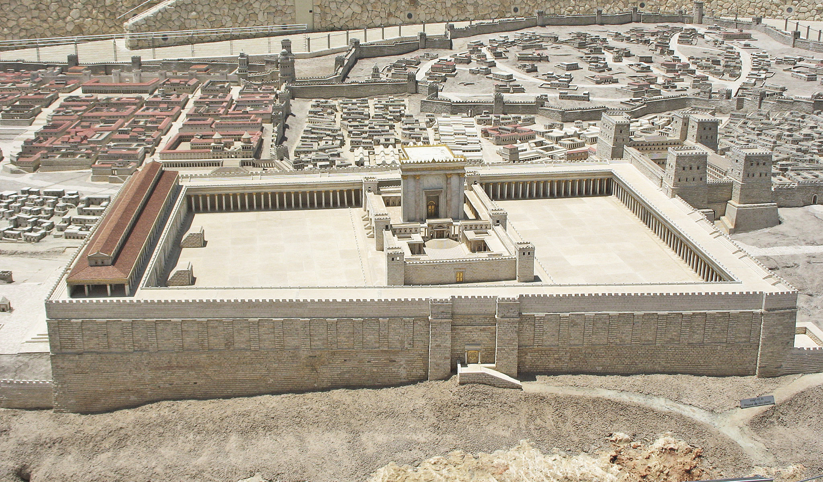
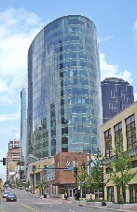
Notes:
https://www.google.com/search?q=second+temple+of+jerusalem&safe=active&source=lnms&tbm=isch&sa=X&ved=0ahUKEwi5uu_lz-3aAhWBwYMKHVGVA44Q_AUICigB&biw=1165&bih=848#imgrc=tHsIaWdSDtDUkM:
It’s hard to get a handle on the grandeur, but if you factor in that the Temple is taller than the H&R Block Tower downtown, it gets more breathtaking.

Slide 26
Mattityahu (Matthew) 24:2
הֵגִיב יֵשׁוּעַ וְאָמַר לָהֶם: ”רוֹאִים אַתֶּם אֶת כָּל אֵלֶּה? אָמֵן אוֹמֵר אֲנִי לָכֶם, לֹא תִּשָּׁאֵר פֹּה אֶבֶן עַל אֶבֶן אֲשֶׁר לֹא תֻּפַּל אַרְצָה.“
But he answered them, “You see all these? Yes! I tell you, they will be totally destroyed — not a single stone will be left standing!”

Slide 27
or unbroken, as Munster's Hebrew Gospel reads it: which prediction had a full and remarkable accomplishment; and which is not only attested by Josephus, who relates, that both the city and temple were dug up, and laid level with the ground;
Notes:
John Gill commentary

Slide 28
but also by Maimonides; who tells us that “on the ninth of Av, a day prepared for punishments, Turnus Rufus the wicked,
(חרש את ההיכל) “plowed up the temple,” and all round about it, to fulfill what is said, "Zion shall be plowed as a field".''
Notes:
Maimon. Hilch. Taaniot, c. 5. sect. 3. T. Bab. Taanith, fol. 23. 1. & Gloss. in ib
John Gill commentary

Slide 29
^{Yer 26.18} “Micah the Morashtite prophesied in the days of Hezekiah king of Judah; and he spoke to all the people of Judah, saying, thus says Adoni-Tzva’ot: ‘Zion will be plowed as a field, and Jerusalem will become ruins, and the mountain of the House as the high places of a forest.’

Slide 30
G-d shakes the apparently unshakeable, the temporal,
to reveal the truly unshakeable.
What in our lives
appears unshakeable?
Notes:
Remember “sound as a dollar”?

Slide 31
^{Mes Jews/Heb 2.26-28} He has made this promise: ^{Haggai 2:6, 21} “One more time I will shake not only the earth, but heaven too!”
Above is condensed New Testament/Mes Scripture quote of the Tanakh:
Full quote:

Slide 32
^{Haggai 2.6-7} For this is what Adoni-Tzva’ot says: “It won’t be long before one more time I will shake the heavens and the earth, the sea and the dry land; and I will shake all the nations, so that the treasures of all the nations will flow in; and I will fill this house with glory,” says Adoni-Tzva’ot.

Slide 33
^{Hag.2.21-22} “Say to Zerubbabel, governor of Judah: ‘I am going to shake the heavens and the earth, and I will overturn the throne of kingdoms and destroy the strength of the kingdoms of the nations.

Slide 34
^{Mes Jews/Heb 2.26-28} Inspired commentary on Tanakh: And this phrase, “one more time,” makes clear that the things shaken are removed, since they are created things, so that the things not shaken may remain.

Slide 35
Inspired commentary: Mes Jews/Heb 2.26-28 Therefore, since we have received an unshakeable Kingdom, let us have grace, through which we may offer service that will please God, with reverence and fear.
Notes:
It’s relatively easy, when seeing the world’s wealth, influence, power, to feel shaken.
Some slides from a guest speaker, Jeanne Nigro…

Slide 36
G-d shakes the apparently unshakeable, the temporal,
to reveal the truly unshakeable.
What in our lives
appears unshakeable?
Notes:
In developing this, I remember the presentation we had some time ago, Jeanne Nigro on “Unshakeable”

Slide 37

Jeanne
Nigro

Slide 38
INTIMACY WITH GOD is your #1 anchor for Standing Strong in Uncertain Times!!!

Slide 39
Be aware of what BLOCKS intimacy with God!

Slide 40
Think about the News...
How do you react?

Slide 41
These responses may be JUSTIFIED, but are they from God?
        Fear & Stress (2 Tim 1:7)
        Frustration & Anger (Eph 4:26-27, 29, 31-32)
        Give up, Do nothing, Apathy (Matt. 25:14-30)
Notes:
^{2 tim 1.7} For God gave us a Spirit who produces not timidity, but power, love and self-discipline.

Slide 42
Justified or not, when we react with:
        Fear & Stress
        Frustration & Anger
        Give up, Do nothing, Apathy
We are aligning with the enemy!
We are believing a lie about ourselves or about God!

Slide 43
Spiritual Warfare made SIMPLE:
With every thought, emotion, word, attitude, & action -- you are either:
    Aligning with God’s Heart (His thoughts, emotions, words) & growing in intimacy or
    Aligning yourself with the enemy

Slide 44
INTIMACY WITH GOD is your #1 anchor for Standing Strong in Uncertain Times!!!

Slide 45
INTIMACY WITH GOD
You are worried and troubled about so many things. But only one thing is needed (Luke 10:41-42)
One thing I have desired of the Lord, that will I seek: that I may dwell in the house of the Lord all the days of my life, to behold the beauty of the Lord, and to inquire in His temple (Ps. 27:4)

Slide 46
INTIMACY WITH GOD
Your Primary Purpose in Life
The Only Thing You Cannot Lose
Will Keep You From Deception
Will Keep You Strong in Persecution

Slide 47
Growing Deeper in Intimacy with God:
“Defensive Strategies”

Slide 48
How will YOU react to uncertain times?
Fleshly Weapons of Warfare:
Fear, Stress, Panic, Worry
Anger, Frustration, Offense
Criticize, Blame & Bash People
Passivity, Apathy, Hiding, Giving up
False sense of peace, complacency
Negativity and Complaining

Slide 49
How will YOU respond?
Results of Fleshly Weapons of Warfare:
Not a light - look like everyone else
Unable to stand strong in
persecution
Susceptible to deception
Unable to partner with God to
release His plans & purposes

Slide 50
How will YOU respond?
Spiritual Weapons of Warfare:
Deal with Strongholds:Lies about
yourself and God
Deal with Negative Emotions/Fleshly
Responses:
    Fear, Stress, Anger, Unforgiveness, Frustration, Bitterness, Resentment, Criticism, Self-Condemnation, Performance, Shame, Hopelessness, Blame

Slide 51
How will YOU react?
Spiritual Weapons of Warfare:
Deal with Strongholds & Fleshy Responses:
        Ask God to show you the LIES about yourself or God
        Confess LIES or Negative Emotions as SIN
        Forgive
        Cancel Satan’s Authority
        Ask God to show you HIS truth

Slide 52
Growing Deeper in Intimacy with God:
“Offensive Strategies”

Slide 53
Intimacy with God is your #1 Purpose!
Notes:
How many of us spend time daily with G-d. One hour/day?
How many are at our Teerosh, and Shavuot late night prayer coming?

Slide 54
How will YOU respond?
  Focus on “One Thing”: Intimacy First!

Slide 55
Dwell on Him throughout the day:
        What He has done for you
            How much He desires you
            How much He values you
            How much He wants you!

Slide 56
Dwell on Him throughout the day:
        Who He is
            Revelation Ch. 1-3 (eyes flaming fire (v.14); one who loved us (v.5))
            Revelation 4 - throne room (sardius stone, jasper diamond, emerald (4:3))

Slide 57
Dwell on Him throughout the day:
        How He sees you
            Song of Solomon -
            “Bridegroom”

Slide 58
G-d shakes the apparently unshakeable, the temporal,
to reveal the truly unshakeable.

Slide 59
^{Asher Intrater} Prayer is so important that it seems to be the primary work that Yeshua has committed himself to for the past 2,000 years. Apparently, He figured He could get more done by intercessory prayer than by anything else.
Notes:
https://tribe.reviveisrael.org/urgency-of-prayer/

Slide 60
^{Mes. Jews Heb 7:25} – For He lives ever to make intercession for them.
^{Romans 8:34} – He is at the right hand of God interceding on our behalf.
Therefore, when we pray by the leading of the Spirit of God, we are actually joining together with Yeshua,
Notes:
https://tribe.reviveisrael.org/urgency-of-prayer/

Slide 61
interceding together with Him as He intercedes for us. This prayer partnership with Yeshua bears much fruit exponentially for the kingdom of God. This urgent intercession martials all the powers of both heaven and earth in strategic effectiveness.
Notes:
https://tribe.reviveisrael.org/urgency-of-prayer/

Slide 62
^{T’hillim/Ps 110.1} Adoni says to my Lord, “Sit at my right hand,
until I make your enemies
your footstool.”
Notes:
I’ve been warned that May could be a dangerous month in Israel for war.
A 24 year veteran in the Naval special forces shared his concerns for Israel in the next two weeks, especially the day after each of the following dates.
May 6: General elections take place in Lebanon. It is expected that Hezbollah will win the majority.
May 12: Trump is expected to make a decision regarding the Iran deal.
May 14: US will move Israel's Embassy to Jerusalem.

Slide 63
G-d shakes the apparently unshakeable, the temporal,
to reveal the truly unshakeable.
Notes:
Some examples of shaking and unshakeable revealed.

Slide 64

Notes:
We’ve all known about Iran’s genocidal statements. Seemingly unstoppable. Benjamin Netanyahu said, concerning this, and the Iran deal, “This is 1937 all over again.” Hitler build up destructive power and no one intervening. Neville Chamberlain made the Munich deal. “Peace in our time.”

Slide 65
Harold Rhode spent 28 years at the Pentagon and studied in Iran before the 1979 revolution there. The fluent Farsi speaker, who is now associated with the Jerusalem Center for Public Affairs, said his views stem from a wave of recent Iranian infighting.
Notes:
https://www.jpost.com/printarticle.aspx?id=553276

Slide 66
He said when things are not going well in Iran, Iranian Revolutionary Guard Corps officials and rival ayatollahs start attacking each other in a public blame game that expresses how exposed and vulnerable they feel their rule has become.
Notes:
https://www.jpost.com/printarticle.aspx?id=553276

Slide 67
The Iranian regime is “quaking in its boots,” after Prime Minister Benjamin Netanyahu revealed secret nuclear-program documents appropriated by the Mossad, an ex-Pentagon Iran expert told The Jerusalem Post on Tuesday.
Notes:
https://www.jpost.com/printarticle.aspx?id=553276

Slide 68
Israel “humiliated the Iranian government by capturing all of this material,” Rhode said, and many Iranians were laughing at the Islamic regime on social media.
Notes:
https://www.jpost.com/printarticle.aspx?id=553276

Slide 69
While the global media stopped covering protests against the regime months ago, he noted, the protests are still churning. The former Pentagon official said that when he asked Iranian friends for a list of where the protests were happening,
Notes:
https://www.jpost.com/printarticle.aspx?id=553276

Slide 70
they said protests were so widespread it would be easier to make a shorter list of cities where they were not happening.
He also said the audacious Mossad raid, “proves what they think of Jews – that they are the smartest people on earth and can do anything.”
Notes:
https://www.jpost.com/printarticle.aspx?id=553276

Slide 71
Last week, the mummified body that likely was that of former Iranian ruler Reza Shah Pahlavi – which had been hidden by the regime since the revolution – was discovered.
Notes:
https://www.jpost.com/printarticle.aspx?id=553276

Slide 72
That, he noted, has led many Iranians, who often think superstitiously, to question whether the discovery is an omen indicating the revolution leading to the Islamic Republic was a mistake.
Notes:
https://www.jpost.com/printarticle.aspx?id=553276

Slide 73
Mark Zell, who heads Republicans in Israel, told WIN that Pompeo does not represent a new US policy direction.
“Under President Trump’s leadership, the top three issues for the US in the Middle East are Iran, Iran and Iran.
Notes:
https://worldisraelnews.com/analysts-pompeo-plans-rock-iranian-world/?utm_source=MadMimi&utm_medium=email&utm_content=Netanyahu+Reveals+Iran%27s+Secret+Nukes%2C+Says+Trump+will+%27Do+Right+Thing%27%3B+18+Iranians+Killed+in+Massive+Bombing%2C+Israel+Silent&utm_campaign=20180430_m145204721_Netanyahu+Reveals+Iran%27s+Secret+Nukes%2C+Says+Trump+will+%27Do+Right+Thing%27%3B+18+Iranians+Killed+in+Massive+Bombing%2C+Israel+Silent&utm_term=_0D_0A_09_09_09_09_09_09_09_09_09_09Read+Now_0D_0A_09_09_09_09_09_09_09_09_09

Slide 74
Middle East Analyst Amotz Asa-el told WIN, “The grand peace plan of Trump was rejected by the Palestinians, so they are irrelevant. He plans to move more forcefully against Iran because they destabilize the entire Middle East.
Notes:
https://worldisraelnews.com/analysts-pompeo-plans-rock-iranian-world/?utm_source=MadMimi&utm_medium=email&utm_content=Netanyahu+Reveals+Iran%27s+Secret+Nukes%2C+Says+Trump+will+%27Do+Right+Thing%27%3B+18+Iranians+Killed+in+Massive+Bombing%2C+Israel+Silent&utm_campaign=20180430_m145204721_Netanyahu+Reveals+Iran%27s+Secret+Nukes%2C+Says+Trump+will+%27Do+Right+Thing%27%3B+18+Iranians+Killed+in+Massive+Bombing%2C+Israel+Silent&utm_term=_0D_0A_09_09_09_09_09_09_09_09_09_09Read+Now_0D_0A_09_09_09_09_09_09_09_09_09

Slide 75
Of course he wants to undo Iran’s nuclear ambitions. But even more than that, he believes that the Islamic regime in Iran can ultimately be toppled. He plans to speak directly to the Iranian people and its silent majority that seeks to depose the radical Islamic regime.”
Notes:
https://worldisraelnews.com/analysts-pompeo-plans-rock-iranian-world/?utm_source=MadMimi&utm_medium=email&utm_content=Netanyahu+Reveals+Iran%27s+Secret+Nukes%2C+Says+Trump+will+%27Do+Right+Thing%27%3B+18+Iranians+Killed+in+Massive+Bombing%2C+Israel+Silent&utm_campaign=20180430_m145204721_Netanyahu+Reveals+Iran%27s+Secret+Nukes%2C+Says+Trump+will+%27Do+Right+Thing%27%3B+18+Iranians+Killed+in+Massive+Bombing%2C+Israel+Silent&utm_term=_0D_0A_09_09_09_09_09_09_09_09_09_09Read+Now_0D_0A_09_09_09_09_09_09_09_09_09

Slide 76
G-d shakes the apparently unshakeable, the temporal,
to reveal the truly unshakeable.
Notes:
This could be 1937 all over again, but Churchill is Prime Minister, not Chamberlain!!
We determine history by our prayerfulness. We are called as cohenim to join with Yeshua in His intercessory work for the last 2000 years. Your personal time, Teerosh time. Shavuot time.
https://www.reviveisrael.org/ri-feature-video/
Korea, Iran, salvations

Slide 77
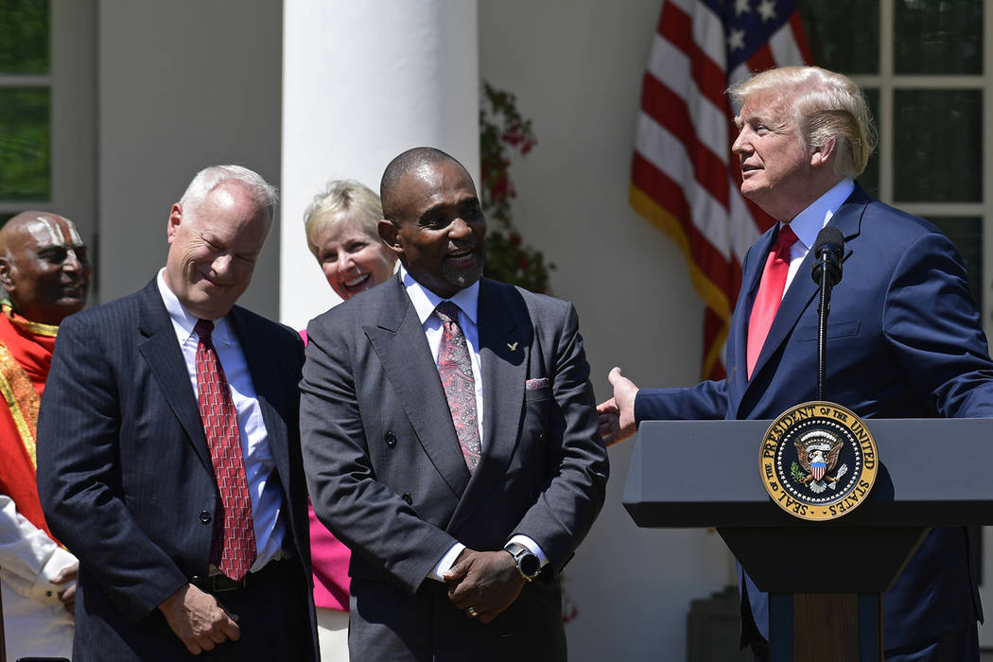
Jon Ponder and FBI Agent Beasley
Notes:
President Donald Trump, right, talks about Jon Ponder, second from right, from Las Vegas, and FBI Special Agent Richard Beasley, second from left, during a National Day of Prayer event in the Rose Garden of the White House in Washington, Thursday, May 3, 2018. (AP Photo/Susan Walsh)

Slide 78
Jon Ponder, a fatherless kid who grew up on the streets and in gangs. Jon was in and out of jail for years until, at age 38, he was arrested for robbing a bank. He ended up in federal prison, in solitary confinement. That's where, as President Trump put it, "God found him."
Notes:
https://www.frc.org/get.cfm?i=WA18E07&f=WU18E03

Slide 79
After reading the Bible and listening to Christian radio, Jon woke up one night with a jolt to the voice of Billy Graham in his head, and he accepted Messiah.
Notes:
https://www.frc.org/get.cfm?i=WA18E07&f=WU18E03

Slide 80
The first day Jon got out of jail, he had a knock on his door. "It was the man who put him in jail, FBI Special Agent Richard Beasley. "I want you to know that I've been praying for you very strongly," Beasley told him.
Notes:
https://www.frc.org/get.cfm?i=WA18E07&f=WU18E03

Slide 81
"God called me to the FBI in part because of you, Jon." As for Jon, he runs a full-time prison ministry now.
https://hopeforprisoners.org/about-us/
Notes:
https://www.frc.org/get.cfm?i=WA18E07&f=WU18E03

Slide 82
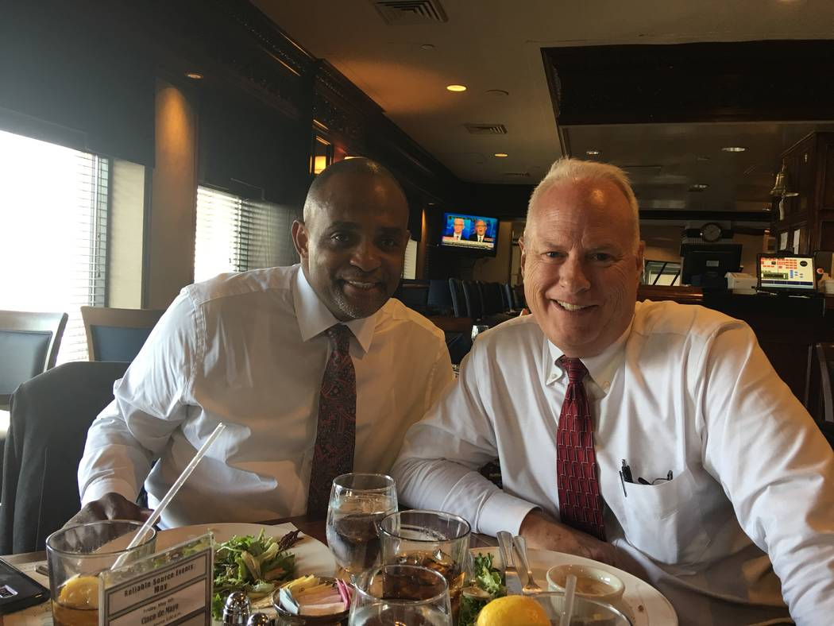
Notes:
Former bank robber Jon Ponder, now CEO of Hope for Prisoners, and Richard Beasley, the FBI agent who arrested him in 2004 after attending a National Day of Prayer ceremony at the White House.

Slide 83
G-d shakes the apparently unshakeable, the temporal,
to reveal the truly unshakeable.
Notes:
Last slide, Clyde.

