Slide 1
If you want to have notes without taking notes,
Go to OrHaOlam.com
WITHOUT WIFI
Click on downloads, messages, 2018 messages
Today’s should be on the top.

Slide 2
Good news from Israel

Slide 3
An Israeli company called SodaStream’s environmentally sustainable product lets thirsty consumers make soda in their own homes, reusing the same bottles over and over again.
SodaStream’s Jewish, Christian, Muslim, and Druze employees prove that coexistence between Jews and Arabs is possible in the region.

Slide 4
Recently, 2,000 Israeli and Palestinian employees came together at the company’s headquarters in southern Israel to celebrate the end of Ramadan as well as peace and harmony.

Slide 5
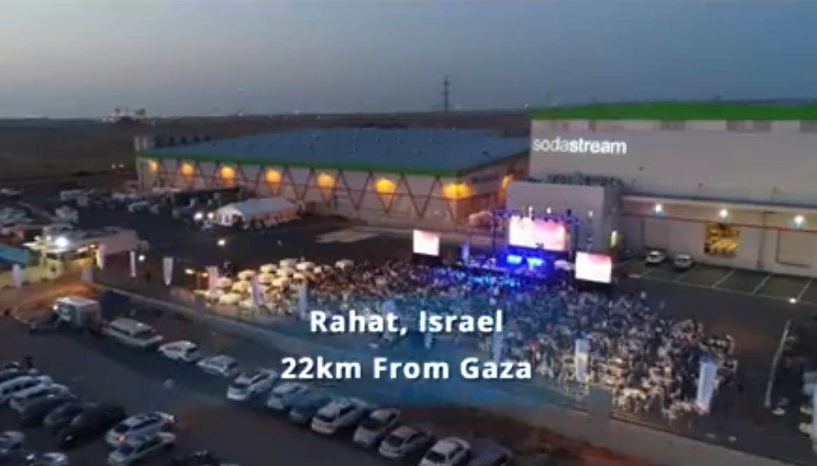

Slide 6
https://www.facebook.com/StandWithUs/videos/10155679819921309/

Slide 7
Two cats were sitting on a fence near a tennis court. “You seem really interested in the game," said the first cat, “Who do you like?”
“None, my old man’s in the racket,” he replied.

Slide 8
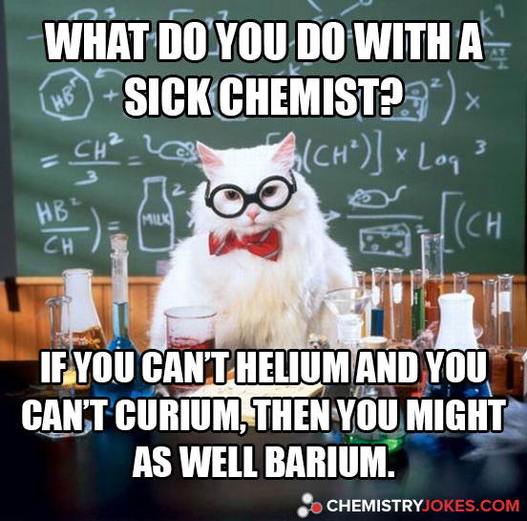

Slide 9
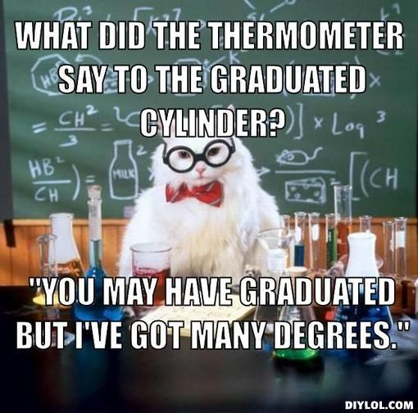

Slide 10
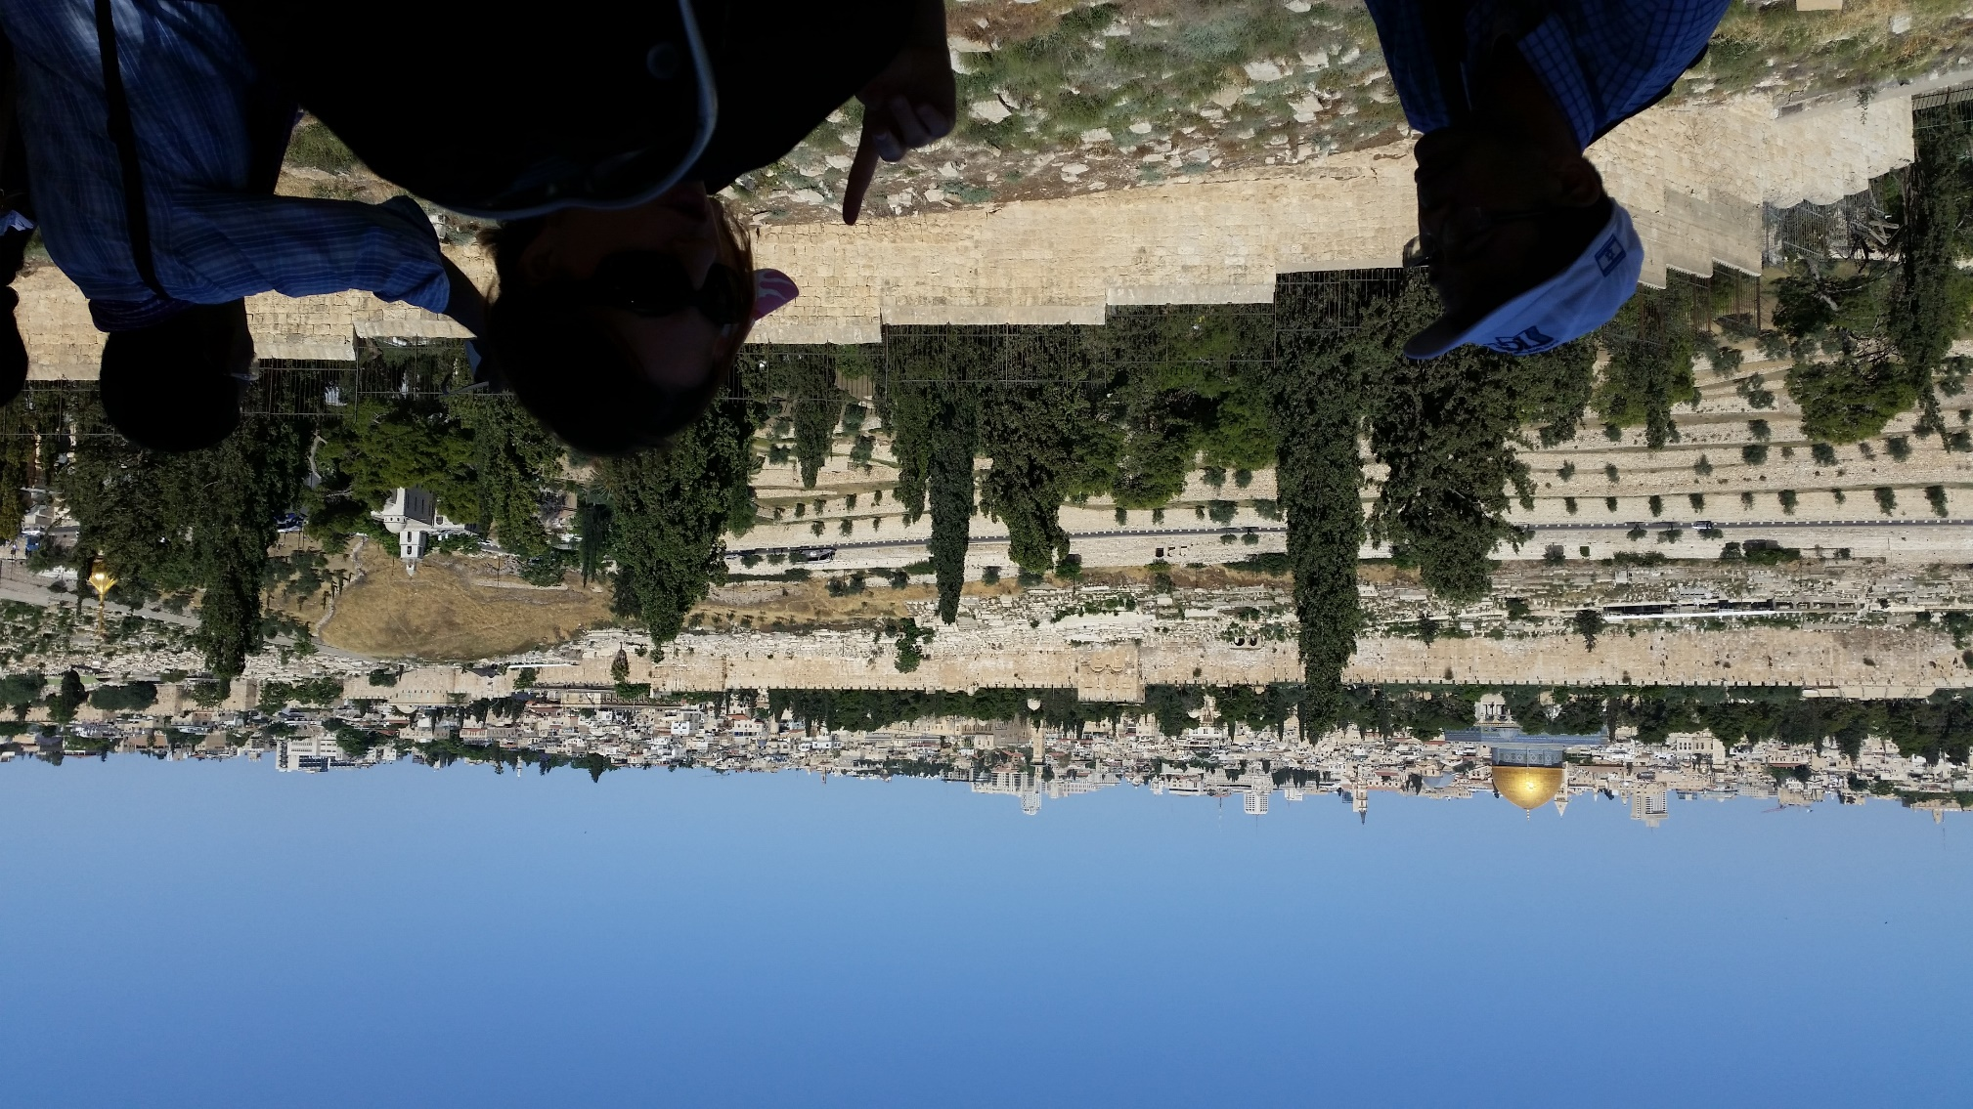
View from Mt. Olives

Slide 11
Mt. Olives, Talmidim/Disciples asking Yeshua:
When will be the end of this age? Seeing as it will happen HERE.
Key lessons to prep for the end:

Slide 12
Don’t be deceived! Many in My Name.
Wars, famines, earthquakes …beginning of birth-pains.
Imprisoned, hated, executed, betrayed
False prophets within, without
Notes:
Next descriptor of end times…

Slide 13
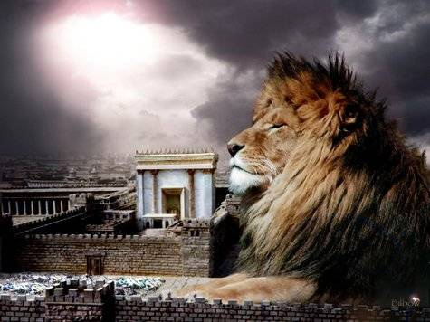
מַתִּתְיָהוּ Mattityahu
(Matthew) 24:12

Slide 14
Mattityahu (Matthew) 24:12
וּמֵאַחַר שֶׁתִּרְבֶּה הַהֶפְקֵרוּת
תִתְקָרֵר אַהֲבַת רַבִּים.
“and many people’s love will grow cold because of increased distance from Torah.”
Notes:
Stern reverses the phrase order to make it flow, but literally: Increased iniquity הֶפְקֵרוּת anomian = lawlessness → Love grow cold

Slide 15
Outline of this message:
Increased הֶפְקֵרוּת hef-kay-rut
Love grow cold
Notes:
What does this exactly mean?
How does it apply to us?

Slide 16
הֶפְקֵרוּת hef-kay-rut
noun abandon, anarchy ; lawlessness, licentiousness,
adj. unbridled, libertine, irresponsible
→ Love grows cold
Notes:
As people have described the Gay Pride parade in Tel Aviv, or Woodstock 1969

Slide 17
^{2 Kefa/P 2.7-8} …Lot, a righteous man who was distressed by the debauchery of those unprincipled people; for the wicked deeds which that righteous man saw and heard, as he lived among them, tormented his righteous soul day after day.
Notes:
Environment
Lot kept his faith, but barely.
His wife looked back, apparently longingly regrettingly at their depraved and now demolished home environment.
His daughters and sons-in-law scoffed,
he didn’t even try his sons [implies he had]
His daughters that he rescued had the spirit of Sodom: depravity and debauchery.
So, how does the depraved world around us affect us?

Slide 18

Notes:
Outline of this message:
Increased הֶפְקֵרוּת anomian = lawlessness
Love grow cold
Other translations…

Slide 19
^{ASV} And because iniquity shall be multiplied, the love of the many shall wax cold
^{CSB} Because lawlessness will multiply, the love of many will grow cold.
^{MSG} The overwhelming spread of evil will do them in - nothing left of their love but a mound of ashes.

Slide 20
If we are around iniquity hefkayrut הֶפְקֵרוּת lawlessness anomia enough,
it will do us in.
Notes:
Define terms better in practical terms…

Slide 21
So, what behaviors/ lifestyles constitute
iniquity hefkayrut הֶפְקֵרוּת lawlessness anomia
?

Slide 22
^{Eph. 4.19} indecency…the practice of every kind of immorality, with greed for more.
^{Eph. 5.3-5} Sexual immorality and any impurity or greed—don’t even let these be mentioned among you, as is proper for kedoshim, holy people. Obscene, coarse, and stupid talk are also out of place,
Notes:
R rated movies, porn on your computer or phone.
No one knows…just you…and G-d!??
Umbrella.

Slide 23
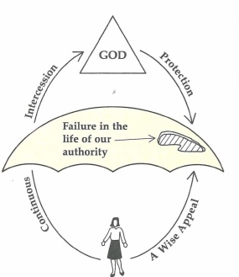
Bill Gothard
on the umbrella
of spiritual
authority,
protection,
and leaks
Notes:
https://www.google.com/search?safe=active&biw=1165&bih=826&tbm=isch&sa=1&ei=HkAuW5X4FcS8sQWrjIOIAQ&q=bill+gothard+umbrella+with+holes&oq=bill+gothard+umbrella+with+holes&gs_l=img.3...2159172.2162286.0.2162749.11.11.0.0.0.0.173.741.9j1.10.0....0...1c.1.64.img..1.1.172...0i30k1.0.r11FRUzG1g0#imgrc=KduzfF5iDwbKwM:

Slide 24
^{Eph. 5.3-5} but instead let there be thanksgiving. Know for certain that no immoral, indecent, or greedy person — who is really an idol worshipper at heart—has any inheritance in the kingdom of Messiah and God.

Slide 25
the malice and wickedness of outrageous persecutors
the treachery and hatred of the deniers/apostates,
the heresies of false teachers;
the wickedness that prevailed in the lives and conversations of some called believers.
Notes:
John Gill: does not say their love shall be lost, but wax cold

Slide 26
People issues -- I don’t like him/her
She intimidates me: too smart, too loud, too beautiful, too athletic, too rich.
He repels me: too irresponsible, too weak, too impoverished, too sloppy

Slide 27
Jonathan Bernis:
Work and overwork doesn’t really drain or discourage a person. [building project]
Adversity, conflict, moral failure discourage and weaken.
Notes:
Something radical, from Blaine Robinson’s website…

Slide 28
lawlessness: Grk. anomia
from nomos, law, and the negative particle "a," making the word the equivalent of Torah-lessness or living contrary to Torah commands.
Notes:
http://www.blainerobison.com/bible2-matt/mattnotes24.htm

Slide 29
does not mean abandonment of governmental laws, rather a rejection of God’s authority and His commandments as the standard for ethics and morality, his Torah.
Notes:
http://www.blainerobison.com/bible2-matt/mattnotes24.htm

Slide 30
most people’s: lit. "of the many." Even today lawlessness pervades the Body of Messiah since many believers don't believe the Torah commandments have any authority and tend to pick and choose what commandments they will obey.
Notes:
http://www.blainerobison.com/bible2-matt/mattnotes24.htm
I almost never mention names of leaders from this pulpit derogatorily, but this topic is compelling. So please bear with me. I’m not condemning, but pointing out necessary issues, I think with respect and charity.

Slide 31
Andy Stanley, the pastor of North Point Community Church in Georgia, recently announced that Christians need to “unhitch” the Old Testament from their understanding of the faith.
Notes:
https://answersingenesis.org/christianity/andy-stanley-says-we-need-to-unhitch-the-old-testament-from-our-faith/
We’ve used Andy Stanley for marriage reinforcement. He’s insightful, anointed, warm, powerful. But, he’s WRONG here.

Slide 32
By this Stanley means to instruct people to ignore the Old Testament and focus solely on the resurrection of Messiah, especially in evangelism. This statement was part of a sermon series encouraging those who’ve left the faith to reconsider.
Notes:
https://answersingenesis.org/christianity/andy-stanley-says-we-need-to-unhitch-the-old-testament-from-our-faith/

Slide 33
Andy Stanley: “Messiah’s new covenant, His covenant with the nations, His covenant with you, His covenant with us, can stand on its own two nail-scarred resurrection feet. It does not need propping up by the Jewish scriptures.”
Notes:
https://answersingenesis.org/christianity/andy-stanley-says-we-need-to-unhitch-the-old-testament-from-our-faith/

Slide 34
“The Bible did not create Christianity. The resurrection of Messiah created and launched the faith. Your whole house of Old Testament cards can come tumbling down. [!] The question is, did Messiah rise from the dead? And the eyewitnesses said he did.”
Notes:
https://answersingenesis.org/christianity/andy-stanley-says-we-need-to-unhitch-the-old-testament-from-our-faith/
If you have questions and issues about Creationism, Biblical history, Torah laws

Slide 35
Messianic Judaism: Throwing away the Torah, the Tanakh [Hebrew Scriptures]
is a form of
Iniquity hefkayrut הֶפְקֵרוּת lawlessness anomia
Does a faith walk without Torah lead to coldness of love?
Notes:
We all know fervent, beautiful believers NOT into Shabbat, the holidays, or Israel. Many Jewish believers have assimilated so. Nevertheless, I’ve heard it said, at the least, that a Torahless faith is like a black and white movie, and Torah and the Jewish connection brings the color.
But I don’t think it’s quite that optional, ultimately. At least not for the fullness of the kingdom, and outreach, even non-Jewish outreach.

Slide 36
When Paul presented Yeshua and the resurrection in pagan Athens in Acts 17, his message fell flat because they didn’t understand who God was and why Messiah needed to die and be raised again.
Notes:
https://answersingenesis.org/christianity/andy-stanley-says-we-need-to-unhitch-the-old-testament-from-our-faith/

Slide 37
^{Acts.17.18} Some were saying, “What’s this babbler trying to say?” while others, “He seems to be a proclaimer of foreign deities”—because he was proclaiming the Good News of Yeshua and the resurrection.
Notes:
Not the best response: “babbler”

Slide 38
But when Paul started with the history in Genesis laying the foundation for the message of Messiah, some people were saved and others wanted to learn more. And our post-Biblical culture is definitely a “Greek” culture much like Paul addressed in Acts 17!
Notes:
https://answersingenesis.org/christianity/andy-stanley-says-we-need-to-unhitch-the-old-testament-from-our-faith/

Slide 39
^{Acts 17.23-24} Therefore what you worship without knowing, this I proclaim to you. The God who made the world and all things in it, since He is Lord of heaven and earth, does not live in temples made by hands…
Notes:
Moreover, context of community…

Slide 40
^{Ro 11.17-18} A wild olive branch — were grafted in among [Israel] and have become equal sharers in the rich root of the olive tree, then don’t boast as if you were better than the branches! However, if you do boast, remember that you are not supporting the root, the root is supporting you.
Notes:
With all due respect, Mr. Stanley is denying his support structure.
Lastly, this tolerance that G-d seems to have about Torah-less believers will NOT continue into the Kingdom, the Millennium.

Slide 41
^{Zekh. 14.16} Finally, everyone remaining from all the nations that came to attack Yerushalayim will go up every year to worship the king, ADONI-Tzva'ot, and to keep the festival of Sukkot.
Notes:
Sukkot, and by implication ALL the festivals will be kept in the Millennial Kingdom.
A dear lady in KC who has greatly helped clarify and correct this in the Christian community…

Slide 42
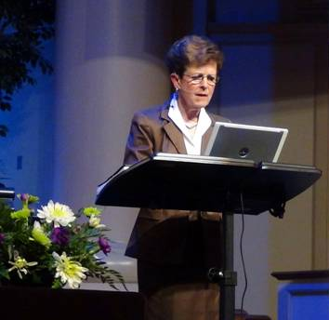
Marilyn Griffin
powerful insight
Notes:
I will forever be grateful to her for her astonishing insight that built the core of her current ministry.

Slide 43
^{Rev.2.1-4} “To the angel of the Messianic Community in Ephesus, write: ‘Here is the message from the one who holds the seven stars in his right hand and walks among the seven gold menorahs: “I know what you have been doing, how hard you have worked,

Slide 44
^{Rev.2.1-4} how you have persevered, and how you can’t stand wicked people; so you tested those…You are persevering, and you have suffered for my sake without growing weary. But I have this against you: you have lost the love you had at first.
Notes:
The early believers were NOT loveless…
They were committed to die for Messiah.
They knew the Word.
They sacrificially gave.
They labored to share the truth.
So, how did they lose their first love??

Slide 45
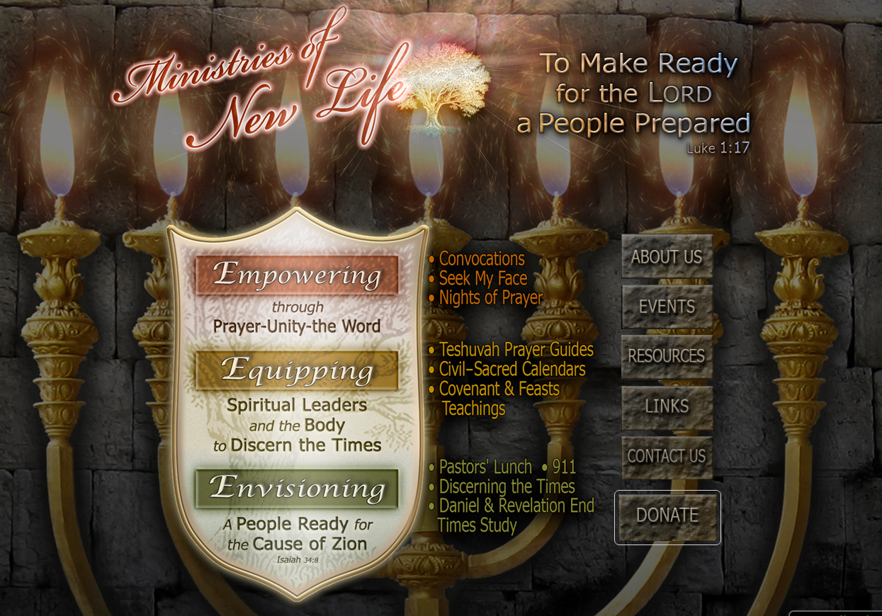
Marilyn’s breathtaking insight

Slide 46
“left their first love,” a deliberate action requiring “teshuvah” to return and repent. Dr. Ryrie points out the word for “left” means “to quit or forsake” By the Spirit revealing the historical record, we found through the sin of ignorance [SW:?] the early
Notes:
http://www.mnewlife.org/files/Rev_Les_06_Seven_Churches__-_Ephesus.pdf

Slide 47
church fathers “left / forsook” their Hebraic (Abrahamic) parentage / heritage (Rom.4) embracing the deception that the church is the New Israel. This error gave place to anti-Semitism that impregnated the church and spread rapidly.
Notes:
http://www.mnewlife.org/files/Rev_Les_06_Seven_Churches__-_Ephesus.pdf
Left your first love usually applied to spiritual life, she applies it to Semitic spirituality, Jewish covenantal awareness. Messianic movement, Or HaOlam about calling people to their covenantal identity in Yeshua.
Since the church world left out Israel, GREAT depredations.
I have to qualify all that by saying that this ministry now has some weaknesses, of which I’ve talked to her. Sacred Name, quoting Zohar and Talmud as if authoritative = Tanakh/Bible. So, I’m NOT giving MNL an endorsement like I used to. Not saying anything here I haven’t said before to Marilyn. Do give her great credit for above!

Slide 48
Summary:
iniquity hefkayrut הֶפְקֵרוּת lawlessness anomia
is unbiblical living:
Sexual sin, greed, pride, social sin despising/ alienation, Torah rejection, replacing Israel
Notes:
In our environment, affects us, chills our love, especially if we expose ourselves much, dabble in these at all.
Characterize all time, especially end time, our time

Slide 49
Mattityahu (Matthew) 24:12
וּמֵאַחַר שֶׁתִּרְבֶּה הַהֶפְקֵרוּת
תִתְקָרֵר אַהֲבַת רַבִּים.
“and many people’s love will grow cold because of increased distance from Torah.”

Slide 50
What constitutes cold love and hot love?

Slide 51
love: Grk. agapē, a relatively high level of interest in the well-being of another, affection, esteem, love. The noun agapē is one of the four Greek words for "love." In the LXX agape renders Heb. ahavah (SH-160, BDB 12), which is used of both human and divine love.
Notes:
http://www.blainerobison.com/bible2-matt/mattnotes24.htm

Slide 52
love: Grk. agapē, The Jewish translators of the LXX apparently coined the noun agapē, since there is no Greek literature earlier than the LXX that uses the word. God's nature and actions are the epitome of agapē (1Jn 4:8) and the preeminent virtue (1Cor 13:1-13).
Notes:
http://www.blainerobison.com/bible2-matt/mattnotes24.htm

Slide 53
love: Grk. agapē, The essential factor in every passage employing agapē is the willingness to sacrifice for an object, which sets it apart from the affection of phileō, the family loyalty of storgē and the passion of eros.
Notes:
http://www.blainerobison.com/bible2-matt/mattnotes24.htm
Who are you willing to sacrifice for, take a bullet for, give to upbuild?

Slide 54
will grow cold: Grk. psuchō, fut. pass., used in imagery of fire that changes from flame to a cold state; go out, be extinguished. The two preeminent commands are to love God and love one's neighbor. When people reject God's authority they will also become unwilling to sacrifice for the good of others
Notes:
http://www.blainerobison.com/bible2-matt/mattnotes24.htm

Slide 55
^{1 Kefa 1.22} Now that you have purified yourselves by obeying the truth, so that you have a sincere love for your brothers, love each other deeply, with all your heart.
^{ASV} love one another from the heart fervently:
Notes:
Cf offended.

Slide 56
^{MSG} love one another as if your lives depended on it.
^{NIV} love one another deeply, from the heart.
Look left and right.
Would you take a bullet for…?
Would you have lunch with…?

Slide 57
Hot love…Love is patient and kind, not jealous, not boastful, not proud, rude or selfish, not easily angered, and it keeps no record of wrongs.
Love does not gloat over other people’s sins but takes its delight in the truth. Love always bears up, always trusts, always hopes, always endures.
Notes:
6x/sec exchange of joy/dopamine

Slide 58
Hot love…Rejoices always,
prays constantly, in everything gives thanks; for this is God’s will for you in Messiah Yeshua.
Notes:
Arush and praise for all…Tikkun
It’s also a bit subjective. Hot love for G-d is in people’s expressions, face, eyes: love, joy, peace.
Sr. Davis in Schenectady, NY for me. Also the lovely and radiant teenager, Patty Fuller. Simplicity, modesty, glory.
Teerosh here last Tuesday and theme was the holiness of G-d, Yesh Is 6

Slide 59
^{2 Corinthians 3:18} So all of us, with faces unveiled, see as in a mirror the glory of the Lord; and we are being changed into his very image, from one degree of glory to the next, by Adonai the Spirit.

Slide 60
Mattityahu (Matthew) 24:12
וּמֵאַחַר שֶׁתִּרְבֶּה הַהֶפְקֵרוּת
תִתְקָרֵר אַהֲבַת רַבִּים.
“and many people’s love will grow cold because of increased distance from Torah.”
Notes:
Increased iniquity הֶפְקֵרוּת anomian = lawlessness → Love grow cold
Are we exposed unnecessarily to iniquity? Torahlessness?
Is our love hot?

Slide 61
^{Rev.3.15-18} “To the Laodiceans…I know what you are doing: you are neither cold nor hot. How I wish you were either one or the other! So, because you are lukewarm, neither cold nor hot, I will vomit you out of my mouth! For you keep saying, 'I am rich, I have gotten rich, I don't need a thing!'

Slide 62
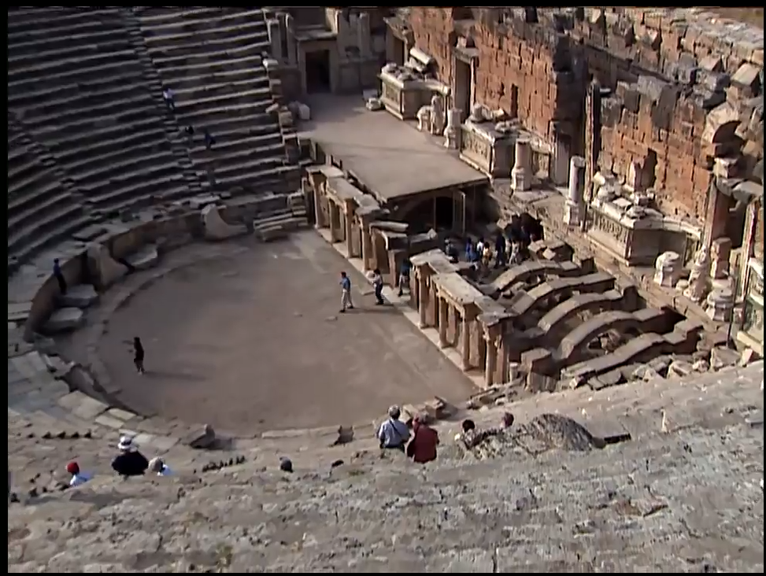
Laodicea, Colasse, Hieropolis

Slide 63
Ray van der Lan:
https://www.thattheworldmayknow.com/hot-or-cold

Slide 64
Several miles northwest of Laodicea, perched atop a small mountain, is a city called Hierapolis. At the base of Hierapolis is an extraordinary geological formation produced by the natural hot springs that surface around the city. Even today, the city is known for its steaming mineral baths snow white.
Notes:
https://www.toughquestionsanswered.org/2014/09/05/what-did-jesus-mean-by-hot-cold-and-lukewarm/

Slide 65
About the same distance from Laodicea in the opposite direction is Colossae. Paul’s colleague Epaphras worked in Colossae, as well as in Laodicea and Hierapolis Col 4:13 Colossae had one thing Laodicea didn’t: a cold, freshwater spring.
Notes:
https://www.toughquestionsanswered.org/2014/09/05/what-did-jesus-mean-by-hot-cold-and-lukewarm/

Slide 66
Unlike its neighbors, Laodicea had no springs at all. It had to import its water via aqueduct from elsewhere: hot mineral water from Hierapolis or fresh cold water from Colossae. By the time the water from either city made it to Laodicea, it had lost the qualities that made it remarkable. The hot water was no longer hot; the cold water was no longer cold.
Notes:
https://www.toughquestionsanswered.org/2014/09/05/what-did-jesus-mean-by-hot-cold-and-lukewarm/

Slide 67
The Laodiceans were left with all the lukewarm water they could drink. There isn’t much use for lukewarm water. Yeshua wished his people were hot (like the salubrious waters of Hierapolis) or cold (like the refreshing waters of Colossae). Instead, their discipleship was unremarkable.
Notes:
https://www.toughquestionsanswered.org/2014/09/05/what-did-jesus-mean-by-hot-cold-and-lukewarm/

Slide 68
It says love will grow cold, not die.

Slide 69
^{Yeshayahu/Is 42.1-3} Behold My servant, whom I uphold. My Chosen One, in whom My soul delights. I have put My Ruakh on Him, He will bring justice to the nations. He will not cry out or raise His voice, or make His voice heard in the street. A bruised reed He will not break. A smoldering wick He will not snuff out.

Slide 70
“Here is My servant whom I chose,
the One I love, in whom My soul takes delight. I will put My Ruakh upon Him, and He shall proclaim justice to the nations. He will not quarrel or cry out, nor will anyone hear His voice in the streets.
A crushed reed He will not break,
and a smoldering wick he will not snuff out
Notes:
G-d, if there is any spark of life, water that spark.

Slide 71
^{Yeshayahu/Is.6.6-7} Then one of the seraphim flew to me, with a glowing coal in his hand, which he had taken with tongs from the altar. He touched my mouth with it and said: “Behold, this has touched your lips. Your iniquity is taken away, and your sins atoned for.”

Slide 72
^{Yeshayahu/Is.4.4-5} After Adonai has washed away the filth of the Daughters of Zion and has purged the blood of Jerusalem from her midst by the spirit of judgment and by the spirit of burning,

Slide 73
^{Yeshayahu/Is.4.4-5} then Adoni will create over the whole area of Mount Zion and over her convocations, a cloud by day, and smoke and shining of a flaming fire by night. For over all, glory will be a canopy/

Slide 74
^{Rev.3.15-18} You don't know that you are the one who is wretched, pitiable, poor, blind and naked! My advice to you is to buy from me gold refined by fire, so that you may be rich; and white clothing, so that you may be dressed and not have to be ashamed of your nakedness; and eyesalve to rub on your eyes, so that you may see.

