Slide 1
If you want to have notes without taking notes,
Go to OrHaOlam.com
WITHOUT WIFI
Click on downloads, messages, 2018 messages
Today’s should be on the top.

Slide 2
Mercy Expressed
in the Midst of War

Slide 3
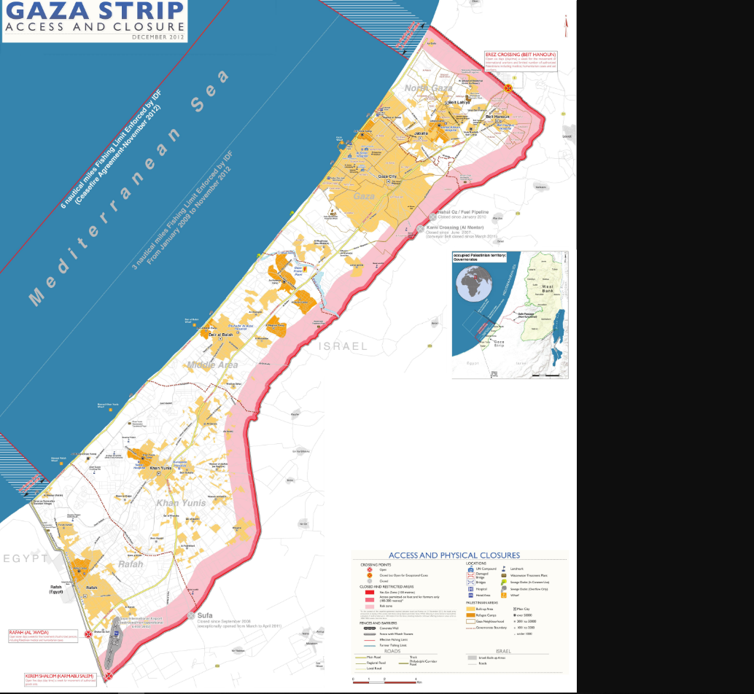
Notes:
Gaza, rockets, fire balloons, fire kites, igniting forests and crops, human wave invasion

Slide 4
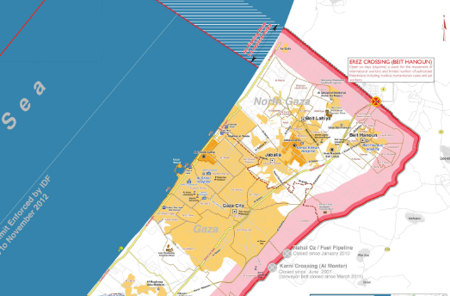

Slide 5
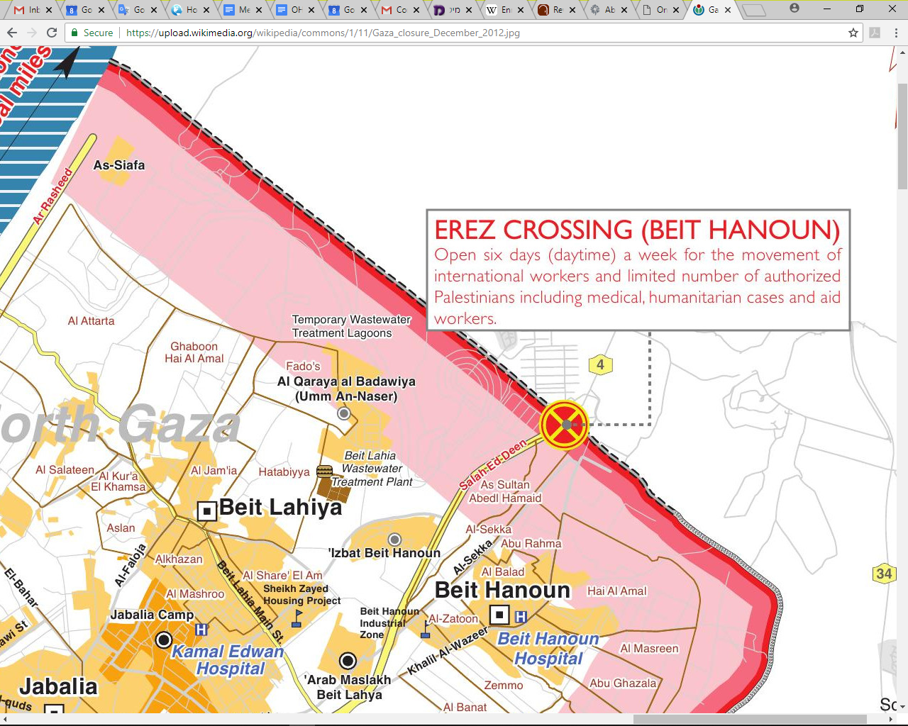

Slide 6
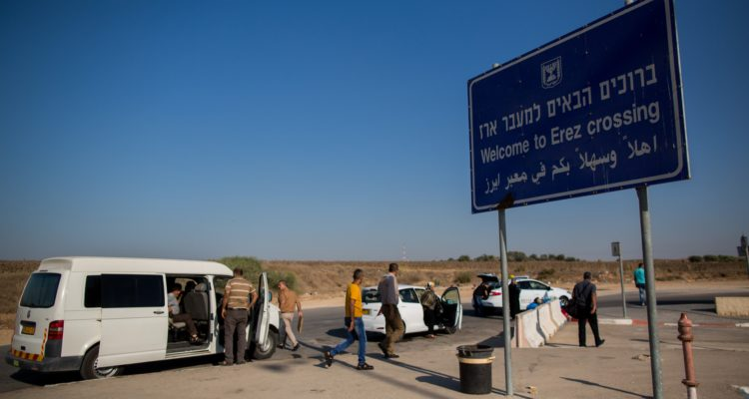
Erez Crossing, Israel to Gaza
Notes:
Palestinians enter Erez crossing into Gaza. (Yonatan Sindel/Flash90) https://worldisraelnews.com/israel-accepted-6000-gazans-for-medical-treatment-in-past-four-months/?utm_source=MadMimi&utm_medium=email&utm_content=Friedman+to+Media%3A+%E2%80%98Keep+Your+Mouths+Shut%E2%80%99+on+Gaza%3B+PA%3A+%27Burn+Photos+of+Messi+if+He+Plays+in+Israel%27%3B+Today%27s+Top+News%21&utm_campaign=20180604_m145713555_Friedman+to+Media%3A+%E2%80%98Keep+Your+Mouths+Shut%E2%80%99+on+Gaza%3B+PA%3A+%27Burn+Photos+of+Messi+if+He+Plays+in+Israel%27%3B+Today%27s+Top+News%21&utm_term=_0D_0A_09_09_09_09_09_09_09_09_09_09Read+Now_0D_0A_09_09_09_09_09_09_09_09_09

Slide 7
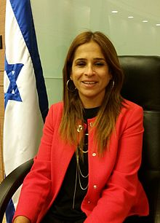
Member of
the Knesset
Meirav
Ben-Ari

Slide 8
Meirav Ben-Ari, a Member of Knesset from the Kulanu party, said that according to data provided to her by the IDF, over 5,000 Gaza residents were allowed through the Erez Crossing that separates southern Israel from Gaza in order to receive medical treatment in Israeli hospitals.
Notes:
https://worldisraelnews.com/israel-accepted-6000-gazans-for-medical-treatment-in-past-four-months/?utm_source=MadMimi&utm_medium=email&utm_content=Friedman+to+Media%3A+%E2%80%98Keep+Your+Mouths+Shut%E2%80%99+on+Gaza%3B+PA%3A+%27Burn+Photos+of+Messi+if+He+Plays+in+Israel%27%3B+Today%27s+Top+News%21&utm_campaign=20180604_m145713555_Friedman+to+Media%3A+%E2%80%98Keep+Your+Mouths+Shut%E2%80%99+on+Gaza%3B+PA%3A+%27Burn+Photos+of+Messi+if+He+Plays+in+Israel%27%3B+Today%27s+Top+News%21&utm_term=_0D_0A_09_09_09_09_09_09_09_09_09_09Read+Now_0D_0A_09_09_09_09_09_09_09_09_09

Slide 9
Genocidal Intentions
Expressed

Slide 10
“Two days ago, the Supreme Leader of Iran, Ayatollah Khamenei, announced his intentions to annihilate Israel,” said Netanyahu. “Yesterday, he explained how he would do so, with the unrestricted enrichment
Notes:
Barry & Batya Segal http://www.netmail411.com/mail/vfi/JOLjun0818.html?utm_source=JNN+Newsletter+-+Global&utm_campaign=1e59d45339-EMAIL_CAMPAIGN_2018_04_08_COPY_01&utm_medium=email&utm_term=0_a7c77e6522-1e59d45339-144069561&mc_cid=1e59d45339&mc_eid=5c6cdd3ee6

Slide 11
of uranium in order to build an arsenal of nuclear weapons. We’re not surprised,” continued Netanyahu, vowing that Israel “won’t let Iran get nuclear weapons.”
How?
Notes:
Barry & Batya Segal http://www.netmail411.com/mail/vfi/JOLjun0818.html?utm_source=JNN+Newsletter+-+Global&utm_campaign=1e59d45339-EMAIL_CAMPAIGN_2018_04_08_COPY_01&utm_medium=email&utm_term=0_a7c77e6522-1e59d45339-144069561&mc_cid=1e59d45339&mc_eid=5c6cdd3ee6

Slide 12
A facility in Iran’s Natanz nuclear plant to build advanced centrifuges will be completed in a month, Iran’s nuclear chief announced on 6 June 2018.
Notes:
Barry & Batya Segal http://www.netmail411.com/mail/vfi/JOLjun0818.html?utm_source=JNN+Newsletter+-+Global&utm_campaign=1e59d45339-EMAIL_CAMPAIGN_2018_04_08_COPY_01&utm_medium=email&utm_term=0_a7c77e6522-1e59d45339-144069561&mc_cid=1e59d45339&mc_eid=5c6cdd3ee6

Slide 13
Everyone Wonders
about
The End of Time

Slide 14

Notes:
Stray asteroid??

Slide 15
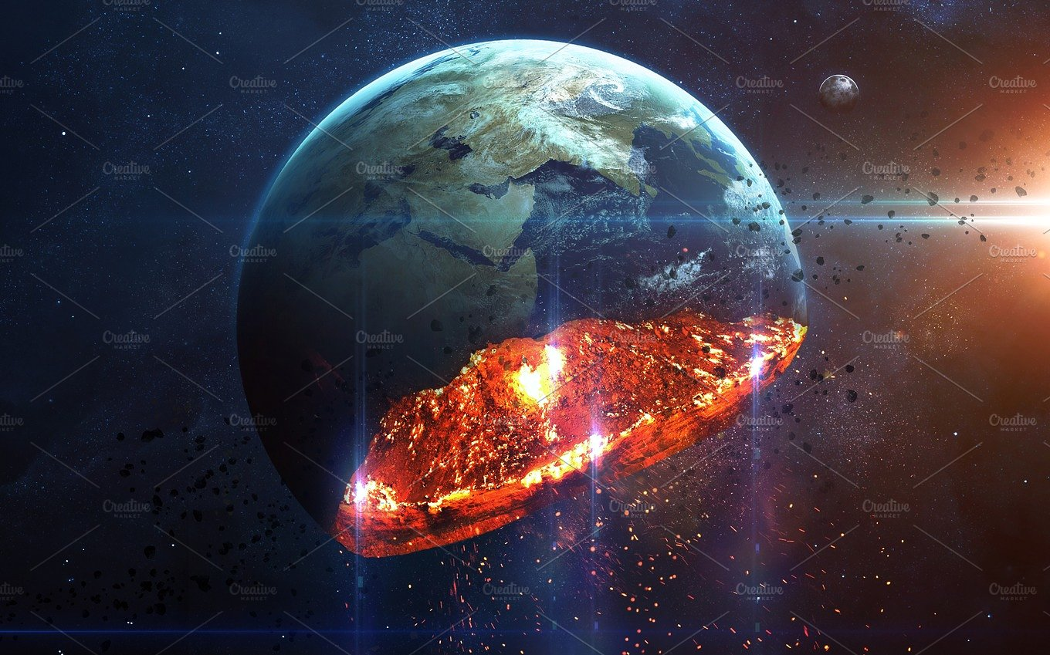
Notes:
https://www.google.com/search?q=end+of+time&safe=active&tbm=isch&tbs=rimg:CTvPVRoypQdCIjhHMSSHmvK742fSly02WgiEKtasXbRjDTQd064WkdFRhzuR7-X13UYbd876b9ymplS6ECN1hP9uYSoSCUcxJIea8rvjETAulPhSmpPIKhIJZ9KXLTZaCIQRdu8E7DWv_1mIqEgkq1qxdtGMNNBFOP71nkzWDqyoSCR3TrhaR0VGHEQ7cUEtLcv_1YKhIJO5Hv5fXdRhsRAqgdfhOvTrsqEgl3zvpv3KamVBGkG3jT-8ADByoSCboQI3WE_125hEawic4KKJ_1bs&tbo=u&sa=X&ved=2ahUKEwimp8aw5MXbAhVPXKwKHW8eB0wQ9C96BAgBEBs&biw=1165&bih=871&dpr=1.1#imgrc=O5Hv5fXdRhtmsM:

Slide 16
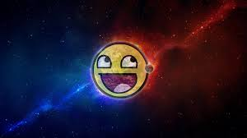
Notes:
https://www.google.com/search?q=end+of+time&safe=active&tbm=isch&tbs=rimg:CXh4eEkMwgFaIji40IkvczgpeEAcW7Ko6GMH2rE5gD5LCMymrHjIcUFhgJFB9z4LbexaRdcM9O0Xuq161I_1dK2cpAyoSCbjQiS9zOCl4ES7-v19DVZyEKhIJQBxbsqjoYwcRDRPrTMbB-_1QqEgnasTmAPksIzBEojSXoFuK8VCoSCaaseMhxQWGAEVLH_1ugDtR5GKhIJkUH3Pgtt7FoRjaILbAiW3TcqEglF1wz07Re6rREHWSEXR-NMpyoSCXrUj90rZykDEcH0j9jNP-9I&tbo=u&sa=X&ved=2ahUKEwj60Izz5MXbAhUNWa0KHT47DY0Q9C96BAgBEBs&biw=1165&bih=871&dpr=1.1#imgrc=G1F73Qn3-aiR0M:

Slide 17
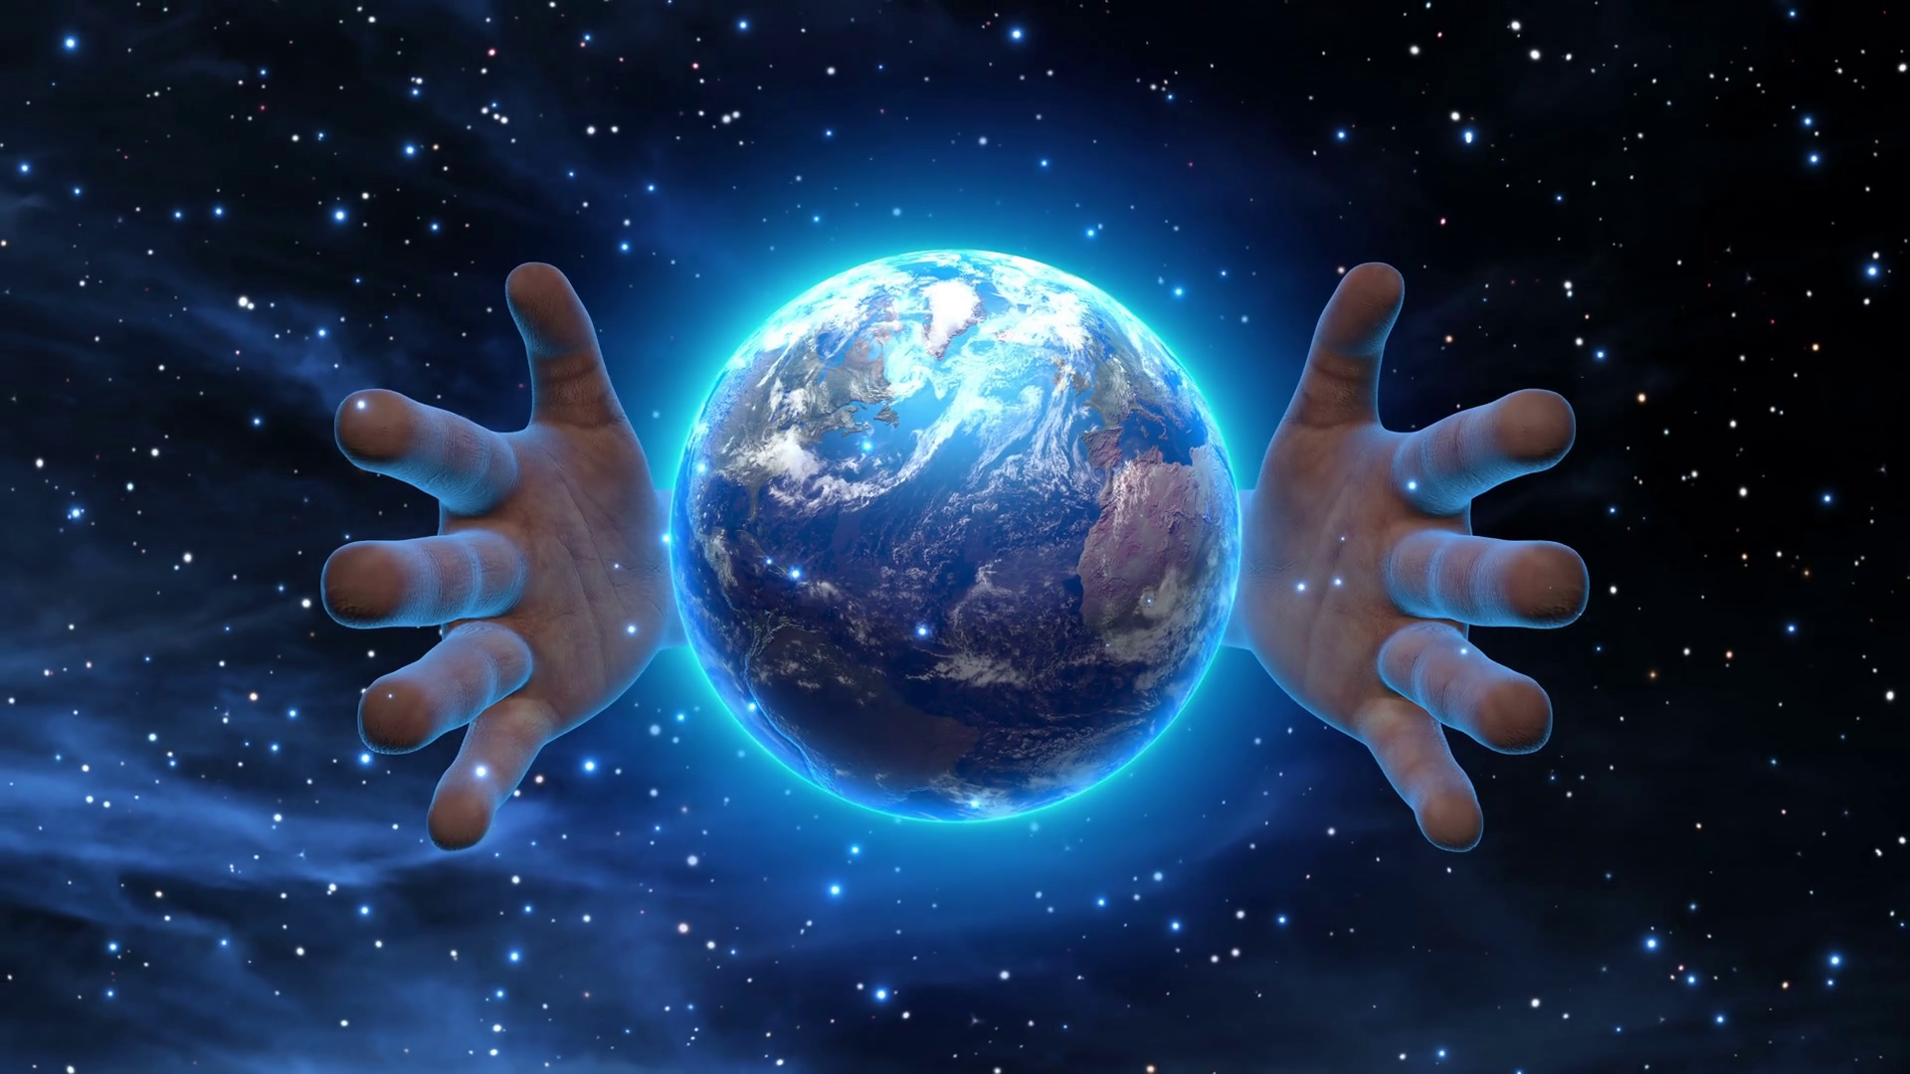
Notes:
https://www.google.com/search?q=end+of+time&safe=active&tbm=isch&tbs=rimg:CXh4eEkMwgFaIji40IkvczgpeEAcW7Ko6GMH2rE5gD5LCMymrHjIcUFhgJFB9z4LbexaRdcM9O0Xuq161I_1dK2cpAyoSCbjQiS9zOCl4ES7-v19DVZyEKhIJQBxbsqjoYwcRDRPrTMbB-_1QqEgnasTmAPksIzBEojSXoFuK8VCoSCaaseMhxQWGAEVLH_1ugDtR5GKhIJkUH3Pgtt7FoRjaILbAiW3TcqEglF1wz07Re6rREHWSEXR-NMpyoSCXrUj90rZykDEcH0j9jNP-9I&tbo=u&sa=X&ved=2ahUKEwj60Izz5MXbAhUNWa0KHT47DY0Q9C96BAgBEBs&biw=1165&bih=871&dpr=1.1#imgdii=kB6GvSei_ffN9M:&imgrc=G1F73Qn3-aiR0M:

Slide 19
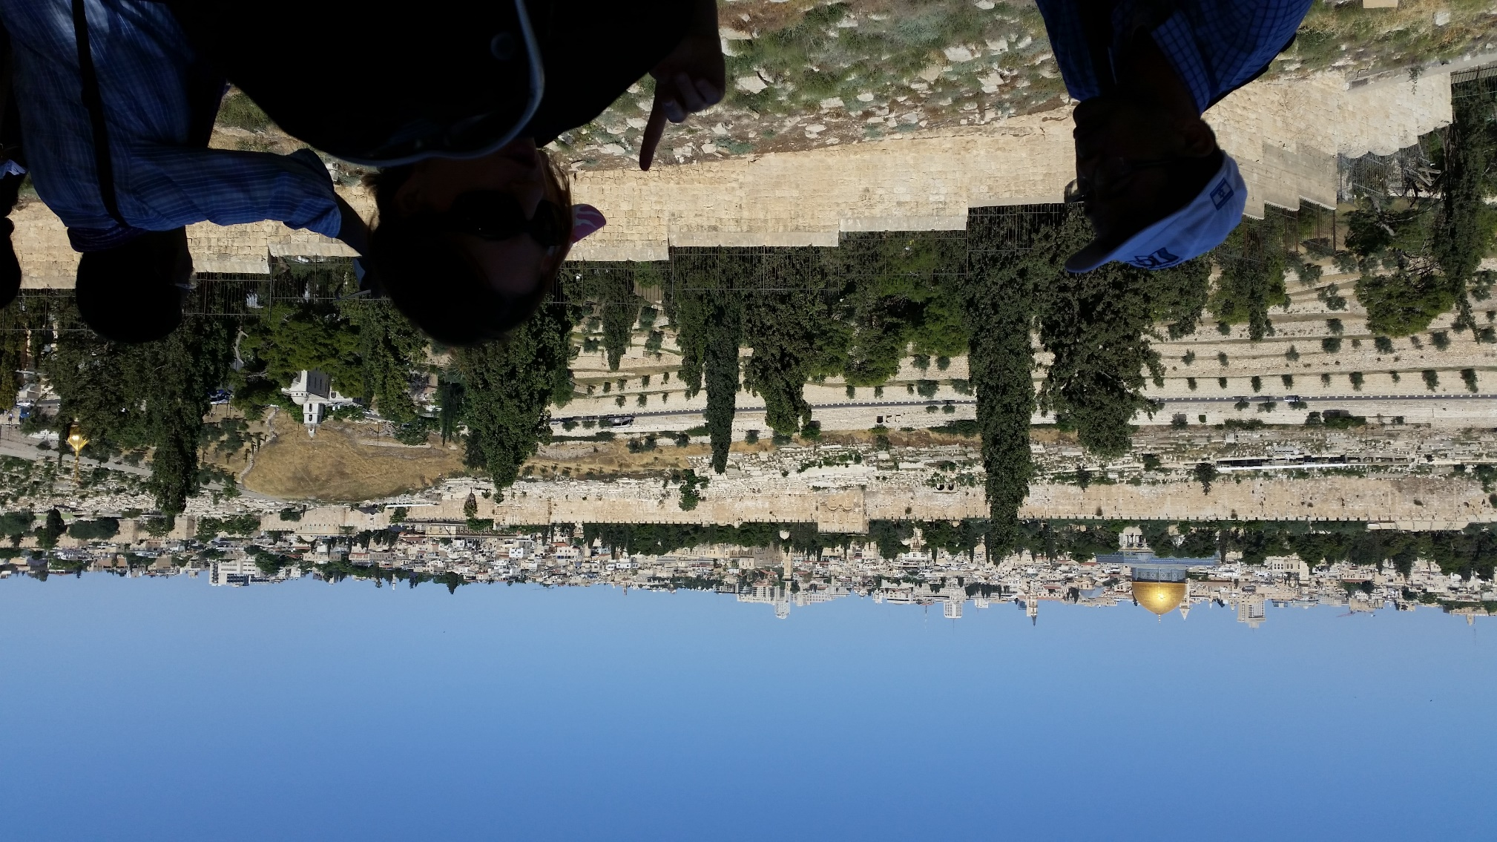
View from Mt. Olives

Slide 20
Talmidim/Disciples asking Yeshua:
When will be the end of this age? Seeing as it will happen HERE.
Key lessons to prep for the end:

Slide 21
Don’t be deceived! Many in My Name. vss. 4-5
Wars, famines, earthquakes…beginning of birth-pains. vss. 6-8
Imprisoned, hated, executed, betrayed vss. 9-10
Today: False prophets…
Notes:
#2.I have it on great authority, that birth pains usually start slowly, but never pleasant, and increase.
First three external to community for the most part. #4 internal.

Slide 22
Mattityahu (Matthew) 24:11
נְבִיאֵי שֶׁקֶר יָקוּמוּ וְיַתְעוּ רַבִּים,
“many false prophets will appear and fool many people;”
Notes:
A bit of repetition of “Don’t be deceived.” vs 4. Back to this in vs. 23, combined false Messiahs false prophets..

Slide 23
pseudoprophētai
ψευδοπροφῆται
false prophets
Seem true and right…
Notes:
Gill: Simon Magus, Ebion, and Cerinthus, who denied the proper deity, and real humanity of Messiah; Carpocrates, and the Gnostics his followers, the Nicolaitans, Hymcneus, Philetus, and others.
Things that seem true and right to the majority…

Slide 24
Gallup on Monday released its annual Values and Beliefs survey
A record 67 percent of American adults believe that gay and lesbian relations are morally acceptable, an increase from last year’s high of 63 percent.
Notes:
https://www.christianheadlines.com/contributors/michael-foust/gallup-record-support-for-gay-relations-and-polygamy-plurality-still-oppose-abortion.html

Slide 25
The survey set records on several other issues. Among them:
43 percent say pornography is morally acceptable. Previous high: 36 percent (2017).
19 percent say polygamy is morally acceptable. Previous high: 17 percent (2017).
Notes:
https://www.christianheadlines.com/contributors/michael-foust/gallup-record-support-for-gay-relations-and-polygamy-plurality-still-oppose-abortion.html

Slide 26
The Messianic scriptures describe false prophets in their time.
Prototypes?
Internal threat.
Cp External: wars, famines, executions.

Slide 27
Examples of Messianic Era false prophets
Characteristics of Messianic Era false prophets.

Slide 28
^{Acts 20.29-32} Even from among your own number, men will arise and teach perversions of the truth, in order to drag away the talmidim after themselves. So stay alert!
Notes:
Never UNtruth, but perversions, half truths.

Slide 29
^{Acts 20.29-32} …“And now I entrust you to the care of the Lord and to the message of his love and kindness, for it can build you up and give you an inheritance among all those who have been set apart for God.
Notes:
Greatest lesson, focus on Messiah’s, Immanuel’s love and kindness, MOTIVATES us to do right.

Slide 30
^{1 Tim 1.3-6} Order certain people who are teaching a different doctrine to stop. Have them stop devoting their attention to myths and never-ending genealogies; these divert people to speculating instead of doing God’s work, which requires trust.
Notes:
Never ending details, cf trust

Slide 31
^{1 Tim 1.3-6} The purpose of this order is to promote love from a clean heart, from a good conscience and from sincere trust. Some, by aiming amiss, have wandered off into fruitless discussion.

Slide 32
^{Jude 1:16} These are bellyaching grumblers, following after their own desires. Kvetchers?
^{Jude 1:19} These are the ones who cause divisions—worldly-minded, not having the Ruach
Notes:
One way to tell a false prophet, complains a LOT.
Another way…devisive.

Slide 33
^{1 Tim 1.18-19} Fight the good fight, holding onto faith and a good conscience. By rejecting these, some have suffered shipwreck regarding their faith.

Slide 34
^{Titus 1.10-11} The Circumcision faction…who are rebellious, who delude people’s minds with their worthless and misleading talk. They must be silenced; because they are upsetting entire households by teaching what they have no business teaching, and doing it for the sake of dishonest gain.

Slide 35
^{2 Peter 2:1-3} But among the people there were also false prophets, just as there will be false teachers among you. Under false pretenses they will introduce destructive heresies, even denying the Master who bought them,
Notes:
We have lost some here who renounced Messiah.

Slide 36
^{2 Peter 2:1-3} and thus bring on themselves swift destruction. Many will follow their debaucheries; and because of them, the true Way will be maligned. In their greed they will exploit you with fabricated stories.

Slide 37
^{Jude 4} For certain people have secretly slipped in—those who from long ago have been marked out for this judgment. They are ungodly people, who pervert the grace of our God into indecency and deny our only Master and Lord, Yeshua the Messiah.

Slide 38
^{Jude 8} Yet in the same way these people also, by their visionary dreaming, defile the flesh, reject the Lord’s authority, and defame glorious beings.

Slide 39
^{Jude 10} These people slander whatever they do not understand.

Slide 40
^{2 Cor 11.13-15} For such men are false emissaries, deceitful workers masquerading as Messiah’s emissaries. And no wonder, for even satan masquerades as an angel of light. It is no great thing therefore if his servants also masquerade as servants of righteousness.
Notes:
One can imitate the light of the knowledge of G-d,
but impossible to imitate the heat of the Love of G-d.

Slide 41
^{2 Tim 2.18-19} …men who have missed the mark concerning the truth, saying that the resurrection has already taken place. They are overturning the faith of some. Nevertheless, the firm foundation of God stands, having this seal:
Notes:
Two quotes from Nu 16 story of Korakh

Slide 42
^{2 Tim 2.18-19} “The Lord knows those who are His,” and, “Let everyone who names the name of the Lord keep away from unrighteousness.”
Notes:
Two quotes from Nu 16 story of Korakh

Slide 43
^{Rev 2.18-20} “To the angel of the Messianic Community in Thyatira, write: ‘Here is the message from the Son of God, whose eyes are like a fiery flame and whose feet are like burnished brass: I know what you are doing, your love, trust, service and perseverance.

Slide 44
^{Rev 2.18-20} And I know that you are doing more now than before. But I have this against you: you continue to tolerate that Izevel woman, the one who claims to be a prophet, but is teaching and deceiving my servants to commit sexual sin and eat food that has been sacrificed to idols.

Slide 45
^{Rev. 2.9} “I know how you are suffering and how poor you are (though in fact you are rich!)I know the insults of those who call themselves Jews but aren’t — on the contrary, they are a synagogue of the Adversary.
Notes:
This is an interesting one for us, since we represent the restoration of Israel. There are many that call themselves Jews, but aren’t. I feel that I should spend some time on this, because it’s close to home.

Slide 46
One popular and seemingly right voice in the Messianic world…
Two House Movement
Ephraimite Movement
Two Sticks
Summary:

Slide 47
The Messianic Jewish View of One Law, Two House, Hebrew Roots
We believe G-d made a unique covenant with the Jewish people, giving them the Land of Israel, the Torah, and an identity as

Slide 48
The Messianic Jewish View of One Law, Two House, Hebrew Roots
His chosen people. All nations are welcome to enter into the joy of a Torah lifestyle, but that doesn't negate Jewish identity.

Slide 50
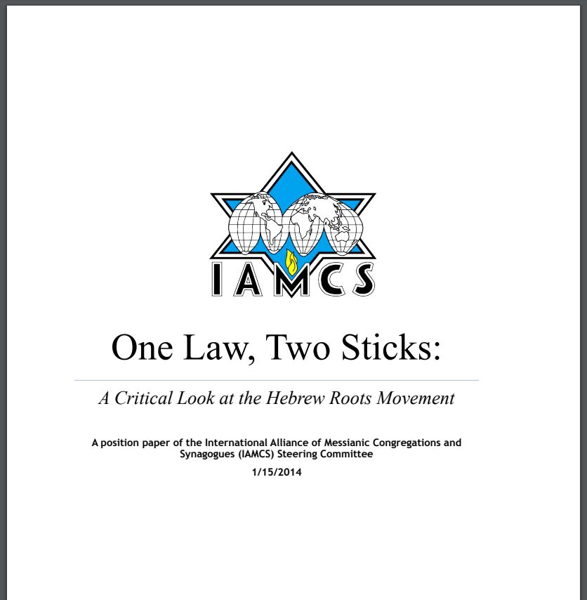
60 page
position
paper

Slide 51
http://media.cloversites.com/8a/8a6bd14a-1a05-4f26-8dc1-b355631ec972/documents/One_Law_Two_Sticks.pdf
Notes:
Most of the following is from this treatise, by Rabbi Michael Stepakoff, Temple New Jerusalem, Palm Harbor [Tampa area], FL
http://www.templenewjerusalem.org/

Slide 52
One Law doctrine is based on the idea that everybody everywhere ought to be keeping the Torah given to the Jews at Sinai. In their view, the law wasn’t intended just for Israel, but for everyone.
Notes:
Seems reasonable. Sort of is, but…

Slide 53
Moreover, neither the coming of Messiah, nor the atonement provided in the New Covenant changes anything in terms of what they see as the universal human need to relate to God through the laws of Moses.

Slide 54
“One Law One People” teaching is associated with the idea that people who keep the Torah given to Israel actually ARE Israel. This idea is usually advanced by myths about the “lost tribes.” The followers of “One Law” typically begin to identify Israel in Bible prophecy as somehow pertaining to them.

Slide 55
Many of them think of themselves as belonging to the northern kingdom of Israel, as represented in the prophecy of the two “sticks” referenced in Ezekiel 37. Thus, they see Torah observance as their duty as members of the people Israel.

Slide 56
We don’t disagree generally with the use of Jewish symbolism and expression by non- Jews. However, such usage by legalistic, non-Jewish groups, many of whom think they are the true Israelites,

Slide 57
and who are often critical and divisive toward the Gentile church, can cause much offense and/or confusion in both the Jewish and Christian community.

Slide 58
First Fruits of Zion went through a period like this, 2003-2009. Tim Hegg was the main proponent. They’ve emerged well, and have it as a core belief to nix the words, “MUST, SHOULD, OUGHT.” Rather “delight.”
Notes:
FFOZ was excluded from the MJAA for a time. 2003-2009

Slide 59
The idea behind “One Law” theology, whether stated or implied, is that he who keeps the law given to Israel, therefore IS Israel. Accordingly, “One Law” theology tends to simply be a form of replacement theology.

Slide 60
By keeping the laws which are specific to Israel, one thereby presumes to be Israel. This incorrect desire to “keep Torah” in order to become Israel is a deception that dates back to the time of the Apostles. (1 Tim. 1:4, Titus 3:9).
Notes:
Family here, several years ago, father said to me: We love the Jewish dance, love the Jewish language, the Jewish liturgy, the Jewish Torah, Jewish holidays. Therefore we ARE Jewish. Yes?
An associated point of confusion, false prophet teaching…

Slide 61
Sacred Name movement
The Sacred Name Movement began within the Church of God (Seventh-Day) in Christianity, propagated by Clarence Orvil Dodd in the 1930s,
Notes:
https://en.wikipedia.org/wiki/Sacred_Name_Movement

Slide 62
which claims that it seeks to conform Christianity to its "Hebrew Roots" in practice, belief and worship. The best known distinction of the SNM is its advocacy of the use of the "sacred name" Yahweh (Hebrew: יַהְוֶה),)
Notes:
https://en.wikipedia.org/wiki/Sacred_Name_Movement
Which I am NOT going to say, because 9 reasons, but the main one is that the Messiah, and all the writers of the Messianic scriptures/New Testament, didn’t pronounce the Name. Here’s the key example…

Slide 63
^{Mtt 26.64} Yeshua said to him, “One day you will see the Son of Man sitting at the right hand of HaG'vurah [Heb. for The Powerful One] and coming on the clouds of heaven.“ Yeshua is quoting the concept in T'hillim/Ps 110 of "right hand of ADONI/YHVH,"

Slide 64
^{Mtt 26.64} but He doesn't say the Sacred Name. He uses the rabbinic device of circumlocution, says an attribute in place of the Name. That actual quote is "A psalm of David: ADONI says to my Lord, "Sit at my right hand...“ This is the definitive paradigm in this discussion. He didn't use the Name. So, we don't.
Notes:
If anyone knew the right pronunciation, and had authority to do so, it would have been Messiah the Son. But He chose not to pronounce the Name.
A spin off to that…

Slide 65
Yahshua is one proposed transliteration of the original Hebrew or Aramaic name of the Messiah commonly used by individuals in the Sacred Name Movement. The English spelling Yahshua originates at least as early as 1950
Notes:
https://en.wikipedia.org/wiki/Yahshua

Slide 66
with Angelo Traina's The New Testament of our Messiah and Saviour Yahshua. The form Yahshua is used in some Sacred Name Bibles, including the Sacred Scriptures Bethel Edition. It cannot be found used prior to that time, however, with that spelling.
Notes:
https://en.wikipedia.org/wiki/Yahshua

Slide 67
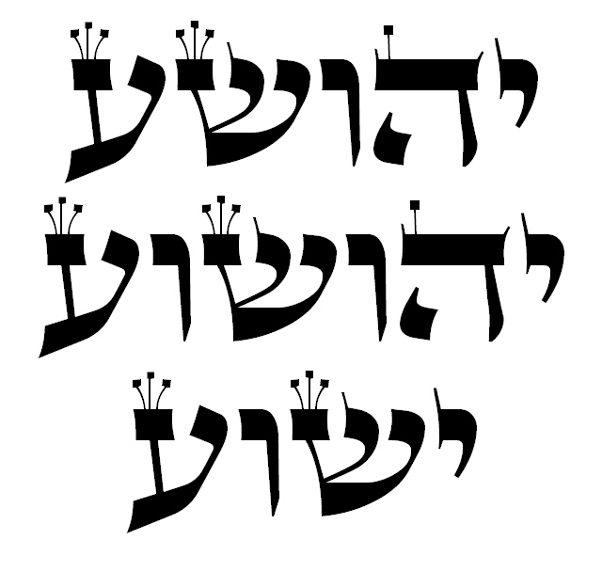
3 spellings
of “Joshua”
found in the
Masoretic
text of the
Heb. Bible:
Yehoshua,
Yehoshua
Yeshua
Notes:
https://en.wikipedia.org/wiki/Yahshua

Slide 68
Christians, historians, and linguists outside the sacred name movement for the most part reject the term Yahshua יהשע in favor of Yeshua ישוע as the original pronunciation. Tal Ilan's Lexicon of Jewish Names in Late Antiquity (2002), notes Yehoshua and the later Aramaic form Yeshua among many names containing Yah.
Notes:
https://en.wikipedia.org/wiki/Yahshua
While were on the subject, there is more, it gets more insidious. This is not just a rabbi trail on theological trivia.

Slide 69
One of the early disciples of the Church of God (Seventh Day) was Herbert W. Armstrong, who came into it at the prodding of his wife in the late 1920’s. Like Dodd, Armstrong identified not only with the Sabbath, but with the idea of keeping the feasts.

Slide 70
Armstrong began his Worldwide Church of God (WCG) in 1934, after being dis-fellowshipped from the Church of God Seventh Day. The reason that Armstrong was kicked out was because he had become a proponent of a controversial doctrine which at the time was known as “British Israelism.”

Slide 71
The theology is based on the myth that the 10 northern tribes of Israel wandered into the lands in northwestern Europe and settled there, after being exiled by the Assyrians in the 8th century B.C.
Armstrong’s linguistics:

Slide 72
Saxony: Isaac’s sons. Sussex, Essex, Wessex.
Really Benei Yitzkhak.
Brit Ish. ברית איש
Armstrong said means “Man of the covenant”
If anything, “Covenant of man”

Slide 74
Though there is zero historical, archeological, biblical or any other kind of evidence in support, the theory became quite popular in the 18th and 19th century, as Great Britain became the leading world power.

Slide 75
Anglo-Israelism in the extreme cases is the driving vision of certain anti-Jewish hate groups such as the ultra-right wing “Christian Identity” movement in America.
Armstrong’s group was called the Worldwide Church of G-d.

Slide 76
After the Holocaust, as Jews poured into the land of Israel, WCG followers saw this event not as a fulfillment of divine will according to Bible prophecy, but rather, some kind of deception. Armstrong’s followers had the idea that the right to possess the land of Israel belonged not

Slide 77
to the Jews, but to the Gentile nations of Britain and America, under the banner of Ephraim. They were urged to observe the Sabbath, the feasts, and the Biblical dietary laws, as a condition of fulfilling the right to be heirs to the land.

Slide 78
Christian Identity is a religious ideology popular in extreme right-wing circles.
Adherents believe that whites of European descent can be traced back to the "Lost Tribes of Israel."

Slide 79
Many consider Jews to be the Satanic offspring of Eve and the Serpent, while non-whites are "mud peoples" created before Adam and Eve. Its virulent racist and anti-Semitic beliefs are usually accompanied by extreme

Slide 80
anti-government sentiments. Despite its small size, Christian Identity influences virtually all white supremacist and extreme anti-government movements.

Slide 81
Later proponents of variations of this are Marshall Moshe Koniuchowsky, Batya Wooten, Ralph Messer [who wrapped a Torah scroll around a penitent leader, Eddie Long], James Trimm Nazarene Yisrael, Monte Judah, Bill Cloud, Michael Rood

Slide 82
Gentile Torah Observance, Our View: !
Paul circumcised Timothy, whose mother was Jewish, (Acts 16:3); but did not circumcise Titus, who was Greek. (Gal. 2:3). Paul saw that circumcision was right and good for the Jewish believer in Yeshua,

Slide 83
Gentile Torah Observance, Our View: !
but made no sense for the Gentile. The fact is, Paul did not see the Torah as having the same application to Gentiles as to Jews under the New Covenant. Paul was the Apostle to the Gentiles.

Slide 84
We do not believe the Gentile church is called necessarily to observe Shabbat, the Levitical feasts, the laws of kashrut, and other Mosaic laws that are specific to Israel. We don’t forbid anyone from doing those things.
In the Millennium…Sukkot plus!
Notes:
P 57

Slide 85
Mattityahu (Matthew) 24:11
נְבִיאֵי שֶׁקֶר יָקוּמוּ וְיַתְעוּ רַבִּים,
“many false prophets will appear and fool many people;”

Slide 86
^{Ro. 15.7-13} Therefore accept one another just as Messiah also accepted you, to the glory of God. For I declare that Messiah has become a servant to the circumcised for the sake of God’s truth, in order to confirm the promises given to the patriarchs and for the Gentiles to glorify God for His mercy.

Slide 87
^{Ro. 15.7-13} As it is written, “For this reason I will give You praise among the Gentiles, and I will sing to Your name.” ^{Ps 18.50}
And again it says, “Rejoice, O Gentiles, with His people.” ^{Dvarim 32.43}
And again, “Praise Adoni all you Gentiles, and let all the peoples praise Him.” ^{Ps 117.1}

Slide 88
^{Ro. 15.7-13} And again, Isaiah says, “There shall be a shoot of Jesse; and the One who arises to rule the Gentiles, in Him shall the Gentiles hope.” ^{Is 11.10}
Now may the God of hope fill you with all joy and shalom in trusting, so you may overflow with hope in the power of the Ruach ha-Kodesh.

Slide 89
Conclusion: Back to the beginning:
^{Ber/Gen 12.2-3} My heart’s desire is to make you into a great nation, to bless you, to make your name great so that you may be a blessing.
My desire is to bless those who bless you.

Slide 90
Blessing to Jews and those who affiliate and bless the Jews.
Walk in the blessing of His atonement and covenantal calling!

