Slide 1
If you want to have notes without taking notes,
Go to OrHaOlam.com
WITHOUT WIFI
Click on downloads, messages, 2018 messages
Today’s should be on the top.

Slide 2
Good news from Israel

Slide 3
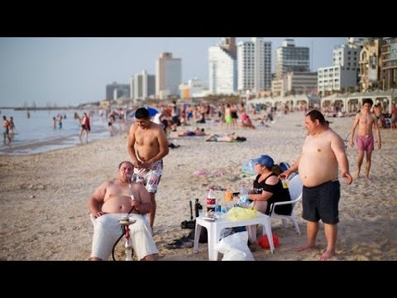
Israelis Happy Despite Cost of
Living and Security Hardships

Slide 4
https://youtu.be/S1fSaNS5XW4
Notes:
Backup format of Israelis happy, and url for docx conversion by Lori

Slide 5
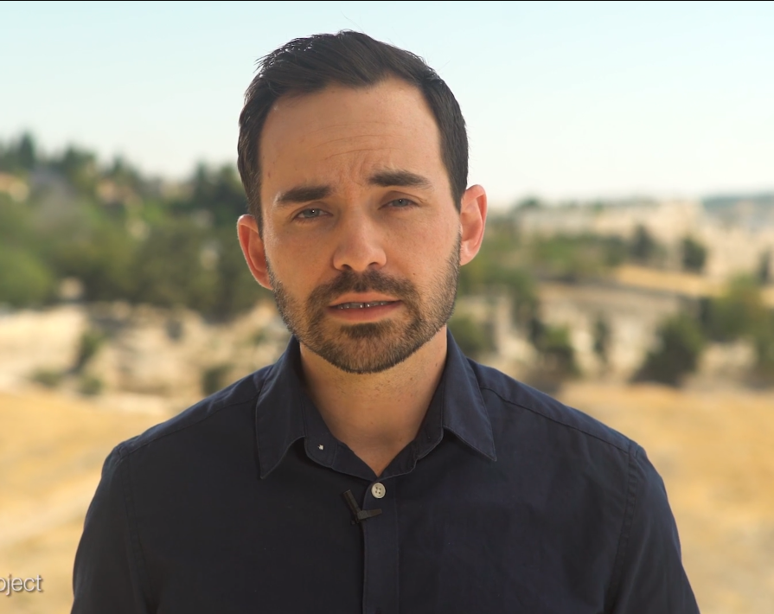
Evan Levine, HaTikva Project

Slide 6
I just wanted to let you know that we are making serious headway with HaTikva Families. Last week we were invited to staff and run two days of activities at a summer camp for orphans

Slide 7
put on by the largest foster care organization in Israel. They know we are believers, know what we stand for, and want us to help.

Slide 8
HaTikva Families – an openly and boldly Messianic organization – was invited in to touch the lives of orphans in the care of the State. It’s been amazing to watch all of this develop.

Slide 9
The team put together two amazing days – one day where they brought in Tae Kwan Do instructors for the kids

Slide 10
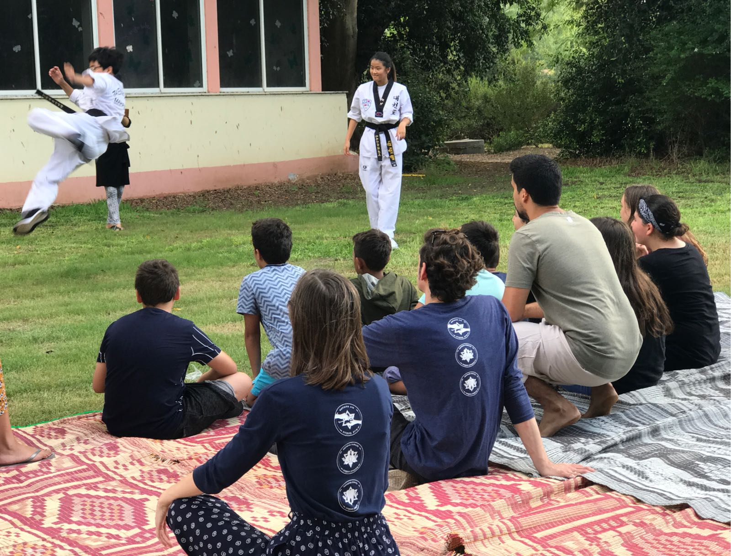

Slide 11
and another where all of the kids got haircuts and makeovers from our team and volunteer stylists.

Slide 12

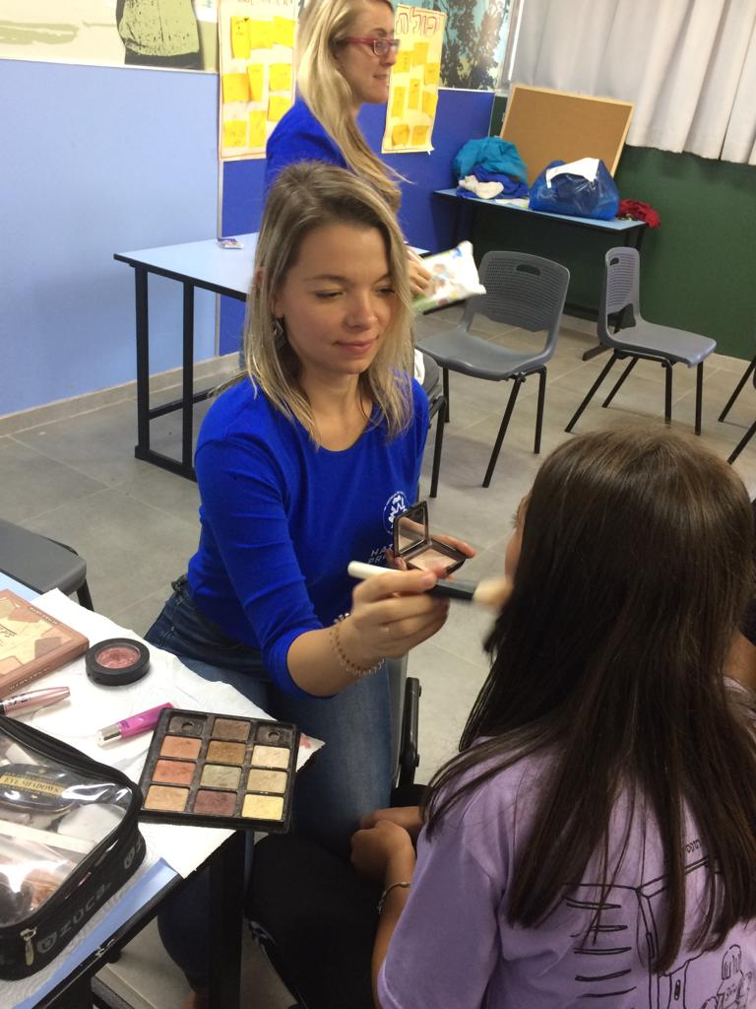

Slide 13
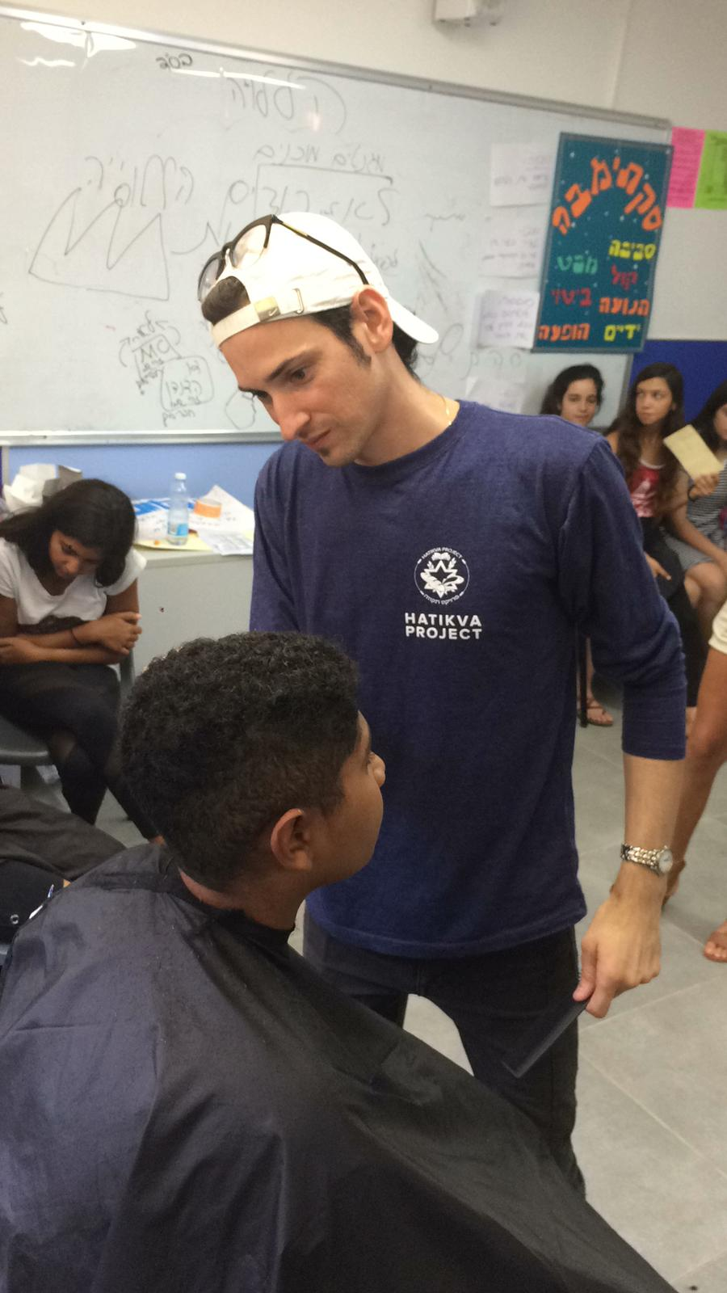
Notes:
HaTikva haircuts
Continuing series in Mtt 24

Slide 14
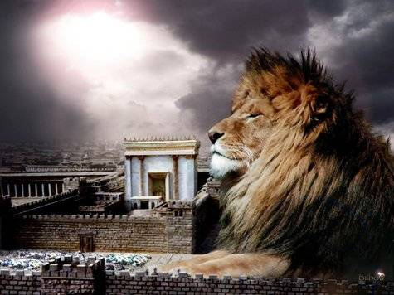
מַתִּתְיָהוּ Mattityahu
(Matthew) 24:29-30
Notes:
Finale of age: like lightning: review ch 24

Slide 15
Don’t be deceived! Many in My Name. vss. 4-5
Wars, famines, earthquakes…beginning of birth-pains. vss. 6-8
Imprisoned, hated, executed, betrayed vss. 9-10
False prophets vs. 11
Notes:
#2.I have it on great authority, that birth pains usually start slowly, but never pleasant, and increase.
First three external to community for the most part. #4 internal.

Slide 16
Love Grow Cold vs. 12-13
Worst of Times vss. 14-24
False Messiahs vss. 23-26
Like Lightning, great slaughter [vultures gather]. vss. 27-28
Today: Astronomical Chaos

Slide 17
Mattityahu (Matthew) 24:29
‏ ”מִיָּד אַחֲרֵי צָרַת הַיָּמִים הָהֵם תֶּחְשַׁךְ הַשֶּׁמֶשׁ וְהַיָּרֵחַ לֹא יַגִּיהַּ אוֹרוֹ,
“But immediately following the trouble of those times, the sun will grow dark, the moon will stop shining, [Note: darkness]
Notes:
Immediately following:
Beginning of sorrows. Birth pains 24.8?
Or max trouble 24.21 = 7 year tribulation, “²¹ For there will be trouble then worse than there has ever been from the beginning of the world until now, and there will be nothing like it again”?
In any case, unprecedented cataclysm. Wording about celestial chaos from Tanakh
5 places of unprecedented astrophysical darkness.

Slide 18
Five Tanakh [Old Test.] scenes, unprecedented celestial darkness
Invading Babylonian army to Israel, 2. Egypt
3.Invading Assyrian army [Yoel]
4.Outpouring of Ruakh
5.Final battle.

Slide 19
^{Yeshayahu/Is 13.1, 10} This is a prophecy about Bavel, which Yesha‘yahu the son of Amotz saw…For the stars, the constellations in the sky, will no longer give their light; the sun will be dark when it rises; and the moon will no longer shine. [Note: darkness]
Notes:
Invading Babylonian army to Israel, Egypt.
Seems metaphorical. War

Slide 20
^{Yekhezkael/Ezek 32.1-2, 7} On the first day of the twelfth month of the twelfth year, the word of Adoni came to me saying: “Son of man,בֶּן-אָדָם ben-Adam lift up a lament for Pharaoh king of Egypt and say to him...
Notes:
2. Invading Babylonian army to Egypt
Seems metaphorical. War

Slide 21
^{Yekhezkael/Ezek 32.1-2, 7} When I extinguish you, I will cover the sky and darken the stars. I will cover the sun with cloud, and the moon will not give her light.
Notes:
3. Invading Assyrian army [Yoel] Seems metaphorical. War

Slide 22
^{Yoel 2.10, 31} At their advance the earth quakes, and the sky shakes, the sun and moon turn black, and the stars stop shining.
^{Yoel 2.28-31} “After this, I will pour out my Spirit on all humanity. Your sons and daughters will prophesy, your old men will
Notes:
3. Invading Assyrian army [Yoel]

Slide 23
^{Yoel 2.28-31} dream dreams, your young men will see visions; and also on male and female slaves in those days I will pour out my Spirit. I will show wonders in the sky and on earth -
Notes:
Outpouring of Ruakh
Maybe NOT metaphorical.

Slide 24
^{Yoel 2.28-31} blood, fire and columns of smoke. The sun will be turned into darkness and the moon into blood before the coming of the great and terrible Day of Adoni.” At that time, whoever calls on the name of Adoni will be saved.

Slide 25
^{Yoel 4.14-17} Such enormous crowds in the Valley of Decision! For the Day of Adoni is upon us in the Valley of Decision! The sun and moon have grown black, and the stars have stopped shining.
Five prophesies of astronomical darkness!
Notes:
5. Final battle. Bigger than history.
NOT metaphorical.

Slide 26
Mattityahu (Matthew) 24:29
‏ ” הַכּוֹכָבִים יִפְּלוּ מִן הַשָּׁמַיִם וְכֹחוֹת הַשָּׁמַיִם יִזְדַּעְזְעוּ.
the stars will fall from the sky,
and the powers in heaven will be shaken.
Got worse, not just darkened!

Slide 27
^{Yoel 4.14-17} Adoni will roar from Tziyon, he will thunder from Yerushalayim, the sky and the earth will shake. But Adoni will be a refuge for his people, a stronghold for the people of Isra’el. “You will know that I am Adoni your God, living on Tziyon my holy mountain.”
Notes:
5. Final battle. Bigger than history.

Slide 28
^{Yeshayahu 34.2-4} For Adoni is angry at every nation, furious with all their armies; he has completely destroyed them, handed them over to slaughter…The whole host of heaven will decompose,

Slide 29
^{Yeshayahu 34.2-4} the heavens themselves be rolled up like a scroll; all their array will wither away like a withering grape-leaf that falls from a vine or a withered fig from a fig tree.

Slide 30
^{Khaggai 2.6} For this is what Adoni-Tzva’ot says: “It won’t be long before one more time I will shake the heavens and the earth, the sea and the dry land; and I will shake all the nations, so that the treasures of all the nations will flow in; and I will fill this house with glory,” says Adoni-Tzva’ot.
Notes:
Restoration of Temple w promises!

Slide 31
^{T’hillim/Ps 102.26-28} Long ago You founded the earth, the heavens are the work of Your hands. They will perish, but You will remain. All of them will wear out like a garment. Like clothing You change them, so they change.
But You are the same, and Your years will never end.

Slide 32
^{2 Kefa 3.10, 12} However, the Day of the Lord will come “like a thief.” On that Day the heavens will disappear with a roar, the elements will melt and disintegrate, and the earth and everything in it will be burned up…

Slide 33
^{2 Kefa 3.10, 12} That Day will bring on the destruction of the heavens by fire, and the elements will melt from the heat.

Slide 34
Catastrophic astronomical chaos!
Have our trust, mainstay in things unshakable.

Slide 35
INTIMACY WITH GOD is your #1 anchor for Standing Strong in Uncertain Times!!!

Slide 36
INTIMACY WITH GOD
Your Primary Purpose in Life
The Only Thing You Cannot Lose
Will Keep You From Deception
Will Keep You Strong in Persecution
Notes:
By repentance toward G-d and faith in the atoning death and resurrection of the Messiah, we walk through all these with confidence, even JOY!!

Slide 37
These astronomical catastrophes are NOT a predictable, normal, expected event.
Much hype and false hope and panic over bogus events.

Slide 38
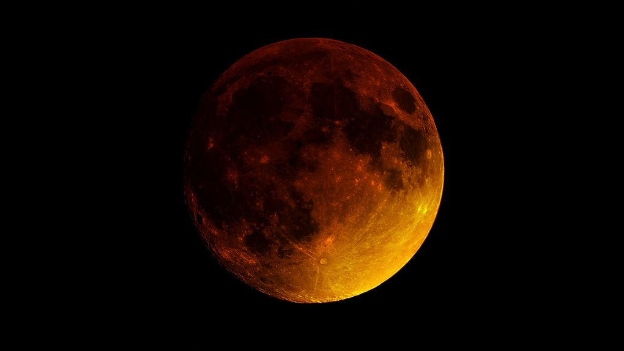
What about the Blood Moons?

Slide 39

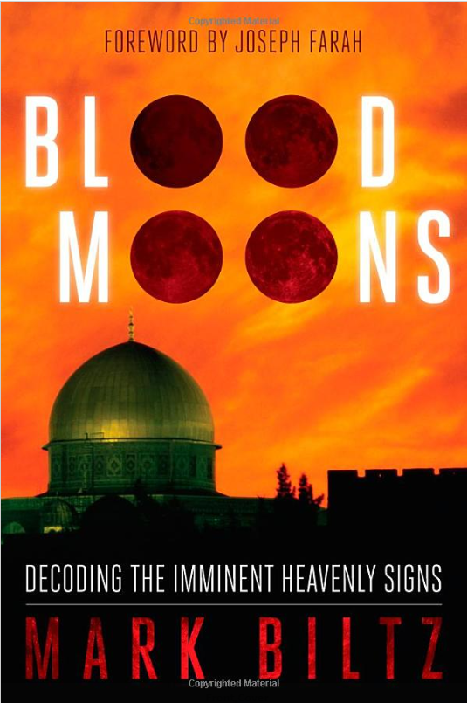
Notes:
Something is about to change!!
Imminent Heavenly signs?

Slide 40
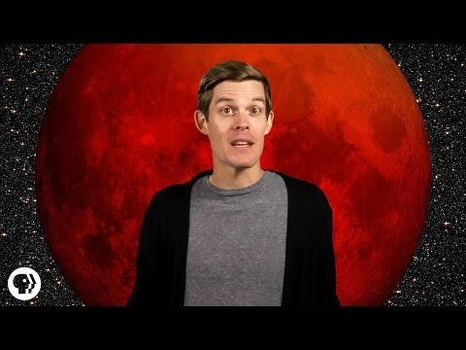
Blood moons 25 sec to 1.40
Notes:
Rosh Hodesh is the first of the lunar month. No moon.
15th of the lunar month, full moon. Sometimes line up for eclipse = blood moon.
Sukkot and Passover are the on the 15 of Tishrie and Nisan. Fall and Spring.

Slide 41
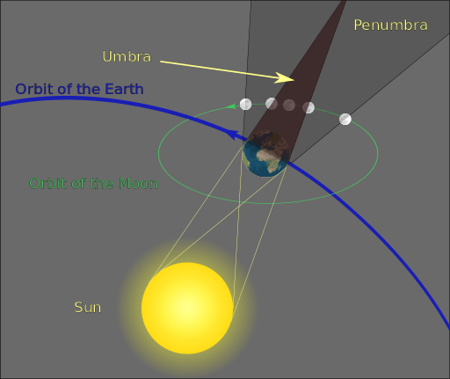
Notes:
Earth and sun move counter clockwise as viewed from the north, above the north pole. Way above.
But not exactly in same plane 5 degrees off, so sometimes line up and shadow.

Slide 42
There is NO apocalyptic prophetic significance to an ordinary, predictable event, like an eclipse, a blood moon! Bogus! DON’T be shaken by that!
While considering bogus, other “Biblical” portents:

Slide 43
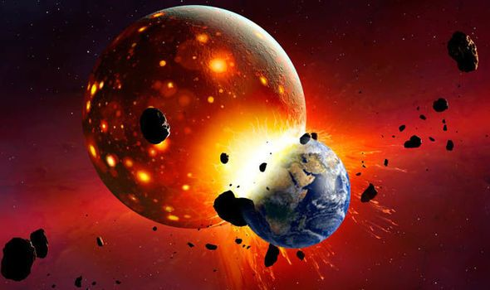
Nabiru
Notes:
https://www.google.com/search?q=nibiru&safe=active&tbm=isch&tbs=rimg:CWQkvDT4ZswgIjgQ1YmLdPhRx0Z0-w1LVbvSSFKzA09ztxfNbrP55z3ojFXqs0s5mL8oCnNDXyExwGaH6n_1sh6XBkyoSCRDViYt0-FHHEfGmvlhCFreVKhIJRnT7DUtVu9IRWVmlEmfD2x8qEglIUrMDT3O3FxGoXSrQhz-UqSoSCc1us_1nnPeiMEd-L_1pB2Il_1jKhIJVeqzSzmYvygRTas-cn1Z2HAqEgkKc0NfITHAZhH5gjJxjoRDACoSCYfqf-yHpcGTESmyzagu_12a1&tbo=u&sa=X&ved=2ahUKEwiD2_yV54PdAhURKqwKHYwxA84Q9C96BAgBEBs&biw=1165&bih=826&dpr=1.1#imgdii=XhP7KuAg-mG-eM:&imgrc=Kc5H3jFw8AKuYM:

Slide 44
The Nibiru cataclysm is a supposed disastrous encounter between the Earth and a large planetary object (either a collision or a near-miss) which certain groups believe will take place in the early 21st century. Believers in this doomsday event usually refer to this object as Nibiru or Planet X. The idea was first put forward in 1995 by Nancy Lieder,
Notes:
https://en.wikipedia.org/wiki/Nibiru_cataclysm

Slide 45
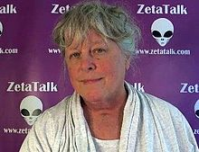
Nancy
Lieder
June
2013
Notes:
https://en.wikipedia.org/wiki/Nibiru_cataclysm

Slide 46
Nancy Lieder is a Wisconsin woman who claims that as a girl she was contacted by gray extraterrestrials called Zetas, who implanted a communications device in her brain. In 1995, she founded the website ZetaTalk to disseminate her ideas.
Notes:
https://en.wikipedia.org/wiki/Nibiru_cataclysm

Slide 47
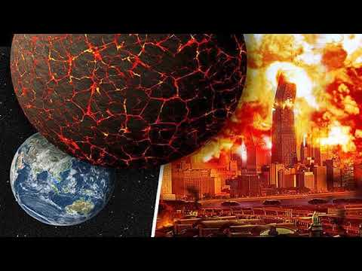
Notes:
https://en.wikipedia.org/wiki/Nibiru_cataclysm

Slide 48
The idea that a planet-sized object will collide with or closely pass by Earth in the near future is not supported by any scientific evidence and has been rejected by astronomers and planetary scientists as pseudoscience
Notes:
https://en.wikipedia.org/wiki/Nibiru_cataclysm

Slide 49
and an Internet hoax. Such an object would have destabilised the orbits of the planets to the extent that their effects would be easily observable today.
Notes:
https://en.wikipedia.org/wiki/Nibiru_cataclysm

Slide 50
In 2017, a conspiracy theorist and self-proclaimed "Christian numerologist" named David Meade revived the Nibiru cataclysm by tying it to various passages from the Bible. Meade declared that these passages contained secret numerological codes
Notes:
https://en.wikipedia.org/wiki/Nibiru_cataclysm#2017_revival

Slide 51
which revealed the exact date on which Nibiru would arrive. He also based his predictions on the geometry of the Giza Pyramids. Meade initially predicted that Nibiru would arrive in October 2017, but he later revised the date back to 23 September.
Notes:
https://en.wikipedia.org/wiki/Nibiru_cataclysm#2017_revival

Slide 52
NASA's position is, and always has been, that Nibiru does not exist.
Two more:
Flat earth
Dec. 2012 phenomena, Mayan calendar
Notes:
I’m spending time on this because I do believe in scriptural astronomical cataclysm, but NOT the type that hyped.
https://en.wikipedia.org/wiki/Nibiru_cataclysm#2017_revival
We have had dear people here who believed these

Slide 53
Flat earth theory:
In 1956, Samuel Shenton set up the International Flat Earth Research Society (IFERS), better known as the Flat Earth Society from Dover, UK, as a direct descendant of the Universal Zetetic Society.
Notes:
https://en.wikipedia.org/wiki/Flat_Earth#Flat_Earth_Society

Slide 54
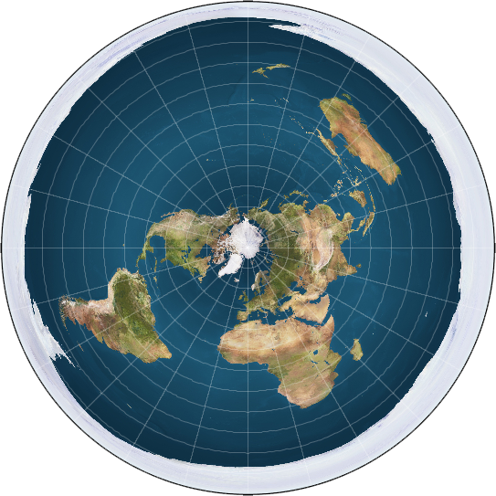
Notes:
https://en.wikipedia.org/wiki/Flat_Earth#Flat_Earth_Society
Azimuthal equidistant projections of the sphere like this one have also been co-opted as images of the flat Earth model depicting Antarctica as an ice wall surrounding a disk-shaped Earth.
One of many refutations is that you can fly a plane south from Africa, and come out in the mid-Pacific.

Slide 55
Mayan calendar, galactic center planetary alignment?

Slide 56
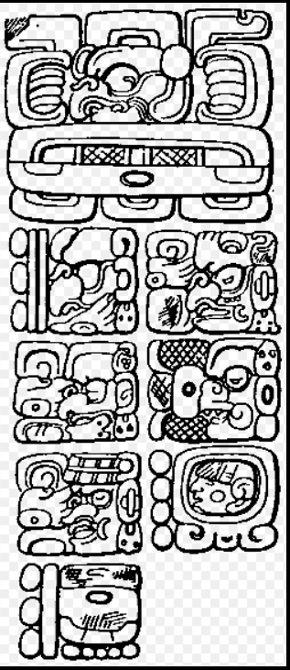
A date inscription in the Maya Long Count on the east side of Stela C from Quirigua showing the date for the last Creation. It is read as 13.0.0.0.0 4 Ajaw 8 Cumku and is usually correlated as 11 or 13 August, 3114 BC on the Proleptic Gregorian calendar. The date of 13.0.0.0.0 4 Ajaw 3 K'ank'in is usually correlated as 21 or 23 December 2012.
A lot of hype!!
Notes:
By Maudslay - Cyrus Thomas (1904) Mayan calendar Systems II, Public Domain, https://commons.wikimedia.org/w/index.php?curid=18354650

Slide 57
The 2012 phenomenon was a range of eschatological beliefs that cataclysmic or otherwise transformative events would occur on or around 21 December 2012. This date was regarded as the end-date of a 5,126-year-long cycle in the Mesoamerican Long Count calendar,
Notes:
https://en.wikipedia.org/wiki/2012_phenomenon#Galactic_alignment

Slide 58
and as such, festivities to commemorate the date took place on 21 December 2012 in the countries that were part of the Maya civilization (Mexico, Guatemala, Honduras, and El Salvador), with main events at Chichén Itzá in Mexico, and Tikal in Guatemala.
Notes:
https://en.wikipedia.org/wiki/2012_phenomenon#Galactic_alignment

Slide 59
Scenarios suggested for the end of the world included
the arrival of the next solar maximum, [sun spots, flares]
Notes:
https://en.wikipedia.org/wiki/2012_phenomenon#Galactic_alignment
https://en.wikipedia.org/wiki/2012_phenomenon

Slide 60
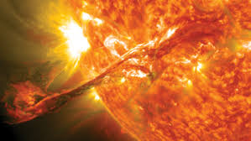

Slide 61
Scenarios suggested for the end of the world included
an interaction between Earth and the black hole at the center of the galaxy, or
Earth's collision with a mythical planet called Nibiru. Dec. 21,2012
Notes:
https://en.wikipedia.org/wiki/2012_phenomenon#Galactic_alignment
https://en.wikipedia.org/wiki/2012_phenomenon

Slide 62
There is NO apocalyptic prophetic significance to an ordinary, predictable event, like an eclipse, blood moon, solar flares. There are a LOT of bogus astronomical “issues.”
Astronomy is a cause for worship!!
End times will not be predictable cataclysm!

Slide 63
Mattityahu (Matthew) 24:30
אָז יֵרָאֶה אוֹת בֶּן־הָאָדָם בַּשָּׁמַיִם וְאָז יִסְפְּדוּ כָּל מִשְׁפְּחוֹת הָאָרֶץ
“Then the sign of the Son of Man will appear in the sky, all the tribes of the Land will mourn,
Notes:
What sign? He is his own sign. For the Lord Himself shall come down from heaven with a commanding shout, with the voice of the archangel and with the blast of God’s shofar.

Slide 64
Mattityahu (Matthew) 24:30
אוְיִרְאוּ אֶת בֶּן־הָאָדָם בָּא "עִם עַנְנֵי הַשָּׁמַיִם בִּגְבוּרָה וּבְכָבוֹד רַב.
and they will see the Son of Man coming on the clouds of heaven with tremendous power and glory.”

Slide 65
^{Dan. 7.13-14} I kept watching the night visions, when I saw, coming with the clouds of heaven, someone like a son of man. He approached the Ancient One and was led into his presence. To him was given rulership, glory and a kingdom,

Slide 66
^{Dan. 7.13-14} so that all peoples, nations and languages should serve him. His rulership is an eternal rulership that will not pass away; and his kingdom is one that will never be destroyed.
Notes:
Halleluyah! So repent, have faith, rejoice!!

Slide 67
^{Zekh. 12. 10-12} I will pour out on the house of David and on those living in Yerushalayim a spirit of grace and prayer; and they will look to me, whom they pierced.” They will mourn for him as one mourns for an only son; they will be in bitterness on his behalf like the bitterness for a firstborn son.

Slide 68
^{Zekh. 12. 10-12} When that day comes, there will be great mourning in Yerushalayim, mourning like that for Hadad-Rimmon in the Megiddo Valley. Then the land will mourn, each family by itself — the family of the house of David by itself, and their wives by themselves.

Slide 69
^{1 Kefa/Peter 3.11,14} Since everything is going to be destroyed like this, what kind of people should you be? You should lead holy and godly lives…do everything you can to be found by him without spot or defect and at peace.

Slide 70
^{T’hillim/Ps 8.2- 5}Adoni our Lord, how excellent is Your Name over all the earth! You set Your splendor above the heavens…When I consider Your heavens, the work of Your fingers, the moon and the stars, which You established — what is man, that You are mindful of him? And the son of man, that You care for him?
Notes:
Call to be astronomers

Slide 71
Before we go into celebration for the glory of G-d in the heavens, AND the heavens imminent shaking, destruction, renewal
Some earthly shakings for our hour of prayer.:

Slide 72

Sderot travesty

Slide 73
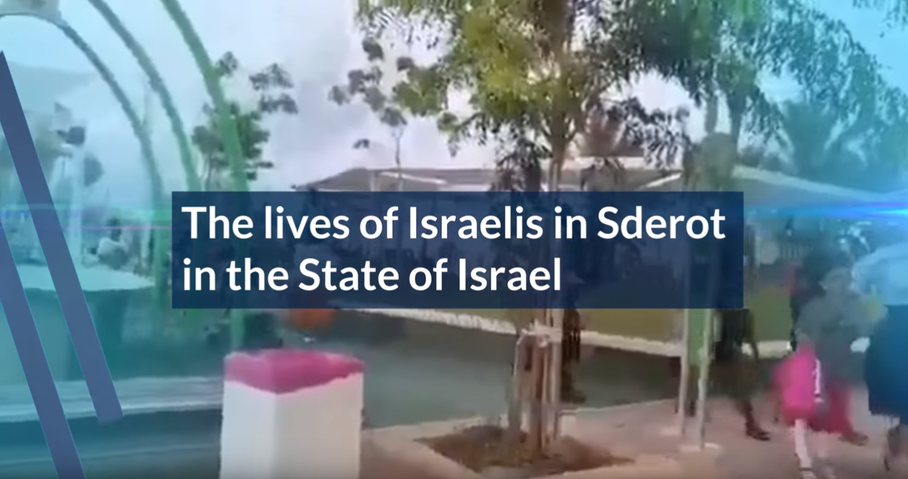
https://www.youtube.com/watch?v=gZxqSHBkdnY&feature=youtu.be

Slide 74
Avraham Levi and his 13-year old son were secured inside the bomb shelter during the recent barrage of rockets. As the silence from the Red Alert finally filled the air, Avraham stepped outside to see the damage from the impacts.
Notes:
https://gallery.mailchimp.com/ece84b5dd3e666fe8cf64a06e/files/7ee7f05f-152a-4731-a88e-f2615bfe5963/AUG22PAINFUL_REALITIES_OF_WAR.pdf
Yishai Rinehardt

Slide 75
Upon stepping outside rockets continued to fill the sky as the mortars are not always detected. His body was thrown against a cement column, shattering his teeth. Shrapnel entered his head and arm. His 13-year old son witnessed the trauma of his father and helped him to tighten a bandage on his arm to stop the bleeding. Avraham is still hospitalized.
Notes:
https://gallery.mailchimp.com/ece84b5dd3e666fe8cf64a06e/files/7ee7f05f-152a-4731-a88e-f2615bfe5963/AUG22PAINFUL_REALITIES_OF_WAR.pdf
Yishai Rinehardt

Slide 76
Israel’s neighbor to the northeast: Syria in tragedy…

Slide 77
Exhortation to us

Slide 78
Before we segue into intercession and worship, consider from the parasha:

Slide 79
^{Dvarim/Dt. 21:10} When you go out to war against your enemies, and God your God will deliver them into your hands.
כִּי תֵצֵא לַמִּלְחָמָה עַל אֹיְבֶיךָ וּנְתָנוֹ ה' אֱלֹהֶיךָ בְּיָדֶךָ.
In this verse it is written "when you (sg.) go out" in the singular.
Notes:
https://www.ulpanor.com/category/newletter/

Slide 80
It says תֵצֵא te'tzeh (sg.)
and not תֵּצְאוּ te'tzoo (pl.)
It is possible to beat the enemies only when we are united becoming “one person.”
Notes:
https://www.ulpanor.com/category/newletter/

Slide 81
Rebbi Menachem Mendel of Kotzk would say
Same Dvarim/Dt verse above:
"When you go out to war against your enemies" in order to teach us that we need to go out to war and to strike the enemy on his own land.
Notes:
https://www.ulpanor.com/category/newletter/
Go out is singular
Ie, not fighting with each other. Fight outside the camp
Elul
Similarly…

Slide 82
^{Shmot/Ex 19.2} And there Israel encamped before the mount.
וַיִּחַן-שָׁם יִשְׂרָאֵל, נֶגֶד הָהָר
The verb encamped appears
וַיִּחַן Va'yikhan singular and not
וְיַחְנוּ Va'Yakhanu plural
Notes:
https://www.ulpanor.com/category/newletter/
Implication: The people of Israel were united when they came to mount Sinai and therefore were unhindered to receive the Torah.

Slide 83
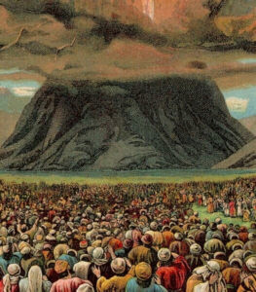
Notes:
https://www.ulpanor.com/category/newletter/
Implication: The people of Israel were united when they came to mount Sinai and therefore were unhindered to receive the Torah.
Are we one in heart, serving each other: spouses, children, friends? “Don’t like?”

Slide 84
[Hebrew chant] Intro. to O L-rd, our L-rd
אֲדוֹנַי, אֲדוֹנַי, אֲדוֹנֵינוּ
Adoni, Adoni, A-do-nay-noo.
מָה אָדִיר שִׁמְךָ בְּכָל הַאָרֶץ!
Ma a-deer sheem-kha b'khawl
ha-a-retz
[L-rd, L-rd, our L-rd
How excellent is Your Name in all the earth]

Slide 85
אֲדוֹנַי, אֲדוֹנַי, אֲדוֹנֵינוּ
Adoni, Adoni, A-do-nay-noo.
אֲשֶׁר תְנָה הוֹדְךָ עַל הַשָׁמַיִם
Asher t'na hod-kha al
ha-sha-ma-yeem.
[L-rd, L-rd, our L-rd
Who has set Your Glory
above the heavens]

Slide 86
O L-rd, Our L-rd words and music by Marty and Jennifer Goetz, ©1992 Singin’ in the Reign Music/ASCAP, Used with permission, CCLI license #2412213
When I consider your heavens,
the work of Your fingers,
The moon and the stars
which You ordain,
What is man
that You are mindful of him;
And the son of man
that you visit him?

Slide 87
O L-rd, our L-rd,
How excellent is Your name in all of the earth.
O L-rd,
how excellent is Your name.
[repeat]

Slide 88
And the avenger, You still with the praises of singers;
The infants and babes, who You ordain.
What is man that you are mindful of him?
And the son of man, that you visit him?

Slide 89
O L-rd, our L-rd,
How excellent is Your name in all of the earth.
O L-rd,
How excellent is Your name.
[repeat]

Slide 90
Your name, given so freely
for us to claim.
The name Yeshua.
You came
a little lower than the angels,
to humble yourself
Only to be exalted, exalted.

Slide 91
O L-rd, our L-rd,
How excellent is Your name in all of the earth.
O L-rd,
how excellent is Your name.
[repeat]

