Slide 1
e-handout
To have these notes
without taking notes
Go to OrHaOlam.com
Click on downloads,
messages, 2018
Notes:
How does a mermaid clean her tail? With Tide.

Slide 2
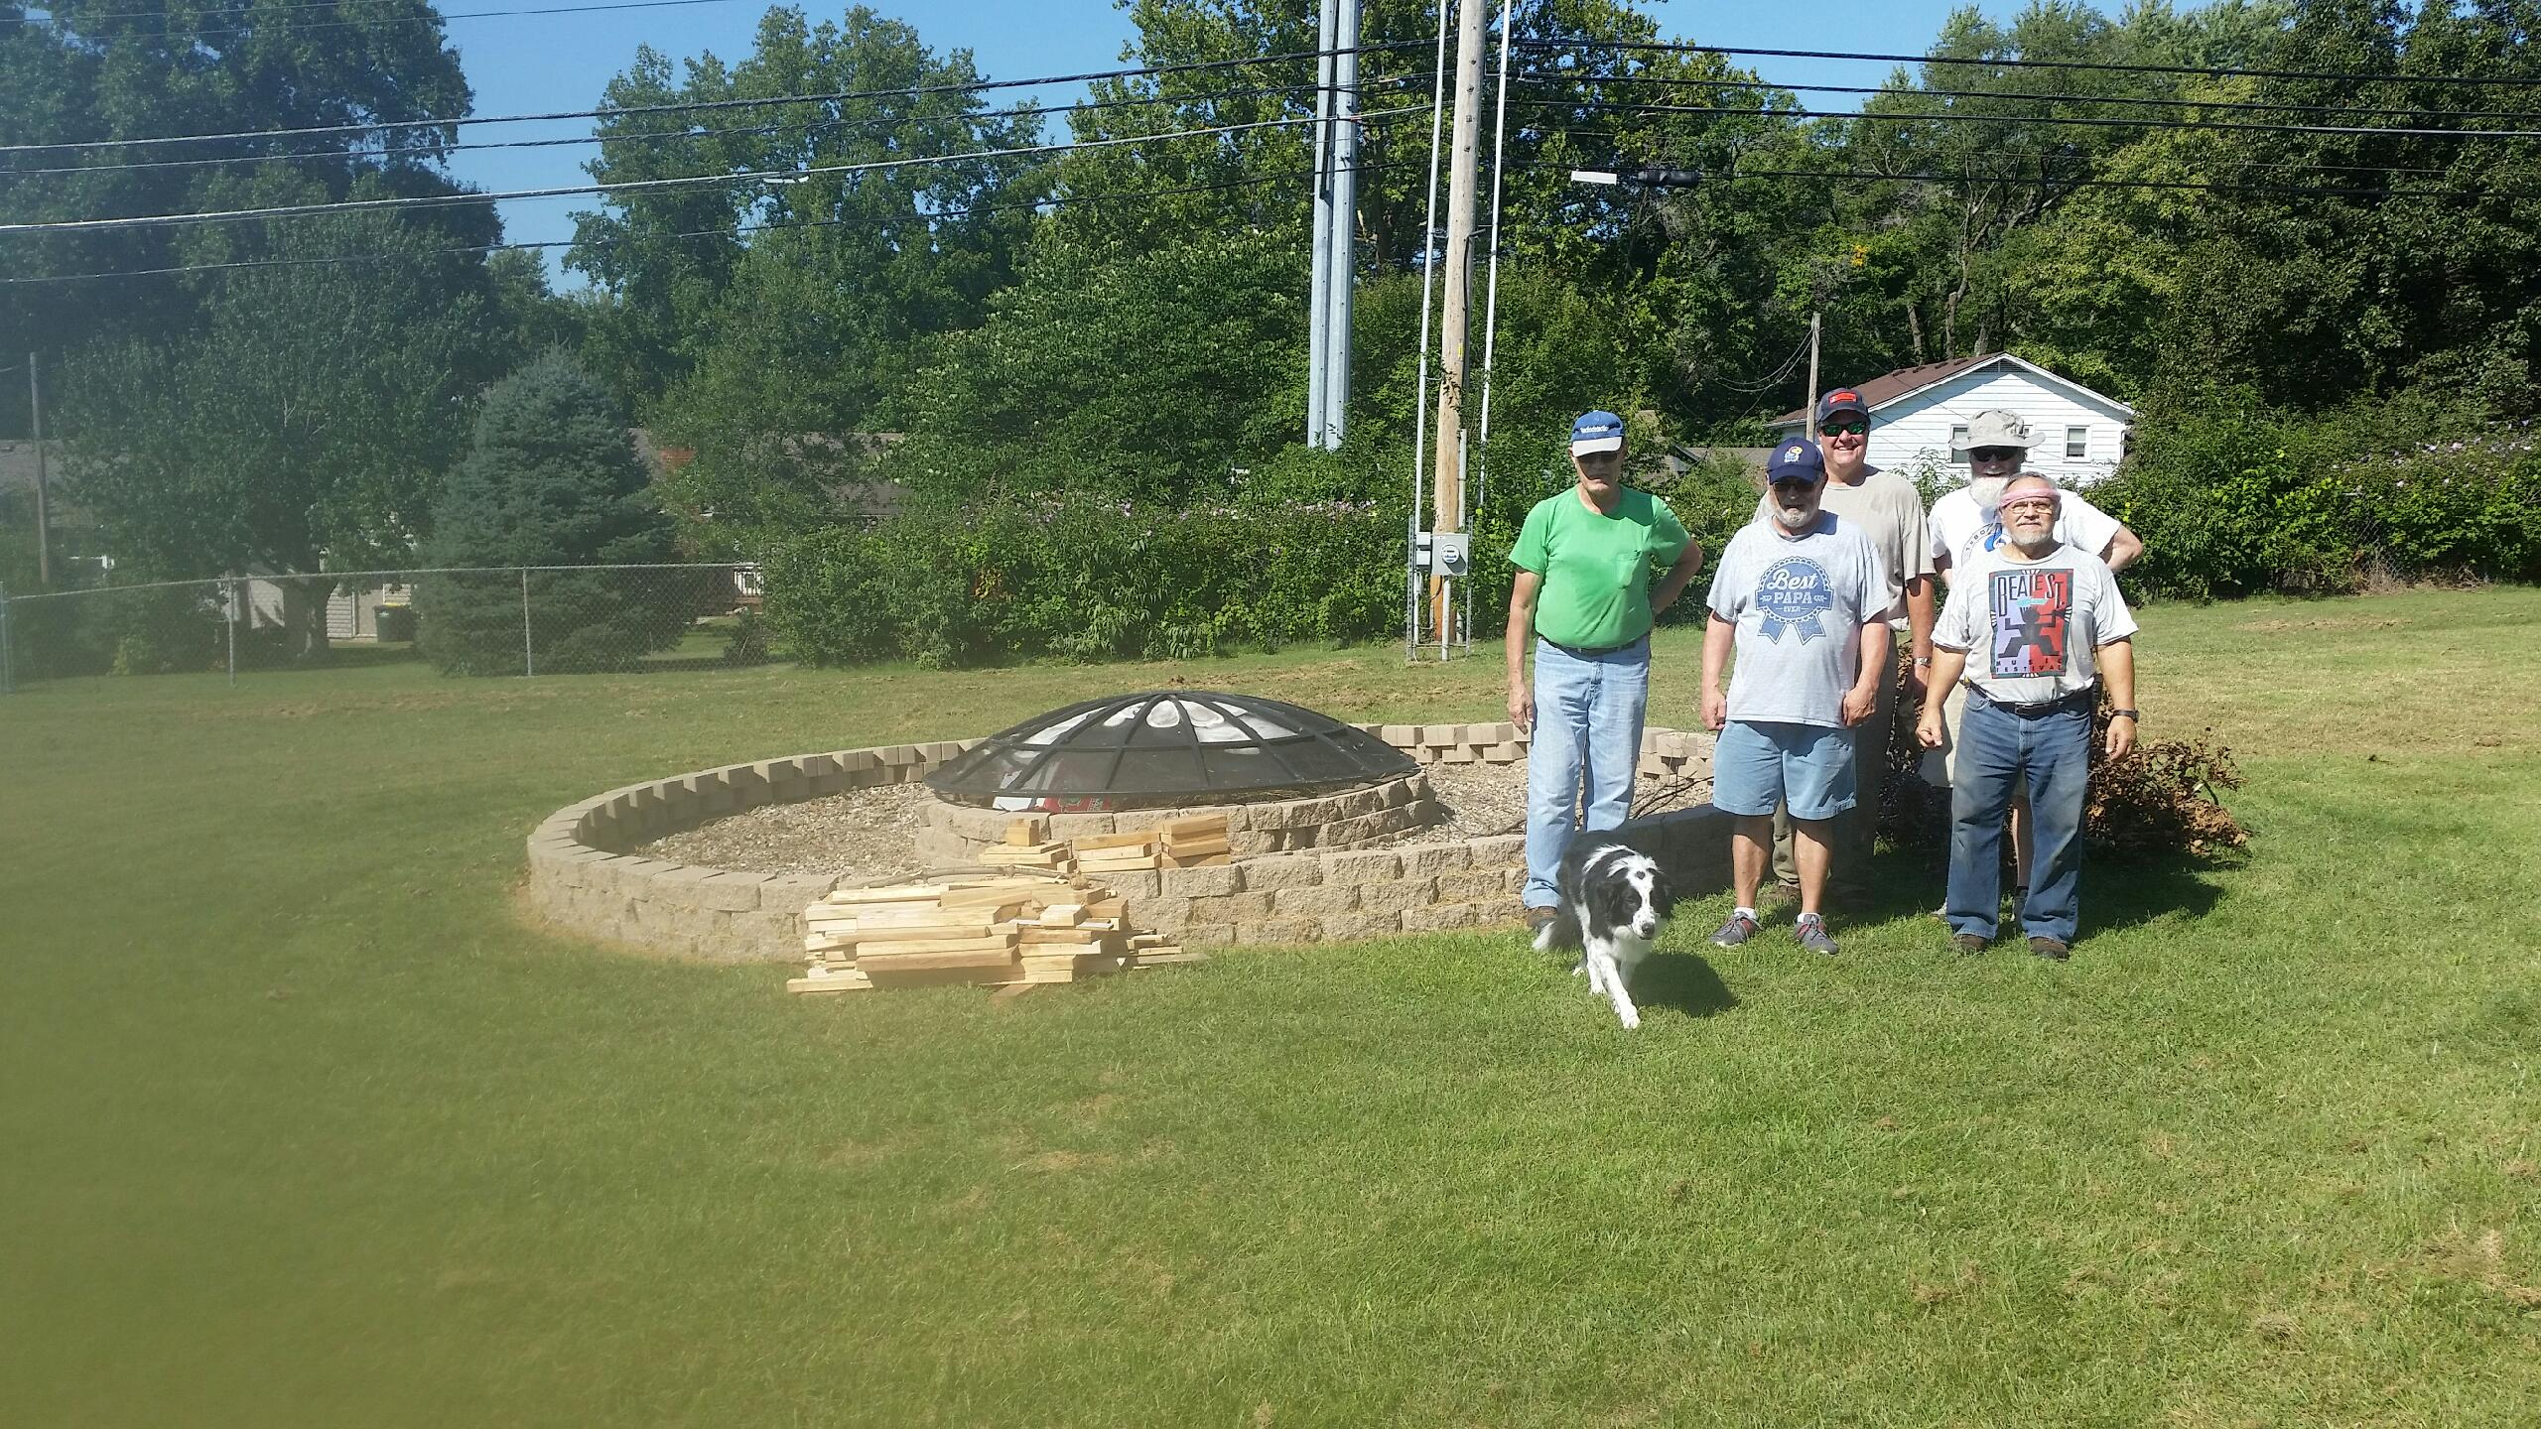
Firepit cleanup crew
Notes:
Emergency preparedness…

Slide 3
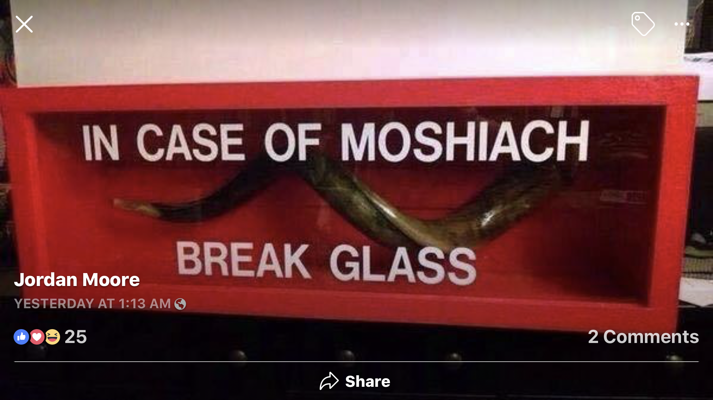

Slide 4
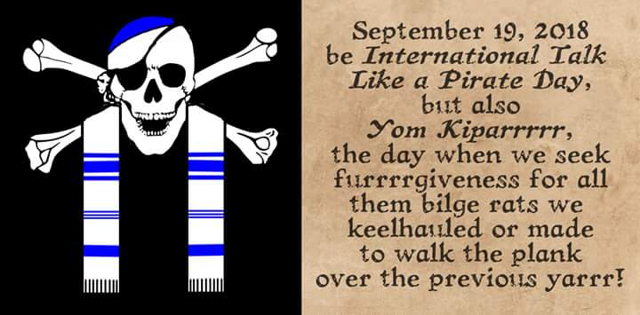

Slide 6
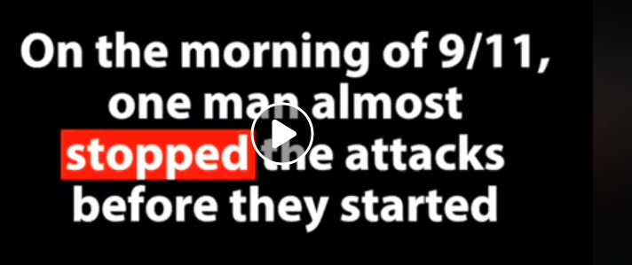
https://www.facebook.com/theisraelproject/videos/10157556808522316/

Slide 7
We recited the Kol Nidre prayer earlier … renunciation of evil bondages.
Kol Nidre grew out of the concept of preparation for Yom Kippur, pinnacle of preparation for worship.
Torah precedent…

Slide 8
^{Shmot/Ex 40.32-34} He [Moshe] set up the courtyard around the Tabernacle and the altar and set up the screen at the gate of the courtyard. So Moses finished the work. Then the cloud covered the Tent of Meeting, and the glory of Adonai filled the Tabernacle.

Slide 9
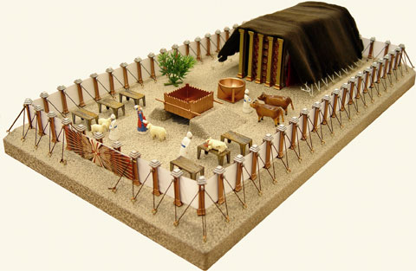
Notes:
https://www.google.com/search?q=mishkan&safe=active&source=lnms&tbm=isch&sa=X&ved=0ahUKEwirsMm-nsXdAhXWqYMKHX96B3UQ_AUIDigB&biw=1165&bih=826#imgrc=JtkQUlH_cJMW5M:

Slide 10
^{Shmot/Ex 40.32-34} Moshe was unable to enter into the Tent of Meeting, because the cloud resided there and the glory of Adonai filled the Tabernacle.
^{T’hillim/Ps 90.16} Show your deeds to your servants and your glory to their children.
Notes:
Isn’t that what we long for?

Slide 11
So it was filled with G-d’s presence, but still not usable. The place was ready, the people were not. Eight chapters later,
instruction in the 5 types of offerings. [knowledge prep]
Personal prep for the priests.
Notes:
Whole, guilt, peace, meal, sin

Slide 12
Vayikra/Lev 8 [summary of prep]
Aharon and sons bathed
Attired in tunic, sash, robe, vest, belt, breastplate, urim, tumim, turban with gold plate.

Slide 13
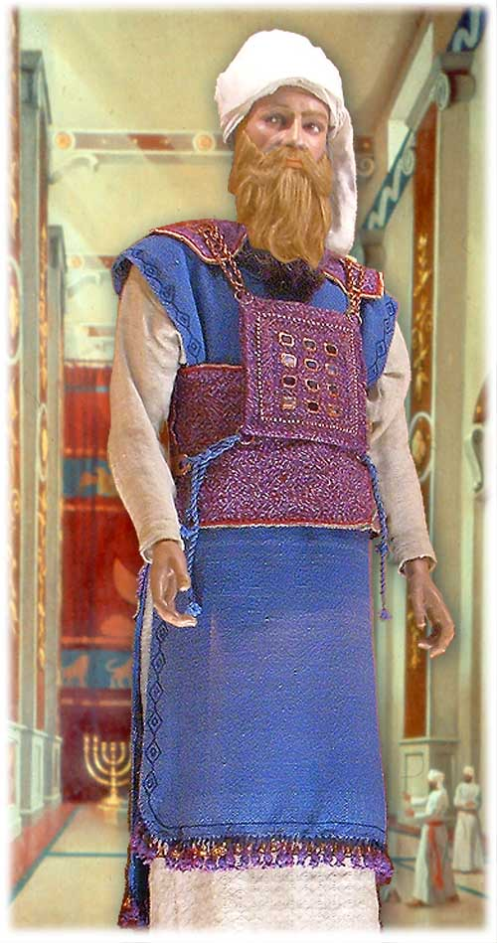
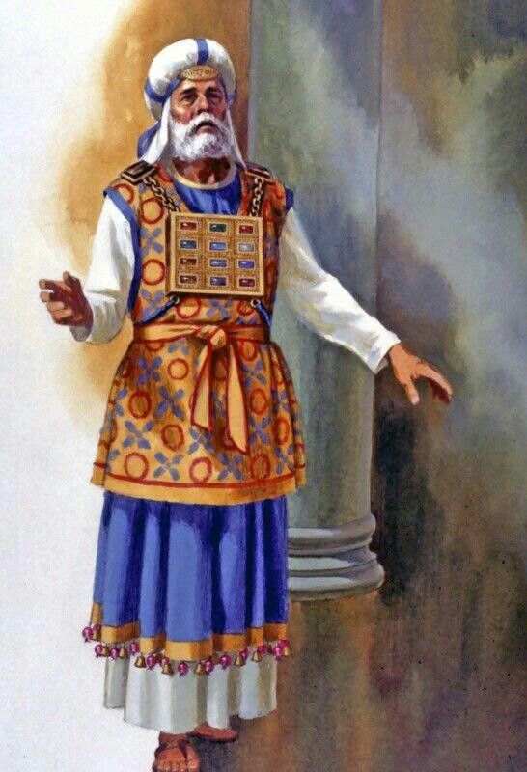
Notes:
https://www.google.com/search?q=site:www.templeinstitute.org+garments+of+Aaron&safe=active&tbm=isch&source=iu&ictx=1&fir=o2zb7jiAHo5fjM%253A%252CQmFjhuAJsBNw_M%252C_&usg=AFrqEze6xHDK3NbjO5HwNVuDoLAe3Kb2nw&sa=X&ved=2ahUKEwj1ps3klsXdAhUFbawKHQKyA-4Q9QEwAHoECAYQBA#imgdii=PqZjFAL95FG6HM:&imgrc=qxkzpqii5XjUZM:

Slide 14
Moshe anointed Aharon and sons with oil.
Bull for sin offering.
Ram for burnt offering.
Ram for ordination with laying on of hands. Blood on right ear, thumb, foot.

Slide 15
Matzah, oiled bread, wafer waved and burned.
Oil and blood sprinkled on Aharon.
Boiled meat eaten.
Then…

Slide 16
^{Viyikra/Lev 8.33-36} You are not to go out from the entrance of the Tent of Meeting for seven days, until the days of your ordination are fulfilled, for he will be filling your hands* for seven days. What has been done this day, Adoni has commanded to be done, in order to make atonement for you.
Notes:
.

Slide 17
^{Viyikra/Lev 8.33-36} You are to stay at the entrance of the Tent of Meeting day and night for seven days, and keep Adoni’s command, so that you do not die, for so I have been commanded.” Thus Aaron and his sons did all the things that Adoni commanded through Moses.
Notes:
John Gill: it was always necessary there should be some upon the spot, keeping the Lord's charge in their turns; and it was always requisite that they should also sleep alternately;

Slide 18
What were they doing for seven days and nights?
Does that relate to erev Yom Kippur, prep for Yom Kippur?

Slide 19
All night serice not unique to Yom Kippur:
^{Viyikra/Lev 6.2-6} “Give this order to Aharon and his sons: ‘This is the law for the burnt offering on its firewood upon the altar all night long, until morning; in this way the fire of the altar will be kept burning.

Slide 20
All night:
^{Viyikra/Lev 6.2-6} When the fire has consumed the burnt offering on the altar, the cohen, having put on his linen garment and covered himself with his linen

Slide 21
shorts, is to remove the ashes and put them beside the altar. Then he is to remove those garments and put on others, before carrying the ashes outside the camp to a clean place. In this way, the fire on the altar will be kept burning and not be allowed to go out. Each morning, the cohen is to kindle wood on it, arrange the burnt

Slide 22
offering and make the fat of the peace offerings go up in smoke. Fire is to be kept burning on the altar continually; it is not to go out.
^{Y’hoshua/Josh 10:9} Having spent the entire night marching up from Gilgal, Y’hoshua fell upon them, taking them by surprise.
Notes:
2 Tired, difficult, night vision goggles?

Slide 23
^{1Sa 15:11} “I regret setting up Sha’ul as king, because he has turned back from following me and hasn’t obeyed my orders.” This made Sh’mu’el very sad, so that he cried to Adoni all night.

Slide 24
^{2 Sa 12:16} David prayed to God on behalf of the child; David fasted, then came and lay all night on the ground.

Slide 25
^{Yoel 1:13} Cohaneem, put on sackcloth, and weep! Wail, you who serve at the altar! Come, lie in sackcloth all night long, you who serve my God! For the grain offering and drink offering are withheld from the house of your God.

Slide 26
^{T’hillim/Ps 134} Come, bless Adoni, all you servants of Adoni, who serve each night in the house of Adoni.
Lift your hands toward the sanctuary, and bless Adoni. May Adoni, the maker of heaven and earth, bless you from Tziyon.

Slide 27
^{T’hillim/Ps 130} I wait longingly for Adoni; I put my hope in his word. Everything in me waits for Adoni more than guards on watch wait for morning, more than guards on watch wait for morning.

Slide 28
So after 7 days of personal preparation for worship, night and day…

Slide 29
^{Vayikra/Lev 9.23-24} Moshe and Aharon entered the tent of meeting, came out and blessed the people. Then the glory of Adoni appeared to all the people! Fire came forth from the presence of Adoni, consuming the burnt offering and the fat on the altar. When all the people saw it, they shouted and fell on their faces.

Slide 30
How does this all night regimen relate to Yom Kippur?

Slide 31
Cohen spent the entire week studying, reviewing the Yom Kippur service
the night before, he stayed up all night with the leading citizens of Jerusalem, studying, preparing
*Filling your hands: knowledge that is cerebellar, ~ dance, play instrument. Habits >> knowledge

Slide 32
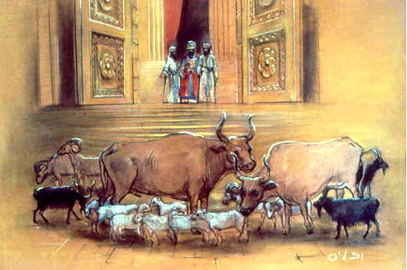
Notes:
15 sacrifices, incense, menorah

Slide 33
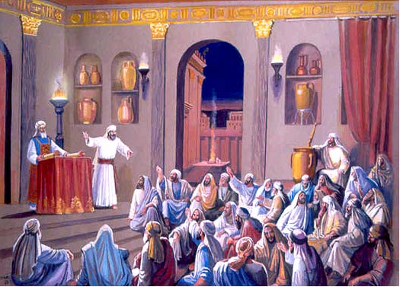
Notes:
As undergrad, I stayed up all-nightery for Chem, used to hate when birds started singing.

Slide 34
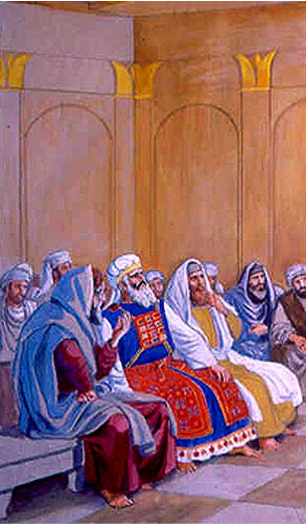
Notes:
Buddies prompted and prodded him

Slide 35
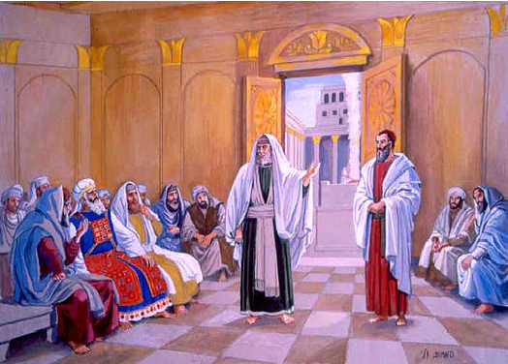

Slide 36
How does this all night regimen relate to our preparation for Yom Kippur in Messiah?

Slide 37
^{Lu 6:12} It was around that time that Yeshua went out to the hill country to pray, and all night he continued in prayer to God.

Slide 38
^{Mark 14.32-37} Going on a little farther, he fell on the ground and prayed that if possible, the hour might pass from him: “Abba!” (that is, “Dear Father!”) “All things are possible for you. Take this cup away from me! Still, not what I want, but what you want.”

Slide 39
^{Mark 14.32-37} He came and found them sleeping; and he said to Kefa, “Shim‘on, are you asleep? Couldn’t you stay awake one hour? Stay awake, and pray that you will not be put to the test!– the spirit indeed is eager,

Slide 40
^{Mark 14.32-37} but human nature is weak.” Again he went away and prayed, saying the same words; and again he came and found them sleeping, their eyes were so very heavy; and they didn’t know what to answer him. The third time,

Slide 41
^{Mark 14.32-37} he came and said to them, “For now, go on sleeping, take your rest…. There, that’s enough! The time has come! Look! The Son of Man is being betrayed into the hands of sinners!

Slide 42
^{2 Cor 6.4} Enduring troubles, hardships, calamities, in stripes, in imprisonments, in tumults, in labors, in watchings, in fastings; beatings, imprisonments, riots, overwork, lack of sleep and food.

Slide 43
^{Daniel 9.2-6} I, Dani’el, was reading the Scriptures and thinking about the number of years which Adonai had told Yirmeyah the prophet would be the period of Yerushalayim’s desolation, seventy years. I turned to Adonai, God, to seek an answer, pleading with him in prayer, with fasting, sackcloth and ashes.

Slide 44
^{Daniel 9.2-6} I prayed to Adonai my God and made this confession: “Please, Adonai, great and fearsome God, who keeps his covenant and extends grace to those who love him and observe his mitzvot! We have sinned, done wrong, acted wickedly, rebelled and turned away from your mitzvot and rulings.

Slide 45
^{Daniel 9.2-6} We have not listened to your servants the prophets, who spoke in your name to our kings, our leaders, our ancestors and to all the people of the land.
Notes:
Very easy to be perfunctory…review Shabbat Shuva..

Slide 46
For not listening to Your voice
within us;
For denying the need of our soul;
For making this world a god;

Slide 47
For not doing ourselves justice;
For giving our money and
withholding ourselves;
For shrugging our shoulders;

Slide 48
For passing blame on others;
For using them for our own ends;
For not taking responsibility;
For calculating kindness and
measuring our pity;
For charity that is cold and prayer without feeling;

Slide 49
For sins we committed against
You, through evading and
avoiding because we could not
face the truth;
For our flight into hypocrisy and deception because we did not dare to speak it;

Slide 50
For feeding our bodies and
starving our souls;
For interfering with
the souls of others
and neglecting their needs;
For the appeals we ignored and
the people whom we refused;

Slide 51
For the affection which died and our love that became bitter;
For the vision which faded, the
ideals we neglected,
and the opportunities we lost;
For the hoarding of grudges and insults, for refusing to let go;

Slide 52
For abandoning hope;
For fear of change and renewal;
For saying prayers aloud, but
refusing to listen;
For being our own worst enemy;

Slide 53
All I repent for myself and those in my generational line for the 7 sins of Mishlei/Proverbs 6.16:
Men A proud look
Women A lying tongue
Men Hands that shed innocent blood

Slide 54
4. Women A heart that manufactures wicked thoughts and plans
5. Men Feet that are swift in running to evil
6. Women A false witness
7. Men He who sows discord among his brothers

Slide 55
Women I repent for myself and all those in my family line who have entered into rebellion, defiance, apostasy and have entered into unholy covenants, divination and legalism.

Slide 56
Men I renounce and repent for all ungodly agreements with ungodly leadership, and unquestioning acceptance of unholy leaders, in word, thought, or deed for myself and past generations.

Slide 57
Women I repent and renounce for myself and for my ancestors who prayed against the will of G-d and spoke false prophecies, incantations, and mystical experiences not of the true Ruakh.

Slide 58
Men I repent and renounce for alignment with any counterfeit holy spirit.

Slide 59
All I repent of and renounce all allegiance to the ungodly world system, break all connections to the queen of heaven or secret societies in my life and my generational line, and choose to come out of the ungodly world system.

Slide 60
Lead by humility: Jewish repentance to the Nations!

Slide 61
^{Mes Jews 6.11-12} We want each one of you to keep showing the same diligence right up to the end, when your hope will be realized; so that you will not become sluggish, but will be imitators of those who by their trust and patience are receiving what has been promised.

Slide 62
^{Mes Jews/Heb 9} When Messiah appeared as Kohen Gadol of the good things that have now come, passing through the greater and more perfect Tent not made with hands (that is to say not of this creation), He entered into the Holies once for all—not by the blood of goats and calves but by His own blood, having obtained eternal redemption.

