Slide 1
If you want to have notes without taking notes,
Go to OrHaOlam.com
WITHOUT WIFI
Click on downloads, messages, 2018 messages
Today’s should be on the top.

Slide 2
Good news from Israel

Slide 3
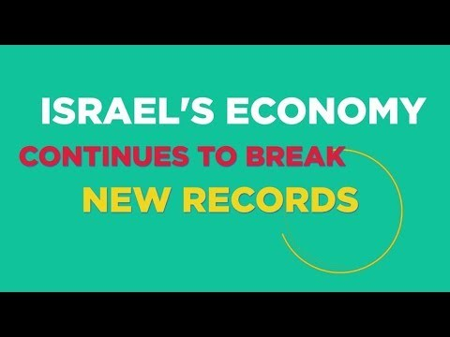

Slide 4
https://youtu.be/3n5A_eA1K8Y

Slide 6
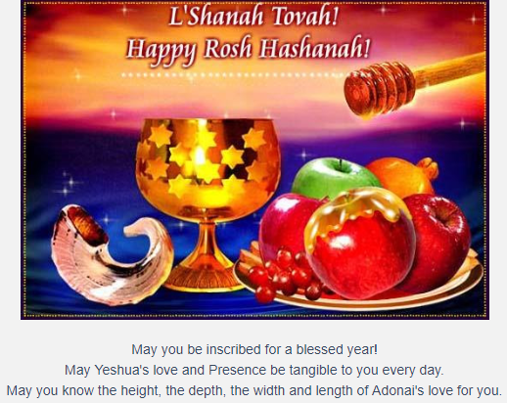
Notes:
Holiday greeting for Rosh HaShanah.
[from Zeitlers newletter]

Slide 7
Astronomical news

Slide 8
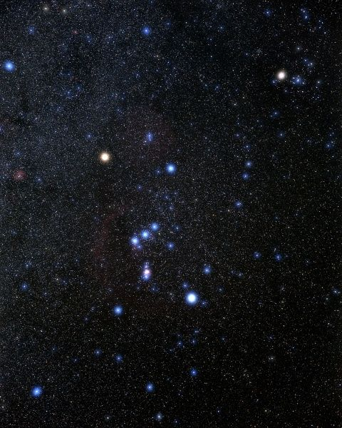
Constellation Orion
Notes:
https://www.google.com/search?q=orion+constellation&safe=active&source=lnms&tbm=isch&sa=X&ved=0ahUKEwjywZDSspDdAhVKKawKHd4EB9EQ_AUICigB&biw=1165&bih=826#imgdii=mwVKNwLdYqiwRM:&imgrc=wwfYRpHRYHTr5M:
See the belt, shoulders, knees, bow?

Slide 9
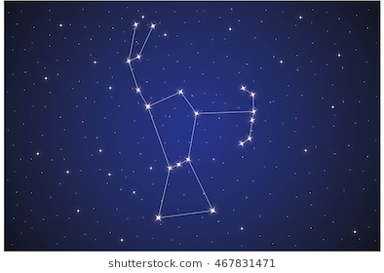
Orion with
bow
Notes:
https://www.google.com/search?q=orion+constellation&safe=active&source=lnms&tbm=isch&sa=X&ved=0ahUKEwjywZDSspDdAhVKKawKHd4EB9EQ_AUICigB&biw=1165&bih=826#imgrc=mroWAJBklBqJxM:

Slide 10
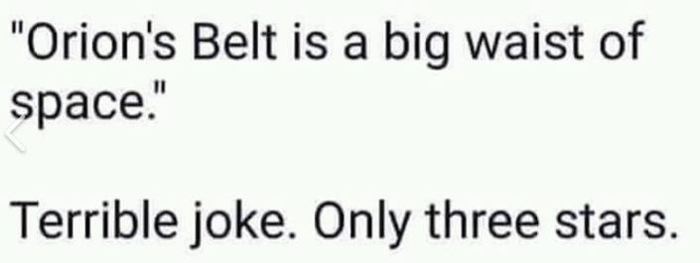
From Suzanne Alongi
Notes:
From Suzanne Alongi

Slide 11
Notes:
https://www.google.com/search?q=orion+constellation&safe=active&source=lnms&tbm=isch&sa=X&ved=0ahUKEwjywZDSspDdAhVKKawKHd4EB9EQ_AUICigB&biw=1165&bih=826#imgdii=mwVKNwLdYqiwRM:&imgrc=wwfYRpHRYHTr5M:

Slide 12
Since we have restarted oneg, I failed to mention that for the 40 day fast, were were doing
No oneg = NONEG. Jeff Arnold.
But speaking of food…

Slide 13
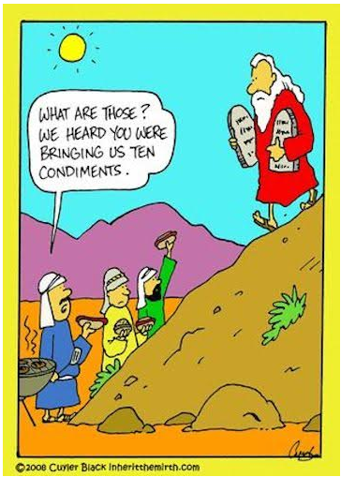
Notes:
Lastly…

Slide 14
New Men’s Room distress instruction sign,
since we have a motion sensor light switch:

Slide 15
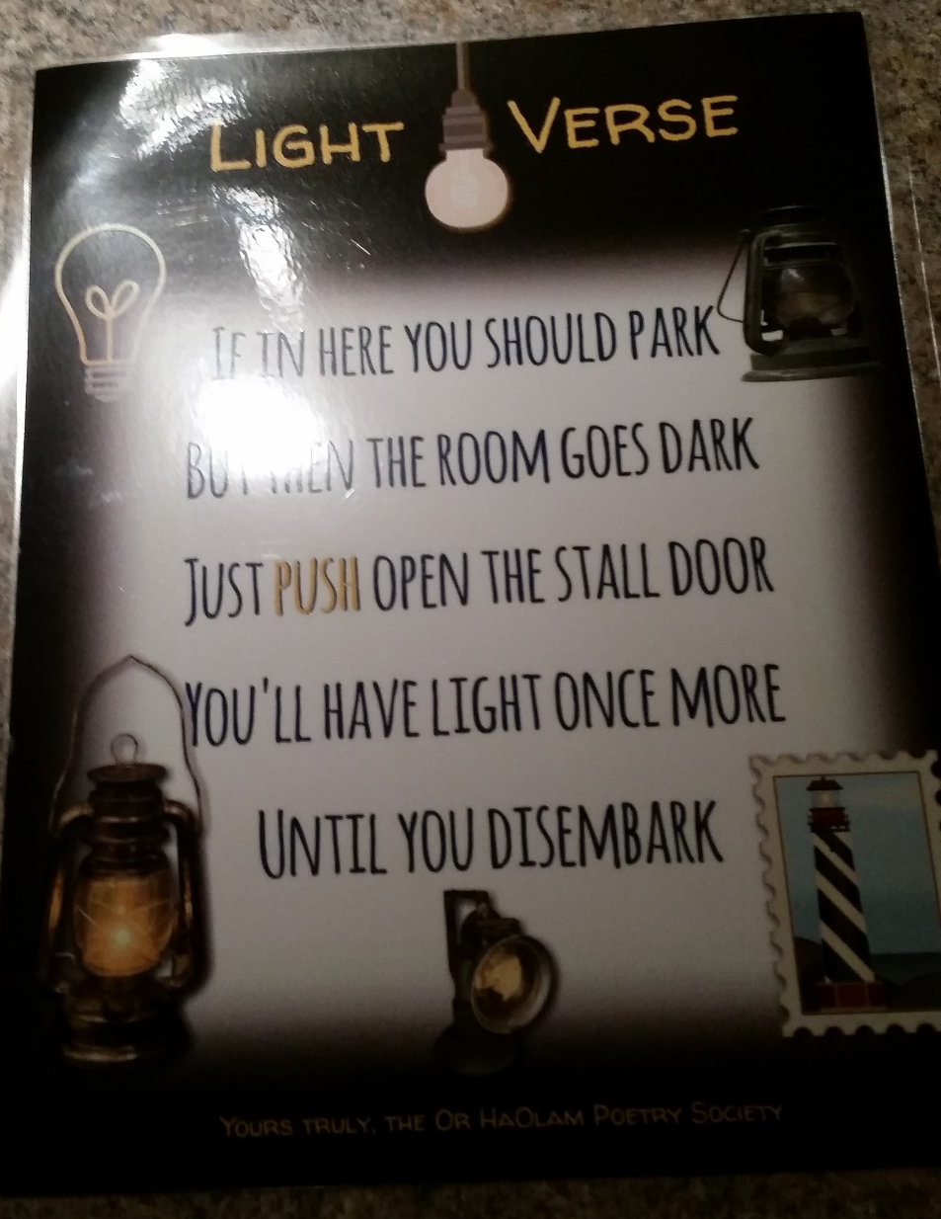
Notes:
Rebbetzin Dawn’s poetry,
Lori Wilson’s graphic design
Continuing in our series

Slide 16
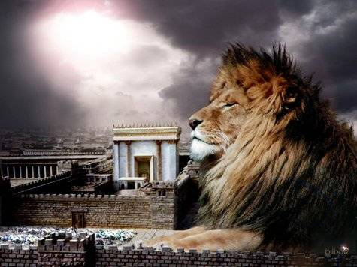
מַתִּתְיָהוּ Mattityahu
(Matthew) 24:31

Slide 17
Mattityahu (Matthew) 24:31
‏ וְהוּא יִשְׁלַח אֶת מַלְאָכָיו בְּשׁוֹפָר גָּדוֹל
He will send out his angels with a great shofar;

Slide 18
Mattityahu (Matthew) 24:31
‏ וִיקַבְּצוּ אֶת בְּחִירָיו מֵאַרְבַּע הָרוּחוֹת, מִקְצוֹת הַשָּׁמַיִם עַד קְצוֹתָם.
and they will gather together his chosen people from the four winds, from one end of heaven to the other.
Notes:
Pretty relevant scripture the day before Rosh HaShannah, day of Shofars.
Summary of dreadful chapter:

Slide 19
Don’t be deceived! Many in My Name. vss. 4-5
Wars, famines, earthquakes…beginning of birth-pains. vss. 6-8
Imprisoned, hated, executed, betrayed vss. 9-10
False prophets vs. 11
Notes:
First three external to community for the most part. #4 internal.

Slide 20
Love Grow Cold vs. 12-13
Worst of Times vss. 14-24
False Messiahs vss. 23-26
Like Lightning, great slaughter [vultures gather]. vss. 27-28
Incalculable Astronomical Chaos

Slide 21
Mattityahu (Matthew) 24:29
‏ ”מִיָּד אַחֲרֵי צָרַת הַיָּמִים הָהֵם תֶּחְשַׁךְ הַשֶּׁמֶשׁ וְהַיָּרֵחַ לֹא יַגִּיהַּ אוֹרוֹ,
“But immediately following the trouble of those times, the sun will grow dark, the moon will stop shining,

Slide 22
Mattityahu (Matthew) 24:30
אָז יֵרָאֶה אוֹת בֶּן־הָאָדָם בַּשָּׁמַיִם וְאָז יִסְפְּדוּ כָּל מִשְׁפְּחוֹת הָאָרֶץ
“Then the sign of the Son of Man will appear in the sky, all the tribes of the Land will mourn,

Slide 23
Mattityahu (Matthew) 24:30
אוְיִרְאוּ אֶת בֶּן־הָאָדָם בָּא "עִם עַנְנֵי הַשָּׁמַיִם בִּגְבוּרָה וּבְכָבוֹד רַב.
and they will see the Son of Man coming on the clouds of heaven with tremendous power and glory.”
Notes:
Here is our text for today:

Slide 24
Mattityahu (Matthew) 24:31
‏ וְהוּא יִשְׁלַח אֶת מַלְאָכָיו בְּשׁוֹפָר גָּדוֹל
He will send out his angels with a great shofar;

Slide 25
Mattityahu (Matthew) 24:31
‏ וִיקַבְּצוּ אֶת בְּחִירָיו מֵאַרְבַּע הָרוּחוֹת, מִקְצוֹת הַשָּׁמַיִם עַד קְצוֹתָם.
and they will gather together his chosen people from the four winds, from one end of heaven to the other.
Notes:
Two thoughts here: shofar, gathering.
Judgement of His people signified by a great shofar is a longstanding theme in Jewish thought.

Slide 26
^{Shmot/Ex 19.16} In the morning of the third day, there was thundering and lightning, a thick cloud on the mountain, and the blast of an exceedingly loud shofar. All the people in the camp trembled.
וַיְהִי קוֹל הַשֹּׁפָר הוֹלֵךְ וְחָזֵק מְאֹד

Slide 27
^{Shmot/Ex 20.18-19} All the people witnessed the thundering and the lightning, and the sound of the shofar, and the mountain smoking. When the people saw it, they trembled and stood far off. So they said to Moses, “You, speak to us, and we will listen, but do not let God speak to us, or we will die.”
Notes:
G-d is a master of special effects.
Do not let G-d speak to us. Shma!? שמע
Judgement gathering of His people signified by a great shofar is a longstanding theme in Jewish thought.

Slide 28
^{Yeshayahu/Is 27.13} On that day a great shofar will sound. Those lost in the land of Ashur will come, also those scattered through the land of Egypt; and they will worship Adoni on the holy mountain in Yerushalayim.
Notes:
This tradition finds expression, for example, in the Amidah, recited in every weekday synagogue service; its tenth blessing reads,

Slide 29
"Sound the great shofar for our freedom, and raise the banner [or: "raise the miracle"] to gather our exiles, and gather us into one from the four corners of the earth. Blessed are you, Adonai, who gathers the dispersed of his people Israel.“ We pray the Siddur on the third Thursday of the month, here at 6:30 a.m. This month at 4th Thursday כי YK
Notes:
May it be so tomorrow, Sunday night through Monday.

Slide 30
^{1 Thes. 4.16} For the Lord himself will come down from heaven with a rousing cry, with a call from one of the ruling angels, and with God’s shofar; those who died united with the Messiah will be the first to rise;

Slide 31
^{1 Thes. 4.16} then we who are left still alive will be caught up with them in the clouds to meet the Lord in the air; and thus we will always be with the Lord.

Slide 32
^{1 Cor 15.51-52} Look, I will tell you a secret — not all of us will die! But we will all be changed! It will take but a moment, the blink of an eye, at the final shofar. For the shofar will sound, and the dead will be raised to live forever, and we too will be changed.

Slide 33
^{Zekh 9.14-16} Adoni will appear over them, and his arrow will flash like lightning. Adonai Elohim will blow the shofar and go out in the whirlwinds of the south. Adoni-Tzva’ot will defend them…On that day Adoni their God will save them as the flock of his people; for they will be like gems in a crown.
Notes:
We have great shofarists, but G-d Himself!!

Slide 34
^{4 Ezra 6:20, 23-26} a Jewish work completed around 120 C.E. ”When the age about to pass away is sealed, then the books will be opened before the firmament, and all will see it together... and the shofar will sound, at which all men, when they hear it, will be struck with sudden fear…

Slide 35
^{4 Ezra 6:20, 23-26} and the springs of the fountains will stand still so that for three hours they will not flow. Whoever survives all these things I have foretold to you will be saved and will see my salvation and the end of my world.”
Notes:
So, when will this shofar sound, relative to other end time events? Relative to the harrowing events of this chapter.

Slide 36
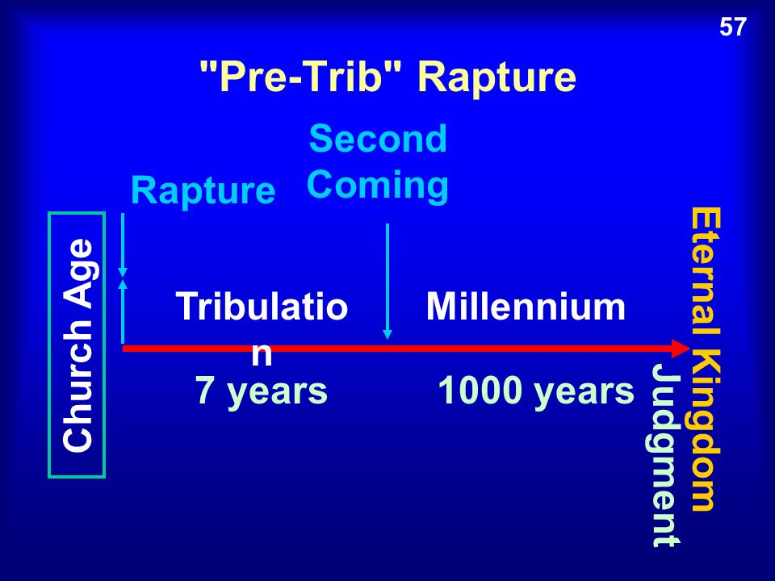
Notes:
https://www.google.com/search?q=pre+tribulation+rapture&safe=active&source=lnms&tbm=isch&sa=X&ved=0ahUKEwj7mO2VyqndAhVHIKwKHUpeArAQ_AUICygC&biw=1165&bih=826#imgdii=2olwBCWrDMCC5M:&imgrc=c-1gTXJ_RMEkHM:
I was taught pre-Trib secret rapture as new believer in 1969. Featured in Left Behind movie series.
Other possible constructs:

Slide 37
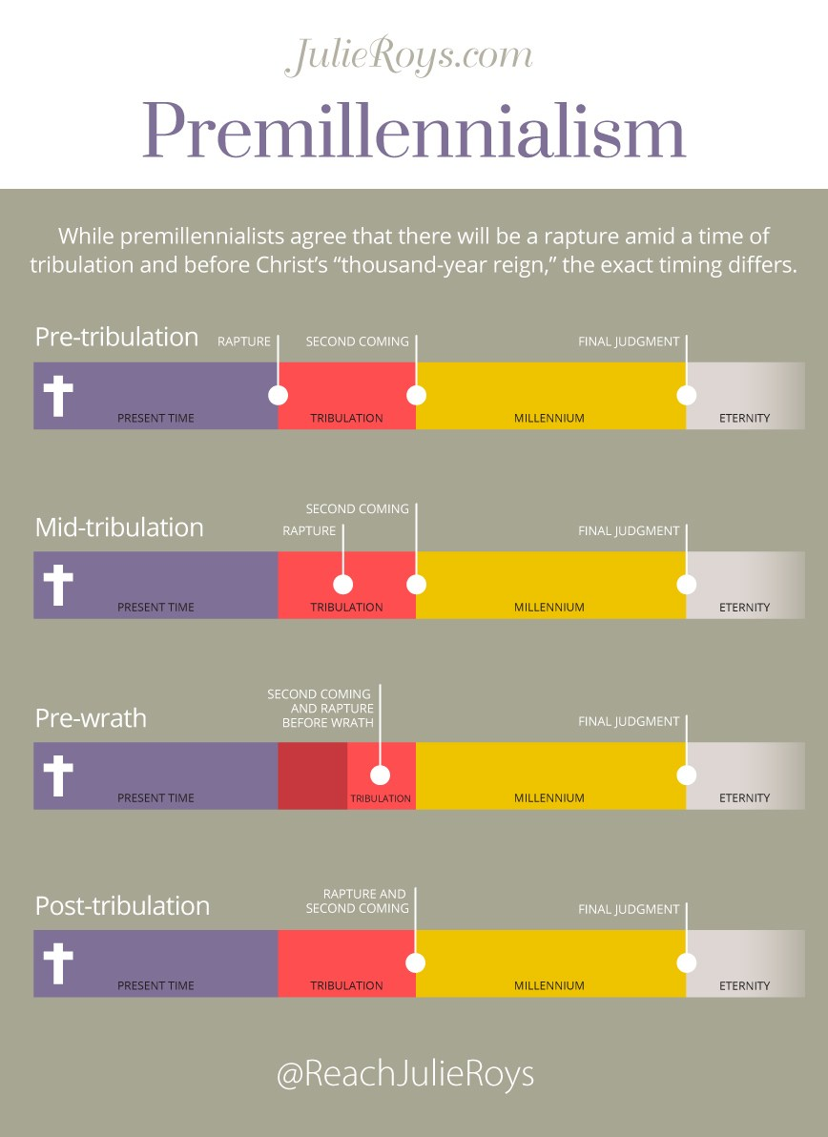
Notes:
http://julieroys.com/making-sense-of-premillennialism-when-will-the-rapture-and-tribulation-occur/

Slide 38
Notes:
http://julieroys.com/making-sense-of-premillennialism-when-will-the-rapture-and-tribulation-occur/
Seals, shofars, vials of wrath

Slide 39
Mattityahu (Matthew) 24:31
‏ וְהוּא יִשְׁלַח אֶת מַלְאָכָיו בְּשׁוֹפָר גָּדוֹל
He will send out his angels with a great shofar;
Notes:
I’m not so sure of the order of event anymore, but I’m more sure that they will happen!
Hard to be very secret disappearance if great shofar

Slide 40
Mattityahu (Matthew) 24:31
‏ וִיקַבְּצוּ אֶת בְּחִירָיו מֵאַרְבַּע הָרוּחוֹת, מִקְצוֹת הַשָּׁמַיִם עַד קְצוֹתָם.
and they will gather together his chosen people from the four winds, from one end of heaven to the other. [astronauts?]
Notes:
Shofar, gathering. For sure! Maybe tomorrow on Rosh HaShannah, the Festival of Shofars!

Slide 41
So, shofar to call, alert then gather his chosen.
Who are His chosen??

Slide 42
^{Ber/Gen 12.1} Now Adoni said to Avram, “Get yourself out of your country, away from your kinsmen and away from your father’s house, and go to the land that I will show you.
Notes:
Why did G-d chose Avraham? Sovereign choice? Maybe there’s a bit more to it. Maybe…

Slide 43
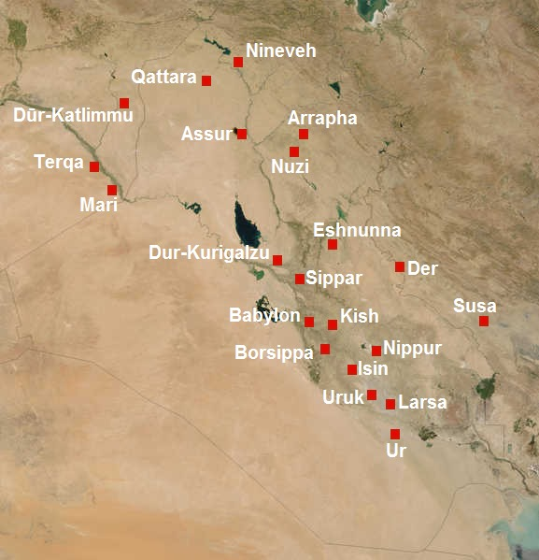
Notes:
https://upload.wikimedia.org/wikipedia/commons/f/fa/Meso2mil-English.JPG

Slide 44
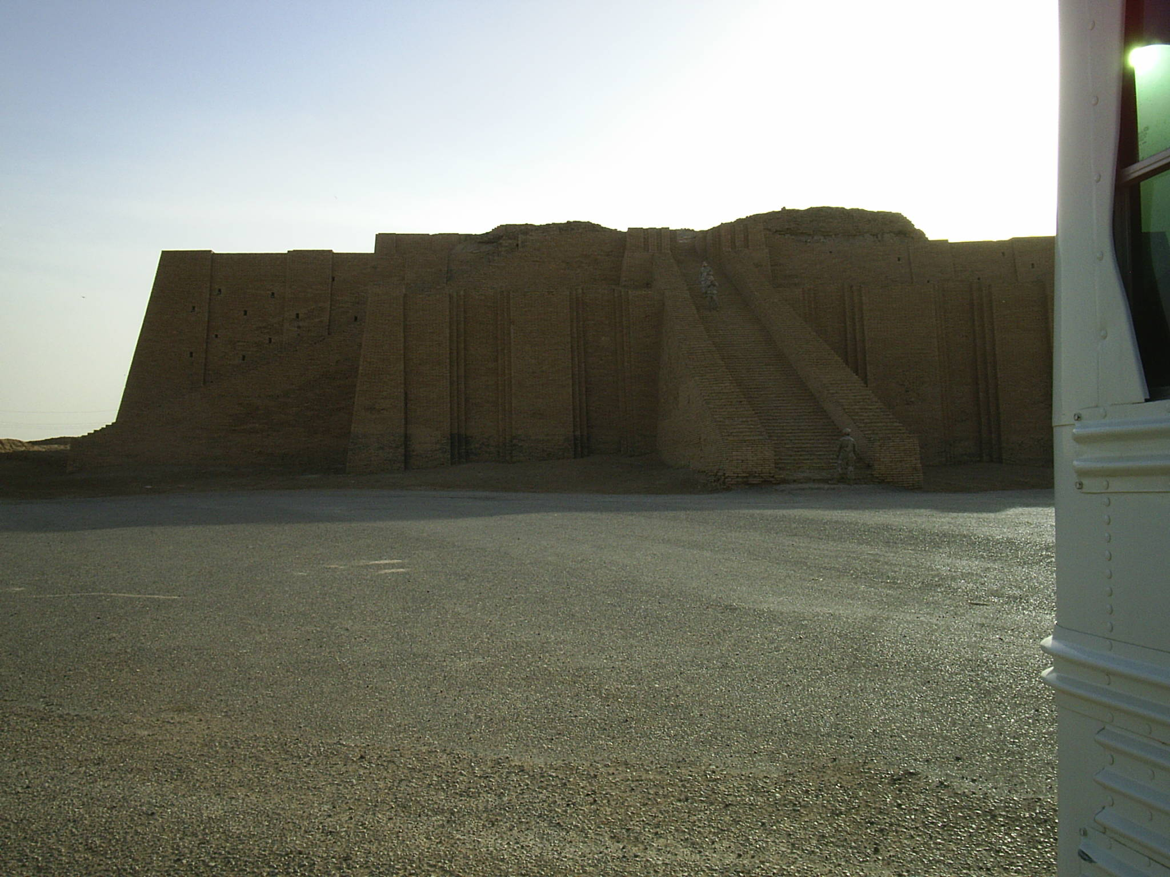
Ziggurat in Ur
Ziggurat in Ur

Slide 45
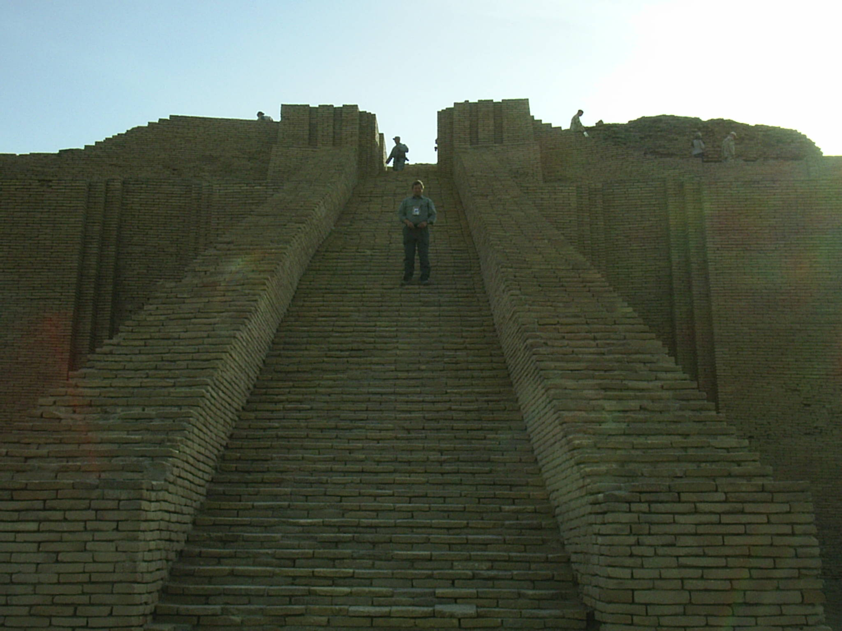
Ziggurat in Ur

Slide 46
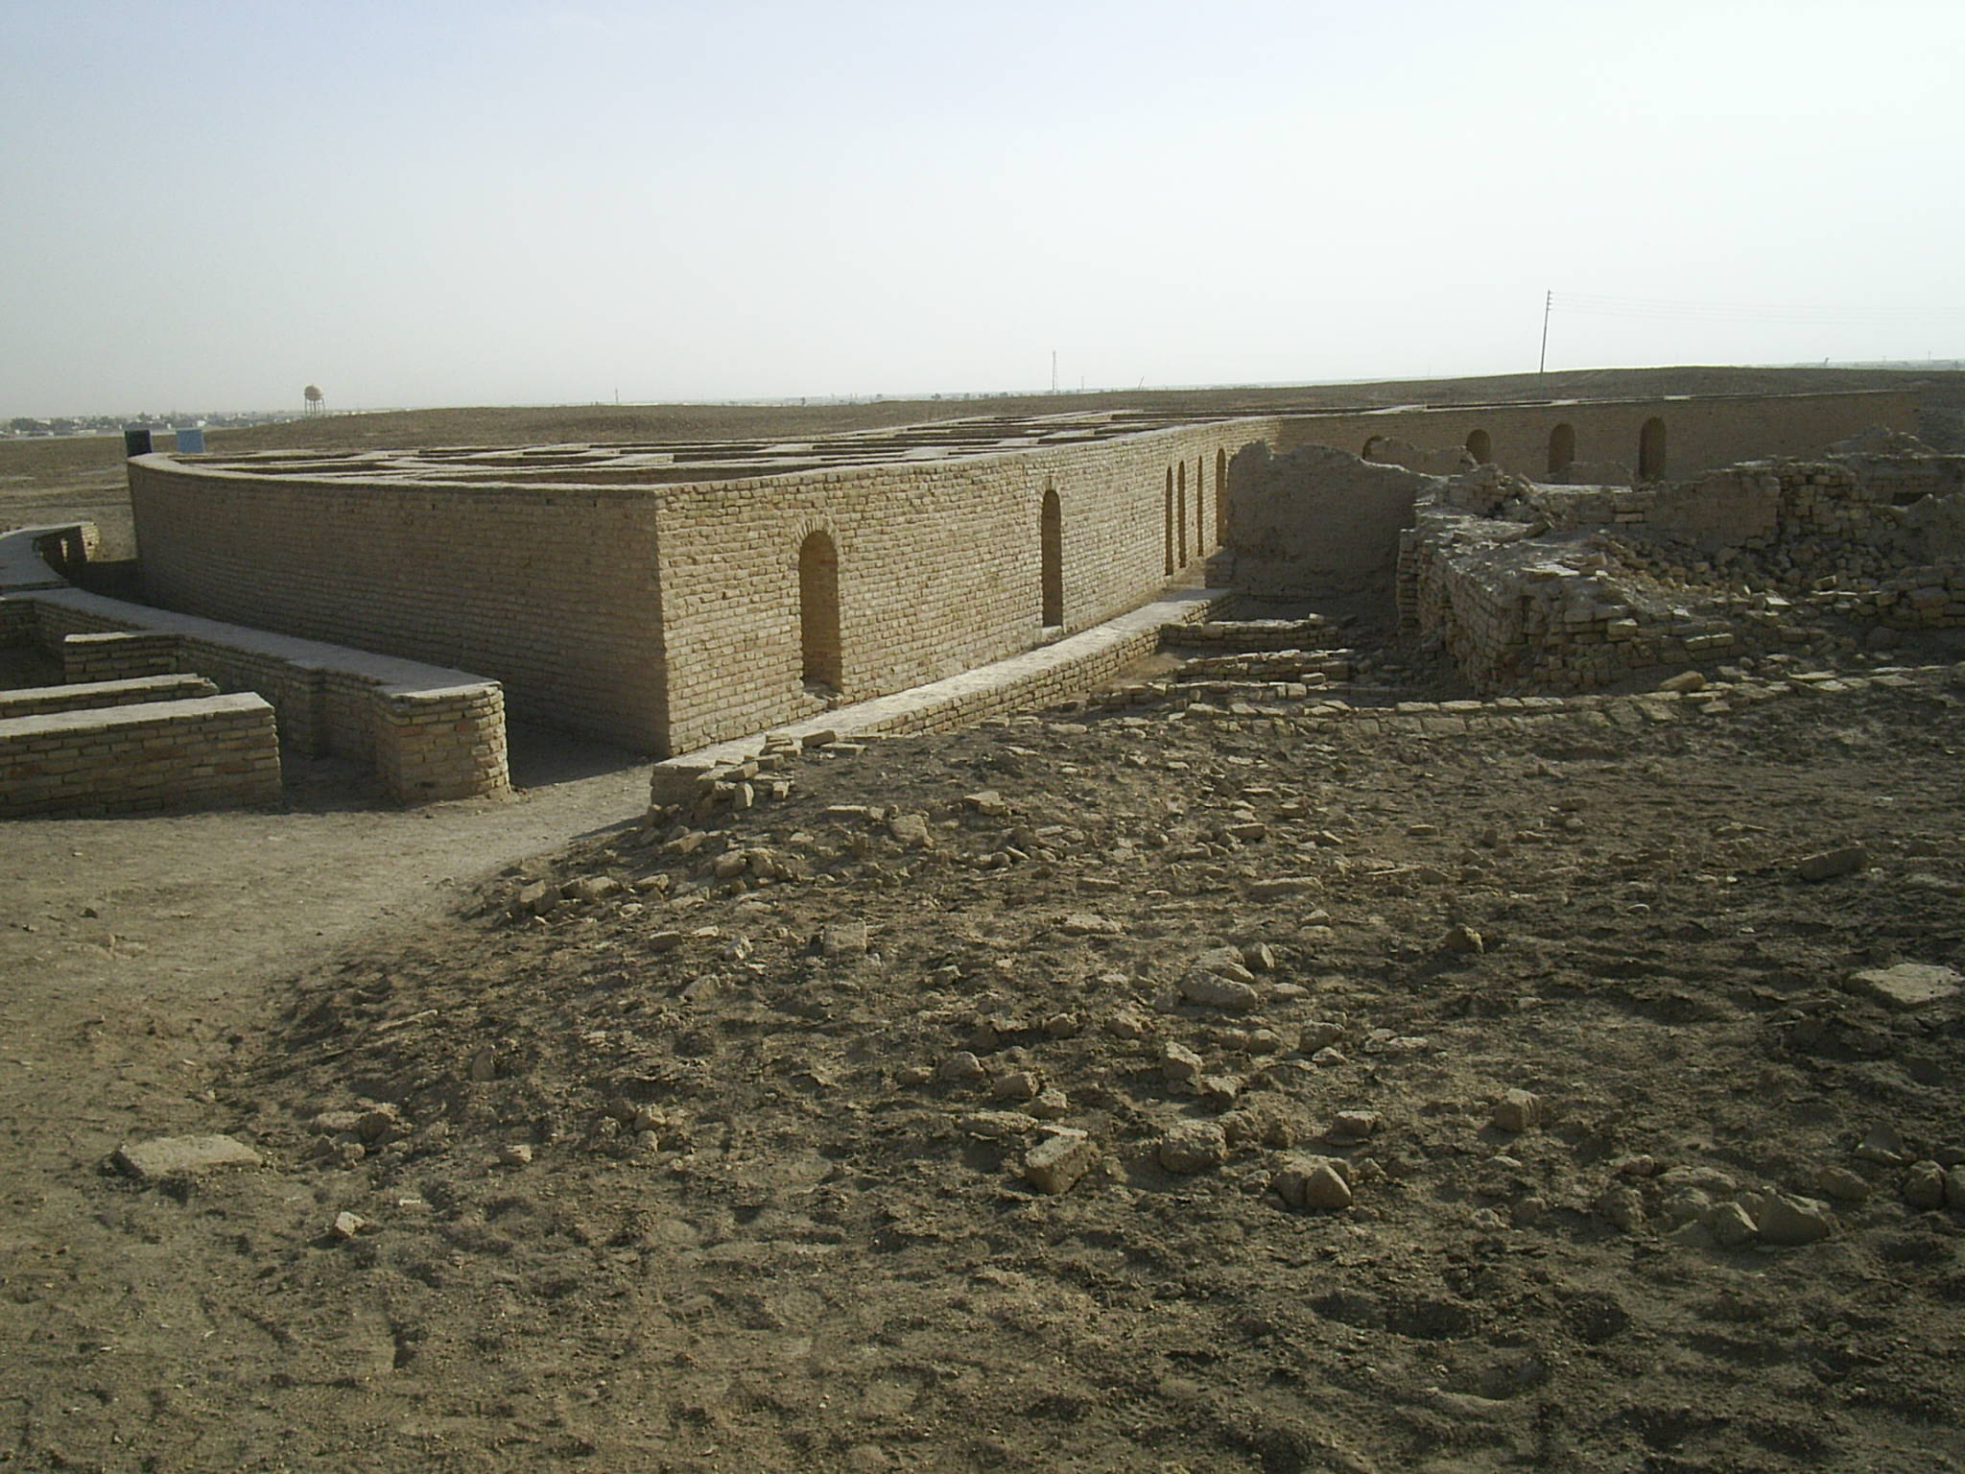
Avraham’s house in Ur
Notes:
Speculative, rebuilt from ruins. But some evidence.

Slide 47
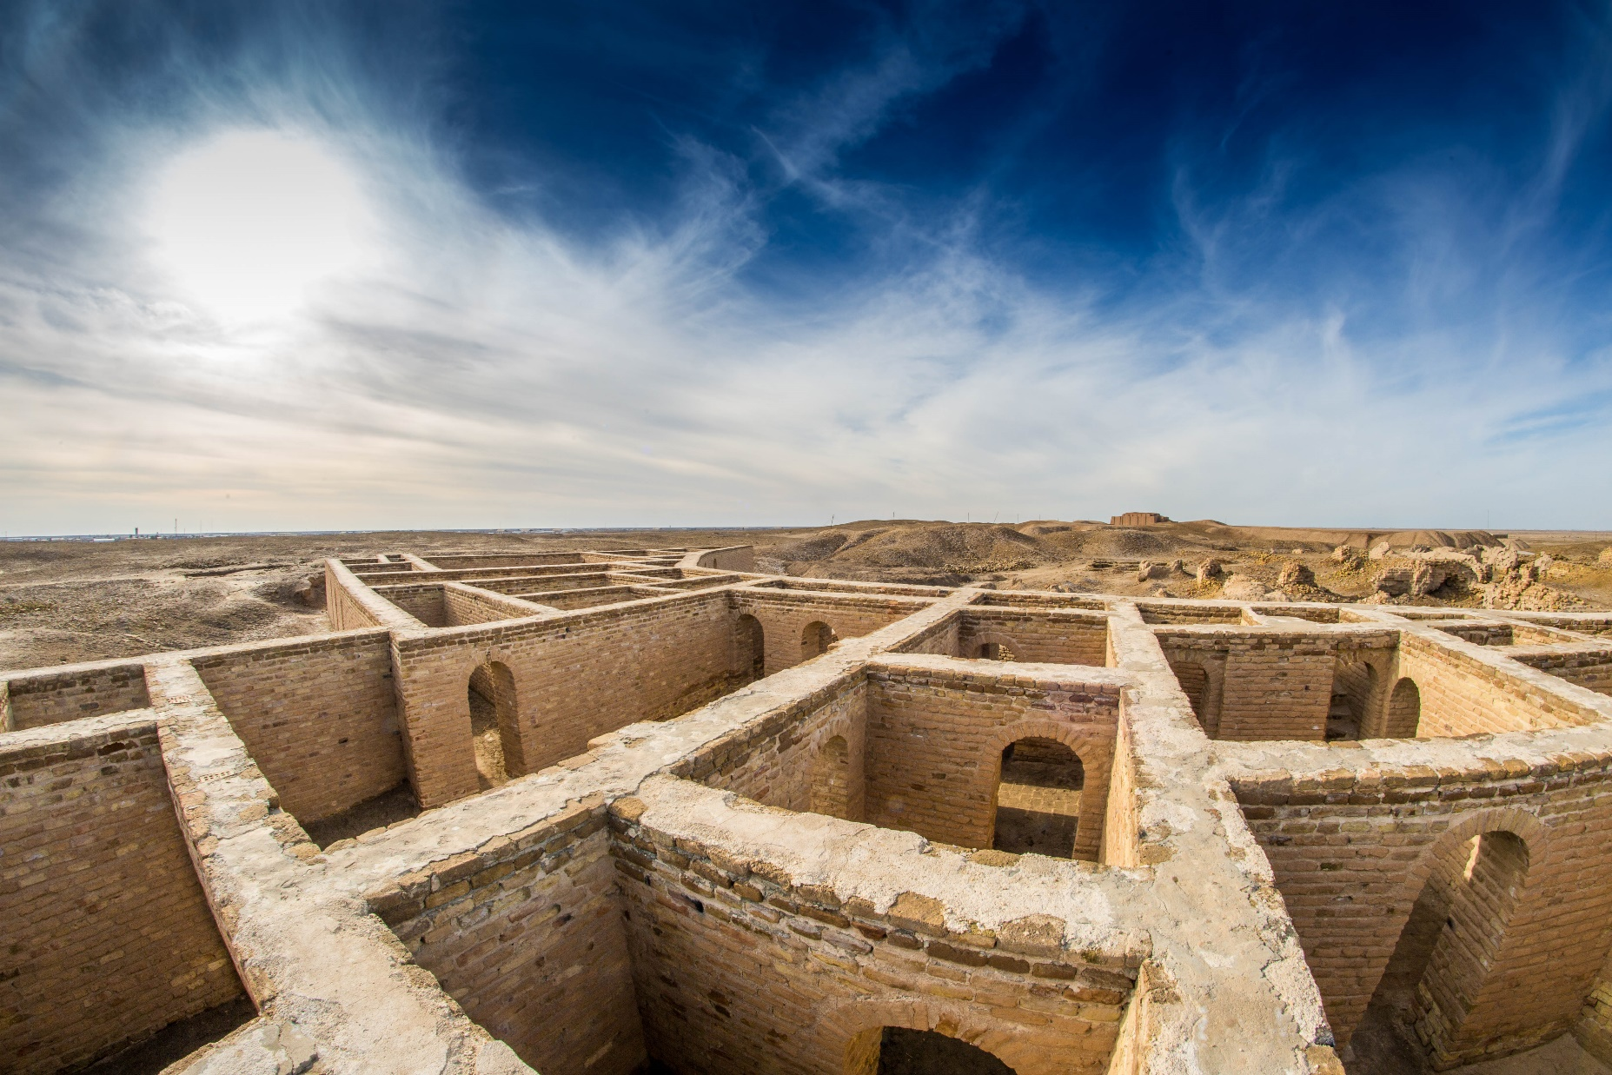
Avraham’s house in Ur
Notes:
https://upload.wikimedia.org/wikipedia/commons/a/a0/20160105-Abraham_house_in_Ur_Iraq.jpg

Slide 48
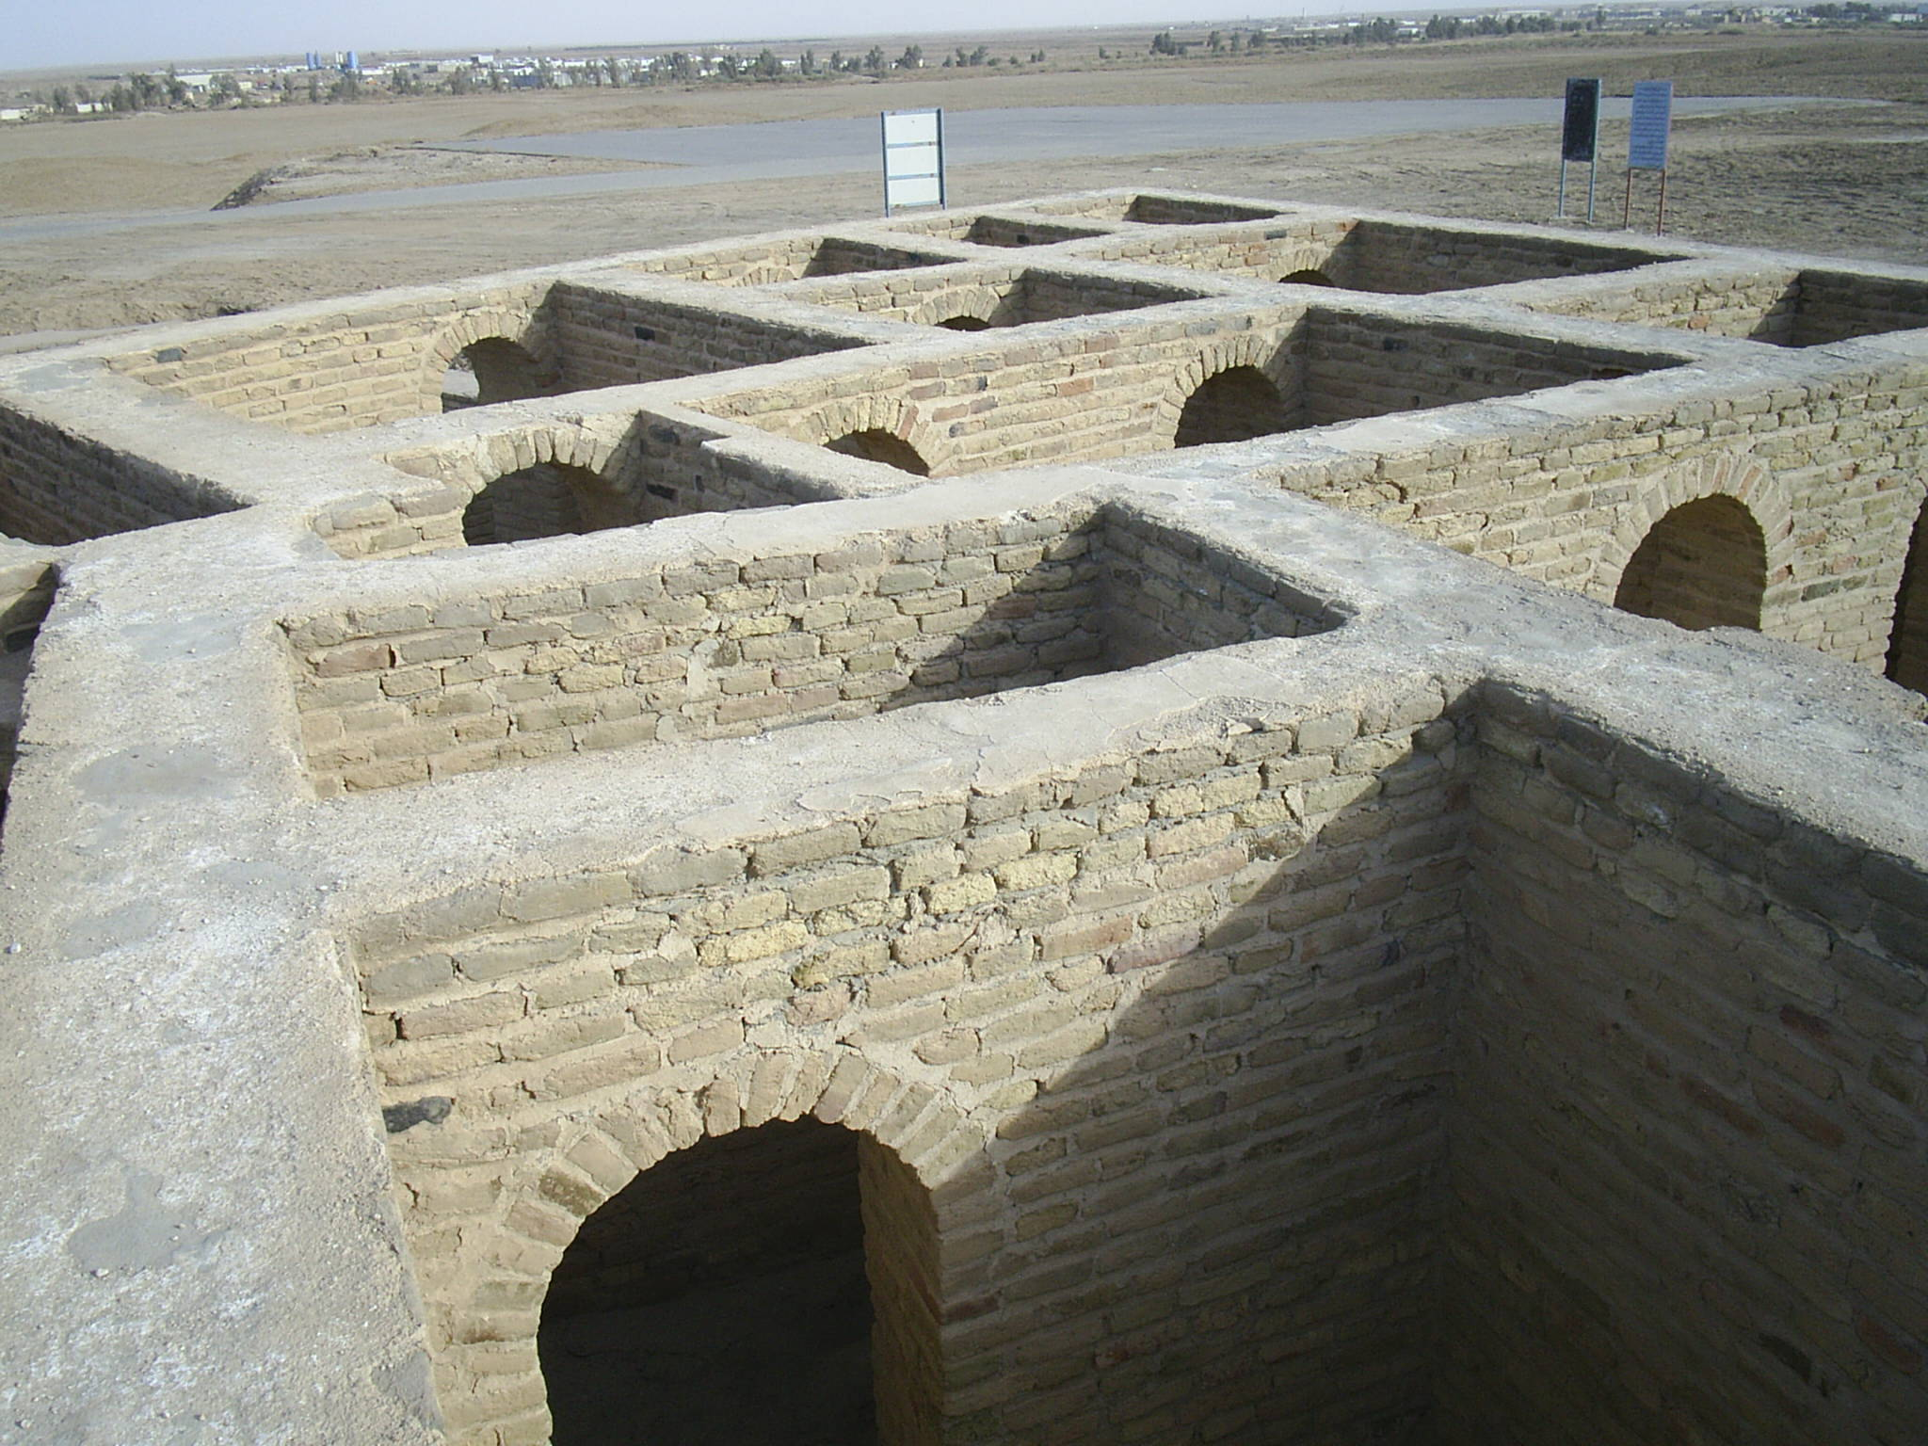
Avraham’s house in Ur

Slide 49
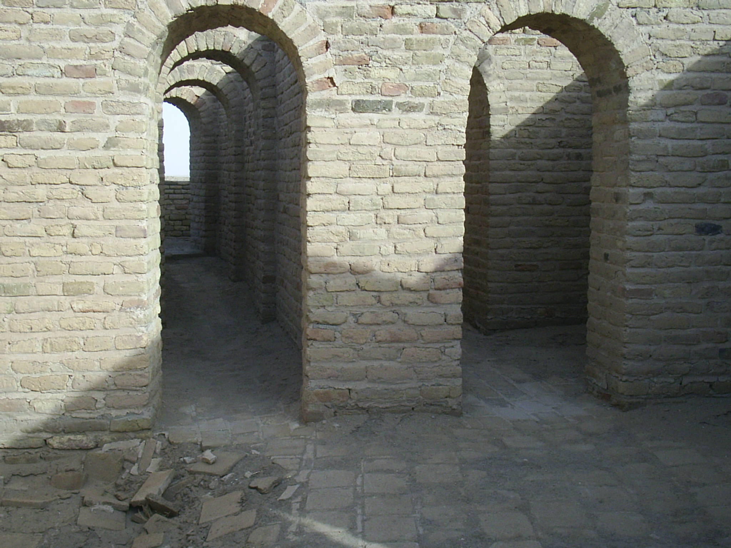


Slide 50
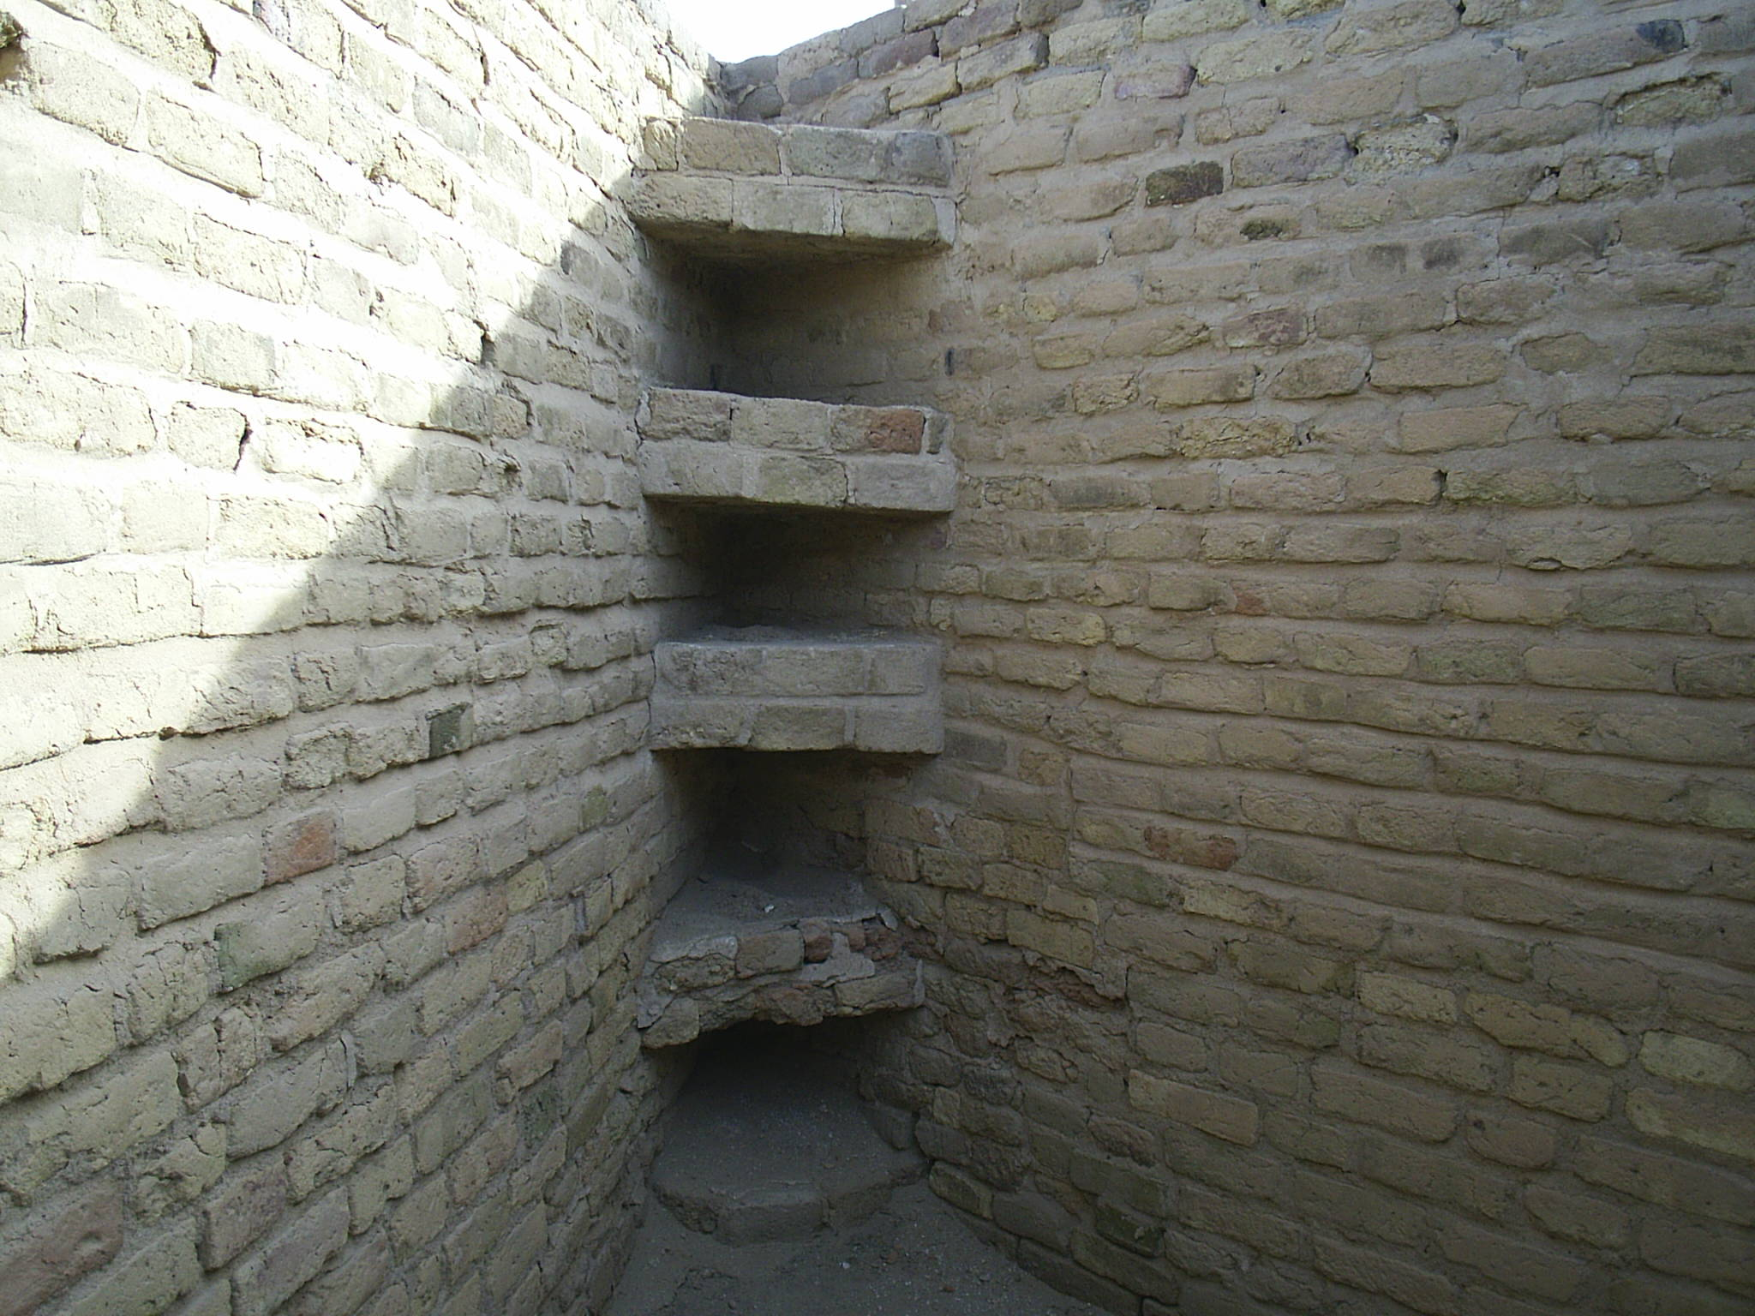
Notes:
From recovered literature on agricultural science…

Slide 51
Ud-ul-uru (Old man cultivator) gave advice to his son: Make eight furrows per ninda of width (approx. 6 m); the barley will lodge in more closely spaced furrows. When you have to work the field with the seeder-plough, keep your eye on the man who drops the seed.
Notes:
http://history-world.org/sumeradvice.htm

Slide 52
The grain should fall two fingers deep (approx. 3 1/2 cm). You should put one gij of seed per ninda (approx. 3 ml/m). If the barley seed is not being inserted into the hollow of the furrow, change the wedge of your plough share. If the bindings become loose, tighten them.
Notes:
http://history-world.org/sumeradvice.htm

Slide 53
Some say their math was developed enough to calculate square roots.
√16 = 4
√15 = 3.87
Notes:
Avraham was called from a sophisticated civilization. To go where??
What was key about Avraham’s people?

Slide 54
^{Ber/Gen 12.1} Now Adoni said to Avram, “Get yourself out of your country, away from your kinsmen and away from your father’s house, and go to the land that I will show you.

Slide 55
Avraham was called from a sophisticated civilization. To go where??
What was key about Avraham’s people?

Slide 56
^{Ro 3.1-2} Then what advantage has the Jew? What is the value of being circumcised? Much in every way!
^{Ro 9.4-5}
the adoption
and the glory
the covenants

Slide 57
the giving of the Torah
and the Temple service
and the promises.
To them belong the patriarchs
and from them, according to the flesh, the Messiah
However, MOST importantly...

Slide 58
^{Ro 3.2} Much in every way! In the first place, the Jews were entrusted with the very words of God.
Avraham was chosen since he and his progeny proved to be sufficient bearers of the Word.
Notes:
That’s what Jews have done, MORE than anything else, underlying everything else.
There are many titles for the Jewish people, but one pre-eminent one is…

Slide 59
In Judaism the term "People of the Book"עם הספר, Am HaSefer has come to refer to the Jewish people and the Torah.
Phoenicians – commerce
Assyrians – conquest
Athenians – math, science
Spartans – discipline
Notes:
https://en.wikipedia.org/wiki/People_of_the_Book

Slide 60
Jews have been known for Torah literacy.
Those grafted in become lovers of the words of the Word.
Davar, Memra, Logos
Yeshua is the WORD.
Notes:
My story with Palestinian Muslim young man.

Slide 61
Thirty-one times In the Koran Jews are referred to as “people of the book.”
The Hai Gaon in 998 in Pumbeditah [Bab.] comments, “Three possessions should you prize - a field, a friend, and a book…a book is more reliable than even friends.”
Notes:
https://en.wikipedia.org/wiki/People_of_the_Book

Slide 62
Mattityahu (Matthew) 24:31
‏ וְהוּא יִשְׁלַח אֶת מַלְאָכָיו בְּשׁוֹפָר גָּדוֹל
He will send out his angels with a great shofar;

Slide 63
Mattityahu (Matthew) 24:31
‏ וִיקַבְּצוּ אֶת בְּחִירָיו מֵאַרְבַּע הָרוּחוֹת, מִקְצוֹת הַשָּׁמַיִם עַד קְצוֹתָם.
and they will gather together his chosen people from the four winds, from one end of heaven to the other.
Notes:
Do we choose his words??

Slide 64
^{Yn 14.23-24} Yeshua answered and said to him, “If anyone loves Me, he will keep My word. My Father will love him, and We will come to him and make Our dwelling with him. He who does not love Me does not keep My words. And the word you hear is not Mine, but the Father’s who sent Me.

Slide 65
^{Mt 5.18-19} Until heaven and earth pass away, not the smallest letter or serif shall ever pass away from the Torah until all things come to pass. Therefore, whoever breaks one of the least of these commandments, and teaches others the same,

Slide 66
^{Mt 5.18-19} shall be called least in the kingdom of heaven. But whoever keeps and teaches them, this one shall be called great in the kingdom of heaven.

Slide 67
^{Yn 17.8,14,17} The words, which You gave Me, I have given to them. They received them and truly understood that I came from You, and they believed that You sent Me… I have given them Your word; and the world hated them…Make them holy in the truth. Your word is truth.

Slide 68
Mattityahu (Matthew) 24:31
‏ וְהוּא יִשְׁלַח אֶת מַלְאָכָיו בְּשׁוֹפָר גָּדוֹל
He will send out his angels with a great shofar;
Notes:
Hard to be very secret disappearance if great shofar

Slide 69
Mattityahu (Matthew) 24:31
‏ וִיקַבְּצוּ אֶת בְּחִירָיו מֵאַרְבַּע הָרוּחוֹת, מִקְצוֹת הַשָּׁמַיִם עַד קְצוֹתָם.
and they will gather together his chosen people from the four winds, from one end of heaven to the other.

Slide 70
Are you chosen? Equivalent to:
Are you a lover of the Word?
Are you a reader of the Word?
Are you a regular reader of the Word, with delight?
Are you a believer of the Word?
Are you an obeyer of the Word?
Notes:
This is what Or HaOlam is all about. The Word. Or HaOlam, the Light of the World. Hebrew, Greek, history, geography, spirituality! Ruakh insight!! To celebrate…

Slide 71
Lightning is the attraction of charged particles toward each other.

Slide 72
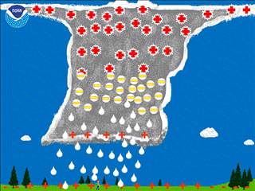

Slide 73
If our hearts are charged with the fiery truth of the word, then when the Word/Logos/Memra appears we’ll be drawn up to Him.

Slide 74
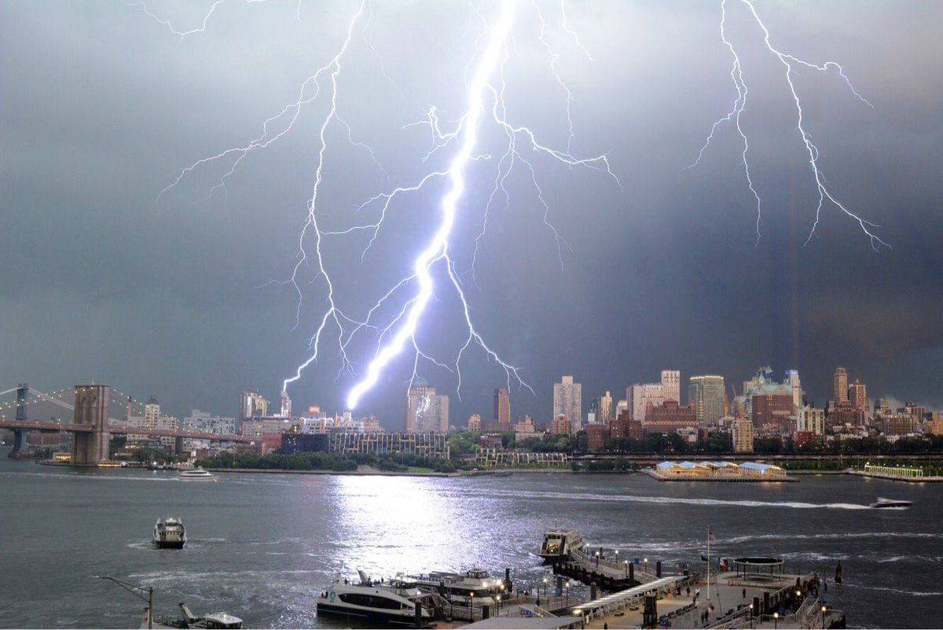
Lightning striking New York City
Aug 8, 2018
Notes:
https://www.google.com/search?q=Lightning&safe=active&source=lnms&tbm=isch&sa=X&ved=0ahUKEwjJiMzn8PTcAhVF5awKHfkgAPIQ_AUICigB&biw=1165&bih=826#imgrc=PUBqoIjlVkyISM:

Slide 75
A celebration of our love of the word…

