Slide 1
e-handout
To have these notes
without taking notes
Go to OrHaOlam.com
Click on downloads,
messages, 2019
Notes:
.

Slide 2
Two Arab plumbers – brothers – recently refused payment from a Jewish client from Haifa after they learned that she was a Holocaust survivor.
Notes:
https://worldisraelnews.com/arab-plumbers-charge-holocaust-survivor-zero-shekels-for-repairs/?utm_source=MadMimi&utm_medium=email&utm_content=German+Synagogue+Attack+Sparks+Calls+for+Action%3B+Netanyahu+Condemns+Turkish+Invasion%2C+Offers+Help%3B+The+Dark+Side+of+Trump%27s+%E2%80%98America+First%E2%80%99&utm_campaign=20191010_m154508688_German+Synagogue+Attack+Sparks+Calls+for+Action%3B+Netanyahu+Condemns+Turkish+Invasion%2C+Offers+Help%3B+The+Dark+Side+of+Trump%27s+%E2%80%98America+First%E2%80%99&utm_term=_0D_0A_09_09_09_09_09_09_09_09_09_09Read+Now_0D_0A_09_09_09_09_09_09_09_09_09

Slide 3
On a Facebook page called: Good Deeds Day, the story is told of Simon and Salim Matari who came to the home of a 95-year-old woman to “fix a routine problem.”
Notes:
https://worldisraelnews.com/arab-plumbers-charge-holocaust-survivor-zero-shekels-for-repairs/?utm_source=MadMimi&utm_medium=email&utm_content=German+Synagogue+Attack+Sparks+Calls+for+Action%3B+Netanyahu+Condemns+Turkish+Invasion%2C+Offers+Help%3B+The+Dark+Side+of+Trump%27s+%E2%80%98America+First%E2%80%99&utm_campaign=20191010_m154508688_German+Synagogue+Attack+Sparks+Calls+for+Action%3B+Netanyahu+Condemns+Turkish+Invasion%2C+Offers+Help%3B+The+Dark+Side+of+Trump%27s+%E2%80%98America+First%E2%80%99&utm_term=_0D_0A_09_09_09_09_09_09_09_09_09_09Read+Now_0D_0A_09_09_09_09_09_09_09_09_09

Slide 4
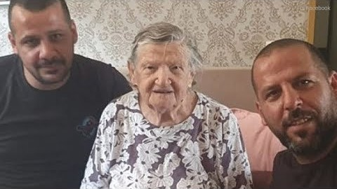
Notes:
https://youtu.be/Zsxk36_VFFk

Slide 5
On the other hand…

Slide 6
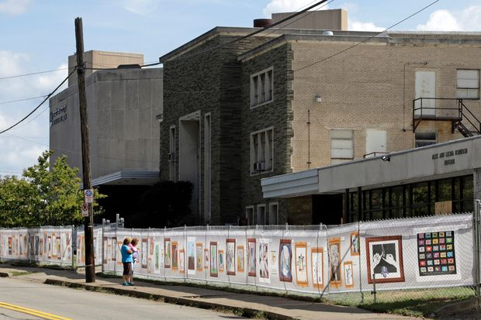
Tree of Life Synagogue still closed.
Notes:
https://www.wsj.com/articles/pittsburgh-prepares-for-first-anniversary-of-tree-of-life-synagogue-shooting-11572012050
Oct 25, 2019 plans are in the works for a new building that will likely include space for worship, a memorial, classrooms and exhibit space.

Slide 7
One year ago, our community suffered the most brutal anti-Semitic attack in the history of the United States when a gunman opened fire in the Tree of Life building in Pittsburgh, taking the lives of 11 innocent people from three congregations.
Notes:
https://pausewithpittsburgh.com/?utm_medium=email&utm_source=email&utm_campaign=pwp&utm_content=KANS

Slide 8

Owns the building
Also
New Light Congregation
Dor Hadash [New Generation]

Slide 9
https://www.wsj.com/video/eleven-killed-at-pittsburgh-synagogue/67F08E8A-A71F-446B-8D44-69C7A3273162.html
Up to 59 seconds.

Slide 10
On October 27, 2019 at 4:00 pm CDT, people from around the world will have the opportunity to join Pittsburgh in a public memorial service. Together, we will pause and pledge to maintain our abiding sense of unity and responsibility for one another.

Slide 11
Sign up to receive a text message at 4:00 pm CDT that will contain a video with a mourning prayer and the names of the 11 people who lost their lives.
Notes:
https://pausewithpittsburgh.com/?utm_medium=email&utm_source=email&utm_campaign=pwp&utm_content=KANS

Slide 12
After sharing this collective moment, we will send you a link so you can virtually join Pittsburgh’s local service. Then, we will provide you with an opportunity to submit a message of solidarity by text.
Notes:
https://pausewithpittsburgh.com/?utm_medium=email&utm_source=email&utm_campaign=pwp&utm_content=KANS

Slide 13
https://pausewithpittsburgh.com/
Notes:
Just note it, don’t register now.
Pay attention to the message.
Paga attencion por favor.
שים לב

Slide 14
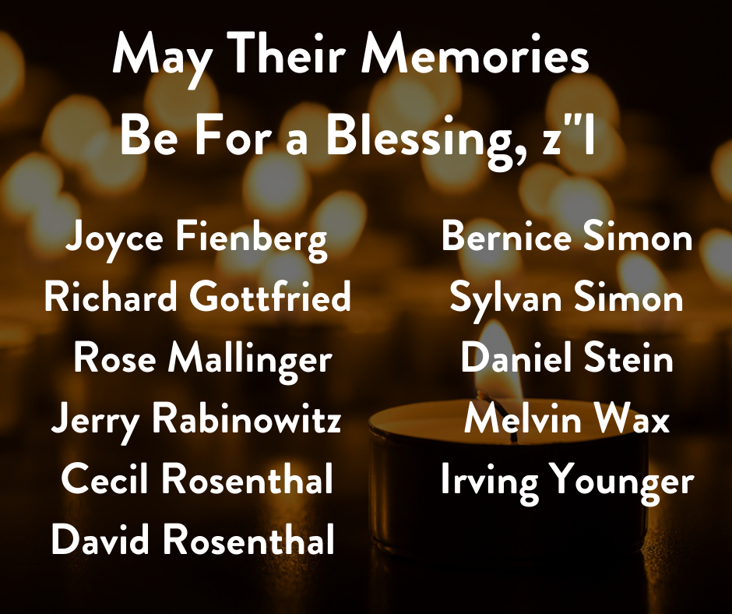

Slide 15
No more silence in the face of hate! We will not indulge or ignore those sowing seeds of division."
Steven B. Nasatir, The Jewish United Fund of Metropolitan Chicago
Notes:
https://pausewithpittsburgh.com/?utm_medium=email&utm_source=email&utm_campaign=pwp&utm_content=KANS

Slide 16


Slide 17
When you get the notes, you can buy a tree in Israel:
https://unitedwithisrael.org/plant-fruit-trees-in-memory-of-the-12-synagogue-shooting-victims/?a=eh_102319&utm_source=MadMimi&utm_medium=email&utm_content=Honor+the+Pittsburgh+Synagogue+Shooting+Victims+-+1+Year+Later&utm_campaign=20191022_m154722477_Honor+the+Pittsburgh+Synagogue+Shooting+Victims+-+1+Year+Later&utm_term=video_jpg#form

Slide 19
On Yom Kippur I spoke on
Mt. 27.32-40 Execution Stake Atonement, ending with the description of the passers-by “hurling insults at him”, fulfilling Ps. 22.8.
Notes:
Continuing in the text is continuing the record of insults.

Slide 20
Summary of today’s message:
Negatives
  Insults
  Supernatural Darkness
  Separation despair
Victory
  Shout key application
  Veil / parokhet ripped
  Earthquake
  Dead raised
  Centurion recognized His Deity
Notes:
First point, insults.
Ruakh /Spirit key to message is the shout.

Slide 21
^{Mtt.27.41-44} Likewise, the head cohanim / priests jeered at him, along with the Torah-teachers and elders, “He saved others, but he can’t save himself!” “So he’s King of Isra’el, is he? Let him come down now from the stake! Then we’ll believe him!”
Notes:
Jeering was prophesied

Slide 22
^{T’hillim/Ps 22.8-9} All who see me jeer at me; they sneer and shake their heads: “He committed himself to Adoni, so let him rescue him!
Let him set him free if he takes such delight in him!”
Notes:
Similar words

Slide 23
^{Mtt.27.41-44} “He trusted God? So, let him rescue him if he wants him! After all, he did say, ‘I’m the Son of God’!” Even the robbers nailed up with him insulted him in the same way.
Notes:
Check out the verbs:
Hurled insults,
jeered,
insulted Him.
Insult fest.
Passers by, Cohanim/Priests, robbers.
Did they know they were quoting the Psalms as they insulted Him?
How does that feel? Three insulting populations, sequentially.
Messiah was experiencing this rejection, humiliation in addition to the torture of the execution stake

Slide 25
Negatives
  Insults
  Supernatural Darkness
  Separation despair
Victory
  Shout
  Veil / parokhet ripped
  Earthquake
  Dead raised
  Centurion recognized

Slide 26
^{Mtt.27.45} Now from the sixth hour, darkness fell upon all the land until the ninth hour.
NOT a natural phenomenon;
NOT an eclipse of the sun.
Darkness of solar eclipses can last only up to 7 minutes.

Slide 27
2. Passover is on the 15th of Nisan.
^{Vayikra/Lev 23.5-6} Adoni’s Passover …on the fifteenth day of the…month

Slide 28
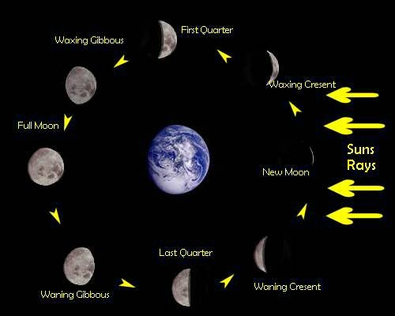
15th
Day
Nisan
Eclipse
of the
Moon
possible

Slide 29
15th
Day
Nisan
Eclipse
of the
Moon
possible
1st of
Nisan
Solar
eclipse
possible
Notes:
1st day of the lunar month the moon is between the earth and the sun, and can block the light. Doesn’t always.
3 hours of darkness, and 15th day of the lunar month, NOT eclipse

Slide 30
This darkness was NOT
a natural phenomenon.
So what was it?

Slide 31
^{Iyob/Job 5.12-14} He frustrates the schemes of the cunning, so that they achieve no success; trapping the crafty in their own tricks
and foiling quickly the plans of the false. They meet with darkness during the day, groping at noon like at night.

Slide 32
^{T’hillim/Ps 105.26-28} He sent his servant Moshe and Aharon, whom he had chosen. They worked his signs among them…He sent darkness, and the land grew dark; they did not defy his word.
Notes:
Like Egyptian darkness

Slide 33
^{Amos 8.7-9} Adoni swears by Ya‘akov’s pride, “I will forget none of their deeds, ever. Won’t the land tremble for this, and everyone mourn, who lives in the land? It will all rise, just like the Nile,

Slide 34
^{Amos 8.7-9} be in turmoil and subside, like the Nile in Egypt. “When that time comes,” says Adonai Elohim, “I will make the sun go down at noon and darken the earth in broad daylight.

Slide 35
“When Adoni entered into a covenant relationship with Abraham, ‘a terror and a great darkness’ overshadowed the solemn event ^{(Gen 15:12)}. God, represented as a blazing furnace, passed between slain animals. By so doing, Adoni was ratifying his covenant for Abraham’s sake,
Notes:
Lori Wilson Hebrews Through a Hebrew’s Eyes, Dr. Stuart Sacks, page 50

Slide 36
respecting the Near Eastern traditions of that day. This profound symbolic action said, in effect, “May the curse befalling these victims come upon me if I am at all unfaithful to my promises.’”
Notes:
Hebrews Through a Hebrew’s Eyes, Dr. Stuart Sacks, page 50
So the supernatural darkness was a statement of divine displeasure, yet covenant making in that dreaded context. Redemption of the earth.
Yeshua was bearing all the darkness of our lives.

Slide 37
Negatives
  Insults
  Supernatural Darkness
  Separation despair
Victory
  Shout
  Veil / parokhet ripped
  Earthquake
  Dead raised
  Centurion recognized

Slide 38
Mattityahu (Matthew) 27:46-49
At about three, Yeshua uttered a loud cry, “Eli! Eli! L’mah sh’vaktani? (My God! My God! Why have you deserted me?)” On hearing this, some of the bystanders said, “He’s calling for Eliyahu.”
Notes:
3 p.m. about the time of the evening lamb offering.
Hearers totally misunderstood His quoting of Ps 22 and thought of earthly remediation, or mockery.
Eliyahu/Elijah thought to help people in times of distress. Therefore at Passover seder hopeful of Jerusalem redemption!!
Eliyahu never died. Could deliver?

Slide 39
^{T’hillim/Ps 22.1} My God! [Eli אלי] My God! Why have you abandoned me?
Notes:
Kylstras, founders of RTF, say abandonment is the underlying pain of all pains.

Slide 40
^{Hab. 1.13} Your eyes are too pure to see evil, you cannot countenance oppression [wrong, mischief, evil].
טְהוֹר עֵינַיִם מֵרְאוֹת רָע, וְהַבִּיט אֶל-עָמָל לֹא תוּכָל:
Yeshua was at that moment bearing all the evil and oppression of all people, all time!
Notes:
All the torment of the oppressed and vileness of the oppressors,
All the anguish of the abused and the viciousness of the abusers,
All the defilement of the trafficked and the perversion of the traffickers
Was on HIM, making atonement.
So the Father separated from the Son for that time.

Slide 41
Mattityahu (Matthew) 27:46-49
Immediately one of them ran and took a sponge, soaked it in vinegar, put it on a stick and gave it to him to drink. The rest said, “Wait! Let’s see if Eliyahu comes and rescues him.”

Slide 42
^{T’hillim/Ps 69.22} They put poison in my food; in my thirst, they gave me vinegar to drink.
Notes:
Wine vinegar supposed to be better than water for quenching thirst, given to prolong torment. Keener p684

Slide 43
Negatives
  Insults
  Supernatural Darkness
  Separation despair
Victory
  Shout
  Veil / parokhet ripped
  Earthquake
  Dead raised
  Centurion recognized
Notes:
Now there is a cosmic shift, from torture to triumph.

Slide 45
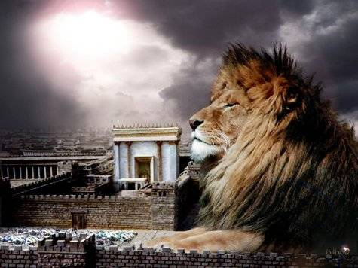
מַתִּתְיָהוּ Mattityahu
(Matthew) 27:50-54

Slide 46
Mattityahu (Matthew) 27:50
יֵשׁוּעַ צָעַק שׁוּב בְּקוֹל גָּדוֹל וְנָפַח אֶת רוּחוֹ.
But Yeshua, again crying out in a loud voice, yielded up his spirit.

Slide 47

Mega phone

Slide 48
krázō – an onomatopoetic term for a raven's piercing cry ("caw") (figuratively) cry out loudly with an urgent scream or shriek, using "inarticulate shouts that express deep emotion"

Slide 49
megas: great
Usage: large, great, in the widest sense.
Ps. 22 summary:

Slide 50
Psalm 22:1-22 -- detailed, vivid, excruciating, word picture of the execution stake in 14 details:
Abandonment, unheard prayer, scorn, mocked, head shaking, quotes, surrounded, dehydration, dislocated bones, pierced hands and feet, naked exposure and staring, gambling for clothes.

Slide 51
T’hillim / Ps. 22.23-32
Victory SHOUT

Slide 52
^{T’hillim / Ps 22.23-26} I will declare Your Name to my brothers. I will praise You amid the congregation. You who fear Adoni, praise Him! All Jacob’s descendants, glorify Him! Revere Him, all you seed of Israel.
Notes:
Keep this phrase in mind. Just want to give the context.

Slide 53
^{T’hillim / Ps 22.23-26} For He has not despised or disdained the suffering of the lowly one. Nor has He hidden His face from him, but when he cried to Him, He heard. From You is my praise in the great assembly
Notes:
In the Letter to the Messianic Jews/Hebrews, this is a big theme:

Slide 54
^{Mes Jews/Heb 2.10-12} For in bringing many sons to glory, it was only fitting that God, the Creator and Preserver of everything, should bring the Initiator of their deliverance to the goal through sufferings.

Slide 55
^{Mes Jews/Heb 2.10-12} For both Yeshua, who sets people apart for God, and the ones being set apart have a common origin — this is why he is not ashamed to call them brothers when he says, “I will proclaim your name to my brothers; in the midst of the congregation I will sing your praise.”
Notes:
Quoting Ps 22.23

Slide 56
Mattityahu (Matthew) 27:51
וְהִנֵּה נִקְרְעָה פָּרֹכֶת הַמִּקְדָּשׁ לִשְׁתַּיִם, מִלְמַעְלָה עַד לְמַטָּה
At that moment the parokhet in the Temple was ripped in two from top to bottom;
Notes:
Some say 4” thick

Slide 57
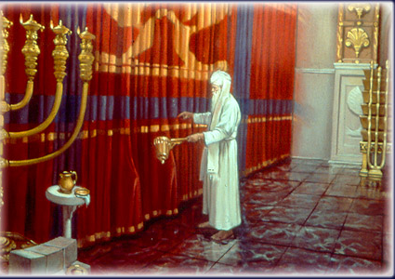
Notes:
https://www.google.com/url?sa=i&source=images&cd=&ved=2ahUKEwjXuanzn7nlAhVNjK0KHZwmCq8QjRx6BAgBEAQ&url=http%3A%2F%2Fthewholebook.blogspot.com%2F2015%2F05%2F198-veiled.html&psig=AOvVaw2FM3XyB2-bU0zO1jAWWTls&ust=1572155893176040

Slide 58
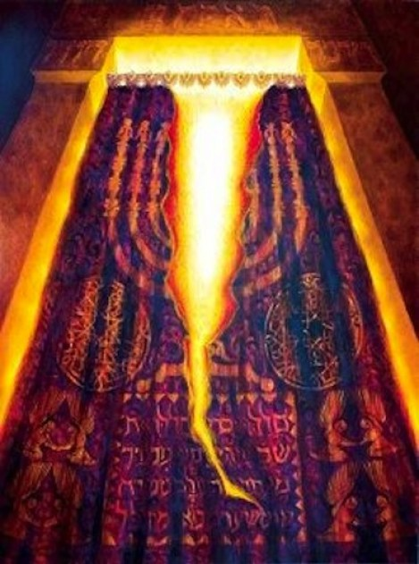
Notes:
https://www.google.com/url?sa=i&source=images&cd=&ved=2ahUKEwj24uSEoLnlAhVKmK0KHXwRBU0QjRx6BAgBEAQ&url=http%3A%2F%2Fwww.minimannamoments.com%2Fmysteries-and-miracles%2F&psig=AOvVaw2FM3XyB2-bU0zO1jAWWTls&ust=1572155893176040

Slide 59
Mattityahu (Matthew) 27:51
הָאָרֶץ רָעֲדָה, הַסְּלָעִים נִבְקְעוּ,
and there was an earthquake, with rocks splitting apart.

Slide 60
Mattityahu (Matthew) 27:52
‏הַקְּבָרִים נִפְתְּחוּ וְגוּפוֹת רַבּוֹת שֶׁל קְדוֹשִׁים יְשֵׁנֵי עָפָר נֵעוֹרוּ.
Also the graves were opened, and the bodies of many holy people who had died were raised to life;

Slide 63
Mattityahu (Matthew) 27:53
‏הֵם יָצְאוּ מִן הַקְּבָרִים אַחֲרֵי שֶׁהוּא קָם, נִכְנְסוּ לְעִיר הַקֹּדֶשׁ וְנִרְאוּ לְרַבִּים.
and after Yeshua rose, they came out of the graves and went into the holy city, where many people saw them.
Notes:
This was NOT a resurrection, but a raising, like Lazarus, eventually to die.

Slide 64
Mattityahu (Matthew) 27:54
‏שַׂר הַמֵּאָה וְהָאֲנָשִׁים אֲשֶׁר אִתּוֹ, הַשּׁוֹמְרִים אֶת יֵשׁוּעַ,
When the Roman officer and those with him who were keeping watch over Yeshua

Slide 65
Mattityahu (Matthew) 27:54
‏אֶת רְעִידַת הָאֲדָמָה וְאֶת כָּל הַנַּעֲשֶׂה, נִתְמַלְּאוּ פַּחַד רַב וְאָמְרוּ: ”בֶּאֱמֶת בֶּן־אֱלֹהִים הָיָה זֶה!“
saw the earthquake and what was happening, they were awestruck and said, “He really was a son of G-d.”

Slide 66
^{Amos 8.7-9} Adoni swears by Ya‘akov’s pride, “I will forget none of their deeds, ever. Won’t the land tremble for this, and everyone mourn, who lives in the land? It will all rise, just like the Nile.

Slide 67
Mattityahu (Matthew) 27:50
יֵשׁוּעַ צָעַק שׁוּב בְּקוֹל גָּדוֹל וְנָפַח אֶת רוּחוֹ.
But Yeshua, again crying out in a loud voice, yielded up his spirit.

Slide 68
Mega phone

Slide 69
Who dies by shouting?
Google on “death shout” →
Only to a game of Skyrim.
Shout at death is NOT expiring, it’s conquering.
Notes:
This is really the Ruakh/Spirit key to this message. Shout of victory!

Slide 70
^{Ps 3.5} I cry out to Adoni with my voice, and He answers me from His holy mountain. Selah

Slide 71
^{Ps 116.1} I love Adoni, for He hears my voice, my cries. Because He has turned His ear to me, I will call on Him all my days.
^{Ps 50.15} Call upon Me in the day of trouble. When I rescue you, you will honor Me.”

Slide 72
^{Ps 145. 18-19} Adoni is near to all who call on Him, to all who call on Him in truth. He will fulfill the desire of those who fear Him. He will hear their cry and save them.
Notes:
Clearly G-d hears our hearts, and whispers. Sometimes that’s all we can do.
But, there is something to the shout, the crying out to G-d, that He delight in.
That’s why we have public prayer together on Tuesday, and once/month on Shabbat in place of the meal. I like the meal. I like the crying out to G-d better!
That’s why I encourage private prayer. Maybe not shout at home, but call out!

Slide 73
^{Yer. 33.3} ‘Call out to me, and I will answer you — I will tell you great things, hidden things of which you are unaware.’”

Slide 74
^{Yaakov/Jas 5.16-18} So confess your offenses to one another and pray for one another so that you may be healed. The effective prayer of a righteous person is very powerful. Eliyahu/ Elijah was a man with a nature like ours,

Slide 75
^{Yaakov/Jas 5.16-18} and he prayed earnestly that it might not rain. And it did not rain on the earth for three years and six months. He prayed again, and the sky gave rain, and the earth produced its fruit.

Slide 76
^{Ps. 55.17-18} As for me, I will call on God, and Adoni will save me.
Evening, morning and noon, I complain and moan, then He hears my voice.

Slide 77
Rosh HaShannah = Yom T’ruah =
יום תרועה = Day of noise to G-d

Slide 78
^{1 Cor. 1.2} God’s Messianic community in Corinth, consisting of those who have been set apart by Yeshua the Messiah and called to be God’s holy people — along with everyone everywhere who calls on the name of our Lord Yeshua the Messiah, their Lord as well as ours:
Notes:
What is your vision, your distress?

Slide 79
^{Yeshayhu/Is 54.1} “Sing, barren woman who has never had a child! Burst into song, shout for joy, you who have never been in labor! For the deserted wife will have more children than the woman who is living with her husband,” says Adoni.

Slide 80
^{Ps. 20.6} We will shout for joy in your victory and lift up our banners in the Name of our God! May Adoni fulfill all your petitions.
Notes:
What is your vision, your distress?
There is a song, one of the first sung at Or HaOlam in 1995, words Messianized:

Slide 81
Shout to the Lord all the Earth, let us sing
Power and majesty, praise to the King
Mountains bow down and the seas will roar
At the sound of Your name

Slide 82
I sing for joy at the work of Your hand
Forever I'll love You, forever I'll stand
Nothing compares to the promise I have in You

Slide 83
Yeshua my Saviour
Lord there is none like You
All of my days I want to praise
The wonders of Your mighty love
My comfort, my shelter
Tower of refuge and strength
Let every breath, all that I am
Never cease to worship You

Slide 84
Shout to the Lord all the Earth, let us sing
Power and majesty, praise to the King
Mountains bow down and the seas will roar
At the sound of Your name

Slide 85
I sing for joy at the work of Your hand
Forever I'll love You, forever I'll stand
Nothing compares to the promise I have in You

Slide 86
Summary of today’s message:
Negatives
  Insults
  Supernatural Darkness
  Separation despair
Victory
  Shout key application
  Veil / parokhet ripped
  Earthquake
  Dead raised
  Centurion recognized His Deity
Notes:
First point, insults.
Ruakh /Spirit key to message is the shout.

Slide 87
Mattityahu (Matthew) 27:50
יֵשׁוּעַ צָעַק שׁוּב בְּקוֹל גָּדוֹל וְנָפַח אֶת רוּחוֹ.
But Yeshua, again crying out in a loud voice, yielded up his spirit.

Slide 88
Mega phone

Slide 89
^{Ps 116.1} I love Adoni, for He hears my voice, my cries. Because He has turned His ear to me, I will call on Him all my days.
^{Ps 50.15} Call upon Me in the day of trouble. When I rescue you, you will honor Me.”
Notes:
What is your vision, your distress?
I have a vision for Or HaOlam, a Messianic Jewish synagogue: Jews and all nations coming to faith and worshipping as Messiah did.
Some say “Too Jewish” Too much Siddur.
Some say too Ruakh/Spirit/charismatic/IHOP.
I have a vision, I will shout to G-d.

Slide 90
^{Yer. 33.3} ‘Call out to me, and I will answer you — I will tell you great things, hidden things of which you are unaware.’”

Slide 92
