Slide 1
e-handout
To have these notes
without taking notes
Go to OrHaOlam.com
Click on downloads,
messages, 2019
Notes:
.

Slide 2
Last week:
Takeaway: prepare for life.
Remember daily
prayer and reading,
and accountability
Simkhat Torah Oct. 21
Notes:
I had said average of one chapter/day to qualify to carry and dance with the Torah on Simkhat Torah Oct. 21. Two people told me that they took it to heart!
However, I didn’t necessarily mean a chapter of the Torah/day, but a chapter anywhere in the Tanakh or Messianic scriptures. Anywhere in the Bible!

Slide 3
Do you pray daily?
Do you read scripture daily?
Do you pray/read daily with your spouse and children?
Do you attend corporate prayer?
  Prepare for Simkhat Torah accountability!

Slide 4
Yom Kippur greeting:
צוֹם קַל tsom kal
Easy fast

Slide 5
Today is Shabbat Shuva.
Why is this Shabbat different from all other Shabbats?
Why should you care?
Notes:
You have maybe heard that tourism is really up in Israel. Yes?

Slide 6
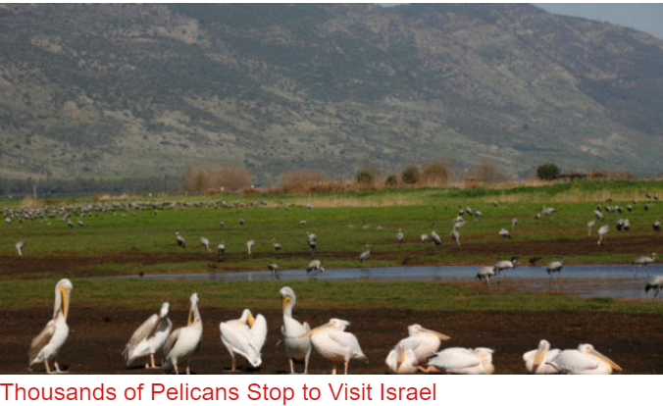
Notes:
https://www.israeltoday.co.il/read/thousands-of-pelicans-stop-to-visit-israel/
You’ve mabe heard that the tourist industry is booming in Israel.

Slide 7
During the migration season some 500 million birds pass through Israel. Especially prominent are white storks; half a million stop in Israel for food and rest. Also pelicans - some 40,000.
Notes:
JNN Barry & Batya Segal
Storks, pelicans, cranes

Slide 8
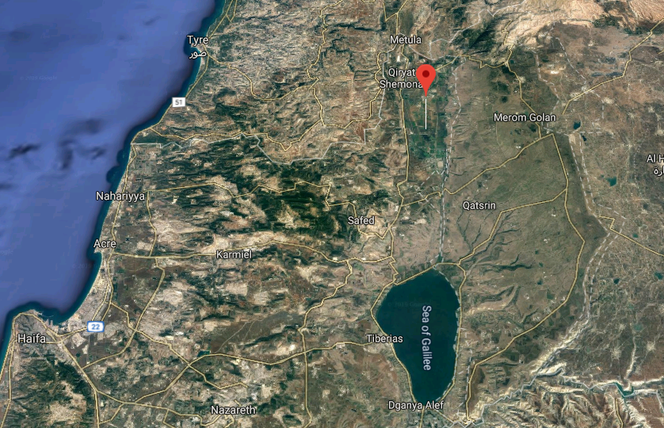
Hula
Valley
Notes:
The area is part of the Great Rift Valley, which stretches from northern Syria to central Mozambique in Africa.
It is akin to a superhighway of bird migration routes, creating thermal currents that birds can ride from central Africa to Europe.
Israel is at a bottleneck on the migratory birds' flight path where an estimated 540 species converge.
Compare that with 460 species in Germany, which is 20 times bigger.

Slide 9
In Israel, thousands of birds are being treated in the Israeli Wildlife Hospital which has been in operation for 14 years. Birds often arrive in the hospital with severe injuries and have to go through complicated orthopedic
Notes:
JNN Barry & Batya Segal

Slide 10
surgeries that call for a long rehabilitation period. In order to be released back into the wild, these birds require a second rehabilitation period that focuses on re-learning how to fly and practicing it.
Notes:
JNN Barry & Batya Segal

Slide 11
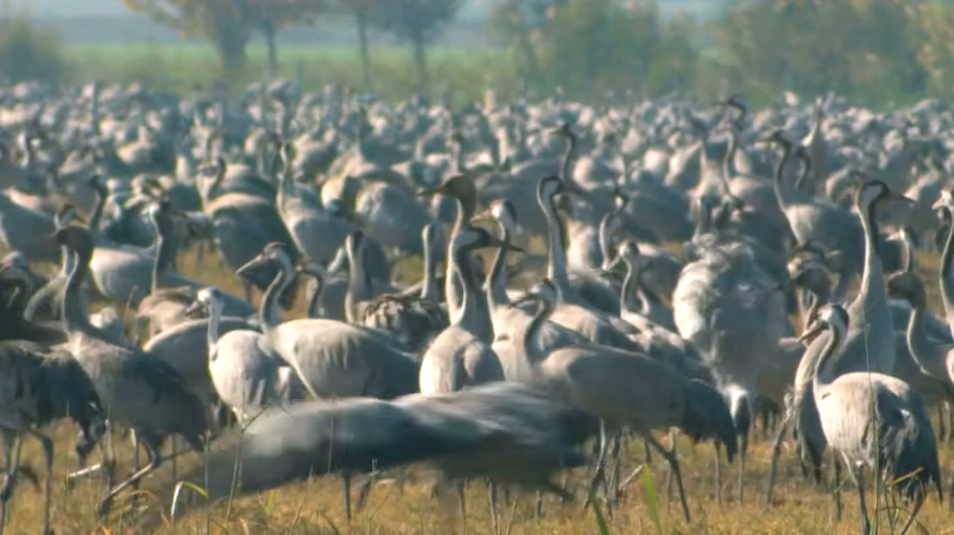
Cranes at the Hula Valley
Notes:
https://youtu.be/ehW53bGbt1M

Slide 12
Can we return wounded people to flight and functionality?
How can we return wounded people to flight?
Does this relate to Shabbat Shuva?

Slide 15
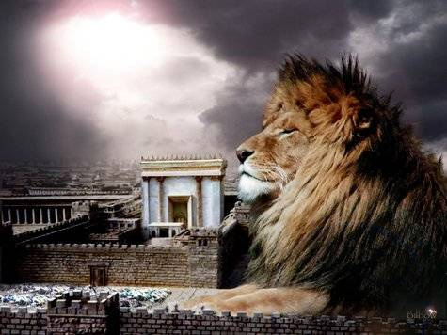
מַתִּתְיָהוּ Mattityahu
(Matthew) 27:27-29
Notes:
As we are continuing through Matityahu, Pilate handed Yeshua to his soldiers for execution.

Slide 16
Mattityahu (Matthew) 27:27
לָקְחוּ חַיָּלֵי הַנָּצִיב אֶת יֵשׁוּעַ לְבֵית הַמִּמְשָׁל וְהִקְהִילוּ אֵלָיו אֶת כָּל הַגְּדוּד.
The governor’s soldiers took Yeshua into the headquarters building, and the whole battalion gathered around him.
Notes:
Battalion = speiran Gk. cohort ~500 men

Slide 17
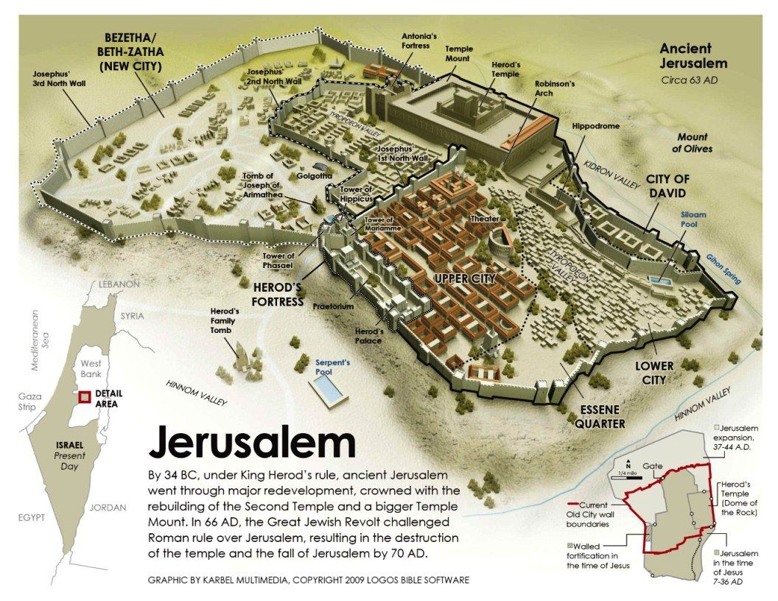
Notes:
https://www.google.com/url?sa=i&source=images&cd=&ved=2ahUKEwjdxuKCrIPlAhUBL6wKHZLpAJkQjRx6BAgBEAQ&url=https%3A%2F%2Fwww.pinterest.com%2Fpin%2F337136722077871808%2F&psig=AOvVaw0GBJmknmCeXNj7cpaHrc_w&ust=1570303859077864

Slide 18
Notes:
https://www.google.com/url?sa=i&source=images&cd=&ved=2ahUKEwjdxuKCrIPlAhUBL6wKHZLpAJkQjRx6BAgBEAQ&url=https%3A%2F%2Fwww.pinterest.com%2Fpin%2F337136722077871808%2F&psig=AOvVaw0GBJmknmCeXNj7cpaHrc_w&ust=1570303859077864
North boundary of Temple Mount more or less same today

Slide 19
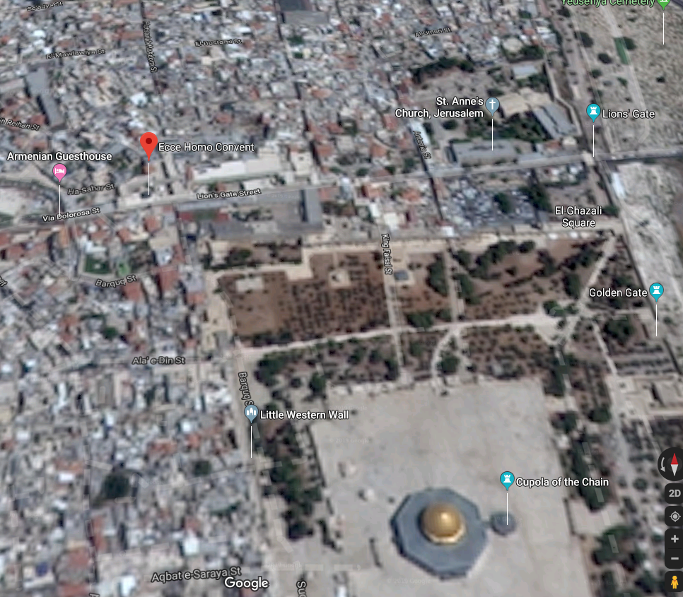
Notes:
Imagine where Antonia Fortress would have been, and note red dot to the north.

Slide 20
Mattityahu (Matthew) 27:27
לָקְחוּ חַיָּלֵי הַנָּצִיב אֶת יֵשׁוּעַ לְבֵית הַמִּמְשָׁל וְהִקְהִילוּ אֵלָיו אֶת כָּל הַגְּדוּד.
The governor’s soldiers took Yeshua into the headquarters building, and the whole battalion gathered around him.
Notes:
Battalion = speiran Gk. cohort ~500 men

Slide 21
Mattityahu (Matthew) 27:28
‏הִפְשִׁיטוּהוּ וְהֶעֱטוּ עָלָיו מְעִיל שָׁנִי,
They stripped off his clothes and put on him a scarlet robe,
Notes:
Color worn by royalty;
also a prophetic picture of his being clothed, as it were with our sins, which are as scarlet, and of his bloody sufferings in the human nature.
Also a fulfillment of the prophetic image of Messiah, conquering evil

Slide 22
^{Yeshayahu/Is.63.2-3} “Why is Your apparel so red, and Your garments like one who treads in a winepress?” “I have trodden the winepress alone— from the peoples, no man was with Me.
Notes:
Winepress?

Slide 23
Mattityahu (Matthew) 27:29
‏וּלְאַחַר שֶׁשָׂרְגוּ עֲטֶרֶת קוֹצִים שָׂמוּ אוֹתָהּ עַל רֹאשׁוֹ, נָתְנוּ קָנֶה בְּיַד יְמִינוֹ.
[They] wove thorn-branches into a crown and put it on his head, and put a stick in his right hand.
Notes:
Thorns and briers being the curse which was inflicted on the earth, He was being made a curse for us.
John Gill commentary

Slide 24
Mattityahu (Matthew) 27:29
‏וְכָרְעוּ לְפָנָיוּ כְּשֶׁהֵם מִתְלוֹצְצִים בּוֹ וְאוֹמְרִים: ”שָׁלוֹם לְךָ, מֶלֶךְ הַיְּהוּדִים!“
Then they kneeled down in front of him and made fun of him: “Hail to the King of the Jews!”
Notes:
There is a place just north of the Temple Mount today that is called Antonia Lithostrotos

Slide 25
Notes:
Where you see the red dot, Antonia Lithostrotos, there is a place with a fascinating pavement. Some think it is the pavement of mockery.

Slide 26
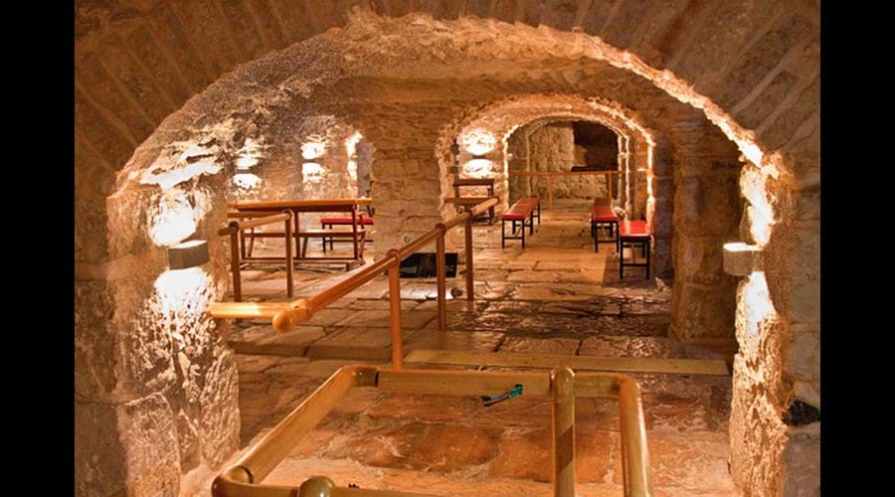
Notes:
http://www.eccehomopilgrimhouse.com/litho

Slide 27
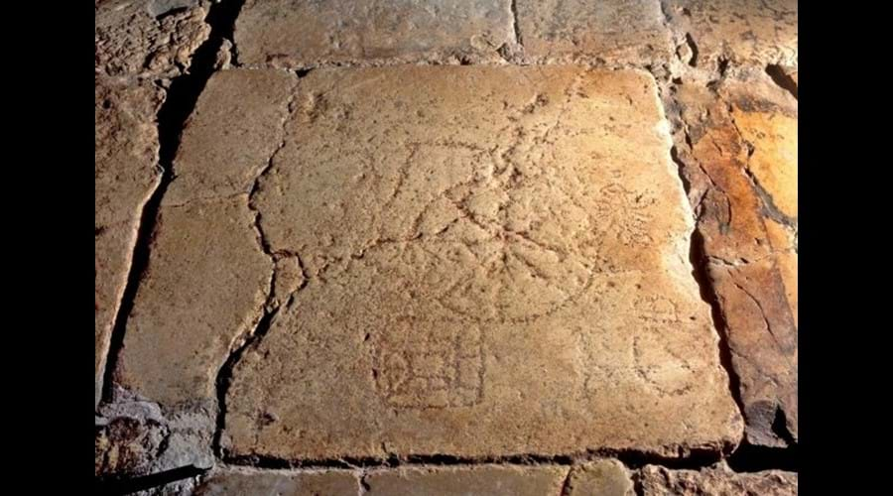
The game of the King.
Notes:
http://www.eccehomopilgrimhouse.com/litho

Slide 28
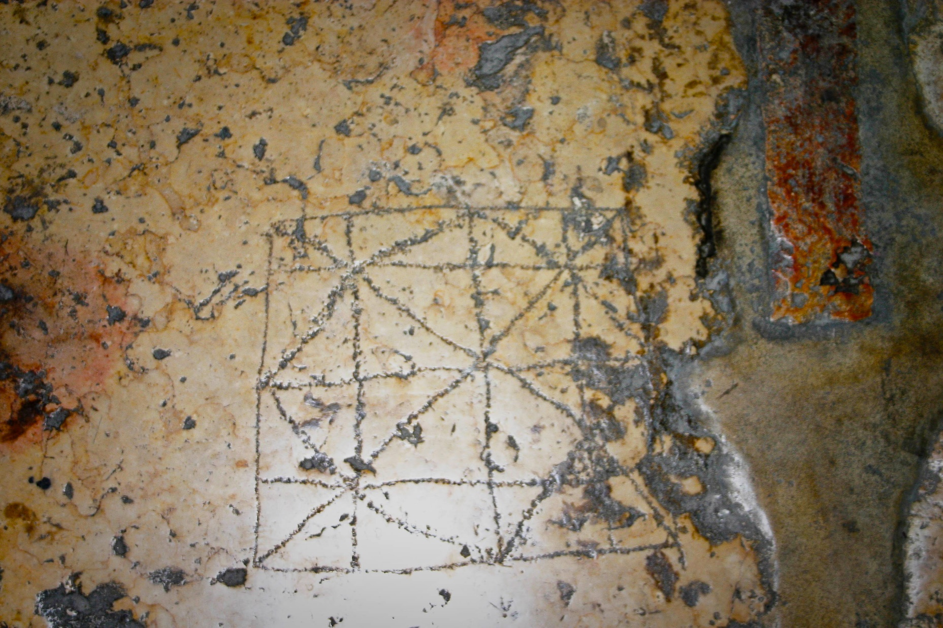
Notes:
https://i1.wp.com/www.seetheholyland.net/wp-content/uploads/One-of-the-soldiers-games-carved-into-Hadrians-plaza-%C2%A9-Stanislao-Lee-Custodia-Terrae-Sanctae.jpg?ssl=1

Slide 29
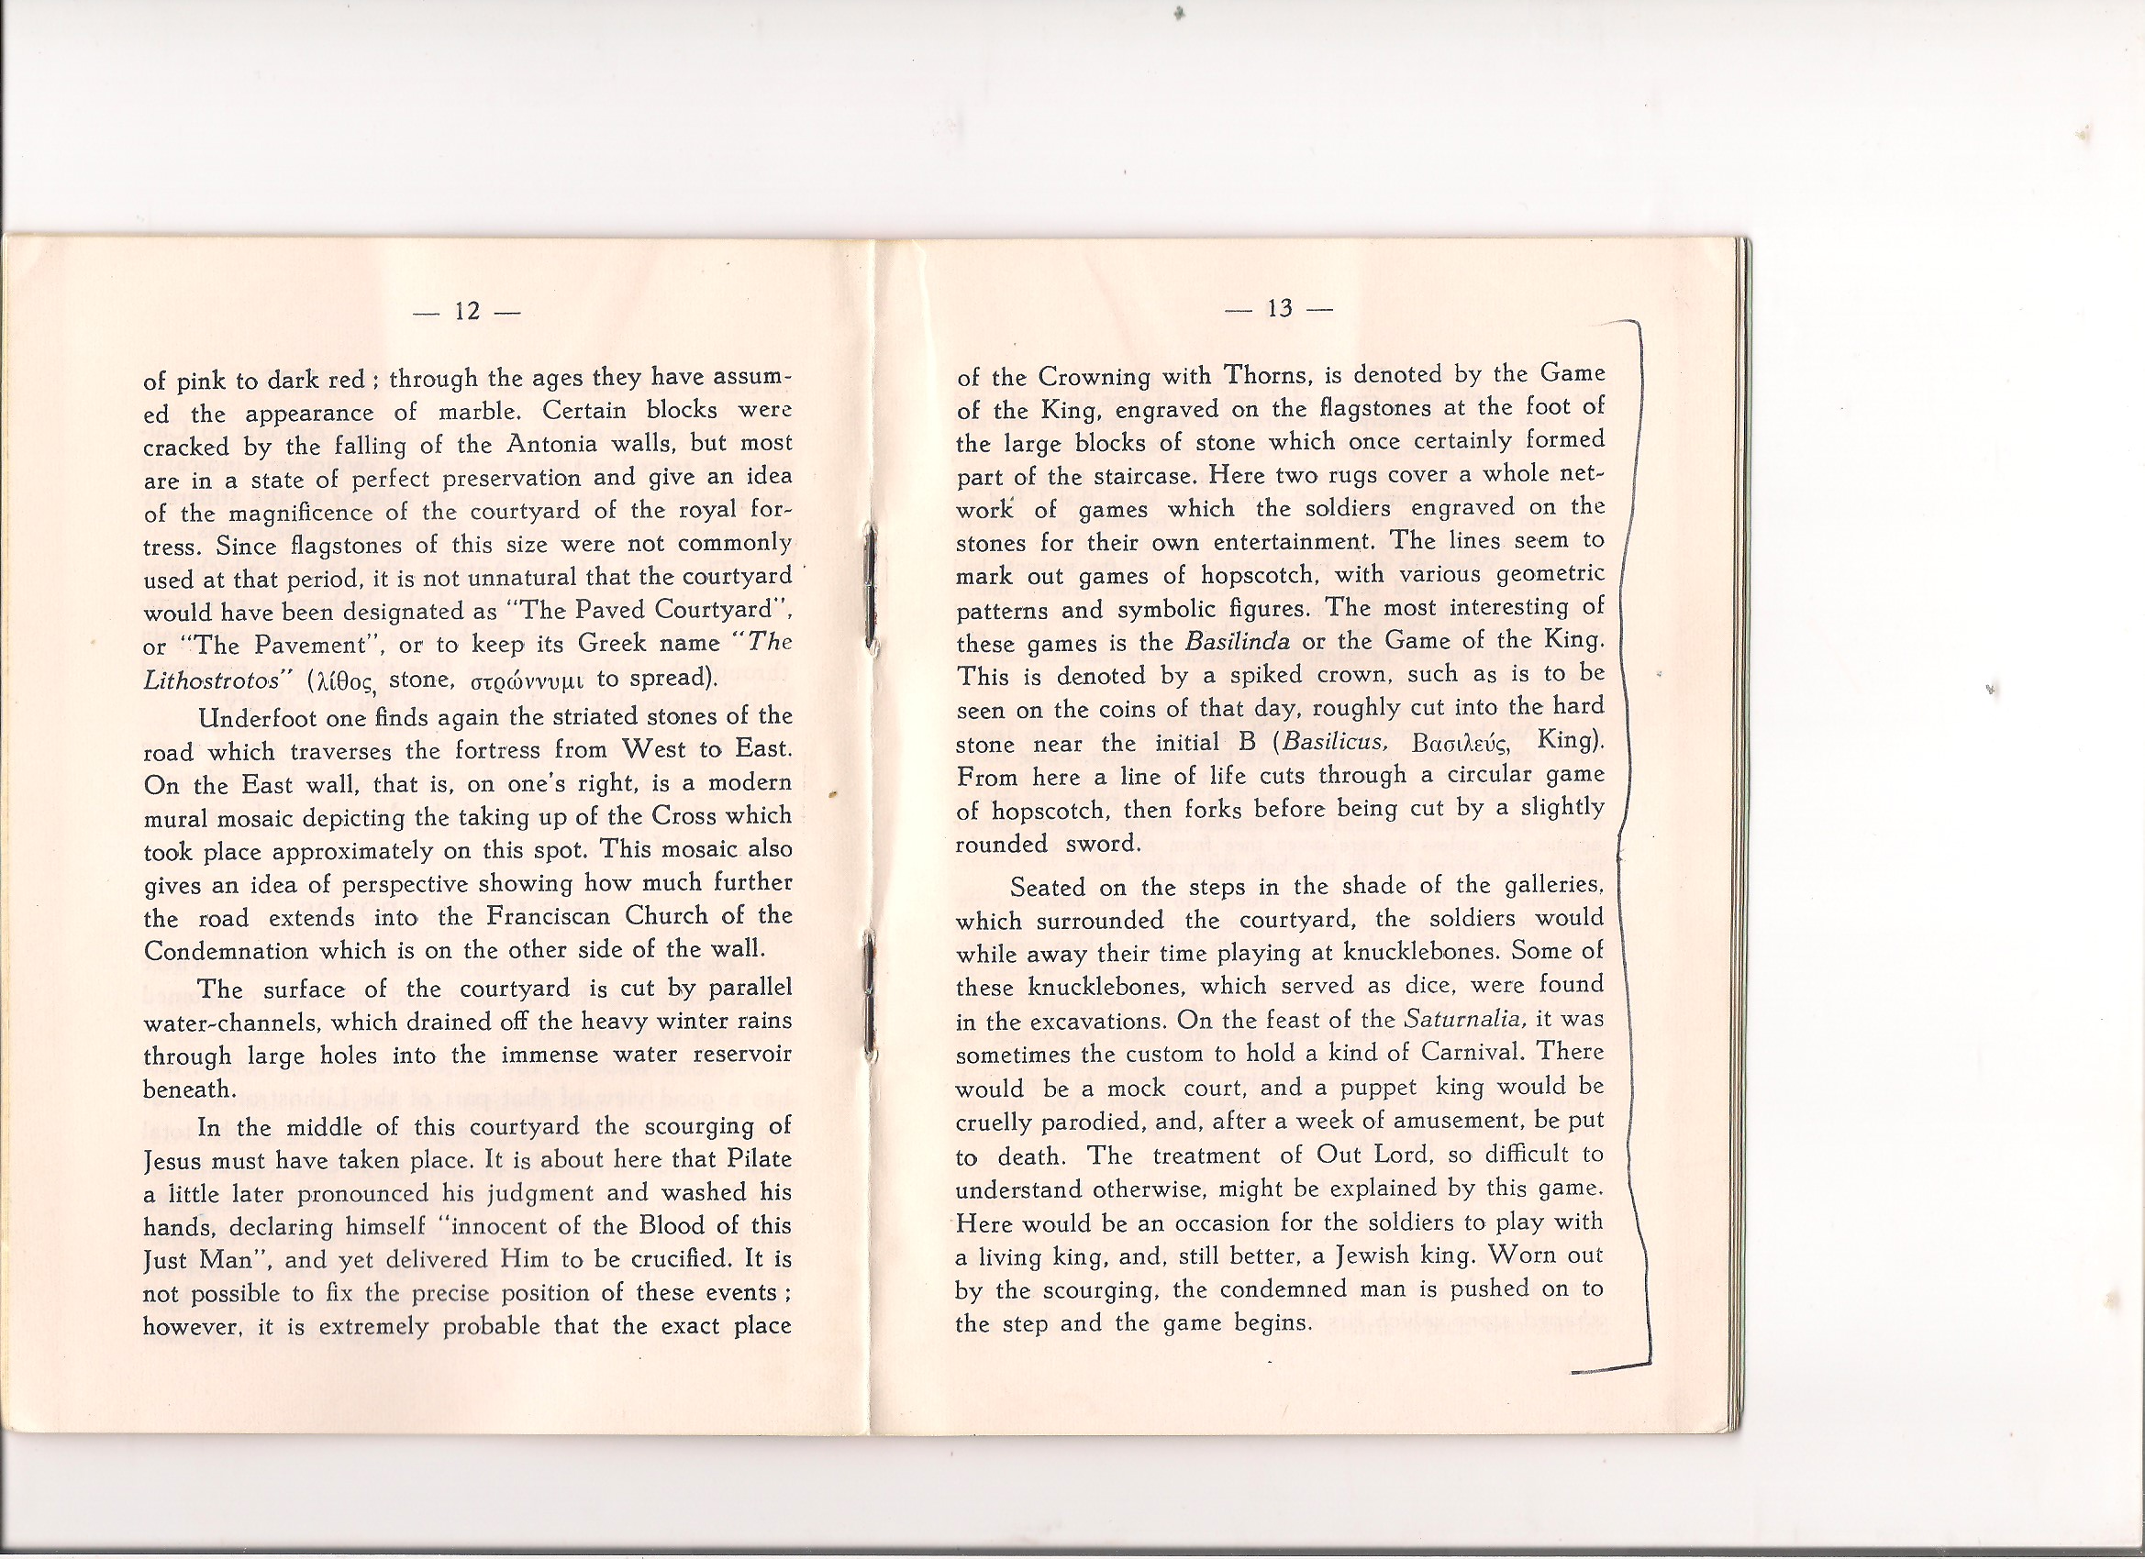

Slide 30
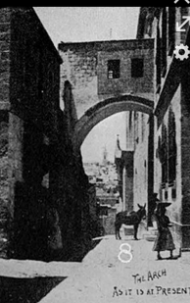
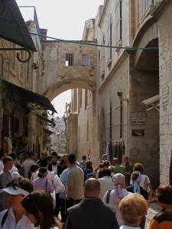
Arch
today
From
Hadrian, 135

Slide 31
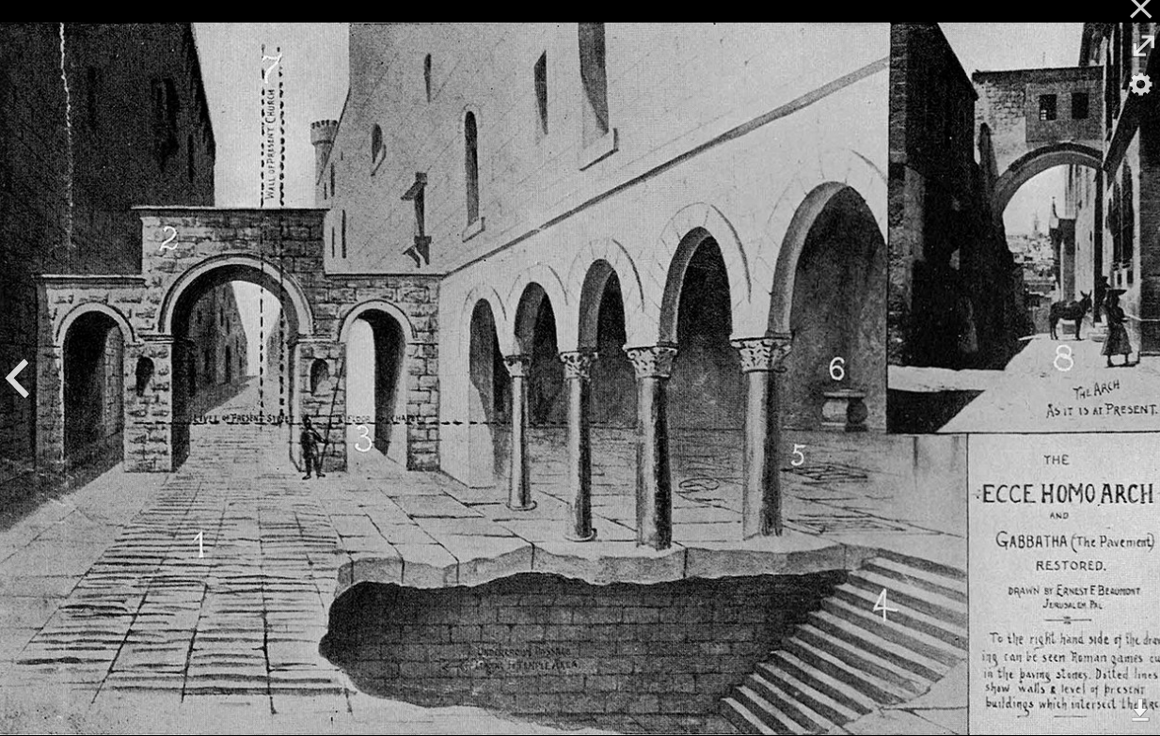
Original 135 look, not in
Yeshua’s time but in more
or less the same place.
Notes:
Depiction of the gateway of the eastern forum of Aelia Capitolina and original Roman pavement. The vertical lines show where the wall of the Convent of the Sisters of Zion currently extends. The horizontal line shows the modern street level. The stairs led to the Antonia Fortress.

Slide 32
^{Yokhanan 19.4-5} Pilate went outside once more and said to the crowd, “Look, I’m bringing him out to you to get you to understand that I find no case against him.” So Yeshua came out, wearing the thorn-branch crown and the purple robe. Pilate said to them, “Look at the man!”
Notes:
So, “Ecco homo” arch. Successor to whatever was there previously.

Slide 33
Mattityahu (Matthew) 30-31
They spit on him and used the stick to beat him about the head.

Slide 34
Ridicule often was the social backdrop of execution, naked execution, the ultimate form of shame.
Public abuse of prisoners, adorning as king and then beating, occurred to others.
Notes:
Craig Keener p 674

Slide 35
All this was in the prophecies, really confirms His supernatural role as Divine Messiah.
^{Mikha /Mic 4.14 [5.1]} With a staff they have struck the Judge of Israel on the cheek.

Slide 36
^{Yeshayahu/is 50.5-7} Adonai Elohim has opened my ear, and I neither rebelled nor turned away. I offered my back to those who struck me, my cheeks to those who plucked out my beard;
I did not hide my face from insult and spitting.

Slide 37
^{Yeshayahu/is 50.5-7} For Adonai Elohim will help.
This is why no insult can wound me. This is why I have set my face like flint, knowing I will not be ashamed.

Slide 38
Jewish leaders mocked Him as a prophet:
^{Mtt 26.65-68} “He deserves death!” Then they spit in his face and pounded him with their fists; and those who were beating him said, “Now, you ‘Messiah,’ ‘prophesy’ to us: who hit you that time?”
Notes:
Keener p 674

Slide 39
Romans mocked Him as royalty.
^{Mtt.26.28} They kneeled down in front of him and made fun of him: “Hail to the King of the Jews!”
Spittle may be a parody of the royal kiss of homage; one of severest expressions of disgust.
Notes:
By implication ridiculing His people.
Really joke was on them. ^{Phil 2.10-11} In honor of the name given Yeshua, every knee will bow — in heaven, on earth and under the earth — and every tongue will acknowledge that Yeshua the Messiah is Adonai — to the glory of God the Father.

Slide 40
^{T’hillim/Ps 22.7-9} Am I a scorn of men, despised by people? All who see me mock me. They curl their lips, shaking their heads: “Rely on Adoni! Let Him deliver him!
Let Him rescue him — since he delights in Him!
Notes:
Have you ever been scorned, ridiculed, mocked? It doesn’t feel good at all, but it’s an opportunity!

Slide 41
Mattityahu (Matthew) 30-31
They spit on him and used the stick to beat him about the head. When they had finished ridiculing him, they took off the robe, put his own clothes back on him and led him away to be nailed to the execution-stake.
Notes:
Even in this simple phrase, there is a great bit of redemptive meaning!

Slide 42
There are some Jewish judicial procedures, later recorded in the Talmud, concerning execution.

Slide 43
Maimon. Hilch. Sanhedrin, c. 13. sect. 1. “He whose sentence for death is finished, they bring him out from the house of judgment; and one stands at the door of it, and linen clothes in his hand,
Notes:
https://www.biblestudytools.com/commentaries/gills-exposition-of-the-bible/matthew-27-31.html#e

Slide 44
Maimon. Hilch. Sanhedrin, c. 13. sect. 1. and a horse at some distance from him; and a crier goes out before him, "saying", such an one is going to be executed with such a death, because he has committed such a sin, in such a place, at such a time,
Notes:
https://www.biblestudytools.com/commentaries/gills-exposition-of-the-bible/matthew-27-31.html#e

Slide 45
Maimon. Hilch. Sanhedrin, c. 13. sect. 1. such and such being witnesses; whoever knows him to be innocent, let him come, and speak in his favor: if one says, I have something to say in his favor: this waves with the linen clothes,
Notes:
https://www.biblestudytools.com/commentaries/gills-exposition-of-the-bible/matthew-27-31.html#e

Slide 46
Maimon. Hilch. Sanhedrin, c. 13. sect. 1. and the other rides upon the horse, and runs and brings back him that is judged, to the Sanhedrin; and if he is found innocent, they dismiss him: but if not, he returns, and goes to execution.
Notes:
https://www.biblestudytools.com/commentaries/gills-exposition-of-the-bible/matthew-27-31.html#e

Slide 47
No one went as a crier to seek a favorable witness for Yeshua.

Slide 48
Below is the Talmudic judicial procedure as alleged to have been applied to Yeshua ישוע

Slide 49
﻿^{Talmud - Mas. Sanhedrin 43a} ﻿On the eve of the Passover Yeshu﻿ the Nasarean was hanged.
Who? Yeshu?

Slide 50
In the Talmud He is call Yeshu ישו
not Yeshua ישוע
An acronym for
Yimakh יִמַּח
shmo שְׁמוֹ
v’zikrono. וְזִכְרוֹ v=u

Slide 51
Yimakh יִמַּח Erase
shmo שְׁמוֹ His name
v’zikrono. וְזִכְרוֹ [v=u] and His memory
Yimakh shemo is one of the strongest curses in the Hebrew language. “Yeshu” is a curse.
Notes:
https://en.wikipedia.org/wiki/Yimakh_shemo

Slide 52
﻿^{Talmud - Mas. Sanhedrin 43a} ﻿On the eve of the Passover Yeshu﻿ the Nasarean was hanged. For forty days before the execution took place, a herald went forth and cried, He is going forth to be stoned because he has practiced sorcery and enticed Israel to apostacy.

Slide 53
﻿^{Talmud - Mas. Sanhedrin 43a} ﻿Any one who can say anything in his favor, let him come forward and plead on his behalf. But since nothing was brought forward in his favor he was hanged on the eve of the Passover!

Slide 54
Jewish Law, Talmudic law, of escorting the condemned, with a crier calling for defense witnesses, was not carried out as described.
This elaborate legend was claimed in its place. “40 days before the execution…”
What really happened?
Notes:
This is why we do not endorse Talmud as authoritative. Helpful at times, but just not right sometimes.
Our afternoon presentation will by Dr. Michael Brown on the Talmud.

Slide 55
^{Isaiah 53:7} . "He is brought as a lamb to the slaughter, and as a sheep before her shearers is dumb, so he opened not his mouth.“ He made no opposition or struggle, but quietly went along with them, where they led him;

Slide 56
so he took every thing patiently from them, uttered not one complaint or any thing by way of reviling; but became meekly subject to them, and submitted himself to him that judges righteously.

Slide 57
^{1 Kefa/Peter 2.23-25} When he was insulted, he didn’t retaliate with insults; when he suffered, he didn’t threaten, but handed them over to him who judges justly. He himself bore our sins in his body on the stake,

Slide 58
^{1 Kefa/Peter 2.23-25} so that we might die to sins and live for righteous-ness — by his wounds you were healed. For you used to be like sheep gone astray, but now you have turned to the Shepherd, who watches over you.

Slide 59
This is how we return wounded people to flight, to functionality.
This is how we relate to Shabbat Shuva.

Slide 60
^{1 Kefa/Peter 2.19-22} For this finds favor. If, for the sake of conscience toward God, someone endures pain from suffering undeservedly. For what credit is there if, when you sin and get a beating, you endure? But if you endure when you do
Notes:
Someone said, “How your kids view your suffering will have more impact than your successes.”

Slide 61
^{1 Kefa/Peter 2.19-22} good and suffer for it, this finds favor with God. For you were called to this, because Messiah also suffered for you, leaving you an example so that you might follow in His footsteps: “He committed no sin, nor was any deceit found in His mouth.”
Notes:
Not only and example, but an empowering.

Slide 62
^{1 Yn 3.16-18} We have come to know love by this—Yeshua laid down His life for us, and we also ought to lay down our lives for our brothers and sisters. But if someone has material possessions and sees his brother

Slide 63
^{1 Yn 3.16-18} in need and closes his heart against him, how does the love of God abide in him? Children, let us not love with word or talk, but in deed and truth!

Slide 64
Takeaway: Prepare your minds that when the next insult, accusation, diminution of your greatness happens, you will take it patiently. With grace. With gentleness, forgiveness. Respond, but in His power.

Slide 65
^{Mishlei 5.1-4} A gentle response deflects fury, but a harsh word makes tempers rise.

Slide 66
There is a LOT of material to learn in this walk with Messiah, but really only one thing to know and to teach.

Slide 67
That is, He went to the execution stake freely for our sins. If we receive Him, we receive atonement, a personal Yom Kippur!
The rest helps us with this,
or it isn’t really helpful.

Slide 68
^{1 Cor. 2.2} I had decided that while I was with you I would forget everything except Yeshua the Messiah, and even him only as someone who had been executed on a stake as a criminal.

Slide 69
^{1 Cor. 1. 17-19} For the Messiah did not send me to immerse but to proclaim the Good News — and to do it without relying on “wisdom” that consists of mere rhetoric, so as not to rob the Messiah’s execution-stake of its power.

Slide 70
^{1 Cor. 1. 17-19} For the message about the execution-stake is nonsense to those in the process of being destroyed, but to us in the process of being saved it is the power of God. Indeed, the Tanakh says, “I will destroy the wisdom of the wise and frustrate the intelligence of the intelligent.”

Slide 71
^{Mtt. 16.24-26} Then Yeshua told his talmidim, “If anyone wants to come after me, let him say ‘No’ to himself, take up his execution-stake, and keep following me. For whoever wants to save his own life will destroy it,
Notes:
Literally, no one followed Him in His walk from Pilate’s judgment hall to the place of execution

Slide 72
^{Mtt. 16.24-26} but whoever destroys his life for my sake will find it. What good will it do someone if he gains the whole world but forfeits his life? Or, what can a person give in exchange for his life?
Notes:
No one followed Him in His walk from Pilates judgment hall to the place of execution.

Slide 73
^{Yokhanan 12.23-26} Yeshua gave them this answer: “The time has come for the Son of Man to be glorified. Yes, indeed! I tell you that unless a grain of wheat that falls to the ground dies, it stays just a grain; but if it dies, it produces a big harvest. He who loves his life loses it,

Slide 74
^{Yokhanan 12.23-26} but he who hates his life in this world will keep it safe right on into eternal life! If someone is serving me, let him follow me; wherever I am, my servant will be there too. My Father will honor anyone who serves me.

Slide 75
^{1 Cor. 1.23-24} We go on proclaiming a Messiah executed on a stake as a criminal! To Jews this is an obstacle, and to Greeks it is nonsense; but to those who are called, both Jews and Greeks, this same Messiah is God’s power and God’s wisdom!
Notes:
We proclaim Him, and seek to be LIKE him in suffering, in life.
I think it fits here to introduce some stellar workers in the kingdom who are doing just this.

Slide 76
Introducing Jason & Janet Rose, who live in Ramat Gan, Israel, and proclaim Messiah with power there in the Land!
5 minute report.

Slide 77

https://vimeo.com/cpmusa/review/360273350/bcfcede3ef

Slide 78
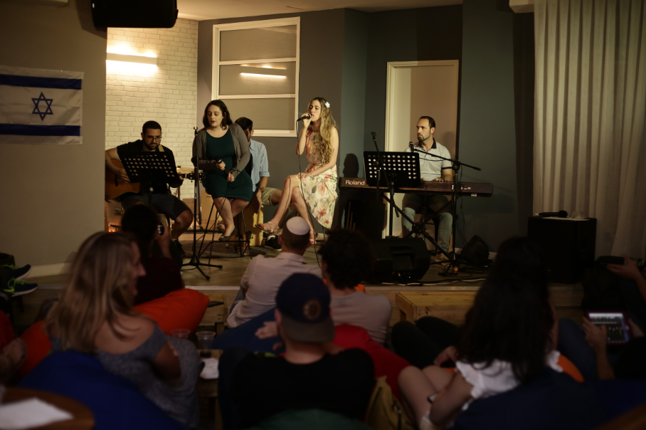

Slide 79


Slide 80


Slide 81
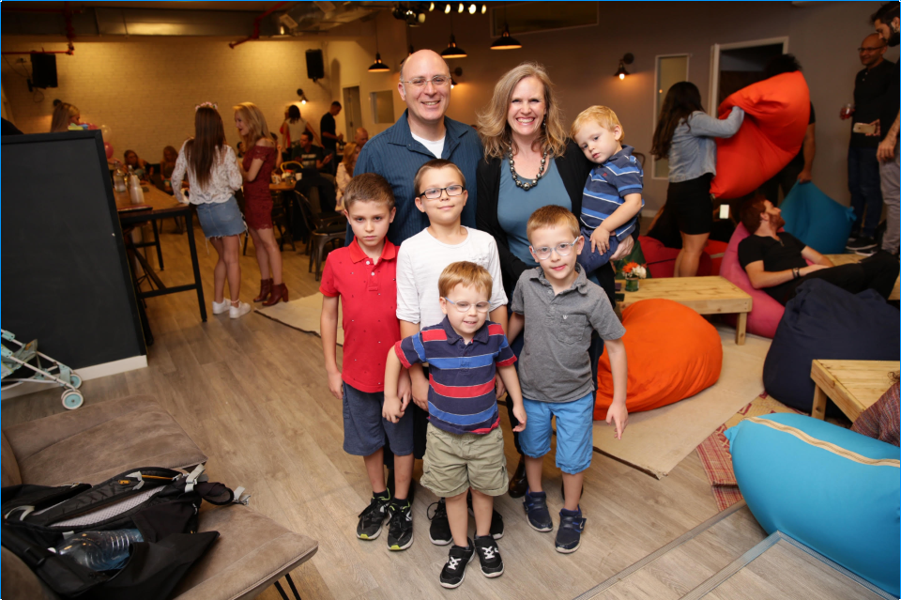

Slide 82
This is how we return wounded people to flight, to functionality: declaring and living the message of Messiah.
This is how we relate to Shabbat Shuva.

Slide 83
Takeaway: Prepare your minds that when the next insult, accusation, diminution of your greatness happens, you will take it patiently. With grace. With gentleness, forgiveness. Respond, but in His power.

Slide 84
^{Mishlei 5.1-4} A gentle response deflects fury, but a harsh word makes tempers rise.

Slide 85
^{Mishlei 5.1-4} The tongue of the wise presents knowledge well, but the mouth of a fool spews out folly. The eyes of Adoni are everywhere, watching the evil and the good. A soothing tongue is a tree of life, but when it twists things, it breaks the spirit.

Slide 86
An extreme example, in the news this week, of an intensely longsuffering presentation of Messiah!

Slide 87
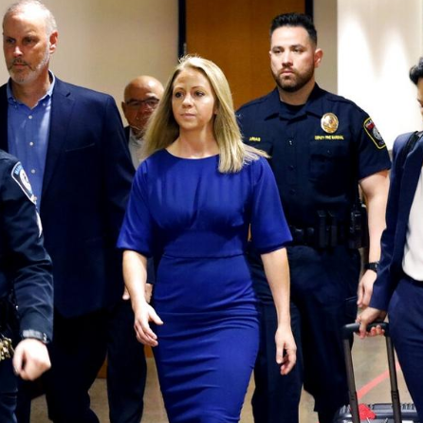
Amber Guyger arrives for trial.

Slide 88
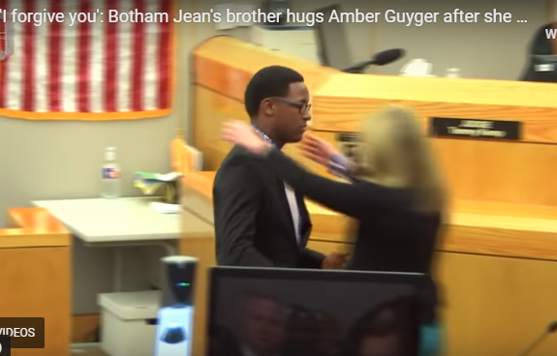
Notes:
https://www.charismanews.com/video/78261-man-forgives-ex-cop-who-killed-his-brother-if-you-go-to-god-and-ask-him-he-will-forgive-you?utm_source=Charisma%20News%20Daily&utm_medium=email&utm_content=subscriber_id:5160390&utm_campaign=CNO%20daily%20-%202019-10-04
"I'm not going to say anything else. I think giving your life to Christ would be the best thing that Botham would want you to do. Again, I love you as a person, and I don't wish anything bad on you."
Brandt then asked Judge Tammy Kemp if he could give Guyger a hug. After his second "Please?" the judge gave permission, and Brandt hugged Guyger, who sobbed on his shoulder for at least 30 seconds.

Slide 89
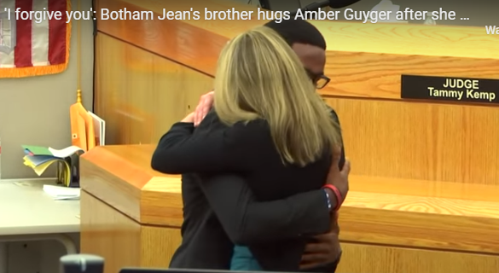

Slide 90
This is how we return wounded people to flight, to functionality: declaring and living the message of Messiah.
This is how we relate to Shabbat Shuva.

Slide 91
Takeaway: Prepare your minds that when the next insult, accusation, diminution of your greatness happens, you will take it patiently. With grace. With gentleness, forgiveness. Respond, but in His power.

