Slide 1
e-handout
To have these notes
without taking notes
Go to OrHaOlam.com
Click on downloads,
messages, 2019
Notes:
.

Slide 2
I received the following from Evan Levine, who runs the first Messianic adoption agency in Israel.

Slide 3
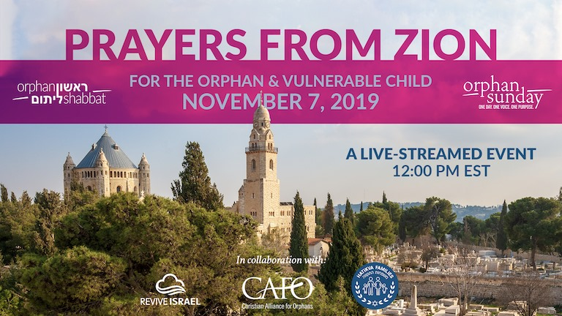

Slide 4
We didn’t get to promote it,
but it was part of
Orphan and Vulnerable Child Sunday, Nov. 10, 2019.
OVC

Slide 5

Notes:
So, if you can change gears, before the message, I am going to dedicate a few minutes to this.

Slide 6
WHY ORPHAN SHABBAT?
God is vested, deeply and personally, in the plight of the orphan (i.e. Devarim 10:18; Tehillim 68:6). He calls His people to defend and care for the fatherless (Yeshayahu 1:17, Tehillim 82:3).

Slide 7
We are in a critical, global, orphan and vulnerable child crisis. Millions of children are left parentless through war, disease, poverty, labor exploitation, human trafficking, accidents, and abandonment, leaving them at-risk and without hope.

Slide 8
There are currently more than 140 million orphans worldwide. 15 million of these children are double orphans, meaning they have lost both parents.

Slide 9
There are anywhere from 2-8 million children on the streets or in institutionalized care.
Inter-country adoption has decreased by 77 percent since its highest point in 2004.

Slide 10
These overwhelming and staggering statistics can create a sense of hopelessness, but they can also inspire and empower us to take action and serve vulnerable children.

Slide 11
IN ISRAEL
The Orphan Crisis in Israel is particularly complex. Because of political, social, and cultural factors, adoption in Israel is difficult and rare. Institutions are the most common orphan-care solution which leaves hundreds of thousands of children at risk.

Slide 12
There are over 365,000 at-risk children in Israel.
Over 10,000 children have been removed from their homes by Social Services, but only 25% of those children have been placed in foster care.

Slide 13
Couples wait an average of 5 years to adopt a child and only 120 successful adoptions occur each year.
But together, we can make a difference. It is our desire to see Israelis take up the cause of orphans and vulnerable children one community at a time.
Notes:
40 K abortions/yr Israel

Slide 14
GET INSPIRED

Slide 15


Slide 16


Slide 17
A PRAYER FOR ORPHANS [read together] Adoni, G-d of all living things, You are the G-d of children whose parents care for them, and You are the G-d of children who have no caring parents. Your love for Your children is

Slide 18
reflected in a mother’s kiss on her child’s cheek and in the warmth of a father’s embrace. Parents are Your partners on Earth to provide children with food for their stomachs, shelter for their bodies, and nourishment for their souls.

Slide 19
Adoni, You are also the G-d of children who have no parents to kiss them when they cry or hug them when they are afraid. You are the G-d of children who face daily the scars of abandonment. And You are the G-d of children who have no hope.

Slide 20
We come to you today to reflect on the children who have no parents or whose parents have forsaken them. We know we cannot eliminate their wounds. Only You can provide true healing. But You have called us to show the love once shown to us—to come alongside, care, sooth, and nurture them in Your love.
The Psalmist declared that You are the Father of orphans. You have eternally been the orphan’s help. Just as You care for the orphan, so must we. Just as You embrace the forgotten child, so must we. Just as You feed the hungry, so must we. Just as You provide a home for our protection and security, so must we provide a warm and welcoming home to those children who are facing the unbearable.
On this day and beyond we pray for the guidance, inspiration, and strength to follow Your example and to live out Your call to provide the care and love of a mother and father to these beautiful children.
In Your Name, let it be so.
Amen.
We come to you today to reflect on the children who have no parents or whose parents have forsaken them. We know we cannot eliminate their wounds. Only You can provide true healing. But You have called us

Slide 21
to show the love once shown to us — to come alongside, care, sooth, and nurture them in Your love.
The Psalmist declared that You are the Father of orphans. You have eternally been the

Slide 22
orphan’s help. Just as You care for the orphan, so must we. Just as You embrace the forgotten child, so must we. Just as You feed the hungry, so must we. Just as You provide a home for our protection and security, so

Slide 23
must we provide a warm and welcoming home to those children who are facing the unbearable.
On this day and beyond we pray for the guidance, inspiration, and strength to follow Your

Slide 24
example and to live out Your call to provide the care and love of a mother and father to these beautiful children.
In Your Name, Yeshua, let it be so.
Amen.

Slide 25
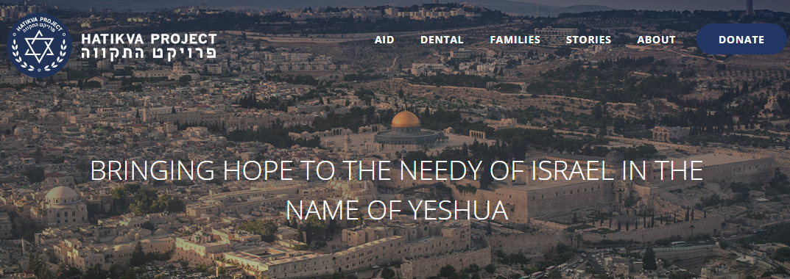
Go to https://hatikvaproject.org/
to do more, adopt adopters!
Notes:
Now transition again, to message mode.

Slide 26
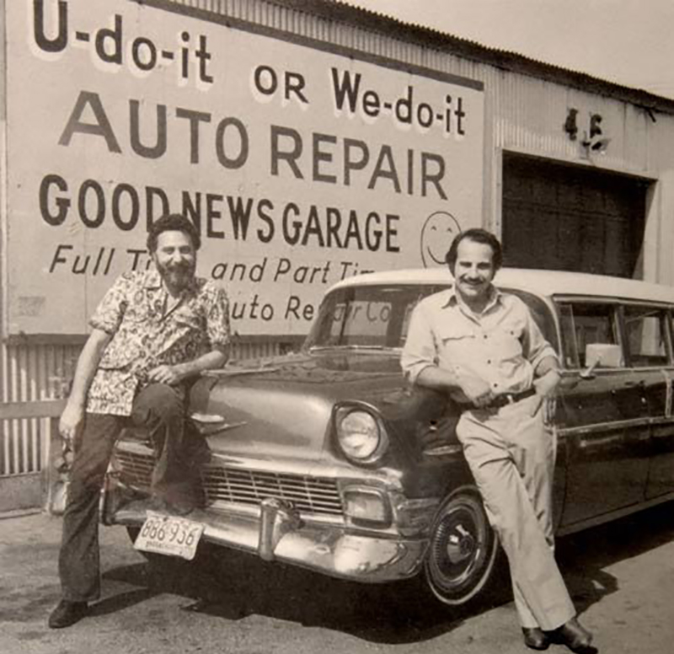
Tom & Ray Magliozzi of Car Talk. In 2012, it had 3.3 million listeners each week on about 660 NPR stations.
Notes:
http://www.brakeforit.com/modern-auto/the-incredible-story-behind-the-radio-show-car-talk/2/?chrome=1
Caller with automotive question. They would make fun of model car, home town, person’s name…all in good sport…then really great advice.
Always closed out their hour long show with credits like you’ve never heard…

Slide 27
Law firm Dewey Chetham and Howe.
statistician Marge Innovera (margin of error),
customer care representative Haywood Jabuzoff
(hey would ya buzz off),
meteorologist Claudio Vernight
(cloudy overnight)
Notes:
https://www.cartalk.com/content/staff-credits

Slide 28
Accounts Payable Imelda Czechs
Air-Quality Monitor Carmine Dioxide
Russian Chauffeur Picov Andropov
Russian Gas Station Attendant Phillip Antopitov
Notes:
https://www.cartalk.com/content/staff-credits

Slide 29
First all-female spacewalk
in the news recently
doing a repair of the
International Space Station
ISS

Slide 30
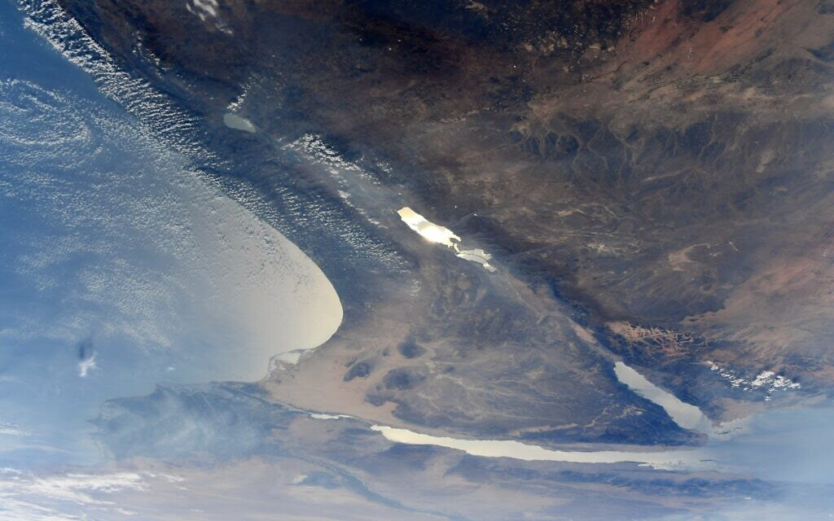
Photo of Israel taken by
astronaut Jessica Meir
Notes:
https://youtu.be/L6WUIUqY8_A

Slide 31
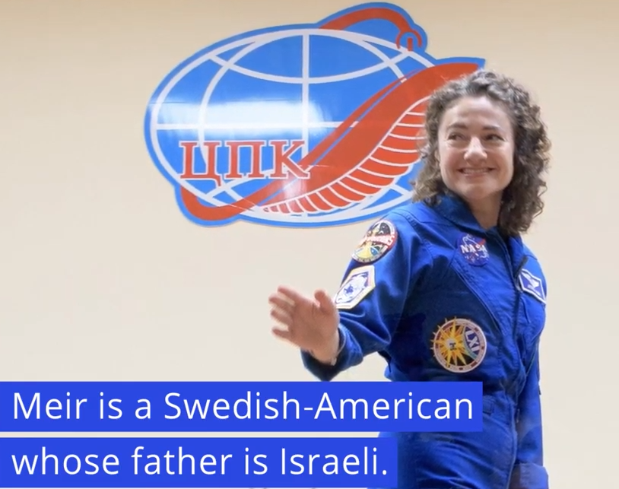
Notes:
Part of first all female duo spacewalk doing a repair of the ISS
https://youtu.be/L6WUIUqY8_A

Slide 32
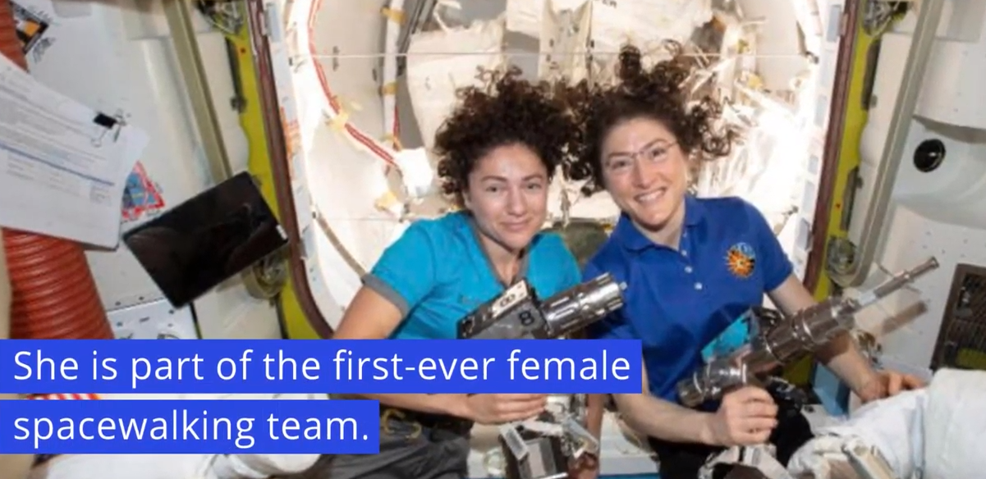
Notes:
https://youtu.be/L6WUIUqY8_A

Slide 33
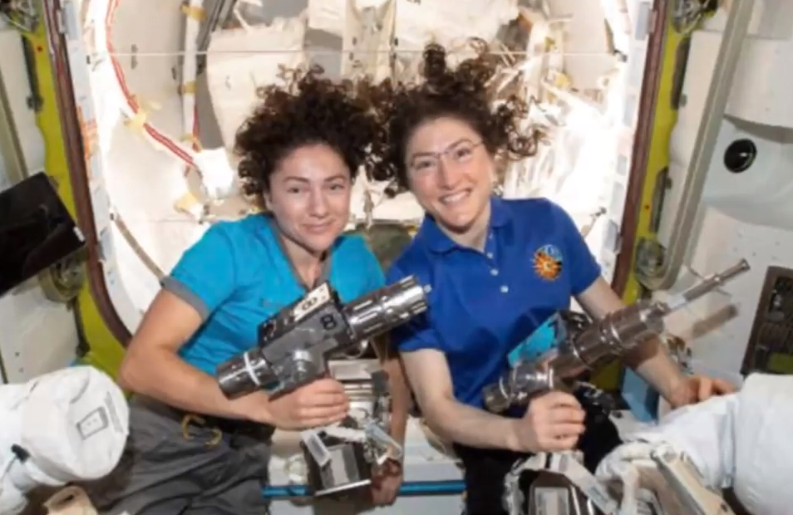
Notes:
https://youtu.be/L6WUIUqY8_A
I think she saw Israel in it’s beautiful entirety, and the concepts of the Pat Boone song, written to support Israel in the movie Exodus, came out.

Slide 34
Photo of Israel taken by
astronaut Jessica Meir
Notes:
https://youtu.be/L6WUIUqY8_A
This land, is mine, G-d gave this Land to me..
Scenery seems all wrong with the song next, but it’s about Israel, written by Pat Boone for the Paul Newman movie Exodus.

Slide 35
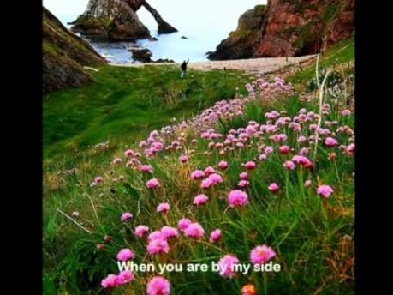
Pat Boone sings the Exodus song, about Israel.
Notes:
Scenery seems all wrong, but it’s about the Paul Newman movie Exodus

Slide 36
Photo of Israel taken by
Astronaut Jessica Meir
Notes:
https://youtu.be/L6WUIUqY8_A
Just after the Holocaust…Children run free was a BIG deal

Slide 37
Speaking of heroic women…
There was a cadre of woman at the tomb first…Why?

Slide 38
What were the women thinking, intending in their visit to the tomb?
“To see” and confirm the end?
“To anoint the body”?
To mourn the tragedy and loss?
Expecting resurrection?
Notes:
This is the download of this message to me, for you.
Forget all previous focus for now:
What were they intending?
What can we learn from them?

Slide 39
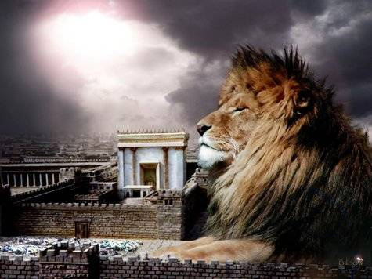
מַתִּתְיָהוּ Mattityahu
(Matthew) 28:1-4

Slide 40
Mattityahu (Matthew) 28:1
אַחֲרֵי הַשַּׁבָּת, עִם עֲלוֹת הַשַּׁחַר שֶׁל יוֹם רִאשׁוֹן, בָּאוּ מִרְיָם הַמַּגְדָּלִית וּמִרְיָם הָאַחֶרֶת לִרְאוֹת אֶת הַקֶּבֶר.‏
After Shabbat, as the next day was dawning, Miryam of Magdala and the other Miryam went to see the grave.
Notes:
Craig Keener notes that women were relegated to a marginal role in discipleship at best, not permitted to be disciples of rabbis. But Yeshua had a cadre of women that followed Him, in ways that may have appeared scandalous in that culture [Keener Commentary on Matthew p 689]
Women could support religious movements as patrons, but their support tended to reflect negatively on those movements.

Slide 41
Backstory about women following Yeshua

Slide 42
^{Lk 8.1-3} After this, Yeshua traveled about from town to town and village to village, proclaiming the Good News of the Kingdom of God. With him were the Twelve, and a number of women who had been healed from evil spirits and illnesses — Miryam (called Magdalit),
Notes:
Limits of propriety?

Slide 43
^{Lk 8.1-3} from whom seven demons had gone out; Yokhanah the wife of Herod’s finance minister Kuza; Shoshanah; and many other women who drew on their own wealth to help him.
Notes:
Women could support religious movements as patrons, but their support tended to reflect negatively on those movements.

Slide 44
^{Mark 15.40-41, 47} [At the execution] There were women looking on from a distance; among them were Miryam from Magdala, Miryam the mother of the younger Ya‘akov and of Yosi, and Shlomit. These women had followed him and helped him when he was in the Galil/ Galilee.

Slide 45
^{Mark 15.40-41, 47} And many other women were there who had come up with him to Yerushalayim …Miryam of Magdala and Miryam the mother of Yosi saw where he had been laid.
Notes:
Mark’s version of the morning after…

Slide 46
^{Mark 16.1-3} When Shabbat was over, Miryam of Magdala, Miryam the mother of Ya‘akov, and Shlomit bought spices in order to go and anoint Yeshua. Very early the next day, just after sunrise, they went to the tomb.

Slide 47
^{Mark 16.1-3} They were asking each other, “Who will roll away the stone from the entrance to the tomb for us?”
Notes:
Luke’s version of the morning after…

Slide 48
^{Lk 24.1-2} The next day, while it was still very early, they took the spices they had prepared, went to the tomb, and found the stone rolled away from the tomb
Notes:
John’s version of the morning after…

Slide 49
^{Yokhanan 20.1-2} Early on the first day of the week, while it was still dark, Miryam from Magdala went to the tomb and saw that the stone had been removed from the tomb. So she came running to Shim‘on Kefa

Slide 50
^{Yokhanan 20.1-2} and to the other talmid, the one Yeshua loved, and said to them, “They’ve taken the Lord out of the tomb, and we don’t know where they’ve put him!”

Slide 51
What were the women thinking, intending in their visit to the tomb?
“To see” and confirm the end.
“To anoint the body.”
To mourn the tragedy and loss.
Expecting resurrection?
Notes:
We look back on the scene with hindsight, and understand that it was a resurrection day. THE resurrection day, but to them it was a day of tragic commemoration…

Slide 52
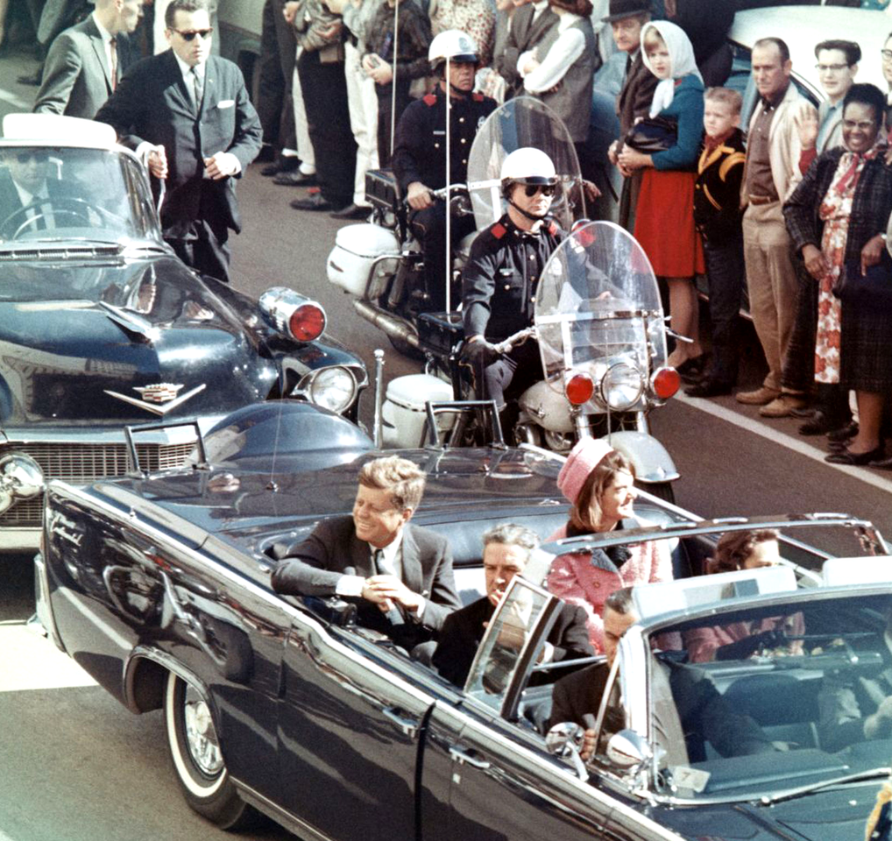
Pres. Kennedy in Dallas, TX, on Main St., minutes before the assassination, Nov. 22, 1962.

Slide 53
The state funeral of John F. Kennedy, 35th President of the United States, took place in Washington, D.C., during the three days that followed his assassination on Friday, November 22, 1963, in Dallas, Texas.
Notes:
Nothing on TV for three days: no cartoons, no sports, no sitcoms.

Slide 54
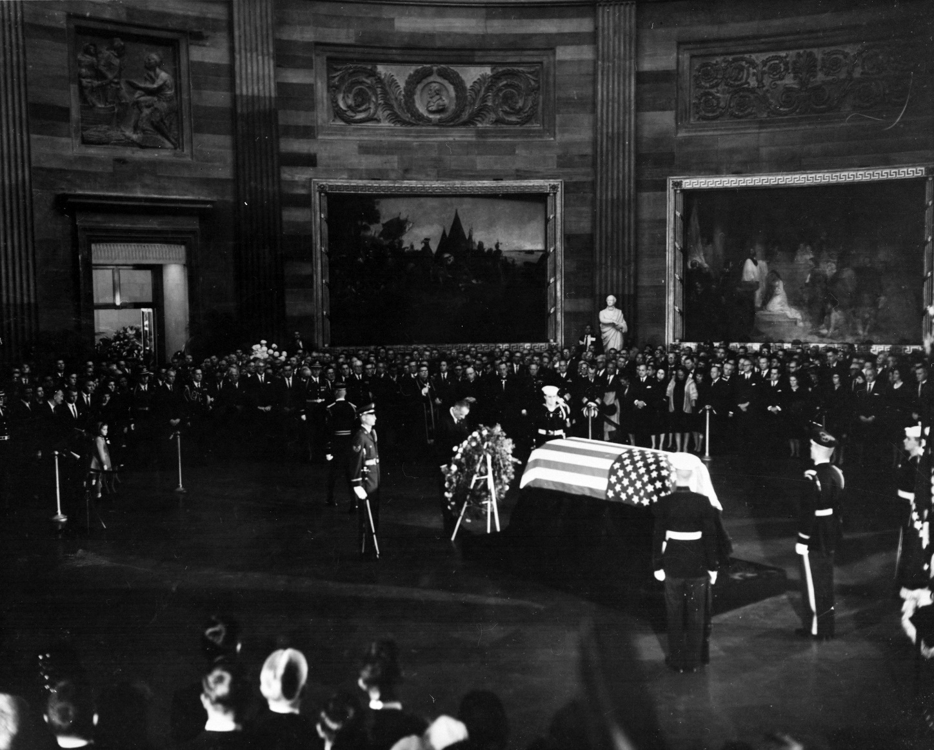
Pres. Johnson places a wreath

Slide 55
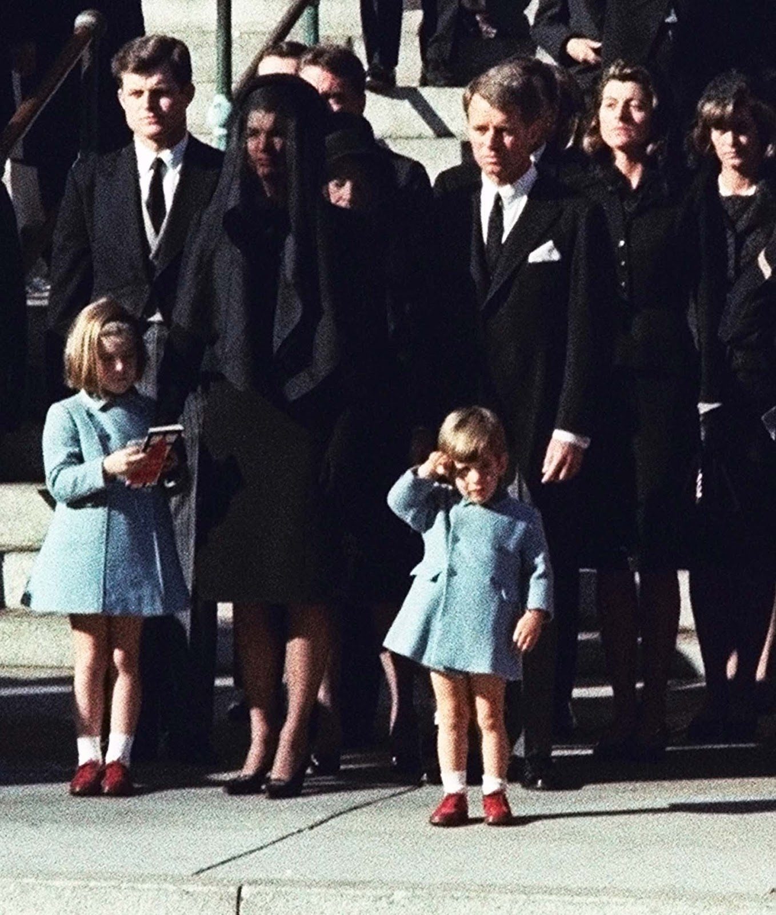
John Jr. salutes his father’s casket.

Slide 56
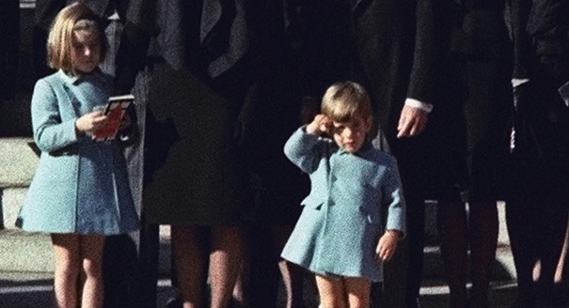
Notes:
https://www.politico.com/blogs/politico-now/2013/11/story-behind-the-salute-178248
Caroline was NOT looking at her phone.

Slide 57
Jewish burial customs
Burial as soon as possible.
Seven days of morning. Shiva
30 days Shloshim
One year saying Kaddish
So, apparently, the women came to start all this!
Notes:
How old these customs: for Moshe and Aharon 30 days.

Slide 58
The men didn’t have hope either.

Slide 59
^{Lk 24.13-24} Now, two of them on that very day were traveling to a village…, a distance of about seven miles from Jerusalem. They were speaking with one another about all the things that had been happening. While they were talking and discussing,

Slide 60
^{Lk 24.13-24} Yeshua Himself approached and began traveling with them…Then He said to them, “What are these things you are discussing with one another as you are walking along?” They stood still, looking gloomy.

Slide 61
^{Lk 24.13-24} The ruling kohanim and our leaders handed Him over to be sentenced to death, and they executed Him. But we were hoping that He was the One about to redeem Israel. Besides all this, today is the third day since these things happened.
Notes:
NOTE Past tense

Slide 62
^{Lk 24.13-24} “But also some women among us amazed us. Early in the morning they were at the tomb. When they didn’t find His body, they came saying that they had also seen a vision of angels, who said He is alive! Some of those with us went to the tomb and found it just as the women said, but they did not see Him.”
Notes:
Were they encouraged by the women’s report?
Seems more perplexed!
So, both the men talmidim, and the women, were in despair. But…

Slide 63
This was the intention of the women:
They were serving Yeshua in faith, without evidence, feeling, ceremony, hope, just because it was right.
Notes:
This is the takeaway: how are WE serving.
What is your intention and mine when it comes to serving and living for Yeshua the Messiah, the King of Israel, the Redeemer of the World? If evidence, feeling, ceremony, hope not present.
When things aren’t going well.
Let’s explore the meaning of faith. “Dry” faith.
Resurrection Day before resurrection, Firstfruits Day before firstfruits faith.
Those ladies came when things going VERY not well.

Slide 64
^{Mes Jews/Heb 11.1-3} Now faith is the substance of things hoped for, the evidence of realities not seen.
Prototype faith. Faith chapter, MJ/Heb chapter 11.
What are the components of MJ/Heb chapter 11 faith?
Notes:
These women came in FAITH. Big picture of faith..

Slide 65
1. ^{Mes Jews/Heb 11.1-3} By faith we understand that the universe was created by the word of God, so that what is seen did not come from anything visible. Ex nihilo
Long day/old earth?
Short day/young earth?
Notes:
Creationism was not their immediate problem that Sunday morning, but this is the MJ/Heb 11 big pix of faith. They believed that it was G-d’s created world!
This idea, of divine special creation, gets scoffed at in the public domain. However…John Ankerberg radio…
Two great problems with evolution at recent conference: Cambrian explosion, and DNA ~ computer coding. Mutations almost always disaster. https://www.lightsource.com/ministry/ankerberg-show/the-importance-of-the-cambrian-explosion-483243.html

Slide 66
^{Ro. 4.17-19} Avraham is our father in God’s sight because he trusted God as the one who gives life to the dead and calls nonexistent things into existence. For he was past hope, yet in hope he trusted that he would indeed become
Notes:
Abraham’s faith tied to creationism. Abe past hope.
These ladies were way past hope. Just walking on, because they believed He Messiah.

Slide 67
^{Ro. 4.17-19} a father to many nations, in keeping with what he had been told, “So many will your seed be.” His trust did not waver when he considered his own body — which was as good as dead, since he was about a hundred years old — or when he considered that Sarah’s womb was dead too.

Slide 68
2. ^{Mes Jews/Heb 11.5} By faith Abel offered God a better sacrifice than Cain.
Notes:
2. Worshiped G-d way. With the blood, in the Spirit, in Word and in Truth!
These women came to worship HIM as Messiah and King!
Messianic genre songs are an expression of TRUTH.

Slide 69
^{Mes Jews/Heb 11.6} Now without faith it is impossible to please God. For the one who comes to God must believe that He exists and that He is a rewarder of those who seek Him.
Notes:
Kind of a footnote: creationist faith, worship expression faith, all forms faith must be saturated with sense that G-d is listening, and will respond.

Slide 70
3. ^{Mes Jews/Heb 11.7} By trusting, Noakh, after receiving divine warning about things as yet unseen, was filled with holy fear and built an ark to save his household. Build: invest, serve, volunteer.
Notes:
Lived with judgement, eternity in sight. Invest resources in Kingdom. These women investing themselves in Yeshua.
NOT MEAN no retirement planning, but first tithe, give. Purim Pay down?
Also SERVE. Volunteer, invest energies, time. See people in the kitchen doing pots and pans? They are building and ark, sort of.

Slide 71
4. By faith, Avraham obeyed, after being called to go out to a place which God would give him as a possession; indeed, he went out without knowing where he was going.
Notes:
Follow G-d, no matter what or where. But know that you are called. Don’t do weird stuff
Women were following the One they thought was Messiah and King of Israel!

Slide 72
Check an impression:
Scriptural
right
reasonable
providential
Notes:
Martin Wells Knapp

Slide 73
5.^{Mes Jews/Heb 11.13} These all died in faith without receiving the things promised—but they saw them and welcomed them from afar, and they confessed that they were strangers and sojourners on the earth.
Notes:
5. There gets to be over time, a disconnect in our hearts from the whole world system and economy. We like things, but a bit less.

Slide 74
6. ^{Mes Jews/Heb 11.17} By faith Abraham, when he was tested, offered up Isaac.
Notes:
To these ladies, the Kingship of Israel was lost, but they were persevering.
What is dearest to us? G-d will test us so we have no idols.

Slide 75
7. ^{Mes Jews/Heb 11.22} By faith and trusting, Yosef, near the end of his life, remembered about the Exodus of the people of Isra’el and gave instructions about what to do with his bones.
Notes:
Yosef remembered G-d’s promises and His Word are TRUE. Will be vindicated. These ladies remembering G-d’s promises, even though looked hopeless.
Wonderful teaching on the vindication of G-d’s word recently.

Slide 76
The biblical account of the Exodus provides the most dramatic story of redemption in the Old Testament. Yet the validity of this story has been challenged by many scholars, due in part to the lack of evidence for a large population in
Notes:
https://patternsofevidence.com/2019/11/01/discovery-of-canaanite-metropolis-supports-bible/?inf_contact_key=fa8ae55b2f4c76dbf2c8fae6ce2c90e8680f8914173f9191b1c0223e68310bb1

Slide 77
Canaan that can be thought of as greater and mightier than the Israelites, as Moses emphasized in the Book of Deuteronomy. However, spectacular new finds being excavated in northern Israel are providing archaeological evidence to the Bible’s claims.
Notes:
https://patternsofevidence.com/2019/11/01/discovery-of-canaanite-metropolis-supports-bible/?inf_contact_key=fa8ae55b2f4c76dbf2c8fae6ce2c90e8680f8914173f9191b1c0223e68310bb1

Slide 78
A new discovery has been made in Northern Israel and according to excavation director Yitzhak Paz, “The study of this site will change forever what we know about the emergence [and] rise of urbanization in the land of Israel and in the whole region.”
Notes:
https://patternsofevidence.com/2019/11/01/discovery-of-canaanite-metropolis-supports-bible/?inf_contact_key=fa8ae55b2f4c76dbf2c8fae6ce2c90e8680f8914173f9191b1c0223e68310bb1

Slide 79
Being dubbed “The New York of the Early Bronze Age,” an ancient city has been discovered in Northern Israel where none was supposed to be. Co-director Dr. Yitzhak Paz added, “There is no doubt that this site dramatically changes what we know about the character of the period and beginning of urbanization in Israel,” he said in a press release from the IAA.
Notes:
https://patternsofevidence.com/2019/11/01/discovery-of-canaanite-metropolis-supports-bible/?inf_contact_key=fa8ae55b2f4c76dbf2c8fae6ce2c90e8680f8914173f9191b1c0223e68310bb1
Calling it a "cosmopolitan and planned city," the authority said the early Bronze Age settlement covered 65 hectares (160 acres) and was home to about 6,000 people.
"In this city, we have a planned settlement with a whole net of streets and alleys and squares, and drainage installations, storage installation," said Yitzhak Paz, a director of excavation on behalf of the authority.
https://phys.org/news/2019-10-israeli-archaeologists-ancient-city.html

Slide 80
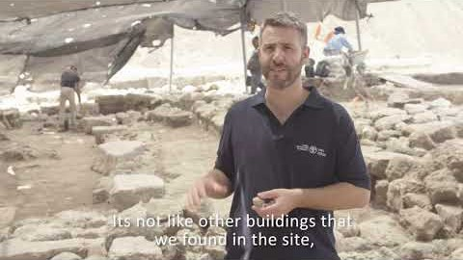
Notes:
3:22

Slide 81
7. ^{Mes Jews/Heb 11.22} By faith and trusting, Yosef, near the end of his life, remembered about the Exodus of the people of Isra’el and gave instructions about what to do with his bones.
Notes:
Yosef remembered G-d’s promises and His Word are TRUE. Will be vindicated. These ladies remembering G-d’s promises, even though looked hopeless.
Wonderful teaching on the vindication of G-d’s word recently.

Slide 82
8. ^{Mes Jews/Heb 11.31-32} By faith the walls of Jericho fell down after they were circled for seven days. By faith Rahab the prostitute did not perish with those who were disobedient, because she welcomed the spies with shalom.
Notes:
8. We can overcome the Jerichos, win the sensual, perverted people of our culture. I’m going to propose something hopeful…

Slide 83
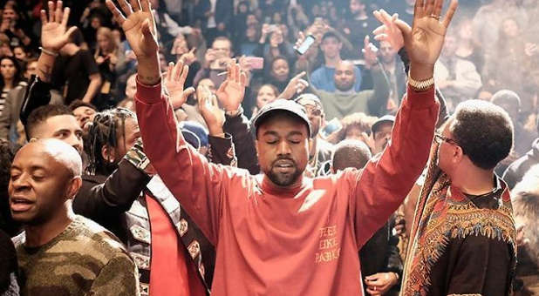
Kanye West a believer?
Notes:
https://www.charismanews.com/opinion/78610-is-kanye-west-s-conversion-to-christ-for-real

Slide 84
Kanye West is one of the top-selling musical artists of all time, but his earliest music was so raunchy that Billboard wrote an article in 2016 listing his most profanity-laced lyrics. We could not print those words here. Kanye was the last guy anybody expected to give his life to Yeshua.
Notes:
https://www.charismanews.com/opinion/78610-is-kanye-west-s-conversion-to-christ-for-real

Slide 85
But things started changing a few years ago. In 2014, during one of his concerts, he referred to himself as a Christian. That same year, his flamboyant wife, Kim Kardashian, made the announcement more official. "He has had an amazing evolution of being born again and being saved," she said.
Notes:
https://www.charismanews.com/opinion/78610-is-kanye-west-s-conversion-to-christ-for-real

Slide 86

Kim Kardashnian West on Kanye’s new faith
Notes:
https://www.charismanews.com/culture/78713-kim-kardashian-says-kanye-west-s-faith-is-a-great-example-for-our-kids?utm_source=In%20the%20Line%20of%20Fire&utm_medium=email&utm_content=subscriber_id:5194514&utm_campaign=Blogger%20-%20Michael%20Brown%20-%202019-11-08

Slide 87
Kim Kardashian Says Kanye West's Faith Is 'a Great Example for Our Kids’ Kim Kardashian has opened up about the many ways in which her husband's newfound Christian faith has impacted their family.
Notes:
https://www.charismanews.com/culture/78713-kim-kardashian-says-kanye-west-s-faith-is-a-great-example-for-our-kids?utm_source=In%20the%20Line%20of%20Fire&utm_medium=email&utm_content=subscriber_id:5194514&utm_campaign=Blogger%20-%20Michael%20Brown%20-%202019-11-08

Slide 88
Kim explained how Kanye West has become increasingly concerned about how to raise their kids and ensure they do not have unrestricted access to many of the damaging aspects of our modern culture.
Notes:
https://www.charismanews.com/culture/78713-kim-kardashian-says-kanye-west-s-faith-is-a-great-example-for-our-kids?utm_source=In%20the%20Line%20of%20Fire&utm_medium=email&utm_content=subscriber_id:5194514&utm_campaign=Blogger%20-%20Michael%20Brown%20-%202019-11-08

Slide 89
"The kids are getting older; he's very cautious about what we have in the house—we got rid of the TVs in the kids' rooms and removed makeup from North's room," Kim explained. "He's... had this epiphany...not that he wasn't an amazing dad, but being a little bit more strict as a dad and being very forceful on the imagery that's in our household and what they see."
Notes:
https://www.charismanews.com/culture/78713-kim-kardashian-says-kanye-west-s-faith-is-a-great-example-for-our-kids?utm_source=In%20the%20Line%20of%20Fire&utm_medium=email&utm_content=subscriber_id:5194514&utm_campaign=Blogger%20-%20Michael%20Brown%20-%202019-11-08

Slide 90
I’m not guaranteeing anything, but let’s pray for Kanye and Kim West!!

Slide 91
Summary:
The women came in “dry” faith.
Faith, according to MJ/Heb 11 means:
G-d is the Creator
We worship in Spirit and Truth AND SERVE.

Slide 92
3. Eternal judgement is a reality.
4. We are committed to follow His leadings.
5. This world is less our home.
6. G-d will test every possible idol
7. G-d will vindicate His Word.
8. G-d will win every battle.

Slide 93
Mattityahu (Matthew) 28:2
לְפֶתַע הָיְתָה רְעִידַת אֲדָמָה חֲזָקָה,
Suddenly there was a violent earthquake,
Notes:
Because G-d moving in history. Sovereignly changing history.
He continues to move, and there are earthquakes in response to our faith…

Slide 94
^{Acts 16.23-26} After giving them a severe beating, they threw them in prison, charging the jailer to guard them securely. Upon receiving such an order, he threw them into the inner cell and clamped their feet securely between heavy blocks of wood.

Slide 95
^{Acts 16.23-26} Around midnight, Sha’ul and Sila were praying and singing hymns to God, while the other prisoners listened attentively. Suddenly there was a violent earthquake which shook the prison to its foundations. All the doors flew open and everyone’s chains came loose.
Notes:
Had to be an earthquake. Was one already in the spirit.

Slide 96
Mattityahu (Matthew) 28:2
לְפֶתַע הָיְתָה רְעִידַת אֲדָמָה חֲזָקָה, כִּי מַלְאַךְ יְיָ יָרַד מִן הַשָּׁמַיִם,
Suddenly there was a violent earthquake, for an angel of Adoni came down from heaven,

Slide 97
Mattityahu (Matthew) 28:2
נִגַּשׁ וְגָלַל אֶת הָאֶבֶן מִן הַפֶּתַח וְיָשַׁב
עָלֶיהָ.
rolled away the stone and sat on it.

Slide 98
Mattityahu (Matthew) 28:3
‏מַרְאֵהוּ הָיָה כְּבָרָק וּלְבוּשׁוֹ לָבָן כַּשֶּׁלֶג,
His appearance was like lightning, and his clothes were as white as snow.

Slide 99
Mattityahu (Matthew) 28:4
‏וּמִפַּחְדּוֹ נִבְהֲלוּ הַשּׁוֹמְרִים וְהָיו כְּמֵתִים.
The guards were so terrified at him that they trembled and became like dead men.

Slide 100
Summary:
The women came in “dry” faith.
Faith, according to MJ/Heb 11 means:
G-d is the Creator
We worship in Spirit and Truth, and SERVE.

Slide 101
3. Eternal judgement is a reality.
4. We are committed to follow His leadings.
5. This world is less our home.
6. G-d will test every possible idol
7. G-d will vindicate His Word.
8. G-d will win every battle.

Slide 103


