Slide 1
e-handout
To have these notes
without taking notes
Go to OrHaOlam.com
Click on downloads,
messages, 2019
Notes:
.

Slide 2
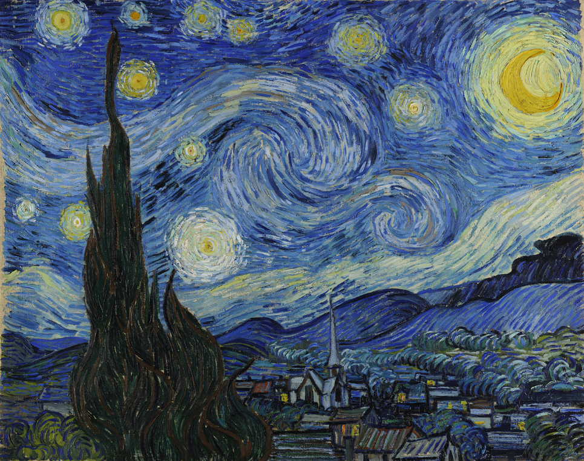
The Starry Night
Vincent van Gogh
1889
Some more of his family
Notes:
Van Gogh's night sky is a field of roiling energy. Below the exploding stars, the village is a place of quiet order. Connecting earth and sky is the flamelike cypress, a tree traditionally associated with graveyards and mourning.

Slide 3
The ballroom dancing aunt …Tang Gogh
The bird lover uncle …Flamin Gogh
The constipated uncle…Can't Gogh
An aunt who taught positive thinking …Way-to-Gogh
Notes:
Alongis

Slide 4
The little bouncy nephew…Poe Gogh
A sister who loved disco…Go Gogh
And his niece who travels the country in an RV…Winnie Bay Gogh
There ya Gogh!
Notes:
Alongis

Slide 5
Progress report

Slide 6
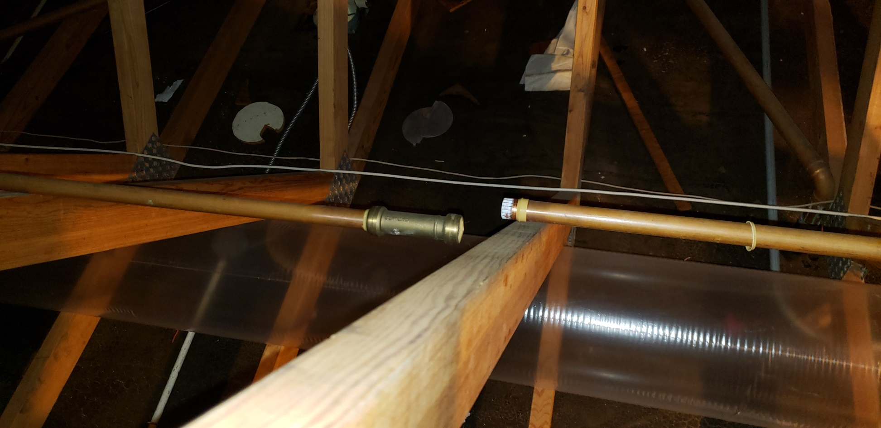
Broken water line that caused all trouble
Notes:
$25K on mitigation: drying and demolition another 20K on rebuilt. Deductible 2K

Slide 7
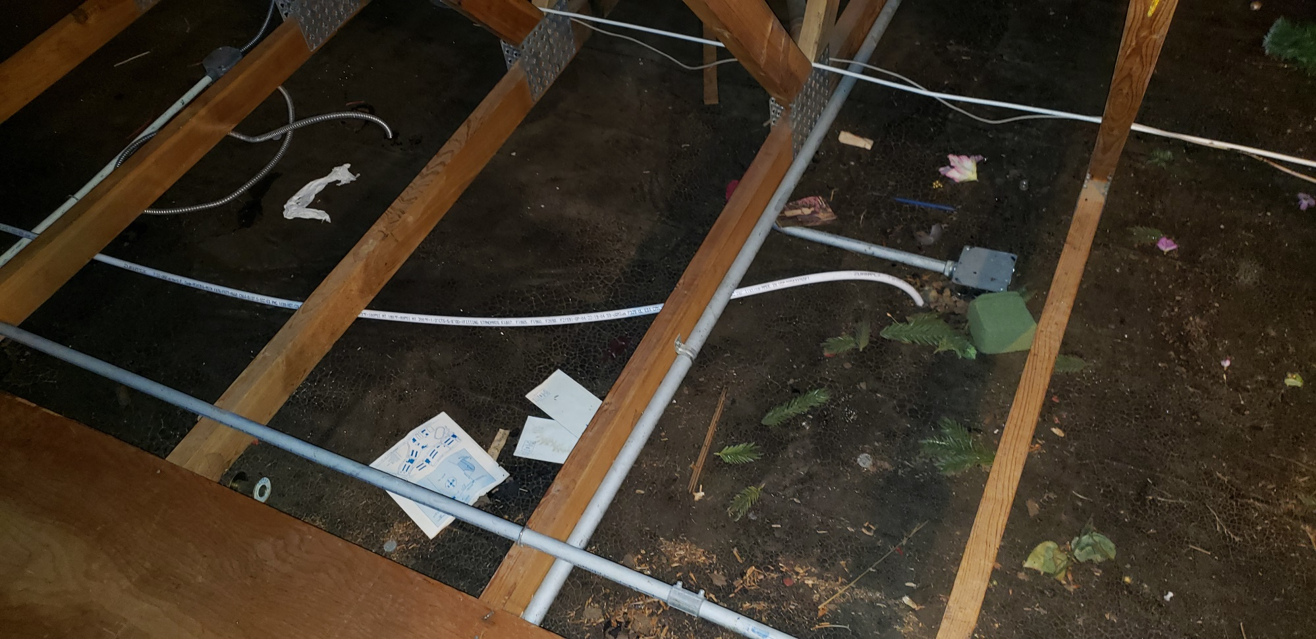
Pex replacement , freeze resistant water line

Slide 8
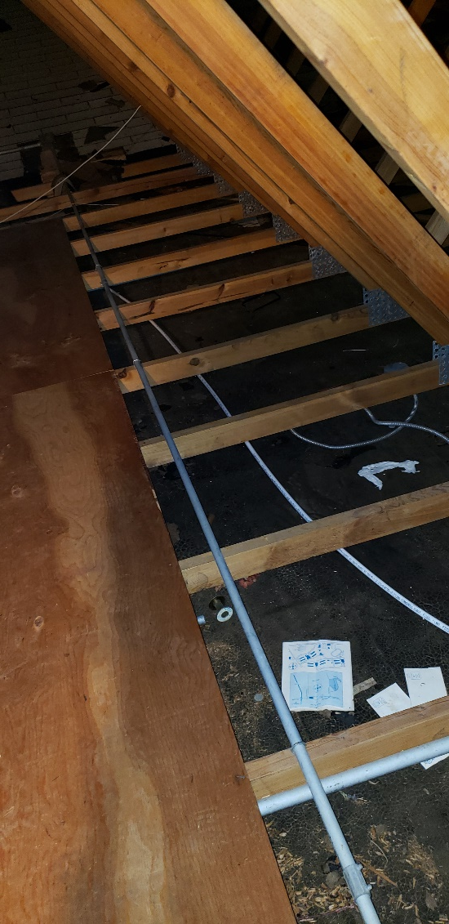
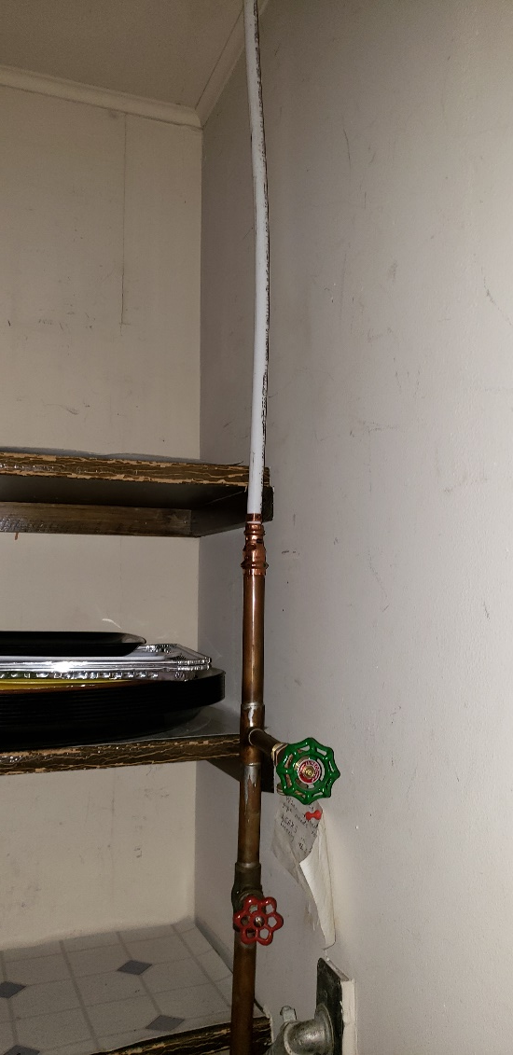

Slide 9
Thursday evening, Dec. 12, plumbing repair done; wiring roughed in for heater and ceiling fan in ladies’ room
Monday Dec. 16 ceiling insulation
Tuesday Dec. 17-18 framing
Monday Dec. 23 drywall

Slide 11
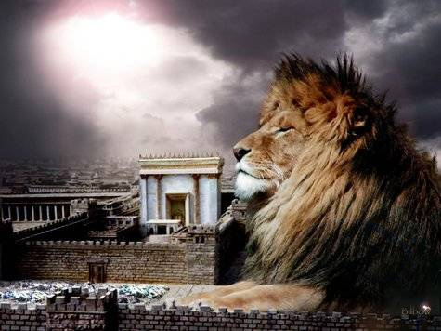
מַתִּתְיָהוּ Mattityahu
(Matthew) 28:11-13
Notes:
Two weeks ago we spoke about the women who saw the resurrected Yeshua and were motivated to GO. Resurrection reality → going and telling! Sharing is a key component of our LIFE in Messiah. It’s almost as exciting to be part of a new birth as to experience our own! Like getting born again, again!
So, the opposition…

Slide 12
Mattityahu (Matthew) 28:11
בְּשָׁעָה שֶׁהָלְכוּ בָּאוּ הָעִירָה כַּמָּה מִן הַשּׁוֹמְרִים וְהוֹדִיעוּ לְרָאשֵׁי הַכֹּהֲנִים אֶת כָּל אֲשֶׁר קָרָה.‏
As they were going, some of the guards went into the city and reported to the head cohanim everything that had happened.
Notes:
These guards were in fatal trouble. Their prized captive had escaped.

Slide 13
Mattityahu (Matthew) 28:12
רָאשֵׁי הַכֹּהֲנִים הִתְכַּנְּסוּ עִם הַזְּקֵנִים וּלְאַחַר הִתְיָעֲצוּת נָתְנוּ לַחַיָּלִים סְכוּם כֶּסֶף נִכָּר
Then they met with the elders; and after discussing the matter, they gave the soldiers a sizeable sum of money

Slide 14
Mattityahu (Matthew) 28:13
בְּאָמְרָם: ”הַגִּידוּ כָּךְ: ’בָּאוּ תַּלְמִידָיו בַּלַּיְלָה וְגָנְבוּ אוֹתוֹ כַּאֲשֶׁר יָשַׁנּוּ‘.
and said to them, “Tell people, ‘His talmidim came during the night and stole his body while we were sleeping.’

Slide 15
^{Mattityahu (Matthew) 28:13-15} If the governor hears of it, we will put things right with him and keep you from getting in trouble.” The soldiers took the money and did as they were told, and this story has been spread about by Judeans till this very day.

Slide 16
A false report was spread to undermine the truth of the Resurrection. Undermining Biblical truth is a main task of the enemy, Ha-Satan.
Courage in the face of [plausible] falsehood is the theme today.
Notes:
The TRUTH of the resurrection is not an optional issue, it is essential to our faith!

Slide 17
^{Ro.10.9-10} If you acknowledge publicly with your mouth that Yeshua is Lord and trust in your heart that God raised him from the dead, you will be saved.
Notes:
No other historical fact, believed or not, affects our lives.

Slide 18
^{1 Cor. 15.14, 19} And if Messiah has not been raised, then our proclaiming is meaningless and your faith also is meaningless…If we have hoped in Messiah in this life alone, we are to be pitied more than all people.

Slide 19
^{Yn 8.44} Satan…has never stood by the truth, because there is no truth in him. When he tells a lie, he is speaking in character; because he is a liar — indeed, the inventor of the lie!

Slide 20
Satan is ^{Rev. 12:10} ”the accuser of our brothers and sisters—the one who accuses them before our God day and night.”

Slide 21
2 Corinthians 10:5
“We destroy arguments and every lofty opinion raised against the knowledge of God”
Notes:
That is our goal today. But remember, we destroy arguments, not people.

Slide 22
^{Eph.6.10-13} Finally, grow powerful in union with the Lord, in union with his mighty strength! Use all the armor and weaponry that God provides, so that you will be able to stand against the deceptive tactics of the Adversary. For we are not struggling against human beings, but against the rulers,

Slide 23
^{Eph.6.10-13} authorities and cosmic powers governing this darkness. So take up every piece of war equipment God provides; so that when the evil day comes, you will be able to resist; and when the battle is won, you will still be standing.

Slide 24
Let’s examine the veracity, historicity of the resurrection, this accusation and some other arguments against the truth of the resurrection.

Slide 25
[This one] The theft theory
The swoon theory
Hallucination theory
Wrong tomb theory
Resurrection defies the laws of science and nature.

Slide 26
Contemporary culture is full of destabilizing, scripture denying theories.
There is no absolute truth.
Israel /Jews are the aggressor.
Gender identity is fluid.
Notes:
I hope to come back to.

Slide 28

Why do you believe the resurrection of Yeshua was a historical event?

Slide 29
The theft theory
“Tell people, ‘His talmidim came during the night and stole his body while we were sleeping.’
Is that possible?
Notes:
Jim Adler, A Lawyer’s Case for His Faith p 112

Slide 30
The theft theory
Those who are accused of stealing the body had no access to the tomb. It was sealed with the seal of Rome.
The soldiers were subject to death by crucifixion for dereliction in duty.
Notes:
Jim Adler, A Lawyer’s Case for His Faith p 112

Slide 31
3. Security was max. “Make the grave as secure as you know how.” Temple guard or Roman.
4. The stone was huge and had the seal of the Empire.
5. Behavior of His followers was fearful, before Resurrection.
Notes:
5. Transformed afterward. If they lied and the Res was a hoax, how have such death defying fearlessness.

Slide 32
6. How did the soldiers know He was stolen if they were asleep?
7. If sleeping, noise of moving stone and transporting body would have awakened them.
8. The orderliness of the graveclothes--not a theft.
Notes:
8. Naked carry would be dishonoring.

Slide 33
9. Within a few months [after Shavuot/Pentecost] the city was seething with the preaching of resurrection. Easy to stop if body found. No accusation of grave robbery in any records.

Slide 34
[This one] The theft theory
The swoon theory
Hallucination theory
Wrong tomb theory
Resurrection defies the laws of science and nature.
Notes:
2. Swoon theory
You WILL encounter this in the marketplace of idea. Democracy and the open marketplace of ideas is the perfect environment for Biblical faith. But, you need prayer, prep, love, and courage.

Slide 35
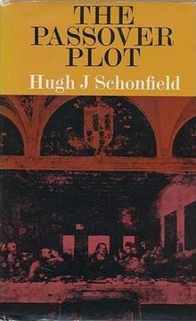
The swoon theory [Passover Plot by Hugh Schonfield 1965]
Notes:
My mother presented me with this.
https://en.wikipedia.org/wiki/The_Passover_Plot
The Passover Plot is the name of a 1976 film which was adapted from this book. The movie starred Zalman King as Yeshua, and was nominated for an Oscar for Best Costume.

Slide 36
Passover Plot alleges that Yeshua had planned everything.
He would not be on the cross for more than a few hours before the Sabbath arrived when it was required by law that Jews be taken down.

Slide 37
Oe of his supporters, who was on hand, would give him water (to quench his thirst) that was actually laced with a drug to make him unconscious.

Slide 38
Joseph of Arimathea, a well-connected supporter, would collect him off the cross while still alive (but appearing dead) so that he could be secretly nursed back to health.
Notes:
https://en.wikipedia.org/wiki/The_Passover_Plot

Slide 39
The swoon theory Passover Plot
Consider the author:
Hugh Schonfield
Notes:
My mother presented me with this.

Slide 40
Hugh Schonfield (London, 1901 –1988.)
Schonfield was one of the original Dead Sea Scrolls team members. A leading Hebrew Christian. In 1937 Schonfield was expelled from the Executive Committee of International Hebrew Christian Alliance (IHCA),
Notes:
https://en.wikipedia.org/wiki/Hugh_J._Schonfield#cite_note-3
Schonfield basically had the same job that Joel Chernoff has today. I don’t know the particulars of Shonfield’s falling out with the leadership, but I understand that he had some doctrinal doubts, and was treated severely.

Slide 41
of which he had been a member since 1925, now the International Messianic Jewish Alliance. He later associated with Messianic Judaism for a while, but was bitterly disillusioned by the experience.
Notes:
https://en.wikipedia.org/wiki/Hugh_J._Schonfield#cite_note-3
Schonfield basically had the same job that Joel Chernoff has today. I don’t know the particulars of Shonfield’s falling out with the leadership, but I understand that he had some doctrinal doubts, and was treated severely.

Slide 42
Daniel Juster corresponded with Schonfield. Schonfield confirmed to him that he indeed had had a bad experience with the organization. He said that after that experience he began to rethink everything
Notes:
https://en.wikipedia.org/wiki/Hugh_J._Schonfield#cite_note-3

Slide 43
and came to new conclusions… Schonfield indicated to Juster that Juster's faith in Messianic Judaism was naive and that he would have to someday "grow up" as Hugh Schonfield had done.
Notes:
https://en.wikipedia.org/wiki/Hugh_J._Schonfield#cite_note-3

Slide 44
I don’t know who was at fault, but the fact is that Shonfield’s doubts grew out of his wounding and unresolved bitterness.

Slide 45
^{Col 3.12-14} Therefore, as God’s chosen people, holy and dearly loved, clothe yourselves in tender compassion, kindness, humility, gentleness, and patience— bearing with one another and forgiving each other,
Notes:
Application: Think of who you disagree with. Do you treat him/her harshly? Your harshness will undermine EVERY good argument.
We demolish arguments, not people.

Slide 46
^{Col 3.12-14} if anyone has a quarrel against another. Just as the Lord pardoned you, so also you must pardon others. But above all these things put on love, which is the bond of perfect harmony

Slide 48
Swoon Theory Refutation
Victims of crucifixion seldom recovered.
Hematadrosis, trial, thorn crown on the scalp, flogging, crucifixion, ~36 hrs in tomb without water, food, care, then wriggle out of grave clothes.
Notes:
McDowell Evidence that Demands a Verdict. P 243

Slide 49
remove the boulder without waking the guards, or fought them off. Walk 7 miles to Emmaus, then back. Then appear to His followers as having vanquished death. 40 days surprise appearances, then Ascension narrative…disappear.
Notes:
Read Evidence 245, 244

Slide 50
The theft theory
The swoon theory
Hallucination theory

Slide 51
Hallucination Theory
All of Messiah’s post-execution appearances were imagined, delusions, or group hallucinations.

Slide 52

Hallucination theory
Clinical psychologist Dr. Gary A. Sibcy points out that even two people
Notes:
Adler p 119

Slide 53
experiencing the same hallucination simultaneously has never been known to occur:

Slide 54
I have surveyed the professional literature written by psychologists, psychiatrists, and other relevant healthcare professionals during the past two decades and have yet to find a single

Slide 55
documented case of a group hallucination, that is, an event for which more than one person purportedly shared in a visual or other sensory perception where there was clearly no external referent.

Slide 56
It is incredulous to believe that over 500 people experienced the same hallucination of a resurrected Yeshua who was walking, talking, and preaching among them again.

Slide 57
Even if one can overlook the incredible improbability of a mass hallucination, the theory arises from the argument that the hallucination occurred because of immense despair. The transformation of Paul uproots this argument because he was not experiencing despair.
Notes:
Adler, p 120

Slide 58
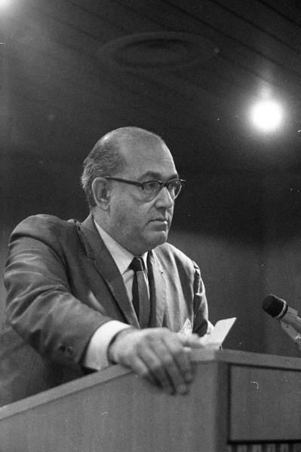
Dr. Pinchas Lapide
“no vision or hallucination is sufficient to explain such a revolutionary transformation [of the disciples].”
- The Resurrection of Jesus: A Jewish Perspective, pgs. 125-26
Notes:
Pinchas Lapide was a Jewish theologian and Israeli historian. He was an Israeli diplomat from 1951 to 1969, among other position acting as Israeli Consul to Milan, and was instrumental in gaining recognition for the young state of Israel. He wrote more than 35 books during his lifetime.

Slide 59
Dr. David Flusser
“I am convinced that there are reliable reports that the Crucified One ‘appeared to Peter, then to the twelve. Then he appeared to more than five hundred brethren at one time . . . Then he appeared to James, then to all the apostles.’”
- Jesus, pg. 155
Notes:
Orthodox Jewish historian

Slide 60
Dr. David Flusser
“The Lord’s brother, James, came to believe as a result of a resurrection appearance. In 62 A.D. James died for his faith in his brother; he was murdered by a Sadducean high priest.”
- Jesus, pg. 35

Slide 61
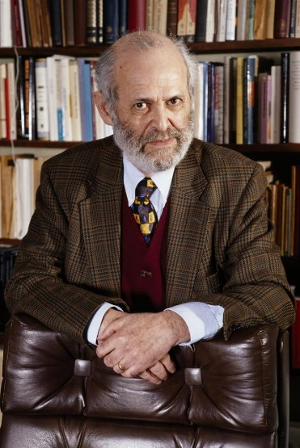
Dr. Geza Vermes
“It is their collective conviction of having seen their dead teacher alive, combined with the initial discovery of the empty tomb, that provides the substance for faith in Yeshua’s rising from the dead.”
- Jesus the Jew: A Historians Reading of the Gospels, pg. 41

Slide 62
[This one] The theft theory
The swoon theory
Hallucination theory
Wrong tomb theory

Slide 63
Wrong tomb theory
Argument: the women got mixed up, and found an open tomb, expecting a closed one. The gardener guessed their mistake, and said, “He is not here…see where they laid him.” [next tomb]

Slide 64
Refutation: if they did go to the wrong tomb, the Sanhedrin could have gone to the right tomb, produced the body, and ended the cause.
Notes:
McDowell Evidence p 267

Slide 65
[This one] The theft theory
The swoon theory
Hallucination theory
Wrong tomb theory
Resurrection defies the laws of science and nature.

Slide 66
Resurrection defies the laws of science and nature.
The “laws” of science are based on induction: what happened in the past will happen again.
Drop your pen.
Induction= generalized conclusion from particular instances.

Slide 67
Who/what enforces the “law” of gravity?
We believe that the universe is consistent, and gravity and other laws will prevail.
That is just faith.
There is a overriding Intelligence

Slide 68
Who enforces the scientific laws.
So, that Intelligence can and does make exceptions = miracles
More amazing that phenomena are consistent at all times, places.
If unimpeachable witnesses saw the Resurrected Messiah, He was!

Slide 69
[This one] The theft theory
The swoon theory
Hallucination theory
Wrong tomb theory
Resurrection defies the laws of science and nature.

Slide 70
^{1 Cor. 15.20-21} But the fact is that the Messiah has been raised from the dead, the firstfruits of those who have died. For since death came through a man, also the resurrection of the dead has come through a man.

Slide 71
^{Ro.10.9-10} If you acknowledge publicly with your mouth that Yeshua is Lord and trust in your heart that God raised him from the dead, you will be saved.

Slide 72
^{Ro.10.9-10} For with the heart one goes on trusting and thus continues toward righteousness, while with the mouth one keeps on making public acknowledgement and thus continues toward deliverance.

Slide 73
All the accusations of the enemy about the Resurrection are false and disprovable!
Repent of your sins, believe in His resurrection to empower you in new life!

Slide 74
What about some other falsehoods that have great sway in our culture?

Slide 75
Contemporary culture is full of destabilizing, scripture denying theories.
There is no absolute truth.
Israel /Jews are the aggressor.
Gender identity is fluid.

Slide 76
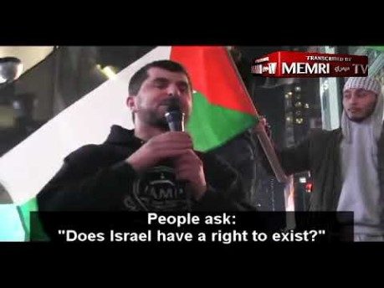
12/5, 2019
Times Square call for Intifada in every class-room
Notes:
https://israelunwired.com/muslims-rally-in-times-square-calling-for-an-intifada-in-america/

Slide 77
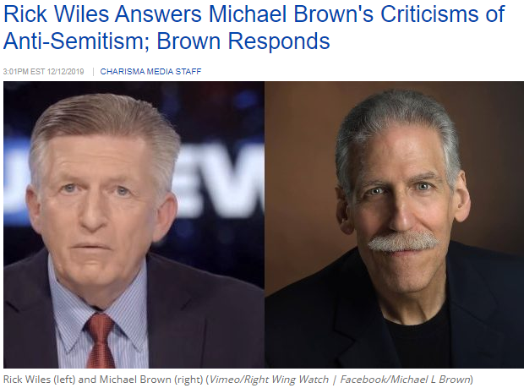
Notes:
https://www.charismanews.com/us/79170-rick-wiles-answers-michael-brown-s-criticisms-of-anti-semitism-brown-responds?utm_source=In%20the%20Line%20of%20Fire&utm_medium=email&utm_content=subscriber_id:5194514&utm_campaign=Blogger%20-%20Michael%20Brown%20-%202019-12-13
https://rationalwiki.org/wiki/Rick_Wiles

Slide 78
Rick Wiles (1954 or 1955–), the host of the TruNews radio program is a far-right fundamentalist Christian radio host and conspiracy theorist. Wiles claims that "the Jews ... are deceivers, they plot, they lie, they do whatever they have to do to accomplish their political agenda. This 'impeach Trump' effort is a Jew coup.
Notes:
https://www.charismanews.com/opinion/in-the-line-of-fire/79067-when-a-jew-bashing-christian-leader-makes-jesus-look-bad

Slide 79
That's what's at the heart of it. You have been taken over by a Jewish cabal.
"The church of Jesus Christ, you're next. Get it through your head! They're coming for you. There will be a purge. That's the next thing that happens when Jews take over a country, they kill millions."
Notes:
https://www.charismanews.com/opinion/in-the-line-of-fire/79067-when-a-jew-bashing-christian-leader-makes-jesus-look-bad

Slide 80
Oct. 27, 2018: A white supremacist kills 11 Jews during Sabbath services in a Pittsburgh synagogue, wounding seven others. The Pittsburgh shooter proclaimed that "All Jews must die!"
Notes:
https://charismamail.com/ga/webviews/4-5194514-58-32569-33796-80548-b31feca097

Slide 81
April 27, 2019: A Presbyterian Christian, concerned that the Jews are destroying the white, European races, opens fire during Sabbath, Passover services in a synagogue in Poway, California, killing one and wounding three others.
Notes:
https://charismamail.com/ga/webviews/4-5194514-58-32569-33796-80548-b31feca097

Slide 82
Dec.10, 2019: Two shooters, target a kosher grocery in Jersey City, New Jersey, resulting in four fatalities. The male shooter has alleged ties to the anti-Semitic, racist group called the Black Hebrew Israelites. His anti-Semitic views have been revealed, with his nearly illegible manifesto claiming his murderous acts were "God's will."
Notes:
https://charismamail.com/ga/webviews/4-5194514-58-32569-33796-80548-b31feca097

Slide 83
Not to display here, but at home when you get the notes, profane anti-Semitic rant in Jersey City blamed the Jews for the attack this week:
https://twitter.com/i/status/1204806510762741760

Slide 84
Another accusation of Jews or Israel, for comic relief actually:

Slide 85
A recent Twitter post reported on a Mossad agent that was captured in northern Saudi Arabia.
The official Saudi report determined that the “Mossad agent” was an Israeli vulture armed with photographic and “espionage” equipment.
Notes:
https://news.visionforisrael.com/en/news/december-13-2019/oh-no-not-again-mossad-spy-captured-in-saudi-arabia?mc_cid=54c1c6d917&mc_eid=5c6cdd3ee6

Slide 86
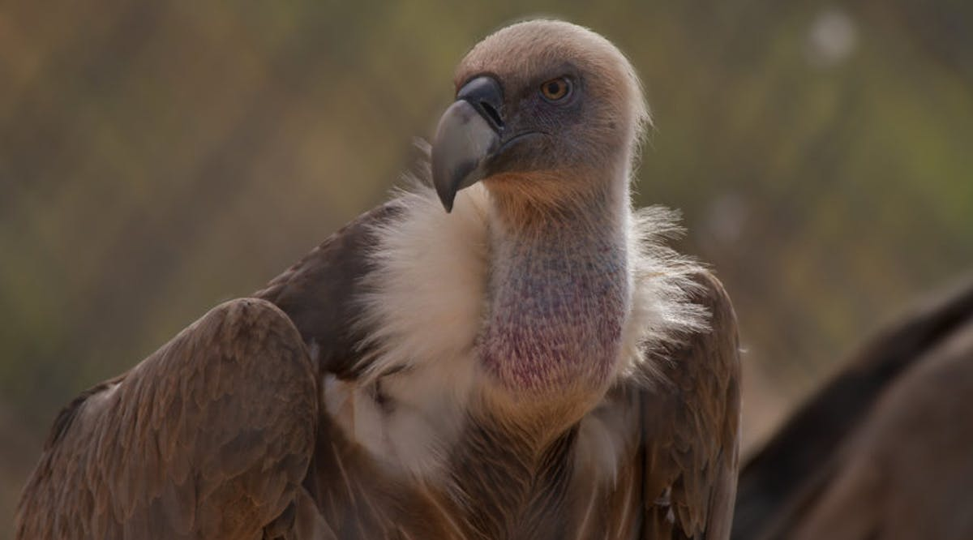
The bird is merely a vulture with a tracking device attached to his body by the Veterinary Department of Tel-Aviv University.
Notes:
https://news.visionforisrael.com/en/news/december-13-2019/oh-no-not-again-mossad-spy-captured-in-saudi-arabia?mc_cid=54c1c6d917&mc_eid=5c6cdd3ee6

Slide 87
In fact, a few years ago another vulture was captured in Lebanon and was immediately accused of being part of an Israeli attempt to spy on Hezbollah. Sharks, pigeons, storks and even squirrels are all animals that have been reported in recent years as being used by the Mossad.
Notes:
https://news.visionforisrael.com/en/news/december-13-2019/oh-no-not-again-mossad-spy-captured-in-saudi-arabia?mc_cid=54c1c6d917&mc_eid=5c6cdd3ee6
Probably still reaction to Eli Cohen infiltration.

Slide 88
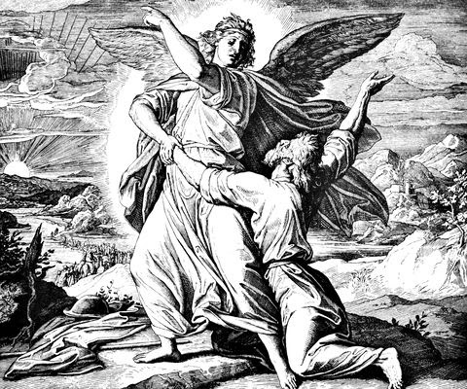
Ya‘akov was left alone. Then some man wrestled with him until daybreak.

Slide 89
וַיֹּאמֶר, לֹא יַעֲקֹב יֵאָמֵר עוֹד שִׁמְךָ--כִּי, אִם-יִשְׂרָאֵל: כִּי-שָׂרִיתָ עִם-אֱלֹהִים וְעִם-אֲנָשִׁים, וַתּוּכָל
^{Beresheet/Gen 32.29} Then the man said, “From now on, you will no longer be called Ya‘akov, but Isra’el; because you have shown your strength to both God and men and have prevailed.”

Slide 90
David Ben-Gurion once said, “Courage is a special kind of knowledge, the knowledge of how to fear what ought to be feared and how not to fear what ought not to be feared.

Slide 91
From this knowledge comes an inner strength that inspires us to push on in the face of great difficulty. What can seem impossible is often possible with courage.”

Slide 92
^{Eph.6.10-13} Finally, grow powerful in union with the Lord, in union with his mighty strength! Use all the armor and weaponry that God provides, so that you will be able to stand against the deceptive tactics of the Adversary. For we are not struggling against human beings, but against the rulers,

Slide 93
^{Eph.6.10-13} authorities and cosmic powers governing this darkness. So take up every piece of war equipment God provides; so that when the evil day comes, you will be able to resist; and when the battle is won, you will still be standing.

Slide 94
Receive the resurrected Yeshua for atonement and forgiveness.
Receive the fullness of His Spirit.
Walk in courage, speaking the truth in love.

