Slide 1
e-handout
To have these notes
without taking notes
Go to OrHaOlam.com
Click on downloads,
messages, 2019
Notes:
.

Slide 2
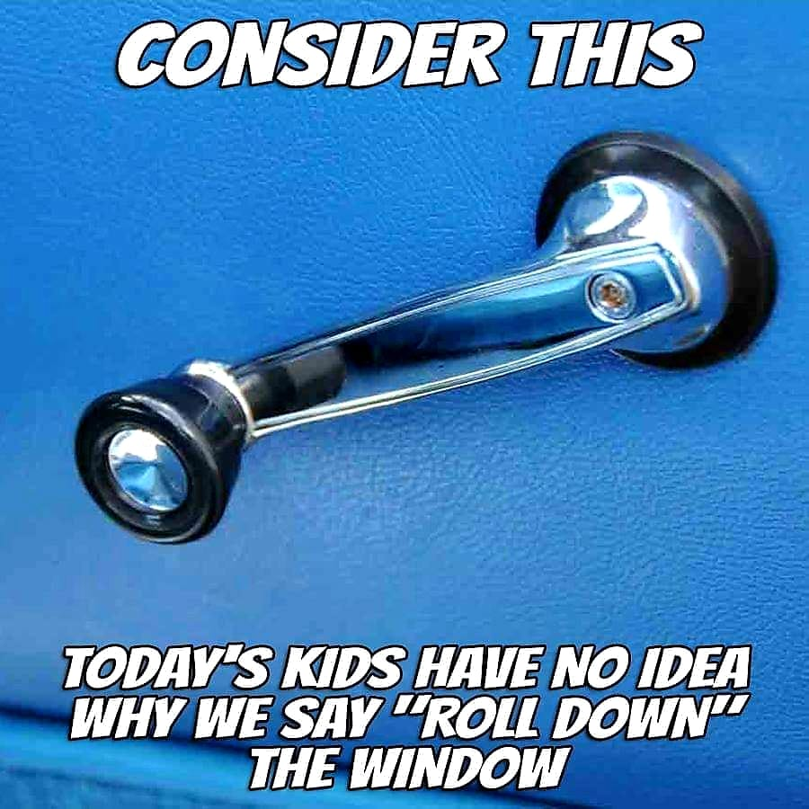

Slide 3
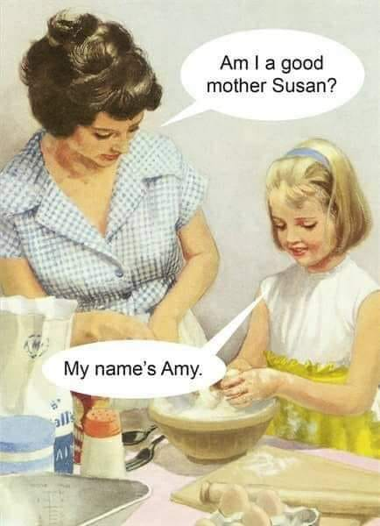

Slide 4
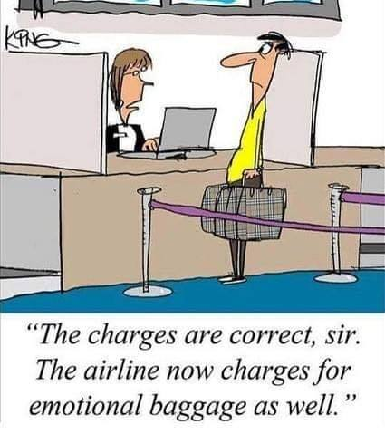
Notes:
Used last week, but only 88 people here. Also, take Thrive. We’ll help if you need.

Slide 5
In a few weeks, Israel's south will be transformed into a beautiful red sea of ​​flowers of countless anemones. The north-western Negev area surrounding Gaza is especially known for this phenomenon. Far too much of the nature in this area has fallen victim to the fire-kite terrorism that originated from Gaza in the last year. But nature and life are stronger than the will of our enemies. "No fire-kite can completely destroy what God has created," said Ilan of Sederot. "Flowers are beginning to grow again and people have helped us through this."
Notes:
Ezk: most beautiful of all lands.

Slide 6
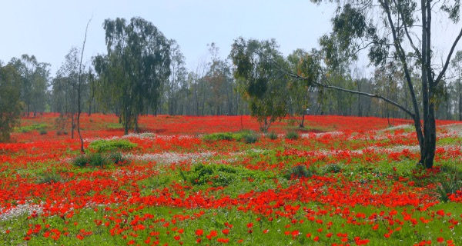
Notes:
For the Prophet Ezekiel, Israel is “the most beautiful of all lands” (Chap. 20:6

Slide 7

Life finds a way.
Notes:
Life finds a way.
Jurassic Park

Slide 9
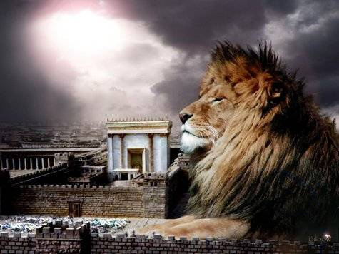
מַתִּתְיָהוּ Mattityahu
(Matthew) 26:26-29

Slide 10
Mattityahu (Matthew) 26:26
כַּאֲשֶׁר אָכְלוּ לָקַח יֵשׁוּעַ לֶחֶם, בֵּרֵךְ וּבָצַע וְנָתַן לַתַּלְמִידִים בְּאָמְרוֹ: ”קְחוּ וְאִכְלוּ, זֶה גּוּפִי.“
While they were eating, Yeshua took a piece of matzah, made the b’rakhah, broke it, gave it to the talmidim and said, “Take! Eat! This is my body!”
Notes:
Communication, community, even revelation is a big thing during meals!
For example, 4 chapters after 10 commandments given, Shmot/Ex 20…

Slide 11
^{Shmot/Ex 24.8-9} Then Moses took the blood, sprinkled it on the people, and said, “Behold the blood of the covenant, which Adoni has cut with you, in agreement with all these words. Moshe, Aharon, Nadav, Avihu and seventy of the leaders went up; and they saw the God of Isra’el.

Slide 12
^{Shmot /Ex 24.10-11} Under his feet was something like a sapphire stone pavement as clear as the sky itself. He did not reach out his hand against these notables of Isra’el; on the contrary, they saw God, even as they were eating and drinking.
Notes:
Revelation during mealtime!
A few verses before the verse in Matityahu above, message two weeks ago…

Slide 13
Mattityahu (Matthew) 26:21
וְכַאֲשֶׁר אָכְלוּ אָמַר: ”אָמֵן אוֹמֵר אֲנִי לָכֶם, אֶחָד מִכֶּם יַסְגִּירֵנִי.“
And as they were eating, he said, “Yes, I tell you that one of you is going to betray me.”

Slide 14
Order of the modern Passover Seder Haggadah [booklet], parts of it possibly as old as 200 C.E.
Something like this in Yeshua’s day and Passover Seder.

Slide 15
First wine cup Kiddush
Handwashing [Footwashing?]
Dip in salt water
Break middle matzah
Tell the story with 4 Questions
Second cup and Diyaynu song
Second handwashing

Slide 16
Eat matzah
Eating maror
Eating matzo and maror
Holiday meal
Notes:
https://en.wikipedia.org/wiki/Passover_Seder

Slide 17
^{Mt.26.20-21} When evening came, Yeshua reclined with the twelve talmidim;
[no ten Haggadah activities]
and as they were eating, he said, “Yes, I tell you that one of you is going to betray me.”
Notes:
Discussion of betrayal…[two weeks ago.]
Much simpler flow

Slide 18
Visualize: evening moved quickly, not like typical modern Seder

Slide 19
Mattityahu (Matthew) 26:26
כַּאֲשֶׁר אָכְלוּ לָקַח יֵשׁוּעַ לֶחֶם, בֵּרֵךְ וּבָצַע וְנָתַן לַתַּלְמִידִים בְּאָמְרוֹ: ”קְחוּ וְאִכְלוּ, זֶה גּוּפִי.“
While they were eating, Yeshua took a piece of matzah, made the b’rakhah, broke it, gave it to the talmidim and said, “Take! Eat! This is my body!”
Notes:
#7 on modern Seder order. Evidently not following exactly כי already eating. Point is, communal meal wasn’t small event. Qumran community meals were a significant community time.
Significant, maybe shocking statement: “Take! Eat! This is My body!”

Slide 20
Statement would be horrifying.
^{Vayikra/lev 3.17} It is to be a permanent regulation through all your generations wherever you live that you will eat neither fat nor blood.’”

Slide 21
Kosher meat is thoroughly bled. Slaughter must be done by means of a swift, smooth cut of a sharp knife whose blade is free of any dent or imperfection.
Then meat is soaked in salt [or Kefir] to extract remaining blood.
Notes:
https://www.myjewishlearning.com/article/kosher-slaughtering-an-introduction/
Animal racked, not anesthetized or shocked.
Some cook well done. Yuck. Not necessary.

Slide 22
^{Yokhanan 6.52-59} The Judeans disputed with one another, saying, “How can this man give us his flesh to eat?” Then Yeshua said to them, “Yes, indeed! I tell you that unless you eat the flesh of the Son of Man and drink his blood, you do not have life in yourselves.

Slide 23
^{Yokhanan 6.52-59} Whoever eats my flesh and drinks my blood has eternal life — that is, I will raise him up on the Last Day. For my flesh is true food, and my blood is true drink. Whoever eats my flesh and drinks my blood lives in me, and I live in him.

Slide 24
^{Yokhanan 6.52-59} Just as the living Father sent me, and I live through the Father, so also whoever eats me will live through me. So this is the bread that has come down from heaven — it is not like the bread the fathers ate; they’re dead,

Slide 25
^{Yokhanan 6.52-59} but whoever eats this bread will live forever!” He said these things as he was teaching in a synagogue in K’far-Nachum.
Notes:
We know this place.

Slide 26
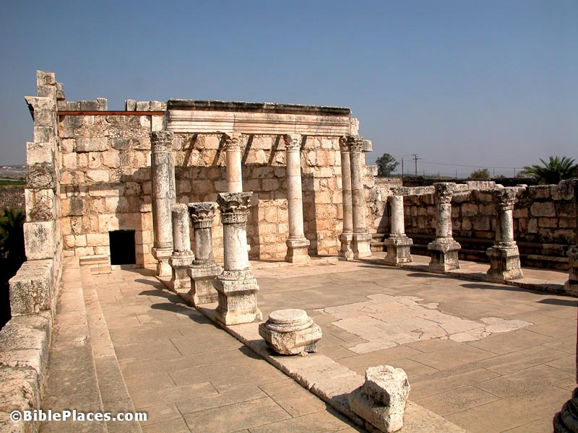
Synagogue in K’far-Nachum

Slide 27
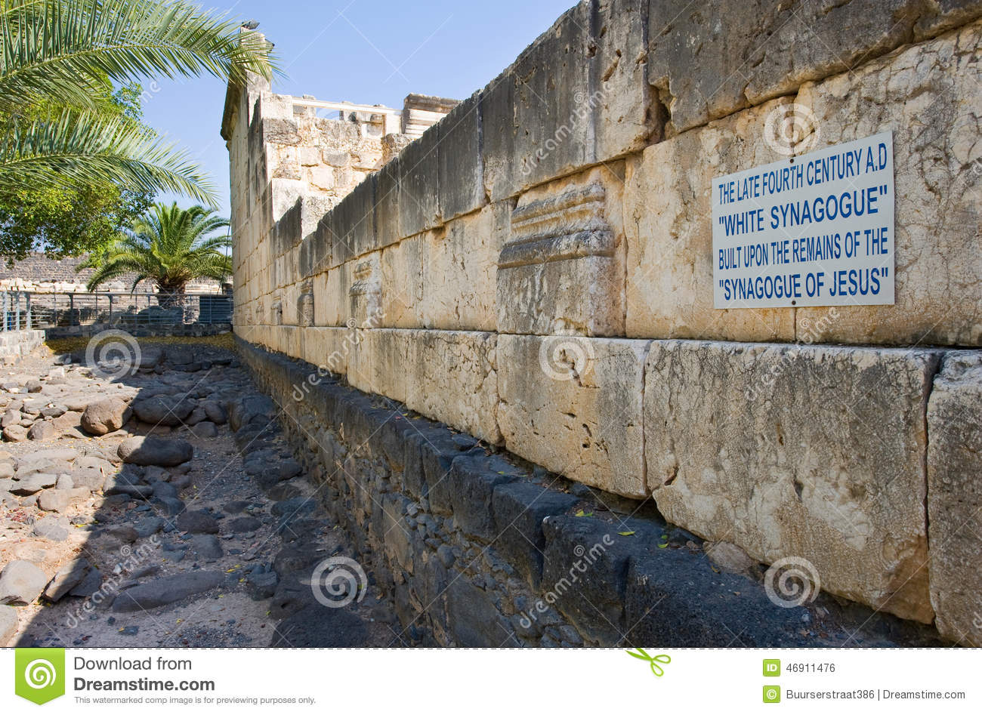
Notes:
White synagogue imported marble 300’s. Below is local volcanic black basalt.

Slide 28
^{Yn 6.66-71} From this time, many of His disciples left and quit walking with Him. Yeshua said to the Twelve, “Don’t you want to leave too?” Shim‘on Kefa answered him, “Lord, to whom would we go? You have the word of eternal life. We have trusted, and we know that you are the Holy One of God.”

Slide 29
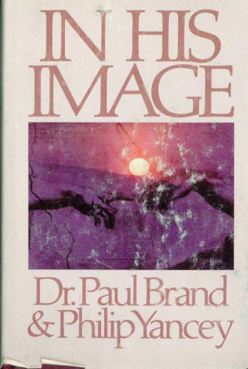
Notes:
P 67-68

Slide 30
Mattityahu (Matthew) 26:26
כַּאֲשֶׁר אָכְלוּ לָקַח יֵשׁוּעַ לֶחֶם, בֵּרֵךְ וּבָצַע וְנָתַן לַתַּלְמִידִים בְּאָמְרוֹ: ”קְחוּ וְאִכְלוּ, זֶה גּוּפִי.“
While they were eating, Yeshua took a piece of matzah, made the b’rakhah, broke it, gave it to the talmidim and said, “Take! Eat! This is my body!”
Notes:
Are we assimilating His LIFE?

Slide 31
Mattityahu (Matthew) 26:27
לָקַח אֶת הַכּוֹס, בֵּרֵךְ וְנָתַן לָהֶם בְּאָמְרוֹ: ”שְׁתוּ מִמֶּנָּה כֻּלְּכֶם,
Also he took a cup of wine, made the b’rakhah, and gave it to them, saying, “All of you, drink from it!

Slide 32
Mattityahu (Matthew) 26:28
כִּי זֶה דָּמִי, דַּם הַבְּרִית [הַחֲדָשָּׁה] הַנִּשְׁפָּךְ בְּעַד רַבִּים לִסְלִיחַת חֲטָאִים
For this is My blood of the covenant, which is poured out for many for the removal of sins.
[Some mss. say: new covenant.]

Slide 33
^{Lk 24.20} He took the cup after the meal [cup of redemption], saying, “This cup is the new covenant in My blood, which is poured out for you.
Notes:
What is Messiah meaning by New Covenant in His Blood?

Slide 34
Similarly:
^{Shmot/Ex 24.8} Then Moses took the blood, sprinkled it on the people, and said, “Behold the blood of the covenant, which Adoni has cut with you, in agreement with all these words.

Slide 35
What did Messiah
mean by Covenant?
Hugely significant word.
Nine points, in Messiah’s mind!

Slide 36
1. Start: How is “covenant” or “New Covenant” understood in the faith world today?
Typical example of an Israel friendly, Messianic friendly evangelical congregation with Covenant in their name identity...

Slide 37
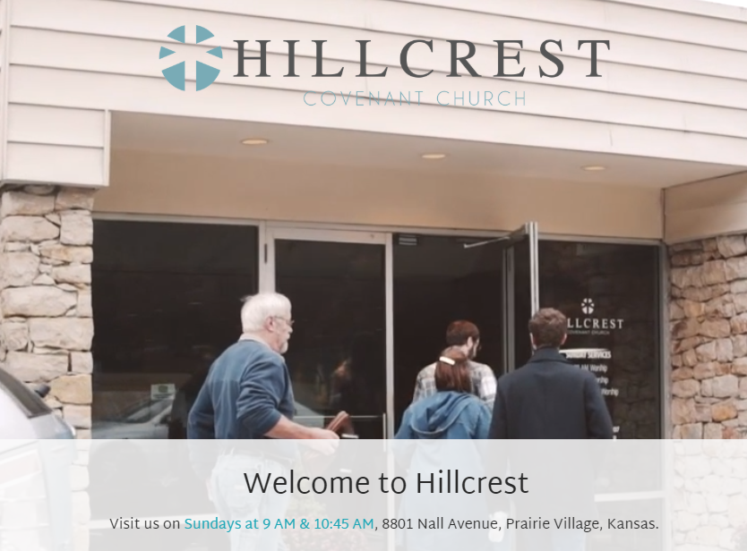
Notes:
Hillcrest Covenant Church.
SNote: 8801 Nall Ave.

Slide 38
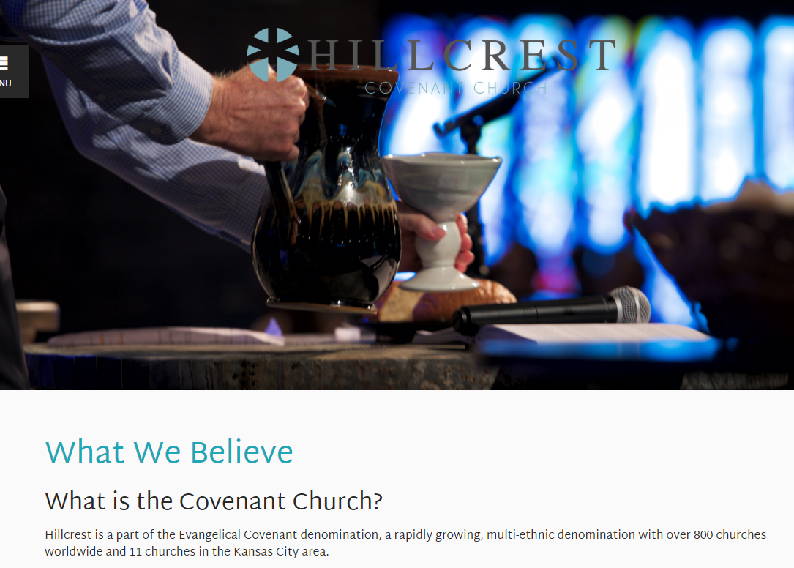
Notes:
http://hillcrestcov.org/about-us/what-we-believe/

Slide 39
For Covenant people, our essential beliefs are summed up in what we call Covenant Affirmations:
We affirm the centrality of the word of God.
We affirm the necessity of the new birth.
We affirm a commitment to the whole mission of believers.
Notes:
https://covchurch.org/who-we-are/beliefs/affirmations/

Slide 40
We affirm the congregation as a fellowship of believers.
We affirm a conscious dependence on the Holy Spirit.
We affirm the reality of freedom in Messiah.
There is no reference here to covenant. There are EIGHT covenants in scripture!
Notes:
https://covchurch.org/who-we-are/beliefs/affirmations/
http://elementsandcovenant.blogspot.com/
Where exactly is the reference to covenant?
Name to differentiate it from official, government back Swedish Lutheran congregations.

Slide 41
2. Word study
בְּרִית שֵם נ’ brit noun fem
(international law) treaty; alliance, covenant,
(Jewish ritual) circumcision
The United States, in modern Hebrew, is “Artsot HaBrit” Lands of the covenant. אַרְצוֹת הַבְּרִית

Slide 42
3. A covenant is not a contract
A contract is a mutual obligation, can be broken if one party fails.
A covenant is a promise, binding, independent of the other party, usually with a shared meal.
Notes:
Few relationships in modern life are covenants, except marriage.

Slide 43
4. A covenant is not a book.
Dan Gruber: The Hebrew word Brit appears about 300x in the Tanakh. It always refers to a relational covenant, never to a set of books or writings.
Notes:
Copernicus and the Jews. P 48

Slide 44
Therefore:
[Not Old Testament, Old Covenant]
Hebrew scriptures, or Tanakh: acronym for
  Torah, Neviim, K’tuvim:
  Torah, Prophets, Writings

Slide 45
Therefore:
[Not New Testament, New Covenant]
Messianic Scriptures, or
[Dan Gruber] במשיח BaMashiakh: Bsorot, Maasei HaShalikhim, Yediot, Khazon, or

Slide 46
[Blaine Robison] בּסח
Beh-sekh: Besorot בּשׂוֹרה, lit. "good news" for Matthew—Acts; Sepharim ספרים, "letters"), for Romans—Judah;
Khezyōnōt חזינוֹת Revelation

Slide 47
Summary:
[Not New Testament, New Covenant]
Messianic Scriptures, or
BaMashiakh, or
Beh-sekh
Notes:
Personally, I use Messianic Scriptures

Slide 48
5. What are the covenants in scripture?

Slide 49
Name: | 1. Edenic, before the Fall
Verses | Ber / Gen Ch 1-3
Provisions | Garden eternally
Type | Conditional
Response | Works / obedience
Sign | Tree of Life?
Participants | all humanity potentially
Notes:
Salvation by works, eternal life there in the Garden.

Slide 50
Name: | 2. Adamic, after the Fall
Verses | Ber / Gen 3.1-9
Provisions | Salvation
Type | Conditional
Response | Faith in future Descendent
Sign | Skins, childbirth issues
Participants | all humanity potentially
Notes:
Promise of eternal salvation, still in force

Slide 51
Name: | 3. Noakhic [Noahide]
Verses | Ber / Gen 8.20-9.13
Provisions | Seasons, no flood
Type | Unconditional
Response | Capital punishment
Sign | rainbow
Participants | all humanity
Notes:
Physical salvation, still in force

Slide 52
Name: | 4. Avrahamic
Verses | Ber / Gen 12, 15, 17
Provisions | Blessings and curses, Land
Type | Unconditional
Response | Avraham’s obedience
Sign | Circumcision
Participants | Avraham’s descendents
Notes:
Abrahamic covenant is NOT salvation. It’s blessings and the LAND.
Abe saved by faith in Gen 15
Abe covenant in Gen 12, still in force

Slide 53
Name: | 5. Mosaic
Verses | Shmot/Ex 19-Dvarim/Dt
Provisions | Blessings, head of nations
Type | Conditional
Response | obedience
Sign | Shabbat Shmot/Ex 31.13
Participants | People of Israel
Notes:
This has a means of salvation, but we Jews failed it.
Actually two means of salvation: faith Dt. 30.11 quoted by Paul
Works in Lev 18.5 quoted by Paul, still in force

Slide 54
Name: | 6. Moavi / Moabite
Verses | Dvarim/Dt 29-30
Provisions | Regathering / Return to Land
Type | conditional
Response | repentance
Sign | May 14, 1948 Hatikvah
Participants | People of Israel
Notes:
This one often gets overlooked. Marilyn Griffin’s insight. Dt 28.69/29.1 These are the words of the covenant which ADONAI ordered Moshe to make with the people of Isra'el in the land of Mo'av, in addition to the covenant which he made with them in Horev 30.3 [after exile] At that point, ADONAI your God will reverse your exile and show you mercy; he will return and gather you from all the peoples to which ADONAI your God scattered you
still in force

Slide 55
Name: | 7. Davidic
Verses | 2 Shmuel 7.8-17
Provisions | Everlasting Kingdom
Type | Conditional
Response | Kings keep Torah
Sign | Two comings of Messiah
Participants | Israel, and all nations
Notes:
The covenant G-d made with David was for an everlasting dynasty. But David got saved by faith in G-d's redemption, as described at length in Ro 4.6-8 quoting Ps 32. The kingly covenant did not save David eternally, still in force

Slide 56
Name: | 8. Renewed
Verses | Yermiyahu/Jer 31.31-34
Provisions | Torah in our hearts
Type | Conditional
Response | Faith
Sign | Torah in our hearts
Participants | Israel & Judah, Nations grafted
Notes:
God made two UNCONDITIONAL choices: salvation information through Jews, salvation fact through Yeshua.
Michael Brown on falling leaders
more of a superstar than a servant
self-exalting, since you think to yourself, "Power is flowing through me.“
use "the Lord told me" as an excuse to sin
so many of our charismatic churches are independent, and because so many are led by forceful leaders, we often have a recipe for extreme unaccountability.

Slide 57
^{Yermiyahu 31.30-36} Here, the days are coming,” says Adonai, “when I will make a new covenant with the house of Isra’el and with the house of Y’hudah. It will not be like the covenant I made with their fathers on the day I took them by their hand and brought them out of the land of Egypt;.

Slide 58
^{Yermiyahu 31.30-36} because they, for their part, violated my covenant, even though I, for my part, was a husband to them,” says Adoni. “For this is the covenant I will make with the house of Isra’el after those days,” says Adoni:

Slide 59
^{Yermiyahu 31.30-36} “I will put my Torah within them and write it on their hearts; I will be their God, and they will be my people. No longer will any of them teach his fellow community member or his brother, ‘Know Adonai’;

Slide 60
^{Yermiyahu 31.30-36} for all will know me, from the least of them to the greatest; because I will forgive their wickednesses and remember their sins no more.”

Slide 61
David Stern: the Messiah is here establishing the New Covenant promised to the Jewish people in Jeremiah 31:30-33. This New Covenant does not revoke God's previous covenants. Rather, all of God's covenants [except Eden] — remain in force today.

Slide 62
6. The tension:
^{Mes Jews/Heb 8.13} By using the term, “new,” he has made the first covenant “old”; and something being made old, something in the process of aging, is on its way to vanishing altogether.
Notes:
Some Jewish roots teachers excised, removed from the cannon Mes Jews/Heb. Monte Judah.

Slide 63
^{Ro 7.4-6} Therefore, my brothers and sisters, you also were made dead to the Torah through the body of Messiah, so that you might be joined to another—the One who was raised from the dead—in order that we might bear fruit for God. For when we were in the flesh,

Slide 64
^{Ro 7.4-6} the sinful passions that came through the Torah were working in our body parts to bear fruit for death. But now we have been released from the law, having died to what confined us, so that we serve in the new way of the Ruach and not in the old way of the letter.

Slide 65
^{2 Cor. 3.6} G-d also made us competent as servants of a new covenant—not of the letter, but of the Ruakh. For the letter kills, but the Ruakh gives life.

Slide 66
Yet, ^{Mtt.517-20} “Don’t think that I have come to abolish the Torah or the Prophets. I have come not to abolish but to complete. Yes indeed! I tell you that until heaven and earth pass away, not so much as a yud or a stroke will pass from the Torah

Slide 67
^{Mtt.517-20} “ — not until everything that must happen has happened. So whoever disobeys the least of these mitzvot and teaches others to do so will be called the least in the Kingdom of Heaven.

Slide 68
^{Mtt.517-20} “ But whoever obeys them and so teaches will be called great in the Kingdom of Heaven. For I tell you that unless your righteousness is far greater than that of the Torah-teachers and P’rushim, you will certainly not enter the Kingdom of Heaven!

Slide 69
Stern on MJ 8.11
There are two words for "new" in Greek, "kainos" and "neos." "Neos" means something which has never before existed, whereas "kainos" carries overtones of freshness and renewal of something which has existed.

Slide 70
Stern on MJ 8.11
The word used in MJ 8 in the phrase, "New Covenant," is always "kainos," and this is as it should be, because in a very real way the New Covenant renews

Slide 71
^{David Stern on MJ 8.13} Is one to infer that the Jewish holidays, Shabbat, kashrut, civil laws, and moral laws of the Mosaic Covenant are on the verge of vanishing altogether?

Slide 72
^{David Stern on MJ 8.13} No, for the author could hardly have been unaware that the Mosaic Covenant presents itself as eternal; also the context shows that he is speaking only of its system of priests and sacrifices,

Slide 73
^{David Stern on MJ 8.13} not its other aspects. Since the laws concerning the Mishkan/ Tabernacle constitute the majority of the Mosaic prescriptions, it is not an inappropriate figure of speech to say that the Old Covenant itself is aging and about to disappear.

Slide 74
It is in the process of aging and on the verge of vanishing in the same sense that "This world's leaders... are in the process of passing away" (2C 2:6). This world's leaders are still with us, and so is the Mosaic Covenant.

Slide 75
David Stern: the Messiah is here establishing the New Covenant promised to the Jewish people in Jeremiah 31:30-33. This New Covenant does not revoke God's previous covenants. Rather, all of God's covenants [except Eden] — remain in force today.

Slide 76
7. The WORST interpretation of covenant.

Slide 77
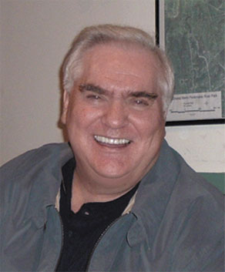
Texe W. Marrs is an American writer and radio host, who runs two fundamentalist Christian ministries, Power of Prophecy Ministries and Bible Home Church, both based in Austin, Texas
Notes:
https://www.google.com/search?q=texe+marrs&safe=active&tbm=isch&source=iu&ictx=1&fir=bMu37bHBi43gaM%253A%252CqjCGijdD3OfGHM%252C%252Fm%252F05w33qp&usg=AI4_-kT3qX-zJGDsyNROqC4UcoSaJcFWFA&sa=X&ved=2ahUKEwiDp9SqxL7gAhUMG6wKHXdGBlgQ_B0wCnoECAYQEQ#imgrc=bMu37bHBi43gaM:

Slide 78
Texe W. Marrs (born 1944) His teaching includes end times conspiracy theory with heavy elements of antisemitism, anti-Catholicism, anti-Illuminati, and anti-Freemasonry.

Slide 79
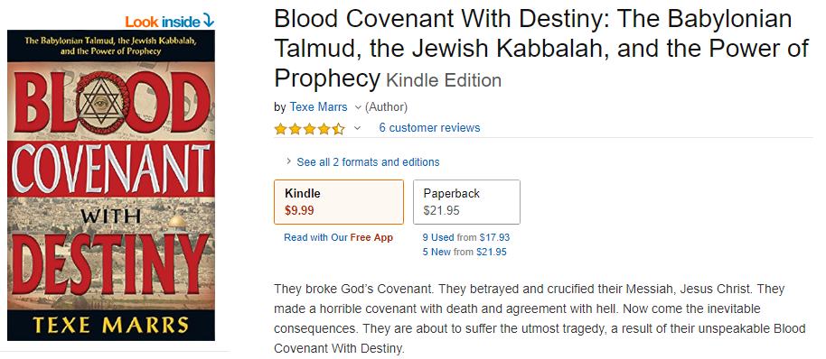

Slide 80
They broke God’s Covenant. They betrayed and crucified their Messiah, Jesus Christ. They made a horrible covenant with death and agreement with hell. Now come the inevitable consequences. They are about to suffer the utmost tragedy, a result of their unspeakable Blood Covenant With Destiny.
Notes:
https://www.amazon.com/Blood-Covenant-Destiny-Babylonian-Kabbalah-ebook/dp/B079GH4QLJ/ref=sr_1_1?ie=UTF8&qid=1550114423&sr=8-1&keywords=Blood+Covenant+With+Destiny&pldnSite=1

Slide 81
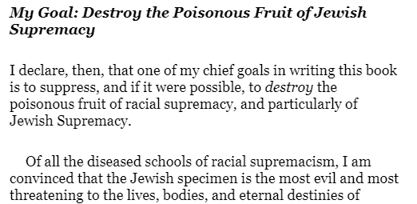
Notes:
https://www.amazon.com/Blood-Covenant-Destiny-Babylonian-Kabbalah-ebook/dp/B079GH4QLJ/ref=sr_1_1?ie=UTF8&qid=1550114423&sr=8-1&keywords=Blood+Covenant+With+Destiny&pldnSite=1
Prayer request for later.

Slide 82
Vision of Or HaOlam: Working to bring Jewish people, and those grafted in, to their covenantal identity in Messiah.
Notes:
Acts 15

Slide 83
8. What about the non-Jews, the Nations, Gentiles?
The Nation [Gentiles] get a free pass into the New Covenant

Slide 84
^{Eph 2.11-16} Therefore, remember your former state: you Gentiles by birth — called the Uncircumcised by those who, merely because of an operation on their flesh, are called the Circumcised — at that time had no Messiah. You were estranged from the national life of Isra’el.

Slide 85
^{Eph 2.11-16} You were foreigners to the covenants embodying God’s promise. You were in this world without hope and without God. But now, you who were once far off have been brought near through the shedding of the Messiah’s blood.

Slide 86
^{Eph 2.11-16} For he himself is our shalom — he has made us both one and has broken down the m’chitzah which divided us by destroying in his own body the enmity occasioned by the Torah, with its commands set forth in the form of ordinances.

Slide 87
^{Eph 2.11-16} He did this in order to create in union with himself from the two groups a single new humanity and thus make shalom, and in order to reconcile to God both in a single body by being executed on a stake as a criminal and thus in himself killing that enmity.

Slide 88
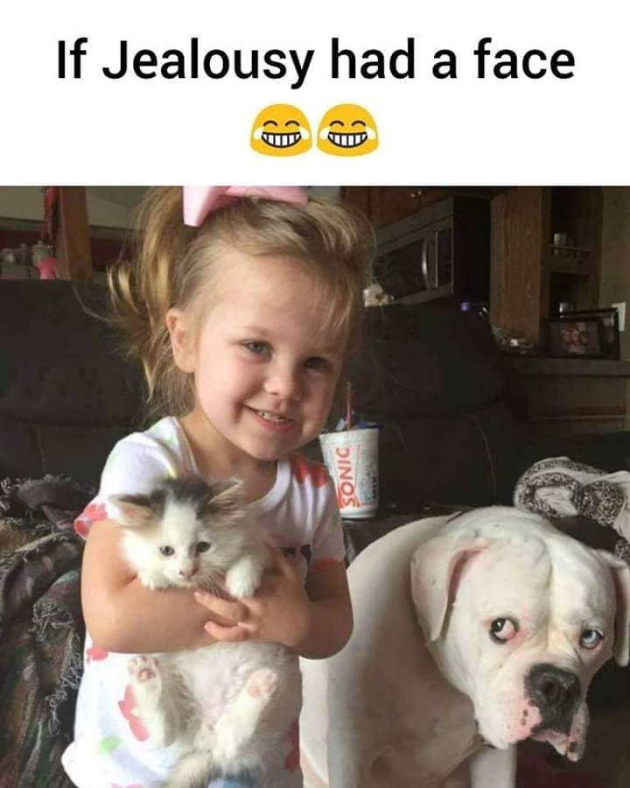
Notes:
Mordekhi Hiatt facebook
Other sheep
Acts 15 Nazarenes and Ebionites
All about blessing

Slide 89
9. The resolution

Slide 90
^{2 Cor 3.7-11}Now if that which worked death, by means of a written text engraved on stone tablets, came with glory — such glory that the people of Isra’el could not stand to look at Moshe’s face because of its brightness, even though that brightness was already fading away

Slide 91
^{2 Cor 3.7-11}— won’t the working of the Spirit be accompanied by even greater glory? For if there was glory in what worked to declare people guilty, how much more must the glory abound in what works to declare people innocent!

Slide 92
^{2 Cor 3.7-11} In fact, by comparison with this greater glory, what was made glorious before has no glory now. For if there was glory in what faded away, how much more glory must there be in what lasts.

Slide 93
^{2 Cor 3.18} So all of us, with faces unveiled, see as in a mirror the glory of the Lord; and we are being changed into his very image, from one degree of glory to the next, by Adoni the Spirit.

Slide 94
^{Yermiyahu 31.30-36} This is what Adonai says, who gives the sun as light for the day, who ordained the laws for the moon and stars to provide light for the night, who stirs up the sea until its waves roar Adonai-Tzva’ot is his name: “If these laws leave my presence,” says Adonai, “then the offspring of Isra’el will stop being a nation in my presence forever.” This is what Adonai says: “If the sky above can be measured and the foundations of the earth be fathomed, then I will reject all the offspring of Isra’el for all that they have done,” says Adonai.

Slide 99
Prayer request for 3rd hour

Slide 100
This Saturday, today, Feb. 16. ultra-nationalist and neo-Nazi groups from across Europe will march in Sofia, Bulgaria in an annual torch-lit parade in honor of Hristo Lukov, a pro-Nazi general whose actions during WWII contributed to the deportation and deaths of thousands of Jews.
Notes:
https://mail.google.com/mail/u/0/#inbox/FMfcgxwBVgnxNgjszJmMBPzHhjbHgXnH

Slide 101
The “Lukov March,” as it is known, has taken place every February since 2003, despite growing opposition and efforts to sanction it from the Sofia municipality and the Bulgarian government.
Last year, the World Jewish Congress presented a petition to the Bulgarian Prime Minister with more than 180,000 signatures urging an administrative ban against the event and the establishment of legislative measures to ban such rallies in the future.
As a result of WJC’s intervention and subsequent actions, the organizers of the march were forced to alter the parade route to less important streets
Notes:
https://mail.google.com/mail/u/0/#inbox/FMfcgxwBVgnxNgjszJmMBPzHhjbHgXnH

Slide 102
The initial roundups were to begin on 9 March 1943. Boxcars were lined up in Kyustendil, a town near the western border. But as the news about the imminent deportations leaked out, protests arose throughout Bulgaria. On the morning of 9 March, a delegation from Kyustendil, composed of eminent public figures and headed by Dimitar Peshev, the deputy speaker of the National Assembly, met with Interior Minister Petur Gabrovski. Facing strong opposition from within the country, Gabrovski relented. The same day, he sent telegrams to the roundup centers in the pre-war territory of Bulgaria, postponing the deportations to a future, unidentified date.
Notes:
https://en.wikipedia.org/wiki/Boris_III_of_Bulgaria#The_Holocaust

Slide 103
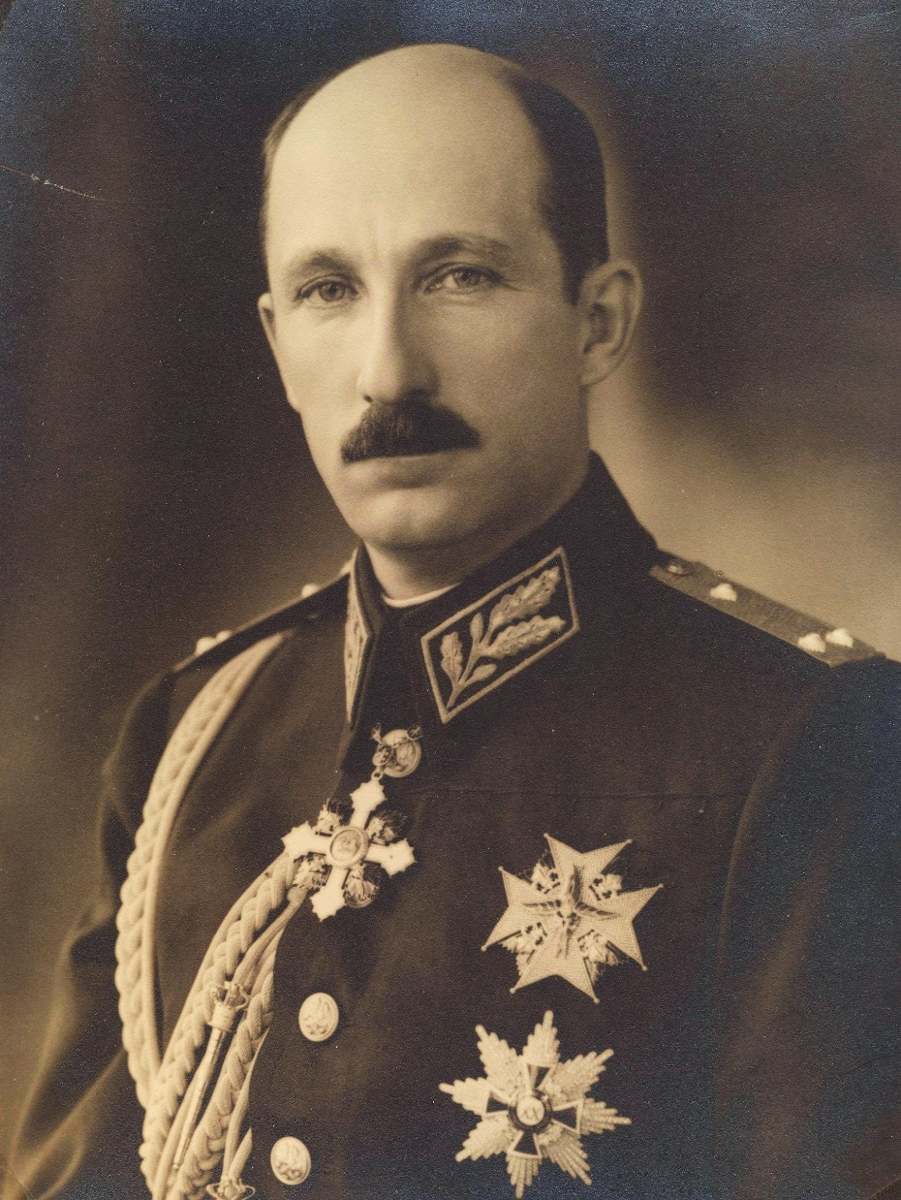
King Boris of
Bulgaria

Slide 104
Even worse, when Bulgarian religious and political leaders successfully campaigned in preventing the deportation of Jews to Nazi death camps, the regime that Lukov supported allowed the deportation of more than 11,000 Jews from territories in northern Greece and Yugoslavia to meet their deaths in Treblinka.

Slide 105
Rep. Ilhan Omar, a Democrat and one of two Muslim women in Congress, speaks Feb. 23 at a fundraiser for an Islamic charity with a "long history of promoting anti-Semitism," Middle East Forum reports.
Omar will address Islamic Relief, a Muslim Brotherhood and Hamas linked group which engages radical Islamic clerics to speak at its events. One of them, Haitham al-Haddad, has described Jews as "the enemies of God, and the descendants of apes and pigs."
Islamic Relief USA's own chairman, Khaled Lamada, traffics in anti-Semitism. He charged, as Middle East Watch documents, that the U.S. is under the sway of a Zionist lobby seeking to demonize Muslims.
Maybe he and Rep. Omar should compare notes.
And Islamic Relief USA's "operations manager," Yousef Abdallah, published a story celebrating “martyrs” who supply guns to “kill more than 20 Jews”and “fire rockets at Tel Aviv.”
Notes:
©2014-2019 Christians In Defense Of Israel.

Slide 106
