Slide 1
e-handout
To have these notes
without taking notes
Go to OrHaOlam.com
Click on downloads,
messages, 2019
Notes:
.

Slide 2
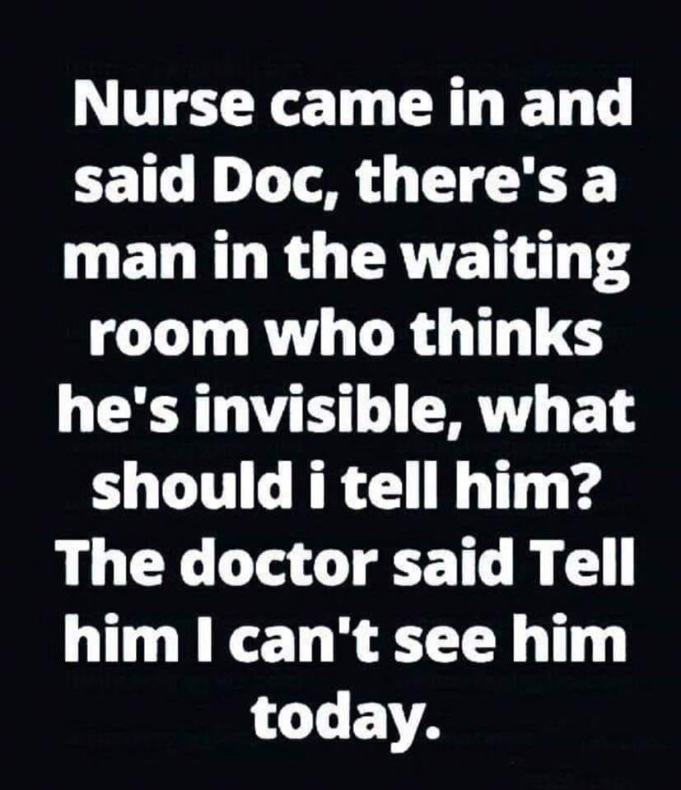

Slide 3
Notes:
Rick Fisher

Slide 4
Good news from Israel

Slide 5
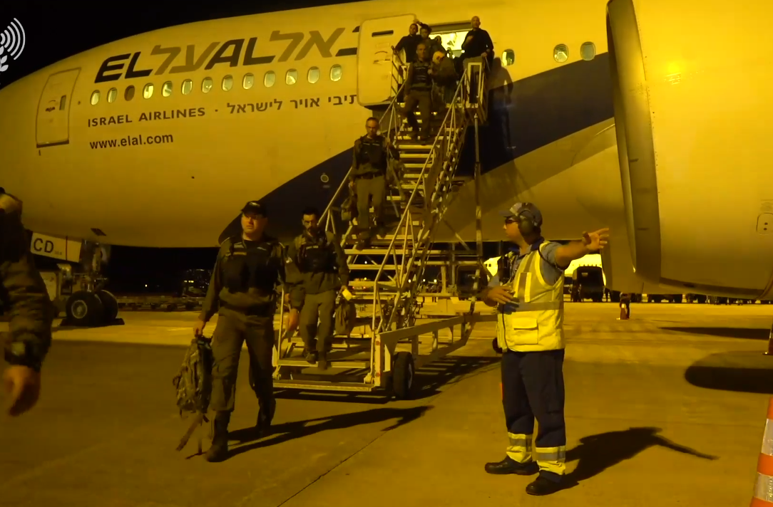
Brazil welcomes Israeli rescue team with open arms:
‘A superpower of kindness and giving
Notes:
Note on the plane: El Al
https://worldisraelnews.com/israel-rescue-team-arrives-in-brazil-to-help-locate-survivors/?utm_source=MadMimi&utm_medium=email&utm_content=Russia%3A+Israel%E2%80%99s+Security+%E2%80%98Top+Priority%27%3B+Iranians+Hide+Faces+in+Touching+Tribute+to+Holocaust%3B+Roseanne+Barr+Praises+Judea+%26+Samaria+%E2%80%98Pioneers%E2%80%99&utm_campaign=20190128_m149482658_Russia%3A+Israel%E2%80%99s+Security+%E2%80%98Top+Priority%27%3B+Iranians+Hide+Faces+in+Touching+Tribute+to+Holocaust%3B+Roseanne+Barr+Praises+Judea+%26+Samaria+%E2%80%98Pioneers%E2%80%99&utm_term=Brazil+Welcomes+Israeli+Rescue+Team_3A+_E2_80_98A+Superpower+of+Kindness+and+Giving_E2_80_99

Slide 6
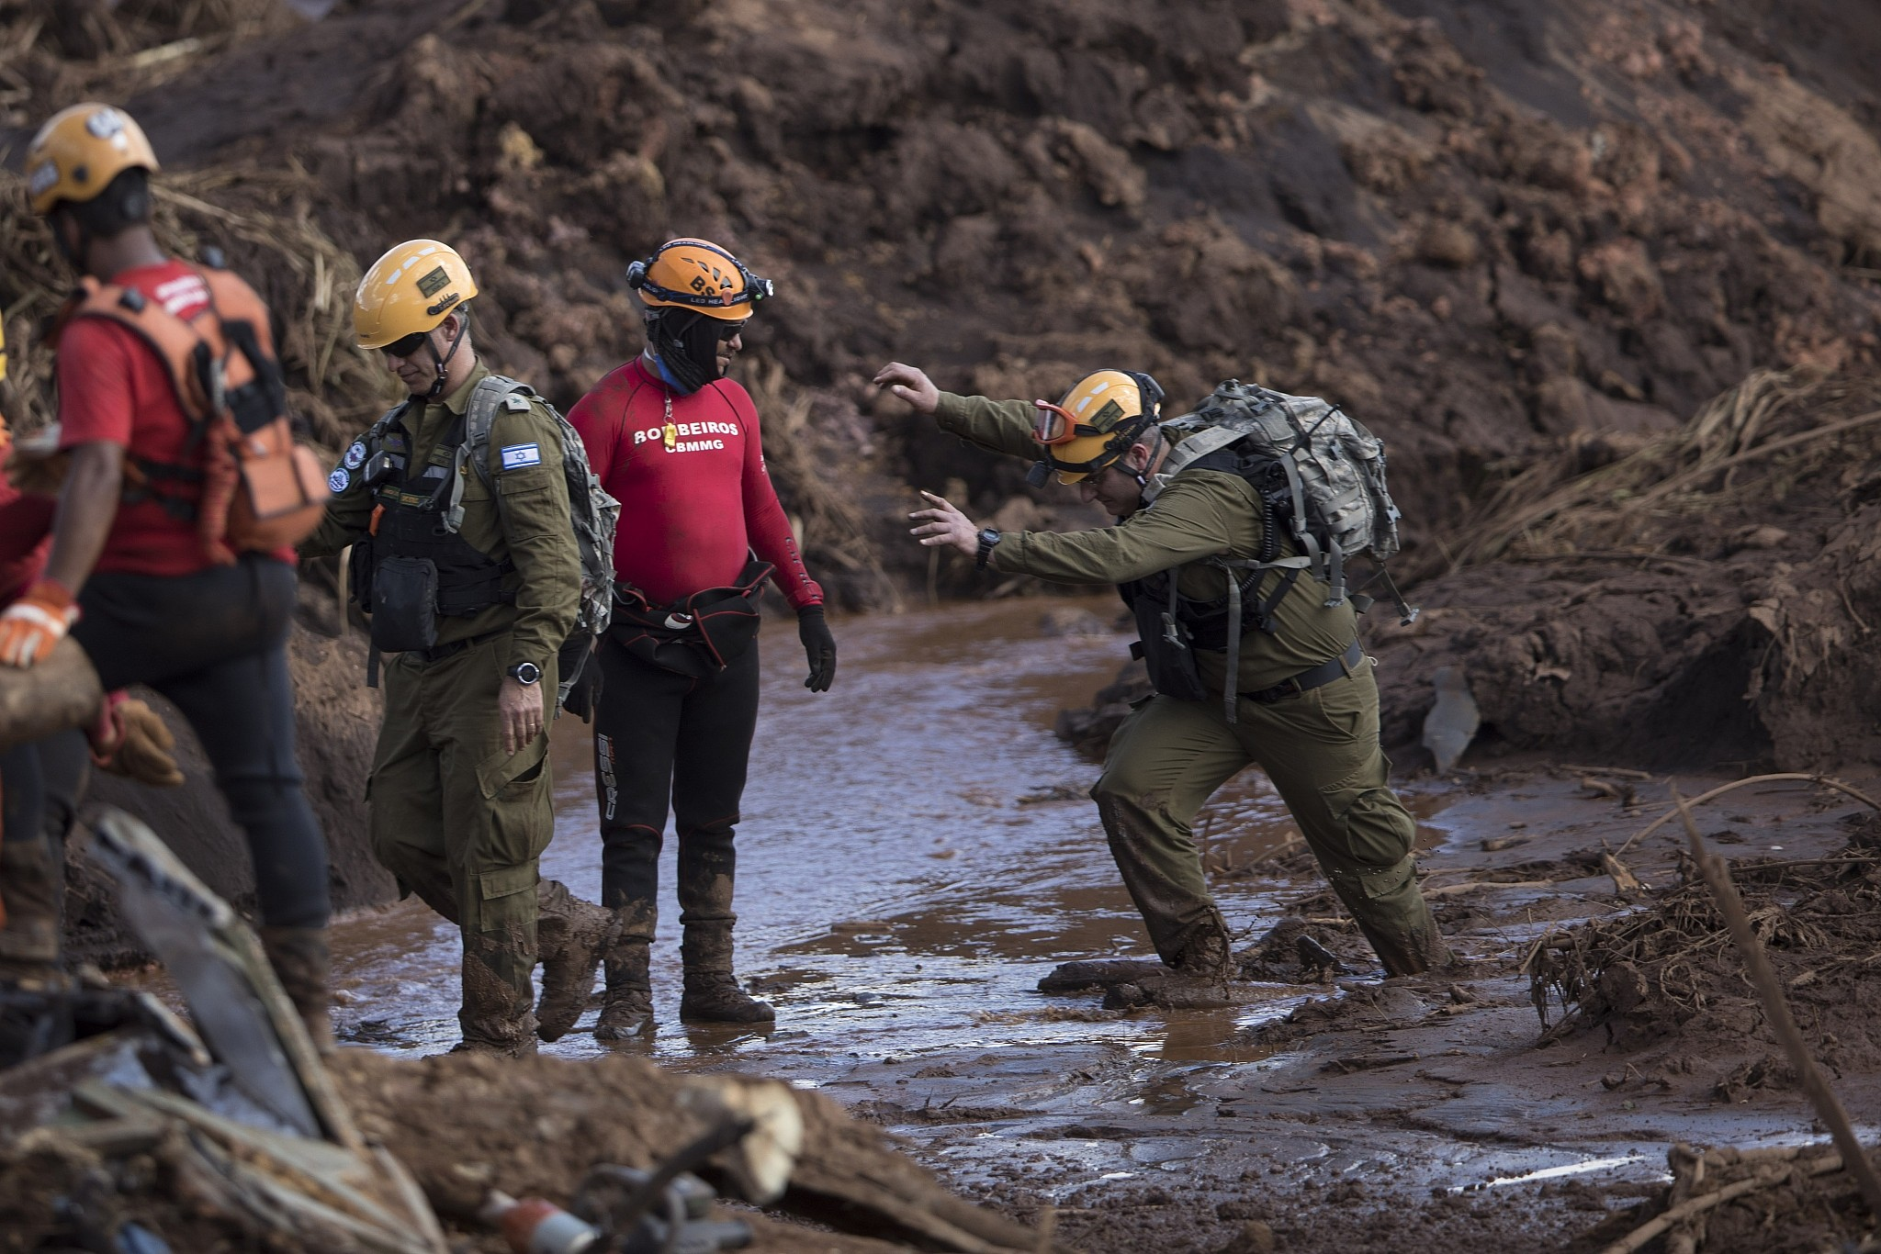
Notes:
https://www.timesofisrael.com/idf-team-aiding-search-at-brazil-dam-disaster-met-with-praise-and-criticism/
An Israeli rescue specialist arrives at a site where a body was found inside a vehicle stuck in the mud, days after a dam collapse in Brumadinho, Brazil, Monday, Jan. 28, 2019.

Slide 7
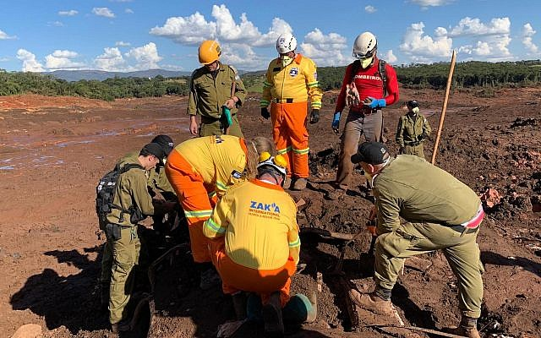
Notes:
https://www.timesofisrael.com/idf-team-aiding-search-at-brazil-dam-disaster-met-with-praise-and-criticism/
Israelis working at the site of a dam collapse at a mining operation in a rural area of the Minas Gerais state of Brazil. (Courtesy of ZAKA via JTA)

Slide 8
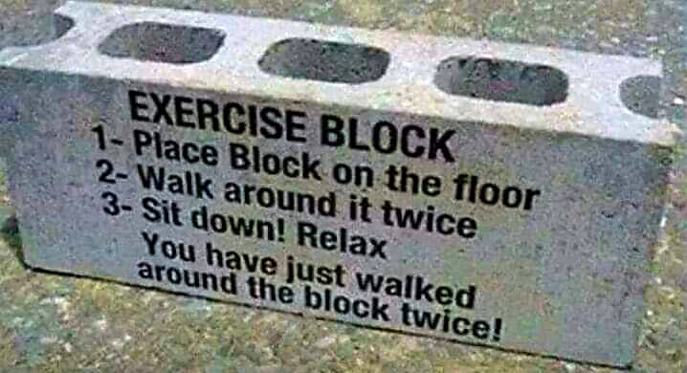
Notes:
Rick Fischer

Slide 9
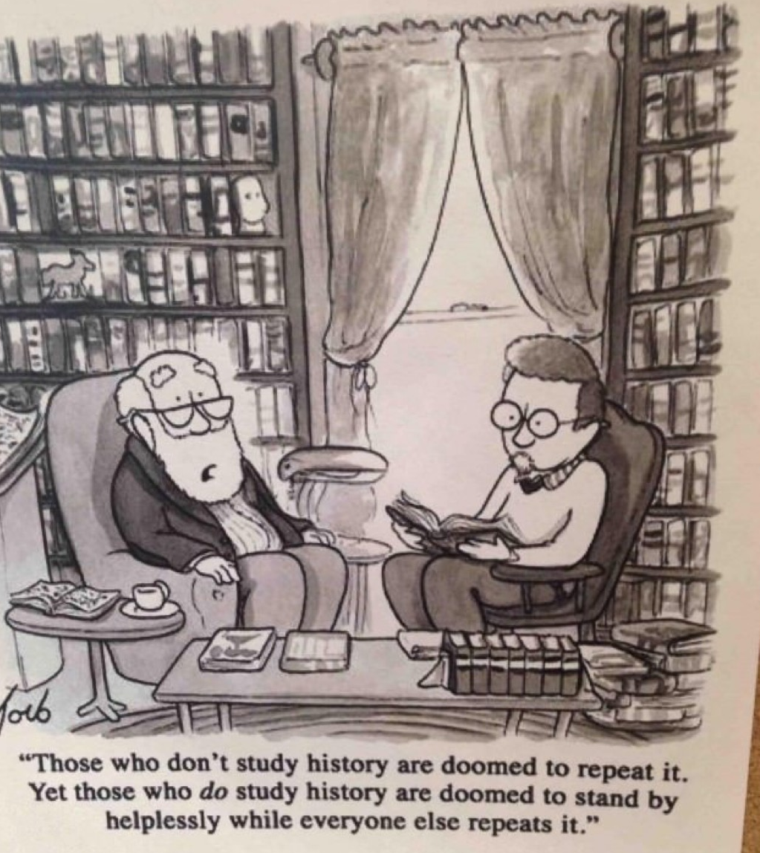
Notes:
Vicki Kline

Slide 10
I’ve been doing a sequential teaching on Mattityahu, started with Mt. 5.5 on Oct. 17, 2015
Why?
“Felt led”
Missed two scheduled readings due to snow. Catch up today.
Notes:
No halakhah or tradition to it.
Maybe someday put it into a devotional commentary.

Slide 11
Last two messages on extravagant worship.
Today:
Betrayal
Notes:
Never spoken on this topic. One great advantage to expounding scripture sequentially. Get to everything. No one offended that I’m picking on them!

Slide 12
^{Mattityahu (Matthew) 26:14-16} Then one of the Twelve, the one called Yehuda of Kriot, went to the ruling kohanim and said, “What are you willing to give me if I hand Him over to you?” And they weighed out thirty shekels of silver for him. From then on, Yehuda began looking for a chance to hand Him over. Why?
Notes:
Why?
That is the topic of the message. Why would Yehuda? Why would anyone?

Slide 13
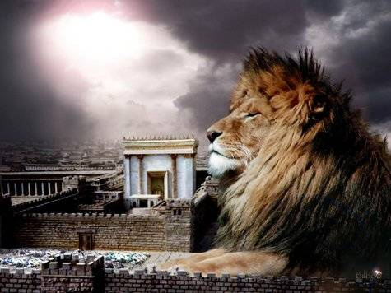
מַתִּתְיָהוּ Mattityahu
(Matthew) 26:20-23
Notes:
Skipping 17-19 about prep and set up for Seder

Slide 14
Mattityahu (Matthew) 26:20
בָּעֶרֶב הֵסֵב עִם הַשְּׁנֵים־עָשָׂר,
When evening came, Yeshua reclined with the twelve talmidim;
Notes:
Note: evening
Rabbi trail

Slide 15
^{Shmot /Ex 12 3-8} Speak to all the assembly of Isra'el and say, 'On the tenth day of this month, each man is to take a lamb or kid for his family, one per household "'You are to keep it until the fourteenth day of the month, slaughter it at dusk…That night, they are to eat the meat, roasted in the fire; they are to eat it with matzah and maror.
Notes:
You’ve all seen the famous Leonardo da Vinci painting…

Slide 16
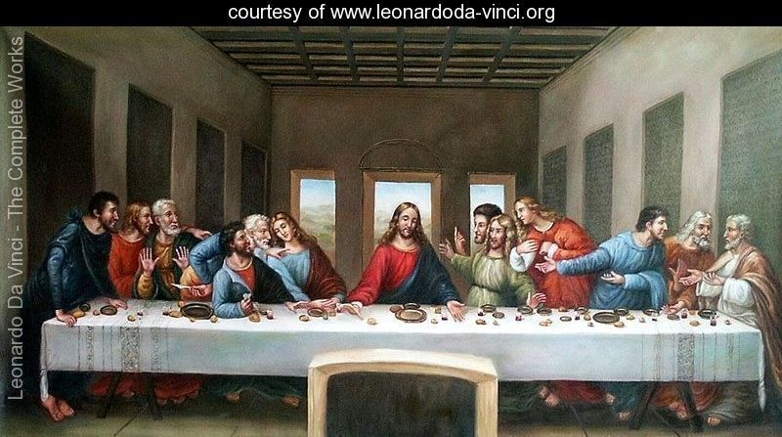
Notes:
Still daylight, supposed to be night
loaves of bread, festival of unleavened bread…Matzah
only one guy looks Jewish!!! With the money bag, the traitor.
Fish? Maybe, but where is the lamb?
Renaissance Italian
No one reclining!
Where are the kids?
That’s why no copies in our building.
https://www.google.com/search?q=bohdan+piasecki+last+supper&safe=active&tbm=isch&tbs=rimg:CeXkc1xKOcm3Ijhrp_1MiCsrPloFArf_1mfc0HZP2fcY6FM2siHwoE7_1eJImgDBT3S4Fp7eZuTJfJ1aOcrqzMwP4OH8yoSCWun8yIKys-WEc280aok8fRpKhIJgUCt_1-Z9zQcRZQB2CM-K8dwqEglk_1Z9xjoUzaxExqnBsOYvXGyoSCSIfCgTv94kiEeIRCmKLvXwwKhIJaAMFPdLgWnsRQn8U664904MqEgl5m5Ml8nVo5xHF9vYVVLNqLyoSCSurMzA_1g4fzEUEo9OKuT5fP&tbo=u&sa=X&ved=2ahUKEwiM-J-q-ZvgAhVJYK0KHR2ECHQQ9C96BAgBEBs&biw=1164&bih=865&dpr=1.1#imgdii=FUBsg2SZsy6vdM:&imgrc=bmthmlXL2OCD2M:

Slide 17
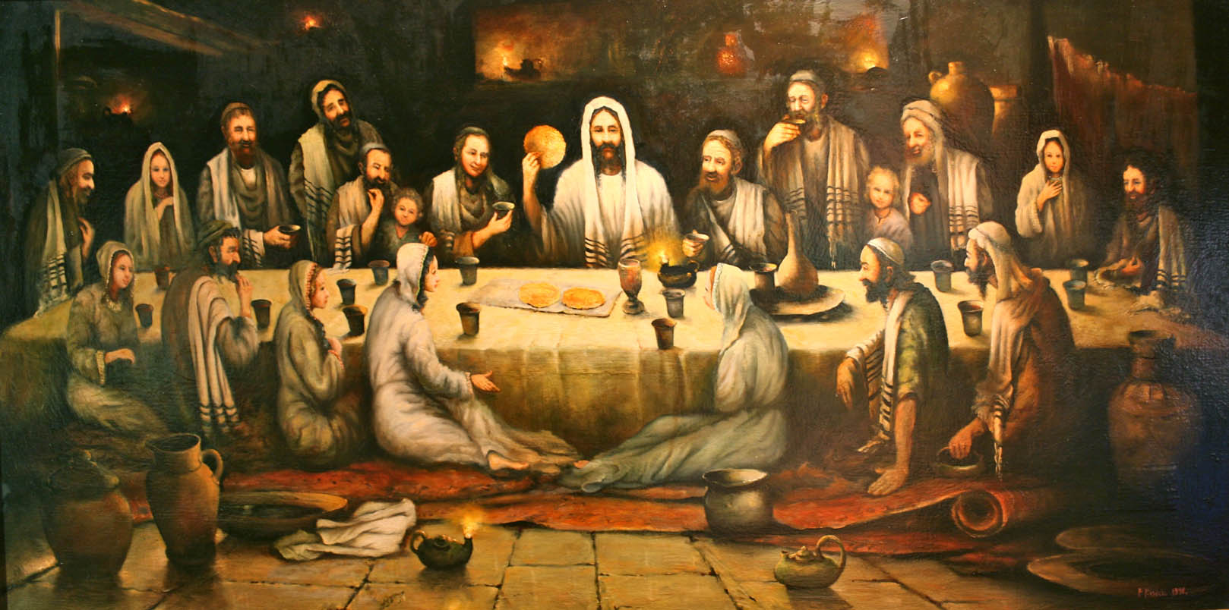
Last Supper by Bohdan Piasecki
Notes:
In order to counter Leonardo's powerful image of the Last Supper, BASIC commissioned the eminent Polish artist Bohdan Piasecki to paint the Last Supper as a Jewish Passover meal with women and children present. The painting is oil on canvas measuring 20" by 48“.
When your children will ask…4 questions
Back to the theme…
https://aidanslegacy.typepad.com/lillylewin/files/last_supper.htm
https://www.google.com/search?q=bohdan+piasecki+last+supper&safe=active&tbm=isch&tbs=rimg:CeXkc1xKOcm3Ijhrp_1MiCsrPloFArf_1mfc0HZP2fcY6FM2siHwoE7_1eJImgDBT3S4Fp7eZuTJfJ1aOcrqzMwP4OH8yoSCWun8yIKys-WEc280aok8fRpKhIJgUCt_1-Z9zQcRZQB2CM-K8dwqEglk_1Z9xjoUzaxExqnBsOYvXGyoSCSIfCgTv94kiEeIRCmKLvXwwKhIJaAMFPdLgWnsRQn8U664904MqEgl5m5Ml8nVo5xHF9vYVVLNqLyoSCSurMzA_1g4fzEUEo9OKuT5fP&tbo=u&sa=X&ved=2ahUKEwiM-J-q-ZvgAhVJYK0KHR2ECHQQ9C96BAgBEBs&biw=1164&bih=865&dpr=1.1#imgrc=0dTQCZ4n35hBYM:

Slide 18
Mattityahu (Matthew) 26:21
וְכַאֲשֶׁר אָכְלוּ אָמַר: ”אָמֵן אוֹמֵר אֲנִי לָכֶם, אֶחָד מִכֶּם יַסְגִּירֵנִי.“
and as they were eating, he said, “Yes, I tell you that one of you is going to betray me.”

Slide 19
Mattityahu (Matthew) 26:22
הֵם הִתְעַצְּבוּ מְאֹד וְהֵחֵלּוּ אִישׁ אִישׁ לִשְׁאֹל אוֹתוֹ: ”זֶה אֲנִי, אֲדוֹנִי?“
They became terribly upset and began asking him, one after the other, “Lord, you don’t mean me, do you?”

Slide 20
Mattityahu (Matthew) 26:23
הֵשִׁיב וְאָמַר: ”הַטּוֹבֵל אִתִּי אֶת יָדוֹ בַּקְּעָרָה הוּא יַסְגִּירֵנִי.
He answered, “The one who dips his matzah in the dish with me is the one who will betray me.”

Slide 21
Rewind…
Yokhanan’s word picture
a bit more extensive…

Slide 22
^{Yn 13.12-14} After he had washed their feet, taken back his clothes and returned to the table, he said to them, “Do you understand what I have done to you? You call me ‘Rabbi’ and ‘Lord,’ and you are right, because I am. Now if I, the Lord and Rabbi, have washed your feet, you also should wash each other’s feet.
Notes:
Note two titles. Differing implications.
[13.15 skipped]

Slide 23
^{Yn.13.16-18a} Yes, indeed! I tell you, a slave is not greater than his master, nor is an emissary greater than the one who sent him. If you know these things, you will be blessed if you do them.
“I’m not talking to all of you — I know which ones I have chosen.

Slide 24
^{Yn 13.18b} But so the Tanakh may be fulfilled, ‘He who eats My bread has lifted up his heel against Me.’
^{T’hillim/Ps 41.10} Even my close friend, on whom I relied, who shared my table, has turned against me.
גַּם-אִישׁ שְׁלוֹמִי, אֲשֶׁר-בָּטַחְתִּי בוֹ--אוֹכֵל לַחְמִי; הִגְדִּיל עָלַי עָקֵב.
lifted up his heel against me
Metaphor of a vocious horse kick
Notes:
Yeshua experienced all our trauma…
Dependent? My bread: intimate trust relationship
[13.19-20 skipped]
Similar psalm…55

Slide 25
^{T’hillim/Ps 55.13-15} For it was not an enemy who insulted me; if it had been, I could have borne it. It was not my adversary who treated me with scorn; if it had been, I could have hidden myself. But it was you, a man of my own kind, my companion, whom I knew well. We used to share our hearts with each other; in the house of God we walked with the crowd.

Slide 26
^{Yn 13.21-23} After saying this, Yeshua, in deep anguish of spirit, declared, “Yes, indeed! I tell you that one of you will betray me.” The talmidim stared at one another, totally mystified — whom could he mean? One of his talmidim, the one Yeshua particularly loved, was reclining close beside him.
Notes:
Why anguish? In pain at impending, internal betrayal. Abandonment is the foundational emotional pain.

Slide 27
^{Yn.13.24-25} So Shim‘on Kefa motioned to him and said, “Ask which one he’s talking about.” Leaning against Yeshua’s chest, he asked Yeshua, “Lord, who is it?”

Slide 28
^{Yn 13.26-27a} Yeshua answered, “It’s the one to whom I give this piece of matzah after I dip it in the dish.” So he dipped the piece of matzah and gave it to Y’hudah Ben-Shim‘on from K’riot. As soon as Y’hudah took the piece of matzah, the Adversary went into him.
Notes:
Like Mt 26.23 above
Why Satanic control at that point?

Slide 29
Dips his matzah in the dish. The dish may well have contained charoset and/or maror, both used in Seder services today. Charoset is a sweet paste made of fruit, nuts, spices and wine; numerous recipes are in use today in the various Jewish ethnic communities.
Notes:
https://kifa.kz/eng/bible/stern/stern_matfey_26.php

Slide 30
Its function in the Seder is to recall by its appearance the mortar which the Israelite slaves made in Egypt, and it is referred to by the mid-second-century rabbis Me'ir and Eli'ezer bar-Tzadok in the Mishna (Pesachim 2:8,10:3).
Notes:
https://kifa.kz/eng/bible/stern/stern_matfey_26.php

Slide 31
Maror means "bitter herbs," calling to mind the bitterness of Israelite slavery to Pharaoh; today horseradish root or lettuce is used as maror. Rabbi Hillel, in the generation before Yeshua, inaugurated the custom of eating a "sandwich" consisting of a piece of the Passover lamb,
Notes:
https://kifa.kz/eng/bible/stern/stern_matfey_26.php

Slide 32
together with matzah and maror, in literal fulfillment of the command, "On (Hebrew 'al) matzah and maror shall they eat it" (Exodus 12:8). (Today Ashkenazi Jews do not eat lamb at Passover because it cannot be slaughtered at the Temple; however, the S'faradim do.)
Notes:
https://kifa.kz/eng/bible/stern/stern_matfey_26.php
Matzah, maror, kharoset symbols of redemption, liberty, deliverance. Yehuda in context of all that, apparently, determined to carry out his plan. Why?? Harden our hearts, then G-d and the Adversary harden MORE!!

Slide 33
^{Yn 13.27b-30} “What you are doing, do quickly!” Yeshua said to him. But no one at the table understood why he had said this to him. Some thought that since Y’hudah was in charge of the common purse, Yeshua was telling him, “Buy what we need for the festival,” or telling him to give something to the poor.
Notes:
Festival, so can’t buy, unless they were in a different calendar than community. Give to the poor more likely.

Slide 34
^{Yn 13.27b-30} As soon as he had taken the piece of matzah, Y’hudah went out, and it was night.
Notes:
It was night. Indeed.
In company with the prince of darkness, opposition, enmity.
Went to the Roman authorities, next we read of him Yn 18.2
What was Yehuda thinking?

Slide 35
^{Yn 18.2-3} Now Y’hudah, who was betraying him, also knew the place; because Yeshua had often met there with his talmidim. So Y’hudah went there, taking with him a detachment of Roman soldiers and some Temple guards provided by the head cohanim and the P’rushim; they carried weapons, lanterns and torches.

Slide 36
^{Mt 26.46-50} Here comes my betrayer!” While Yeshua was still speaking, Y’hudah (one of the Twelve!) came, and with him a large crowd carrying swords and clubs, from the head cohanim and elders of the people. The betrayer had arranged to give them a signal:

Slide 37
^{Mt 26.46-50} “The man I kiss is the one you want — grab him!” He went straight up to Yeshua, said, “Shalom, Rabbi!” and kissed him. Yeshua said to him, “Friend, do what you came to do.” Then they moved forward, laid hold of Yeshua and arrested him.

Slide 38
Betrayed
What is going on?
What does it mean to Yehuda?
What can we learn, apply to our lives?
Other historical lessons?

Slide 39
Benedict
Arnold
in American
Uniform
1741-1801

Slide 40
George Washington had given him his fullest trust and placed him in command of the fortifications at West Point, New York. Arnold planned to surrender the fort to British forces, but the plot was discovered in September 1780 and he fled to the British.

Slide 41
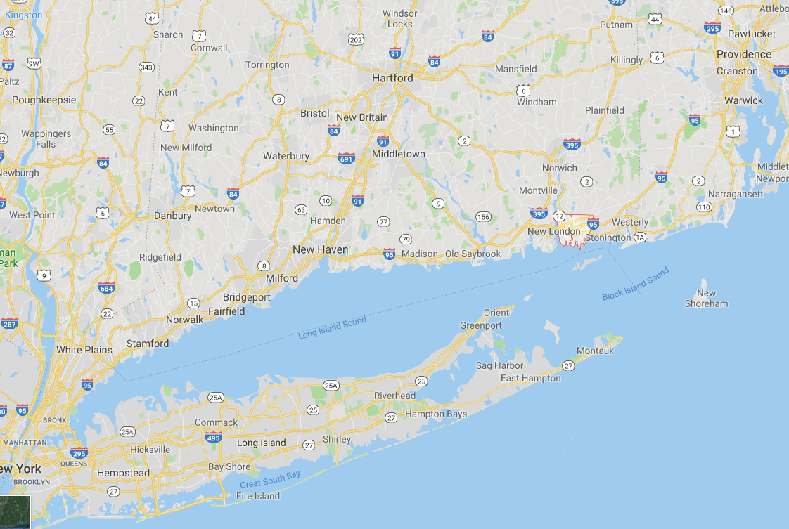

Slide 42
In 1781, they burned much of New London, Connecticut to the ground and slaughtered surrendering forces after the Battle of Groton Heights
Notes:
Slaughtered surrendering forces…destructive murderous rage?

Slide 43
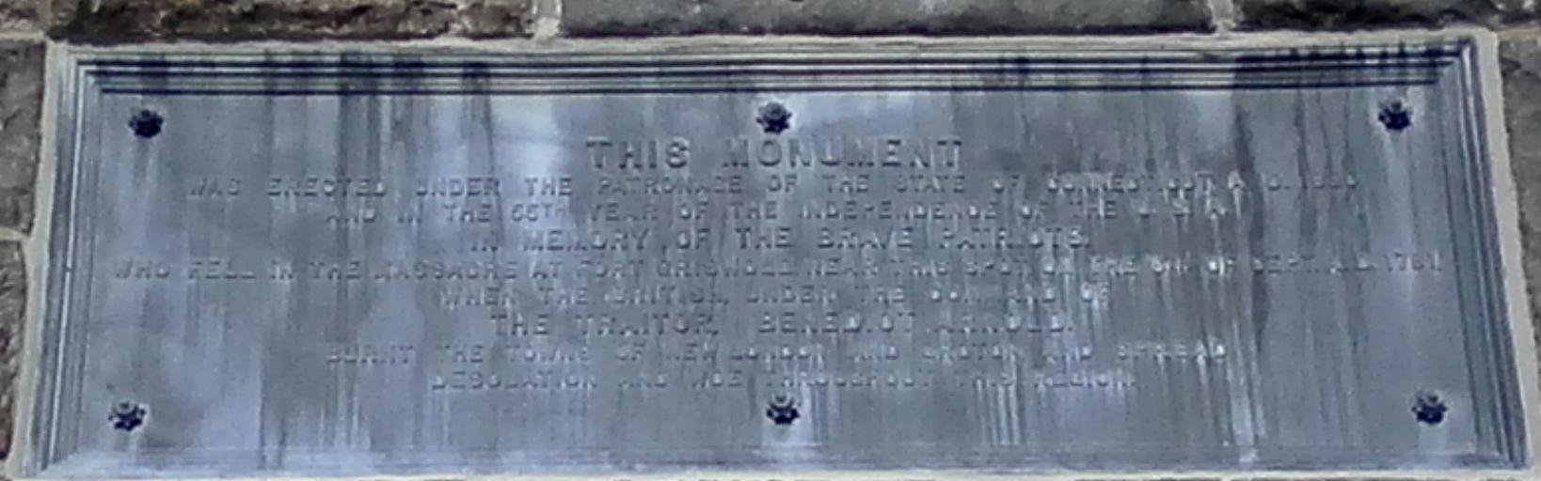
Dedication plaque on Groton Monument in Groton, CT to victims of Arnold's slaughter following the Battle of Groton Heights

Slide 44
His name quickly became a byword in the United States for treason and betrayal, Benedict Arnold
Notes:
Motive: Mad because skipped over a promotion?
Believed in the cause of King George III?
Not so well known, but more damaging…

Slide 45
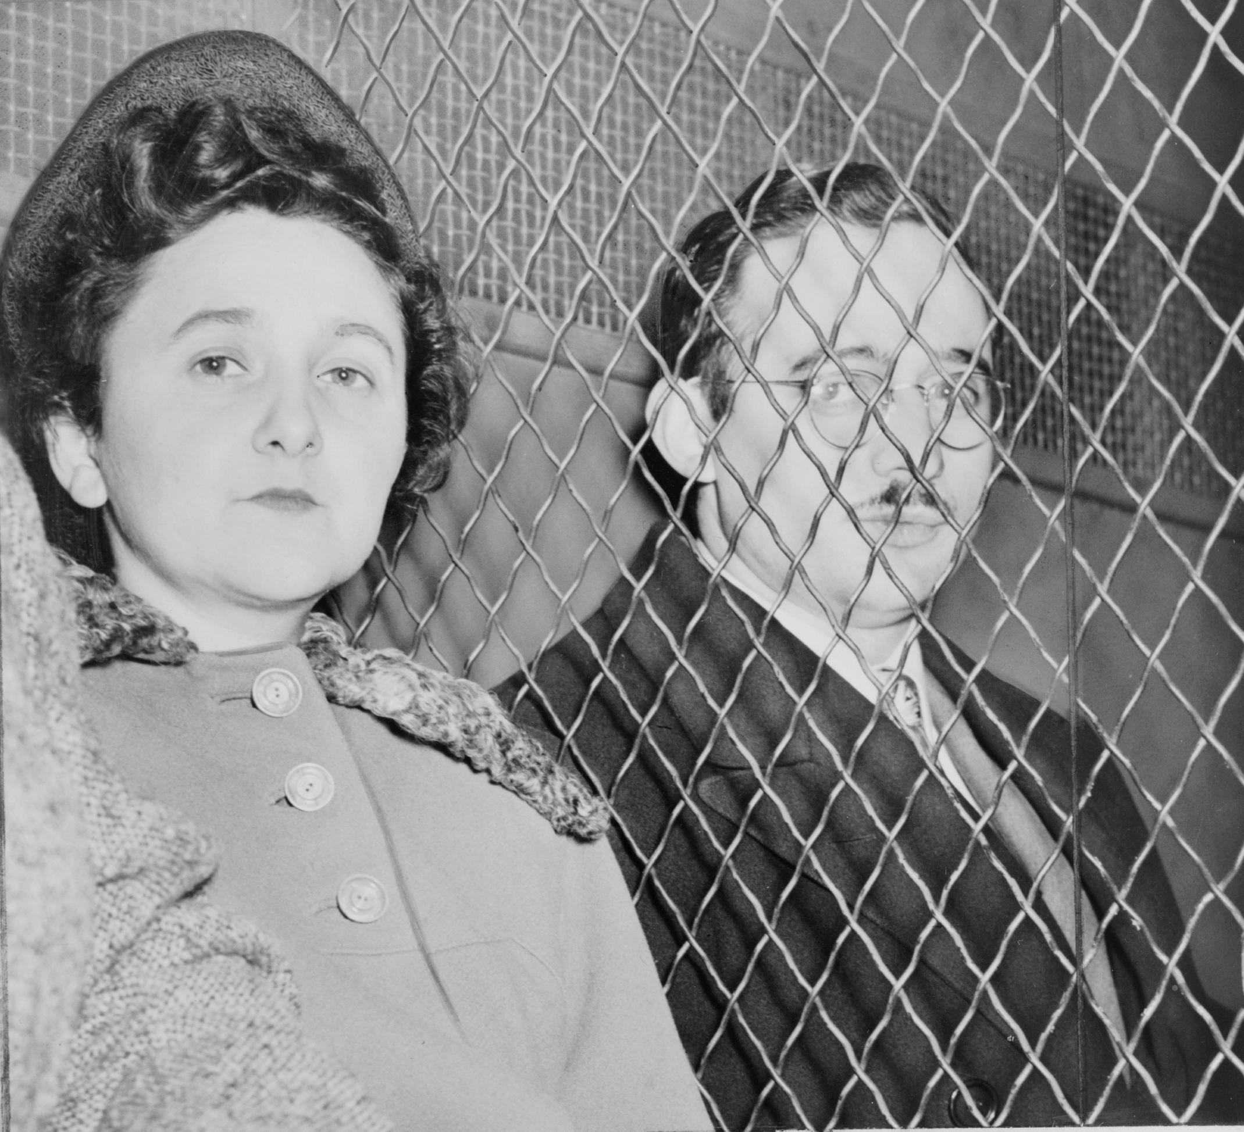
Julius and Ethel Rosenberg
Notes:
https://en.wikipedia.org/wiki/Julius_and_Ethel_Rosenberg
Julius and Ethel Rosenberg, separated by heavy wire screen as they leave U.S. Court House after being found guilty by jury.

Slide 46
Julius and Ethel Rosenberg were American citizens who spied, with others, for the Soviet Union and were tried, convicted, and executed in 1953 by the federal government of the United States. They provided top-secret information about radar, sonar,
Notes:
https://en.wikipedia.org/wiki/Julius_and_Ethel_Rosenberg

Slide 47
and jet propulsion engines and nuclear weapon designs to the Soviet Union; at that time the United States was the only country in the world with nuclear weapons
Notes:
https://en.wikipedia.org/wiki/Julius_and_Ethel_Rosenberg
Wouldn’t have been a Cold War without this betrayal of the United States.
Believed in Communism?

Slide 48
Since the Middle Ages, Judas has sometimes been portrayed as a personification of the Jewish people and his betrayal of Messiah has been used to justify Christian antisemitism.
Notes:
https://en.wikipedia.org/wiki/Judas_Iscariot

Slide 49
What is in the mind of a betrayer, a traitor?
Noble, if deceived, cause?
Materialism and gain?
Anger, bitterness?
Notes:
Arnold received a commission as a brigadier general in the British Army, an annual pension of £360, and a lump sum of over £6,000. Rosenbergs? People have left Yeshua for compromised jobs.
Anger at USA, at Geo. Washington, Rosenbers mad at capitalism.

Slide 50
Betray, in Hebrew
יַסְגִּיר from הִסְגִּיר פ' הפעיל causative form
hees-geer
to extradite, to hand over (someone) ; to give oneself up ; to give away, to expose, to reveal
Notes:
From root sagar, to close

Slide 51
Betray, in Greek
παραδίδωμι paradidómi
to hand over, to give or deliver over, to betray, pledge, hand down, deliver, commit, commend, abandon.

Slide 52
How can we understand Yehuda’s betrayal?
What can we learn, apply to our lives?

Slide 53
^{Lk 9.1-2} Calling together the Twelve [including Yehuda], Yeshua gave them power and authority to expel all the demons and to cure diseases; and he sent them out to proclaim the Kingdom of God and to heal.
Yehuda had Messiah’s power!
Notes:
Maybe not grateful? Not enough?

Slide 54
Yehuda always addresses Yeshua as “Rabbi,” but never as “Lord”
Notes:
How do we address Him?

Slide 55
"Iscariot" may be a conflation of the Hebrew Ish Kerioth, or “man from Kerioth,” קְרִיּוֹת איש a town in the southern part of Judea. If so, it has been weakly speculated, Judas was the only non-Galilean.
Isolation, unresolved loneliness?

Slide 56
Keriot is mentioned in Joshua 15:25. Yehuda was probably a native of this place, and hence his name Iscariot. It has been identified with the ruins of el-Kureitein, about 10 miles south of Hebron.

Slide 57
"Iscariot" also closely resembles a Greek word meaning "dagger-bearer.“Sicarii” Terrorist assassins.
Early warning…
Notes:
https://en.wikipedia.org/wiki/Sicarii
https://www.osv.com/OSVNewsweekly/ByIssue/Article/TabId/735/ArtMID/13636/ArticleID/10524/Why-Did-Judas-Betray-Jesus.aspx

Slide 58
^{Yn 6.67-71} Yeshua said to the Twelve, “Don’t you want to leave too?” Shim‘on Kefa answered him, “Lord, to whom would we go? You have the word of eternal life. We have trusted, and we know that you are the Holy One of God.”
Notes:
https://en.wikipedia.org/wiki/Judas_Iscariot

Slide 59
^{Yn 6.67-71} Yeshua answered them, “Didn’t I choose you, the Twelve? Yet one of you is an adversary.” (He was speaking of Y’hudah Ben-Shim‘on, from K’riot; for this man — one of the Twelve! — was soon to betray him.)
Notes:
Early warning?
https://en.wikipedia.org/wiki/Judas_Iscariot

Slide 60
^{Yn 12.4-6} But one of the talmidim, Y’hudah from K’riot, the one who was about to betray him, said, “This perfume is worth a year’s wages! Why wasn’t it sold and the money given to the poor?”

Slide 61
^{Yn 12.4-6} Now he said this not out of concern for the poor, but because he was a thief — he was in charge of the money box and used to steal from it.

Slide 62
Yehuda carried the disciples' money bag or box γλωσσόκομον, glōssokomon
Notes:
https://en.wikipedia.org/wiki/Judas_Iscariot

Slide 63
Possible betrayal motives:
Ingratitude for power
Not submitting to lordship
Isolation, loneliness
Political purposes
Progressive purloining

Slide 64
No matter how close you are to Yeshua’s physical presence, ie His Seder table in Yerushayim, you are not nearly as close as
^{Yn 14.23} Yeshua answered him, “If someone loves me, he will keep my word; and my Father will love him, and we will come to him and make our home with him.

Slide 66
How do we betray people, King Messiah?
Betray, in Greek
παραδίδωμι paradidómi
to hand over, to give or deliver over, to betray, pledge, hand down, deliver, commit, commend, abandon.

Slide 67
Start with easiest:
Betrayal in marriage: heart adultery >> physical adultery. Every email, phone call, friendship, my wife knows. She’s FIRST! Date her/him.

Slide 68
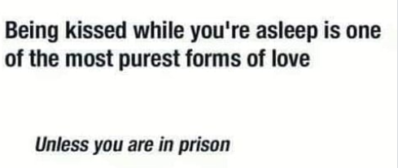
Notes:
Bad grammar, double superlative, nevertheless sweet…

Slide 69
Or in a dormitory

Slide 70
Betrayal of confidentiality. Sozo, we are instructed to forget. Pastoral ministry, we are taught to remember. If you are entrusted with information, zip it.
Notes:
Way to rememember…if using anyone’s name, do you have permission to speak??

Slide 71
Vision One vision in a congregation: two visions = division! “Working to bring Jewish people, and those grafted in, to their covenantal identity in Messiah. Implies: Messiah, Land, Scripture living. Every department is a department of outreach!
Notes:
Salvation through the Atonement of the Messiah; personal faith in the atoning death and resurrection of Yeshua; it's all about the King 2.) Covenantal identity of Jewish people, not replacement 3.) Restoration to Torah lifestyle 4.) Restoration/survival of the nation of Israel. (Covenantal identity, so Jewish believers don't assimilate. Romans 11:15 "For if their casting Yeshua aside means reconciliation for the world, what will their accepting him mean? It will be life from the dead!)

Slide 72
“For if their [the Jewish people’s] casting Yeshua aside means reconciliation for the world, what will their accepting him mean? It will be life from the dead!
Notes:
Are you here to be blessed in working for the salvation of Israel?

Slide 73
Being compliant: ^{Mishlei 27.6} Faithful are the wounds of a friend, but an enemy’s kisses are insincere. ^{Vayikra/Lev 19.17-18} Do not hate your brother in your heart, but rebuke your neighbor frankly, so that you won’t carry sin because of him.

Slide 74
Don’t take vengeance on or bear a grudge against any of your people; rather, love your neighbor as yourself; I am Adonai.

Slide 75
We are in a culture war, and Biblical values will get less and less popular.

Slide 76
Sixty-four percent of clergy said they felt “limited” in their ability to speak out on “moral and social issues” due to those within their congregations, while 69 percent reported feeling “pressured” to speak out on “moral and social issues” when they were “not comfortable discussing” them.
Notes:
https://www.christianpost.com/news/pastors-feel-greatest-pressure-to-address-avoid-divisive-issues-from-inside-the-church-barna.html

Slide 77
Further, the pressure to speak on certain controversial issues increased between 2014-2016, going from 44 percent to 69 percent.
Notes:
https://www.christianpost.com/news/pastors-feel-greatest-pressure-to-address-avoid-divisive-issues-from-inside-the-church-barna.html
So, I’ll speak out on something politically incorrect.

Slide 78

Spire atop rebuilt World Trade Center
Notes:
https://www.frc.org/get.cfm?i=WA19A51&f=WU19A17

Slide 79
The spire of New York's One World Trade Center was lit up in it's-a-girl pink, a 408-foot reminder that the law it celebrated will mean fewer daughters, fewer mothers, fewer chances.
Notes:
https://www.frc.org/get.cfm?i=WA19A51&f=WU19A17

Slide 80
Abortion has just massively expanded its target zone in New York State. Under the Reproductive Health Act, late-term abortion is the new normal.
Notes:
https://www.frc.org/get.cfm?i=WA19A51&f=WU19A17

Slide 81
“Person,” as far as this law is concerned, means a human being who has been born and is alive. Not a second before, and maybe -- without infant protections -- not few seconds after either. Midwives and nurse practitioners can also perform abortions under the law,
Notes:
As far as scripture is concerned, it’s a person from the instant of conception.
https://www.frc.org/get.cfm?i=WA19A51&f=WU19A17

Slide 82
"The U.S. is one of only seven nations on the planet to allow elective abortion after 20 weeks, or more than halfway through pregnancy.
Europe has the memory of the Holocuast.
Notes:
https://www.frc.org/get.cfm?i=WA19A51&f=WU19A17

Slide 83
Abortion Was Leading Cause Of Death Worldwide In 2018: More human beings died in abortions than any other cause of death in 2018, a new report indicates. A heartbreaking reminder about the prevalence of abortion, statistics compiled by Worldometers indicate that there were nearly 42 million abortions world-wide in 2018.
Notes:
Barry & Batya Segal http://www.netmail411.com/mail/vfi/JOLjan0419.html?utm_source=JNN+Newsletter+-+Global&utm_campaign=abe084319c-EMAIL_CAMPAIGN_2018_10_08_02_05_COPY_01&utm_medium=email&utm_term=0_a7c77e6522-abe084319c-144069561&mc_cid=abe084319c&mc_eid=5c6cdd3ee6

Slide 84
As of December 31, 2018, there have been some 41.9 million abortions performed in the course of the year, the report revealed. By contrast, 8.2 million people died from cancer in 2018, 5 million from smoking, and 1.7 million died of HIV/AIDS.
Notes:
Barry & Batya Segal http://www.netmail411.com/mail/vfi/JOLjan0419.html?utm_source=JNN+Newsletter+-+Global&utm_campaign=abe084319c-EMAIL_CAMPAIGN_2018_10_08_02_05_COPY_01&utm_medium=email&utm_term=0_a7c77e6522-abe084319c-144069561&mc_cid=abe084319c&mc_eid=5c6cdd3ee6

Slide 85
Globally, just under a quarter of all pregnancies (23%) were ended by abortion in 2018, and for every 33 live births, ten infants were aborted.
Every conceived embryo has unique DNA and chromosomal structure.
Notes:
Barry & Batya Segal http://www.netmail411.com/mail/vfi/JOLjan0419.html?utm_source=JNN+Newsletter+-+Global&utm_campaign=abe084319c-EMAIL_CAMPAIGN_2018_10_08_02_05_COPY_01&utm_medium=email&utm_term=0_a7c77e6522-abe084319c-144069561&mc_cid=abe084319c&mc_eid=5c6cdd3ee6

Slide 86
Another issue…
Notes:
From Avner Boskey

Slide 87
A massacre of Kurds is set to be carried out by Turkish forces in the very near future
The vacuum which will be created by the upcoming U.S. withdrawal of forces from Syria will open up opportunities for Turkey to once again butcher its opponents.
Notes:
Copyright © 2018 Final Frontier Ministries, All rights reserved.

Slide 88
Trump: Turkey’s Erdogan Is The Man For The Job In Syria: Mere hours after Netanyahu dubbed Erdogan as an 'anti-Semitic dictator, President Trump said that Turkey’s leader is the right man for the job in Syria.
Notes:
http://www.netmail411.com/mail/vfi/JOLdec2618.html?utm_source=JNN+Newsletter+-+Global&utm_campaign=70ff5c5f55-EMAIL_CAMPAIGN_2018_10_08_02_05_COPY_01&utm_medium=email&utm_term=0_a7c77e6522-70ff5c5f55-144069561&mc_cid=70ff5c5f55&mc_eid=5c6cdd3ee6

Slide 89
Turkey will fill the void left in Syria by America’s impending departure, President Donald Trump announced Mon. morning, 24 Dec. 2018 praising Turkish President Recep Tayyip Erdogan
Notes:
http://www.netmail411.com/mail/vfi/JOLdec2618.html?utm_source=JNN+Newsletter+-+Global&utm_campaign=70ff5c5f55-EMAIL_CAMPAIGN_2018_10_08_02_05_COPY_01&utm_medium=email&utm_term=0_a7c77e6522-70ff5c5f55-144069561&mc_cid=70ff5c5f55&mc_eid=5c6cdd3ee6

Slide 90
History shows that Turkey’s pursuit of Caliphate glory has left a bloody trail of Christian Armenians and Greeks victims between the 1840's and 1918. Here are some main milestones (https://en.wikipedia.org/wiki/List_of_massacres_in_Turkey):
Notes:
Copyright © 2018 Final Frontier Ministries, All rights reserved.

Slide 91
Hamidian massacres in 1894-96 – 100,000-300,000 Christian Armenians by Turkish Ottoman and Arab soldiers (https://en.wikipedia.org/wiki/Massacres_of_Diyarbak%C4%B1r_(1895); http://www.armenian-genocide.org/hamidian.html)
Adana massacres in 1904 – 15,000-30,000 Christian Armenians by Turkish nationalists
Notes:
Copyright © 2018 Final Frontier Ministries, All rights reserved.

Slide 92
Greek genocide 1913-22 – 500,000-900,000 Christian Greeks by the Young Turk government
Assyrian genocide 1914-18 – 270,000-750,000 Assyrian Christians by the Young Turk government and Kurdish tribes
Notes:
Copyright © 2018 Final Frontier Ministries, All rights reserved.

Slide 93
Armenian genocide 1915-18 – 850,000-1,500,000 Armenian Christians by the Young Turk government and Kurdish tribes (https://en.wikipedia.org/wiki/Armenian_Genocide)
Notes:
Copyright © 2018 Final Frontier Ministries, All rights reserved.

Slide 94
How to protect loyalty, avoid betrayal?
Negative and positive.

Slide 95
^{Mes Jews/Heb. 3.12} Take care, brothers and sisters, that none of you has an evil heart of unbelief that falls away from the living God. But encourage one another day by day—as long as it is called “Today”—so that none of you may be hardened by the deceitfulness of sin.

Slide 96
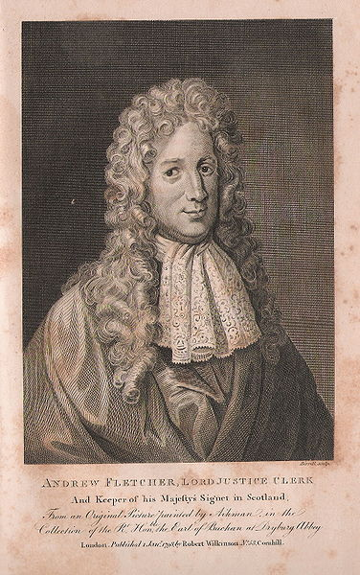
Andrew Fletcher
(1653 –1716)
was a Scottish
writer, politician,
and patriot.

Slide 97
He believed if a man were permitted to make all the ballads he need not care who should make the laws of a nation, and we find that most of the ancient legislators thought that they could not well reform the manners of any city without the help of a lyric, and sometimes of a dramatic poet.
Notes:
https://mail.google.com/mail/u/0/#inbox/KtbxLwGkKGlGHkVrGNxHCNLmFtWpkfjKbq

Slide 98
Let me make the songs of a nation, and I care not who makes its laws.
Notes:
https://mail.google.com/mail/u/0/#inbox/KtbxLwGkKGlGHkVrGNxHCNLmFtWpkfjKbq

Slide 99
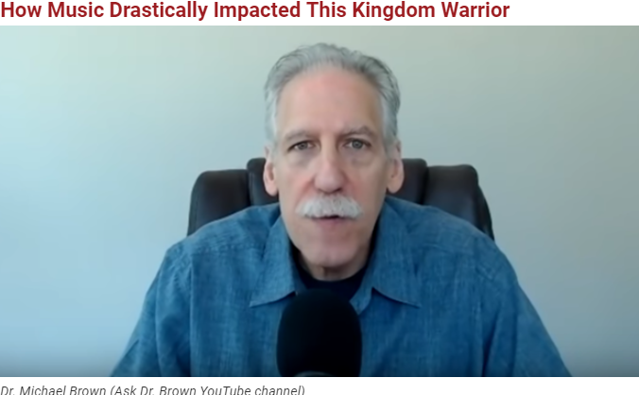

Slide 100
When the Beatles came to America in 1964, a 9-year-old Michael Brown was fascinated. He started playing the drums and saw his first rock concert at age 13. At that point, his life took a negative turn.

Slide 101
"That opened up my life to drugs and rebellion, and that shaped my life between the ages 14 and 16," he said. "I went to one rock concert after another. My life was going to school, getting high, playing in a rock band, practicing and going to rock concerts."

Slide 102
But then…it was in a little Italian Pentecostal church, and the pastor's wife [was] playing piano. It was something about those joyous hymns; the Lord really touched me. I was supernaturally overcome. I experienced and encountered the love of God in this little church.

Slide 103


