Slide 1
e-handout
To have these notes
without taking notes
Go to OrHaOlam.com
Click on downloads,
messages, 2019
Notes:
Some really distressing world news, not in the normal media…

Slide 2
Some really distressing world news, not in the normal media…

Slide 3
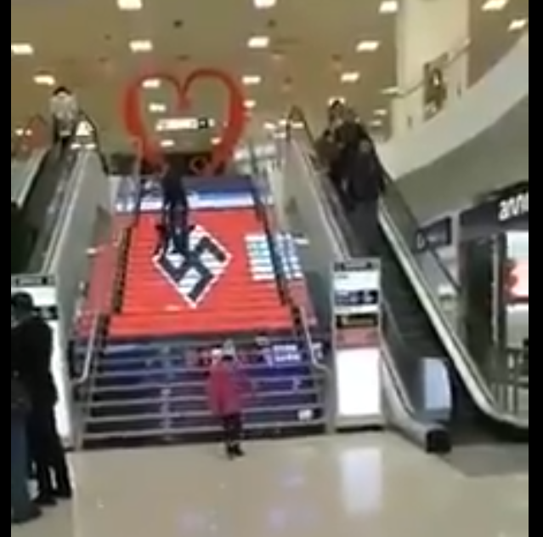
Kyiv’s shopping mall “Gorodok”
Notes:
February 19, 2019 A Ukraine shopping mall on Kiev’s Bandera Avenue decorated its staircase with a large Nazi flag. Video of the “decoration” surfaced on Monday on Facebook.
The mall is located on a street named for Stepan Bandera, a man who briefly collaborated with the Nazis and whose troops reportedly killed 1,000s of Jews. I know that Ukraine is under invasion from Russia under Putin, but it’s really hard to feel very sympathetic. Second worst massacre, to Hitler, is the Ukrainian Khmelnytsky. He’s on their currency.

Slide 4
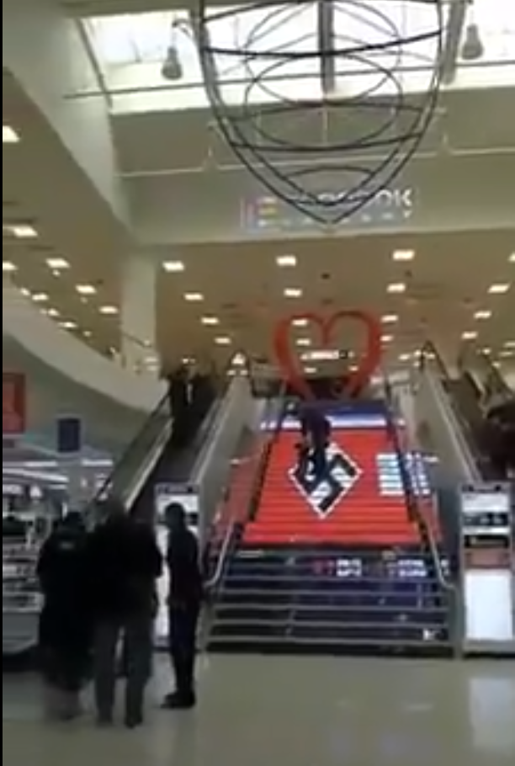
Kyiv’s shopping mall “Gorodok”
Notes:
https://worldisraelnews.com/watch-ukrainian-mall-decorates-staircase-with-nazi-flag/?utm_source=MadMimi&utm_medium=email&utm_content=PA%3A+Israel+%E2%80%98Playing+with+Fire%E2%80%99+on+Temple+Mount%3B+Omar+to+Keynote+Event+for+Hamas-Linked+Group%3B+Jewish+Cemetery+Defaced+in+France&utm_campaign=20190219_m149864593_PA%3A+Israel+%E2%80%98Playing+with+Fire%E2%80%99+on+Temple+Mount%3B+Omar+to+Keynote+Event+for+Hamas-Linked+Group%3B+Jewish+Cemetery+Defaced+in+France&utm_term=AP_16104499585826-289x159_jpg

Slide 5
Very good news from Israel

Slide 6
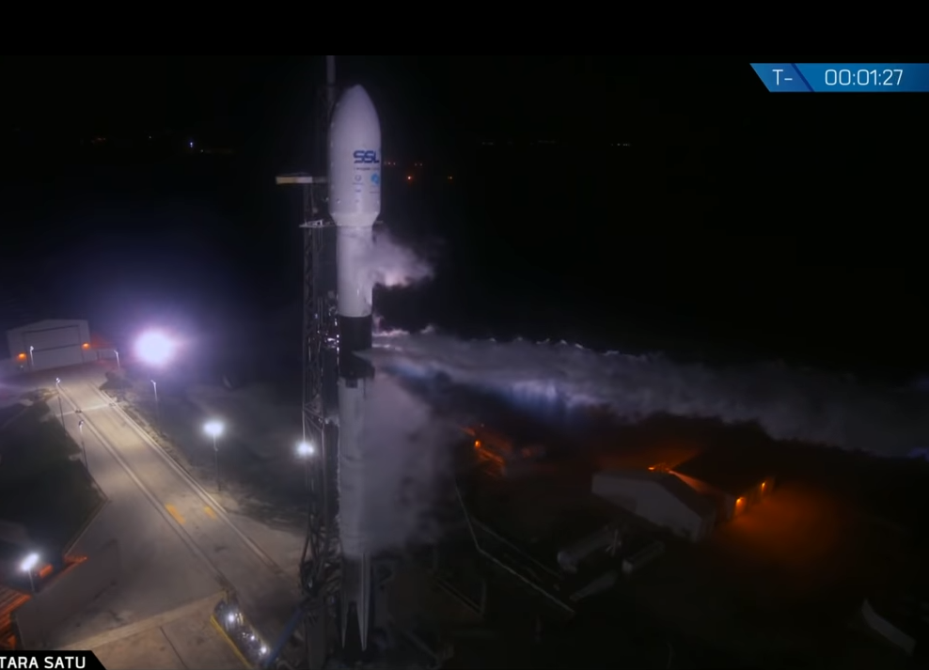
Falcon 9 rocket
ready to go, Feb.21, 2019
Notes:
Note: T-1.27

Slide 7
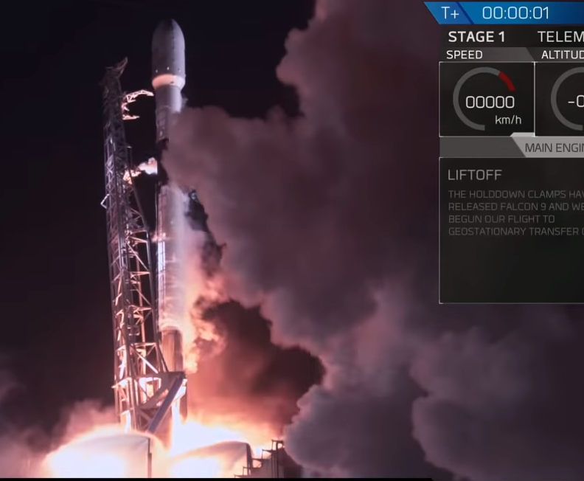
Notes:
T 1 second

Slide 8
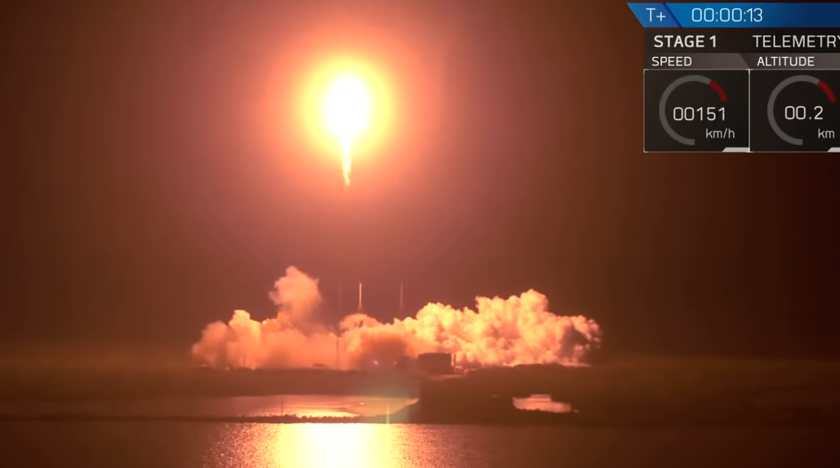
Notes:
T + 13 seconds Following liftoff, SpaceX recovered the first-stage booster, which flew twice last year. The booster landed smoothly on an offshore ocean platform, after the hottest re-entry yet, according to SpaceX founder and chief executive Elon Musk. Sparks from burning metal were visible in the landing video.
Musk said the booster will fly a fourth time in April, during a launch abort test of the new crew Dragon capsule. No one will be aboard.

Slide 9

Beresheet Israeli lunar probe בְּרֵאשִׁית

Slide 10
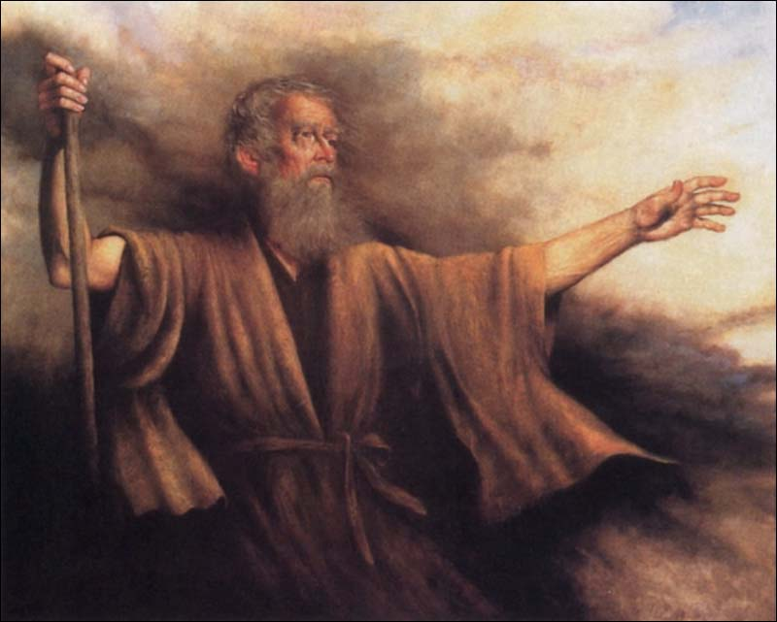
Sh'mot שְׁמוֹת
(Exodus) 30:14-16
(from) Ki Tisa (When you take) כי תשא

Slide 11
An anomaly
An apparent doctrinal discrepancy in scripture.
Notes:
So significant that we made this the focus of the main message today.

Slide 12
Sh’mot (Exodus) 30:14
ג כִּי שֵׁם יְהוָה אֶקְרָא ס הָבוּ גֹדֶל לֵאלֹהֵינוּ׃
כֹּ֗ל הָעֹבֵר֙ עַל־הַפְּקֻדִ֔ים מִבֶּ֛ן עֶשְׂרִ֥ים שָׁנָ֖ה וָמָ֑עְלָה יִתֵּ֖ן תְּרוּמַ֥ת יְיָ
“Everyone over twenty years of age who is subject to the census is to give this offering to Adoni —

Slide 13
Sh’mot (Exodus) 30:15
ג כִּי שֵׁם יְהוָה אֶקְרָא ס הָבוּ גֹדֶל לֵאלֹהֵינוּ׃
ג כִּי שֵׁם יְהוָה אֶקְרָא ס הָבוּ גֹדֶל לֵאלֹהֵינוּ׃
הֶֽעָשִׁ֣יר לֹֽא־יַרְבֶּ֗ה וְהַדַּל֙ לֹ֣א יַמְעִ֔יט מִֽמַּחֲצִ֖ית הַשָּׁ֑קֶל לָתֵת֙ אֶת־תְּרוּמַ֣ת יְיָ לְכַפֵּ֖ר עַל־נַפְשֹׁתֵיכֶֽם׃
“the rich is not to give more or the poor less than the half-shekel when giving Adoni’s offering to atone for your lives.

Slide 14
Sh’mot (Exodus) 30:16
ג כִּי שֵׁם יְהוָה אֶקְרָא ס הָבוּ גֹדֶל לֵאלֹהֵינוּ׃
ג כִּי שֵׁם יְהוָה אֶקְרָא ס הָבוּ גֹדֶל לֵאלֹהֵינוּ׃
וְלָקַחְתָּ֞ אֶת־כֶּ֣סֶף הַכִּפֻּרִ֗ים מֵאֵת֙ בְּנֵ֣י יִשְׂרָאֵ֔ל וְנָתַתָּ֣ אֹת֔וֹ עַל־עֲבֹדַ֖ת אֹ֣הֶל מוֹעֵ֑ד
“You are to take the atonement money from the people of Isra’el and use it for the service in the tent of meeting,

Slide 15
Sh’mot (Exodus) 30:16
ג כִּי שֵׁם יְהוָה אֶקְרָא ס הָבוּ גֹדֶל לֵאלֹהֵינוּ׃
ג כִּי שֵׁם יְהוָה אֶקְרָא ס הָבוּ גֹדֶל לֵאלֹהֵינוּ׃
וְהָיָה֩ לִבְנֵ֨י יִשְׂרָאֵ֤ל לְזִכָּרוֹן֙ לִפְנֵ֣י יְיָ לְכַפֵּ֖ר עַל־נַפְשֹׁתֵיכֶֽם׃
so that it will be a reminder of the people of Isra’el before Adoni to atone for your lives.”
Notes:
Word Atone 3x in two verses

Slide 16
^{Shmot/Ex 32.30} So it happened the following day, Moses said to the people, “You have committed a horrendous sin. So now I will go up to Adoni —perhaps I can make atonement for your sin.”
אוּלַי אֲכַפְּרָה בְּעַד חַטַּאתְכֶם.

Slide 17
“I thought atonement was ONLY by the blood sacrifice.”

Slide 18
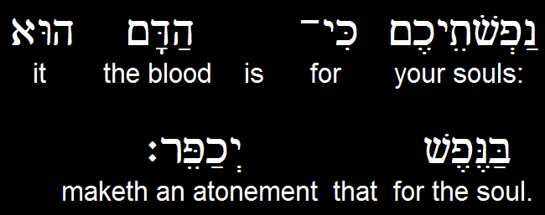

Vayikra (Leviticus) 17.11b
Notes:
Only by the Blood??

Slide 19
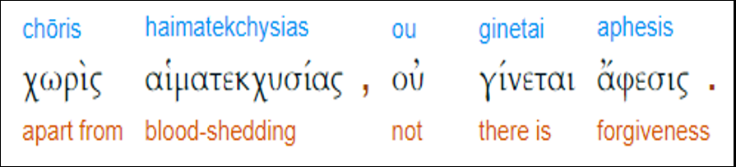
Mes Jews/Heb 9.22
aphesis a sending away, a letting go, a release, pardon, complete forgiveness.

Slide 20
^{Mes Jews/Heb 2.17-18} Therefore He had to be made like His brothers in all things, so He might become a merciful and faithful Kohen Gadol in matters relating to God, to make atonement for the sins of the people. Because He Himself suffered when put to the test, He is able to help those being tested.

Slide 21
John Piper Fifty Reasons Why Yeshua Came to Die
Notes:
Piper: P15 ~Holocaust denial: too horrific
Weisel Night: p 9
Piper 16, 20, 28, 32, 34, 36, 38

Slide 22
^{Gal 3.13} The Messiah redeemed us from the curse pronounced in the Torah by becoming cursed on our behalf; for the Tanakh says, “Everyone who hangs from a stake comes under a curse.”
Notes:
Piper: P15 ~Holocaust denial: too horrific
Weisel Night: p 9
Piper 16, 20, 28, 32, 34, 36, 38

Slide 23
^{Yn 3.16} For God so loved the world that he gave his only and unique Son, so that everyone who trusts in him may have eternal life, instead of perishing.
Notes:
Piper: P15 ~Holocaust denial: too horrific
Weisel Night: p 9
Piper 16, 20, 28, 32, 34, 36, 38

Slide 24
^{Col 2.13} You were dead because of your sins, your old nature. But God made you alive along with the Messiah by forgiving you all your sins.
Notes:
Piper: P15 ~Holocaust denial: too horrific
Weisel Night: p 9
Piper 16, 20, 28, 32, 34, 36, 38

Slide 25
^{Eph 1.7} In Him we have redemption through His blood—the removal of trespasses—in keeping with the richness of His grace.
Notes:
Piper: P15 ~Holocaust denial: too horrific
Weisel Night: p 9
Piper 16, 20, 28, 32, 34, 36, 38

Slide 26
^{Mark 10.45} For the Son of Man did not come to be served, but to serve — and to give his life as a ransom for many.”
Notes:
Piper: P15 ~Holocaust denial: too horrific
Weisel Night: p 9
Piper 16, 20, 28, 32, 34, 36, 38

Slide 27
So, how do we understand all these other references to atonement?
half-shekel when giving Adoni’s offering to atone for your lives.
Moshe going up to Adoni’s presence to make atonement for Yisrael
There are other such references…

Slide 28
^{Nu 31.48-50} The officers in charge of the thousands who fought … approached Moshe and said to him, “Your servants have counted all the soldiers under our command, and not one of us is missing. We have brought an offering for Adoni

Slide 29
^{Nu 31.48-50} what every man has obtained in the way of gold jewelry — armlets, bracelets, signet rings, earrings and belts — to make atonement for ourselves before Adoni.”
לְכַפֵּר עַל-נַפְשֹׁתֵינוּ,
Notes:
Restitutionary atonement for the depredations and corruptions of war. Who knows what happened in the rage of battle and siege.

Slide 30
^{Nu 17.11} Moshe said to Aharon, “Take your fire pan, put fire from the altar in it, lay incense on it, and hurry with it to the assembly to make atonement for them, because anger has gone out from Adoni, and the plague has already begun!” Intercession
Notes:
Intercessory atonement

Slide 31
^{T’hillim 51.16-19} Rescue me from the guilt of shedding blood, God, God of my salvation! Then my tongue will sing about your righteousness — Adoni, open my lips; then my mouth will praise you.

Slide 32
^{T’hillim 51.16-19} For you don’t want sacrifices, or I would give them; you don’t take pleasure in burnt offerings. My [atoning] sacrifice to God is a broken spirit.
Repentance and contrition as atoning sacrifice.

Slide 33
^{Hoshea 14.2-3} Return, Isra’el, to Adoni your God, for your guilt has made you stumble. Take words with you, and return to Adoni; say to him, “Forgive all guilt, and accept what is good;
we will pay instead of bulls
[the offerings of] our lips.
Notes:
Prayer instead of sacrifice?

Slide 34
^{Mishlei/Prov.16.6} Grace and truth atone for iniquity, and people turn from evil through fear of Adoni
lovingkindness
The verb יְכַפֵּר y’kha-per, to make atonement
Notes:
Many forms of atonement. So, do we really need the blood sacrifice of the Temple then, of the Lamb Yeshua now??
Anti-Messianic teachers say no. Are they right?

Slide 35
^{Nekhemiah 10.33-34} “We will impose on ourselves a yearly tax of one-third of a shekel [one-seventh of an ounce of silver] for the service of the house of our God, for the showbread, for the regular grain offering,
Notes:
Who gave Nekhemiah authority to change scripture? Not a census, so Shmot/Ex 30 didn’t exactly apply.

Slide 36
^{Nekhemiah 10.33-34} for the regular burnt offering, for [the offerings] on Shabbat, on Rosh-Hodesh, at the designated times and at other holy times, for the sin offerings to make atonement for Israel, and for all the work connected with the house of our God.”
Notes:
Carried down to Yeshua’s time…

Slide 37
Various forms of atonement in scripture…
Notes:
Tovia Singer, the anti-Messianic teacher, mocks us for this!

Slide 38
Various forms of atonement in scripture NOT mutually exclusive
Repentance and contrition
Grace and truth [lovingkindnes]
Restitution
Intercessory prayer
Blood sacrifice IS the foundation
Notes:
When we come to Yeshua, we need indeed to be in repentance and contrition, grace and truth in our living, restitution for wrong, intercession in our lifestyle. His sacrifice, without all that, is not really applied!
You may say, “I don’t think all that stuff is necessary. I prayed the sinner’s prayer, and I’m eternally saved.”
Scripture says, “No. You receive Him and in Him a lifestyle of Messiah likeness.”
A bit like Sacred Namers. If I have the right Name, I’m pleasing G-d. No, if have right LIFE. Hallowed by thy Name means lifestyle of honoring G-d in Yeshua.

Slide 39
Actualizing
the
Atonement

Slide 40
^{Col. 1.23-24} This is the Good News that has been proclaimed in all creation under heaven; and I, Sha’ul, have become a servant of it. I rejoice in my present sufferings on your behalf!

Slide 41
^{Col. 1.23-24} Yes, I am completing in my own flesh what has been lacking of the Messiah’s afflictions, on behalf of his Body, the Messianic Community.

Slide 42
^{Gal.4.19} My dear children, I am suffering the pains of giving birth to you all over again — and this will go on until the Messiah takes shape in you.

Slide 43
We are called to actualize the atonement…make it actual, real, applied to our attitudes, character, relationships, culture!

Slide 44
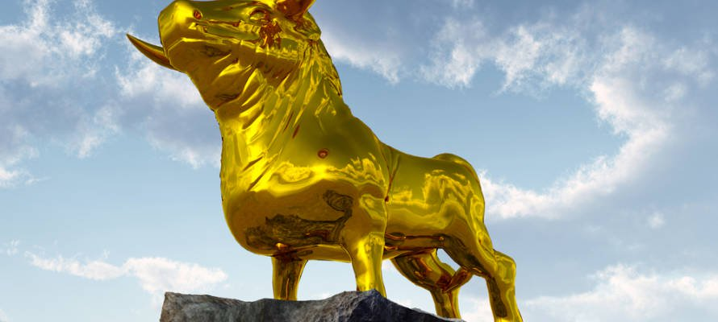
Was Aharon guilty?
Notes:
https://unitedwithisrael.org/living-torah-was-aaron-guilty-of-the-sin-of-the-golden-calf/?utm_source=MadMimi&utm_medium=email&utm_content=Israeli+Rocket+Blasts+Off+to+Moon%2C+4th+Nation+in+History%21+Demand+CUNY+End+Abuse+of+Pro-Israel+Professor%2C+Stop+Anti-Semitic+Attacks&utm_campaign=20190222_m149918158_Israeli+Rocket+Blasts+Off+to+Moon%2C+4th+Nation+in+History%21+Demand+CUNY+End+Abuse+of+Pro-Israel+Professor%2C+Stop+Anti-Semitic+Attacks&utm_term=more_btn_dark_jpg

Slide 45
Notice how throughout scripture, the penalty for idol worship is death, not merely the cancellation of your flight to Israel! If Aaron was truly responsible for the Golden Calf, his punishment would have been much more severe.
Notes:
https://unitedwithisrael.org/living-torah-was-aaron-guilty-of-the-sin-of-the-golden-calf/?utm_source=MadMimi&utm_medium=email&utm_content=Israeli+Rocket+Blasts+Off+to+Moon%2C+4th+Nation+in+History%21+Demand+CUNY+End+Abuse+of+Pro-Israel+Professor%2C+Stop+Anti-Semitic+Attacks&utm_campaign=20190222_m149918158_Israeli+Rocket+Blasts+Off+to+Moon%2C+4th+Nation+in+History%21+Demand+CUNY+End+Abuse+of+Pro-Israel+Professor%2C+Stop+Anti-Semitic+Attacks&utm_term=more_btn_dark_jpg

Slide 46
Some commentators explain that Aaron’s sin was not one of idol worship, but rather of failure to calm the fears of the people. In other words, he ‘compromised’ the sin of idolatry for the sake of peace.
Notes:
https://unitedwithisrael.org/living-torah-was-aaron-guilty-of-the-sin-of-the-golden-calf/?utm_source=MadMimi&utm_medium=email&utm_content=Israeli+Rocket+Blasts+Off+to+Moon%2C+4th+Nation+in+History%21+Demand+CUNY+End+Abuse+of+Pro-Israel+Professor%2C+Stop+Anti-Semitic+Attacks&utm_campaign=20190222_m149918158_Israeli+Rocket+Blasts+Off+to+Moon%2C+4th+Nation+in+History%21+Demand+CUNY+End+Abuse+of+Pro-Israel+Professor%2C+Stop+Anti-Semitic+Attacks&utm_term=more_btn_dark_jpg

Slide 47
This is consistent with the view that the Golden Calf was intended to replace Moshe, not God. So, to avoid conflict and to avoid betraying Moshe, he decided to create a harmless figurehead, just to keep them busy, which could be discarded upon Moses’ return.
Notes:
https://unitedwithisrael.org/living-torah-was-aaron-guilty-of-the-sin-of-the-golden-calf/?utm_source=MadMimi&utm_medium=email&utm_content=Israeli+Rocket+Blasts+Off+to+Moon%2C+4th+Nation+in+History%21+Demand+CUNY+End+Abuse+of+Pro-Israel+Professor%2C+Stop+Anti-Semitic+Attacks&utm_campaign=20190222_m149918158_Israeli+Rocket+Blasts+Off+to+Moon%2C+4th+Nation+in+History%21+Demand+CUNY+End+Abuse+of+Pro-Israel+Professor%2C+Stop+Anti-Semitic+Attacks&utm_term=more_btn_dark_jpg

Slide 48
According to another approach, did everything he could to avoid having to build it. For example, Aaron said to the people “Take off your gold rings that are in the ears of your wives, your sons and your daughters, and bring them to me.”
Notes:
https://unitedwithisrael.org/living-torah-was-aaron-guilty-of-the-sin-of-the-golden-calf/?utm_source=MadMimi&utm_medium=email&utm_content=Israeli+Rocket+Blasts+Off+to+Moon%2C+4th+Nation+in+History%21+Demand+CUNY+End+Abuse+of+Pro-Israel+Professor%2C+Stop+Anti-Semitic+Attacks&utm_campaign=20190222_m149918158_Israeli+Rocket+Blasts+Off+to+Moon%2C+4th+Nation+in+History%21+Demand+CUNY+End+Abuse+of+Pro-Israel+Professor%2C+Stop+Anti-Semitic+Attacks&utm_term=more_btn_dark_jpg

Slide 49
Since women and children are protective of their jewelry, he didn’t expect them to give it up so quickly, which would have allowed him to ‘buy time’ until Moses returned.
Notes:
https://unitedwithisrael.org/living-torah-was-aaron-guilty-of-the-sin-of-the-golden-calf/?utm_source=MadMimi&utm_medium=email&utm_content=Israeli+Rocket+Blasts+Off+to+Moon%2C+4th+Nation+in+History%21+Demand+CUNY+End+Abuse+of+Pro-Israel+Professor%2C+Stop+Anti-Semitic+Attacks&utm_campaign=20190222_m149918158_Israeli+Rocket+Blasts+Off+to+Moon%2C+4th+Nation+in+History%21+Demand+CUNY+End+Abuse+of+Pro-Israel+Professor%2C+Stop+Anti-Semitic+Attacks&utm_term=more_btn_dark_jpg

Slide 50
Furthermore, we are told that Aaron built the altar first in order to further delay the building of the calf, among other tactics.
The bottom line is that Aaron was trying to do everything to delay and keep the peace.
Notes:
https://unitedwithisrael.org/living-torah-was-aaron-guilty-of-the-sin-of-the-golden-calf/?utm_source=MadMimi&utm_medium=email&utm_content=Israeli+Rocket+Blasts+Off+to+Moon%2C+4th+Nation+in+History%21+Demand+CUNY+End+Abuse+of+Pro-Israel+Professor%2C+Stop+Anti-Semitic+Attacks&utm_campaign=20190222_m149918158_Israeli+Rocket+Blasts+Off+to+Moon%2C+4th+Nation+in+History%21+Demand+CUNY+End+Abuse+of+Pro-Israel+Professor%2C+Stop+Anti-Semitic+Attacks&utm_term=more_btn_dark_jpg

Slide 51
Keeping peace doesn’t justify violating the laws of the Torah. Nevertheless, God “went easy” on him with the punishment in recognition of his noble intentions.
Notes:
https://unitedwithisrael.org/living-torah-was-aaron-guilty-of-the-sin-of-the-golden-calf/?utm_source=MadMimi&utm_medium=email&utm_content=Israeli+Rocket+Blasts+Off+to+Moon%2C+4th+Nation+in+History%21+Demand+CUNY+End+Abuse+of+Pro-Israel+Professor%2C+Stop+Anti-Semitic+Attacks&utm_campaign=20190222_m149918158_Israeli+Rocket+Blasts+Off+to+Moon%2C+4th+Nation+in+History%21+Demand+CUNY+End+Abuse+of+Pro-Israel+Professor%2C+Stop+Anti-Semitic+Attacks&utm_term=more_btn_dark_jpg

Slide 52
G-d was merciful on Aharon, although he didn’t stand against the idolatry.
G-d may be merciful on us if we don’t stand against sin.
Aharon compromised.
Moshe made atonement, actualized atonement.

Slide 54
Does this apply to us?
Are we called to actualize the atonement?

Slide 55
Monday, Feb 25, the U.S. Senate will take one of the most defining votes in its 230-year history. One hundred men and women, from different backgrounds and different parties, will decide where America stands: with the innocent or with infanticide.

Slide 56
On Monday, February 25, 2019, the U.S. Senate is scheduled for a floor vote on Senate bill S.311, the Born-Alive Abortion Survivors Protection Act sponsored by Senator Ben Sasse (R., Neb.). The bill would guarantee that any child born alive in the context of an abortion would be provided full legal protection as a living human being.
Notes:
Why should a law be necessary that a born alive child in ANY context has legal protection? It should be a given!
Dr. James Dobson's Family Talk 540 Elkton Drive, Suite 201 Colorado Springs, CO 80907

Slide 57
The bill also mandates that medical treatment to attempt to save the child's life also be provided.
Sen. Sasse had originally called for "unanimous consent," a parliamentary procedure that would have expedited the bill's passage through the Senate, however the effort was blocked by Senator Patty Murray (D., Wash.) on behalf of Senate Democrats.
Notes:
Dr. James Dobson's Family Talk 540 Elkton Drive, Suite 201 Colorado Springs, CO 80907

Slide 58
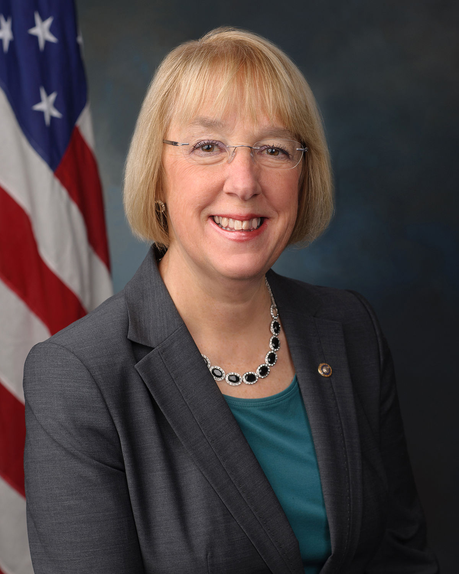
US Senator Patty Murray (D., Wash.)
Notes:
She looks like a normal human, likely a mother, maybe a grandmother. But she stopped the legislation that would have banned infanticide!

Slide 59
There is currently no federal law which requires medical professionals to provide treatment for children born alive after attempted abortions, and as of 2014 only 26 states had laws mandating medical care in such instances.
Notes:
Dr. James Dobson's Family Talk 540 Elkton Drive, Suite 201 Colorado Springs, CO 80907

Slide 60
Furthermore, New York's recently passed Reproductive Health Act (RHA) removed that state's protection for children born alive after an abortion.
Contact your Senators about the Monday, Feb. 25 vote!
https://www.govtrack.us/
Notes:
Dr. James Dobson's Family Talk 540 Elkton Drive, Suite 201 Colorado Springs, CO 80907

Slide 61
We are called to actualize the atonement…make it actual, real, applied to our attitudes, character, relationships, culture!

Slide 62
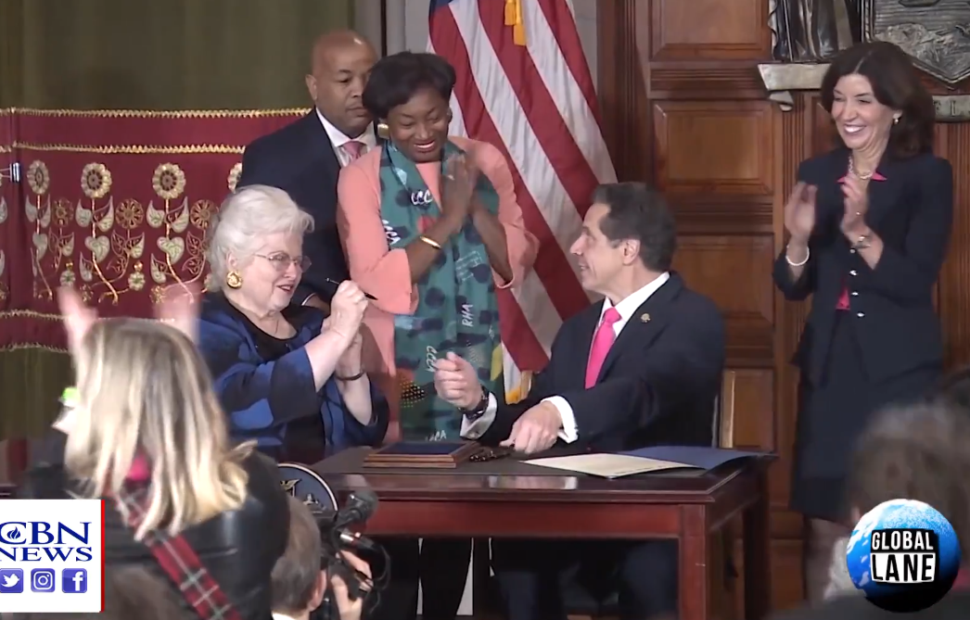
NY Gov. Cuomo signing the abortion
Law.

Slide 63
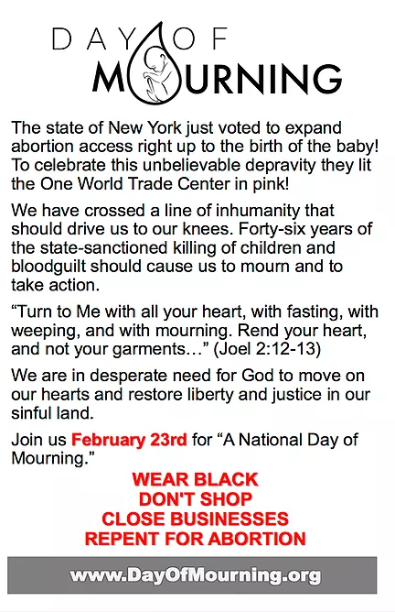

Slide 65
"We're asking the nation to wear black. To not shop. To close down their businesses and to mourn and repent with us on the 23rd - this Saturday.
Major event in front of the New York State Capitol, Albany, NY
Notes:
We don’t shop on Shabbat anyway. Yes??

Slide 66
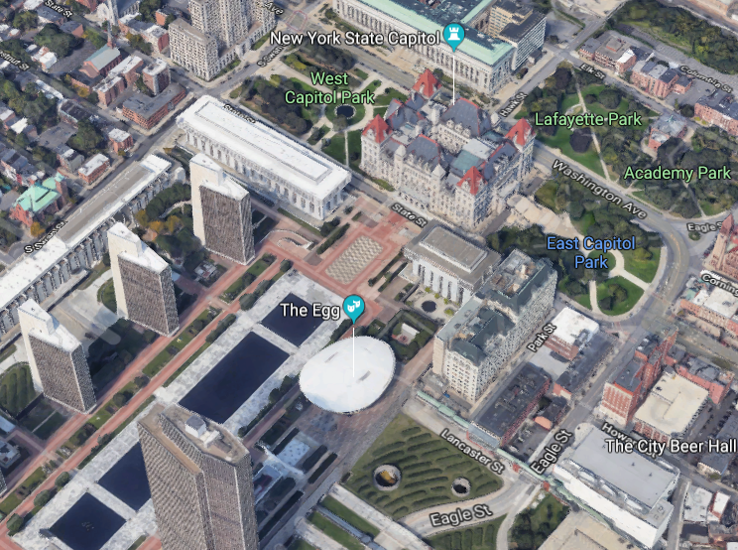
NYS Capitol

Slide 67

NYS Capitol Building

Slide 68
Events are also scheduled in cities like Dallas, TX; Nashville, TN; Charlotte, NC; Chicago, IL; and more than 20 others.

Slide 69
We at Or HaOlam will gather for prayer and intercession for our nation after the FPU/Dave Ramsey class.
Starting with Kadesh at 3 p.m.

Slide 70
Michael Brown on Desperation

Slide 71
We are called to actualize the atonement…make it actual, real, applied to our attitudes, character, relationships, culture!

Slide 72
Does it work?
Can we reverse our attitudes, character, relationships, [Thrive 19 brain skills] culture?
Can we actualize the Atonement?

Slide 73
He's one of the biggest names in the pro-life movement, and with good reason. David Benham knew Norma McCorvey, the "Roe" in Roe v. Wade, well.
Notes:
https://www.charismanews.com/us/74792-david-benham-shares-the-radical-testimony-of-the-woman-behind-roe-v-wade?utm_source=In%20the%20Line%20of%20Fire&utm_medium=email&utm_content=subscriber_id:5194514&utm_campaign=Blogger%20-%20Michael%20Brown%20-%202019-01-15%20(2)

Slide 74
The Benham family often invited McCorvey and her lesbian lover, Mrs. Connie, to eat dinner with them as they built a life-changing relationship.
Notes:
https://www.charismanews.com/us/74792-david-benham-shares-the-radical-testimony-of-the-woman-behind-roe-v-wade?utm_source=In%20the%20Line%20of%20Fire&utm_medium=email&utm_content=subscriber_id:5194514&utm_campaign=Blogger%20-%20Michael%20Brown%20-%202019-01-15%20(2)

Slide 75
When the couple got saved, Benham says he and his brother Jason got a truck and helped move Mrs. Connie out so the two could honor the Lord. McCorvey went on to testify before Congress about the truth behind abortion—and her own story.
Notes:
https://www.charismanews.com/us/74792-david-benham-shares-the-radical-testimony-of-the-woman-behind-roe-v-wade?utm_source=In%20the%20Line%20of%20Fire&utm_medium=email&utm_content=subscriber_id:5194514&utm_campaign=Blogger%20-%20Michael%20Brown%20-%202019-01-15%20(2)

Slide 76
We are called to actualize the atonement…make it actual, real, applied to our attitudes, character, relationships, culture!

Slide 77
Search our hearts. Are we actualizing the Atonement of Messiah
Attitudes
Character
Relational patterns
Culture

Slide 78
We at Or HaOlam will gather for prayer and intercession for our nation after the FPU/Dave Ramsey class.
Starting with Kadesh at 3 p.m.

