Slide 1
e-handout
To have these notes
without taking notes
Go to OrHaOlam.com
Click on downloads,
messages, 2019
Notes:
.

Slide 2
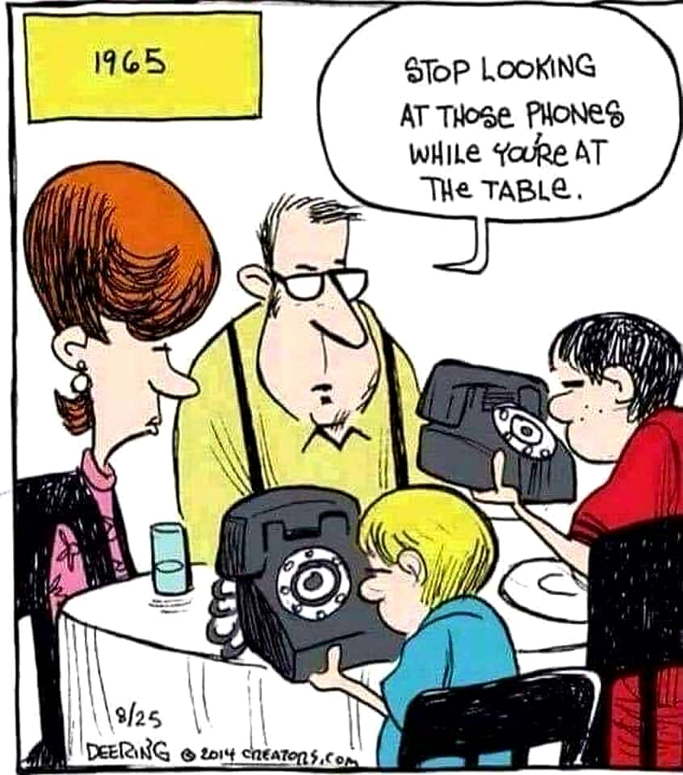

Slide 3
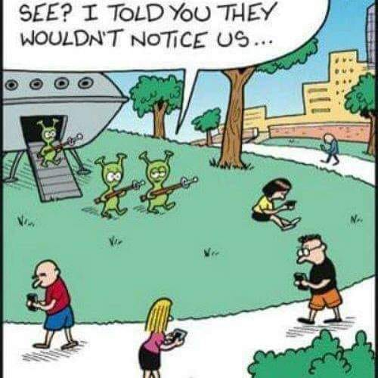

Slide 4
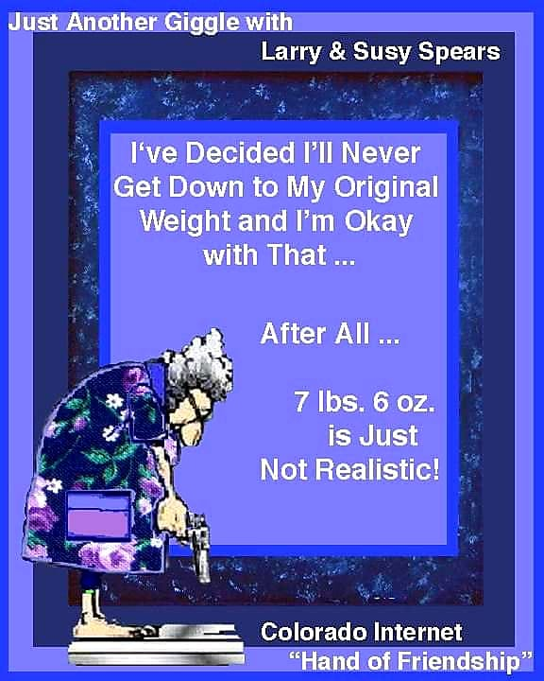
Notes:
Rick Fisher

Slide 5
Holidays that we participate in:

Slide 6
Jewish holidays
Purim
Pesakh*
Shavuot*
Tisha B’Av
Rosh * HaShana
Yom Kippur*
Sukkot*
Shmini Atzeret*
Simkhat Torah
Hanuk-kah
*means from Lev 23

Slide 7
Plus as Messianics, we celebrate
Messiah’s Birthday [during Sukkot]
Messiah’s Resurrection [Firstfruits]

Slide 8
With modern Israel, there is
Israel Independence Day
Israel Memorial Day
Holocaust Memorial Day
We keep kind of busy partying, or mourning!

Slide 9
We DON’T do Valentine’s Day
Nevertheless, love is a very important scriptural theme.
Notes:
Much of the following from Neil and Jamie Lash, http://www.jewishjewels.org/blog/love-god-love-your-neighbor/

Slide 10
^{1 Cor. 13.4-8} Love is patient and kind, not jealous, not boastful, not proud, rude or selfish, not easily angered, and it keeps no record of wrongs. Love does not gloat over other people’s sins but takes its delight in the truth. Love always bears up, always trusts, always hopes, always endures. Love never ends.
Notes:
#1

Slide 11
^{Mark 12.28-31} One of the Torah scholars came and heard them debating. Seeing that Yeshua had answered them well, he asked Him,
“Which commandment is first of all?”
Yeshua answered, “The first is,

Slide 12
שְׁמַע יִשְׂרָאֵל יְיָ אֱלהֵינוּ יְיָ אֶחָד
Sh’ma Yees-ra-ayl
Ah-do-ni E-lo-hay-nu
Ah-do-ni eh-khad
Hear O Israel ADONI is our G-d
ADONI is one

Slide 13
וְאָהַבְתָּ אֵת יְיָ אֱלהֶיךָ בְּכָל-לְבָבְךָ
V’a-hav-ta et Ah-do-ni
Eh-lo-heh-kha b’khawl l’vav’kha
וּבְכָל-נַפְשְׁךָ וּבְכָל-מְאדֶךָ
Oov’khawl naf-sh’kha
oov’khawl m’o-deh-kha
Notes:
Yeshua gives an imprecise, midrashic translation. Adds a word. He’s entitled to. He is the Word. Everything He says is the Word.

Slide 14
^{Mark 12.28-31} And you shall love Adoni your God with all your heart, and with all your soul, and with all your mind, and with all your strength.’
The second is this…

Slide 15
וְאָהַבְתָּ לְרֵעֲךָ כָּמוֹךָ
V’a-hav-tah l’rey-ah-kha kha-mo-kha
And you shall love
your neighbor as yourself.
There is no other commandment greater than these.”
Notes:
#2

Slide 16
The Shema, above, as a declaration of faith, a pledge of allegiance to the One True God, and a command to love Him, is the first prayer that children are taught, and the last utterance of martyrs.
Notes:
Much of the following from Neil and Jamie Lash, http://www.jewishjewels.org/blog/love-god-love-your-neighbor/
Rabbinic Judaism agrees with the dual duty of love…

Slide 17
Love of God is not considered the epitome of Jewish living. Even more important, as mentioned in A Code of Jewish Ethics Volume 1 by Rabbi Joseph Telushkin, is the love of one’s neighbor. Why?
Notes:
Much of the following from Neil and Jamie Lash, http://www.jewishjewels.org/blog/love-god-love-your-neighbor/

Slide 18
Because the love of one’s neighbor is seen as a measure of one’s love of God. What matters most to God? According to Rabbi Akiva (Jerusalem Talmud, Nedarim 9:4), “Love your neighbor as yourself; this is the major principle of the Torah.”
Notes:
#3

Slide 19
In the Jewish mind, there is an equation, and equal quantities on each side of an equal sign.
Love God = Love your neighbor.
Notes:
With this perspective, many of us might not love God as much as we think we do. First of all, God is much easier to love than people.

Slide 20
The Messianic Scriptures similarly link love of God and love of one’s neighbor. “If someone says, ‘I love God,’ and hates his brother, he is a liar; for he who does not love his brother whom he has seen, how can he love God whom he has not seen? And this commandment we have from Him: that he who loves God must love his brother also” ^{(1 Jn. 4:20-21).}
Notes:
#4

Slide 21
“You shall love your neighbor as yourself” appears in the Bible for the first time in Leviticus 19:18. The verse ends with, “Ani Adoni” It is as if God signs His signature to the command to love one’s neighbor as oneself, to give it special emphasis.

Slide 22
A non-Jew, who wanted to be converted to Judaism, approached the great Rabbi Hillel and asked if he could teach him the entire Torah while he stood on one foot. Hillel, standing on one foot, responded: “What is hateful unto you, do not do to your neighbor. This is the whole Torah! All the rest is commentary. Now, go and study” (Shabbat 31a).
Notes:
#5
Hillel lived in the century before Yeshua.

Slide 23
Irene Lipson, in The Greatest Commandment, mentions some Hebrew concepts connected with compassion. The first is Li-fenim mi-shurath ha-din
לִפְנִים מִשּׁוּרַת הַדִּין
beyond the letter of the law

Slide 24
This means that a person concedes something that is rightfully theirs in favor of someone whose need is greater. Sacrificial love.
Messiah teaches this, even more dramatically:
Notes:
http://www.jewishjewels.org/blog/love-god-love-your-neighbor/

Slide 25
^{Mtt 5.39-41} If someone hits you on the right cheek, let him hit you on the left cheek too! If someone wants to sue you for your shirt, let him have your coat as well! And if a soldier forces you to carry his pack for one mile, carry it for two!
Notes:
#6
What can you or I do that is beyond what is required?

Slide 26
Another Hebrew concept is Gemilut Hasadim, Acts of Love.
גְּמִילוּת חֲסָדִים charity, benevolence
Doing something only out of a sense of duty is not Gemilut Hasadim. A good deed must be performed in a spirit of love and compassion.
Notes:
#7
http://www.jewishjewels.org/blog/love-god-love-your-neighbor/

Slide 27
Examples: visiting the sick, helping the poor, providing for widows and orphans, and providing a wedding for a poor bride.
Notes:
http://www.jewishjewels.org/blog/love-god-love-your-neighbor/

Slide 28
It is of the utmost importance to attend a funeral, accompanying the dead to the grave. This is regarded as an act of pure love because it is the only mitzvah (good deed) where the recipient can never reciprocate!”

Slide 29
There still remains the question of who exactly is “our neighbor.” For traditional Jews, the “stranger” גֵּר Ger, definitely falls into this category. The Torah is clear on this: “The stranger who dwells among you [Ger toshav] shall be to you as one born among you, and you shall love

Slide 30
him as yourself; for you were strangers [gerim] in the land of Egypt: I am the Adoni your God” ^{(Lev. 19:34).}
Aside from the stranger, the term “neighbor” in Jewish tradition does not apply to all people indiscriminately.

Slide 31
Yeshua’s Jewish audience would, therefore, be shocked, maybe even repulsed, by “You have heard that it was said, ‘You shall love your neighbor and hate your enemy. But I say to you, love your enemies, bless those who curse you, do good to those who hate you, and pray for those who spitefully use you and persecute you'” ^{(Matt. 5:43-44).}
Notes:
#8
I attended a lecture at Union Station on the Dead Sea Scrolls, when they were on traveling exhibit. The lecturer said that this is one shocking difference Y and Judaism.
Whose authority was Yeshua citing? Proof of deity.
Think of someone you are irritated by, or is a serious enemy. Good one to bless.

Slide 32
A law is mentioned is Yaakov/James 2:8 that fulfills the Law given to God’s People at Mt. Sinai. It is the Law of the Kingdom of Heaven, the Torah internalized, the law of Love. “If you really fulfill the royal law according to the Scripture, ‘You shall love your neighbor as yourself,’ you do well.”
Notes:
#9
http://www.jewishjewels.org/blog/love-god-love-your-neighbor/

Slide 33
The Royal Law is a law that should govern us in all our dealings with people, regardless of their status or ethnicity. All people should be regarded as “neighbors” and treated with love.
Rabbi Shaul comments further on the Royal Law: “Owe no one anything except to love one another, for he who loves another has fulfilled the law.
Notes:
Love and adultery?
Love and slander?
Is there someone you don’t like? Make it a point to greet them, smile, show warmth, show kindness!

Slide 34
The Messiah gave His followers a “new commandment”: “A new commandment I give to you, that you love one another; as I have loved you, that you also love one another…” ^{(Jn. 13:34).}
Notes:
#10
called to a deeper, more selfless, sacrificial, and unconditional love for their “neighbor.” Not just loving their neighbor as themselves, but loving as Yeshua loved,

Slide 35
This commandment was “new” because the disciples were being called to a deeper, more selfless, sacrificial, and unconditional love for their “neighbor.” Not just loving their neighbor as themselves, but loving as Yeshua loved, who was about to show them a love that would die for them.
Notes:
called to a deeper, more selfless, sacrificial, and unconditional love for their “neighbor.” Not just loving their neighbor as themselves, but loving as Yeshua loved,

Slide 36
As Yeshua Himself said it: “This is My commandment, that you love one another as I have loved you. Greater love has no one than this than to lay down one’s life for his friends” ^{(Yn. 15:12-13).}
Notes:
called to a deeper, more selfless, sacrificial, and unconditional love for their “neighbor.” Not just loving their neighbor as themselves, butloving as Yeshua loved,

Slide 37
^{Yn 13.35} Everyone will know that you are my talmidim by the fact that you have love for each other.”
So, how is Or HaOlam doing?
So, what do Google reviews say?
Notes:
#11

Slide 38
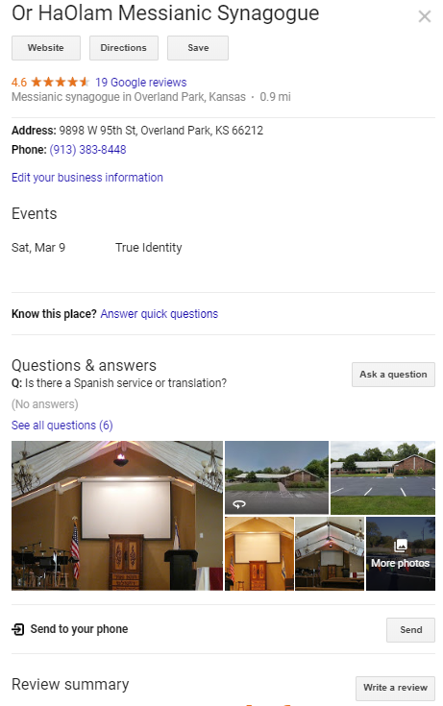
Notes:
https://www.google.com/search?safe=active&sa=X&biw=1164&bih=865&q=messianic+synagogues+near+me&npsic=0&rflfq=1&rlha=0&rllag=38965888,-94703135,995&tbm=lcl&ved=2ahUKEwisl9Ltja3gAhVFS60KHdaRBy8QtgN6BAgAEAQ&tbs=lrf:!2m1!1e2!2m1!1e16!3sIAE,lf:1,lf_ui:1&rldoc=1#rlfi=hd:;si:15968579055536242378,l,ChxtZXNzaWFuaWMgc3luYWdvZ3VlcyBuZWFyIG1lIgOQAQFaFgoUbWVzc2lhbmljIHN5bmFnb2d1ZXM;mv:!1m2!1d38.97346247859716!2d-94.6828665263672!2m2!1d38.96001551356231!2d-94.70095534396364!4m2!1d38.96673931515238!2d-94.69191093516542!5i16

Slide 39
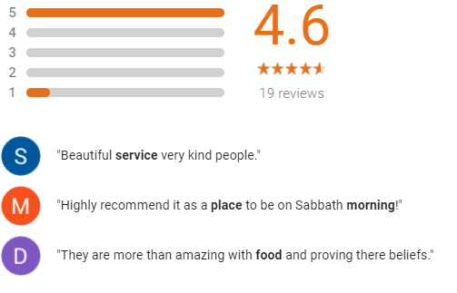
Notes:
https://www.google.com/search?safe=active&sa=X&biw=1164&bih=865&q=messianic+synagogues+near+me&npsic=0&rflfq=1&rlha=0&rllag=38965888,-94703135,995&tbm=lcl&ved=2ahUKEwisl9Ltja3gAhVFS60KHdaRBy8QtgN6BAgAEAQ&tbs=lrf:!2m1!1e2!2m1!1e16!3sIAE,lf:1,lf_ui:1&rldoc=1#rlfi=hd:;si:15968579055536242378,l,ChxtZXNzaWFuaWMgc3luYWdvZ3VlcyBuZWFyIG1lIgOQAQFaFgoUbWVzc2lhbmljIHN5bmFnb2d1ZXM;mv:!1m2!1d38.9754479!2d-94.680922!2m2!1d38.9560941!2d-94.708157

Slide 40
I have visited there twice and thoroughly enjoyed the joyful worship, friendly people, and thought-provoking/inspiring messages! Highly recommend it as a place to be on Sabbath morning!
Notes:
https://www.google.com/search?safe=active&sa=X&biw=1164&bih=865&q=messianic+synagogues+near+me&npsic=0&rflfq=1&rlha=0&rllag=38965888,-94703135,995&tbm=lcl&ved=2ahUKEwisl9Ltja3gAhVFS60KHdaRBy8QtgN6BAgAEAQ&tbs=lrf:!2m1!1e2!2m1!1e16!3sIAE,lf:1,lf_ui:1&rldoc=1#rlfi=hd:;si:15968579055536242378,l,ChxtZXNzaWFuaWMgc3luYWdvZ3VlcyBuZWFyIG1lIgOQAQFaFgoUbWVzc2lhbmljIHN5bmFnb2d1ZXM;mv:!1m2!1d38.9754479!2d-94.680922!2m2!1d38.9560941!2d-94.708157

Slide 41
Lovely place to find Yeshua, it's a warm welcoming place and so nice to have oneg with the congregation afterwards.
Coming again. The people are great. They are more than amazing with food and proving there beliefs
Notes:
Three references to food with people!

Slide 42
How much credibility to Google reviews?
Do you try to visit with newcomers, loners? Get people’s story. Make new friends? Bless old friends?

Slide 43
“Let nothing be done through selfish ambition or conceit, but in lowliness of mind let each esteem others better than himself. Let each of you look out not only for his own interests but also for the interests of others” ^{(Phil. 2:3-4)}.
Notes:
#12

Slide 44
“Therefore be imitators of God as dear children. And walk in love, as Messiah also has loved us and given Himself for us, an offering and a sacrifice to God for a sweet-smelling aroma” ^{(Eph. 5:1-2).}
Notes:
#13

Slide 45
Yokhanan, known as the Shaliakh [representative] of Love, has more to say about love between believers in Messiah than anyone else in the Messianic Scriptures. “My little children, let us not love in word or in tongue, but in deed and in truth” ^{(1 Jn.3:18).}

Slide 46
^{(1 Jn 4:12)} If we love one another, God abides in us, and His love has been perfected in us.
^{(1 Jn. 3:14)} We know that we have passed from death to life because we love the brothers. He who does not love his brother abides in death.
Strong words!
Notes:
#14

Slide 47
[Neil and Jamie Lash]: This is one of our all-time favorite books by Henry Drummond, a renowned nineteenth-century Scottish evangelist. Commentary on 1 Cor 13

Slide 48
Patience: Love is patient and longsuffering, even with difficult people. Drummond calls patience the “normal attitude of love.” Love is not in a hurry, is able to wait and not make demands on others.
Notes:
Are we patient?

Slide 49
Kindness: Are we kind in our dealings with others? Do we see their needs and help meet them if possible? Kindness is love in action. Do we do kind things? “What God has put in our power is the happiness of those about us, and that is large to be secured by our being kind to them.” (Drummond p. 26)
Notes:
Are we kind? Let me amplify this one.
About a year ago I heard then introduced Shaunti Feldhan’s Kindness Challenge.

Slide 50

In The Kindness Challenge, innovative researcher Shaunti Feldhahn reveals three simple steps proven to make any interaction better and any relationship thrive.
Notes:
https://shaunti.com/tb-books/the-kindness-challenge/
Only one or two have told me of doing this.

Slide 51
https://vimeo.com/193956690
Take the Kindness Challenge
https://www.jointhekindnesschallenge.com/
Notes:
https://shaunti.com/tb-books/the-kindness-challenge/

Slide 52
Marriage/Valentines
immediate application
From Shaunti:
Notes:
If you are single, please bear with me.

Slide 53
After You’re Married, Keep Dating Your Wife (It is Much Easier Than You Think)
Your wife doesn’t feel forever loved and happy just because at your wedding you declared your forever love and married her.
Notes:
November 30, 2018 by Shaunti Feldhahn https://shaunti.com/2018/11/after-youre-married-keep-dating-your-wife-it-is-much-easier-than-you-think/

Slide 54
Make Her Happy Action
#1: Continue to go on dates, weekly.
#2: Spend time together, regardless of what you’re doing
#3: Put down your phone, turn off the TV and listen to her – so that it is obvious that you’re listening
#4: Do the little daily things that say “I would choose you all over again.”
Notes:
Like taking her hand when you are crossing a parking lot. Like calling her for no reason, just to say hi. Like apologizing when you’ve been in a funk and reassuring her that the two of you are okay. Like sending her a text message during the day that says, “I was just watching some drama play out at work, and feeling so grateful for how kind and generous you are. I really scored when I met you. I love you.”

Slide 55
Fully 82% of women in our research have an unspoken question about “am I loveable?” and “does he really love me?” that doesn’t go away in marriage. Your wife is asking that unspoken question every day, and you are answering it “yes” or “no” every day –whether you realize it or not. Answering that question “yes” in the little things of life, every day, is the way to make your wife happy.
Notes:
https://shaunti.com/2018/11/after-youre-married-keep-dating-your-wife-it-is-much-easier-than-you-think/

Slide 56
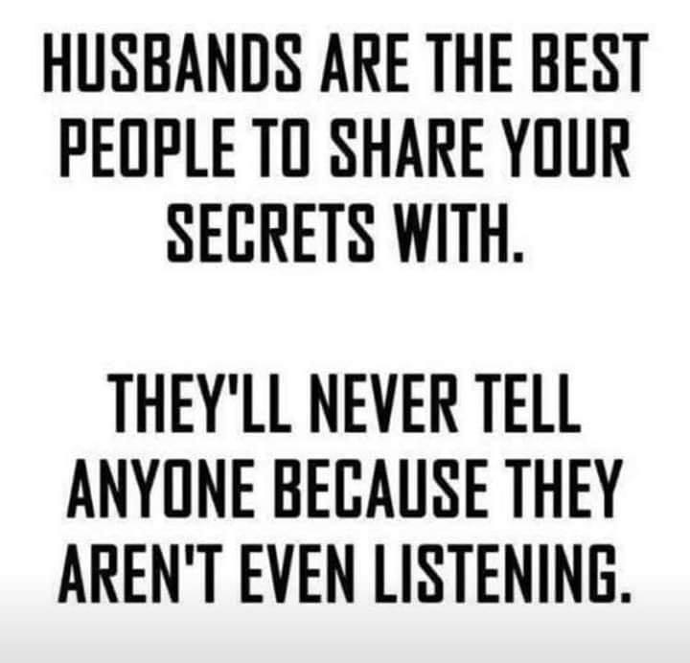

Slide 57
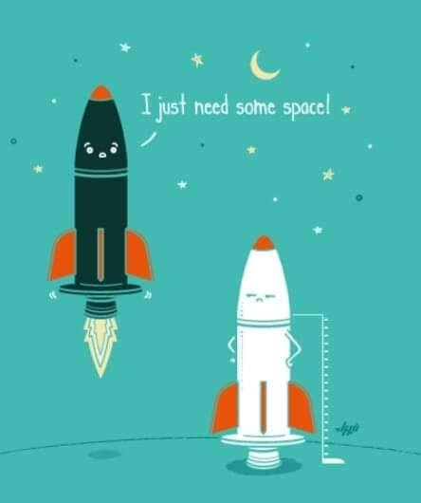
Notes:
Continuing in Drummonds exposition on 1 Cor 13 from Neil & Jamie Lash…

Slide 58
Generosity: Love refuses to be jealous when another is blessed but rejoices with them. Generosity in heart attitude thinks the best of others with a largeness of soul.
Humility: The humble person does not inflate his own importance, but considers others better than himself. He is not “puffed up,” nor does he brag about his achievements. Humility is love hiding.
Notes:
Henry Drummond not jealous, not boastful,

Slide 59
Courtesy: Love has manners and shows respect for other people. It is polite, is never rude, and doesn’t push itself to the head of the line. Love, like the Holy Spirit, is a gentleman.
Unselfishness: The unselfish person thinks of others before themselves. Their heart loves to give. Love is others-centered. It does not “seek its own,” has no “rights.” Serves.
Notes:
Henry Drummond not rude or selfish

Slide 60
Good temper: Not overly sensitive, nor irritated, nor quick to take offense. The man or woman with a good temper is not easily provoked and is not sullen, bitter, or angry. They have a good disposition.
Guilelessness: Guileless people overlook offenses. They keep no record of wrong but focus on the good in people. A person without guile doesn’t hold resentment in his or her heart.
Notes:
Henry Drummond not easily angered, and it keeps no record of wrongs.

Slide 61
Sincerity: This includes honesty and integrity in dealing with others as well as a love of the truth. It excludes hypocrisy. Love rejoices in the truth but also refrains from exposing the weaknesses of others.
Notes:
Henry Drummond Love does not gloat over other people’s sins but takes its delight in the truth.

Slide 62
Loving as Messiah loved includes unselfishness, a gracious disposition, guilelessness, and sincerity. This is only possible if we first receive the love from God. Without Him, we can do nothing, including loving our neighbor. The love of God is poured out in our hearts by the Holy Spirit ^{(Romans 5:5)}.
Notes:
Henry Drummond

Slide 63
The more of the Ruakh we
have, the more love we should have! Henry Drummond sums it up nicely: “Life is not a holiday, but an education. And the one eternal lesson for all is how better we can love.”
Notes:
Henry Drummond

Slide 64
^{Eph 5.21-33} Submit to one another in fear of the Messiah. Wives should submit to their husbands as they do to the Lord; because the husband is head of the wife, just as the Messiah, as head of the Messianic Community, is himself the one who keeps the body safe. Just as the Messianic Community submits to the Messiah, so also wives should submit to their husbands in everything.
Notes:
Me and the Quintana home in Schenectady, NY.

Slide 65
^{Eph 5.21-33} As for husbands, love your wives, just as the Messiah loved the Messianic Community, indeed, gave himself up on its behalf, in order to set it apart for God, making it clean through immersion in the mikveh, so to speak, in order to present the Messianic Community to himself
Notes:
Me and the Quintana home in Schenectady, NY.

Slide 66
^{Eph 5.21-33} as a bride to be proud of, without a spot, wrinkle or any such thing, but holy and without defect. This is how husbands ought to love their wives — like their own bodies; for the man who loves his wife is loving himself. Why, no one ever hated his own flesh!
Notes:
Me and the Quintana home in Schenectady, NY.

Slide 67
^{Eph 5.21-33} On the contrary, he feeds it well and takes care of it, just as the Messiah does the Messianic Community, because we are parts of his Body. “Therefore a man will leave his father and mother and remain with his wife, and the two will become one.”
Notes:
Me and the Quintana home in Schenectady, NY.

Slide 68
^{Eph 5.21-33} There is profound truth hidden here, which I say concerns the Messiah and the Messianic Community. ³³ However, the text also applies to each of you individually: let each man love his wife as he does himself, and see that the wife respects her husband.
Notes:
Me and the Quintana home in Schenectady, NY.

Slide 69
^{Eph. 6.1-4} Children, what you should do in union with the Lord is obey your parents, for this is right. 2 “Honor your father and mother” — this is the first commandment that embodies a promise — 3 “so that it may go well with you, and you may live long in the Land.”
Fathers, don’t irritate your children and make them resentful; instead, raise them with the Lord’s kind of discipline and guidance.

Slide 70
My vision was that Or HaOlam would be a place of wholeness in joyful service to the King, of healing for wounded Jewish people and all people, and therefore an end to our wounding people.
Giving all to Him is key to wholeness.

Slide 71
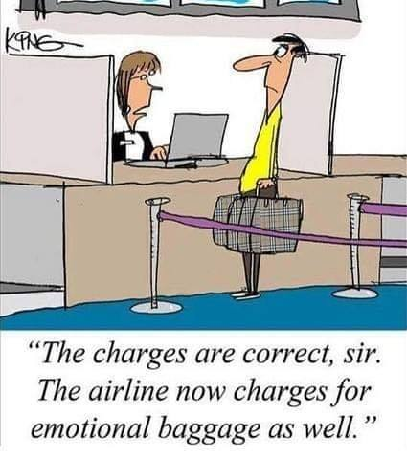

Slide 72
History of Healing Helps:
Sozo sessions, ongoing as needed
Tramua healing sessions for groups
Nov. 2007 Ancient Paths Empowering Relationships
Feb. 2009 Ancient Paths Overcoming Anger

Slide 73
June, 2012 Ancient Paths: Blessing Generations
Mar. 8-9, 2013 Ancient Paths Financial Foundations
Oct 19, 2013 Chris Coursey: Joy Starts Here
Feb 20-23, 2014 RTF w Brawers

Slide 74
Oct., 2015 Darrell Brazell: Power of Joy
Dec. 10, 2016 Jeanne Nigro
Oct 6-7, 2018 Father Son campout
Nov 10-11, 2018 RTF Brawers
March 9, 2019 Chris Coursey: Thrive: 19 Relational Brains Skills https://thrivetoday.org/

Slide 75
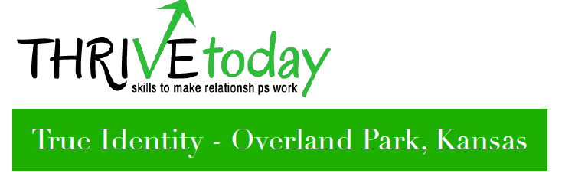
True Identity is where you jump start your experience with joy using a variety of relational brain skills. Mar. 9-10, 2019 Soon!

Slide 76
Life is about relationships; your relationship with God and your relationships with people.
But many relationships don't work because people lack relational skills.
We train people in the skills that make relationships work.

Slide 77
All of this means you live peacefully and joyfully with the comforting awareness of God by your side [Immanuel]. Your normal everyday life is transformed to a new normal of joy and peace.

Slide 78

Notes:
http://thrivetoday.org/thrive/

Slide 79

Notes:
http://thrivetoday.org/thrive/

Slide 80

Notes:
http://thrivetoday.org/thrive/

Slide 81
THRIVE Training equips you with relational skills that even the best families may miss or overlook. Careful study of Scripture and of how the brain is configured led us to identify 19 brain-based relational skills that provide the full range of life functions for our minds and relationships. When we lack these skills, pain, addictions, conflicts and other problems prevail.
Notes:
http://thrivetoday.org/thrive/

Slide 82
If you feel pushed beyond your limits by someone else’s anger, fear or even joy, for example, you know what it feels like when Skill 9 is missing. Perhaps your parents were not fully equipped or lacked the time to practice a skill with you.
Notes:
http://thrivetoday.org/thrive/
From Peter van der Steur: The greatest benefits I actually received from the
Life Model were:
1. understanding the maturity stages and being
able to place myself in them and realize what skills
I had never learned,
2. understanding the joy center, its importance,
how to strengthen it and learning to relate to
myself and others with this understanding.

Slide 83
Whatever the case THRIVE today gives you the strategic training you missed growing up and changes patterns that were handed down for generations, all for under $20 a training hour! It’s hard to hire a life coach, counselor or consultant for that price. Mar. 9-10, 2019
Notes:
http://thrivetoday.org/thrive/
It is expensive. Investment. Talk to me if you need help.

Slide 84
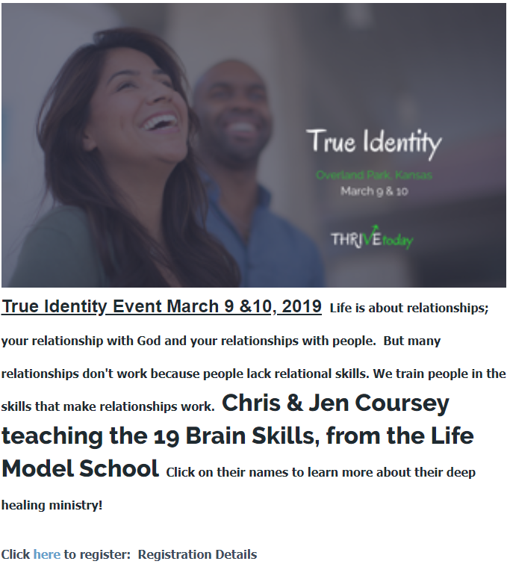
Just go to
orhaolam.com/
Scroll down

Slide 85
A point about emotional, spiritual, relational, physical health that is deeply politically incorrect.
Notes:
You’ve maybe seen these ads….

Slide 86

Notes:
https://www.cnn.com/2019/02/07/investing/cannabis-stocks-bubble/index.html

Slide 87
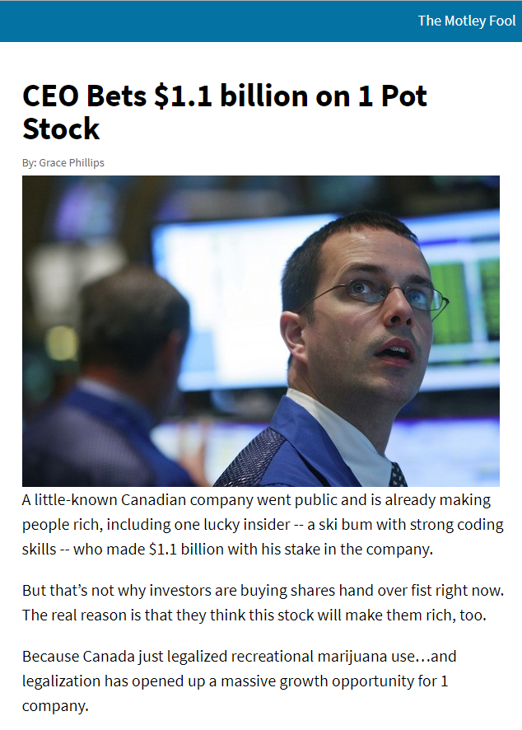

Slide 88
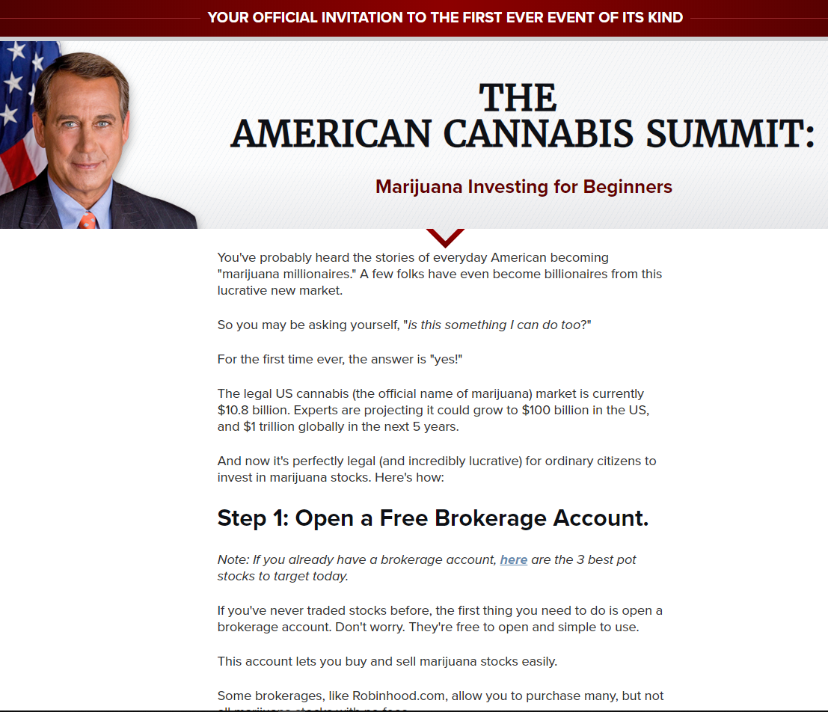
Notes:
You've probably heard the stories of everyday American becoming "marijuana millionaires." A few folks have even become billionaires from this lucrative new market.
So you may be asking yourself, "is this something I can do too?"
For the first time ever, the answer is "yes!"

Slide 89
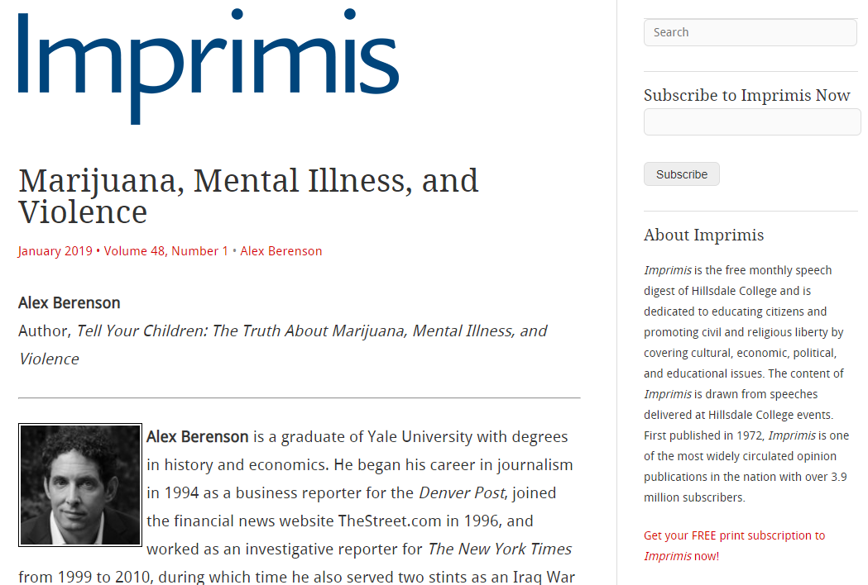
Notes:
https://imprimis.hillsdale.edu/marijuana-mental-illness-violence/

Slide 90
Seventy miles northwest of New York City is a hospital that looks like a prison, its drab brick buildings wrapped in layers of fencing and barbed wire. This grim facility is called the Mid-Hudson Forensic Psychiatric Institute. It’s one of three places the state of New York sends the criminally mentally ill—defendants judged not guilty by reason of insanity.
Notes:
https://imprimis.hillsdale.edu/marijuana-mental-illness-violence/

Slide 91
Until recently, my wife Jackie­—Dr. Jacqueline Berenson—was a senior psychiatrist there. Many of Mid-Hudson’s 300 patients are killers and arsonists. At least one is a cannibal. Most have been diagnosed with psychotic disorders like schizophrenia that provoked them to violence against family members or strangers.
Notes:
https://imprimis.hillsdale.edu/marijuana-mental-illness-violence/

Slide 92
A couple of years ago, Jackie was telling me about a patient. In passing, she said something like, Of course he’d been smoking pot his whole life.
Of course? I said.
Yes, they all smoke.
So marijuana causes schizophrenia?
Notes:
https://imprimis.hillsdale.edu/marijuana-mental-illness-violence/

Slide 93
I was surprised, to say the least. I tended to be a libertarian on drugs. Years before, I’d covered the pharmaceutical industry for The New York Times. I was aware of the claims about marijuana as medicine, and I’d watched the slow spread of legalized cannabis without much interest.
Notes:
https://imprimis.hillsdale.edu/marijuana-mental-illness-violence/

Slide 94
^{1 Yn 4.19} We love, because He first loved us.
^{1 Yn 4.9-11} The love of God was revealed among us by this—that God sent His one and only Son into the world so that we might live through Him.

Slide 95
^{1 Yn 4.9-11} This is love—not that we have loved God, but that He loved us and sent His Son as an atonement for our sins. Loved ones, if God so loved us, we also ought to love one another.

