Slide 1
e-handout
To have these notes
without taking notes
Go to OrHaOlam.com
Click on downloads,
messages, 2019
Notes:
.

Slide 2
Shameful news for
The United States of America

Slide 3
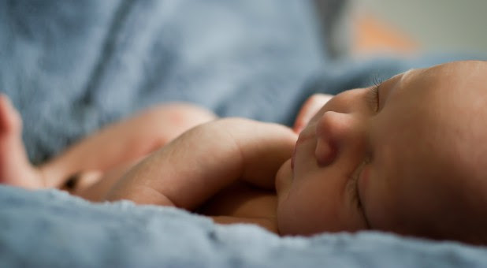
On Feb. 25, 44 Democrat senators,
including all six declared
presidential candidates,
voted against the
Born Alive Protection Act.
Put another way,
they voted for infanticide.
Notes:
https://www.charismanews.com/opinion/in-the-line-of-fire/75353-all-6-democratic-presidential-candidates-vote-for-infanticide?utm_source=In%20the%20Line%20of%20Fire&utm_medium=email&utm_content=subscriber_id:5194514&utm_campaign=Blogger%20-%20Michael%20Brown%20-%202019-02-27

Slide 4
As Senate majority leader Mitch McConnell stated plainly before the vote was taken, "It isn't about restrictions on abortion. It's just about recognizing that a newborn baby is a newborn baby, period."
Notes:
https://www.charismanews.com/opinion/in-the-line-of-fire/75353-all-6-democratic-presidential-candidates-vote-for-infanticide?utm_source=In%20the%20Line%20of%20Fire&utm_medium=email&utm_content=subscriber_id:5194514&utm_campaign=Blogger%20-%20Michael%20Brown%20-%202019-02-27

Slide 5
The Democrats truly have become the party of death, joined enthusiastically by far-left Bernie Sanders.
Notes:
https://www.charismanews.com/opinion/in-the-line-of-fire/75353-all-6-democratic-presidential-candidates-vote-for-infanticide?utm_source=In%20the%20Line%20of%20Fire&utm_medium=email&utm_content=subscriber_id:5194514&utm_campaign=Blogger%20-%20Michael%20Brown%20-%202019-02-27

Slide 6
Good News from
Space IL
Israel

Slide 7
Israel's first lunar lander appears to be back on track. The 5-foot-tall spacecraft, known as בראשית Beresheet, missed a planned engine firing Monday, Feb. 25, after its onboard computer reset unexpectedly. But the mission team managed to troubleshoot the issue, and the lander performed the maneuver Thursday, Feb. 28.

Slide 8
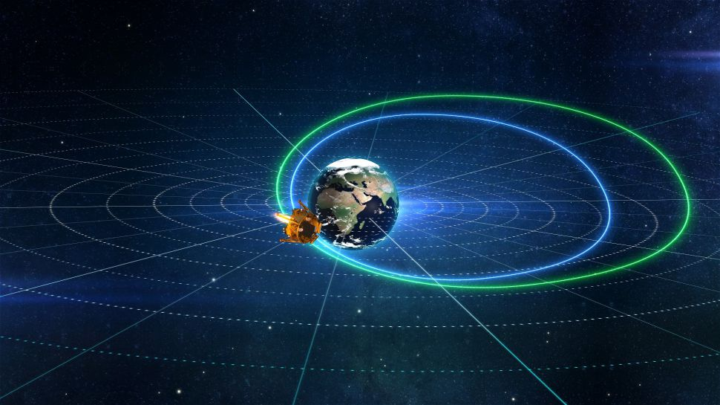
Beresheet בראשית firing its rocket motor

Slide 9
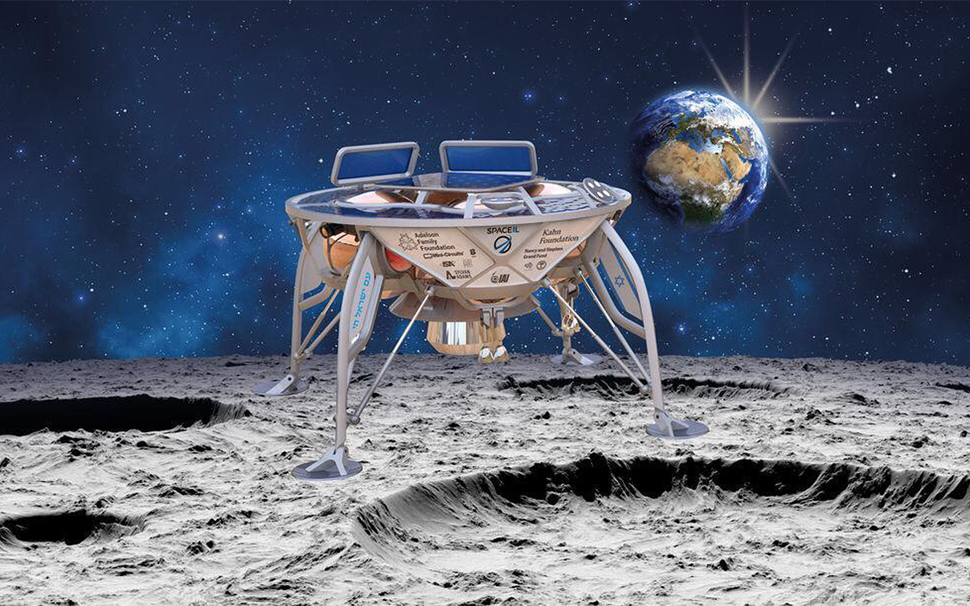
בראשית Beresheet
Notes:
Artists rendering.
Zooming in…

Slide 10
בראשית Beresheet
Notes:
Am Yisrael khi on one of the legs: The people of Israel live
Adelson Family Foundation: Las Vegas Casino billionaire philanthropists

Slide 11
מַתִּתְיָהוּ Mattityahu
(Matthew) 26:30-32

Slide 12
Mattityahu (Matthew) 26:30
לְאַחַר שֶׁשָּׁרוּ אֶת הַהַלֵּל יָצְאוּ אֶל הַר הַזֵּיתִים
After singing the Hallel, they went out to the Mount of Olives.
Notes:
Might not seem that there is a whole sermon here, but the Ruakh got my attention…
Why does Stern translate it as “singing the Hallel”

Slide 13
humneó: to sing to, to laud
Notes:
Note: Praise, laud

Slide 14
Why does Stern translate hymnēsantes ὑμνήσαντες
as Hallel?
Hallel הַלֵּל Praise is a Jewish prayer, a verbatim recitation from Psalms 113–118 which is recited by observant Jews on Jewish holidays as an act of praise and thanksgiving. Rabbi’s tradition
Notes:
https://en.wikipedia.org/wiki/Hallel

Slide 15
Hallel is recited…by all communities during the Pesakh Seder service, according to the Talmud,[Pesakhim 116b].
Why?
Notes:
https://en.wikipedia.org/wiki/Hallel

Slide 16
The psalms of Hallel are closely related to the song that the Israelites sang at the Sea of Reeds, a prayer of thanksgiving. Hallel highlights the movement from Egypt to the Temple, and the movement from human bondage to service of God is what the Passover story is all about.
Notes:
https://www.myjewishlearning.com/article/hallel-at-the-seder

Slide 17
^{Shmot/Ex 15.16b-18} until your people pass over, Adoni, till the people you purchased pass over. You will bring them in and plant them on the mountain which is your heritage, the place, Adoni, that you made your abode, the sanctuary, Adoni, which your hands established. Adoni will reign forever and ever.
Notes:
https://www.myjewishlearning.com/article/hallel-at-the-seder
Connecting leaving Egypt with the Temple worship, as its goal

Slide 18
The Rabbis chose to end the seder with Hallel for another reason as well. The Hallel we recite at the seder and in holiday prayers is called “the Egyptian Hallel” not only because of the explicit reference to Israel leaving Egypt in Psalm 114,
Notes:
https://www.myjewishlearning.com/article/hallel-at-the-seder

Slide 19
but also because the historical Exodus story and the experience of personal redemption are predominant motifs throughout the passages.
Notes:
https://www.myjewishlearning.com/article/hallel-at-the-seder

Slide 20
The Israelites do not pray to God in response to their suffering at the hands of the Egyptians. The Israelites “groan” when their labor is intensified and “cry out” when they cannot bear the oppression (Exod. 2:23), and God responds to these cries of pain (2:23-25); but they are not expressions of prayer.
Notes:
https://www.myjewishlearning.com/article/hallel-at-the-seder

Slide 21
Lack of voice and personal agency is a fundamental feature of slavery that precludes prayer. Remarkably, by the end of the story, the People of Israel are able to sing–to tell of their experiences, to express their gratitude, to articulate their hopes–which is the ultimate mark of freedom.
Notes:
https://www.myjewishlearning.com/article/hallel-at-the-seder

Slide 25
So Yeshua followed normative Rabbinic Jewish custom in this.
Questions:
Did He always follow Rabbinic custom?
Should we always follow Rabbinic custom?

Slide 26
Mattityahu (Matthew) 26:30
לְאַחַר שֶׁשָּׁרוּ אֶת הַהַלֵּל יָצְאוּ אֶל הַר הַזֵּיתִים
After singing the Hallel, they went out to the Mount of Olives.

Slide 27
Another example of Rabbinic custom followed.
^{Acts 1.12} They returned to Jerusalem from the Mount of Olives (which is near Jerusalem, a Shabbat day’s journey).
Leads me to a Rabbi trail…
Notes:
Nu 35:4-5 which they understand thus:
“a thousand cubits are the suburbs (of the city), and two thousand cubits the bounds”
And that this was the proper space they also gather from ( Joshua 3:4 ) it being the distance between the ark and the people when they marched

Slide 28
Three hazard zones in the Messianic movement:
Do we always follow normative Judaism, Rabbinic halakhah?
Do Gentiles and Jews follow the same level of obedience to Torah and/or rabbinics?
Who is a Gentile or a Jew?
Notes:
It’s a bit insane for me to address all three of these in one Shabbat message, and then just as a rabbit trail. But “I feel led.” Need to give some attention. May offend some. Very divisive issues.
Closest thing to a split, lost about 20 people over this.

Slide 29
Do we always follow normative Rabbinic halakhah?
A. Plus side: We love rabbinics. Gives context to scripture. Last week I was speaking on the many forms of atonement in scripture, which seemed to undermine the pre-eminent need of Blood Atonement.
Notes:
Talmud 101 minus [less than]

Slide 30
My understanding is that Blood sacrifice is primary, but ALL forms of atonement are needed.
“Actualize the atonement.”
Since I gave the message received Talmudic insight that the Blood is primary!

Slide 31
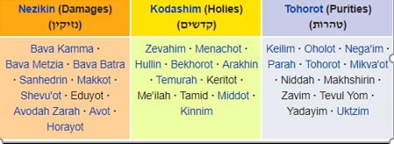
Six orders of the Mishnah:
Seeds
Festivals
Women
Damages
Holies
Purity
Notes:
Within each Order/Seder are Tractates/masekhtot;

Slide 32
Soncino Classics Collection:
Babylonian Talmud
Seder Moed
Masekhet / Tractate Yoma
Notes:
Soncino Classics Collection

Slide 33
Soncino Classics Collection:
Babylonian Talmud
Seder Moed
Masekhet / Tractate Yoma
Notes:
Deals with all levels of complexity…

Slide 34
^{﻿Talmud - Mas. Yoma 5a} For we have been taught: 7 To be waved, to make atonement for him.8 Does the waving make atonement? Is it not the blood which makes atonement, as it is written, For it is the blood that maketh atonement by reason of the life? Then why does Scripture say, To be waved, to make atonement for him? To say that if he treats the waving as an unimportant part of the ceremony, Scripture accounts it to him as if he had not obtained proper atonement.
Notes:
Focus in on highlighted phrase.

Slide 35
﻿אֵין כַּפָּרָה אֶלָּא בַּדָּם.
נֶאֱמַר וַיִּקְרָא יז כִּי הַדָּם הוּא ﻿בַּנֶּפֶשׁ יְכַפֵּר.
And there is no atonement but with blood. As it is written (Leviticus 17) that blood in the soul will be atoned
Notes:
Soncino Classics Collection
That will preach! Take that in memory if in discussion.

Slide 36
Rabbinic understanding:
In the existence of “Space-Time”, Shabbat is like an island in time, a day of rest in the rush of activity that engulfs the other six days of the weekly cycle.
Notes:
https://www.ulpanor.com/2019/03/01/not-to-miss-the-royalty/?inf_contact_key=defd9050d7f8d2ff7dae7000a51e7c65680f8914173f9191b1c0223e68310bb1

Slide 37
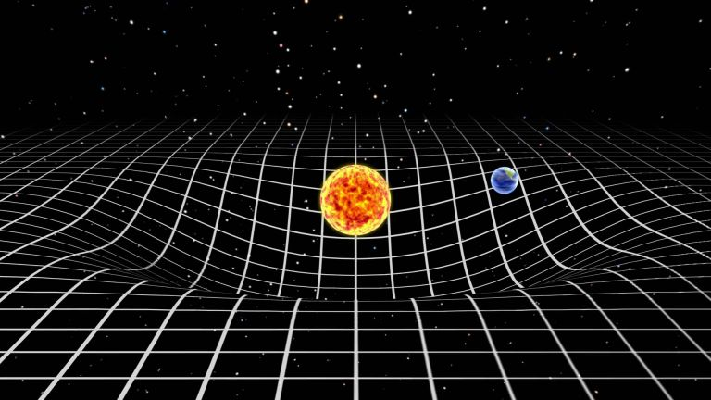
Curve of space time according
to the Theory of Relativity
Notes:
https://www.ulpanor.com/2019/03/01/not-to-miss-the-royalty/?inf_contact_key=defd9050d7f8d2ff7dae7000a51e7c65680f8914173f9191b1c0223e68310bb1

Slide 38
From sundown Friday evening to nightfall Saturday night — we cease all activities that considered to be “creation”. We transcend the worries and struggles of our daily routine, and enjoy the divine tranquility of G‑d‘s “day of rest”.
Notes:
https://www.ulpanor.com/2019/03/01/not-to-miss-the-royalty/?inf_contact_key=defd9050d7f8d2ff7dae7000a51e7c65680f8914173f9191b1c0223e68310bb1
Pretty beautiful

Slide 39
Do we always follow normative Rabbinic halakhah?
We love rabbinics.
Nevertheless, it was rabbinic leaders that rejected Yeshua.

Slide 40
^{Mtt 21.44-45} Therefore, I tell you that the Kingdom of God will be taken away from you and given to the kind of people that will produce its fruit!” As the head cohanim and the P’rushim listened to his stories, they saw that he was speaking about them.
Notes:
Not replacing Jewish covenantal PEOPLE, but leaders.

Slide 41
Do we always follow normative Rabbinic halakhah?
We love rabbinics.
Nevertheless, it was rabbinic leaders that rejected Yeshua.
Test everything by Scripture. Only the 66 books of the cannon are authoritative.

Slide 42
Three hazard zones in the Messianic movement:
Do we always follow normative Rabbinic halakhah?
Do Gentiles and Jews follow the same level of obedience to Torah and/or rabbinics?
Who is a Gentile or a Jew?
Notes:
Closest thing to a split, lost about 20 people over this.

Slide 43
Do Gentiles and Jews follow the same level of obedience to Torah and/or rabbinics?
One Law movement,
Hebrew Roots, filled Bartle Hall.
Summary:
Divine permission for the Nations.
Divine invitation for Jews.

Slide 44
Following from Ron Cantor’s paper that we distributed [which evaluates FFOZ at a bad point in their evolution of thinking about Torah]
1990’s excluded “must, should, have to”
Divine mandate
back to first position

Slide 45
Even were we to say that Gentiles are free to embrace Torah, the calendar of Israel, and more, there is no word that there is any covenant responsibility for Gentiles to do so. Acts 21 reinforces this impression. Here James/Yaakov tells Paul of the rumor that he teaches Jews who embrace Yeshua to forsake Torah. This of course is not true.

Slide 46
So, Paul demonstrates this to be a false rumor by his Temple sacrifice involvement. Yaakov reminds Paul that Gentiles were freed from responsibility for the full weight of Torah. Neither Paul nor Yaakov gives the slightest hint that they were encouraging full Torah observance among Gentiles.

Slide 47
Paul could have said, “Not only do I not teach Jews to forsake Moses, but I even encourage Gentiles to embrace more and more of the Torah as they come to understand and appreciate it.”
Key phrase: covenant responsibility

Slide 48
Three hazard zones in the Messianic movement:
Do we always follow normative Rabbinic halakhah?
Do Gentiles and Jews follow the same level of obedience to Torah and/or rabbinics?
Who is a Gentile or a Jew?
Notes:
Closest thing to a split, lost about 20 people over this.

Slide 49
Who is a Gentile or a Jew?
Family: By genealogy or marriage
Major false idea on this: Everyone who believe in Messiah must have DNA from on of the Israelite tribes.
Saxons = sons of Isaac?
Danube river = tribe of Dan?

Slide 50
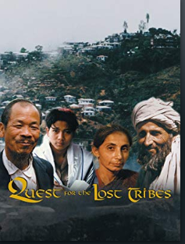
Israeli archeologist Simcha Jacobovici makes a near world-wide search for the ten so-called "Missing Tribes " of Israel. He searches throughout the Middle East and Central Asia, North and East Africa, India and Asia to find evidence for the missing tribes
Notes:
evidence, genetic, genealogical, and historic
https://www.amazon.com/Quest-Lost-Tribes-Simcha-Jacobovici/dp/B06XV87W9W?ref_=nav_signin&

Slide 51
Not every believer in Messiah is a Jew or Israelite.
We don’t do conversions to Judaism. ”I will bless you…and you are to be a blessing. I will bless those who bless you”

Slide 52
Three hazard zones in the Messianic movement:
Do we always follow normative Rabbinic halakhah?
Do Gentiles and Jews follow the same level of obedience to Torah and/or rabbinics?
Who is a Gentile or a Jew?

Slide 53
End of Rabbi trail addressing 3 Messianic Judaism theological landmines.

Slide 54
Mattityahu (Matthew) 26:30
לְאַחַר שֶׁשָּׁרוּ אֶת הַהַלֵּל יָצְאוּ אֶל הַר הַזֵּיתִים
After singing the Hallel, they went out to the Mount of Olives.
Notes:
Why does Stern translate it as “singing the Hallel”

Slide 55
What was the content of the
Hallel / praise time for Messiah?
T’hillim/Psalms 115 to 118
Notes:
Not read in entirety, but relative to His soon coming death

Slide 56
^{T’hillim/Ps 115.2-8} Why should the nations say: “Where is their God now?” Our God is in the heavens— He does whatever pleases Him! Their idols are silver and gold, the work of human hands. They have mouths, but cannot speak; eyes, but cannot see.
Notes:
Roman gods, eagles, idols all around.

Slide 57
^{T’hillim/Ps 115.2-8} They have ears, but cannot hear; noses, but cannot smell. They have hands, but cannot feel; feet, but cannot walk, nor utter a sound with their throat. Those making them will become like them, everyone trusting in them.

Slide 58
^{T’hillim/Ps 115.9, 17-18} O Israel, trust in Adoni — He is their help and their shield! The dead do not praise Adoni, nor do any who go down into silence. But we—we will bless Adoni both now and forever. Halleluyah!

Slide 59
^{T’hillim/Ps 116.3,6} The ropes of death entangled me, and the torments of Sheol found me. I found trouble and sorrow. Adoni protects the simple-hearted. When I was brought low, He saved me.

Slide 60
^{T’hillim/Ps 116.8-10} For You delivered my soul from death, my eyes from tears, my feet from stumbling. I will walk before Adoni in the lands of the living. I trusted even when I said, “I am very afflicted.”

Slide 61
^{T’hillim/Ps 116.15} Precious in the sight of Adoni is the death of His kedoshim /seekers of holiness.

Slide 62
^{T’hillim/Ps 117} Praise Adoni, all you nations! Glorify Him, all you peoples. For great is His lovingkindness toward us, and Adoni’s truth endures forever. Halleluyah!
Boskey: Nations praise G-d for His love to Israel!!!

Slide 63
^{T’hillim/Ps 118.6-8} Adoni is for me—I will not fear! What can man do to me? Adoni is for me, as my helper. I will see the downfall of those who hate me. It is better to take refuge in Adoni than to trust in man.

Slide 64
^{T’hillim/Ps 118.13-14} You pushed me hard to make me fall, but Adoni helped me. Adoni is my strength and song, and He has become my salvation. [incarnational]

Slide 65
^{T’hillim/Ps 118.17-19} I will not die, but live, and proclaim what Adoni has done! Adoni has chastened me hard, but has not given me over to death. Open to me the gates of righteousness, that I may enter through them and praise Adoni.

Slide 66
^{T’hillim/Ps 118.22-25} The stone the builders rejected has become the capstone. It is from Adoni: it is marvelous in our eyes! This is the day that Adoni has made! Let us rejoice and be glad in it! Hoshia-na! Please, Adoni, save now! We beseech You, Adoni, prosper us!

Slide 67
Mattityahu (Matthew) 26:31
אָמַר לָהֶם יֵשׁוּעַ: ”אַתֶּם כֻּלְּכֶם תִּכָּשְׁלוּ בִּגְלָלִי הַלַּיְלָה, שֶׁהֲרֵי כָּתוּב,
Yeshua then said to them, “Tonight you will all lose faith in me, as the Tanakh says,

Slide 68
Mattityahu (Matthew) 26:31
א’אַכֶּה אֶת־הָרֹעֶה וּתְפוּצֶין הַצֹּאן.‘
‘I will strike the shepherd dead, and the sheep of the flock will be scattered.’

Slide 69
^{Zekh 13.7-9} Awake, O sword, against My shepherd, against the man who is My companion! It is a declaration of Adoni Tzva’ot. Strike the shepherd and the sheep will be scattered! I will turn My hand against the little ones. Then it will happen — it is a declaration of Adoni—

Slide 70
^{Zekh 13.7-9} that in the entire land two-thirds will be cut off and die, but a third will be left in it. This third I will bring through the fire. I will refine them as silver is refined, and will test them as gold is tested. They will call on My Name and I will answer them. I will say, ‘They are My people,’ and they will answer, ‘Adoni is my God.’

Slide 71
Mattityahu (Matthew) 26:32
הֵשִׁיב לוֹ כֵּיפָא וְאָמַר: ”אִם הַכֹּל יִכָּשְׁלוּ בִּגְלָלְךָ, אֲנִי לְעוֹלָם לֹא אֶכָּשֵׁל!“‏
“But after I have been raised, I will go ahead of you into the Galil.”

Slide 72
Build your heart in the promises of G-d. Life won’t be easy, may be excruciating. But it will be ultimately glorious.
Surrender to Him, to His praise, His Hallel.

