Slide 1
e-handout
To have these notes
without taking notes
Go to OrHaOlam.com
Click on downloads,
messages, 2019
Notes:
A somber note from the Safety Seminar some of us attended…

Slide 2
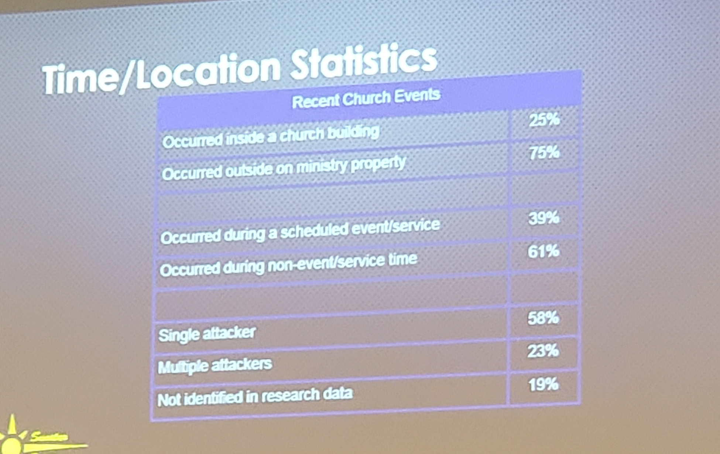
Notes:
Next from my son Daniel.

Slide 3
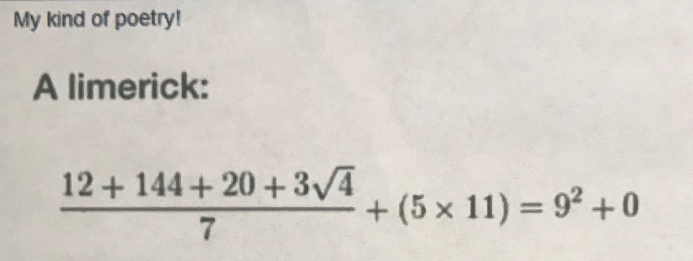
Doesn’t look like a limerick to you?
Notes:
From my son Daniel

Slide 4
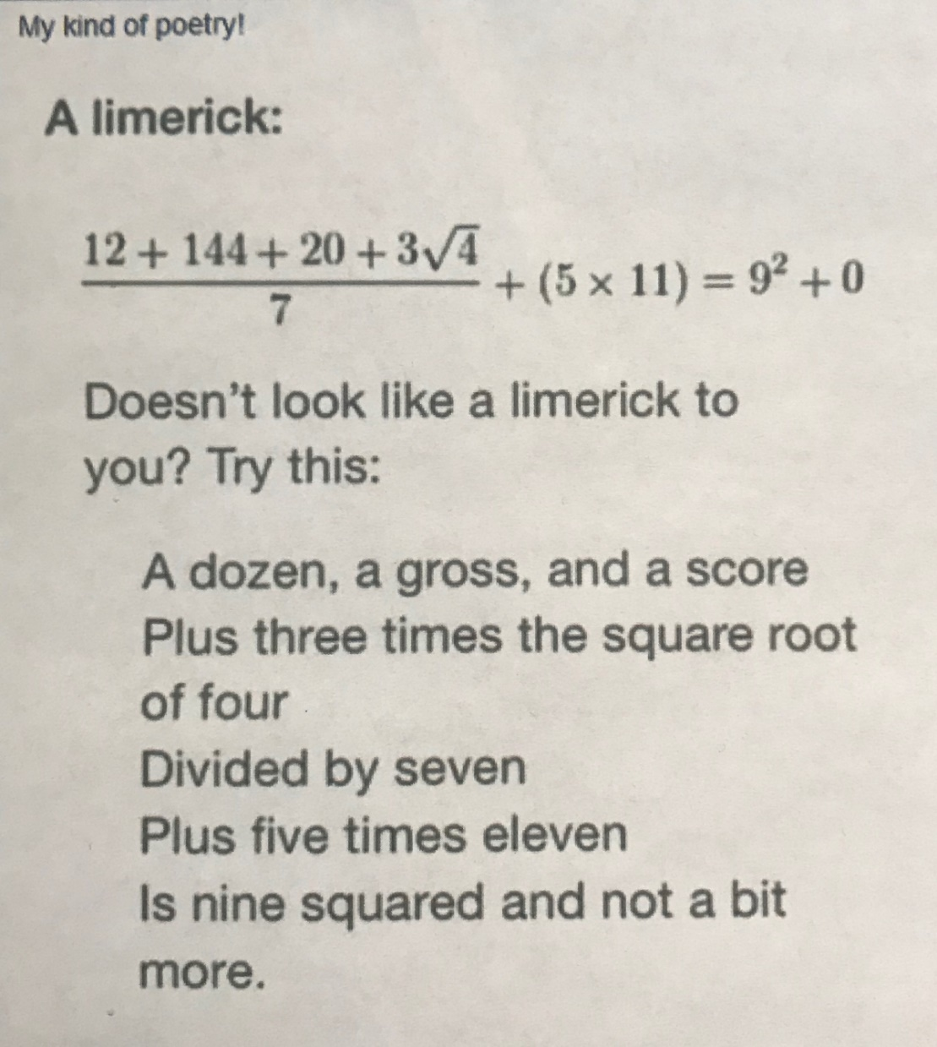
(186 ÷ 7) + 55
= 81

Slide 5
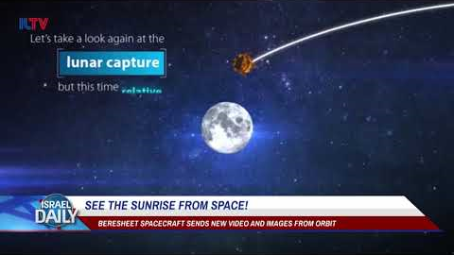
Beresheet updateבראשית

Slide 6
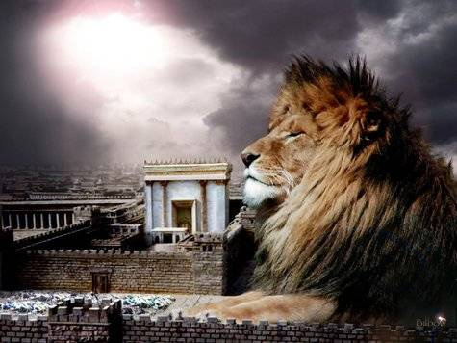
מַתִּתְיָהוּ Mattityahu
(Matthew) 26:33-35
Notes:
Returning to the series I feel called to do in Matityahu. Last time was four Shabbats ago! So, I have 4 hours of accumulated material!
Sang the Hallel and went out. Why sing Hallel after Passover Seder meal? → discussion of traditional practice and hazards of Messianic movement.
As they go, Yeshua predicts the soon coming abandonment of Him by the Twelve. Eleven now.
Their reaction to His predicition…

Slide 7
Mattityahu (Matthew) 26:33
הֵשִׁיב לוֹ כֵּיפָא וְאָמַר: ”אִם הַכֹּל יִכָּשְׁלוּ בִּגְלָלְךָ, אֲנִי לְעוֹלָם לֹא אֶכָּשֵׁל!“
“I will never lose faith in you,” Kefa answered, “even if everyone else does.”

Slide 8
Mattityahu (Matthew) 26:34
אָמַר לוֹ יֵשׁוּעַ: ”אָמֵן אוֹמֵר אֲנִי לְךָ כִּי בַּלַּיְלָה הַזֶּה, בְּטֶרֶם יִקְרָא הַתַּרְנְגוֹל, שָׁלוֹשׁ פְּעָמִים תִּתְכַּחֵשׁ לִי.“
Yeshua said to him, “Yes! I tell you that tonight before the rooster crows, you will disown me three times!”

Slide 9
Mattityahu (Matthew) 26:35
אָמַר כֵּיפָא: ”גַּם אִם עָלַי לָמוּת אִתְּךָ לֹא אֶתְכַּחֵשׁ לְךָ!“. וְכֵן אָמְרוּ כָּל הַתַּלְמִידִים.‏
“Even if I must die with you,” Kefa replied, “I will never disown you!” And all the talmidim said the same thing.

Slide 10
Further in the same chapter
^{Mtt 26:55} Then the talmidim all deserted him and ran away.

Slide 11
This was an panicked leaving, with soon restoration.
But, why did they panic? Do we ever panic, despair, fall to depression, discouragement?
We need to examine what keeps us really centered in the faith, what keeps us from panic, etc.
Three weeks ago ThriveToday.
Notes:
I got a whole new level of view of the Kingdom of G-d, and my spiritual life.
Similarly, RTF really helped me, last Fall.
Want to know a rabbi, listen to what he speaks about. If sincere, his own journey, own sins!
My gifting is teaching, and so I get so caught up in explaining that sometimes I forget to give application. “Sticky Statement” This message is all application.

Slide 12

Re-centering: resetting the brain’s NORMAL
Notes:
After Thrive weekend, I came home overloaded. Frustrated. So I went back through the book that night and it was life changing!!
First premise, maybe only point today: New normal.
Ever drive behind a vehicle not centered in lane?
Re-centering: restarting the brain’s NORMAL

Slide 13
A new view of
Repentance
תשובה
T’shuvah

Slide 14
Philippians 4 Paradigm

Slide 15
^{Phil. 4. 4-5} Rejoice in union with the Lord always! I will say it again: rejoice! Let everyone see how reasonable and gentle you are. The Lord is near!

Slide 16
^{Phil. 4. 6-9} Don’t worry about anything; on the contrary, make your requests known to God by prayer and petition, with thanksgiving. Then God’s shalom, passing all understand-ding, will keep your hearts and minds safe in union with the Messiah Yeshua.

Slide 17
^{Phil. 4. 6-9} In conclusion, brothers, focus your thoughts on what is true, noble, righteous, pure, lovable or admirable, on some virtue or on something praiseworthy. Keep doing what you have learned and received from me, what you have heard and seen me doing; then the God who gives shalom will be with you.

Slide 18
Focus on vs 6
Don’t worry about anything; on the contrary, make your requests known to God by prayer and petition, with thanksgiving.
Negative normal aspect
Positive normal aspect
Notes:
This will be the new normal. Maybe some of you are already there, but can be deeper!

Slide 19
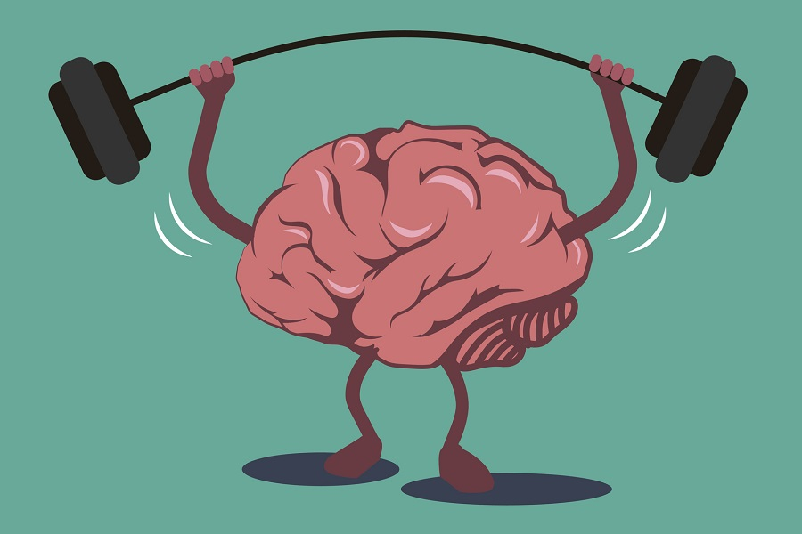
Train your brain T’shuvah תשובה
Notes:
https://www.google.com/search?q=brain+training&safe=active&source=lnms&tbm=isch&sa=X&ved=0ahUKEwj4xfLr3ajhAhUVHzQIHRyXBHsQ_AUIDygC&biw=1164&bih=865#imgdii=pEDTREwjQWp7TM:&imgrc=D15AUzLqiN_0OM:
https://www.google.com/url?sa=i&source=images&cd=&cad=rja&uact=8&ved=2ahUKEwjXiLmn3qjhAhWxoFsKHS_fAJYQjRx6BAgBEAU&url=https%3A%2F%2Fbrainfitnesssolutions.com%2Fbrain-fitness-guide%2F&psig=AOvVaw2cDd7ARLZGPS_mVKAReDdA&ust=1553996406944215
Psycho-babble?

Slide 20

^{Phil 4.6} New normal: negative aspect
Notes:
https://biblehub.com/greek/3309.htm

Slide 21
^{Phil. 4. 6} Not anything;
μηδείς médeis
no one, none, nothing
Notes:
https://biblehub.com/greek/3309.htm

Slide 22
^{Phil. 4. 6} Don’t worry
μεριμνᾶτε merimnate
over-anxious; distracted, worried
Notes:
https://biblehub.com/greek/3309.htm

Slide 23
^{Phil 4.6 MSG} Don’t fret or worry.
אַל תִּדְאֲגוּ al tid-agu
תִּדְאֲגוּ to worry, to be concerned
לְשׁוּם דָּבָר l’shum davar
nothing, (not) anything
Is there ANYTHING you are stressing about??

Slide 24
^{Lk 7.10-13} The next day Yeshua, accompanied by his talmidim and a large crowd, went to a town called Na‘im. As he approached the town gate, a ₁dead man was being carried out for burial. His mother was a ₂widow, this had been ₃her only son, and a sizeable crowd from the town was with her. When the Lord saw her, he felt compassion for her and said to her, “Don’t cry.”
Notes:
She’s alone in terms of spouse, now only son GONE. Relationally lonely, also financially destitute!
Is He saying, “Man up. Suck it up.”
There’s of course more to the story, but it lays a Yeshua model for this concept.

Slide 25
SW version
Don’t stress out
Over ANYTHING!
Sounds heartless:
Money woes: survive, outlive, shamed
People problems: offended, failure, rejection
Health: pain, disability, weakness

Slide 26
Negative side of the new normal.
“Sticky statement”
Don’t stress out over ANYTHING!
How is that possible?
How can I just turn off stress?
Notes:
People offend me, insult me.
Life challenges scare me.

Slide 27
Positive side of the new normal.

Slide 28
^{Phil. 4. 6-7} Don’t worry about anything; on the contrary, make your requests known to God by prayer and petition, with thanksgiving. Then God’s shalom, passing all understand-ding, will keep your hearts and minds safe in union with the Messiah Yeshua.
Notes:
I am a believer and doer of prayer. Daily personal, Tuesday Teerosh, with my family, extended times, prayer retreat.
I also believe in praising G-d. Tikkun
What was radically new to me was combining heavy intercession with uplifting thanksgiving.
You can pray and cry and groan, and come away as an oppressed groaning loner.

Slide 29

prayer and petition, with thanksgiving.
Notes:
https://biblehub.com/greek/2169.htm
Let’s look at the words of the Word.

Slide 30
δέησις deésis supplication:
praying for a specific, felt need
heart-felt petition, arising out of deep personal need (sense of lack, want).
a felt need that is personal and urgent
Notes:
https://biblehub.com/greek/2169.htm

Slide 31
~ ^{Ro.8.26} The Spirit himself pleads on our behalf with groanings too deep for words;
~ ^{1 Tim 2.1} Therefore, first of all I urge that requests, prayers, intercessions, and thanksgiving be made on behalf of all people.
Notes:
Heavy stuff! However…

Slide 32

With thanksgiving. ?!?
εὐχαριστία eucharistia thankfulness, gratitude; giving of thanks, thanksgiving
Notes:
https://biblehub.com/greek/2169.htm
Messianic scriptures/New Testament original is Greek but thinking is Hebrew. So…

Slide 33
בִּתְפִלָּה וּבְתַחֲנוּנִים וּבְהוֹדָיָה
Bi-tifeelah, uv-tkhanunim, uv-hodayah
בִּתְפִלָּה prayer; wish, entreaty, supplication
וּבְתַחֲנוּנִים supplicatory prayer; plea, entreaty, cry for help
Notes:
Heavy stuff

Slide 34
וּבְהוֹדָיָה
thanksgiving, prayer of thanks, praise,
Notes:
Uplifting, empowering, liberating JOY!

Slide 35
Positive side of the new normal:
prayer and petition, with thanksgiving.
Takes time. Lament, then praise. For Who G-d is, for how Yeshua is working, for what it unseen.
Notes:
https://biblehub.com/greek/2169.htm
Prayer is generally heavy, even a lament, a cry in distress. It’s right to start there, to vent to G-d. In Sozo Ps 42
But if we stay there, we ruin it. We lament → lamentable. We lament, then thanks.

Slide 36
“Sticky statement”
Don’t stress out over ANYTHING! [rather do] prayer and petition, with thanksgiving.
New normal
Brain training by dwelling on chosen emotion
Notes:
I do a fair amount of crisis counseling. People come to me upset with each other, and G-d helps us.
I would like to suggest that MOST of that work can be done by entering this new normal.

Slide 37
Train your brain
Notes:
https://www.google.com/search?q=brain+training&safe=active&source=lnms&tbm=isch&sa=X&ved=0ahUKEwj4xfLr3ajhAhUVHzQIHRyXBHsQ_AUIDygC&biw=1164&bih=865#imgdii=pEDTREwjQWp7TM:&imgrc=D15AUzLqiN_0OM:
https://www.google.com/url?sa=i&source=images&cd=&cad=rja&uact=8&ved=2ahUKEwjXiLmn3qjhAhWxoFsKHS_fAJYQjRx6BAgBEAU&url=https%3A%2F%2Fbrainfitnesssolutions.com%2Fbrain-fitness-guide%2F&psig=AOvVaw2cDd7ARLZGPS_mVKAReDdA&ust=1553996406944215
Psycho-babble?

Slide 38
New Normal:
^{Mtt 4.17} Yeshua began proclaiming, “Turn from your sins to God, for the Kingdom of Heaven is near!”
Means?
From gross sin: soldiers and tax collectors, prostitutes

Slide 39
From slothfulness and negligence of the Torah mitzvot
Better: prep for the present Kingdom of the Spirit: humility, meekness, purity, hunger, mercy, peacemaking, longsuffering
Heaven = the atmosphere we breathe

Slide 40
^{Col.3.15-17} Let the shalom of Messiah rule in your hearts—to this shalom you were surely called in one body. Also be thankful. Let the word of Messiah dwell in you richly, teaching and admonishing one another
Notes:
Here’s something I learned from JB last week. What I teach you about dwelling in the heavenly atmosphere of
“No stress, intense prayer WITH thanksgiving” you exemplify and teach to others. That is, if I’m just a shepherd and comfort and help to you [I hope] but don’t equip you to do the same for others, then I’ve failed as equipper.

Slide 41
^{Col.3.15-17} with all wisdom in psalms and hymns and spiritual songs, singing with gratitude in your hearts to God. And whatever you do in word or deed, do all in the name of the Lord Yeshua, giving thanks to God the Father through Him.

Slide 42
Do some brain training,
Impart some brain training,
and let me know!!
Breathe the heavenly air of
“I refuse stress, rather live in intense prayer WITH thanksgiving”

Slide 43
^{Yn 15.4-5} Stay united with me, as I will with you — for just as the branch can’t put forth fruit by itself apart from the vine, so you can’t bear fruit apart from me. “I am the vine and you are the branches. Those who stay united with me, and I with them, are the ones who bear much fruit; because apart from me you can’t do a thing.

Slide 44
What about when I get out of this mindset, not prayerful, intercessory, not joyful?
Mad, grouchy, frustrated, irritated, insulted, offended, scared…

Slide 45
Exercises and 19 Brain skills
https://thrivetoday.org/tag/19-skills/

Slide 46
I don’t feel like I want to stay in joy and shalom.
Armed intruder
Dirty dishes left out

Slide 47
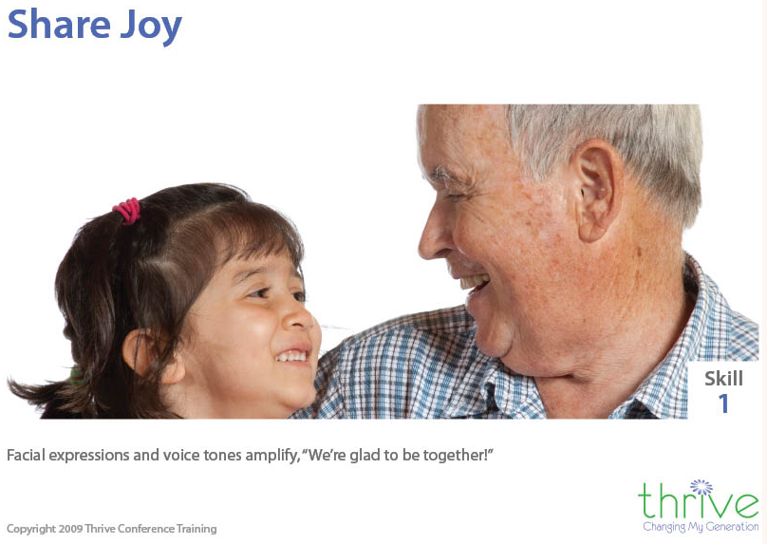
Notes:
http://www.thrivetraining.org/nineteenskills.html
Right-hemisphere-to-right-hemisphere communication of our most desired positive
emotional state.

Slide 48
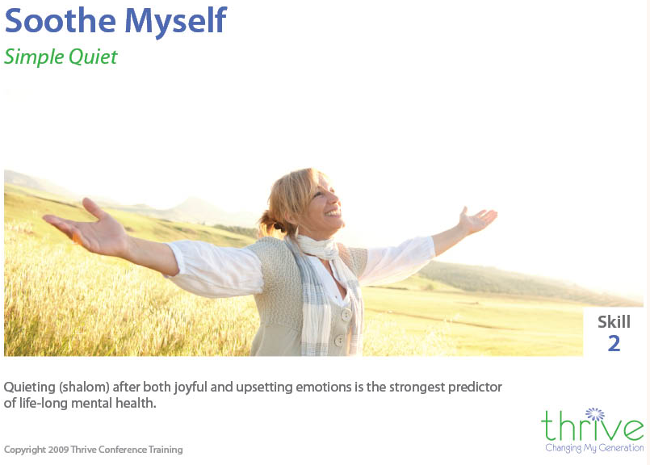
Notes:
Skill 2 Soothe Myself Simple Quiet Lowering my own energy level so I can rest after both joyful and upsetting emotions, as I need to and on my own, makes me feel stable. This self-soothing capacity is the strongest predictor of good mental health for the lifetime.
Technical description: Release-on-demand of serotonin by the vegetative branch of para-sympathetic nervous system to quiet both positive and distressing emotional states.

Slide 49
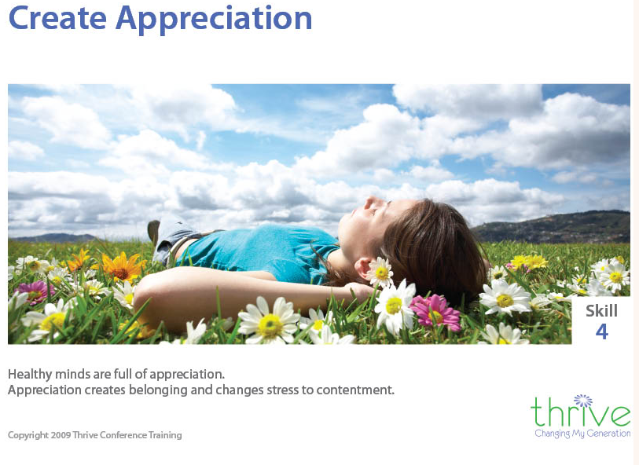
Skill 4
Notes:
A trained brain will scan the environment looking for things to appreciate, amplify, enjoy!
Untrained brain amplifies problems and pain.
High levels of the emotional state of appreciation closely match the healthy balanced state of the brain and nervous system. Creating a strong feeling of appreciation in yourself or others relieves unpleasant states and stress.
Appreciation is very similar to the let down reflex that produces milk flow when nursing and the warm contented feeling that follows for mother and child
http://www.thrivetraining.org/nineteenskills.html

Slide 50
^{Phil. 4. 6-9} In conclusion, brothers, focus your thoughts on what is true, noble, righteous, pure, lovable or admirable, on some virtue or on something praiseworthy. Keep doing what you have learned and received from me, what you have heard and seen me doing; then the God who gives shalom will be with you.

Slide 51
What about PEOPLE issues?

Slide 53
Relational Circuits [RC] are foundational to joy. Our eyes light up when we see people and there is a release of serotonin.
If relational circuits are shut down
We want to make the problem, person, or feeling go away.

Slide 54
We don’t want to listen to what others feel or say.
Our minds are locked onto something upsetting.
I don’t want to be connected to…
I more aggressively fix or judge
Notes:
If you answer yes to any of these your relational circuits are off with that person.

Slide 55


Slide 56
Steps to restore RC
Startle or yawn exercise.
Lament with G-d. Ps 42.
Express appreciation to G-d for His faithfulness and presence!
Begin dialogue.

Slide 57
Train your brain T’shuvah תשובה
Notes:
https://www.google.com/search?q=brain+training&safe=active&source=lnms&tbm=isch&sa=X&ved=0ahUKEwj4xfLr3ajhAhUVHzQIHRyXBHsQ_AUIDygC&biw=1164&bih=865#imgdii=pEDTREwjQWp7TM:&imgrc=D15AUzLqiN_0OM:
https://www.google.com/url?sa=i&source=images&cd=&cad=rja&uact=8&ved=2ahUKEwjXiLmn3qjhAhWxoFsKHS_fAJYQjRx6BAgBEAU&url=https%3A%2F%2Fbrainfitnesssolutions.com%2Fbrain-fitness-guide%2F&psig=AOvVaw2cDd7ARLZGPS_mVKAReDdA&ust=1553996406944215
Psycho-babble?

Slide 58
“Sticky statement”
Don’t stress out over ANYTHING! [rather do] prayer and petition, with thanksgiving.
New normal
Brain training by dwelling on chosen emotion

Slide 59
Living in this is subtle but powerful!!

Slide 60
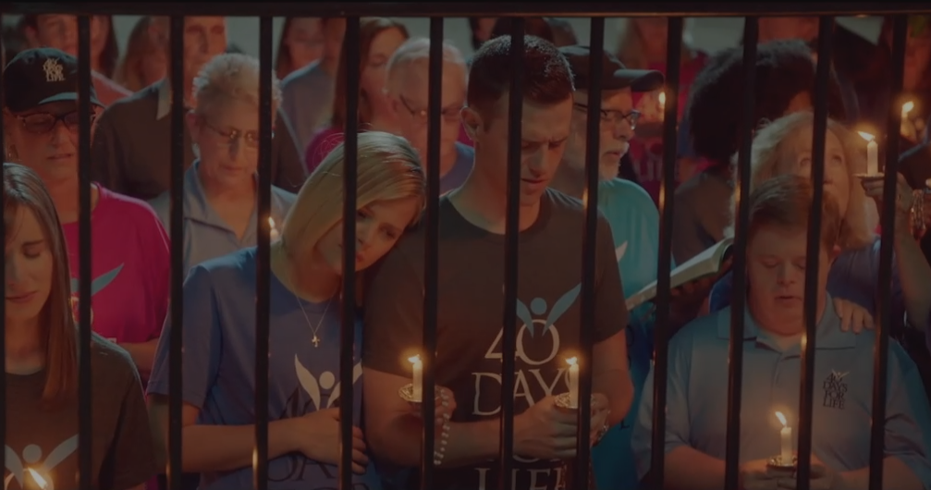
UnPlanned Movie

Slide 61
The movie…tells the true story of former Planned Parenthood executive Abby Johnson, who quit the organization to become a prominent pro-life advocate.
40 Days for Life people praying outside the Planned Parenthood clinic.

Slide 62
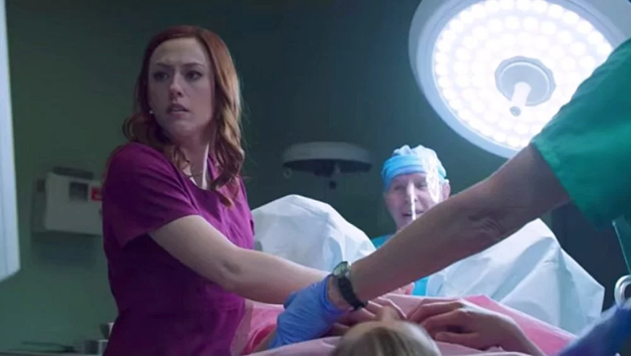
Direcor Abby Johnson observing the ultra sound of an abortion

Slide 63
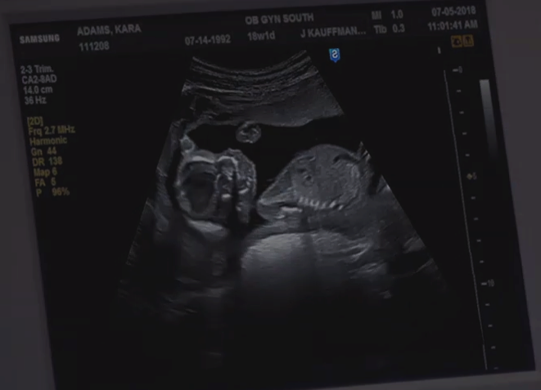
Notes:
A baby in the uterus, with a cannula [suction tube] about to be inserted. She sees the baby apparently trying to evade the tube, then sucked into it.

Slide 64
After never having actually witnessed one, she’s suddenly called in to assist in the ultrasound-guided abortion of a 13-week-old fetus, and what she sees on the monitor looks to her like a baby reacting to what’s being done to it.

Slide 65
At the end of the movie, a title informs us that the activist organization she joined, 40 Days for Life, has gotten 500 workers to drop out of what it describes as “the abortion industry.”
Also, dozens of clinics closed, many women see pray-ers, circle clinic and go home. Unseen effects!!
Notes:
https://variety.com/2019/film/reviews/unplanned-review-1203175761/

Slide 66
Concerning the power of gratefulness…

Slide 67
There is one word that can save a marriage, say Jerusalem’s Orthodox Jewish community leaders, who offer sound advice on keeping those healthy, long-term relationships so crucial to a happy family and long life.
Notes:
http://www.israeltoday.co.il/NewsItem/tabid/178/nid/36277/Default.aspx

Slide 68
One of the main problems in every lasting marriage is that we start to take each other for granted, and this can lead to unwanted consequences in any relationship, be it family, friends or marriage.
Notes:
http://www.israeltoday.co.il/NewsItem/tabid/178/nid/36277/Default.aspx

Slide 69
Can you remember your first year of marriage, when your partner would get up early to surprise you with a full breakfast, just the way you like? How thoughtful it was, and you couldn’t stop marveling at your amazing husband or wife. But, when he made you a cup of tea last night, you hardly noticed.
Notes:
http://www.israeltoday.co.il/NewsItem/tabid/178/nid/36277/Default.aspx

Slide 70
It is all too easy in our lifelong relationships to start taking each other for granted. Not only is this unpleasant, it spoils the atmosphere between you, misrepresents your true feelings about one another, and can have fateful implications for your marriage.
Notes:
http://www.israeltoday.co.il/NewsItem/tabid/178/nid/36277/Default.aspx

Slide 71
In an article published in an Orthodox Jewish journal, the rabbis reported that gratitude is the key to a healthy and successful marriage.
Notes:
http://www.israeltoday.co.il/NewsItem/tabid/178/nid/36277/Default.aspx

Slide 72
"The sense of appreciation and belief that your partner appreciates you directly influences how you feel about your marriage, how committed you are to it, and your belief that it will continue," said the author of the study, Ted G. Futris, an Associate Professor and Extension Family Life Specialist at the University of Georgia.
Notes:
http://www.israeltoday.co.il/NewsItem/tabid/178/nid/36277/Default.aspx

Slide 73
Rabbis and researchers alike argue that the simple act of saying "thank you" to your partner regularly, as simple and trivial as that may sound, can be a strong protection against divorce. [Even if a bit irritated]
Notes:
http://www.israeltoday.co.il/NewsItem/tabid/178/nid/36277/Default.aspx

Slide 74
More concerning gratefulness…

Slide 75

An Israel mother’s response to terror
Notes:
Gratitude, then Proactive organizationally

Slide 76
Train your brain
Notes:
https://www.google.com/search?q=brain+training&safe=active&source=lnms&tbm=isch&sa=X&ved=0ahUKEwj4xfLr3ajhAhUVHzQIHRyXBHsQ_AUIDygC&biw=1164&bih=865#imgdii=pEDTREwjQWp7TM:&imgrc=D15AUzLqiN_0OM:
https://www.google.com/url?sa=i&source=images&cd=&cad=rja&uact=8&ved=2ahUKEwjXiLmn3qjhAhWxoFsKHS_fAJYQjRx6BAgBEAU&url=https%3A%2F%2Fbrainfitnesssolutions.com%2Fbrain-fitness-guide%2F&psig=AOvVaw2cDd7ARLZGPS_mVKAReDdA&ust=1553996406944215
Psycho-babble?

Slide 77
^{Phil. 4. 6-9} In conclusion, brothers, focus your thoughts on what is true, noble, righteous, pure, lovable or admirable, on some virtue or on something praiseworthy. Keep doing what you have learned and received from me, what you have heard and seen me doing; then the God who gives shalom will be with you.

Slide 78
“Sticky statement”
Don’t stress out over ANYTHING! [rather do] prayer and petition, with thanksgiving.
New normal
Brain training by dwelling on chosen emotion
Do it, teach it to someone, let Rabbi know!

