Slide 1
e-handout
To have these notes
without taking notes
Go to OrHaOlam.com
Click on downloads,
messages, 2019
Notes:
A LOT of preliminaries today…

Slide 2
Beresheet בראשית
Update

Slide 3
After traveling over 5.5 million kilometers (3.4 million miles) around the Earth and drawing ever closer to the moon, the Israeli spacecraft Beresheet needed to slow down from 5,300 mph to 4,700 mph, to be captured by lunar gravity.
Notes:
https://unitedwithisrael.org/israeli-spacecraft-enters-lunar-orbit-ahead-of-moon-landing/?utm_source=MadMimi&utm_medium=email&utm_content=UN+Investigating+Iran%27s+%E2%80%98Secret+Atomic+Warehouse%E2%80%99+Identified+by+Israel%3B+Omar+%E2%80%98Didn%E2%80%99t+Know+Nothing+About+No+Anti-Semitism%E2%80%99%3B+Getting+Closer+to+Moon%21&utm_campaign=20190405_m150852845_UN+Investigating+Iran%27s+%E2%80%98Secret+Atomic+Warehouse%E2%80%99+Identified+by+Israel%3B+Omar+%E2%80%98Didn%E2%80%99t+Know+Nothing+About+No+Anti-Semitism%E2%80%99%3B+Getting+Closer+to+Moon%21&utm_term=more_btn_dark_jpg

Slide 4
Spectators observed from behind glass, holding their breath as screens showed Beresheet’s engines kicking into gear at 10:18 a.m. Eastern Time Thursday.
Notes:
Otherwise: Lost in Space, in Solar orbit
https://unitedwithisrael.org/israeli-spacecraft-enters-lunar-orbit-ahead-of-moon-landing/?utm_source=MadMimi&utm_medium=email&utm_content=UN+Investigating+Iran%27s+%E2%80%98Secret+Atomic+Warehouse%E2%80%99+Identified+by+Israel%3B+Omar+%E2%80%98Didn%E2%80%99t+Know+Nothing+About+No+Anti-Semitism%E2%80%99%3B+Getting+Closer+to+Moon%21&utm_campaign=20190405_m150852845_UN+Investigating+Iran%27s+%E2%80%98Secret+Atomic+Warehouse%E2%80%99+Identified+by+Israel%3B+Omar+%E2%80%98Didn%E2%80%99t+Know+Nothing+About+No+Anti-Semitism%E2%80%99%3B+Getting+Closer+to+Moon%21&utm_term=more_btn_dark_jpg

Slide 5
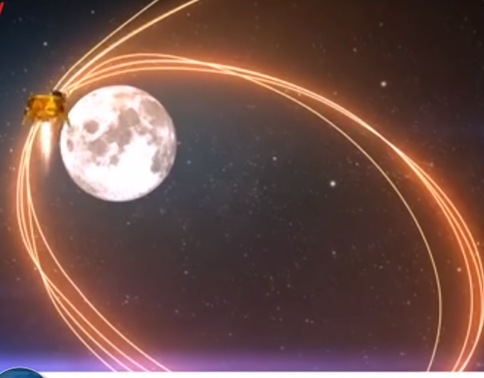
Lunar orbit insertion
Notes:
https://unitedwithisrael.org/watch-israels-lunar-spacecraft-takes-a-selfie/

Slide 6
After five minutes, Beresheet hit the perfect velocity, and the engineers burst into applause, congratulating each other with hugs and handshakes. It finally swung into the moon’s elliptical orbit — keeping it on track for touchdown April 11.
Notes:
https://unitedwithisrael.org/israeli-spacecraft-enters-lunar-orbit-ahead-of-moon-landing/?utm_source=MadMimi&utm_medium=email&utm_content=UN+Investigating+Iran%27s+%E2%80%98Secret+Atomic+Warehouse%E2%80%99+Identified+by+Israel%3B+Omar+%E2%80%98Didn%E2%80%99t+Know+Nothing+About+No+Anti-Semitism%E2%80%99%3B+Getting+Closer+to+Moon%21&utm_campaign=20190405_m150852845_UN+Investigating+Iran%27s+%E2%80%98Secret+Atomic+Warehouse%E2%80%99+Identified+by+Israel%3B+Omar+%E2%80%98Didn%E2%80%99t+Know+Nothing+About+No+Anti-Semitism%E2%80%99%3B+Getting+Closer+to+Moon%21&utm_term=more_btn_dark_jpg

Slide 8
Some of us attended a Security and Safety all day seminar, Mar. 26, hosted by our insurance carrier, Brotherhood. We received some VERY important information that we are instituting as policies.

Slide 9
One is to prep our children against predators. We want to show the following video frequently, until the kids have it so memorized that it’s boring. First, to you parents. Then parents and children. Then spam.

Slide 10

Safe and Secure Orientation
https://youtu.be/gm4Wh16twhw
Jeff & Melissa
Notes:
Camp Kanakuk

Slide 11
One more…

Slide 12
When Or HaOlam was acquiring this building, we let other organizations know about our need.
Several helped us substantially.

Slide 13
Hylan Slobodkin, Beit Tikvah Messianic congregation Portland: $4000
Kevin Solomon, Beth Hallel $1000
Don Goldstein, Shoresh David Brandon FL $1000
Jewish Voice, Jon Bernis $10,000
Kingdom Living Richard, Cleary $1000
Tiffany Fellowship, Barry Clair $2,143
Yehudim 4 Yeshua, Dvd Brickner $10,000
We received $29,143
Notes:
https://www.shemayisrael.org/

Slide 14
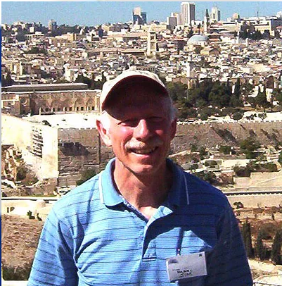
Rabbi Jim Appel, Congregation Shma Yisrael, Rochester, NY
Notes:
https://www.shemayisrael.org/
previously worked for Xerox Corporation in Webster, N.Y., for 24 years as an optical engineer and engineering manager. He holds more than 45 patents

Slide 15
Congregation Shma Yisrael was established by Jonathan Bernis in 1984. 35 years after Congregation founding, most of the people we are trying to reach still don’t even know we exist. We are invisible to them, even though we have put on many outreach events, advertised, have an online presence and use social media.
Notes:
https://www.shemayisrael.org/

Slide 16
The Ruakh Ha Kodesh has has opened a door of opportunity for us to purchase a beautiful facility whose location will make us very visible to the Jewish community of the Greater Rochester area, located very near the Jewish Community Center and on the most frequently used street leading to the JCC.
Notes:
https://www.shemayisrael.org/

Slide 17
A sanctuary that is twice the size of our current one.
A large lobby for before and after-service fellowship.
A 50% larger fellowship hall that seats 100 people with a well equipped, modern kitchen.
Office space sufficient for our expanding needs.
A large parking lot.
Notes:
https://docs.wixstatic.com/ugd/e8b26e_1afd4213b120467080f9e99431c2283c.pdf

Slide 18
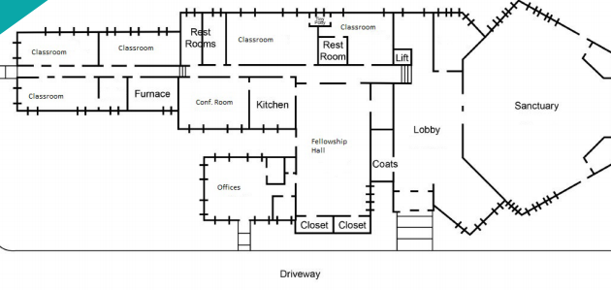
Notes:
https://docs.wixstatic.com/ugd/e8b26e_1afd4213b120467080f9e99431c2283c.pdf

Slide 19
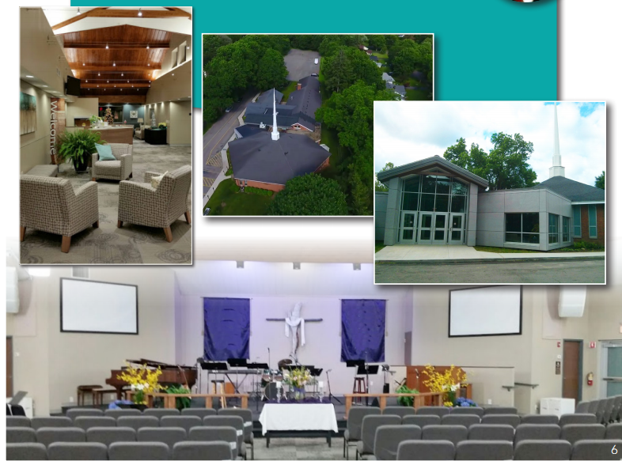
Notes:
They have a paid off current facility.
https://docs.wixstatic.com/ugd/e8b26e_1afd4213b120467080f9e99431c2283c.pdf

Slide 20
Or HaOlam has given $2500 to help Congregation Shma Yisrael Rochester!
Notes:
The Z’m and I decided

Slide 22
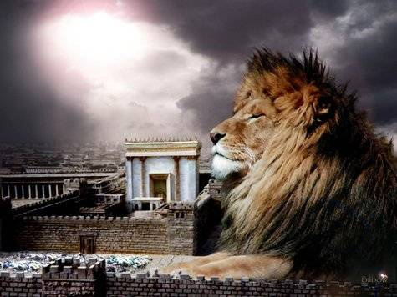
מַתִּתְיָהוּ Mattityahu
(Matthew) 26:36-39
Notes:
Last week, we considered the Talmidim in panic mode. Spoke about distress…

Slide 23
Last Shabbat “Sticky statement”
Don’t stress out over ANYTHING! [rather do] prayer and petition, with thanksgiving.
New normal
Brain training by dwelling on chosen emotion
Do it, teach it to someone, let Rabbi know!

Slide 24
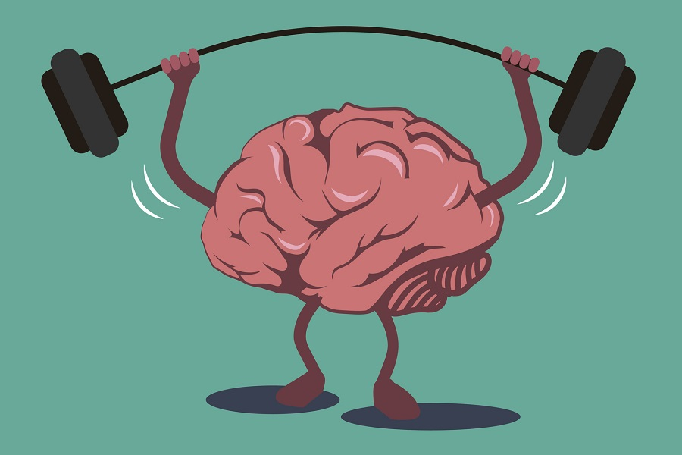
Train your brain T’shuvah תשובה
Notes:
Didn’t get a lot of affirmations of this happening. Actually…none, except one person to whom this was already her life verse.
I feel that I need more application and your impartation to others, than previously knowledge impartation, or even my pastoral ministry to you.
I minister to you, and you pass it on!
Review sticky statement. Don’t stress out over ANYTHING! [rather do] prayer and petition, with thanksgiving.
Did Yeshua follow this?
https://www.google.com/search?q=brain+training&safe=active&source=lnms&tbm=isch&sa=X&ved=0ahUKEwj4xfLr3ajhAhUVHzQIHRyXBHsQ_AUIDygC&biw=1164&bih=865#imgdii=pEDTREwjQWp7TM:&imgrc=D15AUzLqiN_0OM:
https://www.google.com/url?sa=i&source=images&cd=&cad=rja&uact=8&ved=2ahUKEwjXiLmn3qjhAhWxoFsKHS_fAJYQjRx6BAgBEAU&url=https%3A%2F%2Fbrainfitnesssolutions.com%2Fbrain-fitness-guide%2F&psig=AOvVaw2cDd7ARLZGPS_mVKAReDdA&ust=1553996406944215
Psycho-babble?

Slide 25
Mattityahu (Matthew) 26:36
אַחֲרֵי כֵן בָּא אִתָּם יֵשׁוּעַ אֶל מָקוֹם הַנִּקְרָא גַּת שְׁמָנִים וְאָמַר אֶל הַתַּלְמִידִים: ”שְׁבוּ לָכֶם פֹּה עַד שֶׁאֵלֵךְ לְשָׁם וְאֶתְפַּלֵּל.“
Then Yeshua went with his talmidim to a place called Gat-Sh’manim and said to them, “Sit here while I go over there and pray.”

Slide 26
גַּת [wine] press gat
שְׁמָנִים oil sh’manim

Slide 27
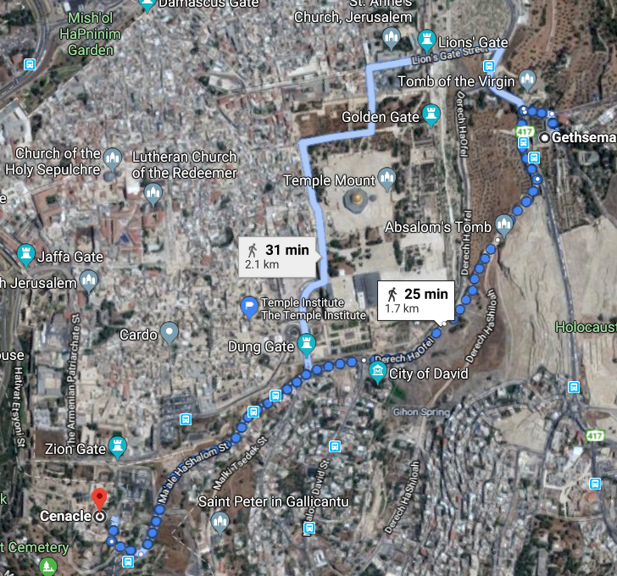
About a half hour walk
Gat Shemini
At base of Mt. Olives
Notes:
At the base of the Mt of Olives, Har Zetim,

Slide 28
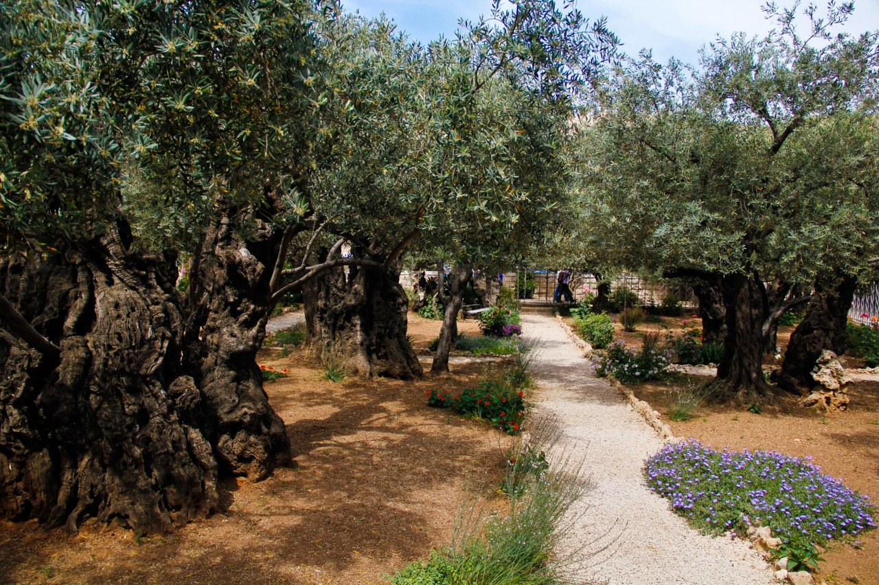
Notes:
Lots Olive trees then and now. Great place to worship. Marissa dancing among those trees.
Parallel reading in Luke’s account…

Slide 29
^{Lk 20.39-44} On leaving, Yeshua went as usual to the Mount of Olives; and the talmidim followed him. When he arrived, he said to them, “Pray that you won’t be put to the test.” He went about a stone’s throw away from them, kneeled down and prayed,

Slide 30
Mattityahu (Matthew) 26:37
הוּא לָקַח אִתּוֹ אֶת כֵּיפָא וְאֶת שְׁנֵי בְּנֵי זַבְדַּי וְהֵחֵל מִתְמַלֵּא עֶצֶב וּמוּעָקָה
He took with him Kefa and Zavdai’s two sons. Grief and anguish came over him,
Notes:
Note expressions of pain.

Slide 31
Mattityahu (Matthew) 26:38
אָמַר לָהֶם: ”נַפְשִׁי מָרָה עָלַי עַד מָוֶת, הִשָּׁאֲרוּ פֹּה וֶהֱיוּ עֵרִים אִתִּי.“ ‏
and he said to them, “My heart is so filled with sadness that I could die! Remain here and stay awake with me.”
Notes:
Was his consistent with new normal? Bigger picture: Psalms…

Slide 32
^{T’hillim/Ps 6.3-6} Be gracious to me, Adoni, because I am withering away; heal me, Adoni, because my bones are shaking; I am completely terrified; and you, Adoni — how long? Come back, Adoni, and rescue me! Save me for the sake of your grace; for in death, no one remembers you; in Sh’ol, who will praise you?

Slide 33
^{T’hillim/Ps 42.6} My soul, why are you so downcast? Why are you groaning inside me?

Slide 34
Mattityahu (Matthew) 26:39
אָז הָלַךְ מְעַט הָלְאָה, נָפַל עַל פָּנָיו וְהִתְפַּלֵּל בְּאָמְרוֹ: ”אָבִי, אִם אֶפְשָׁר הַדָּבָר, ‏
Going on a little farther, he fell on his face, praying, “My Father, if possible,
Notes:
My father a bit of an innovation. Often אבינו Avinu, Our Father in Siddure prayers.
Moshe prayed for G-d to change His plan, more than once.
Was it possible?

Slide 35
Mattityahu (Matthew) 26:39
הַעֲבֵר נָא מִמֶּנִּי אֶת הַכּוֹס הַזֹּאת, אַךְ לֹא כִּרְצוֹנִי אֲנִי כִּי אִם כִּרְצוֹנְךָ אַתָּה.“ ‏
let this cup pass from me! Yet — not what I want, but what you want!”
Notes:
RW Dunn, Bible school in Cincinnati ~1971, Dawn in the class, said could have been praying for anguish to lift, so He could GET to the execution stake for our redemption.

Slide 36
^{Lk 20.39-44} “Father, if you are willing, take this cup away from me; still, let not my will but yours be done.” There appeared to him an angel from heaven giving him strength, and in great anguish he prayed more intensely, so that his sweat became like drops of blood falling to the ground.

Slide 37
Hematidrosis is a rare, but very real, medical condition where one’s sweat will contain blood. The sweat glands are surrounded by tiny blood vessels. These vessels can constrict and then dilate to the point of rupture where the blood will then effuse into the sweat glands. Its cause—extreme anguish.
Notes:
https://www.gotquestions.org/sweat-blood-Jesus.html

Slide 38
He knew in painstaking detail the events that were to follow soon after He was ₁betrayed by one of His very own talmidim, several trials where ₂all of the witnesses against Him would lie. Crowd ₃screaming for His execution. He knew He would be ₃flogged nearly to the point of death before they ₄pounded the metal spikes into His flesh.
Notes:
https://www.gotquestions.org/sweat-blood-Jesus.html

Slide 39
He knew the prophetic words of Isaiah spoken seven centuries earlier that He would be beaten so badly that He would be ₅“disfigured beyond that of any man” and “beyond human likeness” ^{(Is. 52:14)}.
Notes:
https://www.gotquestions.org/sweat-blood-Jesus.html

Slide 40
₆Crucifixion was considered to be the most painful and torturous method of execution ever devised and was used on the most despised and wicked people. In fact, so horrific was the pain that a word was designed to help explain it—excruciating, which literally means “from the cross.”
Notes:
https://www.gotquestions.org/sweat-blood-Jesus.html

Slide 41
₇As our sinless Kapparah/Atoning sacrifice, He bore the weight of the world’s sins on His shoulders, His ₈Father must have looked away, as His “eyes are too pure to look on evil” ^{(Hab 1:13)}, causing the suffering Servant to cry out “Eli, Eli, lama sabakhthani?” —“My God, my God, why have you forsaken me?” ^{(Ps 22:1; Matt 27:46).}
Notes:
https://www.gotquestions.org/sweat-blood-Jesus.html

Slide 42
The spiritual pain of this feeling of ₉abandonment no doubt greatly exceeded the intense physical pain the Master endured on our behalf.
Notes:
Kylstra RTF originators: Abandonment is the underlying of all emotional pain
https://www.gotquestions.org/sweat-blood-Jesus.html

Slide 43
^{Eikhah/Lam 1.12} All you who pass by on the road, just look, and see, is any suffering like my suffering that was brought on me, that Adoni has inflicted in the day of His fierce anger?
Applied to sufferings of Messiah

Slide 44
Are we ever called into deep levels of intercessory prayer?
^{Gal 4.19} My dear children, I am suffering the pains of giving birth to you all over again — and this will go on until the Messiah takes shape in you.

Slide 45
~ ^{Ro.8.26} The Spirit himself pleads on our behalf with groanings too deep for words;
~ ^{1 Tim 2.1} Therefore, first of all I urge that requests, prayers, intercessions, and thanksgiving be made on behalf of all people.
Notes:
Heavy stuff! However…

Slide 46
^{Dan 9.3}וָאֶתְּנָה אֶת-פָּנַי, אֶל-אֲדֹנָי הָאֱלֹהִים, לְבַקֵּשׁ תְּפִלָּה, וְתַחֲנוּנִים--בְּצוֹם, וְשַׂק וָאֵפֶר.
^{Dan 9.3} So I set my face to Adoni Elohim, to seek Him by prayer and supplications, with fasting, sackcloth and ashes.

Slide 47
^{Ro. 9.2-3} My sorrow is great and the anguish in my heart unending. For I would pray that I myself were cursed, banished from Messiah for the sake of my people—my own flesh and blood.
Ravenhill Revival Praying p63-4,62
Notes:
Avner Boskey sings this.

Slide 48
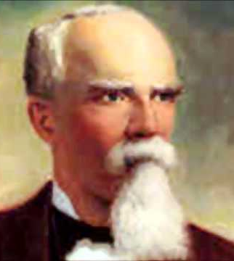
Edward McKendree Bounds prominently known as E.M. Bounds, was an American author, attorney, and member of the Methodist Episcopal Church South clergy. He is known for writing 11 books, nine of which focused on the subject of prayer.
Notes:
August 15, 1835, Shelby County, Missouri, MO
Died: August 24, 1913

Slide 49
Study universal holiness of life. Your whole usefulness depends on this, for your sermons last but an hour or two; your life preaches all the week. If Satan can only make a covetous minister a lover of praise, of pleasure, of good eating, he has ruined your ministry.
Notes:
E.M. Bounds Power through Prayer

Slide 50
Give yourself to prayer, and get your texts, your thoughts, your words from God. Luther spent his best three hours in prayer.--Robert Murray McCheyne
Notes:
E.M. Bounds Power through Prayer

Slide 51
But above all he excelled in prayer. The inwardness and weight of his spirit, the reverence and solemnity of his address and behavior, and the fewness and fullness of his words have often struck even strangers with admiration as they used to reach others with consolation.
Notes:
E.M. Bounds Power through Prayer

Slide 52
The most awful, living, reverend frame I ever felt or beheld, I must say, was his prayer. And truly it was a testimony. He knew and lived nearer to the Lord than other men, for they that know him most will see most reason to approach him with reverence and fear.--William Penn of George Fox
Notes:
E.M. Bounds Power through Prayer

Slide 53
WE are constantly on a stretch, if not on a strain, to devise new methods, new plans, new organizations to advance the congregation and secure enlargement and efficiency for the message of Yeshua.
Notes:
Power Through Prayer: E. M. Bounds 4

Slide 54
This trend of the day has a tendency to lose sight of the man or sink the man in the plan or organization. God's plan is to make much of the man, far more of him than of anything else. Men are God's method. The believers are looking for better methods;
Notes:
Power Through Prayer: E. M. Bounds 4

Slide 55
new plans, new organizations to advance the Kingdom and secure enlargement and efficiency for the gospel. This trend of the day has a tendency to lose sight of the man or sink the man in the plan or organization. God's plan is to make much of the man,
Notes:
Power Through Prayer: E. M. Bounds 4

Slide 56
far more of him than of anything else. Men are God's method. The Congregation is looking for better methods; God is looking for better men. "There was a man sent from God whose name was John. “God is looking for better men.
Notes:
Power Through Prayer: E. M. Bounds 4

Slide 57
What the Congregation needs to-day is not more machinery or better, not new organizations or more and novel methods, but men whom the Ruakh can use--men of prayer, men mighty in prayer.
Notes:
Power Through Prayer: E. M. Bounds 4

Slide 58
The Ruakh HaKodesh does not flow through methods, but through men. He does not come on machinery, but on men. He does not anoint plans, but men--men of prayer.
Notes:
Power Through Prayer: E. M. Bounds 4

Slide 59
^{1 Shmuel 1.7-10} she would cry and not eat…So Hannah got up after they had finished eating and drinking in Shiloh. ‘Eli the cohen was sitting on his seat by the doorpost of the temple of Adoni. In deep depression she prayed to Adonai and cried.

Slide 60
^{1 Shmuel 1.12-13} She prayed for a long time before Adoni; and as she did so, ‘Eli was watching her mouth. Hannah was speaking in her heart — her lips moved, but her voice could not be heard — so ‘Eli thought she was drunk.

Slide 61
^{T’hillim/Ps 30.5-6} Sing praise to Adoni, His faithful ones, and praise His holy name.
For His anger lasts for only a moment, is favor is for a lifetime.
Weeping may stay for the night,
but joy comes with the dawn.
Notes:
Sometimes there are periods of protracted grief, and joy later.

Slide 62
^{Mattityahu 26:40} He returned to the talmidim and found them sleeping. He said to Kefa, “Were you so weak that you couldn’t stay awake with me for even an hour?

Slide 63
~ ^{Ro.8.26} The Spirit himself pleads on our behalf with groanings too deep for words;

Slide 64


Slide 65
Weeping may stay for the night, but joy comes with the dawn.
Sticky statement: We have a culture of prayer. Let’s be moreso.
Private, family, Teerosh, prayer retreats.
Notes:
Ravenhill Revival Praying p 63-64

Slide 66
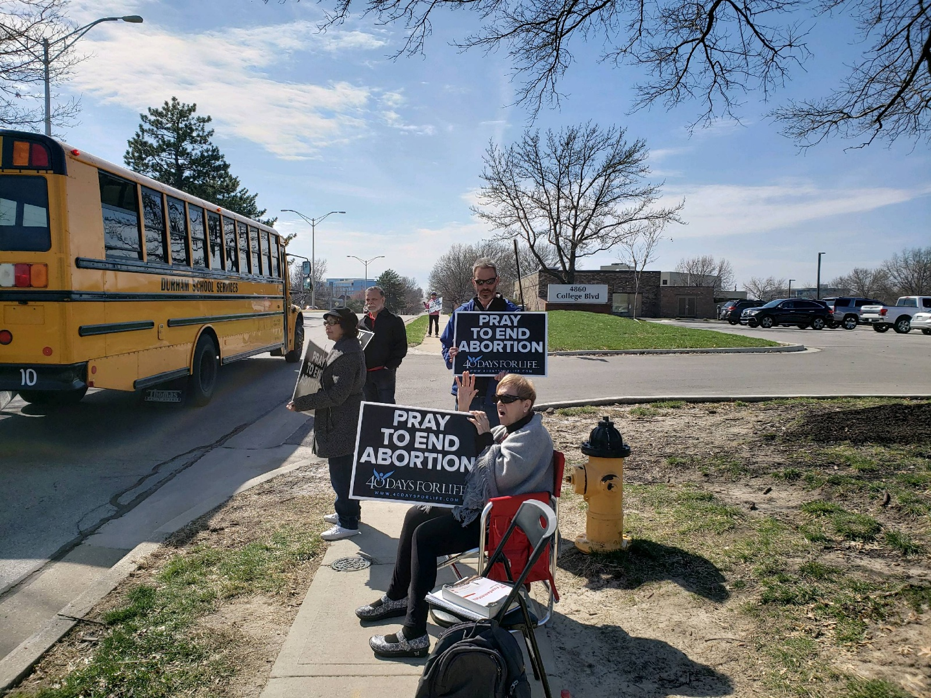

Slide 67
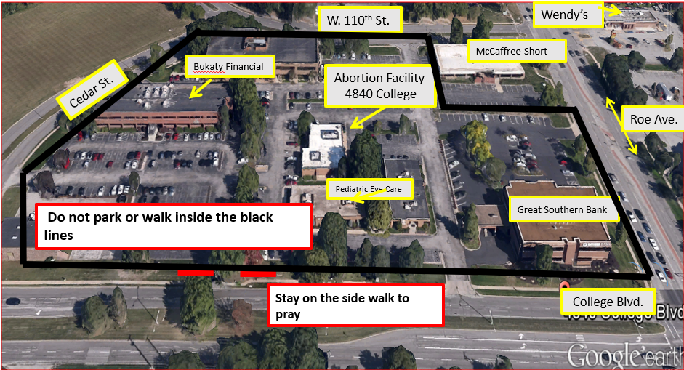
Notes:
Something sort of hilarious…

Slide 68
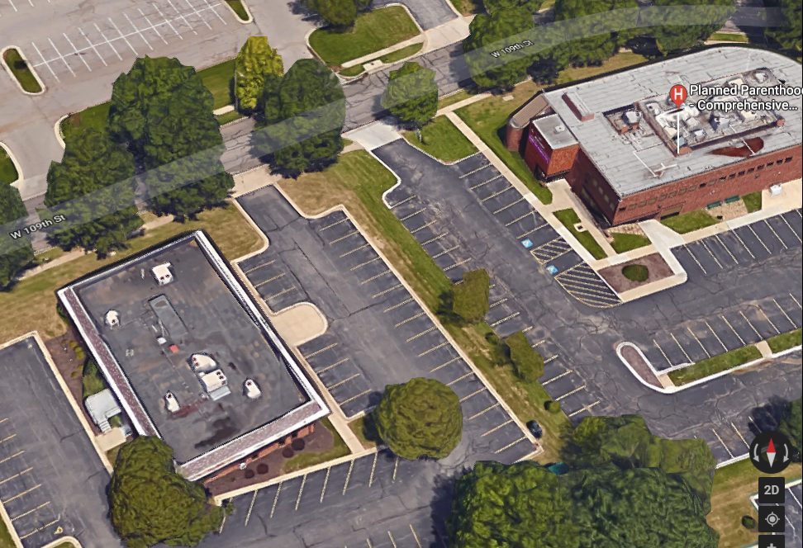
Advice and Aid
Pregnancy Information

Slide 69
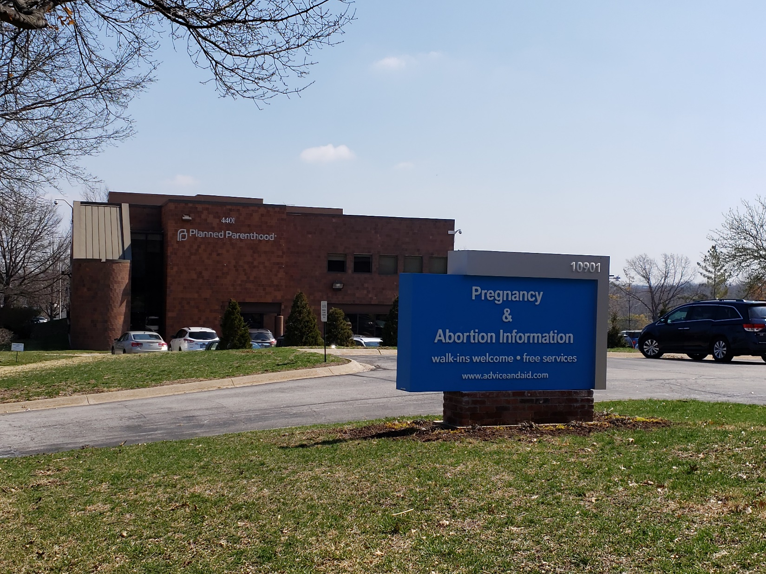

Slide 70
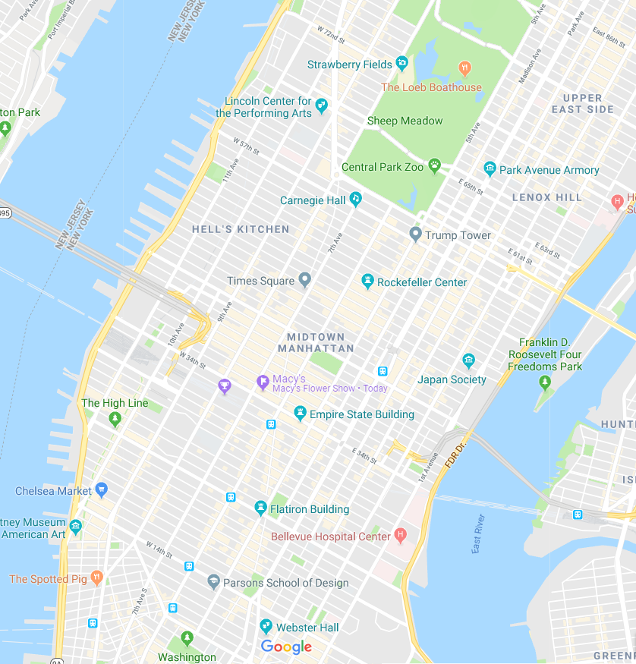

Slide 71
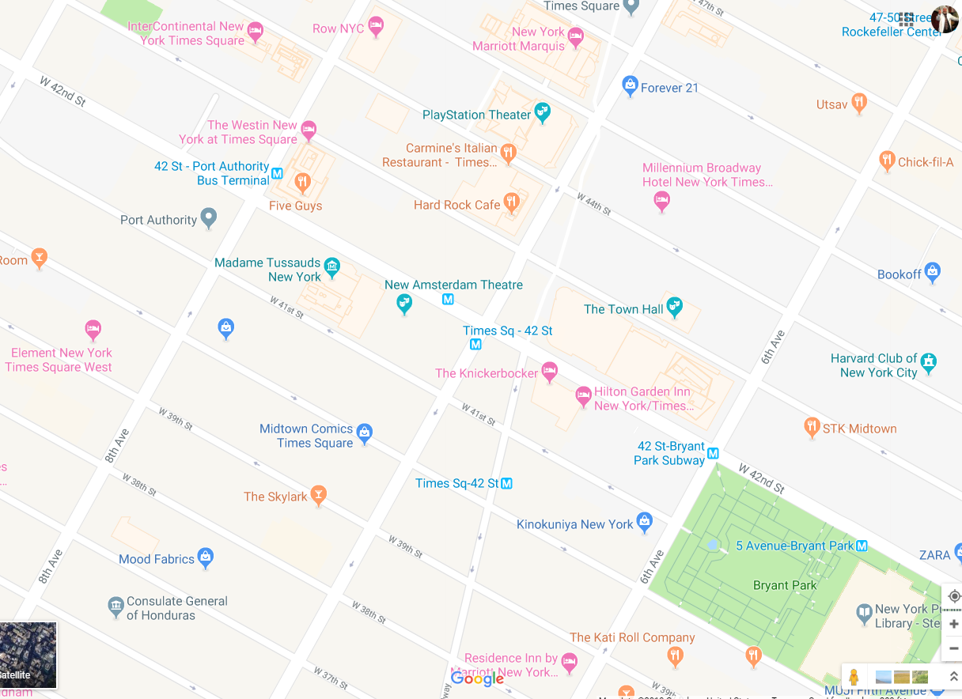

Slide 72
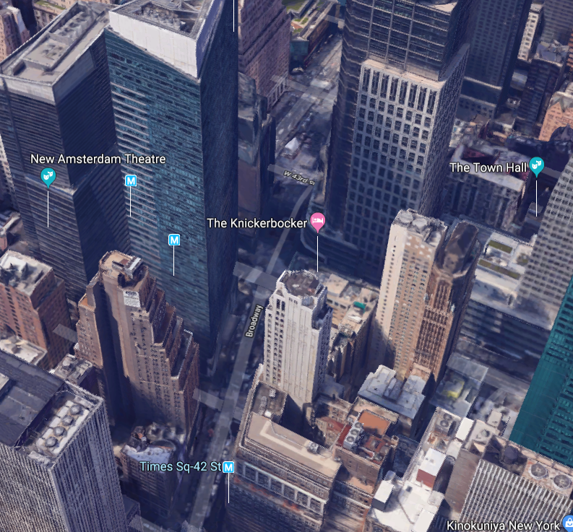

Slide 73

2:30 pm - 4:30 pm EDT

Slide 74
“Alive from New York” is a Focus on the Family event designed to celebrate the sanctity of human life; marvel at the wonder of human development in the womb; and encourage advocacy for women facing unplanned pregnancies and the preborn. The event will feature live music and inspirational speeches from special guests, as well as abortion survivors.

Slide 75
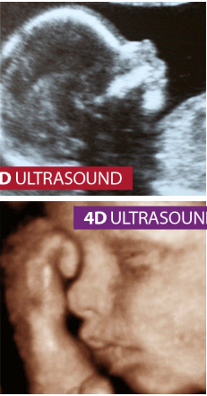
The culminating event will feature LIVE 4D ultrasounds displayed on the massive digital screens in Times Square, powerfully showing the world that a baby inside the womb is fully human and deserving of life.
Notes:
https://store.focusonthefamily.com/singleitem/checkout/donation/item/don-declaration-of-life#refcd=730404?utm_source=focusonthefamily.com/pro-life&utm_medium=referral&utm_campaign=SeeLifeClearly2019&utm_content=

Slide 76
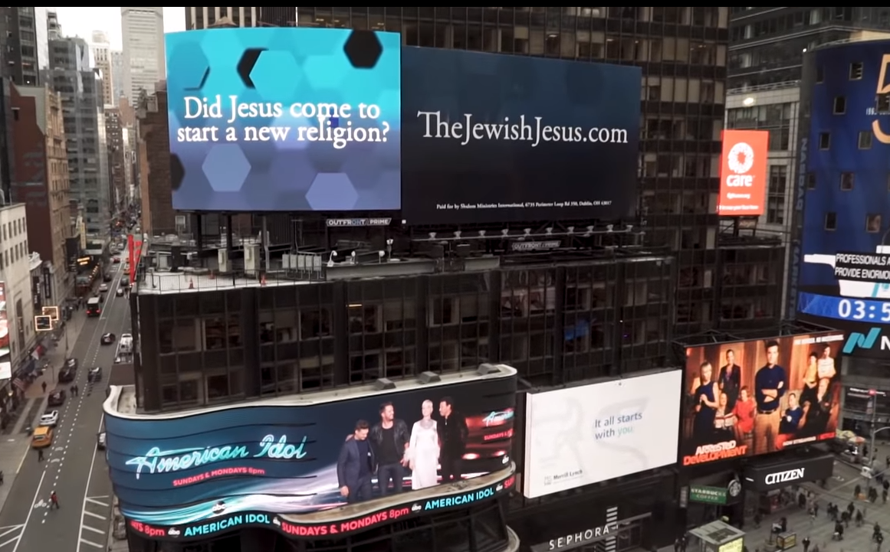
Notes:
https://www.youtube.com/watch?v=HjjxFDmtxSc&feature=youtu.be

Slide 77


