Slide 1
e-handout
To have these notes
without taking notes
Go to OrHaOlam.com
Click on downloads,
messages, 2019
Notes:
.

Slide 2
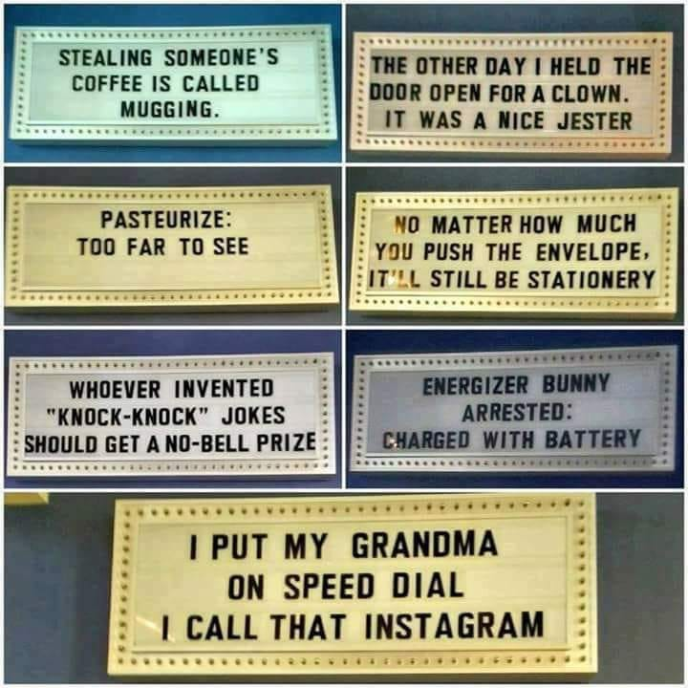
From Mordekhi Hiatt’s Facebook
Notes:
Hiatt’s Facebook

Slide 3
From Mordekhi Hiatt’s Facebook
Notes:
Hiatt’s Facebook

Slide 4
From Mordekhi Hiatt’s Facebook
Notes:
Hiatt’s Facebook

Slide 5
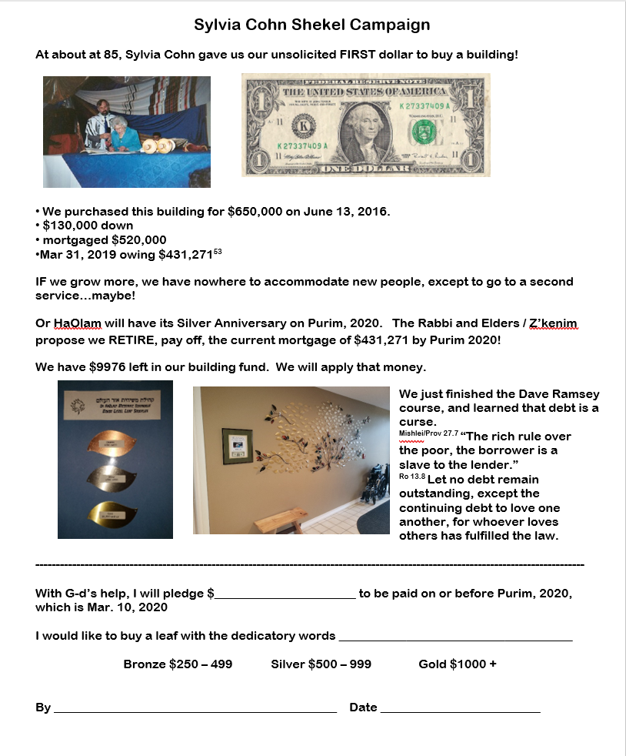
Pray about making a mortgage retirement pledge commitment by Shavuot, June 8.

Slide 6
Mother’s Day 5779 2019
Notes:
Honoring Sylvia, in a sense.

Slide 7
The beginning of Motherhood

Slide 8
^{Beresheet/Gen 3.20} The man called his wife Havah [Eve] [life], because she was the mother of all living.
וַיִּקְרָא הָאָדָם שֵׁם אִשְׁתּוֹ חַוָּה: כִּי הִוא הָיְתָה, אֵם כָּל-חָי.
Motherhood = source of life.
Notes:
Not at all obvious in the English Eve.
Phonetically spell Havah or Khavah.
Theme of message, think about Khavah = Motherhood = Source of Life

Slide 9
Two possible roots to Khava: Khayah חיה and Khavah חווה.
Words structurally related to Khavah:
Notes:
Could be both, or ambivalent, so use both. Certain things in scripture not clear, so use both meanings.

Slide 10
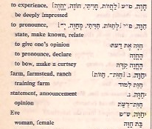
Complete
Hebrew
Dictionary
Reuben
Alcalay
1974
Notes:
[Two possible roots to her name. Khayah חיה and חווה. Some say related, such as the Baal Turim, Jacob ben Asher, also known as Ba'al ha-Turim as well as Rabbi Yaakov ben Raash, was probably born in the Holy Roman Empire at Cologne about 1269 and probably died at Toledo, then in the Kingdom of Castile, about 1343. https://en.wikipedia.org/wiki/Jacob_ben_Asher
To experience, to pronounce, to farm
Apud Fagium in loc. vid. Baal Hatturim in loc.]

Slide 11
Modern Hebrew words structurally related to Khavah summary:
To give life
To experience,
To pronounce, express opinion,
To farm
Notes:
Physical motherhood
Women experience things often more intensely, right brain perception, spatial perception
Women have an opinion

Slide 12
from “Khayah, to live”
Adam’s prophetic word of what she would be; that he and his wife should not die immediately for the offence they had committed, but should live and propagate their species, as well as be partakers of spiritual and eternal life, from her.
Notes:
https://www.biblestudytools.com/commentaries/gills-exposition-of-the-bible/genesis-3-20.html

Slide 13
She would also be the mother of Him that should bring life and immortality to light. Previous verse:
^{Beresheet/Gen 3.14-15} Adoni Elohim said to the serpent…“Because you did this,
I will put animosity between you and the woman—between your seed and her seed. He will crush your head, and you will crush his heel.
Notes:
https://www.biblestudytools.com/commentaries/gills-exposition-of-the-bible/genesis-3-20.html

Slide 14
^{Ro. 16.20} Now the God of shalom will soon crush satan under your feet. May the grace of our Lord Yeshua be with you.
This message practical/ relational, but theological/ spiritual underpinnings is Atonement of Messiah.
Notes:
All about Messiah Yeshua, ultimately!
When we worship dance, arguable that we invoke this crushing of satan.
https://www.biblestudytools.com/commentaries/gills-exposition-of-the-bible/genesis-3-20.html

Slide 15
It appears that her being seduced by the serpent, and of drawing him into the transgression, did not alienate his affection from her; since her seed was to break the serpent's head, and procure life and salvation for them.
Notes:
https://www.biblestudytools.com/commentaries/gills-exposition-of-the-bible/genesis-3-20.html

Slide 16
Khavah, motherhood = the honorable SOURCE of physical life, experiencing life, proclaiming life:
Honor body in courtesy, contact.
Honor in heeding her words.
Honor for experiential creativity.
Honor for protecting life: combat.
Notes:
1. I want to address a miscommunication. Two weeks ago I named Joe Biden as the doer of some disrespectful touching of women. I did NOT mean to indicate that only he, or only Democrats were guilty of indiscretions. There have been plenty of others, from BOTH parties, starting apparently with Thomas Jefferson, 15 past presidents, Warren Harding, Eisenhower, Kennedy, according to https://www.businessinsider.com/president-sex-scandal-history-2018-3
Sin is unique to no group.
4. Focus on this protective aspect of motherhood.

Slide 17
Warrior Princesses

Slide 18
^{Shoftim /Ju 4.1-8} But after Ehud had died, the people of Isra’el again did what was evil from Adonai’s perspective. So Adonai handed them over to Yavin king of Kena‘an. He ruled from Hatzor.

Slide 19
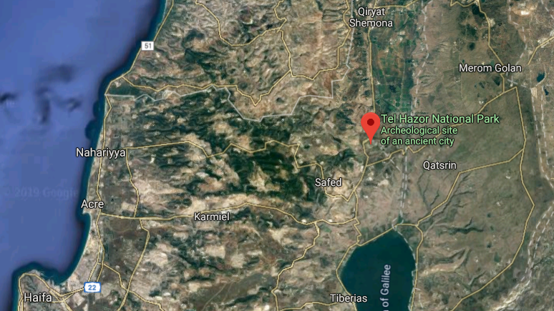
Tel Hatzor
Notes:
The Hazor expedition headed by Yigal Yadin in the mid-1950s was the most important dig undertaken by Israel in its early years of statehood. Tel Hazor is the largest archaeological site in northern Israel, featuring an upper tell of 30 acres and a lower city of more than 175 acres.
In 2005, the remains of Hazor were designated a World Heritage Site by UNESCO as part of the Biblical Tels - Megiddo, Hazor, Beer Sheba.
https://en.wikipedia.org/wiki/Tel_Hazor

Slide 20
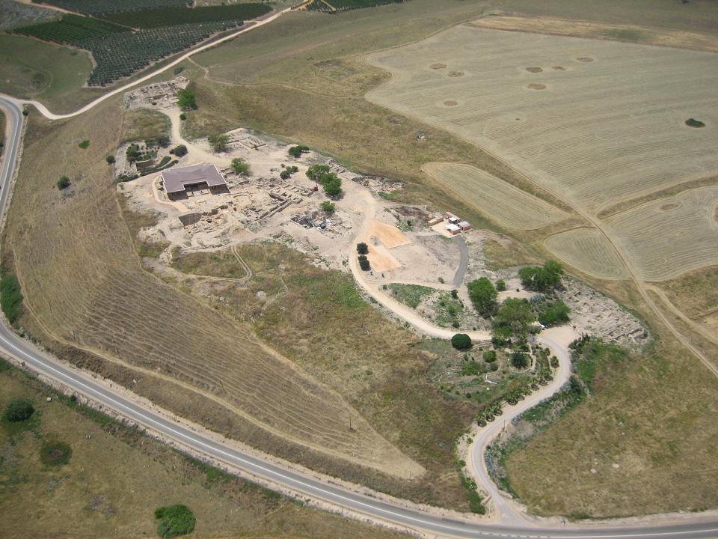
Tel Hatzor

Slide 21
^{Shoftim /Ju 4.1-8} The people of Isra’el cried out to Adonai, because he had 900 iron chariots, and for twenty years he cruelly oppressed the people of Isra’el. Now D’vorah, a woman and a prophet, the wife of Lapidot, was judging Isra’el at that time…and the people of Isra’el would come to her for judgment.

Slide 22
^{Shoftim /Ju 4.1-8} She sent for Barak the son of Avino‘am, from Kedesh in Naftali, and said to him: “Adonai has given you this order: ‘Go, march to Mount Tavor, and take with you 10,000 men from the people of Naftali and Z’vulun… Barak answered her: “If you go with me, I’ll go; but if you won’t go with me, I won’t go.”
Notes:
Barak needed the help and encouragement and company of Dvorah
After battle and victory, praise song to Adoni:

Slide 23
אֲזַמֵּר,לַייָ אֱלֹהֵי יִשְׂרָאֵל...חָדְלוּ פְרָזוֹן בְּיִשְׂרָאֵל, חָדֵלּוּ-- עַד שַׁקַּמְתִּי דְּבוֹרָה, שַׁקַּמְתִּי אֵם בְּיִשְׂרָאֵל.
^{Ju 5.3,7} I will sing praise to Adoni, the God of Israel…Villages were deserted in Israel, deserted, until I, Deborah, arose, a mother in Israel arose.
Notes:
Warrior princess.
Women can be warriors for righteousness. Heed them, honor them, love them, respect them

Slide 24
Motherhood in the animal world:
^{Mishlei/Prov 17.12} Better to meet a bear robbed of her cubs than to deal with a fool in his folly.

Slide 25
Another warrior princess

Slide 26

Notes:
When we do Sozos, Jude is the really insightful leader. But one time, we were working with a wounded young woman, and the Ruakh gave me this picture, that really helped her, the young woman receiving over deep wounds, sozo-ee, as a warrior princess.
https://www.youtube.com/watch?v=sHsA_lVrrDc&feature=youtu.be

Slide 27
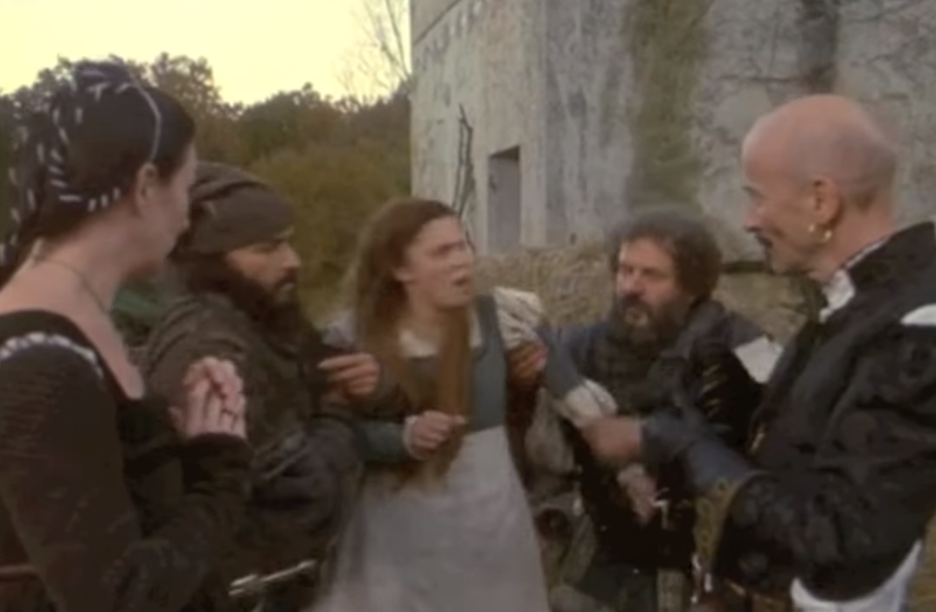
Notes:
The Cinderella of this movie, Danielle, [Drew Barrymore] is abducted from her ancestral home in a sale by her wicked stepmother
https://www.youtube.com/watch?v=xfDHqE1okVk

Slide 28
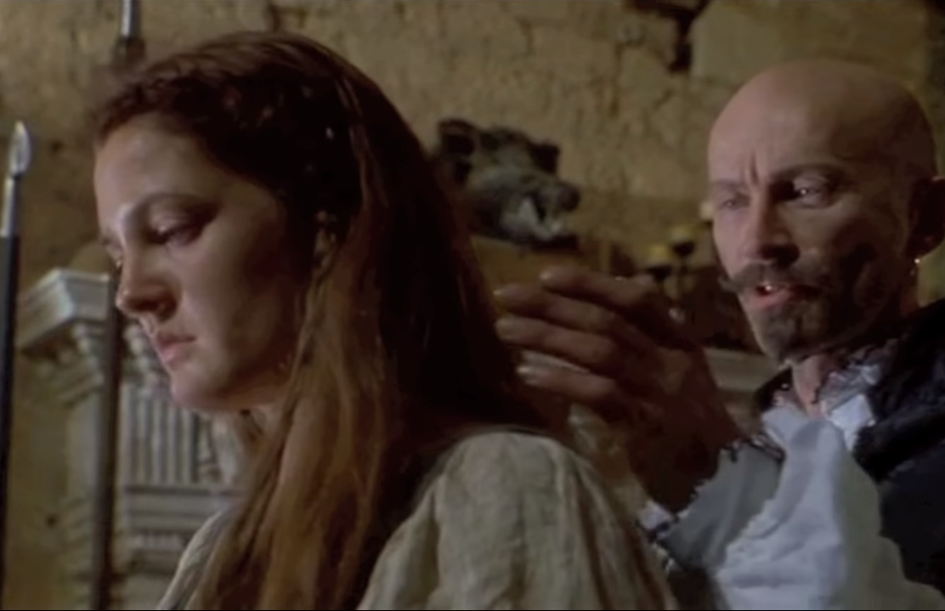
Notes:
The new slave owner thinks he can abuse, control her.
https://www.youtube.com/watch?v=xfDHqE1okVk

Slide 29
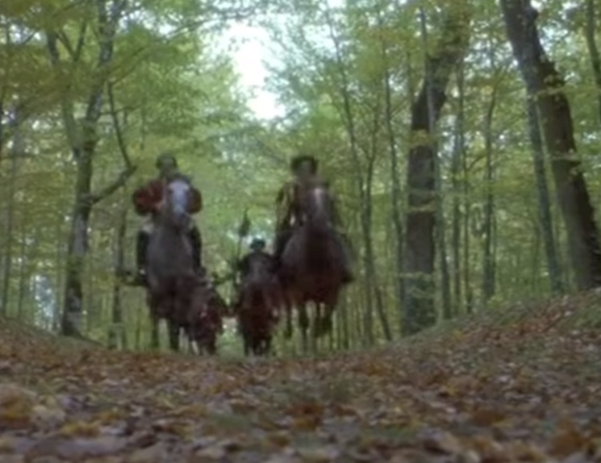
Notes:
The prince, Henry, sets out to rescue Danielle
https://www.youtube.com/watch?v=xfDHqE1okVk

Slide 30
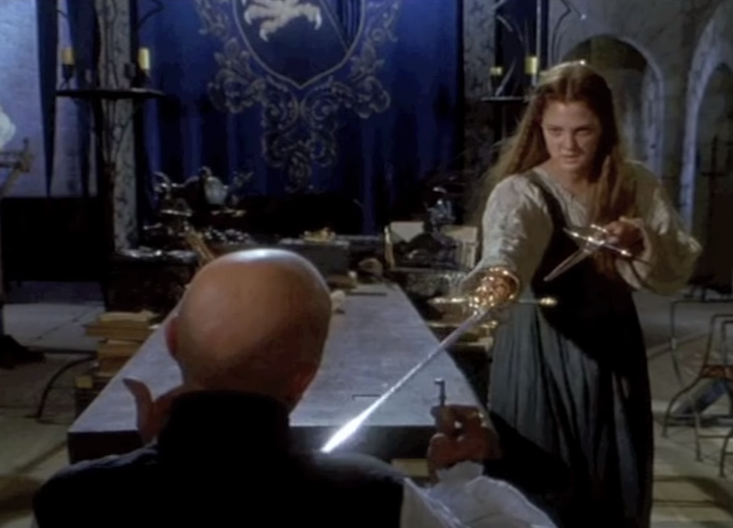
Notes:
Danielle was trained in swordsmanship by her birth father, and remembers her skills, grabs his swords, overpowers the slaver.
https://www.youtube.com/watch?v=xfDHqE1okVk

Slide 31
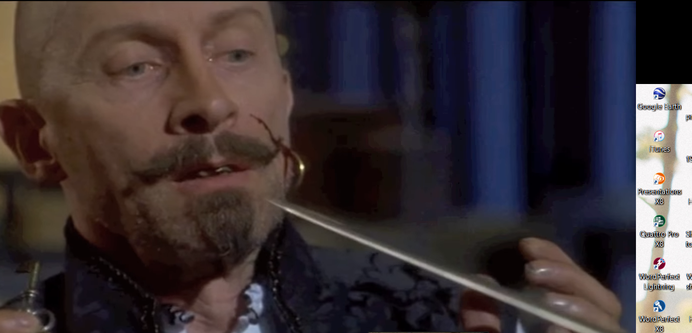
Notes:
https://www.youtube.com/watch?v=xfDHqE1okVk

Slide 32
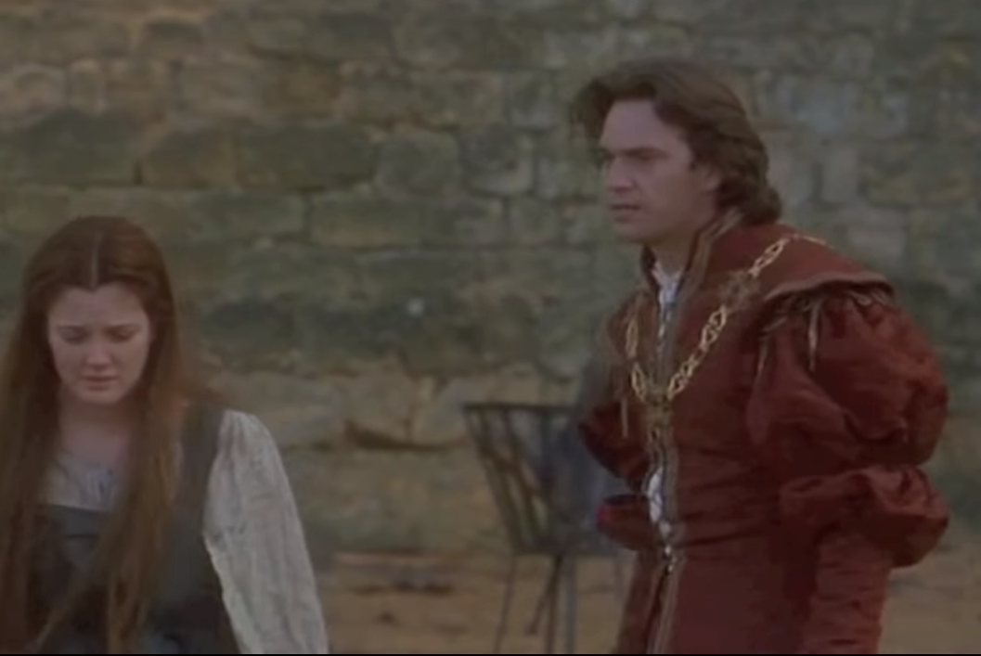
Notes:
Henry arrives to rescue her, but she already rescued herself. He apologizes, confesses his betrayal of her, and his love for her.
https://www.youtube.com/watch?v=xfDHqE1okVk

Slide 33
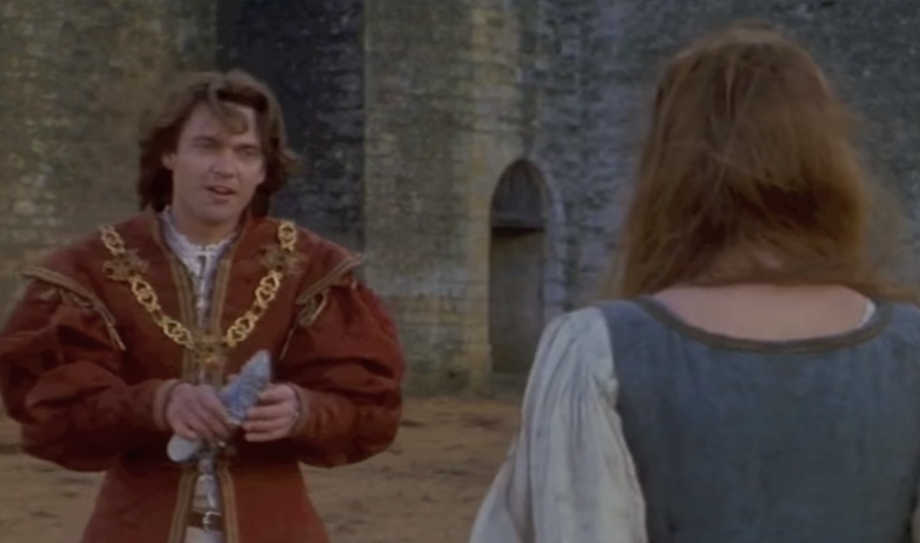
https://youtu.be/sHsA_lVrrDc
Notes:
https://www.youtube.com/watch?v=xfDHqE1okVk
The greatest [righteous] love scene ever, from Ever After with Drew Barrymore
Not time to play the clip, and really not relevant to the message, but it’s really sweet. Brings tears to my eyes. When you get the notes, enjoy!

Slide 34
From comments:
Yay! She rescues herself! I loved the rest of the movie but this is what made it top of the list of romantic movies for me. Hollywood, give us more damsels in distress saving themselves, please.
Notes:
https://www.youtube.com/watch?v=sHsA_lVrrDc

Slide 35
I love that Danielle is brave and resourceful while still being allowed to be kind, gentle and at times vulnerable. I feel like most directors think 'strong' women have to be hard and tough-talking at all times, which is so far removed from reality that it makes me cringe when I see it. ﻿
Notes:
https://www.youtube.com/watch?v=sHsA_lVrrDc

Slide 36
Another warrior mother.

Slide 37
^{1 Shmuel 1.11-12} Then she took a vow; she said, “Adoni-Tzva’ot, if you will notice how humiliated your servant is, if you will remember me and not forget your servant but will give your servant a male child, then I will give him to Adoni for as long as he lives; and no razor will ever come on his head.” She prayed for a long time before Adoni.

Slide 38
Roots to Khavah/Eve. Khayah חיה and Khavah חווה.
To give life
To experience,
To pronounce,
To farm

Slide 39
Khavah, motherhood is the honorable SOURCE of physical life, experiencing life, proclaiming life:
Honor body in courtesy, contact.
Honor in heeding her words
Honor for experiential creativity.
Honor for protecting life: combat.

Slide 40
In a recent poll by ChristianMingle.com, single believers between the ages of 18 and 59 were asked, if, given the opportunity, would they have sex before marriage. A whopping 63% stated that they would. How can that be? Is this protecting/ honoring women, future mothers?
Notes:
https://www.charismanews.com/opinion/the-flaming-herald/76301-are-you-serving-american-jesus?utm_source=In%20the%20Line%20of%20Fire&utm_medium=email&utm_content=subscriber_id:5194514&utm_campaign=Blogger%20-%20Michael%20Brown%20-%202019-05-10

Slide 41
Warrior Protective Parents called Liberty Counsel recently with an urgent plea for help. They had just found out that the public school where their daughter attended hid from them the fact that the school referred their daughter for "gender-transition“ hormone blocking pills.
Notes:
©1995-present, Liberty Counsel, with offices in Florida, Virginia and Washington, D.C., is a nonprofit litigation, education, and policy organization dedicated to advancing religious freedom, the sanctity of human life, and the family.

Slide 42
Not only was there no parental
consent -- the parents were not even
informed!
But it gets worse...
When the parents discovered
what was going on behind their
backs,
Notes:
©1995-present, Liberty Counsel, with offices in Florida, Virginia and Washington, D.C., is a nonprofit litigation, education, and policy organization dedicated to advancing religious freedom, the sanctity of human life, and the family.

Slide 43
they stepped in to protect
their daughter. They stopped the
hormone "therapy" and other
"gender altering" measures
(hormone and surgery) that were
being considered. Now, the local
officials are raising a claim of
child abuse against the parents!
Notes:
Mothers and Fathers, we ARE at war with a deteriorating, attacking culture.
©1995-present, Liberty Counsel, with offices in Florida, Virginia and Washington, D.C., is a nonprofit litigation, education, and policy organization dedicated to advancing religious freedom, the sanctity of human life, and the family.

Slide 44
We are called to honor mothers.
Honor body in courtesy, contact.
Honor in heeding her words
Honor for experiential creativity.
Honor for protecting life: combat.

Slide 45
We are called to honor mothers.
Another application: we are called to BE spiritual mothers, as the Bride of Messiah.
Give life to the Jewish community around us.
Birth involves pain and work!
Notes:
Our four kids were wonderfully nursed by my wife, but I would get up in the night when they cried, and change diapers and bring them to her.
Outreach in July with JB, to give life

Slide 46
Housing for JB for a month, with kitchen privileges or a kitchenette.
Volunteers to go out with JB.
Volunteers to make follow up phone calls.
Scripts for phone calls.

Slide 47
Volunteers to do follow up home visits.
Prayer point person.
Small group discipleship point person: guidelines as to reporting, leadership. 13 weeks, then transition into regular small groups.

Slide 48
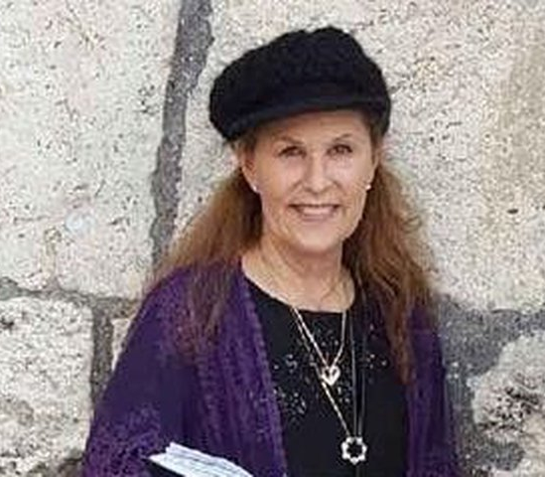
Lori Gilbert Kay was a warrior mother at the Poway Chabad.

Slide 49
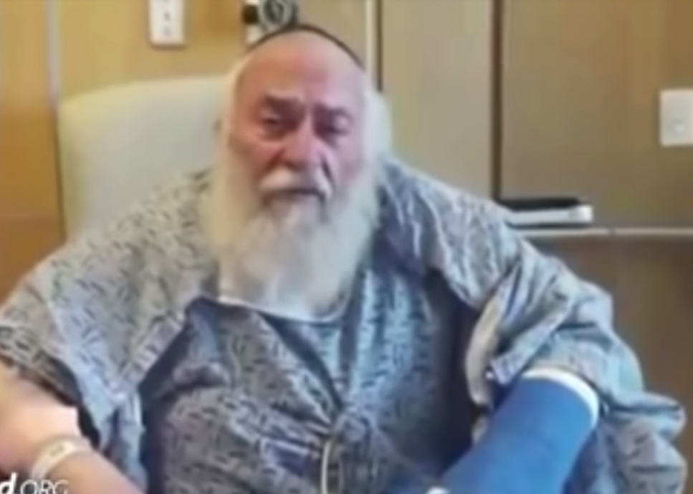
Rabbi Yisroel Goldstein
Notes:
Rabbi Goldstein was finishing his Shabbat message, and heard a bang. Lori had moved to shield some children, and was shot. She was lying on the ground, unconscious. Beside her was her husband, a physician who had tried to save her but fainted. The couple’s daughter emerged, screaming.
https://worldisraelnews.com/watch-daily-israel-news-recap-april-30-2019/?utm_source=MadMimi&utm_medium=email&utm_content=Israel+Blasts+French+Official+Over+%E2%80%98Apartheid%E2%80%99+Accusation%3B+After+Apology%2C+NY+Times+Publishes+Next+Anti-Semitic+Cartoon%3B+Large+Protest+Over+Anti-Semitism&utm_campaign=20190430_m151269553_Israel+Blasts+French+Official+Over+%E2%80%98Apartheid%E2%80%99+Accusation%3B+After+Apology%2C+NY+Publishes+Next+Anti-Semitic+Cartoon%3B+Large+Protest+Over+Anti-Semitism&utm_term=ij-600x315_jpg

Slide 50
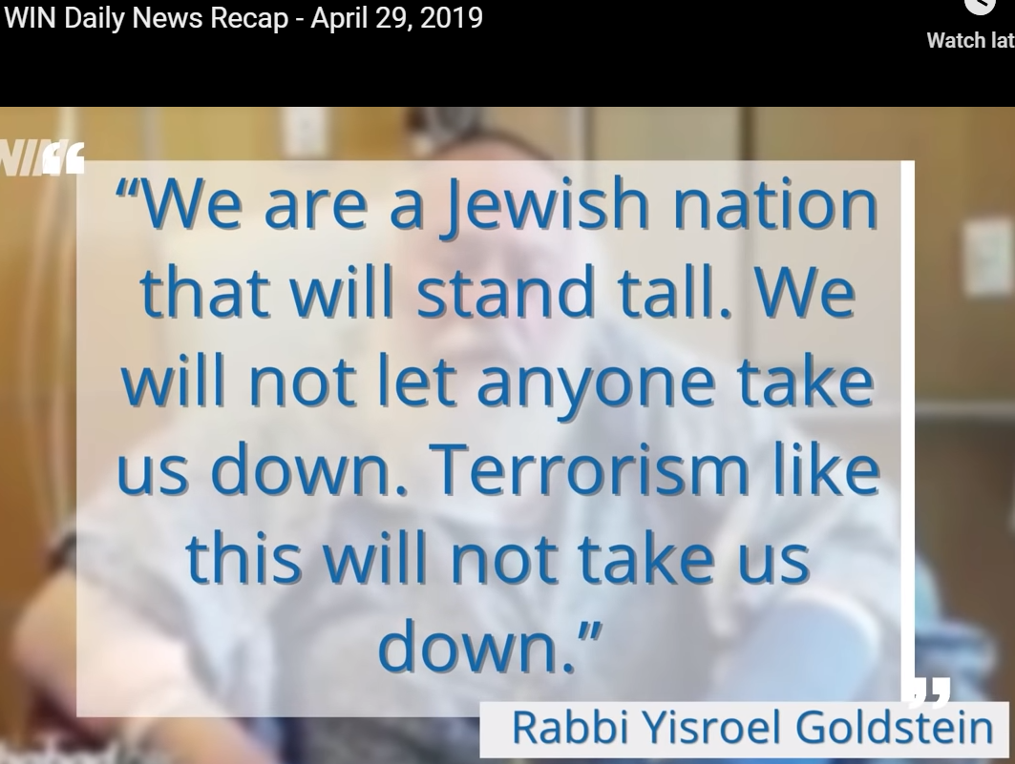
Notes:
https://worldisraelnews.com/watch-daily-israel-news-recap-april-30-2019/?utm_source=MadMimi&utm_medium=email&utm_content=Israel+Blasts+French+Official+Over+%E2%80%98Apartheid%E2%80%99+Accusation%3B+After+Apology%2C+NY+Times+Publishes+Next+Anti-Semitic+Cartoon%3B+Large+Protest+Over+Anti-Semitism&utm_campaign=20190430_m151269553_Israel+Blasts+French+Official+Over+%E2%80%98Apartheid%E2%80%99+Accusation%3B+After+Apology%2C+NY+Publishes+Next+Anti-Semitic+Cartoon%3B+Large+Protest+Over+Anti-Semitism&utm_term=ij-600x315_jpg

Slide 51
Not a mother, but another great protector this week:

Slide 52
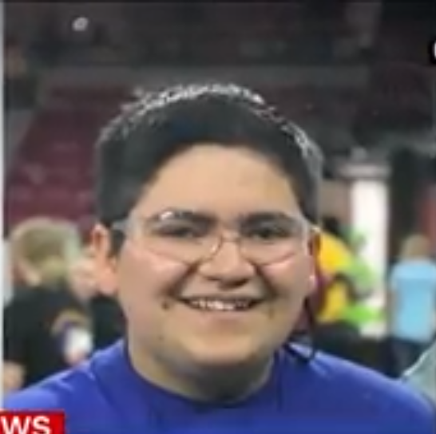
Kendrick Castillo,
Highlands Ranch, Colorado
Notes:
Kendrick was about a foot away from the shooter at his high school and he immediately sprang into action, said Brendan Bialy, one of other students who jumped the gunman. As soon as the shooter said, “Don’t move,” Kendrick lunged at him. After Bialy was able to move the gun away from the shooter, he checked on Kendrick and tried to get him to talk, but he wasn't moving. He recalls helping a teacher who came into the room and tried to render medical aid.

Slide 53
We are called to honor mothers.
Honor body in courtesy, contact.
Honor in heeding her words
Honor for experiential creativity.
Honor for protecting life: combat.

Slide 54
We are called to honor mothers.
Another application: we are called to BE spiritual mothers.
Give life to the Jewish community around us. Birth involves pain and work: pray, go out, track, follow up.
Notes:
If you are single, or childless, we understand your pain. Please try to focus on blessing moms.

Slide 55
Rebbitzin Dawn will honor Moms
Notes:
If you are single, or childless, we understand your pain. Please try to focus on blessing moms.

