Slide 1
e-handout
To have these notes
without taking notes
Go to OrHaOlam.com
Click on downloads,
messages, 2019
Notes:
.

Slide 2
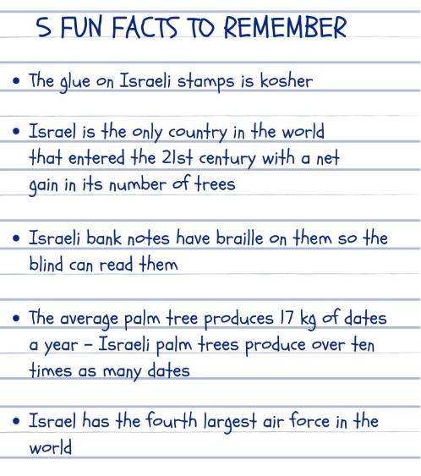

Slide 3
How do they get deer to cross the road only at those yellow road signs?
One nice thing about egotists: they don't talk about other people.
How is it possible to have a civil war?
Notes:
From Alongis

Slide 4
If one synchronized swimmer drowns, do the rest drown too?
Why is it called tourist season if we can't shoot at them?
Notes:
From Alongis

Slide 5
3 scriptures/week
Summer launch, not summer campaign

Slide 6
About a month ago
Mother’s Day Message:
Warrior Princesses

Slide 7
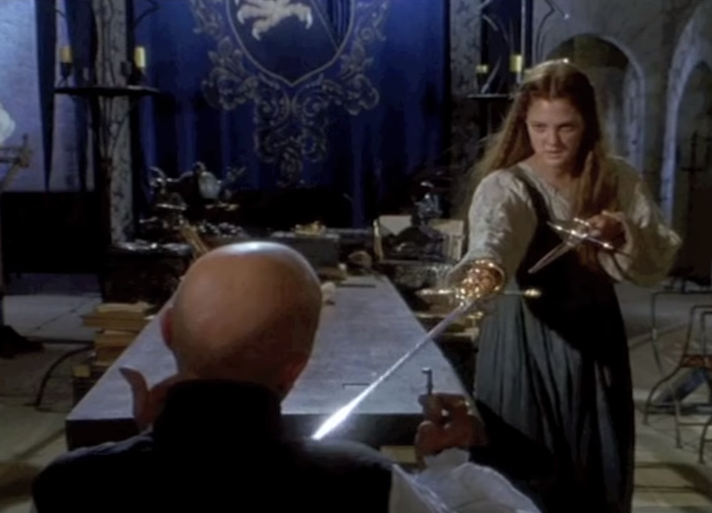
Notes:
Danielle [played by Drew Barrymore in Ever After] was trained in swordsmanship by her birth father, and remembered her skills, grabs her captor’s swords, overpowers the slaver.
https://www.youtube.com/watch?v=xfDHqE1okVk

Slide 8
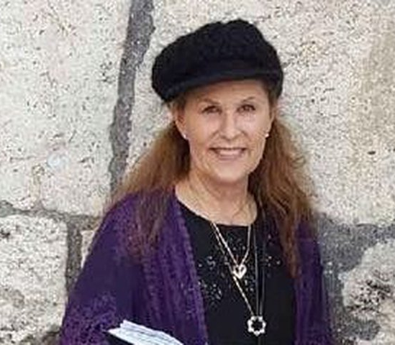
Lori Gilbert Kay was a real life sacrificial warrior mother at the Poway Chabad.

Slide 9
Today, the complement:
Father’s Day Message:
Warrior / Protector

Slide 10
Five point outline of a
Men’s Manual
used in the 1980’s

Slide 11
^{1 Cor. 16.13-14} Stay alert, stand firm in the faith, behave like a mentsh, grow strong. Let everything you do be done in love.
Notes:
https://biblehub.com/greek/1127.htm

Slide 12
Stay alert,
Stand firm in the faith,
Behave like a mentsh,
Grow strong.
Let everything you do be done in love.
Notes:
https://biblehub.com/greek/1127.htm
I’d like to start with some great words from John Eldredge

Slide 13

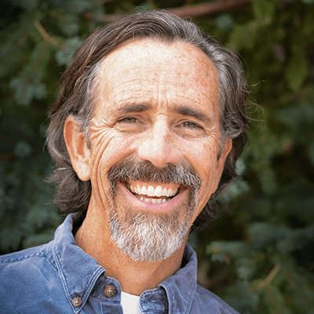
John Eldredge
Notes:
https://www.google.com/search?q=john+Eldredge&safe=active&tbm=isch&source=iu&ictx=1&fir=ktVM4SFeg3x9FM%253A%252CDUUy0ke_jAL1KM%252C%252Fm%252F05d2hl&vet=1&usg=AI4_-kRhvhpc147Dc06FGodgbRXgfp0YCg&sa=X&ved=2ahUKEwiJ0NHqxeriAhVIY6wKHWtIBTQQ_B0wCnoECAoQAw#imgrc=ktVM4SFeg3x9FM:

Slide 14
John Eldredge: “Sleeping Beauty, Cinderella, Helen of Troy, Romeo and Juliet, Antony and Cleopatra, Arthur and Guinevere, Tristan and Isolde…the theme of a strong man coming to rescue a beautiful woman is universal to human nature.”
Notes:
Wild at Heart p 181 A A story of their meeting and falling in love, and out.
After years he realized… [He’s a bit descriptive.]

Slide 15
“The deep cry of a little girl’s heart is “Am I lovely?” Every woman needs to know that she is exquisite and exotic and chosen. This is core to her identity, the way she bears the image of G-d.
“Will you pursue me? Do you delight in me? Will you fight for me?”
Notes:
His wife Stasi was ignored as a child, teen. Older siblings in trouble. Too much trouble . So, she became a hidden child. Out of the way. Then p184 B Eldredge weakness, deficiency.

Slide 16
“I wasn't mean; I wasn't evil. I was nice. And let me tell you, a hesitant man is the last thing in the world a woman needs. She needs a lover and a warrior, not a Really Nice Guy.”
John Eldredge, Wild at Heart: Discovering the Secret of a Man's Soul
Notes:
Then 184 C
https://www.goodreads.com/author/quotes/1236.John_Eldredge

Slide 17
The number one problem between men and their women is that we men, when asked to truly fight for her…hesitate. We are still seeking to save ourselves, we have forgotten the deep pleasure of spilling our life for another.
Notes:
Eldredge Wild p 184
This is what a man is. Gives his life for others.
Shalom Arush teaching exactly.
Messiah’s teaching exactly, and exemplified by Yeshua for his bride

Slide 18
^{Eph 5.25-27} Husbands, love your wives just as Messiah also loved His community and gave Himself up for her to make her holy, having cleansed her by immersion in the word. Messiah did this so that He might present to Himself His glorious community

Slide 19
^{Eph 5.25-27} not having stain or wrinkle or any such thing, but in order that she might be holy and blameless.
Back to our text, first phrase…

Slide 20
^{1 Cor. 16.13-14} Stay alert, stand firm in the faith, behave like a mentsh, grow strong. Let everything you do be done in love.
Stay alert: grégoreó: to be awake, to watch "stay awake"; be vigilant (responsible, watchful).
Notes:
https://biblehub.com/greek/1127.htm

Slide 21
House fly eyes are compound organs that are comprised of thousands of individual lenses. House fly eyes can recognize even the slightest movements in a wide field. This allows the fly to see a far wider range,
Notes:
https://www.orkin.com/flies/house-fly/house-fly-eyes

Slide 22
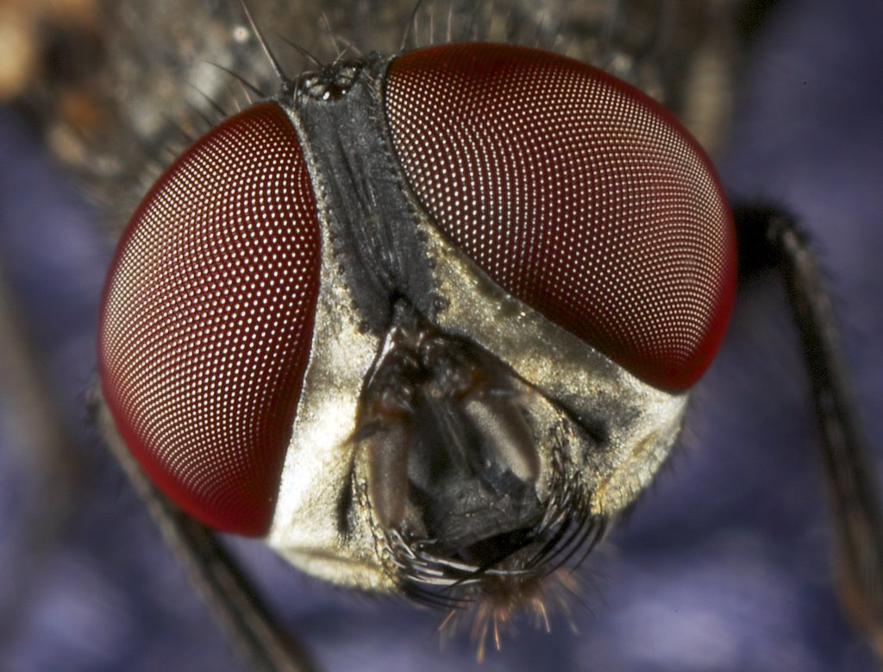
Housefly thousands lenses

Slide 23
as well as detect and react to movement at a quicker pace than species with simple eyes. This is the reason that it is extremely difficult to swat a house fly.
But a praying mantis gets the fly if it moves slowly enough!
Notes:
G-d is always watching, alert. “I’m too depressed, discouraged to watch now.” G-d is depressed?
https://www.orkin.com/flies/house-fly/house-fly-eyes

Slide 24
Watch
For closed spirits, hard responses
For tensions in the home
Bright eye response [6x/sec dopamine]
Loss of fervor, excitement
Loss of joy

Slide 25
What to do if father sees such?
Ask. “What’s going on?” “Are you OK?”
Ask them what is is / was to have you as a father. Ask them what they feel your message to them was /is while they were growing up. “I’ve been doing some
Notes:
Eldredge You Have What it Takes p 43

Slide 26
thinking about our relationship and how I may have hurt you over the years. I’d be honored if you would tell me what it was/is like to have me as a dad. What was my message to you?

Slide 27
Did you feel loved and respected by me as a son?
Did you feel loved and pursued by me as a daughter?
Notes:
Eldredge You Have What it Takes p 43
Read p 44 D
“I’m not watching for that. I’m watching for sin.”
Similar for your wife. It’s father’s day, but most of the time you will be a husband before being a dad. Be alert to her spirit.
“But they’ve done many things wrong…”
~Yeshua, we did MANY things wrong, yet He went to the execution stake first, so we could repent. Fathers, husbands, humble yourself FIRST, so you wife and kids can open up!
This message is about the power and pattern of Yeshua. ALL our messages here are, though sometimes that gets a bit buried. Power and pattern of Yeshua!

Slide 28
“She is the crescendo, the final, astonishing work of God. Woman. In one last flourish creation comes to a finish with Eve. She is the Master's finishing touch.”
― John Elderedge
Notes:
https://www.goodreads.com/author/quotes/1236.John_Eldredge

Slide 30
^{1 Cor. 16.13-14} Stay alert, [2] stand firm in the faith, behave like a mentsh, grow strong. Let everything you do be done in love.
στήκω stékó stand fast, stand firm, persevere. [Longest Day movie]
Notes:
https://biblehub.com/greek/1127.htm

Slide 31

Bénouville Bridge, Normandy, FR

Slide 32
Bénouville Bridge a major objective of the British airborne troops during Operation Deadstick, in the opening minutes of the Allied invasion of Normandy on 6 June 1944. A unit of glider infantry of the 2nd Battalion was to land, take the bridges intact and hold them until relieved.
Notes:
https://en.wikipedia.org/wiki/Pegasus_Bridge

Slide 33
The successful taking of the bridges played an important role in limiting the effectiveness of a German counter-attack in the days and weeks following the Normandy invasion.
Find your principles and hold…
Notes:
https://en.wikipedia.org/wiki/Pegasus_Bridge

Slide 34
Supreme Ct. ruled that the First Amendment only applies if based on conviction. If you oppose certain literature at school, what TV programs, magazines, downloads at home?
Are you consistent in their eyes?

Slide 35
Stand in the Word. The culture is changing. What was shocking is getting acceptable.
Read the Word, pray.
Read to your family.
Apply the Word to your life.
Apply the Word to the culture.

Slide 37
^{1 Cor. 16.13-14} Stay alert, stand firm [consistent] in the faith, [3] behave like a mentsh, grow strong. Let everything you do be done in love.
ἀνδρίζομαι andrizó
act like a man, brave
Notes:
https://biblehub.com/greek/1127.htm
David Stern’s translation. Ashkenazi Jewish Yiddish/English.
Yiddish word subject to various English spellings. Stern, Wikipedia

Slide 38
Mensch ( Hebrew/Yiddish: מענטש‎ mentsh, means "a person of integrity and honor". The opposite of a "mensch" is an "unmensch", meaning an utterly unlikeable or unfriendly person.
Notes:
https://en.wikipedia.org/wiki/Mensch

Slide 39
According to Leo Rosten, the Yiddish maven and author of The Joys of Yiddish, a "mensch" is "someone to admire and emulate, someone of noble character. The key to being 'a real mensch' is nothing less than character,
Notes:
https://en.wikipedia.org/wiki/Mensch

Slide 40
rectitude, dignity, a sense of what is right, responsible, decorous.” The term is used as a high compliment, implying the rarity and value of that individual's qualities.
Notes:
https://en.wikipedia.org/wiki/Mensch
Fiddler on the Roof, when Motel Kamzoil the poor tailor got a sewing machine?

Slide 41
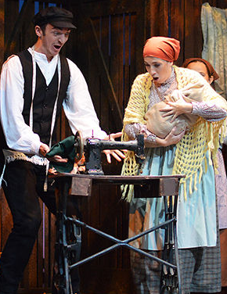
Motel Kamzoil got a sewing machine and now he is a mentsh!
Notes:
https://www.google.com/search?q=Motel+Kamzoil+got+a+sewing+machine&safe=active&source=lnms&tbm=isch&sa=X&ved=0ahUKEwid8Yfnz-riAhVLlKwKHUw2DbgQ_AUIECgB&biw=1164&bih=865#imgdii=tIbdkPLAGoSAUM:&imgrc=K24SqWNmv_XkVM:

Slide 42
There once were two evil brothers. They were rich and used their money to keep their evil ways from the public eye. They attended the same temple, and to everyone else, they appeared to be perfect Jews.
Due to the rabbi's honesty and integrity, the temple's membership grew in numbers
Notes:
http://www.getamused.com/jokes/mensch.html

Slide 43
Eventually, a fundraising campaign was started to build a much bigger synagogue. All of a sudden, one of the brothers died. The remaining brother sought out the rabbi the day before the funeral and handed him a check for the amount needed to complete the new building. He held the check for the rabbi to see.
Notes:
http://www.getamused.com/jokes/mensch.html

Slide 44
"I have only one condition," he said. "At the funeral, you must say my brother was a mensch. You must say those exact words."
After some thought, the rabbi gave his word and took the check. He cashed it immediately. At the funeral the next day, however, the rabbi did not hold back
Notes:
http://www.getamused.com/jokes/mensch.html

Slide 45
"He was an evil man," he said about the dead brother. "He cheated on his wife and abused his family. Never once did he commit an unselfish act." He railed on and on about the deceased. After nearly a half hour of the evil truth, the rabbi paused and shrugged his shoulders.
Notes:
http://www.getamused.com/jokes/mensch.html

Slide 46
Finally, he said, "But compared to his brother, he was a mensch.”
It’s not enough to do right or be right or sound right, all are necessary to be a mensch.
Be a man of character, reputation, and good words.
Notes:
http://www.getamused.com/jokes/mensch.html

Slide 47
Phil. 4.5 Let everyone see how reasonable and gentle you are.
Dress for Success: first impression. LET this be our impression.

Slide 48

Dress for Success is a 1975 book by John T. Molloy about the effect of clothing on a person's success in business and personal life. It was a bestseller and was followed in 1977 by The Women's Dress for Success Book. Together, the books popularized the concept of "power dressing"

Slide 49
Phil. 4.5 Let everyone see how reasonable and gentle you are, what a mensch you are.
Dress for Success: first impression. LET this be our impression.

Slide 51
^{1 Cor. 16.13-14} Stay alert, stand firm in the faith, behave like a mentsh, [4] grow strong. Let everything you do be done in love.
κραταιόω krataioó: strengthen, confirm; pass: grow strong, become strong
Notes:
https://biblehub.com/greek/1127.htm

Slide 52
How are we to be strong?
^{Mishlei/Prov 18.20-21} From the fruit of his mouth a man’s stomach is filled— with the harvest of his lips he is satisfied. Death and life are in the control of the tongue. Those who indulge in it will eat its fruit. Strength in our WORDS!

Slide 53
“A violent man destroys with his words…a silent man starves his wife…of several things, his words, his touch, but mostly his delight.” A man of strength nurtures, ~Yeshua, by the power of Yeshua “nourishes and cherishes it—just as Messiah also does His community.”
Notes:
Eldredge Wild p 186
Some men are confrontational, demanding, driving. Not good.
Some are compliant. “Yes, dear”

Slide 54

Larry Crabb challenges men to move beyond the fear of failure that paralyzes them in spiritual matters and relationships.

Slide 55
^{Ber/Gen 3.6} When the woman saw that the tree was good for food, that it had a pleasing appearance and that the tree was desirable for making one wise, she took some of its fruit and ate. She also gave some to her husband, who was with her; and he ate.
Notes:
Yes, dear. Compliance is no favor. Yeshua was the Word, the Logos, the Memra, Davar Adoni.
Guys: speak up, but in love and tenderness!
My marriage, Dawn remembers everything. Except family prayer time. She has her own private devotions, but family prayer is just up to me..
This principle, of strength in speaking, gentle intervention, explains one of the strangest commands in the Torah…

Slide 56
^{Bamidbar/Nu 30.2-2} Then Moshe spoke to the heads of the tribes of the people of Isra’el. He said, “Here is what Adonai has ordered: when a man makes a vow to Adonai or formally obligates himself by swearing an oath, he is not to break his word but is to do everything he said he would do.

Slide 57
^{Bamidbar/Nu 30.2-2} “When a woman makes a vow to Adonai, formally obligating herself, while she is a minor living in her father’s house; then, if her father has heard what she vowed or obligated herself to do and holds his peace, then all her vows remain binding — every obligation she has bound herself to will stand.
Notes:
Similar for your wife!
He doesn’t get involved

Slide 58
^{Bamidbar/Nu 30.2-2} But if on the day her father hears it, he expresses his disapproval, then none of her vows or obligations she has bound herself to will stand; and Adonai will forgive her, because her father expressed his disapproval.
Notes:
Veto power? Right? Sexist? Domineering?
ENGAGEMENT. Break bondages!
Bitterness → vows!
Can she talk him into it? Convince him? Likely. But

Slide 59
“She is the crescendo, the final, astonishing work of God. Woman. In one last flourish creation comes to a finish with Eve. She is the Master's finishing touch.”
― John Elderedge
Notes:
https://www.goodreads.com/author/quotes/1236.John_Eldredge

Slide 60
Astonishing Time Mag. Article May 20, 2019

Slide 61
Research strongly suggests that children whose parents love each other are much happier and more secure than those raised in a loveless environment. They have a model of not just what a relationship looks like but also of how people should treat each other.
Notes:
https://time.com/5586397/loving-your-spouse/

Slide 62
When Pew Research asked young parents in 2010 whether kids or a good marriage was more important for a happy life, kids won by a margin three times as big as when researchers asked the previous generation in 1997.

Slide 63
Cuddly toddlers turn into teenagers, who greet any public display of warmth with revulsion, suspicion or sullenness. Then they leave. Grown children do not want to be the object of all your affection or the main repository for all your dreams,
Notes:
https://time.com/5586397/loving-your-spouse/

Slide 64
just as you never really wanted to hear their full toddler recaps of PAW Patrol. If you’ve done your job as parents, one day your home is mostly going to hold you, your spouse and devices for sending your kids messages that they then ignore.
Notes:
https://time.com/5586397/loving-your-spouse/

Slide 65
Some therapists say this is what’s behind the doubling of the divorce rate among folks over 50 and tripling among those over 65 in the past 25 years: it’s an empty-nest split.
Notes:
https://time.com/5586397/loving-your-spouse/
Marriageology: The Art and Science of Staying Together.

Slide 66
Focus on your relationship with your wife.
It’s “till death do us part” with her.
It’s till “adulthood do us part” with them, somewhat.
Strength of words of affirmation.

Slide 67
^{1 Cor. 16.13-14} Stay alert, stand firm in the faith, behave like a mentsh, grow strong. Let everything you do be done in love.
Another way to be strong: be a worshiper.
Notes:
https://biblehub.com/greek/1127.htm

Slide 68
^{T’hillim 144 .1-2} Blessed be Adoni, my rock, who trains my hands for war and my fingers for battle. He shows me grace; and he is my fortress, my stronghold, in whom I find shelter, my shield, in whom I take refuge, who subdues my people under me.
Notes:
https://time.com/5586397/loving-your-spouse/

Slide 69
^{T’hillim 144 .9-12} God, I will sing a new song to you; sing praises to you with a ten-stringed harp. You give kings their victories; you save your servant David from the cruel sword. Rescue me, save me from the power of strangers, whose mouths speak worthless words
Notes:
https://time.com/5586397/loving-your-spouse/

Slide 70
^{T’hillim 144 .9-12} and whose right hands swear false oaths. Our sons in their youth will be like full-grown saplings, our daughters will be like sculptured pillars fit for the corner of a palace.
Notes:
https://time.com/5586397/loving-your-spouse/

Slide 71
Worship/devotions together does NOT fix every problem, but it changes the atmosphere! Then problems can be solved.
It’s up to the Papa to initiate!

Slide 72
^{1 Cor. 16.13-14} Stay alert, stand firm in the faith, behave like a mentsh, grow strong. Let everything you do be done in love.
Another way to be strong: Purity. ^{Iyov/Job 31.1} “I made a covenant with my eyes not to let them lust after any girl. [You may need accountability. ]
Notes:
https://biblehub.com/greek/1127.htm

Slide 73
^{Dvarim /Dt 21.10-13} When you go to war against your enemies and Adoni your God delivers them into your hands and you take captives, if you notice among the captives a beautiful woman and are attracted to her, you may take her as your wife. Bring her into your home

Slide 74
^{Dvarim /Dt 21.10-12} and have her shave her head, trim her nails and put aside the clothes she was wearing when captured. After she has lived in your house and mourned her father and mother for a full month, then you may go to her and be her husband and she shall be your wife.
Notes:
According to Rabbi Yohanan in the Jerusalem Talmud, only after deciding to marry the female captive are sexual relations permitted. This in effect prohibits rape in the process of war, but does not prohibit forced marriages and marital rape.

Slide 75
Rape has accompanied warfare in virtually every known historical era. Writes women's historian Gerda Lerner, “The practice of raping the women of a conquered group has remained a feature of warfare and conquest from the second millennium B.C. to the present.
Notes:
https://en.wikipedia.org/wiki/Wartime_sexual_violence#Antiquity

Slide 76
Anti-Israel activists called [and Israeli soldier] a rapist. In one case, a professor asked me if I knew how many Palestinians have been raped by IDF forces. I answered that as far as I knew, none.
Notes:
http://frontpagemag.com/2013/dgreenfield/ex-israeli-soldier-denounced-on-us-campus-for-not-raping-palestinian-women/

Slide 77
She triumphantly responded that I was right, because, she said, “You IDF soldiers don’t rape Palestinians because Israelis are so racist and disgusted by them that you won’t touch them.”
Why won’t you rape them? You’re a racist!
Notes:
http://frontpagemag.com/2013/dgreenfield/ex-israeli-soldier-denounced-on-us-campus-for-not-raping-palestinian-women/

Slide 78
One more way to be strong: stand with Israel and the Jewish people.

Slide 79
In Dearborn, Michigan, a speaker at a Quds Day event railed at the “cancer” named Israel and called the U.S. government “Satanic.” His solution to the Israeli/Palestinian conflict is “returning every inch, every centimeter, every pebble of Palestine back to the people of Palestine.”
Notes:
https://cidisrael.org/details/20190613a-day-to-hate-israel

Slide 80
But that “return” won’t happen through legislation or international deals, he insisted. Violence—what he called “resistance”—is the one path forward. Standing on a plaza outside the Henry Ford Centennial Library, he declared, “There is only one solution, intifada, revolution.”
+ + “We don’t want no Jewish state!”
Notes:
https://cidisrael.org/details/20190613a-day-to-hate-israel

Slide 81
Meanwhile, Quds Day protesters in New York’s Times Square chanted that same slogan and others. All bristled with hostility toward Israel. One chant declared: “We don’t want no Jewish state. We want ’48. We want all of it.” It’s easy to smile and dismiss all this. But we shouldn’t. And here’s why. People who hold these views are gaining power.
Notes:
https://cidisrael.org/details/20190613a-day-to-hate-israel

Slide 82
“Deep in his heart, every man longs for a battle to fight, an adventure to live, and a beauty to rescue.”
― John Eldredge, Wild at Heart: Discovering the Secret of a Man's Soul
Notes:
https://www.goodreads.com/author/quotes/1236.John_Eldredge

Slide 83
“A man needs a much bigger orbit than a woman. He needs a mission, a life purpose, and he needs to know his name. Only then is he fit for a woman, for only then does he have something to invite her into.”
― John Eldredge, Wild at Heart Revised and Updated: Discovering the Secret of a Man's Soul
Notes:
https://www.goodreads.com/author/quotes/1236.John_Eldredge

Slide 84
^{1 Cor. 16.13-14} Stay alert, stand firm in the faith, behave like a mentsh, grow strong. [5] Let everything you do be done in love.
Notes:
https://biblehub.com/greek/1127.htm

Slide 85
A continuous reminder of what matters most in life.
A father's affirming love.
Success is defined by one's character—not one's performance.
Never quit.
I'll be there for you.
Notes:
https://www.drjamesdobson.org/blogs/the-fatherhood-challenge/the-fatherhood-challenge/2017/06/23/5-things-every-child-needs-from-dad?sc=TYdadsurvey

Slide 87


