Slide 1
e-handout
To have these notes
without taking notes
Go to OrHaOlam.com
Click on downloads,
messages, 2019
Notes:
.

Slide 2
A midget fortune-teller who escapes from prison is a small medium at large.
Once you've seen one shopping center, you've seen a mall.
Bakers trade bread recipes on a knead-to-know basis.
Notes:
From Rukhel

Slide 3
3 scriptures/week
No one is a stranger, just friends we haven’t met yet.
Summer launch, not summer campaign

Slide 4
Outline
Breakdown in judicial procedures.
Political maneuver to trap Yeshua.
Real role of Yeshua. Divine Messiah.
Application to us.

Slide 5
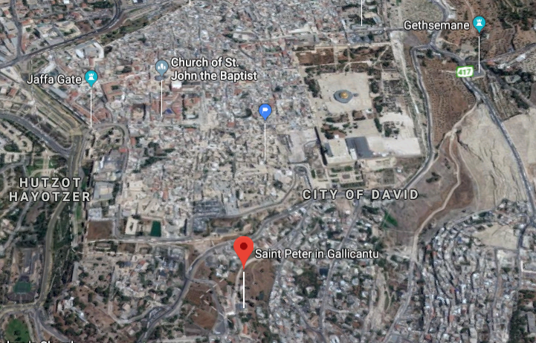
Notes:
Yeshua received criminal and religious accusations, but the Cohen HaGadol was having judicial problems getting a conviction according to Torah rules of dealing with charges.
There is a serious application to us about handling differences and accusations in love. Mt 6, Mt 18, Gal 6. Three weeks ago, before Kokeb and Father’s Day.

Slide 6
Summary of Torah on accusations:
Two or three accusers needed
Accusers to be cross examined
Malicious false witness gets same punishment as crime.
All witnesses “hands on” to execution.

Slide 7
Mishnah [developing Oral Law] requirements for death penalty expanded 4 in Torah to 8 requirements.
In either method, no conviction.

Slide 8
^{Mtt. 26.62} The cohen hagadol stood up and said, “Have you nothing to say to the accusation these men are making?”

Slide 9
Mattityahu (Matthew) 26:63
אוּלָם יֵשׁוּעַ שָׁתַק.
Yeshua remained silent.
Notes:
Why? Miranda right to remain silent?
“You have the right to remain silent. Anything you say can and will be used against you in a court of law. You have the right to an attorney. If you cannot afford an attorney, one will be provided for you.”
Miranda comes out of the 5th Amendment to the US Constitution. Non-self incrimination. Similar in Jewish jurisprudence.
No such thing in Canada.
He fulfilled prophecy by remaining silent…

Slide 10
^{Yeshayahu/Is 53.7} Though mistreated, he was submissive — he did not open his mouth. Like a lamb led to be slaughtered, like a sheep silent before its shearers, he did not open his mouth.

Slide 11
^{Yeshayahu/Is 53.8} After forcible arrest and sentencing, he was taken away; and none of his generation protested his being cut off from the land of the living for the crimes of my people, who deserved the punishment themselves.
Notes:
Fulfilled prophecy by breach of Torah justice procedures.
Malicious false witness gets same punishment as crime.

Slide 12
The Cohen HaGadol knew he was in violation of the developing jurisprudence. So, he sought self-incrimination for Yeshua.

Slide 14
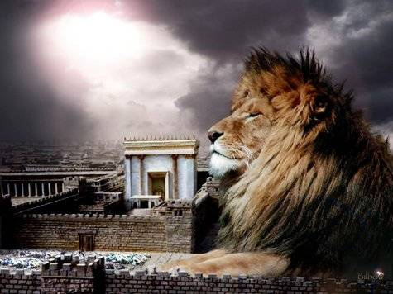
מַתִּתְיָהוּ Mattityahu
(Matthew) 26:63-65

Slide 15
Outline
Breakdown in judicial procedures.
Political maneuver to trap Yeshua.
Real role of Yeshua. Divine Messiah.
Application to us. Listen.

Slide 16
Mattityahu (Matthew) 26:63
אָמַר אֵלָיו הַכֹּהֵן הַגָדוֹל: ”אֲנִי מַשְׁבִּיעַ אוֹתְךָ בֵּאלֹהִים חַיִּים שֶׁתֹּאמַר לָנוּ אִם אַתָּה הַמָּשִׁיחַ בֶּן־הָאֱלֹהִים?
The cohen hagadol said to him, “I put you under oath! By the living G-d, tell us if you are the Mashiakh, the Son of G-d!”
Notes:
This may not be the intention you think.
This was actually a political question, to incriminate Yeshua to the Romans.
To understand this, let me introduce, or re-introduce, one of my favorite non-Messianic Jewish scholars.

Slide 17
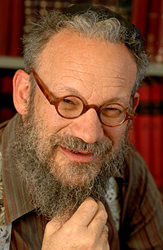

Daniel Boyarin

Slide 18
Daniel Boyarin (born 1946) is a historian of religion. Born in Asbury Park, New Jersey, he holds dual United States and Israeli citizenship. Trained as a Talmudic scholar, in 1990 he was appointed Professor of Talmudic Culture, Departments of Near Eastern Studies and Rhetoric, University of California, Berkeley, a post which he still holds.

Slide 19

Daniel Boyarin, professor of Talmudic Culture at the University of California Berkeley, may be the most influential scholar of ancient Judaism today.
Notes:
Bear with me, he’s speaking as a non-believer about our faith, so uses non-Messianic terminology.
Quotes from p 1-2, 5-6, 25-26

Slide 20
Messiah = Son of G-d in Jewish concepts, but not what you think.
^{1 Shmu 10.1} Then Sh'mu'el took a flask of oil he had prepared and poured it on Sha'ul's head. He kissed him and said, "ADONI has anointed you to be prince over his inheritance.”
משחך m’shakhekha Messiah = prince

Slide 21
^{T’hillim 2.6-7} "I myself have installed my king on Tziyon, my holy mountain." "I will proclaim the decree: ADONI said to me, 'You are my son; today I became your father.
Notes:
Later got to have secondary meanings, but at first, simply son of G-d as royal king with divinely appointed authority.

Slide 22
All the kings, priests anointed for service sons of G-d in a royal sense. No hint of deity ~ Pharoah.
^{1 Chron 7. 11-14} When your days come to an end and you go to be with your ancestors, I will establish one of your descendants to succeed you,

Slide 23
All the kings, priests anointed for service sons of G-d in a royal sense. No hint of deity ~ Pharoah.
^{1 Chron 7. 11-14} one of your own sons; and I will set up his rulership. He will build me a house, and I will establish his throne forever.

Slide 24
^{1 Chron 7. 11-14} I will be a father for him, and he will be a son for me; I will not take my grace away from him, as I took it away from your predecessor. Rather, I will maintain him in my house and in my kingdom forever; and his throne will be set up forever.'"
The king is special to G-d, a son in authority, but very human.

Slide 25
After the exile, prayer was for a restoration of the Davidic kingdom.
^{Lk 1.31-32} Look! You will become pregnant, you will give birth to a son, and you are to name him Yeshua. He will be great, he will be called Son of Ha`Elyon. ADONI, God, will give him the throne of his forefather David
Focus here primarily Davidic throne
Notes:
Reversal: Son of G-d = divinely appointed king.
So, back to the question…

Slide 26
Mattityahu (Matthew) 26:63
אָמַר אֵלָיו הַכֹּהֵן הַגָדוֹל: ”אֲנִי מַשְׁבִּיעַ אוֹתְךָ בֵּאלֹהִים חַיִּים שֶׁתֹּאמַר לָנוּ אִם אַתָּה הַמָּשִׁיחַ בֶּן־הָאֱלֹהִים?
The cohen hagadol said to him, “I put you under oath! By the living G-d, tell us if you are the Mashiakh, the Son of G-d!”
Notes:
This was actually a political question, to incriminate Yeshua to the Romans. Son of G-d = pretender to the David throne, rebel against Rome!

Slide 27
Mattityahu (Matthew) 26:64
הֵשִׁיב לוֹ יֵשׁוּעַ: ”אַתָּה אָמַרְתָּ, “
Yeshua said to him, “The words are your own.”
David Stern: The literal translation of the Greek text there is, "You have said," and the phrase is taken as the equivalent of a straight "Yes" answer, much like the English phrase, "You said it!"
Notes:
Hebrew “yes” ken, כן

Slide 28
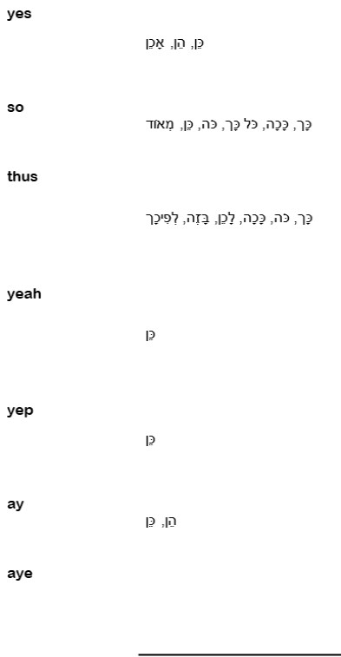
כן
According to Google translate.
“As you wish”

Slide 29
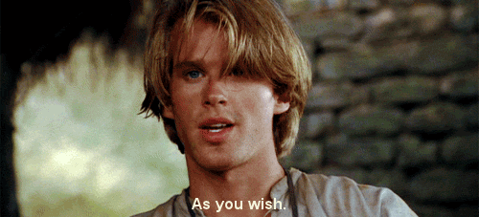
“as you wish”
From Princess Bride
Notes:
https://www.google.com/search?q=as+you+wish+gif&tbm=isch&source=iu&ictx=1&fir=B7c3jWhwAvRbvM%253A%252CIcGl6AQZi3QKRM%252C_&vet=1&usg=AI4_-kR9uJvmhSNQ-dGuK5EOdPtgr8Xwww&sa=X&ved=2ahUKEwihgPSvg_ziAhUEjq0KHZG1AtcQ9QEwAHoECAYQBA#imgrc=iDMkVtTRB8R-cM:&vet=1

Slide 30

“As you wish…”
Notes:
https://www.google.com/search?q=as+you+wish+gif&source=lnms&tbm=isch&sa=X&ved=0ahUKEwiArNepqfziAhVPLKwKHfM6D7QQ_AUIECgB&biw=1164&bih=822&dpr=1.1#imgrc=06Mj2FbX535A0M:

Slide 31
Yeshua was being set up to identify as a rebel king against Rome. Messiah, Son of G-d.
Then Yeshua goes way beyond politics to give the real meaning of His role in Israel.

Slide 32
Outline
Breakdown in judicial procedures.
Political maneuver to trap Yeshua.
Real role of Yeshua. Divine Messiah.
Application to us. Listen.

Slide 33
Mattityahu (Matthew) 26:64
אַךְ אוֹמֵר אֲנִי לָכֶם, מֵעַתָּה תִּרְאוּ אֶת בֶּן־הָאָדָם יוֹשֵׁב לִימִין הַגְּבוּרָה וּבָא עִם עַנְנֵי הַשָּׁמַיִם.“
But I tell you that one day you will see the Son of Man ₁sitting at the right hand of HaG’vurah and coming on the clouds of heaven.”
Notes:
This is a loaded sentence. Three deep doctrinal statements in these 28 words!
Quotes both Ps 110.1 and Daniel 7, mixed together.
Two of them earthquake radical statements!
#1. He is at the right hand of HaG’vurah. What?

Slide 34

G’vurah = גבורה = might, power, heroism, valor
In this case: the Almighty,
the YHVH

Slide 35
T’hillim/Ps 110.1
נְאֻם יְיָ לַאדֹנִי -- שֵׁב לִימִינִי; עַד-אָשִׁית אֹיְבֶיךָ הֲדֹם לְרַגְלֶיךָ.
Adoni declares to my Lord: “Sit at My right hand until I make your enemies a footstool for Your feet.”
Notes:
Lesson #1 Yeshua is referring to the YHVH, but He doesn’t pronounce the Name. He uses a ‘circumlocution’ an attribute of G-d, rather than the Name.
That is our pattern. He didn’t say the Name, so we don’t. Adoni, HaShem, HaG’vurah, etc.

Slide 36
Mattityahu (Matthew) 26:64
אַךְ אוֹמֵר אֲנִי לָכֶם, מֵעַתָּה תִּרְאוּ אֶת בֶּן־הָאָדָם יוֹשֵׁב לִימִין הַגְּבוּרָה וּבָא עִם עַנְנֵי הַשָּׁמַיִם.“
But I tell you that one day you will see the Son of Man ₂sitting at the right hand of HaG’vurah and coming on the clouds of heaven.”
Notes:
First radical building rattling statement.

Slide 37
T’hillim/Ps 110.1
נְאֻם יְיָ לַאדֹנִי -- שֵׁב לִימִינִי; עַד-אָשִׁית אֹיְבֶיךָ הֲדֹם לְרַגְלֶיךָ.
Adoni declares to my Lord: “Sit at My right hand until I make your enemies a footstool for Your feet.”
Notes:
He is claiming this for Himself, David’s Adon, Deity, sitting at the right hand of the YHVH!!!
He is the divine Messiah.

Slide 38

Shocking statement:
Yeshua is self-identifying as the Lord of King David in Ps 110!
Shocker.
Notes:
https://www.google.com/search?biw=1164&bih=822&tbm=isch&sa=1&ei=eJ0NXdL-MoOwsAW7wqm4Bg&q=shoked+expression&oq=shoked+expression&gs_l=img.12...9166.9166..12768...0.0..0.135.135.0j1......0....1..gws-wiz-img.K8cUBQwaggk#imgrc=qmeXvfQ6c0K7oM:

Slide 39
T’hillim/Ps 110.1
נְאֻם יְיָ לַאדֹנִי -- שֵׁב לִימִינִי; עַד-אָשִׁית אֹיְבֶיךָ הֲדֹם לְרַגְלֶיךָ.
Adoni declares to my Lord: “Sit at My right hand until I make your enemies a footstool for Your feet.”
Notes:
He is David’s Adon, Deity, sitting at the right hand of the YHVH!!!
He is the divine Messiah.
Next phrase is MORE radical.

Slide 40
Mattityahu (Matthew) 26:64
אַךְ אוֹמֵר אֲנִי לָכֶם, מֵעַתָּה תִּרְאוּ אֶת בֶּן־הָאָדָם יוֹשֵׁב לִימִין הַגְּבוּרָה וּבָא עִם עַנְנֵי הַשָּׁמַיִם.“
But I tell you that one day you will see the ₃Son of Man sitting at the right hand of HaG’vurah and ₃coming on the clouds of heaven.”
Notes:
.

Slide 41
^{Daniel 7.13} “I kept watching the night visions, when I saw, coming with the clouds of heaven, someone like a son of man. He approached the Ancient One and was led into his presence.
Radical phrases: son of man, coming in the clouds of heaven
Notes:
P 44 Boyarin Jewish Gospels
Daniel in his vision, sees two divine beings.
Earthquake impact phrases, He is
The Son of Man
Coming in the clouds of heaven

Slide 42
Mattityahu (Matthew) 26:64
אַךְ אוֹמֵר אֲנִי לָכֶם, מֵעַתָּה תִּרְאוּ אֶת בֶּן־הָאָדָם יוֹשֵׁב לִימִין הַגְּבוּרָה וּבָא עִם עַנְנֵי הַשָּׁמַיִם.“
But I tell you that one day you will see the Son of Man sitting at the right hand of HaG’vurah and coming on the clouds of heaven.”
Notes:
Two earthquake impact statements in 28 words!

Slide 43
Mattityahu (Matthew) 26:65
מִיָּד קָרַע הַכֹּהֵן הַגָּדוֹל אֶת בְּגָדָיו וְאָמַר: ”מְגַדֵּף הוּא. מַה לָּנוּ עוֹד צֹרֶךְ בְּעֵדִים? הִנֵּה כָּעֵת שְׁמַעְתֶּם אֶת הַגִּדּוּף.
At this, the cohen hagadol tore his robes. “Blasphemy!” he said. “Why do we still need witnesses? You heard him blaspheme!”
Notes:
Tear robes and clothes over grief at tragedy, at blasphemy of G-d.
This was not an admission of a crime, so witness against himself.
The saying these words WAS a crime, a travesty, a sin in itself.

Slide 44
^{Ber/Gen 37.34} Ya‘akov tore his clothes and, putting sackcloth around his waist, mourned his son for many days.
^{Ber/Gen 44.12-13} The goblet was found in the pack belonging to Binyamin. At this, they tore their clothes from grief.

Slide 45
^{Bamidbar/Nu 14.5-6} Moshe and Aharon fell on their faces before the entire assembled community of the people of Isra’el. Y’hoshua the son of Nun and Kalev the son of Y’funeh, from the detachment that had reconnoitered the land, tore their clothes.

Slide 46
^{Ezra 9.3} The officials and leaders have been the main offenders in this treachery.” When I heard this, I tore my robe and tunic, pulled hair from my head and beard, and sat down in shock.

Slide 47
Mattityahu (Matthew) 26:65
מִיָּד קָרַע הַכֹּהֵן הַגָּדוֹל אֶת בְּגָדָיו וְאָמַר: ”מְגַדֵּף הוּא. מַה לָּנוּ עוֹד צֹרֶךְ בְּעֵדִים? הִנֵּה כָּעֵת שְׁמַעְתֶּם אֶת הַגִּדּוּף.
At this, the cohen hagadol tore his robes. “Blasphemy!” he said. “Why do we still need witnesses? You heard him blaspheme!”

Slide 48
What’s your verdict?”
Mattityahu (Matthew) 26:66

Slide 49
^{Vayikra/Lev 24:16} Whoever blasphemes the Name of Adoni must surely be put to death. The whole congregation must stone him. The outsider as well as the native-born, when he blasphemes the Name, is to be put to death.

Slide 50
“Guilty,” they answered. “He deserves death!” Then they spat in His face and pounded Him with their fists. Others slapped Him and demanded, “Prophesy to us, you Messiah! Which one hit You?”
Mattityahu (Matthew) 26:66-69
Notes:
Actually fulfilled His prophetic credentials by slapping Him.

Slide 51
^{Yeshayahu/Is 50:6} I gave My back to those who strike, and My cheeks to those pulling out My beard;
I did not hide My face from humiliation and spitting.
Notes:
Similar to other Hebrew prophets…

Slide 52
^{1K 22.24} Then Tzidkiyah the son of Khena‘anah came up, slapped Mikhay’hu in the face and said, “And how did the Spirit of Adoni leave me to speak to you?”

Slide 53
Outline
Breakdown in judicial procedures.
Political maneuver to trap Yeshua.
Real role of Yeshua. Divine Messiah.
Application to us. Listen.

Slide 54
So, how does this apply to us?:
He is the divine Messiah of
Ps 110 ‘my Lord’ and
Dan. 7 ‘clouds of heaven’ and ‘son of man’ and
Is. 50 ‘the face slapping’?

Slide 55
^{Messianic Jews 3.1} Therefore, brothers whom God has set apart, who share in the call from heaven, think carefully about Yeshua, whom we acknowledge publicly as God's emissary and as cohen gadol.

Slide 56
^{Messianic Jews 3.1} think carefully
Katanohsate κατανοήσατε
carefully consider
to consider attentively, fix one's eyes or mind upon, behold, consider, discover, perceive, take note of, perceive, consider carefully, discern, detect, make account of.

Slide 57
So, how does this apply to us:
He is the divine Messiah of
Ps 110 ‘my Lord’ and
Dan. 7 ‘clouds of heaven’ and ‘son of man’ and
Is. 50 ‘the face slapping’?

Slide 58
He will be victorious, and we can participate in that victory.
There may be face slapping.

Slide 59
^{Yeshayahu/Is 63.1-5} “Who is this coming from Edom, in crimsoned garments from Bozrah? This One splendid in His apparel, pressing forward in His great might?” “It is I who speak in righteousness, mighty to save.” “Why is Your apparel so red, and Your garments like one who treads in a wine press?”

Slide 60
^{Yeshayahu/Is 63.1-5} “I have trodden the winepress alone — from the peoples, no man was with Me.
Notes:
Omitting the references to wrath. They are later.

Slide 61
^{Yeshayahu/Is 63.1-5} My year of redemption has come. I looked, but there was no one to help. I was amazed, but no one was assisting. So My own arm won victory for Me, and My wrath upheld Me.

Slide 62
^{Yeshayahu/Is 63.7-9} I will remember the lovingkindnesses of Adoni, the praises of Adoni, according to all that Adoni has granted us, and the great goodness toward the house of Israel, which He has granted them according to His compassion,

Slide 63
^{Yeshayahu/Is 63.7-9} and according to the abundance of His loving-kindnesses. For He said, “Surely they are My people, children who will not deal falsely.” So He became their Savior. In all their affliction He was afflicted.
Notes:
That’s where G and Yeshua were in the Holocaust. Suffering, appearing, redeeming,

Slide 64
^{Yeshayahu/Is 63.7-9} So the angel of His presence saved them. In His love and in His mercy He redeemed them, then He lifted them and carried them all the days of old.

Slide 65
^{Yeshayahu/Is 45.21-25} There is no other God besides me, a just God and a Savior; there is none besides me. Look to me, and be saved, all the ends of the earth! For I am God; there is no other. In the name of myself I have sworn, from my mouth has rightly gone out,
Notes:
When I spend time looking to Y about a problem, I get
Points to repent about internal change relative to the problem
Points to repent about, relational asking forgiveness or just attitude change relative to the problem and the people
Strategies of change
Joy that G is doing something bigger than me.

Slide 66
^{Yeshayahu/Is 45.21-25} a word that will not return - that to me every knee will bow and every tongue will swear about me that only in ADONI are justice and strength." All who rage against him will come to him ashamed, but all the descendants of Isra'el will find justice and glory in ADONI.
Notes:
I can remember in my early days as a believer: How will I win my family? Know enough Torah, Talmud, Hebrew, history, Siddur, lifestyle practices?
Know Yeshua, that is the key. Diyaynu. דיינו Enough. Central.
He is Deity. Divine Messiah.
Lets lSook at a self disclosed inside view of the mind of Messiah, His mental processes…

Slide 67
^{Yn 5.17-21} Therefore, Yeshua said this to them: “Yes, indeed! I tell you that the Son cannot do anything on his own, but only what he sees the Father doing; whatever the Father does, the Son does too.
Notes:
He looks at the Father. Implies listens. Shma. שמעS

Slide 68
^{Yn 5.17-21} For the Father loves the Son and shows him everything he does; and he will show him even greater things than these, so that you will be amazed. Just as the Father raises the dead and makes them alive, so too the Son makes alive anyone he wants.
Notes:
Last week I was teaching on fatherhood, and listening. I confess, I had instructions to stop after the first point, and allow the Ruakh, the Spirit to work in our hearts to apply the point. But, I got obsessed with the content of the message, and failed the pastoral responsibility. Need to go back there, since it fits with the role of the Divine Messiah listening.

Slide 69
^{1 Cor. 16.13-14} Stay alert, stand firm in the faith, behave like a mentsh, grow strong. Let everything you do be done in love.
Stay alert: grégoreó: to be awake, to watch "stay awake"; be vigilant (responsible, watchful).
Notes:
https://biblehub.com/greek/1127.htm

Slide 70
Watch
For closed spirits, hard responses
For tensions in the home
Bright eye response [6x/sec dopamine]
Loss of fervor, excitement
Loss of joy

Slide 71
What to do if father sees such?
Ask. “What’s going on?” “Are you OK?”
Ask them what is is / was to have you as a father. Ask them what they feel your message to them was /is while they were growing up. “I’ve been doing some
Notes:
Eldredge You Have What it Takes p 43

Slide 72
thinking about our relationship and how I may have hurt you over the years. I’d be honored if you would tell me what it was/is like to have me as a dad. What was my message to you?

Slide 73
Did you feel loved and respected by me as a son?
Did you feel loved and pursued by me as a daughter?
Pause to listen to the Father about closed spirits: spouse, children, friends, congregants.
Notes:
Eldredge You Have What it Takes p 43
Read p 44 D
“I’m not watching for that. I’m watching for sin.”
Similar for your wife. It’s father’s day, but most of the time you will be a husband before being a dad. Be alert to her spirit.
“But they’ve done many things wrong…”
~Yeshua, we did MANY things wrong, yet He went to the execution stake first, so we could repent. Fathers, husbands, humble yourself FIRST, so you wife and kids can open up!
This message is about the power and pattern of Yeshua. ALL our messages here are, though sometimes that gets a bit buried. Power and pattern of Yeshua!

Slide 74
Outline
Breakdown in judicial procedures.
Political maneuver to trap Yeshua.
Real role of Yeshua. Divine Messiah.
Application to us.

Slide 75
So, what does this mean:
He is the divine Messiah of
Ps 110 ‘my Lord’ and
Dan. 7 ‘clouds of heaven’ and
Is. 50 ‘the face slapping’?

Slide 76
He will be victorious,
There may be face slapping, humbling of ourselves to HEAR from G-d and people.

Slide 77


