Slide 1
e-handout
To have these notes
without taking notes
Go to OrHaOlam.com
Click on downloads,
messages, 2019
Notes:
This message is based on material referred to me by one of my sons. So, here is some other wisdom from one of them…

Slide 2
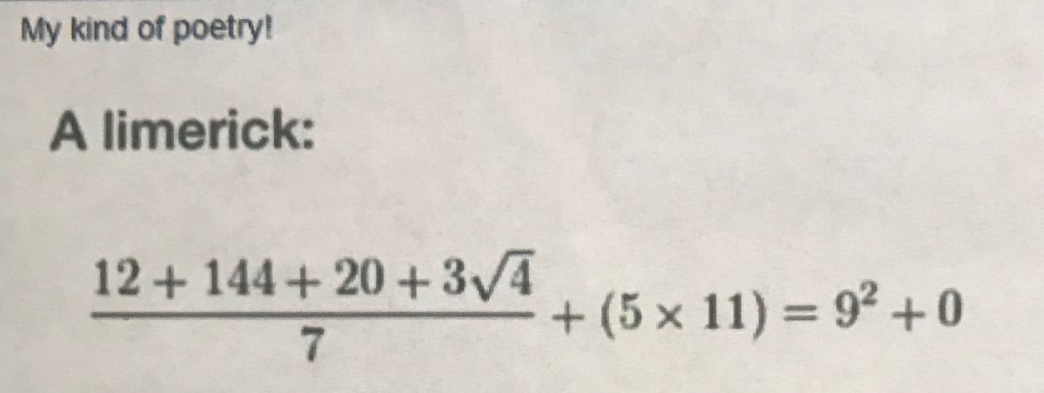
Doesn’t look like a limerick to you?
Notes:
From my son Daniel

Slide 3
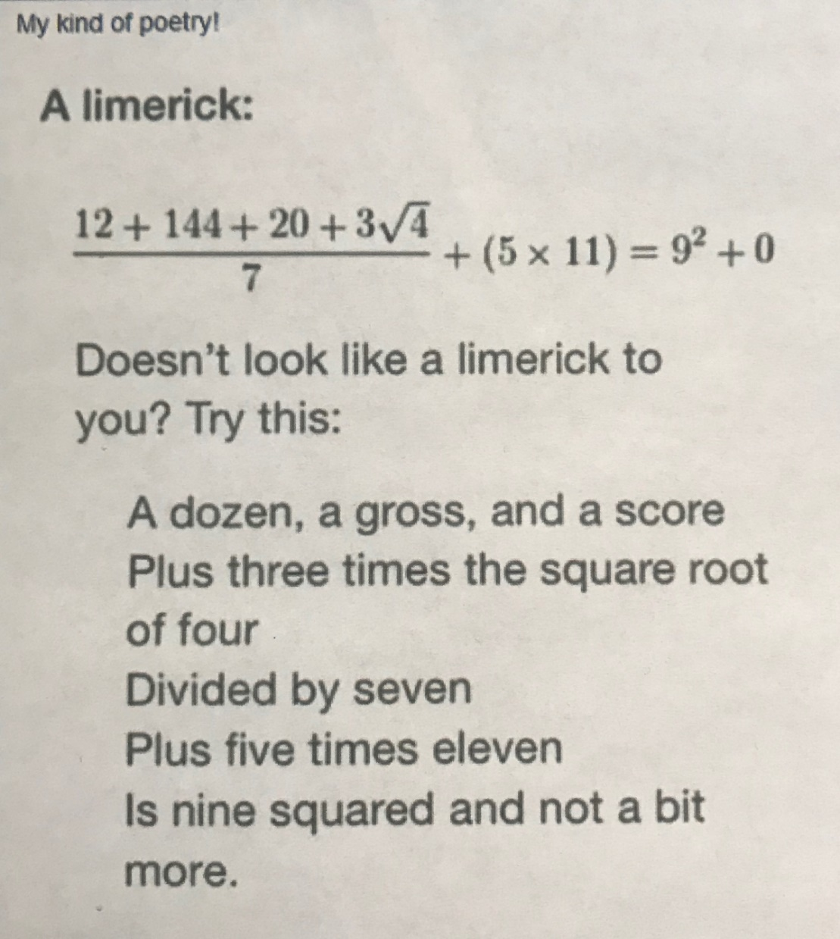
(186 ÷ 7) + 55
= 81
Notes:
A word study in the difference between completed and finished.
Guyanese man won competition
If you marry the right woman you are completed.
If you marry the right woman you are finished.
If the right woman sees you with the wrong woman, you are completely finished.

Slide 4
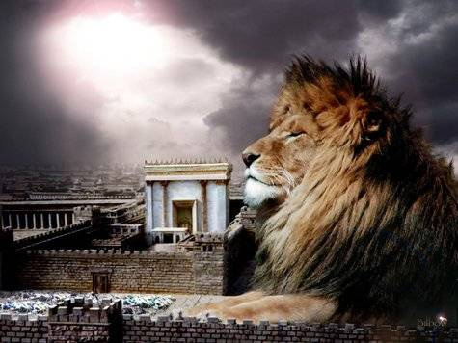
מַתִּתְיָהוּ Mattityahu
(Matthew) 26:33-35
Notes:
Series I feel called to do in Matityahu in my home synagogue, and this one was so impactful that it seems that I should bring it to Conference. At least, impactful to me.
Know inner life and failures of a preacher? Listen to his messages. Wounded healer: Way ahead of flock, unattainable. Behind flock, bad influence. Few steps ahead: leader. So, this message is for me, if not for you.
Context Sang the Hallel and went out.
As they went, Yeshua predicts the soon coming abandonment of Him by the Twelve. Eleven now.
Their reaction to His prediction…

Slide 5
Mattityahu (Matthew) 26:33
הֵשִׁיב לוֹ כֵּיפָא וְאָמַר: ”אִם הַכֹּל יִכָּשְׁלוּ בִּגְלָלְךָ, אֲנִי לְעוֹלָם לֹא אֶכָּשֵׁל!“
“I will never lose faith in you,” Kefa answered, “even if everyone else does.”
Notes:
Literally ‘stumble’

Slide 6
Mattityahu (Matthew) 26:34
אָמַר לוֹ יֵשׁוּעַ: ”אָמֵן אוֹמֵר אֲנִי לְךָ כִּי בַּלַּיְלָה הַזֶּה, בְּטֶרֶם יִקְרָא הַתַּרְנְגוֹל, שָׁלוֹשׁ פְּעָמִים תִּתְכַּחֵשׁ לִי.“
Yeshua said to him, “Yes! I tell you that tonight before the rooster crows, you will disown me three times!”

Slide 7
Mattityahu (Matthew) 26:35
אָמַר כֵּיפָא: ”גַּם אִם עָלַי לָמוּת אִתְּךָ לֹא אֶתְכַּחֵשׁ לְךָ!“. וְכֵן אָמְרוּ כָּל הַתַּלְמִידִים.‏
“Even if I must die with you,” Kefa replied, “I will never disown you!” And all the talmidim said the same thing.

Slide 8
Further in the same chapter
^{Mtt 26:55} Then the talmidim all deserted him and ran away.

Slide 9
This was a panicked leaving.
Why did they panic? Do we ever panic, despair, fall to depression, discouragement?
We need to examine what keeps us really centered in the faith, what keeps us from panic, etc.
At Or HaOlam 3/19,ThriveToday event.
Notes:
Part of the Life Model School. James Wilder the initiating force.

Slide 10
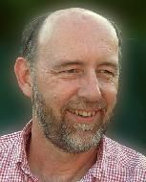

James Wilder
Notes:
Someone gave me this book about spiritual maturity. I’ll keep it anonymous, but they said, “Dad this would be a great book to read.”
Five levels of maturity. “Grow up before we grow old.” Most American males come in as late infants.
Thrive ministry is an extension of this.

Slide 11

https://thrivetoday.org/
Re-centering: resetting the brain’s NORMAL

Slide 12
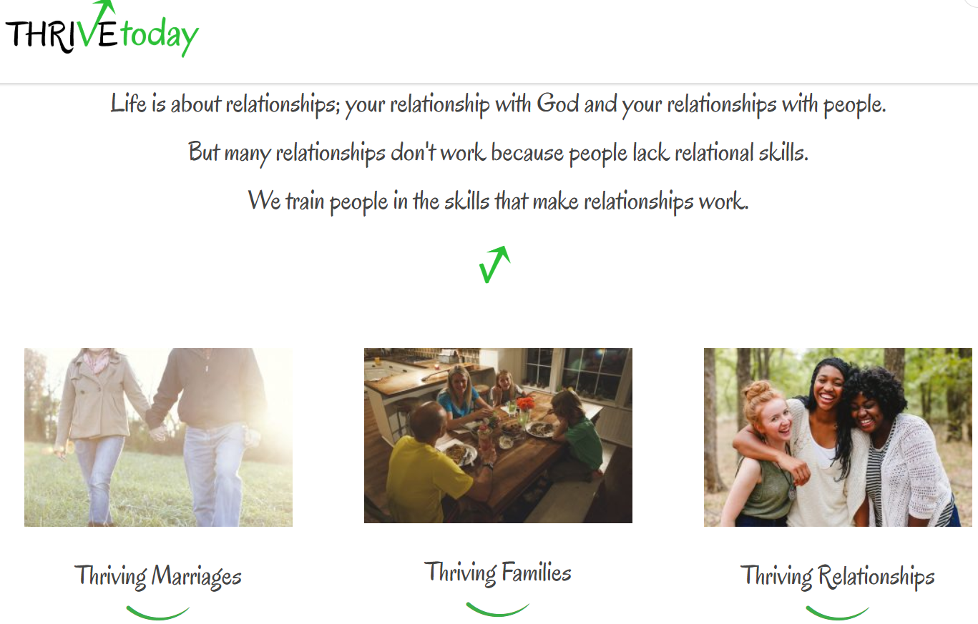
Notes:
Taught by Chris and Jen Coursey. Very Messianically attuned.

Slide 13
First premise, New normal.
Ever drive behind a vehicle not centered in lane?
Re-centering: restarting the brain’s NORMAL
Why did they panic? Do we ever panic, despair, fall to depression, discouragement?

Slide 14
A new view of
Repentance
תשובה
T’shuvah

Slide 15
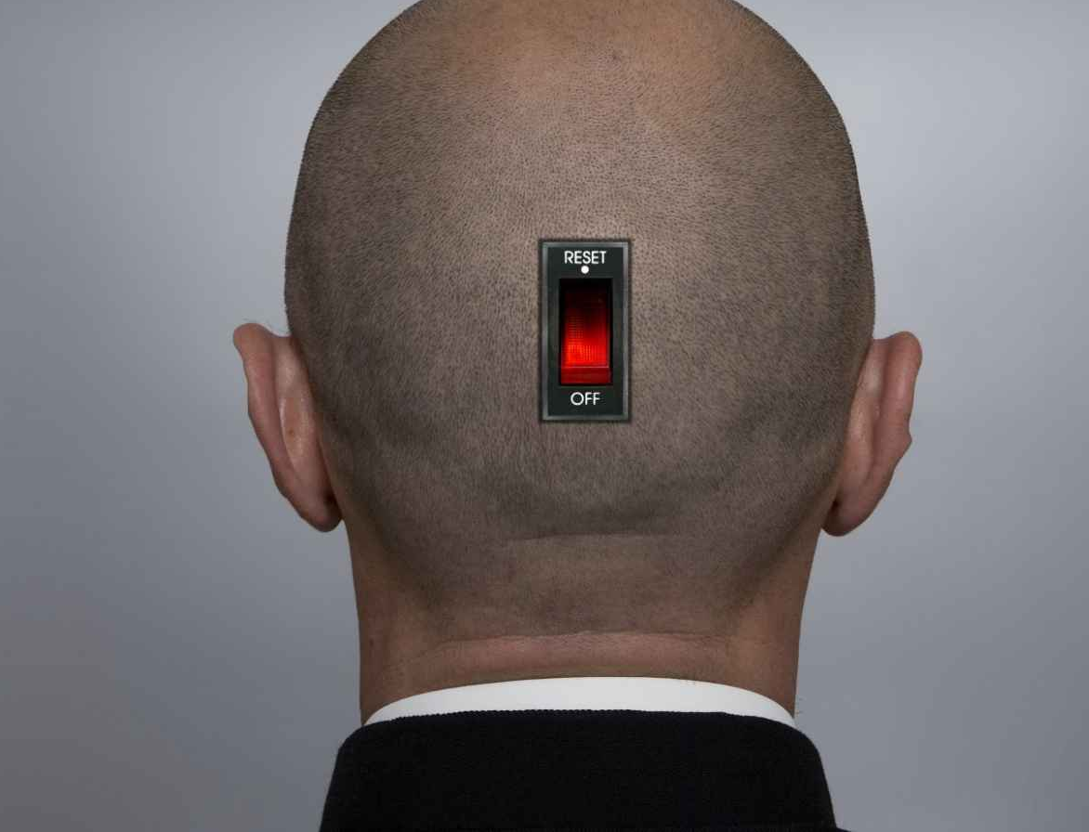
Brain reset:
Notes:
https://www.google.com/url?sa=i&source=images&cd=&cad=rja&uact=8&ved=2ahUKEwjO8buo8pvjAhWEm-AKHfrnCb8QjRx6BAgBEAU&url=%2Furl%3Fsa%3Di%26source%3Dimages%26cd%3D%26ved%3D%26url%3Dhttps%253A%252F%252Fwww.inc.com%252Fmatthew-e-may%252F4-scientifically-proven-steps-to-resetting-your-brain.html%26psig%3DAOvVaw0zUzj4AUNgXCIk717gmmER%26ust%3D1562351248568816&psig=AOvVaw0zUzj4AUNgXCIk717gmmER&ust=1562351248568816

Slide 16
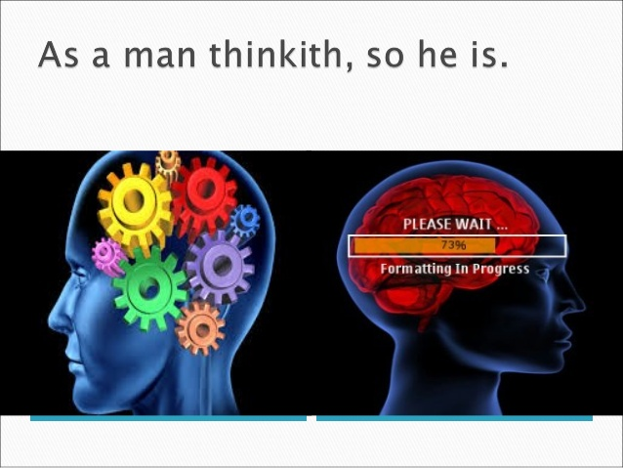
Notes:
https://www.google.com/search?q=brain+reset&safe=active&source=lnms&tbm=isch&sa=X&ved=0ahUKEwiV756H8pvjAhWFnOAKHdPVDEwQ_AUIESgC&biw=1396&bih=720#imgdii=vyejTSX91q3uOM:&imgrc=-HoVfQv4wKInXM:

Slide 17
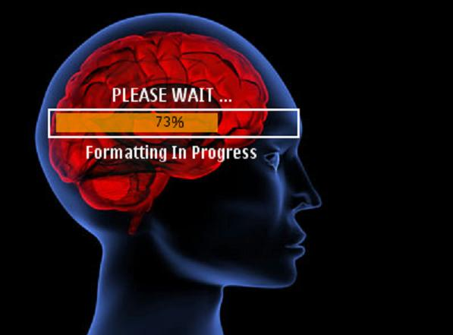
Notes:
We’re talking about a Ruakh HaKodesh Holy Spirit reset. But it takes a while to reboot, as you see.
Not psychological manipulation.

Slide 20
Philippians 4 Paradigm
Notes:
Here is the reset goal:

Slide 21
^{Phil. 4. 4-5} Rejoice in union with the Lord always! I will say it again: rejoice! Let everyone see how reasonable and gentle you are. The Lord is near!
Notes:
Do any of you remember the bestseller book “Dress for Success”? “You only get one chance to make a first impression.”

Slide 22

Dress for Success is a 1975 book by John T. Molloy about the effect of clothing on a person's success in business and personal life. It was a bestseller and was followed in 1977 by The Women's Dress for Success Book. Together, the books popularized the concept of "power dressing"
Notes:
What are we projecting, communicating?

Slide 23
^{Phil. 4. 4-5} Rejoice in union with the Lord always! I will say it again: rejoice! Let everyone see how reasonable and gentle you are. The Lord is near!

Slide 24
How do we become able
to project that image?

Slide 25
^{Phil. 4. 6-9} Don’t worry about anything; on the contrary, make your requests known to God by prayer and petition, with thanksgiving. Then God’s shalom, passing all understand-ding, will keep your hearts and minds safe in union with the Messiah Yeshua.
Notes:
Three main points
Don’t worry
Prayer and supplication
With thanksgiving
New normal

Slide 26
^{Phil. 4. 6-9} In conclusion, brothers, focus your thoughts on what is true, noble, righteous, pure, lovable or admirable, on some virtue or on something praiseworthy. Keep doing what you have learned and received from me, what you have heard and seen me doing; then the God who gives shalom will be with you.

Slide 27
Focus on vs 6
Don’t worry about anything; on the contrary, make your requests known to God by prayer and petition, with thanksgiving.
Negative normal aspect
Positive normal aspect
Notes:
This will be the new normal. Maybe some of you are already there, but can be deeper!

Slide 28
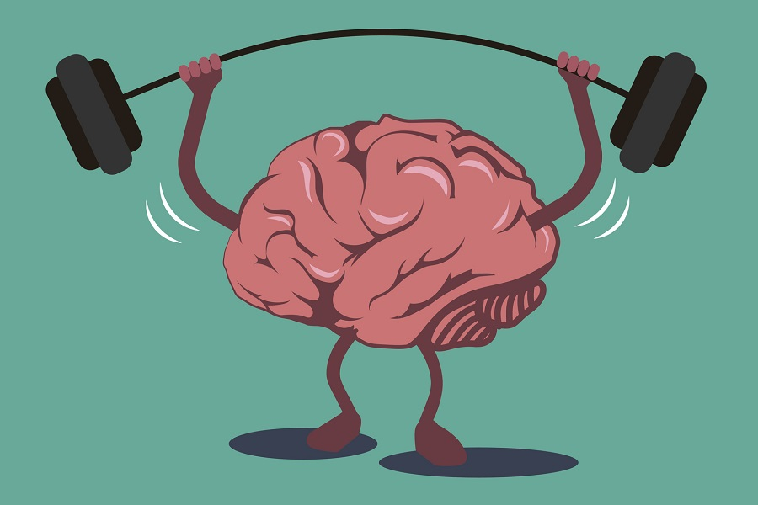
Reset, then train your brain T’shuvah תשובה
Notes:
https://www.google.com/search?q=brain+training&safe=active&source=lnms&tbm=isch&sa=X&ved=0ahUKEwj4xfLr3ajhAhUVHzQIHRyXBHsQ_AUIDygC&biw=1164&bih=865#imgdii=pEDTREwjQWp7TM:&imgrc=D15AUzLqiN_0OM:
https://www.google.com/url?sa=i&source=images&cd=&cad=rja&uact=8&ved=2ahUKEwjXiLmn3qjhAhWxoFsKHS_fAJYQjRx6BAgBEAU&url=https%3A%2F%2Fbrainfitnesssolutions.com%2Fbrain-fitness-guide%2F&psig=AOvVaw2cDd7ARLZGPS_mVKAReDdA&ust=1553996406944215
Psycho-babble?

Slide 29

^{Phil 4.6} New normal: negative aspect
Notes:
https://biblehub.com/greek/3309.htm

Slide 30
^{Phil. 4. 6} Not anything;
μηδείς médeis
no one, none, nothing
Notes:
https://biblehub.com/greek/3309.htm

Slide 31
^{Phil. 4. 6} Don’t worry
μεριμνᾶτε merimnate
over-anxious; distracted, worried
Notes:
https://biblehub.com/greek/3309.htm

Slide 32
^{Phil 4.6 MSG} Don’t fret or worry.
אַל תִּדְאֲגוּ al tid-agu
תִּדְאֲגוּ to worry, to be concerned
לְשׁוּם דָּבָר l’shum davar
nothing, (not) anything
Is there ANYTHING you are stressing about??
Notes:
A Yeshua example of the command NOT to worry.

Slide 33
^{Lk 7.10-13} The next day Yeshua, accompanied by his talmidim and a large crowd, went to a town called Na‘im. As he approached the town gate, a ₁dead man was being carried out for burial. His mother was a ₂widow, this had been ₃her only son, and a sizeable crowd from the town was with her. When the Lord saw her, he felt compassion for her and said to her, “Don’t cry.”
Notes:
She had a LOT to worry about.
She’s alone in terms of spouse, now only son GONE. Relationally lonely, also financially destitute!
Is He saying, “Man up. Suck it up.”
There’s of course more to the story, but it lays a Yeshua model for this concept. DON’T WORRY.

Slide 34
SW version
Don’t stress out
Over ANYTHING!
Sounds heartless:
Money woes: survive, outlive, shamed
People problems: offended, failure, rejection, abandonment
Health: pain, disability, weakness

Slide 35
Negative side of the new normal.
“Sticky statement”
Don’t stress out over ANYTHING!
How is that possible?
How can I just turn off stress?
Notes:
People offend me, insult me.
Life challenges scare me.

Slide 36
Positive side of the new normal.
Notes:
Two parts

Slide 37
^{Phil. 4. 6-7} Don’t worry about anything; on the contrary, make your requests known to God by prayer and petition, with thanksgiving. Then God’s shalom, passing all understand-ding, will keep your hearts and minds safe in union with the Messiah Yeshua.
Notes:
I am a believer and doer of prayer. Daily personal, Tuesday Teerosh, with my family, extended times, prayer retreat.
I also believe in praising G-d. Tikkun
What was radically new to me was combining heavy intercession with uplifting thanksgiving.
You can pray and cry and groan, and come away as an oppressed groaning loner.

Slide 38

prayer and petitions
Notes:
https://biblehub.com/greek/2169.htm
Let’s look at the words of the Word.

Slide 39
δέησις deésis supplication:
praying for a specific, felt need
heart-felt petition, arising out of deep personal need (sense of lack, want).
a felt need that is personal and urgent
Notes:
https://biblehub.com/greek/2169.htm

Slide 40
~ ^{Ro.8.26} The Spirit himself pleads on our behalf with groanings too deep for words;
~ ^{1 Tim 2.1} Therefore, first of all I urge that requests, prayers, intercessions, and thanksgiving be made on behalf of all people.
Notes:
Heavy stuff! However…

Slide 41

With thanksgiving. ?!?
εὐχαριστία eucharistia thankfulness, gratitude; giving of thanks, thanksgiving
Notes:
https://biblehub.com/greek/2169.htm
Messianic scriptures/New Testament original is Greek but thinking is Hebrew. So…

Slide 42
בִּתְפִלָּה וּבְתַחֲנוּנִים וּבְהוֹדָיָה
Bi-tifeelah, uv-tkhanunim, uv-hodayah
בִּתְפִלָּה prayer; wish, entreaty, supplication
וּבְתַחֲנוּנִים supplicatory prayer; plea, entreaty, cry for help
Notes:
Heavy stuff

Slide 43
וּבְהוֹדָיָה
thanksgiving, prayer of thanks, praise,
Notes:
Uplifting, empowering, liberating JOY!

Slide 44
Positive side of the new normal:
prayer and petition, with thanksgiving.
Takes time. Lament, then praise. For Who G-d is, for how Yeshua is working, for what it unseen.
Notes:
https://biblehub.com/greek/2169.htm
Prayer is generally heavy, even a lament, a cry in distress. It’s right to start there, to vent to G-d. In Sozo Ps 43
But if we stay there, we ruin it. We lament → lamentable. We lament, then thanks.

Slide 45
^{T’hillim /Psalm 43} Vindicate me, O God, and champion my cause against an ungodly nation. From a deceitful and unjust man, deliver me! For You are my God, my stronghold. Why have You spurned me? Why do I go about gloomy under pressure by the enemy?
Notes:
Is that a good description of being down?

Slide 46
^{T’hillim /Psalm 43} Send forth Your light and Your truth— let them guide me. Let them bring me to Your holy mountain and to Your dwelling places. Then I will come to the altar of God, to the God of my exceeding joy, and praise You upon the harp —O God, my God.

Slide 47
^{T’hillim /Psalm 43} Why are You downcast, O my soul? Why are you murmuring within me? Hope in God, for I will yet praise Him, the salvation of my countenance.
Notes:
Salvation of your face…your gloomy face → JOY in Him. In Messiah and His love and faithfulness and resurrection power.

Slide 48
“Sticky statement”
Don’t stress out over ANYTHING! [rather do] prayer and petition, with thanksgiving.
New normal
Brain training by dwelling on chosen emotion
Notes:
I do a fair amount of crisis counseling. People come to me upset with each other, and G-d helps us.
I would like to suggest that MOST of that work can be done by entering this new normal.

Slide 49
Reset, then train your brain to
the new normal: prayer with praise
Notes:
Pause now: consider some grief. Family issue, financial issue, health issue. Marriage, children, congregation. Prayer and supplication with THANKSGIVING!!
Jake Rosenberg. PhD 2nd gen Messianic rabbi. Ideal kid. Man. Mass in spleen…
https://www.google.com/search?q=brain+training&safe=active&source=lnms&tbm=isch&sa=X&ved=0ahUKEwj4xfLr3ajhAhUVHzQIHRyXBHsQ_AUIDygC&biw=1164&bih=865#imgdii=pEDTREwjQWp7TM:&imgrc=D15AUzLqiN_0OM:
https://www.google.com/url?sa=i&source=images&cd=&cad=rja&uact=8&ved=2ahUKEwjXiLmn3qjhAhWxoFsKHS_fAJYQjRx6BAgBEAU&url=https%3A%2F%2Fbrainfitnesssolutions.com%2Fbrain-fitness-guide%2F&psig=AOvVaw2cDd7ARLZGPS_mVKAReDdA&ust=1553996406944215

Slide 50
New Normal:
^{Mtt 4.17} Yeshua began proclaiming, “Turn from your sins to God, for the Kingdom of Heaven is near!”
Means?
From gross sin: soldiers and tax collectors, prostitutes

Slide 51
From slothfulness and negligence of the Torah mitzvot
Better: prep for the present Kingdom of the Spirit: humility, meekness, purity, hunger, mercy, peacemaking, longsuffering
Heaven = the atmosphere we breathe

Slide 52
^{Col.3.15-17} Let the shalom of Messiah rule in your hearts—to this shalom you were surely called in one body. Also be thankful. Let the word of Messiah dwell in you richly, teaching and admonishing one another
Notes:
What I teach you about dwelling in the heavenly atmosphere of
“No stress, intense prayer WITH thanksgiving” you exemplify and teach to others. That is, if I’m just a shepherd and comfort and help to you [I hope] but don’t equip you to do the same for others, then I’ve failed as equipper.

Slide 53
^{Col.3.15-17} with all wisdom in psalms and hymns and spiritual songs, singing with gratitude in your hearts to God. And whatever you do in word or deed, do all in the name of the Lord Yeshua, giving thanks to God the Father through Him.
Notes:
New normal: no worry, prayer with PRAISE
Breathe it. Kingdom of Heaven: heavenly atmosphere!!

Slide 54
Do some brain training,
Impart some brain training!!
Breathe the heavenly air of
“I refuse stress, rather live in intense prayer WITH thanksgiving”
Notes:
What time I am afraid, I will trust in you.
Practice gesture.

Slide 55
^{Yn 15.4-5} Stay united with me, as I will with you — for just as the branch can’t put forth fruit by itself apart from the vine, so you can’t bear fruit apart from me. “I am the vine and you are the branches. Those who stay united with me, and I with them, are the ones who bear much fruit; because apart from me you can’t do a thing.

Slide 56
What about when I get out of this mindset, not prayerful, intercessory, not joyful?
Mad, grouchy, frustrated, irritated, insulted, offended, scared…

Slide 57
Exercises and 19 Brain skills
https://thrivetoday.org/tag/19-skills/

Slide 58
I don’t feel like I want to stay in joy and shalom.
Armed intruder
Dirty dishes left out

Slide 59
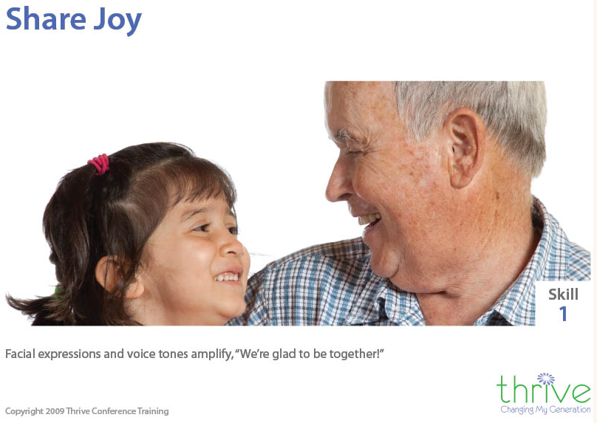
Notes:
http://www.thrivetraining.org/nineteenskills.html
Right-hemisphere-to-right-hemisphere communication of our most desired positive
emotional state. p. 42

Slide 60
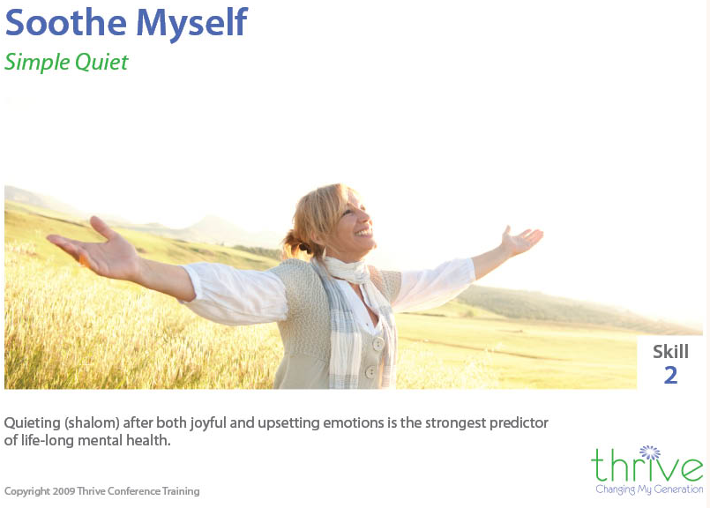
Notes:
Skill 2 Soothe Myself Simple Quiet Lowering my own energy level so I can rest after both joyful and upsetting emotions, as I need to and on my own, makes me feel stable. This self-soothing capacity is the strongest predictor of good mental health for the lifetime.
Technical description: Release-on-demand of serotonin by the vegetative branch of para-sympathetic nervous system to quiet both positive and distressing emotional states.
P 8 Thrive book

Slide 61

Skill 4
Notes:
A trained brain will scan the environment looking for things to appreciate, amplify, enjoy!
Untrained brain amplifies problems and pain.
High levels of the emotional state of appreciation closely match the healthy balanced state of the brain and nervous system. Creating a strong feeling of appreciation in yourself or others relieves unpleasant states and stress.
Appreciation is very similar to the let down reflex that produces milk flow when nursing and the warm contented feeling that follows for mother and child
p. 43
http://www.thrivetraining.org/nineteenskills.html

Slide 62
^{Phil. 4. 6-9} In conclusion, brothers, focus your thoughts on what is true, noble, righteous, pure, lovable or admirable, on some virtue or on something praiseworthy. Keep doing what you have learned and received from me, what you have heard and seen me doing; then the God who gives shalom will be with you.

Slide 63
What about PEOPLE issues?

Slide 66
Relational Circuits [RC] are foundational to joy. Our eyes light up when we see people and there is a release of serotonin.
If relational circuits are shut down
We want to make the problem, person, or feeling go away.

Slide 67
We don’t want to listen to what others feel or say.
Our minds are locked onto something upsetting.
I don’t want to be connected to…
I more aggressively fix or judge
Notes:
If you answer yes to any of these your relational circuits are off with that person.

Slide 68

Notes:
p. 43

Slide 69
Steps to restore RC
Startle or yawn exercise.
Lament with G-d. Ps 42.
Express appreciation to G-d for His Atonement, faithfulness and presence!
Begin dialogue.

Slide 70
Train your brain T’shuvah תשובה
Notes:
https://www.google.com/search?q=brain+training&safe=active&source=lnms&tbm=isch&sa=X&ved=0ahUKEwj4xfLr3ajhAhUVHzQIHRyXBHsQ_AUIDygC&biw=1164&bih=865#imgdii=pEDTREwjQWp7TM:&imgrc=D15AUzLqiN_0OM:
https://www.google.com/url?sa=i&source=images&cd=&cad=rja&uact=8&ved=2ahUKEwjXiLmn3qjhAhWxoFsKHS_fAJYQjRx6BAgBEAU&url=https%3A%2F%2Fbrainfitnesssolutions.com%2Fbrain-fitness-guide%2F&psig=AOvVaw2cDd7ARLZGPS_mVKAReDdA&ust=1553996406944215
Psycho-babble?

Slide 71
“Sticky statement”
Don’t stress out over ANYTHING! [rather do]
prayer and petition,
with thanksgiving.
New normal: Brain training by dwelling on chosen emotion

Slide 72
Living in this is subtle but powerful!!

Slide 73
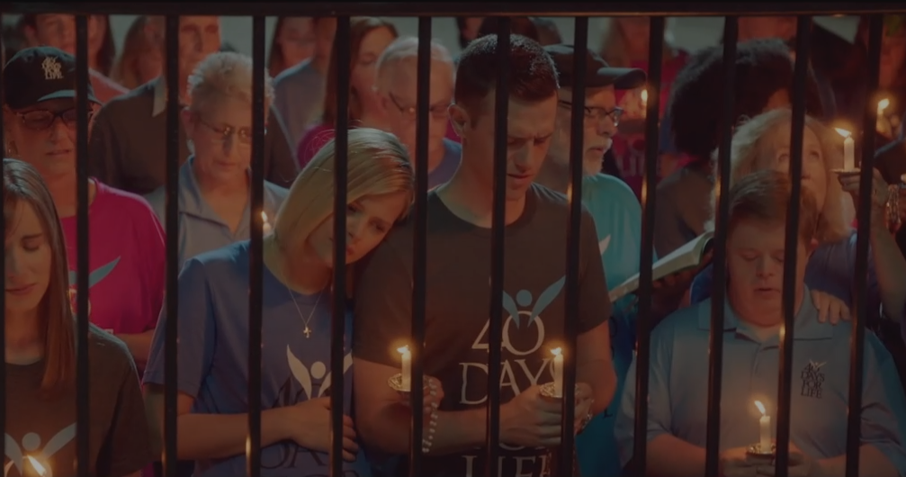
UnPlanned Movie

Slide 74
The movie…tells the true story of former Planned Parenthood executive Abby Johnson, who quit the organization to become a prominent pro-life advocate.
40 Days for Life people praying outside the Planned Parenthood clinic.

Slide 75
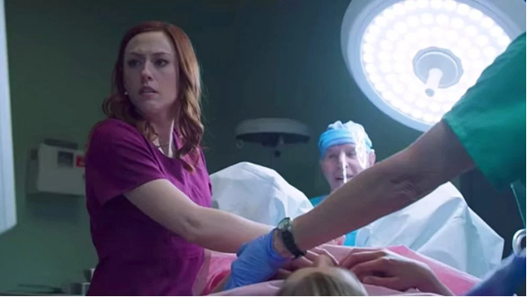
Director Abby Johnson observing the ultra sound of an abortion

Slide 76
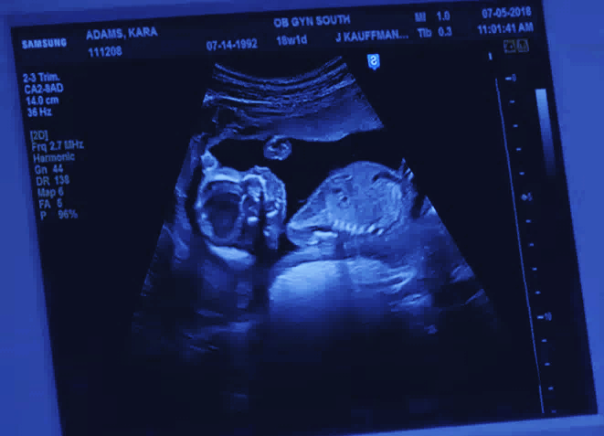
Notes:
A baby in the uterus, with a cannula [suction tube] about to be inserted. She sees the baby apparently trying to evade the tube, then the surgeon calls out, “Beam me up!” to turn on suction pump. Baby is sucked into the tube, piece by piece, brutally dismembered,

Slide 77
After never having actually witnessed one, she’s suddenly called in to assist in the ultrasound-guided abortion of a 13-week-old fetus, and what she sees on the monitor looks to her like a baby reacting to what’s being done to it.

Slide 78
At the end of the movie, a title informs us that the activist organization she joined, 40 Days for Life, has gotten 500 workers to drop out of what it describes as “the abortion industry.”
Also, dozens of clinics closed, many women see pray-ers, circle clinic and go home. Unseen effects!!
Notes:
https://variety.com/2019/film/reviews/unplanned-review-1203175761/

Slide 79
Concerning the power of gratefulness…

Slide 80
There is one word that can save a marriage, say Jerusalem’s Orthodox Jewish community leaders, who offer sound advice on keeping those healthy, long-term relationships so crucial to a happy family and long life.
Notes:
http://www.israeltoday.co.il/NewsItem/tabid/178/nid/36277/Default.aspx

Slide 81
One of the main problems in every lasting marriage is that we start to take each other for granted, and this can lead to unwanted consequences in any relationship, be it family, friends or marriage.
Notes:
http://www.israeltoday.co.il/NewsItem/tabid/178/nid/36277/Default.aspx

Slide 82
Can you remember your first year of marriage, when your partner would get up early to surprise you with a full breakfast, just the way you like? How thoughtful it was, and you couldn’t stop marveling at your amazing husband or wife. But, when he made you a cup of tea last night, you hardly noticed.
Notes:
http://www.israeltoday.co.il/NewsItem/tabid/178/nid/36277/Default.aspx

Slide 83
It is all too easy in our lifelong relationships to start taking each other for granted. Not only is this unpleasant, it spoils the atmosphere between you, misrepresents your true feelings about one another, and can have fateful implications for your marriage.
Notes:
http://www.israeltoday.co.il/NewsItem/tabid/178/nid/36277/Default.aspx

Slide 84
In an article published in an Orthodox Jewish journal, the rabbis reported that gratitude is the key to a healthy and successful marriage.
Notes:
http://www.israeltoday.co.il/NewsItem/tabid/178/nid/36277/Default.aspx

Slide 85
"The sense of appreciation and belief that your partner appreciates you directly influences how you feel about your marriage, how committed you are to it, and your belief that it will continue," said the author of the study, Ted G. Futris, an Associate Professor and Extension Family Life Specialist at the University of Georgia.
Notes:
http://www.israeltoday.co.il/NewsItem/tabid/178/nid/36277/Default.aspx

Slide 86
Rabbis and researchers alike argue that the simple act of saying "thank you" to your partner regularly, as simple and trivial as that may sound, can be a strong protection against divorce. [Even if a bit irritated]
Notes:
http://www.israeltoday.co.il/NewsItem/tabid/178/nid/36277/Default.aspx

Slide 87
Reset to new normal, then train
your brain
Notes:
https://www.google.com/search?q=brain+training&safe=active&source=lnms&tbm=isch&sa=X&ved=0ahUKEwj4xfLr3ajhAhUVHzQIHRyXBHsQ_AUIDygC&biw=1164&bih=865#imgdii=pEDTREwjQWp7TM:&imgrc=D15AUzLqiN_0OM:
https://www.google.com/url?sa=i&source=images&cd=&cad=rja&uact=8&ved=2ahUKEwjXiLmn3qjhAhWxoFsKHS_fAJYQjRx6BAgBEAU&url=https%3A%2F%2Fbrainfitnesssolutions.com%2Fbrain-fitness-guide%2F&psig=AOvVaw2cDd7ARLZGPS_mVKAReDdA&ust=1553996406944215
Psycho-babble?

Slide 88
^{Phil. 4. 6-9} In conclusion, brothers, focus your thoughts on what is true, noble, righteous, pure, lovable or admirable, on some virtue or on something praiseworthy. Keep doing what you have learned and received from me, what you have heard and seen me doing; then the God who gives shalom will be with you.

Slide 89
“Sticky statement”
Don’t stress out over ANYTHING! [rather do] prayer and petition, with thanksgiving.
New normal: Brain training by dwelling on chosen emotion
Kingdom of Heaven “air”

