Slide 1
e-handout
To have these notes
without taking notes
Go to OrHaOlam.com
Click on downloads,
messages, 2019
Notes:
.

Slide 2
Jewish technological advances:

Slide 3
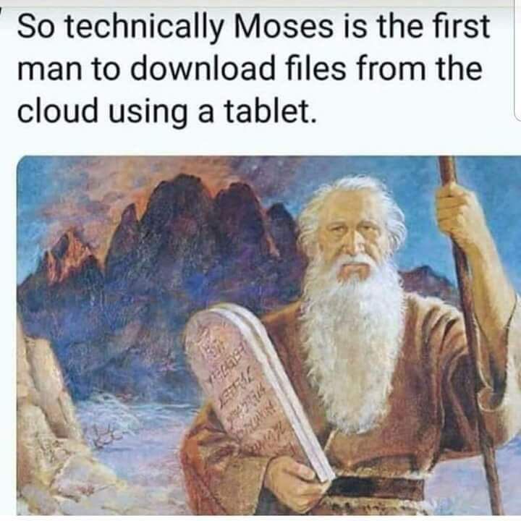
Notes:
https://me.me/i/so-technically-moses-is-the-first-man-to-download-files-2eb79f732c2744e592e511c8a8683a6f
From Brian Kaufman
Yes, these are written in stone, not changeable,
but they do have cloud support!
First text message:

Slide 4
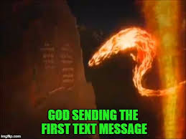
Notes:
“with the finger of G-d”

Slide 6

Israel supplies about 60%
of the global market
Fruiting Israeli date palm tree
(© Noam Armonn/Corbis)
Notes:
https://www.google.com/url?sa=i&source=images&cd=&ved=2ahUKEwis1K3vsJnkAhUNWqwKHbuFCcIQjRx6BAgBEAQ&url=https%3A%2F%2Fsonurai.com%2Fbingwallpapers%2F88&psig=AOvVaw3zH4dpxyt0s7778kLcFTuO&ust=1566662938016476 - Bing Wallpapers - Sonu Rai

Slide 7
Even Turkey And Arab Countries Buy Israel’s Medjool Dates: If you want a great Israeli dessert try a few Medjool dates. Healthy and delicious, they are low in fat and packed with nutrients like potassium, copper, magnesium, vitamin B6, niacin, calcium, iron, and vitamin K. Israelis eat on the average of a kilo of dates each year while their Arab neighbors eat around ten kilos annually.
Notes:
You would think that Turkey and the Arab countries could grow their own! Not so much.

Slide 8
However, Israelis have a corner on the sale on the giant nutritious and flavorful Medjool dates. Today Israel supplies about 60% of the global market for Medjool dates exporting this caramel-flavored fruit to some 30 different countries .(JNN)

Slide 9
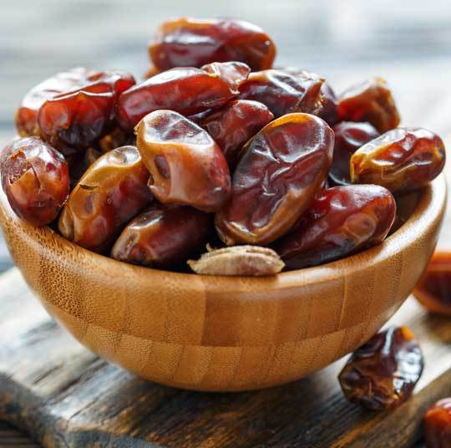
Medjool dates
Notes:
https://www.google.com/url?sa=i&source=images&cd=&ved=2ahUKEwiTur_EpZnkAhUFVK0KHUqFB30QjRx6BAgBEAQ&url=https%3A%2F%2Fwww.challahconnection.com%2Fmedjool-dates%2F&psig=AOvVaw0CTyY3YL33FvlFsttQjTqE&ust=1566659632267521

Slide 11
Last week three topics in the verses read:
Human energized vs
Yeshua / Ruakh energized
righteousness
2. Remorse vs repentance
3. Despair → suicide
Notes:
I’m an expository guy. What does the Word say? How does it apply?
I only spoke on the first one of the three.
Quick summary: Sometimes very subtle seeming difference, but huge implication and fruit over time. Applies to Jewish people and the Nations, if you love G-d and Torah, a right way and a wrong way.
Right way will instill joy and outreach, fruitfulness. Torah in the Spirit, course I took a few years ago with Michael Brown.
Wrong way will build clannishness and walls, judgementalism → murder.
So, it works to present the other two points from last week, today.

Slide 12
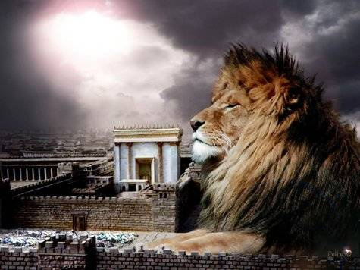
מַתִּתְיָהוּ Mattityahu
(Matthew) 27:6-8

Slide 13
Mattityahu (Matthew) 27:3
יְהוּדָה שֶׁהִסְגִּירוֹ, כְּשֶׁרָאָה שֶׁהִרְשִׁיעוּ אוֹתוֹ,
When Y’hudah, who had betrayed him, saw that Yeshua had been condemned,

Slide 14
Mattityahu (Matthew) 27:3
הִתְחָרֵט וְהֶחֱזִיר לְרָאשֵׁי הַכֹּהֲנִים וְלַזְּקֵנִים אֶת שְׁלוֹשִׁים שִׁקְלֵי הַכֶּסֶף בְּאָמְרוֹ:
he was seized with remorse and returned the thirty silver coins to the head cohanim and elders, saying,

Slide 15
Mattityahu (Matthew) 27:4
”חָטָאתִי, כִּי דָּם נָקִי הִסְגַּרְתִּי.“ אַךְ הֵם אָמְרוּ: ”מָה אִכְפַּת לָנוּ? זֶה עִנְיָנְךָ שֶׁלְּךָ!“
“I sinned in betraying an innocent man to death.” “What is that to us?” they answered. “That’s your problem.”
Notes:
דָּם נָקִי blood of an innocent

Slide 16
Mattityahu (Matthew) 27:5
הִשְׁלִיךְ אֶת הַכֶּסֶף לְתוֹךְ בֵּית אוֹצַר הַמִּקְדָּשׁ, הָלַךְ מִשָּׁם וְתָלָה אֶת עַצְמוֹ.
Hurling the pieces of silver into the sanctuary, he left; then he went off and hanged himself.
Notes:
בֵּית אוֹצַר the house of the treasury.

Slide 17
Mattityahu (Matthew) 27:6
לָקְחוּ רָאשֵׁי הַכֹּהֲנִים אֶת הַכֶּסֶף וְאָמְרוּ: ”אָסוּר לְהַכְנִיס אֶת הַכֶּסֶף לְאוֹצַר הַמִּקְדָּשׁ, כִּי מְחִיר דָּמִים הוּא.“
The head cohanim took the silver coins and said, “It is prohibited to put this into the Temple treasury, because it is blood money.”

Slide 18
Mattityahu (Matthew) 27:7
הִתְיָעֲצוּ וְקָנוּ בּוֹ אֶת שְׂדֵה הַיּוֹצֵר לקְבוּרַת הַזָּרִים.
So they decided to use it to buy the potter’s field as a cemetery for foreigners.

Slide 19
Mattityahu (Matthew) 27:8
עַל כֵּן נִקְרָא הַשָֹדֶה הַהוּא ”שְׂדֵה הַדָּם“ עַד הַיּוֹם הַזֶּה.
This is how it came to be called the Field of Blood, a name it still bears.

Slide 20
What does this portion of the Word say to us?
Remorse vs repentance
Notes:
Ever get into trouble? Traffic light, speeding ticket, faux pas in something?

Slide 21
Mattityahu (Matthew) 27:3
יְהוּדָה שֶׁהִסְגִּירוֹ, כְּשֶׁרָאָה שֶׁהִרְשִׁיעוּ אוֹתוֹ,
When Y’hudah, who had betrayed him, saw that Yeshua had been condemned,

Slide 22
Mattityahu (Matthew) 27:3
הִתְחָרֵט וְהֶחֱזִיר לְרָאשֵׁי הַכֹּהֲנִים וְלַזְּקֵנִים אֶת שְׁלוֹשִׁים שִׁקְלֵי הַכֶּסֶף:
he was seized with remorse and returned the thirty silver coins to the head cohanim and elders,
Notes:
Hebrew translation, not תשובה Tshuvah.

Slide 23

was seized with remorse
change his mind, regret
Remorse is not repentance! Metamelitheis vs metanoia
Notes:
Meta = change
Μεληθεὶς = true Melitheís
So, a change of truth, changed his story.
Cp Metanoia = changed his mind, heart, commitment.

Slide 24

A counselor writes:
He sat in my office and was remorseful.
Notes:
https://www1.cbn.com/familymatters/why-remorse-is-not-the-same-as-repentance

Slide 25
He acknowledged struggling with a sexual addiction that cost him his marriage. He was sorry for the pain his problem caused everyone. But he wasn't repentant. What's the difference?
Notes:
https://www1.cbn.com/familymatters/why-remorse-is-not-the-same-as-repentance

Slide 26
was seized with remorse
change his mind, regret
Remorse is not repentance! Metamelitheis vs metanoia
Notes:
Meta = change
Μεληθεὶς = true Melitheís
So, a change of truth, changed his story.
Cp Metanoia = changed his mind, heart, commitment.

Slide 27
^{2 Cor. 7.9-11} You were grieved according to God’s will, so that you might in no way suffer loss from us. For the grief that God wills brings a repentance that leads to salvation, leaving no regret. But the world’s grief brings death.
Notes:
https://www1.cbn.com/familymatters/why-remorse-is-not-the-same-as-repentance
World’s grief = remorse, fix this, cover this, get out of this.

Slide 28
^{2 Cor. 7.9-11} For see what this very thing—this grieving that God wills—has brought you! What diligence, what defense, what indignation, what fear, what longing, what zeal, what rendering of justice!
Notes:
https://www1.cbn.com/familymatters/why-remorse-is-not-the-same-as-repentance

Slide 29
Remorse is the beginning step on the road to repentance. Remorse has to do with getting caught, with wrong doing, and the consequences of actions. The words of remorse deal with our guilt -- a guilt we would like to have removed.
Notes:
https://www1.cbn.com/familymatters/why-remorse-is-not-the-same-as-repentance
If you get stopped for speeding?

Slide 30
Words like, "I am sorry for hurting you" or "I let you down, please forgive me" are statements of remorse. But they don't acknowledge what the person has actually done. They aren't true repentance.
Notes:
https://www1.cbn.com/familymatters/why-remorse-is-not-the-same-as-repentance

Slide 31
Paul says in Corinthians that when we have godly repentance, we go first to God and acknowledge our sin. We acknowledge our wrong doing first rather than only focusing on the consequences of our actions. My client was sorry for the pain he caused his family, but there was no acknowledgement for his sin and personal problem.
Notes:
https://www1.cbn.com/familymatters/why-remorse-is-not-the-same-as-repentance
I was wrong

Slide 32
He was hoping his family would accept his remorse and take away his guilt. He had regret and wanted it removed. His family noticed that he never took responsibility for his behavior. He didn't confess his sin to them. Only God can take our regret and remove it completely.
Notes:
https://www1.cbn.com/familymatters/why-remorse-is-not-the-same-as-repentance

Slide 33
Remorse is managing consequences, but repentance is a turning away from our behavior or sin and changing. Repentance involves grief towards God because of our sin. Once we take that grief to Him, we can leave it at the Execution Stake, and allow His grace and love to change us.
Notes:
https://www1.cbn.com/familymatters/why-remorse-is-not-the-same-as-repentance
Change the situation, or
Change me, my heart, my attitudes.
You can’t bring remorse and situation change to the atonement of Messiah.
You can bring repentance there.

Slide 34
Repentance leads to change. So while remorse is important, it is true repentance that's needed.
Notes:
https://www1.cbn.com/familymatters/why-remorse-is-not-the-same-as-repentance
From G-d’s thunder through Billy Graham:

Slide 35
There are three elements in genuine repentance.
First, there is conviction. You must know what is right before you can know what is wrong.
Notes:
https://billygraham.org/decision-magazine/january-2007/true-repentance-real-change/
Before GPS, when you know you are on the blue line, we knew which Hwy we were supposed to be on. See a road sign I 90 whew!
Usually a revelation of His Holiness to really know what is right and wrong. The old hymn “Holy, Holy, Holy”
Otherwise, compared to the rest of people, I’m OK.

Slide 36
The second element of true repentance is contrition. “The Lord is near to those who have a broken heart, and saves such as have a contrite spirit”
Notes:
https://billygraham.org/decision-magazine/january-2007/true-repentance-real-change/
Not angry, hostile, but easily intreated.

Slide 37
^{Yeshayahu/Is 57.15} For thus says the High and Exalted One who inhabits eternity, whose Name is Holy: “I dwell in a high and holy place, yet also with a contrite and humble spirit, to revive the spirit of the humble, and revive the heart of the contrite.

Slide 38
Third, repentance carries with it the idea of changing – changing your mind, changing your attitude, changing your ways.
Notes:
https://billygraham.org/decision-magazine/january-2007/true-repentance-real-change/

Slide 39
The repentant heart is the one that God can use. Peter repented, and he became a mighty rock in the structure of the faith. David repented, and his joy broke forth in the music of the Psalms.
Notes:
https://billygraham.org/decision-magazine/january-2007/true-repentance-real-change/

Slide 40
Jonah repented, and a great city heard the message in power and turned to God. Jacob repented, and God made him an ancestor of the Messiah. Paul repented, and God used him to take the light of the Good News to a pagan world.
Notes:
https://billygraham.org/decision-magazine/january-2007/true-repentance-real-change/

Slide 41
The underlying principle:
“I was wrong”
Notes:
No excuses, no you did…, he did…., she did…. Capitalism did…

Slide 42
Tonight is the beginning of the Hebrew calendar month of Elul, beginning the season of repentance, tshuvah, תשובה. Start to search where you can say, “I was wrong.”
But in the welcoming context of Messiah’s love.
Notes:
NOT “Change the situation.”
Rather: “Change me, my heart, my joy.”

Slide 43
Elul אלול
אני לדודי ודודי לי
Ani l’dodi v’dodi lee
I am my beloved’s,
and my beloved is mine.

Slide 44
In the context of faith in the atoning death and resurrection of the Messiah, expressing His love for us!
Notes:
PAUSE for seekers.

Slide 46
What else does this portion of the Word say to us?
Repentance vs Remorse
Despair → suicide

Slide 47
Mattityahu (Matthew) 27:4
”חָטָאתִי, כִּי דָּם נָקִי הִסְגַּרְתִּי.“ אַךְ הֵם אָמְרוּ: ”מָה אִכְפַּת לָנוּ? זֶה עִנְיָנְךָ שֶׁלְּךָ!“
“I sinned in betraying an innocent man to death.” “What is that to us?” they answered. “That’s your problem.”
Notes:
דָּם נָקִי blood of an innocent

Slide 48
Mattityahu (Matthew) 27:5
הִשְׁלִיךְ אֶת הַכֶּסֶף לְתוֹךְ בֵּית אוֹצַר הַמִּקְדָּשׁ, הָלַךְ מִשָּׁם וְתָלָה אֶת עַצְמוֹ.
Hurling the pieces of silver into the sanctuary, he left; then he went off and hanged himself.
Notes:
בֵּית אוֹצַר the house of the treasury.

Slide 49
Mattityahu (Matthew) 27:6
לָקְחוּ רָאשֵׁי הַכֹּהֲנִים אֶת הַכֶּסֶף וְאָמְרוּ: ”אָסוּר לְהַכְנִיס אֶת הַכֶּסֶף לְאוֹצַר הַמִּקְדָּשׁ, כִּי מְחִיר דָּמִים הוּא.“
The head cohanim took the silver coins and said, “It is prohibited to put this into the Temple treasury, because it is blood money.”

Slide 50
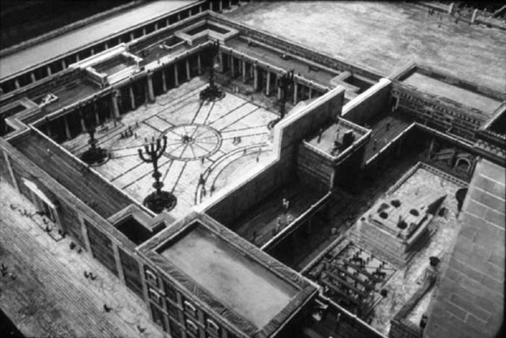
Notes:
http://www.womeninthebible.net/women-bible-old-new-testaments/the-widows-mite/
Court of women, 1.5x football field,
with giant Sukkot menorahs

Slide 51
Mattityahu (Matthew) 27:7
הִתְיָעֲצוּ וְקָנוּ בּוֹ אֶת שְׂדֵה הַיּוֹצֵר לקְבוּרַת הַזָּרִים.
So they decided to use it to buy the potter’s field as a cemetery for foreigners.

Slide 52
Mattityahu (Matthew) 27:8
עַל כֵּן נִקְרָא הַשָֹדֶה הַהוּא ”שְׂדֵה הַדָּם“ עַד הַיּוֹם הַזֶּה.
This is how it came to be called the Field of Blood, a name it still bears.

Slide 53
Despair → suicide

Slide 54
Yehudah/Judas should have run to Yeshua. Instead, he tried to fix it, renounce the money…
But he abandoned hope from the power of G-d, despaired. He could not, on his own, fix this.
Dante’s Inferno: sign over the gate of hell:

Slide 55
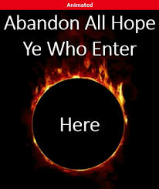
Notes:
https://www.google.com/url?sa=i&source=images&cd=&ved=2ahUKEwjAkauBjZrkAhURlKwKHQKICZwQjRx6BAgBEAQ&url=%2Furl%3Fsa%3Di%26source%3Dimages%26cd%3D%26ved%3D%26url%3Dhttp%253A%252F%252Fslaterpress.com%252F%26psig%3DAOvVaw3PhBkDB5bvCEL_6OkRd089%26ust%3D1566687715014260&psig=AOvVaw3PhBkDB5bvCEL_6OkRd089&ust=1566687715014260

Slide 56
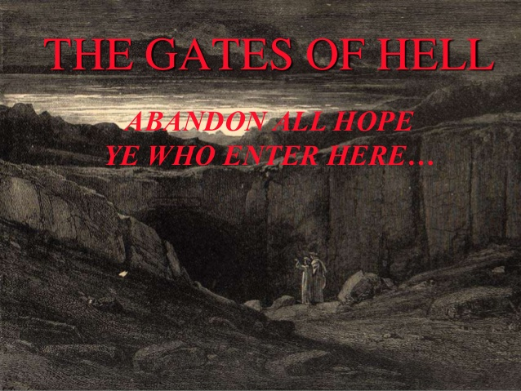
Notes:
Essence of hell: end of hope. There is a real hell, for those who refuse Messiah’s salvation.

Slide 57
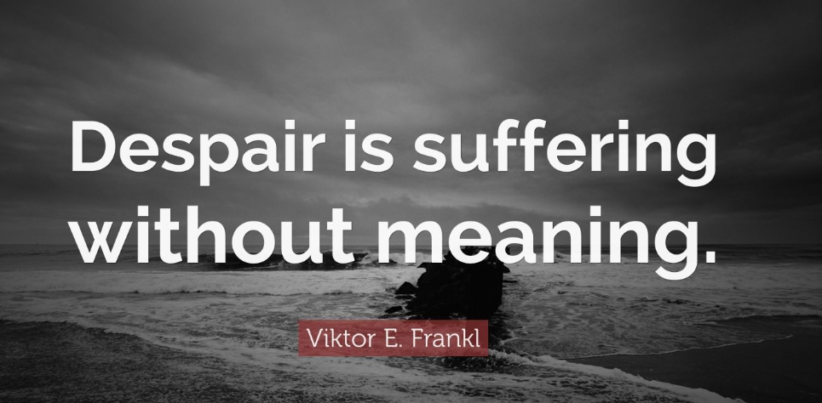
Notes:
https://quotefancy.com/quote/927256/Viktor-E-Frankl-Despair-is-suffering-without-meaning
an Austrian psychologist as well as a Holocaust survivor. Surviving Theresienstadt, Auschwitz, Kaufering and Türkheim.

Slide 58
“The opposite of hope is despair, and when we despair, it is because we feel there are no choices.” Warren G. Bennis, On Becoming a Leader

Slide 59
Causes of suicide:
Guilt, real and toxic
Abandonment
Hopelessness
Notes:
Me as a teen. Fatherlessness. Motherlessness. Jewish mother criticism / performance. Likely would have been a suicide if Yeshua hadn’t found me!

Slide 60
In 2017, 47,173 Americans killed themselves. In that single year, in other words, the suicide count was nearly seven times greater than the number of American soldiers killed in the Afghanistan and Iraq wars between 2001 and 2018.
Notes:
https://www.thenation.com/article/suicide-rate-americas-latest-epidemic/

Slide 61
A suicide occurs in the United States roughly once every 12 minutes. What’s more, after decades of decline, the rate of self-inflicted deaths per 100,000 people annually—the suicide rate—has been increasing sharply since the late 1990s.
Notes:
https://www.thenation.com/article/suicide-rate-americas-latest-epidemic/

Slide 62
Suicides now claim two-and-a-half times as many lives in this country as do homicides, even though the murder rate gets so much more attention.
Notes:
https://www.thenation.com/article/suicide-rate-americas-latest-epidemic/

Slide 63
United States military veteran suicide is an ongoing phenomenon regarding a reportedly high rate of suicide among U.S. military veterans, in comparison to the general public. According to the most recent report published by the United States
Notes:
https://en.wikipedia.org/wiki/United_States_military_veteran_suicide

Slide 64
Department of Veterans Affairs (VA) in 2016, which analyzed 55 million veterans' records from 1979 to 2014, the current analysis indicates that an average of 20 veterans a day die from suicide.
Notes:
https://en.wikipedia.org/wiki/United_States_military_veteran_suicide

Slide 65
From Psychology Today: They [suicides] are depressed. This is, without question, the most common reason people die by suicide. Severe depression is almost always accompanied by a pervasive sense of suffering as well as the belief that escape from it is hopeless.
Notes:
https://www.psychologytoday.com/us/blog/happiness-in-world/201004/the-six-reasons-people-attempt-suicide

Slide 66
…depression, as we all know, is almost always treatable, we should all seek to recognize its presence in our close friends and loved ones. Often, people suffer with it silently, planning suicide without anyone ever knowing.
Notes:
https://www.psychologytoday.com/us/blog/happiness-in-world/201004/the-six-reasons-people-attempt-suicide

Slide 67
Despite making both parties uncomfortable, inquiring directly about suicidal thoughts, in my experience, almost always yields an honest response. If you suspect someone might be depressed, don't allow your tendency to deny the possibility of suicidal ideation prevent you from asking about it.
Notes:
https://www.psychologytoday.com/us/blog/happiness-in-world/201004/the-six-reasons-people-attempt-suicide
“I didn’t want to get involved!” BOGUS

Slide 68
The warning signs of suicide are indicators that a person may be in acute danger and may urgently need help.
Talking about wanting to die or to kill oneself;
Looking for a way to kill oneself;
Talking about feeling hopeless or having no purpose;
Notes:
https://save.org/about-suicide/warning-signs-risk-factors-protective-factors/

Slide 69
Talking about feeling trapped or being in unbearable pain;
Talking about being a burden to others;
Increasing the use of alcohol or drugs;
Notes:
https://save.org/about-suicide/warning-signs-risk-factors-protective-factors/

Slide 70
Acting anxious, agitated, or reckless;
Sleeping too little or too much;
Withdrawing or feeling isolated;
Showing rage or talking about seeking revenge; and
Displaying extreme mood swings.
Notes:
https://save.org/about-suicide/warning-signs-risk-factors-protective-factors/

Slide 71
Are we careful when feeling overwhelmed, hopeless, to run to Yeshua AND to friends?
Are we on the lookout for people entering / appearing hopeless?

Slide 72
Fatherlessness

Slide 73
Charisma Magazine:
At this point, however, what is clear is the vast majority of shooters came from broken families without a consistent biological father throughout their rearing and development.
Notes:
https://www.charismanews.com/opinion/in-the-line-of-fire/77655-the-spirit-of-jezebel-fatherless-america-and-mass-shootings?utm_source=In%20the%20Line%20of%20Fire&utm_medium=email&utm_content=subscriber_id:5194514&utm_campaign=Blogger%20-%20Michael%20Brown%20-%202019-08-19

Slide 74
We found maybe four or five of the 27 shooters that we could definitively conclude (without doubt) had been raised in an intact family, or a family that included the biological dad at home, or a biological father who was consistently at home.
Notes:
https://www.charismanews.com/opinion/in-the-line-of-fire/77655-the-spirit-of-jezebel-fatherless-america-and-mass-shootings?utm_source=In%20the%20Line%20of%20Fire&utm_medium=email&utm_content=subscriber_id:5194514&utm_campaign=Blogger%20-%20Michael%20Brown%20-%202019-08-19

Slide 75
Are we careful when feeling overwhelmed, hopeless, to run to Yeshua AND to friends?
Are we on the lookout for people entering / appearing hopeless?

Slide 76
When overwhelmed, see G-d’s hand in the fire, the flood, the opposition.

Slide 77
Here in Southern California we are very fire conscious. We have discovered that many varieties of plants don’t reproduce unless there is a fire that generates enough heat to burn off the outer shells. So, fire is a part of the renewal process.
Notes:
I regularly praise G-d for the things going backward in my life, ministry! The fire is part of the renewal!!

Slide 78
“When you are in distress and all these things have come upon you, in the latter days You will return to the Lord your God and listen to His voice. For the Lord your God is a compassionate God; He will not fail you nor destroy you nor forget the covenant with your fathers which He swore to them.” ^{(Deuteronomy 4:30-31)}

Slide 79
Mattityahu (Matthew) 27:4
”חָטָאתִי, כִּי דָּם נָקִי הִסְגַּרְתִּי.“ אַךְ הֵם אָמְרוּ: ”מָה אִכְפַּת לָנוּ? זֶה עִנְיָנְךָ שֶׁלְּךָ!“
“I sinned in betraying an innocent man to death.” “What is that to us?” they answered. “That’s your problem.”
Notes:
They may have been referring to a Torah technicality. That it was his problem. He accused Yeshua, now he was bearing the responsibility and consequences.

Slide 80
^{Dvarim 19.16-19} “If a malicious witness comes forward and gives false testimony against someone, then both the men involved in the controversy are to stand before Adoni, before the cohanim and the judges in office at the time.

Slide 81
^{Dvarim 19.16-19} The judges are to investigate carefully. If they find that the witness is lying and has given false testimony against his brother, you are to do to him what he intended to do to his brother.

Slide 82
Mattityahu (Matthew) 27:5
הִשְׁלִיךְ אֶת הַכֶּסֶף לְתוֹךְ בֵּית אוֹצַר הַמִּקְדָּשׁ, הָלַךְ מִשָּׁם וְתָלָה אֶת עַצְמוֹ.
Hurling the pieces of silver into the sanctuary, he left; then he went off and hanged himself.

Slide 83
Mattityahu (Matthew) 27:6
לָקְחוּ רָאשֵׁי הַכֹּהֲנִים אֶת הַכֶּסֶף וְאָמְרוּ: ”אָסוּר לְהַכְנִיס אֶת הַכֶּסֶף לְאוֹצַר הַמִּקְדָּשׁ, כִּי מְחִיר דָּמִים הוּא.“
The head cohanim took the silver coins and said, “It is prohibited to put this into the Temple treasury, because it is blood money.”

Slide 84
Mattityahu (Matthew) 27:7
הִתְיָעֲצוּ וְקָנוּ בּוֹ אֶת שְׂדֵה הַיּוֹצֵר לקְבוּרַת הַזָּרִים.
So they decided to use it to buy the potter’s field as a cemetery for foreigners.

Slide 85
Mattityahu (Matthew) 27:8
עַל כֵּן נִקְרָא הַשָֹדֶה הַהוּא ”שְׂדֵה הַדָּם“ עַד הַיּוֹם הַזֶּה.
This is how it came to be called the Field of Blood, a name it still bears.

Slide 86
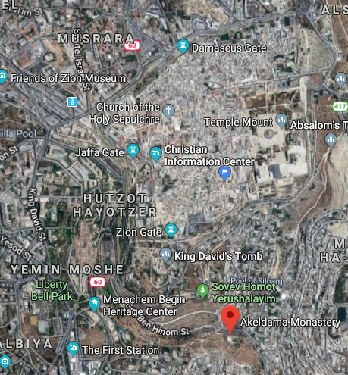

Slide 87
What does this portion of the Word say to us?
Remorse vs repentance
Despair → suicide
  Do you have hope? Yeshua is our hope!! Friends can help.
  Are you watching for hopelessness in others?

Slide 88
Repentance and faith go hand in hand. You cannot have saving repentance unless it is accompanied by saving faith in Yeshua the Messiah the Lord. We must receive Messiah by faith.
We must continue to run to Him in faith.
Notes:
https://billygraham.org/decision-magazine/january-2007/true-repentance-real-change/

Slide 89
Has there been a moment in your life when you repented of sin and then by faith received the Lord HaAdon Mashiakh Yeshua?
Have you committed ALL, even the overwhelming issues, to the Lord HaAdon Mashiakh Yeshua?
Notes:
https://billygraham.org/decision-magazine/january-2007/true-repentance-real-change/

Slide 90
If not, you can today. Your life can be changed. Your sins can be forgiven. You can live a new life.
Your overwhelming issues can begin to be addressed.
Notes:
https://billygraham.org/decision-magazine/january-2007/true-repentance-real-change/

Slide 91
Emunah אמונה = faith
In the following clip, Emunah needs to be understood as faith in Messiah, Who said to the despairing sister of Elazar/Lazarus

Slide 92
^{Yn 11.38-40} Yeshua said, “Roll away the stone!” Marta, the dead man’s sister, said to Him, “Master, by this time he stinks! He’s been dead for four days!” Yeshua said to her, “Didn’t I tell you that if you believed, you would see the glory of God?”

Slide 93
^{Yn 11.25-26} Yeshua said to her, “I AM the Resurrection and the Life! Whoever puts his trust in me will live, even if he dies; and everyone living and trusting in me will never die.

Slide 94
Repent, then believe!
Emunah in the
resurrected Messiah
Tonight starts the month of Elul, leading to High Holidays.
[Movie wording hard to hear:
“If you are pregnant,
and planning an abortion]

Slide 95
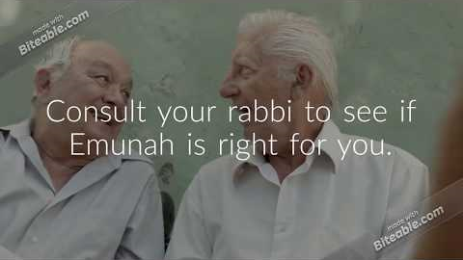
Emunah אמונה in Yeshua!
https://youtu.be/uu0L6-wwCQY

Slide 96
Repentance and faith go hand in hand. You cannot have saving repentance unless it is accompanied by saving Emunah / faith in Yeshua the Messiah the Lord. We must receive Messiah by faith.
We must continue to run to Him in faith.
Notes:
https://billygraham.org/decision-magazine/january-2007/true-repentance-real-change/

Slide 97
What does this portion of the Word say to us?
Remorse vs repentance
Despair → suicide
  Do you have hope? Yeshua is our hope!! Friends can help.
  Are you watching for hopelessness in others?

