Slide 1
e-handout
To have these notes
without taking notes
Go to OrHaOlam.com
Click on downloads,
messages, 2019
Notes:
.

Slide 2
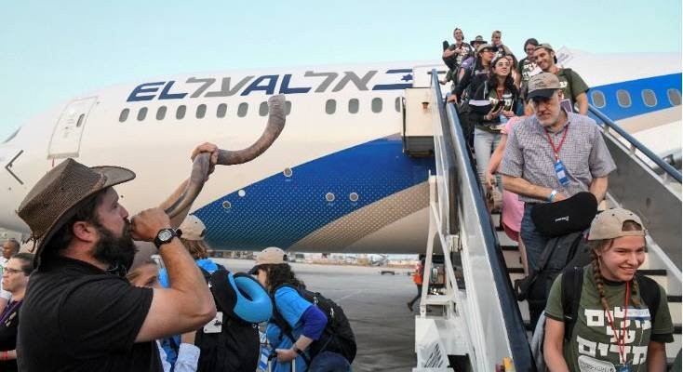
Immigration to Israel Rises 21 %
This Year
Notes:
Israel’s population is also being boosted by a decrease in emigration, according to the Central Bureau of Statistics.
The annual emigration rate in 2017, the number of Israelis not returning from abroad for more than a year, fell to 14,300, the smallest number since 2010, says the Globes report. The newcomers are said to include the returning children of Israeli citizens living abroad and who already have Israeli citizenship.
https://unitedwithisrael.org/immigration-to-israel-rises-21-percent-so-far-this-year/?utm_source=MadMimi&utm_medium=email&utm_content=War+Against+Gaza+is+Israel%E2%80%99s+Only+Option%3B+Trump%3A+%E2%80%98I+Don%E2%80%99t+Believe+the+Israelis+Are+Spying+on+Us%E2%80%99%3B+Facebook+Must+Ban+Fatah%E2%80%99s+Pro-Terror+Page%21&utm_campaign=20190913_m153996054_War+Against+Gaza+is+Israel%E2%80%99s+Only+Option%3B+Trump%3A+%E2%80%98I+Don%E2%80%99t+Believe+the+Israelis+Are+Spying+on+Us%E2%80%99%3B+Facebook+Must+Ban+Fatah%E2%80%99s+Pro-Terror+Page%21&utm_term=more_btn_dark_jpg

Slide 3
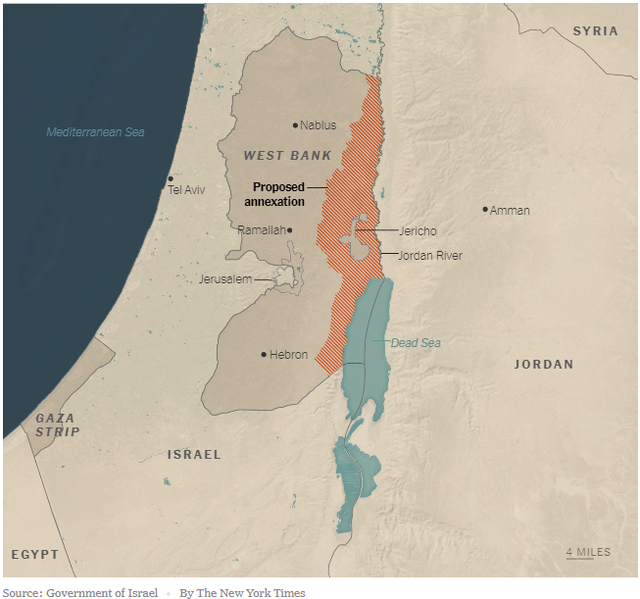
Netanyhu’s proposed annexation of Judea, Samaria, excluding Jericho
Notes:
https://www.nytimes.com/2019/09/10/world/middleeast/netanyahu-israel-west-bank.html?te=1&nl=morning-briefing&emc=edit_NN_p_20190911&section=topNews?campaign_id=9&instance_id=12293&segment_id=16919&user_id=0c340ef4a0010f69a562b70ff5e66878&regi_id=35997600tion=topNews

Slide 4
Personal:
I never ever make ethnic jokes, racial jokes, denominational jokes. I don’t say “Gosh, gee…”
From now on, you will never hear me make gender jokes. I apologize for ever doing so.
Notes:
If you don’t know why I’m saying this, better.

Slide 5
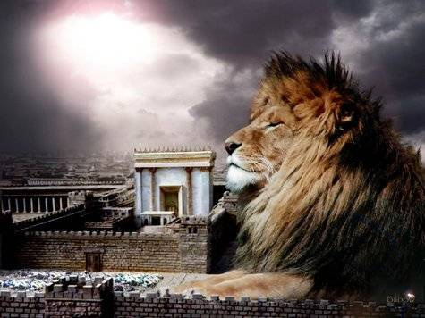
מַתִּתְיָהוּ Mattityahu
(Matthew) 27:11-14

Slide 6
Mattityahu (Matthew) 27:11
יֵשׁוּעַ עָמַד לִפְנֵי הַנָּצִיב. שָׁאַל אוֹתוֹ הַנָּצִיב:
Meanwhile, Yeshua was brought before the governor, and the governor put this question to him:

Slide 7
Mattityahu (Matthew) 27:11
”אַתָּה מֶלֶךְ הַיְּהוּדִים?“ הֵשִׁיב יֵשׁוּעַ: ”אַתָּה אוֹמֵר“,
“Are you the King of the Jews?” Yeshua answered, “The words are yours.”

Slide 8
Mattityahu (Matthew) 27:12
וְלֹא עָנָה דָּבָר כַּאֲשֶׁר הֶאֱשִׁימוּהוּ רָאשֵׁי הַכֹּהֲנִים וְהַזְּקֵנִים.
But when he was accused by the head cohanim and elders, he gave no answer.

Slide 9
Mattityahu (Matthew) 27:13
אָמַר אֵלָיו פִּילָטוֹס: ”אֵינְךָ שׁוֹמֵעַ כַּמָּה הֵם מְעִידִים נֶגְדְּךָ?“
Then Pilate said to him, “Don’t you hear all these charges they are making against you?”

Slide 10
Mattityahu (Matthew) 27:14
אַךְ הוּא לֹא הֵשִׁיב לוֹ גַּם לֹא עַל טַעֲנָה אַחַת, לְתִמְהוֹנוֹ הָרַב שֶׁל הַנָּצִיב.
But to the governor’s great amazement, he did not say a single word in reply to the accusations.

Slide 11
Summary: Two topics
Relating to royalty.
Relating to leadership.

Slide 12
Mattityahu (Matthew) 27:11
”אַתָּה מֶלֶךְ הַיְּהוּדִים?“
“Are you the King of the Jews?”

Slide 13
We don’t understand/visualize Kingship in our republic.

Slide 14
The British crown was once over the 13 colonies of America. We had Kingship.
British Parliamentary, governmental behavior in the absence of the Queen…

Slide 15
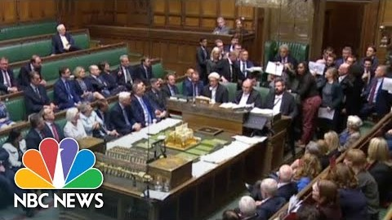
Raucous Parliament
Notes:
Am I already making an ethnic spoof? Just reporting.

Slide 16
But when the Queen is present…

Slide 17
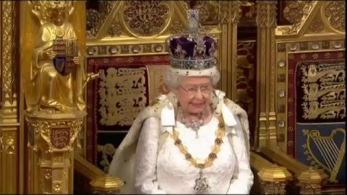
Notes:
Start at 31 seconds.

Slide 18
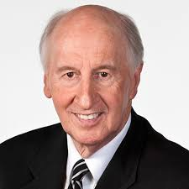
Jack Hayford
Notes:
https://www.jackhayford.org/teaching/articles/the-birth-of-majesty/

Slide 19
In 1977 my wife Anna and I spent our vacation in Great Britain, traveling throughout the land from the south country and Wales to the northern parts of Scotland. It was the same year as the 25th Anniversary of Queen Elizabeth’s coronation, and symbols of royalty were abundantly in evidence.
Notes:
https://www.jackhayford.org/teaching/articles/the-birth-of-majesty/

Slide 20
For years I have been convinced that the provisions of the Messiah for the believer not only include our forgiveness for sin; but provide restoration to a royal relationship with God as sons and daughters born into the family through His Majesty, our Savior, the Messiah Yeshua.
Notes:
https://www.jackhayford.org/teaching/articles/the-birth-of-majesty/

Slide 21
Within that relationship, as people of The Kingdom, I felt the Bible disclosed a new dimension of dominion over “all the works of the devil” bequeathed to us as heirs of God and joint-heirs with the Messiah.
Notes:
https://www.jackhayford.org/teaching/articles/the-birth-of-majesty/

Slide 22
One day, as Anna and I drove along together, the opening lyrics and melody of “Majesty” simply came to my heart. I continued driving, asking Anna to jot the words and melody line in the notebook she had beside her.
Join me. Messianized lyrics…
Notes:
Peter van der Steur and I and others were in a weeklong course taught by Jack Hayford in Van Nuys, CA. He mentioned this story, that he was driving away from one of the palaces.
https://www.jackhayford.org/teaching/articles/the-birth-of-majesty/

Slide 23
Majesty, worship His Majesty!
Unto Yeshua be all glory, honor and praise.
Majesty, Kingdom authority,
Flows from His throne, unto His own,
His anthem raise.
Notes:
https://www.jackhayford.org/teaching/articles/the-birth-of-majesty/

Slide 24
So exalt, lift up on high the name of Yeshua.
Magnify, come glorify, Messiah the King.
Majesty, worship His Majesty,
Yeshua who died, now glorified,
King of all kings.
Notes:
https://www.jackhayford.org/teaching/articles/the-birth-of-majesty/

Slide 25
^{1 Tim 1.17} Now to the King eternal, immortal, invisible, the only God, be honor and glory forever and ever. Amen.
Notes:
Only G-d, only Son. Shma שמע

Slide 26
We need to acknowledge Messiah Yeshua as King.
Royal worship
Royal behavior as His princes and princesses.
Royal authority as His princes and princesses.
Notes:
Maybe you’ve never entered into your inheritance. Receive Him, Repent of your sins, receive His Love, grace, forgiveness, royal sonship, daughterhood.

Slide 27
^{1 Tim 6.15-16} He will reveal in His own time—the blessed and only Ruler, the King of kings and the Lord of lords, who alone has immortality, dwelling in unapproachable light, whom no man has seen or is able to see. To Him be honor and eternal dominion! Amen.
Notes:
Do we live a life of praise

Slide 28
^{Rev 1.4-6} Him who is and who was and who is to come, as well as from the seven spirits who are before His throne, and from Messiah Yeshua, the faithful witness, the firstborn of the dead, and the ruler of the kings of the earth.

Slide 29
^{Rev 1.4-6} To Him who loves us and has freed us from our sins by His blood and made us a kingdom, kohanim to His God and Father—to Him be glory and power forever! Amen!

Slide 30
Look at someone next to you, and say,
“You are royalty, adopted by thye King by His Blood atonement!”

Slide 31
^{Rev. 17.14} They will make war against the Lamb, and the Lamb will overcome them — because He is Lord of lords and King of kings, and those with Him are called and chosen and faithful.”

Slide 32
We need to acknowledge Messiah Yeshua as King.
Royal worship
Royal behavior as His princes and princesses.
Royal authority as His princes and princesses.
Notes:
Maybe you’ve never entered into your inheritance. Receive Him, Repent of your sins, his Love,

Slide 33
Rosh HaShannah has a theme of the Kingship of G-d.

Slide 34
But first, a rabbit trail.
Reasons why it’s OK to call the holiday New Year, Rosh HaShannah in Vayikra/Lev.23.24

Slide 35
^{Vayikra/Lev.23.24} “Tell the people of Isra’el, ‘In the seventh month, the first of the month is to be for you a day of complete rest for remembering, a holy convocation announced with blasts
Zikaron T’ruah זִכְרוֹן תְּרוּעָה
lit: “remembering a loud sound”
Notes:
Some say we should only say “Yom T’ruah”

Slide 36
1. According to the Encyclopedia Judaica, the Babylonian name Tishri seems to derive from the root Ugaritic or Akkadian seru, which means "to begin." The ancient Semitic peoples thought of the year as beginning in the autumn, at the time of the late harvest.

Slide 37
This was the beginning of the economic year, when crops began to be sold.
2. The historian Josephus, and the ancient Aramaic translation of the Bible, the Targum Jonathan, identify Rosh HaShannah as the New Year observed by the people of Israel before the holiday of Passover was instituted.

Slide 38
3. In addition, the traditional Jewish concept is that the world was created on Rosh HaShannah, so this day is indeed the beginning of the year chronologically.
4. G-d made a spiritual cycle to start on Pesakh, but the chronological year didn't change.

Slide 39
So, Jews have two new years [actually more], a chronological one, and a spiritual one. Passover is described in these terms for it is written, ^{Ex. 12:1-2} Now Adoni said to Moses and Aaron in the land of Egypt,

Slide 40
[about Passover]: "This month shall be the beginning of months for you; it is to be the first month of the year to you. NASU

Slide 41
Therefore, it is not unscriptural to call this holiday the New Year, or Rosh HaShannah.

Slide 43
Rosh HaShannah has a theme of the Kingship of G-d.
a holy convocation announced with blasts
Zikaron T’ruah זִכְרוֹן תְּרוּעָה lit: “remembering a loud sound”

Slide 44
^{Lev 23:24} is “commemorated with loud blasts זִכְרוֹן תְּרוּעָה
Zikaron t’ruah

Slide 45
T’ruah תְּרוּעָה connotes a loud noise, whether made by
a silver trumpeter (Num 10:5),
a human outcry (Josh 6:5),
or a shofar (Lev 25:9).^{[3]}

Slide 46
^{Bamidbar/Nu 23.21} Adoni their God is with them — the King’s shout is among them!עִמּוֹ וּתְרוּעַת מֶלֶךְ בּוֹ:
Teruah here is explicitly associated with kings (Numbers 23:21 “king’s acclaim” תְרוּעַת מֶלֶךְ
Ancient interpretive translations:
Notes:
Teruah and Kings, therefore Rosh HaShannah/Teruah and royalty.

Slide 47
the Targum of Onkelos: of God their King, the Shekhinah of their King
Targum of Jonathan: of the King Messiah
Pesikta in Ketoreth Hassamim in Numb. fol. 25. 4 the days of the Messiah: and this shout may respect the joyful sound of the good news presented
Notes:
So, an ancient connection with Teruah → Rosh HaShannah and King Messiah
Targum Onkelos on the Torah (Written Law)
Targum Jonathan on the Nevi'im (Prophets)
https://www.biblestudytools.com/commentaries/gills-exposition-of-the-bible/numbers-23-21.html

Slide 48
So when we hear the shofar, it’s Messiah’s ROYAL proclamation!

Slide 49
The related root is associated with royal coronations
Sh’mu’el said to all the people, “Do you see the man Adoni has chosen, that there is no one like him among all the people?” Then all the people shouted, “Long live the king!”
וַיָּרִעוּ כָל-הָעָם וַיֹּאמְרוּ, יְחִי הַמֶּלֶךְ.

Slide 50
^{1 Kgs 1:34} Let Zadok the kohen and Nathan the prophet anoint him as king over Israel, blow the shofar and say: ‘Long live King Solomon!’

Slide 51
^{1 K 1.39-41} Then Zadok the kohen took the horn of oil out of the Tent and anointed Shlomo. Then they blew the shofar, and all the people said: “Long live King Shlomo!” All the people went up after him,

Slide 52
^{1 K 1.39-41} while the people were playing on flutes and rejoicing with great joy, so that the ground shook at their noise. Now Adoniyah and all the guests who were with him heard it, just as they finished eating. When Joab heard the sound of the shofar, he said: “Why is the city in an uproar?”

Slide 54
A number of psalms…explicitly mention God’s kingship as well as many in which this is an implicit theme, originated in a Temple-based festival in which God was (re)enthroned annually as king. This most likely occurred at the (agricultural) new-year.
Notes:
https://thetorah.com/coronation-on-rosh-hashanah-what-kind-of-king/ Professor Marc Zvi Brettler is Dora Golding Professor of Biblical Literature at Brandeis University.

Slide 55
^{T’hillim/Ps 93.1-2} Adonai is king, robed in majesty; Adonai is robed, girded with strength; The world is well established; it cannot be moved. Your throne was established long ago; you have existed forever.
Notes:
https://thetorah.com/coronation-on-rosh-hashanah-what-kind-of-king/

Slide 56
^{T’hillim/Ps 97.1-3} Adoni is king, let the earth rejoice, let the many coasts and islands be glad. Clouds and thick darkness surround him; righteousness and justice are the foundation of his throne.
Notes:
https://thetorah.com/coronation-on-rosh-hashanah-what-kind-of-king/

Slide 57
^{T’hillim/Ps 97.1-3} Fire goes before him, setting ablaze his foes on every side. His flashes of lightning light up the world; the earth sees it and trembles.
Notes:
https://thetorah.com/coronation-on-rosh-hashanah-what-kind-of-king/

Slide 58
^{T’hillim/Ps 97.1-3} The mountains melt like wax at the presence of Adoni, at the presence of the Lord of all the earth. The heavens declare his righteousness, and all the peoples see his glory.
Notes:
https://thetorah.com/coronation-on-rosh-hashanah-what-kind-of-king/

Slide 59
^{Exodus 15:18} “Adoni will reign for ever and ever!”
Adoni Melekh יי מלך
Adoni Malakh יי מלך
Adoni Yim-lokh, l’olam vaed.
יי מלך לעולם ועד

Slide 60
^{Numbers 23:21} “No harm is in sight for Jacob, no woe in view for Israel. Adoni their God is with them, And their King’s acclaim in their midst”

Slide 61
^{Deut 33:5} “Then He became King in Yeshurun, When the heads of the people assembled, The tribes of Israel together.”

Slide 62
^{Yeshyahu/Is 6.1} In the year of King ‘Uziyahu’s death I saw Adonai sitting on a high, lofty throne! The hem of his robe filled the temple.
Ps 23 Shepherd/King

Slide 63
^{Isaiah 44:6} “Thus said Adoni, the King of Israel, their Redeemer, the Adoni of armies: I am the first and I am the last, and there is no god but Me.”

Slide 64
^{Rev. 19.15-16} And out of his mouth comes a sharp sword with which to strike down nations — “He will rule them with a staff of iron.” It is he who treads the winepress from which flows the wine of the furious rage of Adoni,

Slide 65
^{Rev. 19.15-16} God of heaven’s armies. And on his robe and on his thigh he has a name written: King Of Kings and Lord Of Lords.

Slide 66
They were singing the song of Moshe, the servant of God, and the song of the Lamb:
“Great and wonderful are the things you have done, Adonai, God of heaven’s armies! Just and true are your ways, king of the nations!

Slide 67
^{Ps 22:29} For kingship is Adoni’s and He rules the nations”
^{Zech. 14:9} “Then Adoni will be king
over the whole world. On that day Adoni will be the only one, and His name will be the only name.

Slide 68
We need to acknowledge Messiah Yeshua as King.
Royal worship
Royal behavior as His princes and princesses.
Royal authority as His princes and princesses.
Notes:
Maybe you’ve never entered into your inheritance. Receive Him, Repent of your sins, his Love.
An example of behavior in the presence of royalty is truthfulness.
How many saw Ever After? 1998 Drew Barrymore

Slide 69
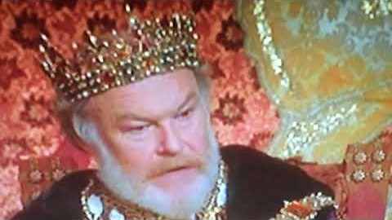
Did you lie to Her Majesty?

Slide 70
Did you lie to Her Majesty the Queen?
I learned a new word Thursday. It’s been around since the 2000’s.
Ghosting.

Slide 71


Slide 72
Ghosting is breaking off a relationship by stopping all communication and contact with the partner without any apparent warning or justification, as well as ignoring the partner's attempts to reach out or communicate.

Slide 73
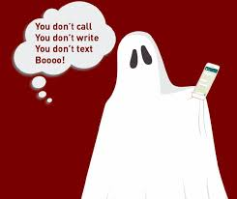

Slide 74
^{Mt. 5.37} Just let your ‘Yes’ be a simple ‘Yes,’ and your ‘No’ a simple ‘No’; anything more than this has its origin in evil.
That is, DO what you say, and if you can’t, SAY so.
Notes:
Do we keep our commitments? Is our word ironclad?

Slide 75
We need to acknowledge Messiah Yeshua as King.
Royal worship
Royal behavior as His princes and princesses.
Royal authority as His princes and princesses.
Notes:
Maybe you’ve never entered into your inheritance. Receive Him, Repent of your sins, his Love,

Slide 76
The Chicago Sun-Times estimated "between 10 percent and 20 percent" of aborted babies "survive for short periods." That means an hour, Jill insists, maybe two. Plenty of time, everyone knows, to save them.
Notes:
https://www.frc.org/get.cfm?i=WA19I04&f=WU19I02

Slide 77
Now is the time to stand up and say, "Enough." Join FRC in calling on your senator to put politics aside and remember who we are as a nation. Call them, email them, even visit them.
Notes:
https://www.frc.org/get.cfm?i=WA19I04&f=WU19I02

Slide 78
Remind them that the Born-Alive Abortion Survivors Protection Act is more than just another piece of legislation. It's our future.
Notes:
https://www.frc.org/get.cfm?i=WA19I04&f=WU19I02

Slide 79
We need to acknowledge Messiah Yeshua as King.
Royal worship
Royal behavior as His princes and princesses.
Royal authority as His princes and princesses.
Notes:
Maybe you’ve never entered into your inheritance.
Receive Him, Repent of your sins, receive His Love.
Enter more deeply. Filled with His Spirit. Speak in tongues.
Pray and intercede.
Act.
All part of living as royalty.
One more topic in this text in Mattityahu

Slide 80
Mattityahu (Matthew) 27:12
וְלֹא עָנָה דָּבָר כַּאֲשֶׁר הֶאֱשִׁימוּהוּ רָאשֵׁי הַכֹּהֲנִים וְהַזְּקֵנִים.
But when he was accused by the head cohanim and elders, he gave no answer.

Slide 81
Mattityahu (Matthew) 27:13
אָמַר אֵלָיו פִּילָטוֹס: ”אֵינְךָ שׁוֹמֵעַ כַּמָּה הֵם מְעִידִים נֶגְדְּךָ?“
Then Pilate said to him, “Don’t you hear all these charges they are making against you?”

Slide 82
Mattityahu (Matthew) 27:14
אַךְ הוּא לֹא הֵשִׁיב לוֹ גַּם לֹא עַל טַעֲנָה אַחַת, לְתִמְהוֹנוֹ הָרַב שֶׁל הַנָּצִיב.
But to the governor’s great amazement, he did not say a single word in reply to the accusations.

Slide 83
Relating to royalty.
Relating to leadership.
^{1 Timothy 5.19} Never listen to any accusation against a leader unless it is supported by two or three witnesses.

Slide 84
^{1 Timothy 5.1} Rebuke not an elder, but intreat him as a father; and the younger men as brethren;

Slide 85
כִּי תֵצֵא לַמִּלְחָמָה עַל אֹיְבֶיךָ וּנְתָנוֹ ה' אֱלֹקֶיךָ בְּיָדֶךָ
"When you go out to war against your enemies, and God your God will deliver them into your hands." (Dt. 21:10)
Our Sages noticed that in this verse it is written "when you (sg.) go out" תֵצֵאin the singular.
Notes:
Ulpan Or

Slide 86
In Hebrew we have a distinction between singular and plural forms related to verbs.
It says כי תצא KI TE'TZEH (sg.) and not
כי תצאו KI TE'TZOO (pl.)
Therefore, one needs to learn from here that it is possible to beat the enemies only when the nation of Israel is united, becoming "one person".

Slide 87
We need to acknowledge Messiah Yeshua as King.
Royal worship
Royal behavior as His princes and princesses.
Royal authority as His princes and princesses.
Notes:
Maybe you’ve never entered into your inheritance. Receive Him, Repent of your sins, his Love,

