Slide 1
e-handout
To have these notes
without taking notes
Go to OrHaOlam.com
Click on downloads,
messages, 2019
Notes:
.

Slide 2
What do you call your Uber driver during the High Holy days?
Notes:
From Jai Cohen

Slide 3
Your Shofar!

Slide 4
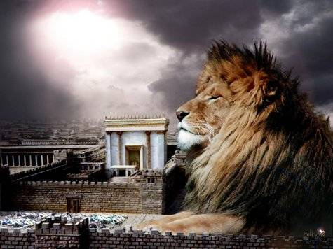
מַתִּתְיָהוּ Mattityahu
(Matthew) 27:15-18

Slide 5
How does G-d look on human government?
How should we look at human government?
How should we respond to human government?

Slide 7
Mattityahu (Matthew) 27:15
בֶּחָג הָיָה הַנָּצִיב נוֹהֵג לְשַׁחְרֵר לָעָם אָסִיר אֶחָד עַל־פִּי בְּחִירָתָם.
It was the governor’s custom during a festival to set free one prisoner, whomever the crowd asked for.

Slide 8
Interruption:
Why did the Sanhedrin, the Jewish Court, need to send Him to Pilate, the Roman governor?
Why didn’t the Sanhedrin just declare Yeshua guilty, and execute Him?
Notes:
Looking back…

Slide 9
^{Mark 15.1} As soon as it was morning, the head cohanim held a council meeting with the elders, the Torah-teachers and the whole Sanhedrin. Then they put Yeshua in chains, led him away and handed him over to Pilate.

Slide 10
^{Lk 23.1-2} The whole Sanhedrin got up and brought Yeshua before Pilate, where they started accusing him. “We found this man subverting our nation, forbidding us to pay taxes to the Emperor and claiming that he himself is the Messiah — a king!”
Notes:
Whole Sanhedrin is 70 men!! Why??

Slide 11
There is a prophetic mystery in the Jewish loss of the power of capital punishment.
Notes:
Jonathan Cahn has sort of taken ownership of the word mystery. I am borrowing it. Will delve into Cahn’s usage shortly.

Slide 12
^{Ber/Gen 49.10} The scepter will not pass from Y’hudah, nor the ruler’s staff from between his legs, until he comes to whom [obedience] belongs; [Heb. Shiloh שִׁילֹה] and it is he whom the peoples will obey.
Notes:
Shiloh שִׁילֹה=Messiah

Slide 13
Babylonian Talmud, Sanhedrin 98b, Rabbi Johanan said, “The world was created…for the sake of the Messiah, what is this Messiah’s name? The school of Rabbi Shila said: His name is Shiloh שִׁילֹה, for it is written, until Shiloh come.'”
Notes:
https://planetzion.wordpress.com/2014/10/22/woe-unto-us-for-judahs-scepter-has-departed-and-the-messiah-has-not-appeared/

Slide 14
Two things were to occur immediately after the arrival [birth] of the Messiah or Shiloh:
The Departure of the scepter of Judah or its identity: “The sceptre shall not depart from Judah…”
The Suppression of Judicial Power: “…nor a lawgiver from between his feet, until Shiloh come.”
Notes:
https://planetzion.wordpress.com/2014/10/22/woe-unto-us-for-judahs-scepter-has-departed-and-the-messiah-has-not-appeared/
Ancient literature to help us understand the Scriptures [not authoritative in and of themselves, but helpful.]

Slide 15
Targum Yerushalmi,
“Kings shall not cease from the house of Judah…until the time of the coming of the King Messiah…to whom all the dominions of the earth shall become subservient.”
Notes:
https://planetzion.wordpress.com/2014/10/22/woe-unto-us-for-judahs-scepter-has-departed-and-the-messiah-has-not-appeared/

Slide 16
Jerusalem Talmud, Sanhedrin, folio 24 “A little more than forty years before the destruction of the Temple, the power of pronouncing capital sentences was taken away from the Jews.”
Notes:
https://planetzion.wordpress.com/2014/10/22/woe-unto-us-for-judahs-scepter-has-departed-and-the-messiah-has-not-appeared/

Slide 17
Tacitus, a Roman historian, once said, “The Romans reserved to themselves the right of the sword, and neglected all else (McDowell, 1979).”
Notes:
https://planetzion.wordpress.com/2014/10/22/woe-unto-us-for-judahs-scepter-has-departed-and-the-messiah-has-not-appeared/

Slide 18
Chapter 4, folio 37 of the Babylonian Talmud “When the members of the Sanhedrin found themselves deprived of their right over life and death, a general consternation took possession of them:
Notes:
https://planetzion.wordpress.com/2014/10/22/woe-unto-us-for-judahs-scepter-has-departed-and-the-messiah-has-not-appeared/
and by Augustin Lemann in his book, “Jesus Before the Sanhedrin,” which reports a comment made by Rabbi Rachmon:

Slide 19
Chapter 4, folio 37 of the Babylonian Talmud they covered their heads with ashes, and their bodies with sackcloth, exclaiming: ‘Woe unto us for the scepter has departed from Judah and the Messiah has not come.'”
Notes:
https://planetzion.wordpress.com/2014/10/22/woe-unto-us-for-judahs-scepter-has-departed-and-the-messiah-has-not-appeared/
and by Augustin Lemann in his book, “Jesus Before the Sanhedrin,” which reports a comment made by Rabbi Rachmon
But in fact, the Messiah had come. Not yet to public revelation to Israel, but He was born.
Similar to how some say the anti-Messiah is born and is living in Europe or the Middle East.

Slide 20
Conclusion: The fact that Messiah / Shiloh / שִׁילֹה was sentenced by a non-Israelite ruler confirmed that Ber/Gen. 49.10 was fulfilled.
Messiah had to be executed by foreigners!
Notes:
G-d is faithful to keep His words of LOVE.
Yeshua IS the prophesied Messiah, the Only Son and Redeemer.

Slide 21
How does G-d look on human government?
How should we look at human government?
How should we respond to human government?
Notes:
We can rejoice! He is in charge of the affairs of men! First response. More coming.

Slide 22
Mattityahu (Matthew) 27:16
אוֹתָהּ עֵת הָיָה לָהֶם אָסִיר מְפֻרְסָם, יֵשׁוּעַ בַּר־אַבָּא שְׁמוֹ.
There was at that time a notorious prisoner being held, named Yeshua Bar-Abba.

Slide 23
Mattityahu (Matthew) 27:17
אלָכֵן כַּאֲשֶׁר נִקְהֲלוּ שָׁאַל אוֹתָם פִּילָטוֹס: ”אֶת מִי אַתֶּם רוֹצִים שֶׁאֲשַׁחְרֵר לָכֶם,
So when a crowd had gathered, Pilate said to them, “Whom do you want me to set free for you?

Slide 24
Mattityahu (Matthew) 27:17
אֶת יֵשׁוּעַ בַּר־אַבָּא אוֹ אֶת יֵשׁוּעַ הַנִּקְרָא מָשִׁיחַ?“
Bar-Abba? or Yeshua, called ‘the Messiah’?”

Slide 25
Mattityahu (Matthew) 27:18
כִּי יָדַע שֶׁמִּקִּנְאָה מָסְרוּ אוֹתוֹ.
For he understood that it was out of jealousy that they had handed him over.
Notes:
Jealousy is a treacherous killer.
There are some other Messianic Congregations in our metro area, even in Joco.
We bless them!
I heard the Kingdom Living prays weekly for the success of Or HaOlam. I love Richard Cleary, and pray for their success! And others!
Right now, think of someone you are competing with, and pray for their success! Forgive if you need to. Repent if you need to! Share issues if you need to. But DON’T stew in jealousy!!
I’m NOT urging prayer for success of abberent groups. One that holds Oral Law = authority to Tanakh and Messianic writings, OT NT

Slide 26
Mattityahu (Matthew) 27:19
While he was sitting on the judgement seat, his wife sent him a message, “Leave that innocent man alone. Today in a dream I suffered terribly because of him.”
Notes:
Very hazardous to ignore the counsel of your wife. Women have intuition: left brain right brain processing. While us guys usually clunk along with our details and logic, the women can often “feel” the right answer.

Slide 27
Mattityahu (Matthew) 27:20-22
But the head cohanim persuaded the crowd to ask for Bar-Abba’s release and to have Yeshua executed on the stake. “Which of the two do you want me to set free for you?” asked the governor. “Bar-Abba!” they answered.
Notes:
Some have denigrated, spoken against democracy, because of mob rule. But it was really unscrupulous rulers. We need to pick our rulers carefully.
Second response, after rejoicing, is responsibility. Study. Vote.

Slide 28
Mattityahu (Matthew) 27:20-22
Pilate said to them, “Then what should I do with Yeshua, called ‘the Messiah’?” They all said, “Put him to death on the stake! Put him to death on the stake!”
Notes:
Here is the question for all of us. What will YOU and I do with Yeshua? In fact, we’ve already put Him to death on the stake by our sins!!
Have you received Him and Messiah, Redeemer, your Atonement, your Master?
Filled with His Ruakh/Spirit. Speaking in tongues?

Slide 29
How does G-d look on human government?
How should we look at human government?
How should we respond to human government?

Slide 30
Is there any rhyme or reason to governmental power? Excesses, abuse, genocide, terror?

Slide 31
^{Ro. 13.1} For there is no authority except from God, and those that exist are put in place by God.
^{Mishlei/Prov 8.16} By me princes govern, nobles too, and all the earth’s rulers.

Slide 32
^{Daniel 2. 20-21} “Blessed be the name of God from eternity past to eternity future! For wisdom and power are his alone; he brings the changes of seasons and times; he installs and deposes kings.

Slide 33
^{Daniel 4.29} The Most High rules in the human kingdom and gives it to whomever he pleases.’

Slide 34
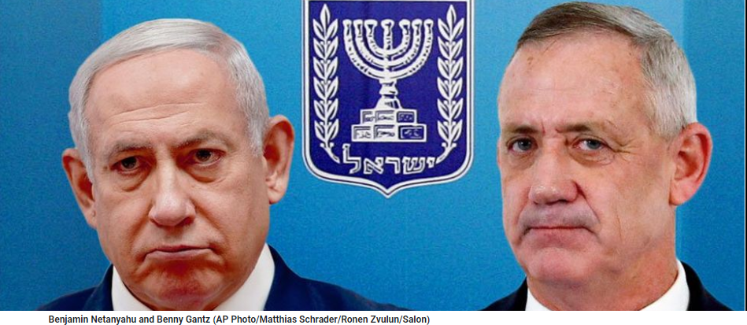
Benjamin Netayuhu Benny Gantz
Notes:
So, Maybe it IS all about the Benjamins!

Slide 35
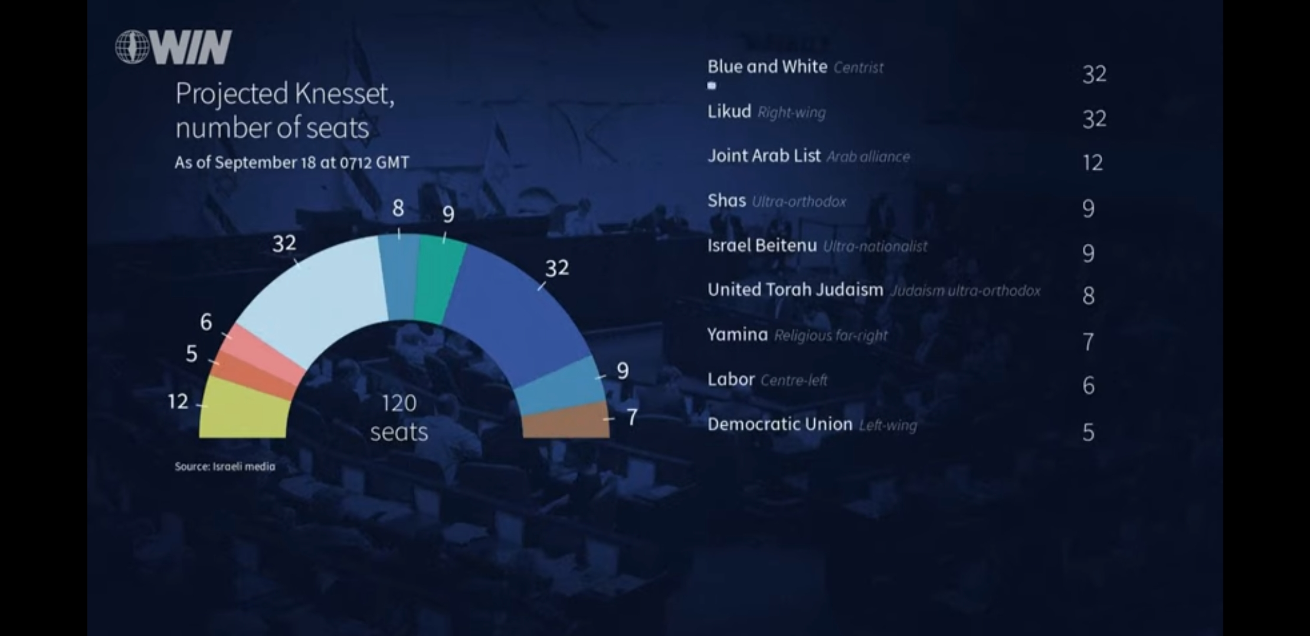
Notes:
Be in prayer. Most of us like Bibi, but he allies with staunch fervent enemies

Slide 36
G-d in His redemptive plan in Messiah is in control.
^{Ro 13.6-8} For this reason you also pay taxes, for the authorities are God’s servants, attending diligently to this very thing. Pay to everyone what is due them—tribute to whom tribute is due; tax to whom tax is due; respect to whom respect is due; honor to whom honor is due.

Slide 37
So, what can WE do?

Slide 38
^{1 Tim 2.1-4} Therefore, first of all I urge that requests, prayers, intercessions, and thanksgiving be made on behalf of all people — for kings and all who are in authority—so we may live a peaceful and quiet life
Notes:
Phil 4 teaching from Thrive this Spring…With thanksgiving

Slide 39
^{1 Tim 2.1-4} in all godliness and respectfulness. This is good and pleasing in the sight of God our Savior. He desires all men to be saved and come into the knowledge of the truth.

Slide 40
So, what can WE do?
Secondly: Save the U.S.A, the world, one heart at a time. New term for outreach:
relational development.

Slide 41
Charles Spurgeon once said, "If you can live without souls being converted, you shall live without their being converted." He prayed, "Oh! I would to God there should come upon us a divine hunger that cannot stay itself unless people yield themselves to Messiah."
Notes:
https://www.charismanews.com/opinion/heres-the-deal/78007-in-today-s-famine-for-god-s-word-here-s-the-one-sermon-i-would-preach?utm_source=In%20the%20Line%20of%20Fire&utm_medium=email&utm_content=subscriber_id:5194514&utm_campaign=Blogger%20-%20Michael%20Brown%20-%202019-09-16

Slide 42
George Barna asked church goers across America, "Have you heard of the Great Commission?"
—6%: "I'm not sure."
—25%: "Yes, but I can't recall the exact meaning."
—17%: "Yes."
—51%: "No."
Notes:
https://www.charismanews.com/opinion/heres-the-deal/78007-in-today-s-famine-for-god-s-word-here-s-the-one-sermon-i-would-preach?utm_source=In%20the%20Line%20of%20Fire&utm_medium=email&utm_content=subscriber_id:5194514&utm_campaign=Blogger%20-%20Michael%20Brown%20-%202019-09-16

Slide 43
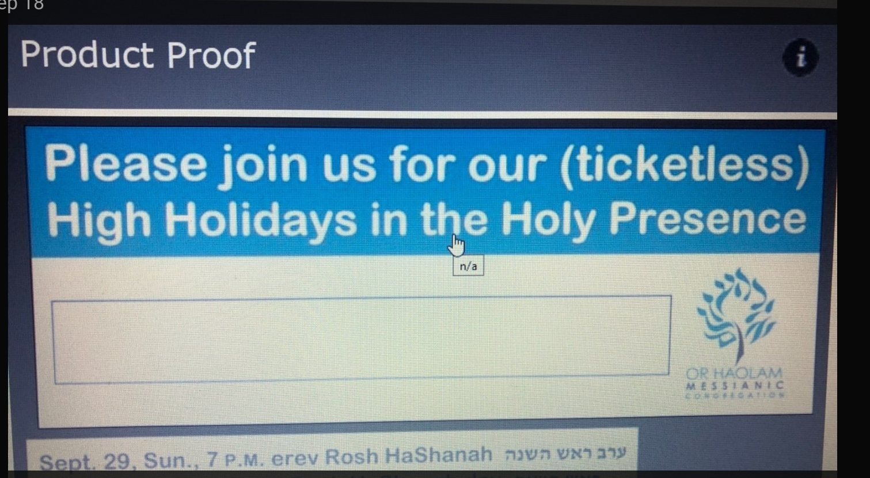

Slide 44
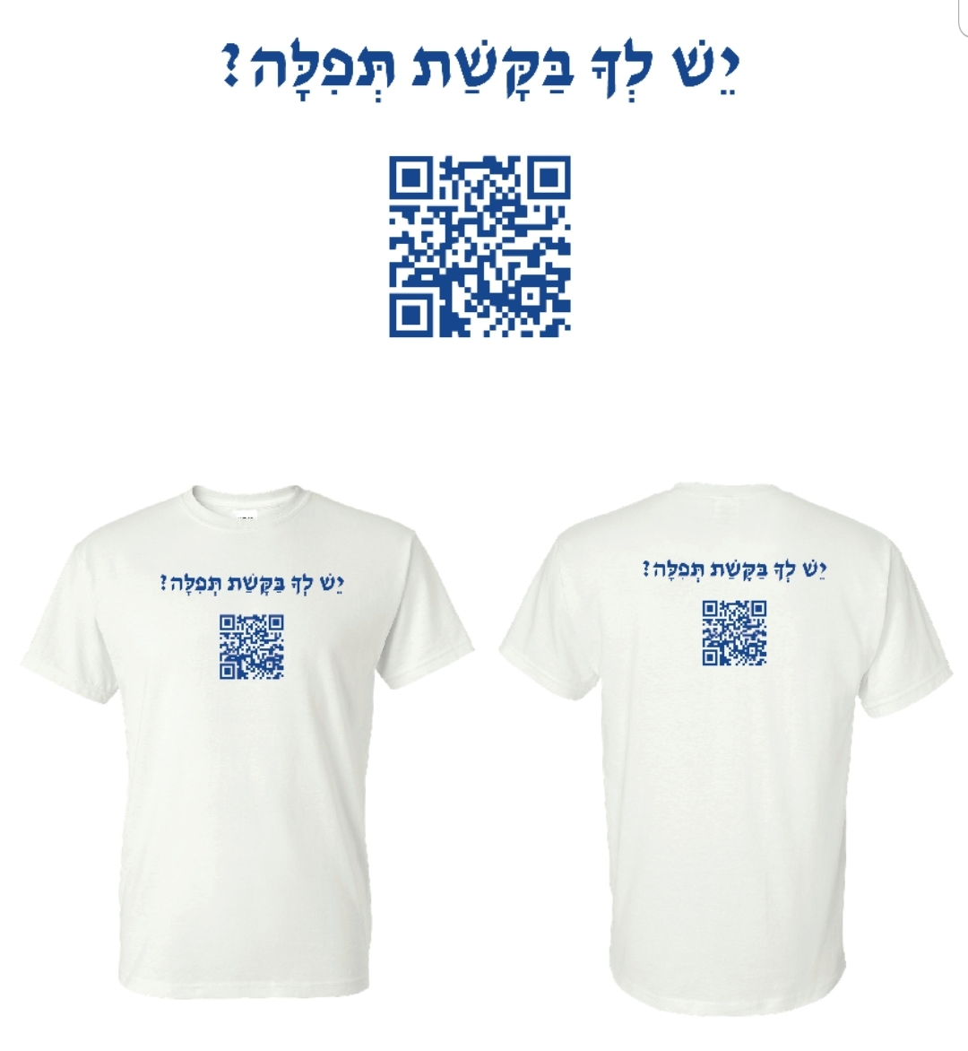

Slide 45
How does G-d look on human government?
How should we look at human government?
How should we respond to human government?

Slide 46
Is there any rhyme or reason to governmental power? Excesses, abuse, genocide, terror?

Slide 47


Slide 48
The Law of Jubilees. Yovel יוֹבֵל
^{Vayikra/Lev 25.9-11} On the tenth day of the seventh month, on Yom Kippur, you are to sound a shofar blast—you are to sound the shofar all throughout your land. You are to make the fiftieth year holy,

Slide 49
^{Vayikra/Lev 25.9-11} and proclaim liberty throughout the land to all its inhabitants. It is to be a Yovel /Jubilee to you, when each of you is to return to his own property and each of you is to return to his family. That fiftieth year will be your Yovel.

Slide 50
The biblical requirement is that the Yovel year was to be treated like a Sabbatical year, with the land lying fallow, but also required the compulsory return of all property to its original owners or their heirs, except the houses of laymen within walled cities, in addition to the freeing of all Israelite slaves.
Notes:
https://en.wikipedia.org/wiki/Jubilee_(biblical)

Slide 51
Yovel has NEVER been kept in Biblical or post-Biblical Jewish history.
It is a concept of liberty and restoration, in 50 year increments.

Slide 52
Notes:
Jon Cahn’s response:
Yes, the first time I shared any of these things outside of Beth Israel was at the Messiah Conference. And yes, the spiritual attack is always very great at the time of the release, and often on the day of the release (including being paralyzed in the hospital on one release day, in emergency surgery on another, a hurricane flooding our ministry on another, etc.) My wife said “Do you have to keep writing books?” J

Slide 53
1867 While in Palestine, Twain took a piece of stationery with “Mediterranean Hotel” printed on the top just above the date, September 24, 1867, and wrote to a Mr. Elias, a local book-binder in the Old City… [So, Twain was in Israel that date.]
Notes:
https://www.jpost.com/Opinion/Unto-the-nations-505760

Slide 54
Parasha for September 24, 1867 Parashat Nitzavim / פרשת נצבים
Torah Portion: Deuteronomy 29:9 - 30:20

Slide 55
^{D’varim 29.21-23} The foreignerהַנָּכְרִי hanokri [singular] who comes from a distant land will say, when they see the plagues of that land and the sicknesses Adoni afflicted on it: ‘Sulfur and salt, the whole land burnt!

Slide 56
^{D’varim 29.21-23} It cannot be planted, it cannot sprout, no grass can grow up on it—like the overthrow of Sodom and Gomorrah, Admah and Zeboiim, which Adoni overturned in His anger and in His wrath!’ “All the nations will say, ‘Why has Adoni done this to this land? Why this great burning anger?’

Slide 57
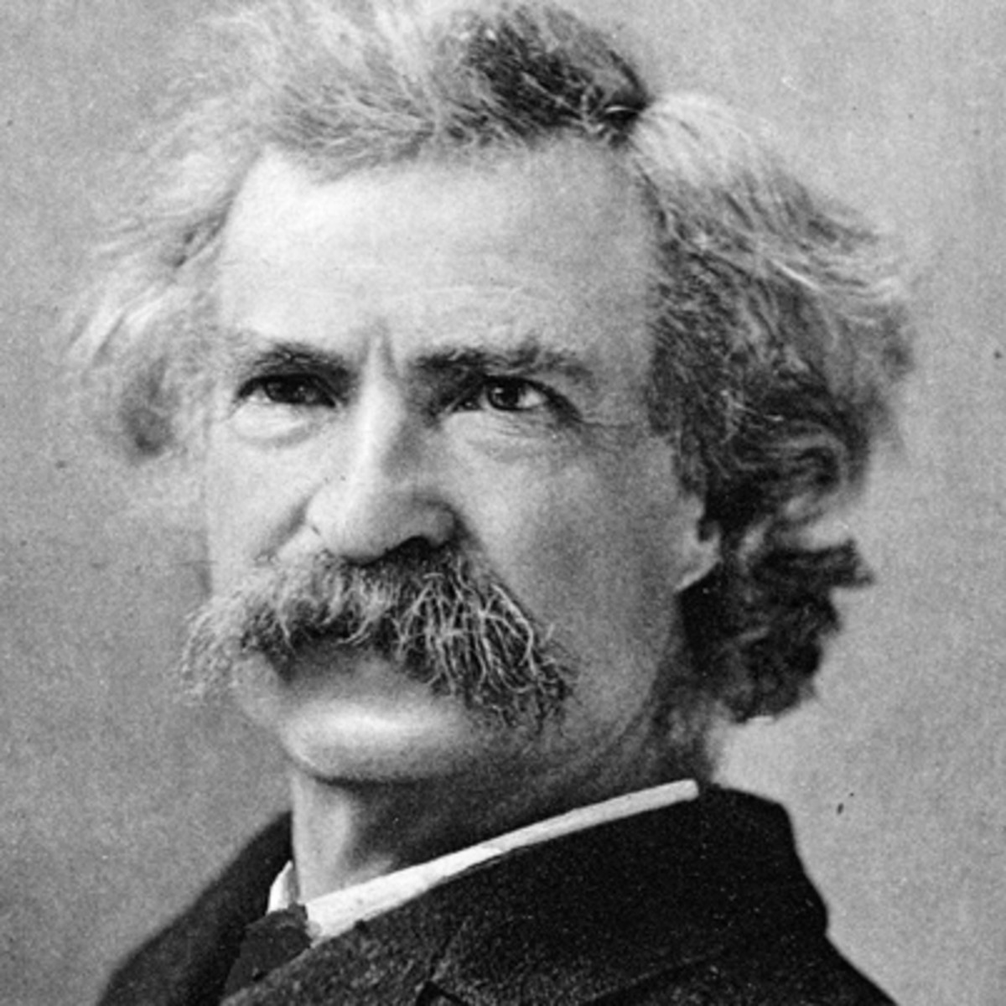
Mark Twain aka
Samuel Clemens

Slide 58
Riding on horseback through the Jezreel Valley, Twain observed, “There is not a solitary village throughout its whole extent – not for 30 miles in either direction. There are two or three small clusters of Bedouin tents, but not a single permanent habitation. One may ride 10 miles, hereabouts, and not see 10 human beings.”
Notes:
https://www.jpost.com/Opinion/Unto-the-nations-505760

Slide 59
He continues, “Of all the lands there are for dismal scenery, I think Palestine must be the prince... Can the curse of the Deity beautify a land? “Palestine sits in sackcloth and ashes. Over it broods the spell of a curse that has withered its fields and fettered its energies.”
Notes:
https://www.jpost.com/Opinion/Unto-the-nations-505760

Slide 60
Innocents Abroad brought global attention to the sorry state of Palestine and proved that Palestine was a land without a people for a people without a land just 15 years before the First Aliya and subsequent waves of Jewish immigration.
Notes:
https://www.jpost.com/Opinion/Unto-the-nations-505760
It was the Ottoman province of Palestine then. Legitimate to use the name then.
Oracle p 37-38
Twain fulfilled the prophecy of Dv/Dt 29.21-23

Slide 61
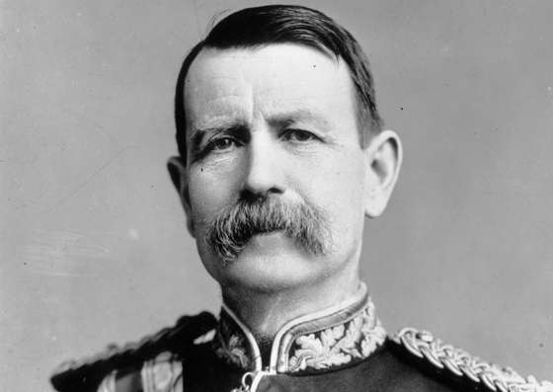
Charles Warren
1840-1927

Slide 62
Also in 1867, Warren was recruited by the Palestine Exploration Fund to conduct Biblical archaeology "reconnaissance." He conducted one of the first major excavations at the Temple Mount in Jerusalem. His most significant discovery was a water shaft, now known as Warren's Shaft, and a series of tunnels underneath the Temple Mount
Notes:
He found the Israeli city, from Yeshua’s day and earlier, now developed as a major underground site south of the Old city. We’ll see it in August, 2020 if we get the tour.
Wrote a book Oracle p 58-59

Slide 63
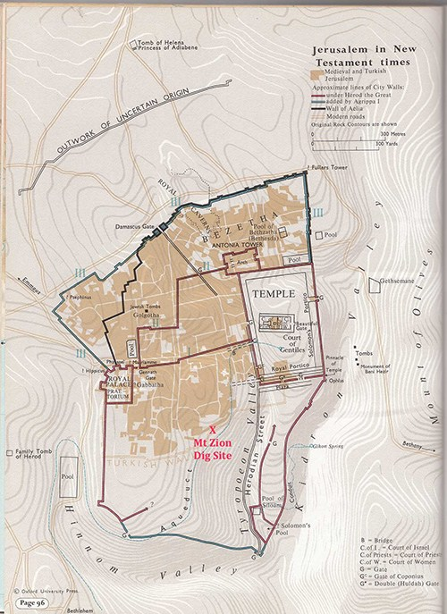
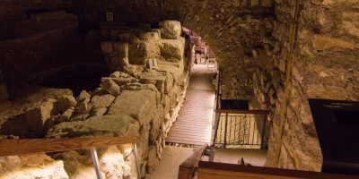
Notes:
https://www.deiahl.de/en/research-and-education/excavations/

Slide 64
^{Zekh 2.5-6 [2.1-2]} I looked up and saw a man with a measuring line in his hand. I asked, “Where are you going?” He said to me, “To measure Yerushalayim, to determine its width and length.”

Slide 65
Charles Warren and Mark Twain stayed at the same hotel in Jerusalem.

Slide 66
Also, in 1867, the results of the Crimean War… a military conflict fought from October 1853 to February 1856 in which the Russian Empire lost to an alliance of the Ottoman [Turkish] Empire, France, Britain and Sardinia.

Slide 67
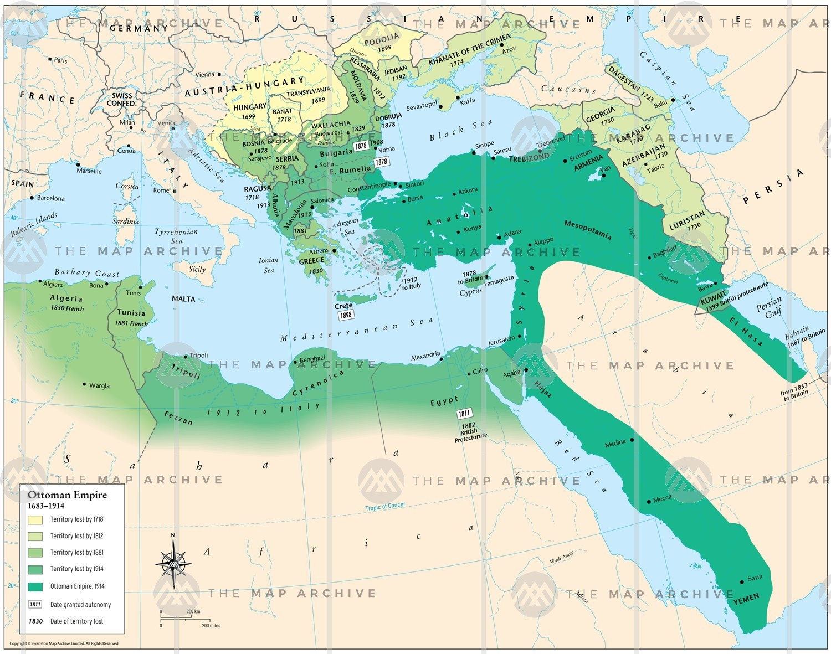

Ottoman Empire

Slide 68
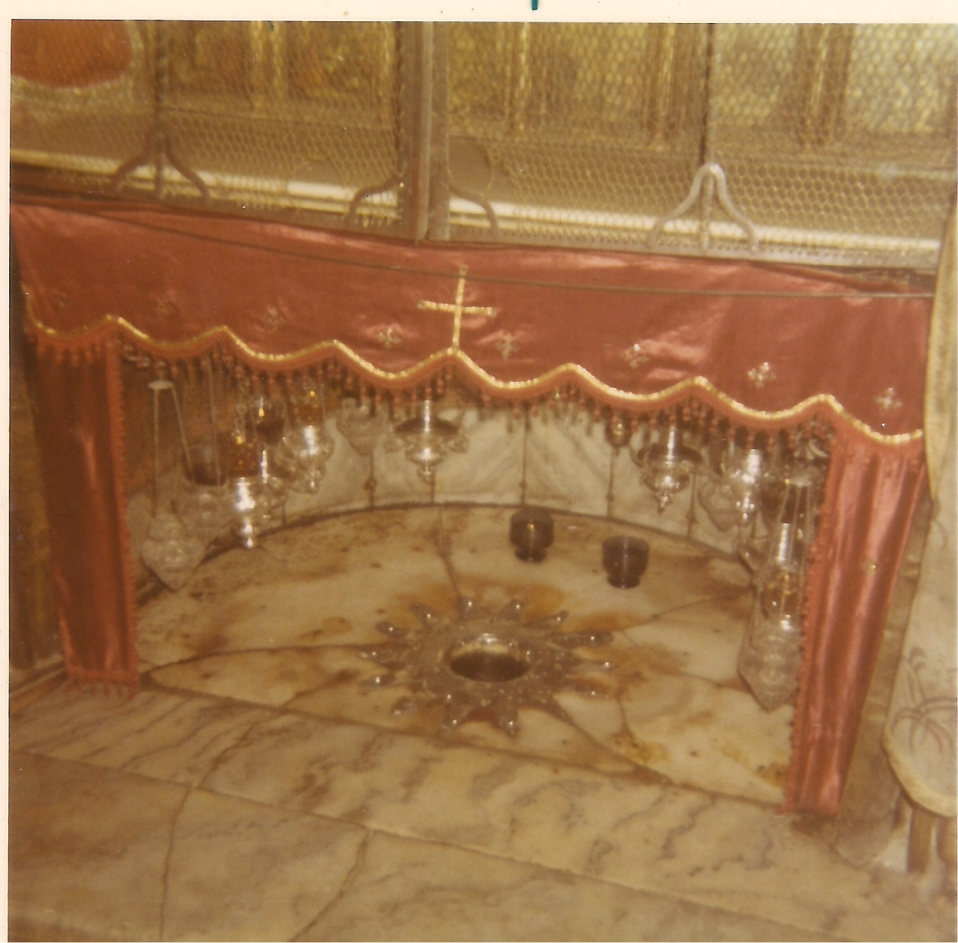
Photo of the silver star surrounding the viewing hole over the cave floor where Yeshua was likely born.
Notes:
Photo taken by me in 1971. This star, or its predecessor

Slide 69
At the Church of the Nativity in Bethlehem, Catholics had placed a silver star to commemorate the place of Jesus' birth. In 1847 it was pried out and stolen, and Catholics described Orthodox monks as the thieves.
Notes:
http://www.fsmitha.com/h3/h47-crimea2.htm

Slide 70
The Russian Tsar sided with the Russian/Greek Orthodox church, the Ottoman Empire, France, and Britain sided with the Catholics. This was one of the causes of the Crimean War.
Notes:
P 51 The Oracle

Slide 71
Also, in 1867, the results of the Crimean War… a military conflict fought from October 1853 to February 1856 in which the Russian Empire lost to an alliance of the Ottoman [Turkish] Empire, France, Britain and Sardinia.

Slide 72
One result of the Crimean war was that the Ottoman Empire got so deep in dept that it changed its land Code.
Notes:
P 51 The Oracle

Slide 73
The Ottoman Land Code of 1858 was the beginning of a systematic land reform of the Ottoman Empire for tax and control. Revised 9 years later, in 1867. Revised so foreigners could buy land.
Notes:
Oracle p 51

Slide 74
Star controversy 1847 →
Crimean War 1853 to 1856 →
Ottoman war debt →
Land Code revision just at the start of the First Aliyah and Jews could buy Palestinian land!! 1867
Notes:
Oracle p 51

Slide 75
^{Yermiyahu Jer 32.43-44} So fields will be bought in this land, about which you are saying: ‘It will be a desolation, without man or beast; it is handed over to the Chaldeans.’ Men will buy fields for money and sign and seal the deeds and call witnesses in the

Slide 76
^{Yermiyahu Jer 32.43-44} land of Benjamin and in the areas around Jerusalem, and in the towns of Judah, in the towns of the hill-country, in the towns of the foothills, and in the cities of the South—because I will bring them back from exile.” It is a declaration of Adoni.

Slide 77
1867
Mark Twain recognized desolations according to parasha of the week Dt 29.22
Charles Warren rediscovered ancient Jerusalem Zech 2.5-8
Ottoman Turks change land law
Notes:
Oracle 52-53
Moreover, 7 x 50 previous was the beginning of Ottoman rule.
Twain and Herzl became friends in 1894 at the Dreyful trial, where Dreyfus had the insignia torn from his uniform and his sword broken and was paraded before a crowd that shouted, “Death to Judas, death to the Jew.”
https://www.history.com/news/what-was-the-dreyfus-affair

Slide 78
1867 + 50 = 1917
David Lloyd George Prime Minister 6 December 1916 Preceded by H. H. Asquith, who was not favorable to Jewish resettlement.
Notes:
https://en.wikipedia.org/wiki/Balfour_Declaration

Slide 79
1867 + 50 = 1917
The Balfour Declaration was a public statement issued by the British government in 2 November 1917 announcing support for the establishment of a "national home for the Jewish people" in Palestine, then an Ottoman region with a small minority Jewish population.
Notes:
https://en.wikipedia.org/wiki/Balfour_Declaration

Slide 80
It read: His Majesty's government view with favour the establishment in Palestine of a national home for the Jewish people, and will use their best endeavours to facilitate the achievement of this object, it being clearly understood that nothing shall be done
Notes:
https://en.wikipedia.org/wiki/Balfour_Declaration

Slide 81
which may prejudice the civil and religious rights of existing non-Jewish communities in Palestine, or the rights and political status enjoyed by Jews in any other country.
Notes:
https://en.wikipedia.org/wiki/Balfour_Declaration

Slide 82
On December 9, 1917, as Hanukkah approached, Turkish forces surrendered. In the battles for Jerusalem some 20,000 Turkish soldiers and 3,600 British and allied troops lost their lives. Two days later, on December 11, the second day of Hanukkah, British troops marched into Jerusalem. Allenby humbly entered its walls by foot through Jaffa Gate as the city’s 34th conqueror.
Notes:
https://www.jewishpress.com/indepth/opinions/chanukah-1917/2010/12/01/

Slide 83
^{Yeshayahu/Is 31.5} Like hovering birds,
so Adoni-Tzva’ot will protect Jerusalem. By protecting, He will deliver. By passing over, He will save.”
Notes:
Allenby sent biplanes which dropped fliers on the city of Jerusalem, urging the Ottomans to surrender. His name Allenby was understood as Allah nabi, prophet of Allah.

Slide 84
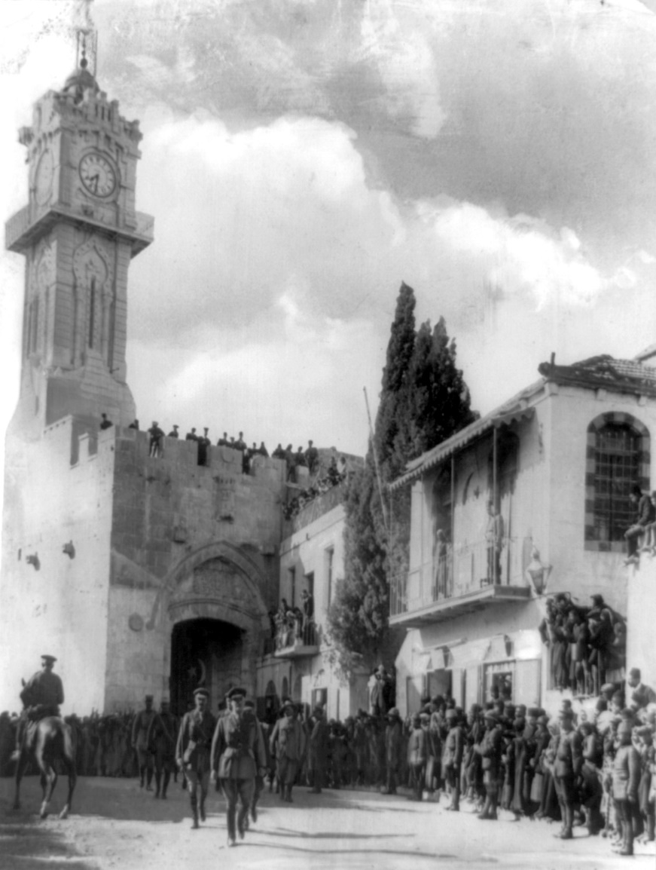
General Sir Edmund Allenby entering the Holy City of Jerusalem on foot 11 Dec., 1917 to show respect for the holy place
Notes:
https://en.wikipedia.org/wiki/Battle_of_Jerusalem

Slide 85
Summarize 1917
British government changed to favor Israel and Balfour Declaration made.
General Allenby conquered Jerusalem so British could follow their policy.

Slide 86
Another Yovel cycle:
Theodore Herzl made prophecy. Dream that he saw Messiah. You will prepare for my coming. 1897 said surely in 50.
Notes:
A Jubilean cycle of it’s own.

Slide 87
The United Nations Partition Plan for Palestine was a proposal by the United Nations, which recommended a partition of Mandatory Palestine at the end of the British Mandate. On 29 November 1947, the UN General Assembly adopted the Plan as Resolution 181
Notes:
https://www.google.com/search?q=un+vote+on+the+partition+of+palestine&oq=UN+vote+on+the+&aqs=chrome.1.69i57j0l5.7848j0j7&sourceid=chrome&ie=UTF-8
IF FDR lived, but Truman loved Israel and chosen as VP 1944 4 months later FDR dies. FDR anti-Semite. 11 minutes after Israel declares rec. Cyrus in govt 30 years. Truman 1923 to 1953 in govt. Cyrus king age 60. Truman 60 Pres. Cyrus said go home. Truman says to Brits let Jewish exiles in. One year later Chief Rabbi Israel to Oval Office. G put you in mother’s womb for this purpose. Reads of Cyrus to Truman. Truman weeps that used of the L. Cyrus not a G-dly man, but used. State Dept fighting Truman. Words of Mark Twain influenced him. JC found out from tour guide

Slide 88
Third door 1967 Six day war Jerusalem Soviet Union sent bogus word to Egypt and Syria that Israel about to attack. So Arabs mobilized. General Mota Gur Har HaBiyit b’yadenu. Lions Gate. Yeshua coming back as Lion. Prophecy G restoring Israel as Lion.

Slide 89
Jubilee initiated by shofar. Goren 1967. Threshing floor born 1917 גורן Owner rec rights to land. Cyrus issued declaration after 70 years. 2017 minus 70 = 1947

Slide 90
Fourth Door 2017 Get legal right and recognition of restoration.

Slide 91
How does G-d look on human government?
How should we look at human government?
How should we respond to human government?

Slide 92
Conclusion

Slide 93
Mattityahu (Matthew) 27:20-22
Pilate said to them, “Then what should I do with Yeshua, called ‘the Messiah’?” They all said, “Put him to death on the stake! Put him to death on the stake!”
Notes:
Here is the question for all of us. What will YOU and I do with Yeshua? In fact, we’ve already put Him to death on the stake by our sins!!
Will we die to ourselves? Let Him in??
Trust Him for LIFE?
Pray for our leaders?
Be involved, in some manner, in expanding His kingdom?

Slide 95
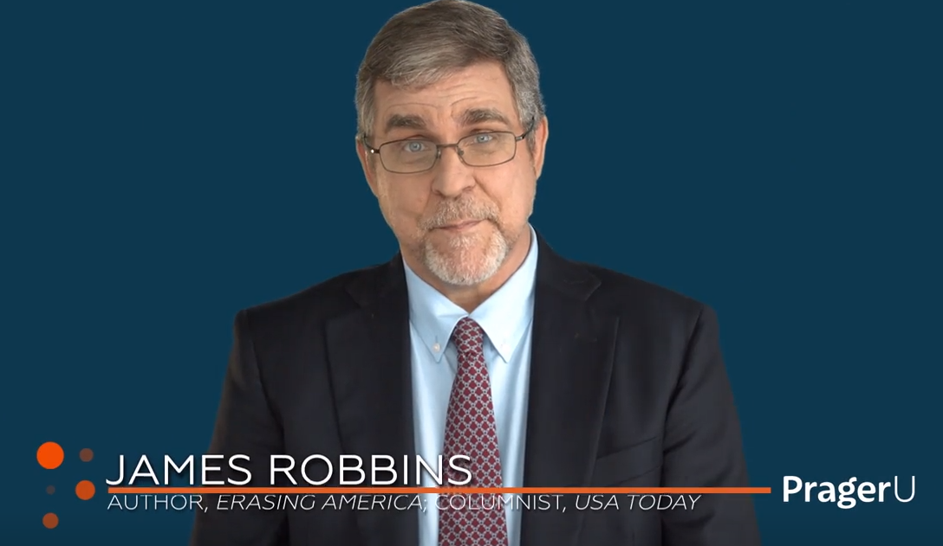
Do you remember America?

Slide 96

https://www.prageru.com/video/goodbye-america/
Notes:
https://www.prageru.com/video/goodbye-america/

Slide 97
https://www.prageru.com/video/goodbye-america/

