Slide 1
e-handout
To have these notes
without taking notes
Go to OrHaOlam.com
Click on downloads,
messages, 2019
Notes:
.

Slide 2
Computer tip:
Apparently you can’t use beefstew as a password

Slide 3
It’s not Stroganoff

Slide 4
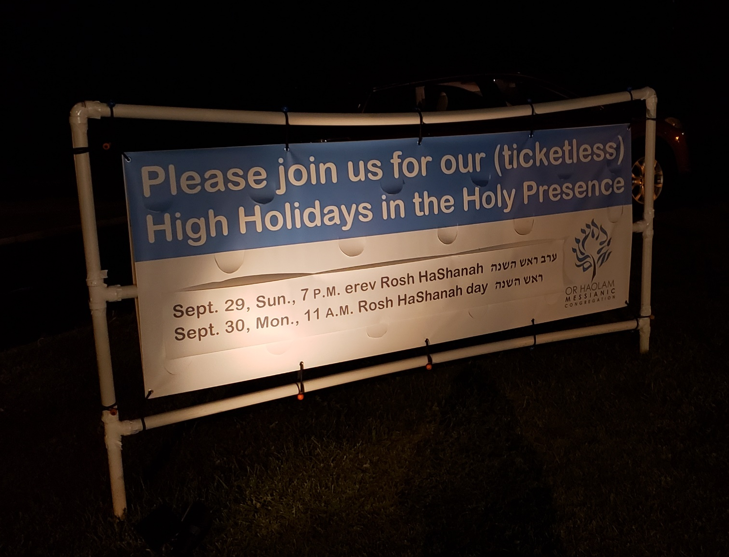
Notes:
Pray that the Holy Presence is here, and that people are drawn. Drawn.

Slide 5
Some Rosh Hashanna greetings
L’Shana Tovah לְשָׁנָה טוֹבָה
[Have a] Good Year
שָׁנָה טוֹבָה וּמְתוּקָה
Shana Tova oo-m’tukah
[Have a] Good and sweet year

Slide 6
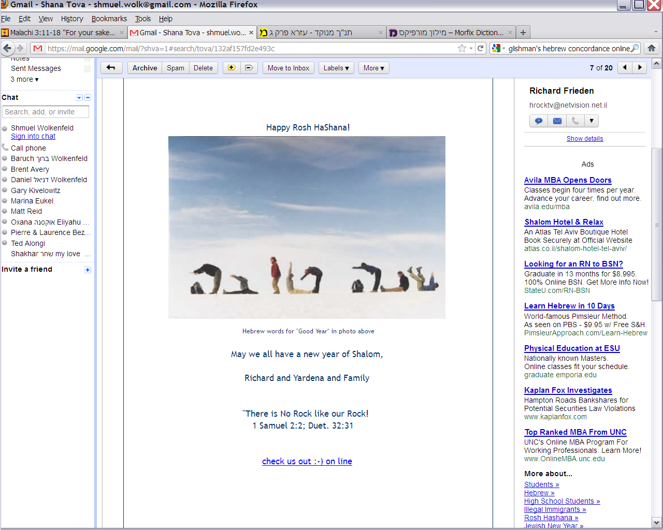
Notes:
8 guys and 2 backpacks

Slide 7
שנה טובה
Notes:
8 guys and 2 backpacks

Slide 8
לְשָׁנָה טוֹבָה תִכָּתֵבוּ
L'shanah tovah tikatevu
May you be inscribed (in the Book of Life) for a good year
Has an OK but non-Biblical implication
Notes:
https://en.wikipedia.org/wiki/Jewish_greetings#Holidays
The idea is that your fate for the next year, 5781, will be determined by your behavior and repentance in the next 10 days. Always a good idea to seek G-d and holiness and repent, but 10 days idea is a rabbinic legend with a good impact. Just treat it as such. There are some who take this as authoritative.

Slide 9
Yiddish greeting,
“Gut yontif ”
And if you are in Rome, and meet the Pope, you say,
“Good yontiff Pontiff!”

Slide 10
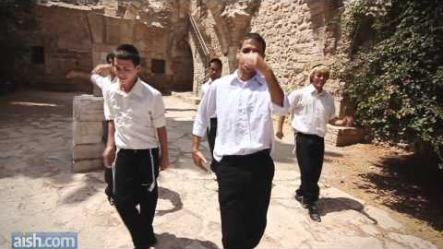
Notes:
https://youtu.be/T_M5-qthA8w

Slide 11
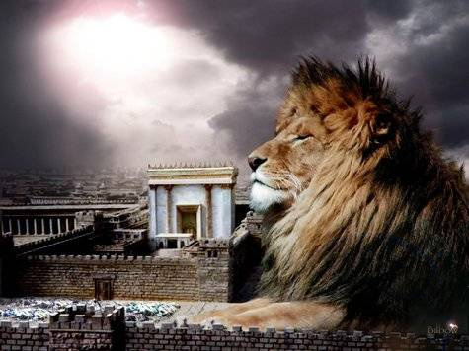
מַתִּתְיָהוּ Mattityahu
(Matthew) 27:23-25
Notes:
Last week, we were considering the sentencing of Yeshua, by Pontius Pilate.
Why couldn’t the Sanhedrin just sentence Him? [Anyone?]
The Jewish people had lost their authority to institute capital punishment, which fact itself was a fulfillment of scripture.
Bigger picture…

Slide 12
Summary: The sentencing of Yeshua by Pilate.
Redemptive implications: receive courage!
Governmental illustration: G-d has it in control!
Notes:
Does this relate to Elul, preparation for High Holidays?

Slide 13
How does G-d look on human government?
How should we look at human government?
How should we respond to human government?

Slide 14
Is there any rhyme or reason to governmental power? Excesses, abuse, genocide, terror?
Notes:
Pilate was having to determine sentencing for Yeshua. But considering a provision of leniency. Asked the crowd. Public opinion poll…
It’s a good thing to get wise counsel. But general public consensus?
Concerning the govt of Or HaOlam: I have three levels of advisers: Shamashim, Zekenim = elders, Directors = Apostolic authority. But, not an election. I am not subject to the crowd.

Slide 15
Mattityahu (Matthew) 27:23
שָׁאַל: ”אֲבָל מָה רָעָה עָשָׂה?“ אַךְ הֵם צָעֲקוּ בְּיֶתֶר שְׂאֵת: ”שֶׁיִּצָּלֵב!“
When he asked, “Why? What crime has he committed?” they shouted all the louder, “Put him to death on the stake!”
Notes:
Railing accusation.
“angels, which are greater in power and might, bring not railing accusation” KJV 2 Kefa 2.11

Slide 16
Mattityahu (Matthew) 27:24
כְּשֶׁרָאָה פִּילָטוֹס כִּי אֵינוֹ מוֹעִיל דָּבָר וּמַה גַּם שֶׁמִּתְרַגֶּשֶׁת מְהוּמָה,
When Pilate saw that he was accomplishing nothing, but rather that a riot was starting,

Slide 17
Mattityahu (Matthew) 27:24
לָקַח מַיִם וְרָחַץ אֶת יָדָיו לִפְנֵי הֶהָמוֹן בְּאָמְרוֹ: ”נָקִי אָנֹכִי מִדָּמוֹ שֶׁל זֶה. זֶהוּ עִנְיַנְכֶם!"
he took water, washed his hands in front of the crowd, and said, “My hands are clean of this man’s blood; it’s your responsibility.”
Notes:
Is it easy to defy the crowd? Go against the culture, the majority.
Gesture of defiance, but really gutless. God wants courage! Scripture talks about brave men. Are you strong to say, in His strength, this is a hill to die on! Here I stand, I can do no other.
Washing hands in this case was a lame gesture, meant nothing decisive.
Faithful to your spouse, or singleness. Finances, tithe first, integrity. Resist gossip!
Precedent in scripture…

Slide 18
^{T’hilim/Ps 26.5-7} I hate the company of evildoers, I will not sit with the wicked. I will wash my hands in innocence and walk around your altar, Adonai, lifting my voice in thanks.

Slide 19
^{Dvarim 21.1-7} “If, in the land Adonai your God is giving you to possess, a murder victim is found lying in the countryside; and the perpetrator of the murder is not known…The leaders of that town are to bring the heifer down to a vadi with a stream in it that never dries up…

Slide 20
^{Dvarim 21.1-7} and they are to break the cow’s neck there in the vadi…All the leaders of the town nearest the murder victim are to wash their hands over the cow whose neck was broken in the vadi. Then they are to speak up and say, ‘This blood was not shed by our hands, nor have we seen who did it.

Slide 21
Philo says,[Pilate was] notoriously guilty of receiving bribes, of injuries, rape, and frequent murders of persons uncondemned. According to Josephus, Pilate's removal from office occurred because he violently suppressed an armed Samaritan movement at Mount Gerizim.
Notes:
Ubi supra. (De Legat. ad Caium, p. 1034.) https://en.wikipedia.org/wiki/Pontius_Pilate

Slide 22
Jewish historian Josephus and philosopher Philo of Alexandria both mention incidents of tension and violence between the Jewish population and Pilate's administration.
Notes:
https://en.wikipedia.org/wiki/Pontius_Pilate
Pilate was NOT a nice guy, torn between the advice of his wife and the demands of a mob. He was a murderous though weak willed demagogue.

Slide 23
Mattityahu (Matthew) 27:25
עָנוּ וְאָמְרוּ כָּל הָעָם: "דָּמוֹ עָלֵינוּ וְעַל בָּנֵינוּ."
All the people answered, “His blood is on us and on our children!”
Notes:
Superficially, he was relieved of responsibility.
This can be taken two ways.
The first murder, fratricide…

Slide 24
The negative implication of
“His blood be upon us”

Slide 25
^{Ber/Gen 4.9-11} Then Adoni said to Cain, “Where is Abel, your brother?” “I don’t know,” he said. “Am I my brother’s keeper?” Then He said, “What have you done? The voice of your brother’s blood is crying out to Me from the ground. So now, cursed are you from the ground.
Notes:
The prophet Yermiyahu/Jeremiah said to his opposers…

Slide 26
^{Yer. 23.15} Only know for certain that, if you put me to death, you will bring innocent blood on yourselves, on this city, and on its inhabitants.

Slide 27
David Stern: This verse has been used to justify persecution of Jews through the centuries by Christians who presumed that the Jewish people had invoked a curse on themselves and on their posterity, and willingly accepted responsibility for "deicide."
Notes:
David Stern commentary
Easter historically was a dangerous time for Jews.

Slide 28
Even were the curse effectual, Yeshua prayed, "Father, forgive them, for they do not know what they are doing" ^{(Luke 23:34).}
Notes:
David Stern commentary

Slide 29
Besides, if the Jews were the only ones who killed him, then He didn't die for anyone else. But he died for all, not just for Jews: the righteous Messiah died for everyone who is unrighteous, which is to say, for everyone.
Notes:
David Stern commentary

Slide 30
Everyone, Jew and Gentile alike, is a sinner. By sinning, everyone, Jew and Gentile alike, killed him. Therefore everyone, Jew and Gentile alike, is guilty of Yeshua's death
Notes:
David Stern commentary
My father, I believe. A woman here in KC. “Christ killer.”S

Slide 31
Guilt does not pass from one generation to the next.
Iniquity [tendency to sin] can be passed from one generation to the next. [epigenetics]
Notes:
This time of year, particularly, free from guilt, delivered from iniquity.

Slide 33
^{Yekhez/Ezek 18.20} The person who sins is the one that will die — a son is not to bear his father’s guilt with him, nor is the father to bear his son’s guilt with him; but the righteous-ness of the righteous will be his own, and the wickedness of the wicked will be his own.
Notes:
Guilt cannot be passed from generation to generation.
Sinful weakness can be inherited. Epigentics.

Slide 34
^{Bamidbar/Nu 14.18} ‘Adoni is slow to anger and abundant in lovingkindness, forgiving iniquity and transgression. Still, He does not leave the guilty unpunished, bringing the iniquity of the fathers upon the children to the third and fourth generations.’
Notes:
Epigenetics transfer of sinful tendencies.

Slide 35
Mattityahu (Matthew) 27:25
עָנוּ וְאָמְרוּ כָּל הָעָם: "דָּמוֹ עָלֵינוּ וְעַל בָּנֵינוּ."
All the people answered, “His blood is on us and on our children!”
Usually taken as a curse on the Jewish people.

Slide 36
The positive implication of
“His blood upon us”

Slide 37
^{Mes Jew/Heb 12.22-24} You have come to Mount Zion—to the city of the living God, the heavenly Jerusalem…and to Yeshua, the Mediator of a new covenant, and to the sprinkled blood that speaks of something better than the blood of Abel.

Slide 38
^{1 Yn 1.7} But if we walk in the light as He Himself is in the light, we have fellowship with one another and the blood of His Son Yeshua purifies us from all sin.

Slide 39
Pilate is a bit like King Zedekiah, in the 500’s BCE. King of Yehuda. The Bible describes him as irresolute, vacillating, Zedekiah was a weak ruler, unsuited for the difficult conditions of the time.
Notes:
https://www.jewishvirtuallibrary.org/zedekiah

Slide 40
Disposed to listen to the advice of Jeremiah the prophet and not rebel against Babylonia, nevertheless, fearing the princes, he followed their wishes and renounced his allegiance.
Notes:
https://www.jewishvirtuallibrary.org/zedekiah

Slide 41
^{Yermiyahu/Jer 38.3-5} The words that Jeremiah spoke…Thus says Adoni: “This city will surely be given into the hand of the army of the king of Babylon, and he will capture it.” Then the officials said to the king: “This man should now be put to death,
Notes:
King Zedekiah/Tsidkiyahu wanted to obey Jeremiah.

Slide 42
^{Yermiyahu/Jer 38.3-5} since he demoralizes the men of war remaining in this city as well as all the people, by speaking such words to them. For this man is not seeking the shalom of this people, but calamity.”
Notes:
You can stand. We have the power of the blood atonement, and resurrection, and the love of G-d, and the power of the Ruakh. We CAN stand.

Slide 43
^{Yermiyahu/Jer 38.3-5} Then King Zedekiah said: “Here he is in your hand. For the king cannot do anything against you.”
Notes:
You can stand. We have the power of the blood atonement, and resurrection, and the love of G-d, and the power of the Ruakh. We CAN stand. His Blood is indeed upon us, to cleanse us and make us warriors in love for TRUTH. Receive Him, be filled with Him! Glory in His love for you!!

Slide 44
Mattityahu (Matthew) 27:226
Conclusion: Then he [Pilate] released to them Bar-Abba; but Yeshua, after having him whipped, he handed over to be executed on a stake.
Notes:
Looks like a loss. But it was the redemption of mankind!!

Slide 45
Summary: The sentencing of Yeshua by Pilate.
Redemptive implications: receive courage!
Governmental illustration: G-d has it in control!

Slide 46
How does G-d look on human government?
How should we look at human government?
How should we respond to human government?

Slide 47
Is there any rhyme or reason to governmental power? Excesses, abuse, genocide, terror?

Slide 48
G-d has government
under His control and timing!

Slide 49
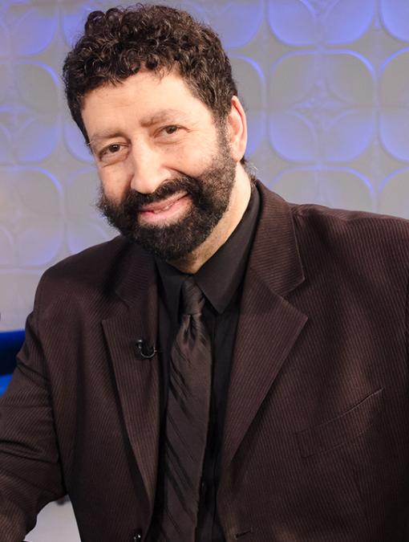


Slide 50
The Law of Jubilees. Yovel יוֹבֵל
^{Vayikra/Lev 25.9-11} On the tenth day of the seventh month, on Yom Kippur, you are to sound a shofar blast—you are to sound the shofar all throughout your land. You are to make the fiftieth year holy,

Slide 51
^{Vayikra/Lev 25.9-11} and proclaim liberty throughout the land to all its inhabitants. It is to be a Yovel /Jubilee to you, when each of you is to return to his own property and each of you is to return to his family. That fiftieth year will be your Yovel.

Slide 52
The biblical requirement is that the Yovel year was to be treated like a Sabbatical year, with the land lying fallow, but also
Was every 50th year
required the compulsory return of all property to its original owners or their heirs, except the houses of laymen within walled cities,
Notes:
https://en.wikipedia.org/wiki/Jubilee_(biblical)

Slide 53
in addition to the freeing of all Israelite slaves.
Was never observed in Biblical or post-Biblical history.
7th year Sabbatical is Hebrew year ÷ 7 if whole number. This year 5780 but 5782 ÷ 7 = 826
Notes:
https://en.wikipedia.org/wiki/Jubilee_(biblical)

Slide 54
Yovel / Jubilee has NEVER been kept in Biblical or post-Biblical Jewish history.
It is a concept of liberty and restoration, in 50 year increments.

Slide 55
G-d has government
under His control and timing!

Slide 57
1867 While in Jerusalem, Palestine, Twain took a piece of stationery at the “Mediterranean Hotel”, September 24, 1867, and wrote a letter.
[So, Twain was in Israel that date.]
Notes:
https://www.jpost.com/Opinion/Unto-the-nations-505760

Slide 58
Parasha for September 24, 1867 Parashat Nitzavim / פרשת נצבים
Torah Portion: Deuteronomy 29:9 - 30:20
Today’s portion

Slide 59
^{D’varim 29.21-23} The foreignerהַנָּכְרִי hanokri [singular] who comes from a distant land will say, when they see the plagues of that land and the sicknesses Adoni afflicted on it: ‘Sulfur and salt, the whole land burnt!

Slide 60
^{D’varim 29.21-23} It cannot be planted, it cannot sprout, no grass can grow up on it—like the overthrow of Sodom and Gomorrah, Admah and Zeboiim, which Adoni overturned in His anger and in His wrath!’ “All the nations will say, ‘Why has Adoni done this to this land? Why this great burning anger?’

Slide 61
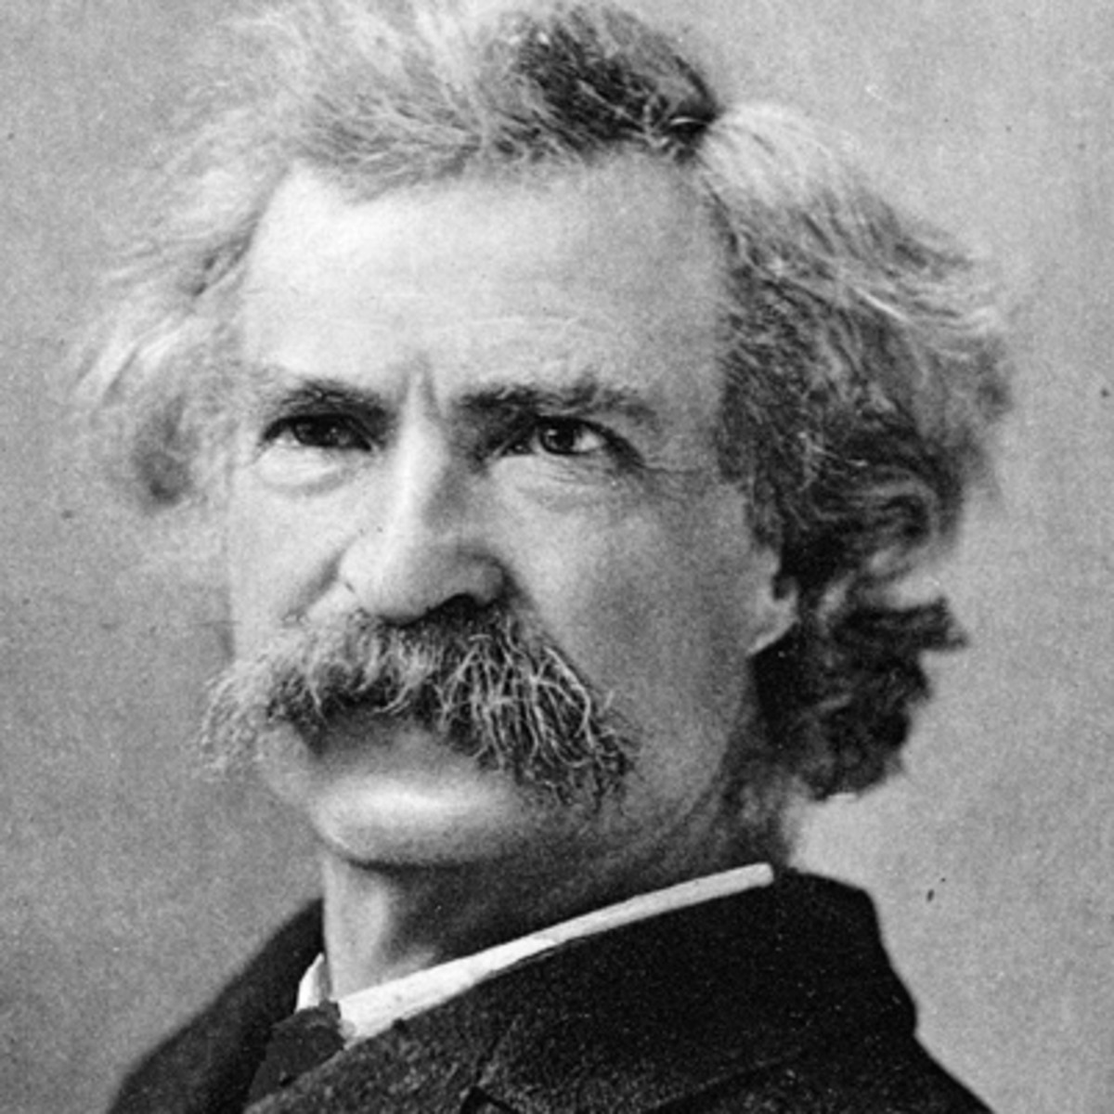
Mark Twain aka
Samuel Clemens

Slide 62
Riding on horseback through the Jezreel Valley, Twain observed, “There is not a solitary village throughout its whole extent – not for 30 miles in either direction. There are two or three small clusters of Bedouin tents, but not a single permanent habitation. One may ride 10 miles, hereabouts, and not see 10 human beings.”
Notes:
https://www.jpost.com/Opinion/Unto-the-nations-505760

Slide 63
He continues, “Of all the lands there are for dismal scenery, I think Palestine must be the prince... Can the curse of the Deity beautify a land? “Palestine sits in sackcloth and ashes. Over it broods the spell of a curse that has withered its fields and fettered its energies.”
Notes:
https://www.jpost.com/Opinion/Unto-the-nations-505760

Slide 64
Twain’s book, Innocents Abroad, brought global attention to the sorry state of Palestine and proved that Palestine was a land without a people for a people without a land just 15 years before the First Aliyah and waves of Jewish immigration.
Notes:
https://www.jpost.com/Opinion/Unto-the-nations-505760
It was the Ottoman province of Palestine then. Legitimate to use the name then.
Oracle p 37-38
Twain fulfilled the prophecy of Dv/Dt 29.21-23

Slide 65
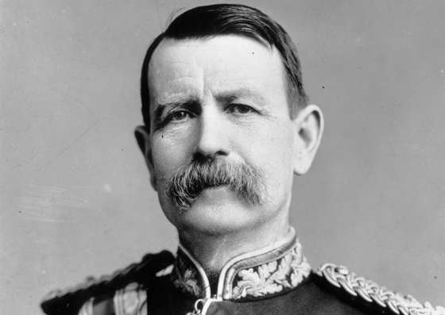
Charles Warren
1840-1927

Slide 66
Also in 1867, Warren was recruited by the Palestine Exploration Fund to conduct Biblical archaeology "reconnaissance." He conducted one of the first major excavations at the Temple Mount in Jerusalem. His most significant discovery was a water shaft, now known as Warren's Shaft, and a series of tunnels underneath the Temple Mount
Notes:
He found the underground Israeli city, from David’s and Yeshua’s day, now developed as a major underground site south of the Old city. We’ll see it in August, 2020 if we get the tour.
Wrote a book Oracle p 58-59

Slide 67
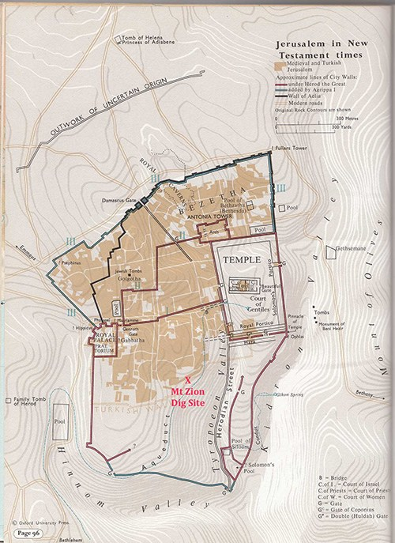
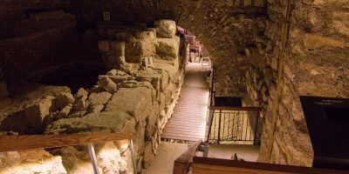
Underground city
from Biblical times
Notes:
https://www.deiahl.de/en/research-and-education/excavations/

Slide 68
^{Zekh 2.5-6 [2.1-2]} I looked up and saw a man with a measuring line in his hand. I asked, “Where are you going?” He said to me, “To measure Yerushalayim, to determine its width and length.”

Slide 69
Charles Warren and Mark Twain stayed at the same hotel in Jerusalem.

Slide 70
Also, in 1867, the results of the Crimean War… a military conflict fought from October 1853 to February 1856 in which the Russian Empire lost to an alliance of the Ottoman [Turkish] Empire, France, Britain and Sardinia.

Slide 71
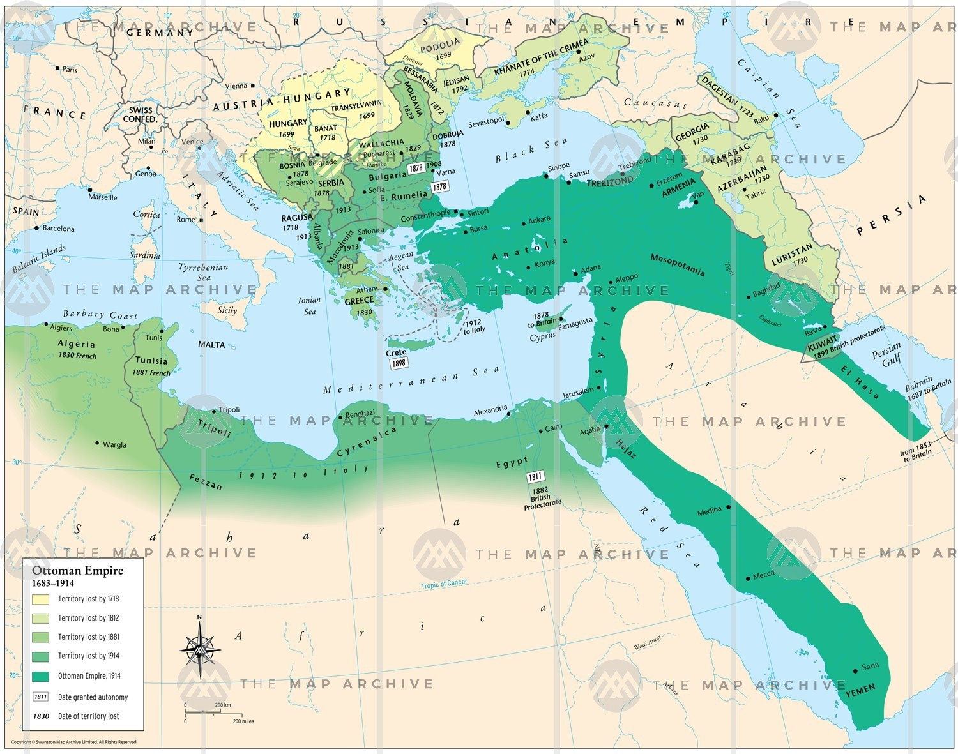

Ottoman Empire
Notes:
It was shrinking, so deep green in 1914. Almost the whole of Europe and North Africa at its height.

Slide 72
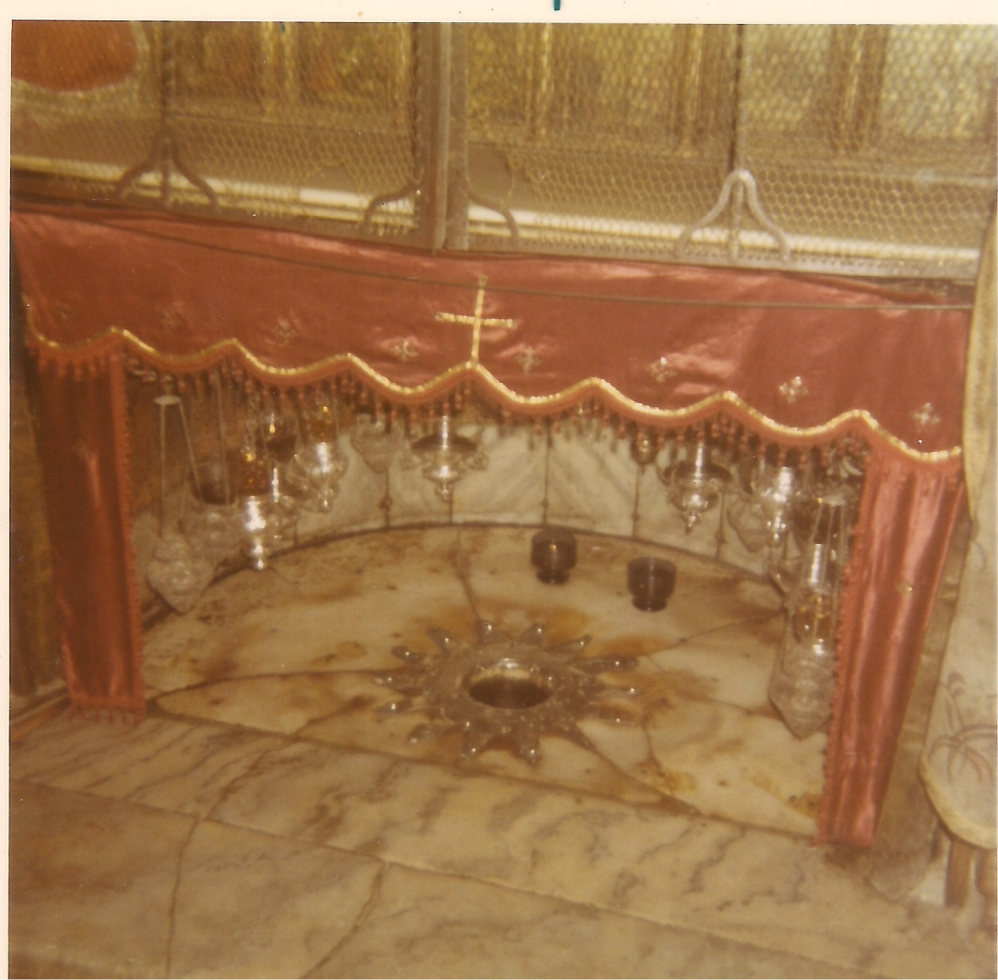
Photo of the silver star surrounding the viewing hole over the cave floor where Yeshua was likely born.
Notes:
Photo taken by me in 1971. This star, or its predecessor

Slide 73
At the Church of the Nativity in Bethlehem, Catholics had placed a silver star to commemorate the place of Yeshua’s birth. In 1847 it was pried out and stolen, and Catholics described Orthodox monks as the thieves.
Notes:
http://www.fsmitha.com/h3/h47-crimea2.htm

Slide 74
The Russian Tsar sided with the Russian/Greek Orthodox church, the Ottoman Empire, France, and Britain sided with the Catholics. This star was one of the causes of the Crimean War.
Notes:
P 51 The Oracle

Slide 75
Also, in 1867, the results of the Crimean War… a military conflict fought from October 1853 to February 1856 in which the Russian Empire lost to an alliance of the Ottoman [Turkish] Empire, France, Britain and Sardinia.

Slide 76
One result of the Crimean war was that the Ottoman Empire got so deep in dept that it changed its Land Code.
Notes:
P 51 The Oracle

Slide 77
The Ottoman Land Code of 1858 was the beginning of a systematic land reform of the Ottoman Empire for tax and control. Revised 9 years later, in 1867. Revised so foreigners, non-Muslims, could buy land!
Notes:
Oracle p 51

Slide 78
Star controversy 1847 →
Crimean War 1853 to 1856 →
Ottoman war debt →
Land Code revision just at the start of the First Aliyah and Jews could buy Palestinian land!! 1867
Notes:
Oracle p 51

Slide 79
^{Yermiyahu Jer 32.43-44} So fields will be bought in this land, about which you are saying: ‘It will be a desolation, without man or beast; it is handed over to the Chaldeans.’ Men will buy fields for money and sign and seal the deeds and call witnesses in the

Slide 80
^{Yermiyahu Jer 32.43-44} land of Benjamin and in the areas around Jerusalem, and in the towns of Judah, in the towns of the hill-country, in the towns of the foothills, and in the cities of the South—because I will bring them back from exile.” It is a declaration of Adoni.

Slide 81
1867
Mark Twain recognized desolations according to parasha of the week Dt 29.22
Charles Warren rediscovered ancient Jerusalem Zech 2.5-8
Ottoman Turks change land law
Notes:
Oracle 52-53
Moreover, 7 x 50 previous was the beginning of Ottoman rule.
Twain and Herzl became friends in 1894 at the Dreyful trial, where Dreyfus had the insignia torn from his uniform and his sword broken and was paraded before a crowd that shouted, “Death to Judas, death to the Jew.”
https://www.history.com/news/what-was-the-dreyfus-affair

Slide 82
1867 + 50 = 1917
David Lloyd George Prime Minister 6 December 1916 Preceded by H. H. Asquith, who was not favorable to Jewish resettlement.
Notes:
https://en.wikipedia.org/wiki/Balfour_Declaration

Slide 83
1867 + 50 = 1917
The Balfour Declaration was a public statement issued by the British government in 2 November 1917 announcing support for the establishment of a "national home for the Jewish people" in Palestine, then an Ottoman region with a small minority Jewish population.
Notes:
https://en.wikipedia.org/wiki/Balfour_Declaration

Slide 84
It read: His Majesty's government view with favour the establishment in Palestine of a national home for the Jewish people, and will use their best endeavours to facilitate the achievement of this object, it being clearly understood that nothing shall be done
Notes:
https://en.wikipedia.org/wiki/Balfour_Declaration

Slide 85
which may prejudice the civil and religious rights of existing non-Jewish communities in Palestine, or the rights and political status enjoyed by Jews in any other country.
Notes:
https://en.wikipedia.org/wiki/Balfour_Declaration
Nice, but how to put it in practice? Ottoman Turks controlled Palestine.

Slide 86
On December 9, 1917, as Hanukkah approached, Turkish forces surrendered. In the battles for Jerusalem some 20,000 Turkish soldiers and 3,600 British and allied troops lost their lives.
Notes:
https://www.jewishpress.com/indepth/opinions/chanukah-1917/2010/12/01/

Slide 87
^{Yeshayahu/Is 31.5} Like hovering birds,
so Adoni-Tzva’ot will protect Jerusalem. By protecting, He will deliver. By passing over, He will save.”
Notes:
Allenby sent biplanes which dropped fliers on the city of Jerusalem, urging the Ottomans to surrender. His name Allenby was understood as Allah nabi, prophet of Allah.

Slide 88
Two days later, on December 11, the second day of Hanukkah, British troops marched into Jerusalem. Allenby humbly entered its walls by foot through Jaffa Gate as the city’s 34th conqueror.
Notes:
https://www.jewishpress.com/indepth/opinions/chanukah-1917/2010/12/01/

Slide 89
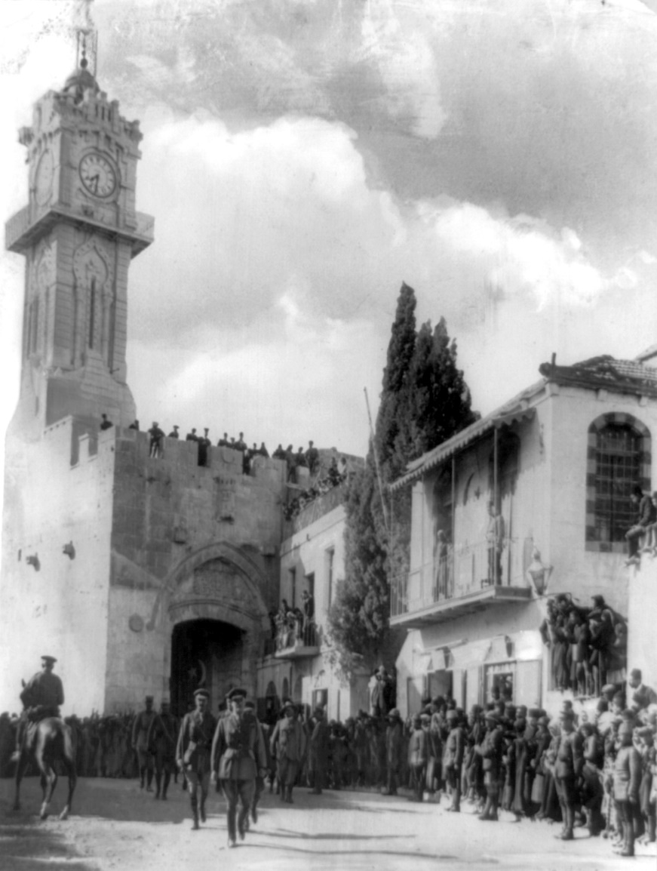
General Sir Edmund Allenby entering the Holy City of Jerusalem on foot 11 Dec., 1917 to show respect for the holy place
Notes:
https://en.wikipedia.org/wiki/Battle_of_Jerusalem

Slide 90
Summarize 1917
British government changed to favor Israel and Balfour Declaration made.
General Allenby conquered Jerusalem so British could follow their policy.
Notes:
1867 + 50= 1917

Slide 91
Another Yovel cycle: 1897
Theodore Herzl had a dream that he saw Messiah. You will prepare for my coming.
First Zionist Congress 1897 Basel, Switzerland.
Notes:
A Jubilean cycle of it’s own. P. 100 Oracle p 101

Slide 92
“At Basel, I founded the Jewish State. If I said this out loud, today, I would be answered by universal laughter. Perhaps in five years, certainly in fifty, everyone will know. Sept. 3, 1897.
Sept. 3, 1947 plan presented to UN General Assembly.

Slide 93
On 29 November 1947, the UN General Assembly adopted the Plan as Resolution 181. Day of parasha to Jacob: “Return to your native land.” “You shall be called Israel.”
Notes:
First time name Israel appears in the Bible is the parasha for Nov. 29, 1947.
https://www.google.com/search?q=un+vote+on+the+partition+of+palestine&oq=UN+vote+on+the+&aqs=chrome.1.69i57j0l5.7848j0j7&sourceid=chrome&ie=UTF-8
IF FDR lived, not so, but Truman loved Israel and chosen as VP 1944 4 months later FDR dies. FDR anti-Semite. 11 minutes after Israel declares rec. Cyrus in govt 30 years. Truman 1923 to 1953 in govt. Cyrus king age 60. Truman 60 Pres. Cyrus said go home. Truman says to Brits let Jewish exiles in. One year later Chief Rabbi Israel to Oval Office. G put you in mother’s womb for this purpose. Reads of Cyrus to Truman. Truman weeps that used of the L. Cyrus not a G-dly man, but used. State Dept fighting Truman. Words of Mark Twain influenced him. JC found out from tour guide p 120 Oracle

Slide 94
Nov. 29, 1947 Israeli professor
Eliezer Sukenik was first to read the Scroll, gotten from a merchant in Bethlehem. His son ran in to tell him about UN vote!
Word and Land restored the same day!!

Slide 95
1967 Six day war 1867, 1917, 1967
Jews regained Jerusalem.
Yeshua coming back as Lion. Prophecy God restoring Israel as Lion.

Slide 96
Soviet Union sent bogus word to Egypt and Syria that Israel about to attack. So Arabs mobilized.
Notes:
Derek Prince: Yeshua is the Lion of the tribe of Judah. Not was, IS. And soon that Lion will roar!

Slide 97
Lt. Gen. Mordechai "Motta" Gur מרדכי "מוטה" גור‎ was the 10th Chief of Staff of the IDF. During the Six-Day War (1967), he commanded the brigade that penetrated the Old City of Jerusalem Lion’s Gate
גּוּר lion cub
Notes:
https://en.wikipedia.org/wiki/Mordechai_Gur
First time Jerusalem conquered from East.

Slide 98
and broadcast the famous words, "The Temple Mount is in our hands!" (Hebrew: הר הבית בידינו‎, Har HaBayit BeYadeinu)
1867, 1917, 1967
Notes:
https://en.wikipedia.org/wiki/Mordechai_Gur

Slide 99
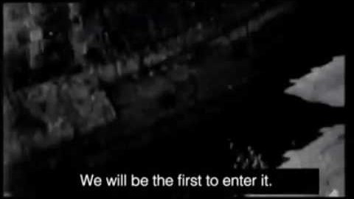

Slide 100
Jubilee initiated by shofar.

Slide 101
Shlomo Goren שלמה גורן‎ February 3, 1917 – October 29, 1994), was an Orthodox Religious Zionist rabbi in Israel, a Talmudic scholar and foremost authority on Jewish law.
Notes:
https://en.wikipedia.org/wiki/Shlomo_Goren

Slide 102
granary, threshing floor גֹּורֶן
Jerusalem was a threshing floor
He used a borrowed shofar from his father in law, David Cohen, a cohen/priest, who had a Nazarite vow not to leave his house till Jerusalem restored

Slide 103
Goren was at the recapture of East Jerusalem on 7 June 1967, where he gave the prayer of thanksgiving broadcast live to the entire country. Shortly afterwards Goren, blowing a shofar and carrying a Torah scroll, held the first Jewish prayer session at the Western Wall since 1948.
Notes:
https://en.wikipedia.org/wiki/Shlomo_Goren

Slide 104
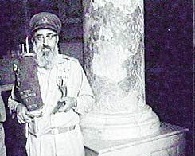
Rabbi
Goren at
the
Temple
Mount
Notes:
https://en.wikipedia.org/wiki/Shlomo_Goren

Slide 105
2017 Get legal right and recognition of restoration.

Slide 106
Conclusion

Slide 107
Summary: The sentencing of Yeshua by Pilate.
Redemptive implications: by faith receive courage to resist, overcome the world!
Governmental illustration: G-d has it in control!

Slide 108
^{Yehoshua 24.15} As for me and my household, we will serve Adoni!”

